Slide 1
Modules:
Workers’ rights and responsibilities
Infection Prevention
Musculoskeletal Safety
This material was produced under grant number SH-29637-SH6 from the Occupational Safety and Health Administration, U.S. Department of Labor. It does not necessarily reflect the views or policies of the U.S. Department of Labor, nor does mention of trade names, commercial products, or organizations imply endorsement by the U.S. Government.

Slide 2
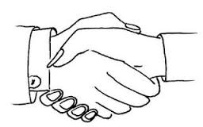
Introduce Yourself!
● What is your name?
● How long have you been a caregiver?
●What is one thing you love about your job?

Slide 3
Learning Objectives
By the end of this training module, participants will be able to:
● Demonstrate proper hand-washing techniques and the use of personal protective equipment (PPE)
● Describe how to prevent the transmission of bloodborne pathogens
● Demonstrate proper body mechanics for job-related tasks, including lifting
● Demonstrate the use of assistive devices, including transfer boards, slide sheets, hydraulic lifts and gait belts
● Identify and request the need for assistance in physical tasks
● Identify key workers’ rights and employer responsibilities
● Raise health and safety concerns with supervisors and file complaints without fear of retaliation

Slide 4
Agenda
● Welcome, Introductions & Pre-Test
● Connect and Reflect: Health and Safety
● Infection Prevention
● Prevention of Musculoskeletal Injuries
● Workers’ Rights and Responsibilities
● Review Game
● Reflection and Action
● Conclusion & Post-Test

Slide 5
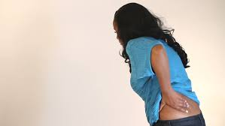
Injuries and Risks
The homecare work environment is not under the control of the employee (the caregiver) or the employer (the agency).
Working in someone else’s home can present unexpected hazards.

Slide 6
Injuries and Risks, cont.
Unexpected hazards in home caregiving include:
  Animals
  Loaded weapons in the home
  Violence
  Other people
  Falls due to snow and ice
  Traffic accidents while driving from home to home
  Unclean living conditions
Source: National Institute for Occupational Safety and Health. (2010).

Slide 7
Injuries and Risks, cont.
Due to these hazards, injuries to caregivers are common. They include:
  Sprains and strains
  Musculoskeletal disorders (from moving consumers)
  Falls
  Bloodborne diseases and other infections
  Occupational stress
  Violence in the home
  Latex allergy
Source: National Institute for Occupational Safety and Health. (2010).

Slide 8
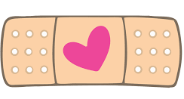
Injuries and Risks, cont.
This training has to do with two categories of on-the-job- injury and risk:
  Infection Prevention
  Musculoskeletal Safety
The goal of this training is to minimize or eliminate these injuries and risks to your health and safety.

Slide 9
Infection Prevention

Slide 10
Caregivers and Infection
Caregivers are exposed to many infections:
    Colds and influenza
    Respiratory infections
    Diarrhea (such as from the parasite Giardia)
    Staph infections (like MRSA)
    Pneumonia
    HIV/AIDS
    Hepatitis B (HBV) and C (HBC)
    Tuberculosis
Some of these infections can be deadly.

Slide 11

How do you get sick?
Infections caused by tiny germs called pathogens
Pathogens move from one person to another,
spreading disease. This is called transmission of infection:
  Breathing in tiny droplets from someone’s coughs and sneezes or talking
  Getting stuck by an infected sharp (needle or syringe)
  Touching people who are infected
  Touching surfaces–such as a chair, bed rail, clothing, bedding–that are infected
  Eating, drinking, or touching infected food and water
Experts believe that there are up to 800,000 sharps injuries every year in U.S. healthcare.
Source: National Institute for Occupational Safety and Health. (2014).

Slide 12
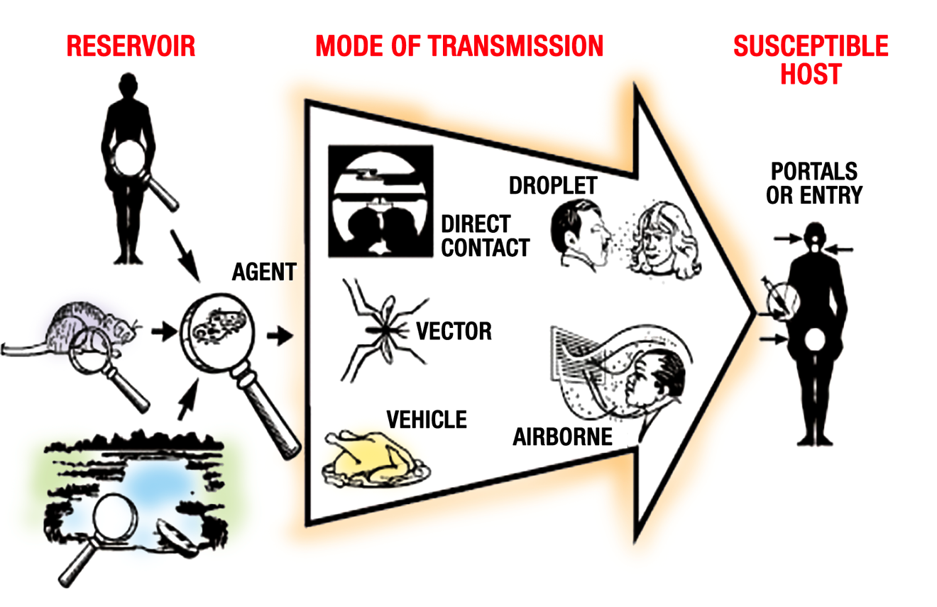
Chain of Infection
Source: Centers for Disease Control and Prevention. (1992). Principles of epidemiology, 2nd ed. Atlanta: U.S. Department of Health and Human Services.

Slide 13
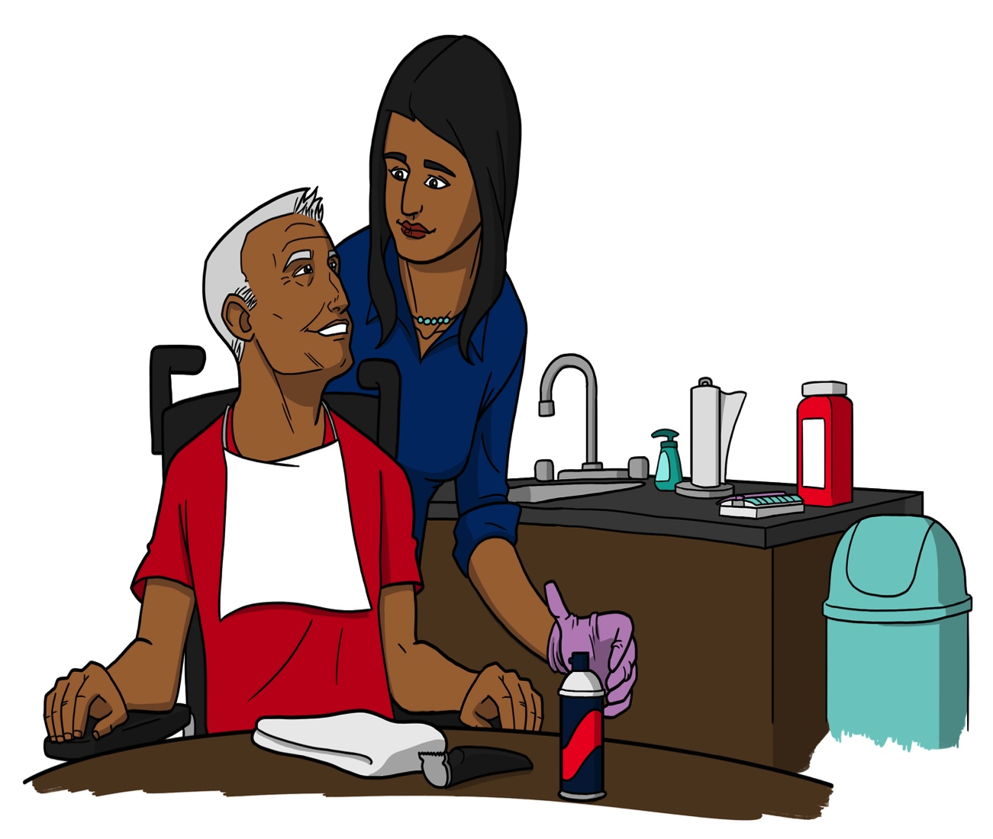
Caregiver
Monica helps Mr. Lujan shave, an activity that presents numerous opportunities for infection.

Slide 14
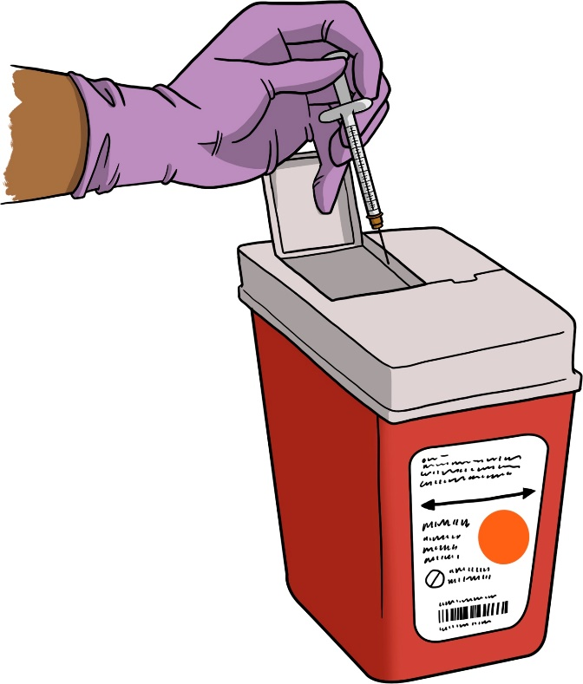
Standard Precautions
Standard Precautions: set of routine practices
for avoiding contact with consumers’ body fluids.
Prevent or minimize the spread of infection –
especially bloodborne infection (carried in the
blood and body fluids).
Standard Precautions involve:
  Handwashing
  Use of protective equipment, like gloves
  Keeping the environment clean
Use them every time you have contact with consumer.
Proper disposal of sharps

Slide 15
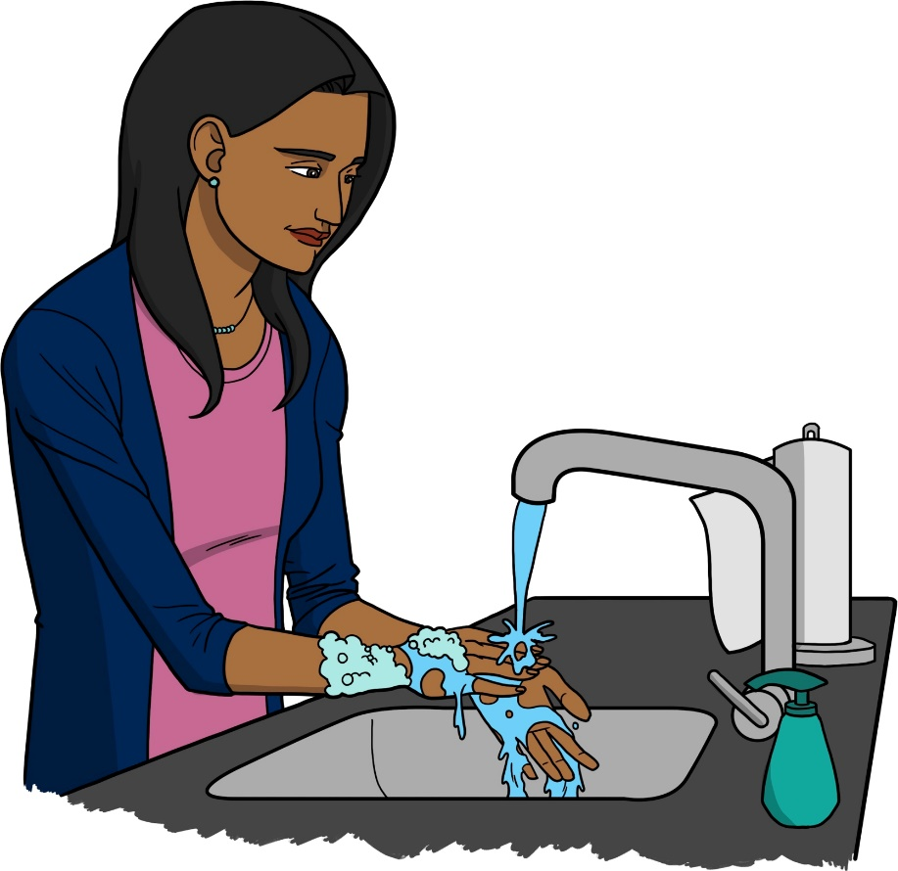
Body Fluids and Infection
Body fluids carry germs that can cause serious infection.
What are body fluids?
  Blood
  Feces (poop or diarrhea)
  Urine (pee)
  Any sores or broken skin
  Tears
  Mucous (phlegm)
  Pus
  Saliva (spit)
  Sweat
  Vomit (throw up)
  Semen
  Vaginal fluid
Handwashing is an easy and effective way to prevent the spread of infection.

Slide 16
Handwashing
Take off jewelry on hands and wrists.
(Try not to wear jewelry while caregiving!)
Turn on warm (not hot!) water.
Wet your hands under running water. Point your fingertips down.
Apply soap to hands.
With fingertips pointing down, lather hands well. Rub your hands together in a circular motion. Wash carefully between fingers, under nails and up wrists.

Slide 17
Handwashing, cont.
Remember: You need to wash your hands for at least 20 seconds. (Sing “Happy Birthday” twice to yourself, so you know how long 20 seconds is.)
Rinse off all the soap. Again, make sure your fingertips are pointed down.
Dry hands with a clean paper towel.
Use paper towel to turn off the water and to open the bathroom door.
Drop the wet paper towel into the trash.

Slide 18
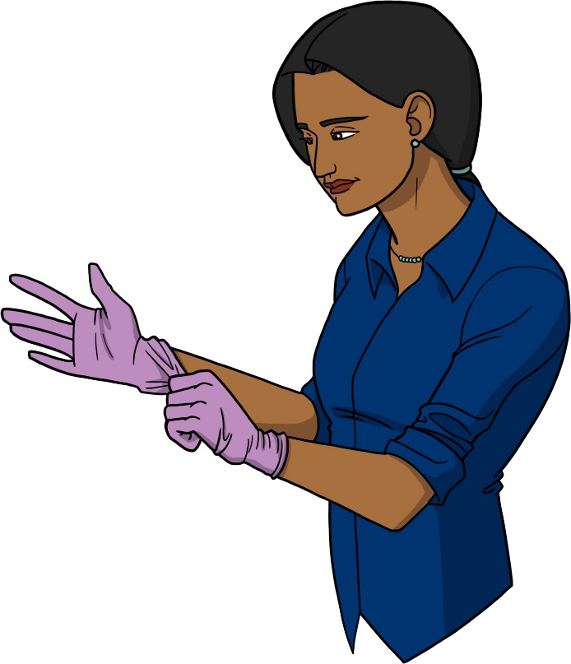
Glove Use
Always use the proper procedure to put on, remove and throw away.
Putting on Gloves:
Wash and dry your hands
carefully.
Get a new pair of gloves from the box.
Pull gloves on carefully. If a glove tears or gets a hole, take it off and start again with a new glove.
Interlace fingers to remove wrinkles, air pockets and achieve a comfortable fit.
If the gloves might get very dirty, wear two pairs of gloves.

Slide 19
Glove Use, Cont.
Removing and Throwing Away Gloves:
Pinch one of the rubber gloves just below the cuff using your opposite thumb and index finger.
Lift glove away from wrist area.
Pull off the glove, turning inside out. Ball that glove tightly into the palm of your gloved hand.
With ungloved hand, slide your index and middle fingers underneath the cuff of the other (infected) glove.
Now with ungloved hand slide your index and middle finger under the cuff of the other glove; again pulling it off inside out. The first glove you removed should now be inside the second glove.
Pull off that second glove inside out. The first glove you removed should now be inside the second glove.
Throw gloves away.
Wash your hands.

Slide 20
Musculoskeletal Safety

Slide 21
Why Do Direct Caregivers get Musculoskeletal Injuries?
Direct caregivers often have to:
  Lift and move consumers without help
  Twist and pivot the body while carrying a load
  Stand for long periods of time
  Reach for things, getting off balance
  Work in places that may be cluttered or
  otherwise hazardous
For these reasons, direct caregivers have more job-related injuries than many other types of healthcare workers.

Slide 22
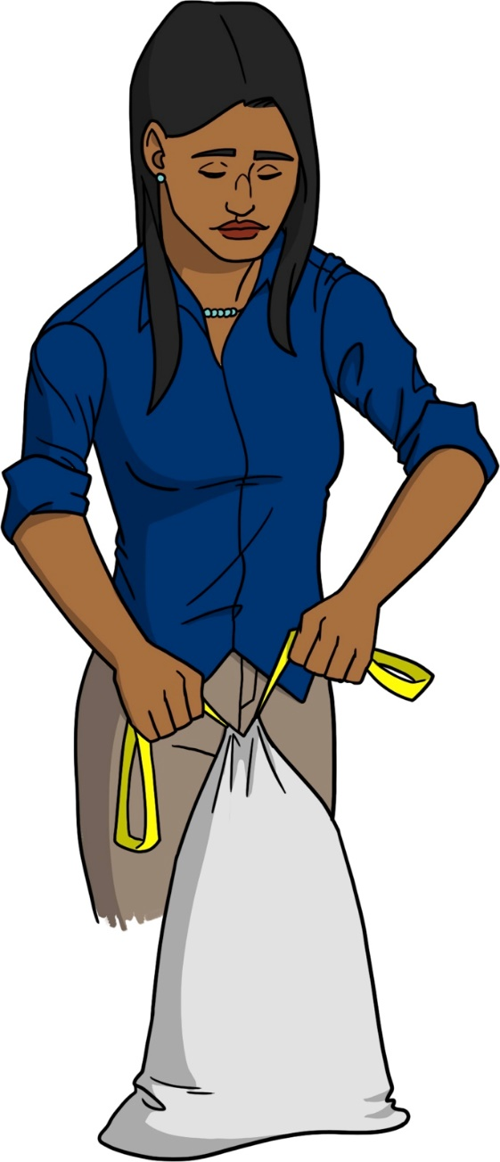
Why Do Direct Caregivers get Musculoskeletal Injuries, cont.
Due to these hazards, direct
caregivers have high injury
rates related to:
  The back, shoulder, and neck
  Slips, trips and falls
  Overexertion (working too hard or
  too long)
  Forceful or frequent lifting, pushing,
  pulling, holding, carrying and
  throwing
  Repetitive activities
Caregiver safely ties garbage bag before disposing. Something is missing in this illustration. What is it?

Slide 23
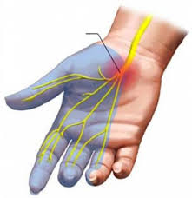
Symptoms and Consequences of Musculoskeletal Injury
Symptoms of musculoskeletal disorders include:
  Pain
  Stiffness
  Tingling
  Numbness
  Swelling
Other consequences include:
  Lost work time and pay
  Consumers lose consistency and quality of care because caregiver cannot work
Musculoskeletal injury of the hand

Slide 24
Consequences of
Musculoskeletal Injury
The health and safety of the direct caregiver has been directly linked to that of the consumer.
Safer, healthier caregiver = Safer, healthier consumer
Your agency saves money when there are fewer worker injuries.
In a safe work environment, everyone wins!

Slide 25
Advice for a New Caregiver
Scenario:
In your agency, many caregivers have been absent from work because of musculoskeletal injuries. You don’t have any injuries, though!
Your boss asks you to give advice to Ben, a new hire, about how he can avoid musculoskeletal injury.
What advice would you give Ben? What strategies would you recommend?

Slide 26
Strategies to Avoid Job-Related Injury
Use assistive devices to move or transfer consumers.
Encourage consumer to have assistive devices installed (shower chairs, raised toilet seats, grab bars).
Keep floors clean and dry.
Remove clutter and obstacles in the home (with the consumer’s permission).

Slide 27
Strategies to Avoid Job-Related Injury, cont.
Wear slip-resistant shoes
Make sure there is adequate lighting
inside and outside the home, if possible.
Secure loose cords in the house –
they are a tripping hazard!

Slide 28
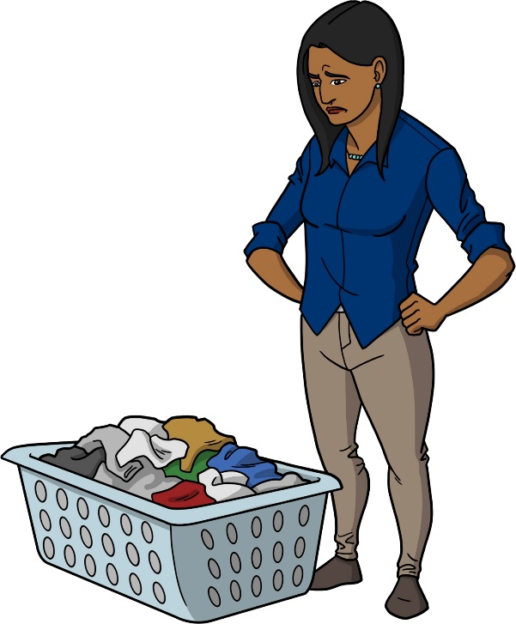
Strategies to Avoid Job-Related Injury, cont.
Be sure ice and snow are
removed from walkways.
Raise your awareness of
fall hazards.
Lift items and stand with proper posture.
Monica, Mr. Lujan’s caregiver, must stay aware and protect herself from infection and musculoskeletal injury.

Slide 29
Safe Transfer
Many consumers need assistance with transfers.
Transferring safely is important for the safety of the caregiver as well as the safety of the consumer.
We will demonstrate 5 tasks:
  Safer lifting of heavy objects
  Assisting the consumer to move to the side of the bed and sit up
  Using a gait belt to transfer the consumer from bed to wheelchair
  Using a gait belt to help a consumer ambulate (walk)
  How to handle the consumer’s fall

Slide 30
Workers’ Rights and Responsibilities

Slide 31

Filing a Complaint with OSHA
  If you believe your workplace is
  unsafe or unhealthy, tell your
  employer.
  You have the right to file a
  complaint with OSHA.
  File a complaint by mail, by telephone or online
  If there is an emergency, use the telephone to file your complaint.
  OSHA will keep your complaint confidential.
Mailing of a letter

Slide 32
Filing a Complaint with OSHA, cont.
  You have the right to file a complaint without fear of retaliation.
  If you believe your employer has retaliated against you for complaining, you can file a Whistleblower Complaint.
  See Handout 10 in your Participant Handbook for information on how to file. You can also visit: www.osha.gov

Slide 33
References
Arizona Direct Care Curriculum Project. (2011). Principles of caregiving: Caregiving fundamentals. Author. Retrieved from link to http://www.azdirectcare.org/uploads/2011_All_Fund_POC.pdf
Centers for Disease Control and Prevention. (1992). Principles of epidemiology, 2nd ed. Atlanta: U.S. Department of Health and Human Services.
Centers for Disease Control and Prevention. (2009). Safe patient handling training for schools of nursing. Retrieved from link to https://www.cdc.gov/niosh/docs/2009-127/pdfs/2009-127.pdf
Collins, J. W., Bell, J. L., and Grönqvist, R. (2010). Developing evidence-based interventions to address the leading causes of workers’ compensation among healthcare workers. Rehabilitation Nursing, 35(6), 226-261.
Hittle, B., Agbonifo, N., Suarez, R., Davis, K. G. & Ballard ,T. (2016) Complexity of occupational exposures for home health-care workers: Nurses vs. home health aides. Journal of Nursing Management, 24, 1071–1079.
Kim, I. H., Geiger-Brown, J., Triankoff, A., & Bonet, C. M. (2010). Physically demanding workloads and the risks of musculoskeletal disorders in homecare workers in the USA. Health & Social Care in the Community, 18(5), 445-455. doi: 10.1111/j.1365-2524.2010.00916.x
National Institute for Occupational Safety and Health. (2014). Caring for yourself while caring for others. Retrieved from link to https://www.cdc.gov/niosh/docs/2015-102/default.html
National Institute for Occupational Safety and Health. (2010). Occupational hazards in home healthcare. Retrieved from link to https://www.cdc.gov/niosh/docs/2010-125/pdfs/2010-125.pdf
Occupational Safety and Health Administration. (n.d.). Infectious diseases. Retrieved from link to https://www.osha.gov/SLTC/healthcarefacilities/infectious_diseases.html
Occupational Safety and Health Administration. (2016). About OSHA. Retrieved from link to https://www.osha.gov/about.html

