Slide 1
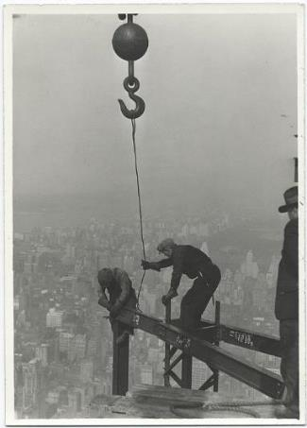
Building Safe Working Environments in Rural Communities

Slide 2

The Need for Training:
FALLS are the Leading Cause of Death in Construction.
Notes:
Why the emphasis for training?
Falls are leading cause of death in the construction industry.
It’s not the fall that kills, it’s the sudden stop at the bottom!
There are other at home that depend on you, work safely!
Cite the Bureau of Labor Statistics as the source for this information.

Slide 3
The Fatal Four
Out of 4,379 worker fatalities in calendar year 2015, 937 or 21.4%, one in five, were in construction
The Fatal Four causes were responsible for 64.2% of all private industry construction worker deaths in 2015:
Falls — 364 out of 937 total deaths in construction in 2015 (38.8%)
Struck by Object - 90 (9.6%)
Electrocutions - 81 (8.6%)
Caught-in/between - 67 (7.2%)
Notes:
OSHA has identified the four leading causes of fatalities in the construction industry. This is an online course that focuses on OSHA Fatal Four Hazards which include electrical, fall, struck-by, and caught-in or between hazards.
Discuss the total number of work-related fatal falls for 2015.
Note – OSHA is always 2 years behind regarding their data collection efforts.
Mention the source: BLS, U.S. Bureau of Labor Statistics.
Mention that out of the 4,379 in 2015, 937 were in the construction industry and 364 resulted in fatalities.

Slide 4
Objectives:
Identify the OSHA Fall Protection Standard for Construction Industry (29 CFR 1926, Subpart M).
Recognize Fall Hazards in order to avoid, abate, and prevent falls from ladders, roofs, scaffolds, and other potential situations.
Recognize and Prevent Fall Protection Issues during Residential Construction.
Discuss the Residential & Commercial Fall Protection Guidelines
Understand some of the different types of fall protection systems available to contractors.
Understand the basics of a Fall Protection and a Fall Protection Plan.
Notes:
Objectives:
Indicate each objective on its own.
There is a lot of material to cover and this brief course cannot cover everything, so additional training and/or education is required.

Slide 5
Training Content
Rights and Responsibilities
Compliance Standards for Fall Protection
Types of Fall Protection
Recognition and Prevention of Falls from Scaffolds, Ladders and Roofs
Fall Protection in Residential & Commercial Construction
Prevent Falls When Handling Trusses
Development of Fall Protection Plans
Notes:
Inform the students of the training content and the order in which it will be discussed.

Slide 6
Employee Responsibilities
Each employee, that means you, shall:
Comply with the standards, rules, regulations and orders issued by your employer
Compliance with company rules and policies are not optional – it is the law
Use safety equipment, personal protective equipment, and other devices and procedures provided by your employer
Understand my rights under the “Whistleblower Act”
Notes:
Discuss the General Duty Clause 29 USC 654
“SEC. 5. Duties
(b) Each employee shall comply with occupational safety and health standards and all rules, regulations, and orders issued pursuant to this Act which are applicable to his own actions and conduct.”
Compliance with company issued rules, policies and procedures is not an option. It’s the law!
Make a distinction between employers responsibilities and employee’s rights

Slide 7
“Whistleblower Act”
  Be free from retaliation for exercising safety and health rights!
    If you ask for a hazard correction, and you get it corrected, that’s great.
    BUT, If you suffer retaliation from a superior (Lead-man, Supervisor or Foreman, etc.) immediately or weeks, even months later – and it is obvious it is retaliation for a safety correction--you have 30 days from the date of retaliation to contact OSHA and file a complaint.
Notes:
What does this mean to you?
Give examples of retaliation – picking on you ‘’Mr. I gotta do it the safe way!”
And then assigning you something like graveyard shift or cleaning UP THE PARKING LOT.
Give participants OSHA handout and example.

Slide 8
Employer Responsibilities
Under the OSH law, employers have a responsibility to:
Provide a workplace free from serious recognized hazards and comply with standards, rules and regulations issued under the OSH Act.
Examine workplace conditions to make sure they conform to applicable OSHA standards.
To provide training :
  How to safely perform your job
  How to use, maintain and inspect your safety equipment
Notes:
Make a distinction between employers responsibilities and employee’s rights – each party has responsibilities. Do your part!
Expanded list of employer responsibilities.
Discuss the General Duty Clause 29 USC 654
“SEC. 5. Duties
(a) Each employer --Per OSHA, the following is a summary list of employer’s OSH responsibilities:
Provide a workplace free from serious recognized hazards and comply with standards, rules and regulations issued under the OSH Act.
Examine workplace conditions to make sure they conform to applicable OSHA Standards.
Make sure employees have and use safe tools and equipment and properly maintain this equipment.
Use color codes, posters, labels or signs to warn employees of potential hazards.
Establish or update operating procedures and communicate them so that employees follow safety and health requirements.
Employers must provide safety training in a language and vocabulary workers can understand.
Employers with hazardous chemicals in the workplace must develop and implement a written hazard communication program and train employees on the hazards they are exposed to and proper precautions (and a copy of safety data sheets must be readily available). See the OSHA page on Hazard Communication.
Provide medical examinations and training when required by OSHA Standards.
Post, at a prominent location within the workplace, the OSHA Poster (or the state-plan equivalent) informing employees of their rights and responsibilities.
Report to the nearest OSHA office all work-related fatalities within 8 hours, and all work-related inpatient hospitalizations, all amputations and all losses of an eye within 24 hours. Call our toll-free number: 1-800-321-OSHA (6742); TTY 1-877-889-5627. [Employers under federal OSHA's jurisdiction were required to begin reporting by Jan. 1, 2015. Establishments in a state with a state-run OSHA program should contact their state plan for the implementation date].
Keep records of work-related injuries and illnesses. (Note: Employers with 10 or fewer employees and employers in certain low-hazard industries are exempt from this requirement.
Provide employees, former employees and their representatives access to the Log of Work-Related Injuries and Illnesses(OSHA 300 form). On February 1, and for three months, covered employers must post the summary of the OSHA log of injuries and illnesses (OSHA 300A form).
Provide access to employee medical records and exposure records to employees or their authorized representatives.
Provide to the OSHA compliance officer the names of authorized employee representatives who may be asked to accompany the compliance officer during an inspection.
Not discriminate against employees who exercise their rights under the Act. See our “Whistleblower Protection” webpage.
Post OSHA citations at or near the work area involved. Each citation must remain posted until the violation has been corrected, or for three working days, whichever is longer. Post abatement verification documents or tags.
Correct cited violations by the deadline set in the OSHA citation and submit required abatement verification documentation.
OSHA encourages all employers to adopt an Injury and Illness Prevention Program. Injury and Illness Prevention Programs, known by a variety of names, are universal interventions that can substantially reduce the number and severity of workplace injuries and alleviate the associated financial burdens on U.S. workplaces. Many states have requirements or voluntary guidelines for workplace Injury and Illness Prevention Programs. Also, numerous employers in the United States already manage safety using Injury and Illness Prevention Programs, and we believe that all employers can and should do the same.
Most successful Injury and Illness Prevention Programs are based on a common set of key elements.
These include:
management leadership,
worker participation,
hazard identification,
hazard prevention and control,
education and training, and
program evaluation and improvement.
OSHA’s Injury and Illness Prevention Programs topics page contains more information including examples of programs and systems that have reduced workplace injuries
Go back over the employee’s responsibilities if needed.

Slide 9
Laws & Regulations
29 CFR 1926, Subpart M- Fall Protection Standard for Construction.
29 CFR 1926.501 – Duty to have Fall Protection
STD 03-11-002, Compliance Guidance for Residential Construction issued December 16, 2010.
Notes:
Note – there’s quite a number of standards governing fall protection within the construction industry.
We can cover every standard within 1-1/2 hours, so we’ll hit the highlights.
This training is awareness only and not inclusive of all the topics and all the material available.
Have in hand the 1926 Standards book to show students the location of the regulations for fall protection.

Slide 10
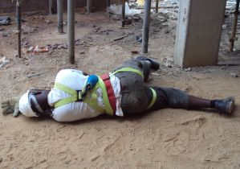
Recognizing General Fall Hazards
Workers can be killed by falling from open-sided floors and through floor openings.
Workers can be hurt or killed if they fall from as little as 4 to 6 feet.
Notes:
Point the photo of the fallen worker. The worker had a harness on…? Look for probable causes from your students.
How could someone fall if they had their harness on?
Not attached on lanyard/retractable?
Anchorage point failed?
Other?
Stress that this fall could have been prevented.
Stress that most work-related injuries and illnesses are preventable.
Other examples of situations where employees need to be protected from falls.

Slide 11
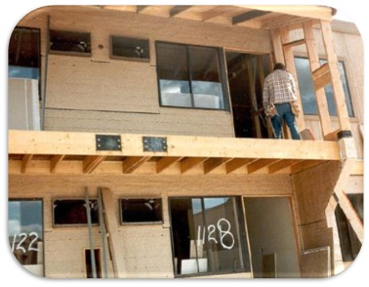
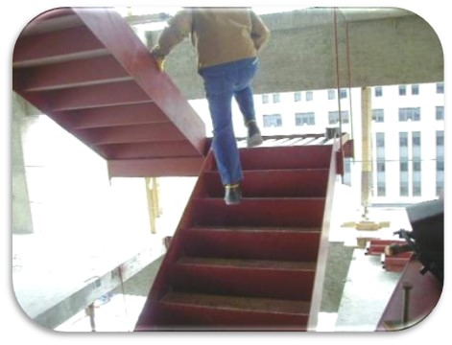
General Fall Hazard Recognition
Open-sided floors and platforms 6 feet or more in height must have a guard to protect from falls.
Notes:
Continue to go over the different fall hazard situations for the photos.
Important to mention at this point the requirement for fall protection in construction of 6 feet or more.
Note, workers, contractor, visitors and anyone exposed to a fall needs to be protected from a possible fall hazard.
Ask the class if they find anything wrong in the images.

Slide 12
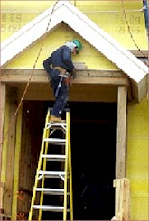
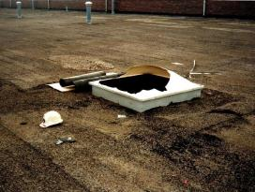
Fall Hazards Include:
Scaffolding
Holes-floor & walls
Skylights
Edges
Roofs
Decking and plywood
Installation of trusses
Excavations
Bricklaying
Notes:
Mention the other types of fall hazards that can be encountered during construction activities.
This list is not all inclusive, so ask if they’ve seen other fall hazards not on this list.
Ask the class what they’ve seen that posed as construction fall hazards.
Scaffold ladders and platforms
Holes-floor & walls
Skylights
Edges
Roofs
Elevator shafts
Ladder sides
Decking and plywood
Installation of trusses
Excavations
Bricklaying
Residential Construction

Slide 13
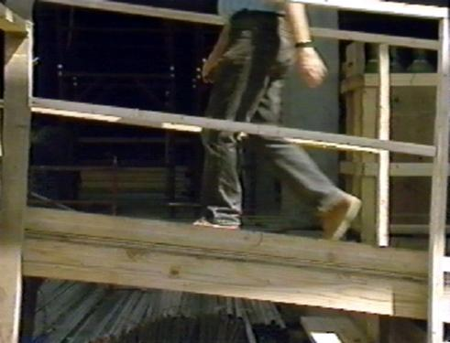
Fall Hazard - Walkways and Ramps
Notes:
Ramps, runways, and other walkways must be protected by guardrail systems when employees, contractors, visitors or anyone can fall 6 feet or more.
The walking/working surface must be strong enough to support employees safely. If not, employees may not work on the surface. This knowledge will be gained during frequent and regular inspections made, as required, by competent persons designated by the employer.

Slide 14
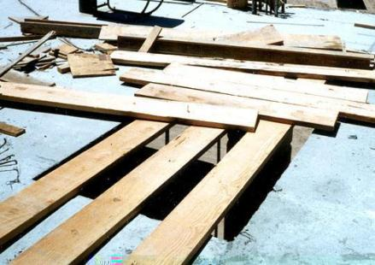
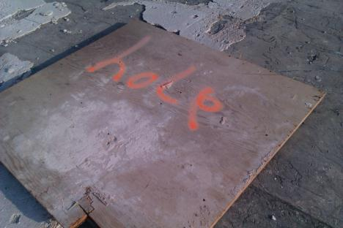
Fall Hazard - Floor Holes
Do either of these coverings comply with the standards?
Notes:
The Occupational Safety and Health Administration (OSHA) allows use of covers to protect employees on walking/working surfaces from falling through holes, including skylights, more than 6 feet above lower levels.
OSHA defines a hole as “a gap or void 2 or more inches in its least dimension in a floor, roof or other walking/working surface.”
Covers are required to protect employees from tripping in, stepping into or through holes, including skylights.
Covers also protect employees from objects falling through holes and skylights.
When covers will be used to address hazards associated with holes and skylights, OSHA imposes certain requirements on construction employers, pursuant to 29 C.F.R. § 1926.502(i) and its subparts. To satisfy OSHA requirements, 29 C.F.R. §1926.502(i) requires covers to:
be capable of supporting, without failure, at least twice the weight of employees, equipment and materials that may be imposed on the cover at any one time;
be secured when installed to prevent accidental displacement by wind, equipment or employees;
be color-coded or marked with “HOLE” or “COVER” to provide warning of the hazard.
When using covers, foremen and superintendents need to ensure:
They are aware of the presence of all holes and skylights on the roof. Before beginning any roofing work, inspect the roof for any holes or skylights.
If there are no guardrails erected around such holes or skylights, covers meeting OSHA’s requirements as set forth above are installed. A hole or skylight that only may be open for a brief period of time is not an excuse for not using a cover. Brevity of exposure to a fall hazard is not a defense to an OSHA citation under the standard addressing holes and skylights. If a skylight meets OSHA’s requirements, as a matter of enforcement policy, OSHA will treat the skylight as a cover.

Slide 15
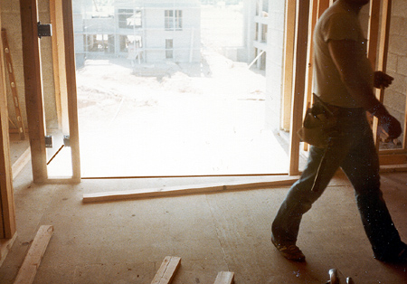
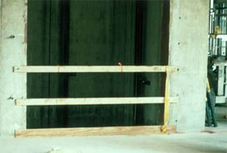
Fall Hazard - Wall Openings
Unguarded wall opening
Wall opening with compliant guards
Notes:
Employees working on, at, above, or near wall openings (including those with chutes attached) where the outside bottom edge of the wall opening is 6 feet or more above lower levels and the inside bottom edge of the wall opening is less than 39 inches above the walking/working surface must be protected from falling by the use of either a guardrail system, a safety net system, or a personal fall arrest system.
The picture on the right shows the proper guardrail system for an elevation opening. Top-rail, mid-rail and toe board. Good job!

Slide 16
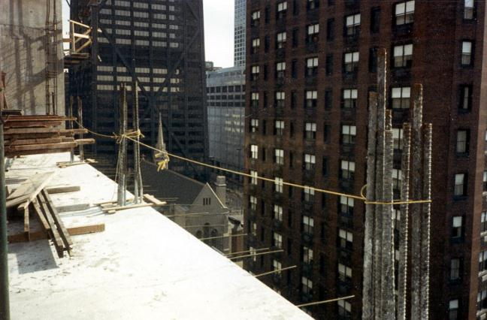
Fall Hazard: Sides & Edges
What’s wrong in this picture?
Notes:
Ask the class what’s wrong with this?
¼ inch rope is allowed, but it does not meet the standard criteria
Under 1910.23(e)(1), OSHA says that a guardrail must have a vertical height of 42 inches nominal from the upper surface of the top rail to floor, platform, runway, or ramp level. "Nominal" simply means that 42 inches has been established as the de facto standard for guardrail height.
Under 1926.502(b)(4), When the 200 pound (890 N) test load specified in paragraph (b)(3) of this section is applied in a downward direction, the top edge of the guardrail shall not deflect to a height less than 39 inches (1.0 m) above the walking/working level. Guardrail system components selected and constructed in accordance with the Appendix B to subpart M of this part will be deemed to meet this requirement.1926.502(b)(5)Midrails, screens, mesh, intermediate vertical members, solid panels, and equivalent structural members shall be capable of withstanding, without failure, a force of at least 150 pounds (666 N) applied in any downward or outward direction at any point along the midrail or other member.
Top rail test of 150 lbs. in any direction
no midrail
no toeboards
sagging is not allowed

Slide 17
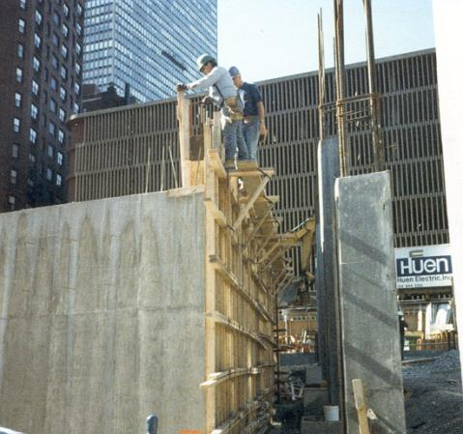
Fall Hazard:
Concrete Forms and Rebar
Notes:
Employees on a form scaffold exposed to falls of more than 10 feet, are required to have fall protection.
Also, exposed rebar shall have caps that prevent impalement.

Slide 18
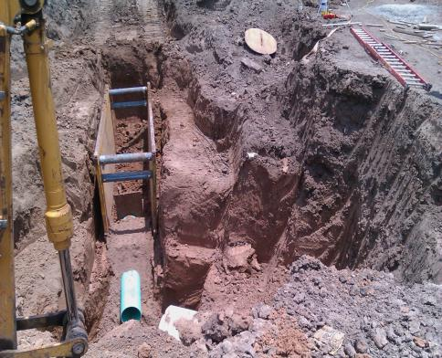
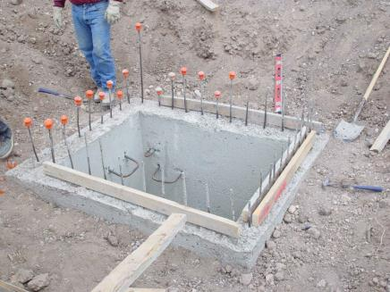
Fall Hazard: Excavations
Notes:
Employees at the edge of an excavation 6 feet or more deep shall be protected from falling by guardrail systems, fences, barricades, or covers.
If walk-ways are used to permit workers to cross over excavations, guardrails are required on the walkway if the fall would be 6 feet or more to the lower level.
Note: some of the exposed rebar have caps installed to prevent impalement, other do not.

Slide 19
How to prevent falls?
Do an assessment of the jobsite
Take necessary steps to mitigate, eliminate or control the fall hazard
If hazard cannot be eliminated, then provide fall protection
  Which type of fall protection?
Notes:
After seeing the different situations where fall protection may be needed, provide the student with some general instructions on how to prevent falls.
Be clear on the fact that the main objective should be to prevent the exposure to the fall or eliminate the fall hazard.
Inform the student that you will discuss the various types of fall protection.

Slide 20
Types of Fall Protection
GUARDRAILS
FALL ARREST SYSTEMS
RESTRAINING & POSITIONING DEVICES
SAFETY NETS
CONTROLLED ACCESS ZONES (CAZ)
CONTROLLED DECKING ZONES (CDZ)
WARNING LINES
SAFETY MONITORS
Notes:
Mention the different types of fall protection and that you will discuss each one in detail.
Good time to mention that some of these systems will be available during the class for students to become familiar with them and practice their implementation.

Slide 21
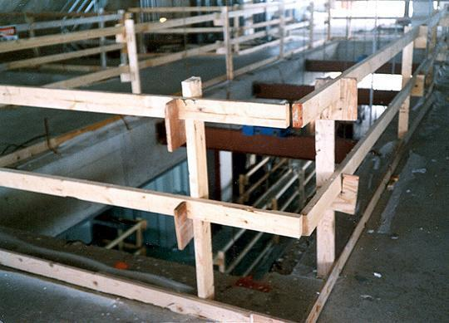
Guardrails
Top Rail
Mid Rail
Toeboard
2 x 4 posts
Notes:
Discuss all 3 parts of the guardrail system, what function they serve, and the specs of each part.
Top Rail
Protect workers from falls on the job if workers are more than 6 feet above the lower surface
42 inches, +/- 3 inches
Be able to withstand 200 lbs. of force
Mid Rail
Protect workers so they can't fall through the guardrail
Middle of top rail and ground (21 inches)
Be able to withstand 150 lbs. of force
Toeboards
Toeboard means a low protective barrier that is designed to prevent materials, tools, and equipment from falling to a lower level, and protect employees from falling.
At least 3 ½ inches tall (quick fix: 2 x 4 lumber)
Be able to withstand 50 lbs. of force
Verticals- not more than 8 feet apart

Slide 22
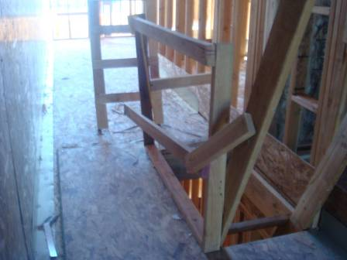
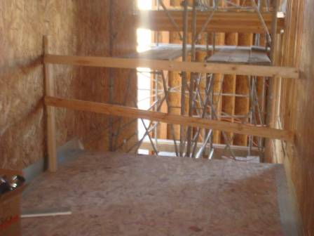
Examples of Improper Installation of Temporary Guard Rails
Are these in compliance with the standards based on what you learned in the last slide? Why or why not?
Notes:
Let the students recognize the hazards of improper installation of guardrails,
1st - Midrail not placed correctly, protruding rail & loosely attached
2nd – Midrail is not properly placed, wall connectors at different heights
2nd - board missing on the right picture
You would not to be under this work area if something fell

Slide 23
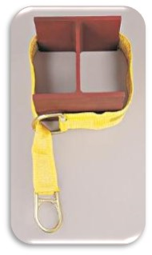
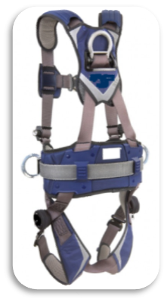
Personal Fall Arrest Systems
You must be trained how to properly use PFAS.
PFAS encompasses anchorage, lifeline/connector and body harness
Notes:
State what PFAS stands for (Personal Fall Arrest Systems).
Briefly mention each component of the PFAS:
Anchor
Lanyard/connector
Full Body Harness
Indicate the equipment and fall protection training requirement

Slide 24
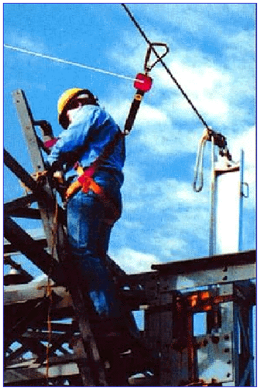
Personal Fall Arrest System-
Anchor Points
Must be independent of any platform anchorage and capable of supporting at least 5,000 lbs. per worker
Notes:
Must be capable of supporting at least 5,000 pounds per employee attached
Or
Must be designed and used as follows:
As part of a complete personal fall arrest system which maintains a safety factor of at least two.
Under the supervision of a qualified person.
Care must be taken when placing an anchor. Use the right anchor for the right job and location. In the photo, a webbing anchor strap was placed adjacent to sharp sheet metal and anchor is not properly secured.

Slide 25
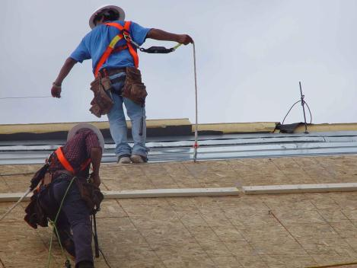
Personal Fall Arrest System-
Full Body Harness
PFAS in use during roofing and re-roofing activities.
Notes:
Next, the Full Body Harness – Here we see Personal Fall Arrest System during use for roofing and re-roofing operations.
As you can see, the harness has to be attached to a connector and this itself to an anchor point.
Depending on the application, there are specific devices designed for attachment or connection.

Slide 26
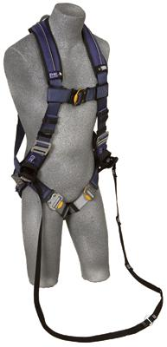
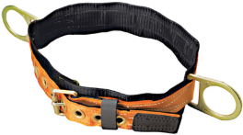
Full Body Harness
A full body harness distributes the force of the fall over the thighs, pelvis, waist, chest and shoulders
Body belts have not been allowed as part of a fall arrest system since January 1998
These are not safe!
Notes:
A full body harness is designed to minimize the impact on the body during a fall by distributing the force of the fall over the entire torso.
And remember, body belts have not been allowed as part of an arrest system since Jan 1998. They can still be used as part of a fall restraint system/positioning only and we’ll cover that in just a few minutes.

Slide 27
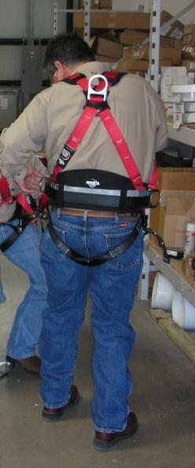
Personal Fall Arrest System-
Full Body Harness 2
The attachment point on a
full body harness is a D-ring in the center of your upper back.
Be sure to use a size that fits
properly.
Use with compatible equipment.
Notes:
Workers must be trained in the proper wear and use of the body harness.
They are not a one size fits all component.
Proper sizing is critical to preventing injuries. The harness must fit snugly across the chest and around the thighs and the D-ring must be positioned in the center of the back between the shoulder blades.
Employers must ensure workers use a size that fits properly.
The D-ring should be positioned between the shoulder blades when properly fitted.
Emphasize the weight limitation of 310 pounds for a standard harness. Higher weight limit harnesses are available in the market.

Slide 28
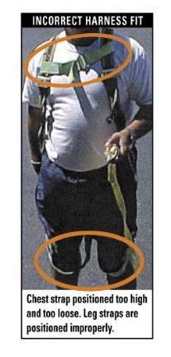
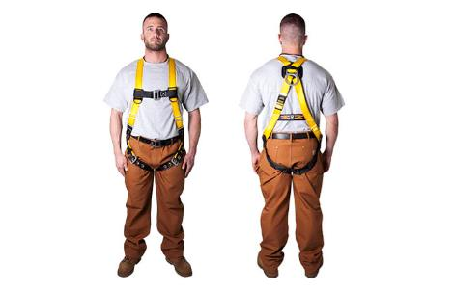
What is OSHA’s Definition of Snug?
There is no OSHA definition of snug or snugly.
Notes:
The picture on the left illustrates a loose fitting harness and the images on the right illustrate what a snug harness should look like.
Strongly note – loose leg straps become scissors in a fall event! Snug is good!!

Slide 29

Harness Inspections
Notes:
Equipment inspection is one of the most important procedures in the world of fall protection. No matter how well designed or high performing the equipment, if it is damaged it will not do what you need it to. Damage cannot be found and remedied unless equipment is inspected thoroughly.
Prior to each use, a harness must be inspected for deficiencies including corrosion, deformation, pits, burrs, rough surfaces, sharp edges, cracking, rust, paint buildup, excessive heating, alteration, broken stitching, fraying, and missing or illegible labels. IMMEDIATELY remove the Harness from service and discard if defects or damage are found, or if exposed to forces of fall arrest.
Webbing
Grasp the webbing with your hands and bend the webbing, checking both sides. This creates surface tension making damaged fibers or cuts easier to see. Webbing damage may not show up through a sight (visual) inspection only - manual (touch) the harness is equally important.
Visual and Touch Inspection
Cuts, nicks or tears
Broken fibers/cracks
Overall deterioration
Modifications by user
Fraying/Abrasions
Discoloration of material (Dependent on cause of discoloration)
Hard or shiny spots (Indicates heat damage)
Webbing thickness uneven (Indicates possible fall)
Mildew (Clean harness)
Missing Straps
Undue Stretching (Indicates possible fall)
Burnt, charred or melted fibers (Indicates heat damage)
Material marked w/permanent marker (Check w/manufacturer)
Excessive hardness or brittleness (Indicates heat or UV damage)
Stitching Visual and Touch Inspection
Pulled stitches
Stitching that is missing
Hard or shiny spots (Indicates heat damage)
Cut stitches
Discoloration of stitching (Dependent on cause of discoloration)
Hardware Visual and Touch Inspection
Distortion (twists, bends)
Rough or sharp edges
Rust or corrosion
Cracks or breaks
Broken/distorted grommets
Modification by users (i.e. additional holes)
Tongue buckle should overlap the buckle frame and move freely back and forth in their socket
Roller of tongue buckle should turn freely on frame
Bars must be straight
All springs must be in working condition

Slide 30
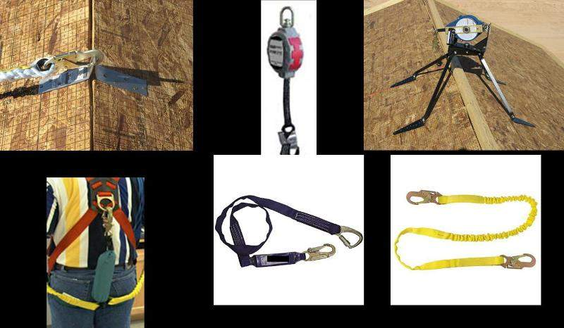
Personal Fall Arrest System-
Connector, Lanyard & Anchors
Notes:
Lanyards shall have a minimum breaking strength of 5,000 pounds.
Self-retracting lifelines and lanyards which automatically limit free fall distance to 2 feet (0.61 m) or less shall be capable of sustaining a minimum tensile load of 3,000 pounds applied to the device with the lifeline or lanyard in the fully extended position.
Self-retracting lifelines and lanyards which do not limit free fall distance to 2 feet (0.61 m) or less, rip stitch lanyards, and tearing and deforming lanyards shall be capable of sustaining a minimum tensile load of 5,000 pounds applied to the device with the lifeline or lanyard in the fully extended position.
Ropes and straps (webbing) used in lanyards, lifelines, and strength components of body belts and body harnesses shall be made from synthetic fibers.

Slide 31
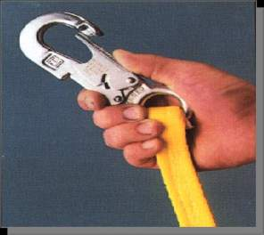
Personal Fall Arrest System-
Connector & Lanyards
Inspect it every time you use it !
There shouldn’t be:
Cracks or tears in the lines
Ripped stitches
Alteration of the equipment
Burrs on the metal
Notes:
Now for the device that ties the anchorage and the body harness together … the connector or lanyard.
Dee-rings and snap hooks shall have a minimum tensile strength of 5,000 pounds.
Snap hooks must be size compatible with the connection point to prevent unintentional disengagement, or shall be a locking type snap hook.
Unless the snap hook is a locking type and designed for the following connections, snap hooks shall not be engaged:
Directly to webbing, rope or wire rope
To each other
To a Dee-ring to which another snap hook or other connector is attached
To a horizontal lifeline or,
To any object which is incompatibly shaped or dimensioned in relation to the snap hook such that unintentional disengagement could occur by the connected object being able to depress the snap hook keeper and release itself.

Slide 32
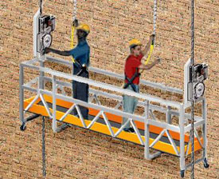
Personal Fall Arrest System-
Vertical Lifelines & Lanyards
Each worker must be attached to a separate vertical lifeline, except during the construction of an elevator shaft
Notes:
Vertical lifelines/lanyards must have a minimum breaking strength of 5,000 lbs.
Regarding elevator shaft work:
During the construction of elevator shafts, two employees may be attached to the same lifeline in the hoist way, provided both employees are working atop a false car that is equipped with guardrails; the strength of the lifeline is 10,000 pounds [5,000 pounds per employee attached] and all other criteria specified for lifelines have been met.
Point out that each workers separate lifeline attachments

Slide 33
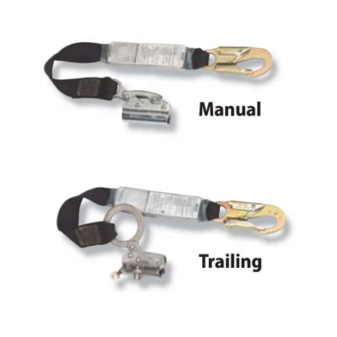
Personal Fall Arrest System-
Vertical Lifelines & Rope Grabs
Notes:
Rope grabs move easily up and down vertical lifelines providing continuous fall protection.
Rope grabs can be one of 2 types:
Trailing- offer complete hands-free operation. In the event of a fall, Miller rope grabs lock quickly.
Manual- user controls the grab, can lock & unlock the mechanism.

Slide 34
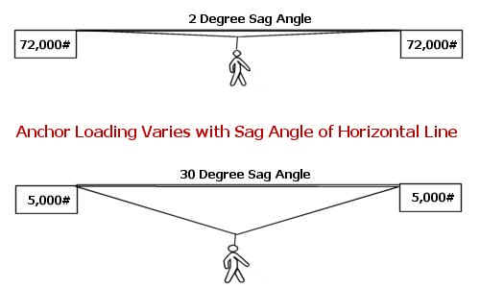
Personal Fall Arrest System –
Horizontal lifeline
Notes:
Horizontal Lifeline
Qualified person should design and install.
Safety factor of at least 2.
Mention how a horizontal lifeline is attached to the anchor point of at least 5,000 pounds per worker
Discuss the tension factor:
More tension on the line, smaller the sag angle = more pressure and load on the anchor
Less tension (30 degrees max.), bigger the angle = less pressure and load on the anchor, preferred method

Slide 35
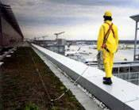
Personal Fall Arrest System -
Horizontal Lifeline
On work platforms, the devices used to connect to a horizontal lifeline must be able to lock in both directions on the lifeline
Notes:
This will be demonstrated during the hands - on experience in the laboratory.

Slide 36
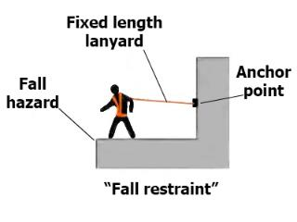
Restraining & Positioning Devices: Mitigating the Hazard!
A fall restraint system consists of equipment/systems used to keep an employee from reaching a fall point, such as the edge of a roof or the edge of an elevated working surface.
Notes:
Fall restraint can be a body belt or full body harness.
Must be tied off so that the worker cannot go past the unprotected side or edge, no matter where the work is on the walking/working surface.
Lanyards should be adjustable to take up slack when workers move about.

Slide 37
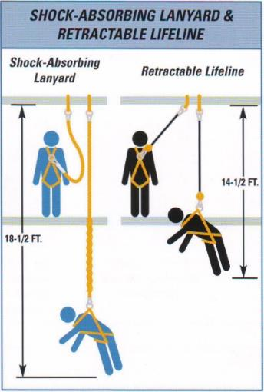
Personal Fall Arrest System-
Calculating Fall Clearance with a Retractable
Notes:
Discuss with class how to calculate fall clearance, and the importance of using the correct size components when working in different scenarios.
Different lanyard sizes are available to fit the needs of specific fall distance situations. A 6ft lanyard with a deceleration device should not be used when the fall distance is less than 18ft.
Whether using shock-absorbing lanyards or self-retracting lifelines, it is very important to position your anchorage point directly overhead whenever possible to minimize swing falls.
If this overhead position is not attained employees can suffer injuries from a swing fall.
Higher the anchorage point, less fall distance.

Slide 38
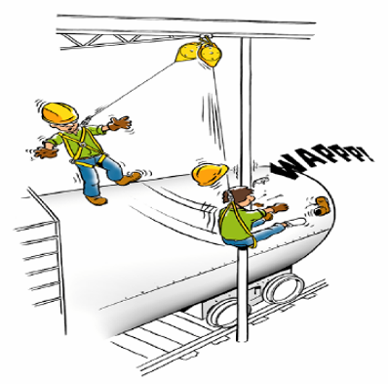
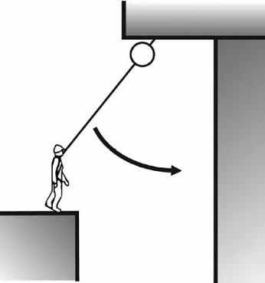
Personal Fall Arrest System-
Swing Calculation
Notes:
Swing fall is the pendulum motion that results when a worker takes a fall when not directly below the anchor point.
Swing needs to be properly understood and accounted when designing and implementing a fall plan/program.

Slide 39
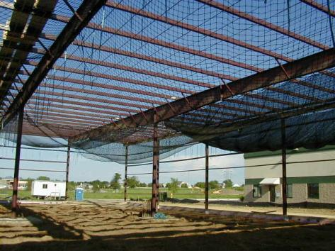
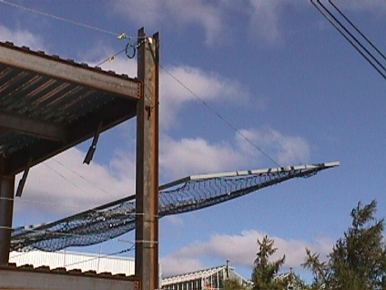
Safety Nets
Assume the fall will occur
Notes:
Remember, when using a safety net, you can assume that a fall will occur.
Employee is put under great stress and can cause traumatic injury to the worker (physically and emotionally)
Employers should be concerned for any employee that has fallen from any elevated work area unto a safety net, observation and retraining should follow the incident.

Slide 40
SAFETY NETS - Check List
Test the net
Remove objects fallen into the safety net
Inspect at least once a week
There should be a recent certification record for each net installation
If more than 25’ above ground or water and other methods not practical to use
Must extend 8’ beyond surface
Mesh size not exceed 6”x6”
17,500 foot lb. impact resistance
Notes:
How to conduct the test:
Each net must be drop-tested at the jobsite:
After initial installation and before being used
Whenever relocated
After major repair
At 6-month intervals if left in one place
A 400 pound (180 kg) bag of sand 30 + or - 2 inches (76 + or - 5 cm) in diameter dropped into the net not from less than 42 inches (1.1 m) height

Slide 41
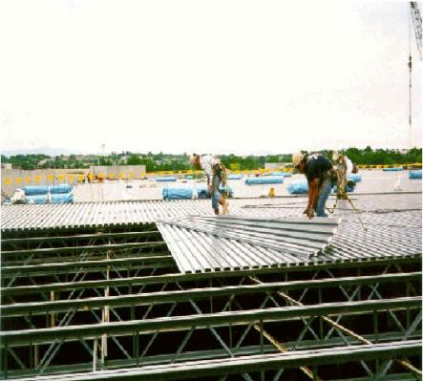
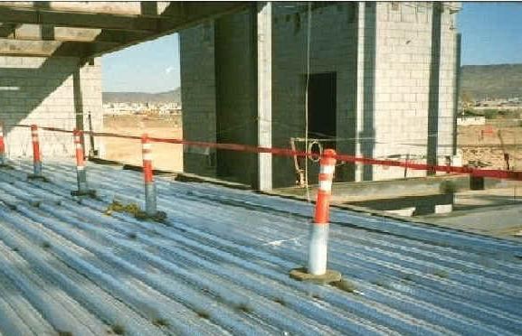
Controlled Access Zones/Controlled Decking Zones (Steel Erection)
Controlled Access Zone (CAZ)
Controlled Decking Zone (CDZ)
Notes:
Controlled Access Zone:
May only be used when employer demonstrates that conventional fall protection methods are not feasible or create a greater hazard.
A fall protection plan needs to be developed.
Shall be defined by a control line or by any other means that restricts access
Controlled Decking Zone:
A CDZ can be established as a substitute for fall protection where metal decking is initially being installed and forms the leading edge of a work area over 15 and up to 30 feet above a lower level
Used to control access to areas where leading edge and initial securement of metal deck and other operations connected with leading edge work are taking place.
Boundaries of the CDZ must be marked by the use of control lines or the equivalent and must clearly designate the CDZ.
Be no more than 90 feet wide and 90 feet deep from any leading edge
Not exceed 3,000 square feet of unsecured decking
Have designated and clearly marked boundaries with control lines or the equivalent

Slide 42
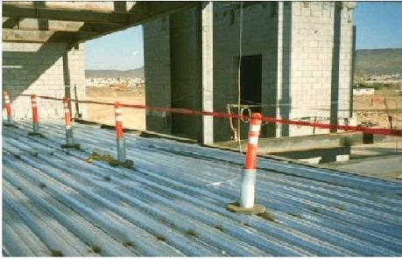
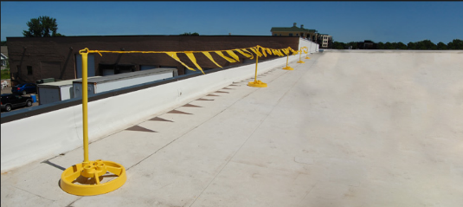
Control Versus Warning Lines
Notes:
Warning lines are used to demarcate safe working areas on an elevated working surface. They can only be used as legitimate fall protection measures under certain conditions. Warning Lines only serve to warn someone of a fall hazard, they do not provide any actual resistance to a fall. Warning lines are barriers placed around a roof to alert employees that they are approaching an unprotected edge. They also identify roof areas where work may be performed without guardrails, body belts or safety nets. Warning lines shall be erected around all sides of the roof work area.
Control lines Controlled access zones also are areas where certain work may be done without the use of guardrails, personal fall arrest systems, or safety nets. However, unlike a warning line, which is barrier that cannot be crossed, a controlled access zone establishes a boundary that can be crossed, but only by a specifically designated employee.

Slide 43
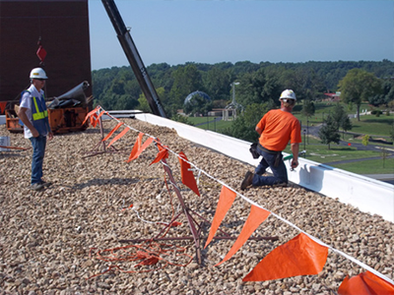
Safety Monitor
Designated by the employer to monitor other employees; and SHALL:
Be a Competent Person
Warn the employee when it appears that the employee is unaware of a fall hazard or is acting in an unsafe manner
Be on the same walking/working surface and within visual sighting distance of the employee being monitored
Be close enough to communicate orally with the employee
Not have other responsibilities which could take the monitor's attention from the monitoring function
Notes:
Discuss the duties of the safety monitor
Cannot be used at all times.

Slide 44
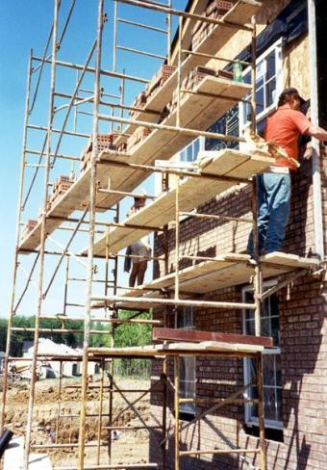
What Is A Scaffold?
An elevated, temporary work platform
Three basic types:
Supported scaffolds -- platforms supported by rigid, load bearing members, such as poles, legs, frames, & outriggers
Suspended scaffolds -- platforms suspended by ropes or other non-rigid, overhead support
Aerial Lifts -- such as “man lifts” or “personnel hoists”
Notes:
Supported scaffolds, which consist of one or more platforms supported by rigid, load- bearing members, such as poles, legs, frames, outriggers, etc.
Suspended scaffolds, which are one or more platforms suspended by ropes or other non-rigid, overhead support.
Other scaffolds, principally man lifts, personnel hoists, etc., which are sometimes thought of as vehicles or machinery, but can be regarded as another type of supported scaffold.

Slide 45
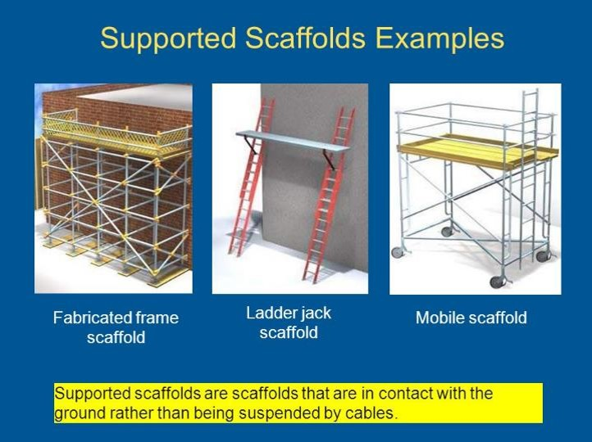
Supported Scaffolds
Notes:
Review the different types of configurations for supported scaffolds.
Ask the class if they are familiar with any of the scaffolds in the image.

Slide 46
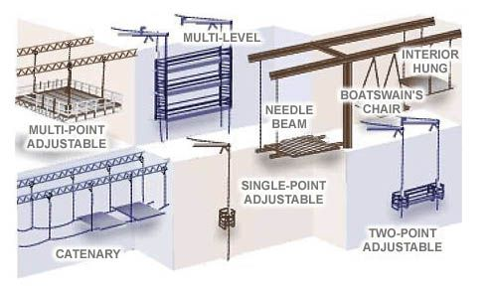
Suspended Scaffolds
Notes:
A suspended scaffold.
On suspended scaffolds each worker needs to have his own separate lifeline.
Lifeline cannot be attached to scaffold.

Slide 47
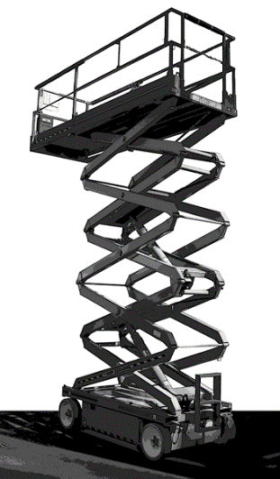
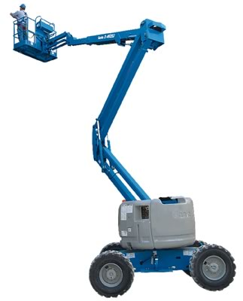
Aerial Lifts Scaffold
Notes:
Are aerials lifts scaffolds? Yes they are. Mobile Platforms.
What are the associated risks?
Leading/reaching over the rails.
Standing on the mid rails.
Not using a harness in the telehandler.
Why a harness in the telehandler?
If you’re traveling in the telehandler and you hit a bump, the driver in the platform can get thrown out if the platform is a distance from the machine when it hits the bump/hole.
Any other hazards?
What about people working under the elevated work platform?

Slide 48
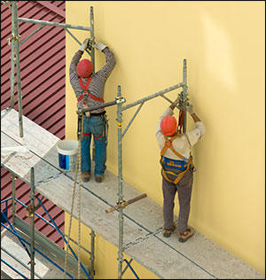
Scaffold - Fall Hazards
Fall may occur:
While climbing on or off the scaffold
Working on unguarded scaffold platforms
When scaffold platforms or planks fail
Notes:
Falls may occur:
While climbing on or off the scaffold
Working on unguarded scaffold platforms
When scaffold platforms or planks fail
What is wrong with this picture?

Slide 49
Scaffolds – Materials
  Planks must be at least 18 inches wide.
  Each plank end that abuts another must rest on a separate support surface
  Planks must be made of scaffold grade wood, not wood purchased at Home Depot or Lowes
Notes:
Avoiding Falls
Planks must be at least 18 inches wide.
Each abutted end of plank must rest on a separate support surface
Overlap platforms at least 12 inches over supports, unless restrained to prevent movement.
Only scaffold grade wood is to be used
Each end of a platform, unless cleated or otherwise restrained by hooks, must extend over its support by at least 6 inches.

Slide 50
Scaffolds - Avoiding Falls
  Follow manufacturer's instructions.
  Install guardrail systems along all open sides and ends.
  Personal fall arrest system are required when on scaffolds higher than 10 feet.
  Height can’t be more than 4 times the base width unless guys, ties, or braces are used
  Do not work on snow or ice covered platforms during storms or high winds
Notes:
Scaffolds and scaffold components shall be inspected for visible defects by a competent person before each work shift, and after any occurrence which could affect a scaffold's structural integrity.
An OSHA "competent person" is defined as "one who is capable of identifying existing and predictable hazards in the surroundings or working conditions which are unsanitary, hazardous, or dangerous to employees, and who has authorization to take prompt corrective measures to eliminate them“
Tag the scaffolding out of service if defects are found during the inspection or workday.
Install guardrail systems along all open sides and ends of platforms.
Personal fall arrest system should be used on scaffolds higher than 10 feet.

Slide 51

Scaffolds - Guardrails
Install along open sides & ends
Front edge of platforms not more than 14 inches from the work, unless using guardrails and/or PFAS
Top rails – 42 +/- 3 inches tall
Midrails halfway between toprail and platform
Toeboards at least 3-1/2 inches high – [2x4 turned on edge]
Notes:
Scaffold Guardrails:
39 inch minimum guardrail height where guardrail is primary fall protection.
36 inch minimum guardrail height where fall arrest systems are primary fall protection.
Protect from falling between the top rail and surface, by using midrails, screens or mesh.
Protective barriers must be strong enough to support a falling employee. Wood, chain and wire rope may be used for top rails and midrails.
Top rails – 42 =/- 3” tall when using the crossbracing as the top rail
When crossbracing is used as a midrail, it must be between 20 and 30 inches above the work platform.
Guardrails are not required:
when the front end of all platforms is less than 14 inches from the face of the work
when outrigger scaffolds are three inches or less from the front edge
when employees are plastering and lathing 18 inches or less from the front edge

Slide 52

Scaffolds--PFAs
  Can use PFAS instead of guardrails on some scaffolds
  Use PFAS & guardrails on suspension scaffolds
  Use PFAS on erectors and dismantlers where feasible
Notes:
What fall protection will I need when working on scaffolds?
Boatswains’ chair, catenary scaffold, float scaffold, needle beam scaffold, ladder jack scaffold – personal fall arrest system.
Single-point or two-point adjustable scaffold – personal fall arrest system and a guardrail system.
Crawling board (chicken ladder) – personal fall arrest system, a guardrail system or by a three-fourth inch diameter grabline or equivalent handhold securely fastened beside each crawling board.
On a walkway within a scaffold – guardrail system installed within 9 ½ inches of and along at least one side of the walkway
On a supported scaffold when performing overhand bricklaying operations – personal fall arrest system or guardrail system on all open sides and ends of the scaffold.
For all other scaffolds, a personal fall arrest system or a guardrail system

Slide 53


Scaffolds – Do you see the Hazards?
Notes:
Scaffolds need to:
Be on a firm foundation with base plates
The footing is the thing upon which the scaffolding rests. It’s where the scaffolding meets the soil and is the first member of the load bearing structural system. If it’s not strong, neither will the scaffolding.
Be plumb, square and adequately braced
Have a fully planked work deck

Slide 54


Scaffolds
Notes:
Scaffold Access: (discuss both images, the good and the bad)
No access by cross braces
Bottom rung can not be more than 24" high
You must use a ladder or frames designed to be used as ladders
Ladder frame must be uniform and less than 16-3/4 inches.
You should check with the manufacturer’s requirements.
Ladder needs to be properly attached and secured to scaffold frame.
If you use a stairway frame there has to be resting platforms every 25 vertical feet.

Slide 55

Scaffolds - Baker-type
Baker scaffolds can be unstable
Never use a double stack without outriggers
Notes:
Baker Scaffold:
A minimum of three wheels must be locked when employees are working on the platform.
Where possible, consider the use of scissor lifts when a mobile scaffold is required.

Slide 56


Seriously?
REMEMBER: SCAFFOLDS NEED TO BE ERECTED, MAINTAINED, DISMANTLED BY TRAINED WORKERS AND INSPECTED BY A COMPETENT PERSON!
Notes:
And you wonder why people get hurt?
It comes down to decisions made minute by minute.
What is wrong in these pictures?
Incorrect scaffold construction
Incorrect ladder use
No use of Personal Fall Arrest System
Working very dangerously
Briefly discuss competent person.
OSHA’s definition of a competent person
An OSHA "competent person" is defined as "one who is capable of identifying existing and predictable hazards in the surroundings or working conditions which are unsanitary, hazardous, or dangerous to employees, and who has authorization to take prompt corrective measures to eliminate them.“ Designated, trained, be able to recognize hazards and stop work.

Slide 57

Stairways & Ladders
A ladder is a structure which is usually portable and has gaps between each step. It is usually strictly vertical and at an angle at which it is used. Stairs refers to a set of multiple steps which is a permanent structure.
Notes:
Make note of the difference between a stairway and a ladder.

Slide 58
Ladders
According to the CDC (Centers for Disease Control):
500,000+ people are treated each year for ladder related falls¹
300+ people die from ladder falls each year²
$24 billion is the annual cost to the U.S. for work loss, medical, legal, liability, and pain and suffering expenses from falls¹
1CPSC (US Consumer Product Safety Commission) [2014]. Unpublished data from the National Injury Information Clearinghouse (CPSC) using the CPSC’s Injury Cost Model. ²CDC, National Center for Health Statistics [2017]. Multiple Cause of Death 1999-2015 on CDC WONDER Online Database. Accessed at https://wonder.cdc.gov/mcdicd10.html.
Notes:
According to the World Health Organization, the United States leads the world in ladder deaths. Each year, there are more than 164,000 emergency room-treated injuries and 300 deaths in the U.S. that are caused by falls from ladders.
Most ladder deaths are from falls of 10 feet or less.
Falls from ladders are the leading cause of deaths on construction sites.
Over the past decade, the number of people who have died from falls from ladders has tripled.
Falls from ladders are the leading cause of ladder-related injuries, followed by using a ladder improperly, using a faulty or defective ladder, and simple carelessness.
Ask the class if anyone has ever fallen off a ladder? You ok? How it happened?

Slide 59

Stairways & Ladders Fall Hazards
Stairways and ladders cause many injuries and fatalities among construction workers
About half the injuries caused by slips, trips and falls from ladders and stairways require time off the job
Notes:
Stairways and ladders cause many injuries and fatalities among construction workers
About half the injuries caused by slips, trips and falls from ladders and stairways require time off the job
Remember, even falls from minor heights can lead to serious injuries.

Slide 60
Stairways - Fall Prevention
Notes:
Handrail -
A rail used to provide employees with a handhold for support.
Under 1910.23(e)(1), OSHA says that a guardrail must have a vertical height of 42 inches nominal from the upper surface of the top rail to floor, platform, runway, or ramp level. "Nominal" simply means that 42 inches has been established as the de facto standard for guardrail height.
Stair rail system -
A vertical barrier erected along the unprotected sides and edges of a stairway to prevent employees from falling to lower levels.
Top edges of stair rail systems used as handrails must not be more than 37 inches (94 cm) high nor less than 36 inches (91.5 cm) from the upper surface of the stair rail system to the surface of the tread. (If installed before March 15, 1991, not less than 30 inches [76 cm]).

Slide 61
Stairways - Fall Prevention
Handrails and the top rails of the stair rail systems must be capable of withstanding, without failure, at least 200 pounds of weight applied within 2 inches of the top edge in any downward or outward direction, at any point along the top edge
Stairways with four or more risers or more than 30 inches high must have a stair rail along each unprotected side or edge.
Notes:
Handrails and the top rails of the stair rail systems must be capable of withstanding, without failure, at least 200 pounds of weight applied within 2 inches of the top edge in any downward or outward direction, at any point along the top edge.
Why 200 pounds? The average man is 200 pounds.

Slide 62


Portable Ladders
Ladders of different types work in different ways and are designed for specific tasks.
Notes:
Portable Ladders:
Step ladders are self-supporting portable ladders that do not adjust in length.
Platform ladders are for special purposes and have a large stable platform from which you can work while standing.
Extension ladders are not self-supporting and are adjustable in length.
Trestle ladders are self-supporting ladders that are not adjustable in length and have two hinged sections at the top so the legs form equal angles at the ladder’s base.

Slide 63
Ladder Types
Type IAA ladders have a load capacity of 375 lbs.
Type IA ladders have a load capacity of 300 lbs.
Type I ladders have a load capacity of 250 lbs.
Type II ladders have a load capacity of 225 lbs.
Type III ladders have a load capacity of 200 lbs.
Notes:
Ladders should be chosen with the weight of a worker and his or her tools in mind. Many companies disallow the use of aluminum ladders due to their conductivity and ease of damage.
Type I-AA ladders are extra heavy duty and can handle up to 375 lbs.
Type I-A ladders are heavy-duty and can handle up to 300 lbs.
Type I ladders can hold up to 250 lbs.
Type II ladders can hold 225 lbs.
Type III ladders are for light duty only and can hold up to 200 lbs.
Store ladders where they are protected from the weather.
Support ladders horizontally on racks or mount on the walls to prevent sagging,

Slide 64

Ladder - Climbing & Use
IT IS NOT SAFE TO USE A LADDER THIS WAY!
Notes:
Can you use a self supported ladder (A-frame), like this?
No!
What can happen to the ladder and to you?
The support leg can contact the ground causing the step leg to kick out
Also employees should not work from the top or second step

Slide 65


Ladder Climbing and Use 1
Secure ladders to prevent accidental movement due to workplace activity
Only use ladders on stable and level surfaces, unless secured
Do not use ladders on slippery surfaces unless secured or provided with slip-resistant feet
Notes:
Mention each setup, and its purpose. What can happen if the base is set up wrong?
Firm Base: concrete, tile, hardwood floor, carpet, or any other firm flat ground
Soft Base: grass, dirt, soft grounds, or uneven terrain

Slide 66

Ladder - Climbing & Use - 2
3 POINT RULE
2 HANDS AND 1 FOOT
OR
1 HAND AND 2 FEET
Notes:
Use this image to discuss:
Use both hands to climb a ladder
Always face the ladder when climbing or descending
Avoid the top two steps of a stepladder and the top four rungs on other ladders
Always read and follow manufacturer’s requirements.
Be sure that ladders are secured before climbing, and that extension ladders extend at least 3 feet above the landing surface, or that a suitable grabrail is available.
Proper ladder placement against a structure/wall.
The 4:1 rule (for every 4 feet of vertical distance, the ladder shall extend 1 foot away from the structure)
3 feet at least on the top or a grab rail need to be provided
Properly secure the ladder on top and bottom
Ladder rungs, cleats, and steps shall be parallel, level, and uniformly spaced when the ladder is in position for use.

Slide 67

Ladder - Inspections
Ladders are inspected before initial use in each work shift, and more frequently as necessary, to identify any visible defects that could cause employee injury;
Any ladder with structural or other defects is immediately tagged "Dangerous: Do Not Use" or with similar language in accordance with § 1910.145 and removed from service until repaired in accordance with § 1910.22(d), or replaced;
Notes:
The takeaway is critical. If there’s any damage to the ladder, don’t use it, tag it out of service until it is repaired or replaced.

Slide 68


Outdoor Warning Lines
Parapet up to at least 39"
Fall Restraint
Safety Monitors
Notes:
Warning Lines/Control Lines/Safety Monitors
Roofs with Parapets lower than 39 inches must be protected by guardrails. Or install warning lines at least 6 feet away from the edge.
Notice in these pictures, examples of both, one using warning lines only and a second photo using both guardrails and warning lines. Note the employee that crossed the warning line is exposed to a fall hazard. Protection can be afforded by the installation of a guardrail or providing the employee with a fall restraint mechanism.

Slide 69

Fall Hazard:
Roofs
Not Safe!
Notes:
If workers are working on roofs with unprotected sides and edges 6 feet or more above lower levels, they shall be protected from falling by using conventional fall protection methods such as:
Guardrail systems
Personal Fall Arrest Systems (PFAS)
Safety Net Systems
Or by combining conventional with unconventional methods such as:
Warning Line Systems
Safety Monitoring Systems
Its important to mention here that the slope of the roof will dictate what specific type of fall protection can be used while performing roofing work.
Tell the class that you will discuss the slope-fall protection type factor later during the class.

Slide 70

Methods of Roof Fall Prevention
Safety monitors, as well as guardrails and warning lines are methods of fall prevention when working on roofs.
Notes:
Discuss each method of fall prevention.
Warning Lines/Control Lines/Safety Monitors
Employees performing roofing work outside warning lines must be protected by fall restraint or positive fall protection systems.
OSHA allows the use of safety monitoring systems in certain limited instances.
This practice must be closely supervised, and must comply with all requirements of the fall protection standard.

Slide 71

Stay Back from Edges
Stay away from edges unless work requires it
Always face the edge
Work from your knees
Notes:
Some work practices, such as precast concrete erection, allow employees to work under a fall protection plan without being positively protected.
It is imperative that all employees are properly trained and equipped to work in these instances, and that they follow all recommended procedures.

Slide 72


Roof Guardrails
Notes:
Roof guardrails can be easily installed and moved as needed.

Slide 73


Access Ways
Notes:
Ladderways and stairwells should planned well in advance to ensure their safe operation from phase to phase.
Additionally, proper guardrails and handrail systems should be installed and maintained throughout the project.
Offset guardrail systems are an ideal way to protect areas where access must be made through perimeter protection.

Slide 74


Holes
Covers – any hole larger than 2”
Guardrails
Notes:
Covers must be properly marked, positively affixed, and capable of supporting twice the intended load
Any signage used onsite should be adequately communicated to all employees, including those who may not speak or read English.
Cover any hole larger than 2 inches
When discussing work on roofs, there is another type of elevated work that requires the use of fall protection systems - residential work.

Slide 75

Residential Construction
Working on a roof with no fall prevention methods used is not safe!
Notes:
Lack of Fall Protection, steep roof.

Slide 76
Residential Fall Protection Program Update
STD 03-11-002, Compliance Guidance for Residential Construction was effective June 16, 2011.
This Instruction cancels OSHA Instruction STD 03-00-001, the Agency's interim enforcement policy on fall protection for certain residential construction activities, and replaces it with new compliance guidance.
Notes:
On December 16, 2010, OSHA rescinded policy directive STD 03-00-001, the Plain Language Revision of OSHA Instruction STD 3.1, Interim Fall Protection Compliance Guidelines for Residential Construction, dated June 18, 1999.
The old guidance, which allowed employers engaged in certain residential construction activities to use specified alternative methods of fall protection, was replaced by STD 03-11-002, Compliance Guidance for Residential Construction.
The Agency is also reviewing all letters of interpretation that referenced the cancelled directive and will either revise, or withdraw, them as needed.

Slide 77
Standard 1926.501(b)(13)
"Residential construction." Each employee engaged in residential construction activities 6 feet (1.8 m) or more above lower levels shall be protected by guardrail systems, safety net system, or personal fall arrest system unless another provision in paragraph (b) of this section provides for an alternative fall protection measure.
Exception: When the employer can demonstrate that it is infeasible or creates a greater hazard to use these systems, the employer shall develop and implement a fall protection plan which meets the requirements of paragraph (k) of 1926.502.
Notes:
It is important to mention that it has always been required to comply with this portion of the Standard.
Residential fall protection methods will also vary depending on the type of roof slope. Roofs vary in pitch, elevation, and other architectural elements. This variation in design and construction will greatly affect how each contractor implements a fall protection system. Roof slopes can be separated into 2 categories:
Low-slope roofs, and;
High slope roofs.
OSHA has specific standards that address fall protection requirements for both types of roofs. Before we cover these requirements, we need to establish a clear definition of what is considered residential construction.

Slide 78
Definitions
  Residence Requirement. To fall within the definition of "residential construction," the end-use of the building in question must be as a home or dwelling. The structure being built must be constructed using traditional wood frame construction materials and methods.
  Wood Frame Construction Requirement. To fall within the definition of "residential construction," the building in question must be constructed using traditional wood frame construction materials and methods.
Notes:
What is considered Residential Construction?
The end use of the structure being built must be as a home, i.e., a dwelling … and,
The structure must be constructed using traditional wood frame construction materials and methods.

Slide 79
Roof Fall Protection
Low-slope roofs:
  “A roof having a slope less than or equal to 4 in 12 ft. (vertical to horizontal).”
  Use conventional Fall Protection Methods:
  Guardrails
  Personal Fall Arrest Systems (PFAS)
  Safety Nets
“On roofs 50-feet or less in width: the use of a safety monitoring system alone [i.e. without the warning line system] is permitted.”
  1926.501(b)(10)
Notes:
In summary, the new directives simply states that all employers must protect their workers who are engaged in residential construction 6 feet or more, above lower levels by conventional fall protection systems (guardrail systems, safety net system, or personal fall arrest system).
… or, by other fall protection measures allowed under 1926.501(b) for particular types of work.
Gone are the special alternative procedures allowed under the old directive for certain residential construction activities.
Now, employers must first demonstrate that it is infeasible to comply with the provisions of the standard, or that it creates a greater hazard.
Then they can use those systems as part of a written, site-specific fall protection plan that meets the requirements of 1926.502(k).
More simply put, all employers doing residential construction now have a clear pathway to compliance.
For roofs 50ft. or less in width, Appendix A, of Subpart M, provides a non-mandatory guideline that can be used to calculate the roof width of non-conventional roofs. The next slide provides a look into this appendix.

Slide 80

Roof Fall Protection
Steep roofs are roofs having a slope greater than 4:12 (vertical to horizontal).
  “Each employee on a steep roof with unprotected sides and edges 6 feet (1.8 m from falling by guardrail systems with toe-boards, safety net systems, or personal fall arrest systems.” 1926.501(b) or more above lower levels shall be protected)(11)
Notes:
Steep roofs are roofs having a slope greater than 4:12 (vertical to horizontal).
Each employee on a steep roof with unprotected sides and edges 6 feet (1.8 m) or more above lower levels shall be protected from falling by guardrail systems with toe-boards, safety net systems, or personal fall arrest systems.

Slide 81


Residential-type roof repairs
Notes:
Temporary Fall Protection Systems can be incorporated into roof structures during repair or replacement of roof components, such as shingles.
Reminder to students: roof work needs to comply with:
1926.501(b)(10) for low-slope roofs; and
1926.501(b)(11) for steep roofs.
And, all residential roof work needs to comply with 1926.501(b)(13).

Slide 82

Roof Trusses
Handling, Installing and Bracing
Handling of roof trusses can be VERY DANGEROUS because:
Truss construction occurs high above the ground
Trusses are not stable until they are properly restrained & braced
Notes:
Roof Trusses, Fall Protection during handling, installing and bracing
(PFAS) are the most widely used form of fall protection in residential construction. They might not be suitable when workers begin installing roof truss sections because there may not be a stable place to attach an anchor.
Trusses are designed to support weight from the top down.
Until trusses are properly restrained and braced, they are weak if pulled from the side (i.e., subjected to lateral force) as can occur when a truss-mounted fall protection system bears the full weight of a falling worker.
No anchor with a single connection point, such as a strap anchor or a bolt-on anchor, will protect a falling worker who is attached to a single truss.

Slide 83


Trusses - Reducing the Risk - 1
Notes:
To reduce the risk do:
Ground assembly: By assembling a truss section on the ground
Lifts: provide a stable, elevated platform from which workers can operate. Workers must follow all safety procedures and conduct all operations from inside the lift basket.
Scaffolds: When properly constructed and used, internal and external scaffolds can provide suitable protection for truss-setting tasks. For example, bracket scaffolds placed on the inside or outside of a building provide large, stable walking and working areas for workers.
Ladders: For certain truss-setting jobs, platform and stepladders can provide a stable work platform for workers.
Spreader: An engineered spreader, when installed in accordance with the manufacturer’s instructions, distributes the force of a PFAS across multiple trusses. The roof trusses do not need to be sheathed to use a spreader. These engineered anchorage devices are reusable and can be uninstalled and reinstalled quickly.
A qualified person should decide if the spreader is suitable for use as an anchor.
Definition of a qualified person - A qualified person is defined by OSHA as one who, “by possession of a recognized degree, certificate, or professional standing, or who by extensive knowledge, training and experience, has successfully demonstrated his ability to solve or resolve problems relating to the subject matter, the work, or the project.”

Slide 84


Trusses - Reducing the Risk - 2
PFAS- can be used after a truss section (typically 4 trusses) has been restrained, braced & sheathed
Anchors can be fixed to the finished truss section
Notes:
Types of anchors that can be used after truss section has been braced and secured are:
Peak anchors
Strap anchors
Bolt-on anchors
Have the class point out the correct anchor!
Discuss how each one works

Slide 85


Falls - Reducing the Risk
Notes:
Some anchors can be left permanent for future work or roof access
Thinking ahead

Slide 86
Fall Protection Plan
1926.502(k)
If an employer can demonstrate that conventional fall protection is infeasible or presents a greater hazard, the employer shall develop and implement a fall protection plan that complies with 1926.502(k).
Only for leading edge work, pre-cast concrete erection and residential construction.
The employer bears the burden of establishing that it is appropriate to implement a fall protection plan for a particular workplace situation.
THE PLAN MUST BE WRITTEN AND BE SITE-SPECIFIC
Notes:
Hopefully we shared several ways workers can be protected while exposed to potential fall hazards.
But, if employers can still demonstrate that using conventional fall protection is infeasible or presents a greater hazard to their employees, they must develop and implement a fall protection plan.
Employers bear the burden of proving that a fall protection plan is needed for a particular workplace situation.
Note to the class this is another of the employer’s responsibilities.
However, the employee must follow the plan.

Slide 87
Fall Prevention Planning
Fall prevention systems and work practices must be in place before you start work.
These must be prepared by a qualified person.
Plan shall be maintained at the job site
A Qualified person should supervise the plan
Notes:
Discuss what makes a person “qualified.”
“Qualified" , means one who, by possession of a recognized degree, certificate, or professional standing, or who by extensive knowledge, training and experience, has successfully demonstrated his ability to solve or resolve problems relating to the subject matter, the work, or the project.

Slide 88
Fall Prevention Plan Details
A fall prevention plan identifies places where regular fall prevention methods, such as guardrails, cannot be used.
These are called Controlled Access Zones.
Safety monitoring system should be installed in Controlled Access Zones
Notes:
Fall Prevention Plan should address controlled zones.

Slide 89
Fall Prevention Plan
If a fall occurs, the employer must investigate (look into the event and determine the root cause).
Investigation will show whether the fall prevention plan needs to be changed, employee retrained or other opportunity.
How long can a worker remain hanging from a harness and lanyard after falling or being ejected from a work platform?
All personnel should be trained that suspension in an upright condition for longer than five minutes can be fatal

Slide 90

Fall Rescue Procedures - 1
How long can a worker remain hanging from a harness and lanyard after falling or being ejected from a work platform?
All personnel should be trained that suspension in an upright condition for longer than five minutes can be fatal.
Notes:
What’s good about having a fall protection plan if you do not include a rescue plan just in case someone falls.
Fall rescue procedures:
It establishes that an employer has:
evaluated fall hazards,
developed procedures to treat an injured worker or rescue a suspended worker,
acquired appropriate supplies and equipment,
trained workers appropriately, and
a self-rescue method that will relieve harness pressure on a suspended worker.

Slide 91
PROCEEDURE:
Rescue your Fallen Worker
If the worker may be hurt, call 911.
Figure out the best way to rescue the fallen worker.
Locate the nearest rescue anchor, many different types
Look for the nearest safe working level for the fallen worker
Identify equipment needed to get the fallen worker to a safe working level
Manage the people needed to operate the rescue equipment
Protect rescue personnel during rescue operations
Emergency medical technicians should give first aid if needed.
The fall prevention plan must include provisions for quick rescue
Notes:
Have your people trained in how to use your rescue plan

Slide 92


When Everything Works Right!
Notes:
This guy is alive because a rescue plan was in place. BEFORE HE FELL!
WORKER HAS FALLEN AND IS HANGING FROM HIS PFAS.
CIRCULATION STARTS TO GET AFFECTED

Slide 93

Training
Employers must provide fall protection training and the training is to teach you:
How to recognize hazards
How to minimize hazards
Must Be Ongoing – Tool-Box Talks
The training must cover:
Fall hazards
Fall protection systems
Use of fall protection devices
Rescue training
Notes:
How should I be trained?
Training must be provided to each employee who might be exposed to fall hazards. In construction, this will involve most employees. The training by a competent person must enable each employee to recognize the hazards of falling and train employees in the procedures to be followed to minimize these hazards.
The training must include:
The nature of fall hazards in the work area;
The correct procedures for erecting, maintaining, disassembling, and inspecting the fall protection systems to be used;
The use and operation of guardrail systems, personal fall arrest systems, safety net systems, warning line systems, safety monitoring systems, controlled access zones, and other protection;
The role of each employee in the safety monitoring system when this system is used;
The limitations on the use of mechanical equipment during the performance of roofing work on low-sloped roofs;
The correct procedures for the handling and storage of equipment and materials and the erection of overhead protection; and
The role of employees in fall protection plans.
The standards of Subpart M
The employer must verify compliance with the training requirements by preparing a written certification record.
The employer must retrain any employee when the employer has reason to believe that the trained employee does not have the understanding and skill required.

Slide 94
Summary
If you can fall more than 6 feet, you must be protected.
Use fall prevention on:
  Open sides & edges,
  Holes,
  Concrete forms & rebar,
  Excavations,
  Roofs,
  Wall openings,
  Walkways & ramps,
  Bricklaying,
  ALL Construction
Protective Measures :
  guardrails
  covers
  safety-nets
  Personal Fall Arrest Systems
Notes:
Do a brief summary.

Slide 95
It’s Your Life, Stay Safe
Know your work area
Utilize your fall arrest equipment when necessary
Use the protection you need
Inspect fall protection equipment prior to each use
Report problems and replace defective equipment
Listen for, watch for, and recognize hazards
Stop and ask questions if there’s any doubt!
Notes:
Know your work area: where are the bridges, ramps, stairs, rails or obstacles in your area?
Remember how to use your fall arrest equipment properly. This equipment will keep you safe from serious injury only when you know how to use it the right way.
Use safety devices. The equipment only helps keep you safe if you use it.
Make sure that your equipment works. A harness with ripped stitches, a line with tears or cracks, a ring with burrs that can cut your line are all items that lead to equipment failure. If your equipment fails, you get hurt.
Use the right equipment for the location/job. Your equipment has to be certified for your weight and the height you work at.
And look for, watch for and report problems.

Slide 96
Attribution and Disclaimer
This material was produced under grant SH-22298-SH1 from the Occupational Safety and Health Administration, U.S. Department of Labor. It does not necessarily reflect the views or policies of the U.S. Department of Labor, nor does the mention of trade names, commercial products, or organizations imply endorsement by the U.S. Government.
Revisions were made to this material under grant number SH-31226-SH7 from the Occupational Safety and Health Administration, U.S. Department of Labor in 2017.
Notes:
Instruct students to read the disclaimer.

Slide 97
Disclaimer
This material provides the participant with an overview of the construction fall protection standards.
This presentation cannot cover all the applicable material within 1-1/2 hours and it is the participant’s responsibility to attend additional training as required.
Notes:
Instruct students to read the disclaimer.
Stress that this course is an overview only and additional training, and education is required based on the fall hazards they’ll be working in and around.

Slide 98

Questions?
Notes:
Any questions?

