Slide 1
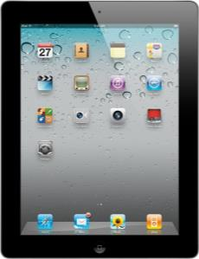
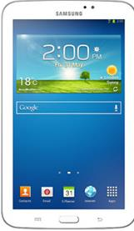
TOUCH SCREEN DEVICE Basic Training Susan Harwood Grant # SH-26321-SH4

Slide 2
Acknowledgement
UNITED STATES DEPARTMENT OF LABOR Occupational Health and Safety Administration (OSHA) Susan Harwood Training Follow-On Grant
SH-27686-SH5
This material was produced under a grant (SH-26321-SH4) from the Occupational Health Administration, U.S. Department of Labor. It does not necessarily reflect the views or policies of the U.S. Department of Labor, nor does the mention of trade names, commercial products, or organization imply endorsement by the U.S. Government.
Notes:
This material was produced under Susan Harwood grant number SH-26321-SH4 Occupational Safety and Health Administration, U.S. Department of Labor, and used for training purposes under the Susan Harwood Training Follow-On Grant SH-27686-SH5

Slide 3
Control Buttons
Microphone
Headphone Jack
Back Camera
Speaker
Dock Connector
Notes:
Device control buttons are as follows:
Back camera
Volume
Mute/rotation
Speaker
Dock connector
Headphone jack
And Microphone

Slide 4
Basic Operations
The main screen shows the time date then a set of apps.
Front Camera
Apps
You can start the application by tapping on the app icon you want to start
Tap on Apps to start
Multi-touch screen
Allows you to swipe right, left, up, down
Screen View Indicator
Home
Once it is pressed, it takes you to your main screen and wakes up the tablet

Slide 5
Multi-finger Gestures
Pinch 4 or 5 fingers together on the screen when an application is open to go to home screen.
Pinch 2 fingers together or apart to zoom in and zoom out
You can position pages by using the index finder

Slide 6
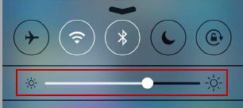
Brightness Settings
To adjust the screen’s brightness, swipe your finger up from the bottom of the screen
Drag the brightness slider in the the multitasking bar. Flick from left to right to set your desired brightness level
You can use Auto-Brightness to automatically adjust the screen’s brightness. In Settings, go to Brightness & Wallpaper, then turn Auto-Brightness on or off.

Slide 7
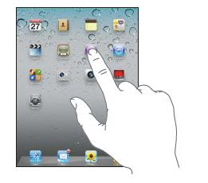
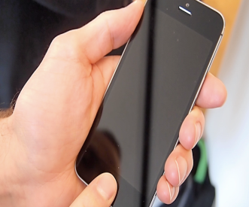
Open and Close Apps
To open an app simply tap its icon on the home screen
In order to close an app double click Home button

Slide 8
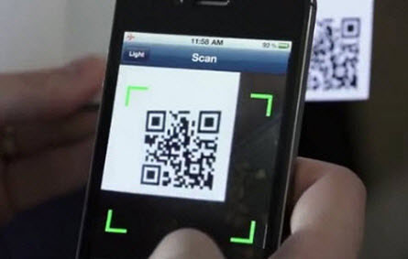
Scanning QR Code
Start the QR scanner app by tapping on the QR reader icon
You will scan the QR by using the back camera on the device
You need to take the device out of its case
Point the camera to the QR code given once it scans you will hear a “ding” sound. hit ok on the open windows and you will be taken to the training portal

Slide 9
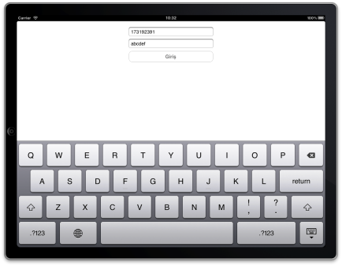
Keyboard Entry
On-screen keyboard
In order to activate the keyboard you have to tap on the fillable area (usually it is in white color) once
you will see a blinking cursor prompting you to enter a character; you can now start typing as requested

Slide 10
QUESTIONS?

