Slide 1
Notes:
INSTRUCTOR NOTE: This module MUST be presented by a knowledgeable, experienced and trained instructor in lifeline systems and their use in a grain bin. See notes below and WARNING.
This presentation covers ONLY TOP ENTRY use of a lifeline in a steel bin.
Display as participants arrive.
Remind participants to sign in.
Pass out the Pre-Test or have it near sign in sheet for participants to take.
Have participants complete pre-test as they take their seats.
Explain Pre and Post tests and evaluations provide on-going information to assist GHSC in ensuring materials are updated, relevant, and useful to participants. In addition, these are comply with accepted training/education practices and are required under the grants funding.
INSTRUCTOR NOTE: The Pre-test can be presented to a group provided answers are recorded. This may be a preferred method for audiences with suspected literacy limitations or audiences which are more difficult to engage.
INSTRUCTOR NOTE: Pre-test slides are hidden following the title slide. The instructor will have to “unhide” the slides in order to display them.
INSTRUCTOR NOTE: There is no separate instructor manual to accompany this training module. Instructor notes are available in the power point notes section.
WARNING: This training is intended to raise awareness of the benefits and ease of using a lifeline system during bin entry. Although it demonstrates how to install and use a lifeline, it is NOT intended to be a “how to” training. This training module does not adequately cover in detail the skills and knowledge the entrant and observer need to safely perform this task.
Learn & Live: Edúcate y Sobrevive

Slide 2
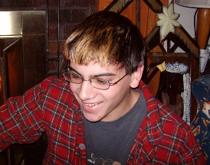
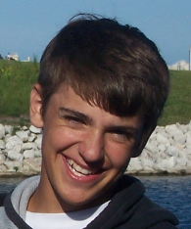
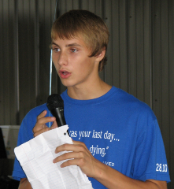
Sistema de Protección con Cuerda Salvavidas
Wyatt -14
EN MEMORIA
Alex - 19
Chris – 15 escapó
Will – 20 rescatado
Notes:
INSTRUCTOR NOTE: This module can accompany the Lifeline Protection System video and/or Grain Bin Entry learning module or stand alone. Link to video: http://grainsafety.org/index.php/training-2/lifeline-protection-system/
SPECIAL INSTRUCTOR NOTE: This module is designed to be used with examples of the different types of equipment mentioned in an active “classroom” style training presentation. For thorough understanding of the concepts, participants need to be able to see and handle the equipment.
EQUIPMENT: Full body harnesses (both good and bad condition); kernmantle rope; carabiners (auto lock and spring gate); loops and slings (manufactured and knotted with water knot); example of Figure 8 knot; knot passing pulley; belay devices such as petzl and grigri (may want a passive one for comparison); Anchor display (show different types of sidewall anchors) or sidewall anchors. Tall ladder and other anchors for demonstration for demonstration of belaying slide 31). Set up “lifeline system” and belay station prior to class.
PURPOSE: To introduce participants to the lifeline system and it’s components for use in a steel bin during a top entry procedure.
Welcome participants & introduce self. Go over any housekeeping (bathroom locations, breaks, etc).
If small enough, have everyone introduce self & say commercial, farm, rescue.
Introduce module.
GHSC was formed after the July 28, 2010 Mt. Carroll, IL incident, it was appropriate to have this page be a tribute to the 4 young men. Two young men died (Wyatt just shy of 15 is in the top right). Alex, 19 is top left. Chris (bottom left) age 15 was able to escape and raise the call for help. Will Piper (bottom right), age 20, was trapped for over 6 hours while over 200 rescue workers and numerous volunteers worked to free him. ALL 4 LOST THEIR LIVES that day – Chris and Will will always remember and struggle with the horrifying events of that day and the loss of their friends.

Slide 3
SISTEMA DE PROTECCIÓN CON CUERDA SALVAVIDAS EXAMEN PRELIMINAR
Un sistema de cuerda salvavidas seguro protege contra:
Electrocución
Caídas de altura
Avalanchas de grano
Atrapamiento o inmersión
Una cuerda salvavidas está asegurada por un ancla(s) en:
El pico del compartimiento y la escalera interior
Escalera interior
Parte superior de pared lateral y el pico del compartimiento
Puerta de entrada en la parte inferior del compartimiento
Notes:
INSTRUCTOR NOTE – These slides are hidden and must be unhidden to display. For audiences where group testing is more appropriate (see previous notes) the instructor should ask the question and present the options. The instructor should not lead the audience toward an answer. The instructor should record how many participants per each choice. For example: Question 1 – choice a – 2; choice b – 3; choice c – 10; choice d – 10. Or yes = 10 and No = 15. Compare pre-test tabulations with post test choices.
Answers are provided during the post test version at the end.

Slide 4
SISTEMA DE PROTECCIÓN CON CUERDA SALVAVIDAS EXAMEN PRELIMINAR
La flojedad en la cuerda salvavidas está controlada por:
Longitud de la cuerda
Observador y dispositivo de amarre
Entrante
Puntos de anclaje
El observador:
Permanece en la puerta en todo momento
Solicita ayuda/inicia el rescate
Mantiene comunicación constante
Todas las anteriores
Notes:
INSTRUCTOR NOTE – These slides are hidden and must be unhidden to display. For audiences where group testing is more appropriate (see previous notes) the instructor should ask the question and present the options. The instructor should not lead the audience toward an answer. The instructor should record how many participants per each choice. For example: Question 1 – choice a – 2; choice b – 3; choice c – 10; choice d – 10. Or yes = 10 and No = 15. Compare pre-test tabulations with post test choices.
Answers are provided during the post test version at the end.

Slide 5
SISTEMA DE PROTECCIÓN CON CUERDA SALVAVIDAS EXAMEN PRELIMINAR
Una polea pasa nudos se adjunta a:
Puerta superior del compartimiento
Pico del compartimiento
Anclaje de pared lateral
Escalera interior
¿Qué tipo de nudo se debe utilizar en el extremo de la cuerda salvavidas?
Nudo 8
Nudo cuadrado
Nudo ballestrinque
Nudo simple
Notes:
INSTRUCTOR NOTE – These slides are hidden and must be unhidden to display. For audiences where group testing is more appropriate (see previous notes) the instructor should ask the question and present the options. The instructor should not lead the audience toward an answer. The instructor should record how many participants per each choice. For example: Question 1 – choice a – 2; choice b – 3; choice c – 10; choice d – 10. Or yes = 10 and No = 15. Compare pre-test tabulations with post test choices.
Answers are provided during the post test version at the end.

Slide 6
SISTEMA DE PROTECCIÓN CON CUERDA SALVAVIDAS EXAMEN PRELIMINAR
Un arnés y una cuerda pueden ser un sistema de cuerda salvavidas efectivo.
Cualquier cuerda que puede sostener 3 veces el peso de una persona, es aceptable como cuerda salvavidas.
SI NO
SI NO
Notes:
INSTRUCTOR NOTE – These slides are hidden and must be unhidden to display. For audiences where group testing is more appropriate (see previous notes) the instructor should ask the question and present the options. The instructor should not lead the audience toward an answer. The instructor should record how many participants per each choice. For example: Question 1 – choice a – 2; choice b – 3; choice c – 10; choice d – 10. Or yes = 10 and No = 15. Compare pre-test tabulations with post test choices.
Answers are provided during the post test version at the end.

Slide 7
SISTEMA DE PROTECCIÓN CON CUERDA SALVAVIDAS EXAMEN PRELIMINAR
Ya que la cuerda salvavidas protege al entrante, no es necesario apagar el equipo dentro del compartimiento.
El soporte de la escalera interior es el mejor y más fácil punto de anclaje.
SI NO
SI NO
Notes:
INSTRUCTOR NOTE – These slides are hidden and must be unhidden to display. For audiences where group testing is more appropriate (see previous notes) the instructor should ask the question and present the options. The instructor should not lead the audience toward an answer. The instructor should record how many participants per each choice. For example: Question 1 – choice a – 2; choice b – 3; choice c – 10; choice d – 10. Or yes = 10 and No = 15. Compare pre-test tabulations with post test choices.
Answers are provided during the post test version at the end.

Slide 8
Introducción
Este mini-modulo de Sistema de Protección con Cuerda Salvavidas es parte de un programa educativo sobre los peligros encontrados en las áreas de manejo de grano, incluyendo los compartimientos de grano y sus alrededores. Su propósito es crear conciencia del uso efectivo de un sistema de cuerda salvavidas durante la entrada al compartimiento de granos y ayudar a los participantes a comprender cuales son los componentes clave de un Sistema de Protección con Cuerda Salvavidas. Este programa no entrena a los participantes en como usar una cuerda salvavidas.
Notes:
Explain this module is part of a series.
Other modules
Overview of Grain Handling Safety and Storage (introductory module)
Lock out Tag out mini module
Entanglement Hazards and Guarding
Falls
Grain Bin Entry
Lifeline Protection System
Characteristics of Confined Spaces (in Agriculture)
WARN - Although this demonstrates how to install and use a lifeline, it is NOT intended to be a “how to” training. This training module does not adequately cover in detail the skills and knowledge the entrant and observer need to safely perform this task.
GHSC, in collaboration with ESRT, Inc (Emergency Services and Rescue Training, Inc) is developing a technical training course to instruct on the use and installation of a lifeline system. It is expected to be completed in Fall 2014.

Slide 9
Descargo de Responsabilidad
Este material fue producido bajo el número de concesión SH-27664-SH5 de la administración de seguridad y salud ocupacional, Departamento de trabajo de los Estados Unidos. No necesariamente refleja las opiniones o políticas del Departamento de trabajo de los Estados Unidos, ni la mención de nombres de oficios, productos comerciales u organizaciones implican el aval del gobierno de los Estados Unidos.
Notes:
Explain – GHSC received funding from OSHA. In order to comply with the grant we do need them to sign in and need to collect the following information:
Supervisor or worker. This information is for statistical purposes to show the types of population receiving training.
Employer. This is to establish an employer/employee relationship as covered under OSHA. Volunteer rescue workers who may be attending should list their employer; not the volunteer rescue squad. Farmers should list the registered business name of their farm. Farm employees should provide the business name listed on their paycheck.
OSHA does NOT contact the employer.
GHSC may contact the attendee or employer for follow-up evaluation in compliance with grant requirements.

Slide 10
Derechos de los Empleados
Los empleados tienen derecho a condiciones de trabajo seguras y saludables que NO representen riesgo de algún daño severo.
Los trabajadores tienen derecho a un salario justo por las horas trabajadas de acuerdo con la ley.
Notes:
Explain - All DOL grants require that employees are informed of their rights. In this instance we want to emphasize employees are entitled to a safe and healthy working environment AND to fair receive compensation for their work.
Remind employees – it is the employee’s responsibility to follow the safety practices, policies, and procedures of their employers.
Tell participants their rights also include the right to report unsafe conditions to the OSHA hotline without retribution.
More information about employee rights can be found on the OSHA website: www.osha.gov or the Department of Labor website www.dol.gov .

Slide 11
Responsabilidad del Empleador
Los empleadores tienen la responsabilidad de proveer un lugar de trabajo seguro y saludable.
Encontrará mas información sobre los derechos del empleador & los empleados en la pagina web ww.osha.gov.
Notes:
Explain employers have a legal responsibility to provide a safe workplace. This means they must ensure the regulations which govern their business are instituted and followed.
It is their responsibility to know the rules and laws – federal and state.
If they are unsure of the regulations they should consult with the appropriate agency. Every state has an on-site consultation program jointly funded by OSHA and the state which provides assistance in learning and complying to the regulations.
The OSHA website provides contact information for each state’s on-site consultation program.
Illinois Department of Labor has the on-site consultation program in Illinois.
Employers should also know and understand the state’s laws as they may be more restrictive than OSHA. Contact the state department of labor.

Slide 12
Objetivos de Aprendizaje
Al finalizar este módulo, los participantes serán capaces de:
Identificar los componentes clave de un Sistema de Protección con Cuerda Salvavidas.
Describir como el observador maneja la cuerda salvavidas del entrante.
Explicar como el sistema de cuerda salvavidas protege al entrante del compartimiento.
Notes:
Introduce the learning objectives.
Explain – the module was designed to seek interaction from the participants. Questions will be asked throughout to generate discussion.
Encourage – the sharing of ideas, information, experiences so everyone can learn.
Repeat the warning - Although this demonstrates how to install and use a lifeline, it is NOT intended to be a “how to” training. This training module does not adequately cover in detail the skills and knowledge the entrant and observer need to safely perform this task.

Slide 13
Temas a Desarrollar
Razones para utilizar Cuerda Salvavidas
Como la cuerda salvavidas protege al entrante del compartimiento
Instalación del Sistema de Cuerda Salvavidas
Componentes del Sistema de Protección con Cuerda Salvavidas
Rol del entrante del compartimiento
Rol del observador en el manejo de la cuerda salvavidas
Repaso de los objetivos de aprendizaje
Notes:
Introduce the module topics/outline.

Slide 14
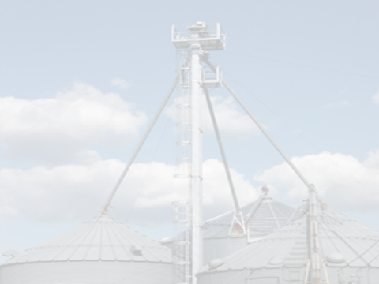
Common Sources of Entanglement Hazards
Uso y Protección de la Cuerda Salvavidas
Notes:
Explain this section provides a brief overview of the OSHA grain standard and how it applies to lifeline use.

Slide 15
Uso de la Cuerda Salvavidas
Entrada al compartimiento es el último recurso.
El uso de la cuerda salvavidas durante la entrada al compartimiento:
Requisito para instalaciones comerciales – norma OSHA 1910.272 (h)(2)(i)
Práctica Recomendada para agricultores y trabajadores agrícolas cuando se determina que la entrada al compartimiento es absolutamente necesaria.
Protege al entrante de atrapamiento e inmersión
Notes:
Stress - It is important to note to the training participants that EVERYTHING possible should be done to avoid entering a grain bin when the grain is more than waist deep. If it is determined that entry into the bin is needed then the entrant must wear a lifeline.
OSHA Grain Handling Standard 1019.272 (h)(2)(i) requires the use of a lifeline or other acceptable protection when someone is entering a grain storage facility.
Emphasize - This is a Best Practice for farmers and farm workers who have a higher percentage of entrapments/engulfments than the commercial facility. (If the reasons for this haven’t been discussed previously, do so at this point).
ASK - What are some of the more unique challenges faced on a farm setting which may prevent a farmer or farm worker from thinking of the need for using a lifeline?
Explain - lifeline is a safety prevention measure to protect from entrapment and engulfment but is the LAST measure of protection.
Discuss - BEFORE entering a bin a thorough assessment of the hazards should be conducted and the hazards abated. Use a bin entry checklist or bin entry permit to assess hazards prior to entry. Free from recognized hazards includes:
all equipment being LOTO and the atmosphere tested.
OSHA regulations - 1910.272(h)(3) No employee shall be permitted to be either underneath a bridging condition, or in any other location where an accumulation of grain on the sides or elsewhere could fall and engulf that employee – EVEN with a lifeline.
Stress - Alternatives to bin entry should be considered and used BEFORE anyone enters a bin. Bin Entry should be a last resort.
INSTRUCTOR NOTE: If not previously stated WARN participants of the following: Although this demonstrates how to install and use a lifeline, it is NOT intended to be a “how to” training. This training module does not adequately cover in detail the skills and knowledge the entrant and observer need to safely perform this task.

Slide 16
Cuerda Salvavidas - Definición
Cuerda Salvavidas:
ANSI – Un componente del sistema de protección contra caídas que consiste en una cuerda flexible diseñada para colgar ya sea verticalmente (cuerda salvavidas vertical), o por conexión a anclajes o conectores de anclaje en ambos extremos para extenderse horizontalmente (cuerda salvavidas horizontal).
Sistema de Cuerda Salvavidas:
El equipo y los procedimientos utilizados para evitar que el entrante de una estructura de granos quede atrapado mas allá de la cintura.
Notes:
Explain - This definition of a Lifeline is from the ANSI/ASSE Z359.0-2007 Standard for Fall Protection/Fall Arrest—Definitions.
ANSI Explanation - A lifeline serves to extend the range of the user through the slidable connection of a fall arrester in the case of a vertical lifeline or a connector or other device in the case of a horizontal lifeline.
Other ANSI definitions:
Fall Protection is defined as: Any equipment, device or system that prevents an accidental fall from elevation or that mitigates the effect of such a fall. Fall protection includes eliminating or controlling hazards, passive fall protection, fall restraint, fall arrest and administrative controls.
Personal Fall Arrest system (PFAS) - An assembly of components and subsystems used to arrest a person in a free fall. A system must always include a full body harness and connecting means between the harness and an anchorage or anchorage connector. Such connecting means may consist of a lanyard, energy absorber, fall arrester, lifeline, self-retracting, lanyard or suitable combinations of these.
Discuss – GHSC definition of a Lifeline System and how it relates to the OSHA standard.
Lifeline must be secured.
Lifeline must not allow person to sink/become entrapped more than waist deep. REMEMBER at knee level a person cannot self extricate.

Slide 17
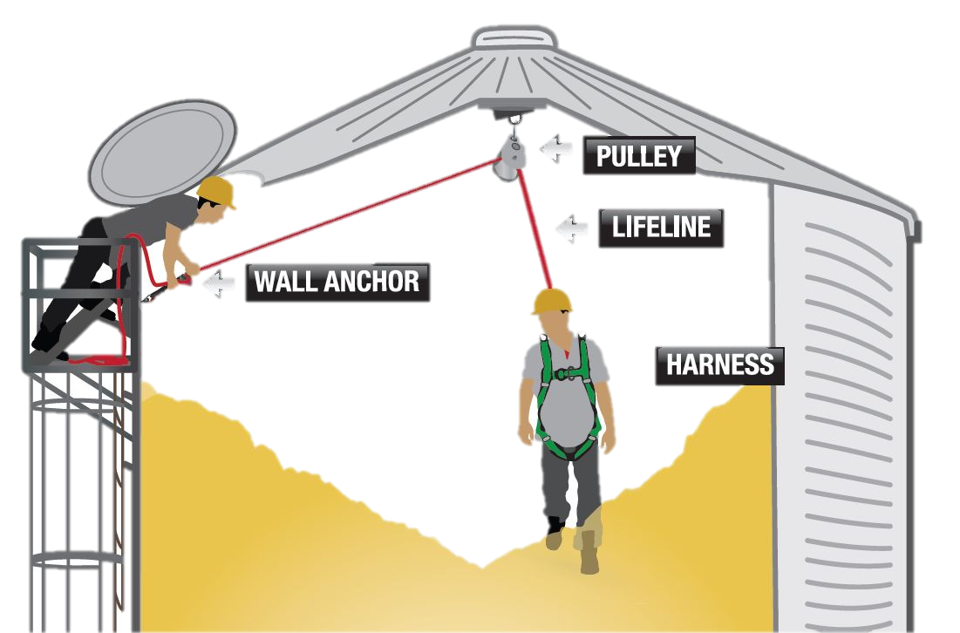
Sistema de Protección con cuerda Salvavidas
Anclajes en el pico y lado para asegurar el sistema de cuerda salvavidas
Notes:
Stress - Lifelines MUST be SECURED in order to be effective in preventing entrapment or engulfments. This graphic shows the basic set-up a lifeline system.
Stress - There are TWO anchor points. These anchor points distribute the weight of the entrant as well as the forces exerted by grain. One anchor point is attached to the peak of the bin and the other to the side near the entry point. Point out - The anchor points are PERMANENTLY installed.
Discuss - The two anchors together should support at least 2X the anticipated load on the anchors. (All anchorages need to support 2 times the anticipated weight. A person waist deep in grain would require two times his/her weight to be pulled out. Bottom line, anchors should be able to withstand 4 times an entrants weight. This would be worse case scenario because we are operating this lifeline system such that no one will be allowed to go any further than waist deep in grain).
Emphasize - to participants they need to CONSULT a bin manufacturer or a qualified person (such as a structural engineer) to determine the type and load capacity of the anchor points a bin can support. This is not a GUESSTIMATE. The age of the bin, the structural integrity of the bin, the roof, sides, etc all are factors to take into consideration when determining and installing anchor points. Warn - Anchor points need to be installed according to the specifications provided by the professional.
WARNING - This system DOES NOT protect an entrant from engulfment or entrapment when the entrant is below the surface of the grain such as would occur if entering from the side door underneath a pyramid of grain or grain built up on the sides of the bin.
This graphic and accompanying graphics was produced by the Grain Handling Safety Coalition (GHSC) to illustrate its Lifeline Protection System. GHSC assumes no responsibility or liability for its use by others including training purposes, lifeline installation or design or any other use for which it is not intended. The graphics are NOT drawn to scale and may not reflect all the relevant safety, manufacturing or other standards.

Slide 18
Sistema de Protección con Cuerda Salvavidas
Máxima flojedad en la cuerda es de 2 pies
El entrante tiene 1 pie de “colchón de seguridad”.
La distancia desde los pies hasta la cintura @ 3 pies
Notes:
Discuss - A lifeline meets the OSHA standards to prevent an entrant from sinking more than waist deep in grain.
Explain -This is done by controlling the slack in the rope to a maximum of two feet.
Explain - On average the distance between a person’s feet to their waist is approximately 3 feet. The two feet of slack in the rope will only allow a person to sink two feet before it grabs. This builds in an extra foot of safety cushion before reaching the person’s waist.
Note - It is important to remember the more a person is entrapped the more force is needed to extricate them. Preventing an entrapment from occurring above the waist will prevent breathing difficulties due to pressure on the upper torso.

Slide 19
Sistema de Protección con Cuerda Salvavidas
Protección:
Impide que el entrante se hunda más de la cintura (norma OSHA 1010.272).
Evita las caídas si la superficie del grano se derrumba.
Notes:
Remind - A lifeline prevents sinking further than waist deep. HOWEVER, once grain is past a person’s knees he/she cannot extricate self.
Discuss - A lifeline is a unique combination of both fall restraint and protection. It allows a person to move freely around the circumference of a grain bin while securely attached to an anchor (restraint) but also prevents a free fall if the grain surface gives way (fall protection).

Slide 20
Common Sources of Entanglement Hazards
Componentes del Sistema de Protección con Cuerda Salvavidas
Notes:
Explain this section provides explanation and examples of the different components of a lifeline protection system and how they work together.

Slide 21
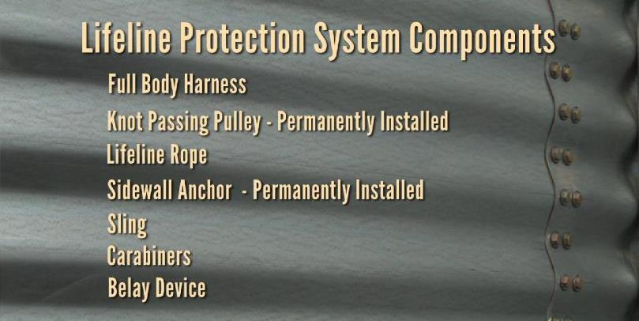
Componentes del Sistema de Protección con Cuerda Salvavidas
Utilice el equipo de acuerdo a las instrucciones del fabricante.
Notes:
Image Translation: Componentes del Sistema de Proteccion con Cuerda Salvavidas
Arnes de cuerpo entero
Polea pasa nudos – Instalada permanentemente
Cuerda Salvavidas
Anclaje de Pared lateral – Instalado permanentemente
Eslinga
Mosquetones
Dispositivo de amarre
Introduce - These are the 7 main components of a lifeline system.
State -Each will be explained in more detail and participants will have the opportunity to examine and handle the various pieces.
Stress - On this slide and ALL slides about equipment that the equipment should be used according to the manufacturer’s instructions, recommendations, procedures, etc.

Slide 22
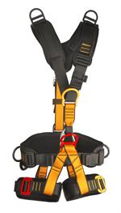
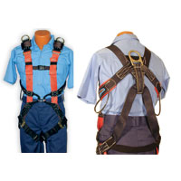
Componentes de la Cuerda Salvavidas
Arnés de Cuerpo Entero Clase III
Se abrocha alrededor de los hombros, pecho, cintura y muslos (tiene perneras). Los puntos de unión(anillos-D) para la cuerda salvavidas, distribuyen las fuerzas sobre los muslos, hombros, pecho y pelvis.
Notes:
Emphasize - Body harnesses should be used according to manufacturers instructions and should be rated for fall protection.
Explain -Leg loops help support the person’s trunk during suspension and help prevents suspension trauma.
Demonstrate or discuss - The harness should fit snugly – allowing the person’s hand to fit between the person’s body and the leg straps. Shoulder straps should not slip off the shoulders. The chest fastener should not constrict a person’s breathing. The waist should not be so tight as to be uncomfortable.
Stress - Harnesses should be adjusted each time they are put on to accommodate for different thicknesses in clothing or weight gains/losses.
Emphasize - Harnesses should be inspected before each use. Follow the manufacturer’s instructions for use and care of the harness. Discard harnesses that are in bad repair by cutting the straps so no one can accidently use it.
ACTIVITIES
Pass around “god” and “bad” harnesses if available and have participants tell which is good or bad. Look for tears, cracks, loose threads and fasteners, etc.
Have volunteers of different sizes put on the harness and show how they are adjusted.
Have participants put on harness and check to make sure it is correct. Have participants identify when it is correctly fitted and fastened by providing good and bad examples.

Slide 23
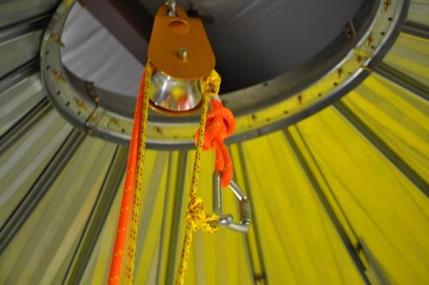
Componentes de la Cuerda Salvavidas
Polea Pasa Nudos
Polea grande instalada en el pico del compartimiento de granos. Permite que cuerdas, nudos y mosquetones pasen a través de ella. Componente efectivo para apoyar al entrante desde arriba para que el/ella no quede atrapado.
Notes:
STRESS - Consult the bin manufacturer or qualified person to determine the load capacity of the knot passing pulley to install and location for installation.
Explain - The two anchors together must accommodate at least 2X the anticipated load.
Discuss - All anchorages need to support 2 times the anticipated weight. A person waist deep in grain would require two times his/her weight to be pulled out. Bottom line, anchors should be able to withstand 4 times an entrants weight. This would be worse case scenario because we are operating this lifeline system such that no one will be allowed to go any further than waist deep in grain.
Demonstrate - The knot passing pulley is simply a large, heavy duty pulley that allows knots, ropes, and carabiners to pass through in the grooved running surface of the pulley.
Point out - At the top of the slide the ring attaching the pulley to the bin peak. It is easiest to install this permanent pulley when the bin is full.
ACTIVITY – Pass around a knot passing pulley so entrants can see how it operates.

Slide 24
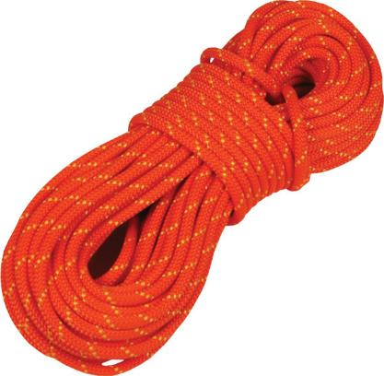
Componentes de Cuerda Salvavidas
Cuerda Salvavidas
Cuerda estática kernmantle con diámetro de 7/16” o 1/2” tal como la que se utiliza para acceso con cuerda o rescate.
Notes:
Explain - This type of rope is rated for climbing and rescue.
Stress - Ropes should be inspected before use for any defects.
Discuss - Kernmantle ropes allow the “give” necessary to prevent unexpected “jerks” but are not so elastic they stretch out (like a polyester rope will)– defeating the purpose of maintaining a safety cushion. They do not fray or unravel and will not be easily cut by sharp edges.
WARN - Do not use utility rope, natural fiber ropes or any other ropes not rated for this purpose!
ACTIVITY –
Pass around various types of ropes both good and bad examples. Have participants pick out the good examples.
For an additional challenge provide only 2 good examples and ask them to find 3 good examples – see if they can spot the disparity.
Discuss the different thickness, manufacturing, and “feel” of the different ropes.

Slide 25
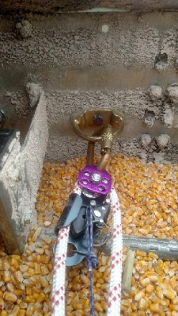
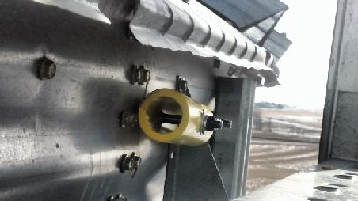
Componentes de la Cuerda Salvavidas
Anclaje de Pared Lateral
Anclaje acoplado a la pared del compartimiento en el punto de entrada superior. Se utiliza junto con una polea pasa nudos.
Notes:
Explain - The sidewall anchor helps support the load capacity put on the lifeline.
WARN – The sidewall anchor t is a NECESSARY and INTEGRAL part of the lifeline system and is permanently installed.
Discuss - There are several types of side anchors which can be used.
Explain - This anchor (pictured) consists of a forged ¾” eye bolt that is installed through the peak of the corrugation in the bin sheet. The back side of the sheet has a 2” schedule 40 pipe that is 6” long and secured by a nut.
Stress - Consult the bin manufacturer or structural engineer to determine which should be used and how to properly install.
WARN - Ladder rails or ladder rungs are NEVER appropriate for this side anchor.
Explain - the specifications of this anchor – the type and thickness of steel, etc. and discuss why it is important to use these materials.
ACTIVITY – Show the display (GHSC has) of different types of sidewall anchors and discuss how they are installed, the materials used, and how they work.

Slide 26
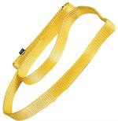
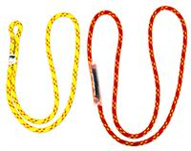
Componentes de la Cuerda Salvavidas
Eslinga / Lazo cocido
Utilizado para conectar los componentes del sistema de cuerda salvavidas.
Ejemplo: conectar el anclaje de la pared lateral al dispositivo de amarre si es necesario.
Hecho de cinta atada con un nudo agua o con un lazo cocido comprado de fábrica.
Notes:
Discuss - These loops attach components of the lifeline system. Specifically they connect the sidewall anchor to the belay device.
Explain - Manufactured slings can be purchased to eliminate the need to tie special knots. GHSC recommends using manufactured slings.
Stress - When using webbing to make your own sling/loop a water knot is the ONLY acceptable knot to us to prevent it from becoming undone when force is exerted on it.
ACTIVITY – Pass around examples of different slings/loops for participants to examine.

Slide 27
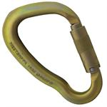
Componentes de la Cuerda Salvavidas
Mosquetón
Anillo de metal rectangular con una puerta con resorte.
Las puertas deben tener un mecanismo de bloqueo para evitar que se abran accidentalmente.
Utilizados para conectar y desconectar los componentes rápidamente en sistemas de seguridad críticos.
Notes:
Explain - Carabiners hold the components together with no issue of them slipping out of the fastening.
Discuss - There are several types and sizes of carabiners made from different materials.
Stress - Ensure the carabiner chosen is rated for the this type of activity.
Warn - Do NOT use cheap metal carabiners. Purchase rated carabiners from a supplier that specializes in rope climbing or rescue. NFPA rated is a good guidelines on what to purchase.
ACTIVITY – Pass the carabiners around to participants and have them manipulate them – opening, closing, and fastening on things. Have participants try this with both their dominant hand and non-dominant hand. Discuss how the carabiner helps “simplify” the ease of use of a lifeline. (Note: have both auto locking and spring-gate carabiners if possible, to show the difference).

Slide 28
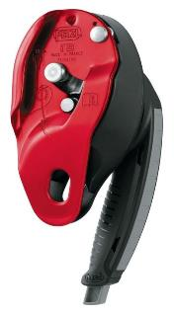
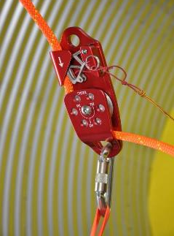
Componentes de la Cuerda Salvavidas
Dispositivos de Amarre/Enganche de cuerda
Pieza mecánica del equipo utilizada para controlar una cuerda(durante el amarre).
Un dispositivo de amarre activo, automáticamente agarra la cuerda si hay una sacudida repentina o un tirón.
Notes:
Explain - A Belay device is a critical component of the system. Belay devices are mechanical friction brake devices used to control a rope when belaying. Their main purpose is to allow the rope to be locked off with minimal effort to arrest a climber's fall. Belay means to secure (a rope) by attaching to a person or to an object offering stable support. (Dictionary.com)
Discuss - There are two kinds of belay devices: active belay device and passive belay device.
Active belay device is recommended. An active device will engage the rope and hold the entrant without any belayer action. It should also be able to release easily to give the entrant slack when he needs it. Active belay devices have a built-in mechanism that locks off the rope without the help of any other pieces of equipment..
Passive belay devices rely on the belayer's brake hand and a carabiner to lock off the rope. A passive belay device is not recommended. It will effectively do an adequate job of controlling the rope but it requires action by the belayer which is less desirable.
Belaying or Belay– Belaying involves one person (called the belayer) having some control over a device & rope to which another person (the entrant) is connected. As the bin entrant moves, the belayer pays out or takes in rope to minimize the potential fall distance. The belayer must take care not to tug on the entrant or pull him off his stance.
Belay (NFPA definition) - The method by which a potential fall distance is controlled to minimize damage to equipment and/or injury to a live load. Belayer (NFPA definition) - The rescuer who operates the belay system.
To use a belay system:
Connect a belay device to an appropriate anchor.
Thread the rope through an appropriate belay device.
Attach the working end of the rope to the entrant’s harness.
Belayer feeds and/or pulls the rope through the device as the entrant moves, taking care to avoid both excessive slack and excessive tension.
Belay device and Belaying explanations - Courtesy of Loui McCurley, VP Pigeon Mountain Industries
ACTIVITY – pass around examples of different belay devices. Discuss the different brands/types of devices and the pros/cons of each. If space and time permit, have participants practice on an appropriately set-up belay system paying out and taking in slack while a volunteer walks around the room. (The volunteer will need to be hooked to a full body harness and anchor systems if possible. Tall ceilinged rooms with beams, tall ladders, etc. can be used to demonstrate if the instructor has been trained). DO NOT ATTEMPT this without appropriate training, knowledge and experience!

Slide 29
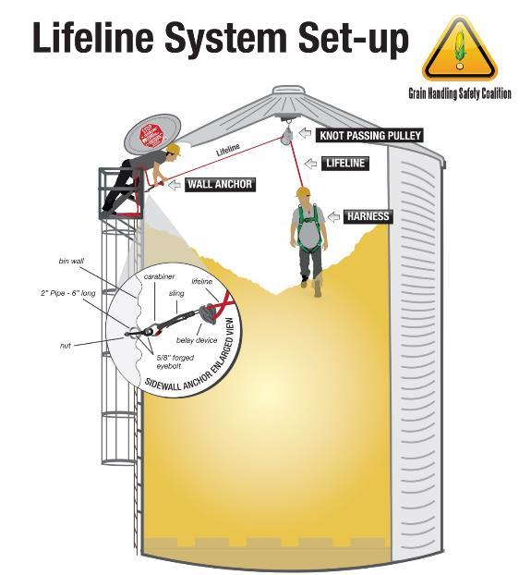
configuración del sistema Lifeline
¡Consulte al fabricante del compartimiento o la persona calificada para designar/instalar los puntos de anclaje!
Notes:
Lifeline System Set-up: Instalacion del Sistema de Cuerda Salvavidas
Wall Anchor: Anclaje de Pared
Knot Passing Pulley: Polea Pasa Nudos
Lifeline: Cuerda Salvavidas
Harness: Arnes
Explain - This is the full lifeline system.
Explain - The insert shows how the sidewall anchor is connected to the lifeline.
IMPORTANT: Anchor points should not be installed without knowing the weight load the bin can support. Anchors need to support 2X the anticipated load. Some bins may not be able to support this safety factor.
STRESS: BEFORE installing the peak anchor consult the bin manufacturer or a qualified person for specific recommendations.
This graphic and its accompanying graphics was produced and is owned by the Grain Handling Safety Coalition (GHSC) to illustrate its Lifeline Protection System. GHSC assumes no responsibility or liability for its use by others including training purposes, lifeline installation or design or any other use for which it is not intended. The graphics are NOT drawn to scale and may not reflect all the relevant safety, manufacturing or other standards.

Slide 30
Common Sources of Entanglement Hazards
Roles del Entrante y el Observador
Notes:
Stress - This section describes the entrant and observer roles under 1910.272.
Explain - Some facilities also use the confined space standard 1910.146 in their bin entry policy. Know the company policy and follow it!
Explain – 1910.272 refers to bin entry ONLY and cannot be used for other confined space entries.

Slide 31
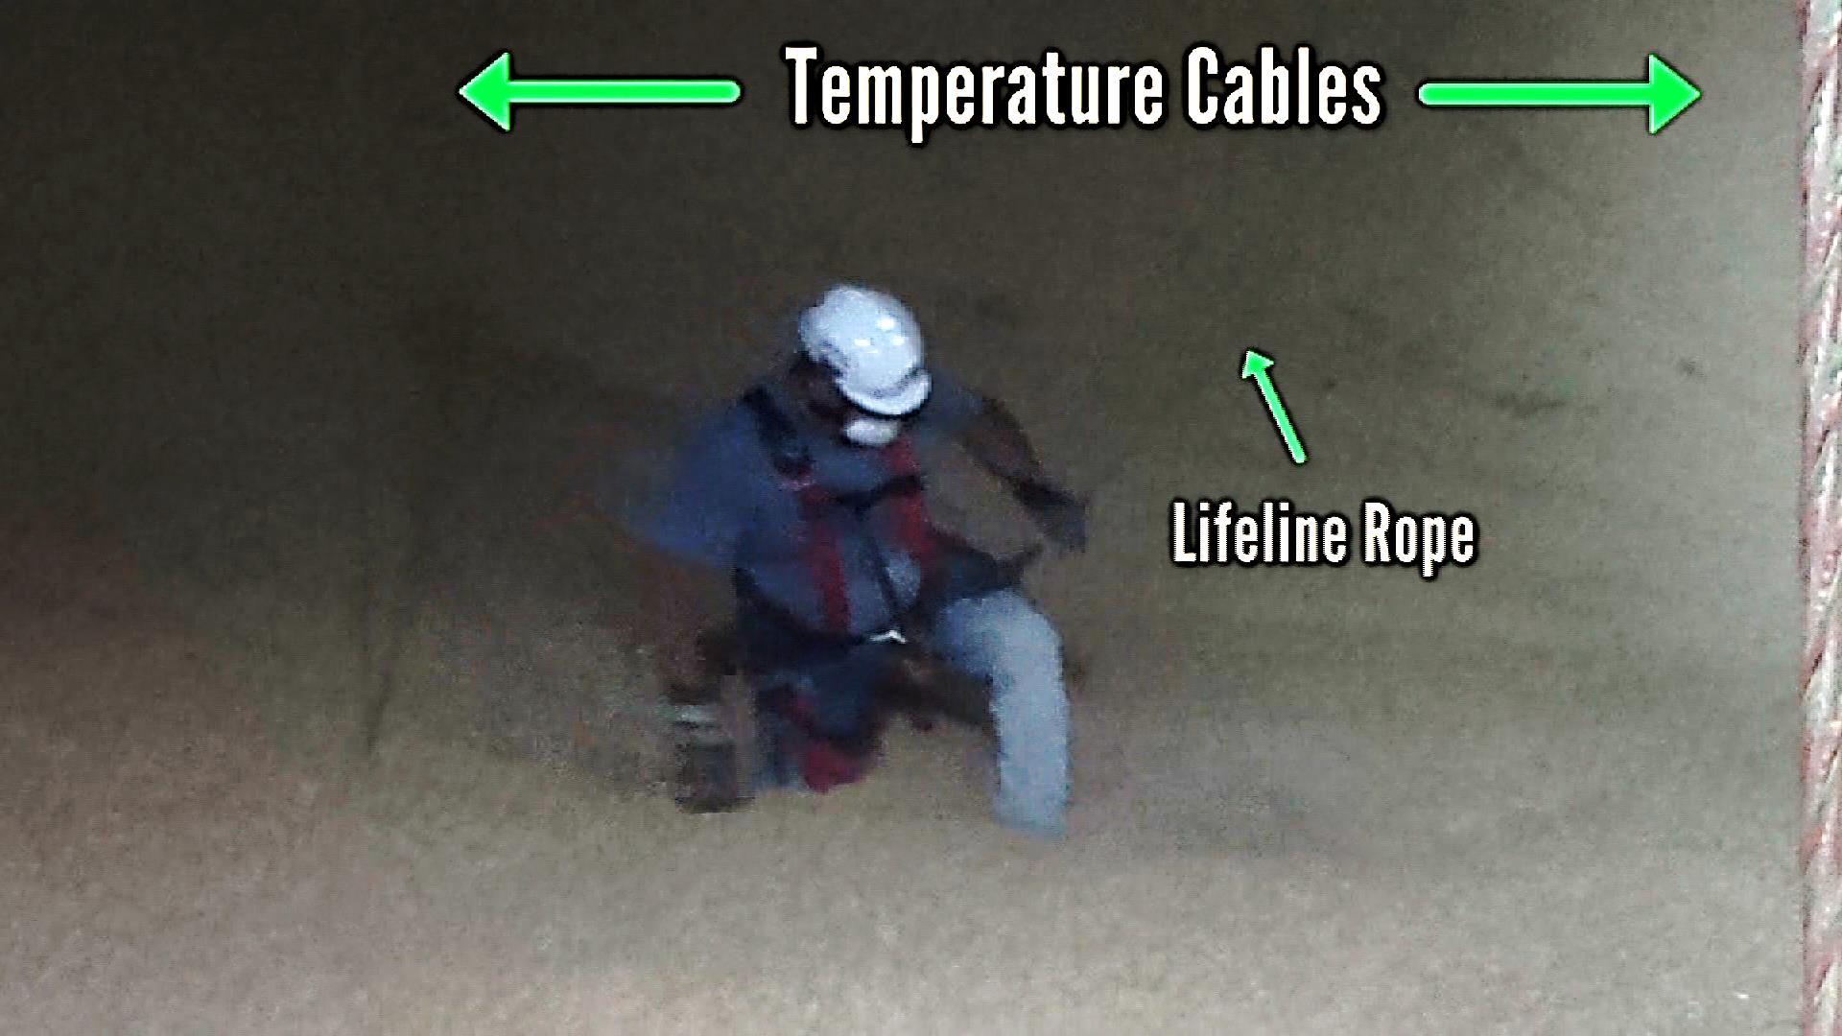
Entrante del Compartimiento
Uso de la Cuerda Salvavidas para prevenir atrapamiento e inmersión
Comunicarse con el observador
Comprobar si hay peligros en el compartimiento
Angulo de reposo
Condición del grano
Notes:
Temperature Cables: Cables de Temperatura Lifeline Rope: Cuerda Salvavidas
Stress - Entrant must ALWAYS assess for hazards PRIOR to any entry as stated in 1910.272.
Warn - Entrant must ALWAYS use a lifeline when entering a bin unless the use of one poses a greater threat. (1910.272(g)(2)
Warn – Entrant must be trained before performing bin entry. 1910.272 (e)
Explain - Entrant stays in communication through either voice or visual means with the observer. 1910.272(g)(3)
Discuss - Entrant helps the observer control slack in the rope by saying “take” or “give”.
Emphasize - Once in the bin, the entrant should continue to assess for hazards such as grain condition and angle of repose.
OSHA standard on training: 1910.272(e) Training.
1910.272(e)(1) The employer shall provide training to employees at least annually and when changes in job assignment will expose them to new hazards. Current employees, and new employees prior to starting work, shall be trained in at least the following:
1910.272(e)(1)(i) General safety precautions associated with the facility, including recognition and preventive measures for the hazards related to dust accumulations and common ignition sources such as smoking; and,
1910.272(e)(1)(ii) Specific procedures and safety practices applicable to their job tasks including but not limited to, cleaning procedures for grinding equipment, clearing procedures for choked legs, housekeeping procedures, hot work procedures, preventive maintenance procedures and lock-out/tag-out procedures.
1910.272(e)(2) Employees assigned special tasks, such as bin entry and handling of flammable or toxic substances, shall be provided training to perform these tasks safely.
Note to paragraph (e)(2): Training for an employee who enters grain storage structures includes training about engulfment and mechanical hazards and how to avoid them.

Slide 32
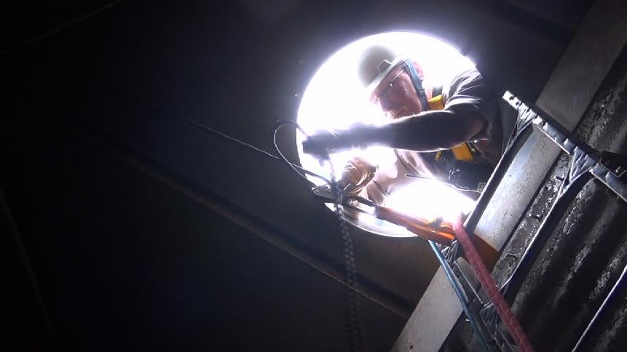
Observador
Controla la flojedad de la cuerda – cuando soltar y cuando tirar.
Monitorea al entrante en TODO momento.
Mantiene contacto con el entrante en todo momento.
Notes:
Explain - Observer is in compliance with OSHA 1910.272. 1910.272(g)(3): “An observer, equipped to provide assistance, shall be stationed outside the bin, silo, or tank being entered by an employee. Communications (visual, voice, or signal line) shall be maintained between the observer and employee entering the bin, silo, or tank.”
WARN - Observer stops bin entry immediately if he determines it is unsafe, is trained and equipped to initiate a rescue as needed.
Stress - Observer is monitoring the bin entrant at ALL times and should be able to respond quickly and appropriately to any signs of trouble.
Explain - The observer controls the slack in the rope with the belay device – never allowing more than two feet of slack to protect the entrant from entrapment or engulfment.
Discuss - Under 1910.272 it is permissible to break the barrier of the hatch opening and have the head shoulders & arms inside the bin to manage the belay. There is no restriction in 1910.272 to prevent the observer from putting arms, head, and shoulders in the bin while observing and operating the belay device. There is a restriction under Confined Space 1910.146.
Explain - Observer requirements are outlined in 1910.272(g)(3-5) and include being trained in rescue and knowing how to call for help.
Knows never to leave post even to attempt rescue – he calls for help, can hand in bucket, etc.

Slide 33
Common Sources of Entanglement Hazards
Resumen
Notes:
Summary of module.

Slide 34
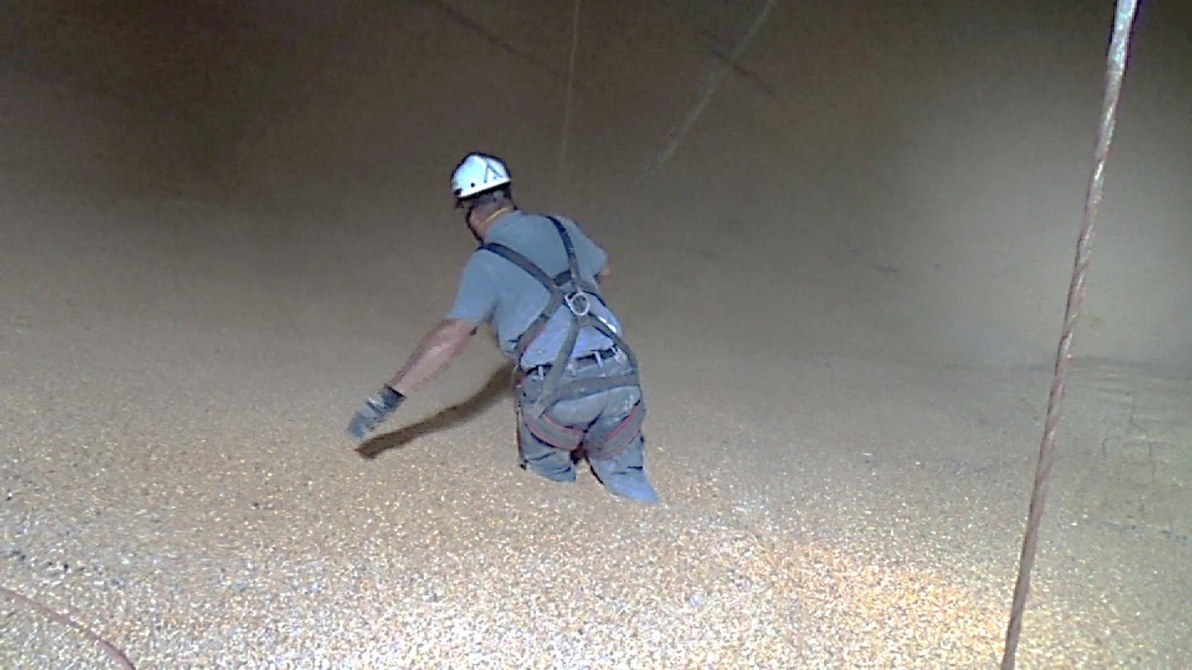
Resumen
Requerido por OSHA para instalación comercial
Práctica Recomendada para todos
Protege al entrante de atrapamiento e inmersión
7 componentes
Anclado en el pico y pared lateral
El observador controla la flojedad de la cuerda
Precio accesible y no es complicado
Cuerda Salvavidas
Cable de Temperatura
Notes:
Lifeline system is relatively easy to install and affordable.
Lifeline is required by OSHA and should be a best Practice for farmers.
Working premise is two anchors – one at the peak and one on the side. A top anchor allows an entrant to be held from above. A side anchor is used to belay (control) the weight of the entrant and any added weight (force) exerted by the grain. The side anchor is really the one that will take the entire force put on the system. The only time the top anchor will take the entire force is if one were pulling straight down next to the load. This will never happen.
Using a belay device grabs the rope if there is a sudden jerk or pull.
The observer controls the slack – never more than 2 feet.
Entrant is protected with an extra foot of safety cushion.
Entrant is able to perform work tasks around the circumference of the bin.

Slide 35
Common Sources of Entanglement Hazards
GUIA DE RESPUESTAS DEL EXAMEN
Notes:
INSTRUCTOR NOTE: ANSWERS ARE ANIMATED AND WILL NOT APPEAR WHEN SCREEN IS FIRST DISPLAYED. SEE INSTRUCTIONS ON SLIDES.
Provides Post Test which can be either given as a group exercise or discussed after participants complete.

Slide 36
Guía de Respuestas del Examen
Un sistema de cuerda salvavidas seguro protege contra:
Electrocución
Caídas de altura
Avalanchas de grano
Atrapamiento o inmersión
Una cuerda salvavidas está asegurada por un ancla(s) en:
El pico del compartimiento y la escalera interior
Escalera interior
Parte superior de pared lateral y el pico del compartimiento
Puerta de entrada en la parte inferior del compartimiento
Notes:
INSTRUCTOR NOTE – ANIMATED SLIDE. For a red circle to appear click the mouse (one click per circle). A third click will advance to next slide.
A lifeline will not protect an entrant from a grain avalanche if the worker is under the peak of the grain. Avalanching grain can knock a worker over. Workers should always work from the TOP of an avalanche condition (such as pyramid, tower, grain clinging to sides of the wall) NOT below it. The lifeline will protect if the worker is on top of the grain and it falls. This lifeline system is not designed for a side entry.
A ladder should NEVER be used to secure a lifeline and neither should a door be used. They cannot withstand the force.

Slide 37
Guía de Respuestas del Examen
La flojedad en la cuerda salvavidas está controlada por:
Longitud de la cuerda
Observador y dispositivo de amarre
Entrante
Puntos de anclaje
El observador:
Permanece en la puerta en todo momento
Solicita ayuda/inicia el rescate
Mantiene comunicación constante
Todas las anteriores
Notes:
INSTRUCTOR NOTE – ANIMATED SLIDE. For a red circle to appear click the mouse (one click per circle). A third click will advance to next slide.
The length of the rope should be enough to rig the lifeline system and allow the entrant movement around the bin. However, the length of the rope the entrant uses for movement is dependent on the slack allowed and should never allow the entrant to become entrapped more than waist deep. Entrant does not control the slack – he only provides instructions a to if he needs more or less slack. Anchor points support the weight of the entrant and the force of the grain on the entrant. Anchor points do not control the slack.
The observer must watch the entrant at all times (stationed outside), be in constant communication (visual, voice or other means); know how and whom to call for help; be able to START a rescue; and CONTROL the slack in the lifeline. 1910.272(g)(3) and (g)(5).

Slide 38
Guía de Respuestas del Examen
Una polea pasa nudos se adjunta a:
Puerta superior del compartimiento
Pico del compartimiento
Anclaje de pared lateral
Escalera interior
¿Que tipo de nudo se debe utilizar en el extremo de la cuerda salvavidas?
Nudo 8
Nudo cuadrado
Nudo ballestrinque
Nudo simple
Notes:
INSTRUCTOR NOTE – ANIMATED SLIDE. For a red circle to appear click the mouse (one click per circle). A third click will advance to next slide.
A knot passing pulley allows the rope, carabiners, and knots to pass through it and helps distribute the weight load. It is attached to an anchor in the peak of the bin. The sidewall anchor is placed at the top bin door inside the bin (not on the door). The inside (or outside) bin ladder should NEVER be used for an anchor.
The other knots are not appropriate and may come unknotted while entrant is moving around. See http://www.animatedknots.com/fig8follow/ or http://www.netknots.com/rope_knots/figure-eight/ .

Slide 39
Guía de Respuestas del Examen
Un arnés y una cuerda pueden ser un sistema de cuerda salvavidas efectivo.
Cualquier cuerda que puede sostener 3 veces el peso de una persona, es aceptable como cuerda salvavidas.
SI NO
SI NO
Notes:
INSTRUCTOR NOTE – ANIMATED SLIDE. For a red circle to appear click the mouse (one click per circle). A third click will advance to next slide.
A lifeline system requires anchor points (peak and sidewall) and some kind of deceleration device (belay device) in order to work effectively. The observer cannot just hold a rope as they would not have the strength to stop an entrant’s fall and prevent the entrant from entrapment.
A lifeline rope has a 7/16” or ½” diameter static kernmantle rope such as one used for climbing, rescue, or rope access. Kermantle rope has low elasticity and can hold several times the weight of a person. Utility, boating, or other rope is not rated for fall protection or this type activity; using the wrong kind of rope can result in serious injury or death.

Slide 40
Guía de Respuestas del Examen
Ya que la cuerda salvavidas protege al entrante, no es necesario apagar el equipo dentro del compartimiento.
El soporte de la escalera interior es el mejor y más fácil punto de anclaje.
SI NO
SI NO
Notes:
INSTRUCTOR NOTE – ANIMATED SLIDE. For a red circle to appear click the mouse (one click per circle). A third click will advance to next slide.
Lockout Tag out MUST be done before entering a bin. There should be NO equipment running while a person is inside the bin – EVER!
A ladder is NEVER an acceptable anchor even though it is an “easy” anchor point.

Slide 41
Gracias a nuestros Colaboradores
La Coalición para la Seguridad en Manejo de Granos desea extender nuestro agradecimiento y reconocimiento a muchas personas y organizaciones que han apoyado nuestros esfuerzos. Las siguientes compañías han proporcionado fotografías, conocimientos específicos, el uso de instalaciones u otro apoyo para este módulo de entrenamiento.
Grain and Feed Association of Illinois
Evergreen, FS
Western Grain Marketing
Agricenter – Asmark Institute
University of Illinois, ACES, Media Services
PMI (Pigeon Mountain Industries)
Illinois Farm Bureau

Slide 42
ADVERTENCIA
Este entrenamiento está destinado para dar a conocer los beneficios y la facilidad de uso del sistema de cuerda salvavidas durante la entrada al compartimiento. A pesar de que muestra como instalar y utilizar una cuerda salvavidas, NO tiene la intención de ser un entrenamiento en “como desarrollarlo”. Este módulo de entrenamiento no cubre adecuadamente en detalle las habilidades y conocimientos que el entrante y el observador necesitan para llevar a cabo esta tarea de forma segura.

