Slide 1
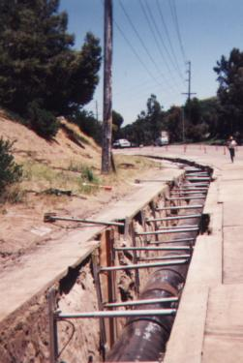
Trenching and Excavating Safety

Slide 2
WHAT CAUSES DEATH?
Asphyxiation
Each time a breath is exhaled the weight of the load restricts inhalation of the next breath. Slow suffocation usually follows unless rescue is immediate.

Slide 3
SOIL WEIGHT?
DEPENDING ON THE DENSITY AND WATER CONTENT:
One cubic yard weighs - 3000lbs or more
One cubic foot weighs - 100lbs or more
3 FEET
1 FOOT
3000lbs or more
100lbs or more

Slide 4
THINGS THAT CAN CAUSE CAVE-INS
DYNA
CAVE-INS RESULT FROM:
Vibrations
Adjacent Structures
Freezing and Thawing
The Weight of the Soil Itself
Addition or Removal of Water
Reduction in Frictional and Cohesive Capacities of Soil

Slide 5
HOW DO MOST DEATHS OCCUR?
Instantaneously
Trenches 5 to 15 deep
With absolutely no warning
In seemingly safe conditions
With workers in a bent or lying position

Slide 6
EVALUATING THE SITE
BEFORE YOU BEGIN EXCAVATION:
The site must be assessed
Potential hazards must be determined
Known hazards reduced or eliminated
Emergency procedures established
Periodic inspection intervals determined
Utility locations must be staked or marked

Slide 7
SAFETY REQUIREMENTS
Conduct inspections before each work shift
Do not work under elevated loads
Do not work over unprotected employees
Wear proper personal protective equipment
Provide walkways or bridges over trenches
Provide trench exits within 25 feet of workers in trenches more than four feet deep
Ensure spoilage is at least 2 ft. from trench edges

Slide 8
WHAT TO DO IN AN EMERGENCY
Immediately call 911, or the Emergency Response Team
Report: - Exact Location
- Number of Victims
- Nature of Emergency
- Trench Measurements
- Special Hazards
Keep all life-support and dewatering systems operating
Clear workers away from the excavation
Shut down heavy equipment
Be prepared to meet and brief rescue personnel

Slide 9
IN AN EMERGENCY
What not to do: - Don’t Panic!
- Control would-be rescuers
- Don’t sacrifice anyone else
- Never attempt to dig someone out
using motorized equipment
Remember - Your actions could save a life!

Slide 10
PROTECTION METHODS
ACCIDENT PREVENTION METHODS:
Warn and reroute public traffic
Post signs, barricades and flagmen
Mandate use of reflective vests
Warn site traffic
Install protective supports systems

Slide 11
UNDERGROUND HAZARDS
Utility lines must be located before excavating begins
Utility companies or owners must be contacted:
-- Response times must be considered
-- Advised of the proposed work
-- Questions concerning underground installations
need to be answered

Slide 12
UNDERGROUND INSTALLATIONS
If no response is given within 24 hours* work can cautiously proceed *(local timeframes may vary ND 48 hours)
Underground installations must be determined by safe and acceptable means
Excavated underground installations must be protected
Never under estimate hazards associated with underground utilities!!!

Slide 13
TRENCH SAFETY
TRENCHES MORE THAN 5 FEET UNLESS MADE IN STABLE ROCK:
Require shoring
Or must have a stabilized slope
IN HAZARDOUS SOIL CONDITIONS:
Trenches under 5 feet need protection

Slide 14
CONTROLLING WATER
Adequate Precautions Must Be Taken When Working in Accumulated Water
Controlling Water and Water Removal Must Be Monitored by a Competent Person
Ditches, Dikes or Comparable Means Should Be Used to Prevent Surface Water From Entering Excavations

Slide 15
SOIL TYPES
TYPE A SOILS
- Clay
- Silty Clay
- Sandy Clay
- Clay Loam
TYPE B SOILS
- Granular Cohesionless Soils (Silt Loam)
TYPE C SOILS
- Gravel
- Sand
- Loamy Sand

Slide 16
HOW TO DETERMINE SOIL TYPES
Continued
SOIL CLASSIFICATION MUST BE DONE BY A
COMPETENT PERSON:
VISUAL TEST
Check entire worksite
Fissured ground
Layered soil
Disturbed earth
Seepage
Vibration
Poor drainage

Slide 17
HOW TO DETERMINE SOIL TYPES
Manual Test
Plasticity
Dry Strength
Thumb penetration
Pocket penetrameter
Hand operated shear vane
WARNING: One soil inspection and classification may not be enough. Outside disturbances during excavation may change even the best soil classification. Inspect the soil after any change in conditions.

Slide 18
1926 Subpart P Appendix A – Soil Classification (c) (2)
The classification of the deposits shall be made based on the results of at least one visual and at least one manual analysis

Slide 19
HOW TO PROTECT PEOPLE
Each employee must be protected from cave-ins by an adequately designed system. Exceptions are:
Excavations made in stable rock
Excavations less than 5 feet
Protective systems must have the capacity to resist all loads that are expected to be applied to the system

Slide 20
BENCHING AND SLOPING
DESIGN OF BENCHING AND SLOPING SYSTEMS:
OPTION 1 - Allowable configurations and slopes
OPTION 2 - Determination of slopes and configurations using Appendices A and B
OPTION 3 - Designs using other tabulated data
OPTION 4 - Design by a registered professional engineer

Slide 21
SPOIL PILES
Continued
2 FEET MINIMUM

Slide 22
BENCHING AND SLOPING
TYPE A SOILS
20
FEET
MAX
1
3/4

Slide 23
BENCHING AND SLOPING
TYPE B SOILS
20
FEET
MAX
1
1

Slide 24
SHIELDING
Shield systems must project at least 18 inches above the lowest point where the excavation face begins to slope

Slide 25
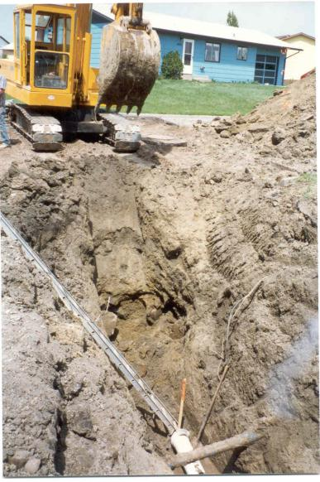
Unsafe trench
Notes:
No sloping or shoring. Previously disturbed soil

Slide 26
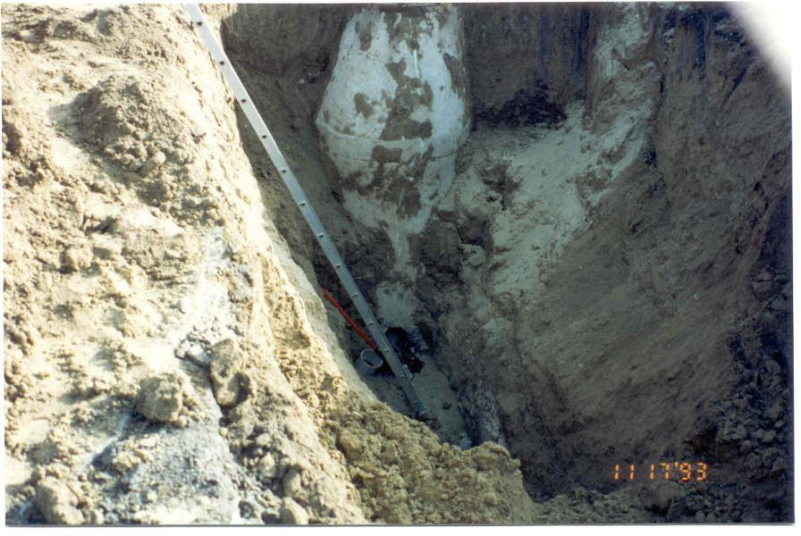
Unsafe trench
Notes:
No shoring, previously disturbed soil and the trench is starting to slough.

Slide 27
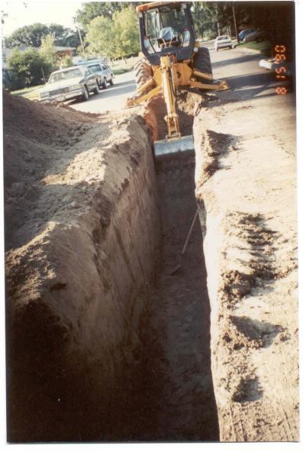
Unsafe trench
Notes:
Straight up and down sides. Not sloped. No visiable traffic control devices.

Slide 28
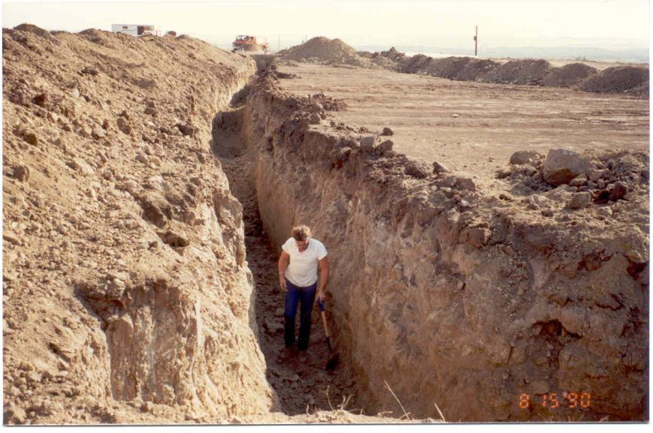
Unsafe trench
Notes:
Straight up and down sides.
Spoil pile too close.
Already caving in.
No egress or access points.
No hard hat.

Slide 29
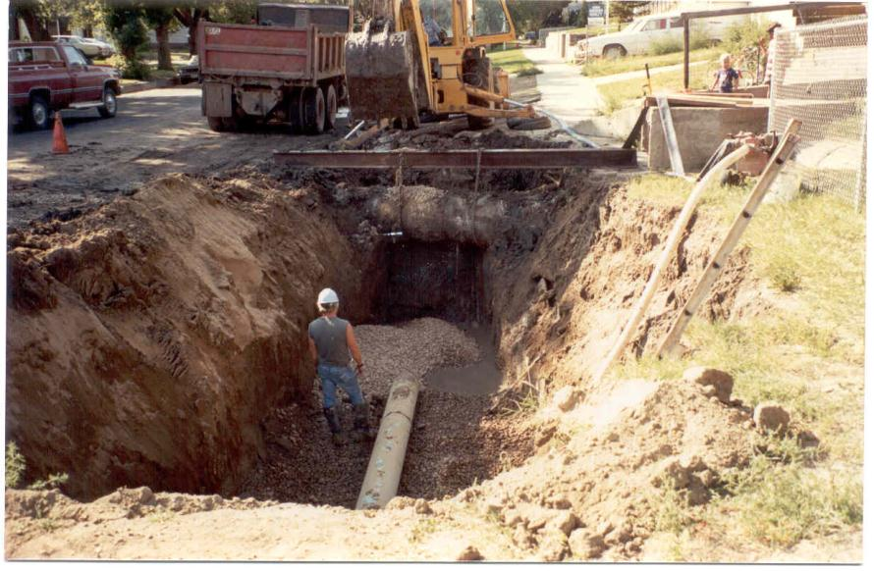
Unsafe trench
Notes:
Improper angle of slope.
Water in trench.
Good example of supporting pipe.

Slide 30
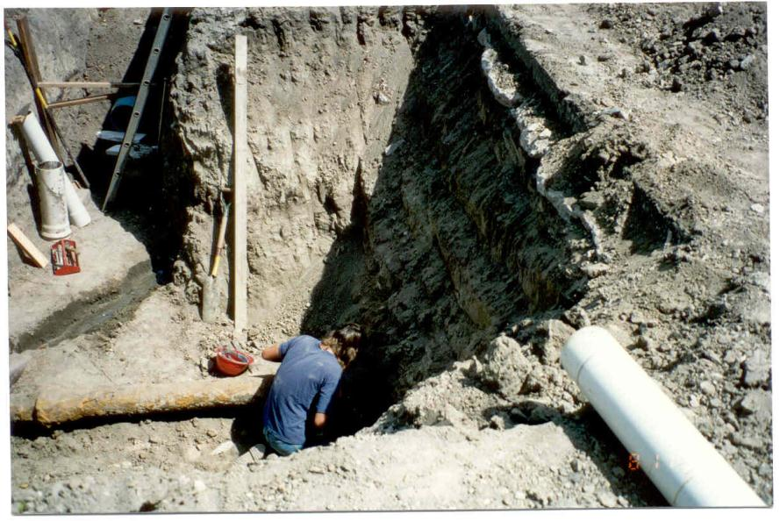
Unsafe trench
Notes:
No sloping.
Not wearing hard hat.
Restricted access to ladder.

Slide 31
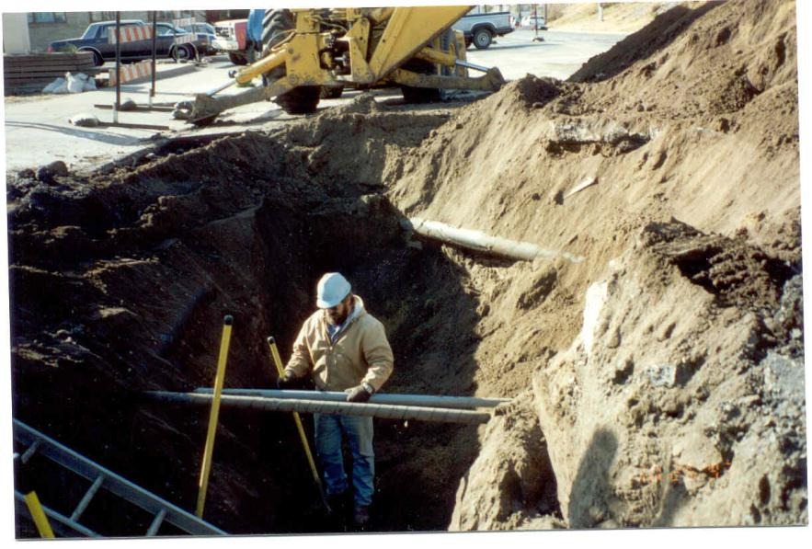
Unsafe trench
Notes:
Improper sloping.
Spoil pile too close.
What is with the ladder?
Overburden applied to pipe in background.

Slide 32
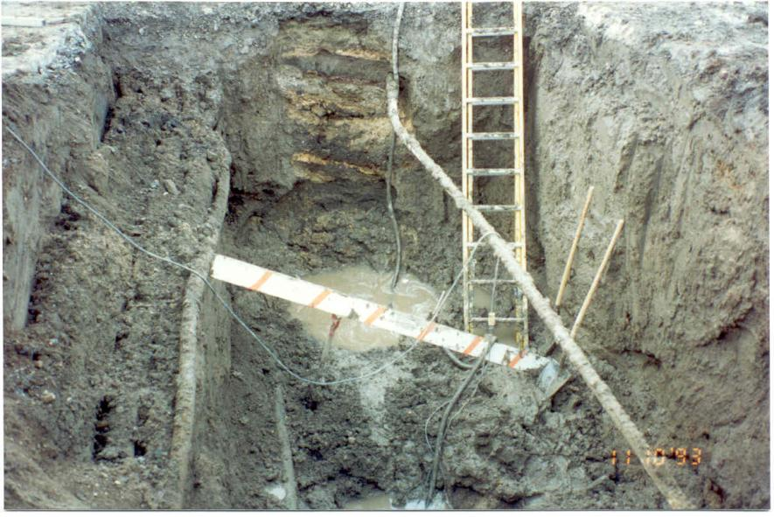
Unsafe trench
Notes:
Not properly sloped.
Water in trench bottom.

Slide 33
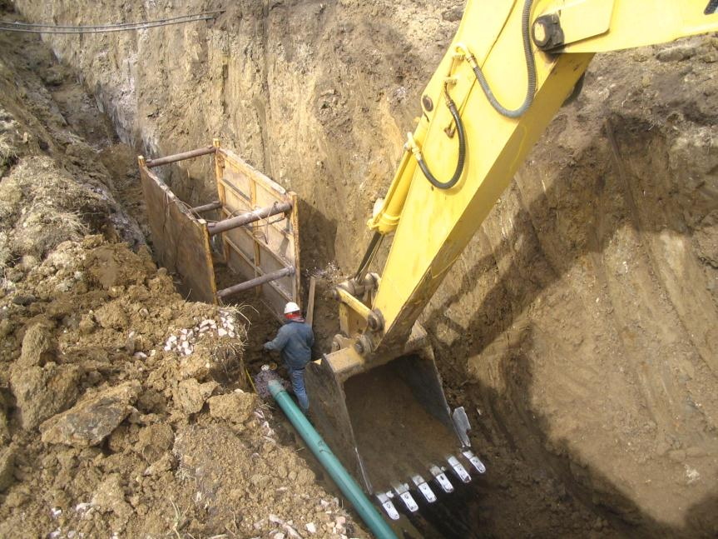
Unsafe trench
Notes:
Improper sloping.
Person outside trench box.
Trench box not effective.
Too close to excavator.

Slide 34
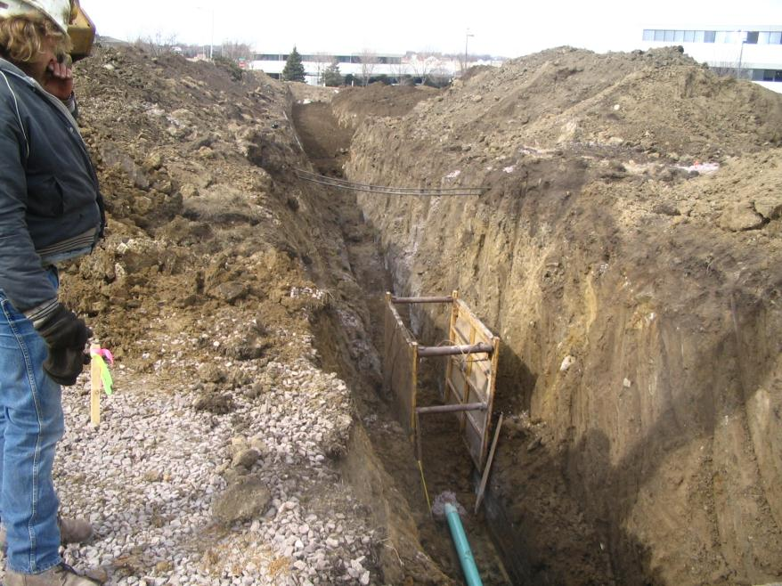
Unsafe trench
Notes:
Same location as previous slide.
No access.
Spoil piles too close.

Slide 35
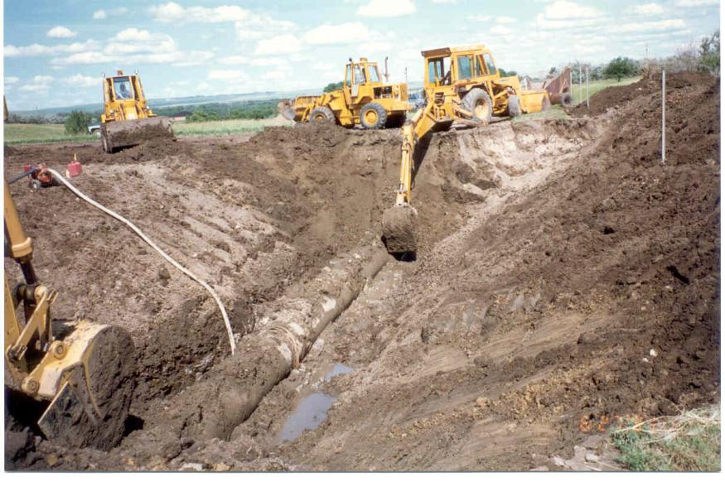
Notes:
Good trench

Slide 36
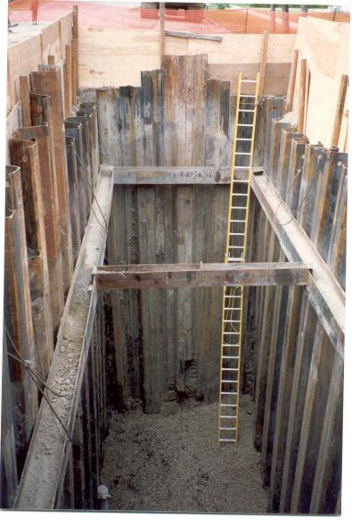
Notes:
Good trench but needs to be engineered because of depth

Slide 37
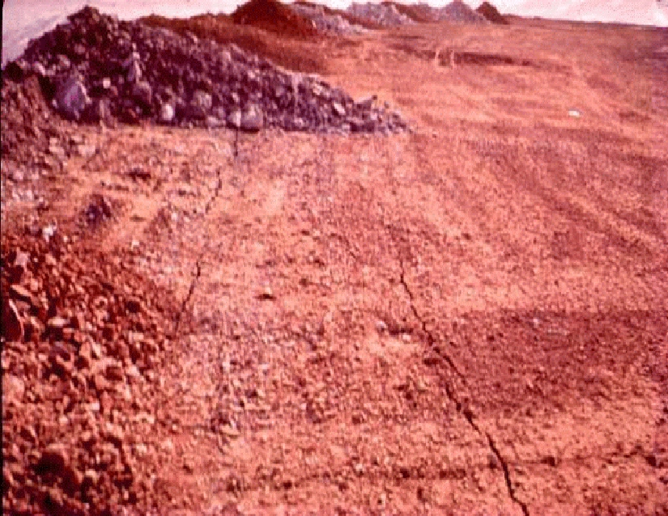
Notes:
As we see here, a very important part of dumping is the ground itself. Will it hold what it’s going to be subjected to? These cracks are showing us that this ground is not solid. It will not support a heavy truck backing out on the edge. It will collapse.

