Slide 1
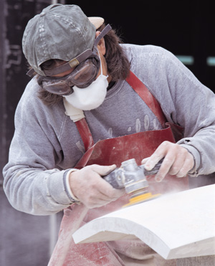
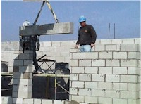
Personal Protective
Equipment
Notes:
1926 Subpart E – Personal Protective and Lifesaving Equipment
This presentation is designed to assist trainers conducting OSHA 10-hour Construction outreach training for workers. Since workers are the target audience, this presentation emphasizes hazard identification, avoidance, and control – not standards. No attempt has been made to treat the topic exhaustively. It is essential that trainers tailor their presentations to the needs and understanding of their audience.
This presentation is not a substitute for any of the provisions of the Occupational Safety and Health Act of 1970 or for any standards issued by the U.S. Department of Labor. Mention of trade names, commercial products, or organizations does not imply endorsement by the U.S. Department of Labor.

Slide 2
Protecting Employees from Workplace Hazards
Employers must protect employees from hazards such as falling objects, harmful substances, and noise exposures that can cause injury
Employers must:
  Use all feasible engineering and work practice controls to eliminate and reduce hazards
  Use personal protective equipment (PPE) if the controls don’t eliminate the hazards.
PPE is the last level of control!
Notes:
29 CFR Part 1926 Subpart E
Personal Protective and Life Saving Equipment (1926.95 to 1926.107)
See Personal Protective Equipment Fact Sheet, also in Spanish, at
-- www.osha.gov/OshDoc/toc_fact.html
See Publications:
-- OSHA 3077, Personal Protective Equipment
-- OSHA 3151, Assessing the Need for Personal Protective Equipment: A Guide for Small Business Employers
How do I identify potential hazards in my workplace?
Begin with a survey. Observe the work environment. Ask employees how they perform their tasks. Look for sources of potential injury such as:
• Objects that might fall from above.
• Exposed pipes or beams at work level.
• Exposed liquid chemicals.
• Sources of heat, intense light, noise, or dust.
• Equipment or materials that could produce flying particles.

Slide 3
Engineering Controls
If . . .
The machine or work environment can be physically changed to prevent employee exposure to the potential hazard,
Then . . .
The hazard can be eliminated with an engineering control.
d can be eliminated with an engineering control
Notes:
Engineering Controls. Engineering controls consist of substitution, isolation, ventilation and equipment modification.

Slide 4
Work Practice Controls
If . . .
Employees can be removed from exposure to the potential hazard by changing the way they do their jobs,
Then . . .
The hazard can be eliminated with a work practice control
Notes:
Administrative Controls. Any procedure which significantly limits daily exposure by control or manipulation of the work schedule or manner in which work is performed. Using PPE is not administrative control.
Work Practice Controls. A type of administrative control where the employer modifies the manner in which the employee performs assigned work. The modification may result in a reduction of exposure through such methods as changing work habits, improving sanitation and hygiene practices, or making other changes in the way the employee performs the job.

Slide 5
Examples of PPE
Body Part Protection
Eye
safety glasses, goggles
Face
face shields
Head
hard hats
Feet
safety shoes
Hands and arms
gloves
Bodies
vests
Hearing
earplugs, earmuffs
Notes:
NOTE:
Respirators and electrical protective equipment (gloves, sleeves, blankets, etc.) are also considered PPE. However, because OSHA has specific requirements for them, they are not discussed here.

Slide 6
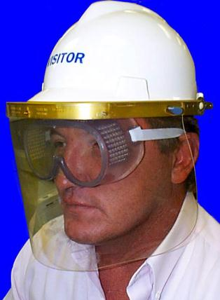
Eye Protection
Notes:
1926.102
See OSHA Fact Sheet 93-03, Eye Protection in the Workplace
WHAT CONTRIBUTES TO EYE INJURIES AT WORK?*
-- Not wearing eye protection. BLS reports that nearly 3 out of every 5 workers injured were not wearing eye protection at the time of the accident.
-- Wearing the wrong kind of eye protection for the job. These workers were most likely wearing protective eyeglasses with no side shields.
WHAT CAUSES EYE INJURIES?*
-- Flying particles. Almost 70% of the accidents studied resulted from flying or falling objects or sparks striking the eye.
-- Contact with chemicals caused one-fifth of the injuries.
WHERE DO ACCIDENTS OCCUR MOST OFTEN?*
-- More than 40% of injuries occurred among craft workers, like carpenters and plumbers. Over a third of the injured workers were operatives, such as assemblers, sanders, and grinding machine operators. More than 20% of the injured workers were employed in construction.
* U.S. Department of Labor, Bureau of Labor Statistics, Accidents Involving Eye Injuries, Report 597, (Washington, DC, Government Printing Office, April 1980.

Slide 7
When must Eye Protection be Provided?
When any of these hazards are present:
Dust and other flying particles, such as metal shavings or sawdust
Corrosive gases, vapors, and liquids
Molten metal that may splash
Potentially infectious materials such as blood or hazardous liquid chemicals that may splash
Intense light from welding and lasers
Notes:
1926.102(a)(1)
Areas of concern include battery charging, installing fiberglass insulation, and compressed air or gas operations.
Never use compressed gas to clean equipment or to blow dust off clothes. Among other hazards, a fire hazard can easily be created even if using oxygen because of its accelerant properties.

Slide 8
Eye Protection for Employees
Who Wear Eyeglasses
Ordinary glasses do not provide the required protection
Proper choices include:
Prescription glasses with side shields and protective lenses
Goggles that fit comfortably over corrective glasses without disturbing the glasses
Goggles that incorporate corrective lenses mounted behind protective lenses
Notes:
1926.102(a)(3)
Prescription lenses must meet specifications of ANSI Z87.1-1968.

Slide 9
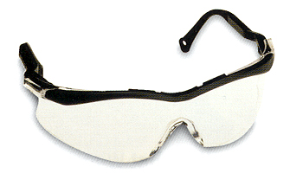
Safety Glasses
Made with metal/plastic safety frames
Most operations require side shields
Used for moderate impact from particles produced by jobs such as carpentry, woodworking, grinding, and scaling
ANSI Z-87
Notes:
1926.102(a)(5)
See OSHA Publication 3151, Assessing the Need for Personal Protective Equipment: A Guide for Small Business Employers.
Table 1 and Figure 1 – Selection and Recommendation

Slide 10
Goggles
Protects eyes and area around the eyes from impact, dust, and splashes
Some goggles fit over corrective lenses
Notes:
1926.102(a)(3)(ii)
1926.102(a)(5)
Corrective lenses include contacts and glasses.

Slide 11
Face Shields
Full face protection
Protects face from dusts and splashes or sprays of hazardous liquids
Does not protect from impact hazards
Wear safety glasses or goggles underneath
Notes:
1926.102(a)(5)
See Personal Protective Equipment Fact Sheet, also in Spanish, at
-- www.osha.gov/OshDoc/toc_fact.html
Only 1% of approximately 770 workers suffering face injuries were wearing face protection; *
A majority of these workers were injured while performing their normal jobs at regular worksites.
* U.S. Department of Labor, Bureau of Labor Statistics, Accidents Involving Head Injuries, Report 605, (Washington, D.C., Government Printing Office, July 1980)

Slide 12
Welding Shields
Protects eyes against burns from radiant light
Protects face and eyes from flying sparks, metal spatter, & slag chips produced during welding, brazing, soldering, and cutting
Notes:
1926.102(a)(5), 1926.102(b)(1)
Use helmets or hand shields during arc welding or arc cutting operations, except submerged arc welding. Helpers or attendants shall be provided with proper eye protection.
Goggles or other suitable eye protection shall be used during all gas welding or oxygen cutting operations. Spectacles without side shields, with suitable filter lenses are permitted for use during gas welding operations on light work, for torch brazing or for inspection.
All operators and attendants of resistance welding or resistance brazing equipment shall use transparent face shields or goggles, depending on the particular job, to protect their faces or eyes, as required.

Slide 13
Head Protection
Notes:
1926.100, 1926.100(a)
Employees working in areas where there is a possible danger of head injury from impact, or from falling or flying objects, or from electrical shock and burns, shall be protected by protective helmets.

Slide 14
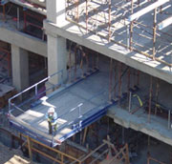
Causes of Head Injuries
Falling objects such as tools
Bumping head against objects, such as pipes or beams
Contact with exposed electrical wiring or components
Notes:
See Personal Protective Equipment Fact Sheet, also in Spanish, at
-- www.osha.gov/OshDoc/toc_fact.html
Hard hats were worn by only 16% of workers sustaining head injuries, although two-fifths were required to wear them for certain tasks at specific locations. *
A majority of these workers were injured while performing their normal jobs at regular worksites.
Cuts or bruises to the scalp and forehead occurred in 85% of the cases, concussions in 26%. Over a third of the cases resulted from falling objects striking the head. *
* U.S. Department of Labor, Bureau of Labor Statistics, Accidents Involving Head Injuries, Report 605, (Washington, D.C., Government Printing Office, July 1980)

Slide 15
Selecting the Right Hard Hat
Class G
General service (building construction, shipbuilding, lumbering)
Good impact protection but limited voltage protection
Class E
Electrical / Utility work
Protects against falling objects and high-voltage shock and burns
Class C
Designed for comfort, offers limited protection
Protects against bumps from fixed objects, but does not protect against falling objects or electrical shock
Notes:
Hard hats require a hard outer shell and a shock-absorbing lining. The lining should incorporate a head band and straps that suspend the shell from 1 to 1-1/4 inches away from the user’s head to provide shock absorption during impact and ventilation during wear. Protective helmets purchased after July 5, 1994, must comply with ANSI Z89.1-1986, whereas those purchased before this date must meet the ANSI Z89.1-1969 standard. Look at the inside of any protective helmet you are considering for your employees, and you should see a label showing the manufacturer’s name, the ANSI standard it meets, and its class. NOTE: Helmets must be worn as designed to be in compliance with ANSI standards. Do not wear helmets backwards.
Employers must make sure that hard hats continue to provide sufficient protection to employees by training employees in the proper use and maintenance of hard hats, including daily inspection.
Remove hard hats from service if the suspension system shows signs of deterioration or no longer holds the shell away from the employee’s head. Also make sure the brim or shell is not cracked, perforated or deformed or shows signs of exposure to heat, chemicals, or ultraviolet light.
Limit use of paints and stickers which can hide signs of deterioration in the hard hat shell. Paints, paint thinners, and some cleaning agents can weaken the shell of the hard hat and may eliminate electrical resistance.

Slide 16
Hats off test

Slide 17

We agree that if you are the type of individual whose head meets the standards for protection, you don’t need a hard hat.
Those feeling they can qualify should contact your supervisor for testing.

Slide 18
Upon satisfactory completion of the test, you will receive a beautiful embossed certificate suitable for framing.
It identifies your head as conforming to American National Standards Institute (ANSI) Z89.2, Classes A, B, C, and D.
You will also receive a wallet-sized card that must be carried on the job site.

Slide 19

The Test goes like this:
You will receive a 24-hour water immersion test.
Maximum permitted absorption is 0.5 % by weight.

Slide 20

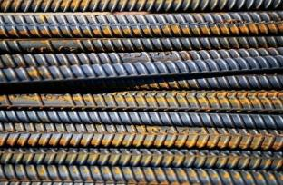
2.
Next the impact test.
While in horizontal position with head upon a steel plate, an eight pound steel ball will be dropped upon you head from a height of
15 feet…..
You must suffer no damage!

Slide 21

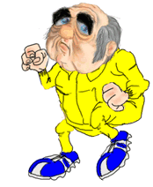
3
Your head will then be subjected to a variety of acids, solvents, and oils.
Once again….. you may suffer no damage.

Slide 22


4
A propane torch will be used to determine if your head is fire resistant. If only slow burning, you will receive an A or B rating. If holes appear in your head, a C or D rating will be given.

Slide 23
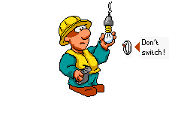
In the final test, your head must sustain 2,200 volts AC, 60 Hz, for three minutes, with leakage currents not exceeding nine milliamperes.

Slide 24
All tests must be conducted at a variety of temperatures ranging from minus 20 to 140 degrees Fahrenheit.

Slide 25

If you feel you cannot qualify, don’t despair.

Slide 26

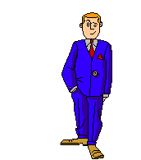
Although not as pretty as your hairdo, the hard hat does provide protection from all of the above.

Slide 27
Foot Protection
Notes:
1926.96

Slide 28
When Must Foot Protection be Provided?
When any of these are present:
Heavy objects such as barrels or tools that might roll onto or fall on employees’ feet
Sharp objects such as nails or spikes that might pierce ordinary shoes
Molten metal that might splash on feet
Hot or wet surfaces
Slippery surfaces
Notes:
Sixty-six percent of injured workers were wearing safety shoes, protective footwear, heavy-duty shoes or boots and 33%, regular street shoes. Of those wearing safety shoes, 85% were injured because the object hit an unprotected part of the shoe or boot.*
* U.S. Department of Labor. Bureau of Labor Statistics. Accidents Involving Foot Injuries. Report 626. Washington, DC: Government Printing Office. January 1981. 22 Pp.

Slide 29
Safety Shoes
Impact-resistant toes and heat-resistant soles protect against hot surfaces common in roofing and paving
Some have metal insoles to protect against puncture wounds
May be electrically conductive for use in explosive atmospheres, or nonconductive to protect from workplace electrical hazards
Notes:
Conductive Shoes
Electrically conductive shoes protect against the buildup of static electricity. Essentially, these shoes ground the employees wearing them. Employees working in explosive and hazardous locations such as explosives manufacturing facilities or grain elevators must wear conductive shoes to reduce the risk of static electricity buildup on an employee’s body that could produce a spark and cause an explosion or fire. During training, employees must be instructed not to use foot powder or wear socks made of silk, wool, or nylon with conductive shoes. Foot powder insulates and retards the conductive ability of the shoes. Silk, wool, and nylon produce static electricity.
Conductive shoes are not general-purpose shoes and must be removed upon completion of the tasks for which they are required. Employees exposed to electrical hazards must NEVER wear conductive shoes.
Safety-Toe Shoes
Safety-toe shoes are nonconductive and will prevent an employee’s feet from completing an electrical circuit to ground. They protect employees against open circuits of up to 600 volts in dry conditions. Use the shoes with other insulating equipment and precautions to reduce or eliminate the potential for providing a path for hazardous electrical energy.
NOTE: Don’t wear nonconductive footwear in explosive or hazardous locations

Slide 30
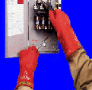
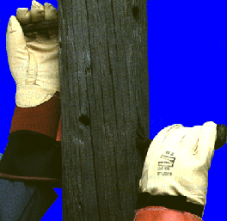
Hand Protection
Notes:
1926.100
See OSHA Publication 3151, Assessing the Need for Personal Protective Equipment: A Guide for Small Business Employers.

Slide 31
What Kinds of Protective Gloves are Available?
Durable gloves made of metal mesh, leather, or canvas
  Protects from cuts, burns, heat
Fabric and coated fabric gloves
  Protects from dirt and abrasion
Chemical and liquid resistant gloves
  Protects from burns, irritation, and dermatitis
Rubber gloves
  Protects from cuts, lacerations, and abrasions

Slide 32
Types of Rubber Gloves
Nitrile protects against solvents, harsh chemicals, fats and petroleum products and also provides excellent resistance to cuts and abrasions.
Butyl provides the highest permeation resistance to gas or water vapors
Notes:
The nature of the hazard(s), the activity, and the length of the activity determines your glove selection. The variety of potential hand injuries may make selecting the appropriate pair of gloves more difficult than choosing other protective equipment. Take care to choose gloves designed for the particular circumstances of your workplace. Glove manufacturers can provide valuable assistance.
Material Safety Data Sheets also provide information on PPE.

Slide 33
Other Types of Gloves
Kevlar protects against cuts, slashes, and abrasion
Stainless steel mesh protects against cuts and lacerations

Slide 34
Body Protection
Notes:
1926.95
See OSHA Publication 3151, Assessing the Need for Personal Protective Equipment: A Guide for Small Business Employers.
The photo depicts a hazardous waste operation covered under 1926.65 or 1910.120.

Slide 35
Body Protection
Criteria for Selection
Provide protective clothing for parts of the body exposed to possible injury
Types of body protection:
  Vests
  Aprons
  Jackets
  Coveralls
  Full body suits
Coveralls

Slide 36
Body Protection
Cooling Vest
Full Body Suit
Sleeves and Apron
Notes:
Protective clothing comes in a variety of materials, each suited to particular hazards. Conduct your hazard assessment and identify potential sources of bodily injury. Install feasible engineering controls, and institute work practice controls to eliminate the hazards. If the possibility of bodily injury still exists, provide protective clothing constructed of material that will protect against the specific hazards in your workplace.
Different materials will protect against different chemical and physical hazards. When chemical or physical hazards are present, check with the clothing manufacturer to make sure that the material selected will provide protection from the specific chemical or physical hazards in your workplace.

Slide 37
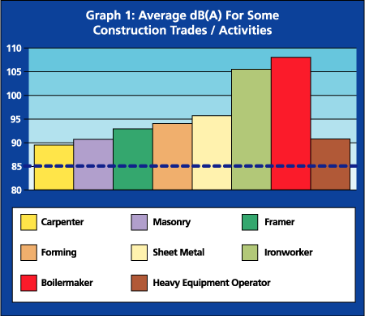
Hearing Protection
Notes:
1926.101 and 1926.52
Determining the need to provide hearing protection is complicated.
Employee exposure to excessive noise depends upon several factors:
- How loud is the noise as measured in decibels (dBA)?
- What is the duration of each employee’s exposure to noise?
- Do employees move between separate work areas with different noise levels?
- Is noise generated from one source or multiple sources?
Generally, the louder the noise, the shorter the exposure time before hearing protection must be provided.
Current permissible noise exposure for the Construction industry is 90 dbA for an 8 hour duration.
See the OSHA technical links for Noise and Hearing Conservation
-- www.osha-slc.gov/SLTC
-- www.osha.gov/SLTC/constructionnoise/index.html

Slide 38
When Must Hearing Protection be Provided?
After implementing engineering and work practice controls
When an employee’s noise exposure exceeds an 8-hour time-weighted average (TWA) sound level of 90 dBA
Notes:
1926.101(a) and 1926.52

Slide 39
Examples of Hearing Protectors
Earmuffs
Earplugs
Canal Caps
Notes:
Employers must implement feasible engineering controls and work practices before resorting to PPE such as earmuffs, earplugs, or canal caps.
If engineering and work practice controls do not lower employee noise exposure to acceptable levels, then employers must provide employees with appropriate PPE.

