Slide 1
Health Hazards in
Construction
Part 2
Developed by:
Construction Safety Council
4100 Madison Street
Hillside, IL 60162
Notes:
Prepare to Learn

Slide 2
Chemical Health Hazards
Learning Goals:
Be able to explain what a chemical health hazard is and how construction workers might be exposed to these hazards.
Define important terms used to describe chemical hazards in the workplace.
Overview the health effects of these hazards on the human body.
Notes:
Learning goals for this lesson.

Slide 3
Important Terms
Gases, vapors, fumes, dusts/fibers & mists
Routes of entry
Units of concentration
Respirable
Breathable Air
Simple asphyxiant
Chemical asphyxiant
Gas & vapor density
Carcinogens
Toxic & highly toxic
Notes:
Important terms that will be discussed during this lesson.

Slide 4
Important Terms
Reproductive toxins
Irritants
Corrosives
Sensitizers
Hepatotoxins (liver toxins)
Nephrotoxins (kidney toxins)
Neurotoxins (nerve toxins)
Hematopoietic system (blood forming system)
Synergistic Effect
Your Right to Know
Material Safety Data Sheet (MSDS)
Notes:
Important terms that will be discussed during this lesson.

Slide 5
Chemical Health Hazards
Gas
Vapor
Fume
Dust/Fiber
Mist
Notes:
Chemical Health Hazard
A chemical health hazard means a chemical for which there is statistically significant evidence based on at least one study conducted in accordance with established scientific principles that acute or chronic health effects may occur in exposed employees. Chemical hazards may take the form of a gas, vapor, fume, dust/fiber and/or mist.
Chemical hazards can damage the lungs, skin, eyes, mucous membranes, and target specific organs in the body!

Slide 6
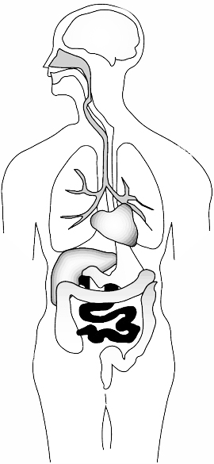


Routes of Entry
Inhalation
Ingestion
Absorption
Alveoli
Injection
Notes:
Inhalation is the primary route of entry for hazardous chemicals in the work environment. Nearly all materials that are airborne can be inhaled.
Absorption through the skin is another route of entry. The skin is the largest organ of your body and a common exposure site for liquid and airborne chemicals. Absorption through the skin can occur quite rapidly if the skin is cut or abraded. Intact skin is an effective barrier to many hazardous materials.
Ingestion - toxic materials can be swallowed and enter the body through the gastrointestinal tract. In the workplace, people can unknowingly ingest harmful chemicals when you eat, drink, or smoke in a contaminated work areas.
Injection occurs when a sharp object punctures the skin, allowing a chemical or infectious agent to enter your body. For example, injection can occur when a contaminated object such as a rusty nail punctures the skin.
Respiratory System (Inhalation)
The respiratory system is the major route of exposure for airborne chemicals. Once air contaminants are inhaled into your respiratory system, they may harm the tissues of the respiratory tract or lungs; cause serious scarring (local effect); and/or be dissolved in the blood and transported throughout the body (systemic effect).
The most serious damage is caused by contaminants that penetrate deep into the lower regions of the lung (alveoli).

Slide 7
Units of Concentration
(ppm) Parts per Million
(mg/m³) Milligrams per Cubic Meter of Air
(µg/m³) Micrograms per Cubic Meter of Air
(f/cc) Fibers per Cubic Centimeter of Air
Notes:
(ppm) Parts per Million
Used to express the amount of a gas or vapor; one part of a gas or vapor per million parts of air.
(mg/m³) Milligrams per Cubic Meter of Air
Used to express the amount of a toxic fume or dust; the amount of a substance (mg) in a given amount of space (m³).
(µg/m³) Micrograms per Cubic Meter of Air
Used to express the amount of a highly toxic fume or dust; the amount of a substance (µg) in a given amount of space (m³).
(f/cc) Fibers per Cubic Centimeter of Air
Fibers are any particle longer than 5 microns (µm), one millionth of a meter, and have an aspect ratio (length : width) greater than 3:1

Slide 8
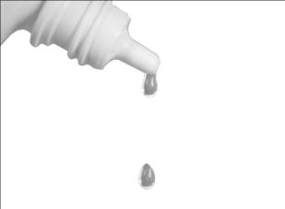
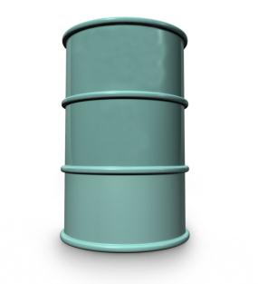
Part Per Million (ppm)
Four (4) eye drops in a 55 gallon drum is equivalent to 1 part per million (1 ppm).
55 gallons
Notes:
(Ratio: 1/1,000,000)
One part per million is equivalent to four (4) eye drops of liquid in a 55 gallon barrel.

Slide 9

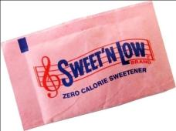
Milligrams per Cubic Meter of Air (mg/m³)
Empire State Building
X 1000 = 1 mg/m³
Approximate Volume = 1,000,000 m³
Notes:
Milligrams per Cubic Meter of Air (mg/m³)
One thousand (1,000) packets of artificial sweeter in the volume of the Empire State Building is equivalent to 1 milligram per cubic meter of air (1 mg/m³).

Slide 10
Micrograms per Cubic Meter of Air (µg/m³)
Empire State Building
X 1 = (1 µg/m³)
X 50 (artificial sweetener packets)
= 50 µg/m³
(OSHA PEL for Lead).
Approximate Volume = 1,000,000 m³
Notes:
Micrograms per Cubic Meter of Air (µg/m³)
One (1) packet of artificial sweeter in the volume of the Empire State Building is equivalent to 1 microgram per cubic meter of air (1 µg/m³).
50 artificial sweetener packets in the volume of the Empire State Building is equivalent to 50 µg/m³ (OSHA PEL for Lead).

Slide 11
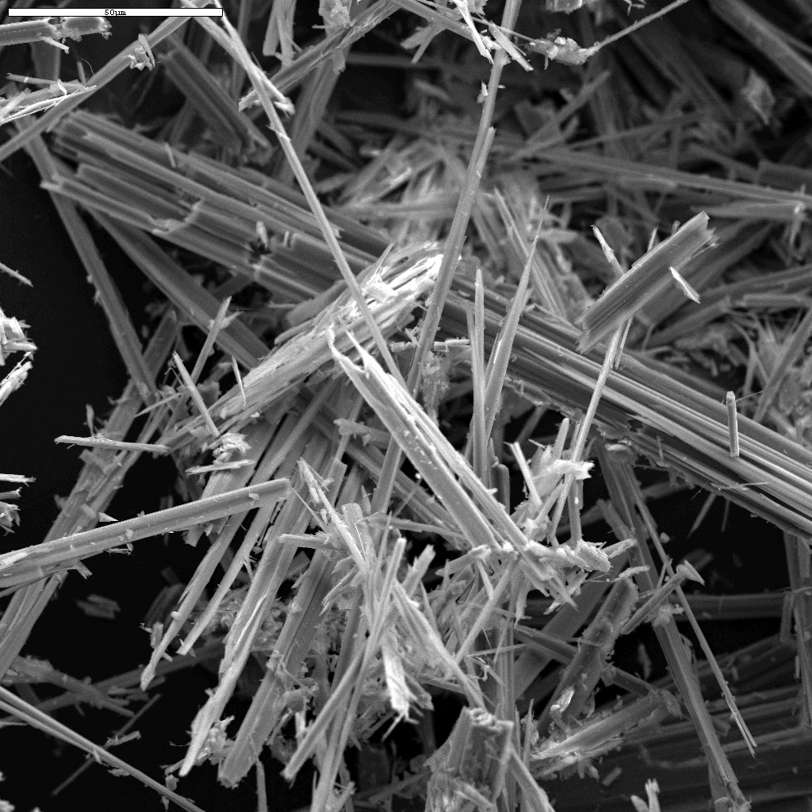
Fibers per Cubic Centimeter (f/cc)
Fiber – Means a particulate form of asbestos, 5 micrometer (µm) or longer, with a length-to-width ratio of at least 3 to 1.
Notes:
Fiber – Means a particulate form of asbestos, 5 micrometer (µm) or longer, with a length-to-width ratio of at least 3 to 1.
Why f/cc for Asbestos?
The unit f/cc (Fibers per Cubic Centimeter) is used to describe limits for asbestos because it’s the number of fibers, not the overall weight of the material that is of concern. Asbestos fibers that are in size and shape (5µm long and length to width ratio of 3:1) are needle sharp particles that damage the inner portions of the lungs. In contrast, asbestos fiber that is shorter or of a length-to-width ratio less than 3:1 does not cause significant damage.

Slide 12
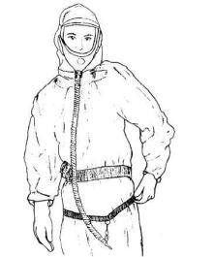



OSHA PEL for Asbestos
0.1 f/cc is equivalent to the number of fibers on the tip of a pencil mixed in with the volume of ten refrigerators.
Average amount of air a worker breathes during an 8-hour shift (ten refrigerators)
Notes:
The Occupational Safety & Health Administration (OSHA) has established a Permissible Exposure Limit (PEL) for asbestos; 0.1 f/cc over a time weighted average (TWA) of 8 hours.
Average amount of air a worker breathes during an 8-hour shift (ten refrigerators)
0.1 f/cc is equivalent to the number of fibers on the tip of a pencil mixed in with the volume of ten refrigerators.
On average, a worker will breathe 10,000,000 cubic centimeters (cc) of air in a typical work shift (8 hours); this is about the volume of 10 refrigerators. The number of asbestos fibers allowed by OSHA during this time period (0.1) can fit onto the tip of a pencil (about 1 million fibers).

Slide 13

Respirable Particles
Respirable dust is less than 10 microns (µm) in diameter!
Human hair is between 80 – 120 microns (µm) in diameter.
Notes:
Dust, fibers, fumes and other particles that can go past the nose and mouth and enter deep into the respiratory system are considered to be respirable; these particles are less than 10 microns (µm) in diameter.
A micron is 1 millionth of a meter (1/96,000 of an inch).
Human hair is between 80 – 120 microns (µm) in diameter.
Some exposures in construction, such as toxic fumes, dusts and mists occur from particles that are less than 10 microns (µm) in diameter; these exposures are invisible.
Examples of respirable (invisible) fume or dust:
Silica
Lead
Asbestos
Hexavalent Chromium

Slide 14

Respirable Particles
Respirable Dust, e.g., Lead, Silica & Asbestos (<10 µm)
A lower case 'o' when printed in Times New Roman size 10 (1mm).
Large Dog
Human Hair (80 – 120 µm)
1 m
1 cm
o
.000001
.001
0.01
0
1
Micron (µm)
Millimeter (mm)
Centimeter (cm)
Meter (m)
Notes:
Respirable particles comparison line.

Slide 15
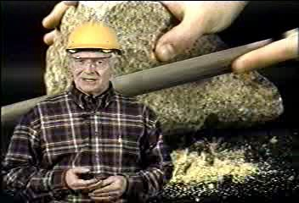
Notes:
Play movie

Slide 16
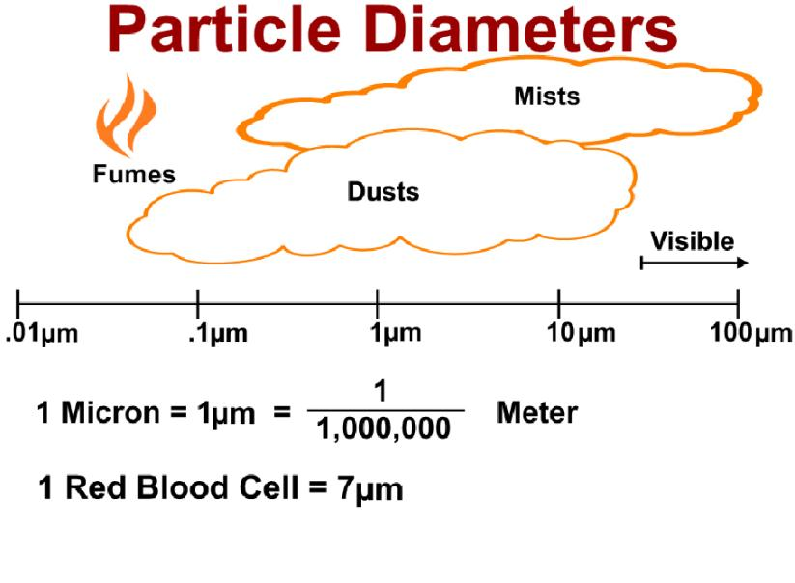
Notes:
Fumes, dusts and some mist particles are so small that they are invisible; these particles can enter deep into the lungs and cause serious health effects.

Slide 17
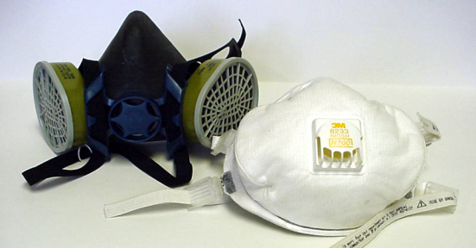
High Efficiency Particulate Air (HEPA)
100
Capable of filtering 0.3 micrometer particles with 99.97% efficiency.
Notes:
High-efficiency particulate air filtration, or HEPA, is capable of filtering 0.3 micrometer particles with 99.97% efficiency, for use in contaminated environments.
Where airborne particles are less than 10 microns (µm) in diameter, a HEPA (100) rated respirator is highly recommended.
(See Respiratory Protection Program, page 201)
Examples of respirators with high-efficiency particulate air (HEPA) filtration; these are recommended to be used where airborne particles are less than 10 µm in diameter.
Respirators designated as HEPA will rated with a 100 efficiency.

Slide 18

Gases
Examples of gases found in construction:
Oxygen – used for welding and cutting.
Acetylene – used for welding and cutting.
Propane – used for heating & fuel.
Carbon Dioxide – used as an inert gas and can be found naturally in sewers.
Methane – the principle component of natural gas and found in earth deposits.
Notes:
Gases are materials that exist as individual molecules in the air at room temperature; gases are measured as a percent volume of air, or parts per million (ppm).

Slide 19
Gases
Examples of gases found in construction:
Hydrogen Sulfide –break down of organic matter and can be found naturally in sewers.
Carbon Monoxide – highly toxic and produced by the incomplete combustion of fuels.
Welding Gases – The welding arc can produce ozone, phosgene and carbon monoxide gases.
Diesel Exhaust – Nitrogen Dioxide.
Notes:
Gases are materials that exist as individual molecules in the air at room temperature; gases are measured as a percent volume of air, or parts per million (ppm).

Slide 20
Group Discussion…
How do Gases Affect the Body?
Who’s at Risk?
What hazardous gases are present on your job?
Notes:
Toxic gases can directly irritate the skin, throat, eyes or lungs (local health effect); or they may pass from the lungs into the blood stream to damage other parts of the body (systemic health effect). Some gases such as carbon dioxide can cause you to suffocate by displacing oxygen in the air.
Heavy equipment operators, welders and persons who enter into confined or enclosed spaces (plumbers & pipefitters, electricians and heating & air-conditioning workers) are the most at risk from chemicals in a gas form; laborers who enter into trenches are also at risk.
Group Discussion…
What hazardous gases are present on your job?

Slide 21
Gases
Important questions concerning gases:
What is the gas density?
What is the flammable range (LFL) of the gas?
How toxic is the gas (PEL, TLV, REL & IDLH)?
Is the gas a simple asphyxiant or a chemical asphyxiant?
Notes:
Gases used in construction are usually kept in compressed gas cylinders. The most common are oxygen and acetylene; these gases are used for hot work (e.g., cutting & welding of metals). However, some hazardous gases are found naturally in the earth and/or can be generated in sewer systems (e.g., carbon dioxide, methane & hydrogen sulfide).
Knowing the gas density, the flammable range and toxicity of the gas will help in understanding the hazards associated with the gas. Gases can also be classified as being either a simple asphyxiant or a chemical asphyxiant.

Slide 22

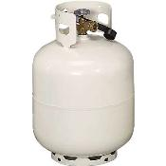

Gas Density
Helium .062
Gas Density
(Air = 1)
Propane 1.55
Carbon Dioxide 1.53
Notes:
Gas density is defined as the relative weight of a gas compared to air, which has an arbitrary value of one (1). If a gas density is less than one it will generally raise in air. If the gas density is greater than one it will generally sink in air.
WARNING! Gases with densities greater than one (1) will sink in air and displace oxygen within confined or enclosed spaces.

Slide 23

Breathable Air
Composition of Air
Substance (Gas) | % by Volume (ppm)
Nitrogen | 78% (780,000)
Oxygen | 20.9% (209,000)
Argon | 0.9% (9,000)
Carbon Dioxide | 0.1% (1,000)
Notes:
The air around us is a mixture of gases, mainly nitrogen and oxygen. But air also contains a small amount of water vapor, argon, and carbon dioxide. Understanding the air we breathe will better prepare us to recognize potential hazardous atmospheres.
Remember…
Oxygen Deficiency Hazard is when air contains less than 19.5% oxygen by volume.

Slide 24

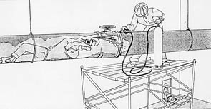
Never use pure oxygen for ventilation, cooling or cleaning!

Slide 25


Simple Asphyxiants
Asphyxiant (Gas) | Gas Density | LFL | PEL | IDLH | NFPA 704M
Carbon Dioxide | 1.53 | NA | 5000 | 40,000 | Fire: 0 Health: 0 Reactivity: 0 Specific Hz: NA
Nitrogen | .97 | NA | E³ | NA | Fire: 0 Health: 0 Reactivity: 0 Specific Hz: NA
Argon | 1.38 | NA | E³ | NA | Fire: 0 Health: 0 Reactivity: 0 Specific Hz: NA
Methane | .55 | 5.3% | E³ | 5300 | Fire: 4 Health: 1 Reactivity: 0 Specific Hz: NA
Notes:
Gases can displace oxygen; these gases are called…
Simple Asphyxiants.
A simple asphyxiant is a gas that displaces oxygen, thus lowers the overall amount of oxygen in the air. A simple asphyxiant by itself is not toxic but can be hazardous because of the oxygen deficient atmosphere that it may create. Simple asphyxiants are especially dangerous in confined and enclosed spaces because the gas gets trapped and has no where to go.

Slide 26
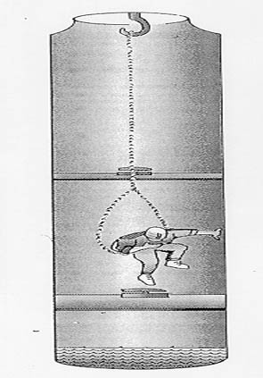
Sewer Entry
Engulfment
Toxic gases
Explosive -Flammable gases
Oxygen Deficiency

Slide 27
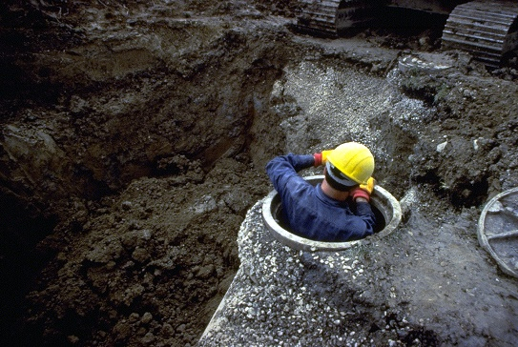
Confined Space Hazards
Confined Space Hazards…
Always check for hazardous atmospheres!
Notes:
Before Entry into Confined Spaces:
Instruct employees to recognize and avoid unsafe conditions associated with their work environment.
Instruction employees on hazards involved in entering confined or enclosed spaces.
Evaluate the space for hazards and eliminate or protect against these hazards before entry.

Slide 28
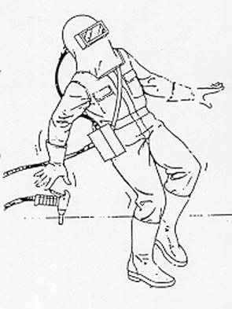

Slide 29

Exposure to simple asphyxiants is like suffocating in a plastic bag.
Notes:
Lessons Learned – Simple Asphyxiants
Air is a mixture of different gases; oxygen is the most important element needed for human life. Because gases have different densities (air = 1), oxygen can be displaced. When this happens, oxygen levels drop and workers can become asphyxiated; oxygen deficiency is less than 19.5% by volume of air.

Slide 30
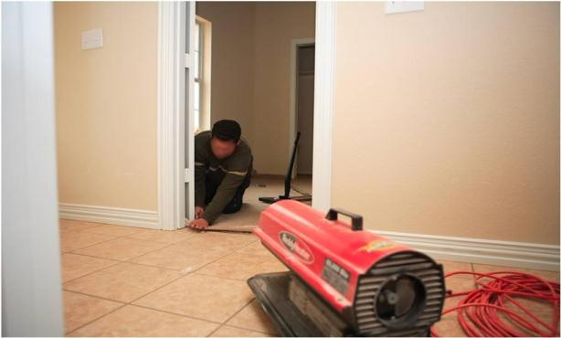
Temporary Heating Devices & Asphyxiation
Fresh air must be supplied in sufficient quantities.
OTI Southwest Education/elcoshimages.org
Notes:
To avoid asphyxiation while using temporary heating devices, follow these OSHA rules:
Fresh air must be supplied in sufficient quantities to maintain the health and safety of workers. Where natural means of fresh air supply is inadequate, mechanical ventilation must be provided.
When heaters are used in confined spaces, special care must be tanked to provide sufficient ventilation in order to ensure proper combustion, maintain the health and safety of workers and limit temperature rise in the area.

Slide 31
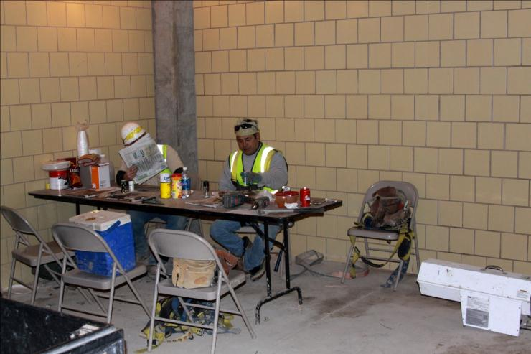
When using portable heaters, special care must be taken to provide sufficient ventilation in order to ensure a safe and healthful environment.
Notes:
When using portable heaters, special care must be taken to provide sufficient ventilation in order to ensure a safe and healthful environment.

Slide 32


Chemical Asphyxiant
Carbon Monoxide – “The Silent Killer”
Hydrogen Sulfide – Rotten Eggs
Notes:
Gases, if inhaled, can be toxic; these are called…
Chemical Asphyxiants.
Chemical asphyxiants reduce the body’s ability to absorb, transport, or utilize inhaled oxygen. They are often toxic at very low concentrations (a few ppm).
Carbon monoxide prevents oxygen transport by combining with hemoglobin
Hydrogen sulfide will cause a swelling of the air passage causing suffocation.

Slide 33
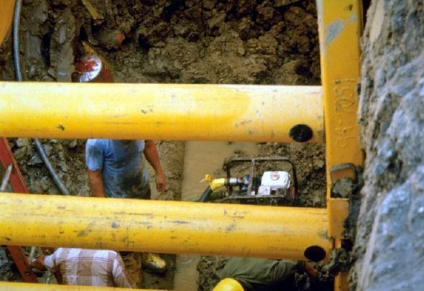
Carbon Monoxide (CO)
Odorless, colorless and toxic gas.
Found in combustion exhaust.
Notes:
Carbon monoxide is an odorless, colorless and toxic gas. Because it is impossible to see, taste or smell the toxic fumes, CO can kill you before you are aware of your exposure. At lower levels of exposure, CO causes mild effects that are often mistaken for the flu. These symptoms include headaches, dizziness, disorientation, nausea and fatigue. The effects of CO exposure can vary greatly from person to person depending on age, overall health and the concentration and length of exposure.
CO is found in combustion exhaust, such as those produced by cars, trucks and small gasoline engines (generators).
Gasoline engine (water pump) being operated inside a trench box (enclosed space); this is a potential hazardous exposure to carbon monoxide!

Slide 34
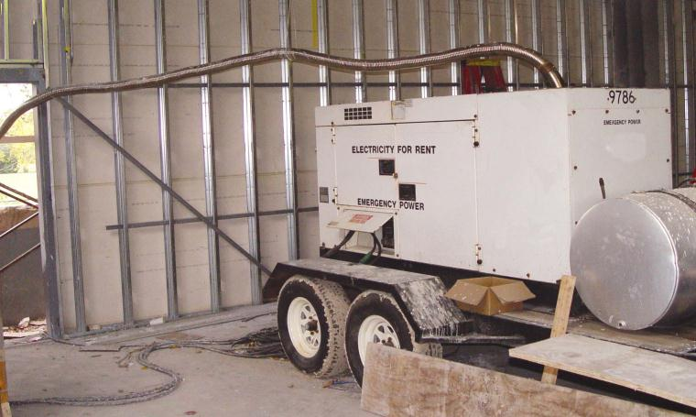
Good example of generator exhausts being vented to the outside.
Notes:
Good example of generator exhausts being vented to the outside.

Slide 35
Concentration of Carbon Monoxide (CO) & Health Effects
% Volume of Air | ppm | Health Effects
.02 | 200 | Possibly headache, mild frontal in 2-3 hrs.
.04 | 400 | Headache, frontal, and nausea after 1-2 hrs.
.08 | 800 | Headache, dizziness and nausea in 3/4 hour, collapse and possible unconsciousness in 2 hrs.
.12 | 1200 | Headache, dizziness and nausea in 20 min.; collapse, unconsciousness, possibly death in 2 hr.
Notes:
Concentration of Carbon Monoxide (CO) & Health Effects

Slide 36

Hydrogen Sulfide
Colorless, very poisonous, flammable gas.
Characteristic foul odor of rotten eggs.
Bacterial breakdown of organic matter in the absence of oxygen.
Found in swamps and sewers (manholes).
Notes:
Hydrogen sulfide is a colorless, very poisonous, flammable gas with the characteristic foul odor of rotten eggs. It often results from the bacterial breakdown of organic matter in the absence of oxygen, such as in swamps and sewers (manholes).
Just a few breaths of air containing high levels of hydrogen sulfide gas can cause death. Lower, longer-term exposure can cause eye irritation, headache, and fatigue.

Slide 37
Concentration of Hydrogen Sulfide & Health Effects
% Volume of Air | ppm | Health Effects
.0002 | .02 | Odor detected by human nose.
.001 | 10 | Irritation of the eyes, nose and throat.
.005 | 50 | Headache, dizziness and nausea; coughing and breathing difficulty.
.01 | 100 | Severe respiratory tract irritation, eye irritation, convulsions, coma & death in severe cases.
Notes:
Concentration of Hydrogen Sulfide & Health Effects
WARNING: when hydrogen sulfide is breathed in, it reacts with the moisture in the airways and forms an acid. This is highly irritating to skin tissue resulting in acute irritant health effects.

Slide 38
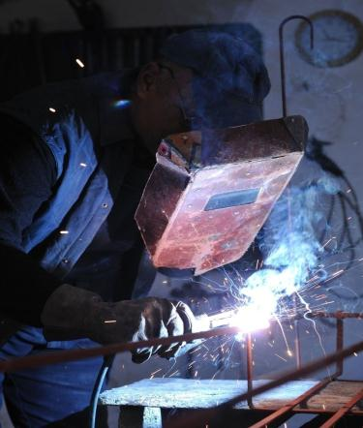
Welding, Cutting & Brazing Gases
Carbon Dioxide
Carbon Monoxide
Nitrogen Dioxide
Nitric Oxide
Hydrogen Fluoride
Ozone
Phosgene
Notes:
Decomposition, or break down of materials during welding, cutting and brazing could result in an exposure to hazardous gas.
A number of gases are produced as a normal part of the welding process. These gases may come from the welding arc (ozone & nitrogen oxides), or the burning process (carbon dioxide, carbon monoxide, hydrogen fluoride and phosgene).
Gases generated during welding, cutting and brazing; these may be produced by the welding operation:
Carbon Dioxide
Carbon Monoxide
Nitrogen Dioxide
Nitric Oxide
Hydrogen Fluoride
Ozone
Phosgene
Welders have potential exposure to hazardous gas.

Slide 39
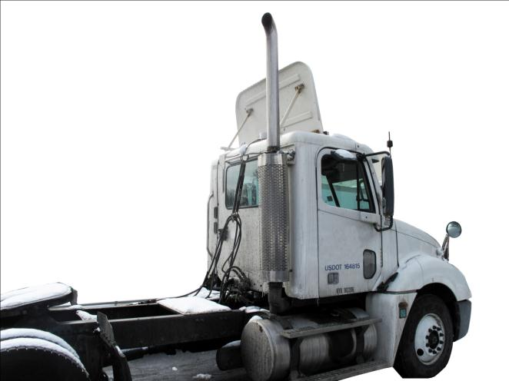
Diesel Exhaust
Ensure proper ventilation.
Do not idle engines excessively.
See manufacturers MSDS.
Notes:
Diesel exhaust is a pervasive airborne contaminant in workplaces where diesel-powered equipment is used. Due to expanding use of diesel equipment, more and more workers are exposed to diesel exhaust. More than one million workers are exposed to diesel exhaust and face the risk of adverse health effects, ranging from headaches and nausea to cancer and respiratory disease.
Manufacturers and importers of diesel fuel are responsible for performing a hazard determination and transmitting the hazard information of diesel fuel to their downstream customers through Material Safety Data Sheets (MSDSs). As part of the evaluation, the manufacturer must anticipate the intended uses of the product, and consider the potential physical and health hazards to which employees may be exposed as a result of those uses. Any health or physical hazards associated with the exhaust must therefore be included on the MSDS.

Slide 40
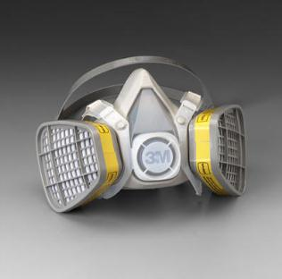
Respiratory Protection for Exposure to Gases
Acid gas cartridges [White]
Organic vapor (OV) acid gas cartridges [Yellow]
Multi vapor gas cartridges [Olive Green]
3M™ Organic Vapor/Acid Gas Respirators 5000 Series
Notes:
NOTE: Before using any respirator and filter combination, always check with the manufacturer to ensure that it is approved and appropriate for the hazard.
Respiratory protection used to protect against gases include:
Acid gas cartridges [White]
Organic vapor (OV) acid gas cartridges [Yellow]
Multi vapor gas cartridges [Olive Green]

Slide 41
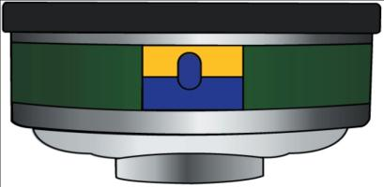

End of Service Life Indicator (ESLI)
The indicator completely changes color when the service life of the cartridge is expired.
The indicator background changes to a different color as the service life shortens.
Notes:
ESLI’s help to eliminate the guesswork in determining when a respirator’s cartridges should be replaced. ESLI’s are indicators on the side of each filter cartridge that change color as the charcoal or other absorbent inside absorbs the chemicals. The color change progresses from one end of the indicator window to the other. The service life of the filter is expired when the indication color fills the indicator window.
Many gas cartridges require an end of service life indicator (ESLI) due to their poor warning properties (e.g., hydrogen sulfide). If the cartridge does not have an ESLI, then a regular respirator cartridge change out schedule must be instituted by the employer.

Slide 42

Vapors
Examples of vapors found in construction:
Gasoline – used for fuel.
Organic Solvents – used as paint thinners (toluene & turpentine) & glue solvents (acetone & methyl ethyl ketone)
Nail polish remover, an organic solvent (usually acetone) has a distinctive vapor odor.
Notes:
Vapors are gaseous form of substances that are normally in a liquid state at room temperature and pressure. They are formed by evaporation; vapors are measured as a percent volume of air, or parts per million (ppm).
Nail polish remover, an organic solvent (usually acetone) has a distinctive vapor odor.

Slide 43


How are Vapors Formed?
Liquid reaches a certain temperature – Flash Point.
At Flash Point – vapor is released into the air.
  The amount of vapor is dependent on the Vapor Pressure.
Water needs to be heated (212ºF) for vapors to be formed.
Some solvents give off vapor at or below room temperature (72ºF).
Notes:
Some solvents give off vapor at or below room temperature (72ºF).
Water needs to be heated (212ºF) for vapors to be formed.
Vapors may be formed when liquids are heated, for example, boiling water creates steam (a form of vapor); some solvents form vapors without being heated (these vapors are formed at or below room temperature). The temperature at which a liquid gives off vapor is called flash point. How much vapor is released into the air and how quickly the vapor will fill a space is based on a liquids vapor pressure.

Slide 44
Vapors
What is the vapor density?
What is the flash point of the liquid to which vapor is produced?
What is the vapor pressure?
What is the flammable range (LFL) of the vapor?
How toxic is the vapor (PEL, TLV, REL & IDLH)?

Slide 45
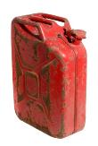

Vapor Density
Vapor Density
(Air = 1)
Gasoline 3 – 4
Turpentine 4.69
Notes:
Vapor density is defined as the relative weight of a vapor compared to air, which has an arbitrary value of one (1). If a vapor density is less than one it will generally raise in air. If the vapor density is greater than one it will generally sink in air. All vapor produced by solvents have densities greater than 1.

Slide 46
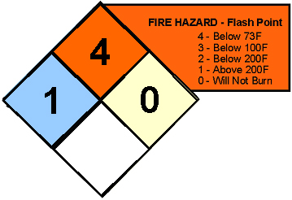
Flash Point
Flash Point is the minimum temperature at which a liquid gives off a vapor in sufficient concentration to ignite.
Notes:
The NFPA 704M Diamond uses a chemical’s flash point to rate its flammability.

Slide 47
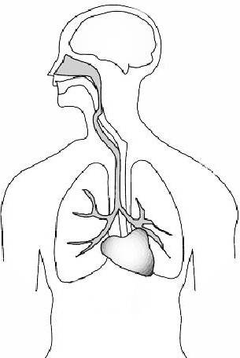


How do Solvents Affect the Body?
Dissolve skin fats and oils.
Skin dryness, cracking, redness, and blisters
Local health effect
Vapors can be inhaled.
Central nervous system damage.
Systemic health effect
Notes:
Solvents are valuable because they can dissolve other substances. But they can also dissolve skin fats and oils. Most of the solvents used in construction cause some form of dermatitis – skin dryness, cracking, redness, and blisters (local health effect).
Some solvents have high vapor pressure, meaning that the solvent evaporates at low temperatures and very quickly; this will result in more vapor being produced causing more of a hazard (more vapor being inhaled).
When breathed in, solvent vapors can enter the blood stream and travel to other parts of the body, particularly the nervous system, resulting in a toxic exposure (systemic health effect).

Slide 48




Vapor Pressure
More Vapors
(More Hazardous)
Fewer Vapors
(Less Hazardous)
Toxic solvent with a relative low vapor pressure
Toxic solvent with a relative high vapor pressure
Notes:
Vapor pressure is the likelihood that a liquid will evaporate at room temperature. Chemicals with a high vapor pressure will evaporate more than chemicals with a low vapor pressure. If two chemicals are equally toxic to the body, the one with the higher vapor pressure is more hazardous because more of it will evaporate and be in the air to be inhaled.
One unit of measurement to describe a substances relative vapor pressure is “mmHg” (millimeter of mercury); the unit of pressure equal to the pressure exerted by liquid mercury one-millimeter-high column at a standard temperature.

Slide 49
Hazardous (Dangerous) Vapor Pressure
Vapor pressure is less than 1mmHg; it is not likely to evaporate (not an inhalation hazard).
Vapor pressure greater than 50 mmHg; it is likely to evaporate (is an inhalation hazard).
Notes:
Toxic substances become more hazardous when a greater potential for entry into the body exists, inhalation is the greatest potential for chemicals to enter the body; more airborne vapor, more hazardous the situation.

Slide 50
Group Discussion…
What hazardous vapors are present on your job?
Notes:
Group Discussion…
What hazardous vapors are present on your job?

Slide 51
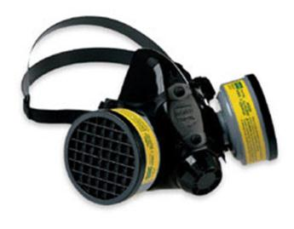
Respiratory Protection for Exposure to Vapors
Organic vapor (OV) cartridge [Black]
Organic vapor (OV) acid gas cartridges [Yellow]
Multi vapor gas cartridges [Olive Green]
North 7700 Series Half-Face Respirator equipped with organic vapor acid gas cartridge (yellow)
Notes:
NOTE: Before using any respirator and filter combination, always check with the manufacturer to ensure that it is approved and appropriate for the hazard.

Slide 52
Fumes
Examples of fumes found in construction:
Welding Fumes
Asphalt
Naphtha – “Coal Tar” a brown or black thick liquid that comes from coal; it’s a skin irritant known to cause cancer.
Lead Fumes
Hexavalent Chromium (CrVI)
Notes:
Fumes are solid particles that are formed when a metal or other solid vaporizes and the molecules condense (or solidify) in cool air. This usually occurs during welding/cutting of metals, e.g., welding fumes. Fumes are also produced by hot asphalt during hot tar roofing and paving. Coal tar (naphtha) and plastics also produces fumes when heated.
Fumes are measured as a concentration of airborne particles in a given space (weight/volume); and are measured in either milligrams or micrograms per cubic meter of air (mg/m³) or (µg/m³).

Slide 53
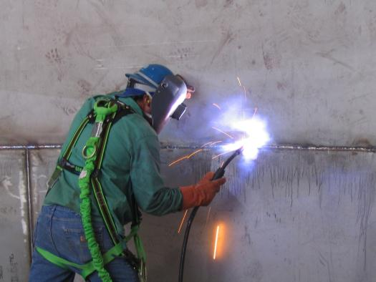
Group Discussion…
Welding fumes are some of the most hazardous exposures a construction worker may experience.
Notes:
Group Discussion…
What hazardous fumes are present on your job?

Slide 54
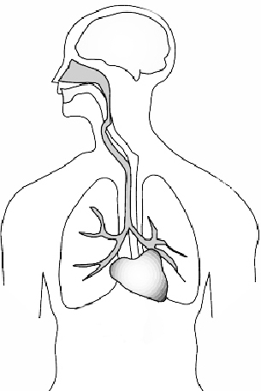
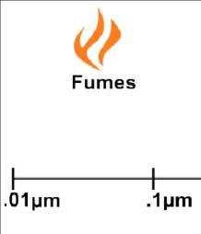
How do fumes affect the body?
Irritate the skin, eyes and nose; causing an immediate (acute) health effect.
Fumes can easily pass from the lungs into the blood stream; resulting in a systemic health effect.
Fumes are respirable size particles that are inhaled and can enter the blood stream.
Notes:
Fumes are generated by heat; either by burning, welding, cutting and heating. At a certain temperature, a solid is vaporized – then as it cools, it forms a small particle; these particles are respirable.
Fumes can irritate the skin, eyes and nose; causing an immediate (acute) health effect. These affects are local to the point of contact, such as mucous membranes, eyes and lungs.
For example, cadmium (welding fume), can cause the lungs to fill with fluid, causing pulmonary edema (fluid in the lungs).
Fumes are respirable in size [less than 10 microns (µm)] and primarily affect the body when they are breathed in. Because of their small size, fumes can easily pass from the lungs into the blood stream; resulting in a systemic health effect.
Fumes are respirable size particles that are inhaled and can enter the blood stream.

Slide 55
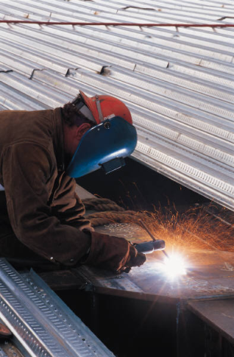
Welding Fumes
Metal Fume Fever [Zinc (Galvanized Metal)]
Siderosis [Iron, Iron Oxide (Rust)]
Manganism (Manganese)
Notes:
Diseases that are caused by welding fumes.

Slide 56
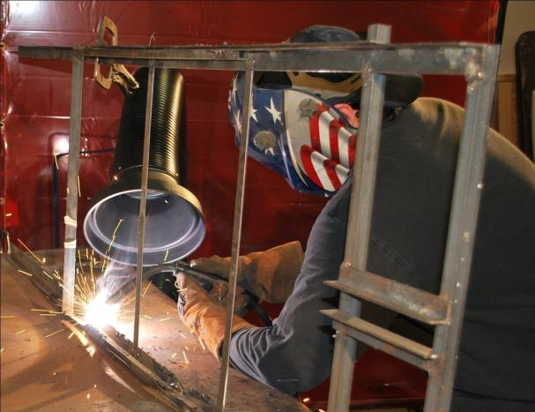
Remember… Using proper engineering controls will help prevent diseases associated with welding and cutting, always use them!
Courtesy of Sentry Air Systems, Inc. Houston, TX USA
Model 300 Welding Fume Extractor
www.sentryair.com
Notes:
Remember… Using proper engineering controls will help prevent diseases associated with welding and cutting, always use them!

Slide 57

Asphalt Fumes
Made from petroleum.
  Headache
  Skin rash
  Sensitization
  Throat and eye irritation
  Cough
  Suspect carcinogen
No specific OSHA standards.
Must wear appropriate PPE.
Notes:
Workers who are exposed to fumes from asphalt, a petroleum product used extensively in road paving, can experience health effects such as headache, skin rash, sensitization, fatigue, reduced appetite, throat and eye irritation, cough, and skin cancer.
There are currently no specific OSHA standards for asphalt fumes. However, exposures to various chemical components of asphalt fumes are addressed in specific standards for the general and construction industries, such as personal protective equipment (PPE).
If asphalt contacts the skin, workers should immediately wash the affected areas with large amounts of soap and water, seek medical attention if acute skin irritation occurs.

Slide 58
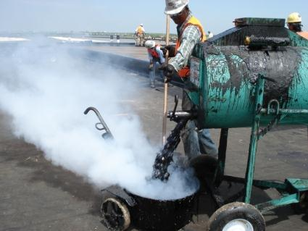
Naphtha (Coal Tar)
By-product of coal.
  Acne
  Allergic skin reactions
  Know to cause cancer
Photosensitivity – A condition in which a person becomes more sensitive to light.
Notes:
Coal tar is a brown or black liquid of high viscosity, which smells of naphthalene and aromatic hydrocarbons. Coal tar is among the by-products when coal is carbonized to make coke or gasified to make coal gas. Coal tars are complex and variable mixtures of phenols, polycyclic aromatic hydrocarbons (PAHs), and heterocyclic compounds, about 200 substances in all.
Coal tar pitch is a skin irritant which can cause acne and allergic skin reactions in exposed workers; it is know to cause skin cancer.
Exposure to the sun when working around coal tar pitch emissions (for long periods of time) could result in a photosensitivity reaction in some sensitized workers.
If coal tar naphtha contacts the skin, workers should immediately wash the affected areas with large amounts of soap and water, seek medical attention if acute skin irritation occurs.

Slide 59
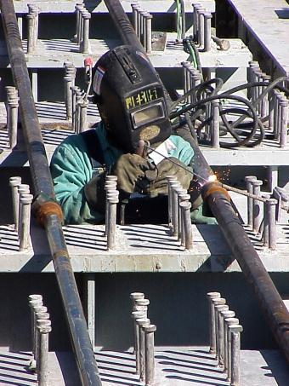
Lead Fumes
Lead poisoning
  Loss of appetite
  Nausea &vomiting
  Stomach cramps & constipation
  Fatigue
  Joint or muscle aches, anemia
  Decreased sexual drive.
Notes:
Lead adversely affects numerous body systems and causes forms of health impairment and disease that arise after periods of exposure as short as days (acute exposure) or as long as several years (chronic exposure). The frequency and severity of medical symptoms increases with the concentration of lead in the blood. Common symptoms of acute lead poisoning are loss of appetite, nausea, vomiting, stomach cramps, constipation, difficulty in sleeping, fatigue, moodiness, headache, joint or muscle aches, anemia, and decreased sexual drive. Acute health poisoning from uncontrolled occupational exposures has resulted in fatalities. Long term (chronic) overexposure to lead may result in severe damage to the central nervous system and reproductive systems.

Slide 60
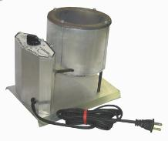
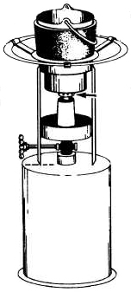
Plumbers Melting Pot (Lead)
Plumbers melt lead in special melting pots.
  Cast iron joints and fittings.
Temperature must never exceeds 900°F.
Use electric pot with temperature gage.
Electric Melting Pot
Fuel (propane)
Melting Pot
Notes:
Plumbers sometimes will melt lead in special melting pots to make cast iron joints and fittings. This type of furnace may consist of a fire pot and valve assembly that mounts directly on a portable propane gas tank.
When melting lead, made sure the temperature never exceeds 900°F; heating lead above this temperature could cause the release of hazardous fumes. To ensure that the melted lead does not release hazardous fumes, use an electric melting pot with a temperature gage.

Slide 61
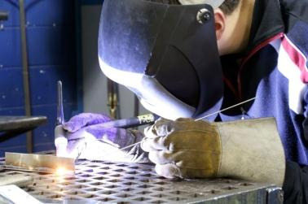
Hexavalent Chromium
(CrVI) compounds
  Dyes, paints, inks, and plastics.
  Stainless steel & chromium metal.
Health effects:
  Lung cancer
  Irritation or damage to the nose, throat, and lungs.
  Irritation or damage to the eyes and skin.
Notes:
Chromium hexavalent (CrVI) compounds, often called hexavalent chromium, exist in several forms. Industrial uses of hexavalent chromium compounds include chromate pigments in dyes, paints, inks, and plastics; chromates added as anticorrosive agents to paints, primers, and other surface coatings; and chromic acid electroplated onto metal parts to provide a decorative or protective coating. Hexavalent chromium can also be formed when performing "hot work" such as welding on stainless steel or melting chromium metal. In these situations the chromium is not originally hexavalent, but the high temperatures involved in the process result in oxidation that converts the chromium to a hexavalent state.
Exposures to hexavalent chromium [Cr(VI)] are addressed in specific standards for the construction industry.

Slide 62
Respiratory Protection for Exposure to Fumes
Particulate Air Filter Use Description
Oil Designation | P | R | N
Efficiency
95 | Oil Proof Low Efficiency | Oil resistant Low Efficiency | Not Oil Proof Low Efficiency
99 | Oil Proof Medium Efficiency | Oil resistant Medium Efficiency | Not Oil Proof Medium Efficiency
100 | Oil Proof High Efficiency | Oil resistant High Efficiency | Not Oil Proof High Efficiency
Notes:
Fumes are generated by the vaporization of melted substances, which condense into solids. Therefore, most applications where fumes are present require respiratory protection that deals with particulate hazards. Particulate respirators fall into three filter designations -- N, R, and P, each with three levels of filter efficiency: 95%, 99%, and 100 (99.97%) – HEPA, resulting in a matrix of nine different filter classifications.
The selection of N, R, and P series filters depends on the presence or absence of oil particulates. If no oil particles are present in the work environment, use a filter of any series -- N, R, or P. If oil particles are present, use an R or P series filter (R series use is limited to eight hours of continuous or intermittent use). If oil particles are present, and a filter will be used for more than one work shift, use only a P series filter. Check for additional time restrictions required by the manufacturer.
A fume is not a gas. A fume is a small particle that is formed when metal is heated and volatizes in air as metal oxide. For example, molten lead gives off toxic lead oxides, while torched galvanized steel produces iron and zinc oxide which can produce welding fume fever.
Since most welding applications deal with fumes (very small respirable particles) – 100 (HEPA) rated filters are preferred.
If oil is present in the air, then an “R” or a “P” rated filter must be used.

Slide 63

Dusts & Fibers
Examples of Dusts & Fibers found in construction:
Crystalline Silica
Asbestos
Metal Dusts
Lead-Based Paint
Fiberglass
Notes:
Dusts are solid particles that are formed by handling, crushing, grinding, drilling, or blasting of materials. Fibers are solid particles whose length is at least 3 times greater than its width – hazardous asbestos is an example of a fiber.
Dusts are measured as a concentration of airborne particles in a given space (weight/volume); and are measured in either milligrams or micrograms per cubic meter of air (mg/m³) or (µg/m³).
Fibers are measured in f/cc (fibers per cubic centimeter).
Stone cutting by cut-off saw with diamond wheel; example of potential exposure to crystalline silica.

Slide 64
Dusts & Fibers
Important questions concerning dusts & fibers:
What is the particle size of the dust and/or fiber?
How toxic is the dust and/or fiber (PEL, TLV, REL & IDLH)?
How does the dust or fiber affect the body?
Is the dust or fiber regulated by OSHA?
Notes:
Important questions concerning dusts & fibers:
What is the particle size of the dust and/or fiber?
How toxic is the dust and/or fiber (PEL, TLV, REL & IDLH)?
How does the dust or fiber affect the body?
Is the dust or fiber regulated by OSHA?

Slide 65
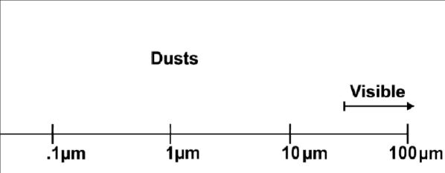
How do dust & fibers affect the body?
Dusts
&
Fibers
Respirable dust
Notes:
Dust & fibers can irritate the eyes and nose; causing an immediate (acute) health effect. These affects are local to the point of contact, such as mucous membranes, eyes and lungs (e.g., shortness of breath, coughing and wheezing). Prolonged exposure to toxic dust can result in chronic health effects.
Remember…
Respirable dust, particles that are less than 10 microns (µm) in diameter, can enter deep into the lungs where damage can occur.

Slide 66
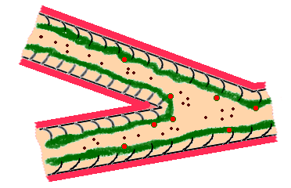
Body’s Defense against Dust
Cilia
Mucous
Notes:
The body’s defenses against large-sized dusts (mucous, the hair-like cells called cilia and special “dust-eating” white blood cells) can break down dust particles. However, these particles can dry out the mucous. Cigarette smoke paralyzes the cilia; this enables more dust particles to reach the lungs (see Synergistic Effect, page 140).

Slide 67
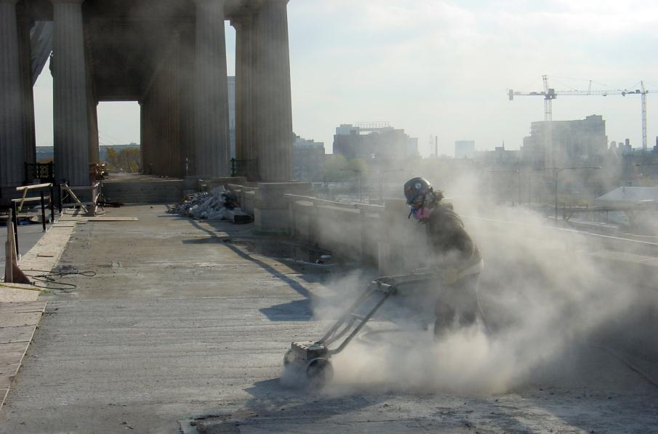
Notes:
Dusts are solid particles suspended in air. They may be produced by crushing, grinding, sanding, sawing or the impact of materials against each other; anyone performing these tasks is at risk.

Slide 68
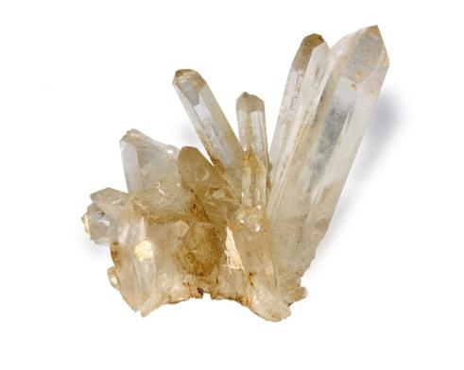
Crystalline Silica
Quartz
  Sand
  Gravel
  Clay
  Granite
  Other forms of rock
Smaller particles can be inhaled deep into the lungs - cause damage.
Notes:
Quartz is the second most abundant mineral in the Earth’s crust. It’s made up of silicone and oxygen.
Silica is one of the most common minerals in the earth’s crust. The most common form of crystalline silica is quartz, which is found in sand, gravel, clay, granite, and many other forms of rock.
Construction workers could be exposed to silica when cutting, grinding, drilling, sanding, mixing, or demolishing materials containing silica.
The size of the airborne silica particles determines the amount of risk. Smaller particles can be inhaled deep into the lungs where they can cause damage. Larger particles, such as beach sand, are not as great a concern because they are too large to inhale.

Slide 69

Silicosis
Disease of the lungs due to the breathing of dust containing crystalline silica particles.
NO cure!
Notes:
Silicosis is a disease of the lungs due to the breathing of dust containing crystalline silica particles. This dust can cause fibrosis or scar tissue formations in the lungs that reduce the lung's ability to work to extract oxygen from the air. There is no cure for this disease, thus, prevention is the only answer.
Chronic silicosis, the most common form of the disease, may go undetected for years in the early stages; in fact, a chest X-ray may not reveal an abnormality until after 15 or 20 years of exposure. The body's ability to fight infections may be overwhelmed by silica dust in the lungs, making workers more susceptible to certain illnesses, such as tuberculosis. As a result, workers may exhibit one or more of the following symptoms:
Shortness of breath following physical exertion
Severe cough
Fatigue
Loss of appetite
Chest pains
Fever

Slide 70
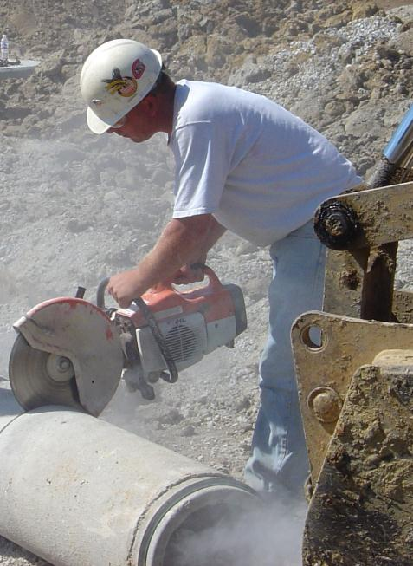
Concrete cutting with no engineering control or PPE!
Notes:
There are three types of silicosis, depending upon the airborne concentration of crystalline silica to which a worker has been exposed:
Chronic silicosis usually occurs after 10 or more years of overexposure.
Accelerated silicosis results from higher exposures and develops over 5-10 years.
Acute silicosis occurs where exposures are the highest and can cause symptoms to develop within a few weeks or up to 5 years.

Slide 71
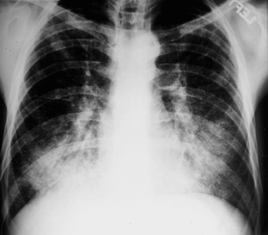
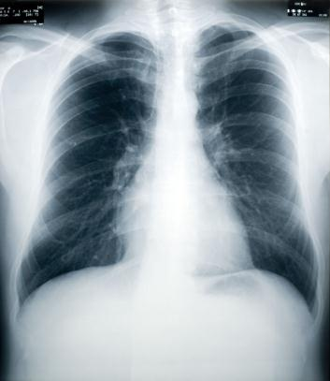
Silicosis
Silicotic Lungs
Normal Healthy Lungs
Notes:
Silicosis is a type of fibrotic lung disease that develops when silica dust particles become trapped in the lungs and form scar tissue.
This can be seen in x-rays by the light areas on the lungs.
Special doctors referred to as “B” Readers are trained to identify diseases of the lungs caused by dust exposure.

Slide 72
Crystalline Silica
Exposures to crystalline silica dust include:
Concrete cutting.
Sandblasting for surface preparation.
Crushing and drilling rock and concrete.
Masonry and concrete work (e.g., building and road construction and repair).
Mining & tunneling.
Cement worker wearing a full-face piece negative pressure air purifying respirator.
Demolition work.
Cement and asphalt pavement manufacturing.

Slide 73

Notes:
Road work (street cutting): worker wearing respirator to protect against potential silica exposure.
NOTE: Respiratory protection must be used in conjunction with engineering controls and other safe work practices (e.g., wetting the work to minimize airborne dust).

Slide 74
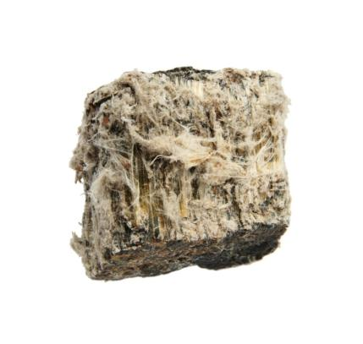
Asbestos
Exposure during demolition or remodeling jobs.
Found in some taping compounds, asbestos cement, pipes and floor tiles.
Measured in fibers per cubic centimeter (ff/cc).
29 CFR 1926.1101 Asbestos
Notes:
Asbestos is well recognized as a health hazard and is highly regulated. And although asbestos is no longer used as an insulation material; building trades workers may still be exposed to asbestos during demolition or remodeling jobs. Asbestos may also still be found in some taping compounds, asbestos cement, pipes and floor tiles. Vinyl asbestos floor tiles may be as much as 15% to 20% asbestos, which is released when old flooring is removed.

Slide 75
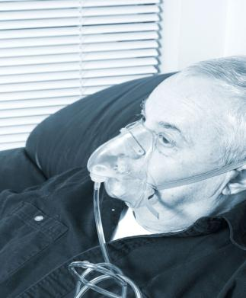
Asbestosis
Asbestosis and mesothelioma
  Rare form of cancer that develops from the protective lining that covers many of the body's internal organs.
Worker with chronic health problems; he needs oxygen.
Notes:
The inhalation of asbestos fibers by workers can cause serious diseases of the lungs and other organs that may not appear until years after the exposure has occurred. For instance, asbestosis can cause a buildup of scar-like tissue in the lungs and result in loss of lung function that often progresses to disability and death.
There is no cure for asbestosis; a doctor can only help you manage your symptoms.

Slide 76
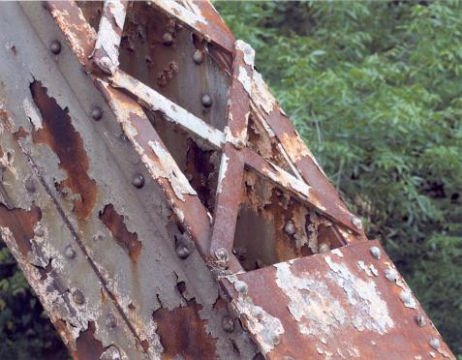
Lead-Based Paint Dust
“White Lead" (a lead carbonate)
“Red Lead" (a lead oxide)
Notes:
Lead has been used since ancient times as a paint pigment. Two major chemical forms of lead are used as colors -- they are called "white lead" (a lead carbonate) and "red lead" (a lead oxide). Both types of lead provide a thick, heavy, tough coating; one that does not crack through wear or temperature variations because it can expand and contract in unison with the base metal to which it is attached. In addition, the chemical nature of lead causes it to provide corrosion resistance as well. For many years, lead paint has been used on bridges, water tanks, ships and other steel and iron structures.
“Lead-based paint” is defined in the Residential Lead-Based Paint Hazard Reduction Act (also known as Title X) as “paint, varnish, shellac, or other coating on surfaces that contain 1.0 mg/cm² or more of lead or 0.5 percent or more lead by weight.”

Slide 77
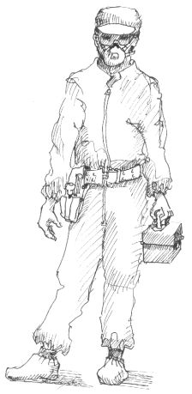
EPA Certified Lead Renovator
All work performed under the supervision of certified lead renovators.
Post signs and warn occupants of buildings.
Barricade off work area and contain lead dust.
Clean all objects and surfaces.
Notes:
The Environmental Protection Agency (EPA) has established training requirements for anyone who disturbs lead-based paint.
Contractor requirements under EPA lead renovation laws:
All work must be performed under the supervision of certified lead renovators.
Post signs clearly defining the work area and warn occupants of buildings to remain outside of the work area.
Barricade off work area and contain lead dust that is created during work.
Clean all objects and surfaces in and around the work area.

Slide 78
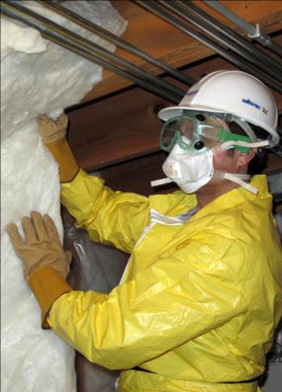
Fiberglass Insulation
Provide general or local exhaust ventilation systems.
Wear PPE.
Maintain PEL for nuisance dusts (15 mg/m³).
Notes:
Everyone has heard about the association between lung cancer and asbestos. Since some forms of asbestos are similar in appearance to fiberglass fibers, many people wonder if handling fiber-glass could also result in the development of cancer or other serious health hazards. Scientists have made over 400 studies of fiberglass in an attempt to answer this question. The conclusion is that it will not, because its properties are very different from asbestos. OSHA confirmed these findings in 1991 when it decided to regulate fiberglass as a nuisance dust, and not as a cancer causing agent. Still, precautions should still be taken while working with fiberglass.
Fiberglass insulation worker – personal protective equipment includes: hart hat, safety goggles, filtering facepiece (respirator), disposable suit & gloves.

Slide 79
Dust & Fiber Respirator Selection Guide
Hazard | Efficiency | Comments
Silica | 100 (HEPA) | Atmosphere supplying respirators may be required.
Asbestos | 100 (HEPA) | Requires specific respirators to be used based on task and exposure level. No disposable filtering facepieces allowed! Atmosphere supplying respirators may be required.
Lead | 100 (HEPA) | Requires specific respirators to be used based on task and exposure level. Atmosphere supplying respirators may be required.
Fiberglass Insulation | 95, 99 or 100 (HEPA) | No specific respirator required. Select approved respirator bases on exposure level, use and comfort.
Nuisance Dust | 95, 99 or 100 (HEPA) | No specific respirator required. Select approved respirator bases on exposure level, use and comfort.
Notes:
Respiratory protection for exposure to dusts & fibers will depend on the size of the particle and its level of toxicity. OSHA requires that specific respirators are used while working with the regulated substances asbestos and lead.
Remember…
To achieve compliance with OSHA Permissible Exposure Limits (PELs), administrative or engineering controls must first be implemented whenever feasible.

Slide 80
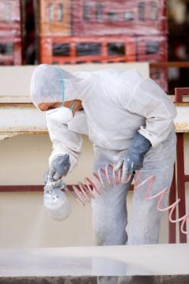
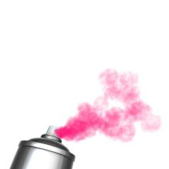
Mists
Examples of mists found in construction:
Oil mist
Paint mist
Pesticides
Aerosols
Notes:
Examples of mists found in construction:
Oil mist produced from lubricants used in metal cutting operations.
Paint mist from spraying operations.
Pesticides sprayed to control or eliminate foliage.
Aerosols from cans and bottles.
Mists are tiny droplets of liquid suspended in the air.
Mists are measured as a concentration of airborne particles in a given space (weight/volume); and are measured in either milligrams or micrograms per cubic meter of air (mg/m³) or (µg/m³).
Mists are generated on construction job-sites by spraying liquids, such as, paints/coatings, form oil, pesticides, etc…
Where employees are engaged in the application of paints, coatings, herbicides, or insecticides or in other operations where contaminants may be harmful to the employees; washing facilities must be in near proximity to the worksite and must be equipped as to enable employee to remove such substances.

Slide 81


How do mists affect the body?
Skin Desig-
nation
X
Mists
Notes:
Mists affect the body by being inhaled and absorbed through the lungs. Exposed skin can also absorb any mist causing a adverse health effect – this is health effect is labeled as a skin designation.
Mists can be…
Inhaled (through the lungs)
Ingested (by direct or indirect contact with the lips and mouth)
Absorbed (through exposed skin)
Injected (through high pressure & aerosol cans)
A "skin" designation serves as a warning that dermal absorption is a possible route of entry for a particular substance; this warning appears with some of the chemical hazards which are found in OSHA Standard, 29 CFR 1926.55 – Appendix A. The use of skin designation does not indicate that the substance may irritate the skin. Similarly, lack of a skin designation does not mean that the substance will not irritate or burn the skin. If a skin designation exists for a substance, be sure to wear chemical resistant clothing and gloves.

Slide 82

Respiratory Protection for Exposures to Mists
AOSafety 95110 Paint Spray Respirator
Filters designated as a “P” or “R” if the mist contains oil.
Organic Vapors
Paints
Lacquers
Enamels
Detachable Prefilter
Notes:
When exposed to mists, employees must wear a respirator that has filters designated as a “P” or “R” if the mist contains oil, if no oil is present then a “N” designated respirator filter is acceptable. These filters have efficiencies of 95, 99 or 100 (HEPA).
AOSafety 95110 Paint Spray Respirator
Protects against organic vapors and sprays of paints, lacquers, and enamels. Also provides protection against dusts and mists. Prefilter is detachable for easy replacement when it becomes clogged with paint sprays.

Slide 83








Chemical Health Hazard Categories
Carcinogen
Corrosive
Toxic & Highly Toxic
Irritant
Sensitizer
Affects a Target Organ
Notes:
Hazardous chemicals are classified as being a carcinogen, corrosive, toxic, irritant, sensitizer, or any chemical that affects a target organ (e.g., liver, kidney, nervous system, blood, lung, reproductive organs, skin & eyes).

Slide 84

Reproductive Toxins
Mutation
  Permanent change of the genetic material in a cell.
Teratogen
  Malformations of an embryo or fetus.
Benzene (mutagen)
Cadmium and compounds (fertility & teratogen)
Chloroform (mutagen)
Lead and compounds (fertility, teratogen & mutagen)
Mercury and compounds (fertility & teratogen)
Notes:
Reproductive toxins are chemicals that can damage the reproductive systems of both men and women. Exposure to these agents before conception can produce a wide range of adverse effects including reduced fertility, an abnormal fetus, reduced libido, or menstrual dysfunction. Maternal exposure after conception may cause prenatal death, low birth weight, birth defects, developmental and/or behavioral disabilities, and cancer.
A mutation is defined as a permanent change in the amount or structure of the genetic material in a cell. The terms mutagenic or mutagen are used to refer to those chemicals that cause an increased occurrence of mutations in populations of cells and/or organisms.
A teratogen is an agent that can cause malformations of an embryo or fetus. This can be a chemical substance, a virus or ionizing radiation.

Slide 85

Synergistic Effect
Two or more hazardous materials are present at the same time.
Smoking paralyses the body’s natural defense – cilia.
Notes:
Smoking increases the chances of illness if you work around hazardous substances.
When two or more hazardous materials are present at the same time, the resulting effect can be greater than the effect anticipated based on the cumulative effect of the individual substances.
An example of synergism is the increased risk of developing lung cancer caused by exposures to both cigarette smoking and asbestos. By either smoking one pack of cigarettes per day or being heavily exposed to asbestos, you may increase your risk of lung cancer to five to ten times higher than someone who does neither. But if you smoke a pack a day and are heavily exposed to asbestos, your risk may be 50 times higher than someone who does neither.
Smoking paralyses the body’s natural defense, specifically the cilia; smoking causes the cilia to relax and not perform its function as a dust capturing mechanism. This means that more dust and/or fiber can get inhaled into the lungs where damage can occur.

Slide 86

Your Right to Know!
OSHA – Hazard Communication Standard (HCS)
  Chemical manufacturer responsibilities
  Labels
  MSDS
Notes:
In the early 80's, OSHA enacting the Hazard Communication Standard (HCS). A fundamental premise of the HCS is that employees who may be exposed to hazardous chemicals in the workplace have a right to know about the hazards and how to protect themselves. The HCS is therefore sometimes referred to as the "Worker Right-to-Know Legislation", or more often just as the "Right-to-Know" law.
OSHA's Hazard Communication Standard (HCS) requires the Chemical manufacturers and importers to evaluate the hazards of the chemicals they produce; also required are warning labels and material safety data sheets (MSDSs) to convey the hazard information to the users of the chemicals. Employers must ensure that all chemicals are properly labeled and that MSDSs are available on the job-site; training on how to take full advantage of this “Right-to-Know” must be conducted.

Slide 87
Contractors Guide to HCS Compliance
Become familiar with the OSHA’s Hazard Communication Standard (29 CFR 1910.1200)
Prepare and implement a Hazard Communication Program.
Assign a competent person to implement all aspects of the Program.
Identify all hazardous chemicals in the workplace.
Labels and other forms of warning must be in place.
Safety Data Sheets (SDSs) available.
Employee information and training conducted.
Notes:
Remember…
The best protection is prevention. With hazardous materials, the only way to prevent harm is to know all the hazards and precautions associated; take full advantage of your Right-to-Know!

Slide 88
Safety Data Sheet (SDS)
Identification
Hazard(s) Identification
Composition/Information on Ingredients
First-aid Measures
Fire-fighting Measures
Accidental Release Measures
Handling and Storage
Exposure Controls/Personal Protection
Physical & Chemical Properties
Stability & Reactivity
Toxicological Information
Ecological Information
Disposal Considerations
Transport Information
Regulatory Information
Other Information
Notes:
SDS Example – Group Discussion

Slide 89
Physical Health Hazards
Learning Goals:
Be able to explain what a physical health hazard is and how construction workers might be exposed to these hazards.
Define important terms used to describe physical hazards in the workplace.
Overview the health effects of these hazards on the human body.
Notes:
Learning goals for this lesson.

Slide 90
Important Terms
Heat Cramps, Heat Exhaustion & Heat Stroke
Frost Bite & Hypothermia
Noise Induced Hearing Loss
Cumulative Trauma Disorder
Ergonomics
Ionizing Radiation
Non-Ionizing Radiation
Melanoma
Notes:
Important terms that will be discussed during this lesson.

Slide 91








Physical Health Hazards
Temperature Extremes
  Too hot or too cold.
Noise
  Irreversible hearing loss.
Repetitive Motion
  Cumulative Trauma Disorder
Radiation
  Discomfort and eye damage (non-ionizing)
  Cancer (ionizing),
Notes:
Temperature Extremes; such as environments that are too hot or too cold.
Noise; loud noise can damage your ear and cause irreversible hearing loss.
Repetitive Motion, Awkward Postures & Vibration; can cause carpal tunnel syndrome, tendonitis, back pain & muscle soreness and nerve damage.
Ionizing & Non-Ionizing Radiation; causes increased risk of cancer (ionizing), tissue heating, discomfort and eye damage (non-ionizing).

Slide 92

Heat
Heat Cramps
  Electrolyte imbalance caused by sweating.
  Too much and too little salt.
  Do not rely on thirst to replenish fluids.
Heat Exhaustion
  Headache
  Nausea
  Fainting
Heat Stroke
  Hot, dry skin
  High temperature
Notes:
Construction workers generally work outside and are exposed to heat, cold and the sun. Too much heat or cold, especially if combined with high humidity or high winds, can harm your health and interfere with work. Hot, humid conditions can cause heat exhaustion, cramps, and even fainting, while working in very cold conditions can result in chapped skin, frost-bite and hypothermia; cold temperatures can also increase the effects of vibration.
At times, workers may be required to work in hot environments for long periods. When the human body’s unable to maintain a normal temperature, heat-related illnesses can occur and may result in death.

Slide 93

Notes:
OSHA does not have a specific regulation regarding heat stress. However, feasible and acceptable methods can be used to reduce heat stress hazards in workplaces. These include, but are not limited to:
Monitor weather conditions (NOAA’s Heat Index) and adhere to precautions and warnings.
Permitting workers to drink water at liberty.
Establishing provisions for a work/rest regimen so that exposure time to high temperatures and/or the work rate is decreased.
Developing a program that provides for training on the effects of heat stress, and how to recognize heat-related illness symptoms and prevent heat-induced illnesses.

Slide 94

Sun
Cover up
Use sunscreen with a sun protection factor (SPF) of at least 30.
Wear a wide brim hard hat.
Wear UV-absorbent sunglasses (eye protection).
Limit exposure

Slide 95

Safe Work Practices (Heat)
Drink water frequently.
Wear light-colored, loose-fitting, breathable clothing.
Take frequent short breaks in cool shade.
Eat smaller meals before work activity.
Avoid caffeine and alcohol or large amounts of sugar.
Work in the shade.
Consult doctor regard medications.
Know limitations of PPE.
Notes:
The combination of heat and humidity can be a serious health threat during the summer months. If you work outside you may be at increased risk for heat related illness. So, take precautions. Here’s how:
Drink small amounts of water frequently.
Wear light-colored, loose-fitting, breathable clothing—cotton is good.
Take frequent short breaks in cool shade.
Eat smaller meals before work activity.
Avoid caffeine and alcohol or large amounts of sugar.
Work in the shade.
Find out from your health care provider if your medications and heat don’t mix.
Know that equipment such as respirators or work suits can increase heat stress.

Slide 96

Cold
Frostbite
Hypothermia
  Wear several layers of clothing.
  Wear gloves and a helmet liner.
  Wear warm footwear with one or two pairs of warm socks.
  Wear a scarf or face mask.
  Take frequent short breaks in a warm shelter.
  Drink warm, sweet beverages.
  Eat warm, high calorie food such as pasta dishes.
Notes:
Prolonged exposure to cold, wet and windy conditions, even when the temperatures are above freezing, can be dangerous. Extreme cold conditions exist when the equivalent (wind) chill temperature is at or below -25° F (-32 °C). Wind chill temperature is a function of the actual temperature and the estimated wind speed. Under windless conditions, air provides an invisible blanket around the skin. As wind speed increases, this layer of heated air is carried away from the body at an accelerated rate resulting in apparent temperatures well below the air temperature.

Slide 97

Workers exposed to cold must dress appropriately for the weather.
Notes:
Workers who take certain medications, are in poor physical condition or suffer from illnesses such as diabetes, high blood pressure, or cardiovascular disease are at increased risk and should therefore check with a doctor for additional advice.

Slide 98

THE COLD STRESS EQUATION
LOW TEMPERATURE + WIND SPEED + WETNESS = INJURIES & ILLNESS
When the body is unable to warm itself, serious cold-related illnesses and injuries may occur, and permanent tissue damage and death may result.
Hypothermia can occur when land temperatures are above freezing or water temperatures are below 98.6°F/37°C. Cold-related illnesses can slowly overcome a person who has been chilled by low temperatures, brisk winds, or wet clothing.
Wind Speed (MPH)
0 10 20 30 40
30°F / -1.1°C –
20°F / -6.7°C –
10°F / -12.2°C –
0°F / -17.8°C –
-10°F / -23.3°C –
-20°F / -28.9°C –
-30°F / -34.4°C –
-40°F / -40°C –
-50°F / -45.6°C –
Little Danger
(Caution)
Freezing to Exposed Flesh within 1 Hour
Danger
Freezing to Exposed Flesh within 1 Minute
U.S. Department of Labor
Occupational Safety and Health Administration
OSHA 3156
1998
Extreme Danger
Freezing to Exposed Flesh within 30 Seconds
Adapted from: ACGIH® Threshold Limit Values, and Physical Agents Biohazard Indices, 1998 – 1999.

Slide 99

Occupational Noise
Noise is measured using sound level meters
Decibel (abbreviated dB) unit used to measure the intensity of a sound.
Standard Sound Level Meter
Quest Technologies
Notes:
Every year, approximately 30 million workers are exposed to hazardous noise that is often ignored because the harmful effects of overexposure are typically not visible and develop over an extended period of time (chronic health hazard). Damage to the ear could also occur from a single impact noise (explosion), this is an example of an acute hearing loss. Workers exposed to high noise levels can develop elevated blood pressure, ringing in the ears (tinnitus), and temporary and/or permanent hearing loss.

Slide 100


Normal Conversation
60 – 65 dB
Yelling
80 – 85 dB
Notes:
Hearing loss is often a chronic, long-term health effect that is caused by prolonged exposure to loud noise.

Slide 101

What is A–Weighted?
A-weighted response most resembles the sensitivity of the human ear.
Notes:
The sensitivity of the human ear to sound depends on the frequency or pitch of the sound. People hear some frequencies better than others; high frequency noise is much better heard than low frequency noise. Noise measurement readings can be adjusted to correspond to this fact; putting more emphasis, or weight, onto the frequencies that people can hear. An A-weighting filter which is built into the instrument de-emphasizes low frequencies or pitches.
Because the A-weighted response most resembles the sensitivity of the human ear, OSHA’s permissible exposure limit (PEL) for noise is determined using this scale.

Slide 102

Tinnitus
“Ringing in the ears”
Damage to tiny sensory hair cells in the inner ear.
Notes:
The National Institute of Health describes tinnitus as a “ringing in the ears”. Although not technically a disease, tinnitus is a symptom of something wrong.
People who work in noisy environments—such as construction workers and road crews, can develop tinnitus over time when ongoing exposure to noise damages tiny sensory hair cells in the inner ear that help transmit sound to the brain.
Anything you can do to limit your exposure to loud noise—by moving away from the sound or wearing earplugs or earmuffs—will help prevent tinnitus and/or hearing loss.

Slide 103

The Inner Ear
Cochlea
Ear Drum
Notes:
The inner ear is a complex system of bones, muscles and nerves. Inside the cochlea (part of the inner ear) are tiny hair-like structures that vibrate nerves which the brain interprets as sound. Loud noises can temporarily paralysis these hairs causing temporary hearing loss; prolonged exposure to loud noise can permanently destroy them!

Slide 104

Cochlea
Notes:
Micro photo of the spiral curve of the human cochlea revealing a total loss of the outer hair cells and their accompanying nerve fibers following occupational noise exposure; this is what could happen to people who expose themselves to prolonged levels of loud noise.

Slide 105

How Noise Damages the Ear
Like walking on grass.
Notes:
Every time you are exposed to loud noise, you damage the hair-like structures in the ear – much like walking on grass. Overtime a path is worn, and like the blades of grass, the tiny hair-like structures in the ear (cochlea) are permanently destroyed!
Think of the hair-like structures in the ear (cochlea) as grass; as grass is walked on, it gets smashed down and flattens, but over time the blades of grass spring back up – this is like temporary hearing loss. But, if the grass gets walked on repeatedly, over a long period of time, a path gets worn into the grass and the blades of grass get destroyed, never to come back – this is permanent hearing loss.

Slide 106

Notes:
The National Institute for Occupational Safety & Health (NIOSH) has conducted studies that show that people in the construction industry are at a higher risk of some kind of hearing loss due to their occupation; one such study was performed on carpenters. For more information on NIOSH and its studies on noise induced hearing loss, visit their website at www.cdc.gov/niosh

Slide 107
Occupational Noise Exposures (29 CFR 1926.52)
Duration per day, hours | Sound level dBA slow response
8 | 90
6 | 92
4 | 95
3 | 97
2 | 100
1 ½ | 102
1 | 105
½ | 110
¼ or less | 115
OSHA Requirement…
When employees are subjected to sound levels exceeding those listed in Table D-2, feasible* administrative or engineering controls must first be utilized. If such controls fail to reduce sound levels within the levels of the table (D-2), ear protective devices must be provided and used.

Slide 108
Engineering & Administrative Controls for Noise
Enclosures (operator cabs)
Routine maintenance on tools and equipment.
Lubrication to reduce friction.
Acoustical enclosures & sound absorbing materials.
Use rubber mallets to erect and dismantle scaffolding and formwork.
Rotate workers
Post warning signs.
Train all employees on how to properly wear hearing protective devices.
Notes:
Contractors can analysis jobs, tasks and equipment; once loud operations are identified, employers can then seek out alternative tools and equipment that are less noisy (eliminate the hazard).
Enclose equipment operators inside cabs.
Routine maintenance on tools and equipment can help to reduce sound; replace worn, loose, or unbalanced machine parts that cause vibration.
Keep machine parts well lubricated to reduce friction.
Place acoustical enclosures and barriers around generators.
Use sound absorbing material and vibration isolation systems on hand tools.
Use rubber mallets to erect and dismantle scaffolding and formwork.
Rotate workers performing loud tasks, and post signs warning of areas where hearing protection is required.
Train all employees on how to properly wear hearing protective devices.

Slide 109

Notes:
Equipment Operator Cab Enclosure

Slide 110

Notes:
Important administrative controls such as posting warning signs and the proper training of employees must be conducted along with the wearing of hearing protection.

Slide 111

Notes:
Plain cotton is not an acceptable protective device against noise.

Slide 112
Hearing Conservation Program
Monitoring of employee noise exposures.
Engineering, work practice, and administrative controls.
Signs and barriers to warn workers of high noise levels).
Individually fitted hearing protector.
Employee training and education.
Baseline and annual audiometry.
Procedures for preventing further occupational hearing loss.
Recording Keeping
Notes:
The Occupational Safety and Health Administration (OSHA) has determined that an effective hearing conservation program consists of the following elements:
Monitoring of employee noise exposures; (e.g., frequent and regular inspecton of the job-site is required by competent person).
The institution of engineering, work practice, and administrative controls for excessive noise; (e.g., maintain equipment to run smooth and quiet, rotate workers, put up signs and barriers to warn workers of high noise levels).
The provision of each overexposed employee with an individually fitted hearing protector with an adequate noise reduction rating; [e.g., attenuation to below 85 decibels (dBA)].
Employee training and education regarding noise hazards and protection measures; (e.g., inform workers of the hazards of noise and when and where to wear hearing protectors).
Baseline and annual audiometry; before beginning work, have an audiometry test conducted to establish pre-work conditions and periodically re-test to determine any hearing loss.
Procedures for preventing further occupational hearing loss by an employee whenever such an event has been identified (e.g., requiring employee use of hearing protective device at 85 decibels (dbA), and;
Recording Keeping (e.g., audiometry tests, inspection logs & noise monitoring data).
Every construction industry employer's hearing conservation program must incorporate as many of the above elements as are feasible*.
* Feasible means – capable of being done.

Slide 113

Notes:
Baseline and annual audiometry; before beginning work, have an audiometry test conducted to establish pre-work conditions and periodically re-test to determine any hearing loss.

Slide 114
Recommendations for Protecting Hearing…
Know your hazard.
Trust the annual audiogram.
Select hearing protection that is right for you.
Wear your hearing protection right.
To test the fit, cup your hands over your ears, then release.
Notes:
Know your hazard. Whenever possible, measure the noise levels in your environment on a frequent basis to determine exactly what the hazards are. Determine, if any, off-the-job exposures to noise.
Trust the annual audiogram. Rely on this information to gauge any hearing loss from year to year.
Select hearing protection that is right for you, that is comfortable for you, and that you will wear.
Wear your hearing protection right. Each type of hearing protector is slightly different. The important thing to remember is that you need to insert ear plugs correctly, or ear muffs completely over the ears. Then, you must always test the fit.
To test the fit, cup your hands over your ears, then release. If you can hear a difference, you may not be wearing your hearing protector correctly. Remove, and then fit again.

Slide 115

Noise Reduction Rating (NRR)
A hearing protector's ability to reduce noise.
The greater the NRR, the better the noise reduction.
Listed on the hearing protector box.
Noise
Reduction
Rating
29
DECIBELS
(When used as directed)
THE RANGE OF NOISE REDUCTION RATINGS FOR EXISTING HEARING PROTECTORS IS APPROXIMATELY 0 TO 30
(HIGHER NUMBERS DENOTE GREATER EFFECTIVENESS)
NMC Company Model Earplug
Notes:
The noise reduction rating (NRR) is the measurement, in decibels (dB), of how well a hearing protector reduces noise. The higher the NRR number the greater the noise reduction. This noise reduction rating is based on the C-weighted sound level scale. Because noise exposures are measured on the A-weighted sound level scale, an adjustment must be made to determine the actual noise reduction (see NRR Adjustment Calculation).

Slide 116
Proposed Noise Reduction Rating (NRR)
Minimally trained users (the lower number) vs. Highly motivated, trained users (the higher number).
Reflects A-weighted attenuation – no adjustment necessary.
NRR
21
Possible for most
individually trained users
to achieve or exceed
34
Possible for a few motivated
proficient users to achieve or
exceed
Noise
Reduction
Rating
0
10
20
30
40
50
Noise Reduction (dB) When Worn As Directed
Notes:
Under a new proposed regulation, a new rating system will be used. While it will be known as the NRR, it will now represent a range of expected protection, as opposed to a single-number estimate. While the proposed method still uses ANSI-standard lab testing to generate the attenuation ratings, the new range noise reduction rating (NRR) will provide an indication of how much attenuation minimally trained users (the lower number) versus highly motivated, trained users (the higher number) can be expected to achieve. For some hearing protectors, the spread of this range may be quite significant. Also, to more accurately depict attenuation of sound to the human ear, range noise reduction ratings are based on the A-weighted sound level scale (no adjustment calculation required).

Slide 117

OSHA NRR Adjustment Calculation
Noise
Reduction
Rating
29
NRR – 7
DECIBELS
(When used as directed)
THE RANGE OF NOISE REDUCTION RATINGS FOR EXISTING HEARING PROTECTORS IS APPROXIMATELY 0 TO 30
(HIGHER NUMBERS DENOTE GREATER EFFECTIVENESS)
For example…
Ear plugs with a listed NRR of 29…
29 – 7 = 22
NMC Company Model Earplug
Notes:
To adjust for inconsistencies in the human ear canal and the fact that manufacturers do not use the A-weighted sound level scale to determine noise reduction ratings, OSHA requires that the users of hearing protectors reduce downward the manufacturers’ noise reduction rating (NRR); this is done by subtracting seven (7) from the listed NRR.

Slide 118



NIOSH NRR Adjustment Calculation
Earmuffs | Subtract 25% from the manufacturer’s adjusted NRR
Formable Ear Plugs | Subtract 50% from the manufacturer’s adjusted NRR
All Other Ear Plugs (Canal Caps) | Subtract 70% from the manufacturer’s adjusted NRR
Notes:
NIOSH has established these percentages to reduce an adjusted noise reduction rating (NRR – 7, then reduce to percentages shown).
This additional reduction takes into consideration of inconsistency of use.

Slide 119




Dual Hearing Protection
22
(Adjusted NRR)
+ 5 = 27
(Dual Protection NRR)
Formable Ear Plugs
Listed NRR = 29
Adjusted NRR (29 – 7) = 22
Earmuffs
Listed NRR = 16
Adjusted NRR for Dual Protection = 5
Notes:
Workers whose 8-hour time weighted average exposures exceed 100 decibels should wear double hearing protection (wearing earplugs and earmuffs simultaneously).
NOTE: The term "double hearing protection" is misleading. The attenuation provided from any combination earplug and earmuff is not equal to the sum of their individual attenuation values.
To calculate the dual hearing protection using the noise reduction rating, take the higher NRR and add five (5) to the field adjusted NRR (listed NRR – 7 + 5); the extra five (5) is all that is added for the second device.

Slide 120

Dual Hearing Protection
WARNING!
Make sure that any plugs used with double protection do not have a cord; it will interfere with the fit of the earmuffs and not provide added protection.
Notes:
WARNING! Make sure that any plugs used with double protection do not have a cord; it will interfere with the fit of the earmuffs and not provide added protection.

Slide 121

Cumulative Trauma Disorders (CTDs)
Repetitive motions
Forceful exertions
Awkward postures
Static postures
Mechanical compression of soft tissues
Fast movement
Vibration
Lack of sufficient recovery
Notes:
Cumulative trauma disorders (CTDs) also known as repetitive strain injuries, repetitive motion disorders, overuse syndrome, and work-related musculoskeletal disorders are the largest cause of occupational disease in the United States and the most frequently reported type of occupational disease in Connecticut. CTDs are injuries of the musculoskeletal system (joints, muscles, tendons, ligaments, nerves, and blood vessels) which are caused by over use as a result of stressful work over a period of time.

Slide 122

Cumulative Trauma Disorders (CTDs)
NIOSH/Steve Clark/elcoshimages.org
Notes:
Concrete finishers using hand trowels can be very stressful on the back, hands and arms. If physically able to do so, stretching before work and taking mini breaks (a few seconds) can help relieve stress and fatigue. Try not to over reach, as this can be place additional stress on your back and wrists. Try to maintain a comfortable position while working.

Slide 123

Cumulative Trauma Disorders (CTDs)
Notes:
Construction work frequently demands performing tasks above the head and the use of vibrating hand and power tools, which are often poorly designed and uncomfortable. There are many different types of CTDs. The most well known CTDs related to construction work are tendonitis, carpal tunnel syndrome (CTS), rotator cuff tendonitis, tennis elbow, golfer’s elbow, thoracic outlet syndrome, Raynaud’s syndrome, and trigger finger.

Slide 124

Cumulative Trauma Disorders (CTDs)
Notes:
Construction work frequently demands performing tasks above the head and the use of vibrating hand and power tools, which are often poorly designed and uncomfortable. There are many different types of CTDs. The most well known CTDs related to construction work are tendonitis, carpal tunnel syndrome (CTS), rotator cuff tendonitis, tennis elbow, golfer’s elbow, thoracic outlet syndrome, Raynaud’s syndrome, and trigger finger.

Slide 125

Cumulative Trauma Disorders (CTDs)
Notes:
Construction work frequently demands performing tasks above the head and the use of vibrating hand and power tools, which are often poorly designed and uncomfortable. There are many different types of CTDs. The most well known CTDs related to construction work are tendonitis, carpal tunnel syndrome (CTS), rotator cuff tendonitis, tennis elbow, golfer’s elbow, thoracic outlet syndrome, Raynaud’s syndrome, and trigger finger.

Slide 126
Cumulative Trauma Disorders (CTDs)
Tendonitis
Carpal tunnel syndrome (CTS)
Rotator cuff tendonitis
Tennis elbow
Golfer’s elbow
Thoracic outlet syndrome
Raynaud’s syndrome
Trigger finger
Notes:
Construction work frequently demands performing tasks above the head and the use of vibrating hand and power tools, which are often poorly designed and uncomfortable. There are many different types of CTDs. The most well known CTDs related to construction work are tendonitis, carpal tunnel syndrome (CTS), rotator cuff tendonitis, tennis elbow, golfer’s elbow, thoracic outlet syndrome, Raynaud’s syndrome, and trigger finger.

Slide 127
Preventing CTDs
Hand tools with smooth, rounded edges and long handles.
Job layout - Tools, parts, and equipment should be easy to reach.
Job rotation or reassignment.
Regular breaks
Adjusting physical factors in the work environment.
The ability to stretch and move around.
Notes:
Hand tools with smooth, rounded edges and long handles are better than tools with hard edges and short handles.
Work area layout is very important. Your tools, parts, and equipment should be easy to reach without excessive stretching or bending.
Job rotation or reassignment as well as and having a variety of job duties is helpful in preventing CTDs from occurring. Using different muscles and body parts helps to prevent CTDs caused by repetition, force, and awkward posture.
Regular breaks give your muscles and tendons time to heal naturally from repetitive motions and force.
Adjusting physical factors in the work environment such as temperature, lighting, and humidity can also help prevent CTDs.
The ability to stretch and move around whenever you feel any pain or tingling in your neck, shoulders, arms, or hands is essential to the prevention of CTDs.

Slide 128

Ergonomics
Study of fitting the job to the person…
  Fits your hand.
  Allows a good grip.
  Takes less effort.
  Does not require you to work in an awkward position.
  Does not dig into your fingers or hand.
  Comfortable and effective.
Paladin Tools 1300 Series
Ergonomically-designed handles for effortless operation.
Notes:
Ergonomics is the study of fitting the job to the person rather than forcing the person to fit the job. An ergonomist is a trained professional who is qualified to evaluate and make recommendations regarding work areas, work organizations, work practices, tools, and equipment. Once a CTD has developed, however, early diagnosis and treatment are very important in order to prevent further or permanent damage.
Tool Tip
A tool can be considered “ergonomic” when it fits the task you do, fits your hand, allows a good grip, takes less effort, does not require you to work in an awkward position, does not dig into your fingers or hand, and is comfortable and effective. Remember that a tool designed for one task may put more stress on the hand or wrist when used for a different task.

Slide 129




Pre-Work Stretch & Flex
Trunk & Low Back
Notes:
Side Bend
Feet shoulder width apart, arms at side.
With one hand, reach up overhead and slowly lean towards opposite side. Keep both feet flat on ground.
Hold for 3 – 5 seconds.
Return to starting position and repeat as desired.
Back Bend
Feet shoulder width apart, hands on hips.
Looking straight ahead slowly and gently bend backwards.
Caution – you should feel tension, not pain in the low back.
Hold for 3 – 5 seconds (do not hold your breath).
Return to starting position and repeat as desired.

Slide 130



Pre-Work Stretch & Flex
Legs
Notes:
Hamstring Stretch
Raise your foot on an elevated surface, at least 10” to 12” high (a truck’s running board or overturned bucket).
Looking forward, slowly bend at the hip keeping raised leg straight.
Stop when you feel tension and hold 3 – 5 seconds.
To increase tension, pull toes towards body.
Switch legs and repeat stretch.
Quadriceps Stretch
Holding on for balance with your left hand, grab your right foot or ankle with your right hand.
Hold for 3 – 5 seconds and feel the pull in the front of your thigh.
Repeat on opposite side.

Slide 131


Pre-Work Stretch & Flex
Upper Body
Notes:
Chest & Shoulder Stretch
Standing up straight, raise your arms with your elbows bent so that your upper arms are parallel to the floor, fingers pointing up.
Slowly squeeze your shoulder blades together and hold for 3 – 5 seconds.
Return to the starting position and repeat.

Slide 132




Pre-Work Stretch & Flex
Forearm Stretch
Notes:
Forearm Stretch
Hold your arms out straight in front of you with your palms facing down.
Make a loose fist with your hands.
Slowly and gently bend your fists down towards the floor. Your knuckles should be pointing towards the floor.
Now, slowly and gently rotate your fists.
Hold for 3 – 5 seconds. You should feel a stretch from the topside of the wrists out to the elbow.
Relax and shale out your hands and arms.
Repeat as desired.

Slide 133


Pre-Work Stretch & Flex Open Hand Stretch
Notes:
Open Hand Stretch
Start with your hands in a loose fist position.
Slowly open your hands and extend your fingers.
Return to a loose fist position and repeat as desired.

Slide 134
Ionizing Radiation
Alpha particles
Beta particles
Gamma rays
X-Rays
Symbol for
Radiation
Notes:
Symbol for Radiation
Ionizing radiation is energy in the form of waves or particles that has enough force to remove electrons from atoms. One source of radiation is the nuclei of unstable atoms. As these radioactive atoms seek to become more stable, their nuclei eject or emit particles and high-energy waves. This process is known as radioactive decay. Some radioactive materials, such as radium, uranium, and thorium, have existed since the formation of the earth. The radioactive gas radon is one type of radioactive material produced as these naturally-occurring radioisotopes decay. Human activities, such as the splitting of atoms in a nuclear reactor, can also create radioactive materials.
The major types of radiation emitted during radioactive decay are alpha particles, beta particles, and gamma rays.

Slide 135

Stopped by a sheet of paper
Stopped by a layer of clothing or by a few millimeters of a substance such as aluminum
Stopped by several feet of concrete or a few inches of lead
Notes:
Alpha Particles
Alpha particles are energetic, positively charge particles consisting of two protons and two neutrons. Alpha particles are commonly emitted in the radioactive decay of the heaviest radioactive elements. Even though they are highly energetic, the high mass of alpha particles means they move slowly through the air.
Beta Particles
Beta particles are fast moving electrons emitted from the nucleus during radioactive decay. Humans are exposed to beta particles from man-made and natural radiation sources.
Gamma Rays
Like visible light and x-rays, gamma rays are weightless packets of energy called photons. Gamma rays often accompany the emission of alpha or beta particles from a nucleus. They have neither a charge nor a mass and are very penetrating. Several feet of concrete or a few inches of lead may be required to stop gamma rays.
X-Rays
X-rays are high-energy photons produced by the interaction of charged particles with matter. X-rays and gamma rays have essentially the same properties but differ in origin. X-rays are either produced from a change in the electron structure of the atom or are machine produced. They are emitted from processes outside the nucleus, while gamma rays originate inside the nucleus. They also are generally lower in energy and therefore less penetrating than gamma rays. A few millimeters of lead can stop x-rays.

Slide 136



Non-Ionizing Radiation
Infrared Radiation (IR)
Microwave (MW) & Radiofrequency (RF)
Extremely Low Frequency (ELF)
Symbol for
Infrared Radiation (IR)
Symbol for
Microwave (MW) & Radio (RF)
Symbol for
Magnetic Field
Notes:
Non-ionizing radiation refers to any type of electromagnetic radiation that does not carry enough energy to ionize atoms or molecules – that is, to completely remove an electron from an atom or molecule.
Non-ionizing radiation includes the spectrum of infrared (IR), microwave (MW), radio frequency (RF), and extremely low frequency (ELF) and ultraviolet (UV). Lasers commonly operate in the UV, visible, and IR frequencies. Non-ionizing radiation is found in a wide range of occupational settings and can pose a considerable health risk to potentially exposed workers if not properly controlled.

Slide 137

Ultraviolet Radiation (UV)
Welding & cutting creates radiant energy that must be protected against (see requirements for filter lens shade number).
Notes:
Ultraviolet radiation (UV) has a high photon energy range and is particularly hazardous because there are usually no immediate symptoms of excessive exposure. Sources of UV radiation include the sun, black lights, welding arcs, and UV lasers.

Slide 138

Ultraviolet Radiation (UV)
Notes:
Hazard Control Example…
Worker wearing sun protection for back of neck.

Slide 139


Ultraviolet Radiation (UV)
NIOSH/John Rekus/elcoshimages.org
Bad Work Practice – not wearing a shirt will result in sunburn and skin damage.
Bad Work Practice – welder unprotected from ultraviolet radiation.
Notes:
Bad Work Practice – not wearing a shirt will result in sunburn and skin damage.
Bad Work Practice – welder unprotected from ultraviolet radiation.

Slide 140

Melanoma
Type of skin cancer.
Leading cause of death from skin disease.
Excessive exposure to sun light.
Notes:
Melanoma is the most dangerous type of skin cancer and is the leading cause of death from skin disease. The single most contributing factor that causes melanoma is excessive exposure to sun light. Complications of melanoma include damage to internal organs and damage to deep tissue. Side effects of treatment include nausea, hair loss, fatigue and pain.

Slide 141
Protect Against UV Radiation
Avoiding working in the sun.
Wear protective clothing and (hats).
Apply sunscreens
Notes:
Avoiding working in the sun, wear protective clothing (hats) and apply sunscreens.
Protective clothing can include long pants, hats, and long-sleeved shirts. Sun-resistant fabrics are more efficient in blocking UV radiation.
Physical sunscreens (e.g., zinc oxide) are opaque (and often greasy) products that reflect or block both UVA and UVB. Chemical sunscreens are non-opaque (i.e., you can see through them on your skin). They absorb UVA, UVB, or both. Wide spectrum sunscreens are intended to block both types of UV radiation.
Sunscreens are rated according to Sun Protection Factor (SPF), an index of protection against skin erythema (reddening of the skin). SPF ranges from 1-50 or more. The higher the SPF is, the more protection it offers from UVB radiation.
* SPF 15 sunscreen may absorb more than 92 percent of UVB radiation.
* SPF 30 sunscreen may absorb 96.7 percent.
* SPF 40 sunscreen may absorb 97.5 percent of UVB radiation.

Slide 142
Biological Health Hazards
Learning Goals:
Be able to explain what a biological health hazard is and how construction workers might be exposed to these hazards.
Define important terms used to describe biological hazards in the workplace.
Overview the health effects of these hazards on the human body.
Notes:
Learning goals for this lesson.

Slide 143
Important Terms
Fungi (mold)
Histoplasmosis
Hantavirus
Blood Borne Pathogens
Universal Precautions
HIV
Hepatitis – HBV & HCV
Rabies
Notes:
Important terms that will be discussed during this lesson.

Slide 144
Biological Health Hazards
When working in health care facilities.
Accumulation of animal waste and the presence of rodents, insects and birds.
During demolition and remolding of old structures.
During clearing operations and the removal of plants, trees and other foliage.
Landscaping
Notes:
Biological agents include bacteria, viruses, fungi (mold), other microorganisms and their associated toxins. They have the ability to adversely affect human health in a variety of ways, ranging from relatively mild, allergic reactions to serious medical conditions, even death. These organisms are widespread in the natural environment; they are found in air, water, soil, plants, and animals. Because many microbes reproduce rapidly and require minimal resources for survival, they are a potential danger in a wide variety of occupational settings.

Slide 145

Fungi (Mold)
Molds are organized into three groups:
Allergenic
Pathogenic
Toxigenic
Notes:
Biological Hazards Example…
Flood damaged structure – preparing for demolition; mold invested building and potential harborage of rodents, insects and other vermin.
Fungi (mold) are found everywhere – both indoors and outdoors all year round. The terms fungi and mold are often used interchangeably, but mold is actually a type of fungi. There are many thousands of species of mold and most if not all of the mold found indoors comes from outdoor sources. Mold seems likely to grow and become a problem only when there is water damage, high humidity, or dampness.
Molds are organized into three groups according to human responses: Allergenic, Pathogenic and Toxigenic.

Slide 146


How do Molds Affect the Body?
Spores small enough to be airborne.
Considered respirable.
Produce toxic agents known as mycotoxins.
Mold
Notes:
Molds produce and release millions of spores small enough to be airborne. They can also produce toxic agents known as mycotoxins. Spores and mycotoxins can have negative effects on human health.
The most common route of entry into the body is through inhalation; mold has a characteristic smell – if you smell mold, you could be inhaling mold.
Mold is generally visible; however, some of the most toxic mold spores are small enough to be considered respirable [less than 10 micrometers (10 µm) in diameter].

Slide 147

Worker exposed to fungi (mold) – wearing personal protective equipment.
Notes:
Remember… molds can be found almost anywhere; they can grow on virtually any substance, providing moisture is present.
Basic Mold Cleanup
Make sure the working area is well ventilated.
Place mold damaged materials in a plastic bag and discard.
Clean mold off hard surfaces and other nonporous materials with detergent and water, and dry completely.
Disinfect these cleaned surfaces with one of the following household bleach solutions: 1/4 cup household bleach per 1 gallon of clean water for light contamination. 1 ½ cups household bleach per 1 gallon of clean water for heavy contamination.

Slide 148

Histoplasmosis
Disease caused by inhaling the spores of a fungus called Histoplasma capsulatum (H. capsulatum).
Fungus seems to grow best in soils having high nitrogen content, especially those enriched with bird manure or bat droppings.
My droppings can
make you sick!
Notes:
Histoplasmosis is an infectious disease caused by inhaling the spores of a fungus called Histoplasma capsulatum (H. capsulatum). Histoplasmosis is not contagious; it cannot be transmitted from an infected person or animal to someone else.
H. capsulatum is a dimorphic fungus, which means it has two forms. It is a mold in soil at ambient temperatures, and after being inhaled by humans or animals, it produces a yeast phase when spores undergo genetic, biochemical, and physical alterations. Spores of H. capsulatum are oval and have two sizes. Macroconidia (large spores) have diameters ranging from 8 to 15 micrometers (μm), and microconidia (small spores) range from 2 to 5 μm in diameter. Yeast cells of H. capsulatum have oval to round shapes and diameters ranging from 1 to 5 μm.
Histoplasmosis primarily affects a person’s lungs, and its symptoms vary greatly. The vast majority of infected people are asymptomatic (have no apparent ill effects), or they experience symptoms so mild they do not seek medical attention and may not even realize that their illness was Histoplasmosis. If symptoms do occur, they will usually start within 3 to 17 days after exposure, with an average of 10 days. Histoplasmosis can appear as a mild, flu-like respiratory illness and has a combination of symptoms, including malaise (a general ill feeling), fever, chest pain, dry or nonproductive cough, headache, loss of appetite, shortness of breath, joint and muscle pains, chills, and hoarseness.
H. capsulatum grows in soils throughout the world. In the United States, the fungus is endemic and the proportion of people infected by H. capsulatum is higher in central and eastern states, especially along the Ohio and Mississippi River valleys. The fungus seems to grow best in soils having high nitrogen content, especially those enriched with bird manure or bat droppings.
Construction workers who work in areas where there is the accumulation of bird and/or bat droppings must be protected against the harmful effects of H. capsulatum.

Slide 149

Hantavirus Pulmonary Syndrome
Disease spread by rodents that is similar to the flu.
Virus is in urine and feces.
Notes:
Hantavirus is a disease spread by rodents that is similar to the flu. The virus is in their urine and feces, but it does not make the carrier animal sick. Humans are thought to become infected when they are exposed to contaminated dust from mice nests or droppings.
The disease is not passed between humans. People may encounter contaminated dust when cleaning long-empty homes, sheds, or other enclosed areas.

Slide 150


Respiratory Protection for Exposures to Fungi (Mold)
Avoid breathing in mold or mold spores!
Approved Filtering Facepiece Respirator (Disposable) – any combination of N, R & P with efficiency 95, 99 or 100.
Half Mask, Elastomeric, Air Purifying Respirator – any combination of N, R & P with efficiency 95, 99 or 100.
Notes:
Respiratory protection for exposure to fungi (mold) will depend on the size of the particle and its level of toxicity. When ever you smell or see the presence of mold, it is important to take precautions to LIMIT YOUR EXPOSURE to mold and mold spores.
Avoid breathing in mold or mold spores!
In order to limit your exposure to airborne mold, wear at a minimum an N-95 respirator; for higher level of protection use a 99 or 100 (HEPA) rated filter. If oil is present in the air then make sure to use either an R or a P designated filter.

Slide 151

Bloodborne Pathogens
Hepatitis B Virus (HBV)
Hepatitis C Virus (HCV)
Human Immunodeficiency Virus (HIV)
Symbol for
Bloodborne Pathogen
Notes:
Bloodborne pathogens means pathogenic microorganisms that are present in human blood and can cause disease in humans. These pathogens include, but are not limited to, hepatitis B virus (HBV), hepatitis C virus (HCV) and human immunodeficiency virus (HIV).
Bloodborne pathogens include:
Hepatitis B Virus (HBV)
Hepatitis C Virus (HCV)
Human Immunodeficiency Virus (HIV)

Slide 152

How Bloodborne Pathogens are Spread
Present
Route of Entry
Quantity
Susceptible
For an infection to occur, all four conditions must be present.
Notes:
For any disease to be spread, including bloodborne diseases, all four of the following conditions must be met:
A pathogen must be present;
There has to be enough of the pathogen to cause disease;
The pathogen enters the body through a route of entry; and
The person is susceptible to the pathogen.

Slide 153

Universal Precautions
Concept of bloodborne disease control which requires that all human blood and fluids be treated as if known to be infectious.
Protect yourself against bloodborne pathogens – always wear gloves.
Notes:
Universal precautions are OSHA's required methods of control to protect employees from exposure to all human blood and other bodily fluids. The term "universal precautions" refers to a concept of bloodborne disease control which requires that all human blood and fluids be treated as if known to be infectious for HIV, HBV, HCV or other bloodborne pathogens.

Slide 154

Preventing Disease
Frequent hand washing will help to prevent sickness and disease.
Notes:
Get vaccinated for hepatitis B and follow the universal precautions towards bloodborne pathogens. Also, practice good hygiene; hands must be washed after using toilet facilities and before preparing food.
NOTE: The viruses that cause hepatitis can live outside the body and be infectious for certain periods of time. A good rule of thumb is that wet material is infectious and dried material is much less infectious.

Slide 155



Poisonous Plants
Poison Ivy
Poison Oak
Poison Sumac
Others?
Notes:
The old saying "Leaves of three, Let it be!" is a helpful reminder for identifying poison ivy and oak, but not poison sumac which usually has clusters of 7-13 leaves. Even poison ivy and poison oak may have more than three leaves and their form may vary greatly depending upon the exact species encountered, the local environment, and the season. Being able to identify local varieties of these poisonous plants throughout the seasons and differentiating them from common nonpoisonous look-a-likes are the major keys to avoiding exposure.

Slide 156
Poisonous & Infectious Animals
Rabies
What are, if any, the poisonous & infectious animals on your job-site?
Notes:
A number of different poisonous & infectious animals are found throughout the United States; workers should be made aware of these health hazards before starting work in a specific location.
Group Discussion…
What are, if any, the poisonous & infectious animals on your job-site?

Slide 157
Special Considerations for Construction
Host Employer
Controlling Contractor
Sub-Contractors
Remember… Cheap is good, until someone gets hurt!
Notes:
To help protect the health of a construction worker, it is important to understand how construction work operates and that special situations need to be considered. These special considerations can make protecting a construction worker’s health a challenge…
Construction sites are temporary and change constantly as the work moves ahead.
New trades arrive on the site constantly; this creates problems for enforcing protective regulations.
Multi-employer work sites; several trades may share the same work area, exposing each other to unsuspected hazards.
Construction workers change employers often and will work for a number of different contractors during the course of their career; making it difficult to track and monitor an individual’s exposure.
Small and specialty trade contractors do not often have the resources or expertise to effectively anticipate, identify and control occupational health hazards.

Slide 158
Questions?
Notes:
Ask the class if anyone has questions – Thank you.

