Slide 1
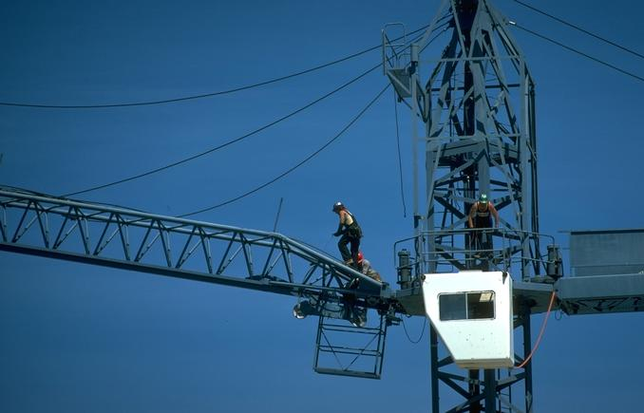
Falls
Unsafe condition
Notes:
Trainer Notes:

Slide 2
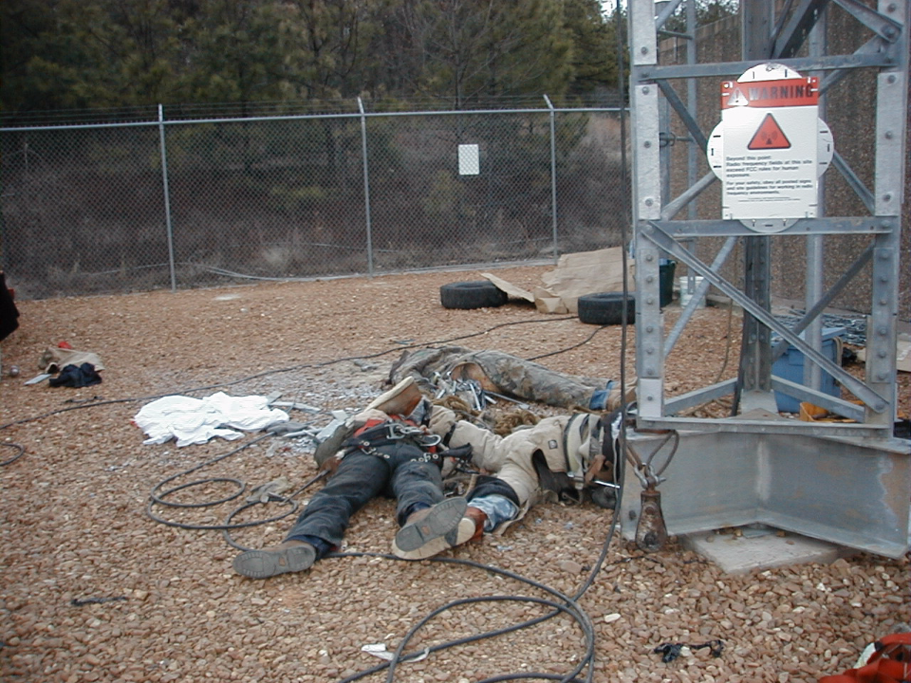
Acceleration = 32 ft/sec²

Slide 3
How far and fast can you fall?
At Time (Seconds) | Distance of Fall (Feet)
0.5 | 4
1.0 | 16
1.5 | 36
2.0 | 64
2.5 | 100
3.0 | 144
4.0 | 256
Notes:
Trainer Notes:
Here is a clearer depiction of how far a worker would drop during the first 4 seconds of a fall.

Slide 4
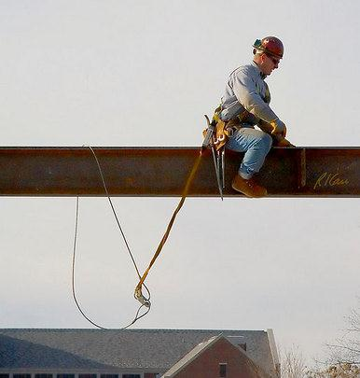
What is fall protection?
Fall protection is a system designed to protect personnel from the risk of falls when working at elevated heights
Is this arrangement acceptable?
Photo courtesy of Robert Carr
Notes:
Trainer Notes:
Ask the broad question, “What is fall protection?”
The picture is from Robert Carr and is an image of structural steel Ironworker straddling wide flange structural steel beam. Fall protection provided by full body harness attached to safety lanyard attached to steel cable loop/sling around beam. Ross School of Business, University of Michigan, Ann Arbor. January, 2007.
Point out that John McFee, Safety Specialist from OSHA felt that this the free fall distance will exceed 6 feet for this particular case, which is unacceptable.

Slide 5
When Fall Protection is Needed
Walkways & ramps
Open sides & edges
Holes
Working over concrete forms & rebar
Excavations
Notes:
Where should I expect fall protection to be provided?
When an employee is on a walking/working surface that has an unprotected edge.
When an employee is constructing a leading edge.
When an employee may fall through a hole in the walking/working surface.
When an employee is working on the face of formwork or reinforcing steel.
When employees are on ramps, runways and other walkways.
When employees are working at the edge of an excavation, well, pit, or shaft.
When employees are working above dangerous equipment (even employees working less than six feet over dangerous equipment must be protected).
When an employee is performing overhand bricklaying and related work.
When an employee is performing roofing work.
When an employee is engaging in precast concrete erection (with certain exceptions).
When an employee is engaged in residential construction (with certain exceptions).

Slide 6
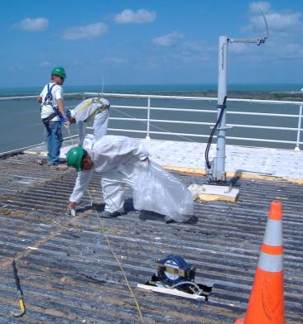
What are examples of fall prevention and protection systems?
Guardrail systems
Restraint systems
Covers
Personal fall arrest systems
Positioning device systems
Safety net systems
Controlled access zones
Safety monitoring systems
Warning line systems
Photo courtesy MARCOR Remediation
Notes:
Trainer Notes:
Review the terms used to see if everyone is familiar with:
Controlled access zones
Guardrail systems
Personal fall arrest systems
Positioning device systems
Safety monitoring systems
Safety net systems
Warning line systems
Covers
The photograph shows MARCOR Remediation demolition crews preparing a structure to be demolished. Because the guardrail will be cut away, all workers are wearing passive restraint systems.

Slide 7
Remember these fall protection basics
Inspect your equipment daily.
Replace defective equipment. If there is any doubt, do not use it.
Replace all equipment involved in a fall.
Ensure all equipment is inspected by a competent person at least annually.
Use shock absorbers if the arresting forces of the lanyard alone can cause injury.
Use the right equipment for the job.
Notes:
Trainer Notes:
These fall protection basics are common sense, but can save lives. It is important to emphasize the following:
Inspect your equipment daily.
Replace defective equipment. If there is any doubt, do not use it. It is everyone’s responsibility to see that damaged equipment is taken out of service.
Replace all equipment involved in a fall.
Ensure all equipment is inspected by a competent person at least annually.
Use shock absorbers if the arresting forces of the lanyard alone can cause injury.
Use the right equipment for the job.

Slide 8
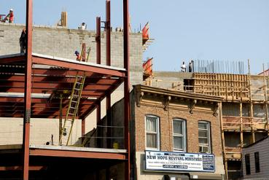
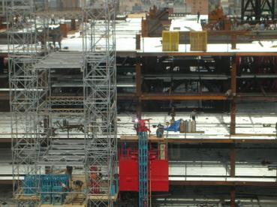
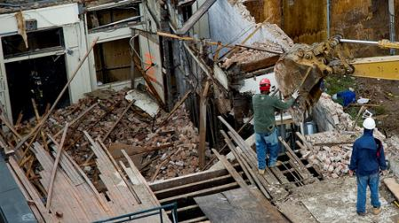
What precautions are needed when working on open-sided decking?
Make sure open edges on decks, roof, mezzanines over 6' high are protected, as OSHA requires
Stay away from edges unless work requires it
Always face the edge
Work from your knees
Fall protection is required
Photos courtesy of Tracy Collins
Notes:
Trainer Notes:
Ask this question and then review the following list, after which you may want to have the class look at the images for good and bad practices.

Slide 9
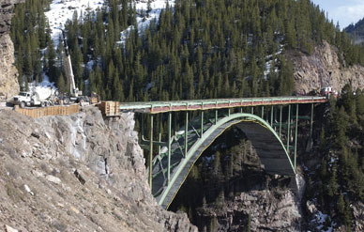
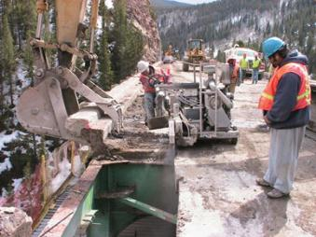
How can falls from bridges be controlled?
Bridge edges must be protected
When working over water, flotation devices must be worn and a skiff must be available
Operating equipment requires increased attention
Fall protection is required
Notes:
Trainer Notes:
Ask the class why bridge work can require increased diligence. Some potential answers:
Falls will almost always be deadly.
The restricted space on a bridge may affect the operation of equipment, particularly swing radius.
Movement of people, equipment and materials can become more difficult.
After establishing that bridge work may be more hazardous, ask “How can falls from bridges be controlled?” Review the bullet list:
Bridge edges must be protected
When working over water, flotation devices must be worn and a skiff must be available to rescue any worker who falls in the water
Operating equipment requires increased attention

Slide 10
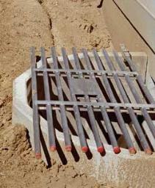
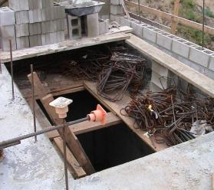
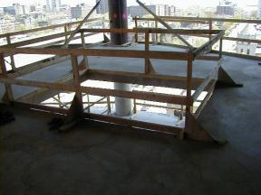
What practices are needed when working around holes?
Cover holes with materials of adequate strength and ensure they are secured
Mark covers so workers know there are holes underneath
Use guardrails
Unsafe conditions
Photo courtesy of Laborers-AGC
Notes:
Trainer Notes:
Note that the OSHA standard requires that holes be covered “with materials of adequate strength.” Guardrails are required to withstand a 200 pound perpendicular stress. Covers must be able to support at least twice the weight of employees, equipment, and materials that may be imposed on the cover at any one time. To prevent accidental displacement resulting from wind, equipment, or workers’ activities, all covers must be secured. All covers shall be color coded or bear the markings “HOLE” or “COVER.”
Of particular interest to heavy equipment operators, OSHA does require that covers of trenches and holes on construction sites where trucks and equipment may run over them must support 20,000 pound:
1910.23(e)(7)(i)
Trench or conduit covers and their supports, when located in plant roadways, shall be designed to carry a truck rear-axle load of at least 20,000 pounds.
1910.23(e)(7)(ii)
Manhole covers and their supports, when located in plant roadways, shall comply with local standard highway requirements if any; otherwise, they shall be designed to carry a truck rear-axle load of at least 20,000 pounds.
Use these images to generate discussions on what is acceptable and what is not.

Slide 11
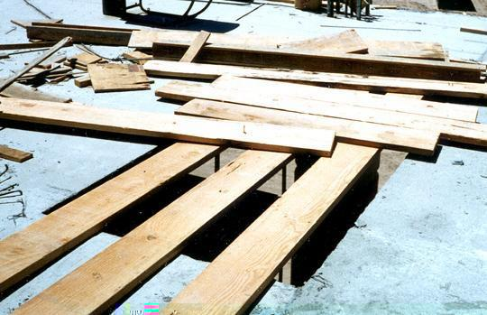
Floor Holes
Improperly
Covered
Cover completely and securely
If no cover, can guard with a guardrail
Notes:
Reference 1926.501(b)(4)

Slide 12
Covers
Withstand twice expected load
Secured
Marked with ‘HOLE’ or ‘COVER’
HOLE!!
Notes:
All other covers shall be capable of supporting, without failure, at least twice the weight of employees, equipment, and materials that may be imposed on the cover at any one time.
All covers shall be secured when installed so as to prevent accidental displacement by the wind, equipment, or employees.

Slide 13
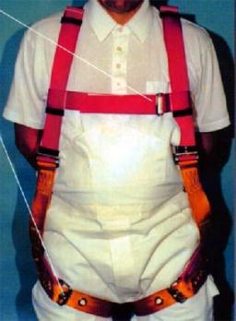
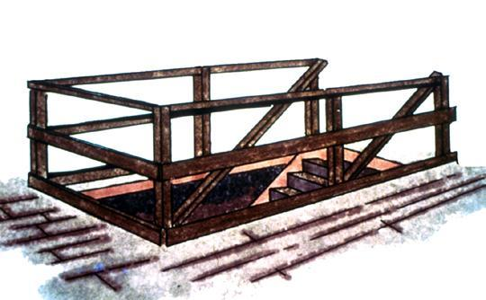
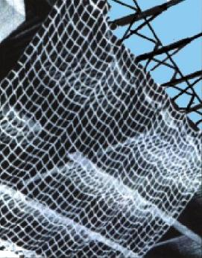
Fall Protection Options
Personal Fall
Arrest System
(PFAS)
Guardrails
Safety Net
Notes:
Reference 1926.501(b)(1)
General rule: If an employee can fall six feet or more onto a lower level, fall protection must be provided.
What type of fall protection will I need?
In most cases, a guardrail system, a safety net system, or a personal fall arrest system must be used. In some cases fences, barricades, covers, equipment guards or a controlled access zone may be used.
Employees must be protected not just from falling off a surface, but from falling through holes and from having objects fall on them from above.

Slide 14
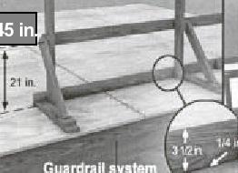
Guardrail Systems
Top Rail: 42 in. +/-3 in.
  Must withstand 200 lbs force outward and downward
  Must not deflect below 39 inches from surface
Mid Rail, Screens/Mesh: 21 in.
  Must withstand 150 lbs force outward and downward
Toeboards, Screens/Mesh:
3½ in.
  Must withstand 50 lbs force
  No more than ¼ in. clearance above work surface
  No more than 1 inch of space between
Post Spacing: 8 feet apart on centers
Guardrail Tips:
1. Surfaced to prevent punctures, lacerations, snagging of clothing.
2. In place at all times around hoist areas, holes, and access points when not in use.
3. Erected on each unprotected edge of a ramp or runway.

Slide 15
Hoist Areas
Hoist areas must be protected by an FPS
If guardrail section(s) are removed and worker must lean into opening, a PFAS is required.
Unsafe condition
Notes:
"Hoist areas." Each employee in a hoist area shall be protected from falling 6 feet (1.8 m) or more to lower levels by guardrail systems or personal fall arrest systems. If guardrail systems, [or chain, gate, or guardrail] or portions thereof, are removed to facilitate the hoisting operation (e.g., during landing of materials), and an employee must lean through the access opening or out over the edge of the access opening (to receive or guide equipment and materials, for example), that employee shall be protected from fall hazards by a personal fall arrest system.

Slide 16
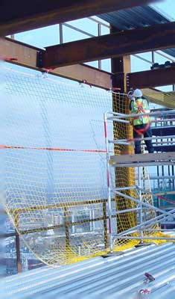
Safety Nets
Installed as close as possible below work surface - never more than 30 ft.
Extend out from 8-13 feet.
Clearance below to prevent impact.
Drop test with 400 lb. bag of sand from highest working level - not less than 42 inches (or certification of proper installation and strength).
Mesh size no larger than 6 in. X 6 in.
5000 lb. minimum breaking strength.
All materials, scrap pieces, & equip that have fallen into net, will be removed ASAP or at least before next shift.
Notes:
I. Speaker’s Notes:
When people think of safety nets, they often envision trapeze artists in the circus. As the performers flip through the air and the audience is amazed, the performers are almost always protected by a safety net.
Safety nets are located under workers to catch them in case of a fall and to protect them from the impact.
Safety nets have specific requirements for their design, which includes the material type, the location under the workers, etc.
Safety nets also have important inspection requirements to make sure they have not been damaged and will still hold a worker in case of a fall.

Slide 17
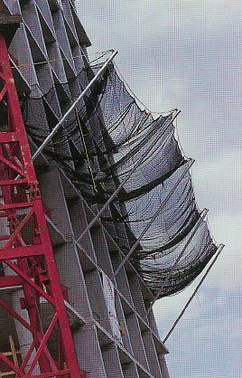
Safety Nets
Nets are not to be placed above any projection hazards.
Drop test to occur
  When net is initially installed,
  When net is relocated,
  When net is repaired, and
  At 6 month intervals if left in one place.

Slide 18
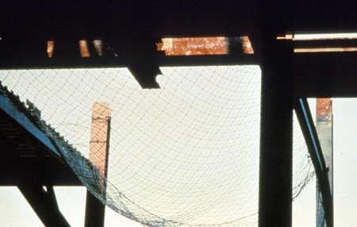
Safety Nets
Place as close as possible, but no more than 30 feet below where employees work
Notes:
Reference 1926.502(c)
How do safety net systems protect me?
Safety net systems catch the employee if he/she does fall. The safety nets:
Must be strong enough to support a falling employee;
Must have sufficiently small mesh openings so the employee cannot fall through the net;
Must be close enough to the surface of the walking/working surface so that the fall into the safety net will not still injure the employee (never more than 30 feet below the walking/working level);
Must be close enough to the edge of the working surface (the outer edge of the net between 8-13 feet from the edge of the walking/working surface, depending on the distance to the walking/working surface) so that the falling employee will not slip past the net.

Slide 19
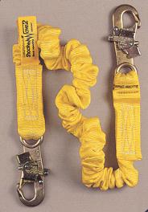
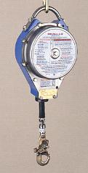
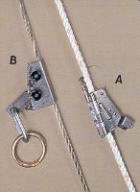
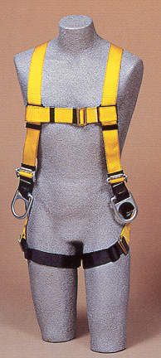


Common Pieces of Equipment
Rope & Cable
Grabs
Self Retracting
Lifelines
Shock Absorbing
Lanyard
Carabiners
Full Body
Harness
Cross-Arm
Strap

Slide 20
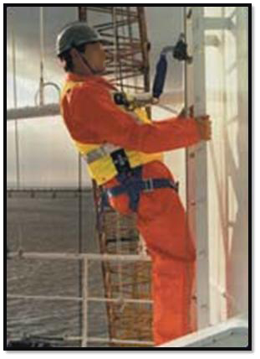

Personal Fall Arrest System
Vertical Lifelines

Slide 21
Additional Requirements PFAS
Inspected prior to each use
Not attached to guardrail systems
At hoist areas, allow movement to edge only
Notes:
Personal fall arrest systems shall be inspected prior to each use for wear, damage and other deterioration, and defective components shall be removed from service.
Personal fall arrest systems shall not be attached to guardrail systems, nor shall they be attached to hoists except as specified in other subparts of this Part.
When a personal fall arrest system is used at hoist areas, it shall be rigged to allow the movement of the employee only as far as the edge of the walking/working surface.

Slide 22
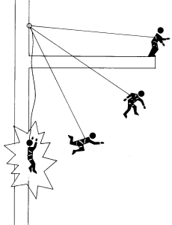
Personal Fall Arrest System
Anchorage Points
Can withstand 5000 lbs. of force per employee
Higher is better
  Reduce free falls and reduce impact load.
  Located directly above to avoid pendulum effect.
  Clear drop zone.
Bigger is better
  The larger the structure the better.
  Don’t use guardrail or other item that may
  break.
  Ex: cable tray, light fixtures, plumbing material are not good
  anchorage points.
More is better
  Try connecting to two structures close together, rather than
  just one.
Notes:
I. Background for the Trainer:
Your Fall Protection Program should also provide specific tie off or anchor points for each situation in which personal fall protection might be needed.
II. Speaker’s Notes:
The location of your anchor, or tie-off point, is critical. In case of a fall, you do not want to swing and potentially crash into something—so you tie off directly above you. You also do not want to fall very far, so you tie off at shoulder height or above. You also want to make sure the fall space, or drop zone, is clear, so do not tie off to an anchor that will result in your falling onto something such as machinery.
The maximum free-fall distance is 6 feet. Remember, the farther the fall, the larger the arresting forces.
The anchor point must be able to withstand 5,000 pounds of force. The construction industry will use special anchors or create horizontal tie-off lines that are safe to tie onto.
General industry must be careful not to tie to electrical conduit, water lines, guardrails, etc. Remember, there is no point in tying off at all if you plan to tie off to an anchor that will not withstand your fall arresting forces.
Ask a supervisor if you are unsure about proper anchor points.

Slide 23
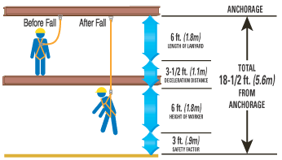
Personal Fall Arrest System
Anchorage Points
NOTE: Should the shock-absorbing
lanyard be used in conjunction
with a cross-arm anchorage
connector or other, the additional
length of the anchorage connector
must be taken into consideration.
Calculating Fall Clearance Distance Using a Shock-Absorbing Lanyard and D-Ring Anchorage Connector
  First, add the length of the shock-absorbing lanyard (6 ft.) to the maximum elongation of the shock absorber during deceleration (3-1/2 ft.) to the average height of a worker (6 ft.).
  Then, add a safety factor of 3 ft. to allow for the possibility of an improperly fit harness, a taller than average worker and/or a miscalculation of distance.
  The total, 18-1/2 ft. is the suggested safe fall clearance distance for
  this example.
Notes:
Calculating Fall Clearance Distance
When selecting connecting devices and anchorage connectors, it is important to understand how to calculate potential fall clearance distance. Fall clearance distance is defined as the height at which a worker must attach to an anchorage to avoid contact with a lower level.

Slide 24
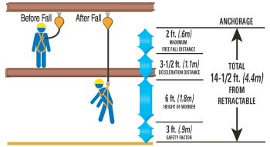
Personal Fall Arrest System
Anchorage Points
NOTE: When using a retractable
lifeline, the distance is calculated
from the point where the
retractable attaches to the back
D-ring of the worker’s harness.
Calculating Fall Clearance Distance Using a Retractable Lifeline
  First, add the maximum free fall distance (2 ft.) with a retractable lifeline to
  the maximum deceleration distance (3-1/2 ft.) to the average height of a worker (6 ft.).
  Then, add a safety factor of 3 ft. to allow for the possibility of an improperly fit harness, a taller than average worker and/or a miscalculation of distance.
  The total, 14-1/2 ft. is the suggested safe fall clearance distance for
  this example.

Slide 25
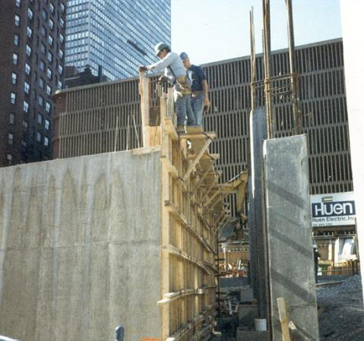
Formwork and Rebar
Workers must be protected by FPS above 6 feet
Fall protection needed
Notes:
"Formwork and reinforcing steel." Each employee on the face of formwork or reinforcing steel shall be protected from falling 6 feet (1.8 m) or more to lower levels by personal fall arrest systems, safety net systems, or positioning device systems.

Slide 26
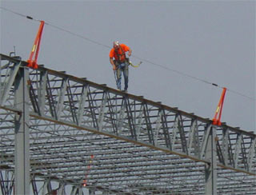
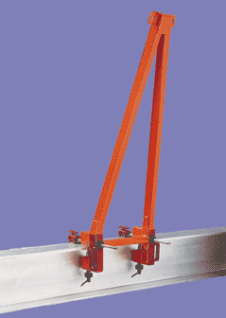
Personal Fall Arrest System
Horizontal Lifelines
Structural Steel Fall Protection

Slide 27
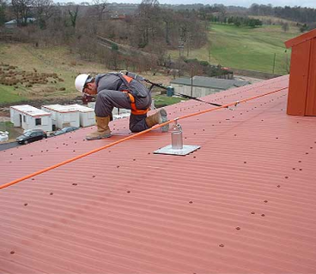
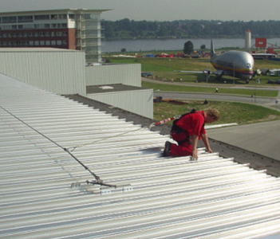
Fall Restraint or Positioning Devices
By the use of lifelines attached to the worker, in which the worker will not be able to approach working edge when working 6 feet or more above the ground.
Notes:
In this situation, the workers can reach the gutter to clean it, or work on the roof, but can go no further.

Slide 28
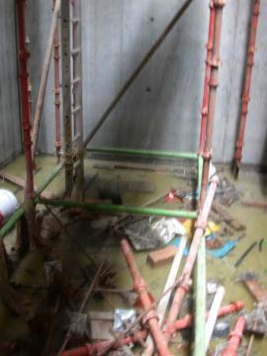
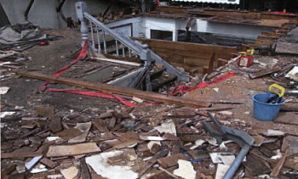
Slip and trip hazards are common
Poor housekeeping
Wet and slippery surfaces
Obstacles in walkway
Poor lighting
Wrong footwear
Improper behavior
Unsafe condition
Notes:
Trainer Notes:
Point out that “slip and trip” hazards are the most common on a construction jobsite and particularly on a demolition site.

Slide 29
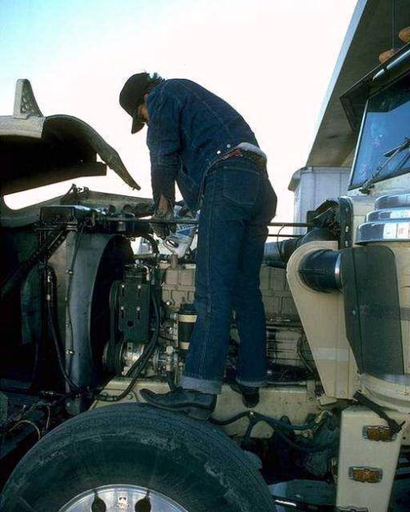
Unsafe work practice
Notes:
Trainer Notes:
Falls don’t have to be dramatic from alarming heights to be crippling. Use this to lead a discussion about creating a culture of avoiding working at any height without considering the risks.

Slide 30
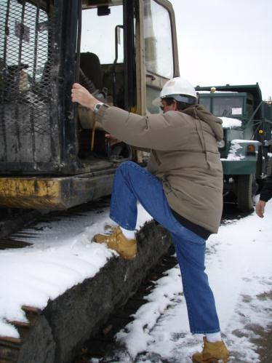
How do you prevent falls from equipment?
Do not jump from equipment
Use three point contact at all times
Be sure of your footing
Do not strain your shoulders
Be sure steps are clear of mud and ice
Notes:
Trainer Notes:
When you review this list, be sure everyone is clear on the meaning of three-point contact: only one hand or foot in motion at a time while the other three limbs are in contact with the equipment.

Slide 31
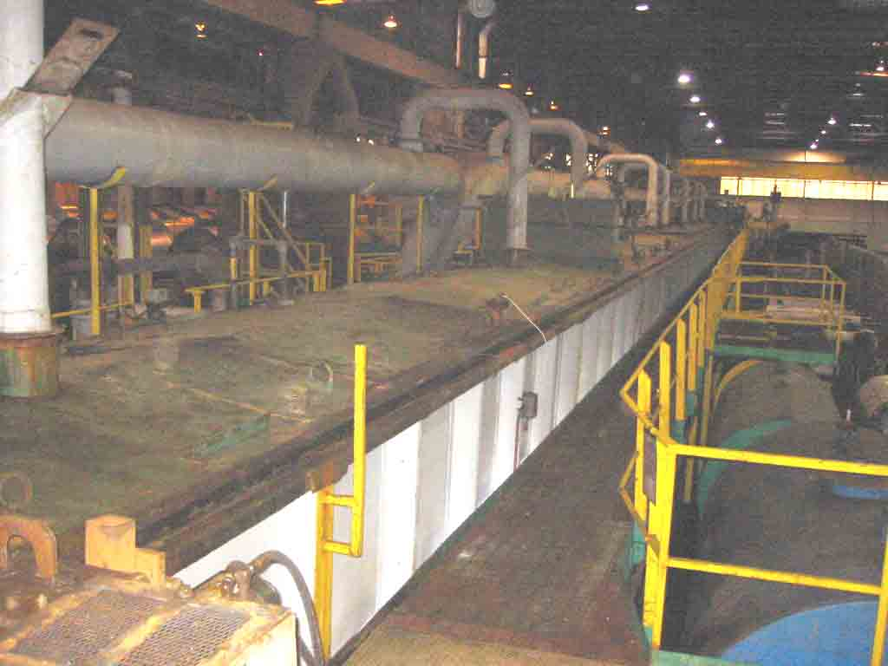
Falls Onto Dangerous Equipment
All potential falls onto dangerous equipment from any height must be guarded!
Notes:
Trainer Notes:
Take the time to define “dangerous equipment” (see below) and ask why OSHA would require guarding, no matter how high above the equipment someone is working.
Dangerous equipment means equipment (such as pickling or galvanizing tanks, degreasing units, machinery, electrical equipment, and other units) which, as a result of form or function, may be hazardous to employees who fall onto or into such equipment.

Slide 32
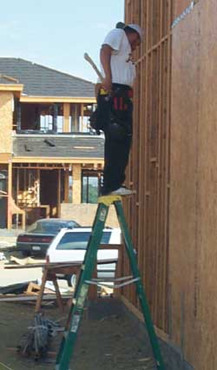
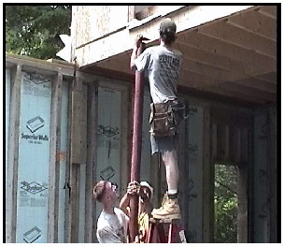
Are these good step ladder practices? What is wrong?
Notes:
Trainer Notes:
Everyone has seen this kind of misuse of stepladders. Ask the class if they have seen this, what is wrong with it, and what should these workers do to correct the situation.

Slide 33
How do you set up a ladder?
Ladders should be set at a ratio of 1 horizontal foot for every 4 vertical feet
Ladders must be secured
Ladder access ways must be guarded
Ladders must extend 3' above the landing surface, or an adequate grabrail must be provided
The ladder base must be properly set
Notes:
Trainer Notes:
Review this list, but point out that you are going to show them an easy rule of thumb for getting the proper lean of a ladder.
Ladders should be set at 1 horizontal to 4 vertical
Ladders must be secured
Ladder access ways must be guarded
Ladders must extend 3' above the landing surface, or an adequate grabrail must be provided
The ladder base must be properly set

Slide 34
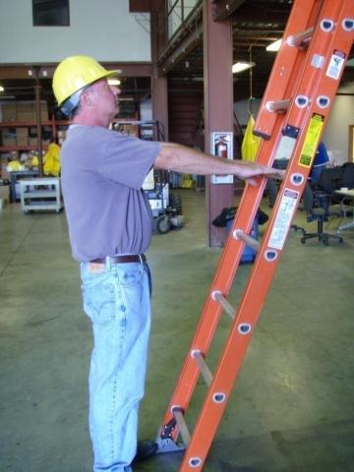
Have you seen this quick ladder check?
Extend Arms
Palms Touch Rung
Ladder At Correct Angle (4:1)
Touch Toes To Ladder Base
Notes:
Trainer Notes:
Have someone from the class demonstrate this if you have the time.
This is a great rule of thumb for getting the right angle for a ladder. This would be a good thing to have a student demonstrate. When the toes are on the ladder base and the arms fully extended to the rung, the angle is right. Be sure to explain that 4:1 means the ladder is extended vertically 4 feet for every 1 foot out horizontally.

Slide 35
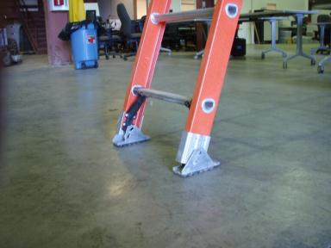
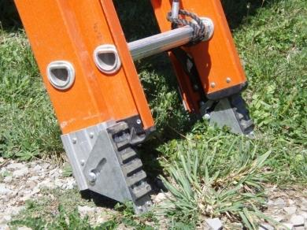
Which way to set the base?
Firm Base
Set both feet level and on the pads
Soft Base
Set on the spikes and seat the ladder in the ground.
Notes:
Trainer Notes:
Make the point that it is very important to determine whether the base is firm or soft and set the feet accordingly.

Slide 36
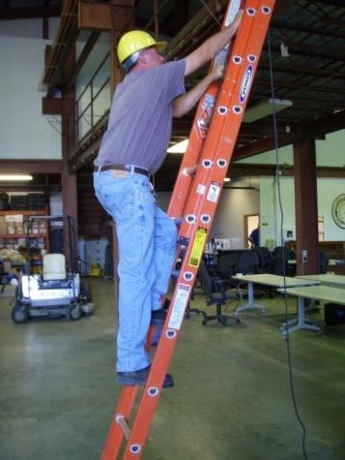
How do you climb a ladder?
Use 3 points of contact to climb a ladder
Always face the ladder when climbing, descending or working
Avoid the top two steps of a stepladder and the top four rungs on other ladders
Notes:
Trainer Notes:
When reviewing the information below, set the stage by making the point that ladders are for moving from a lower level to a higher level and not a continuous work platform. Scaffold and aerial lifts are for doing continuous elevated work.
Consider having a volunteer set up and use the extension ladder to demonstrate the safe way to climb:
Use both hands to climb a ladder;
Always face the ladder when climbing, descending or working; and
Avoid the top two steps of a stepladder and the top four rungs on other ladders.

Slide 37
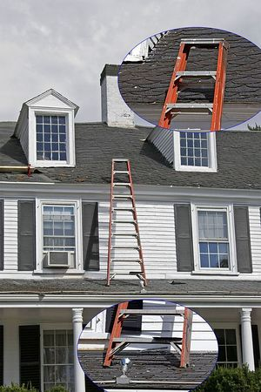
Using A Step Ladder
Don’t lean a step ladder
  the support leg can contact the ground causing the step leg to kick out
Employees should not work from the top or second step
Unsafe ladder use
Photo courtesy of Robert Carr
Notes:
Trainer Notes:
This slide makes one key point: step ladders are completely unsafe to use like a straight ladder. We need to impress on students that leaning a step ladder against a surface for any period of time is unacceptable. The support leg can cause the step leg to kick out. In this photo by Robert Carr, the stepladder is being misused. The stepladder feet (shown in the inset) sit on roof that slopes away, without proper footing or cleating, and it can slip down roof when worker is on it. Taken in Massachusetts in 2004.

Slide 38
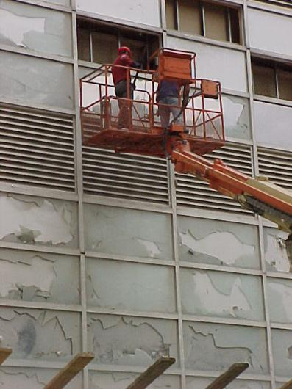
How do you safely use aerial lifts?
Choose correct equipment
  Boomlifts
  Scissorlifts
  Boom trucks (cherry pickers)
  Mast climbers
Maintain equipment
Use it as rated
Consider wind loading
Use personal fall arrest systems when required
Fall protection required
Notes:
Trainer Notes:
Use this list to generate discussions on aerial lifts.
Choose correct equipment
Boomlifts
Scissorlifts
Boom trucks (cherry pickers)
Mast climbers
Maintain equipment
Use it as rated
Consider wind loading

Slide 39
Scaffold Requirements
Firm foundation with base plates
Plumb, square and adequately braced
Fully planked work deck
Guardrails, when scaffolding is >10 ft
Tied-in over 4:1 height to base ratio
Adequate means of access and egress
Notes:
Trainer Notes:
After the image with all of the problems, now review the right way to do things:
Be on a firm foundation with base plates
Be plumb, square and adequately braced
Have a fully planked work deck
Have guardrails over 10 feet in height
Be tied-in over 4:1 height to base ratio
Have an adequate means of access and egress
Make sure the class understands the 4:1 requirement. When a supported scaffold reaches a height that is more than four times its minimum base dimension (4:1), it must be restrained by guys, ties, or braces to prevent it from tipping. [1926.451(c)(1)] Guys, ties, and braces must be installed at locations where horizontal scaffold components support both inner and outer legs. [1926.451(c)(1)(i)] Guys, ties, and braces must be installed according to the scaffold manufacturer's recommendations or at the closest horizontal member to the 4:1 height ratio and be repeated every 20 vertical feet for narrow scaffolds (3 feet or less in width), and every 26 vertical feet for scaffolds greater than 3 feet in width. [1926.451(c)(1)(ii)]

Slide 40
Types Of Scaffold Access
Hook-on and attachable ladders
Stairway-type ladders
Stair towers
Built-in scaffold ladders
Ramps and walkways
Direct access
Notes:
Trainer Notes:
If direct access from another scaffold, structure, or personnel hoist access is not possible, the following methods of access must be used:
Hook-on and Attachable Ladders
Stairway-type Ladders
Stair Towers
Built-in Scaffold Ladders
Ramps and Walkways
Direct Access

Slide 41
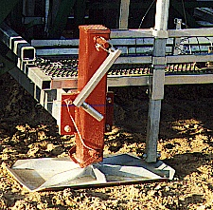
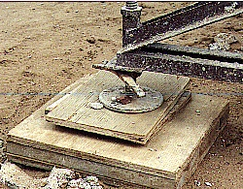
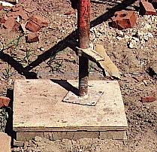
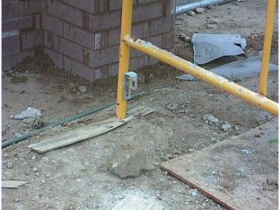

Foundations
Hydro Mobile
Masons Adjustable
Frame Base Plate
Improper Bases
Notes:
Trainer Notes:
Ask why the top row are acceptable, but the lower row isn’t.

Slide 42

Who is protected?
Unsafe condition
Photo courtesy of Robert Carr
Notes:
Trainer Notes:
Use this photo of the crew working concrete forms to talk about personal responsibility and the need for all members

Slide 43

What is wrong?
Photo courtesy of Robert Carr
Notes:
Trainers Notes:
Bridge construction, steel construction: Superintendent at upper right listens to radio with right ear while directing the dozer operators pushing the bridge with signals of his left hand. Ironworkers standing on top of each temporary bridge pier watch process and signal superintendent with hand signals/ radio if there is reason to stop. They also unlock and lock rollers to allow movement when dozers push and to prevent movement thereafter. Superintendent is standing on stack of temporary bridge deck panels, which will span transverse bridge joists to provide final driving surface. Tyngsborough, MA 2005.

Slide 44

What’s Wrong With This Picture?
Notes:
No fall protection system being utilized
What the heck is he standing on?
Wheels should be chocked on front-end loader.
Anything else?

Slide 45

Personal Fall Arrest System
Rescue Plan
Each worksite or
facility must have
a rescue plan.
Employees must be
trained on the plan.
Limit hanging/
suspension time.
Notes:
Speaker’s Notes:
Employers should rescue plans in place for each work area in which personal fall protection devices are used.
Designated rescuers are aware of the rescue plan.
The goal of any rescue is to limit the hanging/suspension time of the fallen employee.

