Slide 1
Drug and Alcohol Awareness
Notes:
1

Slide 2
Substance Abuse Issues
Drug and alcohol abuse
Misuse of prescription and over-the-counter medication
Drug trafficking and dealing
Emotional distress and illness
Physical illness and chronic health problems
Lifestyle issues
Notes:
2

Slide 3
Signs and Symptoms of Abuse
Absenteeism
Staff Turnover
Lower productivity
Poor work quality
Poor moral
Increased accidents and near misses
Theft of equipment and materials
Equipment breakdowns
Notes:
3

Slide 4
Drug Effects
Slow reactions
Poor coordination
Fatigue
Delayed decision making
Confusion
Learning difficulty
Poor memory
Loss of concentration
Depression or anxiety
Erratic judgment quality

Slide 5
Drug Effects
Difficulty sorting out priority tasks from non-essential activity
Neurotic or psychotic behavior
Refusal to accept authority

Slide 6
Behavioral Signs
Change in attitude, work performance or behavior
“I don’t care” attitude
Erratic performance
Hangover symptoms
Drug culture jargon
Secretive behavior

Slide 7
Behavioral Signs
Wanting to be alone
Forgetfulness, indecision, erratic judgment
Impulsive and temperamental behavior
Changes in personal appearance and hygiene
Jitters, hand tremors, hyperexcitability
Carelessness

Slide 8
Behavioral Signs
Sleeping on the job
Trouble with police
Can not keep a job
Aggressive towards others
Constant illnesses

Slide 9
Physical Symptoms
Blood spots on shirt sleeves
Bloodshot or watery eyes
Changes in speech
Hand tremors
Intoxicated behavior
Odor of alcohol on breath or marijuana smoke

Slide 10
Physical Symptoms
On-the-job, out-in-the-open drug use
Poor coordination
Racing heart, irregular rhythms
Runny nose or sores around nostrils
Sleeping on job
Slow reactions
Slurred speech

Slide 11
Physical Symptoms
Unsteady gait
Very large of very small pupils
Wearing sunglasses indoors

Slide 12
Common Sites for Use
Lunchroom or lounge areas
Parking lots and cars
Remote areas of the worksite
Equipment or storage rooms
Restrooms

Slide 13
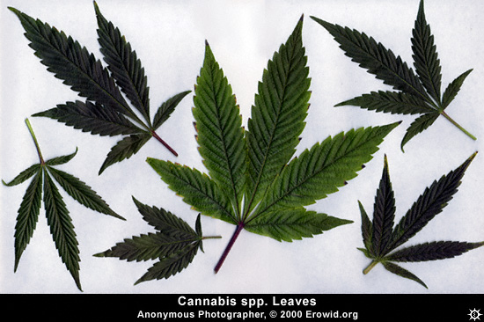
MARIJUANA

Slide 14
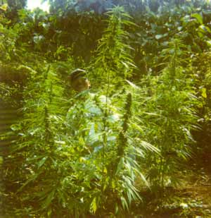
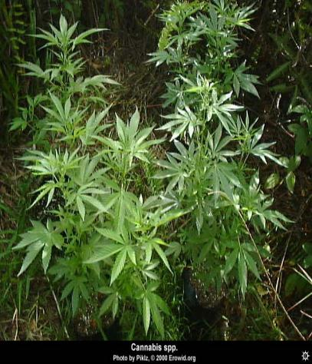
From Hemp plant –
Cannabis Sativa

Slide 15
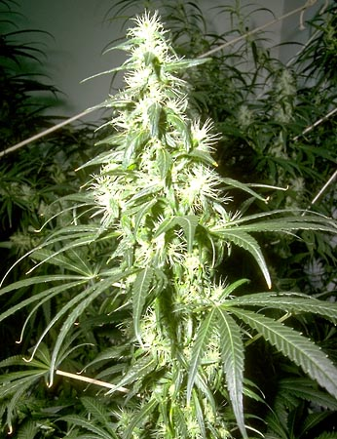
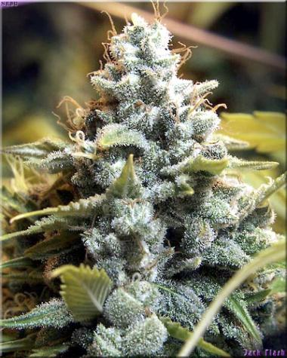
1974 – 1% THC level
Today – more than 17%

Slide 16
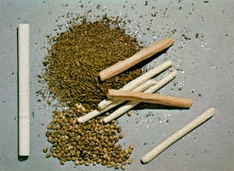
When dried and manicured looks like oregano

Slide 17
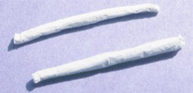
1 Joint is equivalent to
25 cigarettes

Slide 18
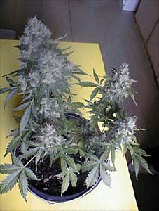
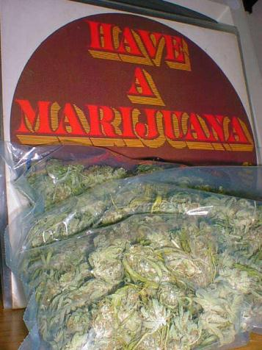
10% of workers claim use

Slide 19
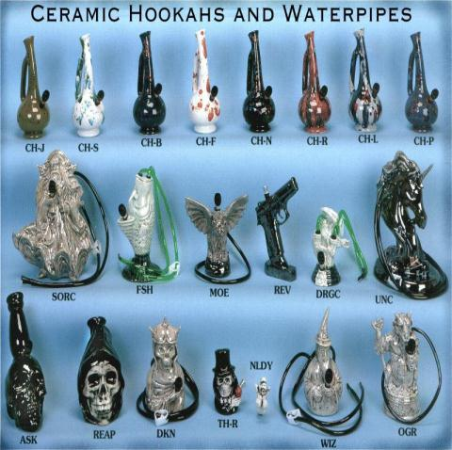

Smoked

Slide 20
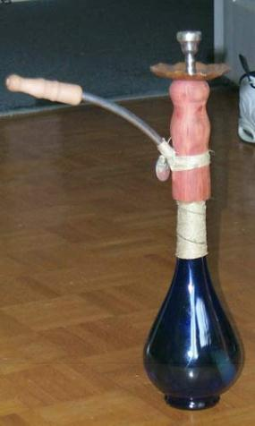
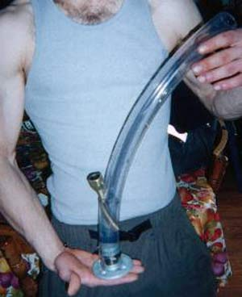
Bongs

Slide 21

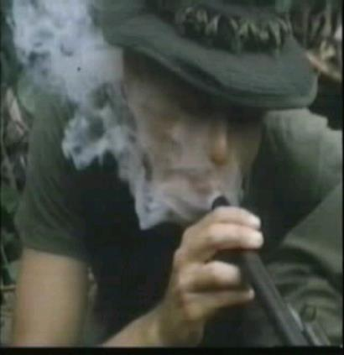
Shot Gunning

Slide 22
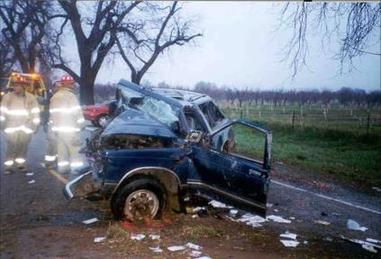
Mental Function
Sense of Well Being
Irritability, insomnia, anxiety, depression
“I don’t care” attitude
Diminished concentration
Delayed decision making

Slide 23
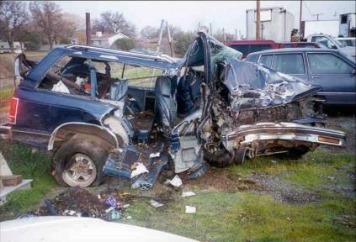
Mental Function
Impaired short-term memory
Erratic cognitive functions
Distortions in time estimation

Slide 24
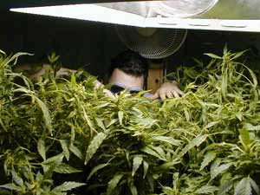
Health Effects
Pulmonary problems
Risk of cancer
Heart disease
Lowers immune system
Irritating cough, chronic sore throat

Slide 25
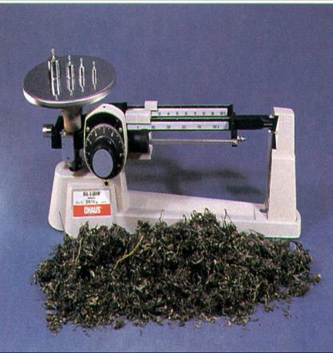
Health Effects
Withdrawal
Loss of appetite
Restlessness
Chronic fatigue and lack of motivation

Slide 26
Pregnancy Problems and Birth Defects
Active chemicals concentrate in ovaries and testes.
Decrease in testosterone in males.
Decrease in fertility, increase in testosterone in females
Females have higher incidences of stillborn births or miscarriages.

Slide 27
Pregnancy Problems and Birth Defects
THC can cause birth defects.
Offspring have fewer chromosomes than normal.
Common effect is underweight newborn babies.
Decrease in visual functioning and other ophthalmic problems.

Slide 28
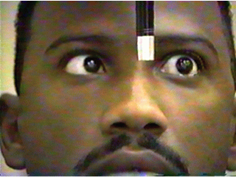
Signs and Symptoms
Affects normal body functions
Impaired tracking
Distinctive odor on clothing

Slide 29
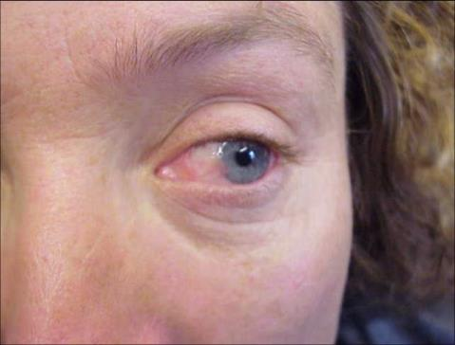
Signs and Symptoms
Reddened eyes
Slowed speech
Chronic fatigue and lack of motivation
Notes:
Pot, grass, weed, reefer, dope, Mary Jane, Acapulco gold
Looks like parsley
Can be eaten or smoked
Hashish is black or brown and can be eaten or smoked
Hash Oil is a syrupy liquid that is smoked or mixed with tobacco

Slide 30
Marijuana Fact Sheet
Acute/Overdose Effects
Aggressive urges
Anxiety
Confusion
Fearfulness
Hallucinations
Heavy sedation
Immobility
Mental dependency
Panic
Paranoid reaction
Unpleasant distortions in body image.

Slide 31
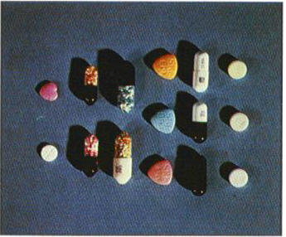
Amphetamine

Slide 32
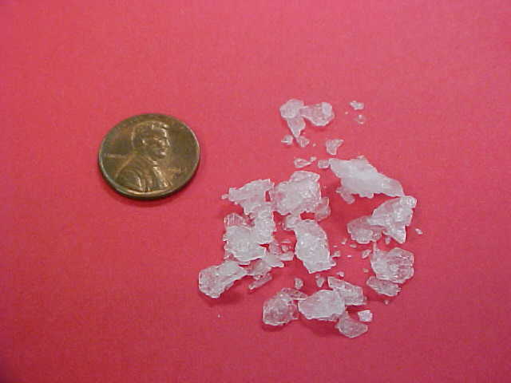
Methamphetamine

Slide 33
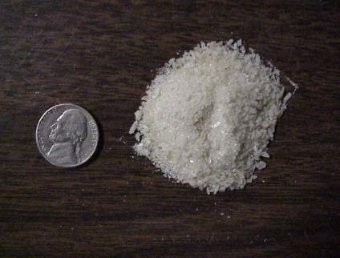
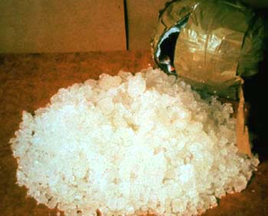
Both Similar in Makeup & Effect

Slide 34
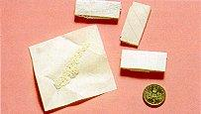
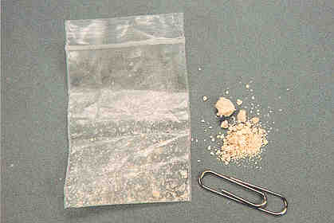
#2 Drug We See –
Catching Marijuana

Slide 35
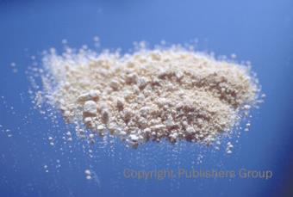
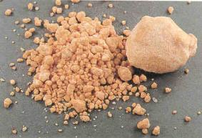
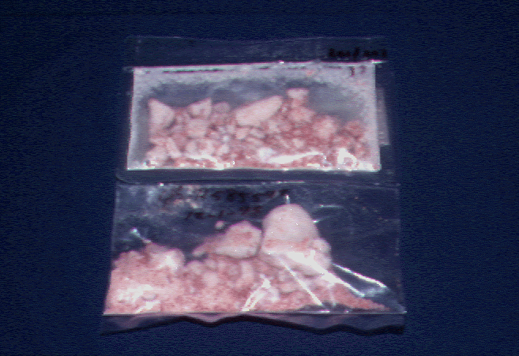
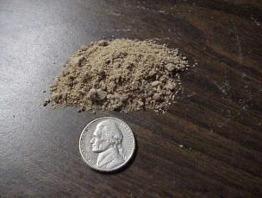
White, Brown, Pink

Slide 36
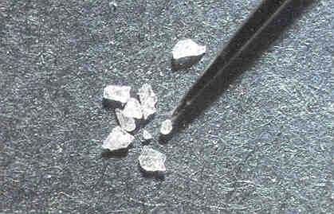
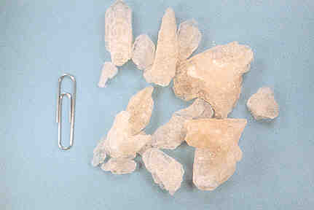
Tablets, Capsules, Liquid, Powder

Slide 37
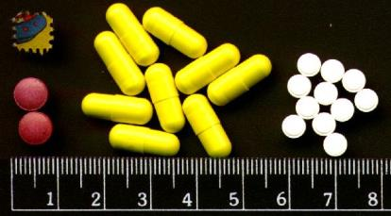
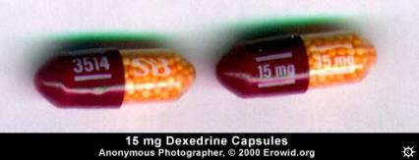
Taken Orally

Slide 38
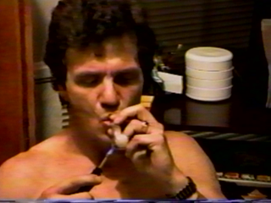
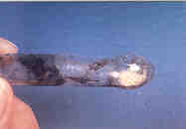
Smoked – Effects in minutes

Slide 39
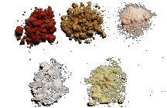
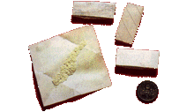
Snorted – effects in minutes

Slide 40
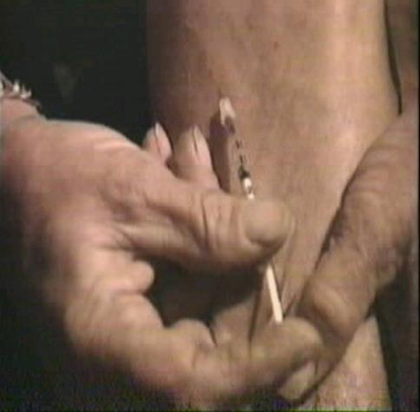
Injected – effects in seconds

Slide 41
All for the “Rush”
Immediately After Smoking Or Injection, The User Experiences An Intense Sensation, Called A “ Rush” Or "Flash," That Lasts Only A Few Minutes And Is Described As Extremely Pleasurable.

Slide 42
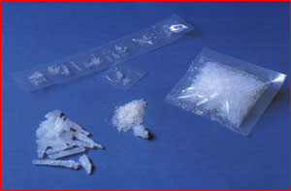
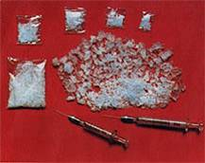
Effects Last Up To 12 Hours

Slide 43
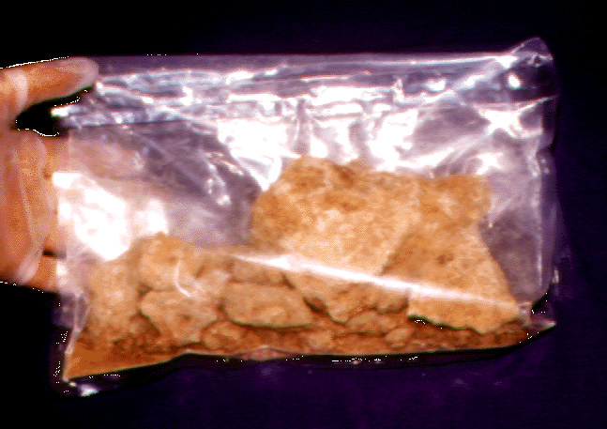
Stay up for days

Slide 44
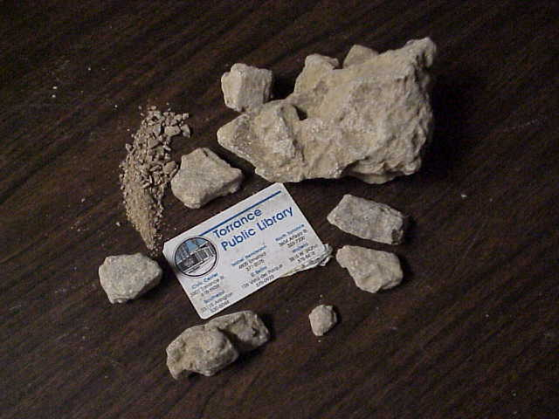
Tolerance – Need More

Slide 45
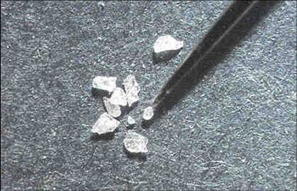
Signs and Symptoms
Hyperexcitability
Dilated pupils
Increased heart rate
Increased blood pressure
Heart palpitations
Profuse sweating
Notes:
Speed, uppers, Ups, Black Beauties, Pep Pills, Copilots, Hearts, Benzedrine, Dexedrine
Capsules, pills or Tablets.
Taken orally, injected or inhaled through the nose
Methamphetamines are called crank, crystal Meth
White powder or pills
Taken orally, injected or inhaled

Slide 46
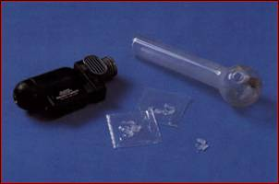
Signs and Symptoms
Rapid respiration
Confusion
Panic
Talkativeness
Inability to concentrate

Slide 47
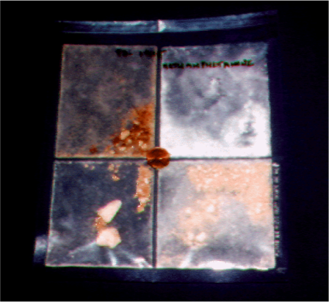
Health Effects
Regular use produces strong psychological dependence and increased drug tolerance
High doses may cause toxic psychosis resembling schizophrenia
Intoxication may induce heart attack or stroke

Slide 48
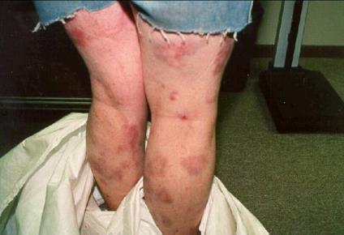
Health Effects
Increases impulsive or risk taking behaviors
Withdrawal causes severe depression
95% relapse rate
Effects are not just internal
Literally eats the body

Slide 49

Possible Effects
Other Possible Immediate Effects Include Increased Wakefulness And Insomnia, Decreased Appetite, Irritability/Aggression, Anxiety, Nervousness, Convulsions And Heart Attack.

Slide 50
Scary Statistic
"More Than 12 Million Americans Have Tried Methamphetamine, And 1.5 Million Are Regular Users."
- David J. Jefferson, "America's Most Dangerous Drug" Newsweek August 8, 2005

Slide 51
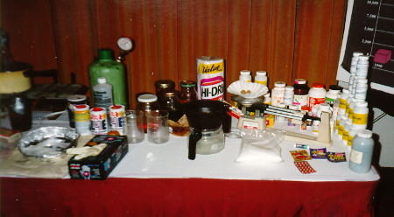
The Makings

Slide 52
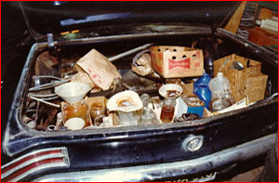
They make it anywhere they can.

Slide 53
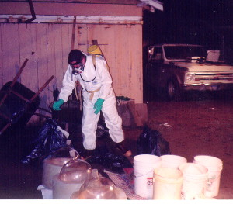
Hazardous Cleanup

Slide 54
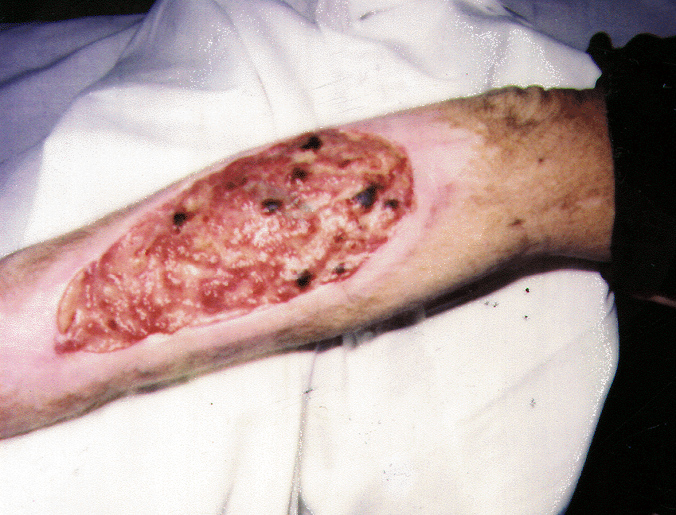

Bugs

Slide 55

Cocaine

Slide 56

Rich Man’s Drug

Slide 57

Effects Short Lived

Slide 58
Signs and Symptoms of Use
Financial problems
Frequent absences
Increased physical activity and fatigue
Isolation and withdrawal
Secretive behaviors
Unusual defensiveness
Wide mood swings
Nose problems
Difficulty in concentration
Dilated pupils
Notes:
Coke, Snow, Flake, White, Nose Candy, Big C, Snow Bird, Lady.
White crystalline powder
Can be inhaled in nose, Injected or smoked
Crack is light brown in color and is smoked

Slide 59
Cocaine Fact Sheet
Health Effects
Regular use can upset chemical balance in brain
Causes heart to beat faster and harder
Strongest mental dependency of all drugs
Treatment success rates are lower
Deaths due to overdose when taken with depressants

Slide 60

Opiates – Heroin - Codeine

Slide 61

Derived From Resin of Poppy Plant

Slide 62


Depresses
Central Nervous System

Slide 63

Signs and Symptoms
Mood changes
Physical fatigue and drowsiness
Constricted pupils
Nausea, vomiting, constipation
Financial difficulties

Slide 64

Signs and Symptoms
Depression and apathy
Impaired coordination
Impaired mental functioning and alertness
Notes:
Heroin, Smack Horse, Brown Sugar, Junk, Mud, Big H
Powder white to dark brown
Injected, inhaled or smoked
Codeine taken orally or injected
Morphine, opium and other pain killing drugs are part of this family

Slide 65
Health Effects
High risk of contacting hepatitis or AIDS
Narcotics increase pain tolerance
Effects are multiplied when combined with other depressant drugs
Tolerance levels increase
Strong mental and physical dependency

Slide 66


Needle Marks

Slide 67


Convulsions - Coma

Slide 68

Hallucinations - Tripping

Slide 69

PCP – Angel Dust

Slide 70

Signs and Symptoms
Impaired coordination
Severe confusion and agitation
Extreme mood shifts
Muscle rigidity
Notes:
PCP, Angel Dust, Loveboat, Lovely, Hog, Killer Weed
Liquid, capsules White Crystalline Powder or pills
Taken orally, Injected or smoked and is usually mixed with tobacco or marijuana
LSD is also in the family of hallucinogens

Slide 71

Signs and Symptoms
Nystagmus (jerky eye movements)
Dilated pupils
Profuse sweating
Rapid heartbeat
Dizziness

Slide 72
Health Effects
Potential for accidents and overdose extremely high
Overdoses are often misdiagnosed as LSD induced and treatment can cause a fatal reaction
Use can cause irreversible memory loss, personality changes and thought disorders

Slide 73

Ecstasy – The Love Drug

Slide 74

Mushrooms

Slide 75


LSD - Acid

Slide 76


Eye Catching

Slide 77

Popular Advertising

Slide 78


Depressant Drugs

Slide 79

Signs and Symptoms
Sedation, drowsiness, sleep
Mental confusion
Inattention
Slurred speech

Slide 80

Signs and Symptoms
Staggering, loss of balance
Lowered blood pressure
Depressed respiration

Slide 81
Health Effects
Strong mental and physical dependency
User develops tolerance so increased dosages are required
Withdrawal may cause extreme excitation and panic
Usually requires medical supervision for withdrawal

Slide 82
Scary Questions
Have you ever gone out to “get drunk”?
Have you ever driven home after having more than two cocktails?
Have you ever not remembered something while drinking?
Have you ever gotten in the vehicle with someone who has been drinking?
Have you ever become physically ill?

Slide 83
Terrifying Answers
Statistics show that most of us will respond yes to three or more of these questions.
If you answered yes to three or more you may have a problem with alcohol!

Slide 84
Alcohol Abuse
Alcohol is a socially acceptable drug that has been consumed as a recreational beverage for thousands of years. When consumed for its physical and mood-altering effects, however, it becomes a dangerous substance of abuse.

Slide 85
Alcohol Fact Sheet
# 1 problem in the work place
What is alcohol?

Slide 86
Alcohol
Number one abused substance
Easy to become dependent
Alcoholics seldom realize they have a problem
Many of us have an alcoholic in our immediate family and know several

Slide 87
Alcohol abuse should concern all of us!
Those who abuse alcohol on the job are
Are far less productive
Use three times as many sick days
Are more likely to injure themselves or someone else
Are five times more likely to file workers comp claims

Slide 88
Alcohol is a Depressant
Slows down and impairs all sensory and motor functions
Poor decisions
Increased friction among workers
Damage to company equipment
Damage to company’s public image
High turnover in personnel

Slide 89
Signs and Symptoms of Use
Dulled mental processes
Lack of coordination
Possible constricted pupils
Sleepy or stuporous condition
Slowed reaction rate
Slurred speech
Odor of alcohol on breath

Slide 90
Health Effects
Decreased sexual functioning
Dependency
Fatal liver diseases
Increased risk of cancer in mouth, throat, rectum, breasts and skin
Kidney disease

Slide 91
Health Effects
Pancreatitis
Spontaneous abortion and neonatal mortality
Ulcers
Birth defects

Slide 92
Social Issues
2/3 of all homicides are committed by people who drink prior to the crime
2% to 3% of the driving population is legally drunk at any one time.
2/3 of all Americans will be involved in an alcohol related vehicle accident in their life
The rate of separation and divorce is 7 times greater

Slide 93
Social Issues
40% of family court cases are alcohol problem related
Alcoholics are 15 times more likely to commit suicide
Accident rates are higher with people who abuse alcohol

Slide 94
Workplace Issues
It takes 1 hour for an average person to process 1 serving of alcohol
Impairment in coordination and judgment can be measured with a BAC of .03
A person who is legally intoxicated BAC .08 is 6 times more likely to have an accident than a sober person

Slide 95
Blood Alcohol Concentration
0.03 – There is a reduction in one’s capacity to correctly choose among several alternatives presented
0.04 – Response to visual and aural stimuli diminishes
0.05 – Reduction in ability to perceive and interpret surroundings.
  Detail in moving objects begins to diminish
  Increased difficulty in coordination
  Completing multiple task assignments becomes increasingly difficult

Slide 96
BAC Reduction
Reduced through three bodily functions
  Metabolism. The liver is the body’s filtration system. Alcohol is reduced each time the blood passes through it.
  Excretion. Alcohol is broken down into carbon dioxide and water – eliminated through urine.
  Evaporation. One’s breath and sweat are the two processes of evaporation.
    Note – breath and body odor

Slide 97
Think about this!
If you go out and come home with a blood alcohol level of 0.25, when you go to work at 8 you still have a blood alcohol level of 0.14. When you finally get to go to lunch at noon your level will be down to 0.05.

Slide 98


Slide 99
I hope that you take at least one thing away from today.
Substance abuse is a subject that most people would rather not discuss. The more knowledge you have the safer your life will be.

Slide 100
REMEMBER
Living for today and making the best out of every moment of life can not be accomplished while under the influence of any substance of abuse!

Slide 101
Misuse of drugs and alcohol can effect the well-being of the employee, their family and the company. It is every employees’ duty to make sure the work place is free from substance abuse for our safety and the general public’s safety.

Slide 102
Doesn’t Take A Rocket Scientist
JUST SAY NO!!

