Slide 1
Session3:
Discussion of ANSI Z10 Elements
ANSI Z10 Section 3.0—Management Leadership and Employee Participation
Notes:
We begin with the part of the system which cultivates the direction, motivation and driving force for the rest of the system. The strength of this element determines the strength of the rest of the elements

Slide 2
Disclaimer
DISCLAIMER: This material was produced under grant number SH-19494-09-60-F-12 from the Occupational Safety and Health Administration, U.S. Department of Labor. It does not necessarily reflect the views or policies of the U.S. Department of Labor, nor does mention of trade names, commercial products, or organizations imply endorsement by the U.S. Government. The U.S. Government does not warrant or assume any legal liability or responsibility for the accuracy, completeness, or usefulness of any information, apparatus, product, or process disclosed.
To this end, permission is granted to use such copyrighted material solely for non-commercial, instructional, personal, or scholarly purposes. The material may be used and incorporated into other workplace safety and health programs on the condition that no fee may be charged for the subsequent use of the material. Use of the material for any other purpose, particularly commercial use, without the prior, express written permission of the copyright owner/s is prohibited. Furthermore, any modification to the material is prohibited without the prior, express written permission of the copyright owners.

Slide 3

CONTINUAL IMPROVEMENT
IMPROVE: employee H&S productivity satisfaction image
REDUCE: hazards risks incidents comp costs lost time
3.0 Policy Management Leadership & Employee Participation
7.0 Management Review
4.0 Planning
6.0 Evaluation and Corrective Action
5.0 Implementation and Operation
Z10 OHSMS Cycle
Notes:
Right now, we’re right here on the cycle
In my experience, you put much of the system together in the same sequence as its implementation, since one element typically lays the groundwork for the one that follows
In the ANSI guidance, it’s inferred that by reducing the negative aspects, you’ll naturally start to see the increase in the positive aspects

Slide 4
Management Leadership and Employee Participation
3.1 Management Leadership
  Occupational Health and Safety Management System (OHSMS): (Establish, implement, maintain)
  OHS Policy (specifies commitments)
  Responsibility and Authority (top management duties to lead, such as provision of resources) Appendix B
  Management must give visible support and take an active role in promoting the OHSMS Policy commitments and OHSMS developmental efforts
Notes:
This is what’s covered under Clause 3.1…
The role of management in any management system is crucial
The Policy must include commitment to:
Protection and continual improvement of employee safety and health
Effective employee participation
Conformance with the company’s health and safety requirements
Compliance with applicable laws and regulations
What does Management Commitment look like?
Integration of safety and health considerations in business planning
Provision of resources to support management system
Recognition to those who step up and participate

Slide 5
Example Policy Statements/Values
Policy Statements:
  “Organization will uphold its position as global leader by promotion of occupational health and safety excellence”
  “Health and safety of each employee is the overriding priority of the organization.”
  This organization pledges to communicate our OHS Policy to our employees and stakeholders”
  “Nothing is more important than safety—nothing”

Slide 6

Management Leadership/Employee Participation
3.2 Employee Participation
  Involvement by employees at all levels
  Provide time and resources for employee involvement in planning, implementation and preventive and corrective actions
  Provide access to OHSMS information
  Remove barriers/obstacles to participation
  Examples of employee participation include process hazard analysis, development of job instructions, training development, committees
Notes:
Emphasizes participation by non-supervisory employees because they are closest to the hazard
They are also invaluable in terms of building support—they take ownership
Their knowledge should be captured by the procedures development process-why go through iterations in getting it right
Principle barriers—time, resources and relief from competing responsibilities

Slide 7

Employee Engagement
Opportunities for upward feedback
Being kept informed
Feeling appreciated
Visible, tangible management commitment

Slide 8

Management Leadership/Employee Participation
Motivating Employee Participation
  Be aware of the morale level
  Ask for suggestions
  Be sure to listen and value ideas
  Demonstrate how their input generates output
  Give appropriate recognition, often
  Understand that not everyone wants to jump in
Notes:
One of the key venues to achieve participation is through the safety committee, but that’s not the only way
Newsletters, recognition, etc.
Ask for input on how others have done it successfully

Slide 9
Management Leadership and Employee Participation
Employee Participation:
  Incident investigation
  Procedures development
  Health and safety-related audits
  Job safety analysis
  All aspects of the Planning process
Typically accomplished through a Safety Committee

Slide 10
Management Leadership and Employee Participation
Provision of Relevant Information to Employees:
  OHSMS objectives, implementation plans
  Results of incident investigations
  Monitoring data
  Injury and illness data
Barriers to participation might include a lack of response to employee input/suggestions

Slide 11

Management Leadership and Employee Participation
Z10 Guidance on Policy:
  Policy should reflect the organization’s culture and health/safety values
  Appendix A of Z10 includes examples and methods of communicating Policy
  Non-supervisory personnel considered to have the most intimate knowledge of work hazards and the ways to address them
Notes:
The Policy would do well to emphasize the importance of employee participation

Slide 12
Management Leadership and Employee Participation
ISO 9001/14001 Linkages:
  Written Policy endorsed by Top Management
  Commitments to compliance, improvement
  Communication of Policy to stakeholders
  ISO 9001:2008 includes a “Management Commitment” element; 14001 has it in Policy
Notes:
Here are some of the linkages between the ANSI Z10 element and the ISO standards

Slide 13
Planning
ANZI Z10 Section 4.0
Notes:
If you

Slide 14
CONTINUAL IMPROVEMENT
IMPROVE: employee H&S productivity satisfaction image
REDUCE: hazards risks incidents comp costs lost time
3.0 Policy Management Leadership & Employee Participation
7.0 Management Review
4.0 Planning
6.0 Evaluation and Corrective Action
5.0 Implementation and Operation
Z10 OHSMS Cycle

Slide 15

4.0 Planning
4.1 Initial and Ongoing Reviews
  Initial Review
    This is commonly referred to as the “gaps analysis” which accesses the status of the organization relative to Z10 conformance, to develop a work plan to fill “gaps”.
    Review should consider:
      Existing business management systems
      Hazards, risks and controls
      Resources
      Applicable regulations/other requirements and
      Assessments and other relevant activities
  Ongoing Review: takes into account OHSMS data
Notes:
The gaps analysis:
Reveals areas of weakness or missing area relative to the ANSI Z10 system
Sets the basis for action plans to fill the gaps or strengthen areas of weakness
Ongoing review:
Basically ongoing review will be achieved in accordance with Z10 elements such as monitoring, measurement, auditing, etc.

Slide 16
4.0 Planning
4.1 Initial and Ongoing Reviews
  Initial Review
    Intent is to review management systems in areas that may be outside the traditional context of health and safety such as:
      Procurement
      Engineering
      Quality
      Environmental
  Hazards/risks may include weather-related emergencies
  Assessments include Workman’s Comp info, injury and illness metrics, audits, monitoring and measurement
Notes:
Assessments in other words make use of existing information to the extent possible
You also want to understand how existing systems that are traditionally outside the safety department can be used

Slide 17
Planning Element Discussion
What are some of the OHSMS concerns with activities occurring in the following areas:
  Procurement?
  Engineering?
  Quality?
  Environmental?
  Information Technology?
Exercise: Possible Information Needs versus Sources
Notes:
Again, the focus here is to understand the systems and elements and how they can be used to conform with Z10

Slide 18
Planning: Initial and Ongoing Reviews
ISO 9001/14001 linkages:
  Several elements in 9001 involve broad organizational involvement including:
    Design and development (Engineering, safety criteria)
    Purchasing process (Procurement)
    Customer communications (Marketing)
    Internal audits (Auditing function)
  ISO 14001 can be less broad but still typically includes:
    Environmental Staff
    Line Management
    Safety Staff (especially where toxic exposure is “significant”)
Notes:
A good place to get a summary of these two systems would be the Quality Manual or the EMS Manual for these two systems
ANSI Z10 emphasizes the hierarchy of controls which starts with, where possible, the elimination of a hazard through process design
Where you have design involved, safety is key because its much easier to fix a process in the design stage rather than after it is constructed

Slide 19
4.0 Planning
4.2 Assessment and Prioritization
  Systematic process to access and prioritize the OHSMS issues identified in 4.1
  Factors used in the assessment include:
    Level of risk
    Potential for system improvement
    Relevant standards and regulations
    Feasibility
    Potential business consequences
Notes:
The key word is systematic—you want to arrive at a non-bias and documented prioritization of risks
Example

Slide 20
4.0 Risk Assessment Resources
ACGIH Threshold Limit Values (TLVs)
OSHA Permissible Exposure Limits (PELs)
NIOSH Pocket Guide to Chemical Hazards
AlChE:
  Guidelines for Chemical Process Quantitative Risk Analysis
  Evaluating Process Safety in the Chemical Industry
Other publications (ANSI, others)—Appendix K in Z10 provides a good list of risk assessment references
Notes:
One of the things that need be considered are the thresholds for hazards that have been published
Remember that the goal is not to eliminate risks to these levels, but completely eliminate them if possible

Slide 21
Systematic Prioritization
Issue | Level of Risk | Potential for Improvement | Laws/ Standards | Feasibility | Business Consequence
1 | High | Medium | High | Medium | High
2 | Low | High | Low | High | Medium
3 | Medium | Medium | High | Medium | Medium
Low = 1.0, Medium = 5.0, High = 10.0, except where weighted (e.g., laws = x 2)
Z10 Appendix E has guidance on how to assess the level of risk.
Notes:
Note that each of these general terms would need to be explained in some type of glossary

Slide 22
4.0 Planning
4.3 Objectives
  Set objectives, especially for those issues with the greatest opportunity for improvement and risk reduction
    In accordance with the Safety Policy
    Periodically reviewed and modified
Links to ISO 9001/14001:
  Both require setting of objectives in accordance with a Policy. Likely overlap in “objective setters”.
Notes:
What you’ve done so far is identify gaps in your way of doing things relative to the standard
You’ve also got a priority list of risks to be addressed
Objectives can be developed with an aim toward reducing risks and/or improving the system
Objectives should address:
Risks
Potential system improvements
Regulatory requirements
Potential business consequences

Slide 23
4.0 Planning
4.3 Objectives
  Objectives should meet “SMART” criteria:
    Specific—Clearly defined desired outcome
    Measurable—Concrete metric for success
    Actionable—Written as a concrete action plan
    Realistic—Practical in its scope
    Time-bounded—A specific timeframe is set
  In ISO 14001, “Objectives” are more general; the relevant “Targets” are what meet SMART criteria
Notes:
You do not have to set objectives for every issue identified, but have enough to be sufficient to reduce risk and make system improvements in a measureable manner

Slide 24
4.0 Planning
4.4 Implementation Plans and Allocation of Resources
  Documented implementation plan for achieving the objectives
    Defines resources
    Responsibilities
    Timeframes
    Intermediate steps
    Appropriate measures of progress
Notes:
The objectives tell you what is to be achieved, but Z10 requires that you come up with a documented plan for achieving objectives
These steps are typically outlined on a form—referenced to more detailed plans

Slide 25
4.0 Planning
4.4 Implementation Plans and Allocation of Resources
Task | Responsible Party | Resources | Completion Criteria | Target Date | Actual Date
This process is analogous to the setting of targets in the ISO 14001 system for significant aspects.
Notes:
These implementation plans should be periodically updated to reflect changing conditions

Slide 26
Implementation and Operation
ANSI Z10 Section 5.0
Notes:
This section defines the operational elements that are required for implementation of an effective safety management system.
These elements provide the backbone of the system and the means to pursue the objectives from the planning process.

Slide 27
CONTINUAL IMPROVEMENT
IMPROVE: employee H&S productivity satisfaction image
REDUCE: hazards risks incidents comp costs lost time
3.0 Policy Management Leadership & Employee Participation
7.0 Management Review
4.0 Planning
6.0 Evaluation and Corrective Action
5.0 Implementation and Operation
Z10 OHSMS Cycle

Slide 28
5.0 Implementation and Operation
5.1 OHSMS Operational Elements
  5.1.1 Hierarchy of Controls
  5.1.2 Design Review and Management of Change
  5.1.3 Procurement
  5.1.4 Contractors
  5.1.5 Emergency Preparedness
These elements are intended to serve as the means to pursue objectives from planning, and provide data on performance for future planning
Notes:
Here’s an overview of what we’ll be talking about.

Slide 29
5.1.1 Hierarchy of Controls
Risk reduction is based on the hierarchy:
Controls | Example
Elimination | Design to eliminate hazards, such as noise
Substitution | Substitute for a less hazardous material
Engineering controls | Ventilation system, machine guarding
Warnings | Signs, barriers, horns, beepers
Administrative controls | Limit employee exposures based on time
PPE | Safety glasses, face shields, gloves, etc.
ISO 9001 has Design and Development Element that might lend itself to risk assessment and hierarchy of controls; ISO 14001 does not specify design analysis.
Notes:
Some of the considerations when examining this hierarchy include:
Level of risk to be reduced
The regulatory requirements
Recognized standards and best management practices in the industry
This is one area where 18001 seems to be most deficient, according to the industries I’ve spoken with that implemented both

Slide 30
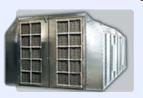
Hierarchy Discussion
Elimination of paint booth
Increase ventilation in paint booth
Substitution of leaded paint
Provide full-face respirator/coveralls
Spray paint booth uses lead paint on one of the painted products, resulting in a potential overexposure to lead.
What is the most acceptable and least acceptable safety approaches?
Post lead warning sign on booth
Limit time in paint booth to <3 hours

Slide 31
5.1.2 Design Review and Management of Change
This element shall address:
  New processes at the design stage
  Changes to existing operations, products, services or suppliers
The process for this element shall include:
  Identification of tasks and associated hazards;
  Consideration of hazards from human factors;
  Consideration of control measures;
  Consideration of applicable regulations, codes, etc.
Notes:
The basic goal here is to identify and manage new hazards and risks before they are introduced into the workplace
Examples of changes include:
New or modified technology
New chemicals, or process changes that use chemicals in new ways
Significant changes to the site’s structure and staffing
New health and safety standards/regulations

Slide 32

Safety Through Design
Project Conception
Build
Eliminate
Design
Operate Maintain
Recycle
Revise
COST OF INTEGRATING SAFETY
Adapted from Safety Through Design, by W.C. Christensen and F.A. Manuele, 1999, Itasca, IL; National Safety Council

Slide 33

5.1.3 Procurement
This element shall address:
  Health and safety risks associated with new products
  Requirements for supplies, equipment, raw materials and other goods purchased
  Ensure that purchased products conform to the organization’s health and safety requirements
ISO 9001/14001 linkages:
  ISO 9001 has strong linkages in terms of design and development reviews and purchasing processes
  ISO 14001 has a much more general requirement to periodically review aspects and operational procedures
Notes:
In my experience, companies tend to overlook the impact of new chemicals and try to manage too much after their arrival
Reducing the health and safety risks associated with chemicals will likely have a big impact on the environmental risks as well

Slide 34

5.1.4 Contractors
This element shall address:
  Identification and control of risks from contractor’s activities, operations and materials on the premises
  Identification of risks presented to contractor from organization’s activities
ISO 9001/14001 linkages:
  ISO 9001 requires a company to maintain control over “outsourced” processes that can affect product quality
  ISO 14001 requires training of contractors whose work involves a significant environmental aspect
Notes:
Z10 requires that the organization coordinate the relevant portions of its system with other organizations
Some regulations require interfacing with the contractor (HazCom, electrical safety, process safety management)
The guidance states that organizations manage through tools such as contract award mechanisms, review of past safety performance, and direct contract requirements

Slide 35



5.1.4 Contractors
Maintenance
Construction
Janitorial
Security
Consultants
Notes:
Again, the relevant portions of the Z10 system should be applied to these—much of this will depend on the risks of the contractor’s job and the risk presented to the contractor by the organization’s activities
Chef—low risk, low hazard contact
Plumber—low risk, but could work in hazardous areas
Nurse—conforms to the company’s blood-borne pathogens program
Questions:
What contractors work with our organization?
What risks are posed by/to the contractors?
How are the risks currently being managed?
What improvements to contractor safety are required?

Slide 36
5.1.5 Emergency Preparedness
The organization shall establish a process to prevent, prepare for and/or respond to emergencies including:
  Development of plans to prevent/minimize risks
  Periodic testing of emergency plans (e.g., drills)
  Evaluating and updating plans/procedures as necessary
ISO 14001 link, 4.4.7, Emergency Preparedness/Response
ISO 9001, weak link, “Control of Non-conforming Product”
Notes:
One of the better documents that might assist in overall emergency planning include NFPA’s 1600 Standard

Slide 37
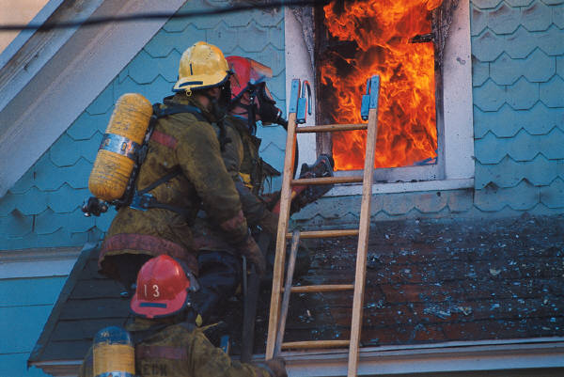
5.1.5 Emergency Preparedness
Yes, we all know you have an Emergency Plan, but:
  Does it address all hazards (e.g., weather disaster)?
  Has it been updated lately?
  Does it meet the most current regulations?
  Is it consistent with other emergency plans?
  Have you conducted emergency drills?
  Considered attacks on physical/cyber assets?
Notes:
Emergency planning cannot be a document on a shelf—it must be effective when needed

Slide 38
5.2 Education, Training, Awareness, Competence
The organization shall establish processes to:
  Define the OHSMS competence needed for employees and contractors
  Ensure that employees and contractors are aware of applicable OHSMS requirements and competent to carry out their responsibilities
  Remove barriers to participation in education and training
  Ensure training is presented in a language trainees understand
  Ensure trainers are competent to train employees
Notes:
Competence is based on job assignments and risks posed by the job
Barriers in participation include time and resources; may be creative:
OTJ Training
Brown bags
Vendor training
Informal training during auditing

Slide 39
5.2 Education, Training, Awareness, Competence
Most regulated issues have a training requirement
Non-regulatory based safety skills training:
  Engineers (safety design)
  Procurement personnel (chemicals to avoid)
  Training in OHSMS awareness, new procedures
Training matrix recommended, periodically reviewed
ISO 9001/14001 linkages
  ISO 9001, 6.2.2
  ISO 14001, 4.4.2
Notes:
What kind of training are we providing?
Does the training meet regulatory requirements?
Is the training performed at the right frequencies to all relevant personnel?
How do we document and track training? Are we missing some areas?

Slide 40
5.3 Communication
The organization shall establish and implement processes to:
  Communicate information about OHSMS and the implementation plan to affected personnel;
  Achieve prompt reporting of injuries, illnesses, hazards and risks;
  Encourage employees to make recommendations regarding possible hazard controls/reporting;
  Identify and remove barriers to all the above.
Notes:
Important OHSMS information to communicate:
Policy
Risks associated with the assigned work
Results of exposure monitoring (regulatory requirement)
Procedures and practices to reduce the work risks
Policies concerning communicating risks to management
Results of safety audits, incident reports, etc. (employee participation)

Slide 41

5.3 Communication
Extent and nature of communication processes should be tailored to the audience in terms of detail, scope
Examples of obstacles or barriers:
  Language differences
  Fear of reprisals from supervisors or peers
  Illiteracy
ISO 9001/14001 linkages:
  ISO 9001, 5.5.3, Internal Communication
  ISO 14001, 4,4,3, Communication
Notes:
I would recommend that everything involving interface with the employees be kept simple for employee buy-in

Slide 42
5.4 Document and Record Control Processes
The organization shall establish and implement a process to create and maintain documents to:
  Implement an effective OHSMS
  Demonstrate conformance with the standard
Demonstration of OSHA compliance isn’t stated but it can be inferred
ISO 9001/14001 linkages (found in “check” sections):
  ISO 9001, 4.2.1, 4.2.3, 4.2.4
  ISO 14001, 4.4.4, 4.4.5, 4.5.4
Notes:
The amount of documentation is commensurate with the size, complexity and risks of the organization
Large organizations commonly use formal documentation and electronic systems
Small organizations may be able to fulfill this requirement through more informal mechanisms

Slide 43
5.4 Document and Record Control Processes
Must identify documents that need to be controlled:
  Policy
  Objectives
  Implementation Plan
  Management reviews
Documents must be labeled with dates of revision
Differences with ISO Standards:
  Records included in the “do” section of Z10
  Z10 does not require an “OHSMS Manual”
Notes:
If a document is referenced, then assume it is subject to auditing (e.g., PSM Program)

Slide 44

5.4 Document and Record Control Processes
Decisions for documents:
  Standard format for operational procedures?
  Centralized document control, or by department?
  Maintain everything hardcopy, or use software?
  Which regulatory plans/procedures incorporated?
Recordkeeping:
  Means of archival (protection against loss, damage)
  Retention periods

Slide 45
Evaluation and Corrective Action
ANSI Z10 Section 6.0
Notes:
The results from these activities are used to determine whether the system is functioning as designed and according to the requirements of Z10

Slide 46
CONTINUAL IMPROVEMENT
IMPROVE: employee H&S productivity satisfaction image
REDUCE: hazards risks incidents comp costs lost time
3.0 Policy Management Leadership & Employee Participation
7.0 Management Review
4.0 Planning
6.0 Evaluation and Corrective Action
5.0 Implementation and Operation
Z10 OHSMS Cycle

Slide 47

6.0 Evaluation and Corrective Action
Defines requirements for processes to:
  Evaluate the performance of the OHSMS using a variety of techniques
  Take corrective actions when non-conformance is found
  Use the results of the evaluation processes as input in the planning processes and management review

Slide 48
6.1 Monitoring, Measuring and Assessment
Processes to monitor and measure hazards, risks and their controls:
  Workplace inspections and testing
  Exposure assessment
  Injury, illness and incident tracking
  Employee input
  Occupational health assessment
  Other methods as required by the OHSMS
The results of these processes shall be communicated to relevant parties, as per laws on medical confidentiality
Notes:
Much of this is regulatory in nature
Z10 recommends that the organization monitor “leading” performance indicators
Indicators that provide information on system effectiveness include:
Reduction of average exposure levels
Rate and timeliness of completion of corrective actions
Completion of required training
Indicators should be designed based on the hazards in the workplace

Slide 49
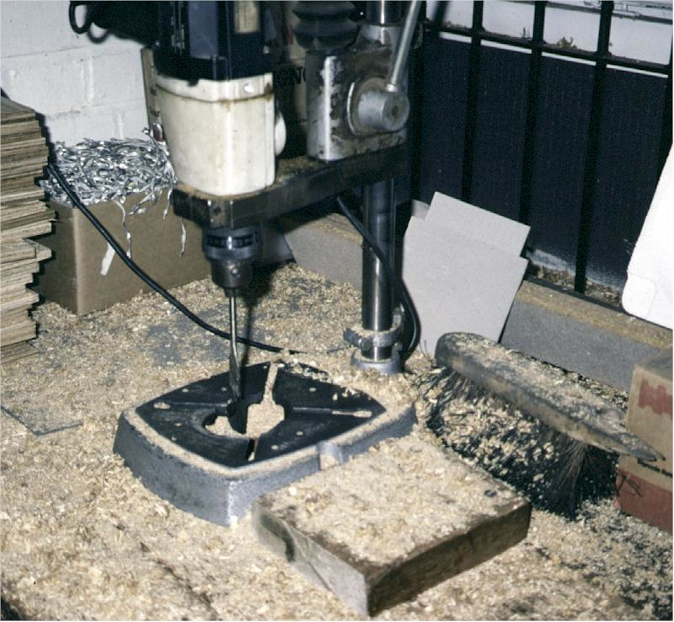

Slide 50
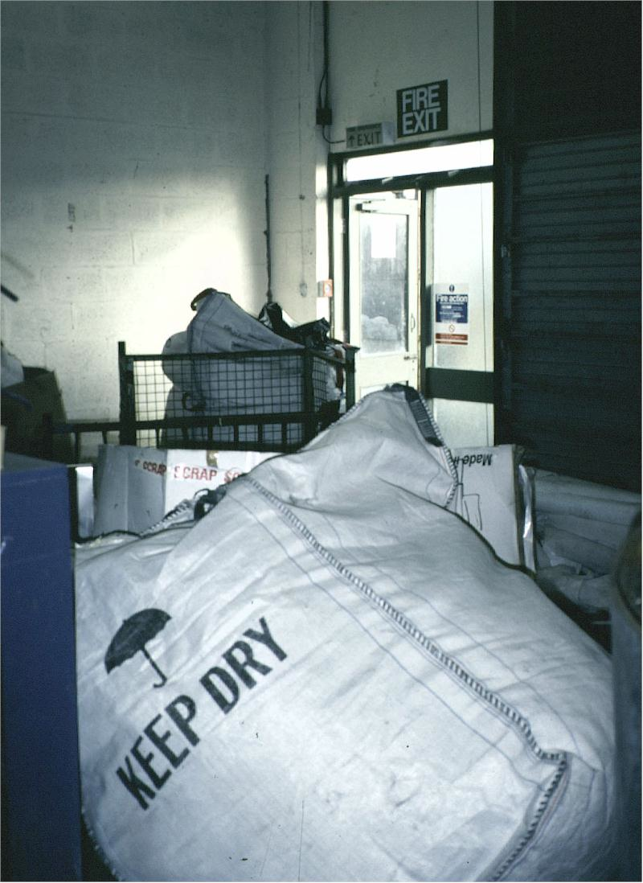

Slide 51
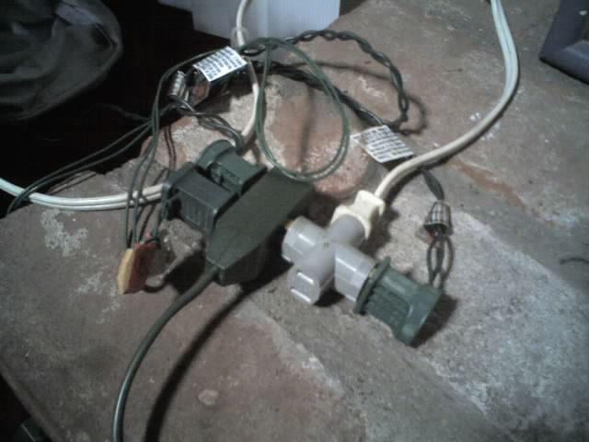

Slide 52
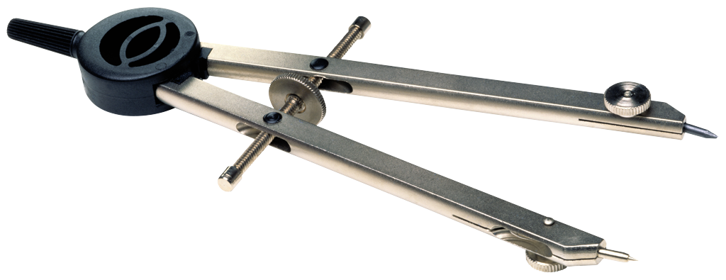
6.1 Monitoring, Measuring and Assessment
Predictive indicators:
  Near-miss incidents
  OHSMS Non-conformances
  Safety climate surveys
Performance indicators:
  Injury and illness rates
  OHSMS non-conformances
  OSHA non-compliances
  Time to correct safety deficiencies
Notes:
Don’t forget the possibility of employee input as a means of monitoring/measurement

Slide 53
6.1 Monitoring, Measuring and Assessment
ISO 9001/14001 Linkages:
  ISO 9001, 8.1, 8.2, 8.3, 8.4 (product focused)
  ISO 14001, 4.5.1 and 4.5.2

Slide 54
6.2 Incident Investigation
Processes to investigate and analyze work-related incidents to determine:
  Deficiencies that may be be causing incidents
  Investigation shall be done in a timely manner
Recommended process elements:
  What needs to be investigated
  When the investigation needs to occur
  Who participates in the investigation
  How recommendations should be handled

Slide 55
6.2 Incident Investigation
The incident investigation should drill deep into causal factors (root causes):
  Organizational
  Operational
  Cultural
Resist the temptation to “fix and fire”
“If you keep doing what you did, you will keep getting what you got”

Slide 56
6.2 Incident Investigation
ISO 9001/14001 Linkages:
  ISO 9001, 8.3 (non-conforming product)
  ISO 14001, 4.5.3 (corrective/preventive action)

Slide 57
6.3 Audits
Processes to:
  Conduct periodic audits to determine if the OHSMS has been appropriately applied and is effectively implemented
  Communicate results to:
    Those responsible for corrective/preventive actions
    Area Supervisors and others that are affected
  Immediately communicate situations that might cause a fatality, serious injury or illness so that corrective actions can be taken
Notes:
Audits required by this section of Z10 are “system-oriented” rather than something like an OSHA safety audit
You treat the requirements set up under your Z10 system as “requirements”
Use the opportunity of auditing as a means to train folks that are non-conforming

Slide 58

6.3 Audits
Benefits of auditing:
  Drive the continual improvement forward
  Opportunity for employee participation
  Identifies risks and OSHA compliance issues
ISO 9001/14001 Linkages:
  ISO 9001, 8.2.2
  ISO 14001, 4.5.5

Slide 59
International Standard for Auditing
ISO 19011:2002, provides audit guidelines on:
  Terms and definitions
  Principles of auditing
  Managing an audit program
  Audit program implementation
  Audit activities
  Preparing for audit activities
  Conducting audit activities
  Audit reporting

Slide 60
6.4 Corrective and Preventive Actions
Processes to:
  Address OHSMS deficiencies and inadequately controlled hazards
  Identify any new hazards resulting from preventive and corrective actions, and overall risk reduction
  Expedite actions on inadequately controlled hazards that could cause serious injury/illness
  Track actions to ensure effective implementation
Notes:
This can often be addressed with a form
Remember SMART criteria

Slide 61
6.4 Corrective and Preventive Actions
When a significant amount of time will be needed to completely correct a hazard, interim measures should be taken
ISO 9001/14001 Linkages:
  ISO 9001, 8.5.2, 8.5.3
  ISO 14001, 4.5.3

Slide 62
6.5 Feedback to the Planning Process
Processes to ensure that the results of monitoring and measuring, audits, incident investigation and preventive and corrective action are included in the ongoing processes of:
  Planning
  Management review
Notes:
There should be a process to ensure this type of feedback occurs
Ideally, there should be a paper trail to document that this feedback has occurred

Slide 63
Management Review
ANSI Z10 Section 7.0

Slide 64
CONTINUAL IMPROVEMENT
IMPROVE: employee H&S productivity satisfaction image
REDUCE: hazards risks incidents comp costs lost time
3.0 Policy Management Leadership & Employee Participation
7.0 Management Review
4.0 Planning
6.0 Evaluation and Corrective Action
5.0 Implementation and Operation
Z10 OHSMS Cycle

Slide 65
6.5 Management Review
Top Management reviews the OHSMS at least annually and makes recommendations to ensure its continued suitability and effectiveness
Information to be covered during the review:
  Progress in the reduction of risk
  Effectiveness of processes to identify, access and prioritize risks and system deficiencies
  Effectiveness in identifying underlying causes of risks and system deficiencies
  Input from employees and their representatives
  Follow-up actions from previous audits and reviews
  The extent to which objectives have been met
Notes:
Again, a primary purpose of the management review is to show that management cares enough about the fulfillment of their Policy to meet and review the system designed to achieve it

Slide 66
6.5 Management Review
ISO 9001/14001 Linkages:
  ISO 9001, 5.6
  ISO 14001, 4.6

