Slide 1
ANSI/AIHA Z10:2005
Session 1: Overview
A U.S.-Based Consensus Standard for a
Occupational Safety and Health Management System
Notes:
What we want to do this session is to briefly discuss the plan→do→check→act concept that defines the typical management system, regardless of whether that system is used to achieve quality, environmental, or in our case, safety objectives.

Slide 2
Disclaimer
DISCLAIMER: This material was produced under grant number SH-19494-09-60-F-12 from the Occupational Safety and Health Administration, U.S. Department of Labor. It does not necessarily reflect the views or policies of the U.S. Department of Labor, nor does mention of trade names, commercial products, or organizations imply endorsement by the U.S. Government. The U.S. Government does not warrant or assume any legal liability or responsibility for the accuracy, completeness, or usefulness of any information, apparatus, product, or process disclosed.
To this end, permission is granted to use such copyrighted material solely for non-commercial, instructional, personal, or scholarly purposes. The material may be used and incorporated into other workplace safety and health programs on the condition that no fee may be charged for the subsequent use of the material. Use of the material for any other purpose, particularly commercial use, without the prior, express written permission of the copyright owner/s is prohibited. Furthermore, any modification to the material is prohibited without the prior, express written permission of the copyright owners.

Slide 3
Course Overview
Management Systems Overview
ANSI/AIHA Z10 Overview
Z10 Standard Elements
Guidance on Putting A System Together

Slide 4
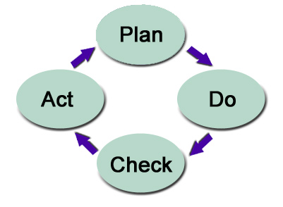
SESSION 1:
OVERVIEW OF
CONTINUAL IMPROVEMENT SYSTEMS
Background, Justification and Benefits of the Management Approach
Notes:
What we want to do this session is to briefly discuss the plan→do→check→act concept that defines the typical management system, regardless of whether that system is used to achieve quality, environmental, or in our case, safety objectives.

Slide 5


The Systems Approach
Notes:
You don’t have to have a system, and most organizations don’t.
So let’s start by discussing the systems way of doing things…what it is, and why it’s beneficial.

Slide 6
The Systems Approach
Management:
  The act or manner of managing; handling, direction, or control
  Generally refers to activities rather than persons
    Planning activities (e.g., identifying what to manage)
    Implementing activities (e.g., how you manage)
    Monitoring and checking (e.g., how well do you manage)
    Acting on the information (e.g., how can we improve?)
System:
  Combination of things or parts forming a complex or unitary whole
Notes:
We are discussing in this course the ANSI safety and health management system.
To understand the systems approach, we would do well by focusing on the term “management system”.
“Management” as it says here is the act of managing, handling or directing something. There are different types of management activities, according to the Plan→Do→Check→Act cycle.
Planning—Identifying a regulatory requirement to train on a certain safety topic
Implementing—The manner of designing, delivering and documenting training
Checking—Processes to determine how effective the training is
Act—Processes to act on the training evaluation to improve training next time
System—Generally refers to manner in which these various activities are arranged, as opposed to being loosely throw together or having missing components
In our context, we are looking to have a system that fosters continual improvement

Slide 7
Deming Cycle
Based on the scientific method
Every run through the cycle should bring you closer to the goals and objectives for the system
Continuous improvement rather than “delayed perfection”
Notes:
Based on the scientific method where you put forth activities to accomplish a set of objectives and you have a “theory” as to what should happen in terms of results
Often people have their theory and they assume it’s a fact until they have a surprise inspection, or an accident, or some other grievous event that wakes them up from their optimism
The management system doesn’t assume things will happen well; you might say it’s a little pessimistic in that sense. It has a checking function to test how things go with an eye toward always making them better

Slide 8
The Systems Approach: Framework
A framework that helps establish and maintain:
  A Health and Safety Policy, with explicit commitments
  Identification of hazards and risks for the organization
  Identification of applicable legal/other requirements
  Planning activities across the full range of activities
  Disciplined processes for achieving objectives
  Emergency preparedness and response plans
  Operational controls to ensure performance
  Processes to review/audit to identify areas of improvement
Notes:
These are some of the basic components of the ANSI management system…
If you want to distill this framework down into its essentials, the framework must:
Establish a Policy and objectives
Establish an organization structure and procedures to achieve the objectives
Use measurement and evaluation to assess performance of the system
Have a process for corrective actions and improvements to the system

Slide 9

The Systems Approach: Framework
Training
Communications
Procedures
Policies
Review
Plan
Records Storage
Planning Meetings
Check
Implement
MANAGEMENT ELEMENTS
MANAGEMENT SYSTEM
Notes:
You can see the need for a framework when you think about how the management elements are typically developed.
A rule or other requirement comes along that requires certain management elements, be it a procedure, or training, or testing, perhaps a records requirement
After time, these different elements get scattered around without any regard of how they might fit together for better effectiveness and less redundancy
The framework provides a mechanism for that each element has a place in the overall system. Over time the things that are done in each phase of the cycle are improved on. What you have is a system that can operate in a pro-active, rather than a reactive fashion.

Slide 10

The Systems Approach:
Compliance- versus Systems-Thinking
Compliance?
INPUT
OUTPUT
Yes!
STOP
Can we improve?
INPUT
OUTPUT
FEEDBACK LOOP
Notes:
One of the challenges when you put system in place is having to break a compliance mind-set.
Having an awareness that compliance is important is not a bad thing. But the problem with regulations is that they set the minimum standards, but also the maximum standards for performance.
In other words, if an activity is “in compliance” then some folks don’t understand the need to go any further.
With the management system, the idea is continual improvement—even where compliance is achieved. “Can we improve” “Can it be made safer” are questions to be asked. The feedback loop of checking the system for conformance helps get you there and creates a “continuous improvement” culture.

Slide 11

Compliance Programs versus Management Systems
Compliance Programs | Management Systems
Required by government entities | Voluntary
Some have feedback loop; others do not require checking or review | All have feedback loop requiring review for continual improvement
Motivation is often based on a need to avoid bad consequences | When done right, motivation tends to be more achievement-oriented
Can be proactive or reactive | Proactive by design
Employee participation during design and improvement often is limited to the compliance experts | Employee participation is typically encouraged at all levels in order to promote employee buy-in
Notes:
Here are some more comparisons between a compliance program and a management system

Slide 12
Systems-Approach Discussion
You’ve just been informed that the members of your company’s emergency response team are required to be trained under HAZWOPER rules (29 CFR 1910.120)
From a narrow compliance perspective, how might this awareness be addressed?
From a systems perspective, what things might be considered?
Notes:
You select a few persons on each shift and send them to a HAZWOPER course.
From a systems perspective, you would first consider the resources needed for a team.
You would then make an informed decision as to how the various emergencies should be addressed—in-house or by mutual aid groups.
You would review the emergency response plans to ensure they are up-to-date.
You would ensure processes are in place to maintain emergency equipment and protective gear.
You would set schedules for training and medical surveillance for team members.
You would periodically test the emergency procedures to ensure their effectiveness.
In short, you would establish an emergency response system, not just train folks.

Slide 13
The Systems Approach: Summary
The Management Systems approach:
  Integrates all management elements
    Less redundancy
    Better performance
  Is a proven management framework
  Requires feedback and review mechanisms
  Promotes continual improvement:
    As a set of policies and procedures
    As a mindset, “This is how we do business”
Notes:
Proven by over a million quality management systems, and hundreds of thousands environmental management systems.
Safety management systems are less numerous, nut nonetheless proven to work.

Slide 14
Management System Applications

Slide 15
Management Systems Through the Years
Year | System | Focus
1987 (2008) | ISO 9001 | Quality; meeting Customer expectations and product specifications; certifiable
1996 (2004) | ISO 14001 | Environment; managing environmental aspects and impacts; certifiable
1996 | BSI 8800 | Occupational health and safety: Non-certifiable guidance document
1999 (2007) | OHSAS 18001 | Occupational health and safety; can be third-party certified
2001 | ILO OHS/2001 | Occupational health and safety: Non-certifiable guidance document
2005 | ANSI Z10 | Occupational health and safety; can be third-party certified
Notes:
At the time of the British Standard 8800, there was not widespread support for a management system standard in the US
It is interesting to note that there are other national standards out there, such as in Australia, Singapore and Canada

Slide 16
Comparison of Systems
ANSI Z10 | ILO-OSH 2001 | OHSAS 18001 | ISO 14001
Management Leadership and Employee Participation | Policy | General Requirements | General Requirements
Planning | Organizing | Policy | Policy
Implementation and Operations | Planning and Implementation | Planning | Planning
Evaluation and Corrective Actions | Evaluation | Implementation and Operation | Implementation and Operation
Management Review | Action for Improvement | Checking and Corrective Action | Checking and Corrective Action
 |  | Management Review | Management Review
Notes:
If you lay these standards together, you can see just how similar they are…
Actually, the “General Requirements” throw off the ISO standards otherwise they’d line up even better

Slide 17
Management Systems and OSHA
1982, Voluntary Protection Programs
1989, Safety and Health Management Guidelines
Regulatory requirements (e.g., PSM):
  Management involvement; employee participation
  Process hazard analysis; plans for improvement
  Requirements of operational/maintenance procedures
  Management of change; pre-startup safety
  Periodic auditing
  Corrective and preventive actions
Safety and Health Management Systems e-Tool
Notes:
I remember OSHA offered an incentive program whereby if an organization could show conformance with the Guidelines they’d be moved to the back of the line for targeted inspections

Slide 18
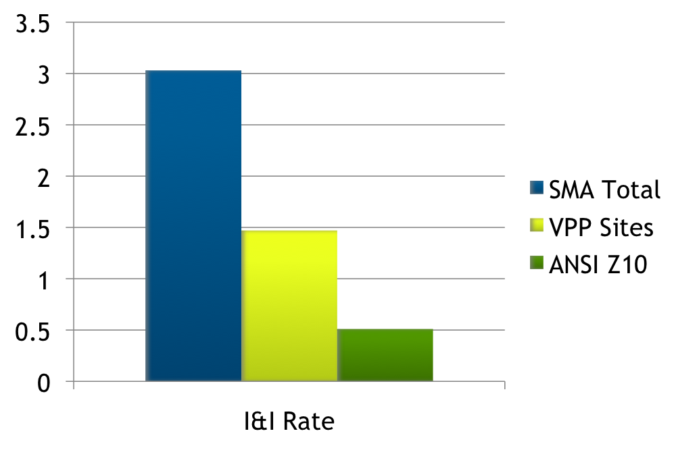
ANSI Z10 Results
Source: SMA OSHA Meeting, September 17, 2009
Notes:
We said that management systems are proven…this was a bit of evidence I found on the internet for the Steel Makers Association

Slide 19

OHS Management System Uses
Reduction of injury/illnesses
Third-party certification
  Performance improvements
  Marketability among Customers
  Contractual reasons
Supplier qualifications
Self-assessment tool
Guidance for existing programs
Regulatory enforcement
Notes:
Obviously, we should never lose sight of the fact that reduction of injury and illnesses is the primary goal
But there are secondary objectives for establishing a system…

Slide 20

Why ANSI Z-10?
OHSAS 18001 is based on British Standard 8800
ANSI Z10 is a US-based model for OHS Systems (better represents US stakeholders)
  Businesses
  Labor (ILO-OHS 2001)
  OSHA
ANSI Z10 is compatible with the ISO Quality (ISO 9001) and Environmental (ISO 14001) management system standards
US input into possible future ISO OHS standard
Notes:
There is a list of participants in the manual

Slide 21
Some Z10 Committee Representatives (Examples)
AFL-CIO | American Chemistry Council
American Foundry Society | Alcoa, Inc.
ASSE | Baxter Healthcare Corporation
Cornell University | Duke Energy
Goodyear | IBM
Liberty Mutual Insurance | National Safety Council
New York State DOT | NIOSH
OSHA | United Auto Workers Union
United Steelworkers of America | University of South Florida
US Chamber of Commerce | VPPA
Notes:
You can see a wide range of participation in putting this standard together

Slide 22
OHSAS 18001 and ANSI Z10
OHSAS 18001:2007 | ANSI Z10:2005
BSI-owned, EU consensus standard | US national consensus standard
OHSAS Project Group: Consortium of 43 organizations from 28 countries, chaired by BSI | Z10 Committee: US industries, industry trade groups, labor, agencies, standard setting bodies
Internationally recognized, can be used for accredited certification | Gaining recognition, can be used for accredited certification
Elements aligned with ISO 14001 | Elements compatible with ISO 14001, but some differences
In absence of ISO Standard, is leading default global standard | Has special significance to US as a national consensus standard
Notes:
Here’s a quick comparison of the British Standard and the ANSI Z10
Some key differences:
18001 has just Policy—ANSI has Policy, Leadership and Employee Participation
Implementation and Operation—ANSI specifies the use of the hierarchy of controls, but 18001 doesn’t

Slide 23
Registrar Observations
STR-Registrar LLC ANAB Accredited for 18001/ANSI Z10
Bryce Carson, 18001/ANSI Z10 Auditor, observations:
  Five companies with Z10-accredited certification (02/2010)
  Hierarchy of controls for ANSI Z10 seem more robust
  As an auditor, prefers auditing Z10 over 18001
  Would recommend Z10 over 18001 for US companies
  18001 more accepted for companies overseas
Notes:
Some registrar observations…

Slide 24
ANSI Z10 as US Consensus Standard
Possible future adoption by OSHA in lieu of a separate government-unique standard (OMB Circular A-119)
Possible enforcement ramifications under the General Duty Clause (GDC) as an industry “standard of care”
Might be employed to satisfy requirements of state-plan OSHA programs (e.g., Cal-OSHA)
Implementation could justify savings on insurance
Implementation may help jumpstart VPP participation
Aid in constructing settlement agreements with federal, state-plan OSHA agencies and MSHA
Notes:
Considerations of the ANSI standard…why it’s important to the Safety Professional

Slide 25

Keys to Successful System Implementation
Top management commitment/support
Employee participation/buy-in
Initial gaps analysis (required by Z10)
Dedicated system “Champion”
Careful management of human resources
Expect and deal positively to challenges
Showcase employee achievements

Slide 26

Case Study 1: Trucast
Manufacturer of turbocharger wheels for the automotive and power generation industries
Small company, approximately 130 employees
First company to receive accreditation to ANAB under ANSI/AIHA Z10:2005
Improved safety performance and awareness
Created a culture of looking to eliminate or minimize safety issues by identifying them, applying hierarchy of controls
Ranking of JSAs, annual objectives for safety, annual review

Slide 27
Case Study 2: Nucor Steel
750 Employees in Crawfordsville, Indiana
First steel mill in nation to be registered to ANSI Z10
First facility in world to be registered to both ANSI Z10 and OHSAS 18001
Nucor Corporation has 36 VPP Sites of which 4 are registered to ANSI Z10 and an additional 5 in process of registration
Nucor Corporation has had discussions with OSHA in Washington regarding ANSI Z10 as complement to the VPP

Slide 28
Case Study 2: Nucor Steel
ANSI implementation involved all functional levels in the development of the OHSAS
100% training on the OHSAS
Developed a risk ranking database to assign numeric factor to each hazard assessment submitted by employees
The OHSAS creates structure and ensures closure to hazard remediation and compliance

Slide 29
Further Information: OSH Systems
ANSI Z10 can be purchased from:
  American Society of Safety Engineers (www.ASSE.org)
  American Industrial Hygiene Association (www.aiha.org)

