Slide 1
Course Material
Overview of Process Safety
Compliance with Standards
Process Hazard Analysis
Standard Operating Procedures
Safe Work Procedures
Mechanical Integrity
Management of Change
Auditing Process Safety Systems
Emergency Response Procedures
Notes:
This training on process safety was developed by the Center for Chemical Process Safety (CCPS), which is a Technology Alliance of the American Institute of Chemical Engineers. It was developed under an OSHA “Susan Harwood Grant”. We have just completed Module 6 on “Mechanical Integrity.” This is module 7 of 9 and is entitled “Management of Change”.
This material was produced under grant SH-19479-09-60-F-36 from the Occupational Safety and Health Administration, U.S. Department of Labor.
It does not necessarily reflect the views or policies of the U.S. Department of Labor, nor does mention of trade names, commercial products, or organizations imply endorsement by the U.S. Government

Slide 2
7. Management of Change
Process Safety Management for Biofuels
29 CFR 1910.119 (l)
Notes:
For hazardous processes, Management of Change systems are required by OSHA’s Process Safety standard, which are referenced in this PowerPoint slide. “The employer shall establish and implement written procedures to manage changes to process chemicals, technology, equipment, and procedures; and, changes to facilities that affect a covered process.”
Management of Change systems help insure that changes will not adversely affect employees, contract workers, the public, or the environment.
This module will discuss
1) The Design of a Management of Change system.
2) The Implementation of such a system
3) Maintaining an effective Management of Change system

Slide 3
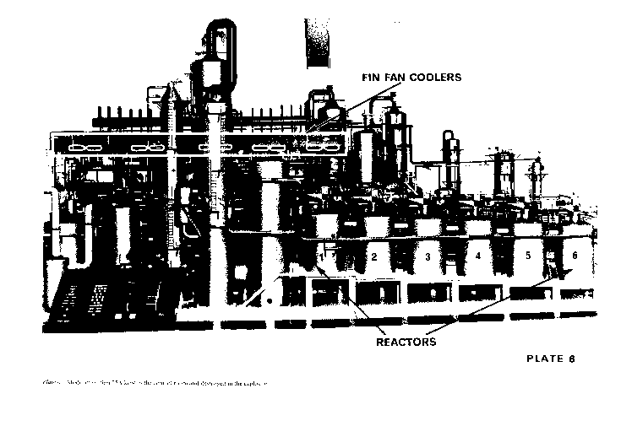
Flixborough Reactor Series
Notes:
We will first start with a tragic failure of a management of change system.
The 1974 explosion at the Nypro site in Flixborough, UK is often cited as the classic example of the failure of “Management of Change”. The Nypro plant was opened in 1967 for the production of a basic raw material for Nylon 6. The portion of the plant where the explosion occurred contained six reactors operating at 150 psig and 300 degrees F for the oxidation of cyclohexane. Each reactor was at a slightly lower elevation than the preceding reactor in the series.

Slide 4
Bellows at Flixborough
Notes:
On March 27, 1974, a crack was detected on Reactor No. 5. A maintenance engineer recommended a three week shut-down to repair the crack in the reactor. The Maintenance Manager, whose role was being filled by the head of the laboratory while awaiting company reorganization, proposed instead a 20 inch diameter bellows connection to bypass Reactor No. 5. The bypass modification was carried out in four days, Reactor 4 was temporarily connected to Reactor 6, and the plant was restarted on April 1. Creases were created in the bellows by the difference in elevation of Reactor 4 and Reactor 6.

Slide 5
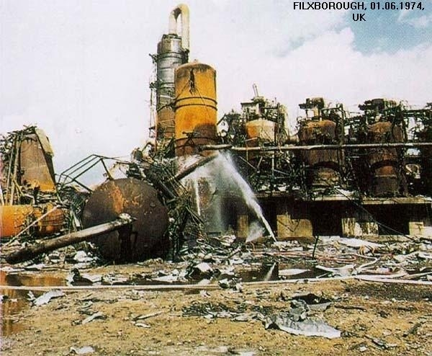
Of
Notes:
On June 1, the temporary piping ruptured at the bellows.
Over 60,000 pounds of hot cyclohexane escaped in 30 seconds forming a flammable vapor cloud more than 300 feet high. The cloud ignited yielding an energy release of about “15 tons of TNT”. The entire plant was destroyed. Neighboring housing was destroyed as the fire burned for over three days. Twenty-eight employees were killed and 36 employees were injured.

Slide 6
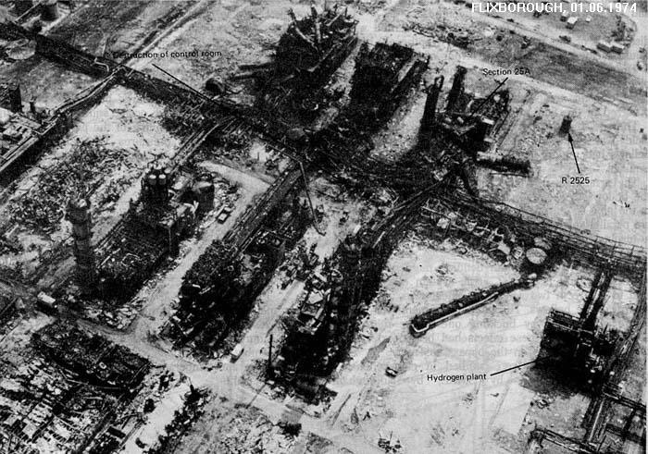
Notes:
Only a very minimal Management of Change process had been performed. As a result, no design calculations had been carried out for the construction of the bellows. The incident investigation concluded that the rupture of the temporary piping was due to excessive fatigue of the bellows. The bellows were not designed for the service in which they were used. The temporary piping modifications were constructed, essentially without design, by people who did not know how to design large pipes with bellows.
An effective Management of Change system would have picked up on the design flaw BEFORE the change was implemented and the disaster would have been averted.

Slide 7
Management of Change
1. System Design
Notes:
Let’s start with the design of a Management of Change system

Slide 8
Management of change (MOC)
A management system for ensuring that changes to processes are properly analyzed, documented, and communicated to affected personnel.
Definitions
Notes:
Management of Change is often called MOC. A definition of Management of Change is on this PowerPoint slide.
Note that the MOC system focuses on three areas: 1) Analysis, 2) Documentation, and 3)Communication.

Slide 9
process chemicals, technology, equipment, procedures facilities
Management of Change
Types of MOC
Notes:
A management of change system is a written, structured program that reviews and obtains approval for any change that could affect the safety of a hazardous chemical.
A Management of Change system should manage changes to the following:
process chemicals,
process technology,
equipment,
procedures, or
Facilities
An MOC system not only addresses the process and equipment being changed but also ensures that all personnel affected by the change have been notified of the change AND have been trained on the ramifications of the change.
More details on the type of changes that can be encountered can be seen by clicking the MOC link.

Slide 10
Process Safety Information
1910.119(l)(4)
If a change covered by this paragraph results in a change in the process safety information required by paragraph (d) of this section, such information shall be updated accordingly.
Notes:
The OSHA PSM regulation is very specific on covering changes to process safety information resulting from a process change. The wording of the regulation is shown on this PowerPoint.
The regulations also state that if a change necessitates a change in procedures or practices associated with a process, whether operations or maintenance procedures, such procedures or practices should be updated and implemented promptly and accurately.

Slide 11
Management of Change
System Design
Written MOC procedures
MOC “owner”
Defined scope
Defined roles and responsibilities
Notes:
On this slide and the next, we will cover the most important aspects of the design of an MOC system. More detail on system design, with twenty-five points to consider, can be found by clicking the “System Design” link.
Establish and implement written procedures to manage changes.
Assign a job function as the “owner” of the MOC system to monitor MOC effectiveness on a routine basis.
3 Define the technical scope of the MOC system so that types of changes to be managed are certain and sources of changes are monitored.
4 Define the MOC roles and responsibilities of various types of company/facility personnel.

Slide 12
Management of Change
System Design
5. Management of Change log
6. Management of Change form
7. Periodic monitoring (field checks)
8. Auditing
Notes:
The MOC system should also include:
5. Maintaining a Management of Change log of every approved change for the past two years.
6. A Management of Change form with approval signatures must be used. Design calculations should be attached. A Readiness checklist (PSSR) should be used for the startup after the Management of Change.
7. Conducting periodic monitoring (field checks) of the Management of Change procedures.
8. The Management of Change system should be audited with the annual Process Safety Audit.

Slide 13

Management of Change Training
Notes:
Provide awareness training on the MOC system to all employees and contractors.
Provide detailed training to all affected employees and contractors who are assigned specific roles within the MOC system.

Slide 14
2. The
Management of Change (MOC) Process
Notes:
Let’s now discuss how an efficient Management of Change process should work.

Slide 15
Notes:
The first step in the Management of Change process is to fill out a “Request For Change” form. This form would describe the proposed change and the reason for the change. (An example RFC form can be seen by clicking on the RFC icon.) The RFC form would then be approved by the originator’s manager and forwarded to the Management of Change manager. At smaller facilities this position is not a full time position. The MOC manager would consult the originator and the affected party to determine if the change should be pursued.
If the change is not to be pursued, then the RFC is returned to the originator.

Slide 16
MOC
Notes:
Once the decision has been made to pursue the change, the determination is then made if the change is a Replacement in Kind (RIK) or a Management of Change (MOC). If the change is a replacement in kind, then that should be noted on the Request For Change and the RFC forwarded to the maintenance/production scheduler. A “Replacement in Kind” is a replacement that meets the original design specifications of the item being replaced and will be discussed in more detail in the next slide.
If the change to be considered is not a Replacement in Kind, then it enters the MOC system. An MOC form, task review, and hazard review need to be completed. This is often a multidisciplinary review. The outcome of this review is MOC documentation of the controls needed in order to implement the Management of Change in a safe manner.
An example MOC form is provided by clicking the MOC link.

Slide 17
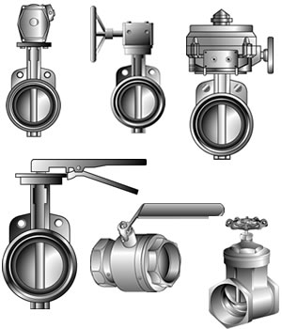
Replacement in Kind
Actuated butterfly valves
Butterfly valve
Ball valve
Gate valve
Notes:
If an item is replaced with a similar item that meets the original design specification, then the replacement item is a replacement in kind.
As an example, a piping specification may call for a threaded 1-1/2” stainless steel ball valve. A 1-1/2” stainless ball valve by any manufacturer of such a valve, such as Apollo or Jamesbury, would be a replacement in kind.
A threaded brass ball valve by American Valve or by Watts would not be a replacement in kind since the material of construction is different.
A gate valve by Apollo or by Jamesbury also would not be a replacement in kind since the type of valve has changed.

Slide 18
Notes:
Pre-implementation tasks should be completed before the actual change is implemented. Pre-implementation tasks include such items as site review, review with affected areas, and safety checks. All work orders should reference the MOC documentation and the safety requirements.

Slide 19
Notes:
Once the pre-implementation tasks have been completed, the actual work to implement the change can begin. The MOC work will be guided not only by the tasks necessary to perform the work, but also by the controls that were specified during the pre-implementation reviews.
Once the physical change has been completed and training has been conducted on the change, a Pre-Startup Safety Review (PSSR) needs to be conducted. More detail on the PSSR will be given later in this module.

Slide 20
Management of Change Training on the Change
Notes:
Employees involved in operating a process, and maintenance and contract employees whose job tasks will be affected by a change in the process, should be trained in the change prior to start-up of the process or affected part of the process.

Slide 21
Management of Change
MOC Form
Technical basis
Impact on safety and health
Modifications to operating procedures
Necessary time period for the change
Authorizations
Notes:
Now that we have covered the work flow involved in implementing a change, let’s look at the documentation that is needed to insure that the MOC work follows the path that is specified by the Request for Change and that is required by the local process safety management system.
The following should be contained in any Management of Change form:
The technical basis for the proposed change;
Any impact the change could have on safety and health;
Any impact that the change will have in requiring modifications to existing operating procedures;
The time period necessary to perform the change; and,
Authorization requirements for the proposed change.
The MOC form should also note items such as scope, design, sketches or drawings, cost estimate, time schedule, and planned pre-startup checks.
A more detailed list of 25 MOC guidelines can be found by clicking the MOC Form link.

Slide 22
1. Technical Basis for Change
What?
How?
Why?
Where?
When?
Notes:
The technical basis for change should include an explanation of the proposed modification, the reason for performing the work, the desired results, technical design, safety precautions, and appropriate implementation instructions. The technical basis for change should be of sufficient detail to allow appropriate supervisory, technical, and management review. The five key questions must be answered: What is the change? Why is the change necessary? How will the change be done? Where will the change take place? When will the change take place?

Slide 23

2. Impact on Safety & Health
Notes:
The MOC form should state if the change will have a potential impact on safety, health, or the environment. A Process Hazard Analysis should be conducted or revalidated, as discussed in module 3, in order to document the impact or lack of impact.

Slide 24

3. Modifications to Operating Procedures
Notes:
If the change will require a revision in either process procedures or maintenance procedures, the revisions should be made prior to the start-up of the changed process.

Slide 25




Necessary time period for the change
MOC
Notes:
The scope of the change and the necessary time period to implement the change should be specified on the MOC form. Click on the MOC link and refer to Item 1, “Description of Change” for an example.

Slide 26

Management of Change
5. Authorizations
Notes:
Since the MOC will require 1) an Environmental, Health, and Safety review, 2) a review of procedures, and 3) training, those responsible for these activities in the affected unit should sign off on the MOC. The area engineer, area manager, and MOC coordinator should also approve the change. See Item 8, “Approvals” of the hypothetical MOC form to see an example.

Slide 27
DEFINING ROLES AND RESPONSIBILITIES
Notes:
Implementing an effective MOC system in a facility requires action by many different departments and individuals. The specific assignments of responsibility and authority may be different from location to location. For example, at a large facility, more than one person may be assigned full-time responsibility for some of the functions. On the other hand, a small facility may have a single individual who performs many of the functions. Also, the MOC roles might not be full-time jobs, even for the MOC coordinator, unless the facility experiences a large number of changes. The written MOC system documentation should describe the titles and specific roles for key personnel in the MOC system. In the following slides we will discuss generic roles and responsibilities associated with implementation of MOC systems.

Slide 28
Change Originators
DEFINING ROLES AND RESPONSIBILITIES
Notes:
Change originators. These individuals (e.g., operators, maintenance technicians, frontline supervisors, process engineers, etc.) typically identify needs and initiate requests for changes. Originators should propose only those changes that they believe can be implemented with manageable safety and health impacts. The originator’s description of a proposed change should provide enough detail to allow for adequate evaluation during the MOC approval process.
The MOC system should ensure that all necessary supporting technical studies, design calculations, drawings, and specifications are completed and provided along with the MOC package.

Slide 29
ROLES AND RESPONSIBILITIES
Reviewers
Notes:
The MOC reviewers must analyze a potential change for hazards before the change is implemented. Different types of reviewers may be required, depending upon the category and risk significance of the change involved.
The designated initial reviewer determines whether (1) a change is truly needed and feasible and whether (2) the originator’s classification of the modification is appropriate. These determinations often involve consultation with technical experts and other individuals. The initial reviewer is often responsible for ensuring that the proposed change does not violate appropriate financial or administrative protocols. The initial reviewer may also determine the level of additional review that is required.
Each MOC approver should consider the results of each review and
(1) approve the change for implementation as requested and thus accept any associated risk,
(2) require amendment to the MOC change request,
(3) require that a more rigorous hazard evaluation be conducted, OR
(4) deny the change request.
Small sites and situations involving simple types of changes may have only a single, experienced individual designated to authorize the completed MOC form. Situations involving complex changes or high hazard levels may require that more than one person approve the change for implementation.

Slide 30

MOC Coordinator
ROLES AND RESPONSIBILITIES
Notes:
MOC coordinator.
This individual directs the activities associated with the MOC system and is often responsible for leading the development, installation, operation, and maintenance of the MOC system, including the MOC system procedures and records. The MOC coordinator also (1) helps define review procedures for changes that do not clearly fit into prescribed MOC categories, (2) serves as coach, counselor, and trainer to those implementing the MOC system, and (3) is often the final authority for deciding whether proposed work is a change or a Replacement in Kind.

Slide 31
PSM Manager
ROLES AND RESPONSIBILITIES
Notes:
Process Safety Management manager.
The PSM manager has responsibility for guiding the overall development of PSM element systems at the site and ensuring that these systems meet applicable requirements, for example OSHA’s PSM regulations. In addition, the PSM manager works to meld the individual PSM element systems (including MOC) into a cohesive PSM program. For example, at some facilities the PSM manager closely monitors the coordination of MOC and pre-startup safety review (PSSR) procedures.

Slide 32
ROLES AND RESPONSIBILITIES
Employees
Notes:
All employees. The effectiveness of all MOC systems ultimately depends upon the employees’ commitment to identifying potential change situations and following the appropriate change review procedures. Because of the need for employee commitment, educating all affected site employees about the following is vitally important:
The goals of the MOC program,
The definition of what constitutes a change, as opposed to a Replacement in Kind,
The identity, responsibility, availability, and authority of each MOC system participant,
Their individual responsibilities under the MOC program.

Slide 33

Senior Management
ROLES AND RESPONSIBILITIES
Notes:
Senior managers, with input from the PSM manager, establish the specifications for the MOC system. They may also specify the scope of the MOC system; for example, they may choose to implement MOC more widely than is specified by regulatory requirements alone.

Slide 34
Changes to cover under MOC
Capital improvement projects
Maintenance work orders
Instrument change requests
Spare parts control, warehousing, and distribution
Engineering change requests
Notes:
Procedures and documents associated with the following activities should be covered under Management of Change:
Capital improvement projects
Maintenance work orders
Instrument change requests
Spare parts control, warehousing, and distribution
Engineering change requests

Slide 35
Changes to cover under MOC
Research and development (R&D) process change recommendations
Company specifications
DCS programming change requests
Process experiments or tests conducted in the manufacturing plant.
10. Contractor service agreements
Notes:
Procedures and documents associated with the following activities should also be covered under Management of Change:
Research and development (R&D) recommendations
Company specifications (e.g., equipment, products, raw materials, packaging)
Programming change requests
Process experiments or tests
Personnel transfers or changes in contractor service agreements (e.g., maintenance, engineering design, sourcing)

Slide 36
1. Keep it simple
2. Obtain acceptance
3. Field test the system
4. Provide adequate training
Guiding Principles for Implementation
Notes:
Four key principles for successfully implementing a Management of Change system at your facility include:
1. Keep the system simple, yet fit for duty. A modest system that works is much better than a complicated system that does not work.
2. Obtain widespread acceptance and commitment from all affected groups by soliciting their opinions when developing the MOC system.
3. Debug the system prior to its official implementation. A system plagued with problems will discourage use by the intended users.
4. Provide robust training for affected personnel so that everyone is aware of the existence of the system and their roles and responsibilities within the system.

Slide 37
3. Maintaining an effective
Management of Change (MOC) Process
Notes:
The next several slides will discuss to maintain an effective Management of Change process at your facility.

Slide 38
1. Monitor effectiveness
2. Audit
3. Demonstrate commitment
Maintaining an MOC System
Notes:
Once the MOC system is implemented, integrate the use of Key Performance Indicators (KPI’s) to continuously monitor the effectiveness of the program.
Audit Management of Change forms and files to make sure that the proper paperwork was completed BEFORE the change was implemented. Talk to personnel that were involved in and affected by the change to ensure that thorough training was completed before the change was made.
Demonstrate management commitment to the MOC program by making the difficult decisions in favor of safety when an MOC review indicates a problem with process or equipment. Keep the Flixborough explosion in mind – the quickest fix for the problem was the wrong choice. Management should provide the necessary resources (people, time, and money) that are required for an effective and safe change in process or equipment.

Slide 39
Effectiveness of MOC System
Key Performance Indicators
The number of MOCs performed each month.
The monthly percentage of work requests that are classified as a change.
The percentage of emergency MOCs.
The average backlog of MOCs.
The average calendar time from MOC origination to MOC authorization.
Notes:
Some Key Performance Indicators to continuously monitor the effectiveness of the MOC program should include the items listed in this PowerPoint slide.
The number of MOCs performed each month. An unexplained drop may indicate that the MOC system is being bypassed.
The monthly percentage of work requests that are classified as a change. A significant increase or decrease could indicate the need for refresher training or training for new employees.
The percentage of emergency MOCs. An increase could indicate an attempt to circumvent the MOC system.
The average backlog of MOCs. An increase may indicate a resource problem or an efficiency problem.
The average calendar time from MOC origination to MOC authorization. Again, an increase may indicate a resource problem or an efficiency problem.

Slide 40
Effectiveness of MOC System
Auditing
Documentation completed
Training conducted
Procedures reviewed for updating
Pre-Startup Safety Reviews
Notes:
A significant or increasing percentage of deficiencies in any of the four areas listed in this PowerPoint indicate the need for refresher training for the MOC authorizers:
1. MOC Documentation
2. Training
3. Updating procedures
4. Conducting Pre-Startup Safety Reviews before restart of the modified process or equipment

Slide 41

Management of Change
Pre-Startup Safety Reviews
Notes:
A pre-startup safety review (PSSR) must be performed before the startup of a new or significantly modified facility is authorized.
How to determine when a PSSR is required follows:
A pre-startup safety review IS required if the modifications to a facility are significant enough to require a change in the process safety information.
A pre-startup safety review IS NOT required for facilities that have been modified so slightly that process safety information does not change.
However, for all modified facilities, management of change (MOC) requirements must be satisfied before startup.

Slide 42
Pre-Startup Safety Review
The term pre-startup safety review (PSSR) means a final check prior
to initiating the use of process equipment.
Notes:
Pre-Startup Safety Reviews are often referred to as “PSSR”s and will be defined further in the following PowerPoint slides.
PSSR s are a final check, initiated by a trigger event, prior to the use of a new or changed aspect of a process.
Also, it is a management system for ensuring that new or modified processes are ready for startup after a change has been made.

Slide 43
PSSR
It is applying a systematic method to confirm that the startup team and process equipment are prepared for startup.
Notes:
It is a management system for ensuring that new or modified processes are ready for startup.

Slide 44
Any change being made to an existing process, or any new facility being added to an existing process or facility, or any other activity a facility designates as needing a pre-startup safety review.
Definitions
Trigger Event
Notes:
Events that can trigger the need for a PSSR include any change to an existing process or facility or the introduction of a new process or facility.

Slide 45

Non-change Trigger Event
Notes:
One example of a non-change related trigger event is performing a PSSR before restart after an emergency shutdown.

Slide 46
When Should a PSSR be Performed
Capital project approved
Changes to Operating Facilities occur
Temporary Changes (Flixborough)
Restart of an idled process
Notes:
A PSSR should be performed after the following events occur:
When a major capital project that impacts PSM is approved.
When Changes to Operating Facilities occur that impacts PSM.
When temporary changes are made. Flixborough was an example of a temporary change
When restarting a mothballed process

Slide 47
1. Regularly evaluating industry process safety related incident reports and how PSSR was potentially involved in the situation.
Best Practices – PSSR
Notes:
The PSM manager or coordinator at the site should research and share the experiences of other chemical plants whenever it might apply to their facility.

Slide 48
2. Using electronic databases for capturing past PSSR documentation.
Best Practices - PSSR
Notes:
This allows PSSR teams to use search engines or other file indexing tools to evaluate similar past PSSRs.
This encourages and enables taking advantage of the company's collective knowledge and lessons learned.

Slide 49
3. Performing PSSRs on selected critical maintenance activities.
Best Practices - PSSR
Notes:
This practice provides a double check on key performance issues.

Slide 50
4. Involving many different workers in the PSSR process.
Best Practices - PSSR
Notes:
This promotes reinforcement of the process safety program at the facility and provides documented employee participation.

Slide 51
5. Selecting a PSSR team leader who is somewhat removed from the specific project involving the change.
Best Practices - PSSR
Notes:
This helps remove the possibility that project schedule pressures and pride of ownership will negatively influence the review.

Slide 52
6. Showing open management support for the importance of PSSR.
Best Practices - PSSR
Notes:
By seeing facility management personnel occasionally delay a planned startup to ensure the final details required by the PSSR team are fulfilled before authorization for startup, all employees realize the critical nature of the review.

Slide 53

Compiling and Using a PSSR Checklist
Checklist
Notes:
The pre-startup safety review activity is focused on a change in the Process Safety status of your facility. The use of a PSSR checklist is recommended. An example PSSR checklist can be seen by clicking the checklist icon.

Slide 54
Compiling and Using a PSSR Checklist
The role of the PSSR program is to provide a second layer of protection around the management of change element.
Notes:
PSSR supports MOC throughout the entire plant and throughout the entire PSM program.

Slide 55
Compiling and Using a PSSR Checklist
Depending upon the specific processes, materials, intermediates, and products involved, the PSSR checklist questions should be customized to match the facility.
Notes:
The PSSR form should be customized to your facility. The PSSR should also allow customization for the process and or equipment that has been changed.

Slide 56
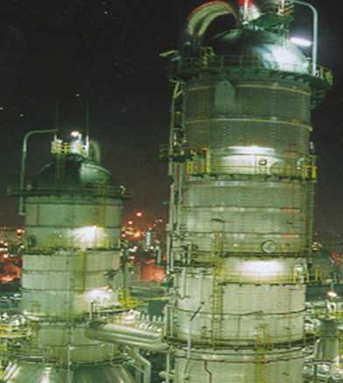
Notes:
Ensure that the Management of change program starts and remains effective
Provide training on the system to employees and to contractors.
Refresher training should be done on a regular basis (annually). Refresher training should also be done when an audit of the system indicates notable deficiencies.
Make the Management of Change form mandatory for all changes on all Process Safety processes. Follow through on decisions, actions, and use of the Management of Change form.
Electronically track any deficiencies noted in the program.

Slide 57
Remaining Course Material
Overview of Process Safety
Compliance with standards
Process Hazard Analysis
Standard Operating Procedures
Safe Work Procedures
Mechanical Integrity
Management of Change
Auditing Process Safety systems
Emergency response procedures
Notes:
We have just completed Module 7 on “Management of Change”.
This training module was the seventh of nine modules contained in this course. The screen shows all nine modules. Our next module will discuss “Auditing Process Safety Systems”

