Slide 1
Process Safety Management In Biofuels
Refineries
Developed by Western Iowa Tech Community College
This material was produced under a grant (SH-16634-07-60-F-19) from the Occupational Safety and Health Administration, U.S. Department of Labor. It does not necessarily reflect the views or policies of the U.S. Department of Labor, nor does the mention or trade names, commercial products, or organization imply endorsement by the U.S. government.
Notes:
Title page and credits for OSHA and WITCC.

Slide 2
Process Safety Management (PSM)
Is the proactive identification, evaluation and mitigation or prevention of chemical releases that could occur as a result of failures in processes, procedures, or equipment.
Notes:
Definition of Process Safety Management (PSM). Discuss the relevance to the plant or industry of your audience.

Slide 3
Purpose of PSM
Prevent Catastrophic Releases of Highly Hazardous Chemicals
Minimize Consequences of Such Releases to Employees and the Community
Notes:
Reasons for a PSM program. Ask for input and see if anyone else can think of other purposes of a PSM program.

Slide 4
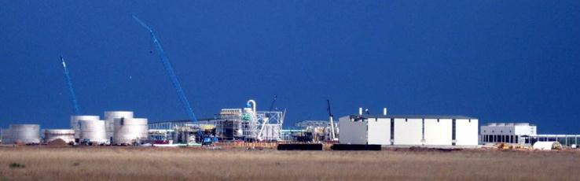
Learning Objectives
What does OSHA require for PSM?
How does it relate to you?
Have you met these requirements?
Notes:
Discuss the learning objectives and see if there are other needed for PSM understanding. Introduce one page checklist.

Slide 5

What does OSHA require for PSM?
Develop and maintain written safety information
Identify workplace chemical and process hazards
Equipment used in the processes
Technology used in the processes
Notes:
Discuss OSHA’s requirements for PSM and why OSHA requires them.
1. Develop and maintain written safety information identifying workplace chemical and process hazards, equipment used in the processes, and technology used in the processes;
A. Information on the hazards of the highly hazardous chemicals in the process shall consist of at least the following:
Toxicity,
Permissible exposure limits,
Physical data,
Reactivity data,
Corrosivity data, and
Thermal and chemical stability data, and hazardous effects of inadvertent mixing of different materials.
B. Information on the technology of the process must include at least the following:
A block flow diagram or simplified process flow diagram,
Process chemistry,
Maximum intended inventory,
Safe upper and lower limits for such items as temperature, pressures, flows or compositions, and
An evaluation of the consequences of deviations, including those affecting the safety and health of employees.
C. Where the original technical information no longer exists, such information may be developed in conjunction with the process hazard analysis in sufficient detail to support the analysis.
D. Information on the equipment in the process must include the following:
Materials of construction,
Piping and instrument diagrams (P&IDs)
Electrical classification,
Relief system design and design basis,
Ventilation system design,
Design codes and standards employed,
Material and energy balances for processes built after May 26, 1992, and
Safety systems (e.g., interlocks, detection or suppression systems).
E. The employer shall document that equipment complies with recognized and generally accepted good engineering practices. For existing equipment designed and constructed in accordance with codes, standards, or practices that are no longer in general use, the employer shall determine and document that the equipment is designed, maintained, inspected, and operated in a safe manner.

Slide 6
Perform a workplace hazard assessment, including, as appropriate;
  Identify potential sources of accidental releases
  Identify previous releases that had a potential for catastrophic consequences in the workplace
  Estimate workplace effects of a range of release
  Estimate health and safety effects of such a range on employees
Notes:
2. Perform a workplace hazard assessment, including, as appropriate, identification of potential sources of accidental releases, identification of any previous release within the facility that had a potential for catastrophic consequences in the workplace, estimation of workplace effects of a range of release, and estimation of the health and safety effects of such a range on employees;
A. The employer must use one or more of the following methods, as appropriate, to determine and evaluate the hazards of the process being analyzed:
What-if,
Checklist,
What-if/checklist,
Hazard and operability study (HAZWOP),
Failure mode and effects analysis (FMEA),
Fault tree analysis, or
An appropriate equivalent methodology.
B. Whichever method(s) are used, the process hazard analysis must address the following:
The hazards of the process;
The identification of any previous incident that had a potential for a catastrophic consequences in the workplace;
Engineering and administrative controls applicable to the hazards and their interrelationships, such as appropriate application of detection methodologies to provide early warning of releases. Acceptable detection methods might include process monitoring and control instrumentation with alarms, and detection hardware such as hydrocarbon sensors;
Consequences of failure of engineering and administrative controls;
Facility siting;
Human factors; and
A qualitative evaluation of a range of the possible safety and health effects on employees in the workplace if there is a failure of controls.
C. OSHA believes that the process hazard Analysis is best performed by a team with expertise in engineering and process operations, and that the team should include at least one employee who has experience with and knowledge of the process being evaluated. Also, one member of the team must be knowledgeable in the specific analysis methods being used.

Slide 7
Consult with employees and their representatives on;
Development and conduct of hazard assessments
Development of chemical accident prevention plans
Provide access to these and other records required by the standard
Notes:
3. Consult with employees and their representatives on development and conduct of hazard assessments and the development of chemical accident prevention plans and provide access to these and other records required under the standard;

Slide 8
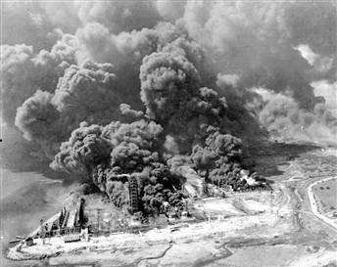
Establish a system to respond to the workplace hazard assessment findings, which shall address;
Prevention
Mitigation
Emergency responses
Notes:
4. Establish a system to respond to the workplace hazard assessment findings, which shall address prevention, mitigation, and emergency responses;
Resolutions must be documented
Document what actions are to be taken,
Develop a written schedule of when these actions are to be completed,
Complete actions as soon as possible, and
Communicate the actions to operating, maintenance, and other employees whose work assignments are in the process and who may be affected by the recommendations or actions.

Slide 9
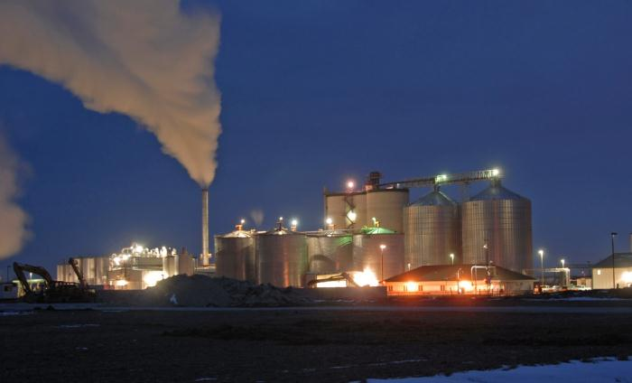
Periodically review the workplace hazard assessment
Notes:
5. Review periodically the workplace hazard assessment
A. At least every 5 years after the completion of the initial process hazard analysis, the process hazard analysis must be updated and revalidated by a team meeting the standard’s requirements to ensure that the hazard analysis is consistent with the current process.
B. Employers must keep on file and make available to OSHA, on request, process hazard analyses and updates or revalidation for each process covered by PSM, as well as the documented resolution of recommendations, for the life of the process.

Slide 10

Develop and implement written operating procedures for the chemical processes including;
Procedures for each operating phase
Operating limitations
Safety and health considerations
Notes:
6. Develop and implement written operating procedures for the chemical processes, including procedures for each operating phase, operating limitations, and safety and health considerations; The procedures must address at least the following elements:
A. Steps for each operating phase:
Initial startup;
Normal operations;
Temporary operations;
Emergency shutdown, including the conditions under which emergency shutdown is required, and the assignment of shutdown responsibility to qualified operators to ensure that emergency shutdown is executed in a safe and timely manner;
Emergency operations;
Normal shutdown; and
Startup following a turnaround, or after an emergency shutdown.
B. Operating limits:
Consequences of deviation, and
Steps required to correct or avoid deviation.
C. Safety and health considerations:
Properties of, and hazards presented by, the chemicals used in the process;
Precautions necessary to prevent exposure, including engineering controls, administrative controls, and personal protective equipment;
Control measures to be taken if physical contact or airborne exposure occurs;
Quality control for raw materials and control of hazardous chemical inventory levels; and
Any special or unique hazards.
Safety systems (e.g., interlocks, detection or suppression systems) and their functions.
D. To ensure that a ready and up-to-date reference is available, and to form a foundation for needed employee training, operating procedures must be readily accessible to employees who work in or maintain a process. The operating procedures must be reviewed as often as necessary to ensure that they reflect current operating practices, including changes in process chemicals, technology, and equipment, and facilities. To guard against outdated or inaccurate operating procedures, the employer must certify annually that these operating procedures are accurate.
E. The employer must develop and implement safe work practices to provide for the control of hazards during work activities such as lockout/tagout; confined space entry; opening process equipment or piping; and control over entrance into a facility by maintenance, contractor, laboratory, or other support personnel. These safe work practices must apply both to employees and to contractor employees.
F. Employers must develop a written plan of action to implement the employee participation required by PSM. Under PSM, employers must consult with employees and their representatives on the conduct and development of process hazard analyses and on the development of the other elements of process management, and they must provide to employees and their representatives access to process hazard analyses and to all other information required to be developed by the standard.

Slide 11

Provide written safety and operating information for employees
Provide employee training in operating procedures
Emphasize hazards and safe practices that must be developed and made available
Notes:
7. Provide written safety and operating information for employees and employee training in operating procedures, by emphasizing hazards and safe practices that must be developed and made available;
A. Initial training;
PSM requires that each employee presently involved in operating a process or a newly assigned process must be trained in an overview of the process and in its operating procedures.
The training must include emphasis on the specific safety and health hazards of the process, emergency operations including shutdown, and other safe work practices that apply to the employee’s job tasks.
B. Refresher training;
Refresher training must be provided at least every 3 years, or more often if necessary. The employer, in consultation with the employees involved in operating the process, must determine the appropriate frequency of refresher training.
C. Training documentation;
Employer must determine whether each employee operating a process has received and understood the training required by PSM.
A record must be kept containing the identity of the employee;
The date of the training; and
How the employer verified that the employee understood the training.
Photo information
http://office.microsoft.com/clipart/preview.aspx?AssetID=MPj0409670&CategoryID=CM790019181033&Scope=20&CTT=4&Origin=CM790019181033&AssetCol=MPj0409722,MPj0409493,MPj0410175,MPj0410092,MPj0409285,MPj0409670,MPj0401916,MPj0409547,MPj0409358,MPj0410176,MPj0402081,MPj0409703

Slide 12
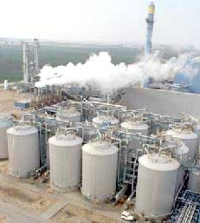
Ensure contractors and contract employees are provided with appropriate information and training
Notes:
8. Ensure contractors and contract employees are provided with appropriate information and training;
A. PSM applies to contractors performing maintenance or repair, turnaround, major renovation, or specialty work on or adjacent to a covered process.
B. Employer responsibilities;
Employer must obtain and evaluate information regarding the contract employer’s safety performance and programs.
The employer also must inform contract employers of the known potential fire, explosion, or toxic release hazards related to the contractors work and process;
Explain to contract employers the applicable provisions of the emergency action plan;
Develop and implement safe work practices to control the presence, entrance, and exit of contract employees in covered process areas;
Evaluate periodically the performance of contract employers in fulfilling their obligations; and
Maintain a contract employee injury and illness log related to the contractor’s work in the process area.
C. Contract employer responsibilities;
Ensure that contract employees are trained in the work practices necessary to perform their job safely;
Ensure that contract employees are instructed in the known potential fire, explosion, or toxic release hazards related to their job or process, and in the applicable provisions of the emergency action plan;
Document that each contract employee has received and understood the training required by the standard by preparing a record that contains the identity of the contract employee, the date of the training, and the means used to verify that the employee understood the training;
Ensure that each contract employee follows the safety rules of the facility including the required safe work practices required in operating procedures section of this standard; and
Advise the employer of any unique hazards presented by the contract employer’s work.

Slide 13
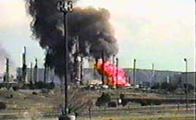
Train and educate employees and contractors in emergency response procedures in a manner as comprehensive and effective as that required by the regulation promulgated pursuant to section 126(d) of the Superfund Amendments and Reauthorization Act
Notes:
9. Train and educate employees and contractors in emergency response procedures in a manner as comprehensive and effective as that required by the regulation promulgated pursuant to section 126(d) of the Superfund Amendments and Reauthorization Act;

Slide 14
Establish a quality assurance program to ensure that initial process-related equipment, maintenance materials, and spare parts are fabricated and installed consistent with design specifications
Notes:
10. Establish a quality assurance program to ensure that initial process-related equipment, maintenance materials, and spare parts are fabricated and installed consistent with design specifications;

Slide 15

Establish maintenance systems for critical process-related equipment, including
  Written procedures
  Employee training
  Appropriate inspections
  Testing of such equipment to ensure ongoing mechanical integrity
Notes:
11. Establish maintenance systems for critical process-related equipment, including written procedures, employee training, appropriate inspections, and testing of such equipment to ensure ongoing mechanical integrity;
A. PSM mechanical integrity requirements apply to the following equipment;
Pressure vessels and storage tanks;
Piping systems (including piping components such as valves);
Relief and vent systems and devices;
Emergency shutdown systems;
Controls (including monitoring devices and sensors, alarms, and interlocks); and
Pumps
B. Hot Work Permit;
Permit must be issued for hot work operations conducted on or near a covered process.
Must document that the fire prevention and protection requirements have been implemented prior to work;
Must indicate date(s) authorized;
Identify the object on which hot work is to be performed;
Permit must be kept on file until completion of the hot work.

Slide 16

Conduct pre-start-up safety reviews of all newly installed or modified equipment
Notes:
12. Conduct pre-start-up safety reviews of all newly installed or modified equipment; the safety review must confirm the following;
A. Construction and equipment are in accordance with design specifications;
B. Safety, operating, maintenance, and emergency procedures are in place and are adequate;
C. A process hazard analysis has been resolved or implemented before startup, and modified facilities meet the management of change requirements; and
D. Training of each employee involved in operating a process has been completed.

Slide 17

Establish and implement written procedures managing change to
Process chemicals
Technology
Equipment
Facilities
Notes:
13. Establish and implement written procedures managing change to process chemicals, technology, equipment and facilities,
Written procedures to manage changes (except for “replacements in kind”) to process chemicals, technology, equipment, and change to facilities that affect a covered process, must be established and implemented. These written procedures must ensure that the following considerations are addressed prior to any change;
The technical basis for the proposed change;
Impact of the change on employee safety and health;
Modifications to operating procedures;
Necessary time period for the change; and
Authorization requirements for the proposed change.

Slide 18
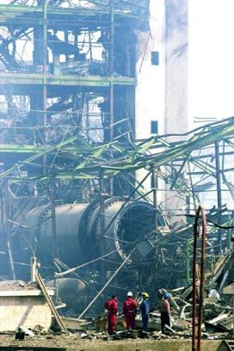
Investigate every incident that results or could have resulted in a major accident in the workplace
All findings need to be reviewed by operating personnel and make modification if appropriate
Notes:
14. Investigate every incident that results in or could have resulted in a major accident in the workplace, with any findings to be reviewed by operating personnel and modifications made, if appropriate.
A. An investigation report must be prepared including at least;
Date of incident;
Date investigation began;
Description of the incident;
Factors that contributed to the incident;
Recommendations resulting from the investigation.
B. The employer must keep these incident investigation reports for 5 years.

Slide 19
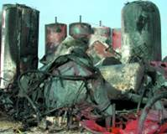
Emergency planning and response
Implement emergency action plan meeting 1910.38:
  Pre-planning
  Escape procedures
  Notification procedures
  Alarm system
  Training
Handling of small releases:
May be subject to 1910.120, Hazardous Waste and Emergency Response
Notes:
15. Emergency planning and response
It is essential that emergency pre-planning and training make employees aware of, and able to execute, proper actions.

Slide 20
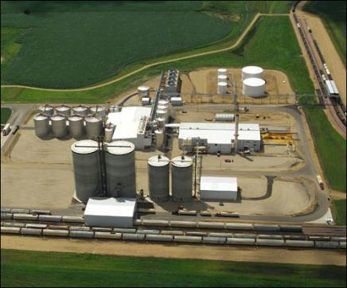
Compliance audits
At least every 3 years – Employer needs to certify compliance with the standard
Conducted by at least 1 person knowledgeable in the process.
Written report and document each abatements
Retain the two(2) most recent compliance audit
Notes:
16. Compliance audits

Slide 21
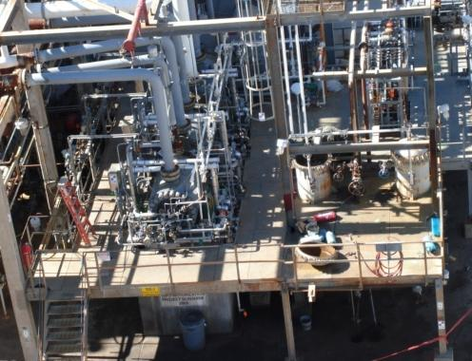
Employers must certify that they have evaluated compliance with the provisions of PSM at least every 3 years
Notes:
17. To be certain process safety management is effective, employers must certify (document) that they have evaluated compliance with the provisions of PSM at least every 3 years.

Slide 22

This unit is across a roadway from the ISOM unit, where a 2005 accident killed 15 workers and injured 180 others.
U.S. Chemical Safety and Hazard Investigation Board
U.S. Chemical Safety and Hazard Investigation Board
Incident Description
BP America Refinery Accident Texas City, TX, January 14, 2008
A worker was fatally injured when the top of a large steel filter housing suddenly blew off in the refinery's ultracracker unit.
Notes:
BP Texas City incident. Video may accompany the presentation.
Incident Description
At approximately 1:20 p.m. on March 23, 2005, a series of explosions occurred at the BP Texas City refinery during the restarting of a hydrocarbon isomerization unit. Fifteen workers were killed and 180 others were injured. Many of the victims were in or around work trailers located near an atmospheric vent stack. The explosions occurred when a distillation tower flooded with hydrocarbons and was overpressurized, causing a geyser-like release from the vent stack.
Final OSHA Recommendations for BP Texas City
Occupational Safety and Health Administration (OSHA)
2005-4-I-TX-R8 Strengthen the planned comprehensive enforcement of the OSHA Process Safety Management (PSM) standard. At a minimum:
Identify those facilities at greatest risk of a catastrophic accident by using available indicators of process safety performance and information gathered by the EPA under its Risk Management Program (RMP).
Conduct, or cause to be conducted, comprehensive inspections, such as those under your Program Quality Verification (PQV) program at facilities identified as presenting the greatest risk.
Establish the capacity to conduct more comprehensive PSM inspections by hiring or developing a sufficient cadre of highly trained and experienced inspectors.
Expand the PSM training offered to inspectors at the OSHA National Training Institute.
2005-4-I-TX-R9 Amend the OSHA PSM standard to require that a management of change (MOC) review be conducted for organizational changes that may impact process safety including
major organizational changes such as mergers, acquisitions, or reorganizations;
personnel changes, including changes in staffing levels or staff experience; and
policy
2005-4-I-TX-R9 Amend the OSHA PSM standard to require that a management of change (MOC) review be conducted for organizational changes that may impact process safety including
major organizational changes such as mergers, acquisitions, or reorganizations;
personnel changes, including changes in staffing levels or staff experience; and
policy changes such as budget cutting.

Slide 23
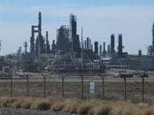
Valero Refinery Propane Fire Sunray, TX, February 16, 2007
Incident Description
On February 16, 2007, a propane fire erupted at the Valero McKee Refinery in Sunray, Texas, north of Amarillo. Three workers suffered serious burns, and the refinery was forced to shut down. The fire began following a leak in the propane deasphalting unit and spread quickly, in part because of the rapid collapse of a major pipe rack carrying flammable hydrocarbons. Some of the rack's support columns had not been fireproofed.
U.S. Chemical Safety and Hazard Investigation Board
Notes:
Valero Refinery Propane Fire Sunray, TX. Discuss the situation and problems with PSM for this incident.
Incident Description
On February 16, 2007, a propane fire erupted at the Valero McKee Refinery in Sunray, Texas, north of Amarillo. Three workers suffered serious burns, and the refinery was forced to shut down. The fire began following a leak in the propane deasphalting unit and spread quickly, in part because of the rapid collapse of a major pipe rack carrying flammable hydrocarbons. Some of the rack's support columns had not been fireproofed.
Root Causes
1. The McKee Refinery had no formal written program in place to identify, review, and freeze-protect dead-legs or infrequently used piping and equipment, such as the propane mix control station.
2. The McKee Refinery did not apply Valero’s mandatory Emergency Isolation Valve procedure when evaluating risks in the PDA unit to ensure that the large quantities of flammable materials in the unit could be rapidly isolated in an emergency.
3. API guidance and Valero’s corporate Fire Proofing Specifications standard do not specify sufficiently protective distances for fireproofing pipe rack support steel for processes handling high-pressure flammables, such as the LPG in the PDA unit.
Contributing Causes
1. API-recommended practices on locating and operating LPG firewater deluge valves do not address potential hazards from nearby processes.
2. Valero–McKee Refinery’s hazard assessment process did not recognize the risk of using chlorine in close proximity to equipment handling flammable hydrocarbons.

Slide 24
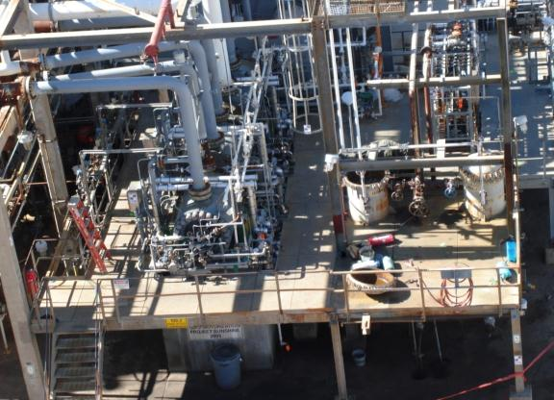
Recommendations
U.S. Chemical Safety and Hazard Investigation Board
BP Texas City Refinery 2005-4-B-TX-R1
Revise the maintenance quality control program to require positive material identification testing or another suitable material verification process for all critical service alloy steel piping components removed and reinstalled during maintenance and inform work crews of special material handling precautions. Status: Open - Awaiting Response or Evaluation/Approval of Response
Notes:
OSHA and CSB response to the BP Texas City, TX incident.

Slide 25
For more information
Environmental Protection Agency (EPA)
National Institute of Standards and Technology (NIST)
Center for Chemical Process Safety (CCPS)
American Chemistry Council (ACC)
OSHA (www.osha.gov)
American Society of Safety Engineers (ASSE)
American Industrial Hygiene Associations (AIHA)
American Institute of Chemical Engineers (AICHE)
U.S Chemical Safety and Hazard Investigation – www.chemsafety.gov Excellent for updates and recent investigations
Notes:
Further resources for more information concerning PSM.

