Slide 1
Heat Stress
This material was produced under grant # SH-29671-SH6 from the Occupational Safety and Health Administration, U.S. Department of Labor. It does not necessarily reflect the views or policies of the U.S. Department of Labor, nor does mention of trade names, commercial products, or organizations imply endorsement by the U. S. Government.

Slide 2
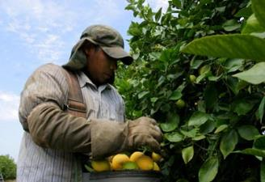
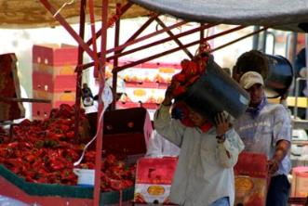
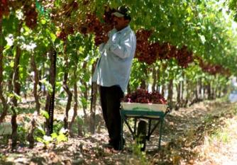
Your Rights Against Heat Related Illnesses and How to Protect Yourself

Slide 3
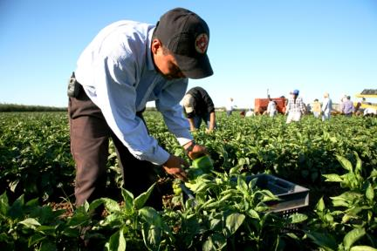
Introduction
Photos by David Bacon

Slide 4
Program
Welcome and Introduction
Evaluation before the Training
What is Heat Illness?
Signs and Symptoms
The Four Elements for Prevention
Emergency Procedures
Evaluation after the Training

Slide 5
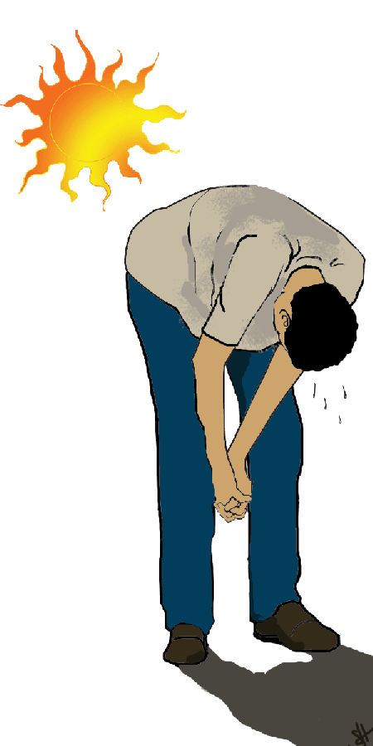
What is Heat Stress?
Heat Stress is one of the illnesses caused by heat.
If you do not take precaution these illnesses can cause death.
If you feel the following symptoms please
inform your supervisor or co-worker.

Slide 6
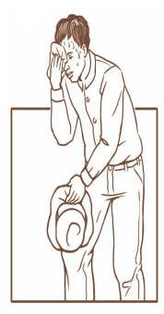
Signs and Symptoms of Heat Related Illnesses
Heat Exhaustion:
Excessive sweating
Cramps
Rapid pulse
Headache
Nausea
Vomiting
Fatigue
Heat Stress:
Dried, red skin
Red hot skin
High body temperature
Disoriented
Confusion
Fainting
Convulsions & Seizures
NEED MEDICAL
HELP

Slide 7
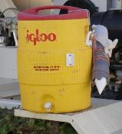
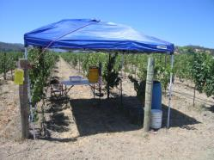
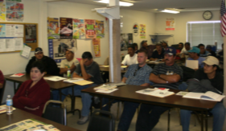
The Four Elements for the Prevention of Heat Related Illnesses
Your employer must provide
and make available:
Drinking Water
Shade
Written procedures for Health and Safety
Training and education to all employees.

Slide 8
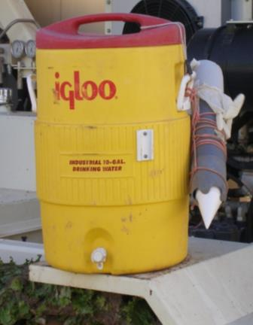
Under the Law Access to Water at your employment is Required
Drinking water must be available
at all times.
From the beginning of the work shift
until the end of the day.
Clean, Fresh, Portable and Free
2 gallons for every worker, for
every 8 hours of work.
- Water must be provided to
workers at no cost to the
employees.

Slide 9
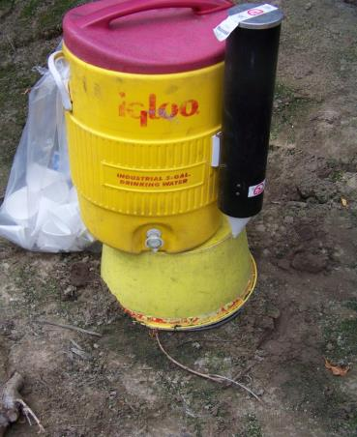
It is Your Right to Have Access to Water
The law requires an employer to ensure the water is fresh at all times for all of the workers.
The water must be placed under the shade.

Slide 10
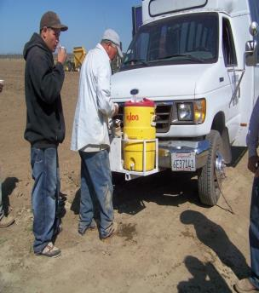
Water Access is Your Right
Encourage one another to drink water and to
take a break if feeling sick.
Water must always be near all the workers.
The employer must provide individual cups.
The water must be kept fresh
During a heat wave its is advised that the
supervisor or foreman increase the number
of breaks to drink water.
You have the right to an extra break if you feel sick in order to prevent excessive warming.

Slide 11
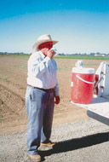
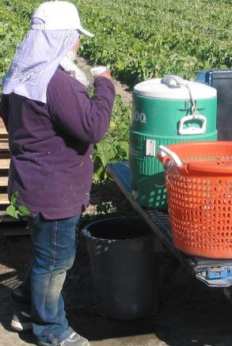
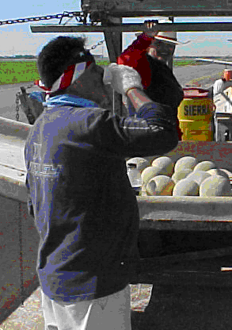
DRINK WATER FREQUENTLY!
Do not wait until you are thirsty.
Drink water in small quantities– Frequently!
It is prohibited that your employer deny your right to drink water.

Slide 12
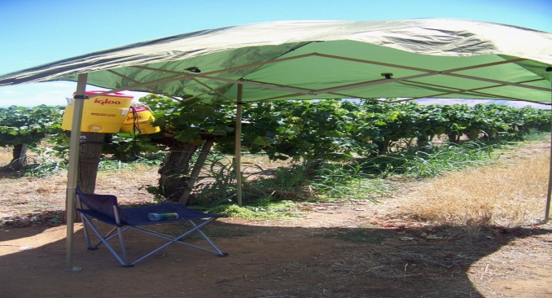
2. Your Right to Shade Access
The definition of shade is direct blockage of
sun rays.
Break periods must be provided to workers
that:
suffer from a heat related illness
believe they need a break to protect
themselves against overheating.
Under the law, workers must have access to
an area with shade that is open to the air to
refresh for at least a 5 minute period.

Slide 13
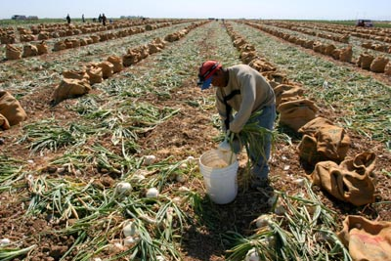
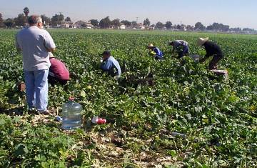
Where is the Shade?

Slide 14
Where is the Shade?

Slide 15
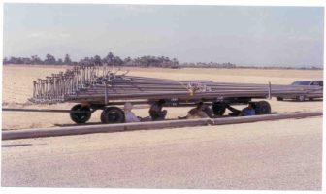
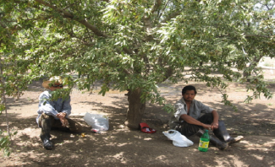
Examples of Inadequate Shade
The shaded area must allow the workers to be in a comfortable posture and it is prohibited to cause that they be exposed to another danger.
To have to seek shade increases the risk of:
exposing the worker to dangerous conditions
exposure to pesticides

Slide 16
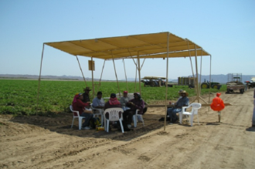
Workers have the Right to Access to Shade at All Times
When the temperature is above 80 degrees F, the shade must be located and available in the workplace.
Regardless of the temperature forecast an employer must always be in the capacity to provide immediate shade if a worker requests it.
The shade must cover 25% of
the crew.

Slide 17
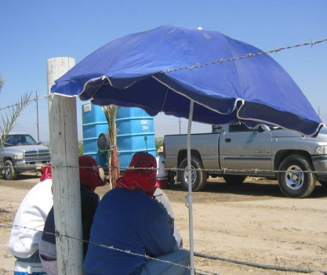
How Much Shade is Sufficent ?
The law requires that all workers be able to sit without touching one another.
An employer must provide at least enough shade for at least 25% of the workers.
For example if there are 40 workers in a crew the amount of shade must be sufficent to accomodate 10 people without them touching one another.

Slide 18
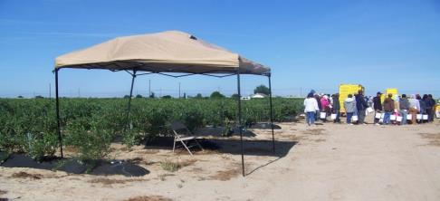
How Close Must the Shade be?
The shaded area must be as near to the workers as possible.
Usually, this means that the shade should be at a distance within 2 1/2 minutes of walking, but never more than 1/4 mile or 5 minutes walking.

Slide 19
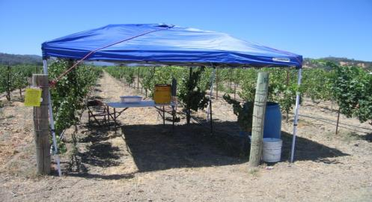
Example of an Acceptable Shade Area
If the temperatures is above 80 degrees F, the shade must be present!
When the temperature does not exceed 80 degrees F, the employer must provide quick access to the shade when requested.

Slide 20
When the temperature equals or exceeds 95 F
For agricultural employers:
Temperatures of 95F or above, ensure employees take a minimum ten minute net preventative cool-down rest every two hours
Additional ten minute cool-down rest at the end of 8th and 10th hour of work

Slide 21
3. Written Procedures
The law requires that workers be educated and know their rights in regards to:
Drinking water.
Access to shade.
Training for all workers and supervisors.
Respond to emergencies caused by heat illness and provide services without delay.

Slide 22
4. Training
All workers must recieve training in:
The Procedures for the prevention of illnesses caused by heat.
The importance of drinking water frequently and in small quantities.
The different types of illnesses caused by heat and common signs and symptoms.
Information, contacts and procedures in case of an emergency.

Slide 23
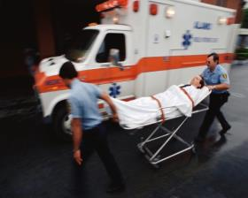
Emergency Procedures
The employer or supervisor is responsible to responding to symptoms of possible illnesses caused by heat.
Contact medical services in an emergency.
Provide clear and precise directions to the workplace.
Summary of the laws and rights relating to heat stress.

Slide 24
What happens if the employer does not follow the law ?
An employer may risk an Order Prohibiting Use (OPU) and a citation if the heat and lack of facilities create an imminent hazard.
An OPU may be issued if:
The temperature is ≥ 95F and water, shade, training or emergency procedures are not in place;
The temperature is ≥ 80F, and there is a heat wave, heavy workload or other critical factor putting employees in danger.
An OPU:
Will shut down the operation, and;
Work will not be allowed to resume until the employer demonstrates that the imminent hazard has been corrected.

Slide 25
A Video…

Slide 26
Questions?

Slide 27
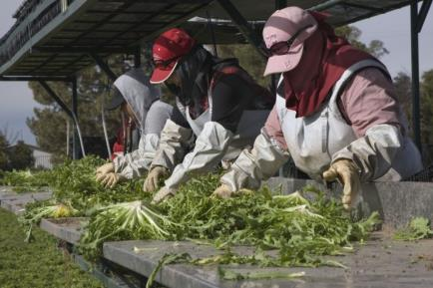
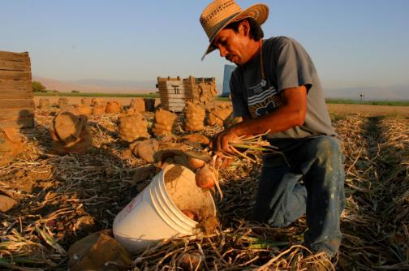
Evaluation

