Slide 1
Silica Jeopardy
This material was produced under grant SH29642SH6 from the Occupational Safety and Health Administration, U.S. Department of Labor. It does not necessarily reflect the views or policies of the U.S. Department of Labor, nor does mention of trade names, commercial products, or organizations imply endorsement by the U.S. Government.

Slide 2
game
SiO₂ | Hazard | Dusty Work | My Health | In Control
$200
$200
$200
$200
$200
$400
$400
$400
$400
$400
$600
$600
$600
$600
$600
$800
$800
$800
$800
$800

Slide 3
This common mineral is found in rock, soil and sand

Slide 4
What is SILICA

Slide 5
This type of silica causes harm to workers

Slide 6
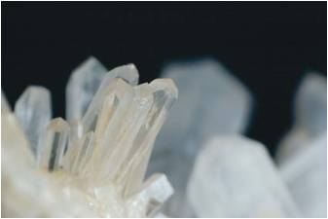
What is Crystalline

Slide 7
Most common form of crystalline silica

Slide 8
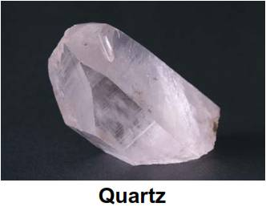
Quarts

Slide 9
While more rare, these forms of crystalline silica are more toxic

Slide 10
What are Cristobalite and Tridymite

Slide 11
Crystalline silica is a hazard when it becomes this

Slide 12
What is respirable dust

Slide 13
According to OSHA, workers should not be exposed to more than this concentration of silica

Slide 14
What is the Permissible Exposure Limit: 50 micrograms/cubic meter of air averaged over 8-hour day.

Slide 15
The metric symbol “µg” means this fraction of a measure of weight

Slide 16
What is a microgram, one millionth of a gram

Slide 17
This combination puts you at much greater risk for getting lung cancer

Slide 18
What is exposure to respirable crystalline silica and smoking

Slide 19
Doing this to concrete may create hazardous silica dust

Slide 20
What is cutting, drilling, coring, grinding, pulverizing

Slide 21
Using silica to do this job creates very high exposures to harmful dust

Slide 22
What is abrasive blasting or sandblasting

Slide 23
A U of W study found this task >80% likely to overexpose workers to hazardous silica dust

Slide 24
What is tuckpoint grinding

Slide 25
Four categories of responsibility on multi-employer worksites

Slide 26
What are: Creating Exposing Controlling Correcting

Slide 27
Silica seriously damages this body part

Slide 28
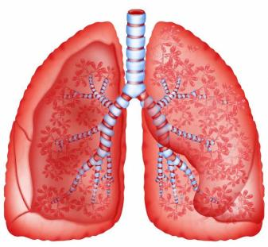
What are your lungs

Slide 29
In 1997 crystalline silica was listed as this in humans

Slide 30
What is a carcinogen (cancer causing)

Slide 31
These 3 forms of this disease are most associated with silica dust exposures

Slide 32
What are acute, accelerated and chronic silicosis

Slide 33
Shortness of breath, wheezing, and decreased lung capacity are symptoms of this disease

Slide 34
What is Chronic silicosis

Slide 35
This pyramid helps define control strategies

Slide 36
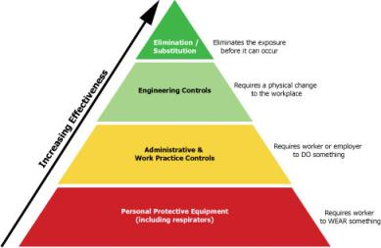
What is the Hierarchy of Controls

Slide 37
These are preferred because they eliminate the hazard

Slide 38
What are Engineering controls

Slide 39
These two methods are the primary ways to control silica dust

Slide 40
What are wet methods and local exhaust ventilation

Slide 41
This says employers must control exposure to silica, create a plan, train workers, and offer medical surveillance

Slide 42
What is the 2016 federal OSHA Silica Standard for Construction

