Slide 1


Hazard
Identification Plan

Slide 2



Overview
Hazard
Identification
Plan
Identifying
Hazards
Costs

Slide 3
Introduction
Safety & Health Program
Employers are to have a written safety and health program.
Notes:
Some exemptions apply to the Written Safety and Health Program plan requirement, though all companies should abide, whether required or not.
This program must demonstrate workplace hazards are identified, evaluated, and controlled.

Slide 4
Introduction
Prevention
OSHA Standards are preventative.
These Standards and Rules are required to be implemented to prevent injury and illness to your workers and your resources.

Slide 5
Introduction
Prevention
OSHA citations are “after the fact” notices that you are not in compliance with a law that you should have been in compliance.
Your defense is the fact that you have a program that provides a safe and healthful workplace free from recognized hazards.

Slide 6
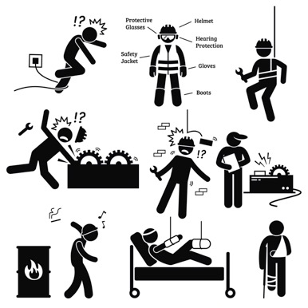
Hazard Identification Plan
Identify the Hazards
Focus Four (construction)
General Industry
Notes:
We’ll emphasize Focus Four

Slide 7
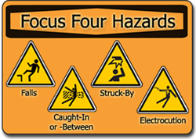
Hazard Identification Plan
Construction: Focus Four
One in five (1/5) private industry, worker deaths are in construction.
Of those, nearly two-thirds (2/3) were caused by the Focus Four hazards.
Notes:
Falls, electrical, struck by, and caught in or between hazards.

Slide 8
Hazard Identification Plan
Construction: Focus Four
In Hawaii, there were 18 fatalities, with 8 of those being in construction.
More than ten of the total fatalities in Hawaii, were under the age of 34 (2015).
Notes:
You may enter your state or Federal statistic on this slide

Slide 9
Hazard Identification Plan
General Industry (2015)
ACTIVITY
Sprain, strains, tears | 324,700
Back injuries | 155,740
Falls, slips, trips | 238,610
          The leading major event or was overexertion and bodily reaction.
Notes:
What are some common hazards? Real or potential?
[SAFETY] Jot these down on page 8 of your Workbook
[WORKER] Jot these down on page 3 of your Workbook
[MANAGER] Jot these down on page 8 of your Workbook

Slide 10
Hazard Identification Plan
      What can we do to mitigate these hazards to prevent injury?
Notes:
Let’s note hazards and hazard prevention in the Workbooks on page 7
[SPEAKER NOTE]: Students will work in groups to brainstorm hazards that are associated with their industry/workplace. These do not have to be actual hazards at their workplace, just potential hazards.

Slide 11
Hazard Identification Plan
Controls
Identify controls that can be taken
Training
Awareness
Equipment
Changing processes, etc.
Monitoring behavior
Notes:
Identify controls that can be taken. For example…

Slide 12
Hazard Identification Plan
To Update Policies
1. Identify necessary changes
2. Define the scope of work
3. Budget for the scope of work
Notes:
To update policies to account for health and safety emphasis:
[SPEAKER NOTE] Elaborate on each of these, based on your experience

Slide 13
Hazard Identification Plan
To Update Policies
4. Assign the responsibilities
5. Develop the policies and procedures
6. Implement them
Notes:
To update policies to account for health and safety emphasis:
[SPEAKER NOTE] Elaborate on each of these, based on your experience

Slide 14
Hazard Identification Plan
To Update Policies
7. Monitor to ensure the program is in place and effective.
8. Focus on values and principles not rules
9. Ensure you have an affirmative defense should you need it.
Notes:
To update policies to account for health and safety emphasis:
[SPEAKER NOTE] Elaborate on each of these, based on your experience

Slide 15
Hazard Identification Plan
To Update Policies
10. Defend Your Program
Avoid penalties by having an effective safety and health program.
A top down program is critical
Can be defended by president or management.
Notes:
To update policies to account for health and safety emphasis:
[SPEAKER NOTE] Elaborate on each of these, based on your experience
[SPEAKER NOTE] We’ll talk more about affirmative defense in Safety Inspection Procedures section

Slide 16
Costs
Types of Accident Costs
Know the cost of these actions, assign responsibilities, and establish accountability.
Notes:
Behaving lawfully: (discussed further in Module 2)

Slide 17
Costs
Types of Accident Costs
        Indirect Costs: Difficult to measure
Direct Costs:
        Easily measured
Notes:
Behaving lawfully: (discussed further in Module 2)

Slide 18

Costs
Impact of Accidents on Profits & Sales
The more accidents in a facility, the higher the insurance premiums
The higher the premiums, the lower the profit on each product sold
Both direct and indirect costs must be reimbursed through the profit margin on each product sold
Notes:
The more accidents that take place in a facility, the higher that company’s insurance premiums. The higher a company’s premiums, the lower the profit on each product sold. Both insurance premium and indirect costs must be reimbursed through the profit margin on each product unit sold.

Slide 19
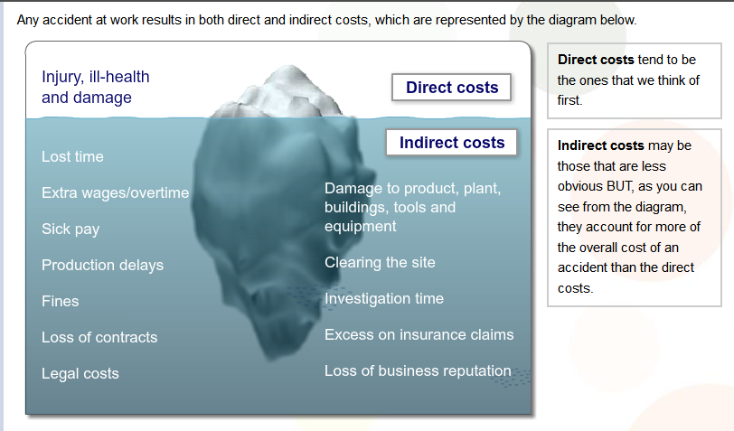
Costs

Slide 20
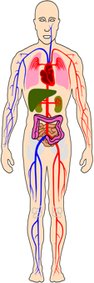
Costs
Costs Categorized by Body Part
Body Part | Average Direct Cost | Indirect Cost | Total Cost
Arm | $2,785 | $12,533 | $15,318
Eye | $266 | $1,197 | $1,463
Lower Back | $6,420 | $7,704 | $14,124
Shoulder | $5,338 | $6,406 | $11,744
Notes:
This slide provides cost information for injuries by body part. The figures for the average direct cost were provided by an insurance company based on three years of data. Using OSHA’s ratio of indirect to direct costs, we have added the average direct and indirect costs for selected injuries. For example, the average direct costs for an injury to the arm was $2,785. Looking at OSHA’s ratio of indirect to direct costs, the indirect cost for this injury would be 4.5 times the direct cost (injuries with a direct cost of $0 to $2,999 have a ratio of 4.5). Therefore, $2,785 X 4.5 = $12,533. Add the direct cost ($2,785) to the indirect cost ($12,533) for a total cost of $15,318.

Slide 21

Costs
Costs Categorized by Accident Cause
Cause | Average Direct Cost | Indirect Cost | Total Cost
Pushing or Pulling | $4,841 | $7,746 | $12,587
Sharp Object | $801 | $3,605 | $4,406
Struck Against | $2,292 | $10,314 | $12,606
Struck By | $3,216 | $5,146 | $8,362
Notes:
This slide shows some examples of injuries classified by cause of the injury. Again, the figures for the average direct cost were provided by an insurance company based on three years of data. Take the first example, which is an injury caused by pushing or pulling. Based on the data, the average direct cost was $4,841. The indirect costs would be estimated at 1.6 times the direct costs, (or $7,746) according to OSHA’s ratio. The total costs of this injury would be $12,587.

Slide 22
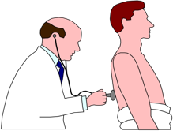
Costs
Costs Categorized by Injury Type
Type | Averaged Direct Cost | Indirect Costs | Total Costs
Sprain | $4,245 | $6,792 | $11,037
Laceration | $1,101 | $4,955 | $6,056
Foreign Body | $317 | $1,427 | $1,744
Notes:
This slide shows some examples of costs classified by type of injury. In a few minutes, we’ll take this sprain example and walk through the calculations.

Slide 23
Costs
How to Estimate the Impact of Accidents on Profits
To calculate indirect cost, multiply direct cost by a cost multiplier. The cost multiplier that you use will depend on the size of the direct cost.
Indirect cost
Direct Cost
To calculate direct cost, enter the following: Total value of the insurance claim for injury or illness $4,245
If your direct cost is: | Use this cost multiplier:
$0-$2,999 | 4.5
$3,000-$4,999 | 1.6
$5,000-$9,999 | 1.2
$10,000 or more | 1.1
Direct Cost x Cost Multiplier = Indirect Cost
4,245 x 1.6 = 6,792
Notes:
These next two slides will walk us through how to calculate the indirect cost, total cost and impact on profitability of one injury.
For a sprain in the manufacturing industry, the average direct cost (based on an insurance company’s data for three years) was $4,245. Using OSHA’s ratio of indirect to direct cost, the multiplier to be used is 1.6. So, $4,245 X 1.6 = $6,792. $6,792 is the estimated indirect cost of this sprain injury. Remember that indirect costs include all the hidden costs of an accident, such as cleaning and repair time, schedule delays, and time and money spent for the investigation of the accident.

Slide 24
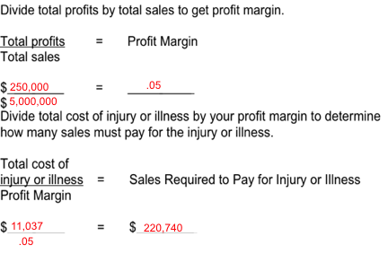
Costs
How to Estimate the Impact of Accidents on Profits
TOTAL COST
Direct Cost + Indirect Cost = Total Cost
$4,245 + $6,792 = $11,037
IMPACT ON PROFITABILITY
Notes:
Continuing with our calculation, we add the direct cost ($4,245) to the indirect cost we just obtained ($6,792) to get a total cost of $11,037.
To determine the impact of this type of injury on a company’s profitability, we obtain the company’s profit margin by dividing total profits by total sales. For our example company, the profit margin is 5%.
To see how much must be generated in sales to pay for an injury of this type, we divide the total cost of the injury by the profit margin and get a final figure of $220,740.

Slide 25

Costs
Sales Required to Pay for an Accident
If your company profit is:
Accident Costs | 1% | 2% | 3% | 4% | 5%
$1,000 | $100,000 | $50,000 | $33,000 | $25,000 | $20,000
$5,000 | $500,000 | $250,000 | $167,000 | $125,000 | $100,000
$10,000 | $1,000,000 | $500,000 | $333,000 | $250,000 | $200,000
$25,000 | $2,500,000 | $1,250,000 | $833,000 | $625,000 | $500,000
$100,000 | $10,000,000 | $5,000,000 | $3,333,000 | $2,500,000 | $2,000,000
Notes:
This chart shows the sales which would be needed to cover the cost of accident. For example, if an accident cost $5,000 and your company profit margin was 5%, you would need $100,000 in sales to pay for that accident.
(On average, manufacturing has approximately a 2% profit margin; construction has a 1% average profit margin; and service industries have a 4 - 5% profit margin.)

Slide 26
Costs
Sales Impact of Selected Injuries
Injury/ Illness | Average Direct Cost | Indirect Cost | Total Cost | Sales Needed (5% profit)
Sprain | $4,245 | $6,792 | $11,037 | $220,740
Laceration | $1,101 | $4,955 | $6,056 | $121,120
Foreign Body | $317 | $1,427 | $1,744 | $34,880
Notes:
This slide shows some other examples of injuries, costs and sales needed to pay for an accident. The sprain example was shown on the previous slides. For a laceration, it is estimated that $121,120 in sales are needed to pay for the injury, assuming a 5% profit margin. For a foreign body in the eye, $34,880 in sales are needed to recover the accident costs.

Slide 27
Costs
Penalties
        OSHA penalties
OSHA penalty for serious is $12,675 (2017)
Notes:
We’ll come back to penalties later today

Slide 28
Costs
Penalties
Repeat citations can be costly:
Double the first citation or
10x higher than the first citation.
Willful citations are:
OSHA: $126,749
Notes:
We’ll come back to penalties later today.
[SPEAKER NOTE] Values are 2017 figures

Slide 29
Costs
Table 2016 Top 10 Focus Four Violations
Subpart | Citations | Total Dollar Value | Description
1926.501 | 5,931 | $21,827,517 | Fall protection
1910.1200 | 4,434 | $3,147,939 | Hazard communication
1926.451 | 3,219 | $6,719,715 | Scaffolds
1910.134 | 2,765 | $2,016,458 | Respiratory protection
1910.147 | 2,694 | $11,297,922 | Lockout/ tagout
1910.178 | 2,294 | $4,208,870 | Powered industrial trucks
1926.1053 | 2,199 | $3,922,801 | Ladders
1910.305 | 1,951 | $7,672,792 | Machine guarding
1910.212 | 1,516 | $1,939,769 | Electrical, Wiring Methods
1910.303 | 1,337 | $2,185,621 | Electrical, general requirements

Slide 30
Identifying Hazards
Work Tasks vs. Safety
The only acceptable way is the safe way.
Moving the ladder the quick way
Moving the ladder the safe way.

Slide 31
Identifying Hazards
An Example
Professional Standards
Medical Procedure: Would you trust a physician who:
      Operated
      without consideration for standards and regulations
      Only followed some
      standards
or
Notes:
How many have had a medical or surgical procedure?
Would you trust a physician who:
Decided that infection control and quality control requirements were inefficient and they only followed some Standards?
Operated without consideration for standards and legal regulations because no one is there to see violations?

Slide 32
Identifying Hazards
An Example
        Professional Standards
        Medical Procedure: Would you trust a physician who:
Would you trust a physician who chose a professionally unacceptable method?
All of the activities in the operating room are integrated, not separate, and must be adhered.
Notes:
How many have had a medical or surgical procedure?
Would you trust a physician who:
Decided that infection control and quality control requirements were inefficient and they only followed some Standards?
Operated without consideration for standards and legal regulations because no one is there to see violations?

Slide 33
Identifying Hazards
ACTIVITY
Safe Choices
The worker chooses the quick way because of their loyalty, dedication, and desire to please.
The employer chooses the quick way because it makes/saves money.
Notes:
What hazards do you encounter at work?
[SAFETY] Jot these down on page 9 of the Workbook
[WORKER] Jot these down on page 3 of your Workbook
[MANAGER] Jot these down on page 9 of the Workbook

Slide 34
Identifying Hazards
Safe Choices
A culture is created where choosing the unacceptable way is acceptable, tolerated, or encouraged.
No one rocks the boat (i.e. complains) for fear of making the company look bad.

Slide 35
Identifying Hazards
Hidden Messages
      Be careful of sending contradictory safety messages
“Be careful”
“Watch out for each other”
“Lift properly”
“Speak up when something is not safe”
“We have a work stoppage rule for everyone”
Notes:
Are we sending hidden or contradictory safety messages in our practices and how we behave when we tell our workers? “Be careful” What does this mean specifically? Give clear instructions.
“Lift properly” What is properly – how much? Give clear instructions.
“Speak up when something is not safe” Puts responsibility solely on workers. Is there a procedure in place for workers to report unsafe conditions? One in which they do not risk retaliation?
“We have a work stoppage rule for everyone.” How often has it been used?
“Watch out for each other” This puts blame on team.

Slide 36
Identifying Hazards
Clear Messages
ACTIVITY
Give clear instructions.
Don’t put the responsibility of safety on workers exclusively.
Communicate safety expectations.
Notes:
Give clear instructions, particularly at the start of any new tasks.
Don’t put the responsibility of safety on workers exclusively. Even if it is not intentional, be careful that your work environment doesn’t imply employee responsibility only for safety.
Communicate safety expectations, including safety commitment, injury prevention, procedures for reporting unsafe work conditions, etc.
What types of messages do employees receive?
How can these message more clearly emphasize safety?
[SAFETY] Jot these down on page 10 of your Workbook
[WORKER] Jot these down on page 5 of your Workbook
[MANAGER] Jot these down on page 10 of your Workbook

Slide 37
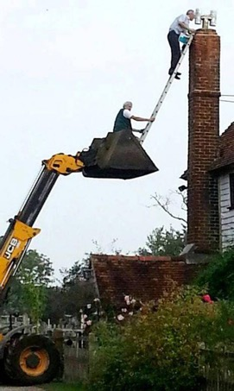
Identifying Hazards
Examples of Hazards
Notes:
Ask the class to identify the hazards in these photos

Slide 38
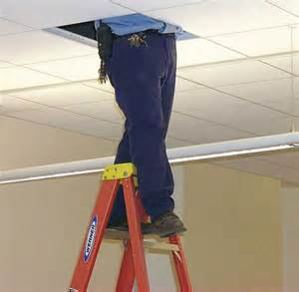
Identifying Hazards
Examples of Hazards
Notes:
Ask the class to identify the hazards in these photos

Slide 39
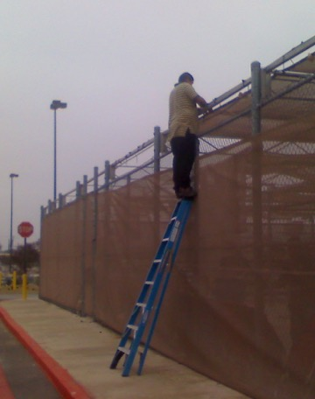
Identifying Hazards
Examples of Hazards
Notes:
Ask the class to identify the hazards in these photos

Slide 40
Questions?
?
?
?
?
?
?

Slide 41
OSHA Disclaimer
This material was produced under grant SH29640SH6 from the Occupational Safety and Health Administration, U.S. Department of Labor. It does not necessarily reflect the views or policies of the U.S. Department of Labor, nor does mention of trade names, commercial products, or organizations imply endorsement by the U.S. Government.

