Slide 1

Disciplinary Policy
& Employer Responsibilities
Notes:
This section is designed for employees AND employers to have a clear understanding of a balanced disciplinary policy. This includes roles and responsibilities as well as tools to building a policy, and OSHA requirements.

Slide 2



Overview
Disciplinary
Policy
Employer
Responsibilities
Record-
Keeping

Slide 3
Disciplinary Policy
      Implementing Safe Work Practices
Supervisors should receive training on the company's safety and health policies, guidelines, and procedures established for day-to-day operations.
They need a clear understanding of their responsibilities and company policies and procedures for disciplining employees (i.e. progressive disciplinary action).
They must be involved in addressing safety performance issues and taking disciplinary action when safety policy is not followed.

Slide 4
Disciplinary Policy
      Implementing Safe Work Practices
Employer Responsibilities
A disciplinary policy should be incorporated into your company’s policies and procedures.
It is important to inform all employees about this policy upon hiring.

Slide 5
Disciplinary Policy
Implementing Safe Work Practices
Employer Responsibilities
Frequent reminders about the policy and consequences of working in an unsafe manner should also be communicated.
This can be achieved a number of ways including: safety orientations, employee handbooks, written procedures, meetings, etc.
It is important that the program be very clear so there are no inconsistencies when the program is used.

Slide 6
Disciplinary Policy
Implementing Safe Work Practices
Employee Expectations
To be notified, by employer, of disciplinary policy at new hire orientation and questions to be answered.

Slide 7
Disciplinary Policy
Implementing Safe Work Practices
Keep It Separate
Your company may have a behavior-based safety program, or similar, for educating employees about unsafe acts. It is important to keep these types of programs separate from your Disciplinary Program. For example:
Behavior-based Safety Program: a supervisor may talk with an employee who is not wearing safety glasses about the hazards involved with the unsafe act (not wearing eye protection).
Disciplinary Policy action: a written warning for a second infraction.

Slide 8
Disciplinary Policy
Implementing Safe Work Practices
Keep It Separate
The goal should be to address behavior by ensuring that the employee understands what hazards are present and the consequences of working in an unsafe manner.
Implementing discipline should only be a consequence of an employee becoming a repeat offender or insubordination.

Slide 9

Disciplinary Policy
Progressive Discipline
Discipline becomes progressively harsher until it leads to termination.
“Inviolable rules” may be grounds for immediate discipline or termination based on the severity.
An inviolable rule may include violations of fall protection, lock out / tag out, trench and excavation, or insubordination.

Slide 10
Disciplinary Policy
Progressive Discipline
1.
Verbal Warning
2.
Written Warning
3.
Suspension
4. Termination
Notes:
A sample progressive system may include (punishment based on severity of violation).
Note: Inviolable rules may result in immediate suspension.

Slide 11
Disciplinary Policy
Progressive Discipline
Responsibility & Expectations
Policy
The Disciplinary Policy should be designed to to provide a structured corrective action process, designed to identify and correct undesirable behavior. The progressive corrective action may skip steps, depending on the nature of the offense, but will be implemented consistently among all staff.
Notes:
The disciplinary policy can consider various offenses; however, we’ll focus on those related to safety

Slide 12

Disciplinary Policy
Progressive Discipline
Procedure
1. Verbal Warning & Counseling
Supervisor should schedule a meeting with the employee to discuss improper conduct.
Within a given timeframe (i.e. 5 business days), the supervisor will document, in writing, the meeting. Employee will sign to demonstrate understanding of the issues and the corrective action.
Notes:
The supervisor should inform the employee the nature of the violation of company policy/ procedures. The supervisor is expected to clearly describe expectations and steps the employee must take to improve performance or resolve the problem.

Slide 13
Disciplinary Policy
Progressive Discipline
Procedure
2. Written Warning
Supervisor and a manager should schedule a meeting with the employee to 1) review prior relevant conduct and corrective action; and 2) inform the employee of the consequences of their continued failure to meet conduct expectations.
A formal plan to improve employee’s performance should be issued in a given timeframe (i.e. 5 business days) and be signed by the employee.
The employee should be informed that continued misconduct and failure to immediately implement corrective action plan, will result in additional discipline, up to termination
Notes:
The written warning includes formal documentation of the conduct issue and the corrective action.

Slide 14
Disciplinary Policy
      Progressive Discipline
Procedure
3. Suspension
For some incidences, the most appropriate action is the temporary removal of the employee.
An investigation should be conducted.
Employers must consider wage laws in determining whether the suspension includes pay.
Notes:
The most effective action in response to especially egregious misconduct, may be the temporary removal of the employee from the workplace. When immediate action is necessary, the supervisor may suspend the employee pending the results of an investigation.
Depending on the seriousness of the infraction, the employee may be suspended without pay in full-day increments consistent with federal, state and local wage-and-hour employment laws.
Due to Fair Labor Standards Act (FLSA) compliance issues, unpaid suspension of salaried/exempt employees is reserved for serious workplace safety or conduct issues. Seek guidance from HR so that the discipline is administered without jeopardizing the FLSA exemption status.
Pay may be restored to the employee if an investigation of the incident or infraction absolves the employee.
This step also includes a final written warning.

Slide 15
Disciplinary Policy
      Progressive Discipline
Procedure
4. Termination
Employers should implement progressive discipline and associated corrective action.
Depending on the nature of the misconduct, employees may be terminated without prior notice and disciplinary action.
Notes:
Your company’s Disciplinary Policy may include the right for an employee to appeal. It is expected that the employee would present evidence of extenuating circumstances that contributed to the offense.
Illegal activity is not subject to progressive discipline.

Slide 16
Disciplinary Policy
Progressive Discipline
Document, Document, Document
Documentation of employee discipline is critical. Document all corrective action (including verbal warnings) by placing a note in the employee’s personnel file.
Maintain a confidential log of disciplinary actions for all employees. A log would easily allow a supervisor to determine which level of discipline is appropriate based on previous infractions.

Slide 17

Disciplinary Policy
Progressive Discipline
Document, Document, Document, cont’d
This log can be used to defend against an OSHA citation if discipline has been enforced in a firm, fair and consistent manner.
Be sure to document what corrective action was taken (i.e. terminated, sent home for the day without pay, verbal warning) and have employee sign.
Notes:
This log can be used to defend against an OSHA citation if IT SHOWS that discipline has been enforced in a firm, fair and consistent manner.

Slide 18
Disciplinary Policy
Clear Communication
Clearly explain the reason(s) for the disciplinary action.
If possible, have a witness to discipline. All in attendance should sign the disciplinary notice.
Inform the employee of the corrective action to be implemented for subsequent violations.

Slide 19
Disciplinary Policy
Applying Discipline
Employer Considerations
Before discipline is applied, a supervisor should ask themselves the following questions:
Did I clearly define what was expected?
Was the employee aware of disciplinary program/ inviolable rule?
Did I perform the necessary training/retraining?
Would others be held to the same standard?

Slide 20
Disciplinary Policy
Applying Discipline
Employer Considerations
ACTIVITY
If a supervisor can answer yes to these questions, it would appear that discipline is appropriate.
The goal of a Disciplinary Program is not to terminate. A Disciplinary Program is one injuries are prevented, safe practices are obeyed, and all employees are safe from harm
Notes:
[WORKER] Let’s pause here and complete page 15 of your Workbook
[MANAGER] Let’s pause here and complete page 23 of your Workbook

Slide 21
Questions?
?
?
?
?
?
?
Notes:
[SPEAKER NOTE] End here for workers.
[SPEAKER NOTE] Pause here for questions on OSHA regulations, then continue

Slide 22


OSHA Recordkeeping Requirements

Slide 23
Recordkeeping
OSHA Recordkeeping Requirements 29 CFR 1904
OSHA’s reporting and recordkeeping regulations require employers to:
Maintain records in each establishment of occupational injuries and illnesses as they occur, and make those records accessible to employees.

Slide 24
Recordkeeping
OSHA Recordkeeping Requirements 29 CFR 1904
Keep injury and illness records and post from February 1 through April 30 an annual summary of occupational injuries and illnesses for each establishment.
A company executive must certify the accuracy of the summary.

Slide 25
Recordkeeping
Employer Requirements
Record any fatality regardless of the length of time between the injury and the death.
Provide, upon request, pertinent injury and illness records for inspection and copying by any representative of the Secretaries of Labor or HHS, or the state during any investigation, research, or statistical compilation.
Comply with any additional recordkeeping and reporting requirements in specific OSHA standards.

Slide 26
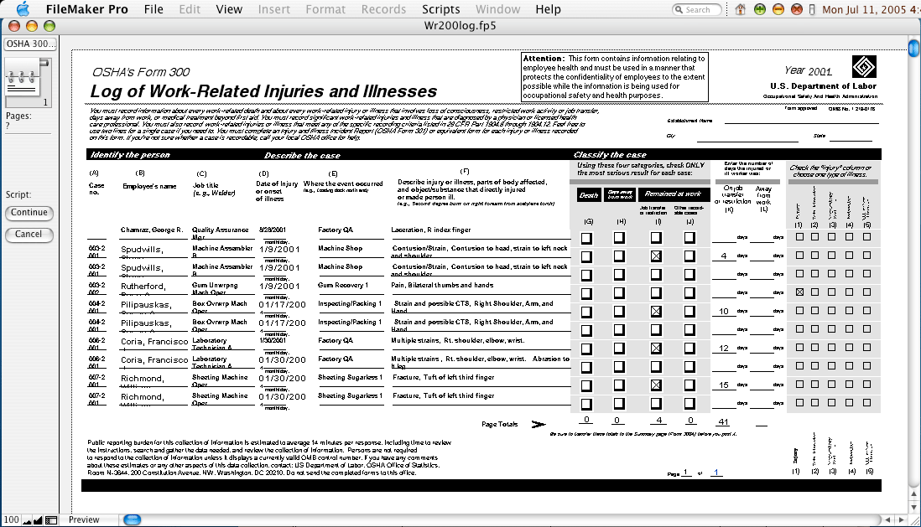
OSHA 300 Log

Slide 27
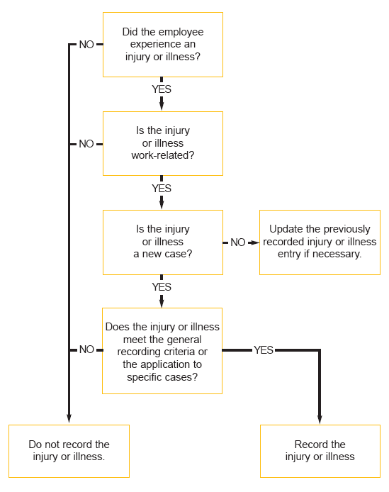
Determining Which Work-Related Illnesses and Injuries to Record

Slide 28

Recordkeeping
Employers with Multiple Worksites
Employers must keep injury and illness records for each establishment.
OSHA defines an establishment as a “single physical location where business is conducted or where services are performed.”

Slide 29
Recordkeeping
Employers with Multiple Worksites
An employer whose employees work in dispersed locations must keep records at the place where the employees report for work.
In some situations, employees do not report to work at the same place each day. In that case, records must be kept at the place from which they are paid or at the base from which they operate.

Slide 30

Recordkeeping
OSHA 301, Injury and Illness Incident Report
Each employer must complete the OSHA 301 form within seven calendar days from the time the employer learns of the work-related injury or illness.
This form includes more data about how the injury or illness occurred.

Slide 31
Recordkeeping
OSHA 301, Injury and Illness Incident Report
Employees and former employees are guaranteed access to their individual OSHA 301 forms. Employee representatives will be provided access to the “information about the case” section of the OSHA 301 form in establishments where they represent employees.

Slide 32

OSHA poster

Slide 33
Recordkeeping
Misconduct
As with any other law employers will be cited, and fined. Penalties are assessed.
Once you violate the law employers can be found to be negligent and liable.
If cited – this means that the law was violated and employees were placed in danger.
If you violate the law you are negligent and if someone is hurt you can be liable.

Slide 34
Recordkeeping
Conflicting Management Directives
Set an example by ensuring the entire message is appropriate
If safety is paramount, avoid pressuring employees to overlook safety in favor of speed
What are some messages that can give conflicting directives?
How an we be clearer in communicating directives?

Slide 35
Recordkeeping
Summary
You must comply with the laws, rules and standards to protect workers. Define the issue, evaluate alternate work methods, develop means and methods that will provide equivalent or better protection for the workers, and evaluate the need for a variance. No excuses.
Protocol for activity hazard analysis must address the participation and involvement of the workers. Do you know what the culture and level of confidence is for workers to participate – and speak up? This is a critical factor.

Slide 36
Recordkeeping
Summary
The identification of work methods, safety and health programs are preventive in nature. Your program, policies, procedures and behaviors must provide “prevention” actions that you can rely. Telling workers to be careful will not work.
You must know your program, how it works, how the workers are involved, and you must know that you and your resources are looking out for each other.
Seek SHARP recognition.

Slide 37
Questions?
?
?
?
?
?
?

Slide 38
OSHA Disclaimer
This material was produced under grant SH29640SH6 from the Occupational Safety and Health Administration, U.S. Department of Labor. It does not necessarily reflect the views or policies of the U.S. Department of Labor, nor does mention of trade names, commercial products, or organizations imply endorsement by the U.S. Government.

