Slide 1
Construction
Safety & Injury Prevention Program
“This material was produced under grant SH29640SH6 from the Occupational Safety and Health Administration, U.S. Department of Labor. It does not necessarily reflect the views or policies of the U.S. Department of Labor, nor does mention of trade names, commercial products, or organizations imply endorsement by the U.S. Government.”

Slide 2



Overview
Structure
OSHA
Considerations
Introduction

Slide 3
CSIP Structure
Targeted Training
Participants
Workers
Safety Manager/Coordinator
Supervisory & Managerial Staff
Notes:
Each participant group will meet for four hours, with Supervisory & Managerial Staff receiving additional technical assistance in developing a written Safety & Injury Prevention Plan.
The topics covered are specific to the participant group, though some information is present in all three courses, as it’s pertinent to all participants.

Slide 4
CSIP Structure
Worker
Module 1
Hazard Identification Plan
Hazard Control
Personal Protective Equipment
PPE Assessment Development
Employer Responsibilities & Disciplinary Policy
Worker Rights and Anti-Retaliation

Slide 5
CSIP Structure
Safety Manager/Coordinator
Module 1
Leadership Commitment to Operational Safety
Workplace Safety & Employee Engagement
Hazard Identification Plan
Workplace Safety Rules & Hazard Control
Module 2
Safety Inspection Procedure
Incident Investigation Procedure
OSHA Inspections
Emergency Planning & Emergency Response Procedures

Slide 6
CSIP Structure
Manager & Supervisory Staff
Module 1
Employee Engagement
Hazard Identification Plan
Hazard Control
Workplace Safety Rules
Job Safety Analysis
OSHA Inspections
Emergency Planning & Emergency Response Procedures
Anti-retaliation
Employer Responsibilities & Disciplinary Policy

Slide 7
OSHA & Rules
Employers are required to have a safety and health program that will protect their employees.
“Protect” meaning preventing injury and illness.

Slide 8
CSIP Introduction
What is the Construction Safety Program?
Who says I have to do it?
How can it be done?
How do I know what I’m getting?

Slide 9
CSIP Introduction
Program Support
Susan Harwood Training Program grants support training and education programs for workers and employers on the recognition, avoidance, abatement, and prevention of safety and health hazards in their workplaces through (Source)
The goal of CSP is to address prevention and identification of construction safety and health hazards to “secure safe and healthy workplaces, particularly in high-risk industries” (DOL’s Strategic Objective, Performance Goal OSHA 2.1).

Slide 10
CSIP Introduction
A program is a combination of activities that are designed to ensure safe and healthful workplaces for employees. A program will include equipment, materials, money, personnel and time. Do it smartly!
Failure to develop and implement an effective program affects costs, and liability.

Slide 11
Rules
Complying with the standards and rules will help employers to meet this duty.
Employers must identify, evaluate and control hazards that can injure employees

Slide 12
Common Questions
Why is OSHA inspecting me?
Because they are required to do so by law.
I’ve been in business for several years and no one told me about OSHA, this is not fair?
Ignorance of the law is not a defense or an excuse.
The compliance officers are not consistent. The other guys did not cite me for this.
They are not required to be. An inspection is only a snapshot in time.

Slide 13
Common Questions
No one in OSHA considers the cost of doing business and how much it costs to survive.
It is not their job to figure out your business. You have the control to do whatever is reasonable and necessary to protect your workers. Performance standards relies on how you apply the standards and implement procedures and processes to protect your workers. Your workers are your resource.

Slide 14
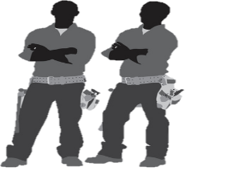
Common Questions
  What If I Don’t?
As with any other law employers will be cited and fined. Penalties are assessed.
Once you violate the law employers can be found to be negligent and liable.
If you violate the law you are negligent and if someone is hurt you can be liable.
If cited – this means that the law was violated and employees were placed in danger.

Slide 15
OSHA
  Purpose of OSHA
  Exists because until 1970, no uniform or comprehensive provisions existed to protect against workplace safety and health hazards.
  Mission:
3.
To Protect America’s Workers
1.
To Save Lives
2.
To Prevent Injury

Slide 16
OSHA
OSHA Facts
In 2015, there were 4,836 fatal work injuries, 21 percent of which were related to the construction industry. This averages to 93 fatalities a week or more than 13 daily.
In 2015, 2.9 million non-fatal work-related injuries and illnesses were reported by private industries and 752,600 work-related injuries and illnesses were related by public industries.

Slide 17
OSHA
  OSHA Strategies
  To Help Reduce Injury and Death on the Job
1.
Strong, fair
& effective enforcement
2.
Outreach, education & compliance assistance
3.
Partnerships & other cooperative programs

Slide 18
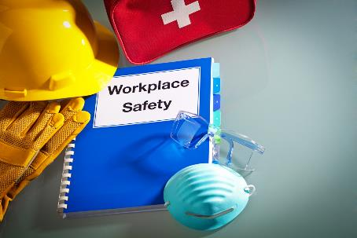
Intended Outcome
We hope that CSIP will provide you with the tools and resources to address safety at your workplace

