Slide 1
Hazard Identification & Control CONFINED SPACES
Build a Better Safety Training | Susan Harwood Grant

Slide 2
Disclaimer
This material was produced under grant number SH-29624-SH6 from the Occupational Safety and Health Administration, U.S. Department of Labor. It does not necessarily reflect the views or policies of the U. S. Department of Labor, nor does mention of trade names, commercial products, or organizations imply endorsement by the U. S. Government. The U.S. Government does not warrant or assume any legal liability or responsibility for the accuracy, completeness, or usefulness of any Information, apparatus, product, or process disclosed.

Slide 3
Confined Spaces
OBJECTIVES
Define confined space
Recognize confined space hazards
Learn confined space hazard controls
Review requirements on training and rescue

Slide 4
Emergency!
Order the cards according to the steps necessary for responding to a confined space emergency (what would should you do first, second, third, etc.). 2 minutes

Slide 5
Emergency Response Steps (not in correct order)

Slide 6
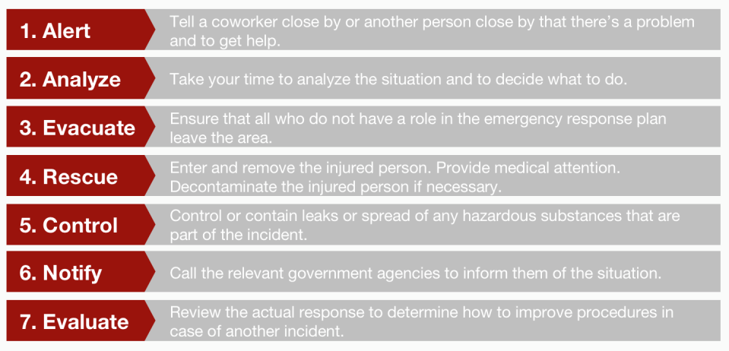
Emergency Response Steps (correct order)

Slide 7
KNOW, IMPLEMENT, COMPLY
1.
What type of confined space?
Does is have one or more of the characteristics of a permit-required confined space?
3.
Supervisor, helper, entrant
Complete required permits, ensure a communication system, and use the proper PPE and rescue equipment.
KNOW!
IMPLEMENT!
COMPLY!
2.
What controls should be used?
Take measurements of the air, and consider ventilation, locking out and tagging.

Slide 8
From 2005-2009, there were a total of 481 deaths, which averages to 96.2 deaths per year.
Notes:
Statistics from the Department of Labor: permit-required confined space incidents from 2005 through 2009: a total of 481 fatalities. This averages to about 96.2 fatalities per year (or 1.85 fatalities per week), which equates to 1 fatality about every 4 days.
Keep in mind that this data only covers incidents with at least one fatality or death, so these numbers don’t include all of those incidents that resulted in serious injuries or illnesses.

Slide 9
According to a federal study on confined spaces, more than 60% of confined space related fatalities were from those who died trying to rescue a coworker.

Slide 10
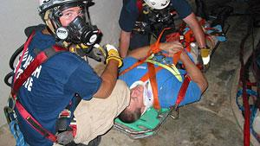
1 DEATH EVERY 4 DAYS

Slide 11
Accident Summary
CONFINED SPACE
OSHA received notification of a fatality on a construction site on August 5, 2004, one day after the accident.
It was reported that a worker was found at the bottom of a utility hole.
A new sewage system was being installed by a small construction company with 20 employees.

Slide 12
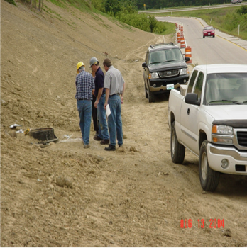
Case Study
The OSHA inspection began after receiving notification of the worksite fatality on August 5, 2004.

Slide 13
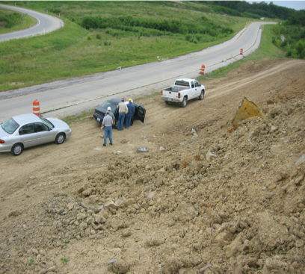
Case Study1
There were 6 workers on site. 5 were installing pipes on the hill. The victim was inside the utility hole.

Slide 14
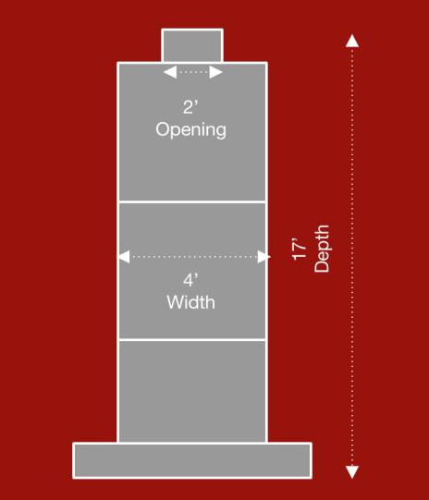
The Confined Space
2 feet at the opening
4 feet internal diameter
Hole constructed from 4’ X 4’ concrete sections
17 feet exterior depth, 16 1/2 feet interior

Slide 15
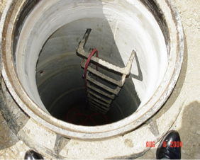
Case Study2
The victim as assigned the task of applying mortar inside the hole.

Slide 16
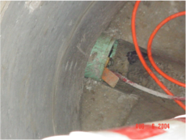
Case Study3
This photo shows the connection that is inserted and located at the entrance to the bottom of the hole and completes the sealed space.

Slide 17
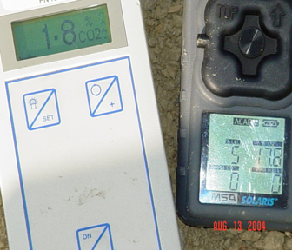
Case Study4
During the inspection it was reported that the employer did not have a confined space entry program or equipment available.

Slide 18
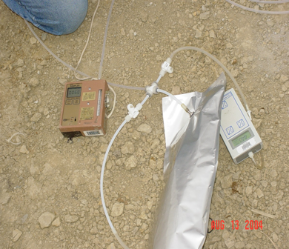
Case Study5
Four samples were taken from the bottom of the utilitiy hole. The results showed between 12.5 to 14.1% oxygen.

Slide 19
Displacement of Oxygen What happens in newly constructed utilitiy holes is the displacement of oxygen by other substances including carbon dioxide. Carbon dioxide is a colorless, odorless, heavier gas than air.
Notes:
In theory, what happens in these newly built nocks is the displacement of oxygen by other substances, including carbon dioxide.
Carbon dioxide is a colorless, odorless gas that is heavier than air.
In the Midwest, limestone rocks and utilitiy holes are built on a bed of limestone / gravel and there are acid soils. It is believed that acids rise from the soil and combine with limestone to produce carbon dioxide.
There are 5 known cases involving fatalities in newly constructed utilitiy holes across the country since 2000. In most cases, utilitiy holes were not connected to active sewer lines (as in this case) and aspiration tests for Detect leaks had been done before admission. It is believed that carbon dioxide is found inside the utilitiy hole, displacing oxygen during these filtration tests. The oxygen content in these utilitiy holes has been found to be less than 3%. In most cases, it has been reported that workers enter the utilitiy holes for years without any problem; And nocks in the same area have normal oxygen and carbon dioxide levels.

Slide 20
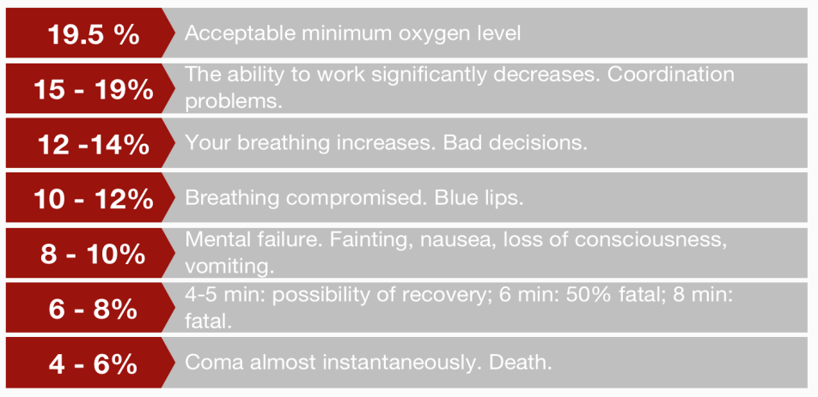
Oxygen Deficient Atmospheres

Slide 21
Part 1. CONFINED SPACES

Slide 22
CONFINED SPACE
It is large enough for an employee’s entire body to enter and to do a job; Has a limited or restricted entry or exit; It is not designed to be occupied continuously by the employee

Slide 23
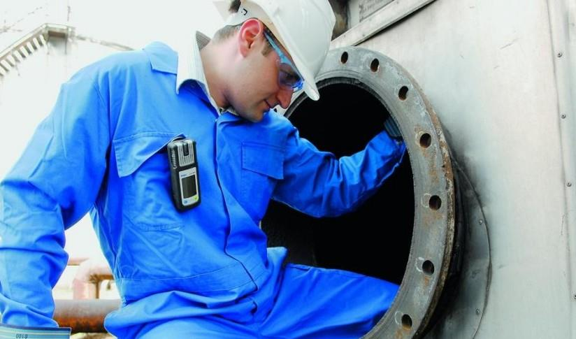
STORAGE TANKS

Slide 24
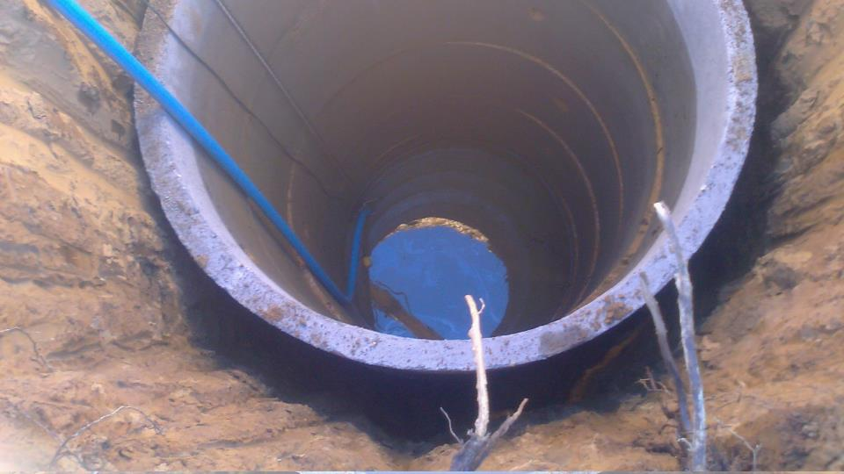
WELLS

Slide 25
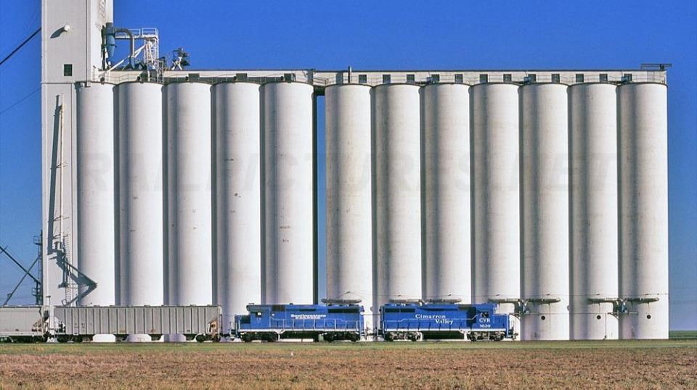
SILOS

Slide 26
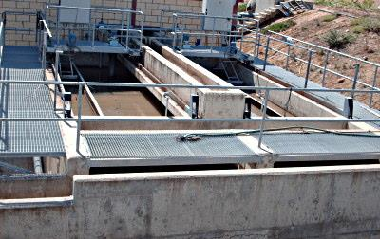
DEGREASERS

Slide 27
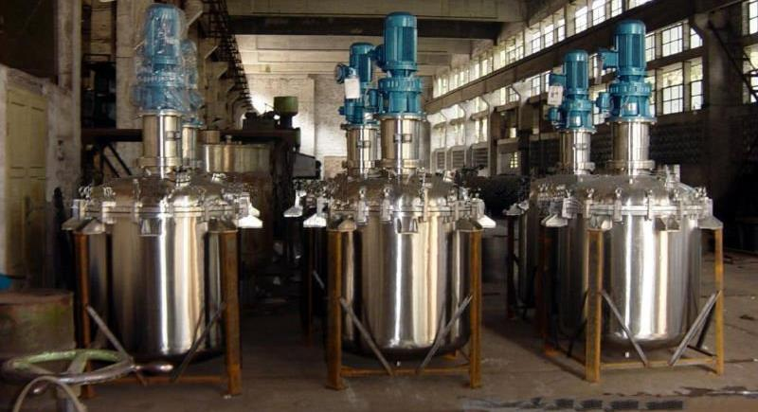
REACTION CONTAINERS

Slide 28
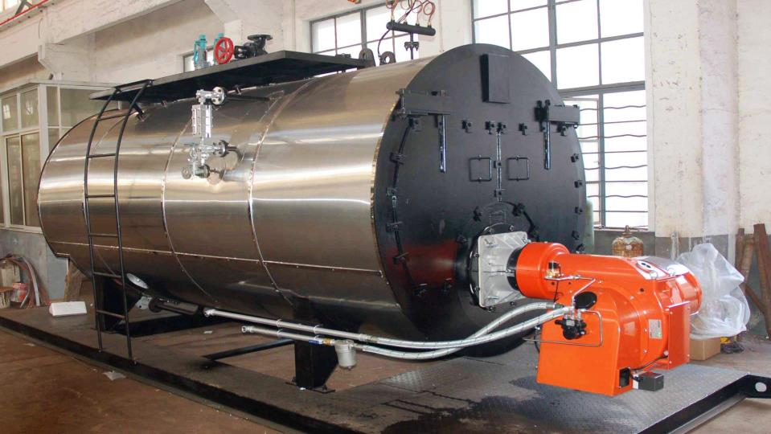
BOILERS

Slide 29
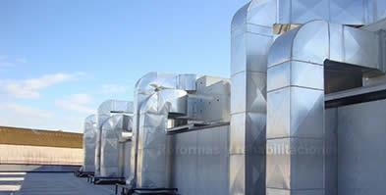
VENTILATION CONDUCT

Slide 30
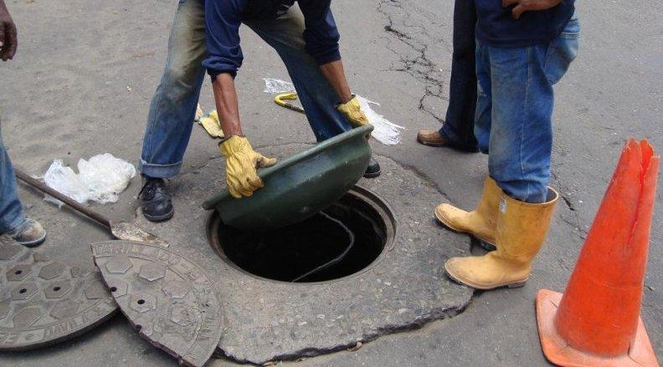
SEWERS

Slide 31
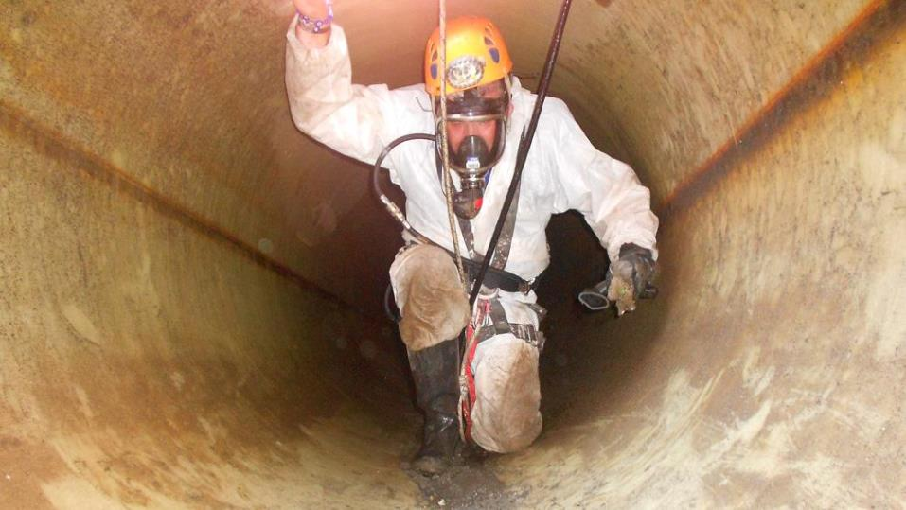
TUNNELS

Slide 32
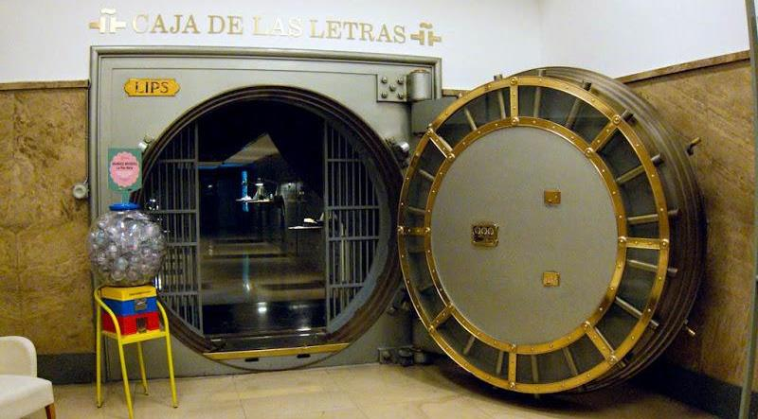
VAULTS

Slide 33
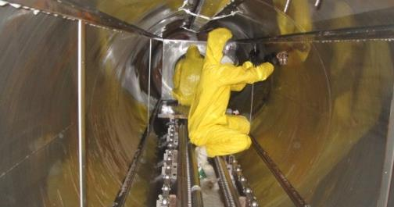
PIPELINES

Slide 34
What is a confined space?
Non-permit required
Permit-required
How to determine when a permit is required

Slide 35
1. CONFINED SPACE
Non-permit required
It is large enough for an employee to enter the entire body and do a job
Has a limited or restricted entry or exit
It is not designed to be occupied continuously by the employee

Slide 36
2. CONFINED SPACE
Permit-Required
Potential to contain a dangerous atmosphere.
Potential to consume an entree;
Internal configuration such that an entrant could be trapped or suffocated by
Contains any other serious risk recognized against health or safety

Slide 37
T

Slide 38
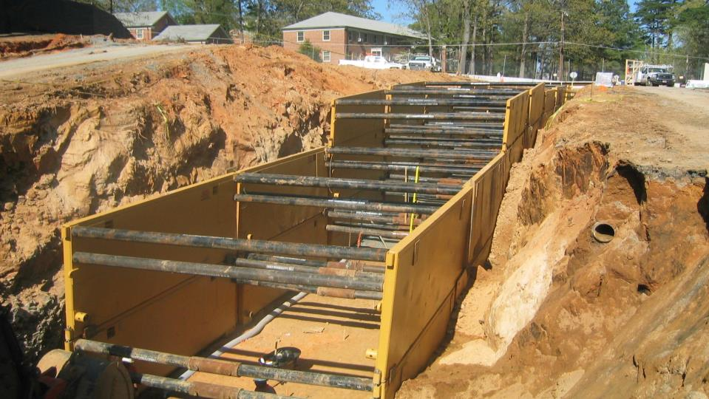
NON-PERMIT REQUIRED?

Slide 39
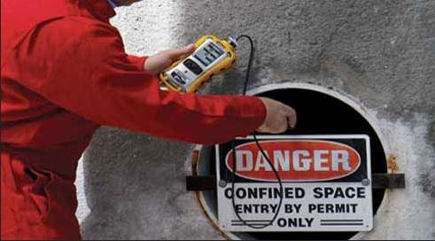
PERMIT REQUIRED?

Slide 40
Part 2. HAZARDS & RISKS

Slide 41
QUESTION
¿Why are confined spaces dangerous?

Slide 42
Oxygen Levels

Slide 43
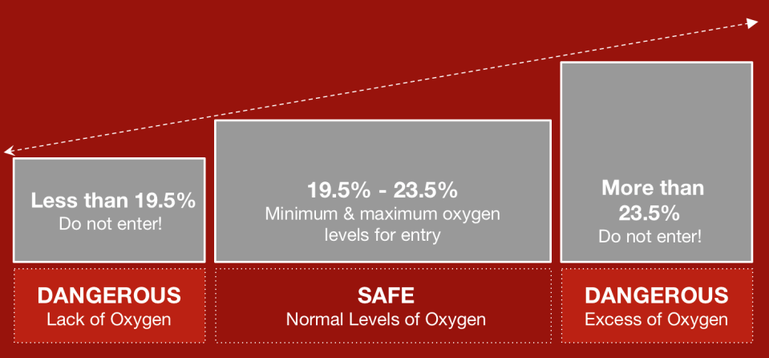
Hazards and Risks
OXYGEN LEVELS

Slide 44
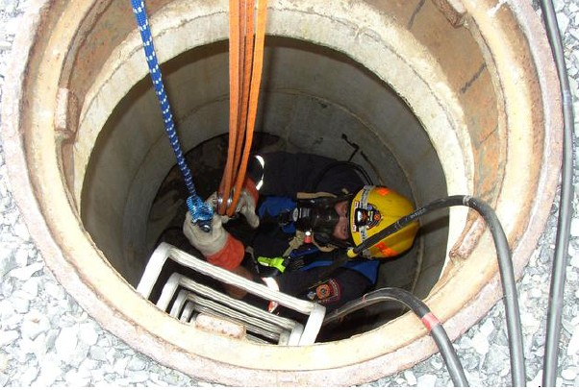
TOXIC GASES

Slide 45
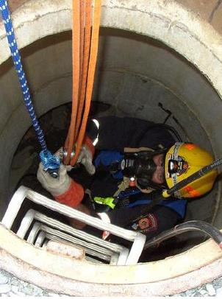
Toxic Gases
Products stored in confined spaces
Gases that are generated when cleaned.
Materials that are absorbed by the walls of the confined space.
Decomposition of materials in the confined space.
Jobs like welding, cutting, painting, scraping, removing grease, sealing, bondear, melting

Slide 46
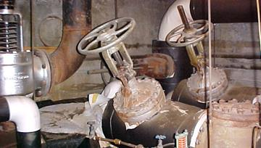
PHYSICAL HAZARDS

Slide 47
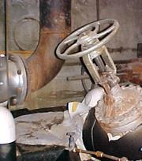
Physical Hazards
Limit Openings to Enter / Exit
Openings as small as 18 inches.
Difficult to enter with SCBA or other rescue equipment
Difficult to get a fainted employee into bent position
Difficult to get out of large openings due to the presence of stairs, or any other equipment removing people or equipment

Slide 48
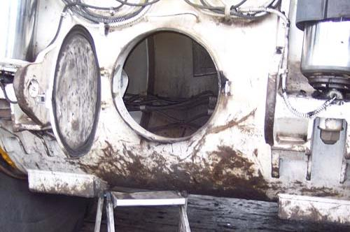
LOW VENTILATION

Slide 49
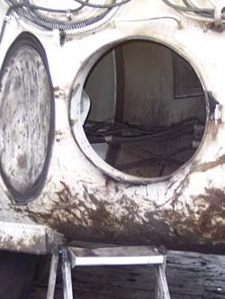
Low Ventilation
Unfavorable Natural Ventilation
Poor air movement in and out of space can create an atmosphere different from the one outside
Dangerous gases can be trapped inside
Organic materials can be broken down
There may not be enough oxygen due to the presence of other gases or chemical reactions

Slide 50
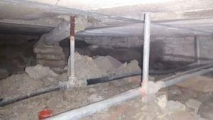
LIMITED ENTRY/EXIT

Slide 51
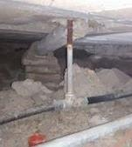
Limited Entry / Exit
They are not designed to enter and work continuously
Designed to store a product
Enclose materials or processes
Transporting products or substances

Slide 52
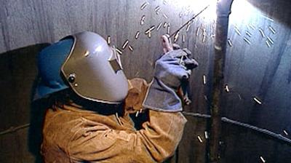
EXTREME TEMPERATURES

Slide 53
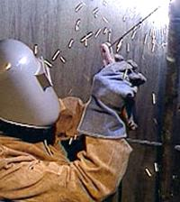
Extreme Temperatures
Extreme heat or cold
Humidity
Extremely cold liquids
Work processes inside the space can increase the temperatures in excess

Slide 54
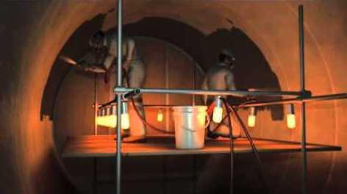
FLAMMABLE ATMOSPHERE

Slide 55
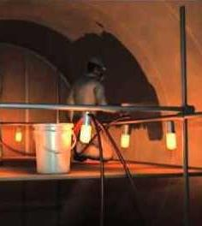
Extreme Temperatures
Oxygen content in the air
Presence of flammable gases or vapors
Presence of fuel (visibility 5’ or less)
Typical sources of ignition: Electric tools, sparks, welding / cutting operations, smoke

Slide 56
Part 3. HAZARD CONTROLS

Slide 57
How can I work more safely?
Take sample measurements
Ventilate area
Isolate and lock out
Personal protection equipment

Slide 58
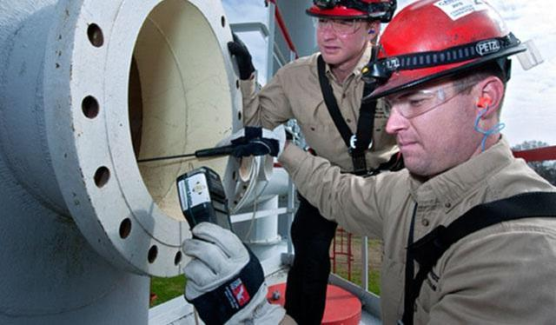
TAKE SAMPLE MEASUREMENTS

Slide 59
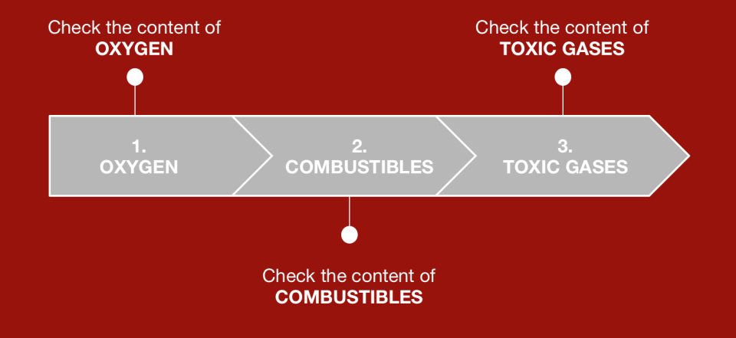
OXYGEN, COMBUSTIBLES, TOXIC GASES

Slide 60
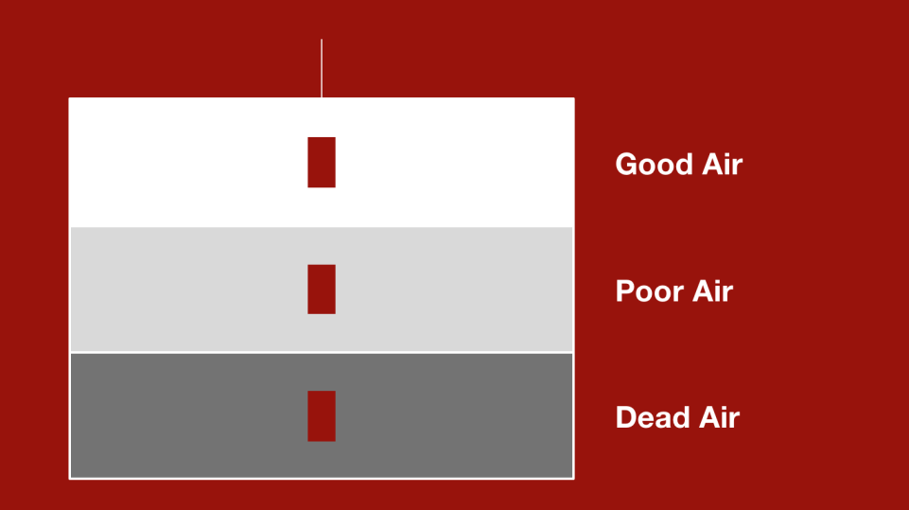
AIR QUALITY

Slide 61
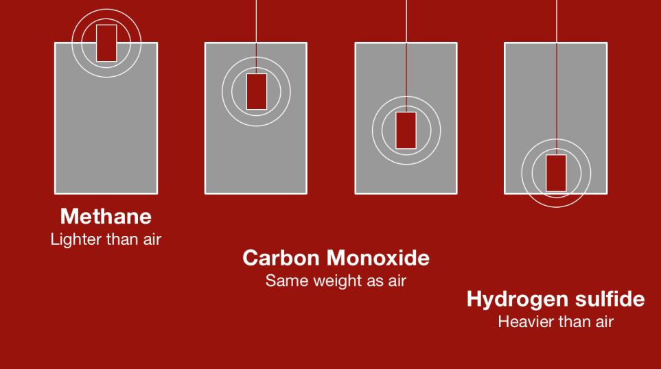
Gas Types
GAS TYPES

Slide 62
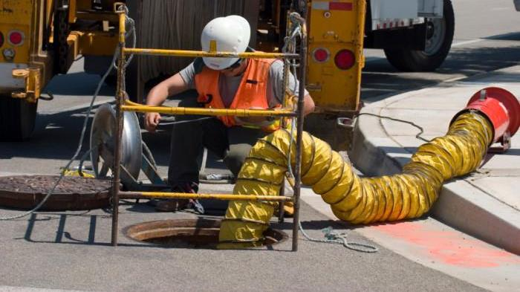
VENTILATION

Slide 63
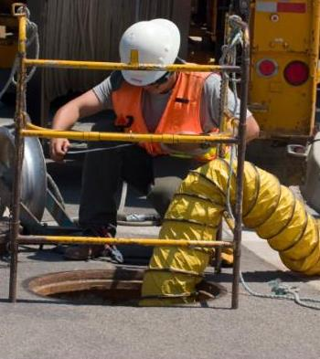
Ventilation
Be aware of the dangers that you want to correct in the confined space.
Make sure the air you are entering is fresh air.
Maintain continuous ventilation when possible.
Take samples of the space before entering, when you have left and re-enter.

Slide 64
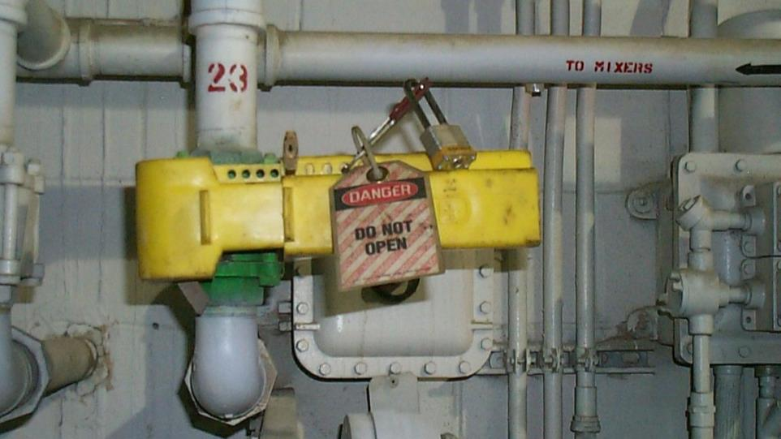
LOCK/OUT & TAG/OUT

Slide 65
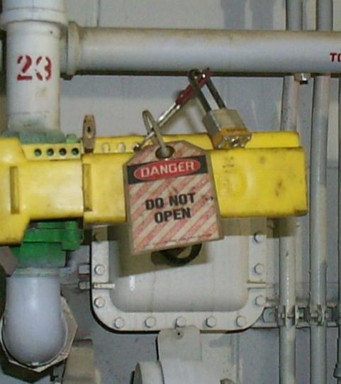
LOCK/OUT & TAG/OUT
Put padlock and card in electrical power sources (Lock / out, tag / out)
Secure the mechanical parts
Lock / out, tag / out and close valves
Bleed the pneumatic and hydraulic lines
Lock/out sewers and water flow

Slide 66
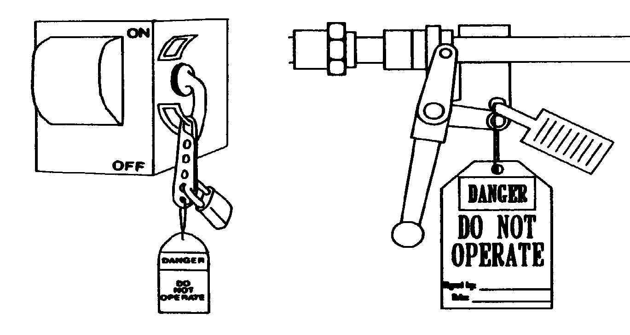
LOCK OUT / TAG OUT

Slide 67
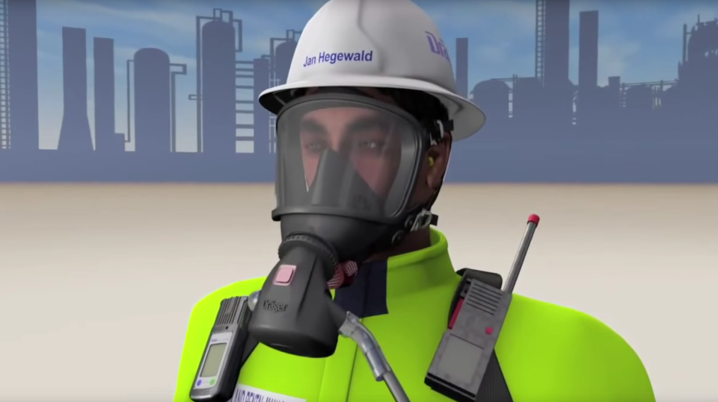
PERSONAL PROTECTIVE EQUIPMENT

Slide 68
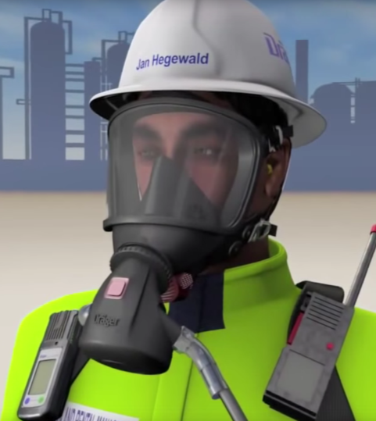
PPE
Safety glasses and helmet, protective gloves
Respirators, safety shoes, protective clothing
Full Body Harness
Rescue equipment

Slide 69
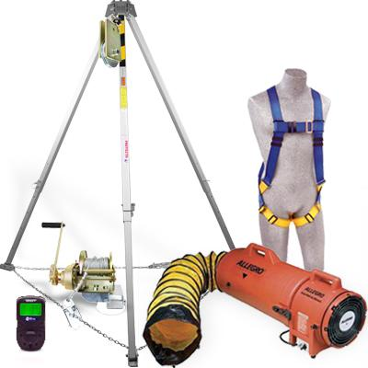
PERSONAL PROTECTIVE EQUIPMENT

Slide 70
What about alerts and permits?
Types of alerts
Permissions (tags)
Permits (sheets)

Slide 71
ENTRY PERMITS

Slide 72
ENTRY PERMITS
Notes:
Confined spaces are required to be identified. You are responsible for following procedures and safety rules.
Place warning signs where pedestrians can see them.
Signs must state the hazard and required action

Slide 73
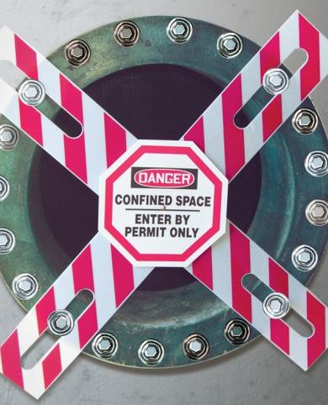
Entry Permit Requirements
Date, location, and name of the confined space.
Purpose of entry and known hazards.
Duration of the entry permit
Authorized entrants, helpers and supervisors
Results of air samples - signature of the person taking the samples.
Protective measures to be taken: Ventilation, Isolate, Flushing, Lockout / Tagout

Slide 74
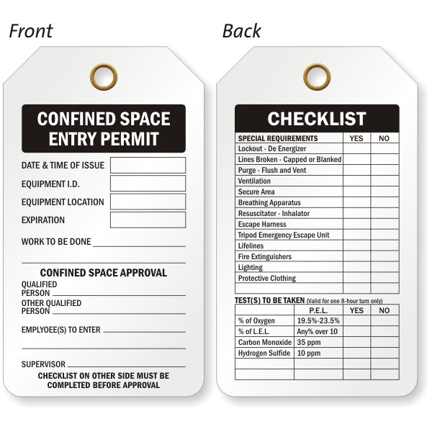
ENTRY PERMITS
Notes:
Entry Permit Requirements
Date, location, and name of the confined space.
Purpose of entry and known hazards.
Duration of the entry permit
Authorized entrants, attendants, supervisors.
Results of air samples - signature of the person taking the samples.
Protective measures to be taken:
Ventilation, Insulate, Flushing
Lockout / Tagout, Purge

Slide 75
ENTRY PERMITS

Slide 76
ENTRY PERMITS

Slide 77
TRAINING

Slide 78
Training
For all employees who have to enter confined spaces.
All attendants and members of the rescue team
Before beginning work assignment
Be sure to include demo

Slide 79
Re-Training
If the job responsibilities change.
Change in the program of spaces that require permission.
If a new danger is present.
If the execution of the work indicates deficiencies.

Slide 80
Is it necessary to have more than one person?
Supervisor
Helper
Entrant

Slide 81
SUPERVISOR

Slide 82
Supervisor
Verify entry conditions are secure
It is ensured that before entering the permit is complete
If the working conditions become unsafe cancel the permit and order the departure of all workers in the space.
When the job is finished, it cancels the permission and the operation is completed. Deliver the work.

Slide 83
HELPERS

Slide 84
Helpers
Keeps in touch with the entrant at all times
It ensures that only authorized persons enter the space
Note a condition that is not permitted by the work permit

Slide 85
ENTRANTS

Slide 86
Entrants
Make sure you know the hazards of the area and the exposure signs.
He stays in communication with the assistant and the Entry Supervisor.
He must have training and be authorized to enter the space.

Slide 87
Hazard Identification & Control CONFINED SPACES
Build a Better Safety Training | Susan Harwood Grant

