Slide 1
Ergonomic Solutions Focusing on Wrist, Hands and Lower Back
This material was produced under a Susan Harwood Grant SH-29599-SH6 from the Occupational Safety and Health Administration, U.S. Department of Labor. It does not necessarily reflect the views or policies of the U.S. Department of Labor, nor does mention of trade names, commercial products, or organizations imply endorsement by the U. S. Government. The U.S. Government does not warrant or assume any legal liability or responsibility for the accuracy, completeness, or usefulness of any information, apparatus, product, or process disclosed.

Slide 2
Learning Objectives
The recognition among day laborers of the consequences and seriousness of musculoskeletal disorders.
Preventive measures such as:
team work, better equipment and
tools.
Notes:
Learning Objectives The recognition among day laborers of the consequences and seriousness of musculoskeletal disorders (MSDs)

Slide 3
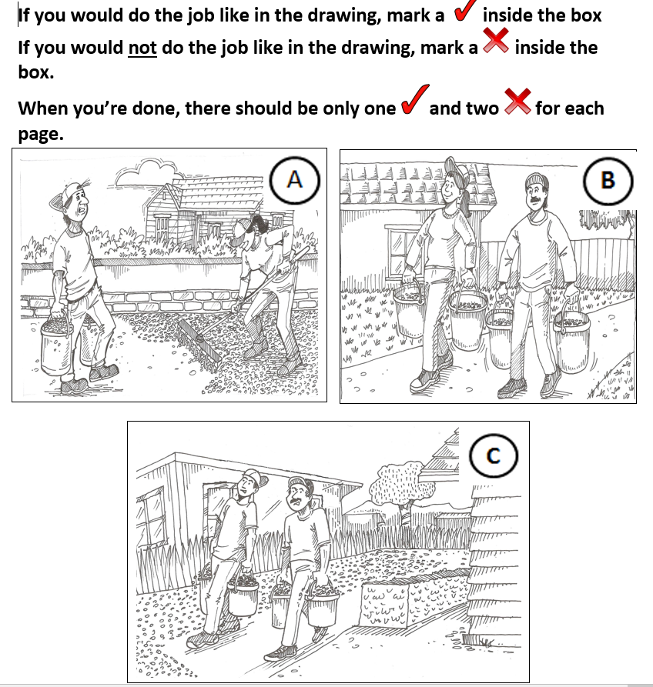
Pre-test

Slide 4
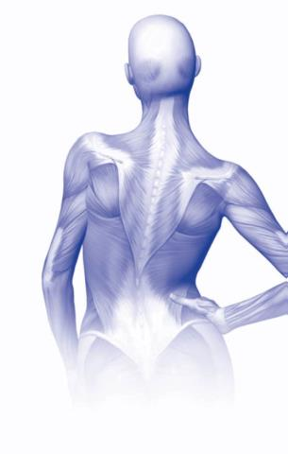
MSD Refresher
What are MSDs?
MSDs are occupational disorders affecting muscles, tendons, ligaments, joints, and/or nerves.
A common term is “OVERUSE”
Notes:
Ask the class: What are examples of MSDs? (Instructor writes what students say on the flipchart).
Tell the class:
Carpal tunnel syndrome (CTS) - Carpal tunnel syndrome is pressure on the median nerve -- the nerve in the wrist that supplies feeling and movement to parts of the hand. It can lead to numbness, tingling, weakness, or muscle damage in the hand and fingers. Using tools that don’t fit your hand properly can cause this type of injury.
Tendinitis – this occurs when tendons rub against the bone and get swollen. Tendinitis refers to inflammation of the tendon. For example, swinging a sledge hammer repeatedly can cause tendinitis in the elbow.
Bursitis – this occurs when the fluid-filled sac (bursa) that lies between a tendon and skin, or between a tendon and bone, gets inflamed. Bursae are found in the knee, elbow, shoulder and wrist. The main symptom of bursitis is pain. In some cases, especially for shoulder bursitis, people may experience some restriction of movement and stiffness. For example, working in an awkward overhead position for extended periods of time can cause bursitis in the shoulder.
See handout: What are MSI’s? Constructive Ideas, Worksafe BC.

Slide 5
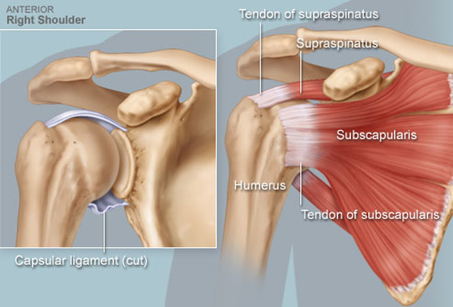
MSD refresher?

Slide 6
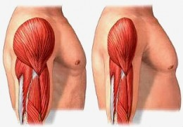
MSD Refresher

Slide 7
Factors that caused MSDs
Heavy
Loads
Has anyone suffered an MSDs?
Awkward Posture
High
Frequency

Slide 8
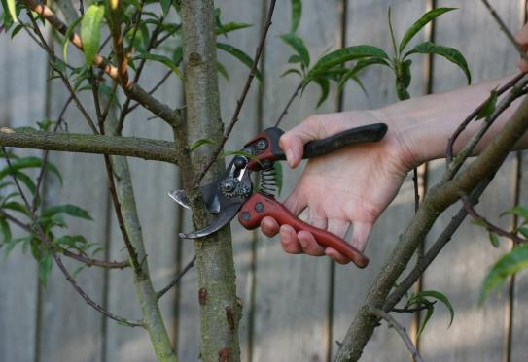
Clippers/gardening demonstration

Slide 9
Analyzing Jobs for Risks and Ideas for Solutions
Identify potential MSD risks and ergonomic solutions from job scenarios

Slide 10
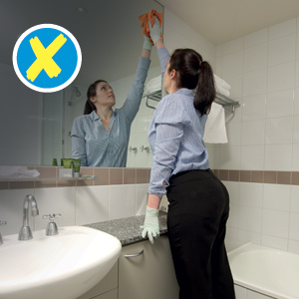
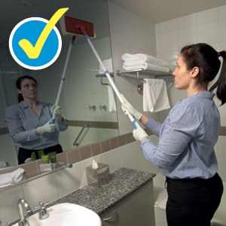
Cleaning

Slide 11
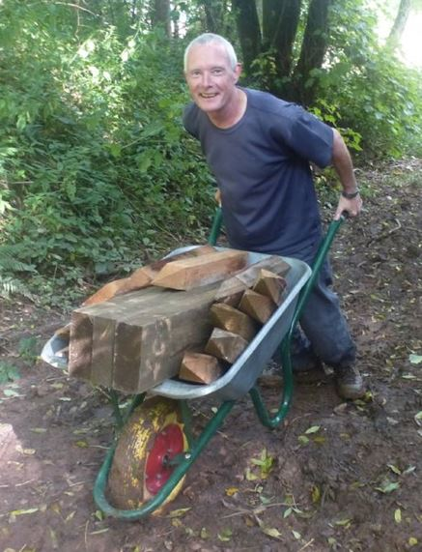
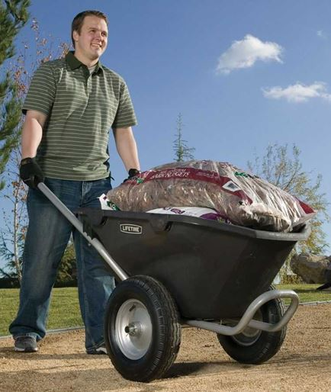
Hauling

Slide 12
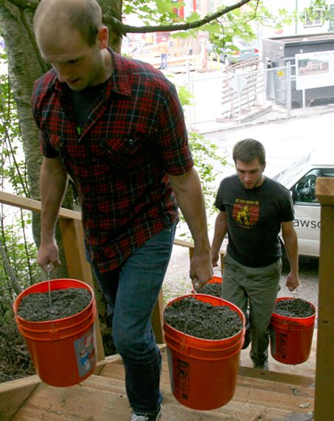
Hauling Buckets

Slide 13
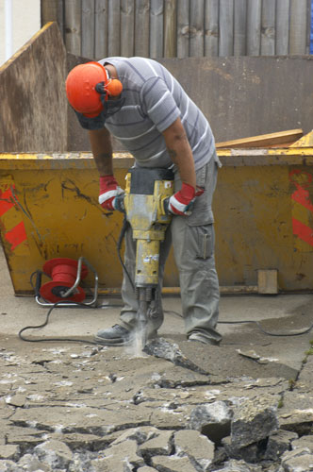
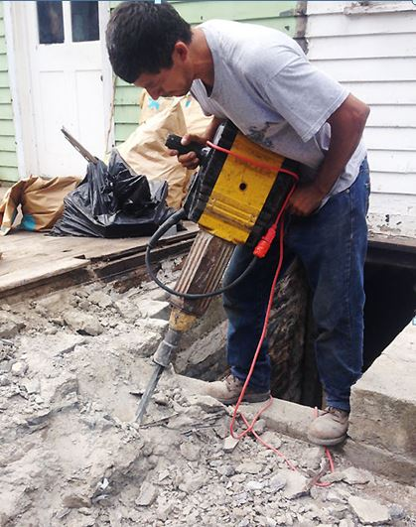
Demolition

Slide 14
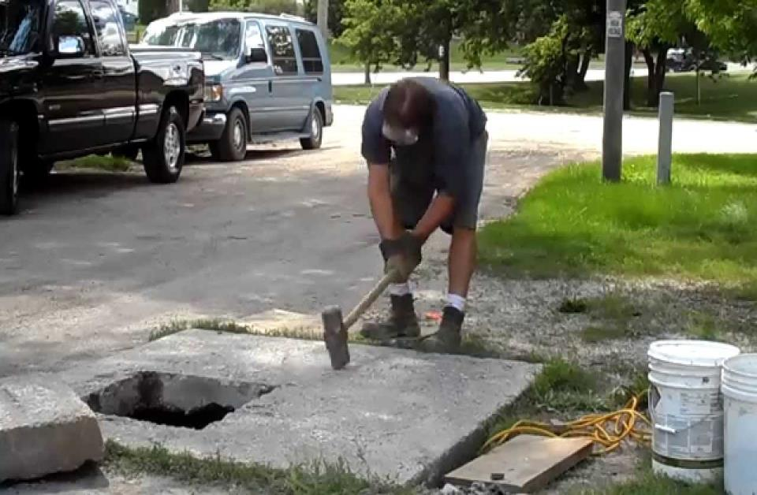
Demolition w/Sledgehammer

Slide 15
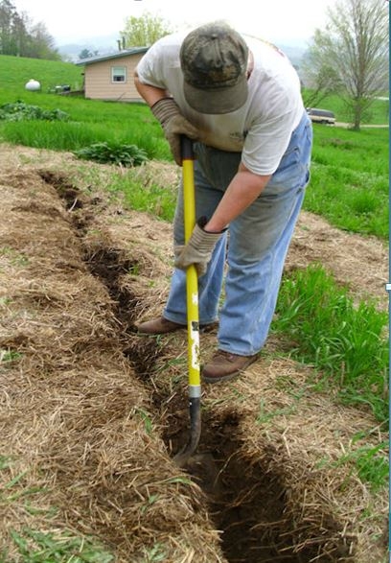
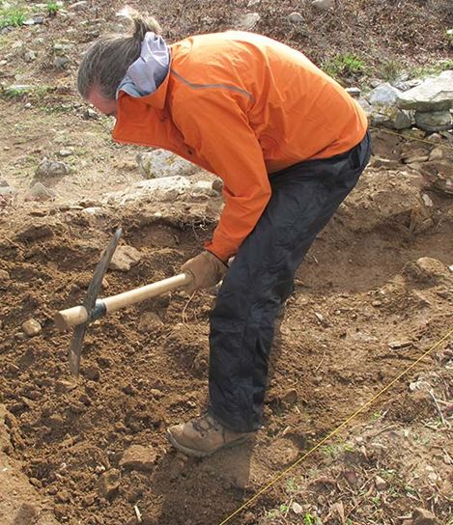
Digging

Slide 16
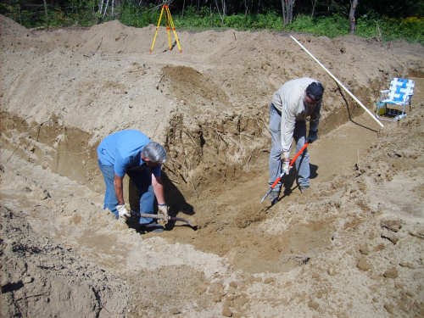
Digging continued

Slide 17
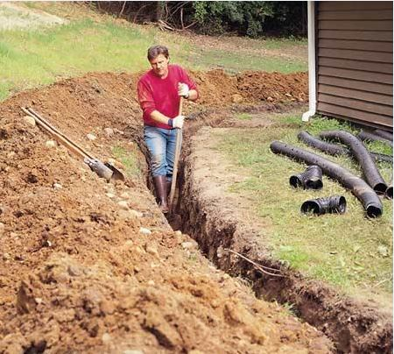
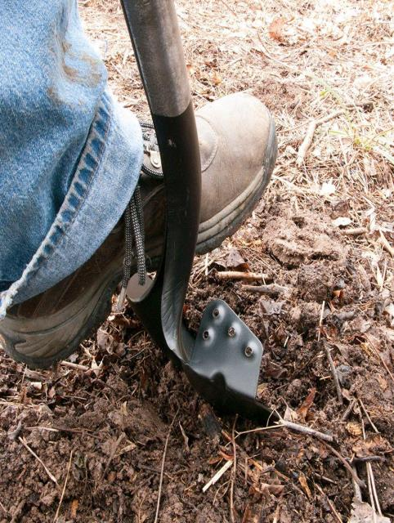
Digging Trench

Slide 18
Team Work
What is team work?
Team work is: the combined action of a group of people, working together to achieved the best results possible

Slide 19
Working as a Team
Suggestions for working as a team:
Listen to co-worker’s ideas
Use open, honest and respectful communication
Agree upon procedures for problem solving
Believe that everyone belongs and has something to offer
Be open to the fact that one is not always right and that everyone is different
Use Casa Latina Support Emergency line to ask for support

Slide 20
Myths & Facts
Home remedies. Myths & facts?
Myths:
Showering after work, causes arthritis
Working in the rain causes arthritis
Facts:
Ibuprofen. to help against inflammation
A bag of ice
Stretching exercises

Slide 21
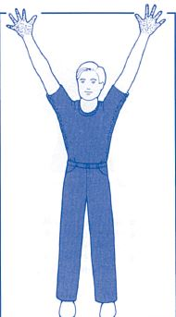
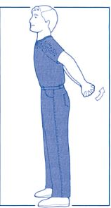
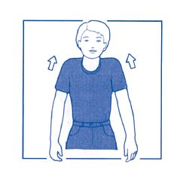
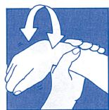
Stretching Exercises
Before and after work

Slide 22
Contact Information
OSHA Regional Office

Slide 23
Closing arguments
Heavy loads, high frequency and awkward posture, are risk factors that cause MSDs.
Stretching exercises, better tools and equipment, and team work, reduce the risk of MSDs.
We have the right to make a report to OSHA or LNI when working in unsafe conditions.

Slide 24
Thank you!
Thank you for your attention!!!!

