Slide 1
Other Hazards and PPE
Notes:
Have participants sign in on attendance sheets provided by GHSC.
GHSC sign-in sheets are necessary to verify attendance to the U.S. Dept. of Labor who provided grant funds.
Alternatively the instructor can verify attendance by providing date, course name, length of course, instructor name, and number of participants or use the classroom attendance sheet.
Have students complete pre-tests.
Verify attendance.
Administer pre-test to students.

Slide 2
Disclaimers
This material was produced under grant number SH26294SH4 from the Occupational Safety and Health Administration, U.S. Department of Labor. It does not necessarily reflect the views or policies of the U.S. Department of Labor, nor does mention of trade names, commercial products, or organizations imply endorsement by the U.S. Government.
Notes:
GHSC received funding from Occupational Safety and Health Administration (OSHA), a federal government agency, to help in the development of this curriculum
While funding was supplied and content reviewed by OSHA, these materials may not reflect their views or policies
GHSC developed these materials with a grant from OSHA under the U.S. Department of Labor.
The GHSC is required to keep certain records. Providing GHSC attendance sheets, evaluations, and pre/post test results assists us in meeting record keeping requirements for the grant.
Records can be sent (mail or electronic) to:
Dr. Robert Aherin
University of Illinois – ACES
1304 Pennsylvania Avenue
Urbana, IL 61801
raherin@illinois.edu

Slide 3
Objectives
Discuss the GHSC Young Worker Position Statement.
Explain “Stand T.A.L.L.” & ways it can empower young workers to speak up.
Identify other grain handling hazards.
Provide examples of prevention strategies including personal protective equipment.
Name parts of an emergency action plan.
Summarize federal child labor laws.
Notes:
This presentation is designed to help the instructor:
Discuss the Young Worker position statement which provides guidance to help young workers & employers when working in grain handling & storage.
Incorporate “Stand TALL” to empower youth to speak up when they identify hazards or feel unsafe.
Explain other potential hazards found in the work environment and learn to identify them.
Explain Personal Protective Equipment and how to use it.
Discuss the elements of emergency action plans for the workplace.
Explore federal child labor laws and how they define the types of jobs workers under the age of 18 can and cannot do in agriculture and other work environments.
NOTE: All modules in this curriculum series present the same content on slides 2 and 4-7 of the presentation.
If other modules have been presented (Entrapments, Engulfments & Entanglements and/or Other Hazards, PPE & Child Labor Laws), the instructor may want to do a brief review of slides 4-7, to save time.
Slide 8 always introduces and discusses briefly the main grain hazards, highlighting the hazards being covered in the module. If other modules have been presented previously this slide can be used as a quick review.
NOTE: Each module is divided into sections. The sections can be presented individually to allow for greater fexibility.
Animated Slide: Each bullet point appears with a mouse click. Total 6 clicks.
Explain today’s lesson objectives.
All GHSC young worker modules contain the first two objectives.
The position statement provides guidance for workers & employers.
Emphasize young workers need to feel comfortable to speak up & ask questions if they are unsure, feel unsafe, or identify hazards in their work area.
The goals of this module are to explore other common hazards in the grain environment, PPE, emergency action plans and child labor laws.

Slide 4




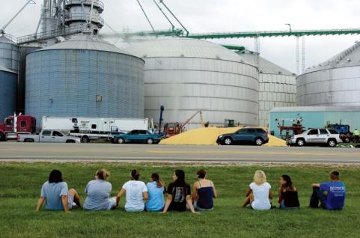

In Memory
Reciting the Lord’s Prayer, Alex asked Will to hold his hand as corn climbed above his head.
Wyatt, 14, screamed for help as the kernels moves past his chest, chin, and over his head within seconds.
“Two people died…One I felt his last heartbeat.”
“There were cars everywhere.”
It took 6 hours and over 300 people to free Will.
People lined the streets anxiously awaiting news.
Notes:
On July 28, 2010 in Mt. Carroll, IL, the four workers pictured were told to break up clumped grain to get it flowing. No formal training or personal protective equipment were provided, and they were unaware of the hazards/risks.
Wyatt Whitebread, age 14 (top right), enjoyed the outdoors, hunting & trap shooting. He was a happy, generous, kind teenager with a ready smile & joyous laugh; loved by all he met. He had been working a couple weeks & “trained” the others. Wyatt’s parents checked out the work & were assured he would only be sweeping out empty bins.
Alex Pacas, age 19 (top left), was the oldest & beloved big brother of 7 children. He loved music, played bass in a church band, and was attending college. It was Alex’s second day of work with his best friend Will. Knowing he was going to die, Alex began to pray with Will, asked him to deliver messages and watch over for his siblings.
Chris Lawton, age 15 (bottom left) was near the inside ladder & left the bin to call for help – he lives wondering if he had stayed would his friend Wyatt be alive today. He was plagued with nightmares, self-doubt, and self-recrimination. Today, Chris serves in the USAF.
Will Piper, age 20 (bottom center) was trapped in the corn inches from his best friend Alex. The rescue tube placed around Will to keep him alive also enclosed Alex’s body. It took 6 hours & over 300 personnel to rescue Will while he could feel Alex under him. Will could not rid himself of the guilt, fear, & loss. He turned to drugs to dull his pain. Will can be seen sitting on the grass by Alex’s grave, talking to his friend and crying. After a long battle, today he is clean & sober, works, attends school & goes on church missions.
Life will never be the same. Chris & Will relive the memory of that day: the sights, sounds, smells and horror of losing their friends.
Alex & Wyatt’s families endure a daily battle of never sharing another moment; creating a new memory; adding a another picture.
From this tragedy, the Grain Handling Safety Coalition was born and works to prevent tragedies like this from happening again
Does anyone in the class know someone who was entrapped or engulfed in grain?
Introduce these young workers and discuss what happened to them.
Explain the origins of the GHSC.
If all modules are presented, instructor can hide duplicate slides.
“Walking down the grain” – refers to workers walking on grain to break up clumps and get the grain flowing for removal. This is often done with the augers running. Once grain starts flowing, it acts like quicksand. Walking down the grain & similar practices are prohibited by OSHA.
Ages listed are at the time of incident.
Image Sources: Whitebread & Pacas families, GHSC, Alex T. Paschal/Sauk Valley Media. Permission granted 2011 by families & individuals to use photos & story anytime for education purposes.

Slide 5

Youth & Grain
Youth = under 18
Do not work in/around grain storage structures:
  unless empty
  when grain is being loaded, unloaded, moved
Properly trained for all tasks
  Experienced & knowledgeable adult
Know ladder & climbing safety
Employers comply with laws
Notes:
GHSC developed a Position Statement for Youth (Young Workers) Working with Grain to ensure the safety of young workers.
As working in and around grain is known to be extremely dangerous, even for adults, special care must be taken to ensure the safety of young workers.
This statement is not exclusive to commercial elevators or farms, but rather a blanket statement for all youth (under age 18).
Youth should NOT enter ANY storage structure, unless it is empty, aerated, and Lock out/Tag out has been done.
Empty infers grain is below knee level & there are no other engulfment hazards present.
Youth should not work inside grain structures (bins, silos, flat storage structures, wagons) when grain is being loaded, unloaded or moved.
Youth must be properly trained by knowledgeable adults.
Youth should be trained to climb and use ladders safely.
Federal labor laws (& some state laws):
May allow 16-17 year olds to engage in tasks not recommended by GHSC.
Though it may be “legal” to perform these tasks, it is strongly recommended to follow the practices outlined by the GHSC position statement to better ensure young workers’ safety.
14 & 15 year olds in non agricultural work – “May NOT be employed in ALL work requiring the use of ladders, scaffolds, or their substitutes.
https://www.dol.gov/whd/regs/compliance/childlabor101_text.htm
Under 16 in agricultural work cannot work from a ladder or scaffold at a height of over 20 feet; http://www.youthrules.gov/know-the-limits/agriculture/hazards.htm
OSHA - www.osha.gov and https://www.osha.gov/youngworkers/
Introduce and discuss the GHSC Position Statement for Youth Working with Grain.
Emphasize no one under the age of 18 should be in or around grain storage structures when grain is present for their safety.
Discuss employers are responsible to know and comply with state and federal laws regarding labor and safety.
Image Source: Jessie Starkey Photography
What risk reduction actions are promoted with the statement?
Avoid – not being in or around storage structures or where grain is being moved.
Remove – grain structures must be empty
Training – for all tasks as well as for correct ladder climbing and proper housekeeping.
PPE – for fall protection
Animated Slide: Each main bullet point appears with a click – total 5 clicks.
Instructors should be familiar with the full text of the GHSC’s Youth & Grain Position Statement: http://grainsafety.org/young-workers/
Direct young workers to the U.S. Dept. of Labor websites for OSHA and the Wage & Hour Division for information.

Slide 6
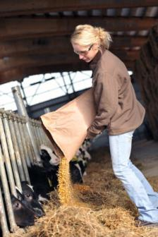
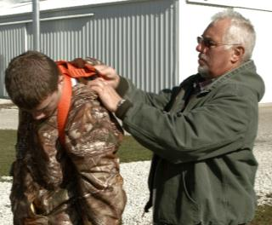
Stand TALL
Roles
  Young worker
  Adult
Stand T.A.L.L.
  Talk
  Ask
  Learn
  Live
Notes:
Roles:
Working youth are under 18 years old; also called young workers.
Adults are typically the employer &/or supervisor. On family farms the adult could also be a parent, legal guardian, grandparent or other family member. See Notes.
Emphasize the concept of empowerment through knowledge.
Young workers need to know their rights to a safe & healthy work place, and should speak up whenever they don’t feel safe.
Adults must ensure a safe worksite by assigning age appropriate jobs, mitigating (fixing) hazards and providing personal protective equipment.
Adults should understand young workers are particularly vulnerable to workplace hazards. They have a strong desire to please, as well as appear knowledgeable and mature which may prevent them from asking questions and seeking help.
Adults need to encourage young workers to learn how to “Stand TALL” when working in/around grain by following these guidelines:
TALK – safety with their boss, family and/or other trusted adults.
ASK – be comfortable & confident to seek assistance or clarification when uncertain about how to complete a task or if they have concerns about their safety.
LEARN – how to recognize workplace hazards & avoid or protect themselves against those hazards before encountering an unsafe or risky situation.
LIVE – Be safe to go home to family & friends, alive & injury free. They may not get a second chance.
These concepts apply to situations at a “paying” job, when helping out around the family farm, or any ag worksite.
Has anyone ever felt unsafe doing a task and spoken up?
Define roles of young workers and adults.
Introduce Stand TALL curriculum.
Explain the TALL acronym to participants.
Image Source: Left – GHSC; Right - Mac Bailey-MC
The Department of Labor defines employment on a family farm as an immediate family member with a direct relation to the farm employer: parent, spouse, or child, step-children, foster children, step-parents, foster parents. Other relatives, even when living permanently in the same household as the employer, are not considered to be part of the immediate family. Reference: Fair Labor Standards Act, 29 CFR 780.308

Slide 7

Employee Rights
Workers are entitled to:
Safe & healthy working conditions
Fair compensation
Report unsafe or unhealthy working conditions without retaliation
https://www.whistleblowers.gov/
https://www.osha.gov/
Notes:
By law, all employees are entitled to know their rights.
ALL workers:
are entitled to a safe and healthy working environment.
have a responsibility to follow the safety practices, policies, and procedures of their employers.
are to receive fair compensation (pay) for all hours worked.
minimum wage may not apply to agricultural work
youth should know their pay rate before beginning work
check federal & state wage laws
have the right to report unsafe/unhealthy work conditions without being punished or retaliated against. Young workers can ask a trusted adult to help them or call the nearest local OSHA office.
There are specific timelines & reporting requirements to follow which can be found on the website www.whistleblower.gov.
Find - the nearest OSHA office. Go to www.osha.gov .
On the home page look in the right column labeled “HOW TO…” or go to the “Contact Us” tab at the bottom of the page and click on the hyperlink for “see map of offices”
For more information and resources:
Worker rights - www.osha.gov or www.osha.gov/youngworkers
Wages & child labor laws - www.youthrules.dol.gov
What is the federal minimum wage? States may have a higher minimum wage.
Are there exceptions to minimum wage? YES
What work can you do at your age? Check the hazardous occupations list and exceptions for agriculture at the Dept. of Labor Wage & Hour Division website – https://www.dol.gov/whd/
Explore how the rights of workers apply to all workers.
Explain worker protection rights.
Discuss reporting violations to the US Department of Labor.
Image Source: United States Department of Labor
OSHA is division of the Department of Labor. Though federal OSHA cannot conduct enforcement activities on family farms and/or small farms (≤ 10 non-family employees) employers still must provide a safe work environment. OSHA regulations are considered minimal best safety practices and should be followed. If a workplace injury occurs and OSHA standards were not complied with, it could result in increased liability (lawsuits).

Slide 8
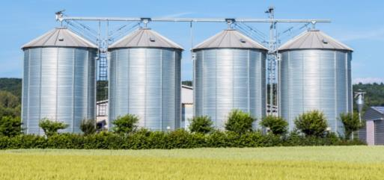
Major Grain Hazards
Entrapment/Engulfment
Entanglement
Falls
Electrical
Other hazards
  Dust
  Struck by
  Noise exposure
Notes:
Major hazards associated with grain handling include:
Engulfment and Entrapment
Entanglement
Falls – such as falls from ladders on bins and silos
Electrical hazards which can cause shock and electrocution.
Other Hazards: dust, struck by; noise exposure
Identified or known hazards in the workplace such as chemicals & fumigants; ergonomic; confined spaces, etc.
Dust hazards
Inhaled dust – can cause illness and disease
Explosions – a leading hazard mostly associated with the commercial grain industry
Struck By hazards
anything that falls on a person (falling debris, tools, etc.)
hit by a moving vehicle
crushed by a vehicle (hydraulic lift) or between a vehicle and stationary object
Noise exposure from equipment, machines, vehicles, or other sources.
Explain – today’s lesson will talk about:
Other hazards – dust, struck by, noise exposure
Personal protective equipment – its use as one type of prevention method for some hazards
Emergency Action Plans
Child Labor Laws
Other modules include Entrapment/Engulfment and Entanglement and Falls and Electricity Hazards
The major hazards are based on types of injuries & OSHA violations recorded in the grain industry.
Review the major grain hazards.
Introduce the hazards being covered in today’s lesson.
Image Source: Thinkstock
Content Source: https://www.osha.gov/dep/leps/RegionV/reg5_fy2016_grain-handling_CPL_04-00-lep017.pdf

Slide 9
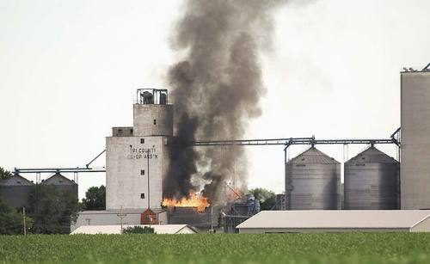
Dust Hazards
Notes:
This section discusses grain dust hazards, including dust inhalation and dust fires/explosions.
Provide a transition to the Dust Hazards section.
Image Source:
The Forum – Fargo Moorehead

Slide 10
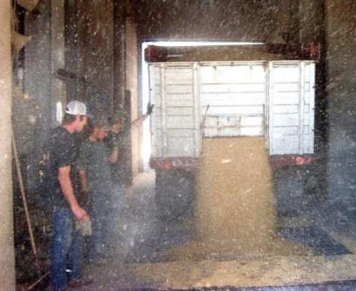
Grain Dust Inhalation
Workers breathe in dust
In combines
Unloading grain
In grain bins
During drying & processing grain
Grinding/mixing grain & feed
Cleaning/housekeeping
No PPE
Notes:
Discuss when workers can breathe in grain dust.
Ask participants if they can think of other tasks where grain dust would be present..
Explore when workers can be exposed to environments containing grain dust.
1. When could workers breathe in grain dust? (Name some of the tasks and/or environments that would contain grain dust).
Image Source: GFAI

Slide 11
Symptoms/Illnesses
Reduce exposure – Wear PPE
Wheezing
Eye & nasal irritation
Chest tightness
Productive cough
Occupational asthma
Chronic bronchitis
Organic Dust Toxicity Syndrome
  ODTS or Grain Fever
Complicates other conditions
Notes:
Exposure to grain dust can lead to produce a variety of health related symptoms and illnesses.
Symptoms or Illnesses associated with inhaling grain dust:
Wheezing
Chest tightness
Productive cough (produces phlegm or mucus)
Eye and nasal irritation
Organic Dust Toxicity Syndrome
Sometimes called ODTS or Grain Fever
Symptoms include tiredness, fever, chills, muscle aches
Symptoms may disappear after a few days
Occupational asthma
Chronic bronchitis
Complications can be an even bigger issue for those who:
Smoke
Have asthma or other lung conditions
Have allergies
Have heart disease
A worker who has been exposed to grain dust and experiences symptoms similar to those of sinus or cold symptoms should seek medical attention.
Content Source: http://www.cdc.gov/niosh/pel88/graindst.html
Discuss the symptoms and illnesses that can result from exposure to grain dust.
Discuss conditions which can complicate these symptoms/illnesses.
Have anyone ever been in a dusty environment like this?
Did you notice any of these symptoms?
How long did they last?

Slide 12
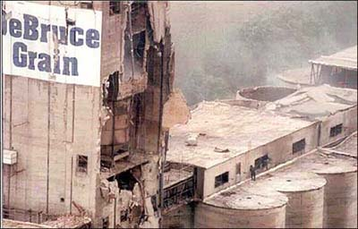
Dust Explosions
Often severe
  Loss of life
  Substantial property damage
Past 35 years:
  503 grain elevator explosions
  677 injuries
  184 deaths
Notes:
Read the news quote as an introduction to the hazards of dust explosions.
Kake.com reported “the damage from the blast was so extensive, it took 6 weeks before all the bodies of the missing were found.”
Dust explosions are caused when grain dust is ignited.
They can be severe resulting in loss of lives.
Substantial property damage is usually a result.
In the past 35 years, there have been over 500 explosions with hundreds of people injured and killed.
During the 1980’s there were a number of severe dust explosions in grain elevators. OSHA’s grain handling standard was written mainly to provide prevention measures and address the issues which contributed to dust explosions. Since the 1980’s advances in technology, such as explosion panels, have helped to decrease the severity and number of explosions.
Most explosions occur in commercial grain elevators. However, as on-site farm storage increases in both size and number, the risk is increasing and it is not uncommon to find reports of fires.
Content Source: https://www.osha.gov/SLTC/grainhandling/
Discuss the severity and consequences of dust explosions.
Explain how past dust explosions influenced the grain dust standard.
Image Source: OSHA – DeBruce Grain near Heaysville, Kansas.

Slide 13

Anatomy of a Dust Explosion
Dust is combustible - fuel
Suspended in air
Confined to space
Exposed to ignition source
  Burns rapidly
  Pressure rises
  Secondary explosion
Notes:
Grain dust is combustible and is a fuel source.
Dust explosions occur when dust that has accumulated in the air is ignited.
Explain there are 5 components required to create a grain dust fire/explosion. This is called the explosion pentagon.
Fuel: grain dust
Oxygen: available in the air
Ignition source: anything that can start a fire, such as a spark or lit cigarette. Sparking sources include exposed wires, equipment running hot, static electricity, electric arc, glowing ember, hot surface, open flame, welding slag, frictional heat, etc.
Dispersion/Suspension: dispersion of the dust particles into a dust cloud suspended in the air. This is exacerbated by dust accumulation on surfaces (more fuel).
Confinement: The dust cloud is within a space (such as a room, building, enclosure, ductwork, vessel) which raises the dust concentration (doesn’t allow the build up of the dust to leave). When dust concentration reaches its lower explosive limit, (the lowest percentage in the air capable of producing a flash of fire in the presence of an ignition source) there is great risk for fire/explosion.
Once dust is ignited it burns rapidly and releases toxic gases (CO2).
The pressure in the confined area rises and causes the explosion.
A secondary explosion generally results as the fire follows the fuel trail (other grain dust) and gains strength. The secondary explosion is usually more powerful than the first explosion.
Explain the explosion pentagon.
Discuss how dust explosions occur.
Explore some prevention methods based on this information.
Image Source: Wikimedia https://commons.wikimedia.org/wiki/File:Dust_Explosion_Pentagon.svg

Slide 14
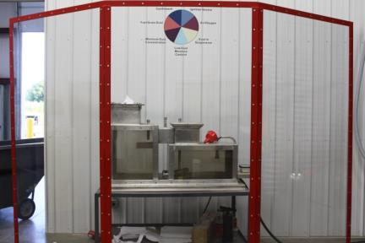
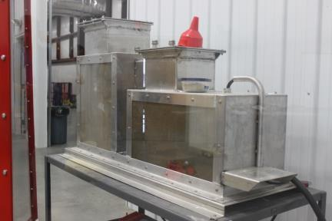
Demonstration Dust Explosion https://www.youtube.com/watch?v=es-WvbfHM6c
Notes:
Play video
Ask participants to watch carefully.
After viewing the video and discuss whether participants could distinguish the second explosion when it occurred in real time.
Animated Slide: Click the arrow on the bottom left of the black box to start the video.
The website link for this video is: https://www.youtube.com/watch?v=es-WvbfHM6c
Explain this is a demonstration of a grain dust explosion.
Discuss how this demonstration illustrates the explosion pentagon.
Video Source: Penn State Ag Rescue Training Program

Slide 15
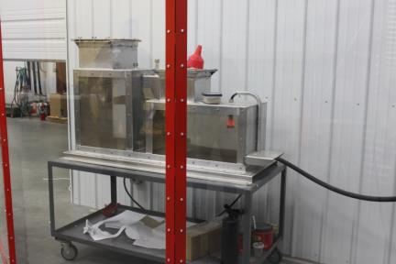
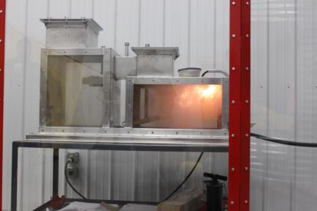
Demonstration Dust Explosion 1
Notes:
Play video
Ask participants to watch carefully.
After viewing the video and discuss whether participants could distinguish the second explosion when it occurred in real time.
Animated Slide: Click the arrow on the bottom left of the black box to start the video.
The website link for this video is: https://www.youtube.com/watch?v=es-WvbfHM6c
Explain this is a demonstration of a grain dust explosion.
Discuss how this demonstration illustrates the explosion pentagon.
Video Source: Penn State Ag Rescue Training Program

Slide 16
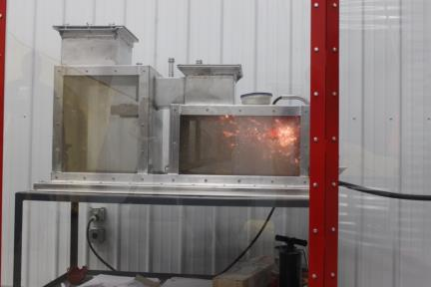
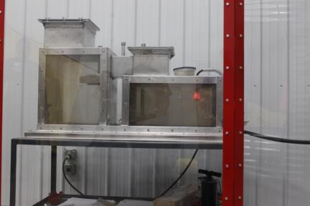
Demonstration Dust Explosion 2
Notes:
Play video by clicking on the arrow at the left bottom of the screen.
The direct link is provided in the notes section to the left.
Ask participants to watch carefully.
After viewing the video and discuss whether participants could distinguish the second explosion when it occurred in real time.
Animated Slide: Click the arrow on the bottom left of the black box to start the video.
The website link for this video is: https://www.youtube.com/watch?v=es-WvbfHM6c
Explain this is a demonstration of a grain dust explosion.
Discuss how this demonstration illustrates the explosion pentagon.
Video Source: Penn State Ag Rescue Training Program

Slide 17
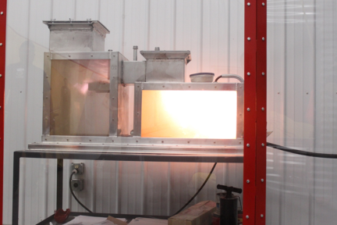
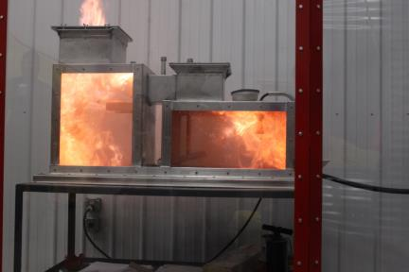
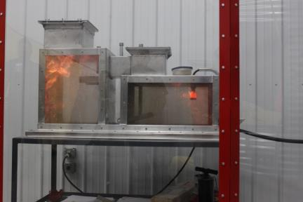
Demonstration Dust Explosion 3
Notes:
Play video by clicking on the arrow at the left bottom of the screen.
The direct link is provided in the notes section to the left.
Ask participants to watch carefully.
After viewing the video and discuss whether participants could distinguish the second explosion when it occurred in real time.
Animated Slide: Click the arrow on the bottom left of the black box to start the video.
The website link for this video is: https://www.youtube.com/watch?v=es-WvbfHM6c
Explain this is a demonstration of a grain dust explosion.
Discuss how this demonstration illustrates the explosion pentagon.
Video Source: Penn State Ag Rescue Training Program

Slide 18
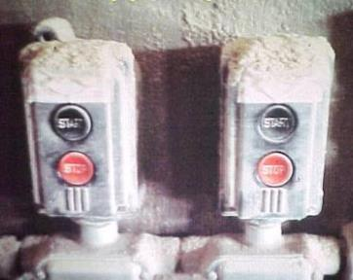
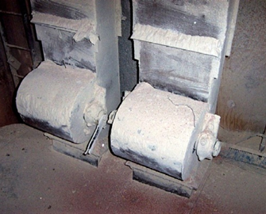
Preventing Dust Explosions
Good housekeeping
  Accumulation <1/8”
  Equals 2 nickels stacked
Wash down procedures
Dust control system
Maintenance
Fire prevention & protection
Policies & training
Notes:
This photo shows an accumulation of grain dust on electrical controls above the limit considered safe.
There are many methods, that if done together, can prevent explosions. Explosion safeguards consist of the following:
Housekeeping
Ensure dust does not accumulate to more than 1/8 inch which is 2 nickels stacked on top of each other.
Sweep on a regular basis.
Wash down procedures – use hose and water to remove accumulated dust (don’t let it become airborne).
Dust Control Systems
Filters and Cyclone Collector
Many systems include explosion panels. These panels blow out when the pressure rises providing release. They help prevent the fire from spreading.
Fire prevention and protection – eliminate sources of ignition (no smoking, no exposed wires, etc.).
Includes using appropriate explosion proof lighting & other equipment.
Hot work, such as welding, requires a permit and fire watch and should be done elsewhere if at all possible to prevent errant sparks. Anyone conducting hotwork – that is doing any task that could produce a spark - should be trained.
Ensure all equipment and machinery are maintained properly. Implement a regular preventive maintenance schedule. This includes keeping bearings and belts properly lubricated and in good repair. Bearings/belts not running properly build up frictional heat and can ignite dust.
Have written policies and procedures for housekeeping and equipment maintenance. Ensure all employees are trained on the policies, fire prevention, and follow the housekeeping procedures.
Note: This photo shows grain dust accumulating on electrical controls
Explore strategies to prevent dust explosions.
Image Source:
Washington State Dept. of Labor & Industries

Slide 19
Dust Hazard Summary
Exposure can cause significant health problems.
Wear a dust mask/respirator to decrease risk.
Grain dust explosions can have severe consequences.
Prevention methods include:
  Practice good housekeeping & maintenance
  Control ignition sources
  Well trained workers
Notes:
Exposure to grain dust can cause significant health problems.
Dust masks/respirators must be worn in dusty environments to decrease exposure risk.
Grain dust explosions can have severe consequences, including loss of life.
Good housekeeping, equipment maintenance, fire prevention (controlling ignition sources) and well trained workers can help prevent dust explosions.
Summarize the main points discussed in the dust hazard section.

Slide 20
Struck By Hazards
Notes:
This section will discuss struck by hazards typically found in grain environments.
Provide a transition to the “Struck by” section.
Image Source: AEM Pictorial Database

Slide 21
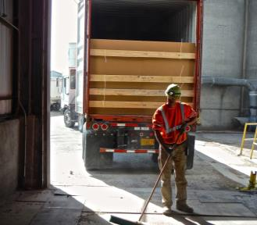
Struck By Hazards
Workers are struck by:
Heavy equipment & vehicles
  Run over, caught between
Falling/flying objects
  Tools, materials, parts, debris
  Machinery can throw objects & fuel
    Beware of residual energy & movement
Notes:
Being struck by an object is a common cause of injury.
Workers are often struck by:
Heavy equipment and vehicles
Workers are run over by equipment or vehicles.
Workers can be caught between the vehicle and stationary object.
Falling or flying objects, such as tools, parts, debris
Machinery can throw objects or fuel. For example, a hydraulic lift can spurt hydraulic fluid if the line is broken.
Machines and machine parts often can have residual energy and movement that can injure a worker. Example: a flywheel or coiled spring.
Explore struck by hazards and how they occur.
Animated Slide: Click once for each major bulleted point to appear – total 2 clicks.

Slide 22
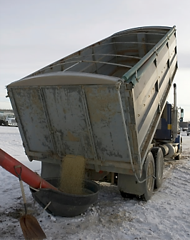
Vehicle: Caught In-between
Never stand, sit, work, play
  near, under, behind, side of
raised grain truck, lift or other vehicle
Lock out lift controls
Before ANY work on vehicle
  Block tires
  Lower or block lift device
Notes:
Grain trucks are one type of equipment that can cause a “struck by” injury. These injuries can occur in 2 ways:
The vehicle strikes the worker and/or pins the worker between the vehicle and a stationary object.
The worker gets “caught between” such as under the lift of the grain truck.
No one should be standing around, playing, sitting, or working in the area of a raised grain truck, lift device or other vehicle – especially underneath – unless there is a reason to be there and it is known.
ALWAYS ensure others know when a person is working under a vehicle or lift.
Workers at times get their bodies near or under a raised grain truck bed. The bed is generally raised by hydraulic cylinders. A hydraulic hose may break causing the raised bed to come down or someone could accidently hit the control to lower the bed crushing the victim.
Use LOTO procedures on the lift controls to prevent another person from accidently engaging them.
Before working on any lift device the vehicle and lift need to be blocked to prevent accidental movement.
Block tires to prevent the vehicle from rolling forward or backward.
Lower or block the lift device and make it incapable of accidently being engaged or falling. Ensure no one else can access the controls except the person working on the vehicle to avoid someone operating the lift while work is being performed.
Discuss strategies to prevent caught between injuries.
An important safety strategy is to avoid being in the area of a raised vehicle.
Image Source: iStock

Slide 23
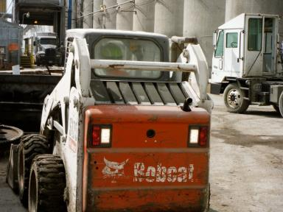
Vehicle – Run over
Be aware of others in area
Avoid blink spots
  Back & side
  Approach in sight
Avoid distraction
Back up lights & sound
Wear high visibility clothing
Notes:
Run over incidents with trucks and machinery is not uncommon.
Run overs occur when the driver is unware of a person in the path of the vehicle or when a person is not paying attention to what the vehicle is doing – such as backing up.
Avoid being in the area of the vehicle when it is not necessary to be there. When possible, block the area of working vehicles off from other traffic/people.
Everyone must be aware of who is in the area – both drivers and workers. New people coming into the area must ensure they approach from a path where they can be seen and must let the driver & others know they are there.
Avoid distractions both as a driver or worker. Texting, phone calls, chatting with others are some of the most common distractions.
Workers should never stand in the driver’s blind spots. The back and side of the vehicle are particularly vulnerable places.
To avoid miscommunication about when it is safe to move the vehicle use recognized hand signals.
High visibility clothing (can be a vest) is recommended for those working around vehicles. It increases the ability of drivers and others to see people.
Use back up lights and sounds to warn others.
Discuss strategies to prevent runover incidents.
Not being seen & distraction are major causes contributing to run over incidents.
Image Source: GHSC

Slide 24
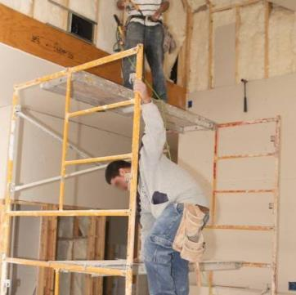
Falling/Flying Objects
Be aware – working under
  Ladders, scaffold, equipment
Work overhead
  Transport tools securely
  Secure objects/tools
  Post warning signs
Maintain tools & use properly
  Loose hammer heads, tool pieces fly off
Wear PPE
Notes:
A common source of struck by injuries is being hit by an object falling from a work surface overhead.
Begin discussion of hazards due to falling/flying objects and safety measures by asking discussion questions.
Working underneath equipment, ladders and scaffolds poses potential for injury when tools, debris, and other objects are dropped or otherwise dislodged from overhead work.
When working overhead use safety strategies to avoid injuring people underneath.
Always transport tools, materials, and other objects to the higher level in a secure manner.
Once at overhead work area, fasten and secure objects and tools, as much as possible, to prevent them from falling.
Post warning signs underneath to make people aware there is a potential for falling objects.
Workers’ can injure themselves by dropping tools, materials and other objects. Arms that are reaching overhead with a tool for extended periods get tired. Often times a dropped tool/object lands on the person’s foot.
Maintain tools in good condition and use them properly:
Loose hammer heads and other loose tool pieces of tools can fly off during use.
Equipment overdue for maintenance can fly apart during use.
Equipment used incorrectly can also result in injury.
The pictures shows hazards of falling objects as well as several fall hazards.
The hammer in the center right is unsecured and the work area is not clean increasing the risk of falling objects.
The worker is not wearing any recommended PPE to protect against falling objects such as a hard hat or safety googles.
NOTE also the fall hazards – there is incomplete planking, no cross bracing on the scaffold’s upper levels and no guard rails
Animated Slide: Click once for each section to appear – total 3 clicks.
Image Source: Elcosh #969
Discuss common causes and strategies to prevent injuries from flying or falling objects.
Understand strategies when working underneath to protect against being struck.
Understand strategies when working overhead to prevent injuring another.
1. Has anyone ever been struck by a flying tool or piece of equipment?

Slide 25




PPE for Struck By Hazards
  Personal Protective Equipment (PPE)
  protects against/reduces severity of injury
  Hard hat - potential for falling objects
  Safety glasses/goggles – flying debris
  Steel toed boots – carrying loads; dropped, falling, rolling objects
  Gloves – extra grip; blister protection
Notes:
Personal protective equipment PPE is the last level of safety protection when other strategies cannot fully eliminate hazards.
PPE generally helps protect the worker against specific injuries and reduces the severity of injury if one occurs.
Recommended PPE for the struck by hazards discussed include:
Hard hat – worn whenever there is the potential for falling objects.
Safety glasses/goggles – worn especially when working underneath to prevent dislodged debris from getting int the eyes.
Steel toed shoes – worn when carrying heavy loads or there is danger of falling/rolling objects to protect feet from being crushed.
Gloves – provide extra grip when working with tools and provide protection against blisters.
Discuss PPE used to protect workers against struck by injuries.
Image Sources: AEM Pictorial Database

Slide 26
Noise Hazard
Notes:
This section discusses noise hazards frequently encountered in the grain handling environment.
Exposure to high frequency sound around grain dryers, running fans, augers, tractors, etc. can result in hearing damage and loss, even for young workers.
Share with participants the following information:
Hearing loss (in general), affects an estimated 48 million Americans http://www.masseyeandear.org/news/press-releases/2016/09/researchers-find-evidence-of-hidden-hearing-loss-in-college-age-human-subjects September 12, 2016
NIOSH https://www.nidcd.nih.gov/health/noise-induced-hearing-loss Last Updated Date: May 15, 2015
“Approximately 15 % of Americans between the ages of 20 and 69—or 26 million - have hearing loss that may have been caused by exposure to noise at work or in leisure activities
https://www.cdc.gov/niosh/topics/noise/stats.html NIOSH
4 million workers go to work each day in damaging noise.
22 million workers/year exposed to potentially damaging noise.
30 – 50 Million people a year exposed to hazardous noise levels – Better Hearing Institute
$242 million spent yearly on worker’s compensation claims for hearing loss.
https://www.nidcd.nih.gov/news/2016/hearing-loss-prevalence-declining-us-adults-aged-20-69 NIOSH December 15, 2016
Across all ages, men were about twice as likely as women to have hearing loss.
Lower education level & heavy use of firearms were associated with hearing loss.
Non-Hispanic white adults were more likely to have hearing loss than adults in other ethnic groups
Non-Hispanic black adults have the lowest risk
Image Sources: AEM Pictorial Database
Provide transition to section on Noise hazards.
Discuss prevalence of occupational hearing loss through NIOSH statistics.

Slide 27
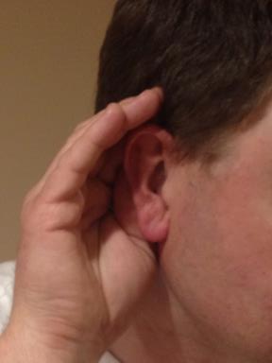
Warning Signs for Hearing Loss
Others raise their voice to be heard at arm's length
Repeatedly asking “Huh?” or “What?”
Turning up the radio/TV
Ringing in ears
Feeling of “fullness” in ears
Notes:
Hearing loss can affect workers of any age.
NIOSH –https://www.nidcd.nih.gov/health/noise-induced-hearing-loss
As many as 16 percent of teens (ages 12 to 19) have reported some hearing loss that could have been caused by loud noise, according to a 2010 report
Better Hearing Institute - 65% of people with hearing loss are younger than age 65.
Discuss the warning signs of hearing loss or damage:
Others must raise their voice to be heard at arm's length
Repeatedly saying “Huh?” or “What?”
Turning up the radio/TV
Ringing in your ears
Feeling of “fullness” in ears
Warning signs are not immediately noticed as they can be subtle and emerge slowly. Some hearing loss can be significant and sudden depending on exposure. (HLAA).
If hearing loss is suspected seek treatment. NOTE: Only 13% of physicians routinely screen for hearing loss during a physical.
Hearing screening – see if further evaluation is needed.
An ear/nose/throat or primary care physician rules out any medical condition; determines presence of hearing loss, possible cause, and if it can be treated.
Hearing evaluation - in-depth assessment determines nature & degree of hearing loss & best treatment options. (audiologist)
Statistic Source: Better Hearing Institute http://www.betterhearing.org/hearingpedia/prevalence-hearing-loss Content Source: Hearing Loss Association of America http://www.hearingloss.org/content/symptoms-hearing-loss
1. Has anyone ever experienced ringing in your ears after attending a concert or a tractor pull? This is because the hair in the ear “bends” for a period of time after exposure to loud noises. If the hairs break (either due to extremely loud noise or repeated exposure), the ringing/hearing loss is permanent.
Image Sources: Amy Rademaker
Explain hearing loss can affect a person at any age.
Discuss the warning signs that may indicate hearing loss.
Explain steps to take if symptoms are noticed.
“On average, it takes people seven years from the time they think they might have a hearing loss to the time they seek treatment. Often, people will blame their hearing problems on the nature of the other person’s speech.” (HLAA).
Hearing loss diagnosis based on person’s history, behavior, and results of medical and audiological examinations. (HLAA)

Slide 28
How loud is too loud?
Prolonged exposure causes damage at 85 decibels(db)
1 hour can damage hearing at 100db
Damage is immediate over 120db
Notes:
The risk and harmful effects of noise on hearing are often underestimated because the damage takes place so gradually. (HLAA). People can lose a significant amount of hearing before becoming aware of it.
Noice Induced Hearing Loss is almost entirely preventable. Once hearing is damaged, it does not come back.
Explain: Sound is measured in decibels (dB)
Prolonged/repeated exposure to noise often considered “normal farm sounds”, like an idling tractor (85 decibels), can cause hearing damage.
Sounds at 100 dB, like a table saw or hand drill, can cause damage when exposure is over one hour.
As the sound level increases, the length of time exposure is considered ‘safe’ decreases. (Better Hearing Institute)
Sounds at or over 120 dB, such as an old chainsaw or a gunshot can cause immediate damage. Hearing protection is mandatory.
Farms and grain facilities have different environments and other factors which influence how long a person can be exposed to noise before needing hearing protection.
General guidelines for when to use hearing protection are:
When a person cannot stand at arm’s length and carry on a conversation with another person
When operating machinery for over 15 minutes whether the same equipment or different types
When machinery is older or does not have a cab
When using a firearm
When unsure what tasks will be done and for how long.
92% of US farmers are subjected to unsafe noise levels, but only 44% of them claim to use hearing protection on an everyday basis. Sonus Hearing Care Professionals July 16, 2015 https://www.sonusarlington.com/the-surprising-statistics-behind-occupational-hearing-loss
Explain noise induced hearing loss s often gradual, often resulting in significant hearing loss before a person becomes aware of it.
Stress noise induced hearing loss is preventable.
Discuss length of exposure and volume of sound which cause hearing damage.
Relate types of common machinery and farm sounds to hearing loss.
Stress the use of hearing protection whenever noise exposure is present & discuss general guidelines for wearing hearing protection.
Image Source: Dept. of Health & Human Services, CDC, & NIOSH

Slide 29
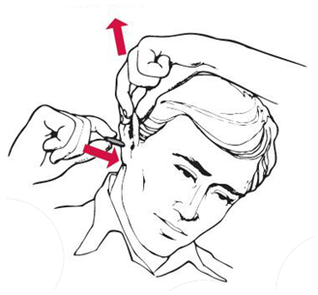
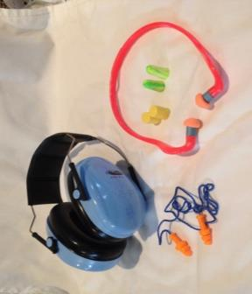
Hearing Protection
Prevent hearing loss at work & play
Ear plugs - pre-molded or formable
Ear muffs - less effective with glasses, earrings, facial hair
How to use ear plugs
Notes:
Hearing protection should be worn whenever noise exposure is present – at work and recreational activities such as concerts, lud sporting events such as auto races/tractor pulls, etc.
There are 2 main types of hearing protection.
Ear plugs (have youth practice if they have some)
Come in different designs (lower left photo)
Can be more comfortable to wear than ear muffs
Ear plugs will not be effective if not inserted correctly
Come in different sizes and the size matters.
Not every earplug will fit every ear
Sometimes a person requires a different size for each ear.
Ear muffs
Easy to put on and completely cover the ear
Look for the outer lining to be soft and pliable
Some people don’t like the minimal amount of pressure: an ear muff pushes against the head
Inserting ear plugs - note illustration. If possible, have participants practice inserting ear plugs.
Roll the ear plug between fingers to compress it (don’t just “squish” it).
Using the opposite hand from the side of the ear you are placing the ear plug in, pull on the top of the ear to open up the ear canal.
When the ear canal is open, insert the ear plug into the ear and then release your hand from your ear. This allows the ear canal to close around the ear plug.
According to NIOSH, a different size is needed when:
You can’t get at least half of the plug into the ear canal
The ear plug cannot expand enough to stay firmly seated
Note: More information on hearing protection is contained in the handout “Hearing Loss (NIOSH)”, included in the Instructor’s Manual Appendix.
Discuss the two most frequently used types of hearing protection.
Explain how to insert ear plugs.
If possible, have participants practice putting in ear plugs.
Image Sources:
Left - Hunter Rademaker
Right - 3M

Slide 30
Personal Protective Equipment
Notes:
Remind participants, some types of personal protective, called PPE, needed in grain facilities and on farms, has been talked about in previous sections such as hearing protection.
Other types of PPE has been introduced such as hard hats, eye protections, gloves and work boot.
This next section will
Talk about respiratory protection – types of respirators
Provide additional information on PPE introduced earlier
Introduce new types of PPE
Explain when PPE needs to be used
PPE is used when other types of hazard control are not feasible or do not provide sufficient protection. Employers must provide PPE, ensure its use, and provide training to the employees on the PPE.
Employers conduct a hazard assessment to identify actual and potential hazards and determine what kinds and types of PPE are needed for employee protection. NOTE: Small employers, such as farmers, may not do a hazard assessment but are still responsible for protecting the health & safety of workers.
Employers must provide & pay for all appropriate PPE (respiratory protection, hard hats, eye protection, gloves, etc). In some circumstances, certain PPE may be required but does not have to be paid for by the employer when it is personal in nature and is used off the job site – such as steel toed boots.
If PPE is needed for protection against identified hazards, ask your employer. If the proper protection is not provided, a person has the right to refuse to do the job.
An employer is only obligated to provide the minimum level of protection for a known or potential hazard – for example grain dust exposure. (Generally, these can be found in OSHA standards & requirements). If an employee wants more protection, it should be discussed with the employer but may have to provide it him/herself.
Image Source: AEM Pictorial Database
Review the types of PPE that have already been presented.
Discuss the additional types of PPE that may be needed when working around grain.
Discuss what to do if the proper PPE is not provided by the employer.
OSHA General Industry PPE Standards:
1910.132: General requirements and
payment
1910.133: Eye and face protection
1910.134: Respiratory protection
1910.135: Head protection
1910.136: Foot protection
1910.137: Electrical protective devices
1910.138: Hand protection
Employer paid PPE reference:
https://www.osha.gov/dte/outreach/intro_osha/7_employee_ppe.pdf

Slide 31
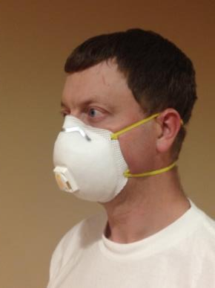
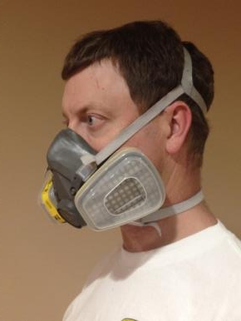
Respirators
Dust Mask
Respirator
Notes:
Respirator: an apparatus worn over the mouth and nose or the entire face to prevent the inhalation of dust, smoke or other toxic substances.
Respirators work by either filtering particles from the air, chemically cleaning (purifying) the air, or supplying clean air from an outside source.
Respirators may be
Disposable – Particulate respirator (often referred to as a dust mask)
Reusable – Air purifying respirator (often referred to as a respirator) which uses cartridges or filters
In the grain environment, respiratory protection is needed from toxic dust and microbial particles.
Note: More information on dust, molds, and respirators is contained in the “Harvesting Health” series in the Instructor’s Manual Appendix:
Dust and Molds
Respirators
Define respirator.
Explain the function of a respirator.
Describe 2 types of respirators.
Explain what types of hazards are found in the grain environment which would require respiratory protection.
Image Source: Amy Rademaker

Slide 32
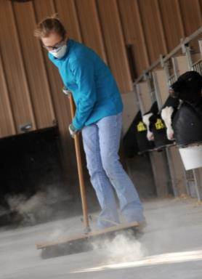
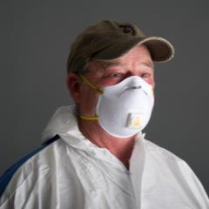
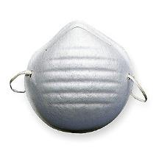
Dust Masks
Protect against dust & molds
2 straps
N95 or N99 masks
Not for gases or vapors
Do NOT use – heart or lung condition
Notes:
Dust masks may be referred to as a particulate respirator or a filtering face piece. Particulate respirators are “air purifying respirators” because they clean particles out of the air as the person breathes.
Types of dust masks
A one strap mask (left photo) is a “dust nuisance mask” and does not protect against hazardous dusts, gases or vapors.
To protect against particulates a 2 strap NIOSH approved dust mask must be used: either a N95 or N99.
N95 masks filter out 95% of dust particles.
N99 filter out 99% of dust particles.
Dust masks only provide protection to levels 10 times above the dust permissible exposure limit (PEL).
A N95 or N99 dust mask is generally appropriate for cleaning a well ventilated grain bin with the use of safety glasses or googles.
Dust masks do not protect against gas or chemical vapors.
Dust masks are not adequate for heavy amounts of dust and may not be suitable for highly toxic dusts.
All respirators, including masks, need to be “fit” to the person wearing them through a process called “fit testing”. This should be done the first time a dust mask or any type of respirator is worn by someone trained to do it. The employer should use fit testing to ensure the dust mask (and other respirators) fit correctly. For more information, see: https://www.usa829.org/Portals/0/Documents/Health-and-Safety/Safety-Library/Respiratory-Protection-Rules_Data-Sheet.pdf
Trim facial hair so it does not interfere with a tight fit of the mask.
Young workers should insist on using a mask in dusty environments or when there is the potential to “raise dust”, e.g. cleaning an empty grain bin. An adult should “fit test” the mask to ensure it fits correctly and works properly.
Discuss what type of dust musk is needed in a dusty environment to protect against harmful particulates.
Discuss what hazards a dust mask does not protect against.
Explain what it means to “fit test” a respirator.
Image Sources:
Left: Honeywell Safety Products
Middle: AgriSafe Network
Right: Mac Bailey, Marshfield Clinic
References:
https://www.osha.gov/dts/shib/respiratory_protection.pdf
Washington State Department of Labor and Industries Division of Occupational Safety & Health (DOSH). Respiratory Protection – filtering facepieces (dust masks),May, 2009 http://wisha-training.lni.wa.gov/training/trainingkits/respirators/dustmask_printable.pdf

Slide 33
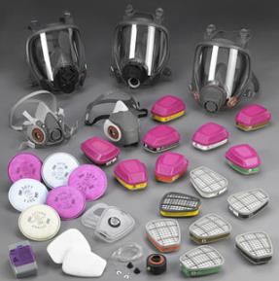
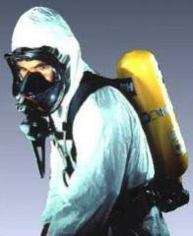
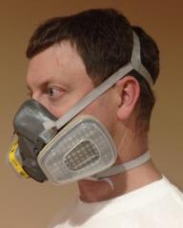
Respirators
Per OSHA review -Tight Fitting respirators (half mask, full mask) require medical clearance, fit testing and training
Various types
Choose correct type & filter/cartridge for job
Replace filter/cartridge as needed
Before use:
  Fit tested
  Medical clearance
  Trained
Air Purifying
SCBA
Notes:
Air-purifying respirators have filters, cartridges, or canisters that remove contaminants from the air. It passes the ambient air through the air-purifying element before it reaches the user.
Half mask – covers mouth and nose
Full face mask – protects eyes as well
Atmosphere (Air) supplying respirators supply clean air directly to the user from an outside source instead of the surrounding air.
Self-Contained Breathing Apparatus (SCBA)
Has its own air supply
Used for toxic or low oxygen level environments
All respirators require medical clearance, fit testing & training before use.
Filters & cartridges wear out and must be replaced periodically.
Choose the correct type of respirator for the job.
Particulate respirator - Captures particles in the air: dusts, mists, and fumes. Does not protect against gases or vapors.
Combination respirator – Has both particulate filters and gas/vapor filters for use when atmosphere contains both hazards.
Gas & Vapor Respirator - Used when there are only hazardous gases and vapors in the air. Chemical filters (cartridges or canisters) remove dangerous gases or vapors. Protect against specific gases/vapors. Does not protect against airborne particles.
Particulate respirators with a cartridge or combination respirators can be used instead of a dust mask for cleaning a well ventilated grain bin or working with hogs or poultry.
When working where paint or pesticide fumes are present a half mask air purifying gas/vapor respirator would be appropriate.
Young workers should not enter areas where an air supplying respirator (SCBA) is needed such as manure pits and grain bins registering low oxygen content.
Image Sources:
Top Left: amy rademaker
Top Right: CONN-OSHA
https://www.ctdol.state.ct.us/osha/images/hazsuit.jpg
Bottom: OSHA
https://www.osha.gov/SLTC/images/respiratoryprotection_index.jpg
Discuss how respirators work to purify air.
Discuss the different types of air purifying respirators available.
Explore how to choose the correct type of respirator for the job.
Explain how to maintain respirator equipment.
Animated Slide: Click once for each bullet to appear – total 4 clicks.
Reference: https://www.osha.gov/SLTC/etools/respiratory/index.html

Slide 34
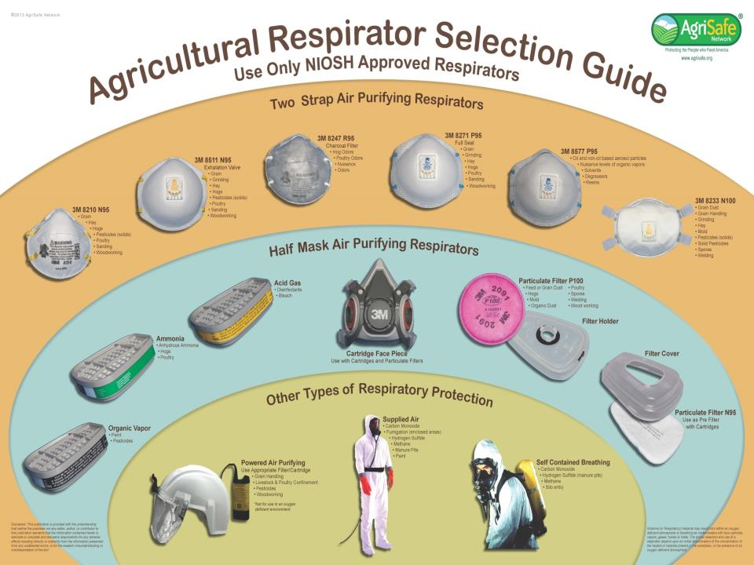
Agricultural Respirators Selection Guide
Notes:
Different respirators/masks will protect for different dusts, chemicals, etc. The right type of respirator depends on the task to be performed.
Handout included in the curriculum.
Note: AgriSafe also has an “Agriculture Respirator Selection Guide”, which can be downloaded from: http://www.uvm.edu/extension/vtfarmhealth/resources/respiratory/as_respirator_selection_guide.pdf
Image Source: AgriSafe Network
Show the array of respirators available for use.

Slide 35

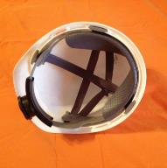
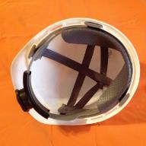
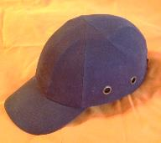
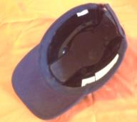

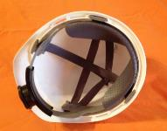
Head Protection
Bump Cap
Hard Hat
Protect – bumps against object, cuts, scrapes, bruises
Lightweight plastic covered by cloth
Not impact protection
Protect – impact of falling/flying objects
Rigid shell
  Expires 4-5 years
Suspension system
  Absorbs shock
  Replace when worn
Notes:
Two basic types of head protection
Bump Caps
Protect against bumps against protruding objects, cuts, scrapes and bruises
Have a hard shell of lightweight plastic (thinner than hard hats) covered by cloth
Do not protect against falling objects or electrical shocks
Hard Hats
Protection against impact & penetration from falling/flying objects; lessens severity of impact
Type 1 – top protection only
Type 2 – top & side protection
Look at label inside hat to tell the difference
Provide a higher level of protection than bump caps
Thick, hard, rigid shell – resists & deflects blows to head
Suspension system provides shock absorbing capability
Never put anything between the suspension system and your head
Do not wear a baseball cap underneath the hard had as it reduces the shock absorbing capabilities
Shield for scalp, face, neck, and shoulders against overhead splashes, spills, and drips of hot or caustic liquids
Use – don’t wear backwards without changing suspension
Inspect shell and suspension system before each use
Keep out of direct sunlight, extreme heat
Don’t use solvents, chemicals, paint, as it weakens and deteriorates the shell and suspension system
Replacement
Shell expires 2-5 years normal use
Check the manufacture date- label on inside of hat
Suspension system about one year of regular use.
Explain the difference between a bump cap and a hard hat.
Discuss when it is appropriate to wear each type of head protection.
Discuss how a hard hat protects the wearer.
Image Sources: Amy Rademaker
Reference: Head Protection (Hard Hats): Training on the use of hard hats in the workplace, Washington State Department of Labor and Industries, Division of Occupational Safety & Health, August 2009

Slide 36
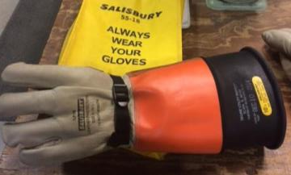
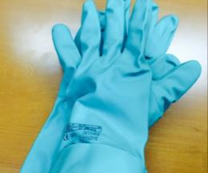
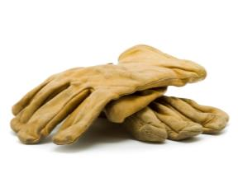
Hand Protection - Gloves
Types of protection
  Cut, burn, insulate
  Chemical
  Electrical
Levels of protection
Choose for job task & hazard
Always wear
  Hand tools, chemicals, electricity
  Excessive hand use
A
B
C
Notes:
There are various types of hand protection for different hazards, as well as different levels of protection depending on the nature of the hazard the glove is designed to protect against.
Cut Protection (A) – Leather gloves as well as other types of gloves provide protection from cuts as well as general scrapes, blisters, and burns from sparks, etc.
Cut Resistance Performance Level indicates the glove’s level of protection against cuts.
Match the level of protection needed and the job task with the Cut Resistant Performance Level to ensure proper protection.
Chemical Protection (B) – These gloves are usually made out of some type of synthetic material and protect the skin from the effects of the chemical (sensitivity, absorption, burns, etc.).
There are different gloves for use with different types of chemicals. Ensure the gloves protect for the type of chemical agent being used.
Electrical Protection (C) – These are usually rubber gloves which protect against electrical shock and burns by providing insulation from the current.
Hand protection should always be used when:
Working with hand tools, knives or other sharp objects or if there is a possibility of being cut on protruding and/or sharp objects/edges.
Working with any kind of chemical or doing electrical work.
When there is excessive hand use in the job task.
Some gloves are light duty to protect the hands against blisters, dirt, and minor abrasions. Insulating gloves may be used when in extreme temperatures.
Employers should provide the appropriate gloves for the work task. Young workers should ask their employer for hand protection.
Discuss how to protect your hands from cuts, chemicals and electrical burns.
Explain there are different types of gloves for different hazards and different levels of protection.
Discuss when hand protection should be worn.
Image Sources:
Left Photo: iStock
Middle Photo: Amy Rademaker
Right Photo: Steve Hancock

Slide 37
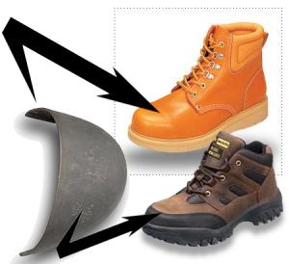
Foot Protection - Shoes
Work Shoes
  Close toed – no sandals or flip-flops
  Non-skid – good tread; not worn down
Safety Shoes
  Steel toed boots - impact
  Non-skid/slip resistant
  Steel plate on bottom
    Optional - puncture
Notes:
Choose among many types and styles of foot protection for the type & level of protection required.
Work Shoes - minimum level of protection against abrasions and slip hazards. Shoes for work around grain or agricultural settings:
Closed toed – no sandals or flip-flops.
Always wear close toes shoes even if working in the office as there may be job tasks outside.
Athletic shoes unless labeled have minimal protection.
Non-skid and/or slip resistant – shoes with good tread, not worn down to prevent slipping. Generally have a rubber sole.
Safety Shoes provide protection from falling/rolling objects, crush injuries and possibly penetration/puncture injuries. They meet ANZI Z41 1191 or 1999/ASTM F 2412 or 2413 minimum impact & compression standards and have protective toes. The types and levels of protection vary. Check the inside label of the shoe with the manufacturer.
Steel toe protects the toes. (Metatarsal guards protect the instep area. May be built-in or external).
Non-skid – soles offer a great deal of traction. May be heat resistant to protect against hot surfaces common with roofing, paving, etc.
Puncture/Penetration injury protection - A steel plate between the bottom of the shoe and the sole. Optional, but required where sharp objects such as nails, screws, scrap metal, etc. could be stepped on by a worker.
Ladder climbing shoes have defined heels and solid shanks – support to stop the feet from bending downward on the rung.
Electrically conductive shoes prevent the buildup of static electricity in areas with the potential for explosive atmospheres (grain elevators). Nonconductive shoes protect employees from workplace electrical hazards by preventing the wearers’ feet from completing an electrical circuit to the ground.
Explain characteristics of good work shoes and safety shoes.
Explain the parts of the foot protected by the features found in safety shoes.
Animated Slide: Click once for each category to appear – total 2 clicks.
Image Source: Amherst College
Animated Slide: Click once for each category to appear – total 2 clicks.
Reference: OSHA Standard 1910.136
OSHA PPE guide: https://www.osha.gov/Publications/osha3151.pdf
Safety Shoe Labeling:
https://www.grainger.com/content/qt-protective-footwear-standards-252
https://www.ccohs.ca/oshanswers/prevention/ppe/footwear.html https://www.safeshoes.com/media/wysiwyg/docs/Protective-footwear-guide.pdf

Slide 38
Eye Protection
Safety Glasses
Safety Googles
Face Shield
Protection
Flying debris
Possibly UV rays
Wrap around or side shields
Front & sides of eye
Fit snuggly
Protection
Check vents
Liquid splash (chemicals)
Possibly fumes
Worn with safety glasses or googles
Protection
Dusty environment
Entire face
Splashes
Debris impact
Notes:
Eye protection is required when debris, chemicals, or other foreign matter. Choose the type according to the type of hazard and protection needed.
Safety glasses –
Worn to protect eyes from flying debris
Usually wrap around or have side shields
May protect against UV rays
Some types available with prescription lenses
Safety googles – can usually be worn over glasses
Worn to protect eyes in dusty environments
Worn when working with chemicals to protect against splashes but need to use appropriate vent style googles
Direct vents – help prevent googles from fogging up; are good in dusty environments; do not protect against chemical splashes
Indirect vents – protect against chemical splashes and are good for dusty environments
Closed vent – the googles do not actually have vents. Protect for fumes as well as other hazards but may fog up.
Anti-fog strategies
Anti-fog coating which reduces fogging
Dual-pane lenses – a thin air pocket between 2 lenses reduces fogging
Face shields – MUST be worn with safety glasses or google
Protec the entire face from splashes and debris impact
Does not protect from fumes
Note: More information on eye protection is contained in the “Harvesting Health – Eye Protection” handout, available in the Instructor’s Manual Appendix.
Describe three common types of eye protection.
Compare and contrast the three types of googles, including their features and use.
Content Source:
https://www.osha.gov/SLTC/etools/eyeandface/ppe/impact.html
http://elcosh.org/document/4152/d001457/eye-protection%3A-a-basic-understanding-of-the-osha-standard.html
https://osha.washington.edu/pages/yw-general-wood-shop-safety-unit-1a
Image Source:
https://osha.washington.edu/pages/yw-general-wood-shop-safety-unit-1a

Slide 39
Struck by, Noise, PPE Summary
Struck By
  Remain visible when working around vehicles.
  Secure overhead items & use appropriate PPE.
Noise induced hearing loss is preventable.
  Hearing protection reduces exposure to dangerous noise levels.
Use PPE when other safety strategies do not fully protect.
Use respiratory protection for dust hazards.
Notes:
To prevent struck by injuries:
Remain visible when working around vehicles and avoid being in the area if it is not necessary.
To protect against falling objects secure overhead items and wear appropriate PPE – especially hard hats
Noise induced hearing loss is preventable. Once hearing is lost it cannot be regained. Whenever working around power tools, machinery, equipment, loud vehicles, etc. wear hearing protection.
PPE is used when other safety strategies cannot fully protect a worker. However, PPE the correct PPE must be chosen and worn correctly for it to be effective. Work in grain environments and agricultural settings expose workers to many hazards which PPE can protect against. Wear appropriate footwear, use eye protection, hardhats, and gloves.
To protect against dust hazards always wear respiratory protection in dusty environments.
Summarize the main points discussed in the struck by, noise exposure and PPE sections.

Slide 40

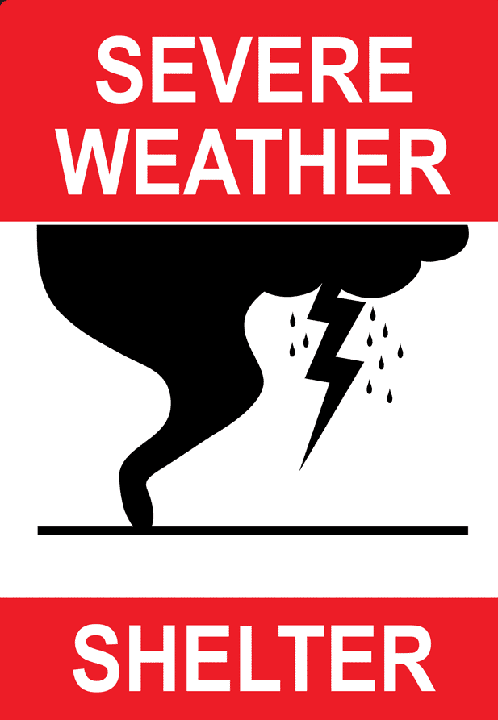


Emergency Prep & Planning
Notes:
Transition to “Emergency Preparation and Planning” using the questions provided in the discussion questions box.
What do you do if someone doesn’t wear their PPE and gets hurt?
What type of emergencies do you think you would need to plan for on a farm or grain elevator? Injuries, weather (storms or tornados), fire
Do you think families need to be prepared for these types of emergencies too?
Note: Some of the signs used in this presentation and many more can be downloaded and printed for free at safeagritourism.org/resources.
Provide a transition to the Emergency Prep and Planning section
Image Sources:
Middle: compliance signs
Others: Integrating Safety into Agritourism: http://safeagritourism.org/resources/

Slide 41
Emergency Action Plan
Plan for Emergency
Develop Procedures
Post emergency phone #s & location
Account for employees
Critical farm/plant operations
Alarm/communication system
Train ALL Employees
Roles & Responsibilities
Procedures; equipment use
Roles & Responsibilities
Practice plan
All potential emergencies
Specific to worksite
Injury, fire, severe weather, chemical, etc.
Emergency evacuation/escape routes
Notes:
An emergency action plan is specific to the worksite and addresses all potential emergencies to ensure the best outcome.
Typical types of emergencies
Injuries – including engulfment
Fire, chemical spills
Severe weather (severe storm, flood, tornado, etc.)
Specific procedures are written for each type of emergency. These should be kept in the workplace and available for employees to review. NOTE: under OSHA, employers with less than 10 employees can communicate the plan orally.
Procedures of an Emergency Action Plan include
How to report a fire or other emergency
Post emergency numbers near phones and other visible areas
Include location information such as GPS coordinates
Evacuation routes and exit assignments
Critical plant/farm operations to be done before evacuation
A way to account for all employees
Who is in charge and who employees can ask about the plan
Roles & responsibilities of employees performing rescue, medical or other duties
Alarm/communication system -distinctive and recognizable as a signal to evacuate or to perform actions assigned under the plan.
Should have back-up communication systems.
Workplaces with less than 10 employees can directly communicate an emergency.
All employees need to be trained on the plan, their roles during an emergency, the equipment to be used and where to report.
The plan should be practiced at least annually.
All employees should know where fire extinguishers, first aid kits, eye wash stations, emergency showers, etc. are located.
It is recommended at least 2 people on farm should have basic first aid & CPR training.
Explore why an emergency action plan is needed.
Discuss what the contents of an emergency action plan should address.
NOTE:
OSHA 1910.38 Emergency Action Plans - specific requirements for emergency action plans one is required under other OSHA standards. The grain handling standard 1910.272 requires an emergency action plan as well as emergency escape means from bin decks and tunnels. Operations, tasks and work covered under other standards may also require emergency action plans.
OSHA 1910.165 – Employee alarm Systems provides requirements for notification and emergency alarms.

Slide 42
When to call for help
Seek immediate medical attention & notify adult
Person is
Unresponsive
Severe allergic reaction
Trouble breathing
Trapped in machinery/grain bin
Other severe injury/illness
If in doubt, call for help!
Notes:
Always seek immediate medical attention under the following circumstance:
Someone is unresponsive
Someone is having a severe allergic reaction and/or trouble breathing
Someone is trapped in machinery or a grain bin
Other severe injury or illness
If unsure whether someone needs assistance, call for help. A qualified person is trained to make an assessment.
It is better to have help than to not have the help needed or wait and risk the help arriving too late.
Always notify an adult right away when an incident occurs.
Discuss when is the appropriate time to call for help if someone is hurt
Explain what the next steps are after calling for help

Slide 43
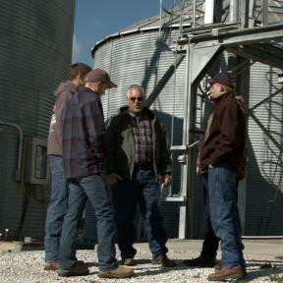
Stand TALL – Emergency Plan
Talk to employer
Ask to see Emergency Plan
Learn your role & responsibility
  Ask to be trained
Live - practice with co-workers
  If no plan – explain necessity
  Share resources to create one
Notes:
Stand TALL. Remember all workers should know the emergency plan and be trained on it.
Young workers should ASK to see the Emergency Plan for the farm or other worksite they are employed at.
Young workers should ASK what their roles and responsibilities are in an emergency as well as others roles/responsibilities and who is in charge.
Young workers should ASK when they will receive training on the emergency action plan.
Worksites with less than 10 employees may not have a written emergency plan, however, the employer still needs to communicate a plan to workers verbally.
Encourage young workers to practice the emergency plan with co-workers under supervision.
If there is no Emergency Action Plan young workers should tell their employer they are uncomfortable not knowing how an emergency will be handled.
Young workers could explain why one is necessary and share information about creating one
The next slide introduces an activity to learn more about emergency action plans.
Empower young workers to know and understand the emergency action plan at their workplace.
Empower young workers to ask questions to ensure they understand their roles and responsibilities in an emergency.
Empower young workers to talk about any issues regarding emergency plans with their employer.
Image Source: GHSC

Slide 44
Emergency P&P Activity/Homework
Develop an Emergency Action Plan
Materials provided
  Farm Description
  Emergency Response Plan – Prep Sheet
  Emergency Response Plan Template
  Procedure, Policy and Report Templates
Notes:
This activity may be done in the training session or assigned as homework, with participants working individually or in groups. NOTE: If done as an activity in class, it will take most of a class period to complete.
The instructions for the teacher/facilitator and the materials needed for this activity can be found in the Instructor’s Manual Appendix. The instructions are briefly summarized below.
Distribute a copy of the following materials to each of the students:
Farm Description
Emergency Action Plan – Prep Sheet
Emergency Action Plan Template
Procedures, Policy & Report Templates (participants should determine which templates will be needed.
Emergency Poster
Incident Policy
Incident Report
Fire Safety Plan
Fire Extinguisher Plan
Severe Storm Safety Procedure
Tornado Safety Procedure
The participants will use the farm description, prep sheet, and other materials provided to develop an Emergency Action Plan for the farm. For the plan, the students will decide who will be in charge, who will receive training, etc.
Alternatively, the students may develop an Emergency Action Plan for their own farm, if they desire.
Information and Materials Source: safeagritourism.org/resources
Educate participants on how to prepare an emergency action plan.
Educate and improve emergency response skills.

Slide 45
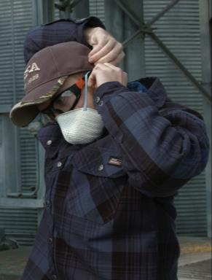
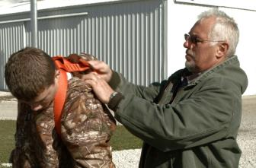
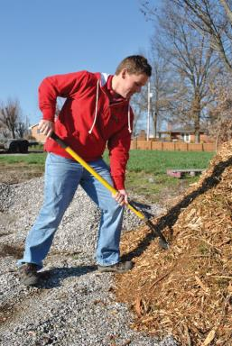
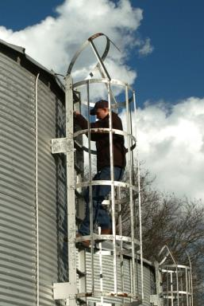
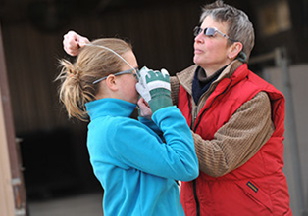
Labor Laws
Notes:
This section introduces participants to the some of the laws which help protect workers under the age of 18 and where to seek information.
Whether employed on a farm, commercial grain facility or even a fast food restaurant ALL workers have a right to a safe and healthy workplace. It is the employers responsibility for ensuring the workplace is safe and healthy.
Additionally, there are other laws which place restrictions on the types of work or tasks young workers can do in different workplaces. It is important for both the employer, the young worker and the parents to know what these restrictions are and how they affect what jobs can be done in different settings.
Image Sources:
Left: Lauren Moseley
Center Top & Right: GHSC
Center Bottom: Mac Bailey -MC
Introduce young workers to the concept that they have rights and that there are laws to protect them against hazardous work

Slide 46
Help for Young Workers
US Department of Labor
Wage & Hour Division (WHD)
  Wage, child labor, hazardous occupation orders
Occupational Safety & Health Administration (OSHA)
  Worker health & safety
  Some states have their own OSHA
State Labor agency
Notes:
Explain WHD and OSHA are part of the federal Department of Labor.
Explain the responsibilities of WHD & OSHA.
Child labor refers to workers under the age of 18.
Each state has their own labor agency that may have stricter laws than the federal agency.
Young workers can get help about wages, work hours, what kind of jobs they can and cannot do through the federal Department of Labor Wage and Hour Division and their State’s labor department.
Child labor laws are for workers under the age of 18.
These laws address when they can work, the hours they can work, who can work, the types of jobs they can work and the types of jobs that are hazardous and they cannot do.
State labor laws must be at least as strict as the federal government laws but can be more strict. For example, some states have a higher minimum wage.
Young workers and their parents should look at the federal WHD website and state labor department website before beginning any job. The federal website has a special section call Youth Rules.
OSHA is responsible for ensuring the safety and health of all workers. They also have resources for young workers.
Some states have their own OSHA. Again, they must have laws at least as strict as the federal laws. For example, California often has stricter OSHA laws than the federal government.
In a few situations the federal Department of Labor is restricted on how they can help workers.
Family farms if the worker is an immediate family member of the farm employer.
Farms with less than 10 employees.
Many people think farms with ≤10 employees do not have to follow OSHA rules. On small farms OSHA cannot enforce their rules – including inspections and issuing citations & fines (a finding saying a rule was violated). The farm employer must still provide a safe & healthy work environment. Following OSHA rules are minimum safety rules and generally best practices. If an incident did occur, the farm’s insurance company, as well as any court proceedings would look to see if OSHA rules were followed.
Commercial grain facilities MUST follow OSHA rules.
NOTE: Immediate family member means those in direct relation to the farm employer such as a parent, spouse, or child. Step-children, foster children, step-parents and foster parents will also be considered as immediate family members. Other relatives, even when living permanently in the same household as the employer, will not be
considered to be part of the immediate family. Reference: Fair Labor Standards Act, 29 CFR 780.308

Slide 47
Child Labor Laws – Agriculture
Administered by the Wage and Hour Division
14 years
  Minimum age to work outside school hours
  No hazardous jobs or heights over 20 feet
16 years
  Minimum age to do jobs labeled hazardous
  No restrictions on school
Wage
  Hourly wage averages state minimum wage
  Rate/hour, piece, day; salary; combination
Exempt
  Family farm or farm operated by parent
  Does not apply to commercial grain industry
Laws
  Check state & federal laws
Notes:
Discuss the basic labor laws concerning age, hours, and wages for youth working in agriculture.
Explain these regulations have exemptions for family farms.
Explain there are different provisions on age, hours, and wages for non-agricultural work such as a commercial grain facility.
Note: For more information on the child labor laws in agriculture revised 2007 visit: http://www.dol.gov/whd/regs/compliance/childlabor102.pdf
Information on child labor laws non-agriculture revised 2013 (pdf file): https://www.dol.gov/whd/regs/compliance/childlabor101.pdf
WHD general provisions for youth working in agriculture
Age requirements
14 years is minimum age to work outside school hours
Hazardous occupation orders apply
Cannot work at heights over 20 feet
16 years no restrictions on school hours.
Minimum age to do jobs labeled hazardous
13 & 14 years - ay be employed outside of school hours with written parental consent or on a farm where the minor’s parent or person standing in place of the parents is also employed.
Under 12 - May be employed outside of school hours with parental consent on a farm where employees are exempt from the Federal minimum wage.
Wages – A minor’s hourly earnings must average at least the applicable minimum wage and overtime provisions do not apply. There are exemptions to minimum wage provisions.
Parental Exemption: A child of any age may be employed
By his parent or person standing in place of the parent
At any time and in any occupation
On a farm owned or operated by that parent or person standing in place of that parent
The parental exemption does not apply to grain elevators or commercial grain companies.
Employers must also comply with any local/state regulations. Some states laws are more restrictive than the federal regulations.
Provisions for non-agricultural work, such as a grain elevator are slightly different. 14 years is the minimum age for employment in specified occupations outside of school hours for limited periods of time each day and each week. At 16 years of age, youth may be employed for unlimited hours in any occupation other than one declared to be hazardous by the Secretary of Labor.

Slide 48
Ag Hazardous Occupation Orders
Workers under 16 years CANNOT
Operate tractor over 20 PTO horsepower or connect/ disconnect implements
Operate or assist with many types of farm machinery & all power saws
Work inside fruit/forage/grain storage; silo; manure pit or areas with nursing or stud livestock
Work at height over 20 feet; Ride on tractor as passenger or helper
Handle/apply anhydrous ammonia, toxic chemicals, blasting agents
Notes:
Workers under 16 cannot perform certain agricultural tasks deemed hazardous on a farm. Hazardous occupations are different for commercial grain facilities, grain elevators, & other industries.
Provide participants a complete list of the Agriculture HO’/As..
Tractors: Cannot operate or assist to operate a tractor 20+ or connect/disconnect an implement or any of its parts.
OTHER MACHINERY: Cannot operate or assist to operate (includes starting, stopping, adjusting, feeding or any other activity involving physical contact) any of the following machines:
Corn or cotton picker
Haw mower, hay baler
Grain combine, forage harvester
Potato digger, potato combine or mobile pea viner
Feed grinder, crop dryer, forage blower
Auger conveyer, unloading mechanism of non-gravity type self unloading wagon or trailer
Power post hole diggers, power post driver, non-walking type rotary tiller, trencher or earthmoving equipment; forklift;
Power-driven circular, band, or chain saw.
Silo - upright silo within 2 weeks after silage has been added or when a top unloading device is in operating position; or a horizontal silo while operating a tractor for packing purposes.
Animal areas include a yard, pen, or stall occupied by a bull, boar, or stud horse maintained for breeding purposes; a sow with suckling pigs, or a cow with a newborn calf.
Height work includes painting, repairing, or building structures, pruning trees, picking fruit, etc.
Toxic chemicals have the word poison, or warning, or a skull & crossbones on the label. Handling is cleaning/decontaminating equipment, disposal/return of empty containers, being flagman for aircraft applying chemicals. Cannot transport, transfer, or apply ammonia.
Note: NO ONE, regardless of age, should ride on farm machinery of any type as a passenger.
The complete list of Agricultural HO/As can be found at: http://www.dol.gov/whd/regs/compliance/childlabor102.pdf
Non-agricultural HOs are at https://www.dol.gov/whd/regs/compliance/childlabor101.pdf
Explain hazardous occupation orders are jobs the US Dept of Labor has labeled as dangerous and likely to cause harm for certain age groups.
Explain hazardous occupation orders are divided in non-agriculture and agriculture jobs.
Discuss the types of agricultural jobs (work tasks) labeled as hazardous.

Slide 49

Determine Job Readiness
Age is only one factor
Workers same age vary
  Size & Strength
  Maturity
  Cognitive ability
Assess ability for job tasks
  Safety Guidelines for Adolescent Farm Workers (SaGHAF)
  Youth Agricultural Work Guidelines
Notes:
Age is not the only measurement that should be used to decide if youth is able to perform a task
May be significant variability in size, strength, maturity and intellectual ability among youth of same age
North American Guidelines for Children/Youth’s Agricultural Tasks help determine if youth is ready to do a task. They use more than just age to determine ability (www.nagcat.org)
Safety Guidelines for Adolescent Farm Workers are guidelines for hired farm youth, and include information on federal regulations: (http://marshfieldresearch.org/nccrahs/safety-guidelines-for-hired-adolescent-farm-workers-saghaf )
Image Source: GHSC “Seconds to Tragedy: Grain Safety for Young Workers” video
Discuss what factors should be considered when determining appropriateness of tasks for workers.
Introduce some tools available to help look at task appropriateness for young workers.

Slide 50
Communication Activity
Purpose: Determine a course of action by evaluating possible positive & negative outcomes.
Directions: Use the scenario & chart provided.
Determine a possible course of action & communication strategy.
List potential positive & negative outcomes for taking action vs. not taking action.
Evaluate the outcomes.
Decide on a course of action.
Notes:
PURPOSE: Decide on a course of action – communication about a safety issue at the workplace – based on evaluating the possible negative & positive outcomes that may result from taking that course of action or not taking it.
MATERIALS NEEDED:
Problem scenario – provided or instructor can develop their own.
Outcome Chart – provided
Instructor may want to provide a copy of the chart to participants to write down notes and/or individual responses.
Visual aid – whiteboard, chalkboard, flip chart, etc.
Alternatively, a note taker can be assigned to write down participant suggestions.
EXPLAIN BASIC DIRECTIONS:
Participants are given the scenario. They must determine the issue or problem the scenario presents.
Determine possible courses of action to address the problem. Choose one and fill in the chart (see note) upper left cell and underneath fill in the opposite course of action.
Develop a list of possible negative/positive outcomes for the course of action.
Evaluate the outcomes. Determine which course of action has the best possible results and make a decision on which action to take.
Provide an overview of the upcoming activity.
NOTE:
A template of the Outcome Chart may be found in Chapter 4 Participant Materials of the Instructor Manual.
ENHANCED ACTIVITY:
Instructors can develop other scenarios as homework or group assignments. Role playing the actions/outcomes & different communication strategies is an effective teaching/learning tool.

Slide 51
Communication Activity
SCENARIO | You are 15 and hired to work on a farm. Boss tells you to climb up 25 feet (top of grain bin).
Action |  | Negative Outcomes | Positive Outcomes
PROBLEM | You are 15 and hired to work on a farm. Boss tells you to climb up 25 feet (top of grain bin).
Action |  | Negative Outcomes | Positive Outcomes
DO Communicate
DO NOT Communicate
Notes:
BEFORE BEGINNING THE ACTIVITY – Engage participants in a discussion using the questions in the question box to the right as a guide. Encourage participants to share personal experiences and/or as the instructor share an example or personal experience.
Remind participants this activity is designed to determine when to take action (Stand TALL) by evaluating possible outcomes.
ACTIVITY DIRECTIONS
Explain the “Outcome Chart” displayed on the screen. List a possible course of action for a problem/situation and its opposite. Then list possible positive & negative outcomes for the different courses of action.
Provide the participants the following scenario:
You are 15 years old and have been hired to work on a farm.
It is your second day on the job.
You have not had any training yet.
The boss asks you to climb to the top of the bin which is over 25 feet in height.
Once at the top, you are to evaluate the level of corn in the bin to determine if it is time to move the auger to another bin.
Have participants suggest courses of action for the scenario. Guide them to get to ” communicate” by asking :
Does this work request involve any known hazards?
Height work always has fall hazards.
Is the work request dangerous and/or involve any risk to you as a worker?
This job is considered dangerous and is listed as a hazardous occupation order.
By law, workers under 16 cannot climb/work at heights over 20 feet.
Click once to reveal the “action” column of the chart. (GO TO NEXT SLIDE FOR REST OF ACTIVITY).
Who has (or had) a job?
Have you ever felt uncomfortable doing a job?
Have you ever been hesitant to approach your supervisor/boss about a workplace problem (i.e. a piece of broken equipment, a different way to do a task)?
If so, how did you deal with the situation?
What was the result of your action?
Discuss situations youth have experienced where they were uncomfortable on the job
Introduce a scenario/activity that the youth will use to help them learn to “Stand TALL”
Explore the potential consequences of speaking up (or not) about an inappropriate job
ANIMATED SLIDE: After discussion click once to reveal the Action column.
NOTE:
Instructors may want to write participant responses on a whiteboard or other type of visual display.
Instructors may want to provide a blank template of the chart to participants for them to take notes and/or fill out their own responses.

Slide 52
Communication Activity
SCENARIO | You are 15 and hired to work on a farm. Boss tells you to climb up 25 feet (top of grain bin).
Action |  | Negative Outcomes | Positive Outcomes
DO Communicate
DO NOT Communicate
PROBLEM | You are 15 and hired to work on a farm. Boss tells you to climb up 25 feet (top of grain bin).
Action |  | Negative Outcomes | Positive Outcomes
DO Communicate |  | Your boss could get angry with you You could get fired* Your hours could be cut | Could keep you from getting hurt Could show you are really thinking about your safety Could prevent a very costly consequence for the boss
DO NOT Communicate |  | You could be severely hurt or die if you were to fall | You do not risk getting your hours cut or being fired You will not look like a complainer
Notes:
Once the “action” is determined spend a few minutes exploring communication strategies by asking the 5 W’s and How, using the questions in the discussion box as a guide.
Have participants suggest possible positive and negative outcomes for each course of action. Put these suggestions on a visual display or have someone take notes.
Display the outcomes on the slide (click once) & compare these to participant responses. Discuss if they think these are possible outcomes.
Do Communicate – Negative Outcomes
Your boss could get angry with you
Your hours could be cut or you could get fired
Do Communicate – Positive Outcomes
Could keep you from getting hurt
Show you are thinking about your safety
Could prevent a costly consequence for the boss
Do not communicate – Negative Outcomes
You could fall and be severely hurt or die
Do not communicate – Positive Outcomes
You do not risk getting your hours cut or being fired
You do not look like a complainer
Have participants evaluate the outcomes & decide on action. Which outcome has the best result? What course of action should be taken? Could outcomes change if the action were different?
Remind participants it is okay to Stand TALL.
When a job is unsafe and/or against the law
When they have not had training for the job
When they don’t understand what they are supposed to do
When they feel uncomfortable for any reason
Because you can always find another job & boss to impress
Because you can NEVER get your life back once it is lost
Who are they going to talk to? boss, parent, co-worker?
What do they want to tell them? I should not do the job; I feel unsafe doing the job.
When & where will they communicate? Ask to speak in private before doing the job
How will they communicate? Talk in person (do not text)
Why - provide an explanation for what you are communicating. You have had no training and the job is against the laws for your age.
Discuss situations youth have experienced where they were uncomfortable on the job
Introduce a scenario/activity that the youth will use to help them learn to “Stand TALL”
Explore the potential consequences of speaking up (or not) about an inappropriate job
ANIMATED SLIDE: Click once for outcome boxes to display bullet points.
NOTE:
Remind participants some employers may not realize certain jobs are against the law. Young workers should to know what these are for safety reasons.
ACTIVITY DIRECTIONS CONTINUED

Slide 53
Child Labor Summary
Workers under 18 restricted in
  work hours
  types of jobs
Hazardous orders - jobs too dangerous for young workers.
Stand TALL - helps young workers “speak up” & protect themselves against harm.
Talk to a boss or trusted adult when you feel uncomfortable about any work issue.
Notes:
The Department of Labor has 2 divisions which help protect young workers by enforcing laws concerning age, hours worked, pay, and safety.
The two divisions are
Wage and Hour Division
Occupational Safety & Health Administration
Many states have their own labor laws and sometimes their own OSHA.
Hazardous occupation orders are jobs the Department of Labor has determined are too dangerous for certain age groups.
In agriculture, hazardous occupation orders apply to anyone under the age of 16.
Many non-agricultural hazardous occupation orders are stricter. Some hazardous occupation orders restrict the types of jobs 16 & 17 year olds can do.
Stand TALL can empower young workers to protect themselves from workplace hazards as well as other situations where they may feel uncomfortable.
Young workers may feel uncomfortable with other workplace situations besides safety and need to be encouraged to talk to a trusted adult and get help. Examples include:
Discriminatory language, slurs or actions
Race, religion, ethnicity, gender, sexual orientation, etc.
Harassment – physical, emotional, sexual
When comments and/or physical touch makes someone feel uncomfortable, it should be reported to the boss or a trusted adult for help.
Summarize the main points discussed in the Child Labor Laws section.
Remind participants to always follow the hazardous occupation orders.
Reaffirm the use of Stand TALL to help protect young workers.

Slide 54
References
whistleblower.gov
osha.gov
osha.gov/youngworkers
youthrules.dol.gov
dol.gov/whd/regs/compliance/childlabor102.pdf.
nagcat.org
marshfieldresearch.org/nccrahs/safety-guidelines-for-hired-adolescent-farm-workers-saghaf
highvoltageconnection.com/articles/ElectricShockQuestions.htm
grainsafety.org
osha.gov/SLTC/controlhazardousenergy/index.html
usa829.org/Portals/0/Documents/Health-and-Safety/Safety-Library/Respiratory-Protection-Rules_Data-Sheet.pdf
uvm.edu/extension/vtfarmhealth/resources/respiratory/as_respirator_selection_guide.pdf
safeagritourism.org/resources
Notes:
Provide sources for information contained in PPT

Slide 55
Acknowledgements
3M
AEM Pictorial Database
AgriSafe Network
Amherst College
Mac Bailey-MC
Compliance Signs
Connecticut Department of Labor
US Department of Health & Human Services, Center for Disease Control (CDC), Nat’l Insitute of Occupational Safety & Health (NIOSH)
Energy Education Council
eLCOSH – Electronic Library of Construction Occupational Safety & Health
Notes:
3M
Slide # 26
AEM Pictorial Database
Slide # 22, 23, 27,
AgriSafe Network
Slide # 29, 31
Amherst College
Slide # 34
Mac Bailey-MC
Slide # 6, 29, 42
Compliance Signs
Slide # 37
Connecticut Department of Labor
Slide # 30
Department of Health & Human Services, Center for Disease Control (CDC), National Inst. of Occupational Safety & Health (NIOSH)
Slide # 25
Energy Education Council
eLCOSH – Electronic Library of Construction Occupational Safety & Health
Slide # 21
Acknowledgements for those who contributed photos

Slide 56
Acknowledgements
The Forum, Fargo Moorehead
Grain & Feed Association of Illinois
Grain Handling Safety Coalition
Steve Hancock
Honeywell Safety Products
iStock
Marshfield Clinic Research Center
Lauren Moseley
Nat’l Children’s Center for Rural & Ag Health & Safety
Occupational Safety and Health Administration (OSHA)
Pacas & Rylatt Family
Alex T. Paschal/Sauk Valley Media
Notes:
The Forum, Fargo Moorehead
Slide #9
Grain & Feed Association of Illinois
Slide # 10,
Grain Handling Safety Coalition
Slide #6, 20, 40, 42
Steve Hancock
Slide # 33
Honeywell Safety Products
Slide # 29
iStock
Slide # 19, 33
Marshfield Clinic Research Center
Lauren Moseley
Slide # 42
Nat’l Children’s Center for Rural & Ag Health & Safety
Occupational Safety and Health Administration (OSHA)
Slide # 12, 30
Pacas Family
Slide # 4
Alex T. Paschal/Sauk Valley Media
Slide # 4
Acknowledgements for those who contributed photos

Slide 57
Acknowledgements
Penn State University Ag Safety & Health Program
The Rademaker Family
Safe Electricity
safeagrotourism.org
Jessie Starkey Photography
Thinkstock
United States Department of Labor
Washington State Department of Labor and Industries
The Whitebread Family
Wikimedia
Notes:
Penn State University Ag Safety & Health Program
Slide # 14
The Rademaker Family
Slide # 24, 26, 28, 30, 32, 33
Safe Electricity
safeagrotourism.org
Slide # 37, 41
Jessie Starkey Photography
Slide # 5
Thinkstock
Slide # 8
United States Department of Labor
Slide # 7
Washington State Department of Labor and Industries
Slide # 15, 35
The Whitebread Family
Slide # 4
Wikimedia
Slide # 13
Acknowledgements for those who contributed photos

