Slide 1
Entrapment, Engulfment & Entanglement Hazards
Notes:
Have participants sign in on attendance sheets provided by GHSC.
GHSC sign-in sheets are necessary to verify attendance to the U.S. Dept. of Labor who provided grant funds.
Alternatively the instructor can verify attendance by providing date, course name, length of course, instructor name, and number of participants or use the classroom attendance sheet.
Have students complete pre-tests.
Verify attendance.
Administer pre-test to students.

Slide 2
Disclaimers
This material was produced under grant number SH26294SH4 from the Occupational Safety and Health Administration, U.S. Department of Labor. It does not necessarily reflect the views or policies of the U.S. Department of Labor, nor does mention of trade names, commercial products, or organizations imply endorsement by the U.S. Government.
Notes:
GHSC received funding from Occupational Safety and Health Administration (OSHA), a federal government agency, to help in the development of this curriculum
While funding was supplied and content reviewed by OSHA, these materials may not reflect their views or policies
GHSC developed these materials with a grant from OSHA under the U.S. Department of Labor.
The GHSC is required to keep certain records. Providing GHSC attendance sheets, evaluations, and pre/post test results assists us in meeting record keeping requirements for the grant.
Records can be sent (mail or electronic) to:
Dr. Robert Aherin
University of Illinois – ACES
1304 Pennsylvania Avenue
Urbana, IL 61801
raherin@illinois.edu

Slide 3
Objectives
Discuss the GHSC Young Worker Position Statement.
Explain “Stand T.A.L.L.” and ways it can empower young workers to speak up.
Understand how entrapment, engulfment, & entanglement occurs.
Identify the hazards which cause these.
Describe appropriate prevention strategies.
Notes:
This presentation is designed to help the instructor:
Discuss the Young Worker position statement which provides guidance to help young workers & employers when working in grain handling & storage.
Incorporate “Stand TALL” to empower youth to speak up when they identify hazards or feel unsafe.
Assist participants to understand how entrapment, engulfment & entanglement occurs.
Teach participants to identify the hazards which lead to entrapment, engulfment & entanglement.
Guide participants to describe appropriate prevention strategies for these hazards.
NOTE: All modules in this curriculum series present the same content on slides 2 and 4-7 of the presentation.
If other modules have been presented (Falls & Electrical Hazards and/or Other Hazards, PPE & Child Labor Laws), the instructor may want to do a brief review of slides 4-7, to save time.
Slide 8 always introduces and discusses briefly the main grain hazards, highlighting the hazards being covered in the module. If other modules have been presented previously this slide can be used as a quick review.
NOTE: Each module is divided into sections. The sections can be presented individually to allow for greater fexibility.
Explain today’s lesson objectives.
All GHSC young worker modules contain the first two objectives.
The position statement provides guidance for workers & employers.
Emphasize young workers need to feel comfortable to speak up & ask questions if they are unsure, feel unsafe, or identify hazards in their work area.
The goals of this module are to explore how entrapments, engulfment & entanglements occur and how to prevent them.

Slide 4




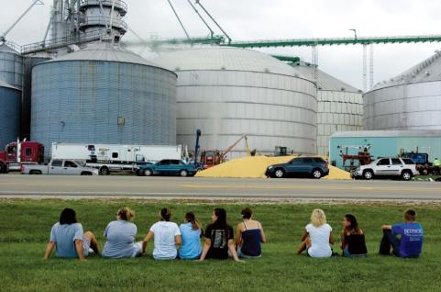
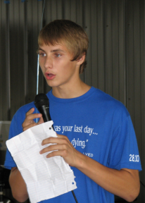
In Memory
Reciting the Lord’s Prayer, Alex asked Will to hold his hand as corn climbed above his head.
Wyatt, 14, screamed for help as the kernels moves past his chest, chin, and over his head within seconds.
“Two people died…One I felt his last heartbeat.”
“There were cars everywhere.”
It took 6 hours and over 300 people to free Will.
People lined the streets anxiously awaiting news.
Notes:
On July 28, 2010 in Mt. Carroll, IL, the four workers pictured were told to break up clumped grain to get it flowing. No formal training or personal protective equipment were provided, and they were unaware of the hazards/risks.
Wyatt Whitebread, age 14 (top right), enjoyed the outdoors, hunting & trap shooting. He was a happy, generous, kind teenager with a ready smile & joyous laugh; loved by all he met. He had been working a couple weeks & “trained” the others. Wyatt’s parents checked out the work & were assured he would only be sweeping out empty bins.
Alex Pacas, age 19 (top left), was the oldest & beloved big brother of 7 children. He loved music, played bass in a church band, and was attending college. It was Alex’s second day of work with his best friend Will. Knowing he was going to die, Alex began to pray with Will, asked him to deliver messages and watch over for his siblings.
Chris Lawton, age 15 (bottom left) was near the inside ladder & left the bin to call for help – he lives wondering if he had stayed would his friend Wyatt be alive today. He was plagued with nightmares, self-doubt, and self-recrimination. Today, Chris serves in the USAF.
Will Piper, age 20 (bottom center) was trapped in the corn inches from his best friend Alex. The rescue tube placed around Will to keep him alive also enclosed Alex’s body. It took 6 hours & over 300 personnel to rescue Will while he could feel Alex under him. Will could not rid himself of the guilt, fear, & loss. He turned to drugs to dull his pain. Will can be seen sitting on the grass by Alex’s grave, talking to his friend and crying. After a long battle, today he is clean & sober, works, attends school & goes on church missions.
Life will never be the same. Chris & Will relive the memory of that day: the sights, sounds, smells and horror of losing their friends.
Alex & Wyatt’s families endure a daily battle of never sharing another moment; creating a new memory; adding a another picture.
From this tragedy, the Grain Handling Safety Coalition was born and works to prevent tragedies like this from happening again
Does anyone in the class know someone who was entrapped or engulfed in grain?
“Walking down the grain” – refers to workers walking on grain to break up clumps and get the grain flowing for removal. This is often done with the augers running. Once grain starts flowing, it acts like quicksand. Walking down the grain & similar practices are prohibited by OSHA.
Ages listed are at the time of incident.
Introduce these young workers and discuss what happened to them.
Explain the origins of the GHSC.
If all modules are presented, instructor can hide duplicate slides.
Image Sources: Whitebread & Pacas families, GHSC, Alex T. Paschal/Sauk Valley Media. Permission granted 2011 by families & individuals to use photos & story anytime for education purposes.

Slide 5

Youth & Grain
Youth = under 18
Do not work in/around grain storage structures:
  unless empty
  when grain is being loaded, unloaded, moved
Properly trained for all tasks
  Experienced & knowledgeable adult
Know ladder & climbing safety
Employers comply with laws
Notes:
GHSC developed a Position Statement for Youth (Young Workers) Working with Grain to ensure the safety of young workers.
As working in and around grain is known to be extremely dangerous, even for adults, special care must be taken to ensure the safety of young workers.
This statement is not exclusive to commercial elevators or farms, but rather a blanket statement for all youth (under age 18).
Youth should NOT enter ANY storage structure, unless it is empty, aerated, and Lock out/Tag out has been done.
Empty infers grain is below knee level & there are no other engulfment hazards present.
Youth should not work inside grain structures (bins, silos, flat storage structures, wagons) when grain is being loaded, unloaded or moved.
Youth must be properly trained by knowledgeable adults.
Youth should be trained to climb and use ladders safely.
Federal labor laws (& some state laws):
May allow 16-17 year olds to engage in tasks not recommended by GHSC.
Though it may be “legal” to perform these tasks, it is strongly recommended to follow the practices outlined by the GHSC position statement to better ensure young workers’ safety.
14 & 15 year olds in non agricultural work – “May NOT be employed in ALL work requiring the use of ladders, scaffolds, or their substitutes.
https://www.dol.gov/whd/regs/compliance/childlabor101_text.htm
Under 16 in agricultural work cannot work from a ladder or scaffold at a height of over 20 feet; http://www.youthrules.gov/know-the-limits/agriculture/hazards.htm
OSHA - www.osha.gov and https://www.osha.gov/youngworkers/
Animated Slide: Each main bullet point appears with a click – total 5 clicks.
Instructors should be familiar with the full text of the GHSC’s Youth & Grain Position Statement: http://grainsafety.org/young-workers/
Direct young workers to the U.S. Dept. of Labor websites for OSHA and the Wage & Hour Division for information.
Introduce and discuss the GHSC Position Statement for Youth Working with Grain.
Emphasize it is the GHSC position no one under the age of 18 should be in or around grain storage structures when grain is present for their safety.
Discuss employers are responsible to know and comply with state and federal laws regarding labor and safety.
Image Source: Jessie Starkey Photography
What risk reduction actions are promoted with the statement?
Avoid – not being in or around storage structures or where grain is being moved.
Remove – grain structures must be empty
Training – for all tasks as well as for correct ladder climbing and proper housekeeping.
PPE – for fall protection

Slide 6
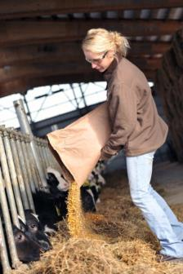
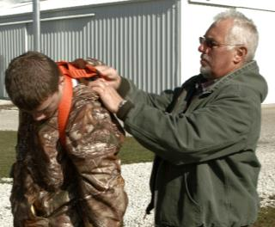
Stand TALL
Roles
  Young worker
  Adult
Stand T.A.L.L.
  Talk
  Ask
  Learn
  Live
Notes:
Roles:
Working youth are under 18 years old; also called young workers.
Adults are typically the employer &/or supervisor. On family farms the adult could also be a parent, legal guardian, grandparent or other family member. See Notes.
Emphasize the concept of empowerment through knowledge.
Young workers need to know their rights to a safe & healthy work place, & should speak up whenever they don’t feel safe.
Adults must ensure a safe worksite by assigning age appropriate jobs, mitigating (fixing) hazards and providing personal protective equipment.
Adults should understand young workers are particularly vulnerable to workplace hazards. They have a strong desire to please, as well as appear knowledgeable and mature which may prevent them from asking questions and seeking help.
Adults need to encourage young workers to learn how to “Stand TALL” when working in/around grain by following these guidelines:
TALK – safety with their boss, family and/or other trusted adults.
ASK – be comfortable & confident to seek assistance or clarification when uncertain about how to complete a task or if they have concerns about their safety.
LEARN – how to recognize workplace hazards & avoid or protect themselves against those hazards before encountering an unsafe or risky situation.
LIVE – Be safe to go home to family & friends, alive & injury free. They may not get a second chance.
These concepts apply to situations at a “paying” job, when helping out around the family farm, or any ag worksite.
Has anyone ever felt unsafe doing a task and spoken up?
Define roles of young workers and adults.
Introduce Stand TALL curriculum.
Explain the TALL acronym to participants.
Image Source: Left – GHSC; Right - Mac Bailey-MC
The Department of Labor defines employment on a family farm as an immediate family member with a direct relation to the farm employer: parent, spouse, or child, step-children, foster children, step-parents, foster parents. Other relatives, even when living permanently in the same household as the employer, are not considered to be part of the immediate family. Reference: Fair Labor Standards Act, 29 CFR 780.308

Slide 7

Employee Rights
Workers are entitled to:
Safe & healthy working conditions
Fair compensation
Report unsafe or unhealthy working conditions without retaliation
https://www.whistleblowers.gov/
https://www.osha.gov/
Notes:
OSHA is division of the Department of Labor. Though federal OSHA cannot conduct enforcement activities on family farms and/or small farms (≤ 10 non-family employees) employers still must provide a safe work environment. OSHA regulations are considered minimal best safety practices and should be followed. If a workplace injury occurs and OSHA standards were not complied with, it could result in increased liability (lawsuits).
By law, all employees are entitled to know their rights.
ALL workers:
are entitled to a safe and healthy working environment.
have a responsibility to follow the safety practices, policies, and procedures of their employers.
are to receive fair compensation (pay) for all hours worked.
minimum wage may not apply to agricultural work
should know their pay rate before beginning work
check federal & state wage laws
have the right to report unsafe/unhealthy work conditions without being punished or retaliated against. Young workers can ask a trusted adult to help them or call the nearest local OSHA office.
There are specific timelines & reporting requirements to follow which can be found on the website www.whistleblower.gov.
Find - the nearest OSHA office. Go to www.osha.gov .
On the home page look in the right column labeled “HOW TO…” or go to the “Contact Us” tab at the bottom of the page and click on the hyperlink for “see map of offices”
For more information and resources:
Worker rights - www.osha.gov or www.osha.gov/youngworkers
Wages & child labor laws - www.youthrules.dol.gov
What is the federal minimum wage? States may have a higher minimum wage.
Are there exceptions to minimum wage? YES
What work can you do at your age? Check the hazardous occupations list and exceptions for agriculture at the Dept. of Labor Wage & Hour Division website – https://www.dol.gov/whd/
Explore how the rights of workers apply to all workers.
Explain worker protection rights.
Discuss reporting violations to the US Department of Labor.
Image Source: United States Department of Labor

Slide 8
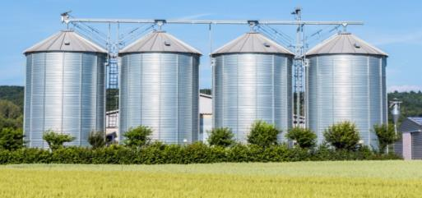
Major Grain Hazards
Entrapment/Engulfment
Entanglement
Falls
Electrical
Other hazards
  Dust
  Struck by
  Noise exposure
Notes:
Major hazards associated with grain handling include:
Entrapment & Engulfment
Entanglement
Falls – such as falls from ladders on bins and silos
Electrical – electrocution or shock from overhead power lines or electric sources a person comes in contact with during work.
Other Hazards:
Dust
Inhaled dust – can cause illness and disease
Explosions – a leading hazard mostly associated with the commercial grain industry
Struck by
anything that falls or strikes on a person (falling debris, tools, etc.)
being hit by a moving vehicle
being crushed by a vehicle (hydraulic lift) or between a vehicle and stationary object
Noise exposure
Identified or known hazards in the workplace such as chemicals & fumigants; ergonomic; confined spaces, etc.
Explain – today’s lesson will talk about:
Entrapment/Engulfment in grain storage structures such as a grain bin or a silo
Entanglement hazards – getting caught in machinery
Other modules include
Fall and Electrical Hazards
Other Hazards, PPE, & Child Labor Laws
The major hazards are based on types of injuries & OSHA violations recorded in the grain industry.
Review the major grain hazards.
Introduce the hazards being covered in today’s lesson.
Image Source: Thinkstock
Content Source: https://www.osha.gov/dep/leps/RegionV/reg5_fy2016_grain-handling_CPL_04-00-lep017.pdf

Slide 9


Hazard & Risk
Notes:
Transition slide.
This section will talk about hazard & risk and what these terms mean in terms of safety.
A yellow triangle designates caution and is warning of a danger.
Provide transition into Hazard & Risk section.
Image Sources: Clker.com - author RU486watch

Slide 10
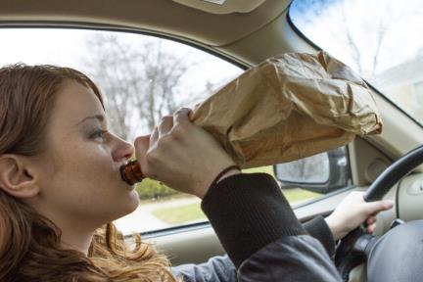
Hazard = Danger. Risk = Action.
Hazard
Something with potential to cause harm.
RISK
Potential of a chosen action to cause harm or loss.
Notes:
Define hazard.
Define risk.
Explain consequences.
Relate concepts to students’ choices & actions.
Animated Slide: Each orange title with definition appear on mouse click – total 2 clicks.
What is the risk in the picture? driving while drinking
What is the hazard? alcohol, car
What are potential consequences? How can these be avoided?
What are other examples of “risky behavior” that could affect safety?
Why is understanding Risks & Hazards important for working or helping in an agricultural environment?
In life, people often see & concentrate on the “reward” - such as peer acceptance; approval/acceptance from a superior such as a boss, coach, teacher, parent; financial reward; recognition; status; etc. - for choosing to act a certain way.
To gain the perceived reward, people often engage in risky behavior without thinking about it – the dangers that could be encountered or possible negative consequences.
Define HAZARD (mouse click). What is a Hazard? Something with potential to cause harm.
Define RISK (mouse click). What is risk? The potential a chosen action or activity could cause harm or loss.
Explain - Hazard is the noun (“thing”); risk is the verb (action).
Consequence is the result of the action.
Safety involves looking at both the hazard (thing that is present that could cause harm) and the risk (action taken with the hazard present) and the potential consequences (results) of that risk.
To illustrate these concepts – Ask participants the questions on the right. Have participants provide examples and relate these to identifying “Risk & Hazard”.
Questions 1-3 relate to the picture on the slide
Question 4
Guide participants with familiar examples – texting & driving, cheating on a test, lying to parents, etc.
Expand the concept with less obvious examples that puts a person’s safety at risk – driving with bald tires, taking an unknown medication from someone, using a tool they don’t know how to operate.
Question 5 - Being able to identify a risk & hazard can prevent a negative consequence by knowing how to act if put in a dangerous situation.
Image Source: Thinkstock

Slide 11
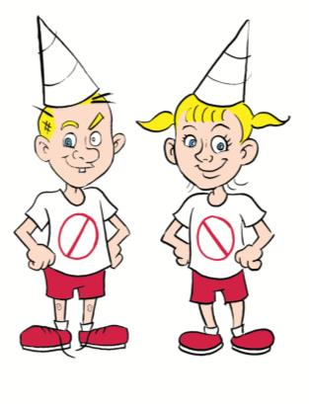
Identifying Hazards & Risks
Don
Dawn
Twannadothis
Notes:
“I’d like to introduce you to Don and Dawn Twannadothis.”
Don & Dawn are the last surviving members in their family and they get themselves in to all sorts of unsafe situations.
You might recognize some of the situations they get into and may have even done the same things.
Do you notice their t-shirts? What does that symbol mean?
Students may not recognize the “dunce cap” and may need explanation.
Introduce characters.
Image Source: Carle Hospital

Slide 12
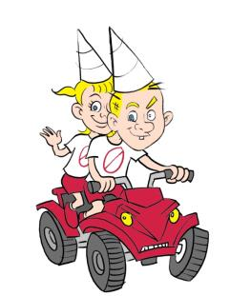
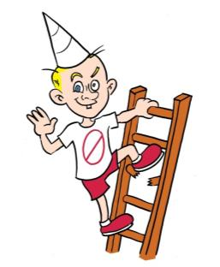
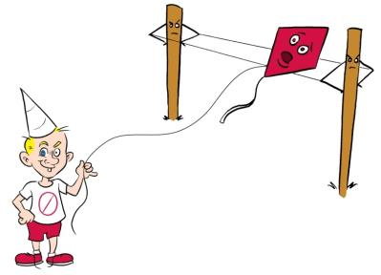
Hazards & Risks
Notes:
Here are a few samples where the hazard & risk can be easily identified. Participants may be familiar with these situations.
There are many hazards & risks in our daily lives most people have been taught about from a very young age. For example:
Looking both ways before crossing a street
Stopping at a stop sign or red light
Not touching a hot stove, fire, etc.
Ask participants the discussion questions. Provide guidance such as “Tell me what’s wrong with the situation” to assist participants in identifing the hazard, risk & consequence for each picture.
ATV
Hazard - 2 riders, no helmets or other personal protective equipment (PPE).
Risk – Injury or death from an accident while riding with 2 people, not wearing a helmet or PPE.
Ladder
Hazard – broken ladder rung; height
Risk – Fall and/or injury from climbing and/or stepping on the broken rung. Consequence – fall and/or injury
Kite
Hazard – power lines
Risk – electrocution from flying a kite near the power lines
These examples of hazards & risks are simple to identify AND there was time to think about them.
A person may not have time to think about the potential hazards and risks and the appropriate response when in a dangerous situation or may not know the hazards/risks.
When working with grain, many people may not know and understand the hazards/risks.
The purpose of this program is to help you understand and identify the hazards/risks and how to respond appropriately.
What is the hazard and risk in each picture? See discussion box for details.
Why is this behavior risky? What are potential consequences?
What are some other common risks & hazards which you may do or have done without really thinking about the consequences? Example: texting while driving.
Animated Slide: Each picture will appear (left, middle, right) with a mouse click – total 3 clicks.
Note: If possible, write down the students answers to question #3 below to use as later examples.
Introduce examples of hazards/risks.
Identify hazards and risks.
Explain the importance of understanding hazards & risks before acting.
Discuss hazards/risks and how to appropriately respond.
Image Source: Carle Hospital

Slide 13
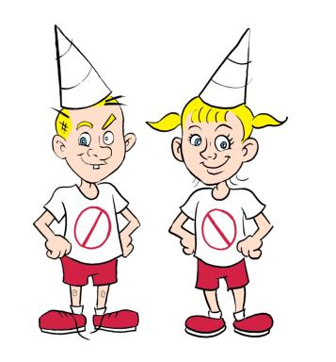
What you don’t know
CAN hurt you!
Reduce Risk
Know hazards
Understand potential seriousness
Take proper precautions
Notes:
Three important steps to prevent or reduce risk:
Know (identify) the hazard(s) involved.
Understand the potential seriousness of the situation.
Take the proper precautions/actions.
Determine how dangerous each hazard is and potential outcomes.
When there is more than one hazard, identify and deal with the most dangerous one first.
Discuss what kinds of precautions could be taken.
Understanding the concepts of hazards and risks and how it relates to one’s safety is essential to being safe while at work.
This presentation will help participants learn to identify hazards in the grain environment and the ways risks can be reduced.
What are the risks/hazards associated with riding the ATV or climbing the ladder as shown in earlier slide?
How potentially serious are the risks/hazards?
What proper precautions or course of action could be taken?
What are some other “risky” behaviors or situations?
Can you identify the risk/hazard with these situations and the potential seriousness?
If possible, use examples of risks/hazards students provided previously to illustrate the teaching points or use the examples on the previous slide.
Have the class determine the seriousness of the hazard(s) and discuss possible precautions to take.
Identifying hazards and determining how dangerous they are is the first step to reducing risk.
Discuss the seriousness of potential outcomes for the identified hazard.
Determine what precautions could be taken against the hazards.
Image Source: Carle Hospital

Slide 14
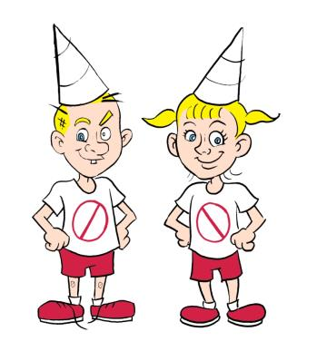
Take Action to Reduce Risk
Simple Risk Reduction Actions:
Avoid hazard
Remove hazard
Control hazard
  Guard equipment
Receive training
Use proper PPE
Notes:
Know the types of actions to take when a hazard is present or potentially present.
Remember risk is associated with an action - what a person does about the hazard or how a person reacts/responds to the hazard.
The following actions will reduce risk.
Avoid the hazard – don’t be near or around the hazard.
Flying a kite– Don & Dawn could avoid the risk of electrocution by not flying a kite near electrical wires.
Remove the hazard – completely take away a hazard. Though not always feasible, it many circumstances a hazard can be removed.
Climbing a ladder with a broken rung – Eliminate the risk completely by removing the ladder from the premises (and destroying it) so it cannot be used.
Control the hazard – when a hazard can’t be avoided or removed using an engineering method to control the hazard and prevent/reduce a person’s exposure to the hazard is the next best option.
Guard Equipment – moving parts on equipment can be guarded so a person cannot come into contact with the hazard. For example, a chain guard on a bicycle prevents a person from coming in contact with the moving chain (getting a pant leg caught in it) and prevents injury.
Receive training – on how to recognize a hazard & specific actions to appropriately respond to the hazard to reduce risk.
Use appropriate PPE (personal protective equipment) - use of PPE does not address the hazard itself, but provides protection against it.
On an ATV, a helmet is PPE and protects against head injury.
The first choice should always be to avoid or remove the hazard.
What are other examples of hazards that can be avoided or removed?
If there is a choice between controlling a hazard or removing the hazard – which action is best? (remove)
Animated Slide: Each bullet point appear with a mouse click – total 5 clicks.
Note: Use the hazard/risk examples shown previously with the characters to point out the different types of risk reduction actions OR use the hazard/risk examples provided earlier by the students.
Introduce strategies to reduce risk.
Discuss behavior choices to select the option with the best outcome.
Image Source: Carle Hospital

Slide 15
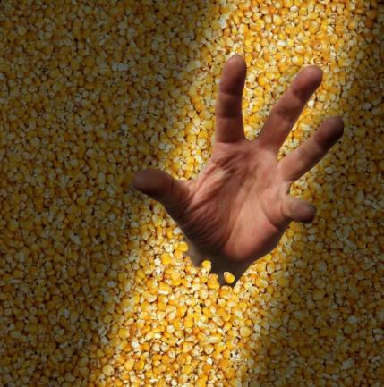
Entrapment/Engulfment
Notes:
Transition slide.
We will now begin our discussion on Entrapment/Engulfment.
Instructors may use examples to illustrate how an engulfment or entrapment may “feel” such as covering up feet with sand, covering someone with leaves, the pressure from holding your breath, etc.
Provide transition into Entrapment/Engulfment section.
Image Source: GHSC

Slide 16
Entrapment vs. Engulfment
Entrapment
Portion of body submerged
Over knees – can’t rescue self
5 seconds to helplessness
Engulfment
Total submersion < 60 seconds
Usually body recovery
Death caused by suffocation
Notes:
Entrapment occurs when a portion of the body becomes submerged and is trapped by the pressure of the grain.
When grain reaches the knees you cannot free yourself. This takes about 5 seconds with flowing grain.
Rescue is possible with trained rescue personnel.
Engulfment occurs when a person is totally submerged in grain.
Takes less than a minute if grain is flowing.
Usually leads to death and recovery of a body.
Only trained rescue personnel attempt rescue/recovery.
Suffocation is a leading cause of death.
Suffocation during entrapment or engulfment occurs because:
Inability to expand chest due to pressure of the grain. Each time you “breathe out” the chest contracts (gets smaller) & the space is filled with grain.
Grain gets into airways (nose, throat, mouth) and blocks airflow.
Suffocation in an entrapment does NOT occur instantly – a person is often conscious until lack of oxygen forces unconsciousness and then death.
Suffocation also occurs when grain bins develop hazardous atmospheres where the oxygen level not sufficient to support breathing and/or toxins affect the body’s ability to function.
Activity: Shrinking Balloon Activity
Instructions can be found in Chapter 4 Participant Materials of the Instructor Manual. Activities may be conducted at this time or after the presentation.
For more information: http://www.nclabor.com/osha/etta/indguide/ig1.pdf
Define entrapment & engulfment.
Emphasize the conditions & time frames which make self-rescue difficult.
Emphasize the time frame a total engulfment can take.
Demonstrate airflow issues with grain. (Activity)

Slide 17
Impact - Entrapments
Entrapments increased ˃183% (2001-2010)
36.8 per year - 5 year average
18% involve youth 11-20 years
80% fatality rate 11- 20 age group
More common on farms
Numbers are under reported
Purdue University Agricultural Confined Space Incident Database
(PACSID).
Notes:
Highlight local impact by sharing data on the frequency of RECORDED entrapment/engulfment cases. Grain entrapment incidents continue to be a concern today.
2001- 2010 the number of entrapment cases rose 183%.
Over a 5 year period the average number of cases per year is 36.8.
The 5 year average climbed steadily throughout the 2000’s. The first significant decrease was in the 5 year period ending in 2015.
However, 2015 saw the first time since 2010 the percent of fatality cases was higher than non-fatal.
There was a significant drop in reported cases in 2015.
Many incidents go unreported, making the actual number of incidents higher than recorded.
There is no mandated reporting of entrapments/engulfments.
Data is based on voluntary reporting, and collection of news sources and OSHA data.
The 11-20 age group represents 18% of recorded entrapment cases from 1964 – 2013 with an 80% fatality rate (almost double the overall rate).
Majority of entrapments occur on farms.
Corn is involved in majority of cases with soybeans second.
Why are these trends concerning? (Because the number of incidents are increasing.)
What factors contribute to these trends? (Increase in production, unloading systems, storage capacity & bin size.)
Source: Purdue University Agricultural Confined Space Incident Database (PACSID) – 2011, 2012, 2013, 2014, 2015 annual reports.
Discuss the frequency of entrapments & engulfments.
Describe the fatality rate among young workers.
Discuss the weakness in the data.

Slide 18
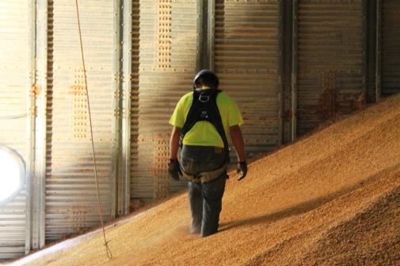
Grain Facts
Normal: sink around 12 inches
One cubic foot of grain weighs~50 lbs.
Grain acts like quicksand
Note: Entrant is not properly tied off. This is a demonstration photo.
Notes:
When there is normal/good grain it will create sinking to about 12 inches when walking/standing. That is about mid-calf deep.
If a person does not sink, there is a crusting or bad grain condition hazard.
A rule to remember: For good condition grain, you never stand ON grain you always stand IN grain.
A cubic foot of grain is approximately 50 pounds. The average body volume is 5-7 cubic feet. Only the body volume of a person needs to be removed for the person to be completely engulfed – this takes about 5 seconds when grain is flowing.
The amount of effort needed to remove a victim increases with level of submersion.
The more of the body buried, the harder it is to get them out.
Removing a person means lifting the person’s weight PLUS the weight of the grain.
For an average person completely buried that is 250-350 pounds of grain in addition (5-7 cubic feet X 50 pounds).
Flowing grain acts like quicksand and flows to fill empty space.
With movement, grain flows to wherever the space was made.
Flowing grain creates a funnel. The sides collapse to fill the funnel.
This is especially dangerous when the unloading system is operating, as it continually creates a funnel the grain will fill.
The flowing grain acts like a suction pulling a person downward into the funnel. Gravity causes the sides to continue to collapse inward to the funnel.
The faster the grain flows, the quicker submersion happens.
It is important to note OSHA standards require the use of a harness and lifeline whenever the depth of gain poses an engulfment hazard and it needs to prevent the worker from sinking more than waist deep in grain.
Discuss “sinking” characteristics of normal and out of condition grain.
Describe how the characteristics of grain relate to entrapment.
If you can lift 250-350 pound, why is it still impossible to free yourself from the grain? (Resistance of the grain against the body.)
Image Source: GHSC
Note: The OSHA Grain Handling Standard – 1910.272 contains specific regulations regarding work in grain storage structures including those surrounding entry. 1910.272(g)(2) specifically addressed engulfment hazards and the use of a lifeline.

Slide 19
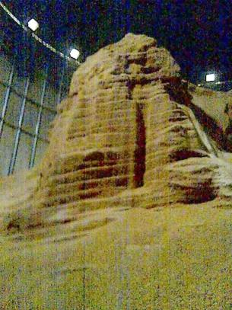
Hazard – BAD Grain Condition
Bad grain condition
  Hot temperature
  High moisture content
  Smell - moldy, musty, fermented, sour
Good grain condition
  Cool temperature
  Low moisture content
  Rolling movement
  Sweet smell
65 feet high striations
Notes:
Grain condition is one of the leading indicators of hazard presence in a bin. Grain condition can be assessed by an EXPERIENCED adult in a variety of ways including smell, temperature, movement/feel, and look. If indicators pointing to potential grain condition problems are present – the probability of hazardous bin conditions increases.
Smell – moldy, musty, fermented or sour smelling grain indicates out of condition (bad) grain.
Out of condition grain clumps (and plugs up the sump), sticks to the sides of bins and can form striations (horizontal sections that look like stair steps) as shown in this photo.
In this photo, the grain is 65 feet high
If a worker entered below the top of the grain and part of the tower broke loose, there is almost certain to be a total engulfment of the worker.
Good grain retains its sweet smell. It also has a rolling movement when walked on moving away from the feet as they can sink into the grain.
Based on previous information what is another indicator of bad grain? (Not sinking into grain when walking on it.)
If grain has a moldy, musty smell what is another potential hazard? (Airborne mold that can cause respiratory problems. Wearing an appropriate dust mask can help.)
Animated Slide: Each main bullet & sub-bullets appears on a separate click – total 2 clicks.
Instructor may want to supplement with photos or examples of good and bad grain.
If students do not understand a fermented smell, a package of yeast can be passed around.
Compare and contrast the characteristics of grain that is in good condition with grain that is in bad condition.
Explore the hazard a tower of grain presents (such as the one pictured).
Image Source: Grain and Feed Association of Illinois

Slide 20
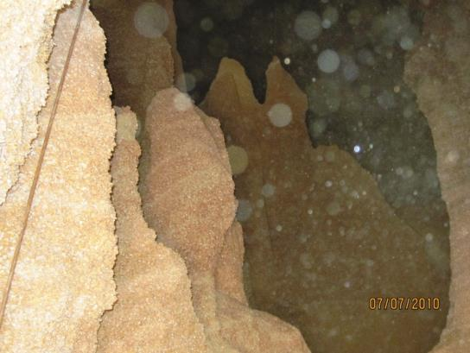
Hazard - Tower, Cone up & Cone Down
Grain towers
Grain cones up (Pyramids)
Grain cones down
Notes:
Out of condition grain can make several noticeable formations - grain towers (previous slide); pyramids (and towers) as shown here, or cone down formations. Some people refer to this as “Dished Up” or “Dished Down”.
The presence of grain in formations indicates out of condition grain – signaling a hazard.
It may be easier to see some of these conditions (pyramids, clinging to the wall, etc.) from a side opening rather than the top opening. See Questions
Before entering a bin, it should be checked and assessed for potential hazards.
Why might it be difficult to see these formations from the top opening? The may be covered by newly loaded grain; the top of the formation may appear to be part of the grain’s surface.
Notice the dark “center” between formations. Would it be safe to be in this area? No. Any of the formations could collapse and bury a worker.
It is difficult to obtain clear pictures of inside grain bins due to high levels of dust and lack of light. The spots on the picture are dust.
The line in the left part of the picture is a temperature cable.
Discuss various forms that out of condition grain may take.
Explain the significance of these formations.
Image Source: Grain and Feed Association of Illinois

Slide 21
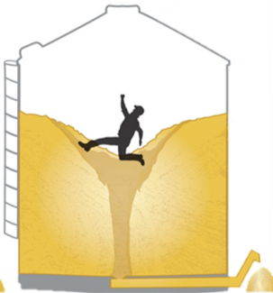
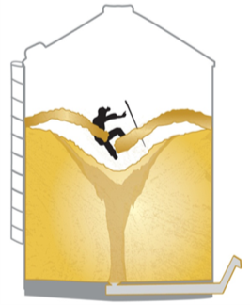
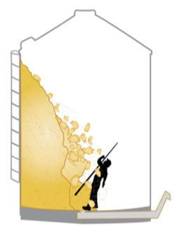
Entrapment/Engulfment
Flowing Grain
Bridged Grain
Avalanche
Notes:
There are three methods that people can become trapped in grain.
Flowing Grain
Bridged (or Bridging) Grain.
Sometimes called “horizontal crust collapse”
Avalanche
Sometimes referred to as a “sidewall build-up” or “vertical collapse”
While entering a bin is strongly discouraged, and should only be done by a trained adult with proper PPE, the following are reasons this may be done.
Out of condition - grain not flowing
Equipment needing repair
Inspection and cleaning of bin
Youth should never enter a bin unless empty
These 3 hazard conditions will be discussed further.
Introduce three ways entrapments & engulfments occur.
Describe the reasons adults may enter a grain bin.
Image Source: Grain and Feed Association of Illinois

Slide 22
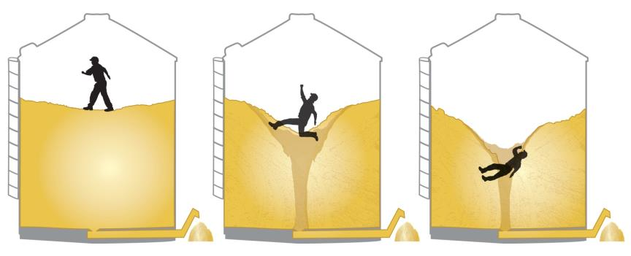
Flowing Grain
Acts like quicksand; pulls worker down
Buries worker in seconds
NEVER “walk down” grain
Notes:
Typically grain storage structures empty by gravity. This is assisted with floor sump holes (gates) in the bottom being opened/closed to direct the flow and mechanical unloading equipment that can help draw out grain and/or move it away.
Flowing grain generally occurs when parts of the unloading mechanisms are operating.
Flowing grain can also occur when a person enters a grain bin to get grain flowing that has stopped or slowed – “walking down the grain.” The flow is quickened if the unloading system is running.
The unloading system causes grain to flow at X number of bushels per second (depending on the size of bin and unloading system). The number of sump holes open also affect the speed.
The faster grain flows the quicker entrapment or engulfment occurs.
Flowing grain creates an inverted cone or funnel. The surface of the grain becomes unstable for the worker.
The flowing grain pulls a worker down – much like quicksand.
As the sides continue to collapse, the worker quickly becomes entrapped/engulfed.
This can happen in less than a minute.
Staying away from open sumps or the center of the bin with unloading equipment running is not safe. The surface of the grain, no matter where the person is located, is unstable.
The force of the grain flow against the body is so great the worker typically has no ability to pull themselves out.
There are other ways bins can be emptied (also causing flowing grain) including grain vacuums and cutting holes in sides.
There are no safe procedures to “walk down grain” & get it flowing, especially with equipment running. Walking down grain or similar practice is prohibited by OSHA & should never be done.
No one should enter a grain bin with unloading equipment running.
What is the best way to eliminate or avoid this hazard? Adults never enter a bin with equipment running.
If the main sump is closed and only the outer ones open, does this eliminate the hazard? No, grain will still be flowing by gravity.
Discuss the causes of flowing grain.
Describe the process of entrapment/engulfment.
Relate the hazard “flowing grain” to the risk of “walking down the grain”.
Explain why “walking down the grain” should never be done.
Embedded Video without Audio: WMV file. Play by clicking on the arrow in the bottom left of the image.
Video Source: Oklahoma State University Stored Products Research & Education Center, “Grain Bin Rescue”
https://www.youtube.com/watch?v=DQSqWbn-3X0​ .
Demonstrate. Use a clear container with bottom hole or a funnel. Plug the hole, fill with bird seed or other product and place an object on top. Unplug the hole. Watch how it empties & what happens to the object.

Slide 23
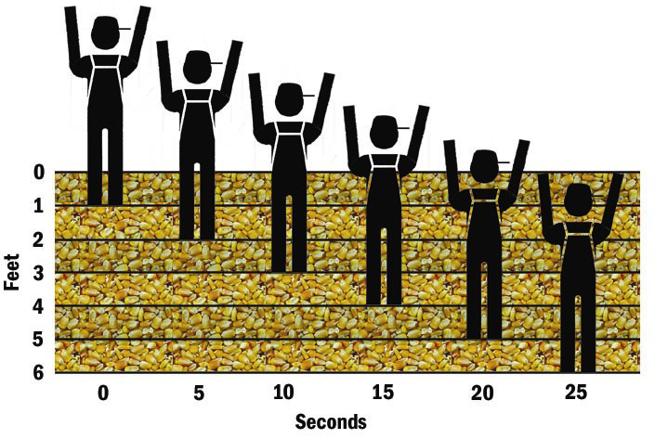
It Happens Fast
Notes:
In an entrapment: “you are in a race you can’t win.” It can happen in seconds.
The chart shows the extremely short time frame it takes for entrapment/engulfment to occur.
NOTE: These rates will vary based depending on size of equipment and number of outlets.
Entrapment/engulfment will still occur too quickly to react, regardless of the size of equipment.
Typically, total engulfment occurs in less than a minute.
Unloading systems are getting larger and faster, making entrapment/engulfment occur more rapidly.
Remind participants: “Once you are submerged to your knees, you can no longer free yourself.” This can happen in 5 seconds.
How far are you from emergency services?
What would happen in the time between the call and their arrival?
Once submerged to the knees a person cannot self rescue. According to the chart, how long does it take to be submerged to knee level? Approximately 5 seconds.
The chart shows time frame it would take for entrapment/engulfment in grain for an unloading rate of 3900 Bushels/hour or 65 bushel/minute (10 inch out auger)..
Discuss the speed and method of entrapment/engulfment.
Explain the effect of equipment size on rate of entrapment/engulfment.
Image Source: Penn State Ag Safety and Health Program

Slide 24
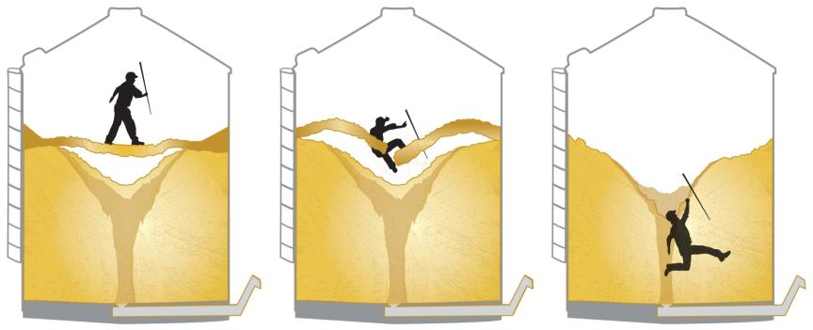
Bridged Grain
Crust forms on top; creates cavity under
Collapses when walked on
Buries worker
Notes:
“Bridged or bridging grain” hazard may also be called a “horizontal crust collapse”.
A bridge occurs when a layer of crust forms on the top surface of the grain due to clumping because of mold or moisture (the grain not dried properly).
The “bridge” forms when grain has been removed or settles from underneath the crust forming a cavity. This empty space is usually the result of grain having been unloaded – the gravity pulling grain from the center of the bin beneath the crusted surface where it flows easier.
The surface can appear to be hard enough to hold a person’s weight creating a false impression they can walk on it.
The weight and/or movement of a person can cause the bridge to collapse and the person will fall into the cavity with the grain swiftly filling in around them.
A good indication of crusted corn is a person not sinking into grain a little bit. With good grain (corn), a person will sink about 12” (mid-calf). If not sinking, there is a problem – GET OUT!
Other indicators of possible bridging:
Grain has been previously removed but the surface doesn’t reflect this.
Uneven slopes or grain is not at a natural angle, generally 22-28°.
Poking at grain before walking on it does not prevent entrapment or engulfment. Breaking the surface from:
Inside the bin – Can cause the area where the worker is standing to collapse
Outside the bin – May be misleading because cavities may not be within reach.
It is NOT possible to “see’ bridging conditions. Anticipate bridging conditions when other indicators are present. (See question 1.)
What are other indicators of out of condition grain which could signify a bridging condition? Moldy, musty sour smell, warm to the touch, visible clumps/formations, clogs, towers/pyramids & discolored.
What are some other hazards which could be present with bridged grain? Respiratory issues due to the molds and dust, hazardous atmosphere.
Explain causes and formation of bridging conditions.
Review indicators of out of condition grain from previous slides
Explore misconceptions about bridging/crusting.
Embedded Video without Audio: This is a WMV file and should play by clicking on the arrow in the bottom left of the image.
Video Source: Safety and Technical Rescue Association

Slide 25
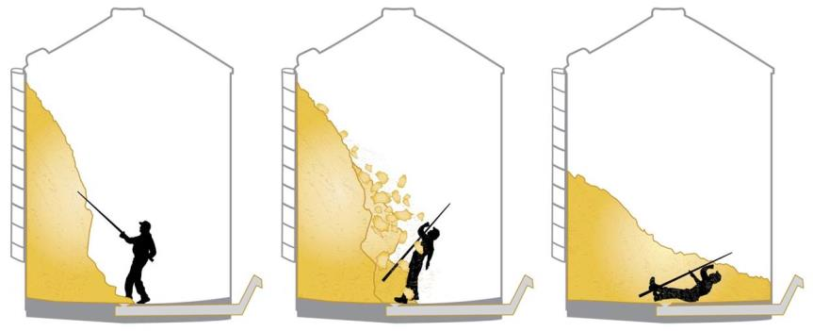
Avalanche
Worker attempts to dislodge grain
Falls unexpectedly; buries worker
Stay above the grain
Notes:
Grain that is out of condition can also form pyramids, towers, or build-up on the side of a grain bin.
Accidents can occur when a worker stands next to or underneath grain that is built up on the walls of the bin or grain that has formed into towers.
The grain pile can avalanche onto the worker unexpectedly or when the worker attempts to dislodge it resulting in full or partial entrapment in grain.
The avalanche can occur from the side or from a grain tower/pyramid or stalagmite (rises from the floor). Also called a “cone or dish up” formation.
Underneath the crusted portion of the mass, the grain may be drier and crumbly. When the solid crust which is holding the other grain in place is broken, the grain falls – creating the avalanche.
Piled-up grain a few feet high is enough to engulf a worker. Once the grain dislodges, the force is enough to knock a worker down and engulf them.
Alternative methods need to be used to clear build ups. See Questions
It is common to knock down grain and sometimes necessary – What are some alternatives? Wait for it to dislodge on its own, refill the bin above the level of build-up and empty, repeating as necessary.
Why is grain clinging to the side of a bin deceptive? What looks like a small amount of build-up may actually be several feet of grain with enough force to knock someone over.
Embedded Video without Audio: This is a WMV file and should play by clicking on the arrow in the bottom left of the image.
An analogy for avalanching grain is a piñata. The first few hits may see only a few pieces of candy falling or may cause the piñata to break and release a bunch of candy. You never know which “hit” will cause the piñata to break open.
Explain causes and formation of grain towers or build-up on the side of the bin.
Discuss the proper an improper ways to address abnormal grain formations or build-up on the side of a bin.
Video Source: Safety and Technical Rescue Association

Slide 26
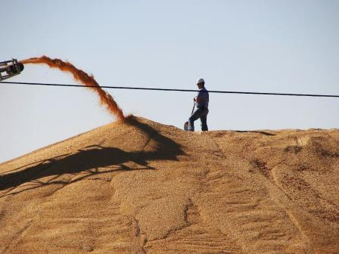

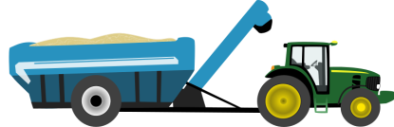
Ground Piles & Flat Storage
Moving/Flowing Grain
Tower/Pyramid
Tower~50’ tall
These are hazards
Notes:
Ground piles and flat storage are another type of grain storage.
They represent unique challenges and hazards.
The same rules for bin entry apply to ground piles and flat storage.
Left Picture – This ground storage pile demonstrates a “fill hazard” as opposed to a emptying/loading out hazard.
The same hazards of flowing grain are present in this filling operation as in bin emptying.
The worker can be trapped if grain starts to flow.
Grain has a natural angle of repose, which is the steepest angle granular material can be piled and remain in place without sliding. This is measured in degrees. See Notes
In ground piles, when the grain is unloaded and reaches it maximum slope (angle of repose) it will begin to flow downward creating an engulfment hazard for a worker standing on the pile.
The angle of repose for most grain is 22°-28° depending on the grain.
Right picture – demonstrates out of condition grain (notice the striations). This creates a pyramid or tower of grain which could cause large blocks of grain to fall unexpectedly.
In this type of storage it is very common for the center loading tower to become clogged with material that can contribute to the grain going out of condition.
As shown, the grain pile could be upwards of 80 feet tall - this is tall enough to engulf a tractor loader or semi-truck should the grain avalanche.
.
Explain ground piles and flat storage.
Discuss the hazards associated with this type of storage.
Explain and/or demonstrate angle of
repose.
Discuss the importance of angle of repose in relation to “fill” hazards.
If time and interest allows, demonstration instructions on the Angle of Repose can be found at:
https://en.wikipedia.org/wiki/Angle_of_repose
Could there be other hazards in addition to flowing grain and avalanching? Yes, bridging could occur.
Could flowing grain occur during unloading of this type of storage? Yes, but it would more likely be the result of the pile being destabilized as a ground pile would not have not have sumps and unloading augers.
Image Source: Grain and Feed Association of Illinois

Slide 27
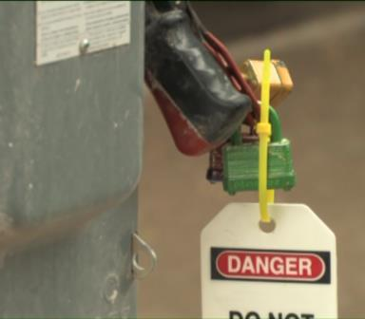
Lock Out/Tag Out/Try Out-LOTO
Remove best practice
De-energize all energy sources
Lock out – put on lock
Tag Out – warn others
Try Out – ensure no energy is present
Keep others from turning machines on!
Notes:
Lock Out/Tag Out (LOTO) must be done before entry into any storage structure even if the level of grain is low.
Ask the students if they know about Lock-out/Tag out .
LOTO controls potential hazardous energy by ensuring all energy sources are disconnected and disabled so it cannot be turned on and all stored energy is dissipated.
Potential energy sources include: electrical, mechanical, hydraulic, pneumatic, kinetic, chemical, thermal and others.
LOTO prevents the unexpected start-up of equipment and stored energy from escaping.
LOTO protects against injury to workers by keeping others from turning on equipment and ensuring no stored energy is present during servicing/maintenance of equipment or while performing tasks near equipment.
Injuries include electrocution; burns, cuts, lacerations; crushing; fractures/amputation of body parts, hematomas, and others.
These injuries cause employees to lose days to weeks of work for recuperation. (Data from OSHA)
Before performing LOTO identify ALL energy sources. Example: ALL unloading equipment including augers, sump gates, and conveying systems that go to a bin.
Perform Lock Out/Tag Out:
Lock Out – disconnect and lock the energy source from being turned on.
Tag Out – identify the energy source is locked and who did it.
Try Out – safely try to turn it on to ensure energy has been fully locked out.
LOTO must be completed by an experienced adult who knows where the power sources are located for all the equipment and how to properly shut equipment down, disconnect & lock out power.
Explain Lock Out/Tag Out and how it protects against injury.
Discuss when Lock Out/Tag Out is done.
Describe various types of injuries that can result from the failure to properly use Lock Out/Tag Out.
Grain Handling Safety Coalition video, “Lock Out/Tag Out – Each Time, Every Time, is a 7 minute video explaining the steps of LOTO. It can be viewed on the website www.grainsafety.org .
Additional information on LOTO can be found under the OSHA standard 1910.147 or from: http://www.osha.gov/SLTC/controlhazar dousenergy/index.html
Why is turning off equipment not enough? Others may turn it on. In addition, even in the off position, stored energy may be present.
Why is it important to “Try Out”? To ensure no energy source was missed and there is no stored energy.
What is the purpose of the tag out part? Let’s others know the energy source is disabled and not to turn it on, as well as who is responsible for locking it out and unlocking it.
Image Source: Grain Handling Safety Coalition

Slide 28


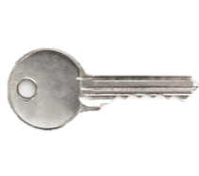
Lock Out/Tag Out Requirements
Your lock cannot be opened with another key.
Notes:
There is one lock & one key per person – no one else should have a key to another’s lock. This ensures no one can remove a lock another person puts on. It prevents others from turning on a power source when someone else may be working on or near equipment and machines.
Employers are responsible for providing appropriate locks & tags.
LOTO – the process of disconnecting & locking out of energy - is performed by trained adults who have been authorized to do this.
All workers must know who is authorized to perform LOTO and be trained in the company’s LOTO procedures and policies.
Training includes placing/removing their lock & keeping their own key.
Any person working on/near equipment – such as entering a grain bin – needs to attach a lock.
LOTO requires a written procedure for EACH piece of equipment/machinery that tells the location of EVERY power source & its type, and shutdown, lockout & start-up processes.
ONLY the person assigned to the task should notify the supervisor the task is completed and LOTO can be removed. The supervisor is responsible to ensure no one is in harm’s way before people remove locks & equipment is started.
Young workers are NEVER responsible for Lock Out/Tag Out – disconnecting power sources without adult supervision.
They should be supervised by an adult when placing & removing their lock.
They must ASK their supervisor if LOTO has been completed, verify it by viewing the tag, place their lock, & test the equipment (if it can be done safely) before doing tasks on/around equipment or entering a grain bin (even empty).
STAND TALL! If workers are unsure LOTO has been done, check with the supervisor. If an employer doesn’t do LOTO, a worker has the right to refuse to do the task. See Questions.
Explain the steps performed to do Lock Out/Tag Out.
Discuss the specific steps that young workers need to follow in LOTO.
Animated Slide: The plus and equal sign and text appear automatically on a timed sequence..
If you are asked to use another person’s key and remove a lock; what should you do? Never remove someone else’s lock. Ask key owner to remove the lock.
You are told to LOTO equipment and you have not been trained, what do you do? State you have not been trained and cannot perform this task.
Image Source: Master Lock® & Thinkstock.

Slide 29
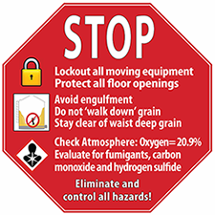
Avoid Entrapment/Engulfment
Do not enter bin with grain
  Law – must be ≥ 16
Lock entrances
Bin entry – all workers
MUST be trained
ALWAYS Lock Out/Tag Out
NEVER “walk down” grain
ALWAYS have observer
Use harness & lifeline
Notes:
To AVOID situations of potential entrapment/engulfment use the following safety strategies.
Workers under 18 should NEVER enter a grain bin unless
It is empty (ie grain is below knew height)
All equipment is properly Lockd Out/Tagged Out
Other safety procedures are followed - SEE QUESTION.
By federal law – workers under the age of 16 cannot enter grain storage structures.
Lock entrances to grain handling & grain storage areas to keep bystanders and children out. Lock, bar, or barricade ladders/stairs to prevent access to fall hazards.
Young workers & children
Do not play in/around grain storage structures and/or transport vehicles (including gravity wagons, semis, etc.)
Do not stand, sit or ride on the edge of a grain transport vehicle as they could lose their balance and fall in.
When it is necessary to enter a bin use the following strategies to REDUCE the risk of entrapment/engulfment – that is remove or control hazards – for all workers.
Anyone entering a bin MUST be trained. NO ONE should enter a bin without training on the hazards.
Lock Out/Tag Out power sources before entering the bin to all the equipment. This should be done even if entering an “empty bin” to sweep, etc.
Never walk down the grain or use similar practices to get it flowing.
Have an observer present outside who is watching the person in the bin and can call for help if there is a problem.
Have several people available outside the bin to in case of emergency.
Use a safety harness and secured lifeline when entering a grain bin.
The course keeps emphasizing young workers should NEVER be in bins when grain is present. Why say “never” instead of focusing on best practices? Good risk reduction strategies avoid or eliminate the hazard completely. Not entering is the BEST risk reduction method and is “mistake-proof”.
The majority of entrapments and engulfments occur because best practices are not followed, especially Lock Out/Tag Out. Many people will argue it is not necessary to use a harness & lifeline if there is no engulfment hazard present. This is technically correct. However, the best way to ensure a worker cannot sink below waist deep is to use a harness & lifeline during ANY bin entry.
Explain risk reduction strategies to eliminate or avoid an entrapment or engulfment.
Discuss the use of best practices by all workers when entering a grain bin.
Image Source: Grain Handling Safety Coalition

Slide 30
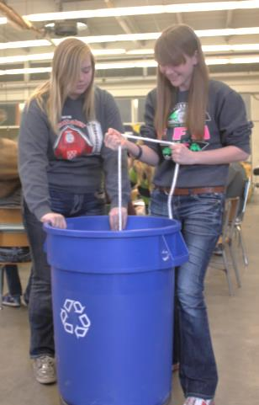
Tug of War Activity
Purpose: Understand how hard it is to pull objects out of grain.
Notes:
Complete instructions and material list is provided in the instructor manual.
In this activity, participants attempt to pull an object out of grain.
Demonstrate the force needed to pull an object or person out of grain using the tug of war activity.
Activity: Grain Tug of War
Instructions can be found in Chapter 4 Participant Materials of the Instructor Manual. Activities may be conducted at this time or after the presentation.
Image Source: Carle Hospital

Slide 31
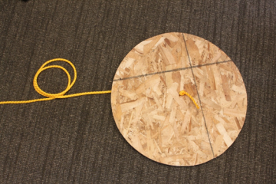
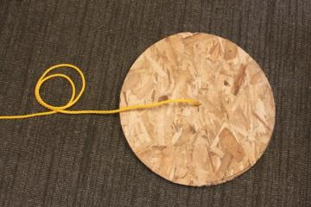
Tug of War Activity
Bottom view of disk
Top view of disk
Knot holding rope to disk
Leave end of rope outside of grain

Slide 32
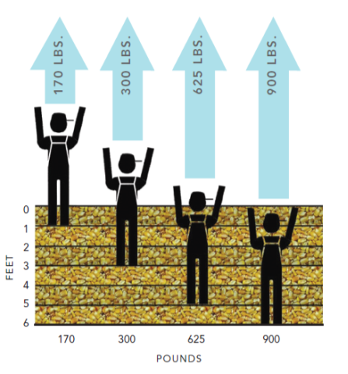
Why Can’t You Help?
Amount of force required to pull a person out of grain depends on depth of entrapment.
Notes:
This chart shows the effort (amount of pull in pounds or force) needed to pull an individual out of grain.
The amount of effort required is dependent on the depth of the entrapment or engulfment.
Once an individual is up to his waist, it is not likely he can simply be pulled out.
Grain would need to be removed from around the person. In order to remove grain, something is needed to hold the surrounding grain back and keep it from flowing to fill the space.
See Questions
Being entrapped also presents other problems.
The weight of the grain can cause breathing difficulties due to constriction of chest expansion, particularly after entrapment for an extended period of time.
The weight of the grain can cause restricted blood flow to extremities that are covered. As shown in the graphic above, the legs and feet would be impacted the most.
Other difficulties include aspiration (grain gets into the airways) or ingestion (grain gets into the throat).
Why should a mechanical device NOT be used to remove a victim from the grain? Could this possibly injure the victim more? How? (The crushing weight of the grain could cause a dislocated arm/leg; internal damage and/or bleeding; broken bones or severe sprains, etc.)
Demonstrate the amount of force needed to extricate a person buried to their knees. Have a group of students attempt to pull out the wooden disk from the previous exercise. Start with one student and keep adding a student until the disk is pulled out.
Discuss the amount of force required to pull a person out of grain.
Explain the factors that contribute to the amount of force required to pull a person out of grain.
Image Source: Penn State Ag Safety and Health Program

Slide 33
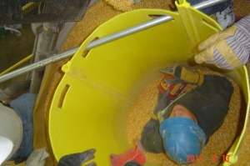
Rescuing a Victim
Only trained personnel enter bin
Stabilize victim
  grain tube or other means
Remove grain
  cut bin exterior evenly
NEVER attempt a rescue
Notes:
Only people TRAINED in rescue should ever attempt to remove a victim. Rescue attempts by untrained personnel typically result in the “rescuer” also being entrapped and/or worsening of the situation. The following information is provided to further clarify the need for trained personnel to do rescues.
Trained personnel have to be careful moving around the victim:
If they cause the grain to move, it will worsen the situation.
Their movements can cause more pressure on the victim.
They can face hazards and become entrapped themselves.
See Question 1
A grain tube or other barrier is used to stabilize the victim.
It stops the flow of grain around or on top of the victim. Once a barrier is erected, the grain inside is removed until the victim is able to be freed.
If the victim’s location is unknown, it is almost impossible to put up an effective barrier.
Holes are cut symmetrically on the exterior sides of the bin at about the same time. This allows gravity to remove grain as all unloading equipment needs to be locked out. The hole placement prevents the bin walls from collapsing with uneven distribution of the grain being removed. See Question 2
Rescue is extremely time consuming. The longer a victim is inside:
The chances of a live rescue diminish.
The greater the chance the rescuer will succumb to a hazard
Discuss why only trained personnel should attempt to rescue a victim.
Explain this information is provided to help young workers understand the complexity of a rescue and the need for trained personnel.
What hazards do rescuers face? Entrapment, heat exhaustion, dehydration, low visibility, respiratory difficulties, fire.
Why is the collapse of bin walls a concern during rescue? Grain bins are shells relying on even pressure on the walls to maintain structure. Unloading too fast and/or on one side causes unequal pressure. When no pressure exists against the wall the side will buckle.
Note: Data from Purdue on slide 16:
The 11-20 age group represents 18% of recorded entrapment cases from 1964 – 2013 with an 80% fatality rate (almost double the overall rate).
Image Source: Penn State Ag Safety and Health Program
Image Source: Penn State Ag Safety and Health Program

Slide 34

Entrapment/Engulfment Summary
<18 do not enter a bin with grain
Occurs 3 ways
  Flowing grain, bridged grain, avalanche
5 seconds – person helpless
Do not attempt a rescue
If entering
  Need training, LOTO, observer, lifeline
Notes:
Review the following main points on entrapment/engulfment.
Entrapment/engulfment happens extremely fast. It only takes five seconds for a person to become helpless and unable to rescue him/herself. It takes less than 60 seconds to become completely buried under grain.
Entrapment & Engulfment most likely occur due to:
Flowing grain
Bridged grain
Avalanching grain
Bad grain condition is the leading indicator of a potential hazard.
It takes a lot of force to pull someone free, once they are entrapped or engulfed in grain. The more a person is submerged, the more force it takes.
Not using Lock Out/Tag Out significantly contributes to the risk of an entrapment/engulfment.
Persons who are going to enter a grain bin MUST receive proper training, including how to identify hazards and how to eliminate, avoid, correct or reduce the risk of the hazard.
Young workers should NEVER enter a grain bin if grain is present.
Only Trained rescuers should try to free a victim.
Review the main points on engulfment/entrapment
Emphasize young workers should not enter a grain bin when grain is present.
Have students try to complete a task in 5 seconds while being timed in order to emphasize the speed in which entrapment and engulfment occur.
Image Source: Thinkstock

Slide 35

Entanglement
Notes:
Transition slide.
This section can be covered in a separate session.
Introduce entanglement hazards – hazards of mechanical motion and/or action.
Transition into entanglement section.
Entanglement hazards or hazards of mechanical motion and/or action and are the result of making contact with moving mechanical parts.
Image Source: AEM pictorial database

Slide 36
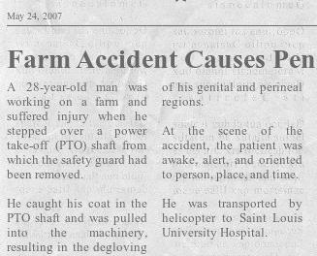
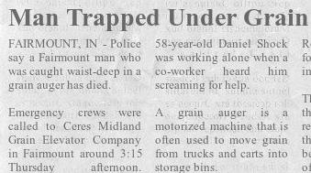
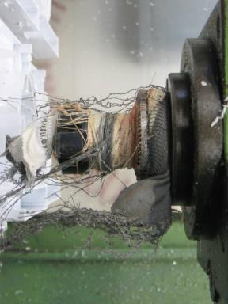
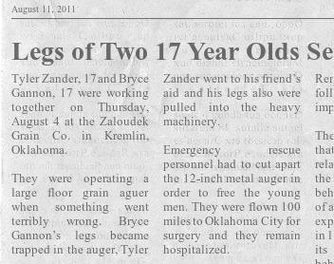
News articles
Bryce Gannon and Tyler Zander, both 17 years old, each lost a leg …
Notes:
Have you seen someone step over a PTO or put their hands near operating machines?
Animated Slide: Click for each article and the picture to appear. The article about the teen age boys opens the Slide - total 3 clicks.
NOTE: Participants may be sensitive to the article concerning the degloving of the genital area and may need to have perineal defined.
Review incidents highlighted in the news clips.
August 2011 - Two 17 year old boys were operating a large floor grain auger when one teen got his legs trapped in the auger. His friend went to his aid and he too became trapped. Both lost a leg.
May 2013 – Fairmount Indiana – 58 year old farmer – got caught waist deep in the grain auger.
May 2007 – 28 year old male stepped over PTO with removed guarding and suffered from “degloving of his genitalia and perineal regions.” He needed several surgeries and at first it was unclear if he would function normally.
There are also reported cases of people being scalped from their hair getting caught in “wrap points”. The picture shows clothing fibers and hair that became wrapped around a shaft.
Entanglements result when people get clothing, hair or other body parts caught or tangled in equipment, sometimes resulting in their bodies being pulled into the machine.
Entanglements are one of the most common causes of injury, and they can range from mild, e.g. getting a finger pinched, to severe, e.g. losing a leg.
Sources:
May 5, 2013 - “Man Trapped Under Grain..” – wbiw.com; “Farm Accident Causes…” – www.hcplive.com
“Legs of Two 17 Year Olds…” – www.scienceblogs.com
Degloving article - http://www.hcplive.com/publications/surgical- rounds/2007/2007-04/2007-04_08/
Human hair – October 14, 2010; “Workers Friend Injured Helping Out in Workshop”; http://www.hse.gov.uk/press/2010/coi-yh-24410.htm
Discuss highlighted incidents to show different entanglement hazards.
Point out the human hair wrapped around the PTO shaft.
Image Source: hse.gov.uk

Slide 37
Common Machine Hazards
Pinch/Nip Points
Shear/Cutting Points
Pull-in Points
Wrap Points
Guard ALL moving parts to reduce exposure & injury.
Notes:
Entanglement hazards result from contact with moving mechanical parts. Machines have a variety of moving motions and actions.
Motions include rotating, reciprocating, transversing.
Actions include cutting, punching, shearing, bending.
Three basic areas on a machine where motions/actions occur:
Point of operation – the place (point) where the actual work of the machine is performed, such as the place where it cuts.
Power transmission apparatus – this is “all the components of the mechanical system which transmit energy to the part of the machine performing the work.” Examples include flywheels, pulleys, belts, chains, cranks, gears, couplings, cams, connecting rods, spindles.
Other moving parts – parts of the machine which move while the machine is working such as the feed mechanism of a machine. An example is a conveyor belt.
The 4 types of entanglement hazards which will be discussed are a result of these mechanical motions & actions and are found in one or more of those 3 basic machine areas.
Pinch Points (Nip Points)
Wrap Points
Pull-in Points
Shear Points
The danger of the actual hazard (moving parts) increases when projections such as screws, bolts, keys nicks, abrasions are exposed or speed reduces the visibility of the action.
Entanglement hazards are preventable. The 2 most effective methods to eliminate or avoid the hazards are:
Guard all moving parts – use appropriate guards and replace any broken or missing guards.
Lock Out/Tag Out – Ensure machines and equipment are locked and tagged out before beginning to work on them.
Can all moving parts on machines be guarded? No. There are a few times when a guard cannot be placed to cover a moving part. When this occurs, other safety measures must be put in place.
Introduce common entanglement hazards found when working with/around equipment used for grain handling.
Entanglement hazards are the result of contact with moving mechanical parts.
Discuss safety strategies which can be implemented to address these hazards.

Slide 38

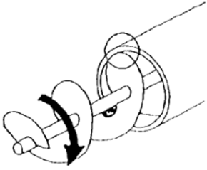
Types of Entanglement Hazards
Pinch/Nip Points
Cutting/Shear Point
Motor
Pulley, belts, gears
Auger Drive motor
Bucket leg drive/belt
Sliding doors (bin)
Augers
Sickles
Mower blades
Harvesters
Windrower cutter bar
Pinch Point
Shear Point
Notes:
Pinch Point (Nip Point) - Any point on a machine, other than the point of operation, where it is possible for a body part (or person) to get stuck between the moving and stationary parts of a machine. Example: belt/pulley system.
Common pinch points are located where:
Two parts move together with one part moving in a circle.
Two machine parts move toward each other.
One part moves past a stationary object.
Between a part of a machine and material.
A pinch point doesn’t necessarily have to cause injury – it only has to trap/pinch the body part and prevent the person from escaping/removing the trapped body part from the pinch point.
Injuries range from a minor pinch to crushing, fracturing, amputation. An example is getting a finger stuck in a machine and it being crushed.
Cutting/Shear Points: The hazard exists at the point of operation.
Shear point - Where the edges of two parts move across each other or close enough to each other to cut an object – usually soft material. Usually one part moves and the other is stationary. Examples: Augers, harvesters
Cut point - Single object moves forcefully or rapidly enough to cut. It cuts due to the force or speed. Examples: sickle blades, mower blades, Windrower cutter bar.
When a body part gets between the blade and The danger is not just the cutting motion but also that most of these types of actions are performed at such high speeds they aren’t visible. People don’t see it moving and get too close.
Additionally, the force & speed result in thrown objects. The head & eyes are particularly vulnerable.
Protective measures are Staying far away from the motion (have a barrier); hard hats & safety googles; guards; LOTO. NEVER reach across or step across a shear/cutting point action.
What are “everyday” examples of pinch points and cutting/shear points?
Pinch - Gear chain on a bike; belt on a motor; pulley
Cutting/Shear –Scissors, Knives, lawnmower, weed whacker, blender
Image Sources: AEM Pictorial Database & Nasdonline.org
Discuss pinch/nip points and where they occur on machinery.
Discuss cutting/shear points and where they are found on machinery used in agriculture.
NOTE: Pinch points are often found in the power transmission apparatus or ‘other moving parts’ area of a machine. Remind participants the point of operation where shear/cutting hazards occur is the point where the machine does its work – ie where the harvester cuts the stalk. When a body part gets in front of the blade it becomes “the point of operation” and gets sliced.

Slide 39
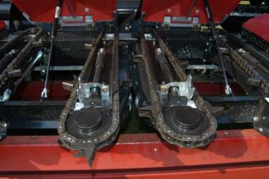
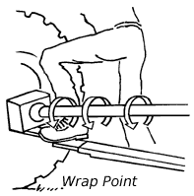
Types of Entanglement Hazards
Pull-in Points
Wrap Points
Crop/forage harvesters
Combine headers
Windrow pickups
Grinders
PTO shafts
Augers
Motor drive shafts
Pulley attachments
Wraps in direction shaft is turning
Notes:
Pull-in Points
The operating point catches an object and drags it in.
Pull-in points are found on equipment designed to take in crops or other materials for processing. Image shown – snappy roles on a corn head
Pull in Hazards
If material is fed manually into the machine the individual may not release the material soon enough and is pulled into the point of operation.
When a machine is automatically fed, the material may get caught. The worker grabs the caught material and tries to get it released with the equipment running. The material suddenly gets pulled into the equipment, also pulling in the worker.
Machines may also catch clothing, hair or limbs, pulling the person into the machine. Machines cannot distinguish between a stalk of corn and a person’s arm.
Wrap Points
Any exposed machine component that rotates – rotating shafts or rods. Image shown – is a PTO or Power Take Off
The equipment spins several revolutions per second/minute.
Increased dangers when there are projecting/protruding parts.
Wrap Point Hazards
Can catch loose threads or ties, loose clothing, or hair.
Can catch hands/arms or feet/legs, and “wrap” body parts around the equipment, causing horrible injuries.
Wrap points pose additional hazards to the user.
They rotate so rapidly they are hard to see, making it easy for a person to misjudge how close he is to the hazard.
The rotating part can “throw” objects, which can seriously injure a person.
What are “everyday” examples of pull-in points? Paper shredder, conveyors, food processor.
What are “everyday” examples of wrap points? Fans, roller towels in a restroom; drill, mixer, pencil sharpener.
Do you believe everyday items protect the user better? Why/Why not?
Are all wrap points equally hazardous?
Introduce the entanglement hazards – pull-in points & wrap points.
These hazards occur at the point of operation and are particularly dangerous.
Discuss the additional hazards posed due to their speed which makes them not easy to see leading to misjudging distance and that the speed results in the machine “throwing” objects.
Image Source: Carle Hospital

Slide 40
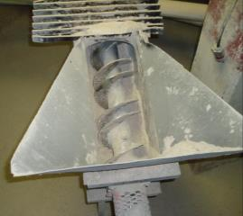
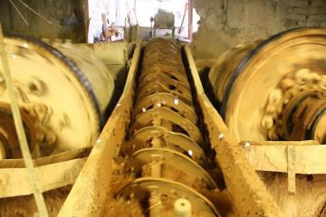
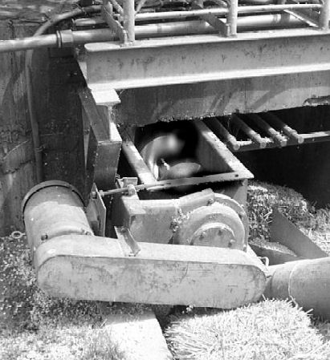
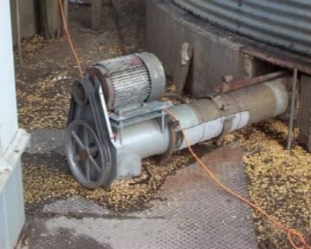
Guarding
Guard ALL exposed moving parts.
These are all hazards.
Notes:
Many types of augers, as well as other machinery, are used when handling/storing grain. All exposed moving parts of equipment are to have guards in place to protect workers from contact.
Photos show typical hazards found in grain storage & handling.
TOP LEFT – Auger intake area is missing a cover, usually a cage.
TOP RIGHT – An unguarded auger that transports grain – also called a screw conveyor. The blur on the left & right shows the power transmission apparatus is operating.
BOTTOM LEFT – This auger is part of the unloading system running beneath a bin & carries grain away from the sump holes – similar to above picture. The exposed part is outside the bin where it connects to the power transmission apparatus. The guard has been removed & it is in operation. The part of the auger under the sump holes is usually unguarded when the bin is full of grain. When grain is unloaded to the level where the auger is exposed a guard needs to be put in place.
BOTTOM RIGHT – unguarded belts of a power transmission apparatus supplying energy to an auger similar to left picture.
LOTO must be done before servicing or maintenance or repair of these types of equipment, or entry into a bin.
YOUNG WORKERS - Check local, state and federal laws before a young worker is assigned tasks involving equipment.
Assess the ability of young workers to determine readiness to perform a task.
STAND TALL – Young workers must understand exposed moving parts need to be properly guarded. It is the employer’s responsibility to ensure properly functioning guarding in in place.
If asked to work with equipment, the young worker must check for proper guarding.
Young workers should not work on equipment with missing guards. They should ask the employer to install PROPER guards before beginning the task.
Explain the importance of having proper guards and shields in place.
Discuss why all machinery must be in good repair and well maintained.
Empower youth to know that if equipment is not well maintained and properly guarded, they can and should refuse to operate it or work around it.
Youth Agricultural Work Guidelines https://cultivatesafety.org/work-guidelines/
Does anyone have experience using any type of auger?
Why is it so necessary to guard augers? They are blades operating at a high speed which gives them a powerful cutting force. Even accidental contact with the blades can be deadly.
What is another term for the blades in an auger? “flighting”.
Image Sources: Top – GHSC;
Bottom – Grain and Feed Association of Illinois
Animated slide: Automatically timed for “no” symbol on all pictures & right text box to appear. No action required.

Slide 41
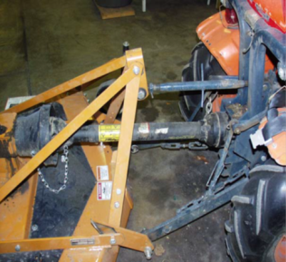
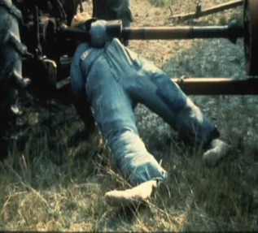
Rotating Speeds
You do not have time to react!
3/4 second to react
Equipment rotates ˃500 rpm
3/4 second pull-in person > 5 feet
Notes:
A PTO or other farm equipment with rotating parts usually rotate at speeds that can cause injury before a person has time to react.
The left photo shows a power take off (PTO) shaft connected to a tractor and a large mower.
The right photo illustrates a typical injury event where the mannequin’s arm is caught into the PTO shaft and wraps around the shaft in less than one second.
Normal human reaction time is ¾ of a second if the person is alert and well rested.
In ¾ of a second, a PTO shaft or any farm equipment component with rapid rotation can pull at least 4 feet of the person’s body into the machine before they would have time enough to react.
It is imperative to:
Keep ALL moving parts guarded
Stay away from moving/rotating parts to prevent injury.
Most often the injury occurs from the equipment accidently catching something & wrapping it and the worker. An example is loose clothing getting caught by the rotating shaft because a person was too close.
When working around any rotating parts:
Always wear tight fitting/form fitting clothes – don’t wear loose, baggy, and/or unfastened clothing.
Keep long hair pulled back and secured.
Remove any drawstrings & ties. Securely tie shoe laces and tuck them inside.
Remove all jewelry. Never wear any type of jewelry around rotating machine parts.
Remove/secure any loose threads on cloths, pocket flaps, etc.
NEVER attempt to step over an operating PTO!
What task do you think you could perform in ¾ of a second? Could you answer your phone that quickly or reply to a text message?
Animated Slide: Each bullet will appear with a click – total 3 clicks.
NOTE: Introduce the concept of human reaction time in preparation for following activity.
Explain the speed and hazards seen with equipment that has rapidly rotating parts.
Discuss safety strategies which can be used to help address these hazards.
Image Sources: Penn State University NSTMOP curriculum

Slide 42

Human Reaction Time Activity
540 RPM
7 ft/second
1000 RPM
13 ft/second
Time | Distance
.1 sec | .7 feet
.2 sec | 1.4 feet
.3 sec | 2.1 feet
.4 sec | 2.8 feet
.5 sec | 3.5 feet
.75 sec | 5.25 feet
Time | Distance
.1 sec | 1.3 feet
.2 sec | 2.6 feet
.3 sec | 3.9 feet
.4 sec. | 5.2 feet
.5 sec | 6.5 feet
.75 sec | 9.75 feet
Notes:
Compare & discuss different scenarios of reaction time vs distance.
If possible, have participants measure their arms, legs, torso, etc. to relate the distance to how far their body would be wrapped.
If possible, have participants use stopwatches (many will have an app on their phones) to ‘see’ the time segments in the chart.
How does this relate to PTO entanglement? This is not a real situation, but can get an idea of how fast you could react.
Imagine if you wear a 32” length pant. How long would it take that leg to be pulled into a machine rotating at 540 RPM? 4/10 of a second.
Demonstrate how long it takes a person to react.
Compare the distance an object can be wrapped in the time increments provided.
Discuss how reaction times impact a person’s ability to prevent injuries from hazards, such as PTOs.
ACTIVITY: Human Reaction Time
Instructions can be found in Chapter 4 Participant Materials of the Instructor Manual. Activities may be conducted at this time or after the presentation.
Note: Activity content was adapted from Progressive Agriculture Foundation’s Topic and Activities Safety Days® Manual and Iowa State University Extension and Outreach publication AEN 149. Permission for use granted 12-12-12.
Image Sources Carle Hospital

Slide 43
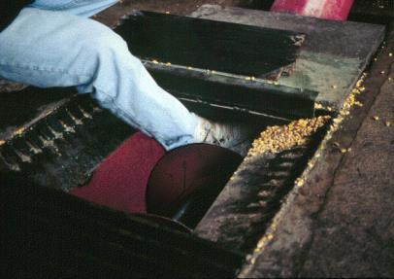
Entanglement Hazard Prevention
Review operators manual
Guards in place
Wear tight fitting clothes
Remove all ties & drawstrings
Pull back & secure hair
No jewelry
Keep children away
Notes:
The photo illustrates how a person’s leg and foot could become entangled in a grain auger when the guard is missing over the intake area.
Strategies to avoid entanglement hazards:
READ the operator’s manual before operating any equipment, especially if it is new or unfamiliar.
Guards and shields need to be in place.
PTO guards include the master shield & drive shaft shield.
Guards should be in proper working condition. Broken & missing guards or those not fitting/working properly need to be replaced.
If guards and shields are not in place it is appropriate to refuse to operate the machinery.
All workers must be trained in the use and maintenance of equipment, including the use of LOTO when necessary.
A common cause of entanglement is clothes, hair, or jewelry getting caught in the machine. Review bullet poiints.
Keep children away from equipment & machines.
Young workers must be properly trained by adults on the proper use of all equipment they are using.
All laws must be followed regarding age and use of equipment.
Employers/parents should assess the maturity and physical ability of the young worker to do the job. Some resources include:
Safety Guidelines for Adolescent Farm (http://marshfieldresearch.org/nccrahs/safety-guidelines-for-hired-adolescent-farm-workers-saghaf )
Youth Agricultural Work Guidelines https://cultivatesafety.org/work-guidelines/
Dept. of Labor WHD website Youth Rules https://www.youthrules.gov/index.htm
OSHA website https://www.osha.gov/youngworkers/
Explain strategies to prevent injuries from entanglements.
Discuss special safety strategies that must be utilized with young workers.
If asked to operate unfamiliar machinery what should you do? Inform the supervisor you do not know how to operate it safely. Ask to review the operator’s manual and to be provided training. Do NOT operate equipment if you are unfamiliar or uncomfortable with it.
Image Source: Iowa FACE Program Case Investigation 95IA057

Slide 44
Entanglement Hazard Summary
Entanglement hazard - contact with moving mechanical parts.
4 main types – pinch, shear/cut, pull-in, wrap
Happens too fast to react.
Stay away from moving parts.
Guard all moving parts.
No loose clothing & hair, or jewelry.
Notes:
Entanglement hazards are the result of contact with moving mechanical parts.
There are 4 main types of entanglement hazards:
Pinch points – stuck between moving & stationary parts and can’t release. Generally located at the power transmission apparatus or other moving parts such as a feed mechanism. Examples: belts, pulleys
Shear/cut – located at the point of operation. Another danger is reduced visibility - a product of force & speed. Example: auger.
Pull-in – located at point of operation. The mechanism catches on something and pulls the worker in. Example Harvesters
Wrap point – located at point of operation. The rapid rotation catches on something and wraps both the object and person. Example: PTO
Entanglement hazards happen too fast to react. The average human response time is ¾ second. By that time you can be pulled in and/or wrapped around.
Prevention strategies include:
Staying clear of moving parts. NEVER attempt to put hands near moving parts, reach over them or step over (such as a PTO).
Guard – properly guard all moving parts at the point of operation; the power transmission apparatus; and other moving parts of the mechanical system.
Prevent getting caught by
Not wearing loose clothing
Tie back and secure hair
Do not wear jewelry
Review and discuss the main points of entanglement hazards.
Review & discuss safety strategies that can be used to prevent injury from entanglement.

Slide 45
References
http://www.hcplive.com/publications/surgical-rounds/2007/2007-04/2007-04_08/
http://www.nclabor.com/osha/etta/indguide/ig1.pdf
http://www.osha.gov/SLTC/controlhazardousenergy/index.html

Slide 46
Acknowledgements
AEM
Mac Bailey, Marshfield Clinic
Clker.com - author RU486watch
Grain and Feed Association of Illinois (GFAI) – John Lee
Grain Handling Safety Coalition (GHSC)
Hse.gov.uk-HSE
Iowa FACE Program
Iowa State University Extension and Outreach
Jessie Starkey Photography
Lake Area Technical Institute
Masterlock®
Nasdonline.org
Notes:
AEM (Association of Equipment Manufacturers) Pictorial Database retrieved from - http://www.aem.org/safety-and-technical/safety/pictorial-database/
Slide # 34, 37,
Mac Bailey, Marshfield Clinic
Slide # 6
Clker.com - author RU486watch
Slide # 9
Grain and Feed Association of Illinois (GFAI) – John Lee
Slide # 19, 20, 21, 26, 39
Grain Handling Safety Coalition (GHSC)
Slide # 15, 18, 27, 29, 39
Hse.gov.uk-HSE
Slide # 35
Iowa FACE Program Case Investigation 95IA057
Slide # 43
Iowa State University Extension and Outreach
Slide # 42
Jessie Starkey Photography
Slide # 5
Lake Area Technical Institute
Slide # 41
Masterlock®
Slide # 28
Nasdonline.org
Slide # 37

Slide 47
Acknowledgements
Oklahoma State University Stored Products Research & Education Center
Pacas Family
Alex T. Paschal/Sauk Valley Media
Penn State Ag Safety and Health Program
Progressive Agriculture Foundation’s Topic & Activities Safety Days® Manual
Purdue University
Safety and Technical Rescue Association (SATRA)
Thinkstock
United States Department of Labor
Whitebread Family
Notes:
Oklahoma State University Stored Products Research & Education Center
Slide #22
“Grain Bin Rescue” https://www.youtube.com/watch?v=DQSqWbn-3X0
Pacas Family
Slide # 4
Alex T. Paschal/Sauk Valley Media
Slide # 4
Penn State Ag Safety and Health Program
Slide # 23, 31, 32
Slide #40 NSTOMP curriculum
Progressive Agriculture Foundation’s Topic and Activities Safety Days® Manual
Slide # 42
Purdue University Agricultural Confined Space Incident Database (PACSID)
Slide# 17
Safety and Technical Rescue Association (SATRA)
Slide # 24, 25
Thinkstock
Slide # 8, 10, 28, 33
United States Department of Labor
Slide # 7
Whitebread Family
Slide # 4

Slide 48
Resources
http://apps.npr.org/grainbins-9876hhiu78jkh89/ - grain bin fatality incident summaries 1984 – 2010 from OSHA sources.
https://www.osha.gov/pls/oshaweb/owadisp.show_document?p_table=STANDARDS&p_id=9874 OSHA grain handling standard
http://www.gpo.gov/fdsys/pkg/FR-1996-03-08/html/96-5341.htm 1996 proposed amendments to the grain handling standard concerning walking down the grain and flat storage & ground piles
https://www.osha.gov/dea/lookback/grainhandlingfinalreport.html Regulatory review of grain handling standard February 2003 concerning justification, necessity, and effectiveness of the grain handling standard
Lock Out/Tag Out- 1910.
https://www.osha.gov/SLTC/controlhazardousenergy/index.html

Slide 49
Angle of Repose Activity
Material | Angle of Repose* Degrees
Baking powder | 35
Barley | 25
Beans, caster (whole) | 25
Beans, cocoa | 35
Beans, coffee (fresh) | 35-45
Beans (whole) | 45
Beans, soybeans | 25-27
Corn | 21-23
Corn, unpopped popcorn | 25.3 - 30.8
Rice | 25-33
Salt, table | 32
Sugar, granulated | 30-35
Sunflower seeds | 27-30
Wheat | 27-28
*Angle may vary due to other factors such as moisture content, variety, hulled/unhulled, etc.

Slide 50
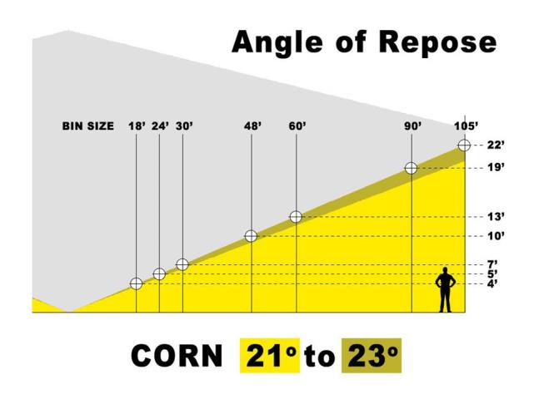
Angle of Repose Activity

Slide 51
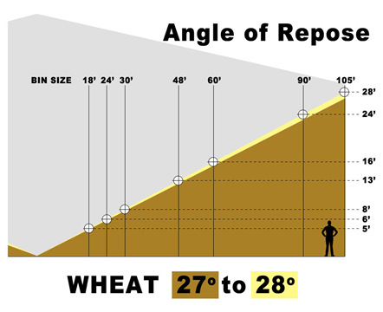
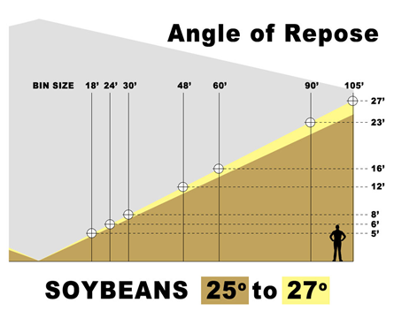
Angle of Repose Activity

