Slide 1

Lifeline Protection System Section
Lifeline Protection System
Installation & Use
Notes:
Have participants sign in on attendance sheets provided by GHSC.
GHSC sign-in sheets are necessary to verify attendance to the U.S. Dept. of Labor who provided grant funds.
Alternatively the instructor can verify attendance by providing date, course name, length of course, instructor name, and number of participants or use the classroom attendance sheet.
Have participants complete pre-test & self assessment form.

Slide 2

Introduction
This Lifeline Installation and Use module is part of a curriculum series addressing hazards found in grain handling facilities including grain bins and their surrounding area. The curriculum series purpose is to assist participants identify and abate hazards in the work place.
The purpose of this module is to provide hands-on, technical skill training in the use and installation of lifeline protection systems.
This module was developed under a joint partnership between the Grain Handling Safety Coalition (GHSC) and E.S.R.T. (Emergency Services Rescue Training, Inc.).
Notes:
GHSC has several curriculum training modules covering hazards found in the grain environment.
This module is a technical skill building curriculum.
Explain this module is part of a series.
Other modules
Overview of Grain Handling Safety and Storage (introductory module)
Lock out Tag out mini module
Entanglement Hazards and Guarding
Falls Hazards and Protection
Grain Bin Entry
Introduction to Lifeline Protection Systems
Agricultural confined Space Hazards
Reducing Grain Bin Entry Risks
Hot Work
Preventive Maintenance for Bucket Elevators
Young Worker curriclum – 3 modules

Slide 3

OSHA Disclaimer
This material was produced under grant number SH-26294-SH4 from the Occupational Safety and Health Administration, U. S. Department of Labor. It does not necessarily reflect the views or policies of the U.S. Department of Labor, nor does mention of trade names, commercial products, or organizations imply endorsement by the U.S. Government.
Additional funding came from grant number 5 U54 OH007548-15 from CDC – NIOSH (Great Plains Center for Agricultural Health – GPCAH).
Its contents are solely the responsibility of the authors and do not necessarily reflect the views or policies of the U. S. Department of Labor, DCD, NIOSH, of the Great Plains Center for Agricultural Health, nor
does mention of trade names, commercial products, or
organizations imply endorsement by the U.S. Government.
Disclaimers
Notes:
This module was originally developed under a NIOSH grant from the GPCAH..
It has undergone several revisions as the industry has made advances in their understanding of lifeline systems. The OSHA Harwood grant funded the major portion of curriculum revision.
Explain – GHSC received funding from OSHA. In order to comply with the grant we do need them to sign in and need to collect the following information:
Supervisor or worker. This information is for statistical purposes to show the types of population receiving training.
Employer. This is to establish an employer/employee relationship as covered under OSHA. Volunteer rescue workers who may be attending should list their employer; not the volunteer rescue squad. Farmers should list the registered business name of their farm. Farm employees should provide the business name listed on their paycheck.
OSHA does NOT contact the employer.
GHSC may contact the attendee or employer for follow-up evaluation in compliance with grant requirements.

Slide 4
Employee Rights
Employees are entitled to safe and healthy working conditions which DO NOT pose a risk of serious harm.
Workers are entitled to be fairly compensated for all hours worked in accordance with the law.
Employee rights
Notes:
Explain - All DOL grants require that employees are informed of their rights. In this instance we want to emphasize employees are entitled to a safe and healthy working environment AND to fair receive compensation for their work.
Remind employees – it is the employee’s responsibility to follow the safety practices, policies, and procedures of their employers.
Tell participants their rights also include the right to report unsafe conditions to the OSHA hotline without retribution.
More information about employee rights can be found on the OSHA website: www.osha.gov or the Department of Labor website www.dol.gov .
It is ESPECIALLY imperative for youth/young workers to access information and know their rights, what to expect, and how to get help if needed.

Slide 5
Employer Responsibility
Employers have the responsibility to provide a safe workplace.
More information about employer & employee rights can be found at www.osha.gov.
Employer responsibility
Notes:
Explain employers have a legal responsibility to provide a safe workplace. This means they must ensure the regulations which govern their business are instituted and followed. This applies to 1 employee or more.
DISCUSS - It is the employers’ responsibility to know the rules and laws – federal and state.
Emphasize – It is employers’ responsibility to ensure employees, know, understand and follow regulations and company policies.
STRESS - If employers are unsure of the regulations they should consult with the appropriate agency. Every state has an on-site consultation program jointly funded by OSHA and the state which provides assistance in learning and complying to the regulations.
The OSHA website provides contact information for each state’s on-site consultation program.
Illinois Department of Labor has the on-site consultation program in Illinois.
Employers should also know and understand the state’s laws as they may be more restrictive than OSHA. Contact the state department of labor.

Slide 6
Whistleblower protection
Employers cannot punish or discriminate against employees who have used their rights to report unsafe or unhealthy working conditions or environmental problems to an employer, OSHA or other government office.
For information about whistleblower protection go to www.whistleblowers.gov
Employees must call, write or email the OSHA area office within 30 days to report acts of employer retaliation.
Whistleblower protection
Notes:
Explain - All DOL grants require that employees are informed of their rights. In this instance we want to emphasize employees are entitled to a report unsafe and unhealthy working environments and not be retaliated against by their employer with personnel discipline actions, termination, etc..
Remind employees – it is the employee’s responsibility to follow the safety practices, policies, and procedures of their employers.
Tell participants their rights also include the right to report unsafe conditions to the OSHA hotline without retribution.
More information about employee rights can be found on the OSHA website: www.osha.gov or the Department of Labor website www.dol.gov .
It is ESPECIALLY imperative for youth/young workers to access information and know their rights, what to expect, and how to get help if needed.

Slide 7

Ccourse and Learning Objectives
Course Objective & Learning Objectives
Notes:
Explain this is designed for participation in discussion as well as hands-on activities.
Objectives reflect the knowledge and skills needed to use a lifeline protection system.

Slide 8
Course Objective
Build confidence in participants to understand and properly use a secured lifeline system.
Eliminate need for rescue
Eliminate deaths
Notes:
Discuss with participants the course objective.
Lifelines have often been misunderstood in terms of how to use them effectively to prevent engulfments. This is a result of unclear guidelines in what an effective lifeline system should encompass in terms of components; how it can be installed in a bin; and how to use it. A requirement for lifeline use in grain bins was included in the grain handling standard, but there was little information about how to install or use a lifeline that was not rescue based and/or requiring significant technical training.
This curriculum was designed to increase participants understanding of lifeline systems – beginning with the key term – secured – and what that system entails. It also is designed to build the confidence level to use a secured lifeline system properly during bin entry. It does this by demonstrating a simple and effective means to have a secured lifeline system installed and the proper way to use it without the more complicated rescue training usually associated with lifeline use.

Slide 9
Learning Objectives
At the end of this session the participant
will be able to:
Describe the duties of the grain bin entrant and the observer.
List the components of a Secured Lifeline System and explain their function.
Understand under what grain bin conditions a secured lifeline system would be effective or ineffective.
Notes:
Introduce the learning objectives. These are the knowledge the participant should acquire as well as tasks or skills they should learn to perform.
Explain – the module was designed to seek interaction from the participants. Questions will be asked throughout to generate discussion.
Encourage – the sharing of ideas, information, experiences so everyone can learn.

Slide 10
Learning Objectives
At the end of this session the participant
will be able to:
Demonstrate understanding of how a secured lifeline system is installed in a grain bin.
Demonstrate proper skills for using a lifeline including harness fit, belay set-up and belaying techniques.
Notes:
Introduce the learning objectives. These are the knowledge the participant should acquire as well as tasks or skills they should learn to perform.
Explain – the module was designed to seek interaction from the participants. Questions will be asked throughout to generate discussion.
Encourage – the sharing of ideas, information, experiences so everyone can learn.

Slide 11
Course Outline
Background
Bin Entry Review
Roles and Responsibilities
Lifeline Protection System & Components
Anchoring Concepts & Lifeline Rigging
Other Anchor & Rigging Alternatives
Hands on Exercises
Review & Summary
Notes:
Introduce the main topic areas of the course.

Slide 12
Baclkground
Background

Slide 13
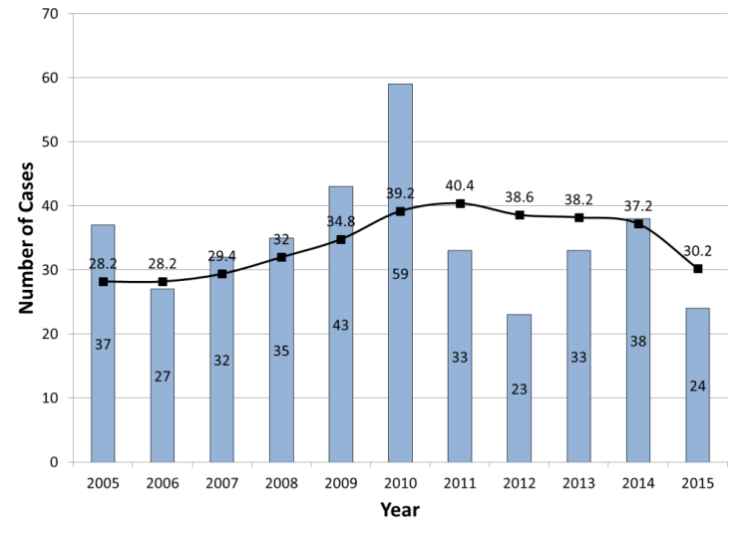
5 year trends – entrapment cases
Annual grain entrapment cases recorded between 2005 and 2015.
Notes:
Note though the five year trend is decreasing, it is not to the lowest point which was in 2002 (18.8)
“Between 1994 and 2002, the five-year average decreased from a then-record of 29.2 recorded entrapments per year to 18.8 in 2002 (the lowest since 1987). Since 2002, however, the five-year average has increased steadily. . . “ (2011 Summary of Grain Entrapments in the United States, March 16, 2012)
“The 24 grain entrapment cases represent a 37% decrease in entrapments from 2014 when 38 entrapments were recorded. This is the lowest number of cases recorded since 2012. The five-year average dropped to 30.2 cases per year, which is significantly below the peak of 40.4 in 2011 (Figure 5) and the lowest five-year average since 2007. “
Emphasize - These trends reflect recorded cases. There is a significant under-reporting of cases, especially outside the corn belt.
“Based upon prior research, it is estimated that the documented annual cases represent approximately 70% of the total cases that have actually occurred annually in the Corn Belt.” (2015 Summary of U.S. Agricultural Confined Space-Related Injuries and Fatalities (released February 2016) from Purdue University page 2).
The reason for underreporting is there is no “comprehensive or mandatory incident/injury reporting systems for most of agriculture; in addition, there has been reluctance on the part of some victims and employers to report non-fatal incidents.” (Ibid).
Of the RECORDED cases – 82% occurred at OSHA exempt facilities in both 2014 and 2015. Historically, MOST engulfments occur at OSHA exempt facilities.
It is estimated there is significant under-reporting of incidents. Currently over 2/3 of the grain storage capacity in the United States is on-site farm storage. Farms are generally exempt from OSHA injury reporting requirements.
“Under the current provisions of the two OSHA workplace safety and health standards most relevant to agricultural confined spaces, most agricultural worksites, including most farms, feedlots, and certain seed processing operations are exempt from compliance.” (2015 Summary of U.S. Agricultural Confined Space-Related Injuries and Fatalities released February 2016 from Purdue University Agricultural Safety and Health Program)
In general, an appropriation rider excludes OSHA from using their budget on enforcement for farms with 10 or less full-time (non-family) employees.

Slide 14
Underreporting increases probability
25 fatal in 2015 (58%)
  Exceed non-fatal (1st year since 2010)
Majority occur OSHA exempt facilities
Under-reporting
  Farms exempt
  Mostly Corn Belt area
  Significant decrease reported non-fatal cases Commercial
Notes:
Fatality ratio – first time since 2010 fatal cases exceeded non-fatal. (2015 Summary of U.S. Agricultural Confined Space-Related Injuries and Fatalities (released February 2016) from Purdue University page 5).
However, it must be noted that this is the first time since 2010 that the number of fatal cases exceeded non-fatal cases. For example, both 2012 and 2015 reported the similar number of grain entrapment cases (23 and 24 respectively); however, 2012 had a fatality rate of 35%, while 2015 fatality rate was 58%. Actually, 2015 represented the second highest number of fatal grain entrapments in the last five years (2014 having the largest with 18 cases in total).
Of the RECORDED cases – 82% occurred at OSHA exempt facilities in both 2014 and 2015. Historically, MOST engulfments occur at OSHA exempt facilities (farms). (Ibid, page 7).
Under-reporting due to being exempt from OSHA reporting requirements (farms) and most recorded cases are in the corn belt. Less voluntary reporting outside the corn belt. Indiana and Iowa both state plan states have aggressive surveillance efforts. (Ibid, pp5-7).
Commercial facilities under the requirements of the grain handling standard may also not likely to report entrapment incidents where the employee was successfully extricated without having to call emergency services. Under OSHA reporting requirements if a fatality, hospitalization and specific injuries did not occur, the incident would not need to be reported although a near miss report should be completed.

Slide 15
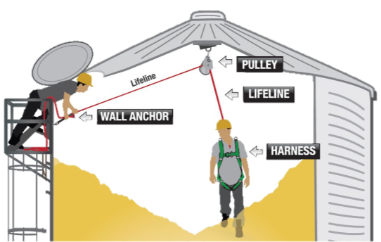
Secure Lifeline Protection System
Equipment & procedures used to:
Prevent entrant from sinking more than waist deep in grain
Prevent a fall if grain surface collapses
Notes:
Stress - Lifelines MUST be SECURED in order to be effective in preventing entrapment or engulfments under the following conditions:
OSHA 1910.272 – prevents an entrant from sinking more than waist deep in grain.
Prevents a fall if the grain surface collapses.
Explain - This graphic shows the basic set-up a lifeline system.
Stress - There are TWO anchor points. These anchor points distribute the weight of the entrant as well as the forces exerted by grain. One anchor point is attached to the peak of the bin and the other to the side near the entry point.
Point out - The anchor points are PERMANENTLY installed.
Discuss - The two anchors together should support at least 2X the anticipated load on the anchors. (All anchorages need to support 2 times the anticipated weight. A person waist deep in grain would require two times his/her weight to be pulled out. Bottom line, anchors should be able to withstand 4 times an entrants weight. This would be worse case scenario because we are operating this lifeline system such that no one will be allowed to go any further than waist deep in grain).
Emphasize - to participants they need to CONSULT a bin manufacturer or a qualified person (such as a structural engineer) to determine the type and load capacity of the anchor points a bin can support. This is not a GUESSTIMATE. The age of the bin, the structural integrity of the bin, the roof, sides, etc all are factors to take into consideration when determining and installing anchor points.
Warn - Anchor points need to be installed according to the specifications provided by the professional.
WARNING - This system DOES NOT protect an entrant from engulfment or entrapment when the entrant is below the surface of the grain such as would occur if entering from the side door underneath a pyramid of grain or grain built up on the sides of the bin.
This graphic and its accompanying graphics was produced and is owned by the Grain Handling Safety Coalition (GHSC) to illustrate its Lifeline Protection System. GHSC assumes no responsibility or liability for its use by others including training purposes, lifeline installation or design or any other use for which it is not intended. The graphics are NOT drawn to scale and may not reflect all the relevant safety, manufacturing or other standards.

Slide 16
Bin Entry review
Bin Entry Review
Notes:
This section will be a review of bin entry hazards and bin entry practices which are the basis of lifeline use for bin entry.
The use of a permit or checklist is strongly recommended and the section follows what a permit typically contains.

Slide 17
Common Reasons for Bin Entry
Common reasons for bin entry
Unplug clogged sump
Break up pyramids, chucks, etc.
Knock down grain on walls
Help grain empty
Check grain quality
Bring in or dig out sweep auger
Clean out a bin
Perform maintenance
Notes:
There are many reasons that people enter grain bins. The reasons for entry, the circumstances and conditions of that entry often affect the entry itself, as well as what hazards may be encountered.
This slide depicts some of the most commmon reasons people enter grain bins – even when it is not safe to do so.

Slide 18
Fatal Work Practices during bin entry
Fatal work practices during bin entry
Top Causes of Entrapment & Engulfment
No LOTO
No Lifeline
Working Alone
Unsafe Conditions or Work Practices
Notes:
When reviewing cases fo entrapment/engulfment, patterns emerge as to the work practices being used.
By far one of the most prevalent factors resulting in entrapment/engulfment is entering a bin with the unloading equipment running – no LOTO. This is especially true on exempt farm facilities where there is not regulations and understanding of LOTO is minimal.
Other leading factors are no lifeline, unsafe practices/conditions (such as no observer, poor grain condition, etc.) and of course working alone – where there is no one to help when the emergency occurs.

Slide 19
Permit says it is safe to enter bin
Bin Entry Permit or Checklist
Ensures ALL critical safety issues are addressed BEFORE entry occurs
Determines bin conditions prior to entry
Says “Safe to Enter”
  BEST PRACTICE!
Notes:
A permit gives employees permission to enter a bin. It ensures all critical safety issues are identified and addressed before the entry occurs.
Most importantly, it determines what the conditions are prior to entry and what must be done to protect the worker.
Only required for commercial facilities when: When employer or employer representative will NOT be present during entry - 1910.272; Designated “permit required confined space” – 1946

Slide 20
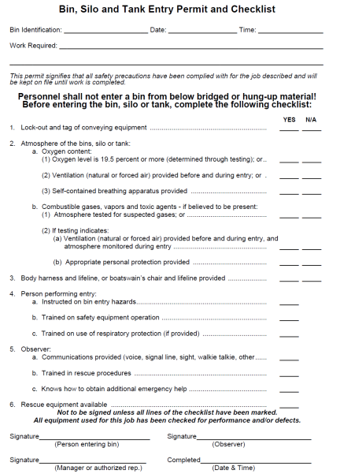
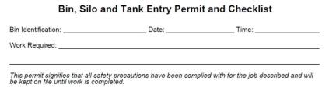

Address ALL critical safety issues
Hazard Assessment & Correction
LOTO
Atmosphere
Lifeline use
Entrant training
Observer training & role
Rescue Availability
bridged or hung up material
Lock-out and tag out of conveying equipment
Atmosphere
Oxygen level
Authorization
Identifying information
Body harness and lifeline
Entrant
Observer
Rescue
Notes:
ANIMATED SLIDE – There are 10 clicks total for this slide. See instructions with points to discuss. The 1st. click brings out the identifying information. The next 7 clicks highlight each bullet. The 9th click brings out the signature and authorization. The 10th click returns the screen to the permit and bullets.
At the back of this PPT presentation is a view of the screen for printing purposes that does not show the multiple layers embedded in the animation. If an instructor is uncomfortable clicking through the animation that slide can be substituted in place of the animated slide.
This is an example of a permit. It address the critical safety issues. CLICK.
Every permit should have identifying information including a way to identify the bin being entered, the date, and the time of entry and the work being completed (reason for entry & task). CLICK.
Hazard assessment – (grain condition) – can be a statement as shown. Some permits may have specific items to check concerning the hazard assessment and grain condition. CLICK
Stress - LOTO – Ensures that LOTO of ALL energy sources for equipment servicing that bin is done. This includes mechanical, electrical, pneumatic and others. It covers all equipment such as unloading and loading equipment, sumps, gates. CLICK
Atmosphere – If there is a potential for atmosphere concerns has it been tested? If needed was ventilation done prior to entry and will it be continued during entry? CLICK
Lifeline use – How will the worker be protected from engulfment? CLICK
Entrant Training – Asks if the entrant was trained on the hazards and use of safety equipment including a lifeline. CLICK
Observer – Ensures the observer is trained, has a communication means and can obtain help and initiate rescue. CLICK
Rescue – Ensures rescue equipment is available and specifically suited to the bin being entered. NOTE: separate rescue equipment for each bin is not necessary as long as it is available. CLICK
Authorization – The entrant and oberver sign as well as the person responsible for entry – a supervisor etc. CLICK
ANIMATED SLIDE
Example of permit showing the critical safety issues addressed
Point out the identifying information
Show how the authorization or signature is by the entrant, observer, and supervisor if different

Slide 21
Assess grain hazards before entry
Flowing Grain
Side build-up pyramids, etc.
Crust on surface & bridges
Structural & Mechanical
Plugged sumps
Angle of Repose
Out of Condition Grain
Unloading equipment running
Open sumps/side draws
Unguarded equipment
Openings, ladders, platforms
Notes:
Explain – Flowing Grain is the # 1 hazard of grain bin entry. This occurs when unloading equipment is running and not properly LOTO. Open sumps/side draws also facilitate grain flow. Explain – Grain condition is one of the leading indicators of hazard presence in a bin. Grain condition can be assessed in a variety of ways including smell, temperature, movement/feel, and look. If indicators pointing to potential grain condition problems are present – the probability of hazardous bin conditions increases. This should signal to the worker to find alternative means rather than entering a bin as the risk for entrapment/engulfment is higher. If workers must enter a bin EXTRA precautions and vigilance is a MUST. Discuss – Out of condition grain clumps (and plugs up the sump), sticks to the sides of bins and can form striations (horizontal sections that look like stair steps). EMPHASIZE - Keeping grain in condition is one of the most important things which can be done to insure you do not need to go into a bin.
Structural/Mechanical - Explain – Unplugging a sump is a specific hazard from a common work practice which leads to flowing grain. A worker enters a bin to break up chunks of grain blocking the removal sump or draw-off. Individual using a rod to break up an obstruction at a sump can be quickly submerged when grain finally flows. Once the obstruction is clear, the grain immediately flows, leaving no time for the worker to get out.
Protect against falls. Properly guarded ladders with cages. Ladders ≥ 24 feet in length more to a maximum unbroken length of 50 feet require safety measures for the user – cage, well, ladder safety device. 1910.27(d)(1)(ii). Access openings should have platforms and when possible grips or railings near.
NOTE: new fall protection standards effective January 2017 will require ladder safety rail systems or the use of personal fall protection. https://www.osha.gov/walking-working-surfaces/RegTextWWSFinalRule.pdf
SIDE ENTRY using a portable ladder presents others problems. If portable ladder being used it must – Follow a 4:1 position. For every 4 feet of height place the ladder base 1 foot out. Correct positioning provides a 75 degree angle. Ladders should extend at least 3 ft above the top surface. Positioning – step ladders. Step ladders should have the spreaders fully opened and locked. There should be anti-slip feet. Brace feet if needed, level ladder , and check stability. Face the ladder toward the work area – not to the side or sideways.
Guarding is the best way to eliminate exposure to the common sources of entanglement hazards. Guarding is a BEST PRACTICE.- AUTO – guard around, through, under, over

Slide 22
Hazard assessment
Grain condition
Mechanical
PERMIT
Notes:
This section will discuss how to identify and correct hazards in the environment which affect entry.

Slide 23
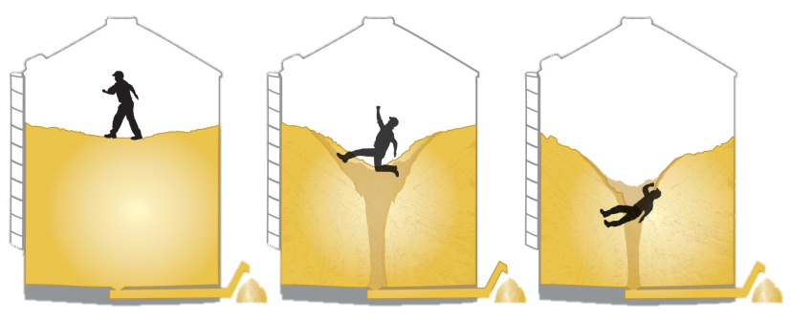
Flowing grain acts like quicksand
  Flowing grain caused by:
    Unloading equipment running
    Open sumps, side draws, gates
  Acts like quicksand
  Faster grain flows = quicker engulfment
Notes:
Flowing Grain
Explain – Flowing Grain is the # 1 hazard of grain bin entry. In 5 seconds a person helpless in flowing grain. In 20 – 60 seconds - total engulfment occurs.
Graphic illustrates removing grain from the bin causes the grain to flow (move) toward the center of the bin and downward. (Grain will flow to the lowest point).
Discuss - The initial depth of an individual who has just step into grain will be somewhere between the top of his ankles and mid-calf or about 12 inches. The depth will be dependent on the condition of the grain. Cool, clean and rolling grain will allow the individual to sink in further. A person is immediately at a disadvantage as he can’t walk freely. He is already exerting more energy & force than normal to pick his feet up out of the grain to take a step. Already submerged halfway to his knees, once grain starts flowing, he is quickly rendered helpless. Once the grain reaches his knees he cannot remove himself without help.
Flowing grain is most likely the result of the unloading equipment running (conveyors, buckets, augers, etc.) and/or open sumps, side draws, gates.
Why does the grain behave like this? The bin acts like a funnel. Even if a person were on the side of the bin he could quickly be drawn toward the center as the grain collapses on the sides and is drawn toward the center.
The remaining grain flows from the sides to the lowest point (the center). A larger auger than the one depicted would remove the corn faster.
The way to prevent flowing grain is to Lockout/Tagout the unloading equipment, sumps, side draws, gates. LOTO will be discussed more later.
Explain - On farms the average grain flow is 4 to 5 thousand bushels per hour. Elevator’s grain storage structures have an average grain flow about 10 thousand bushels per hour. This means you will sink about twice as fast.
Emphasize – A worker should NEVER be in a bin with flowing grain! This is a NO EXCEPTION rule. You cannot stop the flow quickly enough to avoid being entrapped or even engulfed. The few seconds it would take for someone to turn off the unloading equipment is enough to entrap someone so totally he would need help to get free. If a farmer is by himself in the bin and the unloading equipment is running, chances are very high they will be looking to recover a body. You should NEVER work alone!
Point out - the worker is not wearing a harness and a life line. A very unsafe act.

Slide 24
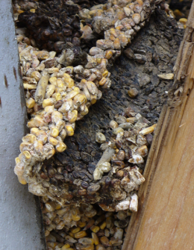
Use senses to ID grain condition
  Out of Condition Grain
  Hot temperature
  High moisture content
  Smell
    Moldy, musty, sour, fermented
  Appearance
    Unnatural color
    Physical formations
    Angle of Repose
Notes:
Grain Condition
Explain – Grain condition is one of the leading indicators of hazard presence in a bin. Grain condition can be assessed in a variety of ways including smell, temperature, movement/feel, and look. If indicators pointing to potential grain condition problems are present – the probability of hazardous bin conditions increases. This should signal to the worker to find alternative means rather than entering a bin as the risk for entrapment/engulfment is higher. If workers must enter a bin EXTRA precautions and vigilance is a MUST.
Discuss - Smell – moldy, musty, fermented or sour smelling grain indicates out of condition grain. Where is the bad smell coming from?
Visual indicators of out of the condition grain include an unnatural color; the appearance of grain formations or grain clumped tor grain clinging to the sides and an unnatural angle of repose including an uneven suface.
EMPHASIZE - Keeping grain in condition is one of the most important things which can be done to insure you do not need to go into a bin.

Slide 25
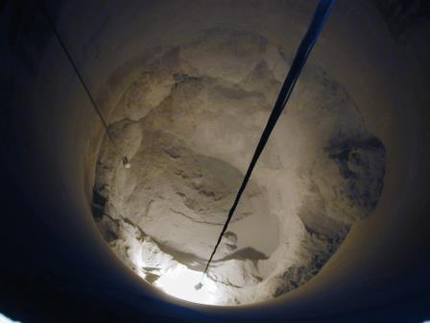

Look for grain formation hazards
Build up on sides
Cliffing, cone up/down
Pyramids, towers
Correct angle of repose
Side wall build up
Photo Pneumat Systems
Pyramid
Notes:
Discuss – Out of condition grain clumps (and plugs up the sump), sticks to the sides of bins and can form striations (horizontal sections that look like stair steps) as shown in this photo. Here the grain shown is 65 feet high – if a worker entered below the top level of grain and part of the tower broke loose, there is almost certain to be a total engulfment with little chance of rescue.
How would you get this grain out? Most people will think they need to enter the bin to unclog a sump, break up the towers, or break the grain off the sidewalls. These are dangerous tasks and what generally lead to entrapment/engulfment. There are several alternative ways to deal with these situations without entering the bin. If entry is absolutely necessary, the worker should always remain above the grain level and work from the top down. Adding and emptying grain to expose only a small portion of the hazard to break up and using a lifeline helps aid in worker safety. Unplugging clogs from the bottom or outside is a preferred alternative.
EMPHASIZE - putting good condition grain into the bin; keeping the grain in good condition; monitoring the grain while it is stored and taking care of problems such as pyramids and build-up when it first appears are the best ways to avoid having to enter a bin.

Slide 26
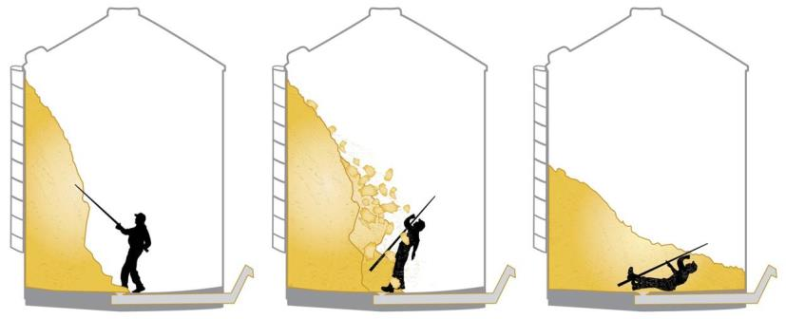
Avalanching Grain
Avalanching grain can bury
Grain collapses
Dislodged or naturally falls
Force can knock down worker
  Helpless to free self
Notes:
Grain formations and build up on the side of a bin (cliffing) are dangerous entry situations.
Often people will enter the bin to break up the pyramid/tower or try to dislodge grain hung up on the sides. When the grain is dislodged, it can quickly break apart and avalanche, burying the worker.
Often in these situations the formation or the grain clinging to the side has a crusted “shell” surrounding it. Inside the shell, the grain is tends to be drier with its floing granular properties. When the shell is broken the grain freely flows out.
The amount of grain on the side can be misleading and lull a false sense of security. A few feet of grain falling has enough force to knock a worker over. Once knocked over the weight of the grain on top of the worker renders him unable to free himself. He literally can be buried under just a few feet of grain.
No one should enter BELOW the surface of the grain – even if it appears to be a small amount.
There are mechanical devices that can help break up these types of grain problems (although they each have their own hazards and should be used by trained personnel.
When there are these issues in the bin, running the fans and drying to get it as dry as possible may let it crumble and fall naturally.

Slide 27
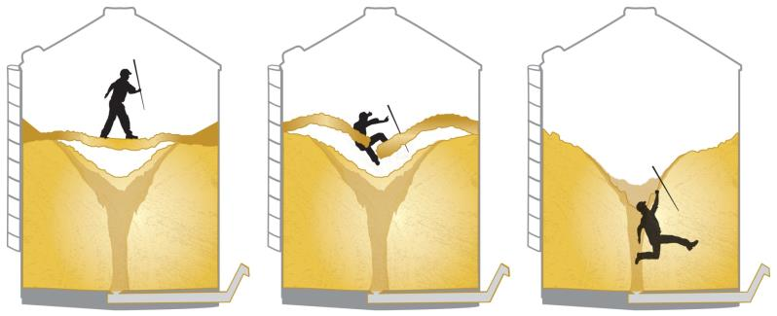
ID potential bridging hazards
  Grain clumped; packed
  Restricted movement – slow
    Minimal sinking
  Surface does not reflect prior unloading
Notes:
Bridging occurs when a crust forms on the grain surface. When grain is unloaded a void forms under the crust. The crust can break through when walked upon causing the entrant to fall into the void.
Indicators of possible bridging conditions are a crust on the surface.
A crust will cause restricted movement.
Grain does not roll freely away from person when walked on and back to fill depression.
Slow or minimal sinking.
If grain has been emptied and the surface of the grain does not reflect the unloading, there is increased risk of bridging conditions.
No one should enter a bin if there are bridging hazards, but if entrance is necessary a lifeline must be worn to protect the entrant if the crusted surface breaks.

Slide 28
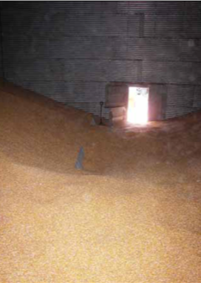
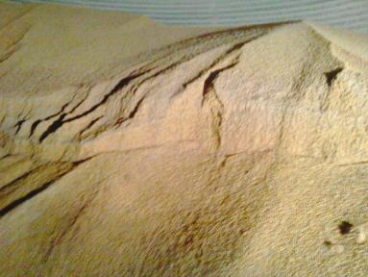
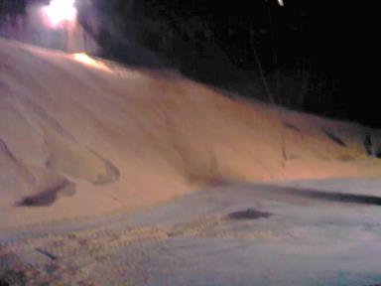
Look for natural Angle of Repose
  Natural slope grain lies
  Normal 22° - 28°
  Steep angles
  Uneven slopes
Correct angle of repose
Bad angle of repose
Notes:
The angle of repose is the natural slope a granular substance like grain lies when piled.
When grain is at its natural angle or repose, there is unlikely to be engulfment hazards due to out of condition grain such as pyramids, side build up, bridging, etc. Out of condition grain does not form the natural angle of repose.
An unnatural angle of repose is characterized by uneven slopes and steep angles. If these are noticed on the grain’s surface, even if other hazards (pyramids, side build up, etc) are not visible, this indicates there is a problem with the grain.
Entry under these conditions should proceed only with caution and only with the entrant wearing a lifeline.
To illustrate a natural angle of repose, the instructor can pour grain onto a couple of different sized circles. Once the grain (birdseed, sugar, or salt can also be used) reaches its natural angle of repose it does not keep piling up as much as it spreads out.
The natural angle of repose for corn is 21.5-23 degrees, soybeans 25-27 degrees and wheat 27-28 degrees (depending on moisture level).

Slide 29
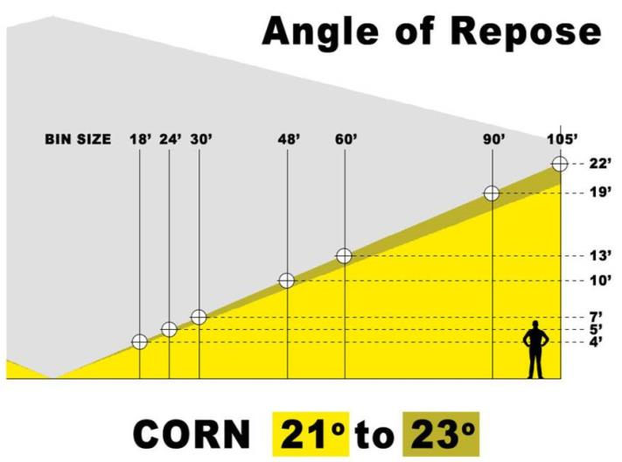
Corn angle of repose - 21° - 23°
Notes:
These charts illustrate what a natural angle of repose would look like for different grains inside a bin of different diameters and height.

Slide 30
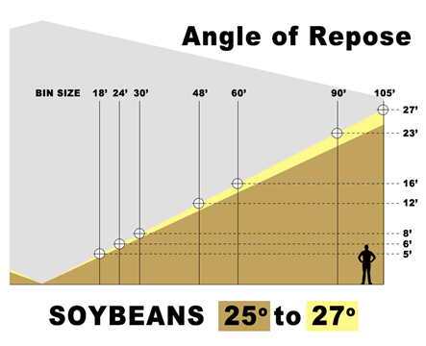
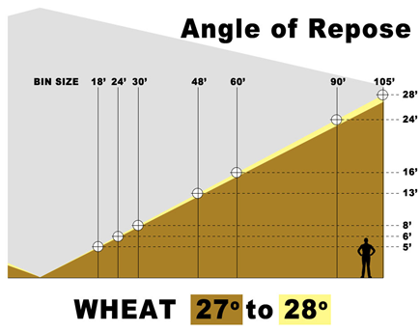
Soybean & wheat angle of repose
Notes:
These charts illustrate what a natural angle of repose would look like for different grains inside a bin of different diameters and height.

Slide 31
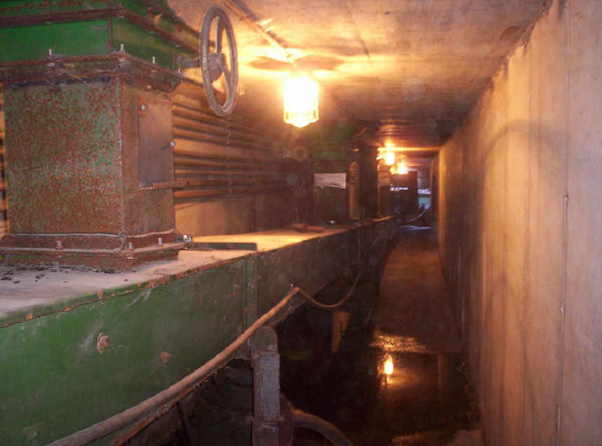
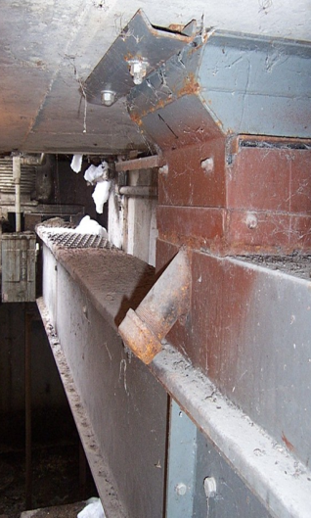
Unclog plugged sumps safely
Opening for rodding grain
Reclaim Tunnels
Use extendable utility pole to reach/knock down grain
Repeat as needed
Notes:
Plugged sumps is one of the leading reasons people enter a bin. Plugged sumps generally occur when clumps of out of condition grain become lodged in the sump and restricts the grain flow during unloading. Uf the auger is running and nothing is coming out, there is generally a plugged sump. Clumps are formed by decomposing grain and/or moisture laden grain. Foreign material in the grain is a leading cause of decomposing grain. For example, soybeans with a large percentage of pods often creates problems. The pods slide toward the bin walls where moisture accumulation is greatest. They begin to decompose and during unloading clog the sumps.
The best way to avoid clogged sumps is to store grain in good condition and maintain the grain during storage.
Use good harvest techniques to reduce foreign material. Adjust fan speeds, concaves & sieves to ensure maximum amount of grain is maintained with the least amount of foreign material like pods, stalks, and damaged grain.
Clean and dry grain properly before putting into storage. Moisture level for corn is 15%, beans 12% and wheat 19%.
When grain is in storage aerate it – keep air flowing through the grain – to keep it dry. Run the fans.
Control the temperature of the grain in storage. As grain heats up the decomposition process begins. The general rule of thumb is to keep the stored product within 20% of the average ambient temperature.
Coring removes the fines/trash/foreign material that accumulates in the center of the bin and deteriorates. It should be done soon after grain is put into storage. Remove 5-10% of the grain from the center. Add the grain back into the bin and flatten the grain surface to assist with airflow. Coring involves pulling grain from the center of the bin.
If you have to unclog the sump try these non-entry methods first.
Forcefully open and close the sumps to try and break up the clumps.
Open secondary sumps.
Running the fans may help dry out the grain enough for it to crumble.
Rod the grain from the OUTSIDE of the bin. Use the reclaim tunnel or from an access hatch stand outside the bin and rod the grain when practical.

Slide 32
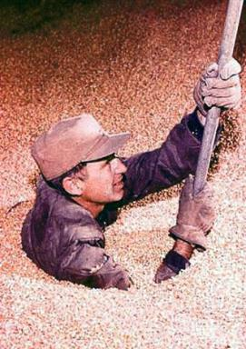
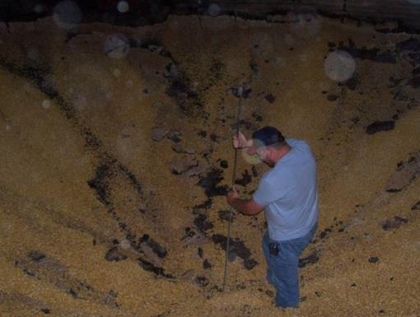
Plugged sumps lead to unsafe entry
LOTO BEFORE entry
to unclog a sump!
Notes:
Plugged sumps lead to unsafe entry and is one of the main causes of engulfment.
It is a common practice to enter the bin and rod the clog to disengage it while leaving the unloading equipment running. Once the plug is cleared the grain will quickly begin to flow as the unloading equipment is helping to convey the flowing grain away. The flowing grain quickly draws the person downward toward the sump – along with the grain. Engulfment occurs within seconds when grain is flowing.
If entry is the ONLY way to unclog a plugged sump – ENSURE THE UNLOADING EQUIPMENT IS LOCKED OUT/TAGGED OUT AND THE SUMPS ARE CLOSED.
No one should ever enter a bin with the unloading equipment running.

Slide 33
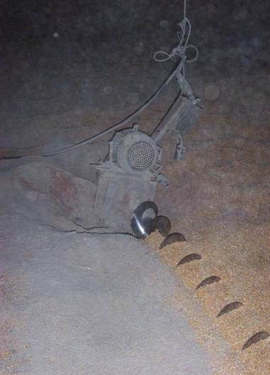
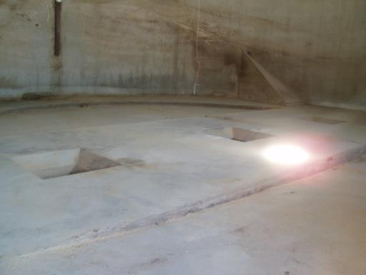
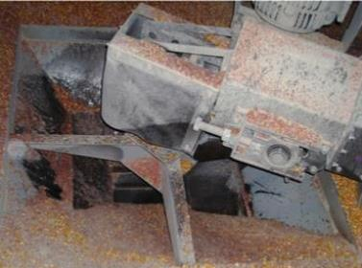
Check for mechanical hazards
Unguarded Sweep Auger
Unguarded Sump Holes
Unguarded Center Sump
Notes:
Before entering a bin check to ensure all mechanical hazards (equipment) is properly guarded such as sump holes, augers, sweep augers, fans, etc.
If sump holes do not have permanent guards – guards should be put in place immediately upon entering.
The electrical cords on portable sweep augers need to be properly addressed as they pose a trip and/or entanglement hazard.

Slide 34
Lockout/Tagout - LOTO
PERMIT

Slide 35
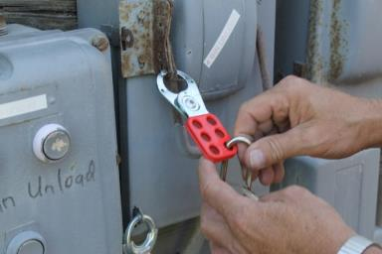

LOTO - Each Time, Every Time!
Lock out/Tag out
ALL energy sources
All equipment
  Fill/empty bin
Control energy
  Prevent unexpected start-up
LOTO
BEFORE
bin entry!
Electrical, mechanical, hydraulic, pneumatic, chemical, thermal, gravitational, kinetic, stored/residual, others
Notes:
Lockout/Tagout must be done on ALL equipment that fills or empties a bin – gates, conveyors, sumps, legs, etc. – before entry.
Lockout/Tagout must also be performed on any equipment which poses a hazard to the entrant.
LOTO is necessary to prevent flowing grain hazards and protect the entrant from entanglement hazards.
Lockout/Tag out involves isolating the energy source and locking it out so the equipment cannot accidently be turned on.
If you are unfamiliar with LOTO, you might want to watch the GHSC video – Lockout/Tagout: Each Time, Every Time.

Slide 36
LOTO - Review
Prepare for shutdown
Shut down machine
Disconnect ALL energy sources
LOTO - Install locks & tags
Tryout – ensure energy disconnected
Complete work
Notify others of start-up
Start - up
Notes:
ALL equipment - fill or empty bin – gates, conveyors, sumps, legs, etc.
Any equipment which poses a hazard.
Discuss the steps to LOTO .

Slide 37

LOTO Demonstration
LOTO Demonstration
Notes:
Divide class into groups depending on # of LOTO units. If only one unit ask for a couple volunteers.
Explain briefly & demonstrate how the LOTO unit works.
Have the groups perform LOTO – switch off to allow most to have a chance to do

Slide 38
atmosphere
PERMIT

Slide 39
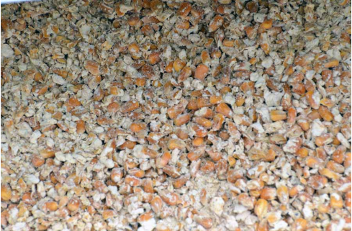
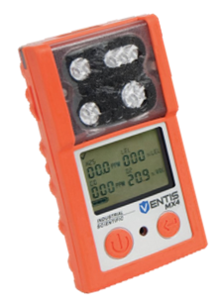

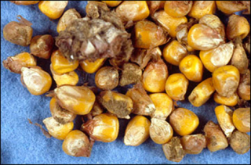
Low O₂ = atmosphere hazard
  Oxygen – normal 20.9%
    19.5% – 23.5%
  Carbon monoxide
    Welding; engine exhaust
  Fumigants – Phosphine
  Carbon dioxide
    Rotting/fermenting grain
    Displaces oxygen
Notes:
Oxygen Deficient - Oxygen level should be 20.9% and cannot be below 19.5%. Below 19.5% is considered oxygen deficient. Any oxygen reading other than the fresh air amount (20.9%) should be investigated to determine the cause of displacement.
Combustion gases such as carbon monoxide (CO) create hazardous conditions. Carbon monoxide ≥ 100 ppm is dangerous.
Oxygen enriched (23.5%+).Oxygen promotes combustion and is necessary for fires to burn. At high concentrations, causes flammable/combustible materials to burn violently when ignited. Never use pure oxygen to ventilate.
Fumigants such as phosphine (PH3) (AKA Hydrogen phosphide) create a toxic atmosphere. It is a colorless, highly toxic, reactive and flammable gas. Do not open in a flammable atmosphere including combustible dust or expose to water (releases the gas). Fire or explosion can occur if gas concentration exceeds 1.8%. Has a garlic-like odor; the result of a different chemical reaction and is not a reliable exposure indicator. Permissible exposure limit is 0.3ppm for 8 hours. Short term exposure limit is 1.0 ppm for 15 minutes. At 15ppm+ or unknown concentrations an SCBA is required. 50 ppm is IDLH. Fumigation levels are usually 200 ppm or higher. Ventilate and test air after fumigation. Exposure symptoms include headache, dizziness, nausea, difficulty breathing, vomiting, and diarrhea. Convulsions can occur after an apparent recovery..
Carbon dioxide is a concern. Corn kernels are made up of 1/3 carbon dioxide. High CO2 concentrations can cause a person to lose consciousness at 20.5% oxygen way before an alarm would sound at 19.5% oxygen if just using an oxygen monitor.
The levels of CO2 in the air and potential health problems are:
Carbon dioxide 250 to 350 ppm - normal outdoor air
250 - 350 ppm – background (normal) outdoor air level
350- 1,000 ppm - typical level found in occupied spaces with good air exchange.
1,000 – 2,000 ppm - level associated with complaints of drowsiness and poor air.
2,000 – 5,000 ppm – level associated with headaches, sleepiness, and stagnant, stale, stuffy air. Poor concentration, loss of attention, increased heart rate and slight nausea may also be present.
>5,000 ppm – this indicates unusual air conditions where high levels of other gases could also be present. Toxicity or oxygen deprivation could occur. This is the permissible exposure limit for daily workplace exposures.
>40,000 ppm - this level is immediately harmful due to oxygen deprivation.

Slide 40

Test in order: O₂, LFL, toxic gas
Use multi-gas tester
  Gases specific to site
  Direct read instrument
Test in order – OLP
  Oxygen 20.8 -20.9%
  Lower explosive/flammable limit <10%
  Toxic gases - Permissible Exposure Limit
Low O2 interferes with combustible reading
Notes:
Air monitoring is the most effective means to know if atmosphere is hazardous. An air monitor is a device which measures the three main characteristics of a hazardous atmosphere – Oxygen, Lower Flammable or Explosive Limit (LFL or LEL) and Permissible Exposure Limit (PEL) (toxic gases).
Testing the atmosphere before entry is a Best Practice. Oxygen levels that are too low can lead to serious complications and death.
Note: OSHA 1910.272(g)(1)(iii) only requires atmosphere testing for hazards when “the employer has reason to believe they may be present.” Some reasons to consider are known or suspected out of condition grain, a bin fire occurred, hot or vehicles are in the area, fumigation has occurred or other conditions which could affect the atmosphere are present.
Use a multi gas oxygen monitor. It should be a direct read monitor, properly calibrated and bump tested and users should be trained on proper testing techniques and reading. Have it set for the gases specific to work environment.
Testing MUST be done in this order – Oxygen, lower flammable limits, PEL or it will not give correct readings.
The atmospheric monitors contain sensors which measure for conditions which may be present at the facility we are in. For example if were working in a facility which conducted fumigations the sensor would need to read the fumigant used. If fumigants aren’t used, the tester would not need that type of sensor. Common levels to consider for grain bins include oxygen, carbon monoxide, carbon dioxide, phosphine, hydrogen sulfide and combustible dusts.
Oxygen Deficient - Below 19.5% is considered oxygen deficient.
Combustible -A combustible atmosphere is present when there is a flammable gas, vapor or mist which exceeds 10% of its lower flammable limit (LFL) of Lower Explosive Limit (LEL) in the space. Combustible dust is also included – discussed later.
A toxic atmosphere is when the permissible exposure limit of a chemical in the air is met or exceeded. Atmospheric concentration of any substance for which a dose or a permissible exposure limit is published in Subpart G, Occupational Health and Environmental Control, or in Subpart Z, Toxic and Hazardous Substances, of this Part and which could result in employee exposure in excess of its dose or permissible exposure limit;
Toxic atmospheres can be caused by material stored, work activity or outside influences. Hot work, for example, uses up the oxygen in the space. Vehicle exhaust displaces the oxygen in a space. Decomposition creates gases that displace oxygen. The wind can carry chemical applications from other places.
Picture: https://www4.uwm.edu/pps/Safety/Confined_Space/multi-gass-meter-instructions.cfm

Slide 41
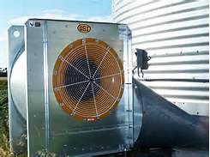
Ventilation increases air quality
Ventilation Needs
Natural or forced air
Run fans before & during entry
Continual monitoring
Notes:
Discuss – ventilate the structure before entry by running the fans or using forced (air) ventilation and continue to ventilate during entry.
Test before entry and continue to test periodically during entry to ensure the atmosphere remains safe.
Emphasize – if problems in the atmosphere are suspected, a test MUST be performed prior to entry and continuous monitoring and ventilation needs to be conducted. OSHA 1910.272(g)(1)(iii), (iii)A, and (iii)B.
Stress – if there are any concerns about the atmosphere, do NOT enter or use an air supplied respirator.
The atmosphere within a bin, silo, or tank shall be tested for the presence of combustible gases, vapors, and toxic agents when the employer has reason to believe they may be present. Additionally, the atmosphere within a bin, silo, or tank shall be tested for oxygen content unless there is continuous natural air movement or continuous forced-air ventilation before and during the period employees are inside. 1910.272(g)(1)(iii).

Slide 42
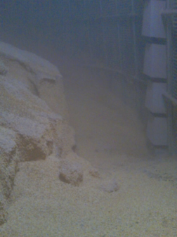
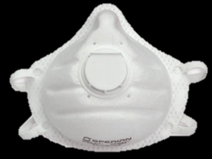
Dust hazards in the bin
Combustible Dust
  At/above LFL
  Vision obscured ≤ 5 ft
  Maximum 1/8 inch
  Explosion hazard!
  Eliminate prior to entry
PPE
  Dust filtering mask
  Respirator
Notes:
A hazardous atmosphere is present when there is a combustible dust concentration that meets or exceeds its LFL and is approximated as in a suspended state which obscures your vision at 5’ or 1.52 meters.
If dust is present in this concentration it needs to be eliminated prior to entry. It is an explosion hazard!
Dust cannot exceed 1/8 inch – or the width of two nickels stacked.
Whenever there is a bin entry, ignition hazards should be controlled.
Bin entrants at a minimum should wear a particulate dust filtering mask (N95 or N99) to help block dust from entering the airways and settling in the lungs.
Farmer’s lung (grain dust lung disease) – hypersensitivity pneumonitis - is caused by inhalation of grain dust.
Grain has moisture which contains bacteria and fungi; generally 30% or > moisture content is the breeding ground.
Symptoms of Farmer’s lung include respiratory fibrosis (inflammation which restricts airways), and lung damage - corpulmonale.
A respirator is needed when the dust hazard is at or above limits. Wearers must be trained in use and properly fitted and medically cleared.

Slide 43
Atmosphere Monitoring Demonstration
Atmosphere Monitoring Demonstration
Notes:
Demonstrate a 4 gas tester and discuss its purpose for a safe bin entry.

Slide 44
Ppe - Lifeline use
PERMIT

Slide 45
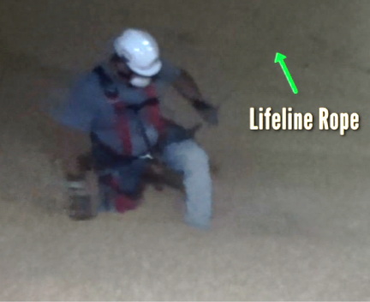
PPE for safe bin entry
Full body harness
Secured lifeline
  Prevents sinking past waist deep
  Protect against falls
Other PPE
  Gloves, hard hat, footwear
  Dust mask/respirator
Notes:
Discuss briefly the types of PPE required in bin entry.
A body harness and lifeline are considered part of a personal fall protection system.
Using an N95 or N99 rated dust mask or a respirator for dust laden environments is recommended. Must be trained and fit tested and if respirator, medically cleared.

Slide 46
ENTRANT & Observer
Training, roles & responsibilities
PERMIT

Slide 47
Training for bin entry
Hazard identification & correction
LOTO
  Machine guarding
Emergency action plan
Lifeline
Roles & responsibilities
Work tasks
Notes:
Both entrant and observer must receive training on their roles & responsibilities during a bin entry. Inclufing hazard identification & correction (avoid, correct, eliminate, reduce), LOTO, machine guarding, the emergency action plan, lifeline use, the work tasks to be performed..
Observers must also have training in how to initate a rescue procedure without entry and call for help.
.OSHA standard on training: 1910.272(e) Training.
1910.272(e)(1) The employer shall provide training to employees at least annually and when changes in job assignment will expose them to new hazards. Current employees, and new employees prior to starting work, shall be trained in at least the following:
1910.272(e)(1)(i) General safety precautions associated with the facility, including recognition and preventive measures for the hazards related to dust accumulations and common ignition sources such as smoking; and,
1910.272(e)(1)(ii) Specific procedures and safety practices applicable to their job tasks including but not limited to, cleaning procedures for grinding equipment, clearing procedures for choked legs, housekeeping procedures, hot work procedures, preventive maintenance procedures and lock-out/tag-out procedures.
1910.272(e)(2) Employees assigned special tasks, such as bin entry and handling of flammable or toxic substances, shall be provided training to perform these tasks safely.
Note to paragraph (e)(2): Training for an employee who enters grain storage structures includes training about engulfment and mechanical hazards and how to avoid them.

Slide 48
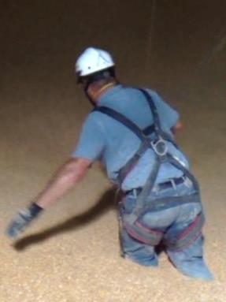
Entrant MUST be trained before entry
Entrant role & responsibilities
Safe entry procedures
  Emergency action plan
Evaluate hazards
Communicate with observer
Perform tasks
Lifeline use
Lifeline
NEVER enter a bin alone!
Notes:
Entrant is never to enter alone. Entrant must ALWAYS assess for hazards PRIOR to any entry and continually assess for hazards while in the bin. If an unsafe condition arises, the entrant should inform the observer and terminate the entry.
Entrant is to follow safe entry procedures including use of appropriate PPE consisting of a full body harness & lifeline; gloves; hard hat, foot wear, dust mask or respirator. Additionally, entrant is to perform the tasks specified on the permit or communicated by the employer if no permit was used in a safe manner
Entrant must ALWAYS use a lifeline when entering a bin unless the use of one poses a greater threat. (1910.272(g)(2) or the employer can demonstrate no engulfment hazard exists.
Entrant stays in communication through either voice or visual means with the observer. 1910.272(g)(3)
Entrant must be trained before performing bin entry. 1910.272 (e). Training includes: how to perform bin entry safely – including how to effectively use a lifeline; identification of engulfment and mechanical hazards and how to avoid them (machine guarding, LOTO, etc); the procedures and safety practices applicable to their job tasks. Other training needs to consider: safe use of equipment; use of communication device to be used.
For the commercial industry, the entrant should be trained on sweep auger entry procedures to work in a bin with an energized sweep auger. This is a BEST PRACTICE for farms to follow.
Note: Several engulfment/entrapment incidents occurred with experienced employees –many in supervisory roles - who think “it’ll just take a quick minute” to resolve a problem encountered. These incidents involved entering without LOTO, under a build-up of grain, entering ALONE to unclog a sump and getting drawn into the flow, under bridging conditions, etc. Entanglement incidents have happened in the same way – entering without telling someone, without guarding sump holes or locking out equipment, etc..
OSHA standard on training: 1910.272(e) Training.
1910.272(e)(1) The employer shall provide training to employees at least annually and when changes in job assignment will expose them to new hazards. Current employees, and new employees prior to starting work, shall be trained in at least the following:
1910.272(e)(1)(i) General safety precautions associated with the facility, including recognition and preventive measures for the hazards related to dust accumulations and common ignition sources such as smoking; and,
1910.272(e)(1)(ii) Specific procedures and safety practices applicable to their job tasks including but not limited to, cleaning procedures for grinding equipment, clearing procedures for choked legs, housekeeping procedures, hot work procedures, preventive maintenance procedures and lock-out/tag-out procedures.
1910.272(e)(2) Employees assigned special tasks, such as bin entry and handling of flammable or toxic substances, shall be provided training to perform these tasks safely. Note to paragraph (e)(2): Training for an employee who enters grain storage structures includes training about engulfment and mechanical hazards and how to avoid them.

Slide 49
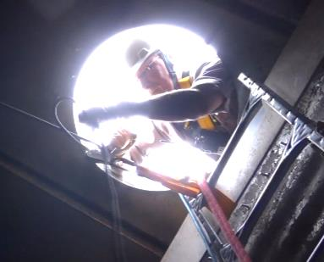
Observer present during entire entry.
Observer Role & Responsibilities
Present entire entry
Constant communication
Emergency Action Plan
  Call for help
  Initiate non-entry rescue
Manage belay
Anchor installed behind ladder
Observer must not leave!
Notes:
The Observer role is especially important as he must remain present during the entire entry and remain in constant contact with the entrant either visually (best) or through other means.
If the observer needs to leave or cannot perform the duties (distracted) a replacement needs to take over. However, the observer cannot leave until a trained person is there. If another observer is not available, the entry needs to be terminated.
The observer must know how and who to call for help and have the means to do so. The observer should initiate non-rescue entry while waiting for emergency response services.
With this secured lifeline system – the observer manages the belay the entrant is hooked to – controlling the slack in the lifeline.
The observer needs to be trained for the role and responsibilities.
Training should include:
ID & correct hazards
LOTO
Machine guarding
Role & responsibility
Must remain present
Constant communication
Lifeline Use
Initiate Rescue without entering
Refer to OSHA standard on training: 1910.272(e) Training for OSHA requirements.

Slide 50
Rescue availability
PERMIT

Slide 51
Rescue plan & equipment available
Emergency Action Plan
Best Practice
Summon rescue team
Rescue equipment
  MUST be available
  Specifically suited for bin, silo, or tank
  Trained in use
GSI
Notes:
If the lifeline is used the entrant should never be entrapped above their waist.
Commercial facilities must have an emergency action plan. This is a best practice for farms. It should include who to summon for rescue, the coordinates for the structure, and what employee roles may be while waiting.
Commercial facilities must have available rescue equipment during any bin entry. It is a best practice for farms and could consist of plywood or at the minimum a bucket with holes.
A rescue may require help from a fire department or technical rescue team which can be started with a phone call per the emergency action plan. The observer should have a radio or phone to make this contact or contact another employee or other adult that is trained to make a call for help.
Since the entrant is being held by the lifeline and the bin entry permit has been followed the entrant is not in an “immediate danger of life and health” (IDLH).

Slide 52
Lifeline Proytection System
Lifeline Protection System

Slide 53
Why a secured lifeline
Commercial
1910.272 OSHA Grain Handling Standard
Farm
“Best Practice”
Protect Entrant
No more than waist deep
Prevents fall
Perform work
Notes:
A lifeline is required under the grain handling standard. Although an exception exists – ie there are no engulfment hazards – the standard practice should be to use a lifeline in any entry.
Exempt farms do not have the weight of OSHA enforcement but using a lifeline is a best practice. Entrapments/engulfments most often occur on exempt farms, clearly emphazing the need for better safety practices.

Slide 54
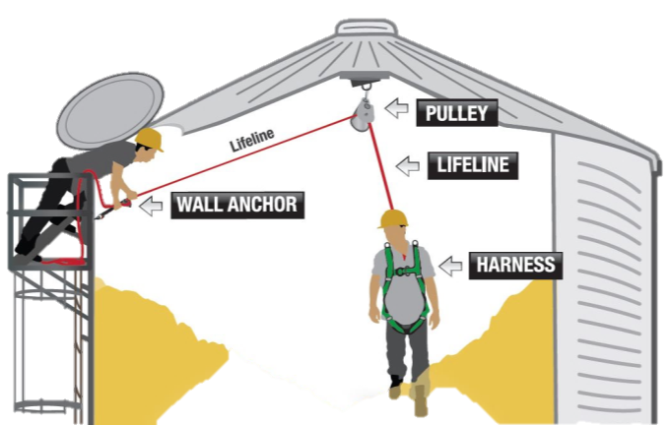
Secure Lifeline Protection System
Anchors at peak & side secure the lifeline system to prevent engulfment or falls.
Notes:
Stress - Lifelines MUST be SECURED in order to be effective in preventing entrapment or engulfments.
Explain - This graphic shows the basic set-up a lifeline system.
Stress - There are TWO anchor points. These anchor points distribute the weight of the entrant as well as the forces exerted by grain. One anchor point is attached to the peak of the bin and the other to the side near the entry point.
Point out - The anchor points are PERMANENTLY installed.
Discuss - The two anchors together should support at least 2X the anticipated load on the anchors. (All anchorages need to support 2 times the anticipated weight. A person waist deep in grain would require two times his/her weight to be pulled out. Bottom line, anchors should be able to withstand 4 times an entrants weight. This would be worse case scenario because we are operating this lifeline system such that no one will be allowed to go any further than waist deep in grain).
Emphasize - to participants they need to CONSULT a bin manufacturer or a qualified person (such as a structural engineer) to determine the type and load capacity of the anchor points a bin can support. This is not a GUESSTIMATE. The age of the bin, the structural integrity of the bin, the roof, sides, etc all are factors to take into consideration when determining and installing anchor points.
Warn - Anchor points need to be installed according to the specifications provided by the professional.
WARNING - This system DOES NOT protect an entrant from engulfment or entrapment when the entrant is below the surface of the grain such as would occur if entering from the side door underneath a pyramid of grain or grain built up on the sides of the bin.
This graphic and its accompanying graphics was produced and is owned by the Grain Handling Safety Coalition (GHSC) to illustrate its Lifeline Protection System. GHSC assumes no responsibility or liability for its use by others including training purposes, lifeline installation or design or any other use for which it is not intended. The graphics are NOT drawn to scale and may not reflect all the relevant safety, manufacturing or other standards.

Slide 55

Avalanche – Would lifeline protect?
Sidewall build- up of grain
Ineffective protection when worker is below the level of the grain.
Note: Drawing does not depict a properly tensioned lifeline
Notes:
Discuss if a lifeline is effective in this situation. If a person were standing on the slope of grain trying to knock down the build up and the grain dislodged a lifeline would not protect the worker. A Lifeline is only effective if the worker is above the potential avalanche.

Slide 56
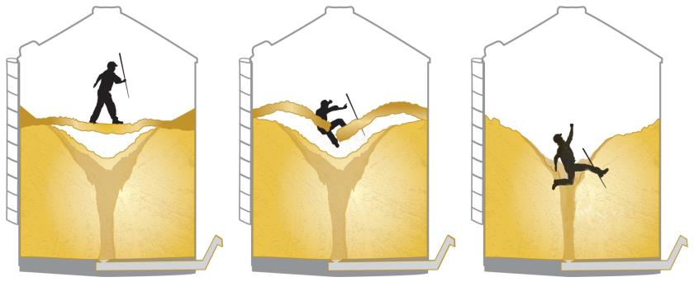
Crust/Bridge – Would lifeline protect?
This wouldn’t happen with a properly tensioned lifeline about same as above except the proper lifeline would protect. Take out, animate? I agree, properly tensioned lifeline will keep person from going this deep. I would show this person just waist deep to show that the lifeline worked.
Effective protection
Notes:
This is a situation of bridged grain. If the worker had a lifeline on, the lifeline would protect him when the grain collapses from an entrapment more than waist deep as the belay device would lock as soon as the worker fell causing stress on the lifeline.

Slide 57
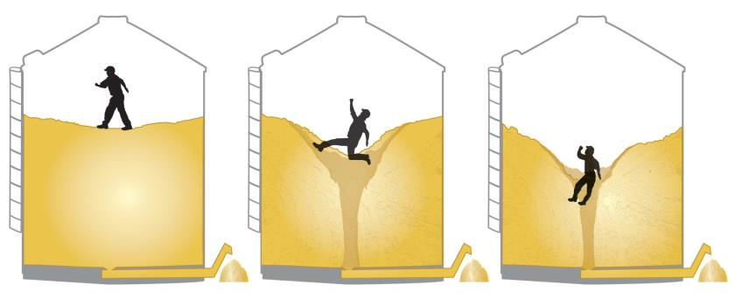
Flowing grain – Would lifeline protect?
Effective protection
Notes:
This is a situation of flowing grain. If the worker had a lifeline on, the lifeline would protect him from an entrapment more than waist deep as the belay device would lock as soon as the worker fell causing stress on the lifeline.

Slide 58
Knowledge Application
Knowledge Application
Notes:
This next section is intended as a group activity/discussion.
NOTE TO INSTRUCTOR – after discussion of the scenario on the slide the next slide will show the risk level and precautions to be considered. Allow discussion before advancing the slide.
Several scenarios will be presented depicting grain bin conditions. Participants would determine the risk of entrapment/engulfment and whether a lifeline system would be effective and what precautions may be needed.

Slide 59
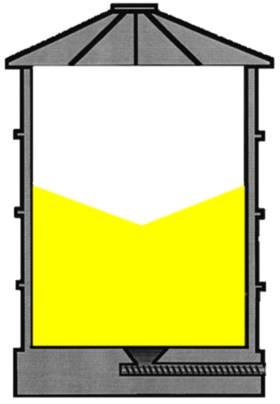
Hazard Presence?
LOW RISK
ONLY if
Auger is LOTO
Notes:
ANIMATED SLIDE – tranagle appears after 1.5 seconds. Instructor does not need to do anything.
Explain - A likely angle of repose from filling or removal of good condition grain.
ANSWER - Low Probability of either hazard - as long as the grain auger is lock out/tagged out.
Lifeline – Lifeline use would be determined by employer after assessing after all hazards. Probably would not be needed if conditions are good and no other hazards are present.

Slide 60
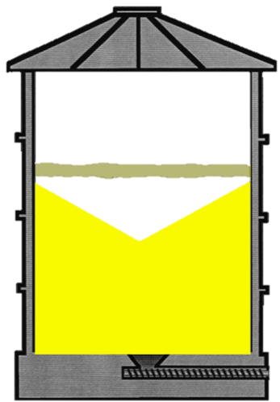
Hazard Presence?
Notes:
ADVANCE TO NEXT SLIDE TO SEE ANSWER.
Explain – Example of bridged grain that could occur from out of condition grain.
Some grain previously removed.
Notice the angle underneath the bridged grain.
May be difficult to see, but a flat surface shows potential of problems.
If employee enters and notices right away, the surface is crusted and not allowing for normal sinking or walking, they should exist immediately.
ANSWER - Great potential for both entrapment and engulfment (dependent on situation).
Discuss – the types of situations or conditions an the entrapment and engulfment would be dependent upon.
Is grain flowing; is unloading equipment running, etc.
Lifeline use.
EMPHASIZE – If unloading equipment is running and there is no lifeline/harness used there is a VERY high probability of engulfment (death) if the person breaks through the crust!
Stress - Even if grain auger is locked out and tagged out a person could fall through the crust and become engulfed if no harness and lifeline is used. With LOTO, harness, lifeline and observer a potential for entrapment still exists.
Lifeline – A lifeline would be effective if installed and used appropriately
Situation only exists if grain has been pulled. Lifeline would protect.

Slide 61
Hazard Presence?
YES!
Entrapment Risk
YES!
Engulfment Risk
HIGH RISK!
MUST
Minimize Risk
Notes:
Explain – Example of bridged grain that could occur from out of condition grain.
Some grain previously removed.
Notice the angle underneath the bridged grain.
May be difficult to see, but a flat surface shows potential of problems.
If employee enters and notices right away, the surface is crusted and not allowing for normal sinking or walking, they should exist immediately.
ANSWER - Great potential for both entrapment and engulfment (dependent on situation).
Discuss – the types of situations or conditions an the entrapment and engulfment would be dependent upon.
Is grain flowing; is unloading equipment running, etc.
Lifeline use.
EMPHASIZE – If unloading equipment is running and there is no lifeline/harness used there is a VERY high probability of engulfment (death) if the person breaks through the crust!
Stress - Even if grain auger is locked out and tagged out a person could fall through the crust and become engulfed if no harness and lifeline is used. With LOTO, harness, lifeline and observer a potential for entrapment still exists.
Lifeline – A lifeline would be effective if installed and used appropriately
Situation only exists if grain has been pulled. Lifeline would protect.

Slide 62
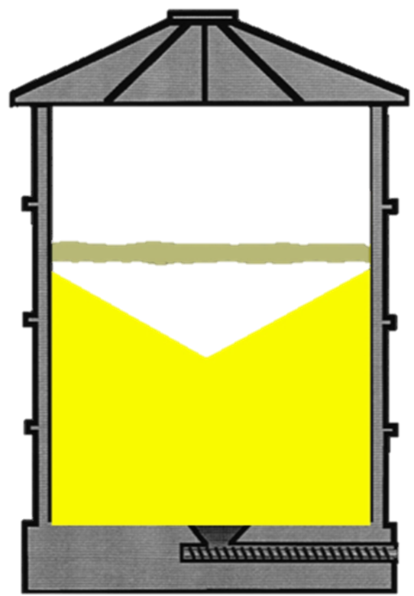

Hazard Presence?
Notes:
INSTRUCTOR NOTE – WHEN YOU ADVANCE THE SLIDE IT SHOWS THE ANSWER.
Explain - Example of another type of bridged grain that could occur from out of condition grain. Some grain previously removed.
Notice - the steeper angle of the grain underneath the bridged (out of condition) grain in the center.
ANSWER - Great potential for both entrapment and engulfment (dependent on situation).
EMPHASIZE - This situation cannot be “seen”.
This situation may be present when there is corn (grain) in a bin, the auger is running and no corn is coming out of auger.
You should assume this is the type of hazard present in the bin.
False security may occur is initially a worker enters the bin and the perimeter appears normal, i.e. the worker’s movements – such as natural sinking – are normal and the crusted area (center) cannot be seen.
Discuss - what situations an entrapment and engulfment would be dependent upon.
If no LOTO was completed and the unloading equipment was running, this could result in a very quick engulfment if the clog in the auger suddenly releases.
EMPHASIZE – If unloading equipment is running and there is no lifeline/harness used there is a VERY high probability of engulfment (death) if the person breaks through the crust!
Stress - Even if grain auger is locked out and tagged out a person could fall through the crust and become engulfed if no harness and lifeline is used. With LOTO, harness, lifeline and observer a potential for entrapment still exists.
Lifeline would be effective if installed and used appropriately.
Per 12/19/14 Discussion. If auger is running and nothing is coming out most likely wither 1) sump is clogged or 2) there is a cavity. (If person can rod underneath bin and doesn’t find anything than most likely a cavity). Can rod from the top with a lifeline and minimal risk of entrapment.

Slide 63

Hazard Presence?
Engulfment
Entrapment
Minimize Risk
HIGH RISK!
Entrapment
High Risk
Entrapment
Engulfment
Engulfment
Notes:
Explain - Example of another type of bridged grain that could occur from out of condition grain. Some grain previously removed.
Notice - the steeper angle of the grain underneath the bridged (out of condition) grain in the center.
ANSWER - Great potential for both entrapment and engulfment (dependent on situation).
EMPHASIZE - This situation cannot be “seen”.
This situation may be present when there is corn (grain) in a bin, the auger is running and no corn is coming out of auger.
You should assume this is the type of hazard present in the bin.
False security may occur is initially a worker enters the bin and the perimeter appears normal, i.e. the worker’s movements – such as natural sinking – are normal and the crusted area (center) cannot be seen.
Discuss - what situations an entrapment and engulfment would be dependent upon.
If no LOTO was completed and the unloading equipment was running, this could result in a very quick engulfment if the clog in the auger suddenly releases.
EMPHASIZE – If unloading equipment is running and there is no lifeline/harness used there is a VERY high probability of engulfment (death) if the person breaks through the crust!
Stress - Even if grain auger is locked out and tagged out a person could fall through the crust and become engulfed if no harness and lifeline is used. With LOTO, harness, lifeline and observer a potential for entrapment still exists.
Lifeline would be effective if installed and used appropriately.
Per 12/19/14 Discussion. If auger is running and nothing is coming out most likely wither 1) sump is clogged or 2) there is a cavity. (If person can rod underneath bin and doesn’t find anything than most likely a cavity). Can rod from the top with a lifeline and minimal risk of entrapment.

Slide 64
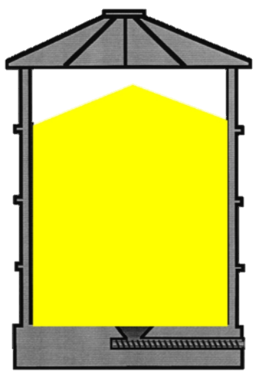
Hazard Presence?
Notes:
INSTRUCTOR NOTE – WHEN YOU ADVANCE THE SLIDE IT SHOWS THE ANSWER.
Explain – A high middle peak could occur if the spreader on the bin loading auger has been broken or removed. Peak in the middle could also indicate no grain has been pulled from the bin.
ANSWER - Little potential for engulfment/entrapment if grain auger is locked out/tagged out.
Lifeline use would be determined be employer after assessing all hazards. Probably would not be needed if conditions good and no other hazards present.

Slide 65
Hazard Presence?
LOW RISK
ONLY if
Auger is LOTO
Notes:
Explain – A high middle peak could occur if the spreader on the bin loading auger has been broken or removed. Peak in the middle could also indicate no grain has been pulled from the bin.
ANSWER - Little potential for engulfment/entrapment if grain auger is locked out/tagged out.
Lifeline use would be determined be employer after assessing all hazards. Probably would not be needed if conditions good and no other hazards present.

Slide 66
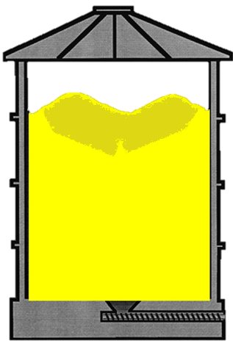
Hazard Presence?
Notes:
INSTRUCTOR NOTE – WHEN YOU ADVANCE THE SLIDE IT SHOWS THE ANSWER.
Explain – the darkened crust and the slightly darker shadow illustrates out of condition grain on top. Most likely this occurs after filling bin and before any unloading.
If grain on top appears to be out of condition, there is a possibility for bridging.
Uneven slopes can also indicate out of condition grain.
ANSWER: If there is crusted grain on top you don’t know if there is a pocket underneath. You have to assume there is something going on. The actual level of risk is unknown. However, if it is known that there was some grain emptied previously, there is a greater possibility of a pocket having formed somewhere in the bin, increasing risk of bridging.
Out of condition grain on top shows a potential risk.
As the person entering the bin would not know if the grain was bridged, it has the potential to be an entrapment and/or engulfment situation.
Minimize risk by ensuring LOTO and lifeline is used.
Emphasize – these chances increase if no LOTO is done and unloading equipment is operational, there is no harness/lifeline, and no observer.
Lifeline would be effective is installed and used appropriately
Per 12/19/14 – Need to clarify the comment that this is a side entry “above the grain” and ladder should extend above. This may be the wrong slide # for the comment.

Slide 67
Hazard Presence?
Out of condition grain
Possible bridging
Engulfment
Minimize Risk
Entrapment
Risk
Unknown
Notes:
Explain – the darkened crust and the slightly darker shadow illustrates out of condition grain on top. Most likely this occurs after filling bin and before any unloading.
If grain on top appears to be out of condition, there is a possibility for bridging.
Uneven slopes can also indicate out of condition grain.
ANSWER: If there is crusted grain on top you don’t know if there is a pocket underneath. You have to assume there is something going on. The actual level of risk is unknown. However, if it is known that there was some grain emptied previously, there is a greater possibility of a pocket having formed somewhere in the bin, increasing risk of bridging.
Out of condition grain on top shows a potential risk.
As the person entering the bin would not know if the grain was bridged, it has the potential to be an entrapment and/or engulfment situation.
Minimize risk by ensuring LOTO and lifeline is used.
Emphasize – these chances increase if no LOTO is done and unloading equipment is operational, there is no harness/lifeline, and no observer.
Lifeline would be effective is installed and used appropriately
Per 12/19/14 – Need to clarify the comment that this is a side entry “above the grain” and ladder should extend above. This may be the wrong slide # for the comment.

Slide 68
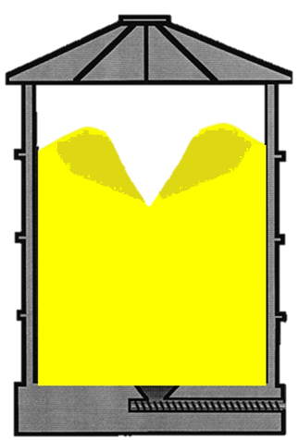
Hazard Presence?
Notes:
INSTRUCTOR NOTE – WHEN YOU ADVANCE THE SLIDE IT SHOWS THE ANSWER.
Explain – Same conditions as previous slide (upon filling the bin) – discolored and probably out of condition grain present on top. Additionally some grain has been removed causing the steep downward angle in the middle.
Point out the middle angle. It is steeper than previous. Well conditioned grain would not remain at such a steep angle shown in the middle.
Explain – there is a High probability of out of condition grain.
ANSWER: Steep angle of repose indicates problems so we would consider this high risk like the out of condition grain – posing hazards of engulfment & entrapment.
Engulfment if no harness and lifeline and observer.
Potential hazard of entrapment even with harness and lifeline and observer. Not using LOTO increases these risks if unloading equipment is running!
Lifeline may or may not be appropriate depending on depth of V.
Best Practice – don’t go into the V.
If the V is over 4 feet than a lifeline may not adequate.
V is caused by out of condition grain which will not empty out during unloading so it will need to be broken up.
Level the cone (by adding more grain) so the person is working only 4 or 5 ft deep.

Slide 69
Hazard Presence?
YES!
Grain removed
Steep angle
HIGH RISK
Minimize Risk!
Entrapment
Engulfment
Notes:
Explain – Same conditions as previous slide (upon filling the bin) – discolored and probably out of condition grain present on top. Additionally some grain has been removed causing the steep downward angle in the middle.
Point out the middle angle. It is steeper than previous. Well conditioned grain would not remain at such a steep angle shown in the middle.
Explain – there is a High probability of out of condition grain.
ANSWER: Steep angle of repose indicates problems so we would consider this high risk like the out of condition grain – posing hazards of engulfment & entrapment.
Engulfment if no harness and lifeline and observer.
Potential hazard of entrapment even with harness and lifeline and observer. Not using LOTO increases these risks if unloading equipment is running!
Lifeline may or may not be appropriate depending on depth of V.
Best Practice – don’t go into the V.
If the V is over 4 feet than a lifeline may not adequate.
V is caused by out of condition grain which will not empty out during unloading so it will need to be broken up.
Level the cone (by adding more grain) so the person is working only 4 or 5 ft deep.

Slide 70
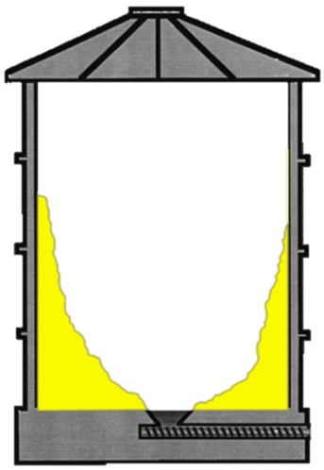
Hazard Presence?
Notes:
INSTRUCTOR NOTE – WHEN YOU ADVANCE THE SLIDE IT SHOWS THE ANSWER.
Discuss – Represents an avalanche hazard.
ANSWER – Avalanche risk! Potential for entrapment exists but more likely engulfment due to the height of the grain. A lifeline would not be effective if grain is above the person; i.e., if person is above the level of the grain and stays above a lifeline would be effective. Should NOT enter this bin as difficult to enter bin safely. To take care of the hazard, fill bin up, level it, and empty it. This situation can be prevented as well as engulfment and entrapment can be prevented. This grain probably won’t fall on itself.
Ask – Why is engulfment more likely? If an individual tried to dislodge the grain with a pole standing on the floor of the bine they could easily become engulfed in the grain when it comes off the side above them.
Ask – how could this be avoided? First option – wait for grain to fall naturally though in some situations like the one depicted a natural collapse may not occur. If entering - Stay above the top of the grain, LOTO, lifeline/harness, observer.

Slide 71
Hazard Presence?
High Risk!
Engulfment!
Notes:
Discuss – Represents an avalanche hazard.
ANSWER – Avalanche risk! Potential for entrapment exists but more likely engulfment due to the height of the grain. A lifeline would not be effective if grain is above the person; i.e., if person is above the level of the grain and stays above a lifeline would be effective. Should NOT enter this bin as difficult to enter bin safely. To take care of the hazard, fill bin up, level it, and empty it. This situation can be prevented as well as engulfment and entrapment can be prevented. This grain probably won’t fall on itself.
Ask – Why is engulfment more likely? If an individual tried to dislodge the grain with a pole standing on the floor of the bine they could easily become engulfed in the grain when it comes off the side above them.
Ask – how could this be avoided? First option – wait for grain to fall naturally though in some situations like the one depicted a natural collapse may not occur. If entering - Stay above the top of the grain, LOTO, lifeline/harness, observer.

Slide 72
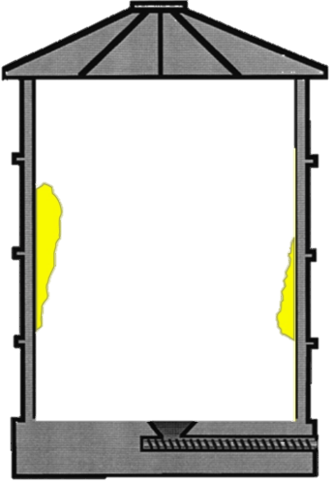
Hazard Presence?
Notes:
INSTRUCTOR NOTE – WHEN YOU ADVANCE THE SLIDE IT SHOWS THE ANSWER.
ANSWER – Represents an avalanche hazard which is a high risk situation. Potential for entrapment exists but more likely engulfment due to the height of the grain.
Ask – Why is engulfment more likely?
Discuss: If an individual tried to dislodge the grain with a pole standing on the floor of the bin they could easily become engulfed in the grain when it comes off the side above them.
Ask – how could this be avoided? First option – wait for grain to fall naturally. If entering - Stay above the top of the grain, LOTO, lifeline/harness, observer.
Lifeline would not be effective if grain could fall and hurt a person or engulf the worker, knock them off their feet, etc.

Slide 73

Hazard Presence?
Engulfment!
Avalanche Potential
Grain could fall
HIGH RISK!
Notes:
ANSWER – Represents an avalanche hazard which is a high risk situation. Potential for entrapment exists but more likely engulfment due to the height of the grain.
Ask – Why is engulfment more likely?
Discuss: If an individual tried to dislodge the grain with a pole standing on the floor of the bin they could easily become engulfed in the grain when it comes off the side above them.
Ask – how could this be avoided? First option – wait for grain to fall naturally. If entering - Stay above the top of the grain, LOTO, lifeline/harness, observer.
Lifeline would not be effective if grain could fall and hurt a person or engulf the worker, knock them off their feet, etc.

Slide 74
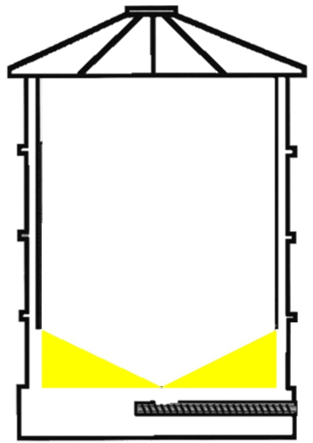
Hazard Presence?
Notes:
INSTRUCTOR NOTE – After discussion below, click once, and all other information will appear on screen. A second click will advance to the next slide.
Explain – this is a bin emptied as far as possible by gravity. The angle of repose is approximately 21 – 22 degrees. There are no pillars of grain and there is no grain clinging to the side of the bin.
ANSWER - Little probability of either engulfment or entrapment. If loading equipment is locked out and reclaim holes are guarded and it is at natural angle of repose gravity is not going to move grain any more so this is low probability even if the bin is 100 ft wide and grain is 25 ft high – if it is a natural angle it won’t flow without mechanisms like the reclaim auger.
Ask – what hazard does exist though?
The real danger is if the reclaim auger is running, a worker in the bin moving grain toward the reclaim holes could step into an open hole and into the running auger if the reclaim holes are not guarded.
Even with the bin mostly empty it would be difficult for a worker to see an unguarded hole while working as it would still be covered with grain.
Lifeline use would be determined be employer after assessing after all hazards. Probably would not be needed if conditions good and no other hazards present.

Slide 75
Hazard Presence?
LOW RISK
Guard Reclaim
Hole
ONLY if
Auger is LOTO
Notes:
Explain – this is a bin emptied as far as possible by gravity. The angle of repose is approximately 21 – 22 degrees. There are no pillars of grain and there is no grain clinging to the side of the bin.
ANSWER - Little probability of either engulfment or entrapment. If loading equipment is locked out and reclaim holes are guarded and it is at natural angle of repose gravity is not going to move grain any more so this is low probability even if the bin is 100 ft wide and grain is 25 ft high – if it is a natural angle it won’t flow without mechanisms like the reclaim auger.
Ask – what hazard does exist though?
The real danger is if the reclaim auger is running, a worker in the bin moving grain toward the reclaim holes could step into an open hole and into the running auger if the reclaim holes are not guarded.
Even with the bin mostly empty it would be difficult for a worker to see an unguarded hole while working as it would still be covered with grain.
Lifeline use would be determined be employer after assessing after all hazards. Probably would not be needed if conditions good and no other hazards present.

Slide 76
Lifeline Protection Systems
Lifeline Protection System Components

Slide 77
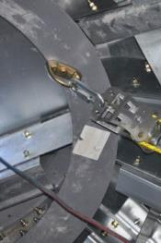
Peak Anchor
D-ring
Top Anchor
Install at peak of bin
Attach to knot passing pulley
Knot Passing Pulley
Notes:
STRESS - Consult the bin manufacturer or qualified person to determine the load capacity of the anchor to install and location for installation.
Discuss - All anchorages need to support 2 times the anticipated weight or 2,000 lbs according to ASABE. A person waist deep in grain would require two times his/her weight to be pulled out.
The peak of the bin is the strongest point to attach to for the anchor.
The bin sheets are held together by a compression ring of some type. The anchor should be attached to this ring.
Explain why the center compression ring is important, how the roof sheets and compression ring work together, how the superstructure under the bin roof supports the bin roof, various methods on how to attach the peak anchor and knot passing pulley in the peak of the bin to support a bin entry lifeline. (Consult a qualified professional for recommendations.)
Commercial bins have internal roof support systems that make it reasonably easy to install an anchor that will support 2,000 pounds. This 2000 pounds is the recommendation of ASABE (American Society of Agricultural and Biological Engineers) for a lifeline.
Farm bins may have internal roof supports but many farm bin roofs are just roof sheets from the sidewall to the top compression ring with no other support and it may be difficult to install an anchor point that will support 2,000 pounds. Show pictures of how some bins have had peak anchors installed.
It is important to stress that we recommend contacting the bin manufacturer or a qualified engineer for instructions on how to install a top anchor in any grain bin.
Point out - At the top of the slide the screwlink attaching the pulley to the bin peak. It is easiest to install this permanent pulley when the bin is full.

Slide 78
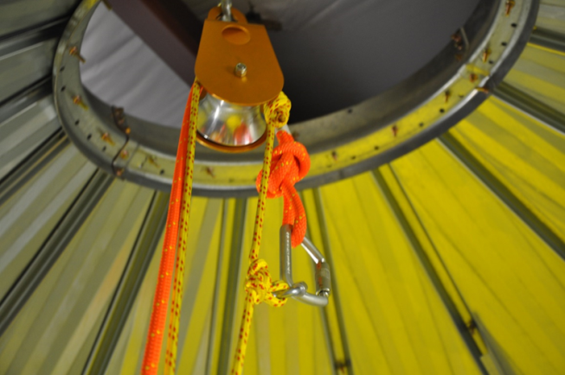
Knot Passing Pulley
Attach to peak anchor
Allows ropes, knots, & carabiners to pass through
Notes:
STRESS - Consult the bin manufacturer or qualified person to determine the load capacity of the knot passing pulley to install and location for installation.
Explain - The two anchors together must accommodate at least 2X the anticipated load or a minimum 2,000 lbs per ASABE.
Discuss - All anchorages need to support 2 times the anticipated weight. A person waist deep in grain would require two times his/her weight to be pulled out. Bottom line, anchors should be able to withstand 4 times an entrants weight. This would be worse case scenario because we are operating this lifeline system such that no one will be allowed to go any further than waist deep in grain.
The knot passing pulley should be as close to the center of the bin as possible.
The most dangerous place is the center of the bin because that is where the unloading system normally pulls grain from. Having the anchor directly over the center of the bin provides the best position to keep the entrant from swinging or being pulled down if a bridge of grain breaks while they are standing on it or if grain moves to the center. It is also important to keep the pulley and clothes line away from the grain flow as the bin is filled. Additionally, it is necessary to keep the pulley and lifeline away from a stirator or other drying equipment in the top of the bin.
Demonstrate - The knot passing pulley is simply a large, heavy duty pulley that allows knots, ropes, and carabiners to pass through in the grooved running surface of the pulley.
Point out - At the top of the slide the ring attaching the pulley to the bin peak. It is easiest to install this permanent pulley when the bin is full.
ACTIVITY – Pass around a knot passing pulley so entrants can see how it operates.

Slide 79
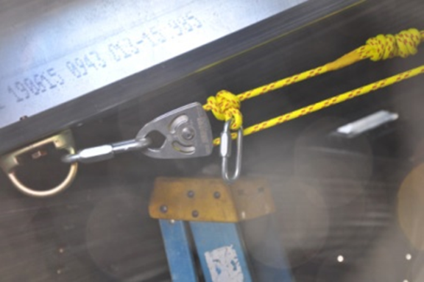
Sidewall Anchor
Attach to bin wall at top entry point
Connect to knot passing pulley
Notes:
Explain - The sidewall anchor helps support the load capacity put on the lifeline.
WARN – The sidewall anchor is a NECESSARY and INTEGRAL part of the lifeline system and is permanently installed.
Discuss - There are several types of side anchors which can be used.
Stress - Consult a qualified person (example: the bin manufacturer or structural engineer) to determine what type of sidewall anchor should be used and how to properly install.
WARN - Ladder rails or ladder rungs are NEVER appropriate for this side anchor.
Explain - the specifications of this anchor – the type and thickness of steel, etc. and discuss why it is important to use these materials.
ACTIVITY – Show the display (GHSC has) of different types of sidewall anchors and discuss how they are installed, the materials used, and how they work.

Slide 80
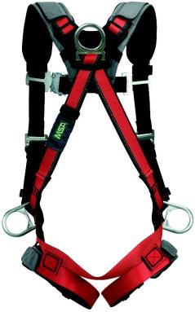
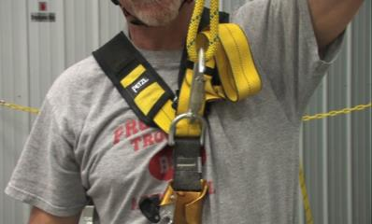
Full Body Harness is a must
Class III
Fasten shoulders, chest, thighs, waist
  leg loops
Lifeline attaches to D-ring
Distributes forces
  thighs, shoulders, chest, pelvis
Back
& side
D-rings
Front D-ring
Courtesy of MSA Safety
Notes:
Fastens around shoulders, chest, waist and thighs (has leg loops). Attachment points (D-rings) for a lifeline distributes forces over a person’s thighs, shoulders, chest, and pelvis.
Emphasize - Body harnesses should be used according to manufacturers instructions and should be rated for fall protection.
Explain -Leg loops help support the person’s trunk during suspension and help prevents suspension trauma.
Demonstrate or discuss - The harness should fit snugly – allowing the person’s hand to fit between the person’s body and the leg straps. Shoulder straps should not slip off the shoulders. The chest fastener should not constrict a person’s breathing. The waist should not be so tight as to be uncomfortable.
Stress - Harnesses should be adjusted each time they are put on to accommodate for different thicknesses in clothing or weight gains/losses.
Emphasize - Harnesses should be inspected before each use. Follow the manufacturer’s instructions for use and care of the harness. Discard harnesses that are in bad repair by cutting the straps so no one can accidently use it.
Explain D-rings. Harnesses have a dorsal D-ring (back D-ring) and/or a sterna D-ring (chest D-ring). Either can be used on a bin entry lifeline. The back D-ring attachment is available on most harness. If you use this you will not be able to use your hands if you are hanging. Using the front attachment will allow you to use your hands if you are hanging. Side D- rings on a harness are for positioning and should never be used on a bin entry lifeline.
DEMONSTRATION
Pass around “god” and “bad” harnesses if available and have participants tell which is good or bad. Look for tears, cracks, loose threads and fasteners, etc.
Have participants of different sizes put on the harness and show how they are adjusted.
Have participants put on harness and check to make sure it is correct. Have participants identify when it is correctly fitted and fastened by providing good and bad examples.

Slide 81
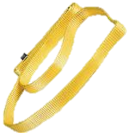

Hardware – Sling or sewn loops
Sling or sewn loops
Webbing tied with water knot
OR manufactured sewn loop
Attach components of lifeline system
Notes:
Discuss - These loops attach components of the lifeline system. Specifically they connect the sidewall anchor to the belay device.
Explain - Manufactured slings can be purchased to eliminate the need to tie special knots. GHSC recommends using manufactured slings. The sling should be labeled at least 4,000 pounds or 17kn per ______ **Dave can you add the conversion value here?.T
Stress - When using webbing to make your own sling/loop a water knot is the ONLY acceptable knot to us to prevent it from becoming undone when force is exerted on it.
ACTIVITY – Pass around examples of different slings/loops for participants to examine.
Used to attach components of the lifeline system. Example: connect sidewall anchor to belay device
Made from webbing tied with a water knot or a purchased manufactured sewn loop.

Slide 82


Hardware - Carabiners
Carabiner
Oblong metal ring with spring loaded gate
Gate locking mechanism
  Pevent accidental opening
Quickly connect/disconnect components
Notes:
A Carabiner is an oblong metal ring with a spring loaded gate. Gates must be of automatic locking type mechanism to prevent accidental opening. Carabiners hold the components together with no issue of them slipping out of the fastening. They are used to quickly connect & disconnect components in safety-critical systems. There are several types and sizes of carabiners made from different materials.
Stress - Ensure the carabiner is rated for the this type of activity. Carabiners need to be approved by ANSI or NFPA which will be written on the equipment. Do NOT use cheap metal carabiners. Purchase rated carabiners from a supplier that specializes in vertical height work or rescue. NFPA rated is a good guidelines on what to purchase.
Explain the use of an approved carabiner by NFPA and ANSI. Carabiners for personal use will have their strength printed on the carabiner. The strength ranges from 25 Kn (5,625lbs) to over 70 Kn (15,750lbs). (1 Kn=225 pounds). NFPA is the National Fire Protection Association and ANSI is the American Nations Standards Institute. Both groups test equipment to see if it is as strong as the manufacture says it is. We do not recommend a certain strength but require equipment to be tested and approved by either organization. This approval will be printed on the carabiner.
OSHA 1910.140 © [7,8,9]
(7) D-rings, snaphooks, & carabiners must be capable of sustaining a minimum tensile load of 5,000 pounds (22.2 kN).
(8) D-rings, snaphooks, and carabiners must be proof tested to a minimum tensile load of 3,600 pounds (16 kN) without cracking, breaking, or incurring permanent deformation. The gate strength of snaphooks and carabiners, must be proof tested to 3,600 lbs. (16 kN) in all directions.
(9) Snaphooks & carabiners must be the automatic locking type that require at least two separate, consecutive movements to open.
. WARN - Dropping a carabiner from a height can damage the mechanism.
ACTIVITY – Pass the carabiners around to participants and have them manipulate them – opening, closing, and fastening on things. Have participants try this with both their dominant hand and non-dominant hand. Discuss how the carabiner helps “simplify” the ease of use of a lifeline.
Picture: Seattle Manufacturing Corporation SMC Carabiner Model #: NFPA102100 Bright Auto-Locking Twist Lock sleeve is designed to be easily opened. The FP features a 1” gate opening, key lock, dual action auto locking gates compliant with the new ANSI Z359.12 2009 edition standards. The exceptional gate break strength of 16kN or 3600 lbf and a total MBS of 45kN or 10,116 lbf make this truly one bomb proof carabiner. Wieghs in at only 254 grams.Certified by Underwriter’s Laboratories to exceed the NFPA 1983 “G” - General Use requirement of 40kN. Certified to exceed the ANSI Z359.12 (2009) strength requirements. Major axis– 45kN (10,116 lbf) Minor axis– 16 kN (3,600 lbf)

Slide 83

Lifeline Rope
Critical safety component
Static kernmantle rope
7/16 inch or 1/2 inch
Use for rope access or rescue
Notes:
Kernmantle ropes allow the “give” necessary to prevent unexpected “jerks” but are not so elastic they stretch out (like a polyester rope will)– defeating the purpose of maintaining a safety cushion. They do not fray or unravel and will not be easily cut by sharp edges.
Kernmantle rope that is a minimum of 7/16” diameter and rated at 20 Kn and 4,496 pounds is the minimum recommended.
This type of rope is rated for rope access, climbing and rescue.
Kernmantle rope is rope constructed with its interior core (the kern) protected by a woven exterior sheath (mantle) designed to optimize strength, durability, and flexibility. The core fibers provide the tensile strength of the rope, while the sheath protects the core from abrasion during use. Wkipedia
Stress - Ropes should be inspected before use for any defects.
OSHA 1910.140 (c) 4 (4) Lanyards and vertical lifelines must have a minimum breaking strength of 5,000 pounds (22.2 kN)
OSHA 1910.140 (c) 15 - Lifelines must not be made of natural fiber rope. Polypropylene rope must contain an ultraviolet (UV) light inhibitor.
WARN - Do not use utility rope, natural fiber ropes or any other ropes not rated for this purpose!
Inspection – Ropes should be inspected before being put into service – even new ropes and after each use.
“Boogers” appear as tufts of white threads poking out of the mantle and indicate internal damage to the kern.
Tapered sections which appear or feel thinner indicate the rope has been severely stressed.
Abrasions or cuts should be examined by an experienced person who may choose to cut the rope at the point of damage rather than risk it parting at the damage location.
Cleaning – Commercial rope cleaning devices are available. Alternatively a rope can be cleaned by forming it into a chain sinnet to prevent excessive tangling and washing it in a front-loading clothes washing machine with soap flakes. Never use strong cleansers, including bleach and detergent on life-critical nylon components.
ACTIVITY –
Pass around various types of ropes both good and bad examples. Have participants pick out the good examples.
For an additional challenge provide only 2 good examples and ask them to find 3 good examples – see if they can spot the disparity.
Discuss the different thickness, manufacturing, and “feel” of the different ropes.
How to inspect your rope: from CMC Rescue http://www.cmcrescue.com/inspecting-life-safety-rope/

Slide 84



Capture System – Belay Device
Belay Device
Mechanical friction brake device
Controls lifeline
Locks off rope to arrest fall
  Minimal effort needed
NEW PIC NEEDED
Notes:
Explain - A Belay device is a critical component of the system. Belay devices are mechanical friction brake devices used to control a rope when belaying. Their main purpose is to allow the rope to be locked off with minimal effort to arrest a climber's fall. They may be generally referred to as descenders or rope grabs.
Belay means to secure (a rope) by attaching to a person or to an object offering stable support. (Dictionary.com) or Belay - Mechanical piece of equipment used to control a rope (during belaying).
There are 2 types of devices shown, although there are many different types. The belay mechanism should be rated ANSI Z359.4 and/or NFPA 1983 General Use.
Top Photo: Petzl I’D L - Self-braking descender for rescue, with anti-panic function. Can be utilized as a belay device. Locks during a fall/jerk on the rope or if the operator changes the handle position to manually lock it up. May not auto lock during entrapment if fall/jerk does not exert enough rapid downward force and would require belayer to manually lock device to stop descent.
Bottom photo: CSR extractor - Auto locking rope grab. Operator lets go of string and the cam automatically activates and grabs the rope stopping the descent. Can be rigged to lower person in event of a rescue.
Belaying or Belay– Belaying involves one person (called the belayer) having some control over a device and rope to which another person (the entrant) is connected. As the bin entrant moves, the belayer pays out or takes in rope to minimize the potential fall distance. The belayer must take care not to tug on the entrant or pull him or her off his or her stance.
To use a belay system:
Connect a belay device to an appropriate anchor.
Thread the rope through an appropriate belay device.
Attach the working end of the rope to the entrant’s harness.
Belayer feeds and/or pulls the rope through the device as the entrant moves, taking care to avoid both excessive slack and excessive tension.
Belay device and Belaying explanations - Courtesy of Loui McCurley, VP Pigeon Mountain Industries
Belay (NFPA definition) - The method by which a potential fall distance is controlled to minimize damage to equipment and/or injury to a live load. Belayer (NFPA definition) - The rescuer who operates the belay system.
ACTIVITY – pass around examples of different belay devices. Discuss the different brands/types of devices and the pros/cons of each. If space and time permit, have participants practice on an appropriately set-up belay system paying out and taking in slack while a volunteer walks around the room. (The volunteer will need to be hooked to a full body harness and anchor systems if possible. Tall ceilinged rooms with beams, tall ladders, etc. can be used to demonstrate if the instructor has been trained). DO NOT ATTEMPT this without appropriate training, knowledge and experience!

Slide 85



Active & Passive Belay Devices
Active device
Mechanism locks rope when sudden jerk or pull occurs
Does not require other equipment or belayer action
Passive device
Rely on belayer's brake hand & carabiner to lock off rope.
Notes:
Discuss - There are two kinds of belay devices: active belay device and passive belay device.
An active belay device automatically grabs rope if there is a sudden jerk or pull.
Active belay device is recommended. An active device will engage the rope and hold the entrant without any belayer action. It should also be able to release easily to give the entrant slack when he needs it. (Source: Wikipedia. Active belay devices have a built-in mechanism that locks off the rope without the help of any other pieces of equipment. The offset cam locks off the rope automatically to catch a falling climber, much like a seat belt in a car locks off to hold a passenger securely.
Passive belay devices rely on the belayer's brake hand and a carabiner to lock off the rope. A passive belay device is not recommended. It will effectively do an adequate job of controlling the rope but it requires action by the belayer which is less desirable.
Active Device – Pros
Easier to release load
Easier for novice
Active Device - Cons
Sinking may not auto lock –Jerk from sin not strong enough
Need assistance to lock
Possible delay to react
Photos from Petzl® and Davis Hill

Slide 86
Anchoring Concetps
Anchoring Concepts Anchors
Lifeline Rigging

Slide 87

Anchor: Secure attachment point
Secure point of attachment
Reference
  OSHA 1910.140
  ANSI – intended to support any forces applied to the system
  NFPA – capable of sustaining the actual & potential load on the rope rescue system
Notes:
Anchor is a secure point of attachment for lifelines, lanyards, and/or deceleration devices.
References can be found in OSHA 1910.140 Personal fall protection systems as well as ANSI (American national standards Institute) and NFPA (National fire Protection Association).
Note the difference in definitions between ANSI and NFPA.
OSHA standard for anchors under 1910.140 (c)
(12) Anchorages used to attach to personal fall protection equipment must be independent of any anchorage used to suspend employees or platforms on which employees work. Anchorages used to attach to personal fall protection equipment on mobile work platforms on powered industrial trucks must be attached to an overhead member of the platform, at a point located above and near the center of the platform.
(13) Anchorages, except window cleaners’ belt anchors covered by paragraph (e) of this section, must be:
(i) Capable of supporting at least 5,000 pounds (22.2 kN) for each employee attached; or
(ii) Designed, installed, and used, under the supervision of qualified person, as part of a complete personal fall protection system that maintains a safety factor of at least two.

Slide 88
Anchorage Connector
Component functioning as interface between anchor & lifeline system
Couples system to anchor
Notes:
In this case the anchorage connector is between the peak anchor and the knot passing pulley.
OSHA 1910.140(c)
(1) Connectors must be drop forged, pressed or formed steel, or made of equivalent materials.
(2) Connectors must have a corrosion-resistant finish, and all surfaces and edges must be smooth to prevent damage to interfacing parts of the system.
(3) When vertical lifelines are used, each employee must be attached to a separate lifeline.

Slide 89

Anchor Load
Capable of supporting 2X anticipated weight
Minimum 2,000 lbs
  ASABE
1000 lbs
Weight of person
&
Impact of fall
1000 lbs
Weight of person
&
Impact of fall
Notes:
Anchor loads – The load (weight and/or force) that will be placed on the anchor and which it must be able to support.
OSHA 1910.140 (c) (13) Anchorages, except window cleaners’ belt anchors covered by paragraph (e) of this section, must be
(i) Capable of supporting at least 5,000 pounds (22.2 kN) for each employee attached; or
(ii) Designed, installed, and used, under the supervision of qualified person, as part of a complete personal fall protection system that maintains a safety factor of at least two
ASABE - American Society of Agricultural and Biological Engineers – X624 Grain Bin Access Design Safety Standards Development Group for X624, Grain Bin Access Design Safety - recommends a 2,000 minimum anchor load limit based on the design of a peak anchor and side anchor lifeline system and a 250 lb person with gear.
“The anchor points shall be clearly identified on the bin with a decal and in the owner’s manual and both shall state the maximum load capacity per anchor point. Both decal and manual shall state that the bin lifeline system is designed to carry one person of up to 250 pounds (113.4 kg) and is designed for a maximum line slack of 2 feet (610 mm).
The 2000 lb rating for the anchor point is derived with the following assumptions and equations:
The weight of the entrant is taken as 250 lbs, as per ANSI A14.3 and ASAE A412.1. The bin entry life line is to be low stretch rescue line and is to be used with a harness. The stretch of the line and harness rigging resulting from a 2 foot drop is assumed to be at least 1 foot. This is based on the stretch factor of 1-10% of the rescue ropes that are used for bin entry, and the lengths of rope that would be used for entry systems.
Using kinematic equations, a 2 foot drop under the force of gravity takes 0.35 seconds and results in a velocity of 11.27 ft/s. An even deceleration from 11.27 ft/s to 0 ft/s over a distance of 1.0 ft results in an acceleration of -63.5 ft/s2. This is 1.97 x gravity and will result in a force of 250 lbs x 1.97 = 492.5 lbs. For simplicity’s sake the 492.5 lbs is rounded up to 500 lbs. Applying a 2 x safety factor increases the required capacity of the peak anchor point to 1000 lbs. With the change of direction of the center roof pulley, the peak anchor point would see as much as 1000 x 2 = 2000 lbs.
The change in direction of the pulley does not affect the anchor point at the roof access point. The required capacity at the roof access point would be the 500 lb deceleration force multiplied by the 2 x safety factor = 1000 lbs. However, for uniformity’s sake the stated required capacity of the roof access point will also be 2000 lbs.

Slide 90
2 anchor points secure lifeline system
Secured lifeline system has 2 anchor points.
Peak
Side
Anchors:
Are permanent
Evenly distribute weight
Allow work around circumference of bin
Notes:
It is important to explain that 2 anchors are necessary. They equalize the weight of the worker as well as the stretch of rope and forces such as gravity.
Furthermore, it allows the worker to move/work around the entire bin.
If there was only a top anchor, the length of the lifeline rope would be too long to be effective if an incident happened.

Slide 91
Inappropriate anchors can be deadly.
Inappropriate anchors cannot support anticipated weight & can fail during use.
Ladder rungs or ladder sidewalls
Duct work
Conduit or piping
Lightweight and/or unfastened structural components
Notes:
Discuss improper or inadequate anchor points in a grain bin.
Do not use ladders, handrails, steps, as anchor points. These are all examples of inappropriate anchors. They do not have the structural strength to hold a person against the force of the grain. Using these types of anchors is highly ineffective and dangerous to the worker.
There are many attachment points inside and outside a grain bin such as ladder rungs, ladder brackets, ladder side rails, angle iron steps, handrails, angle iron brackets, fans, vents, electric conduits, wind rings, and many more. None of these are designed as anchors for a lifeline system. A few of these may be adequate but none of these are recommended without consulting with the bin manufacturer or a qualified engineer.

Slide 92
Peak anchor installation
  Install when bin is full
  Install during construction
  Varies depending on type of roof
    Attach to compression ring
  Connects the knot passing pulley
Consult the grain bin manufacturer or an engineer for proper installation.
Notes:
Peak anchor installation will vary depending on the structure of the grain bin, particularly the roof. In most cases the peak anchor is installed on the compression ring of the bin as near to center as possible.
In an existing bin the optimal time to install a peak anchor is when the bin is full, allowing easier access to the highpoint of the roof. Anchors should not be installed without first consulting the bin manufacturer, an engineer or a company that specializeds in lifeline anchor point installation. This is for your safety. They will be able to determine IF your structure can support the forces put on the roof and where to install the anchor.
For new bins, consult your bin manufacturer as man now have anchor points as either an option or standard feature.

Slide 93


Peak anchor – Forged D bracket
Forged D anchor bracket
Permanent or portable
Fall protection
Rating
  ANSI Z359.1
  CSA Z259.12-00
Specifications
  MBS 5,000 lbs
  WLL 400 lbs
Notes:
The D ring is bolted to the compression ring. The key here is attached to the compression ring.
A forged D anchor bracket is used in fall protection, fall restraint and work positioning systems.

Slide 94

Peak anchor – 10K swivel anchor
10K swivel anchor
Permanent or portable
Steel bolt – use in steel
Used in various PFPS
Rating
  ANSI Z359.1
  CE EN 795
Specifications - MBS 10,000 lbs; WLL 5,000 lbs
Notes:
The swivel anchor is designed for use in fall protection, work positioning, restraint, tie back anchoring, 4 man lifeline systems.
Installed by qualified person.
As a portable anchor they can be removed and used again elsewhere.
They are designed for use in steel.

Slide 95

Peak anchor – beam clamp
Beam clamp anchor
Fit I-beams 3” – 9.25”
Simple to install
Removable
Meets ANSI, CAS, & OSHA
Rating - ANSI Z359.1; CSA
Specifications - WLL 2,000 lbs
Notes:
Rated for a one person load. Clamp is removable.
Clamp is rated at 1 ton.
Meets ANSI, CAS & OSHA (1910.140) anchorage requirements.
Simple to install and removable.

Slide 96
Sidewall anchor installation
Sidewall Anchor
Install near top opening
Install new construction
Weight distribution
Attach to belay device
Consult the grain bin manufacturer or an engineer for proper installation.
Notes:
The sidewall anchor helps to distribute the fall forces evenly.
The belay device is attached here. The side anchor is what prevents an entrant from becoming entrapped more than waist deep.
They are attached near the top opening of the bin.
Again, for existing bins, consult a professional for installation. The side anchor is necessary to an effective lifeline system and needs to be placed near the opening for optimal advantage of the observer. Bins lacking adequate work platforms may need special consideration.

Slide 97



Sidewall anchors – D bracket/swivel
Forged “D” anchor bracket
10K swivel anchor
Needs a backer
  Corrugation of bin sheets
Backer secures anchor
Notes:
The swivel anchor and the D anchor with pipe as a backer are examples of sidewall anchors.
These anchors are designed and manufactured to hold one person for fall arrest and for positioning or just holding a person.
They are rated at 5,000 pounds and this is printed on the equipment. This extra strength guarantees it will hold a single person.
In a grain bin the bin sheets are thin and most often corrugated so it is important to have a large backer on the outside of the bin to keep the nut on the outside from pulling through the bin sheet.
Manufacturers do not suggest what backer should be used on a grain bin. Some engineers have suggested what we are showing.
Show the anchor installation on a simulator.

Slide 98
Basic Concepts and Skills
Basic Concepts & Skills

Slide 99


Disclaimer
This material was revised or produced under grant numbers
SH-26305-SH4 or SH-27664-SH5 from the Occupational Safety and Health Administration, U. S. Department of Labor. It does not necessarily reflect the views or policies of the U.S. Department of Labor, nor does mention of trade names, commercial products, or organizations imply endorsement by
the U.S. Government.

Slide 100
Harness inspection
Demonstration & activity
BASIC CONCEPTS & SKILLS
Notes:
Participants will be assessed on performing a proper pre-entry harness inspection.
Instructor should show/discuss slides and demonstrate the skill to participants.
The following slides list what to look for and have some photos.
There are MANY resources available for harness inspection including several excellent videos on youtube. Instructors may wish to use a video or other appropriate resource in place of the slides in this power point.

Slide 101


Clean your harness after each use
Clean after each use
  Brush off dirt
  Scrub gently with water & mild soap
  Follow manufacturer instructions
Notes:
Inspect the harness before and after each use.
Look for: Frayed edges, broken fibers, pulled stitches, cuts/tears, abrasions, burns, mold, chemical damage (discoloration).

Slide 102



Inspect your harness – each time
Inspect harness BEFORE each use
Labels – legible, intact
Impact indicator
Webbing
Hardware
  D-rings, buckles, tongues, grommets
Annual inspection by competent person – document
Notes:
Harnesses must be inspected before each use.
If the impact indicator has been activated, the harness must be inspected by a competent/qualified person before being used.
The hardware is checked for nicks, gouges, losose grommets/tongues, etc.
The webbing is checked for frayed edges, broken fibers, pulled stitches, cuts/tears, abrasions, burns, mold, chemical damage (discoloration).
Mark the inspection date on the label.
An annual inspection by a competent person should be completed and documented.

Slide 103

Inspect your harness – each time
Inspect harness BEFORE each use
Labels – legible, intact
Impact indicator
Webbing
Hardware
  D-rings, buckles, tongues, grommets
Annual inspection by competent person – document
Notes:
Harnesses must be inspected before each use.
If the impact indicator has been activated, the harness must be inspected by a competent/qualified person before being used.
The hardware is checked for nicks, gouges, losose grommets/tongues, etc.
The webbing is checked for frayed edges, broken fibers, pulled stitches, cuts/tears, abrasions, burns, mold, chemical damage (discoloration).
Mark the inspection date on the label.
An annual inspection by a competent person should be completed and documented.

Slide 104


Webbing
Wear indicator
Impact indicator
Notes:
Left photo: Explain the darker threads indicate wear. If there is no “margin” of lighter threads to the side of the wear indicator, the harness the harness should be taken out of service.
Right photo: There are several different types of impact indicators which vary according to the harness and manufacturer. Once the impact indicator is shows an impact was sustained the harness needs to be inspected by a qualified person before being used again and in most cases should be removed from service.

Slide 105


Inspect Webbing
Inspect both sides, entire length
Bend 6-8 inch segments - inverted U
  Frayed edges
  Broken fibers/pulled stitches
  Cuts/tears, abrasions
  Burns, & chemical damage (discoloration)
  Tufts on surface indicate broken fibers
Notes:
All webbing should be inspected before use.
Making an inverted U with the webbing allows any broken, pulled stiches, cuts, etc. to be more visually noticeable.
Picture – blink.univ of california san diego
Picture – frayed webbing - gravitec

Slide 106
Inspect hardware
Attachment points – buckles & D-rings
  Unusual wear, frayed or cut fibers
D-rings
  Distortion, cracks, breaks, rough/sharp edges
  Check back pads for damage
Rivets
  Tight/cannot be moved. Flat against material.
  Pitted or cracked show chemical corrosion
Grommets
  Loose, torn, distorted or broken
Notes:
From https://www.ccohs.ca/oshanswers/prevention/ppe/belts.html
Inspect hardware for cracks, dents, bends, rust, signs of deformation, or other defects. Replace the belt if the "D" ring is not at a 90 degree angle and does not move vertically independent of the body pad or "D" saddle.
Make sure that any hardware is not cutting into or damaging the belt or harness.
Inspect tool loops and belt sewing for broken or stretched loops.
Check bag rings and knife snaps to see that they are secure and working properly. Check tool loop rivets. Check for thread separation or rotting, both inside and outside the body pad belt.
Inspect snaps for hook and eye distortions, cracks, corrosion, or pitted surfaces. The keeper (latch) should be seated into the snap nose without binding and should not be distorted or obstructed. The keeper spring should exert sufficient force to close the keeper firmly.

Slide 107

Inspect – tongue buckle
Tongue buckle
  Free of distortion in shape & motion
  Move freely back & forth in socket
  Roller turn freely on frame
  Overlap buckle frame
  No sharp edges
  Clear of debris
Miller Fall Protection
Notes:
Buckles need to be inspected to ensure they are closing properly and securely. If the tongue of the buckle does not rest flat, it will not only be uncomfortable for the user, but could work itself loose.

Slide 108
Inspect – friction & mating buckle
Friction & mating buckles
  Free of distortion
  No sharp edges
  Free of debris in mechanism
  Outer & center bars – straight
  Look at corner & attachment points of center bar
  Release tabs – work freely; click when buckle engages
Notes:
A distinctive click should occur when latching. If he “clilck” does not appear to be normal, have a qualified person inspect the harness before using it.

Slide 109
Harness Donning & Adjustment
Demonstration & activity
BASIC CONCEPTS & SKILLS
Notes:
Participants will be assesse on performing a proper pre-entry harness inspection.
Instructor should show/discuss slides and demonstrate the skill to participants.
Instructor should demonstrate how to properly don and adjust a harness. Although all steps are listed in the following slides, there are several videos available on you tube the instructor may wish to substitute.
Participants should practice putting on harnesses and practice “buddy checks” – having someine else ensure the D-ring is centered on the back correctly, and the chest strap is in the right location.

Slide 110

Harness size
One size does not properly fit all
Height consideration
Weight
Appropriate type for work
Must have back D-ring
  Recommend front D-ring also
Notes:
One size does not fit all. Participants should work with a qualified person to try on different size/types of harness and find a harness not only suited to the job but comfortable.

Slide 111


Prepare the harness
Hold harness by back D-ring & gently shake
Release/unbuckle any fastened straps
Straps fall into place
Photos: Honeywell Safety Products / Miller Fall Protection Media Library
Notes:
To properly disentangle a body harness – hold it by the back D-ring and gently shake. This allows all the straps to fall into place.
Release/unbuckle any fastened straps including ches, leg, waist, straps.
Pictures: Honeywell Safety Products/Miller Fall Protection Media Library. GHSC is a registered user with Honeywell Safety Products Media Library .

Slide 112


Shoulder straps
Slip straps over shoulders. Position D-ring middle of back between shoulder blades.
Pull leg straps between legs & fasten around thighs. Connect waist strap.
Photos: Honeywell Safety Products / Miller Fall Protection Media Library
Notes:
The D-ring needs to sit between the shoulder blades and in the middle of the back.
Shoulder straps should not slip over shoulder. Adjust shoulder straps so the chest strap/retainer is just under the level of your armpits.
Leg straps go underneath buttocks. Do one leg at a time. Connect waist strap after leg straps.

Slide 113


Adjust harness
Connect chest strap. Position in mid-chest area. Shoulder taps taut.
Adjust straps snug. Retain full range of movement. Check fit.
Photos: Honeywell Safety Products / Miller Fall Protection Media Library
Notes:
Connect chest strap. Position in mid-chest area
If a chest strap is not fastened properly, it can slide up around a worker’s neck after a fall.
Adjust all straps snugly but so they retain full range of movement. Pass excess staps through loop keepers or fold & tuck.
Check – holding hand flat, you should be able to fit fingers underneath leg straps.

Slide 114
Knot tying
Demonstration & activity
BASIC CONCEPTS & SKILLS
Notes:
Participants will be assesse on performing a proper pre-entry harness inspection.
Instructor should show/discuss slides and demonstrate the skill to participants.
The instructor should demonstrate this skill and/or use one of the many video resources available such as animatedknots.com to show participants how this knot is tied.

Slide 115

Figure 8 on a bight - knot
Most used
End of rope
Easy to untie & inspect
  2 strands beside each other
  Loops parallel - do not cross over each other
Connect body harness & anchor
Notes:
AKA - Figure 8 Loop, Flemish Loop, Flemish 8
Figure eight on a bite-used as an end of the rope knot. The most used knot. Will be used to connect to the full body harness and to the anchor. Strong knot that is easy to untie after being loaded. Can be called figure 8 loop. Can be used around object such as figure 8 follow through.
Black background Pictures from nmmi.edu where noted as Pictures Courtesy of: http://www.iland.net/~jbritton/figure8loop.htm
Picture of figure 8 on a bight and knot components from wikipedia. Knot components - "BightLoopElbow" by Original uploader was (Automated conversion) at en.wikipedia(Original text : en:User:Satsun) - Originally from en.wikipedia; description page is/was here.(Original text : Created by uploader). Licensed under CC BY-SA 3.0 via Wikimedia Commons - http://commons.wikimedia.org/wiki/File:BightLoopElbow.jpg#mediaviewer/File:BightLoopElbow.jpg

Slide 116




Figure 8 on a bight
Make a bight
360°
Make a bight. Form a loop with bight as working end.
Wrap working end around standing end 360 degrees.
Feed working end through loop.
Dress & set.
Loops parallel – do not cross over each other.
Minimum 4” pigtail after safety knot.
Notes:
Figure eight on a bite-used as an end of the rope knot. The most used knot. Will be used to connect to the full body harness and to the anchor. Strong knot that is easy to untie after being loaded. Can be called figure 8 loop. Can be used around object such as figure 8 follow through.
Black background Pictures from nmmi.edu where noted as Pictures Courtesy of: http://www.iland.net/~jbritton/figure8loop.htm
Directions: http://www.nmmi.edu/academics/leadership/documents/step-by-stepfigure8andbowline.pdf
Picture of figure 8 on a bight and knot components from wikipedia. Knot components - "BightLoopElbow" by Original uploader was (Automated conversion) at en.wikipedia(Original text : en:User:Satsun) - Originally from en.wikipedia; description page is/was here.(Original text : Created by uploader). Licensed under CC BY-SA 3.0 via Wikimedia Commons - http://commons.wikimedia.org/wiki/File:BightLoopElbow.jpg#mediaviewer/File:BightLoopElbow.jpg
Directions :
Form a bight in the rope about as large as the diameter of the desired loop.
With the bight as the working end, form a loop in rope (standing part). Wrap the working end around the standing part 360 degrees and feed the working end through the loop.
DRESS THE KNOT - Dress it and pull tight
Make sure you have enough tail to tie a safety knot, as the knot will slip a bit when loaded.
CHECK IT - The loop is the desired size.
The loops are parallel and do not cross over each other.
The knot is tightly dressed.
There is a minimum 4-inch “pigtail” after tying the safety knot

Slide 117
Prepare Lifeline for Use
Demonstration & activity
BASIC CONCEPTS & SKILLS
Notes:
Participants will be assesse on performing a proper pre-entry harness inspection.
Instructor should show/discuss slides and demonstrate the skill to participants.

Slide 118

Clothesline - Rig lifeline to anchors
Clothesline - loop of rope between peak anchor & sidewall anchor.
  Permanent
  Has 2nd loop in it
  Installs lifeline
    Through KPP
  Not part of lifeline system
Notes:
The clothes line is installed from the bin sidewall through the KPP and back to the sidewall and the ends are tied together in a loop.
The loop is attached to the sidewall using an eyebolt, pulley, or other simple attachment.
It is easiest to install this when the bin is being built or on existing bins that are full of grain. You can walk on the surface of the grain and install everything.
In larger bins you may need an extension ladder for the peak anchor point and KPP. Use FALL PROTECTION OR GO THROUGH ROOF. Using a ladder on grain is dangerous. There is no way to correctly position an extension ladder and block it.
Keep the clothes line tight to minimize tangling the lifeline and clothes line. The KPP should be pulled by the clothes line to face the bin entry point.
While it does not have to be a load bearing rope, care should be taken to use a rope that will stand up to the harsh environment so it does not disintegrate quickly or it will have to be reinstalled. Do not use a hemp rope. RECOMMEND CORDED, STRANDED PROTECTIVE GOOD QUALITY TO ICREASE LONGEVITY PRUSSIC POLY OR NYLON NOT BRAIDED, NOT HEMP,

Slide 119
Prepare Belay Device for Use
Demonstration & activity
BASIC CONCEPTS & SKILLS
Notes:
Participants will be assesse on performing a proper pre-entry harness inspection.
Instructor should show/discuss slides and demonstrate the skill to participants.

Slide 120

Installing lifeline through the KPP
Attach lifeline to clothesline
Pull opposite rope toward sidewall anchor
  Move loop around KPP
Pull lifeline back to start
Unhook lifeline from clothesline
  Attach to sidewall anchor to keep accessible
NO PPE – simulated in controlled training environment.
Notes:
The close line will have a knot that connects the two ends into a loop. At the point there should be a loop or bite to attach the lifeline to by using a knot or a carabiner. Attaching one end of the lifeline to the clothes line a person can then pull the opposite side of the clothes line to move the lifeline toward the center. Moves the loop toward the knot passing pulley and through it.
Repeating this process many times will move the clothes line through the KPP and back to the bin entry door where the sidewall anchor is located.
At this point the lifeline is removed from the clothes line. The clothes line has no other function. As the environment is harsh – you don’t want the clothesline to disintegrate quickly or it needs to be reinstalled so use a better quality rope.

Slide 121

Set up & test the belay device
Set up belay device
  Follow manufacturer instructions
  Practice - qualified person
Few feet from knot
Test proper set up
  Jerk firmly on end to entrant
  Ensure it grabs line
NOTE: Example is Petzl® I’D L descender.
See manual for COMPLETE instructions.
Notes:
It is possible to install the lifeline incorrectly. Some devices, such as the one pictured, have safety features to reduce error but they may not catch all errors.
After purchasing a belay device it is HIGHLY recommended the new user work with the certified sales rep to learn how to properly set up the device and practice a number of times to become comfortable and familiar.
After installation the participant takes the end of the rope that goes to the entrant and jerks it to make sure it grabs the line to ensure the ends of the lifeline are not installed backwards or the belay device is not backward.

Slide 122



Belay device – install lifeline
1) Open belay device & thread lifeline
2) Close/lock belay device
3) Test belay device
Notes:
(It is possible to install the lifeline incorrectly. After installation the participant takes the end of the rope that goes to the entrant and jerks it to make sure it grabs the line to ensure the ends of the lifeline are not installed backwards or the belay device is not backward.

Slide 123
Attach lifeline & Belay Device to entrant
Demonstration & activity
BASIC CONCEPTS & SKILLS
Notes:
Participants will be assesse on performing a proper pre-entry harness inspection.
Instructor should show/discuss slides and demonstrate the skill to participants.

Slide 124


Connect lifeline to anchor & entrant
Use carabiner - connect belay device to side anchor
  After belay set-up complete
Use Figure 8 on byte, attach lifeline rope to carabiner
Attach carabiner to entrant harness D-ring
No PPE Controlled demonstration
Notes:
(It is possible to install the lifeline incorrectly. After installation the participant takes the end of the rope that goes to the entrant and jerks it to make sure it grabs the line to ensure the ends of the lifeline are not installed backwards or the belay device is not backward.

Slide 125
Managing the lifeline
Demonstration & activity
BASIC CONCEPTS & SKILLS
Notes:
Participants will be assesse on performing a proper pre-entry harness inspection.
Instructor should show/discuss slides and demonstrate the skill to participants.

Slide 126

Managing the Lifeline
Maximum slack in rope is 2 feet
Entrant has 1 foot of “safety cushion”.
Distance from feet to waist @ 3 feet
Notes:
Discuss - A lifeline meets the OSHA standards to prevent an entrant from sinking more than waist deep in grain.
Explain -This is done by controlling the slack in the rope to a maximum of two feet.
Explain - On average the distance between a person’s feet to their waist is approximately 3 feet. The two feet of slack in the rope will only allow a person to sink two feet before it grabs. This builds in an extra foot of safety cushion before reaching the person’s waist.
Note - It is important to remember the more a person is entrapped the more force is needed to extricate them. Preventing an entrapment from occurring above the waist will prevent breathing difficulties due to pressure on the upper torso.

Slide 127

Managing the lifeline - Entrant
Entrant
No more than 2 feet slack
Say “Take” - too much slack
Say “Give” - need more slack
Notes:
The entrant is responsible for communicating with the observer about his needs for the lifeline rope. There should never be more than 2 feet of slack. The entrant needs to tell the observer when to take slack in because there is too much or when to let rope out.
More than 2 feet puts entrant at gooing more than waist deep if an entrapment/engulfment situation occurs.

Slide 128

Managing the lifeline -Observer
Observer
Lean into opening
One hand hold lifeline
One hand on extra rope
Give slack - feed rope out
Remove slack - take rope in
Device locks & holds entrant if fall occurs
  Observer can lock mechanism
Notes:
Explain these are the roles and responsibilities of the people involved in a bin entry. The Observer role is especially important as he must remain in constant contact with the entrant either visually (best) or through other means.
Walking and worker surfaces & ladders– Add OSHA reference
Platforms - Extend 42” from ladder & landing; 12” distance between rungs
Using a portable ladder - Improper ladder use – using step ladder for extension ladder; Need to extend 3 feet above access. No place for Observer to stand and manage belay and observe and it is difficult to maintain 3 points contact.
The observer can lock the mechanism and hold the entrant if needed. Because a person might not fall “quickly” and exert enough force on the lifeline to trigger the mechanism, the observer needs to remain diligent & communicate with the entrant. If sinking occurs the observer will want to lock the lifeline and keep the entrant from sinking more. This protects the entrant.
A major concern is breaking the plane of entry under the confined space regulations. The grain handling standard does not have this provision regarding entry – therefore, the observer can break the plan and lean inside to manage the belay system.

Slide 129
Knowledge review and summary
Knowledge Review & Summary

Slide 130
Course Summary – Pre-Entry
Course Summary – Pre-entry
Assess hazards
ALWAYS LOTO
ALWAYS - Observer present
  Duties of entrant & observer - TRAINED
Check atmosphere
Use a lifeline system:
  Top entry, potential bridging/crusting
  NOT effective - below grain level or avalanche conditions
Notes:
Entrapments and engulfments are preventable if the hazards were correctly assessed and corrected PRIO to entering the grain bin.
A lifeline protects a worker from unknown hazards which may be in the bin. However, proper assessment of the conditions and staying out of the bin when it is dangerous is the best prevention.
LOTO cannot be stressed enough. Almost all incidents of entrapment involve lack of LOTO.

Slide 131

Course Summary - Lifeline
Course Summary - Lifeline
Components of lifeline protection system
Describe how the lifeline system works
  Anchors – Peak & side minimum 2000#
  Belay – keep slack in lifeline rope at 2 feet
Notes:
Lifeline Protection System Components
Peak Anchor
Knot Passing Pulley
Sidewall Anchor
Full body harness
Lifeline rope
Sling or sewn loops
Carabiner
Belay Device
Effective Lifeline
Top Entry most effective
Bridging or Crusting Conditions when worker could unexpectedly fall
If grain starts to flow
Angle of repose is steep or uneven
When can stay above grain
Ineffective Lifeline
Avalanche conditions – sidewall build up or exposed pyramids/towers when worker cannot stay above grain level.
Not very effective in side entry for operating sweep or final bin unloading.
Describe how lifeline system works
Anchors – 2 anchors one at peak and one at side to evenly distribute weight and force.
Belay – no more than 2 feet of slack. Locks if unexpected fall.

Slide 132
Remember for assistance with lifeline installation
REMEMBER
Contact your bin manufacturer or an engineer to assist with lifeline installation.
Use a reputable dealer for equipment purchases.
ALWAYS follow manufacturer’s instructions.

Slide 133
Skill Acquisition
Skill Acquisition
Notes:
This next section is the hands-on portion of the training. The slides provide information to support the skill levels being taught, demonstrated. In some instances, the same information can be provided through other means – such as videos on harness inspection.
Instructors will work with participants to demonstrate and practice the skills outline.
All participants will act as an observer and entrant practicing belaying techniqes and understanding how the lifeline works.
Participants are to practice the skills and then ask an instructor to observe them performing the skill.
It is imperative instructors watch EACH participant perform the skills in the 7 areas identified and complete the Proficiency Certification form.
These are life critical skills. “passing someone through” when they cannot demonstrate a level of proficiency is dangerous to that person.
It is anticipated the majority of participants will receive “With Assistance” ratings. It is important to let them know the skills will develop over time with use and practice.

Slide 134
Hands on Exercises.
Skill testing
Participants will demonstrate skill acquisition & proficiency in the following areas:
Harness inspection
Harness donning, sizing & adjusting
Figure 8 on a byte
Installing lifeline through KPP
Preparing the belay device
Attaching lifeline & belay device to entrant
Managing the belay device & lifeline

Slide 135
Certification Proficiency
General Skill Test
To receive course certification participants are required to show proficiency in course topics and hands on exercises. Proficiency will be evaluated by both a written examination and skill demonstration.
Written examinations evaluate participants’ knowledge of the subject topic. A 70% on the written exam is required for proficiency.
Skill demonstrations evaluate participants’ ability to complete the skill – either independently or with assistance.
An evaluation of “unsuccessful completion” will be given if participant
was unable to successfully complete the task, either in part or entirety, whether or not assistance was provided;
the participant does not attempt to complete the skill;
the participant did not complete the skill while being observed by an instructor.

Slide 136
Harness Instection #1
Skill Acquisition # 1
Harness inspection

Slide 137
Proficiency #1 - Harness inspection
Participants will be asked to demonstrate to the course instructor skill in inspecting their full body harness.
Impact indicator
Inverted U – webbing & stitching check
Hardware – D-ring, grommets, buckles, tongues
  Check for free movement
  Check for distortion
  Check attachment points

Slide 138
Harness donning, sizing and adjusitng #2
Skill Acquisition # 2
Harness donning, sizing, and adjusting

Slide 139
Proficiency #2 – don, size, adjust harness
Participants will be asked to demonstrate to the course instructor skill in donning, sizing, & adjusting their full body harness.
Hold harness by D-ring & shake straps loose
Position & size harness correctly
  Back D-ring between shoulder blades
  Chest strap in mid-chest area
Adjust harness correctly and perform check
  Shoulder straps taut
  Snug fit with free range of movement
  Finger check in leg loops

Slide 140
Figure 9 on a byte #3
Skill Acquisition # 3
Figure 8 on a byte

Slide 141
Proficiency #3 - Figure 8 on a bight
Participants will be asked to demonstrate to the course instructor skill tying a Figure 8 on a bight knot.
Make a bight the diameter of the desired loop
Forms knot correctly
Dress & set knot correctly (tightened correctly)
Perform check
  Loops parallel & do not cross over each other
  Minimum 4” pigtail after tying safety knot.

Slide 142
Installing lifeline #4
Skill Acquisition # 4
Installing lifeline through the KPP with a clothesline

Slide 143
Proficiency #4 - Install lifeline
Participants will be asked to demonstrate to the course instructor skill in using the clothesline to install the lifeline.
Participants will be asked to demonstrate to the course instructor skill in the use of a clothesline to install the lifeline.
Attach lifeline to the clothesline loop with a carabiner
Pull lifeline around knot passing pulley and back to side anchor
Attach lifeline to side anchor for safe keeping
Notes:
http://science.howstuffworks.com/transport/engines-equipment/pulley.htm

Slide 144
Preparing the belay device #5
Skill Acquisition # 5
Preparing the belay device

Slide 145
Proficiency #5 - Prepare belay device
Participants will be asked to demonstrate to the course instructor skill in correct preparation of the belay device.
Correctly run lifeline through the belay device.
Correctly perform the “check” to ensure the rope is not run backward.

Slide 146
Attaching lifeline & belay device to entrant #6
Skill Acquisition # 6
Attaching lifeline & belay device to entrant

Slide 147
Proficiency #6 - Attach lifeline
Participants will be asked to demonstrate to the course instructor skill in correctly attaching lifeline to entrant & side anchor.
Correctly attach lifeline to entrant.
  Use Figure 8 on a bight knot tied earlier & carabiner.
Correctly attach belay device to side anchor.

Slide 148
Managing the lifeline & belay device #7
Skill Acquisition #7
Managing the lifeline & belay device

Slide 149
Proficiency #7 - Manage lifeline & belay device
Participants will be asked to demonstrate to the course instructor skill in correctly managing the lifeline & belay device.
Correctly provide slack to entrant.
Correctly take slack from entrant.
Correctly lock device to hold entrant.

Slide 150
Questions
QUESTIONS?

Slide 151

Thank you slide
Thank you!
Protect our most valuable resource –
OUR WORKERS

Slide 152
Address ALL critical safety issues
PRINT VERSION
Hazard Assessment & Correction
  grain condition
LOTO
Atmosphere
Lifeline use
Entrant training
Observer training & role
Rescue Availability
Notes:
ANIMATED SLIDE – There are 10 clicks total for this slide. See instructions with points to discuss. The 1st. click brings out the identifying information. The next 7 clicks highlight each bullet. The 9th click brings out the signature and authorization. The 10th click returns the screen to the permit and bullets.
At the back of this PPT presentation is a view of the screen for printing purposes that does not show the multiple layers embedded in the animation. If an instructor is uncomfortable clicking through the animation that slide can be substituted in place of the animated slide.
This is an example of a permit. It address the critical safety issues. CLICK.
Every permit should have identifying information including a way to identify the bin being entered, the date, and the time of entry and the work being completed (reason for entry & task). CLICK.
Hazard assessment – (grain condition) – can be a statement as shown. Some permits may have specific items to check concerning the hazard assessment and grain condition. CLICK
Stress - LOTO – Ensures that LOTO of ALL energy sources for equipment servicing that bin is done. This includes mechanical, electrical, pneumatic and others. It covers all equipment such as unloading and loading equipment, sumps, gates. CLICK
Atmosphere – If there is a potential for atmosphere concerns has it been tested? If needed was ventilation done prior to entry and will it be continued during entry? CLICK
Lifeline use – How will the worker be protected from engulfment? CLICK
Entrant Training – Asks if the entrant was trained on the hazards and use of safety equipment including a lifeline. CLICK
Observer – Ensures the observer is trained, has a communication means and can obtain help and initiate rescue. CLICK
Rescue – Ensures rescue equipment is available and specifically suited to the bin being entered. NOTE: separate rescue equipment for each bin is not necessary as long as it is available. CLICK
Authorization – The entrant and oberver sign as well as the person responsible for entry – a supervisor etc. CLICK
ANIMATED SLIDE
Example of permit showing the critical safety issues addressed
Point out the identifying information
Show how the authorization or signature is by the entrant, observer, and supervisor if different

