Slide 1
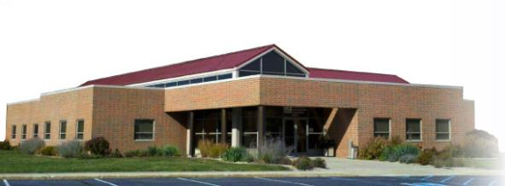
Fall Protection for Construction - Class #8
This material was produced under grant number SH-22224-SH1 from the Occupational Safety and Health Administration, U.S. Department of Labor. It does not necessarily reflect the views or policies of the U.S. Department of Labor, nor does mention trade names, commercial products, or organizations imply endorsement by the U.S. Government.
1
Notes:
1
Workers were working at heights greater than 10 feet.

Slide 2
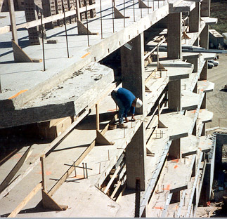

Fall Protection
Notes:
1926 Subpart M – Fall Protection
This presentation is designed to assist trainers conducting OSHA 10-hour Construction Industry outreach training for workers. Since workers are the target audience, this presentation emphasizes hazard identification, avoidance, and control – not standards. No attempt has been made to treat the topic exhaustively. It is essential that trainers tailor their presentations to the needs and understanding of their audience.
This presentation is not a substitute for any of the provisions of the Occupational Safety and Health Act of 1970 or for any standards issued by the U.S. Department of Labor. Mention of trade names, commercial products, or organizations does not imply endorsement by the U.S. Department of Labor.
.

Slide 3
Falls in Construction
Falls are the leading cause of deaths in the construction industry.
Most fatalities occur when employees fall from open-sided floors and through floor openings.
Falls from as little as 4 to 6 feet can cause serious lost-time accidents and sometimes death.
Open-sided floors and platforms 6 feet or more in height must be guarded.
Notes:
The issues of how to provide fall protection for employees at construction sites are difficult ones. There are so many different types of work and so many different kinds of fall hazards that it is not possible to organize fall protection into a neat set of rules that fit all situations. OSHA reflects this difficulty when it places its rules for fall protection in several different subparts in the Construction Standards, depending primarily on the nature of the work being undertaken. There are separate locations, for example, for fall protection during work on scaffolds, during work on certain cranes and derricks, during work in tunnels, during work on stairways and ladders, during steel erection, etc.

Slide 4
Fall Protection
This presentation will discuss:
The working conditions that prompt use of fall protection
Options that are available to protect workers from falls
At the end of this topic, you will be able to:
List at least four methods of fall protection available for protecting workers
State the main criteria that prompts use of fall protection for construction workers
Group Activity
Find the locations in the 1926 OSHA standards that require the use of fall protection
Notes:
The issues of how to provide fall protection for employees at construction sites are difficult ones. There are so many different types of work and so many different kinds of fall hazards that it is not possible to organize fall protection into a neat set of rules that fit all situations. OSHA reflects this difficulty when it places its rules for fall protection in several different subparts in the Construction Standards, depending primarily on the nature of the work being undertaken. There are separate locations, for example, for fall protection during work on scaffolds, during work on certain cranes and derricks, during work in tunnels, during work on stairways and ladders, during steel erection, etc.

Slide 5
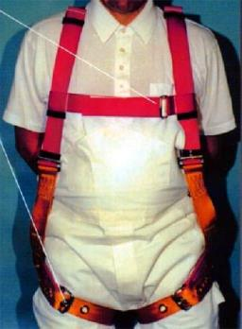

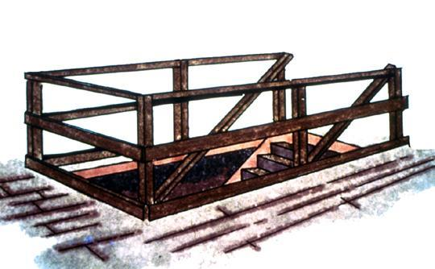
Fall Protection Options
Guardrails
Personal Fall
Arrest System
(PFAS)
Safety Net
Notes:
Reference 1926.501(b)(1)
General rule: If an employee can fall six feet or more onto a lower level, fall protection must be provided.
What type of fall protection will I need?
In most cases, a guardrail system, a safety net system, or a personal fall arrest system must be used. In some cases fences, barricades, covers, equipment guards or a controlled access zone may be used.
Employees must be protected not just from falling off a surface, but from falling through holes and from having objects fall on them from above.

Slide 6
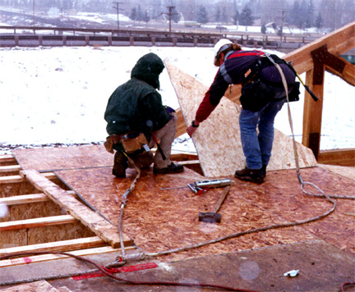
Fall Protection Planning
Lanyards and PFAS in use
Fall protection systems and work practices must be in place before you start work.
Notes:
Reference 1926 Subpart M App C
An employer may use a variety of fall protection systems to protect employees. These systems must meet OSHA requirements. The competent person must make frequent and regular inspections, as required, to determine if these systems meet OSHA requirements before employees rely on these systems. More detail may be found in 29 CFR 1926.502.
Employers engaged in leading edge work, precast concrete erection work, or residential construction work who can demonstrate that it is infeasible or it creates a greater hazard to use conventional fall protection equipment may develop a fall protection plan that provides other measures to be taken to reduce or eliminate fall hazards for workers. Fall protection plans must conform to OSHA provisions and be prepared by a qualified person. Although a fall protection is required, it does not have to written, nor does it have to be site specific. Fall protection plans must identify locations where conventional fall protection methods cannot be used and set up controlled access zones and any necessary safety monitoring systems.
See STD 3-0.1A

Slide 7
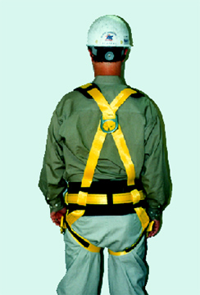
Personal Fall Arrest Systems
You must be trained how to properly use PFAS.
PFAS = anchorage, lifeline and body harness.
Notes:
Reference 1926.502(d)
What will my personal fall arrest system do to protect me?
A personal fall arrest system places the employee into a body harness that is fastened to a secure anchorage so that he/she cannot fall. Body belts are not acceptable as personal fall arrest systems. A few key requirements:
There should be no free fall more than 6 feet.
There should be prompt rescue after a fall.
PFAS’s must be inspected prior to each use.
PFAS’s must not be used until they have been inspected by a competent person.

Slide 8
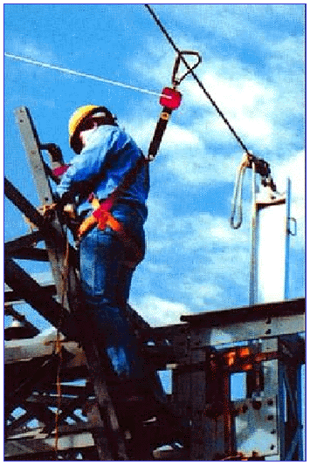
Safety Line Anchorages
Must be independent of any platform anchorage and capable of supporting at least 5,000 lbs. per worker
Notes:
Reference 1926. 502(d)(15)

Slide 9
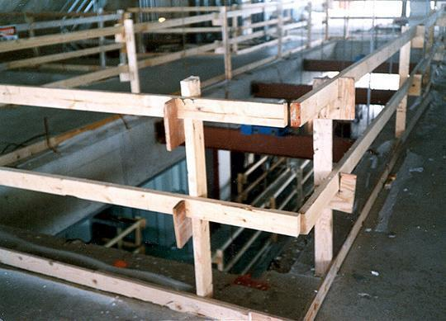
Guardrails
Top Rail
Mid- Rail
Toeboard
Top rails between 39 and 45 inches tall
Toe boards at least 3 1/2 inches high
Notes:
Reference 1926.502(b) and 1926.502(j)
How do guardrail systems protect me from falling?
Guardrail systems provide a barrier to protect the employee from falling:
Top edge of the guardrail must be 39-45 inches above the walking/working level.
There must also be protection from falling between the top rail and the walking/working surface. Midrails, screens, mesh, or intermediate vertical members may be used for this protection. There are specific requirements for their installation.
The protective barriers must be strong enough to support a falling employee. Wood, chain and wire rope may be used for top rails and midrails.

Slide 10
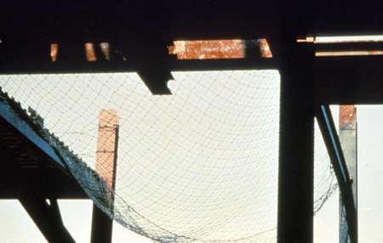
Safety Nets
Place as close as possible, but no more than 30 feet below where employees work
Notes:
Reference 1926.502(c)
How do safety net systems protect me?
Safety net systems catch the employee if he/she does fall. The safety nets:
Must be strong enough to support a falling employee;
Must have sufficiently small mesh openings so the employee cannot fall through the net;
Must be close enough to the surface of the walking/working surface so that the fall into the safety net will not still injure the employee (never more than 30 feet below the walking/working level);
Must be close enough to the edge of the working surface (the outer edge of the net between 8-13 feet from the edge of the walking/working surface, depending on the distance to the walking/working surface) so that the falling employee will not slip past the net.

Slide 11
When Fall Protection is Needed
Walkways & ramps
Open sides & edges
Holes
Concrete forms & rebar
Excavations
Roofs
Wall openings
Bricklaying
Residential Construction
Notes:
Where should I expect fall protection to be provided?
When an employee is on a walking/working surface that has an unprotected edge.
When an employee is constructing a leading edge.
When an employee may fall through a hole in the walking/working surface.
When an employee is working on the face of formwork or reinforcing steel.
When employees are on ramps, runways and other walkways.
When employees are working at the edge of an excavation, well, pit, or shaft.
When employees are working above dangerous equipment (even employees working less than six feet over dangerous equipment must be protected).
When an employee is performing overhand bricklaying and related work.
When an employee is performing roofing work.
When an employee is engaging in precast concrete erection (with certain exceptions).
When an employee is engaged in residential construction (with certain exceptions).

Slide 12
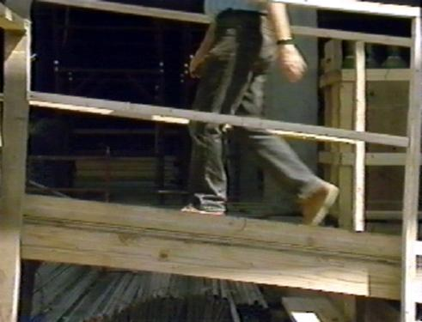
Walkways and Ramps
Guard ramps, runways, and other walkways
Notes:
Reference 1926.501(b)(6)
Ramps, runways, and other walkways must be protected by guardrail systems when employees can fall 6 feet or more.
The walking/working surface must be strong enough to support employees safely. If not, employees may not work on the surface. This knowledge will be gained during frequent and regular inspections made, as required, by competent persons designated by the employer.

Slide 13
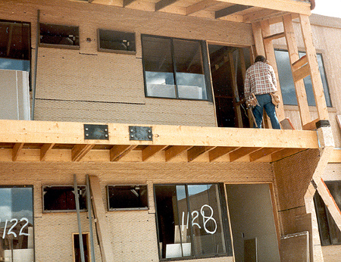
Fall Protection -
Residential Construction
In residential construction, you must be protected if you can fall more than 6 feet
Notes:
Reference 1926.501(b)(13)
This is correct for activities not covered by STD 3-0.1A
All other activities – refer to STD 3-0.1A, Interim Fall Protection Guidelines for Residential Construction

Slide 14
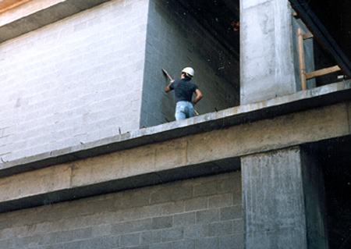
Unprotected Sides & Edges
Unprotected edge
Unprotected sides and edges must have guardrails or equivalent
Notes:
Reference 1926.501(b)(1)

Slide 15
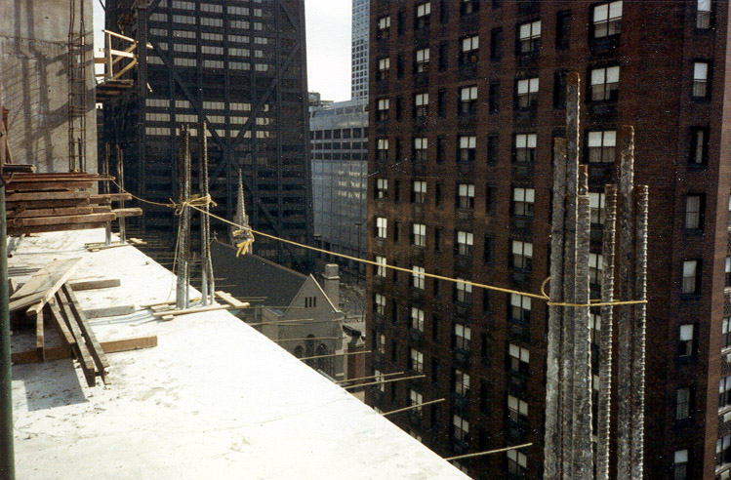
Sides & Edges - Improper Guarding
This 1/4" nylon rope alone is not a proper way to guard this open floor
Notes:
Reference 1926.502(b)
What’s wrong with this?
¼ inch rope is allowed, but it must meet the criteria of 1926.502(b)(3), etc.
no midrail
no toeboards
- sagging is not allowed

Slide 16
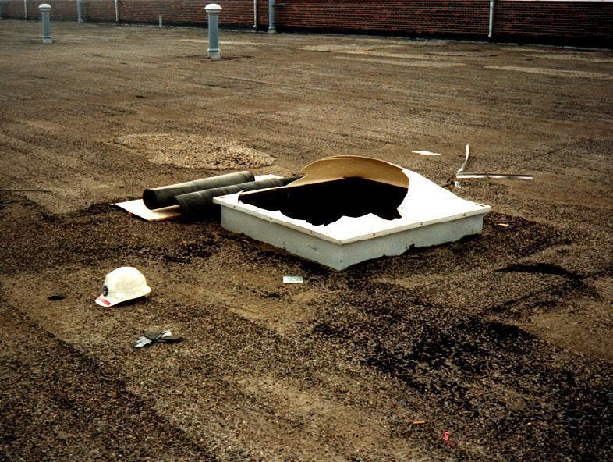
Sky Lights and Other Openings
Holes more than 6 feet high must be protected
This opening could be made safe by using a guardrail, or strong cover
Notes:
Reference 1926.501(b)(4)(i), 1926.501(b)(10), 1926.501(b)(11), and 1926.502(i)
Covers must be:
-- able to support at least twice the weight of employees, equipment, and materials that may be imposed on them at one time.
-- secured to prevent accidental displacement from wind, equipment, or workers’ activities.
-- color coded or bear the markings “HOLE” or “COVER.”
Holes - 1926.501(b)(4):
Personal fall arrest systems, covers, or guardrail systems shall be erected around holes (including skylights) that are more than 6 feet above lower levels.
NOTE – All floor holes must be protected against slips/trips – even if less than 6 feet

Slide 17
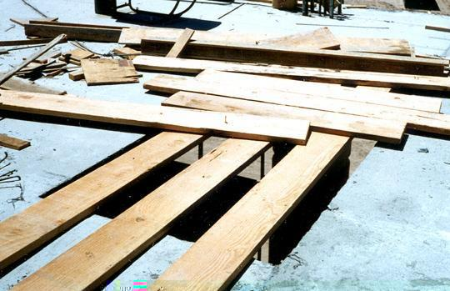
Floor Holes
Improperly
Covered
Cover completely and securely
If no cover, can guard with a guardrail
Notes:
Reference 1926.501(b)(4)

Slide 18
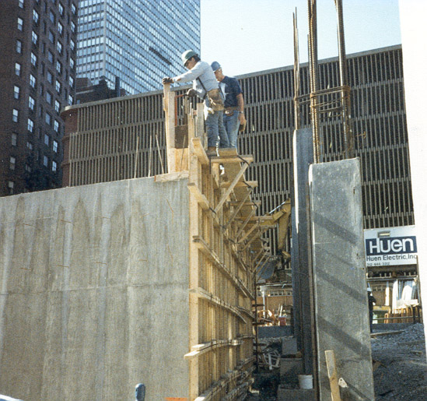
Concrete Forms and Rebar
    Use PFAS when working on formwork or rebar
    Cover or cap protruding rebar
Notes:
Reference1926.452(g) and 1926.701(b)
Employees on a form scaffold can be exposed to falls of less than 10 feet.
1926.501, covers employees working on whalers.

Slide 19
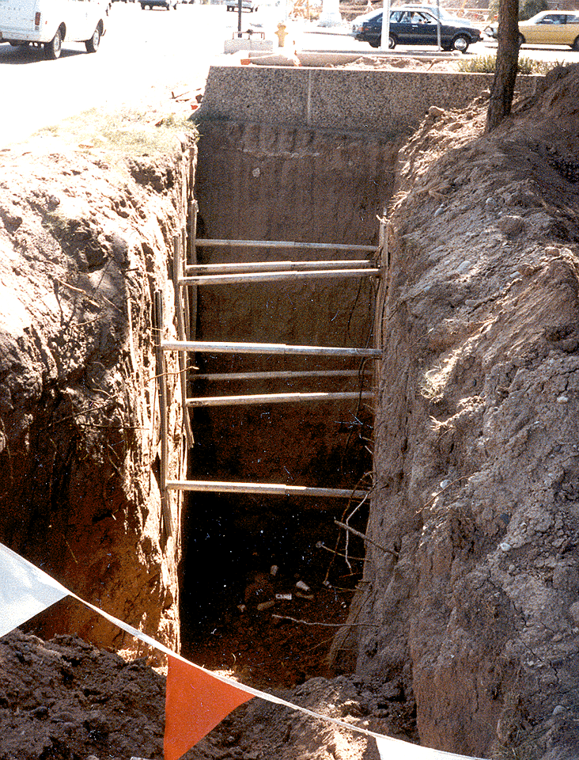
Excavations
Guard excavations more than 6 feet deep when they are not readily seen because of plant growth or other visual barriers
In addition to needing guarding, this excavation is not properly shored
Notes:
Reference 1926.501(b)(7)
Employees at the edge of an excavation 6 feet or more deep shall be protected from falling by guardrail systems, fences, barricades, or covers.
If walk-ways are used to permit workers to cross over excavations, guardrails are required on the walkway if the fall would be 6 feet or more to the lower level.

Slide 20
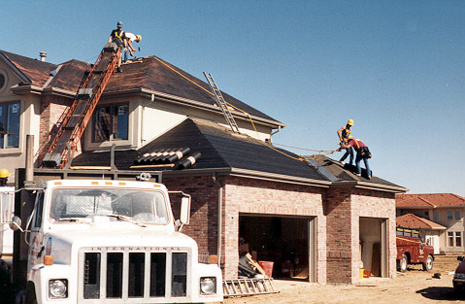
Roofs
If you work on roofs and can fall more than 6 feet, you must be protected
Notes:
Reference 1926.501(b)(10)
Reference 1926.501(b)(11) - steep roofs
Roofers - First refer to STD 3-0.1A
If workers are working on roofs with unprotected sides and edges 6 feet or more above lower levels, they shall be protected from falling by guardrail systems, safety net systems, personal fall arrest systems or a combination of a warning line system and guard-rail system, warning line system and safety net system, warning line system and personal fall arrest system, or warning line system and safety monitoring system.

Slide 21
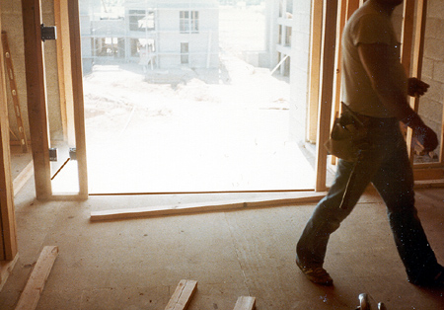
Wall Openings
Wall opening
If you work near wall openings 6 feet or more above lower levels you must be protected from falling
Notes:
Reference 1926.501(b)(14)
Employees working on, at, above, or near wall openings (including those with chutes attached) where the outside bottom edge of the wall opening is 6 feet or more above lower levels and the inside bottom edge of the wall opening is less than 39 inches above the walking/working surface must be protected from falling by the use of
either a guardrail system, a safety net system, or a personal fall arrest system.

Slide 22
Good Work Practices
Perform work at ground level if possible
  Example: building prefab roofs on the ground and lifting into place with a crane
Tether or restrain workers so they can't reach the edge
Designate and use safety monitors (This is less desirable of all the systems)
Use conventional fall protection

Slide 23
Training
Employers must provide fall protection training
The training is to teach you:
How to recognize hazards
How to minimize hazards
The training must cover:
Fall hazards
Fall protection systems
Use of fall protection devices
Notes:
Reference 1926.503(a)(1)
How should I be trained?
Training must be provided to each employee who might be exposed to fall hazards. In construction, this will involve most employees. The training by a competent person must enable each employee to recognize the hazards of falling and train employees in the procedures to be followed to minimize these hazards.
The training must include:
The nature of fall hazards in the work area;
The correct procedures for erecting, maintaining, disassembling, and inspecting the fall protection systems to be used;
The use and operation of guardrail systems, personal fall arrest systems, safety net systems, warning line systems, safety monitoring systems, controlled access zones, and other protection;
The role of each employee in the safety monitoring system when this system is used;
The limitations on the use of mechanical equipment during the performance of roofing work on low-sloped roofs;
The correct procedures for the handling and storage of equipment and materials and the erection of overhead protection; and
The role of employees in fall protection plans.
The standards of subpart M
The employer must verify compliance with the training requirements by preparing a written certification record.
The employer must retrain any employee when the employer has reason to believe that the trained employee does not have the understanding and skill required.

Slide 24
Summary
If you can fall more than 6 feet, you must be protected
Use fall protection on:
  walkways & ramps, open sides & edges, holes, concrete forms & rebar, excavations, roofs, wall openings, bricklaying, residential construction
Protective measures include guardrails, covers, safety nets, and Personal Fall Arrest Systems
Notes:
Duty to have fall protection.
OSHA requires employees to provide fall protections systems that must meet certain criteria:
Walking and working surfaces must have sufficient strength and structural integrity to support employees safely.
Employers must provide protection to employees working in areas with unprotected sides or edges 6 feet or more above a lower level.
Specific types of protection are required in work areas with leading edges, in hoist areas, in work areas with holes, ramps, runways, and other walkways, in areas where excavations are being conducted, where dangerous equipment is being used, during overhand bricklaying, in roofing, in precast concrete erection, in residential construction, and in work areas with wall openings.
Hard hats are required when workers may be exposed to falling objects.
Other requirements include either
use of toeboards, screens or guardrail systems; or
use of a canopy structure; or
barricading area to which objects could fall and prohibiting employees from entrance.

Slide 25
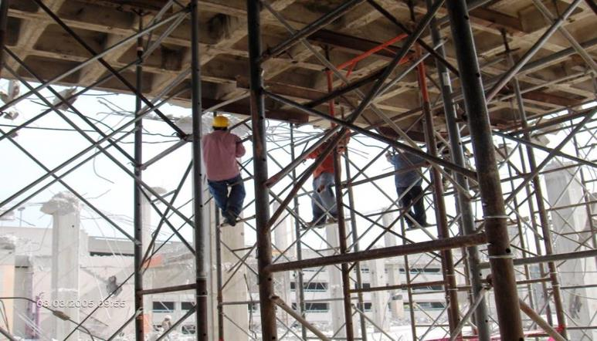
Is This a Fall Hazard?
Photos in this presentation are from the OSHA Region 4 National Photo Archive and OSHA Region 5.
25
Notes:
25
TRAINER NOTE: Your options are to use:
this presentation as developed to prompt hazard recognition classroom discussions; or
the presentation as developed along with the alternative activity approach to encourage student note taking regarding hazard recognition (see “Falls_HazRec_AltActivity” folder provided); or
your own photos to cover the hazard recognition component.
PHOTO: Workers are climbing on the shoring structure during set up and removal.

Slide 26

YES
Workers could fall while climbing on the shoring structure to set it up and remove it.
Ladders and lifts must be provided.
26
Notes:
26
Ladders/lifts are needed for safe access to the shoring structure.

Slide 27
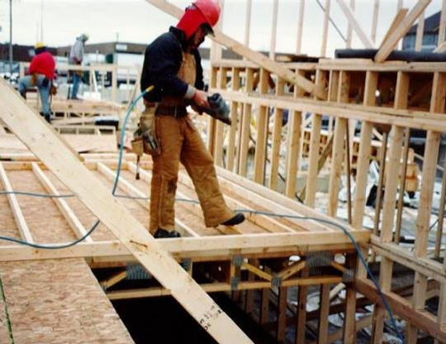
Any Fall Hazard Here?
27
Notes:
27
Worker working above ground level.

Slide 28
YES
Workers are exposed to a fall hazard greater than 6 feet, while working near stairwell opening.
Workers must be protected from falls over 6 feet.
28
Notes:
28
Workers are exposed to a fall hazard greater than 6 feet, while working near a stairwell opening.

Slide 29
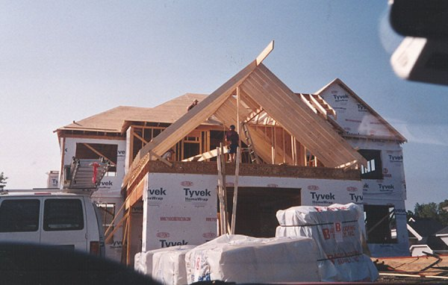
Is This a Fall Hazard?
29
Notes:
29
Residential Construction: Fall protection not provided.

Slide 30
YES
Unprotected open-sided floors 6 feet or more above ground level.
Guardrail systems, safety net systems or personal fall arrest systems are required.
30
Notes:
30
Fall protection must be provided for workers on open-sided floors 6 feet or more above a lower level. Often material handling is the reason guardrails are not in place.

Slide 31
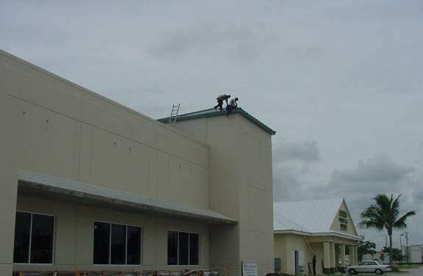
Any Fall Hazard Here?
31
Notes:
31
Workers are installing a new metal roof.

Slide 32
YES
Workers are installing a new metal roof without fall protection.
NOTE: Remember that ladders must extend 3 feet above the landing area.
32
Notes:
32
Workers exposed to a fall

Slide 33
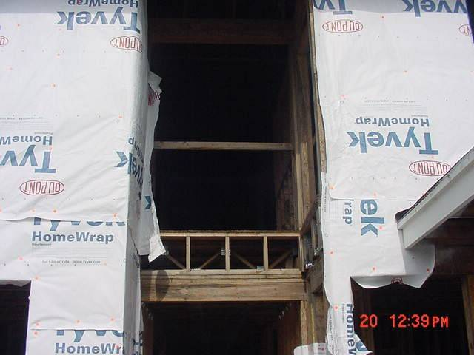
Is This a Fall Hazard?
33
Notes:
33
This is 12 feet above the lower level.

Slide 34
YES
The photo shows a mid-rail and toeboard are missing on an open-sided floor of a building.
This could expose workers to a 12 foot fall.
Toeboards are required to protect workers below from falling objects.
34
Notes:
34
There is a missing mid-rail and toeboard on an open-sided floor of a building, exposing workers to a 12 foot fall. When workers are exposed to falling objects from above, hard hats must be worn

Slide 35
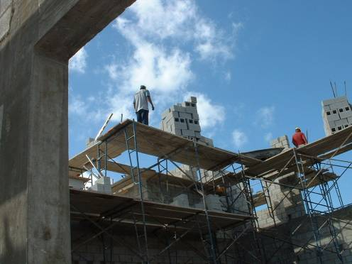
Can You Identify the Fall Hazard?
35
Notes:
35
Workers on fabricated frame scaffolds stacking blocks.

Slide 36
YES
Lack of fall protection for workers on fabricated frame scaffolds.
Planks appear to be overloaded and there is no safe access for workers.
The workers are exposed to a 35-foot fall hazard from a scaffold while stacking blocks prior to overhand bricklaying operations.
36
Notes:
36
Workers on fabricated frame scaffolds stacking blocks are exposed to a 35-foot fall hazard from a scaffold.
Lack of fall protection for workers on fabricated frame scaffolds. The workers are exposed to a 35-foot fall hazard from a scaffold while stacking blocks prior to overhand bricklaying operations. The planks appear to be overloaded and there is no safe access for the workers.

Slide 37
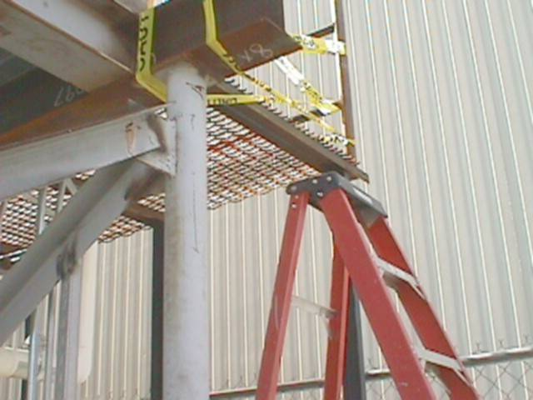
Can You Identify the Fall Hazard?
37
Notes:
37
Improper ladder access

Slide 38
YES
It must extend 3 feet above the working surface.
Ladder to work platform is not of sufficient length.
38
Notes:
38
Ladder to work platform is not of sufficient length.
The ladder must extend 3 feet above the working surface.

Slide 39
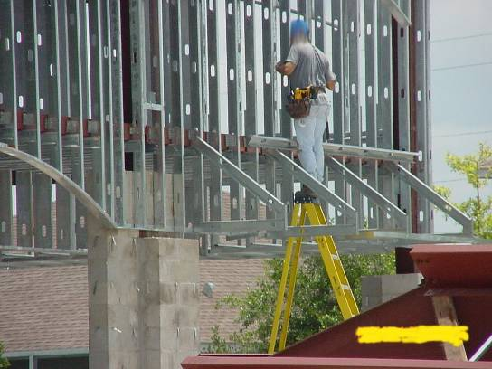
Is This a Fall Hazard?
39
Notes:
39
Worker is working off of the top of a step ladder.

Slide 40
YES
The top of a stepladder shall not be used as a step.
Worker is working off of the top of a step ladder.
40
Notes:
40
OSHA standards do not permit the top or top step of a stepladder to be used as a step. See 1926.1053(b)(13).

Slide 41
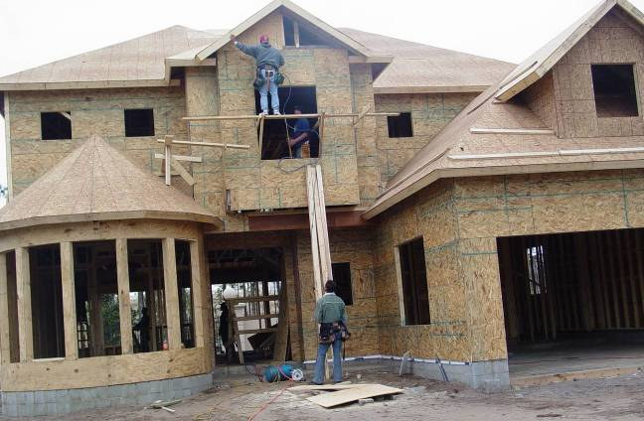
Can You Identify the Fall Hazards?
41
Notes:
41
Not a proper work platform.

Slide 42
YES
A worker is working from a carpenters' scaffold that has no guardrail, extends too far beyond either end, and is not wide enough.
The worker inside of the window is not provided with fall protection as there is no standard guardrail for the window.
The worker also does not have proper access to the scaffold.
The worker working below is exposed to the struck-by hazards of tools and equipment falling from the employees working above.
42
NOTE: A competent person must supervise as scaffolds are erected, moved and taken apart.
Notes:
42
There is no guardrail or other fall protection for the worker on the carpenters' scaffold. This scaffold extends too far beyond either end, and is not wide enough. It must be at least 18 inches. The scaffold must meet 1926.451(a)(1), four times the intended load. If installed, the top rails must have 200 lbs. capacity and the midrails must have 150 lbs. capacity. In addition, the worker did not have proper access to the scaffold. The worker inside of the window was not provided with fall protection because a standard guardrail was not provided for the window. The worker working below was exposed to the struck-by hazards of tools and equipment from the employees working above. When workers are exposed to falling objects, the employer shall have each employee wear a hard hat and implement protective measures, such as toeboards, screens, or barricades for the area underneath. In addition, scaffolds must be erected, moved, dismantled and altered only under the supervision of a competent person. See 1926.451(f)(7).

Slide 43
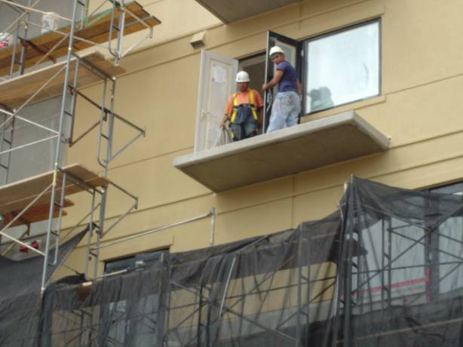
Any Fall Hazard Here?
43
Notes:
43
Workers working on balcony of structure.

Slide 44
YES
Workers working on balcony of structure exposed to fall hazard due to unprotected side/edge.
44
Notes:
44
Workers are exposed to a fall hazard due to the unprotected sides/edges of the balcony.

Slide 45
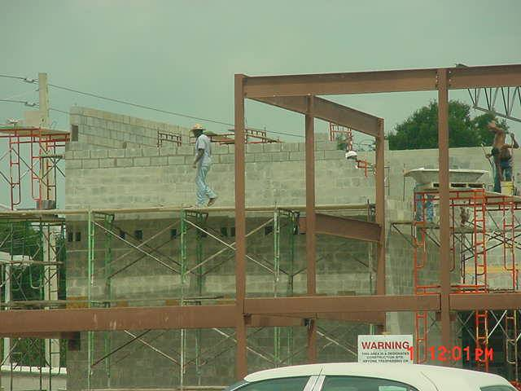
Is This a Fall Hazard?
45
Notes:
45
Workers were working at heights greater than 10 feet.

Slide 46
YES
Scaffold was not erected with guardrails in areas where workers were working at heights greater than 10 feet.
46
Notes:
46
The scaffold was not erected with guardrails in areas where workers were working at heights above 10 feet.

Slide 47
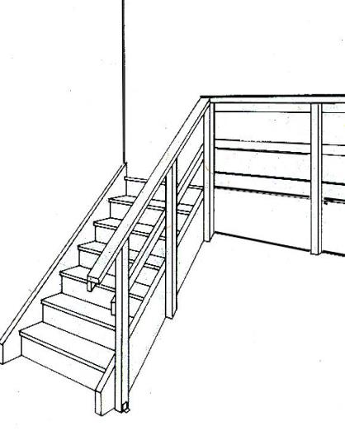
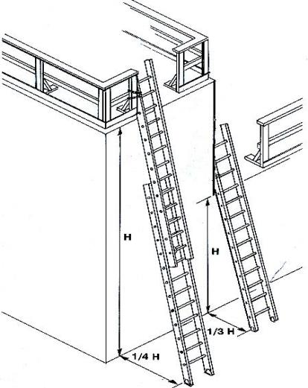
Stairways and Ladders
Notes:
1926 Subpart X - Stairways and Ladders
This presentation is designed to assist trainers conducting OSHA 10-hour Construction Industry outreach training for workers. Since workers are the target audience, this presentation emphasizes hazard identification, avoidance, and control – not standards. No attempt has been made to treat the topic exhaustively. It is essential that trainers tailor their presentations to the needs and understanding of their audience.
This presentation is not a substitute for any of the provisions of the Occupational Safety and Health Act of 1970 or for any standards issued by the U.S. Department of Labor. Mention of trade names, commercial products, or organizations does not imply endorsement by the U.S. Department of Labor.

Slide 48
OSHA Course Objectives
Name the three types of hazards that are predominant when using stairs or ladders at a construction site.
List or describe at least four safety guidelines or requirements that reduce or eliminate slipping, tripping or falling hazards on stairs in use at a construction site.
List or describe at least four safety practices or requirements that reduce or eliminate slipping, tripping or falling hazards when ladders are in use at a construction site.
Notes:
Reference – OSHA Publication 3124, Stairways and Ladders

Slide 49
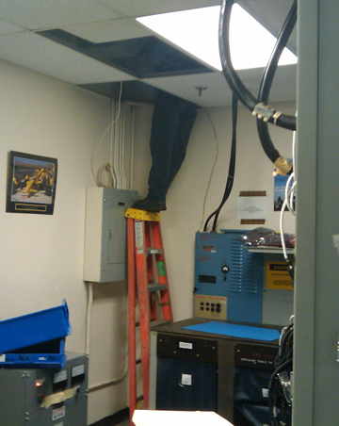
Hazards
Stairways and ladders cause many injuries and fatalities among construction workers
About half the injuries caused by slips, trips and falls from ladders and stairways require time off the job
Notes:
Reference – OSHA Publication 3124, Stairways and Ladders

Slide 50
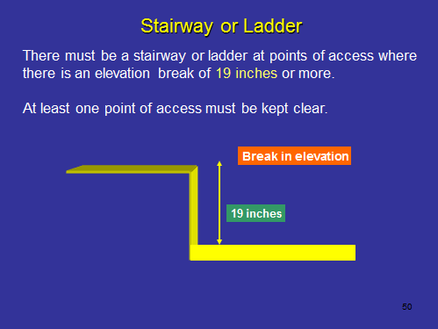
Stairway or Ladder

Slide 51
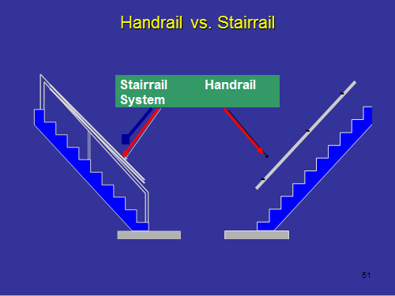
Handrail vs. stairrail

Slide 52
Handrail and Top Rail Strength
Rails must be able to withstand a force of 200 pounds in all directions
Notes:
Reference 1926.1052(c)(5)
Handrails and the top rails of the stairrail systems must be capable of withstanding, without failure, at least 200 pounds of weight applied within 2 inches of the top edge in any downward or outward direction, at any point along the top edge.

Slide 53
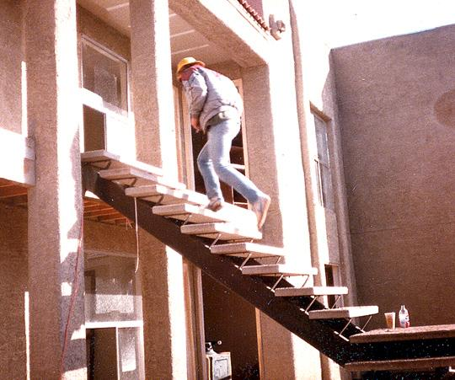
Stairrails
Stairways with four or more risers or more than 30 inches high must have a stairrail along each unprotected side or edge.
Notes:
Reference 1926.1052(c)
All stairways of 4 steps or more must have a handrail. If there is a fall hazard of 6 feet or more on an exposed side of the stairs, then a stairrail system must be provided to prevent workers from falling off the side.

Slide 54
Stairs
Installed between 30 and 50 degrees.
Must have uniform riser height and tread depth, with less than a 1/4-inch variation.
Uniform - 30 & 50 deg. angle
No more than 1/4 inch
variation in any stairway system
Notes:
Reference 1926.1052(a)(3) and (a)(2)

Slide 55
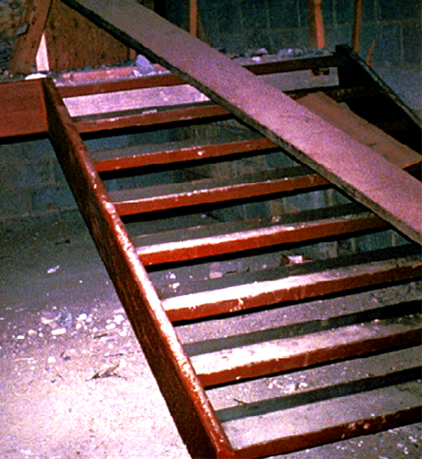
Temporary Stairways
Stair pans must be have filler material at least to the top edge of each pan.
Pan
Notes:
Reference 1926.1052(b)(1)
Temporary Service Stairway -
A stairway where permanent treads and/or landings are to be filled in at a later date. The pans are are just “concrete forms” that are filled with concrete after the stairs have been set in place.
Secure metal pan landings and metal pan treads in place before filling.
Relpace all treads and landings when worn below the top edge of the pan.
Workers may not use spiral stairways that will not be a permanent part of the structure.

Slide 56
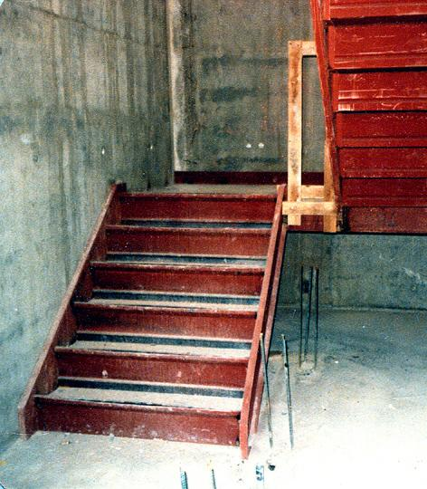
Stairway Landings
Stairways landings must be at least 30 inches deep and 22 inches wide at every 12 feet or less of vertical rise
Unprotected sides of landings must have standard 42 inch guardrail systems
Landing
Notes:
Reference 1926.1052(a)(1) and (b)
Stairway landings 6 feet or more above the surrounding area need to be provided with a guardrail system along the exposed perimeters of the landing

Slide 57
Platforms and Swing Doors
Where doors or gates open directly on a stairway, provide a platform that extends at least 20 inches beyond the swing of the door.
Notes:
Reference 1926.1052(a)(4)
Remember that a guardrail system may also be needed on a platform with a swinging door to protect from potential falls of 6 feet or more.

Slide 58
Dangerous Conditions
Fix slippery conditions before using.
Stairway parts must be free of projections which may cause injuries or snag clothing.
Notes:
Reference 1926.1052(a)(7) and (a)(6)
In addition to the components of a stair system, it is important to address other potentially dangerous conditions such as slippery stairs, rails or landings due to weather conditions or the composition of the stair material (e.g. smooth, metal surfaces).

Slide 59
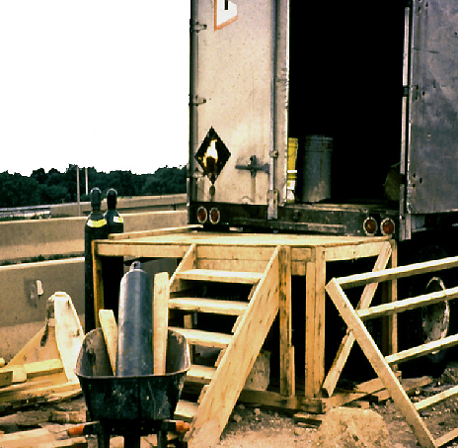
Handrails are required
Notes:
Reference 1926.1052(c)
Handrails must provide an adequate handhold for employees to grasp to prevent falls. Temporary handrails must have a minimum clearance of 3” between the handrail and walls, stairrail system and other objects. OSHA has specific height requirements for handrails. Check the standard to ensure these are met during installation of handrails, stairrails and guardrails

Slide 60
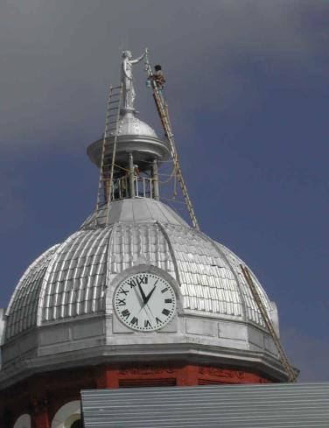
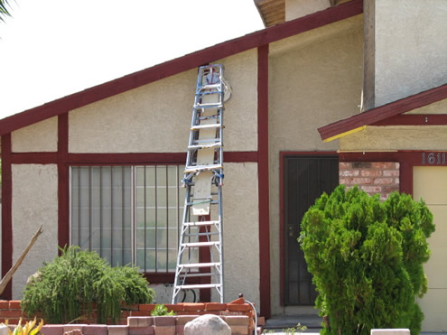
Ladders

Slide 61
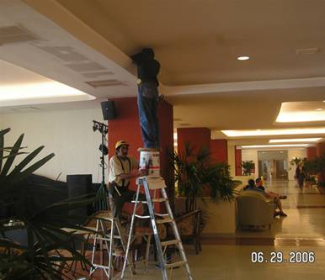
General Ladder Requirements
Ladders must be kept in a safe condition
-- DO –
Keep the area around the top and bottom of a ladder clear
Ensure rungs, cleats, and steps are level and uniformly spaced
Ensure rungs are spaced 10 to 14 inches apart
Keep ladders free from slipping hazards
Notes:
Reference 1926.1053(a) and (b)

Slide 62

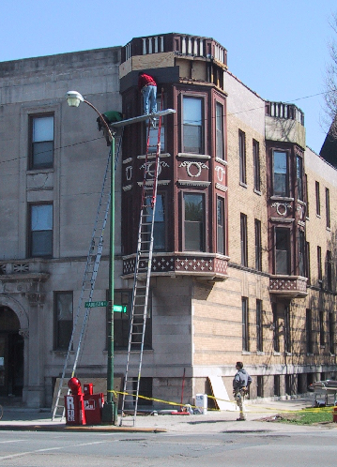
General Ladder Requirements
Use ladders only for their designed purpose
-- DON’T –
Tie ladders together to make longer sections, unless designed for such use
Use single rail ladders
Load ladders beyond the maximum load for which they were built, nor beyond the manufacturer’s rated capacity
Notes:
Reference 1926.1053(a) and (b)

Slide 63
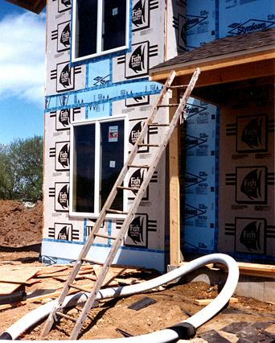
Securing Ladders
Secure ladders to prevent accidental movement due to workplace activity
Only use ladders on stable and level surfaces, unless secured
Do not use ladders on slippery surfaces unless secured or provided with slip-resistant feet
Notes:
Reference 1926.1053(b)(8), (b)(6), (b)(7), and (b)(1)
Ladders placed in areas such as passage-ways, doorways, or driveways, or where they can be displaced by workplace activities or traffic must be secured to prevent accidental movement, or a barricade must be used to keep traffic or activities away from the ladder.

Slide 64
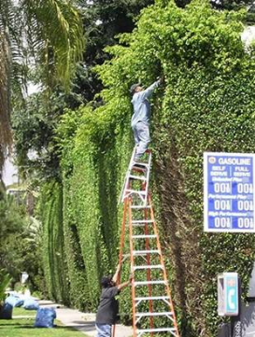
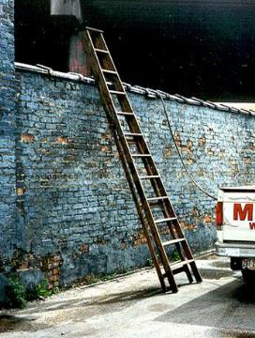
Portable Ladders
Inspect before use for cracks, dents, and missing rungs
Design or treat rungs to minimize slipping
Side rails -- at least 11 1/2 inches apart
Must support 4 times the maximum load
Notes:
Reference 1926.1053(b)(15), (b)(6)(ii) and 1926.1053(a)(4)(ii)
See the OSHA web site at:
www.osha.gov/SLTC/construction_ecat/falls/4ladders.html
Portable Ladder: a ladder that can be readily moved or carried.
Ladder rungs, cleats, and steps must be parallel, level and uniformly spaced.
The rungs and steps of portable metal ladders must be corrugated, knurled, dimpled, coated with skid-resistant material or treated to minimize slipping.

Slide 65
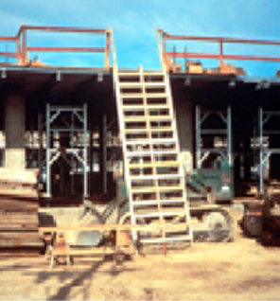
Double - Cleated Ladder
Use a double-cleated ladder ( with center rail) or 2 or more ladders:
when ladders are the only way to enter or exit a working area with 25 or more employees
when a ladder will serve simultaneous two-way traffic
Notes:
Reference 1926.1051(a)(2)
Double-cleat Ladder -
A ladder with a center rail to allow simultaneous two-way traffic for employees ascending or descending.
When there is only one point of access between levels, it must be kept clear to permit free passage by workers. If free passage becomes restricted, a second point of access must be provided and used.

Slide 66
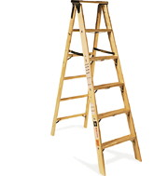
Painting Wood Ladders
Don’t paint ladders
Don’t use an opaque covering (like varnish) on a wood ladder
Notes:
Reference 1926.1053(a)(12)
Wood ladders must not be coated with any opaque covering, except identification or warning labels on one face only of a side rail.

Slide 67
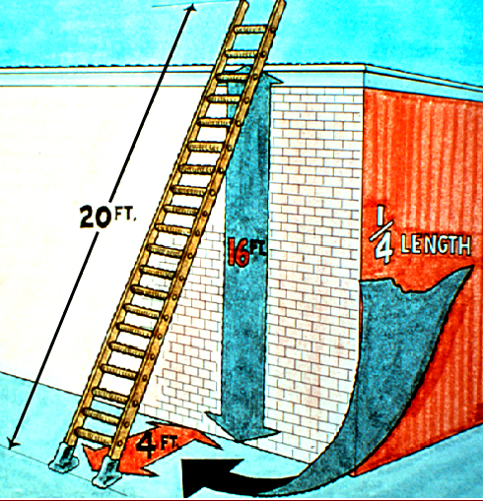
Ladder Angle
Non-self-supporting ladders: (which lean against a wall or other support)
Position at an angle where the horizontal distance from the top support to the foot of the ladder is 1/4 the working length of the ladder
Notes:
Reference 1926.1053(b)(5)
Working length of ladder
– Distance along the ladder between the foot and top support

Slide 68
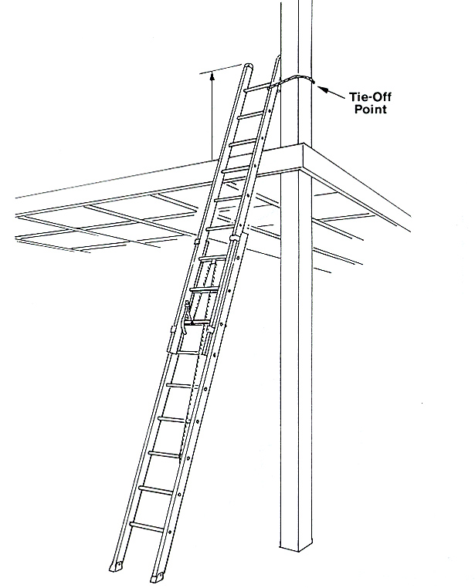
Ladder Rail Extension
When using a portable ladder for access to an upper landing surface, the side rails must extend at least 3 feet above the upper landing surface
Notes:
Reference 1926.1053(b)(1)
When portable ladders are used for access to an upper landing surface, the side rails must extend at least 3 feet above the upper landing surface. When such an extension is not possible, the ladder must be secured, and a grasping device such as a grab rail must be provided to assist workers in mounting and dismounting the ladder. A ladder extension must not deflect under a load that would cause the ladder to slip off its support.

Slide 69

Near Energized Electrical Equipment
If using ladders where the employee or the ladder could contact exposed energized electrical equipment, they must have nonconductive siderails such as wood or fiberglass.
Notes:
Reference 1926.1053(b)(12)

Slide 70


Top Step
Do not use the top or top step of a stepladder
Notes:
Reference 1926.1053(b)(13)

Slide 71

Damaged or Defective Ladders
A Competent Person must inspect ladders for visible defects, like broken or missing rungs
If a defective ladder is found, immediately mark it defective or tag it "Do Not Use”
Remove defective ladders from service until repaired
Missing rung
Notes:
Reference 1926.1053(b)(16)
Ladders must be inspected on a periodic basis and after any incident that could affect their safe use.
Ladder components must be surfaced to prevent injury from punctures or lacerations and prevent snagging of clothing.

Slide 72

Climbing the Ladder
Face the ladder when going up or down
Use at least one hand to grab the ladder when going up or down
Do not carry any object or load that could cause you to lose balance
Notes:
Reference 1926.1053(b)(20),(21),(22)

Slide 73


Ladder Applications
Notes:
Reference 1926.1053(b)(16)
Ladders must be inspected on a periodic basis and after any incident that could affect their safe use.
Ladder components must be surfaced to prevent injury from punctures or lacerations and prevent snagging of clothing.

Slide 74

Ladder Applications
Notes:
Improper use of ladders on roof.

Slide 75

Ladder Applications
Notes:
Unsafe, Fall hazard with lift and access to elevation.

Slide 76
OSHA Training Requirements
Training Requirements 1926.1060(a)(i) through (v) and (b)
The employer shall provide a training program for each employee using ladders and stairways, as necessary. The program shall enable each employee to recognize hazards related to ladders and stairways, and shall train each employee in the procedures to be followed to minimize these hazards.
The employer shall ensure that each employee has been trained by a competent person in the following areas, as applicable:
The nature of fall hazards in the work area;
The correct procedures for erecting, maintaining, and disassembling the fall protection systems to be used;
The proper construction, use, placement, and care in handling of all stairways and ladders;
The maximum intended load carrying capacities of ladders used; and
The standards contained in this subpart.
Notes:
Fall protection training requirements.

Slide 77
OSHA Course Review
Name the three types of hazards that are predominant when using stairs or ladders at a construction site. Possible responses.
  Trips, Slips and Falls
List or describe at least four safety guidelines or requirements that reduce or eliminate slipping, tripping or falling hazards on stairs in use at a construction site.
  Install handrails that are at least 3” from the wall or other objects and can withstand a force of 200 pounds at the top of the rail.
  Install handrails on stairways of 4 or more steps, and stair rails when there is a fall hazard of 6 feet or more.
  The overall angle of the stairs should be between 30 and 50 degrees.
  Stairs should have uniform riser height and tread depth variation of less than ¼ “.
  Fill temporary pan stairs to the top edge of each pan, and replace temporary treads and landings when worn below the top edge.
  Stairway landings must be 30” deep and 22”wide at every 12” or less of vertical rise.
  Where doors or gates open directly on a stairway, provide a platform that extends at least 20” beyond the swing of the gate.
  Fix slippery conditions before using stairs.
  Ensure stairway parts are free of projections that may cause injury or snag clothing.
Notes:
Reference – OSHA Publication 3124, Stairways and Ladders

Slide 78
OSHA Course Review
3. List or describe at least four safety practices or requirements that reduce or eliminate slipping, tripping or falling hazards when ladders are in use at a construction site.
  Keep the area around the top and bottom of the ladder clear.
  Ensure rungs, cleats and steps are level and uniformly spaced.
  Keep ladders free from slipping hazards.
  Use ladders for the purpose for which they were designed.
  Don’t load ladders beyond their maximum intended load.
  Secure ladders to prevent accidental movement, use on level surfaces, and barricade to keep traffic away.
  Be sure ladders are used at the correct angle.
Notes:
Reference – OSHA Publication 3124, Stairways and Ladders

Slide 79
Key Components for Ladder Safety Summary
A Competent Person must inspect
Use the correct ladder for the job
Use the correct angle, supports, treads, cross braces and rails
Don’t overload
Your employer must train you in proper use of a ladder
Notes:
Summary and review of ladders.

Slide 80
What rights do you have under OSHA
What Rights Do You Have Under OSHA?
You have the right to:
  A safe and healthful workplace
  Know about hazardous chemicals
  Information about injuries and illnesses in your workplace
  Complain or request hazard correction from employer
  Training
  Hazard exposure and medical records
  File a complaint with OSHA
  Participate in an OSHA inspection
  Be free from retaliation for exercising safety and health rights.
  Whistleblower protection and 11c rights
  Employer rights and responsibilities.
Notes:
Explain worker rights.

