Slide 1
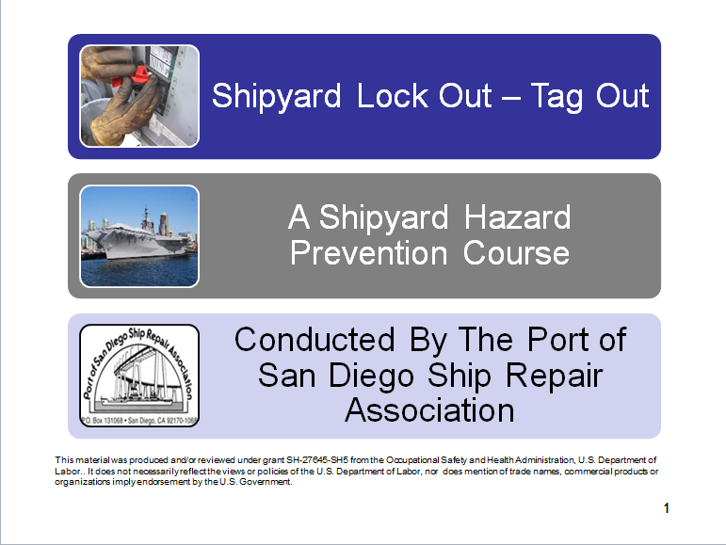
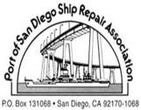
Title Page
Developed by the Port of San Diego Ship Repair Association
This material was produced and/or reviewed under grant SH-27645-SH5 from the Occupational Safety and Health Administration, U.S. Department of Labor.. It does not necessarily reflect the views or policies of the U.S. Department of Labor, nor does mention of trade names, commercial products or organizations imply endorsement by the U.S. Government.
1
Notes:
1
Workshop Objectives
At the completion of this workshop it is expected that all trainees will pass a quiz, have the ability to identify energy hazards and follow both OSHA and NAVSEA safety procedures associated with:

Slide 2

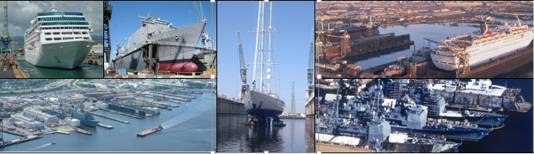
References
Notes:
OSHA 1915.89 SUBPART F
Control of Hazardous Energy -Lock-out/ Tags Plus
This CFR allows specific exemptions for shipboard tag-outs when Navy Ship’s Force personnel serve as the lockout/tags-plus coordinator and maintain control of the machinery per the Navy’s Tag Out User Manual (TUM).
Note to paragraph (c)(4) of this section: When the Navy ship's force maintains control of the machinery, equipment, or systems on a vessel and has implemented such additional measures it determines are necessary, the provisions of paragraph (c)(4)(ii) of this section shall not apply, provided that the employer complies with the verification procedures in paragraph (g) of this section.
Note to paragraph (c)(7) of this section: When the Navy ship's force serves as the lockout/tags-plus coordinator and maintains control of the lockout/tags-plus log, the employer will be in compliance with the requirements in paragraph (c)(7) of this section when coordination between the ship's force and the employer occurs to ensure that applicable lockout/tags-plus procedures are followed and documented.

Slide 3
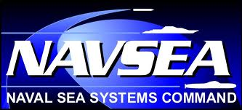
More References
Notes:
Note to paragraph (e) of this section: When the Navy ship's force shuts down any machinery, equipment, or system, and relieves, disconnects, restrains, or otherwise renders safe all potentially hazardous energy that is connected to the machinery, equipment, or system, the employer will be in compliance with the requirements in paragraph (e) of this section when the employer's authorized employee verifies that the machinery, equipment, or system being serviced has been properly shut down, isolated, and deenergized.
Note to paragraph (f) of this section: When the Navy ship's force applies the lockout/tags-plus systems or devices, the employer will be in compliance with the requirements in paragraph (f) of this section when the employer's authorized employee verifies the application of the lockout/tags-plus systems or devices.

Slide 4
Navsea References
Notes:
NAVSEA STANDARD ITEM 009-24 – “Isolation, Tagging and Blanking Requirements”
This standard item provides general requirements for accomplishing tag-out on shipboard systems
TAG-OUT USER MANUAL (TUMS) - SO3000-AD-URM-010
This manual provides detailed requirements to both ships force personnel and repair activities for tag-out. of shipboard systems
Naval Ships Technical Manual 300 Part II
This manual describes electrical safety precautions while working on a Navy vessel

Slide 5

Pretest

Slide 6

Pretest Continued

Slide 7
OSHA
Notes:
OSHA and You!
You have rights!
No retribution
Filing a complaint

Slide 8
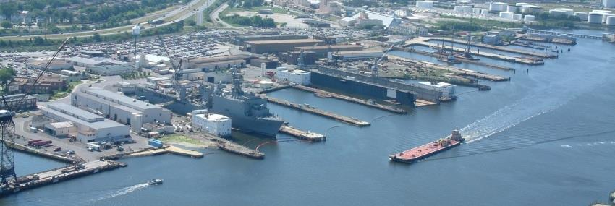
OSHA
Notes:
Employee’s Responsibilities and Rights
Responsibilities include:
Complying with OSHA standards
Wearing required PPE
Reporting hazards to supervisor
Complying with your organization’s rules and policies
Rights include:
Reviewing standards
Receiving training
Requesting an OSHA investigation (employer or OSHA) and receiving
feedback upon request
Reviewing the OSHA 300 Log

Slide 9

OSHA Employer’s Responsibility
9
Notes:
9
9
Employer’s Responsibility
Employers have certain responsibilities under the OSH Act of 1970. The following list is a summary of the most important ones.
Provide a workplace free from serious recognized hazards and comply with standards, rules and regulations issued under the OSHA Act
Examine workplace conditions to make sure they conform to applicable OSHA standards
Make sure employees have and use safe tools and equipment and properly maintain this equipment
Use color codes, posters, labels or signs to warn employees of potential hazards
Establish or update operating procedures and communicate them so that employees follow safety and health requirements
Provide medical examinations and training when required by OSHA standards
Post, at a prominent location within the workplace, the OSHA poster (or the state-plan equivalent) informing employees of their rights and responsibilities.

Slide 10

OSHA
More Employer’s Responsibilities
10
Notes:
10
10
More Employer’s Responsibility
Report to the nearest OSHA office within 8 hours any fatal accident or one that results in the hospitalization of 3 or more employees
Keep records of work-related injuries and illnesses. (Note: Employers with 10 or fewer employees and employers in certain low-hazard industries are exempt from this requirement)
Provide employees, former employees and their representative’s access to the Log of Work Related Injuries and Illnesses (OSHA Form 300)
Provide access to employee medical records and exposure records to employees or their authorized representatives
Provide to the OSHA compliance officer the names of authorized employee representatives who may be asked to accompany the compliance officer during an inspection
Not discriminate against employees who exercise their rights under the Act
Post OSHA citations at or near the work area involved. Each citation must remain posted until the violation has been corrected, or for three working days, whichever is longer. Post abatement verifications documents or tags
Correct cited violations by the deadline set in the OSHA citation and submit required abatement verification documentation

Slide 11


OSHA
Notes:
No Retribution
Section 11(c) (1) No person shall discharge or in any manner discriminate against any employee because such employee has filed any oral and written complaints.
OSHA administers the whistleblower protection provisions of more than twenty whistleblower protection statutes, including Section 11(c) of the Occupational Safety and Health (OSH) Act, which prohibits any person from discharging or in any manner retaliating against any employee because the employee has complained about unsafe or unhealthful conditions or exercised other rights under the Act.

Slide 12
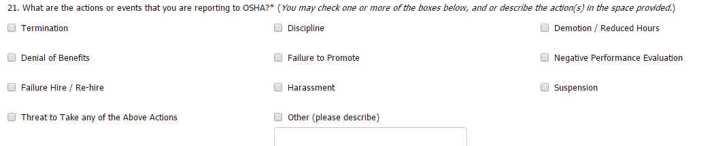
No Retribution!
http://www.whistleblowers.gov
Notes:
Discrimination includes:
Firing or laying off
Blacklisting demoting
Denying overtime or promotion
Disciplining
Denial of benefits
Failure to hire or rehire
Intimidation
Reassignment affecting future promotions
Reducing pay or hours
BY LAW, A COMPLAINANT'S INFORMATION, INCLUDING HIS/HER IDENTITY, MUST BE PROVIDED TO THE EMPLOYER. A WHISTLEBLOWER COMPLAINT FILED WITH OSHA CANNOT BE FILED ANONYMOUSLY.

Slide 13
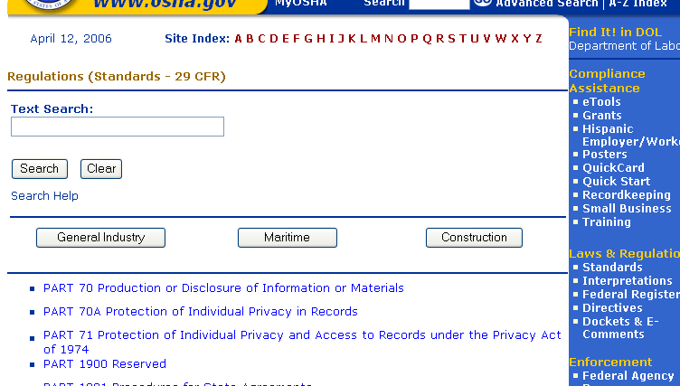
OSHA
Notes:
Resolve With Your Company – Follow your chain of command. Go to your Lead, Supervisor or Safety Technician. However, if this fails you should file a valid complaint.
Online - Go to the Online Complaint Form. Written complaints that are signed by workers or their representative and submitted to an OSHA Area or Regional office are more likely to result in onsite OSHA inspections.
Telephone - your local OSHA Regional or Area Office. OSHA staff can discuss your complaint and respond to any questions you have call 1-800-321-OSHA.
Download and Fax/Mail - Download the OSHA complaint form* [En Espanol*] (or request a copy from your local OSHA Regional or Area Office), complete it and then fax or mail it back to your local OSHA Regional or Area Office. Written complaints that are signed by a worker or representative and submitted to the closest OSHA Area Office are more likely to result in onsite OSHA inspections. Please include your name, address and telephone number so we can contact you to follow up. This information is confidential.

Slide 14
OSHA Exercise
Stump the class!
With a partner, write two questions from this section that you believe the rest of the class will be challenged in answering correctly. (Questions must be reasonable! If your instructor can’t answer, it doesn’t count!)
Notes:
Question One:
_____________________________________________________________________________________________________________________________________________________________________________________________________________________________________________________________________________________________________________________________________
Question Two:
_____________________________________________________________________________________________________________________________________________________________________________________________________________________________________________________________________________________________________________________________________

Slide 15
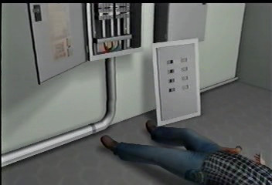
Electricity Hazards
Notes:
Electrical Injuries
Electricity is one of the most common causes of fire in homes and workplaces. Explosions have also resulted from electrical sources. On average of one worker is electrocuted on the job every day. There are four main types of electrical injuries:
Electrocution (death due to electrical shock)
Electrical shock
Burns
Falls
The following training content is subject to change as shipyard rules and governmental regulations change. You should follow your company’s procedures, rules and regulations. You should also study applicable OSHA and NAVSEA standards and best practices before beginning work.

Slide 16
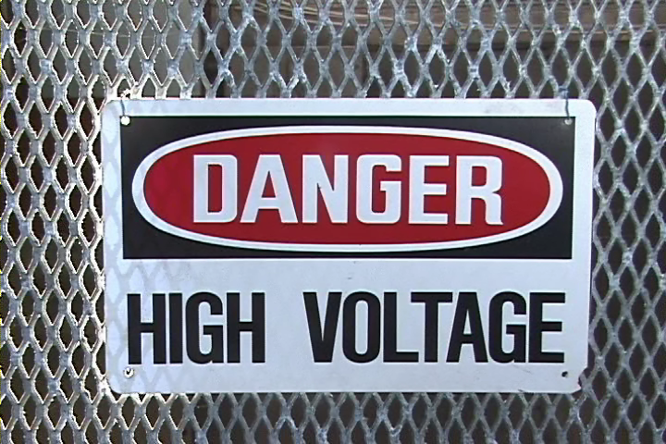
Electrical Terminology
Notes:
Common Terms
Amperes (Amps)– Amperage (A) is a measure of current flow, i.e., how many electrons flow through something per second. One amp is about 6 million trillion electrons per second. This flow of electrons is what actually causes tissue or nervous system damage. All those electrons passing through a body either heat and burn tissues or interfere with essential electrical signals, such as those that cause the heart to beat.
The latter phenomenon is why an electrocution above a certain amperage will cause your muscles to clench and make it impossible for a person to let go of the current source. Being physically unable to let go of a live wire is called tetanic contraction.
Current – the movement of electrical charge
Resistance – opposition to current flow

Slide 17

Electrical Terminology
Notes:
Common Terms
Voltage – Voltage (V) is how strong the "urge" is for the current to flow. Voltage is the push on the electrons. A rough analogy is that current is like water molecules, and voltage is like a slope. The steeper the slope, the more the water molecules wants to flow down it. Zero voltage between two points is like a plateau and, hence, there is no current flow.
Watts – a measure of electrical power. In an electrical system power (P) is equal to the voltage multiplied by the amps. W = P x A
Conductors – substances, such as metals, that have little resistance to electricity
Insulators – substances, such as wood, rubber, glass, and bakelite, that have high resistance to electricity
Grounding – a conductive connection to the earth which acts as a protective measure

Slide 18

Electricity Hazards
Notes:
Electric Shock
An electric shock occurs when a person comes into contact with an electrical energy source. Electrical energy flows through a portion of the body causing a shock. Exposure to electrical energy may result in no injury at all or may result in devastating damage or death.
Nationwide – 30,000 work-related non-fatal shocks per year
Nationwide – 1000 deaths per year
Navy – Three deaths in three years (2009, 2010, and 2011)
Electrocuted sailor’s family visits ship-San Diego Union Tribune
“The parents and brother of a sailor electrocuted aboard the frigate Rentz last fall made an emotional trip to see the ship yesterday as it returned to port in San Diego. Larry Mudge, father of Petty Officer 3rd Class David Mudge, 22, of Sutherlin, Ore., said the visit brought closure for his family.”
“We were happy for a while, then crying for a while, then laughing for a while,” Larry Mudge said. “All in all, it was a very good day.”

Slide 19
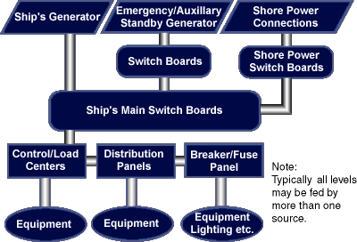
Electrical Sources
Notes:
Electricity On-Board (1915.181) (1915.157)
There are two sources of electrical power used during building and repair of a vessel -- shore side and vessel generated. (See diagram).
The potential for electrical shock hazards is greater in shipbuilding and repair than in other industries, because workers stand on metal decks and often work in a wet environment. Work on or around energized electrical equipment, or using portable electrical tools, can expose workers to electrocution, burns, or electrical shock. Before work is performed, energized equipment must be locked and/or tagged out, guarded, de-energized, and/or appropriate PPE used to prevent worker exposure.
Never plug into ships power without permission.

Slide 20

Electricity
Notes:
What Went Wrong?
Based on the video you just saw, working with your partner, identify “What Went Wrong”?
____________________________________________________________
____________________________________________________________
____________________________________________________________
____________________________________________________________
____________________________________________________________
____________________________________________________________
____________________________________________________________

Slide 21
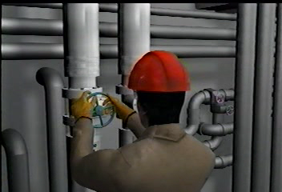
Non-Electrical Energy Hazards
Notes:
Other Potential Hazards

Slide 22

Hazardous Energy
Notes:
What Went Wrong?
Based on the video you just saw, working with your partner, identify “What Went Wrong”.
____________________________________________________________
____________________________________________________________
____________________________________________________________
____________________________________________________________
____________________________________________________________
____________________________________________________________
____________________________________________________________

Slide 23

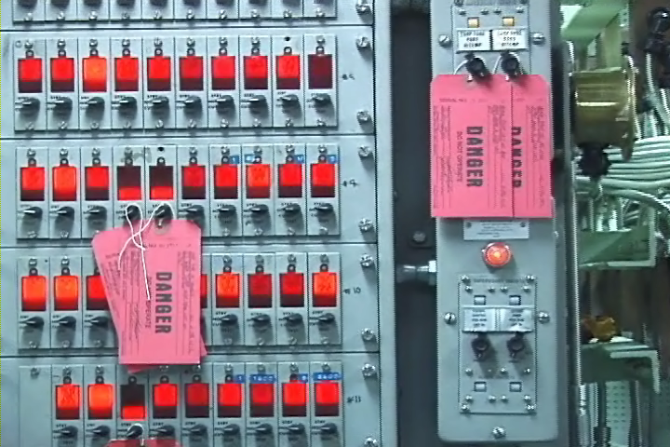
Lockout-Tag Out
Notes:
Lockout-Tag out
Lockout-Tag out is a specific work safety procedure or practice that safeguards employees from the unexpected powering or startup of machinery and equipment, or the release of hazardous energy during service or maintenance activities. This training is an overview of the process and is not intended to qualify you to perform lockout-tag out procedures.
Start up question!
Lockout-Tag out:
Requires a lock
Requires a tag
Requires both
It depends
___________________
___________________
___________________
___________________
___________________
___________________
___________________

Slide 24
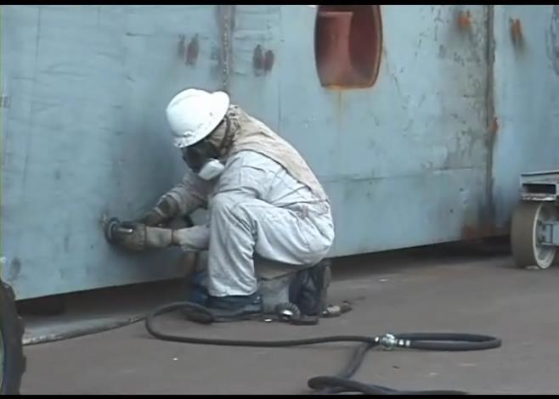
Terminology
Notes:
Affected Employee – An employee whose job requires the operation or use of machines or equipment on which servicing or maintenance is being performed under lockout or tag out, or whose job requires work in an area where such activities are being performed.
Authorized Employee– A person who locks or tags out systems / equipment in order to perform servicing or maintenance on equipment / system. Each authorized employee should receive training in NAVSEA Standard Item 009-24
recognition of applicable hazardous energy sources, the type and magnitude of the energy available onboard, and the methods and means necessary for energy isolation and control. Each employee who is authorized to perform a tag-out must be trained in accordance with the Tag-out Users Manual S0400-AD-URM-101/TUM.
Authorizing Officer – On Navy ships, is the person (typically Ships Force) with the authority to sign tags or labels to be issued or cleared. They are responsible to lock or tag out machines or equipment in order to perform the servicing or maintenance on that machine or equipment.
Energy Control Procedure - Safety program adopted by the employer that includes energy control procedures plus provisions for inspecting the procedures and training employees for lockout-tag out.

Slide 25
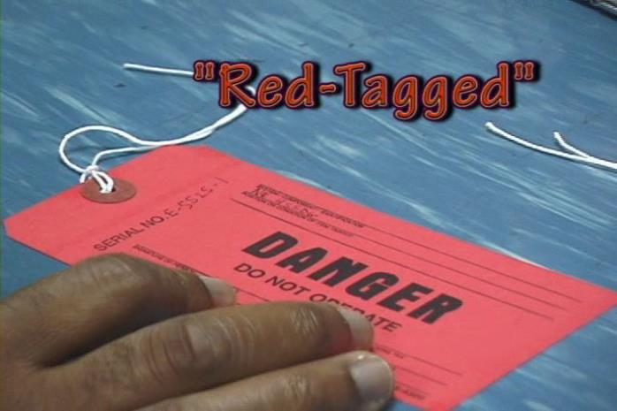
Terminology Continued
Notes:
Energy Isolating Device - A mechanical device that physically prevents the transmission or release of energy.
Energy Source – Any source of electrical, mechanical, hydraulic, pneumatic, chemical, thermal, or other energy source.
Lockout – The placement of a lockout device or an energy isolation device.
Lockout Tagout Coordinator - The employer shall designate a lockout/tags-plus coordinator who is responsible for overseeing and approving application, verification and removal. This person is often, but not necessarily, the WAF Coordinator. This person may be, but is not necessarily, an Authorized Person.
Repair Activity (RA) – A shipyard contractor or subcontractor familiar with the Navy’s Tag-Out process that initiates the tagout procedure.
RA Designated Representative – A person authorized and qualified to do the following: 1) ensure repair personnel comply with the NAVESEA Standard Item 009-24 and the TUMS Manual, 2) Reviews tag-outs associated with RA work 3) ensure the accuracy of tag-outs before signing the TORs, 4) authorizes tags for removal, 5) witnesses or verifies posted tags.

Slide 26
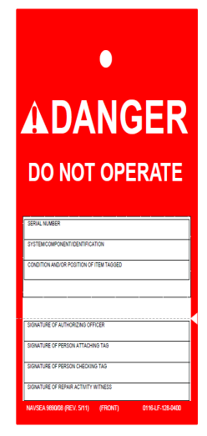
Terminology Continued
Notes:
“Red-Tagged” – On military vessels red tags are used and when a system is tagged out it is often referred to as “red-tagged”.
Tagout – The placement of a tagout device on an energy isolating device, in accordance with an established procedure, to indicate that the energy isolating device and the equipment being controlled may not be operated.
Tagout Device – A prominent warning device, such as a tag, and a means of attachment. Can be securely fastened to an energy isolating device in accordance with an established procedure, to indicate that the energy isolating device and the equipment being controlled may not be operated until the tagout device is removed.
Tag out Record Sheet (TORS) - A record and process control document for each tag associated with the tag-out.
Tag Out Log - A control document for administering tag-out procedures and a record of authorization for each active tag-out action.
Work Authorization Form (WAF) – A form submitted by a subcontractor to the Navy requesting that a specific type of work be done on a vessel.

Slide 27
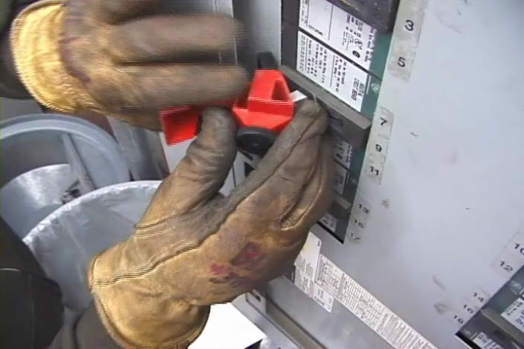
Electrical Protective Devices
Notes:
Overcurrent Devices
The basic idea of an overcurrent device is to make a weak link in the circuit. In the case of a fuse, the fuse is destroyed before another part of the system is destroyed. In the case of a circuit breaker, a set of contacts opens the circuit. Unlike a fuse, a circuit breaker can be re-used by re-closing the contacts. Fuses and circuit breakers are designed to protect equipment and facilities, and in so doing, they also provide considerable protection against shock in most situations. However, the only electrical protective device whose sole purpose is to protect people is the ground-fault circuit-interrupter (GFCI).

Slide 28
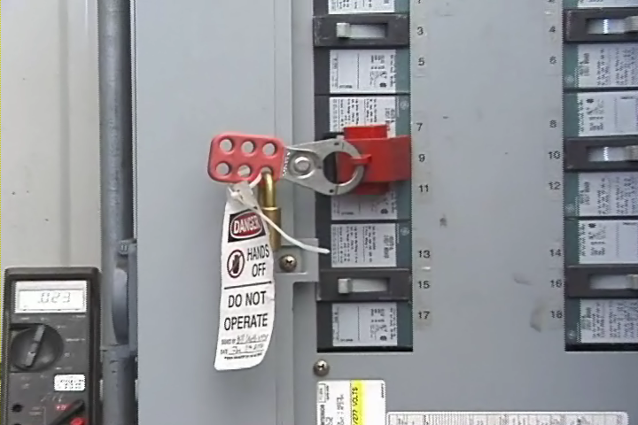
OSHA Requirements
Notes:
Key Word: De-Energize! (1915.181)
Before work is performed on circuits, except those being tested or adjusted, circuits must be de-energized and checked at the point where work will be performed to ensure the circuits are actually de-energized.
When testing or adjusting energized circuits, a rubber or other suitable insulated deck mat must be used.
De-energizing the circuit must be appropriately completed by opening the circuit breaker, opening the switch, or removing the fuse.
The circuit breaker, switch, or fuse location must be locked and/or tagged to indicate work is occurring on the circuit. Such tags must not be removed nor the circuit energized until the work has been completed.
When work is performed immediately adjacent to exposed energized parts, these parts must be covered (for example, insulated) or other equally safe means provided.

Slide 29

Hazardous Energy/Terminology
29
Notes:
29
For each statement below circle T for True or F for False.

Slide 30
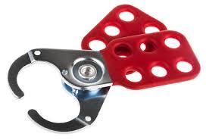
Lockout Tagout Piers / Facilities
Notes:
There are many different ways to lock out a piece of equipment. Commonly, the main disconnect switch has one opening where a lock can be placed.
When more than one employee works on any equipment, a lockout adapter designed for the installation of several locks must be used, enabling all workers to lock out the machine with their individual locks.
If switches are in a metal box, the box must be locked out.
If a fuse was removed in order to de-energize the equipment, the fuse box must be locked.
If the controls are in a metal covered box, a hasp may be welded or riveted to the door, along with a lock staple. Fuse boxes can also be locked in this way.
Machines activated by compressed air or steam will have valves that control movement. These valves must be locked out and bled down to release any back pressure.

Slide 31
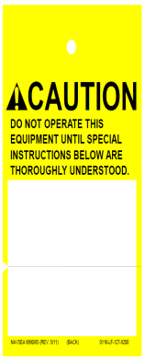
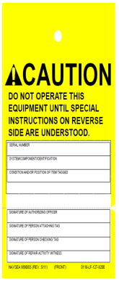
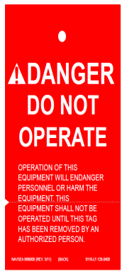
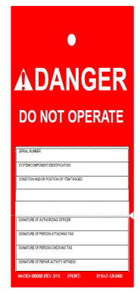
Tagging Out On A Navy Ship
CAUTION TAG
DANGER TAG
Notes:
When tagging out on a Navy Ship there are additional and specific requirements. The following training content is subject to change as shipyard rules and governmental regulations change. You should follow your company’s procedures, rules and regulations. You should also study applicable OSHA (Federal and California) and NAVSEA standards and best practices before beginning work.

Slide 32
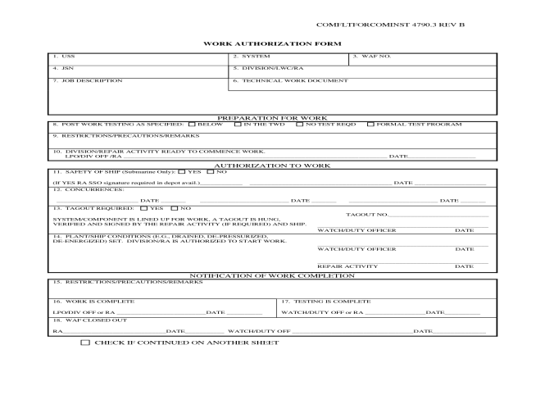
Work Authorization Form (WAF)
Notes:
RA personnel must be qualified and familiar with the Navy’s Tag-Out process established in the TUMS manual prior to signing any tags or forms.
The following guidelines shall be followed when requesting ships force to have a system or component isolated, de-energized, drained and depressurized.
Authorization to work (WAF)
1) A qualified trades person shall notify the WAF Coordinator or Commanding Officer's representative in writing, of the equipment and systems that require isolation to accomplish work in the Work Item.
2) WAF has to be approved by the WAF Coordinator.
3) Block 13 of the WAF indicates if a Tag-Out is required. If a tag-out is required the following steps will take place.
4) The Approved WAF initiates the request for the ship to tag-out your system / component.

Slide 33
The Tag Out Process
Notes:
All NAVESEA Standard Item 009-24 and the TUMS Manual Shall Apply
Ship will prepare tags based on the WAF.
The RA shall review accuracy of proposed tag out and sign block 10 of the TORS sheet (Tag-out record sheet).
The ships Engineering Duty Officer will authorize the tag outs for engineering related systems.
The ships Combat System Officer of the Watch will authorize tag outs for combat related systems.
Only Ships Force will do the actual positioning of equipment, switches, breakers and valves as required!

Slide 34
The Tag Out Process Cont.
Notes:
All NAVESEA Standard Item 009-24 and the TUMS Manual Shall Apply
Tags will be hung by the ships force representative first signer (Authorizing Officer).
A second qualified ships force representative shall conduct an independent review and sign tag.
The RA shall conduct an independent review for the validation and accuracy of the tags, print name, badge, and company and sign block 7 of the hung tag and initial block 18b of the TORS.
The RA will have the Watch / Duty Officer Sign block 13 of the WAF form after verification of tags has been completed by the RA.
The RA and the Watch / Duty Officer will sign block 14 of the WAF form once the system and or component has been verified to have been drained / de-energized / depressurized and cooled down when working with steam.
It is critical to note that validating the accuracy of tags needs to include system diagrams and hand over hand inspection / circuit schematics and or drawings to achieve completeness of system isolations

Slide 35
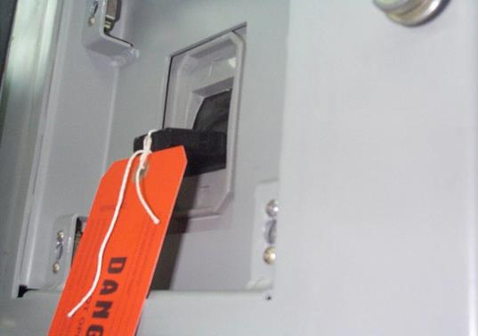
Tag Attachment
Notes:
This is the correct way to post a tag on a breaker (large or small). The tag is inserted through the hole on the breaker handle.
Ship's Force personnel will remove tags after BAE Systems concurrence and clearance
has been recorded and removal is authorized by the Commanding Officer’s designated
representative.
11.5.9 Verify removal and clearance of DANGER or isolation tags in accordance with ship's
instruction before the equipment is operationally tested or operated.
11.6 Other than in accordance with the foregoing instructions, no tag or lock is to be installed

Slide 36
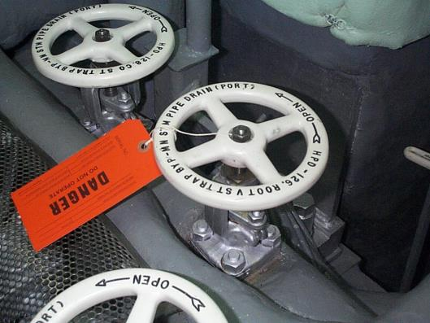
Tag Attachment Continued
Notes:
This is the correct method for applying a danger tag to a valve. Tags may be placed on the stem in cases where the handwheel must be removed for maintenance

Slide 37
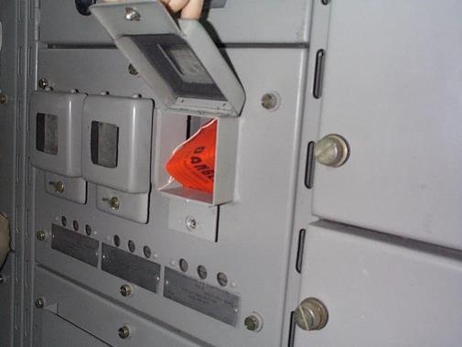
Tag Attachment Continued
Notes:
This is the correct method for applying a danger tag to a recessed breaker. The tag is attached to the breaker handle.

Slide 38
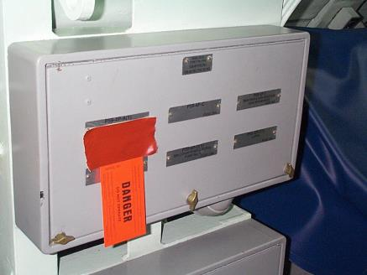
Tag Attachment Continued
Notes:
This is the correct method for attaching a danger tag to a power panel. The tag is attached over the label plate in a manner that allows viewing of the plate beneath the tag.
.

Slide 39
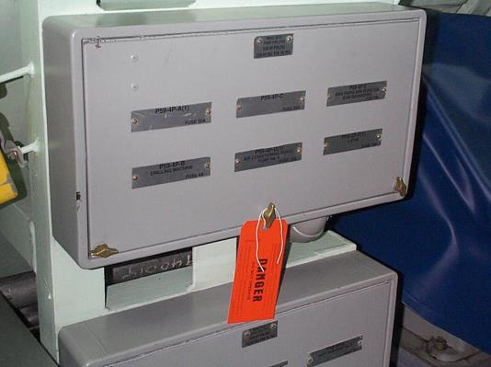
Tag Attachment Continued
Notes:
This is an incorrect method for applying a danger tag to fuses removed from a panel. It is not obvious from which component fuses have been removed.
.

Slide 40
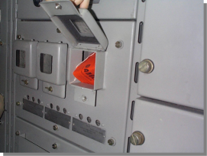
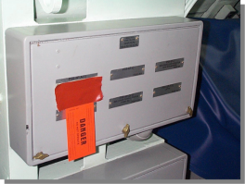
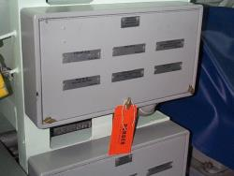

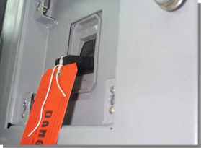
Quiz
A
B
C
D
E
Notes:
Which of the above is incorrect?
.

Slide 41
Clearing Tags
Notes:
All NAVESEA Standard Item 009-24 and the TUMS Manual Shall Apply
Upon the completion of work, only the person initiating the tag out can authorize tag removal. Exception: If the person who initiated the tag out cannot be contacted then all equipment/circuits affect by the tag out are inspected to ensure there is no safety hazard and the Job Foreman/Leadman must verify that all work is 100% complete.
The RA responsible for the work item shall sign the TORS to show concurrence in tag removal and clearance before removal.
Block 12 and 13 are signed to indicate that work is complete. Block 20b is signed which allows tag to be cleared.
Ships Force will remove tags and return system to normal conditions.

Slide 42
The Tag Out Process Exercise
1
2
3
Notes:
Number the steps below in the correct order. Put the number 1 in the box in front of the first step, the number 2 in the box in front of the second step and so on.
The RA shall review accuracy of proposed tag out and sign block 10 of the TORS sheet (Tag-out record sheet).
The RA and the Watch / Duty Officer will sign block 14 of the WAF form once the system and or component has been verified to have been drained / de-energized / depressurized and cooled down when working with steam.
The ships Engineering Duty Officer will authorize the tag outs for engineering related systems.
Ship will prepare tags based on the WAF.
The RA shall conduct an independent review for the validation and accuracy of the tags, print name, badge, and company and sign block 7 of the hung tag and initial block 18b of the TORS.
Tags will be hung by the ships force representative first signer (Authorizing Officer).
A second qualified ships force representative shall conduct an independent review and sign tag.
The RA will have the Watch / Duty Officer Sign block 13 of the WAF form after verification of tags has been completed by the RA.
The ships Combat System Officer of the Watch will authorize tag outs for combat related systems.

Slide 43
The Tag Out Process Exercise
Answers
Are On
The Following
Page!
Notes:
________________________________________________________________________________________________________________________________________________________________________________________________________________________________________________________________________________________________________________________________________________________________________________________________________________________________________________________________________________________________________________________________________________________________________________________________________________________________________________________________________________________________________________________________________________________________________________________________________________________________________________

Slide 44
The Tag Out Process Exercise
1
2
3
Notes:
Number the steps below in the correct order. Put the number 1 in the box in front of the first step, the number 2 in the box in front of the second step and so on.
2. The RA shall review accuracy of proposed tag out and sign block 10 of the TORS sheet (Tag-out record sheet).
9. The RA and the Watch / Duty Officer will sign block 14 of the WAF form once the system and or component has been verified to have been drained / de-energized / depressurized and cooled down when working with steam.
3. The ships Engineering Duty Officer will authorize the tag outs for engineering related systems.
1. Ship will prepare tags based on the WAF.
7. The RA shall conduct an independent review for the validation and accuracy of the tags, print name, badge, and company and sign block 7 of the hung tag and initial block 18b of the TORS.
5. Tags will be hung by the ships force representative first signer (Authorizing Officer).
6. A second qualified ships force representative shall conduct an independent review and sign tag.
8. The RA will have the Watch / Duty Officer Sign block 13 of the WAF form after verification of tags has been completed by the RA.
4. The ships Combat System Officer of the Watch will authorize tag outs for combat related systems.

Slide 45
PPE And Other Requirements
NAVAL SHIPS’ TECHNICAL MANUAL
CHAPTER 300
ELECTRIC PLANT - GENERAL

Slide 46

Don’ts & Do’s!
Notes:
You must comply with all provisions set forth in Federal, State and all government policies and procedures.
Non-compliance with, or violation of, these policies and/or procedures will result in immediate disciplinary action on the first offense up to and including termination.

Slide 47
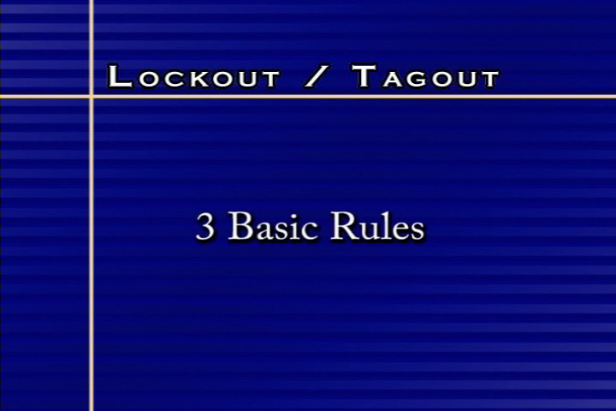
Don’ts!
Notes:
Never
Work on an energized system (unless testing)
Operate any tagged device
Re-energize without proper tag-in
Also Never
Willfully demonstrate non-compliance with lockout / tagout procedures.

Slide 48
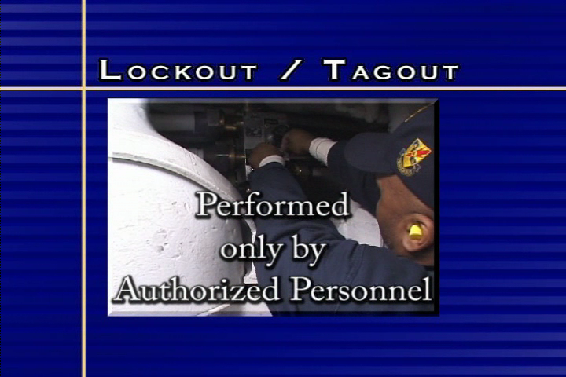
More Don’ts
Notes:
Never
Lockout or tag out a device unless you are specifically trained and authorized to perform this function!
(However, you will be required to follow the production worker lockout-tag out rules that apply to all of the MSR’s and specific host yards where you work.)
Plug into ships power!
Use another contractor’s tag. Your company must initiate a WAF to work on a system.
Remove, modify or disturb a lock or a tag (or the device it is affixed to)!
Assume a system is de-energized.
Break the rules!

Slide 49

MSR Do’s
Notes:
Always test circuit before working on it!
When you see a “floating” tag (a tag no longer attached to a device such as a valve) notify Ship’s Force and your Supervisor immediately
Near misses: Report a “little shock”
Verify Tags
Test at the source
Re-Test at the source!

Slide 50

In Case Of An Emergency
Notes:
Do not touch someone being shocked!
Call for help
Secure power immediately
Remove them from the source with a non-conducting material, such as something made with rubber or plastic (be sure the material is not wet)
After the person is removed from the source, start CPR if necessary and you are trained!

Slide 51

Training
Notes:
OSHA 1915.89(o)(2) General training content. The employer shall train each employee who is, or may be, in an area where lockout/tags-plus systems are being used.
Training is to be conducted with any new employee that will be involved with shipboard tag out.
Annual training will be given to all authorized employees.
OSHA 1915.89(o)(7) Upon completion of employee training, the employer shall keep a record that the employee accomplished the training, and that this training is current. The training record shall contain at least the employee's name, date of training, and the subject of the training.
OSHA 1915.89(o)(6) (i) through (iii) Employees may need re-training based on new job assignments, equipment changes, procedure changes, proficiency changes, program investigations and/or audits, or evidence that there is a lack of knowledge. Re-training must ensure the required employee knowledge and proficiency in the employer’s program and procedures.

Slide 52
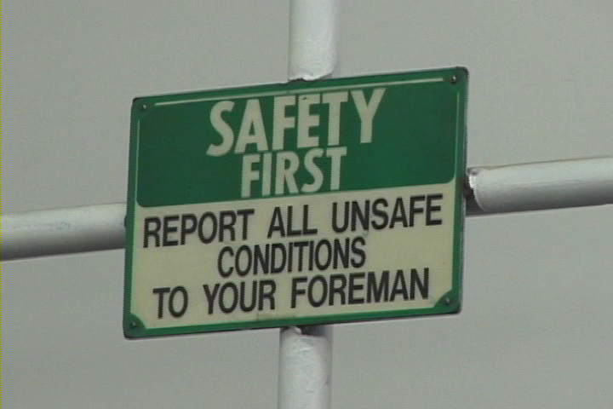
One More Thing!
Notes:
Take Action!
Whenever you find equipment that is defective, in need of repair or unsafe to operate you should immediately:
Turn off equipment to protect yourself
Place a warning tag or barrier on the equipment to prevent others from using it
Notify your supervisor of the condition

Slide 53
Electrical/Lockout-Tag out
53
Notes:
53
For each statement or question below circle the best answer.

Slide 54

Questions / Comments
54
Notes:
54
___________________________________________________________________________________________________________________________________________________________________________________________________________________________________________________

