Slide 1
Title Page
FALL PROTECTION IN SHIPYARDS
A 4-Hour Fall Hazard Recognition Course
For Shipyard Workers
Developed by the Port of San Diego Ship Repair Association
This material was produced under grant SH-27645-SH5 from the Occupational Safety and Health Administration, U.S. Department of Labor. It does not necessarily reflect the views or policies of the U.S. Department of Labor, nor does mention of trade names, commercial products or organizations imply endorsement by the U.S. Government.
1
Notes:
1
Course Introduction Page 2
OSHA Page 5
Falls Page 14
Fall Protection Page 22
Ladder Safety Page 28
Ladder Best Practices Page 37
Scaffolding Page 40
Scaffold Best Practices Page 53
This material was produced under grantSH-27645-15 from the Occupational Safety and Health Administration, U.S. Department of Labor. It does not necessarily reflect the views or policies of the U.S. Department of Labor, nor does mention of trade names, commercial products or organizations imply endorsement by the U.S. Government.

Slide 2

Introduction
Introduction
2
2
Notes:
2
2
Introduction
Welcome to Fall Protection training course. This course is designed to provide you with the knowledge needed to work safely and prevent falls in a shipyard environment. The target audience of this training is shipyard workers who work on-board a vessel and therefore the course content is based primarily on Federal OSHA standards. References are from 29 CFR and when appropriate NAVSEA FY16 Standard Items. This class covers not only OSHA regulations but also some Navy requirements as well as host yard rules and expectations.
Design Delivery Strategy
The delivery will be: Instructor-led, video-supported and conducted in a classroom. You will be asked to participate and demonstrate your knowledge throughout the course.
.

Slide 3
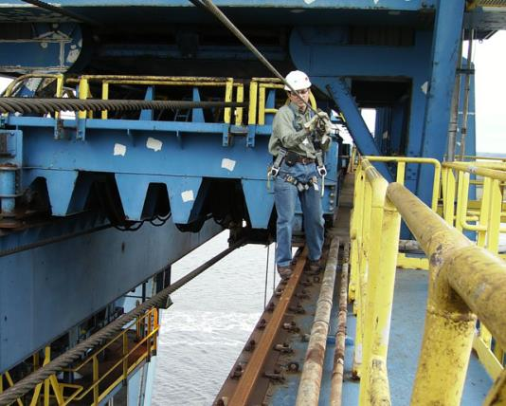
Overview
What’s wrong
with this picture?
3
3
Notes:
3
3
Course Objective
At the completion of this course, the trainee will pass a certification test, and demonstrate safe work practices as defined by Federal OSHA standards, Navy specifications and host-yard requirements.
Learning Progress
At the end of most lessons there will be practice exercises for the participants to complete.
Evaluation Strategy
This course will be considered successful if there is a test rate of over 70% after the participant completes this course.
Training Audience
This course is intended for all production shipyard workers.

Slide 4
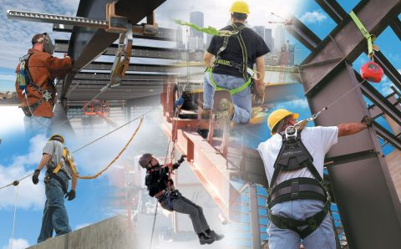
Overview – Trainee Expectations
Overview
4
Notes:
4
Trainee Expectations
It is expected that all trainees will:
Pay attention
Avoid interruptions, including cell phones
Participate
Pass the post-assessment
Practice the material learned
Training Logistics
This training program will:
Be conducted for 4 hours
Have four 10-minute breaks (2 in the morning and 2 in the afternoon)
Have a 30-minute lunch break (food opportunities)
Start and end on time
Know Where
Restrooms are located
Muster area is located (also know the sound of the emergency alarm

Slide 5

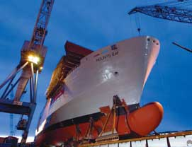
Lesson One Objectives
OSHA
5
Notes:
5
5
Lesson One Objectives
At the completion of this lesson, It is expected that all trainees will:
Describe the organization known as OSHA
Understand your rights
Understand what “No Retribution” means
Know how to file a complaint

Slide 6
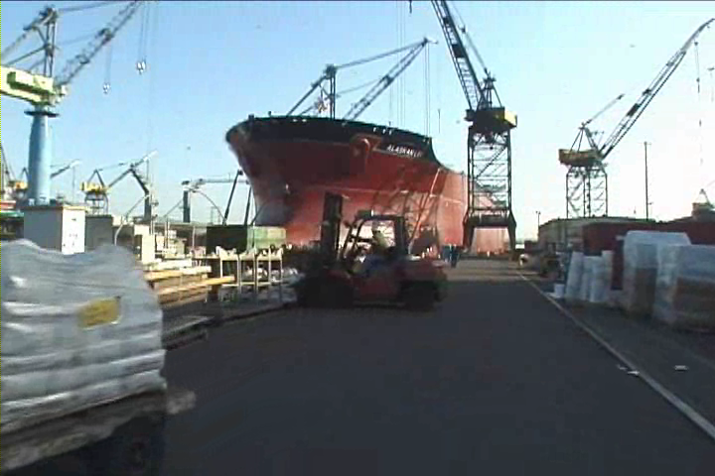
The Need for OSHA
OSHA
6
6
Notes:
SDSRA-S2P2
6
6
6
On December 29th, 1970, the Occupational Safety and Health Administration (Federal OSHA) was founded. OSHA is responsible for spreading legally enforceable safety and health standards to protect workers on the job.
The Need for OSHA
Prior to 1970:
• More than 14,000 worker deaths annually
• 2.5 million workers disabled by work-related injuries
• Estimated 300,000 cases of work-related illness
Since 1970:
Work-related fatalities cut by 62%
Overall injury and illness rate reduced 42%
Brown lung disease eliminated
Trenching fatalities reduced 35%
There were 4,679 workers who died on the job in 2014
2014 Fatal occupational injuries by falls, slips and trips, 793 (BLS)

Slide 7
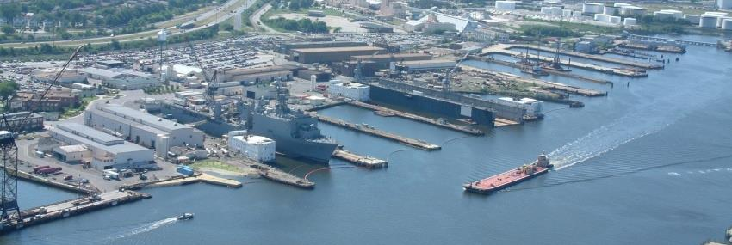
OSHA
Notes:
Employee’s Responsibilities and Rights
Responsibilities include:
Complying with OSHA standards
Wearing required PPE
Reporting hazards to supervisor
Complying with your organization’s rules and policies
Rights include:
Reviewing standards
Receiving training
Requesting an OSHA investigation (employer or OSHA) and receiving
feedback upon request
Reviewing the OSHA 300 Log

Slide 8

Employer’s Responsibility
OSHA
8
Notes:
8
8
Employer’s Responsibility
Employers have certain responsibilities under the OSH Act of 1970. The following list is a summary of the most important ones.
Provide a workplace free from recognized hazards and comply with standards, rules and regulations issued under the OSHA Act
Examine workplace conditions to make sure they conform to applicable OSHA standards
Make sure employees have and use safe tools and equipment and properly maintain this equipment
Use color codes, posters, labels or signs to warn employees of potential hazards
Establish or update operating procedures and communicate them so that employees follow safety and health requirements
Provide medical examinations and training when required by OSHA standards
Post, at a prominent location within the workplace, the OSHA poster (or the state-plan equivalent) informing employees of their rights and responsibilities.

Slide 9

More Employer’s Responsibility
OSHA
9
Notes:
9
9
More Employer’s Responsibility
Report to the nearest OSHA office within 8 hours any fatal accident or one that results in the hospitalization of 3 or more employees
Keep records of work-related injuries and illnesses. (Note: Employers with 10 or fewer employees and employers in certain low-hazard industries are exempt from this requirement)
Provide employees, former employees and their representative’s access to the Log of Work Related Injuries and Illnesses (OSHA Form 300)
Provide access to employee medical records and exposure records to employees or their authorized representatives
Provide to the OSHA compliance officer the names of authorized employee representatives who may be asked to accompany the compliance officer during an inspection
Not discriminate against employees who exercise their rights under the Act
Post OSHA citations at or near the work area involved. Each citation must remain posted until the violation has been corrected, or for three working days, whichever is longer. Post abatement verifications documents or tags
Correct cited violations by the deadline set in the OSHA citation and submit required abatement verification documentation

Slide 10


OSHA
Notes:
No Retribution
Section 11(c) (1) No person shall discharge or in any manner discriminate against any employee because such employee has filed any oral and written complaints.
Discrimination includes:
Firing or laying off
Blacklisting demoting
Denying overtime or promotion
Disciplining
Denial of benefits
Failure to hire or rehire
Intimidation
Reassignment affecting future promotions
Reducing pay or hours

Slide 11

OSHA
Notes:
Resolve With Your Company – Follow your chain of command. Go to your Lead, Supervisor or Safety Technician. However, if this fails you should file a valid complaint.
Online - Go to the Online Complaint Form. Written complaints that are signed by workers or their representative and submitted to an OSHA Area or Regional office are more likely to result in onsite OSHA inspections.
Telephone - your local OSHA Regional or Area Office. OSHA staff can discuss your complaint and respond to any questions you have call 1-800-321-OSHA.
Download and Fax/Mail - Download the OSHA complaint form* [En Espanol*] (or request a copy from your local OSHA Regional or Area Office), complete it and then fax or mail it back to your local OSHA Regional or Area Office. Written complaints that are signed by a worker or representative and submitted to the closest OSHA Area Office are more likely to result in onsite OSHA inspections. Please include your name, address and telephone number so we can contact you to follow up. This information is confidential.

Slide 12
OSHA Exercise
Stump the class!
With a partner, write two questions from this section that you believe the rest of the class will be challenged in answering correctly. (Questions must be reasonable! If your instructor can’t answer, it doesn’t count!)
Notes:
Question One:
_____________________________________________________________________________________________________________________________________________________________________________________________________________________________________________________________________________________________________________________________________
Question Two:
_____________________________________________________________________________________________________________________________________________________________________________________________________________________________________________________________________________________________________________________________________

Slide 13
OSHA
QUIZ!
13
Notes:
13
For each statement below circle T for True or F for False.

Slide 14
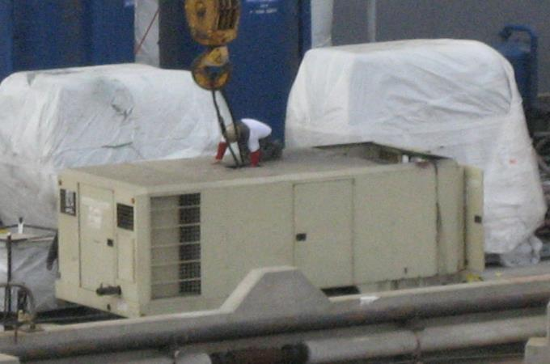
Falls
Notes:
Behaviors That Lead to Falls
The following behaviors can lead to falls!
Walking too fast
Running
Rapid changes in direction
Horseplay
Distractions
Not following rules and regulations!
What is wrong with this picture?!

Slide 15
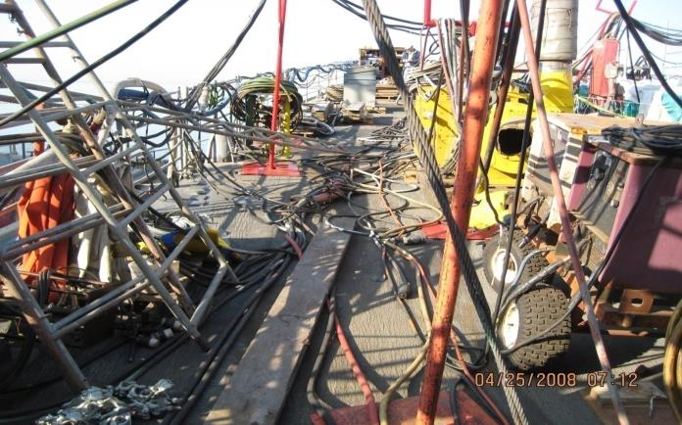
Prevention
15
Notes:
15
Preventing Slips, Trips and Falls 1910.22(a)
Permanent floors and platforms shall be free of dangerous projections or obstructions, maintained in good repair, and reasonably free of oil, grease, or water. Where the type of operation necessitates working on slippery floors, such surfaces shall be protected against slipping by using mats, grates, cleats, or other methods which provide equivalent protection. Where wet processes are used drainage shall be maintained and false floors, platforms, mats, or other dry standing places provided
The following are examples of what causes workers to fall and some advise for prevention.
Poor Housekeeping OSHA 1915.81
According to the Safety Council, workers are injured from slips, trips and falls more than any other occupational injury. These can be avoided if proper housekeeping procedures are used.
Good housekeeping includes picking up, wiping up, and cleaning up. It includes the prompt removal of scrap and waste. If housekeeping is delegated to another crafts such as laborers, we must keep in mind that like “safety” it self, housekeeping is everyone’s responsibility.

Slide 16
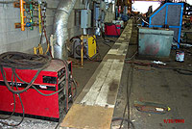
Prevention
Notes:
Lack of designated walkway 1915.81(a)(2)(i)
Designated walkways provide safe pathways for workers to travel from one part of the facility to another. They prevent workers walking through production areas where they could be injured by moving materials or equipment operations where they can easily trip and fall.
Walkways must be maintained in proper working conditions. This means not storing materials in the walkway or running cords and lines across the path, presenting a trip hazard, cleaning up, spills and being well lit to assure workers can see where they are walking.
Distractions
As simple as this may sound, it is a huge problem. It is common to see workers walking and talking on cell phones or to one another and not being aware of what is in front of them. By not staying alert, workers loose sight of what they are doing and are not aware of hazardous surroundings. Being in a hurry may result in walking too fast, even running; this can require rapid changes in direction of travel and often a loss of balance. Not watching where one is going and speed, are common factors in many job injuries.
Employees must be made aware of the importance of being aware of their surroundings, this can be done by posting signs, posters and banners in work areas and/or break rooms. Also, supervisors should be on the look out for employees who appear not to be paying attention and intervene.
.

Slide 17

Prevention
17
Notes:
17
Wet, slippery working/walking surfaces 1910.22(a)(2)
Outdoor operations are at the mercy of changes of weather that may come suddenly creating wet slippery conditions that were not present at the beginning of the work day. This problem may be aggravated when workers may have been conducting operations indoors or in areas protected by the elements and suddenly walk outside. Not knowing what the conditions are, they may slip on wet slippery surfaces. Ladder rungs can become slippery along with hand grips on objects used to maintain stability. Operations may cease during periods of heavy weather; however, sometimes operations must continue. If this is the case, workers must be alerted to the hazards of working under such weather conditions.
Provide adequate lighting 1915.82(a)(2)
It is extremely important to have the proper illumination in the work area. If a worker can’t see properly, an opportunity for injury can exist. In addition to injury, poor lighting will lead to poor work quality. Work procedures should include ensuring proper lighting before workers enter work areas, inspection of temporary lights to make sure that they are properly installed and in good working conditions, check illumination levels periodically to ensure proper level of light.
NAVSEA STD Item 009-74 states:
3.12 Each employee shall have a flashlight or other adequate light source onboard a navy vessel.

Slide 18

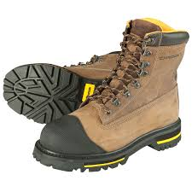
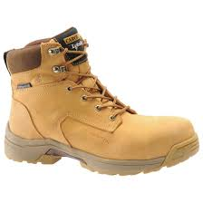
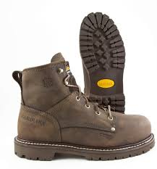
Prevention- Proper Footwear
Notes:
Wear proper footwear (1910.136)
The shoes we wear play a big part in preventing falls. The slickness of the soles and the type of heels need to be evaluated to avoid slips, trips and falls. In wet- process areas, non skid footwear is required.
Not only is important to wear good quality good quality slip resistant boots, it must also be worn properly and maintained in good condition. Work boots that are not properly lacey up may cause tripping over loose laces. Improperly laced boots do not provide ankle support which can lead to twisted ankle injuries. Work boots in poor condition with worn out soles and heels create slip hazards and will not protect workers from the hazards that may be present such as sharp edges, wet/slippery conditions, etc.
Follow your employer’s policy requiring the type, maintenance and inspection of safety foot wear. Supervisors should periodically inspect workers foot wear to make sure they are in proper working condition.
.

Slide 19
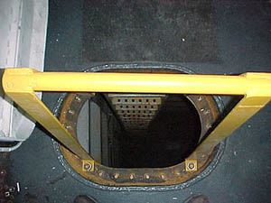
Guarding Deck Openings & Edges
Notes:
Small Openings (1915.73(b))
When employees are working in the vicinity of flush manholes and other small openings of comparable size in the deck and other working surfaces, such openings shall be suitably covered or guarded to a height of not less than 30 inches. Except where the use of such guards is made impracticable by the work actually in progress.
Unguarded Edges (1915.73(d))
When employees are exposed to unguarded edges of decks, platforms, flats, and similar flat surfaces, more than 5 feet above a solid surface, the edges must be guarded by adequate guardrails. Unless the nature of the work in progress or the physical conditions prohibit the use or installation of such guardrails.

Slide 20
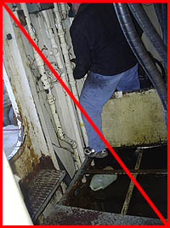
Guarding Deck Openings & Edges
Notes:
Guardrails (1915.73(f)) Guardrail System is a barrier erected to prevent employees from falling to lower levels
Sections of bilges from which floor plates or gratings have been removed shall be guarded by guardrails, except where they would interfere with work in progress.
If these open sections are in a walkway at least two 10‑inch planks placed side by side and safely secured, or equivalent, must be laid across the opening to provide a safe walking surface.

Slide 21

Working Surfaces
Notes:
Working Over Water (1915.73(e)) (1915.158(a)) (1915.158 (b))
When employees are working near the unguarded edges within 5 feet of decks of vessels afloat, they shall be protected by approved personal flotation devices meeting the requirement of 1915.158(a) . Prior to each use, personal flotation devices shall be inspected for dry rot, chemical damage, or other defects which may affect their strength and buoyancy. Defective personal flotation devices shall not be used.
When work is being performed on a floating vessel 200 feet (61 m) or more in length, at least three 30-inch (0.76 m) U.S. Coast Guard approved ring life buoys with ninety foot lines attached shall be located in readily visible and accessible places. Ring life buoys shall be located one forward, one aft, and one at the access to the gangway.
On floating vessels under 200 feet (61 m) in length, at least one 30-inch (0.76 m) U.S. Coast Guard approved ring life buoy with a ninety foot line attached shall be located at the gangway. At least one 30-inch (0.76 m) U. S. Coast Guard approved ring life buoy with a ninety foot line attached shall be located on each staging alongside of a floating vessel on which work is being performed. There shall be at least one portable or permanent ladder in the vicinity of each floating vessel on which work is being performed.
When employees are boarding, leaving, or working from small boats or floats, they must be protected by personal flotation devices.
Distance between ring buoys shall not exceed 200 feet.

Slide 22
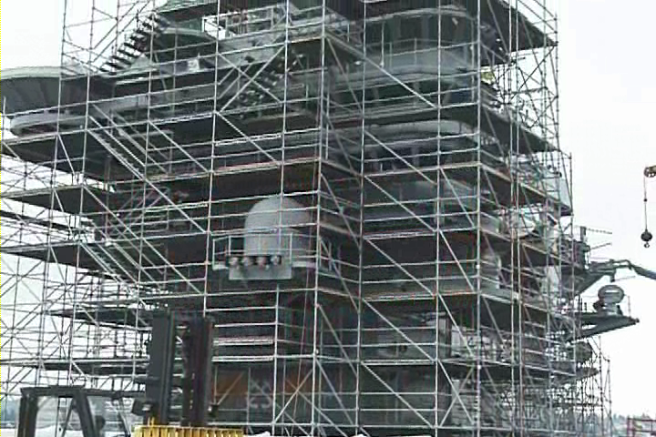
Fall Protection
Fall Protection
22
Notes:
22
22
At the completion of this lesson, It is expected that all trainees will pass the quiz at the end of this lesson and have the ability to identify and take appropriate actions to abate fall hazards that me be encountered at worksites, such as:
Unprotected elevated work areas
Floor and walls openings
Slippery Surfaces
Trip Hazards
Scaffolding
Elevated Work Platforms
Ladders

Slide 23
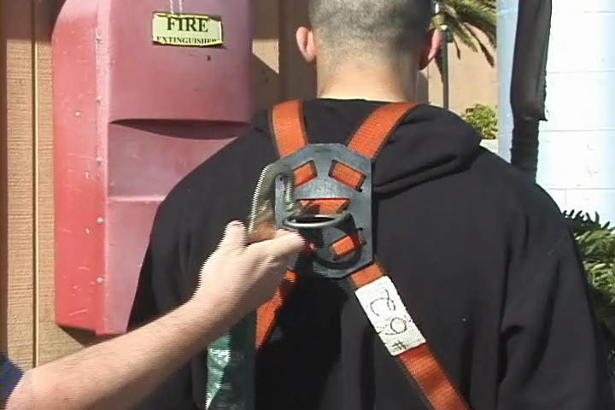
Personal Fall Arrest System
Notes:
When To Use a Personal Fall Arrest System (PFAS) (1915.77) (1915.159)
Fall protection is required when:
Working 5 feet or more above a lower level
There is a hazard of falling into dangerous equipment
Working in specific areas or activities
While walking and working surfaces are being inspected
Connectors, D-rings, snap hooks, anchorages, lifelines, lanyards and personal fall arrest systems must be in compliance with 1915.159.
NAVSEA Standard Item FY 6 009-74, 3.18.2 States:
Provide and use personal fall arrest system (PFAS), working
lanyard, and climber safety device when going aloft where a climber safety
rail is installed. If a climber safety rail is not installed, use a double
lanyard configuration.
Notes: Platform above 4 feet should be guarded with a handrail and toe board.
A best shipyard practice is to be sure you are wearing fall protection when working within 6 feet from an unguarded edge.

Slide 24
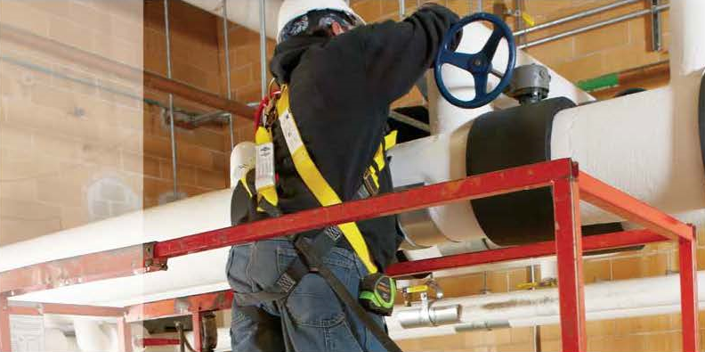
Prevent Falls /Safety Rules
Notes:
Rules!
Follow these rules to prevent falls in the workplace:
Stay away from edges, even if they’re guarded, unless you’re performing a specific task there
Do not engage in horseplay
Clean up all spills promptly
Take special care on icy surfaces
Don’t carry a stack of materials you can’t see over
Carry only tools and materials you need to upper work levels
Keep all tools, equipment, and materials as far away from the edge as possible
Dispose of trash regularly and properly
Platforms/scaffolds should have toeboards
When tying off to a pad eye or cleat be sure that they are labeled to support 5,000 pounds. When tying off to a hard point be sure it can support 5,000 pounds.

Slide 25
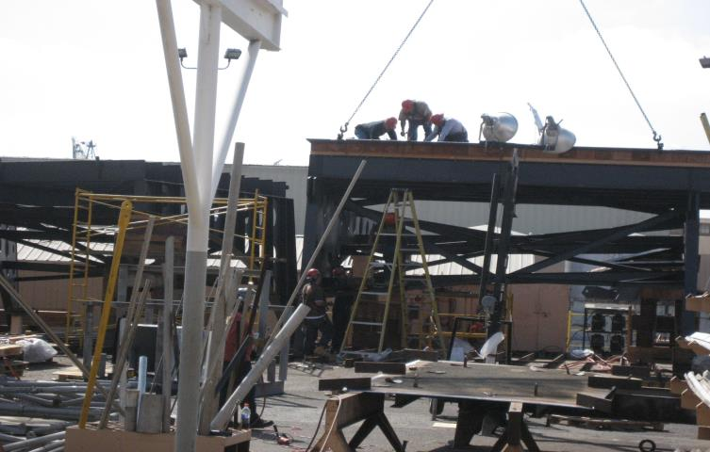
What’s Wrong in this Picture?
What’s Wrong in this Picture?
Notes:
What’s Wrong With This Picture?
________________________________________________________________________________________________________________________________________________________________________________________________________________________________________________________________________________________________________________________________________________
________________________________________________________________________________________________________________________________________________________________________________________________________________________________________________________________________________________________________________________________________________

Slide 26

Prevent Falls /Safety Rules
Notes:
Rules Continued!
Follow these rules to prevent falls in the workplace:
Obey verbal warnings, signs, warning lines, and barriers
Don’t enter a controlled access zone without authorization
Use assigned personal protective equipment, such as a personal fall arrest system and a hard hat
Inspect your personal fall arrest system before each use to make sure it is in good condition and safe to use
Use common sense and caution at all times
Wear sturdy shoes with nonskid soles and short laces
Avoid wearing long, loose pants you could trip over
Walk slowly and watch where you are going—don’t run!
Don’t lean on guardrails
Be sure you are trained!!

Slide 27

Fall Protection and Scaffolding
Notes:
What Went Wrong?
Based on the video you just saw, working with your partner, identify “What Went Wrong”.
____________________________________________________________
____________________________________________________________
____________________________________________________________
____________________________________________________________
____________________________________________________________
____________________________________________________________
____________________________________________________________

Slide 28
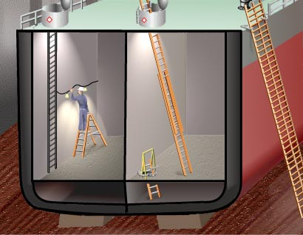
Ladder Safety
Notes:
Injuries Caused by Ladders
Ladders are used in shipbuilding and ship repair to allow workers to gain access to multiple levels, and in some cases to work from.
According to The U.S. Consumer Product Safety Commission it is estimated that 65,000 individuals receive emergency room treatment because of ladder accidents. However, the hazards associated with using ladders can be significantly reduced when using the ladder properly.
Hazards
Hazards associated with the use of ladders include:
Falls from the ladder caused by structural failure
Poor placement
Inappropriate work practices.

Slide 29
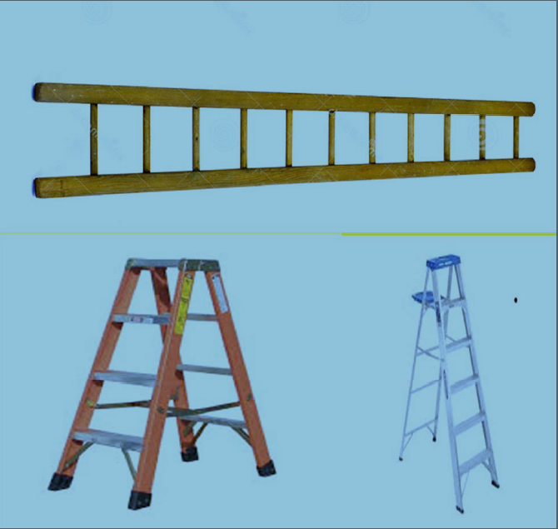
Ladder Material Types
Notes:
Ladder Material Pros and Cons
Three types of materials most commonly used:
Wood
Pro - non-conductor of electricity when dry
Pro - the best natural insulator against heat of all materials
Con - ages very fast
Fiberglass
Pro - non-conductor of electricity
Pro - dense material and is slower to conduct heat than metals
Pro - ages very slow
Con - heavier than aluminum or wood models
Con - tends to chip and crack under severe impact, or when dropped upon solid objects
Aluminum
Pro - in general are tough
Pro - age very slow
Pro - will not chip or crack when subjected to severe impact
Con - can conduct electricity
Con - not a good insulator against heat

Slide 30
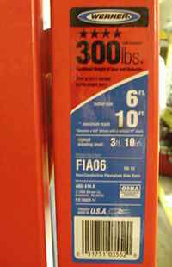
Ladder Duty Rating
Notes:
Duty Rating
A ladder's duty rating should be prominently displayed by a color-coded label on the ladder side rail. Look for the proper duty ratings to match the highest level of use. The ratings are:
Type III light-duty ladders.
3-6 feet long.
These are rated for a maximum load of 200 pounds (user plus materials)
Type II medium-duty ladder.
3-12 feet long.
225 pounds
Type I heavy-duty ladder
3-20 feet long.
250 pounds.

Slide 31

Step Ladder Safety
Notes:
Step Ladders
The following rules should be followed when working on a step ladder:
A stepladder should be set-up on a flat surface
Fully extend the legs before climbing a stepladder
Lock the spreader. This may present a pinching hazard so keep fingers clear!
Never use a step ladder as a straight ladder.
Stepladders do not exceed 20 feet.
Do not step on the top two steps or the bucket shelf
Do not rear section supports. They are not designed to support your weight

Slide 32
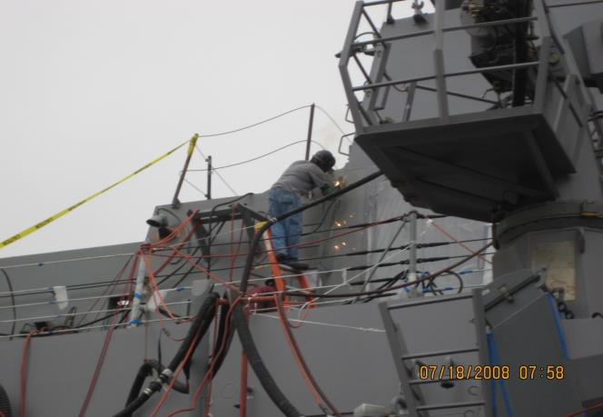
What’s Wrong With this Picture?
What’s Wrong With This Picture?
Notes:
What’s Wrong With This Picture?
________________________________________________________________________________________________________________________________________________________________________________________________________________________________________________________________________________________________________________________________________________
________________________________________________________________________________________________________________________________________________________________________________________________________________________________________________________________________________________________________________________________________________

Slide 33
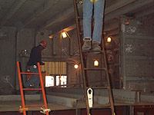
Portable Ladder Safety
Portable Ladder Safety
Notes:
Portable Ladders (Extension Ladders) (1915.72)
When using portable ladders remember:
When you raise it to the desired height be sure the locks engage securely on both sides of the ladder
They do not exceed 44 feet when extended
They should not be used fully extended. The overlap between sections should not be less than 10% of the working length of the ladder
They shall be lashed, blocked or otherwise secured to prevent their being displaced
Side rails of ladders used for access to any level must extend not less than 36 inches above that level

Slide 34
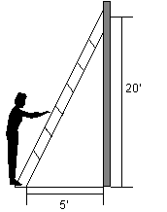
Safe Ladder Angle
Notes:
Ladder Angle (1915.72)
Always use a portable ladder at angle where the horizontal distance from the top support to the foot of the ladder is ¼ the working length of the ladder (length along ladder between the foot and top support).
Remember – 4 up
1 out

Slide 35
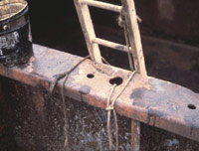
Ladder Safety Continued
Notes:
Do! (1915.72)
Below are some of things you should do:
Face the ladder when climbing or descending and use both hands
Mount the ladder from the center, not from the side
Tools should be carried in the pockets, in a bag attached to a belt, or raised and lowered by rope
Be sure that the soles of your shoes are clean and dry
Work facing the ladder, holding on with one hand
If it is ever necessary to work with both hands, hook one leg over the rung
Immediately remove ladders with broken or missing rungs or steps, broken or split side rails, or other faulty or defective construction
Always have a 3-point contact (such as, one hand and two feet)
.

Slide 36
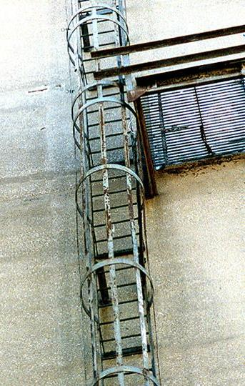
Fixed Ladder
Notes:
Fixed Ladders 1917.118(b)(3)
Fixed ladders:
Are permanently attached to a structure, building or equipment
Must be inspected regularly and be maintained in a safe condition

Slide 37
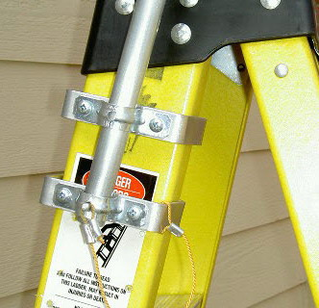
Ladder Best Practices
Ladder Best Practices
37
Notes:
37
37
Best Practices
Fiberglass ladders are to be used on-board ship. No wood or aluminum ladders!
Extension ladders used on-board must be secured on the top and bottom
Escape trunks should be used as an emergency egress only and kept clear
When working from a ladder over 5 feet you must be tied off!

Slide 38

Ladder Inspection
Notes:
Ladder Inspection
You should inspect the following:
The ladders have no nails, screws, or splinters sticking out
The side rails have no dents or bends
The rivets are not sheared
The hardware connections are secure
There are no excessively dented rungs
The rungs are firmly attached to side rails
The rungs have no oil or grease on them
The non-slip safety feet or bases on ladders are in good condition
The non-slip safety material on ladder rungs is in good condition
The ladder is not wobbly and that steps are not worn or broken
Capacity - Check the capacity label and make sure the ladder has sufficient capacity to hold you and everything you are wearing/carrying
Coatings or Paint - Check for paint or other coating hiding defects. Wood ladders shall not be painted or coated with any opaque covering, except for identification or warning labels which may be placed on one face only of a side rail. When other types of ladders are painted it is very hard for the user to observe defects/damage such as cracks or dents and painted areas must be inspected carefully for hidden damage.

Slide 39
Fall and Ladder Safety
QUIZ!
39
Notes:
39
Fill in the blank!

Slide 40

Scaffolding
Notes:
Defining Scaffolds and Staging
Scaffolds, or staging, are devices used to provide an elevated working surface. Staging may be of several different designs and is often constructed to fit the ship.
Common Scaffolds in shipyards
Supported scaffold - one or more platforms supported by outrigger beams, brackets, poles, legs, uprights, posts, frames, or similar rigid support.
Suspension scaffold - one or more platforms suspended by ropes or other non-rigid means from an overhead structure(s)

Slide 41
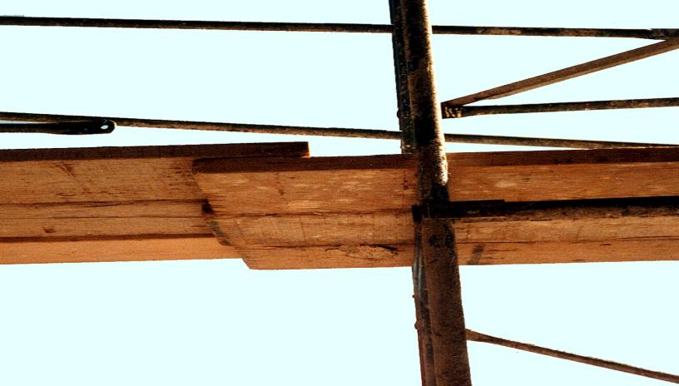
Scaffolding Hazards
Notes:
Potential Hazards
Scaffolds must be adequate for the work performed because falls are a significant hazard in the shipyard. Scaffolding hazards include:
Failure of the staging components or overloading may result in collapse of the unit in whole or in part, causing workers to fall
Workers falling off the staging due to lack of edge guards
Items falling off the staging and injuring workers below
Surging (for example movement of work surface) when working on floating scaffolds
Workers on the scaffolds falling to the level below
Electrocution from overhead power lines

Slide 42
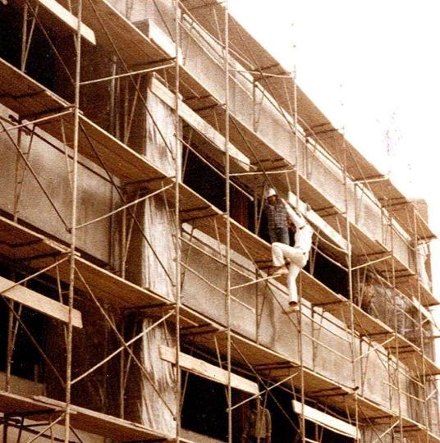
Scaffolding Falls
Notes:
Fall Hazards
Falls may occur:
While climbing on or off the scaffold
Working on unguarded scaffold platforms
When scaffold platforms or planks fail
When planks are separated
Slippery surfaces
Damaged ladders

Slide 43
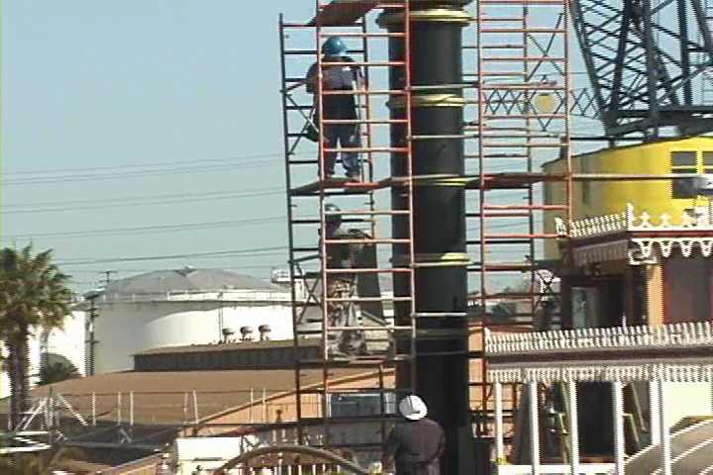
You need scaffolding when…
You Need Scaffolding When…
Notes:
When Scaffolding Is Required? (1915.71)
Scaffolding is required when you are working aloft, or elsewhere at elevations more than 5 feet above a solid surface. Scaffolds or a sloping ladder must be used to afford safe footing. Or…
…the employees must be protected by a Personal Fall Arrest System (PFAS).

Slide 44
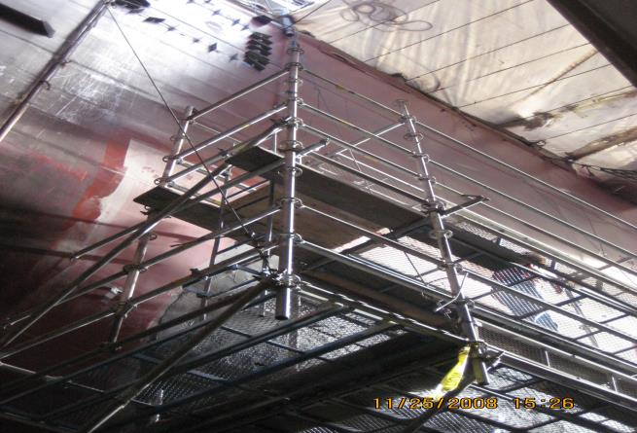
Scaffolding Requirements
Scaffolding Requirements
Notes:
Safety (1915.71)
All scaffolds and their supports whether of lumber, steel or other material, shall be capable of supporting the load they are designed to carry with a safety factor of not less than four (4).
If working from a suspended working platform or from a lift, always check with your supervisor regarding training in safety requirements.

Slide 45
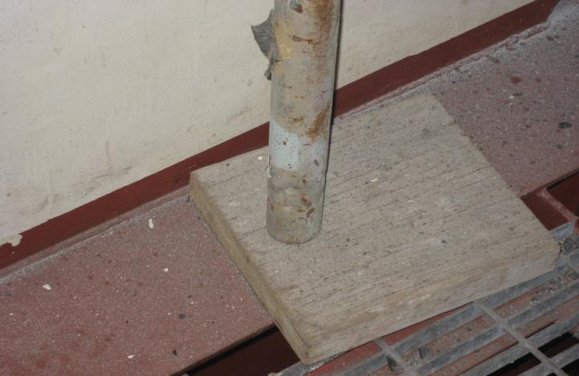

Causes of Inadequate Support
What’s Wrong With This Picture?
Notes:
Causes of Inadequate Support
Over a seven-year period, OSHA statistics report that about 28% of the scaffold accidents that occur are the result of construction deficiencies. These deficiencies include using substandard components, omitting essential components, or failing to complete the assembly.
Of the fatalities that occurred, 23% occurred as a result of construction deficiencies. About 14% occurred while climbing. Another 8% occurred while assembling/disassembling the scaffolding. About 10% of the fatalities occurred where the result of the scaffolding structurally failing. Another 18% of the fatalities happened as a result of electrocutions. Approximately 10% of the fatalities were from falling objects, while 10% happened because of falls while working on the platform.
An estimated 2.3 million construction workers, or 65 percent of the construction industry, work on scaffolds. Protecting these workers from scaffold-related accidents may prevent some of the 4,500 injuries and over 60 deaths every year (Bureau of Labor Statistics (BLS), 2003 and 2004 data for the private sector). In a recent BLS study, 72 percent of workers injured in scaffold accidents attributed the accident either to the planking or support giving way, or to the employee slipping or being struck by a falling object. All of these accidents can be controlled by compliance with OSHA standards.

Slide 46
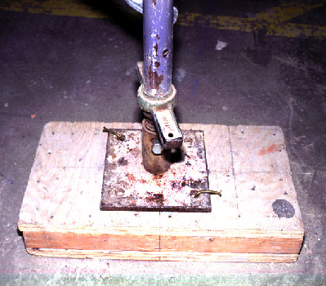
Scaffolding Support
Scaffolding Support
Base plate
Mud sill
Notes:
Proper Support Example (1915.71)
It is impossible for a stable structure to be built upon a foundation that does not start out square and level. OSHA has standards that apply specifically to the steps that must be taken to assure a stable scaffold base. The scaffold structure must have a metal base plate secured to a plumb, wood mud sill.

Slide 47

Scaffolding Access
Notes:
Access to Staging (1915.71)
Staging more than 5 feet high requires appropriate access (for example ladders ramps, stairways).
Ramps and stairways must be provided with 36-inch handrails with midrails.
Ladders must be located so employees do not need to step more than one foot from the ladder to any intermediate landing or platform. Staging with built-in ladders meets these requirements. Staging more than three feet below the point of access requires straight, portable, or Jacob's ladder.
You will find the scaffolding tag at staging access points!

Slide 48
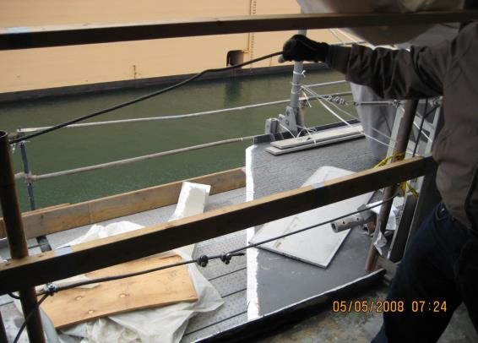
Scaffolding Rails
Scaffolding Rails
Notes:
Rails (1915.71)
Scaffolding, staging, runways, or working platforms which are supported or suspended more than 5 feet above a solid surface, or at any distance above the water. These rails:
Must be provided with a railing which has a top rail whose upper surface is from 42 to 45 inches above the upper surface of the staging, platform, or runway
Have a mid-rail located halfway between the upper rail and the staging, platform, or runway
Must be of 2 x 4 inch lumber, flat bar or pipe Firmly secured
What is wrong with this picture?

Slide 49
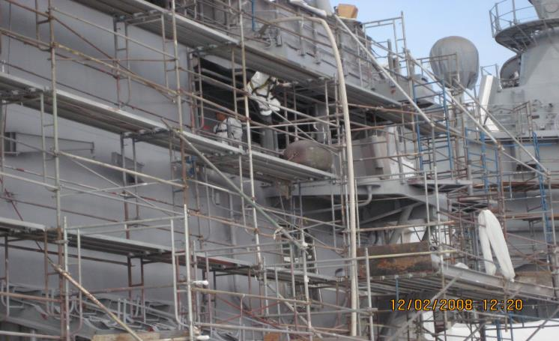
Scaffolding On Vessels
Scaffolding On Vessels
Notes:
Rails Continued (1915.71)
Additional rail requirements are below:
Rails may be omitted where the structure of the vessel prevents their use.
When rails are omitted, employees working more than 5 feet above solid surfaces shall be protected by safety belts and life lines. Employees working over water must be protected by buoyant work vests meeting the requirements of 1915.158(a).
When used with rigid supports, taut wire or fiber rope of adequate strength may be used.
If distance between supports is more than 8 feet, rails must be equivalent in strength to 2 x 4 inch lumber.
Where exposed to hot work or chemicals, fiber rope rails must not be used.
NAVSEA Standard Item FY 6 009-74 States:
3.18.2 Provide and use personal fall arrest system (PFAS), working
lanyard, and climber safety device when going aloft where a climber safety
rail is installed. If a climber safety rail is not installed, use a double
lanyard configuration.

Slide 50
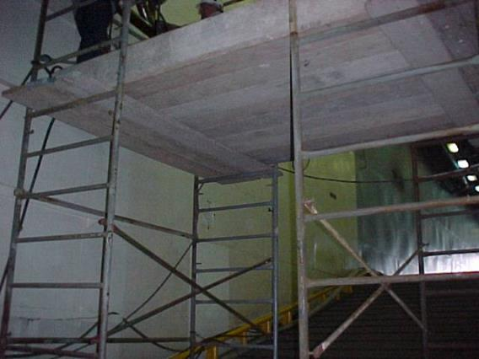
Scaffolding Toeboards
Scaffolding Toeboards
Notes:
Toeboards (1915.71)
When necessary, to prevent tools and materials from falling on men below, Toeboards of not less than 1 x 4 inch lumber or metal shall be provided.

Slide 51
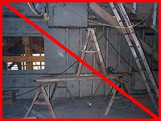
Scaffolding Dangers
Scaffolding Dangers
Notes:
Scaffolding Don’ts! (1915.71)
When using scaffolding, don’t:
Use Barrels, boxes, cans, loose bricks, or other unstable objects as working platforms or for the support of planking intended as scaffolds or working platforms
Erect, move, dismantle or altered scaffolding unless you are under the supervision of competent persons
Platforms of staging shall be not less than two 10 inch planks in width except in such cases as the structure of the vessel or the width of the trestle ladders make it impossible to provide such a width. Wood platform planking must be straight‑grained and free from large or loose knots and may be either rough or dressed. Metal planking is acceptable.
Use unless there is a secure mid-rail and top-rail
Use unless the platform planking projects beyond the supporting members at either end by at least 6 inches but not more than 12 inches (unless the planks are fastened to the supporting members)

Slide 52
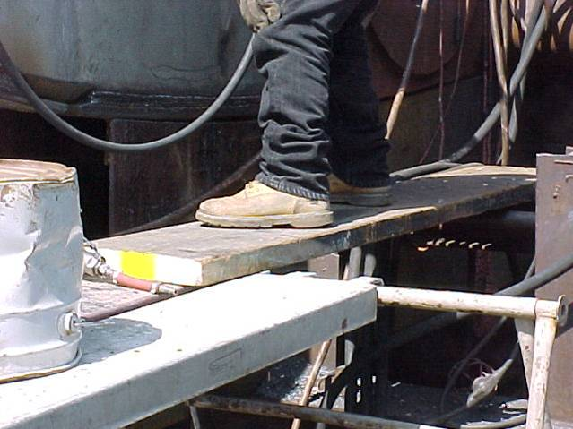
What’s Wrong With This Picture?
Exercise
What’s Wrong With This Picture?
Notes:
What’s Wrong With This Picture?
________________________________________________________________________________________________________________________________________________________________________________________________________________________________________________________________________________________________________________________________________________________________________________________________________________________________________________________________________________________________________________________________________________________________________________________________________________________________________________

Slide 53
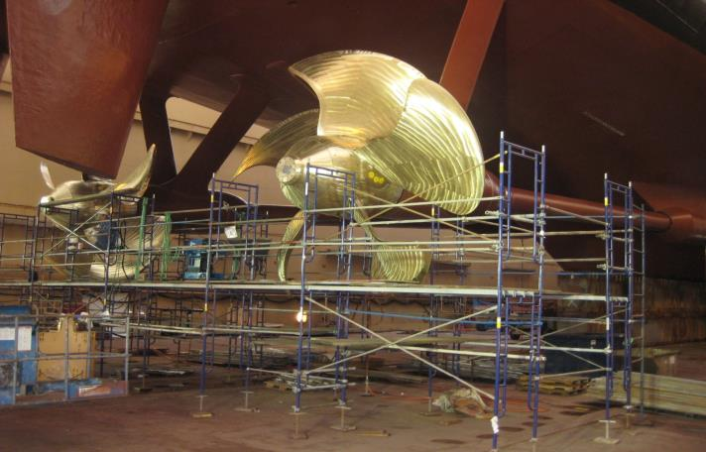
Shipyard Best Practices
Scaffolding Best Practices
53
Notes:
53
53
Shipyard Best Practices
Each scaffold must be inspected daily
All scaffolds must maintain toe boards
Metal planking is required in all scaffolding and exceptions must be approved by the safety department
All scaffolding must utilize incline steps versus vertical ladders. If incline steps cannot be utilized because of a confined nature, or vessel configuration, swing gates will be utilized at each level of access.
Do not tie off to the scaffold. If you feel you must do this contact your supervisor or safety.
When working on a scaffold over water, even with a proper railing system, you must wear a personal floatation device (Life Vest) and Personal Fall Arrest System.

Slide 54

Scaffolding Checklist
Notes:
Your Scaffold Checklist
Based on what you have learned, create a scaffolding checklist!
________________________________________________________________________________________________________________________________________________________________________________________________________________________________________________________________________________________________________________________________________________________________________________________________________________________________________________________________________________________________

Slide 55

Scaffold Checklist
Notes:
Scaffold Checklist
Before working on or near any scaffold, workers should ensure that scaffolds are:
Not cracked or split greater than ¼ inch
Level
Provided with safe access (such as ladders)
Adequately decked (for example have a work surface and platform)
Provided with guard rails
• Check for employees under the platform and provide falling object protection or barricade
Make sure that hard hats are worn.
• Check to see if power lines are near scaffolds and if so, report to supervisor.
• Verify that the scaffold is the correct type for the loads, materials, employees, and weather conditions.
• Check footings to see if they are level, sound, rigid and capable of supporting the loaded scaffold.

Slide 56
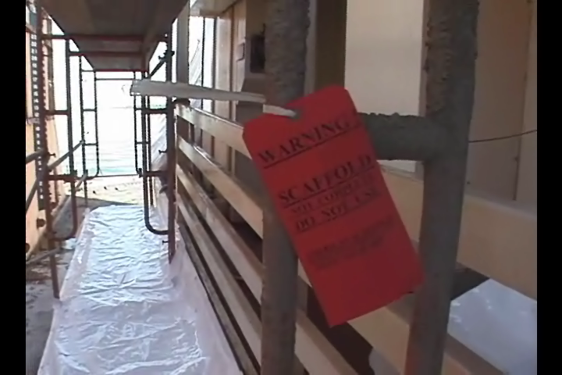
Scaffolding Safety Reminders
Notes:
Remember!
Scaffolding must comply with strict OSHA requirements
Only authorized people can install and maintain scaffolds
Before using a scaffold be sure it has an approved green tag
If there is a red tag, or no certification, do not use the scaffold!
If there is a yellow tag check with your supervisor before using
Immediately notify your supervisor of any unsafe condition

Slide 57
Fall Protection and Scaffolding Quiz
Fall Protection and Scaffolding
QUIZ!
57
Notes:
57
Circle the correct answer or fill in the blanks.

