Slide 1
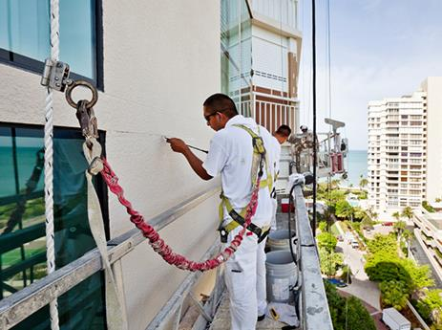

Fall Protection – Taking It to a Whole New Level 1
Notes:
Image: http://www.metrosafety.ca/fall-protection-training/

Slide 2
Fall Protection 2017
This material was produced under Susan Harwood Grant number SH-21006-SH10 and revised under Grant number SH-27643-SH5 from the Occupational Safety and Health Administration, U.S. Department of Labor. It does not necessarily reflect the views or policies of the U.S. Department of Labor, nor does mention of trade names, commercial products, or organizations imply endorsement by the U.S. Government.
This presentation has been developed by Sunflower Community Action in Wichita, KS and El Centro in Kansas City, KS. We would like to acknowledge and thank the University of Alabama for allowing us to use their original material from which this curriculum was developed.
Notes:
Fall Protection 2017:
This material was produced under Susan Harwood Grant number SH-21006-10 and revised under Grant number SH-27643-SH5 from the Occupational Safety and Health Administration, U.S. Department of Labor. It does not necessarily reflect the views or policies of the U.S. Department of Labor, nor does mention of trade names, commercial products, or organizations imply endorsement by the U.S. Government.
This presentation has been developed by Sunflower Community Action in Wichita, KS and El Centro in Kansas City, KS. We would like to acknowledge and thank the University of Alabama for allowing us to use their original material from which this curriculum was developed.
Sunflower Community Action
1751 N. Ash St.
Wichita, KS 67214
316-264-9972
El Centro, Inc.
650 Minnesota Ave.
Kansas City, KS 66101
(913) 677-0100
University of Alabama
College of Continuing Studies
Box 870388
Tuscaloosa, AL 35487
1-866-307-3917

Slide 3
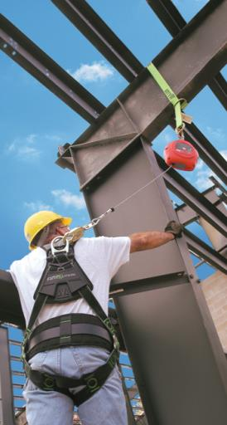
Welcome!
The purpose of this training is to inform you about:
  Fall hazards.
  Fall prevention.
  How to create a basic safety system that will prevent you from becoming a victim of a fall.
  Safety procedures while using ladders, scaffolding, and aerial lifts.
Notes:
Welcome
Emphasis the Safety System, not the same old Fall Protection Training
Why Focus on these three – leads into the next slide
Image: http://www.honeywellsafety.com/BR/Training_and_Support/Exames_f%C3%ADsicos_e_testes_de_resist%C3%AAncia_para_colaboradores_que_utilizam_equipamentos_contra_queda_.aspx

Slide 4
Know Your Rights
What is OSHA?
Who is covered by OSHA?
You have the right to a safe workplace.
What should I do if there is a safety risk at my workplace?
What should I do if I have been injured at work?
You have the right to file a complaint with your employer or OSHA.
You have 30 days to file a retaliation report about your injury.
Call 1-800-321-OSHA (6742) and ask them to mail you a complaint form.
Ask OSHA to keep your identity confidential.

Slide 5

Did you know that… 1
falls kill more construction workers than any other workplace hazard.
Why?
Notes:
Out of all the hazards why do falls kill more construction workers that other hazards?
Highest level of Exposure?
How many times have you found people who have just had Fall Protection training and found them not following the rules?
Low Perception of risk?
Denial – I won’t fall
People are taught to do work wrong
It is the only way they know how
“We can’t get stuff done if you follow all these rules”

Slide 6

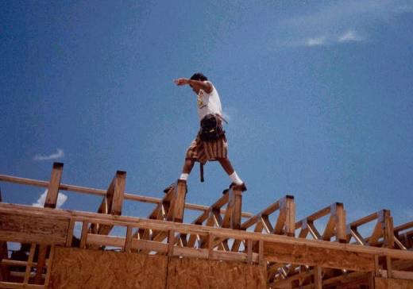
Did you know that… 2
the majority of falls occur from roofs.
Notes:
We will focus on falls in three areas
Employees are taught wrong, observed people doing it the wrong way
Doing what is quickest
Behavior/ Culture – Following your rules
Ask students why?

Slide 7
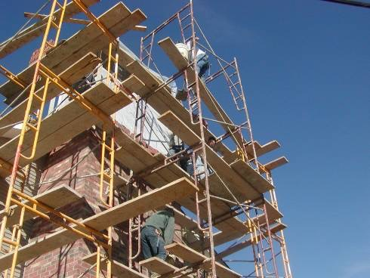
Did you know that… 3
falls from scaffolding or the collapse of scaffolding are the second most common type of fall.

Slide 8
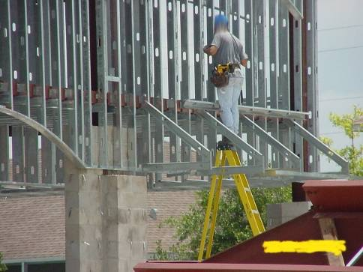
Did you know that… 4
falls from ladders are the third most common?
Notes:
People are taught to do work wrong
This is how they see others doing the work
Told it is not macho to use fall protection
That is all we know how to do

Slide 9


Did you know that… 5
the majority of falls happen on low-budget construction projects?
Why?
Notes:
Ask them the question – pull it out of them
When people are bidding lower cost jobs do the companies skimp on Safety?
On small jobs there is a low cost margin, cutting safety is done to save money
Bigger bid jobs usually have a safety clause or requirements to meet certain TRIR or other measurements
Do you want to be part of this statistic?
Are we really saving money by cutting safety?
Image: http://mainer.co.uk/construction-workers-share-mental-health-experiences/

Slide 10
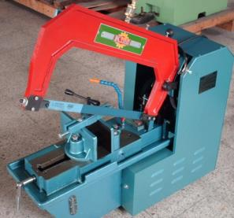
OSHA Fall-Related Death Reports
industrial jigsaw
In 2015, there were 903 fatal accidents involving Hispanic workers.
This is equivalent to 4 workers in 100,000.*
For Hispanics, this is the highest rate of fatal accidents since these statistics were first recorded.
Example: In 2010 in Iowa City, IA a worker suffered a fatal injury after losing his balance and falling from 24 feet onto a concrete slab. He was using an industrial jigsaw on a ladder.
*Full-time workers.
Notes:
Recent ladder / scaffold fatal accidents reported on OSHA’s Weekly Fatality Report.
This shows that even with the emphasis on FP through industry programs and OSHA programs, that we are still having accidents
Image: http://www.ecuama.com/inv-fotos-n-p2.htm

Slide 11
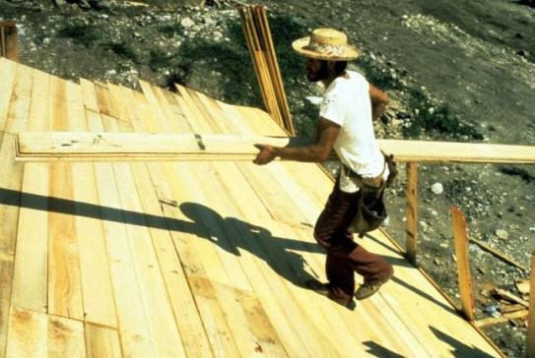

Did you know that… 6
I’m safe. I’m only working 15’ above the ground.
65% of falls happen from less than 30 feet?
In roofing, 45% of falls happen from less than 20 feet?
Why?
Notes:
The perception of danger is not there
This fall won’t kill me!
I fallen before and not been hurt
Ask them for more examples or if they agree

Slide 12
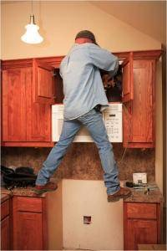
Did you know that… 7
you are more likely to misjudge the risk of falling when you are working at less than 20 feet?
Why?
I just have to do something quick here.
Notes:
This won’t hurt me
If I fall I won’t get hurt
What about a fall from 20 feet or less onto your head?
Low perception of risk

Slide 13
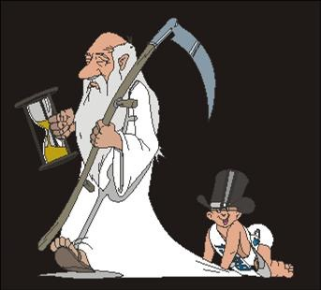
Do you think that… 1
age and experience significantly reduce the risk of falls?
Why?
Notes:
The risk is always there no a matter the age
Young people take risks more often – they feel bulletproof, misjudge the hazards do not know any better
However seasoned workers at times become more complacent and as we age we are more likely to suffer greater injuries or to take longer to heal

Slide 14
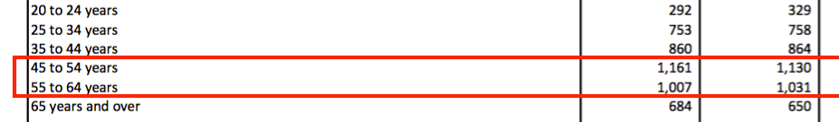
Did you know that… 8
workers ages 45-65 experience fatal accidents more frequently than younger workers?
Why?
Years of Age
Deaths 2014
2015
Notes:
The risk is always there no a matter the age.
Young people take risks more often – they feel bulletproof, misjudge the hazards do not know any better.
However seasoned workers at times become more complacent and as we age we are more likely to suffer greater injuries or to take longer to heal.

Slide 15
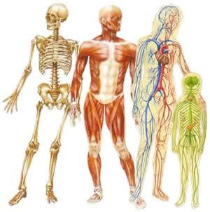
The Risk Is Real
The majority of falls involve fractures and injury in:
  the head (the main and often fatal target)
  the chest
  the neck
  the back
  the abdomen
  arms and legs
Common outcomes are death, brain damage, paralysis, and severe internal injuries.
Notes:
Fall injuries are severe not just bumps and scratches
Head injuries are many times fatal
But if you do walk away from a fall will your quality of life be the same?

Slide 16
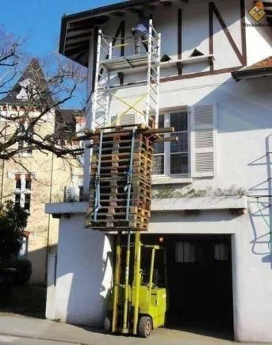
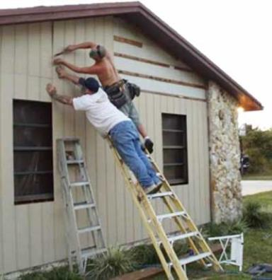


What is the real story here?
The risks of life and limb is everywhere, but people continue to work at heights, without adequate protection against falls.
Why?
Notes:
Why are people over and over again willing to put themselves at risk?
Look at this example
Who made the decision that this as a safe process? What was the thinking process?
How could they think this was OK or safe?
Images: http://safetytrainingguru.blogspot.com/2010/08/i-call-this-one-ladder-safety_11.html
http://curiosidadeterra.blogspot.com/2014/04/10-flagras-de-pessoas-que-nao-ligam.html

Slide 17
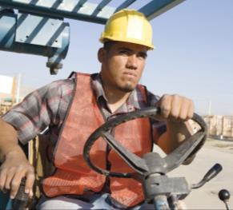
John Doe Myths 1
Myth #1:
Fall protection is for weaklings.
  “There's a correct way to fall… One just needs to know how to do it.”
  “I have fallen and I’m not dead yet.”
The Reality:
Free falls from 6 foot heights can result in serious injury, because most falls are unexpected.
  In two-thirds of a second, you have already fallen 7 feet.
Notes:
Do you teach people how to hit their finger with a hammer properly? How to grab a live wire properly? NO!
We must stop the fall, not make it OK to fall.
What is the right way to fall?
Who in this room as fallen before?
Image: https://holanoticias.com/crece-demanda-de-trabajadores-de-la-construccion-certificados/

Slide 18
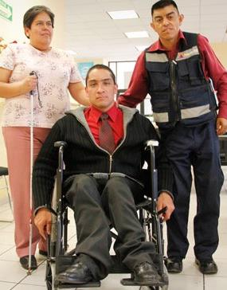
Reality Check
Assuming that you don’t die after a fall, you should be prepared for:
  the loss of your personal capacity and means of earning a living.
  the loss of your freedom and independence.
  depending on others for the rest of your life.
  the mental and emotional consequences of your disability for yourself and your family.
Notes:
Examples from our experiences.
Image: http://www.24-horas.mx/impulsan-trabajo-digno-para-los-discapacitados-en-magdalena-contreras/

Slide 19
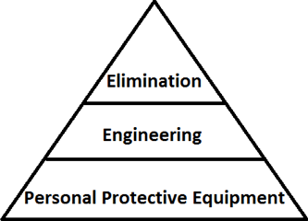
John Doe Myths 2
Myth #2:
  – Harnesses are the best way to avoid a fall.
The Reality:
  – Harnesses should be considered the last option; if they fail, you’re toast (dead).
  Eliminate the risk.
    Doing your work at ground level is the safest option.
  Find engineering changes to eliminate risk.
    Fall protection that doesn’t depend on PPE?
Notes:
Both of these, Safety by design or doing it on the ground are both questions we will use as we work the safety system that we will talk about in the next sections
We first try to prevent the fall before we try to keep them from hitting the ground

Slide 20

John Doe Myths 3
Myth # 3 – “Time is money.”
  Fall protection costs time and money.
The Reality – Fall protection is highly economical.
  When you compare it to the real costs of a fall:
    the cost of Worker’s Compensation for workers
    third-party claims
    OSHA fines
    losses in production and lost work time
    damage to the image of the company
    the loss of work opportunities
Notes:
National Safety Council, 2004 Injury Facts, WC cost for falls averages around $ 20,000 per case.
OSHA penalties for serious fall hazards can reach into the hundreds of thousands if employer is found to be willful or negligent
Third party lawsuits usually run in the millions
Lost time and loss of opportunity - ???
Imagen: https://www.theodysseyonline.com/open-questionnaire-feminists

Slide 21
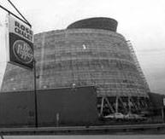
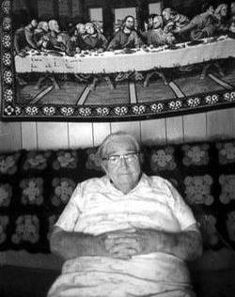
The Disaster at Willow Island 1
May 1978
A company was constructing a 400 foot cooling tower.
As concrete was being poured at 170 feet, the scaffolding began to fall off of the concrete.
When the scaffolding collapsed, 51 workers were killed, 10 from the same family, and no one survived.
Mrs. Lillie Steele, the matriarch of the Steele family, lost 1 son, 4 grandchildren and 2 great grandchildren in the tragedy.
Notes:
The cable that was hoisting a bucket of concrete went slack. The crane that was pulling it up fell toward the inside of the tower. Scaffolding followed. The previous day’s concrete, Lift 28, started to collapse. Concrete began to unwrap off the top of the tower. First, it peeled counter-clockwise, and then in both directions. A mess of concrete, wooden forms, and metal scaffolding crumbled to the ground, crushing the 51 workers.

Slide 22
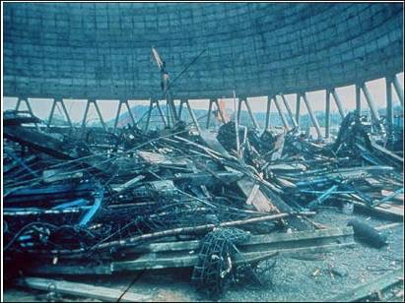
The Disaster at Willow Island 2
Afterwards, the OSHA investigation discovered:
  The scaffolding was connected to concrete that wasn’t cured (not dry and solid).
  There was only 1 ladder, which limited escape capacity.
  The contractors wanted to increase the speed of construction.
  Construction was delayed for 17 months (almost a year and a half) after the accident.
Notes:
In this way we must look for the Root Cause, not the intermediate causes or the first thing that is taught up.

Slide 23
What could the workers have done to avoid this accident?
Question: 1
Notes:
1.Do you think they knew the hazards?
2.Did they fix the hazards/ No the accident happened
3.Yes, In one case, a pair of brothers where working on the project, one refused to go up on the scaffolds any longer, the other died in the accident
4.No, think about it no one survived

Slide 24

How to improve our procedure?
More fall protection regulations / enforcing them.
More financial incentives to prevent falls.
More training on fall protection.
Empowering workers to create a culture of safety.
Notes:
How long as has Fall Protection been an emphasis program?
Most incidents occur when a regulation or rule was not followed
We will prove that there are plenty of financial incentives to fall protections
Who here believes that there is not enough fall protection?
What technologies are out there to make it better?
These are all things that could help with fall protection but are they the answer?
But they can all fail if you do not have a (change slide)
Image: https://www.venturepacificcontractors.com/?lightbox=dataItem-iq9hlrnt3

Slide 25



Why develop safety systems? 1
to create a culture of safety.
to improve morale.
for a good reputation.
to lower Worker’s Compensation Insurance.
Notes:
Safety culture – How are people to know what to do with out a system in place? Can we develop a culture without knowing what it is?
Better morale – When an employee knows that the company cares about more than making money, they feel like they have a part of a family who cares about their well being, look at the amount of wellness programs coming into being.
Good name in business – Most of our companies work for someone else correct? A company with systems in place is more likely to have good relationships with the General Contractor, these large companies like to work with other companies who have their ducks in a row.
Your accident rates will also of course be lower, companies with higher accident rates can be black listed by the government or large companies, from bidding on contracts
Lower workers comp – If you are self insured this is a no brainer, through systems people know what to expect, and they know the safe working practices, this leads to fewer incidents and less money going to the medical bills, lost wages, and legal fees.
If you have insurance it works just like car or home owners insurance, the more you use it the more expensive it becomes, in turn you experience modifier can go up causing larger companies to black list you as a dangerous contactor

Slide 26

The Cultural Component 1
An organizational culture is a set of values shared by the members of the organization and the workers.
The heart and soul of the organization.

Slide 27
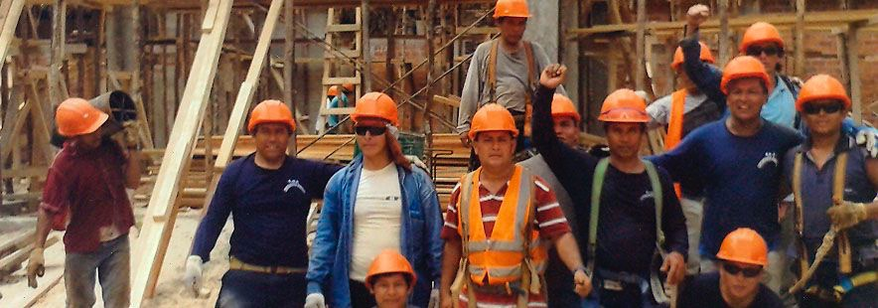
The Cultural Component 2
Values are deeply-held beliefs and principles that guide our decisions and behavior.
Notes:
These are our guides
Why do we want people to be safe?
Image: http://amanecertumbesino.blogspot.com/2015/10/amanecer-tumbesino_24.html

Slide 28
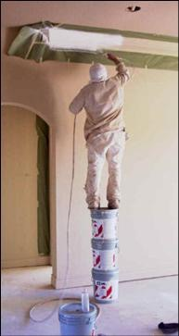
The Cultural Component 3
What are the values held in a culture of safety?
  I have the right to work safely.
  I am responsible for my own safety.
  I am responsible for the safety of my coworkers.
  I have a responsibility to provide for my family.
Notes:
“Where can I get one of those Safety Cultures?”
You cannot get one it must be grown out of our values
It is a right and a legal requirement
Everyone in this room has a right, no one must give up safety, we are not in a War or in Public Safety (Cop, Firefighter) we always have the right
I will look out for myself, I will follow the rules and abide by the regulations for myself
Highest value, that shows a fully grown mature safety culture

Slide 29

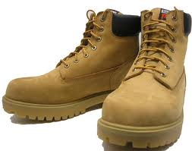
Shared Responsibility
You represent the “hands and feet” of the organization.
You all do the work that enriches the company.
Likewise, the company has a responsibility to provide a safe working environment for you all.

Slide 30

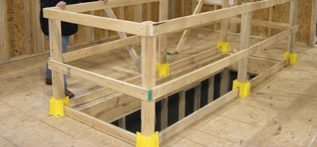
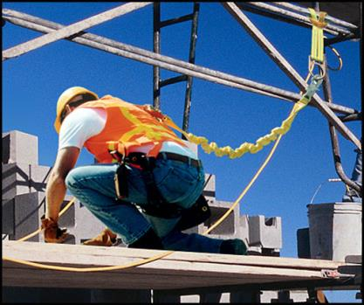
The Operational Component
Eliminate risks through:
  Cleanliness and order.
  Proper maintenance.
  Safety controls:
    Hole covers and guardrails
    Personal Protection Equipment
Notes:
Images: http://www.contractlumber.com/blog/2015/6/17/part-2-exploring-the-true-cost-of-jobsite-safety
http://www.metrosafety.ca/fall-protection-training/

Slide 31
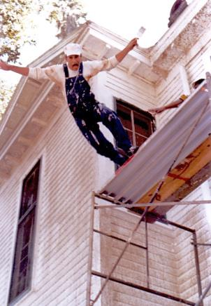

The Operation of the Fall Protection Safety System
The areas of construction that cause the majority of injuries and fines due to lack of fall protection are:
  ladders
  scaffolding
  roofing or working at heights
Notes:
Image: http://www.larryray.com/the-beyond---behind-the.html

Slide 32

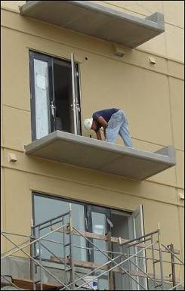
The Obligation to Provide Fall Protection
Protection is required for:
  Unprotected sides and edges
  Leading edges
  Ramps and walkways
  Roofs with excessive slope
  Residential construction
  Roofing
  Excavations, wells, pits and gaps
Notes:
We have to protect our construction workers any time they are working on an unprotected side or edge, such as a roof, any leading edges, walkways, roofs, even in excavation sites where they may fall into a hole that is over six feet deep.

Slide 33
When is fall protection required?
15’
10’
6’
4’
Construction Scaffolding Steel Beam Erection General Industry
If construction workers are working above hazardous materials, they must use fall protection below 6 feet.

Slide 34

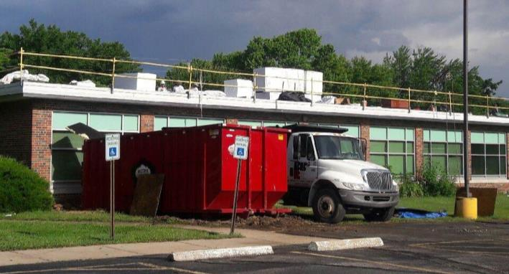
Fall Prevention
Use protective railings to prevent workers from falling.
This is the 2nd best option, after eliminating the risk.
Notes:
Or if we decide that we must put the system on the roof, let’s design a set of guard rails into the building itself to keep the worker from falling off. In normal construction we can erect temporary guardrails around the site so that the worker hits the guard rail and bounces back into the work area. A guardrail is designed to withstand 200 pounds of force and deflect that force back to the safe area.
Image: © Dessiree Monnott 2017

Slide 35

Warning Lines or Strings
On some jobs, you can place a cord or metal cable as a barrier around the edge of the roof to warn workers that they are approaching the edge.
Notes:
A warning line is a system that merely warns the worker that he is getting close to the edge. Don’t confuse this warning line with the guardrail system that keeps him from going over. This line is just a system to alert the worker that he is getting close to the edge! And it has to go all around the edge. It won’t help you if your workers are on the outside of the line!

Slide 36



Fall Protection - Warning Line Systems 1
They consist of ropes or cables and uprights to support them.
They should be able to resists a force of 16 lbs. directed outwards and applied to a 30” span.
With a minimum tensile strength of 500 lbs.
If working between the roof edge and the warning line, other precautions should be taken.
Warning Line
Edge of Roof
Notes:
Warning lines shall consist of ropes, wires, or chains, and supporting stanchions erected as follows:
The rope, wire, or chain shall be flagged at not more than 6-foot (1.8 m) intervals with high-visibility material;
The rope, wire, or chain shall be rigged and supported in such a way that its lowest point (including sag) is no less than 34 inches from the walking/working surface and its highest point is no more than 39 inches
After being erected, with the rope, wire, or chain attached, stanchions capable of resisting, without tipping over, a force of at least 16 pounds applied horizontally against the stanchion, 30 inches above the base, perpendicular to the warning line, and in the direction of the floor, roof, or platform edge;

Slide 37
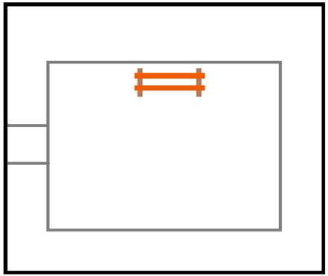
Fall Protection - Warning Line Systems 2
  Warning lines should be raised around all sides of the area of roof work, and be at least 6’ from the roof edge.
  If mechanical equipment is being used, the lines must be at least 10 feet from the edge.
  When the point of access is not being used it should be closed.
  The lines should not be higher than 39” and no lower than 34.”
If mechanical equipment is being used.
10ꞌ
6ꞌ
Access Point
(closed when not in use)
6ꞌ
Warning Line
6ꞌ
Edge of Roof
Work at least 6 feet away from roof’s edge.
Notes:
When the path to a point of access is not in use, a rope, wire, chain, or other barricade, equivalent in strength and height to the warning line, shall be placed across the path at the point where the path intersects the warning line erected around the work area, or the path shall be offset such that a person cannot walk directly into the work area.

Slide 38
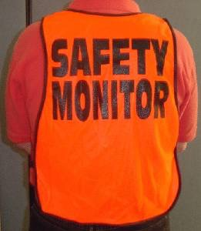
Safety Monitor
In some jobs, you may have the ability to designate a person to stand on site and verbally alert workers when they are close to the edge.
Notes:
A safety monitor is another warning system. In this case, you may be allowed to have an individual on the roof who is designated as the safety monitor. He or she must have no other duties on the roof that interfere with their duty as a monitor. Basically, they stand around and warn people that they are getting too close to the edge and order them back.

Slide 39
Question: 2
Why should we have these rules and norms?
Notes:
Possible Answers:
So that we can protect our health and safety.
So that we can continue to work and provide for our families.
So that employers know their responsibilities regarding worker safety.
So that the next generation learns the importance of workplace safety.

Slide 40

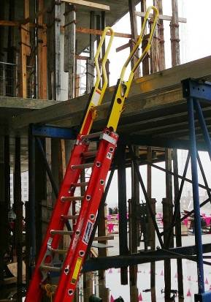

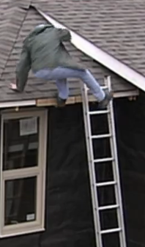
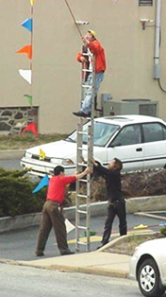
Ladders 1

Slide 41
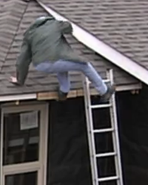


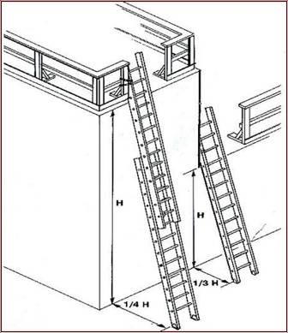

Ladders 2
3’ above the surface
Risks when working with ladders:
  Incorrect placement or position
  Ladder slides (above or below)
  Loss of user’s balance
  Over-reaching of the body
  Slipping when stepping on rungs
  Damaged or defective ladders
  Improper ladder to do the job
Notes:
There are appropriate uses for stepladders and for extension ladders, but the choice of the wrong ladder for a particular job can put the user at increased risk for a fall.
Ladders are generally used with minimal fall protection, with workers relying on balance and coordination to avert falls.
Top Image: http://www.drtombrownchiro.com/workplace-injury/

Slide 42
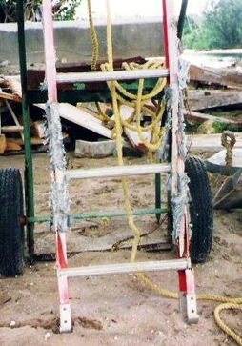

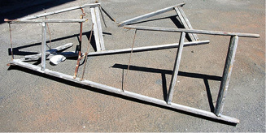
Critical Outcomes for Ladder Safety 1
Use a ladder when it’s the safest option.
The areas around the top and bottom of the ladder are clear.
The rungs (steps) are level and evenly spaced.
Ladders are raised and placed correctly.
Use ladders according to the purposes for which they were designed.

Slide 43
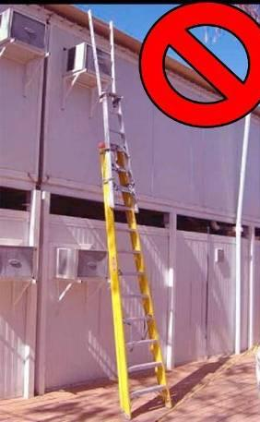
Critical Outcomes for Ladder Safety 2
DO NOT tie ladders together to make a longer one.
Tools should be carried in a tool belt or pulled up by a rope.
Do not varnish or paint wooden ladders.
Grab the ladder rungs (stairs/crossbars) with your hands, not the vertical side rails.

Slide 44
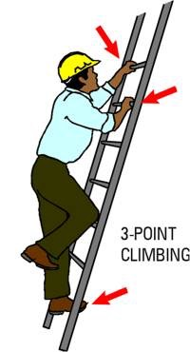
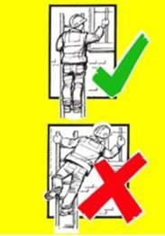

Critical Outcomes for Ladder Safety 3
Follow the 3 points of contact rule.
Always go up and down while facing the ladder, using both hands.
Use a tool belt to carry tools: keep your body centered between the vertical rails of the ladder.
Notes:
The three-point rule is applied: When climbing either two hands and one foot or two feet and one hand
When working Keep at least both feet and one hand (if not fall protection is required)

Slide 45
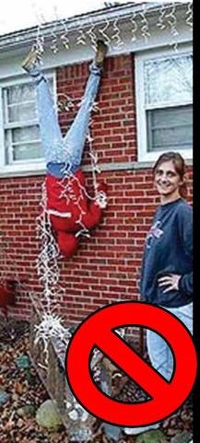
Ladder-Related Training
The employer must provide a training program on how to use portable ladders and fixed staircases:
  The training must be provided in a language that workers understand.
  The training must be provided by a competent person.
  In addition, re-training should be provided to each worker, as necessary, so that workers retain the information, and maintain the knowledge required to comply with the standard.
Notes:
1926.1060(a) The employer shall provide a training program for each employee using ladders and stairways, as necessary. The program shall enable each employee to recognize hazards related to ladders and stairways, and shall train each employee in the procedures to be followed to minimize these hazards.
1926.1060(a)(1) The employer shall ensure that each employee has been trained by a competent person in the following areas, as applicable:
1926.1060(a)(1)(i) The nature of fall hazards in the work area;
1926.1060(a)(1)(ii) The correct procedures for erecting, maintaining, and disassembling the fall protection systems to be used;
1926.1060(a)(1)(iii) The proper construction, use, placement, and care in handling of all stairways and ladders;
1926.1060(a)(1)(iv) The maximum intended load-carrying capacities of ladders and
1926.1060(a)(1)(v) The standards contained in this subpart.
1926.1060(b) Retraining shall be provided for each employee as necessary so that the employee maintains the understanding and knowledge acquired through compliance with this section.

Slide 46

An Example 1
A man was cleaning windows.
The highest point to be cleaned was 9 feet.
A normal ladder wasn’t available.
Notes:
On the afternoon of 1/22/09, the victim was just going to clean the windows in a recently finished elevator lobby in a new 10 story luxury condominium complex. The highest point to clean was 9’ above the ground. When cleaning, he usually used a six foot step ladder with a pail shelf, a two gallon bucket and a shorthanded (7inch) squeegee. However this morning he used an 8’ step ladder without a pail shelf and a 5 gallon bucket. That was OK he had some rags, he could tie the bucket to the ladder.
Image: https://www.tabswindowcleaning.com/?lightbox=dataItem-ievj62wi1

Slide 47
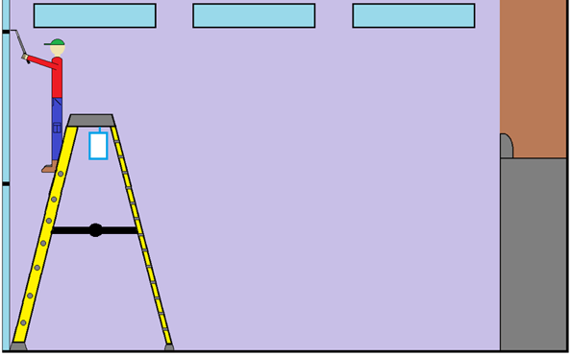
An Example 2
The worker was working backwards on the ladder.
The spacer bar was fully extended and locked.
The worker went up the ladder with a sponge and squeegee in one hand, and a towel in the other.
He was working on the next to last rung (step).
Notes:
At around 12:25 a tile foreman working for another subcontractor saw the victim climb the ladder, with a sponge and squeegee in his right hand and a rag in his left hand. The contractor said the victim climbed up to the sixth step (one from the top) and began to clean the windows. The tile foreman said that the ladder was fully spread and faced the window and the victim working facing the ladder. The foreman did not notice if a bucket was being used.

Slide 48
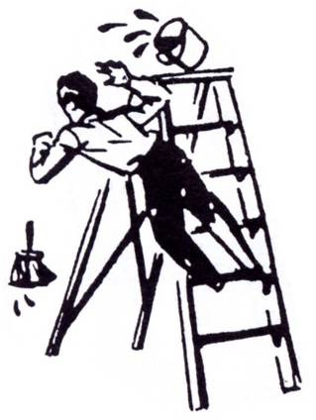
35 minutes later…
The foreman was approaching the hall and heard a loud noise.
He saw the victim lying on the floor trembling and trying to get up.
The foreman called 911.
The victim was taken to the hospital.
The victim died the next day.
Notes:
At around 13:00 as the same tile foreman was entering the elevator on the second floor he heard a loud crashing sound. When the elevator opened on the first floor he saw the victim one side of the room, lying on the ground, shaking and trying to get up and on the other side of the room the ladder was toppled over. At this point he saw the bucket tied to the ladder. He called 911 and tried to keep the victim on the ground. When EMS showed up at 13:14 the victim was unresponsive and having seizures. He was immediately transported to the local hospital. The victim died in the hospital the following day.

Slide 49
What happened?
Note the ladder:
  The rungs were placed in front of the window.
  The cross sections were facing away from the window.
  The opposite of what a witness saw during the preparation of the work.
Notes:
The investigating officer, based on photos taken following the incident and the location of the victim and ladder, believes that the victim had repositioned the step ladder with the rungs facing towards the windows. He then stood backwards on the step ladder and gripped the rungs of the ladder with his boot heels while he cleaned a portion of the windows. It was concluded that the victim working backwards on the ladder, while facing the windows and working from approximately the sixth or seventh step, combined with the dynamic weight from solution in the bucket and the victim’s squeegee strokes across the window, resulted in a lateral force to the step ladder that caused it to tip.

Slide 50
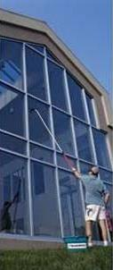

What was the safest way to do the job?
Did he choose the right ladder for the job?
Did he need to do the work with the help of a ladder?
OR
Was there another way to do it from ground-level?
Notes:
Continue to talk about safety and eliminating the hazard. This could have been done by using a simple pole with a squeegee attached and then the victim would have had no chance of falling.

Slide 51
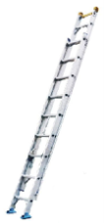


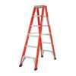
Types of Ladders
Metal: light weight – DO NOT USE NEAR UNPROTECTED ELECTRIC EQUIPMENT / WITHOUT PROTECTIVE COVERS.
Fiberglass: durable – use when doing electrical work.
Wood: does not last long.
Constructed in the work place (job-built): very resistant, made to measure and according to the demands of the work.
Straight ladder: rigid, one piece.
Extensions ladder: extends to various heights.
Portable ladder: foldable sections, A-shaped.
Notes:
Talk about the different types of ladders
Explain when to use a step versus straight ladder (a step ladder must be fully opened and locked, it does not need to be used leaned up against something
A straight or extension ladder needs to be used when working against a surface and but needs to be secured against falling over

Slide 52
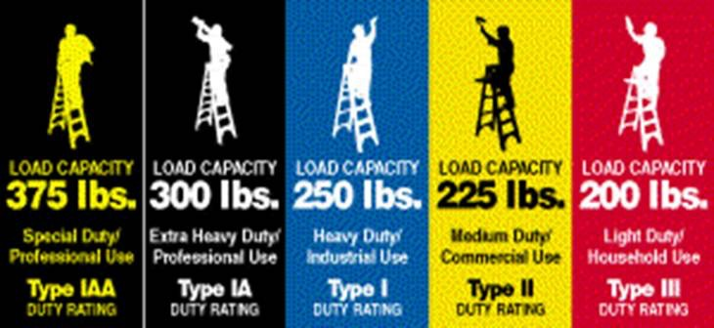
Ladder Reach and Capacity
Read and follow all manufacturer's instructions
Portable Ladder: max. 20 foot reach
Individual Ladder: max. 30 foot reach
Extension Ladder (2 sections): max. 60 foot reach
Notes:
Explain the different types of ladders and the max heights for each type

Slide 53
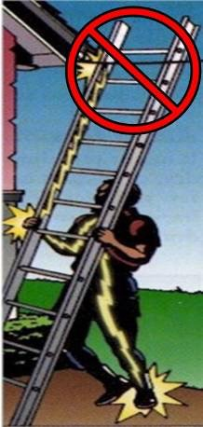

Inspect and place your ladder 1
Inspect the ladder each time you use it.
If it is damaged, repair it or remove it from service.
Avoid areas with heavy pedestrian traffic, or use barriers or barricades.
Do not place within 10 feet of overhead electrical wiring.
Notes:
Inspection
According to ANSI A14.1-2000, a ladder should be thoroughly inspected each time it is used. Rungs should be firm and unbroken, braces fastened securely, and ropes, pulleys and other moving parts in good working order. If an inspection reveals damage, the ladder should be repaired. If repairs are not feasible, the defective ladder should be taken out of service and a new ladder used in its place. To ensure that ladders are being inspected, ladder inspection tags can be filled out and attached to the ladder.
Ladder Usage
Before working with a ladder for the first time, read the manufacturer's instructions. Do not use ladder if sleepy or ill, if you are taking medication, or if bad weather conditions exist. Do not use ladders in doorways or other high traffic areas. If a ladder must be used near a door, make sure the door is locked. If the door has to be open or the ladder is in a raised position, ask a coworker to stay with the ladder to make sure an accident does not occur. Use fiberglass or wood ladders, rather than metal, near power lines or other sources of electricity to avoid electrical shock hazards.

Slide 54
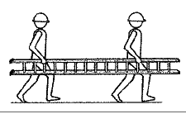
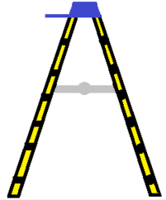
Inspect and place your ladder 2
Ask for help moving or placing very large or heavy ladders.
Place the ladder on a solid and level surface.
Be careful on wet or muddy surfaces.
Don’t step on the top rung (step) or the top of the ladder (cap).
Use a portable ladder with its legs fully separated and the space bar fully extended and locked.
Notes:
INSPECT YOUR LADDER:
Proper Setup
The feet of a ladder should be level and positioned solidly on the ground. If the ground is soft or uneven, use boards under the legs for support. Test the ladder to verify it is secure. For stability, both sides of the ladder need to be against the wall or other support. The legs on a stepladder should be spread fully and locked into position.

Slide 55
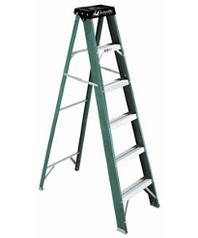

Horizontal Cross Sections
Don't use the horizontal cross sections on the back of the portable ladder to go up the ladder.
Certain ladders are designed so that you can use both the front and back sections of the ladder.
Cross Sections
Rungs
Note that there are rungs on both sides.
Notes:
Reference 1926.1053(b)(14)
A metal spreader or locking device must be provided on each stepladder to hold the front and back sections in an open position when the ladder is being used.

Slide 56


Inspect and place your ladder 3
Check the angle of the ladder; position it at 75 ͦ, or 1 foot of horizontal run for every 4 feet of vertical raise.
Tie and extend the ladder 36” or 3 feet above the level where the worker will dismount.
Ladder rungs (stairs) must be inspected by a competent person on a regular basis, and after any incident that could affect their safe use.
Secure the base when extending an extension ladder, and don’t move the ladder while it’s extended.
Point of attachment
Building
Notes:
INSPECT YOUR LADDER:
Get help to move or set up heavy and awkward ladders
Erect the ladder on a solid, level surface and install a manufacturer approved "leveler" if using on uneven surfaces
Secure base when raising an extension ladder and never set up when extended. Watch for wet or muddy surfaces
Check ladder angle As stated in the regulatory requirements above, ladders should be placed at a 75 degree angle.
Tie off and extend the ladder 36 to 42" above the dismount level when stepping off at a higher level; or use a grab bar to mount and dismount
Secure the ladder against displacement by tying it at the top or the bottom or both, depending on the conditions

Slide 57



The Straight Ladder
Have someone hold the ladder safely in position until the ladder has been tied.
Also, have someone hold the ladder while the worker descends at the end of the job and continue to hold until the ladder is untied.
arms straight
hands grabbing the rungs
toes touching the base of the ladder
Notes:
Left Image: https://nikawa.vn/tag/su-dung-thang-an-toan/

Slide 58

All Ladders
Clean or remove mud and grease from your shoes before climbing the ladder.
Clear debris and materials from the area around the ladder.
Hold onto the ladder when you dismount or mount the ladder if you are on a platform or roof.
Carry tools in your pocket, belt, or hoist them up by rope.
Take your time, don’t be in a rush!
Notes:
USE SAFE CLIMBING TECHNIQUES:
Clear the area around the ladder of debris and materials
Clean mud and grease from the footwear before climbing
Carry tools in pockets or belt or hoist them on a rope
Don't rush

Slide 59

Key Components for Ladder Safety
Use the correct ladder for the job.
Practice proper placement and use of the ladder.
Training of workers on the correct use of rungs (stairs) by the employer.
Use the correct procedure when climbing the ladder.
Inspect the ladder before using it.
Do not overload the ladder with excessive weight.
Notes:
image: https://www.owenahearn.com/blog

Slide 60

Scaffolding

Slide 61





What is a scaffolding?
It is an elevated platform for doing temporary work. There are 4 basic types:
Supported Scaffolding – platforms supported by rigid, load bearing members, such as masts/posts, legs, structures/sections and stabilizers.
Suspended Scaffolding – platforms suspended by ropes or other non-rigid aerial supports located above the scaffolding.
Mobile Scaffolding –powered or not, portable, with rollers or wheels mounted on supported scaffold .
Aerial Lifts – such as “cherry pickers” or “boom truck (trucks with arms)”
Notes:
Supported scaffold - one or more platforms supported by outrigger beams, brackets, poles, legs, uprights, posts, frames, or similar rigid support.
Suspension scaffold - one or more platforms suspended by ropes or other non-rigid means from an overhead structure(s)
Aerial lifts – Vehicle-mounted devices used to get a worker to an elevated position, — referred to as “cherry pickers” or “boom trucks”
Mobile Scaffolds powered or unpowered, portable, caster or wheel-mounted supported scaffold
Remember that aerial lifts are covered under scaffolds in 1926.453

Slide 62


Scaffolding Risks
Worker falls caused by a slip, unsafe access, and lack of fall protection.
Struck-by falling tools or debris.
Electrocution caused by contact with overhead electric cables.
Scaffolding collapse due to instability or excessive loads.
Floor planks that are in bad condition and give way.
Very strong winds that cause falls from scaffolding.
Notes:
About 2 of every three construction workers (2.3 million) work on scaffolds frequently.
Protecting these workers from scaffold-related accidents would prevent 4,500 injuries and 50 deaths every year, at a savings of $90 million in workdays not lost.

Slide 63


Risks of Falls from Scaffolding
Falls can happen…
while the scaffolding is being erected or dismantled.
while a worker is climbing or descending the scaffolding.
while working on scaffolding platforms that do not have guardrails.
when the platforms or their planks are split and do not support the weight.

Slide 64


Critical Outcomes for Safety with Scaffolds
Workers can identify hazards with scaffolding and tell a Competent Person.
Perform regular inspections.
Use an aerial lift only when appropriate and necessary.
Use the right type of scaffolding or lift for the job.

Slide 65


Training - Scaffolding
The employer is responsible for training workers about scaffolding risks and procedures to minimize them.
  How to construct and dismantle
  PPE and appropriate procedures
  Protection against falls
  The handling of materials
  Scaffolding access
  Working on the platforms
  Construction of scaffold foundations
  Tension cables, ties, and reinforcement with cross bars.

Slide 66

Training - Suspended Scaffolding
Training must be provided in a language that workers understand.
Scaffolds must be assembled, moved, dismantled, or altered only under the supervision and direction of a competent person, qualified in scaffolding.
Such activities shall be performed only by experienced and trained employees selected for such work by the competent person

Slide 67


Construction of the Scaffolding Platform 1
    All employees who work more than 10 feet above a lower level must be protected against falls by railings or a personal fall protection system.
    The platform must be made entirely of planks and prefabricated metal parts.
    The scaffold must be at least 18 inches wide.
Notes:
Each scaffold platform & walkway must be at least 18 inches wide.
When the work area is less than 18” wide, guardrails and/or personal fall arrest systems must be used.
Employees on a walkway located within a scaffold must be protected by a guardrail system installed within 9 1/2 inches of and along at least one side of the walkway.
Planking should be graded and marked as scaffold planking.
Images: http://www.esglobalsolutions.com/scaffold/
http://thecontractorscouncil.com/2012/08/

Slide 68


Construction of the Scaffolding Platform 2
Guard rails or a personal fall arrest system must be installed.
The height of the top rail must be between 38” and 45”.
The mid-rail must be installed midway between the top rail and the platform surface.
Scaffolds and their components must withstand at least 4 times the maximum load expected.
The space between planks must be less than 1.”
Notes:
Imagenes: http://www.esglobalsolutions.com/scaffold/

Slide 69

Construction of the Scaffolding
A competent person should inspect the scaffolding and scaffold components for visible defects after any changes to the scaffold and prior to each shift.
Notes:
Image: http://www.realworkersofnewyork.com/news-blog/

Slide 70


Construction of the Scaffolding Platform 3
    Each adjacent end of a plank should rest separately on a support surface.
    Overlap platform planks at least 12” beyond their supports, unless they are restrained to prevent them from moving.
    No large gaps at the front edge of the platform between the scaffold and the building/working surface.
Notes:
Front edge of all platforms No more than 14" from the face of the work
- 3" from the face for outrigger scaffolds
18" from the face for plastering and lathing operations
Platforms 10' and less to extend at least 6" but not more than 12" past support unless designed and installed and/or guarded properly
Platforms greater than 10' no more than 18" past support unless designed and installed and/or guarded properly

Slide 71

Supported Scaffolding
Fall protection must be provided by guardrails or personal fall arrest systems.
Scaffold platforms must be fully planked.
Cross Brace
Fall protection is required at 10 foot or higher.
Toe boards are required on the platforms to avoid falling objects.
Notes:
Important here to stress not only having guardrails but keeping them in place.
Mention that cross-bracing (stabilizing bars that cross like an X) can be used as top or mid-rail , providing the crossing point is:
- 20-30 inches above work platform if used as a mid-rail, or
- 38 – 48 inches above work platform if used as a top rail.

Slide 72

Scaffolding Supported by Floor/Surface -
Height and Base
20’
  The height of the scaffold shall be no more than 4 times the minimum dimension of its base, unless tension cables (guys), tie-downs, and cross-ties are used.
5’
5’ width x 4 = 20’ maximum height

Slide 73


Supported Scaffolding - Base
The base of a scaffold must be level and able to withstand the loaded scaffold.
The legs, posts, sections, and uprights must rest on the base plates and mud sills.
Unstable objects cannot be used to support scaffold or scaffolding components.
Mud Sill
Base Plate
Notes:
Mudsill:
The size of the mudsill is determined by the load carried over a particular ground area, and by the nature of the soil supporting these sills.
The use of blocking or packing such as bricks, short pieces of lumber or scrap material either under scaffold base plates or under mudsills is prohibited. Vibration can cause blocking to move or shift, and leave a scaffold leg unsupported. Under such conditions, the scaffold can topple when heavy loads are applied.
Note : Base plate with screw jacks should always be used so that you will be able to make leveling adjustments later. Start at high ground, try to keep screw jack extension to a minimum. Make sure the jack handles firmly contact the frame leg.

Slide 74

Mobile Scaffolding
Make sure vertical elements are straight, level all 4 corners, secure the crossbars.
Use horizontal and diagonal crossbars and reinforcements to prevent jolts or collapse.
The frame of mobile scaffolds must meet other requirements as well.
Wheels and swiveling rollers (castors) must be locked and immobilized before use.
Notes:
Trainer's Notes:
If mobiles are being used – a good place for a discussion of poor practices, “bad behaviors” and serious consequences with moveable scaffolds, especially tip-overs due to movement while occupied, generally by the user from above.

Slide 75

Accessing a Mobile Scaffold
    The wheels must be locked before using the scaffold.
    Make sure there are no people on the scaffold before moving it or changing its position.
Notes:
Need to explain that even on motorized mobile scaffolding you can only move it in the correct manner, not with a forklift!

Slide 76


Accessing a Supported Scaffolding
    It can be accessed from another scaffold, structure, or raised surface.
    Some lateral/side structures may be used to access the scaffolding.
    Do NOT climb on the crossbars.
    When using the scaffold ladder, the last rung cannot be more than 24” above the floor/ground.
Notes:
Reference 1926.451(e)

Slide 77


Suspended Scaffolding - Tie-Back Cables
Secure a suspended scaffold to structural anchor points.
DO NOT attach cables to pipes, ventilation ducts, or electric cable guards.
They must be secured to an anchor point on the building or structure, which is in good structural condition.
The support cables must be installed perpendicular to the face of the structure.
This pilar is 97 yrs. old
Tie-back cables must have a strength equivalent to that of the suspension cables and the hoist rope.
Notes:
Secured against movement by tiebacks installed at right angles to the face of the building or structure, or opposing angle tiebacks shall be installed and secured to a structurally sound point of anchorage on the building or structure. Sound points of anchorage include structural members, but do not include standpipes, vents, other piping systems, or electrical conduit.
Tiebacks shall be equivalent in strength to the hoisting rope.
Image: http://gondola-bacha.com/-dich-vu/p_15.html

Slide 78


Suspended Scaffolding 1
Scaffolds must be located away from high voltage cables.
Prevent suspension cables or any electrically conductive material from being used on the scaffold within 10 feet of the electrical lines.
For example: paint rollers handles or scaffold components.
Notes:
There must be a 10’ distance
What if you can’t? Must cut power and Lock Out
Bottom Image: http://www.carcanyon.com/cartoon-character-getting-electrocuted_SdisM3kBCDm0honn5z0OK38GBZ4cA1okLmXS84J*CltCSpFHuHlbOmikRbaNAnTo3SRf*w1nEwdjLUUlRFeY0w/

Slide 79

Suspended Scaffolding 2
Suspended scaffolding also requires that:
  Evaluation of the direct connections that support the load/weight.
  Assess whether the scaffold needs to be secured at two points or several points to avoid wobbling.
Notes:
Image: https://www.osha.gov/dte/library/scaffolds/scaffolding/handout.html

Slide 80

Suspended Scaffolding 3
Any worker mounted on a suspended scaffold, having one or two adjustment points, shall be protected by BOTH a personal fall arrest system and a guardrail system.
Notes:
Image: http://www.lifesafetysystems-lss.com/author/admin223/

Slide 81

Accessing a Suspended Scaffolding
Direct access to the platform from another surface is permitted only when the scaffold is no more than 14 inches horizontally or 24 inches vertically from other surfaces.
24”
Roof
Building
14”
Notes:
This is when you are entering the suspended scaffold from the roof or other elevated areas.

Slide 82

Scaffolding – Work on Scaffolding
Improvised devices, such as boxes, barrels, or buckets, should not be used on the scaffolding platforms, to increase the height of the work level of the workers.

Slide 83


Scaffolding Inspections
Inspect the structure of the scaffold once it has been assembled, and daily when it is being used.
Any damaged or weakened part of the scaffold must be immediately repaired or replaced, or withdrawn from service until it has been repaired.
But do not remove or allow component parts of the scaffold to be removed without proper approval.
Direct connections to suspended scaffolds should be inspected.
Notes:
Imagen: http://www.realworkersofnewyork.com/news-blog/

Slide 84


Scaffolding - Inspection Labels
Safe
Not Safe

Slide 85

Aerial Lifts 1

Slide 86


Operator Training for Aerial Lifts
(“cherry picker" or “scissor lifts")
  Use an aerial (elevating) platform under the direction of a professionally qualified person.
  A student must demonstrate his level of competence to operate the aerial platform.
  Familiarity with all parts of the equipment is essential.
Notes:
Bottom Image: http://www.shreeprabhatlifters.com/about-us.html

Slide 87


Aerial Lifts 2
  Always use stabilizers and outriggers.
  Stabilizers and outriggers must be on solid surfaces.
  Only elevate the aerial platform when the base is on a solid and level surface, or within the incline limits set by the manufacturer.
  Aerial lifts installed on vehicles:
    Apply the vehicle’s breaks before elevating the platform.
    When the vehicle is on an incline use wheel chocks, before elevating the platform.
Stabilizers

Slide 88


The Risks Involving Aerial Lifts
  Falls from the platform.
  Flipping over.
  Inadequate training of the platform operator.
  Failure to inspect equipment and malfunctioning equipment.
  Overloading the platform or using it as a crane.
Notes:
Images: https://zh.wikipedia.org/wiki/File:Crane_flip.jpg

Slide 89


Accessing an Aerial Lift
A worker must not dismount from an aerial lift that is in an elevated position, unless this is the safest way for him to enter a work zone.
Proper fall protection must be used when dismounting from an overhead aerial platform.
When driving an aerial lift that is elevated, the operator must maintain a clear view of the path and direction, and ensure that the route is firm and level.
Notes:
We will talk more about PFAS in the section on Elevated work and Roofing

Slide 90

Elevated Work Surfaces

Slide 91


Types of Elevated Work
Roofs
  Flat Roofs
  Low Pitch
  Steep Pitch
Flat Roof
Steep Pitch
Roofs with low pitch rise 4 units or less for each 12 units of run.
4
Rise
12
Run
Notes:
Flat Roof is the same as a low pitched roof, having a slope lesser than or equal to 4 in 12
A steep roof is a slope greater than 4 in 12

Slide 92

Residential Work at Heights
Changes in regulations:
  Slide guards can not be used as the only means of fall protection.
  Contractors must be able to provide evidence of the use of alternative fall protection methods.
  The fall protection should be used on any roof that has a slope of 4 in 12 or greater (previous rule was 8 in 12).
Notes:
Changes
Slide guards cannot be used as the sole means of fall protection
Must prove that conventional fall protection will not work to use any alternative method.
The action level when you must use conventional fall protection has changed from 8 in 12 to 4 in 12.
Image: http://simplifiedsafety.com/blog/positioning-devices-how-do-they-differ-from-personal-fall-arrest/

Slide 93


Risks Associated with Working at Heights
Guardrails must be used around holes in roofs and floors.
Notes:
Right Image: Imagenes: http://www.contractlumber.com/blog/2015/6/17/part-2-exploring-the-true-cost-of-jobsite-safety

Slide 94

Fall Protection - Guardrails
Top guardrail must be between 38” and 42” high.
Top guardrail must resist 200 lbs. of force.
Mid-rail must resists 150 lbs. of force.
All of the guardrails must be 1/4” in diameter.
Mid-rail – Halfway between the top guardrail and the working surface.
Toe board must be a minimum of 3.5” tall.
Notes:
The requirements for guardrails are clearly stated in the regulation. They must withstand 200 pounds of pressure in any direction and they must have a top rail and a mid rail. So you can put a top rail of 2X4 wood at 42 inches (plus or minus 3 inches) and a midrail at 21 inches to make your guardrail. Intermediate members must be less than 20 inches apart.

Slide 95


Fall Protection — Mid-rail
Mid-rails are required, if there is no wall at least 21” high.
Installed halfway in between the top rail and the work surface.
You can use screens/meshes or balusters instead of mid-rails.
  Screens and meshes must extended all the way across the opening.
  Balusters (vertical rails) when used, must be separated to no more than 19."
19”
Notes:
Midrails, screens, mesh, intermediate vertical members must be installed between the top edge of the guardrail system and the walking/working surface when there is no wall or parapet wall at least 21 inches high.
Midrails, screens, mesh, intermediate vertical members, solid panels, and equivalent structural members shall be capable of withstanding, without failure, a force of at least 150 pounds (666 N) applied in any downward or outward direction at any point along the midrail or other member.

Slide 96

Training
The employer must provide a training program.
  The training must be provided in a language that workers understand.
  It should allow the worker to recognize the risks.
  And the procedures to be followed in order to minimize those risks.
The employer must verify the training through a written record that indicates:
  The name and other identification of each trained worker.
  The date(s) of the training.
  The signature of the person who conducted the training or that of the employer.

Slide 97

Are they using the best form of fall protection?
Notes:
Remember the fall protection hierarchy
Elimination
Engineering/ Prevention
Fall Arrest
Warning Lines
Safety – Monitoring/ Administration

Slide 98



Personal Fall Protection Systems
Notes:
Left Image: http://www.honeywellsafety.com/BR/Training___Support.aspx

Slide 99







Fall Protection -
Personal Fall Protection Systems
Personal Fall Protection systems include:
D Ring
Lanyard
Quick Release Hook
Carabiner
Anchor Point
Harness
Notes:
The personal fall arrest system includes Lanyards, harnesses and an anchorage point. D rings can also be included in the personal fall arrest system. Remember, you cannot use body belts or non locking snap hooks on a construction site!

Slide 100


Fall Arrest
Fall arrest systems, harnesses, and lifelines will catch the worker before he has fallen 6 feet.
Notes:
Once the worker makes it past the edge, we can arrest his fall. We can catch him. We can do this with a fall arrest system, consisting of an anchor point, a shock absorbing lanyard and a body harness. When you jump off the building, remember that the speed of gravity is 32 feet per second per second. This means that you will accelerate on your way down until you reach a speed at which it takes about 5,000 pounds of arresting force to catch you.
If you tied off to the guardrail, you would’t be able to arrest that fall, would you? A guardrail only holds 200 pounds of force. Therefore, when you fall off the roof and put my 5,000 pounds of moving weight against it, it won’t hold!

Slide 101




Fall Protection – Anchors 1
"Anchor" means a secure connection point for lifelines, lanyards, or deceleration devices.
Notes:
Imagen: http://simplifiedsafety.com/blog/positioning-devices-how-do-they-differ-from-personal-fall-arrest/

Slide 102

Fall Protection – Anchors 2
life line
Life lines must be independent of any anchor points being used to support suspended platforms.
Never attach to a guardrail or aerial platform unless it is designed for that purpose.
Anchor points and lifelines must be installed by a qualified person.
Notes:
Image: http://www.lifesafetysystems-lss.com/author/admin223/

Slide 103


Fall Protection – Connectors
The quick-locking hooks used to connect to "D" rings, harnesses, or horizontal lifelines, must be of the self-closing/self-locking type.
Make sure the safety latch is in good working order.
Do not connect more than one hook to a single, individual "D" ring.

Slide 104






Fall Protection – Safety Lanyards
Positioning Lanyard
Shock Absorbing Lanyard
Tie-back Lanyard
Self Retractable Lanyard
Rip Stitch Lanyard
Single Lanyard

Slide 105


Personal Fall Protection Systems 2
IMPORTANT: Inspect the harness and fall arrest systems before each use.
Notes:
A qualified person must install these systems and the system must be capable of withstanding 5,000 pounds pressure. You can’t use body belts any more, and all snap hooks have to be self closing and locking!
Left image: http://www.coatingspromag.com/articles/safety/2014/10/inspecting-personal-fall-protection-equipment

Slide 106



Fall Protection – Safety Lanyard
It can not be made of natural fiber.
It must be protected against damage from cuts and abrasions.
Every worker must be provided with their own safety lanyard.
Notes:
Images: http://www.coatingspromag.com/articles/safety/2014/10/inspecting-personal-fall-protection-equipment
https://www.fallproof.com/faqs/when-inspecting-my-fall-protection-harness-before-each-use-what-should-i-look-for/

Slide 107

Fall Protection – Harness
It should only be used for fall protection and not for hoisting materials.
The harness must be inspected each time it is to be used.
The safety lanyard must be attached to the central part of the back.
Body belts can not be used as fall protection devices, only as positioning devices.
Notes:
The attachment point of the body belt shall be located in the center of the wearer's back. The attachment point of the body harness shall be located in the center of the wearer's back near shoulder level, or above the wearer's head.

Slide 108
Safety Monitor System
The competent person designated by the employer must:
  Be located at the same level and within sight of workers.
  Communicate verbally and be close enough to be heard.
  The monitor cannot have other responsibilities that interfere.
  Be in control of all workers working on the roof.
  Warns workers when they are not aware of risks or acting in an unsafe manner.
  Ensure that no mechanical equipment is being used in the area.
Notes:
To use the safety monitoring system the monitor must receive special training on the hazards. He has to be in sight of all the workers and be on the same level as the workers. He has to be able to talk to the workers, so no mechanical equipment may be used. Everyone on the roof must be under the control of the competent person, either by working for his company or being designated as a controlling contractor on a job site. Naturally, the monitor’s sole purpose up there is to keep workers from falling off the roof, so he can’t have any other duties!

Slide 109

Why develop safety systems? 2
to create a culture of safety.
to improve morale.
for a good reputation.
to lower Worker’s Compensation Insurance.
Notes:
Safety culture – How are people to know what to do with out a system in place? Can we develop a culture without knowing what it is?
Better morale – When an employee knows that the company cares about more than making money, they feel like they have a part of a family who cares about their well being, look at the amount of wellness programs coming into being.
Good name in business – Most of our companies work for someone else correct? A company with systems in place is more likely to have good relationships with the General Contractor, these large companies like to work with other companies who have their ducks in a row.
Your accident rates will also of course be lower, companies with higher accident rates can be black listed by the government or large companies, from bidding on contracts
Lower workers comp – If you are self insured this is a no brainer, through systems people know what to expect, and they know the safe working practices, this leads to fewer incidents and less money going to the medical bills, lost wages, and legal fees.
If you have insurance it works just like car or home owners insurance, the more you use it the more expensive it becomes, in turn you experience modifier can go up causing larger companies to black list you as a dangerous contactor

Slide 110

A Culture of Safety
Reduce Accidents.
I am responsible for the safety of my coworkers.
Who is in charge of safety? … I am.
Safety doesn’t slow us down, it pushes us forward.
Notes:
Fewer Accidents - Can this be done with out people realizing they have a right to safety? NO
What better way to make every person their own safety manager and their neighbors, instead of having one set of eye you have many
Safety is Everyone’s responsibility
How can we keep everyone on the same page so that how can we make CULTURE a reality? I hope today we have shown that systems can do that
Safety is part of the job not something that slows the job down!

Slide 111
Improve Work Morale
A concern for safety shows that there is:
  Interest in the workers.
  A commitment to the workforce.
  Respect for the worker that he/she can perceive.
  Good communication between management and workers.
Notes:
Image: http://amanecertumbesino.blogspot.com/2015/10/amanecer-tumbesino_24.html

Slide 112

A Good Commercial Reputation
Most large companies and general contractors require safety systems as part of the qualification and selection process.
You may be disqualified if your accident rate or your modifier experience is very high.

Slide 113

Did you know that…
it’s better to use a harness than…

Slide 114
Fall Protection – Taking It to a Whole New Level 2
Notes:
Image: http://www.metrosafety.ca/fall-protection-training/

