Slide 1

Susan Harwood Training Grants
#SH-27643-15-60-F-20
OSHA
Ergonomics
and
My Workplace

Slide 2
How do people get hurt?

Slide 3
What is ergonomics?
OSHA
Ergonomics is the science of design/adjustment of the job to the needs of the worker
Ergonomics is important because when you do a job in one position uncomfortable, forced or exposed to extreme temperatures and repeated movements it effects your body.

Slide 4
what are the trastornos músculo esqueléticos?
The (TME) are cumulative injuries and cronic that affect:
The soft tissue
Muscles
Tendos
Ligaments
Nerves
Joints and blood vessles
OSHA

Slide 5
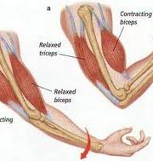
The Muscles
Proportion the energy to move parts of our body.
Notes:
Por ejemplo los musculos son los que:

Slide 6
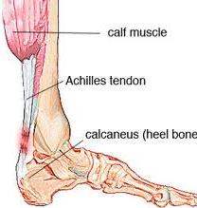
The Tendons
Are pulleys that join the muscles and the bones, helping move parts of the body.
Notes:
Y los tendones:

Slide 7
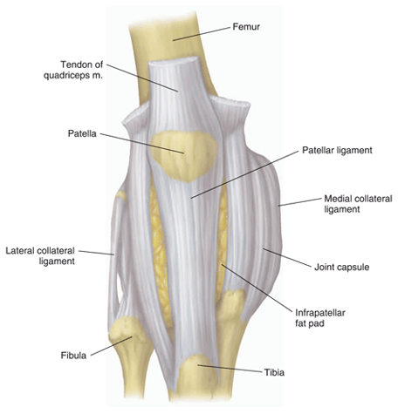
The ligaments
Connect the bones each, stabilizing the joints.

Slide 8
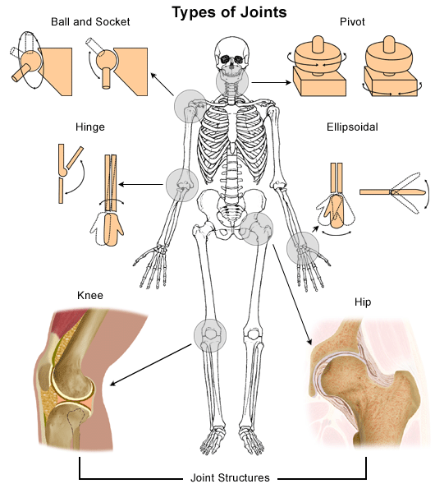
The Joints
Are the connections between the bones.
Notes:
Los ligamentos

Slide 9
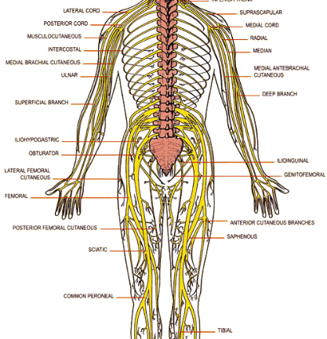
The Nerves
They take the messages between the brain and other parts of the body.
Notes:
Usar ejemplo: cuando golpeamos el codo:

Slide 10
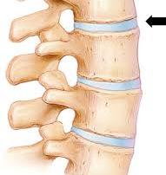
The Vertebrate Discs
They act like dampers Shock absorber for the spine.

Slide 11
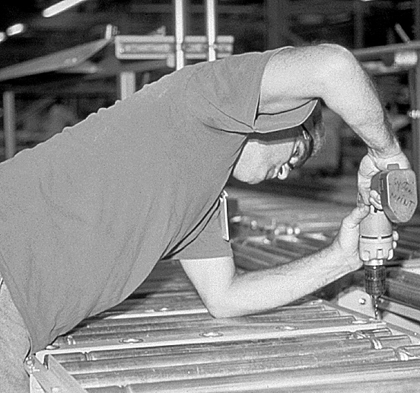
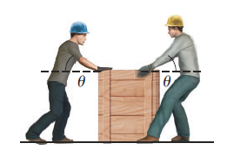
Factors of ergonomic risk that can develop TME
Force
Pushing or pulling

Slide 12
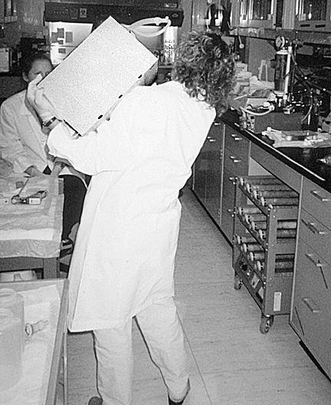
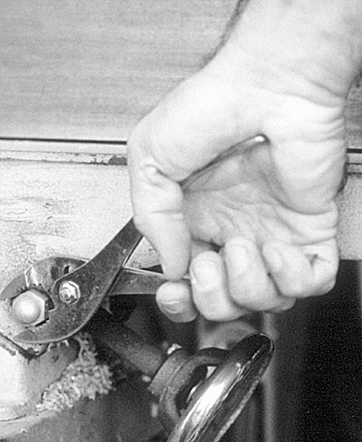
Factors of ergonomic risk that can develop TME
Carrying (Lifting)
Grabbing (Grasp)

Slide 13
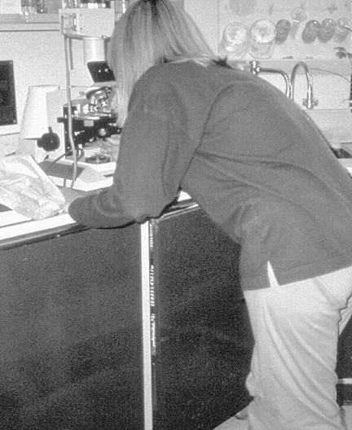
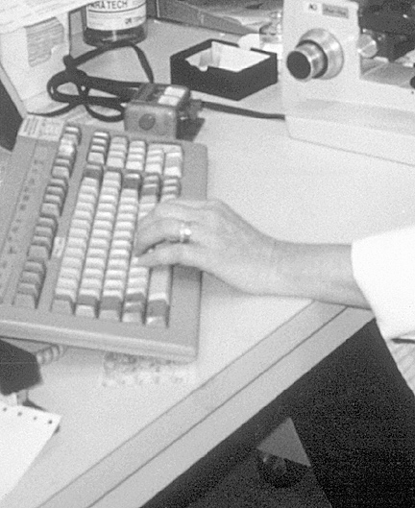
Factors of ergonomic risk that can develop TME
Forced Postures
Repeated Movement

Slide 14
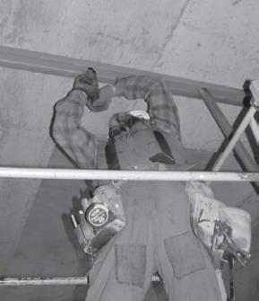
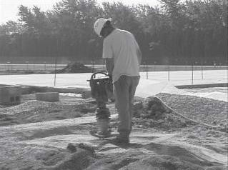
Factors of ergonomic risk that can develop TME
Working with your hands above your head
Vibration

Slide 15
How do I know if Im at risk of developing TME?
Symptoms of trastornos músculo esqueléticos
Pain
Weakness
Rigidity
Sensability
Swelling
Sensación de ardor
Tingling
Dificult to move
Clumsiness
Notes:
PAGINA 7 DE EL WORK BOOK Bueno ya que vimos cuáles son las actividades que pueden lastimarnos, como puedo identificar los síntomas de éstos trastornos y evitar lastimarme?

Slide 16
Two ways to reduce egronomic risks
includes engineering improvements:
reorganization, modification, redesign or substitution of work tools
For example:
administrative improvements:
Change of practices or forms of work.
Proporcion variety at work.
Time adjustments or rythm of work.
Proportion time to recuperate (break).
Modify the practices of work.
Promote excersise.
Notes:
La primera forma de reducir el riesgo ergonomico es haciendo cambios, ya sean de ingenieria como-----. O administrativos.

Slide 17
Personal Protection Team
(PPE) for your acronyms in English.
Includes:
Gloves
Elbow and knee pads
Footwear
And other articles
Notes:
Segunda forma de reducir riesgos ergonomicos es usando apropiadamente todo el equipo de proteccion recomendado por osha para su tipo de trabajo.

Slide 18
Ergonomic Risks and possible solutions.
Notes:
Formar Grupos y proveer Butcher paper y marcadores para ejercicio interactivo. Usando los ejemplos de riesgos como repeticion, postura forsada etcetera. El grupo deve pensar ipoteticamente cual es el dano que causa el riesgo y cual podria ser la solucion.

Slide 19
What ergonomic risks exist at my job?
Ergonomic Risk
Possible solution
Notes:
Segundo ejercicio de parejas o grupo. Luego seleccione unas personas para compartir con el grupo lo que trabajaron.

Slide 20
What can I do if there are ergonomic risks at my job?
Do your homework, inform yourself.
Together we can improve ourselves.
Analyze the problem.
Write it down.
Lastly contact OSHA

Slide 21
Why are ergonomic changes good for the employer?
barriers
Solutions
Cost money
The other workers don’t care to change
The employer does not care about the comfort or security of the employees.
The ergonomic techniques prevent cost for injuries.
Teach them how change can make the job easier or more comfortable.
Show them how your idea will save time and money in the long run.
Notes:
Si usted cree que su patron se negara a invertir o crear cambios en su trabajo, preparese para mostrarle en que le beneficiaran a el los cambios que usted propone. Por ejemplo si cree que el patron le dira------ leer ejemplos del power point.

Slide 22
What rights do I have under the OSHA Law?
Know Your Rights.
Take Action!

Slide 23
The Workers ' Rights Under the OSH Act
Workers have the right to working conditions without risk of serious harm
Workers have the right to…
Ask OSHA to perform an inspection of the work place;
Exercise their rights under the law, free from retaliation or discrimination;
Recieve information and training over hazards, methods to prevent damages, and the standards of OSHA that apply to your work site. The training must be in a language you can understand;
Have access to the results of the testing that they do to find hazards at the work site;
Read the files of injuries and
Diseases related to the work;
Have access to copies of your medical records
Notes:
Do you know any of your rights as a worker under the OSH Act?

Slide 24

The Workers ' Rights Under the OSH Act
Workers have the right to working conditions without risk of serious harm
Workers have the right to…
Refuse to participate in the dangerous work , but only if they are protected by OSHA if the following situations exists: If you Have a very high belief that there is a danger or risk of serious harm;
  You have asked your employer to eliminate or control the hazard;
  You have no other alternative but to refuse to participate in the work; and
  The elimination of the danger or risk is an urgent need and can not wait for an OSHA inspection.
  If all the above situations exist , you can refuse to participate in the work and may be protected.

Slide 25

If the OSHA standards are not met ...
So what else I can do?
… You have the right to file a complaint.
How can I present a complain?
  You or your representative may file a complaint with OSHA and request an inspection of the workplace.
  Visit www.osha.govand download the complaint form , fill in the blanks with the correct information and send it to the OSHA office nearest you .
  Call 1-800-321-OSHA (6742) to ask them to send the complaint form .
  Ask OSHA to keep your identity confidential .

Slide 26
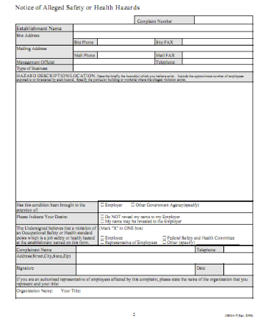
What happens when I file a complaint ?
  Complaints through internet or telephone will be resolved informally by phone .
  Written complaints with the worker's signature or a representative often result in an inspection of the workplace. ( You can call OSHA first).

Slide 27
During the inspection…
You have the right to…
Be present during the inspection of your area (this can help the inspector identify the problems);
Talk to the OSHA inspector in private;
Call the inspector (you can do it from home); and
Have acess to the results of the inspection.

Slide 28

If my employer retaliates against me for exercising my rights of health and safety?
Employers can not discriminate against you because …
  File a complaint about an illness or injury;
  Complain to your employer , union, OSHA or another agency about a problem of safety or health;
  Participate in a committee of safety and health; or
  Participating in OSHA inspections and other OSHA activities.
  If you have been fired, demoted , transferred or discriminated against in any way use your rights under this law , you have 30 days to make a complaint.

Slide 29
Conclusion
OSHA helps to avoid the dangers and risks of serious injury and requires employers to provide free working conditions and unsafe hazards .
Employers have a responsibility to provide a safe workplace.
Workers are entitled to a workplace free of hazardous conditions.
The relationship between the employer and the worker must be professional, fair and mutual understanding.

Slide 30

For more information call:
OSHA
Occupational Safety and Health Administration
U.S. Department of Labor
1-800-321-OSHA (6742)
www.osha.gov

Slide 31

NO ONE should die for a pay check!
We can help
Thanks to the National Labor College for information provided in its Draft Training Occupational Safety and Health - Facilitator's Guide.
This material was produced under grant number # SH20833SH0 reviewed under grant # SH26296 - SH4 Administration Occupational Health and Safety United States Department of Labor and not necessarily reflect the views or policies of the Department of Labor ; should mention the names of commercial products, or organizations imply endorsement by the government

