Slide 1
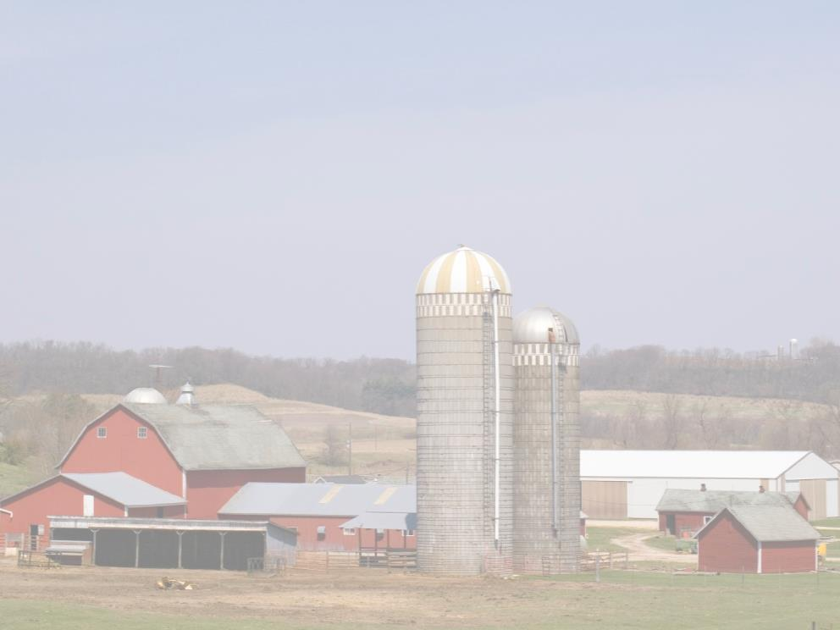
ATV Safety for Youth
This material was produced under a grant (SH-27642-SH5) from the Occupational Safety and Health Administration, U.S. Department of Labor. It does not necessarily reflect the views or policies of the U.S. Department of Labor, nor does the mention of trade names, commercial products, or organization imply endorsement by the U.S. Government.

Slide 2
Program Objectives
At the conclusion of this presentation, participants will:
  Be able to identify hazards associated with ATV/UTV use in Agriculture
  Know where to look for OSHA references and resources related to ATV/UTV use in Agriculture
  Be able to do a pre-trip inspection on your ATV/UTV

Slide 3
Statistics:
Involvement in Farming in the U.S.
2.1 Million farmers
2% of the population
Reference: http://www.epa.gov/oecaagct/ag101/demographics.html
Notes:
5
Here in the US it include about 2% of the population and we are seeing a shift from the family farm to larger production units.
The spouse is working off the farm to bring revenue and insurance back to the farm.
Reference: http://www.epa.gov/oecaagct/ag101/demographics.html

Slide 4
Statistics of Injury/Mortality:
U.S.
570 Fatalities (2015)
22.8 deaths per 100,000 workers
Notes:
7
This data is nationwide for Agriculture
22.8 deaths per 100,000 workers for Agriculture
2015 CFOI-BLS

Slide 5
Causes of Fatalities include
Operating at excessive speeds for the terrain/operation
Operating ATVs on paved roads
Not wearing a protective helmet
Insufficient or no training
Carrying extra riders
Notes:
Source - OSHA Safety and Health Bulletin: SHIB 08-03-2006

Slide 6
Chose the right size ATV
Age of Operator | ATV/UTV Engine Size
Under 6 years of age | Not recommended
Age 6-11 | Under 70 cc
Age 12-15 | 70-90 cc
16 years and older | Over 90 cc
Source: Penn State ATV Safety Brochure
Notes:
From Penn State University: Used with permission

Slide 7
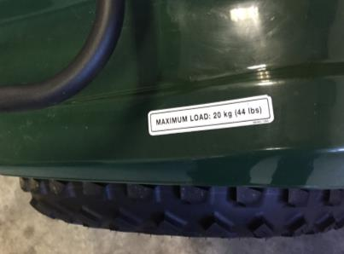
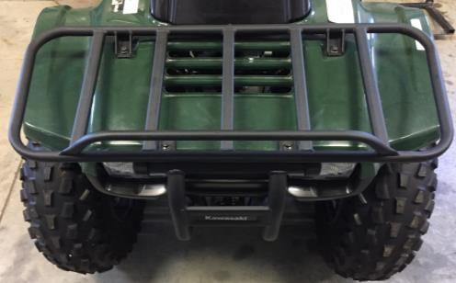
Carrier Racks
Carrier racks should not be installed on youth size ATVs because the weight of objects or materials carried on the rack can shift the ATVs center of gravity and reduce its stability. The material on the rack may also block the youth’s vision.
Source: Penn State ATV safety brochure
Notes:
Pictures courtesy of NECAS. Permission given from Penn State to use material

Slide 8
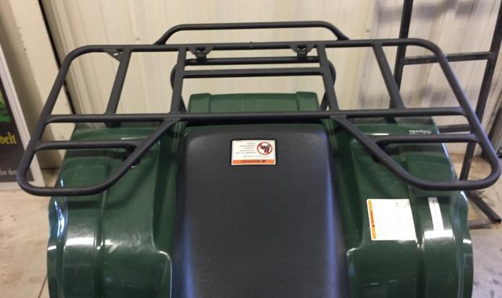
Carrier Racks
For Adult ATV’s care should be given not to put overweight oversized loads onto carrier racks that may reduce visibility or impair steering or braking
Source: Penn State ATV safety brochure
Notes:
Picture from NECAS. Permission given from Penn State to use material

Slide 9
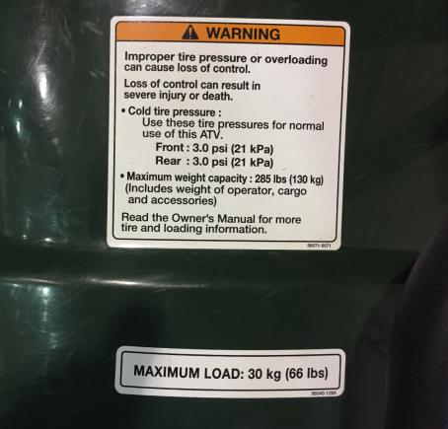
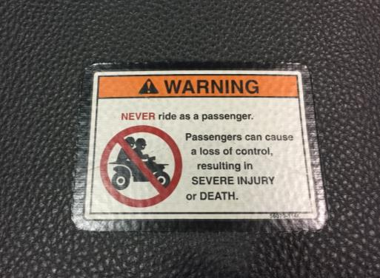
Read Warning labels
Notes:
Read and follow manufacturer recommendations.

Slide 10
One Seat-One Rider
A second person changes the center of gravity of the machine and it’s steering and braking capabilities.
Notes:
HOSTA Task sheet 6.2 Permission to use from Penn State University

Slide 11
Shifting your weight on an ATV
When you are going down hill you need to shift your weight to the back of the ATV to prevent the back wheels from coming off the ground.

Slide 12
Shifting your weight on an ATV continued
When you are going up hill you need to shift your weight to the front so the front wheels don’t come off the ground.

Slide 13
Shifting your weight on an ATV (continued)
When you are making a left turn you need to shift your weight to the left.
When you are making a right turn you need to shift your weight to the right.
When making turns you need to make sure you are not going too fast and are able to control the ATV/UTV all the way through the turn.

Slide 14
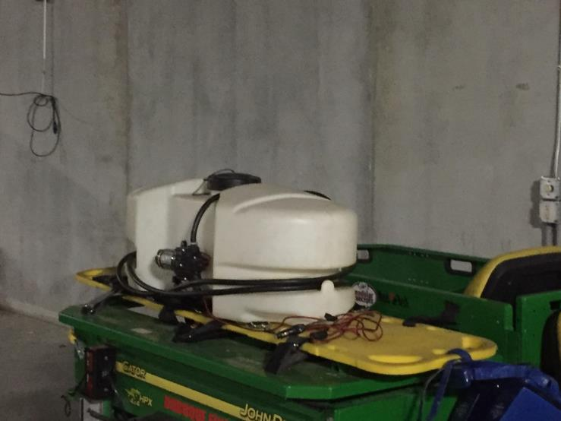
Chemical Sprayers on ATV’s
Notes:
Chemical Sprayers can change the center of gravity and if the ATV/UTV would roll over there is no protection for the occupants from the chemicals that would spill. Chemical tanks need baffles installed on them to prevent the liquid from moving back and forth rapidly.

Slide 15
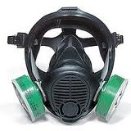
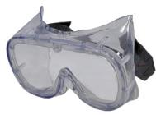


Personal Protective Equipment (PPE)
Personal Protective
Equipment (PPE)
Notes:
Read and follow the label directions for the PPE that should be worn with each chemical used.

Slide 16
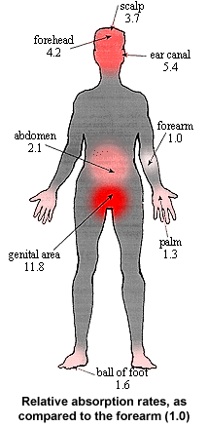
Head to Toe Protection
Absorption rates of body - why PPE is important
Donning and Doffing proper methods of putting PPE on and taking PPE off
Practical use - Long sleeve long pants – when is that okay.
From: Resources in Agricultural Safety, University of Missouri-Columbia
Notes:
For a given chemical, if the forearm was assign a arbitrary base rate of 1.0, in comparison to the forearm, other parts of the body will absorb the same chemical from a range of 1.3 to11.8 times faster than the forearm.
Used by permission

Slide 17
ATV/UTV Safety Issues
The operator should thoroughly review the operators manual and receive training before operating any newly acquired ATV/UTV.
The operator should conduct a pre-trip safety check of the ATV/UTV at least once daily and more often if necessary.
  The safety check should cover the functionality of the brakes, lights, tires, and steering system.

Slide 18
ATV/UTV Safety Issues continued:
Never fuel an ATV/UTV if the engine is running. Engine fuels are highly combustible materials.
Make sure the ATV/UTV is in gear when traveling downhill.
Disconnect the ground wire when servicing batteries.

Slide 19
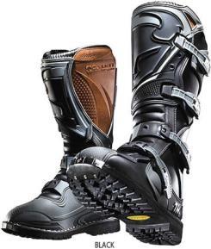



Safety Gear for ATVs

Slide 20

Helmets
Helmets provide protection from head injuries
Notes:
Photo courtesy of NECAS

Slide 21
Shirts
Denim shirts provide a rugged but flexible fabric.
Cotton shirts provide a flexible but breathable fabric.
Flannel shirts provide warmth.
Shirts should be long sleeved to provide protection from scrapes and bruises.
Shirts should fit comfortably but not be baggy.
Long sleeve helps with Sun exposure

Slide 22
Pants:
Denim material.
  A relatively tough but flexible fabric.
Cotton material.
  A flexible but breathable material.
Pants should be full length so as to provide protection from scrapes, nicks.

Slide 23
Gloves
Gloves provide protection from blisters, splinters, insect bites, scrapes and bruises.
Leather gloves provide the best protection for standard uses.
Notes:
Photo’s courtesy of NECAS

Slide 24
Footwear:
Medium to high top work boot or cowboy boot.
Made of leather to include a steel toe.
  Provides protection from falling objects.
  Provides protection if driving thru brush
  Avoid flip-flops
Notes:
Photo courtesy of NECAS

Slide 25
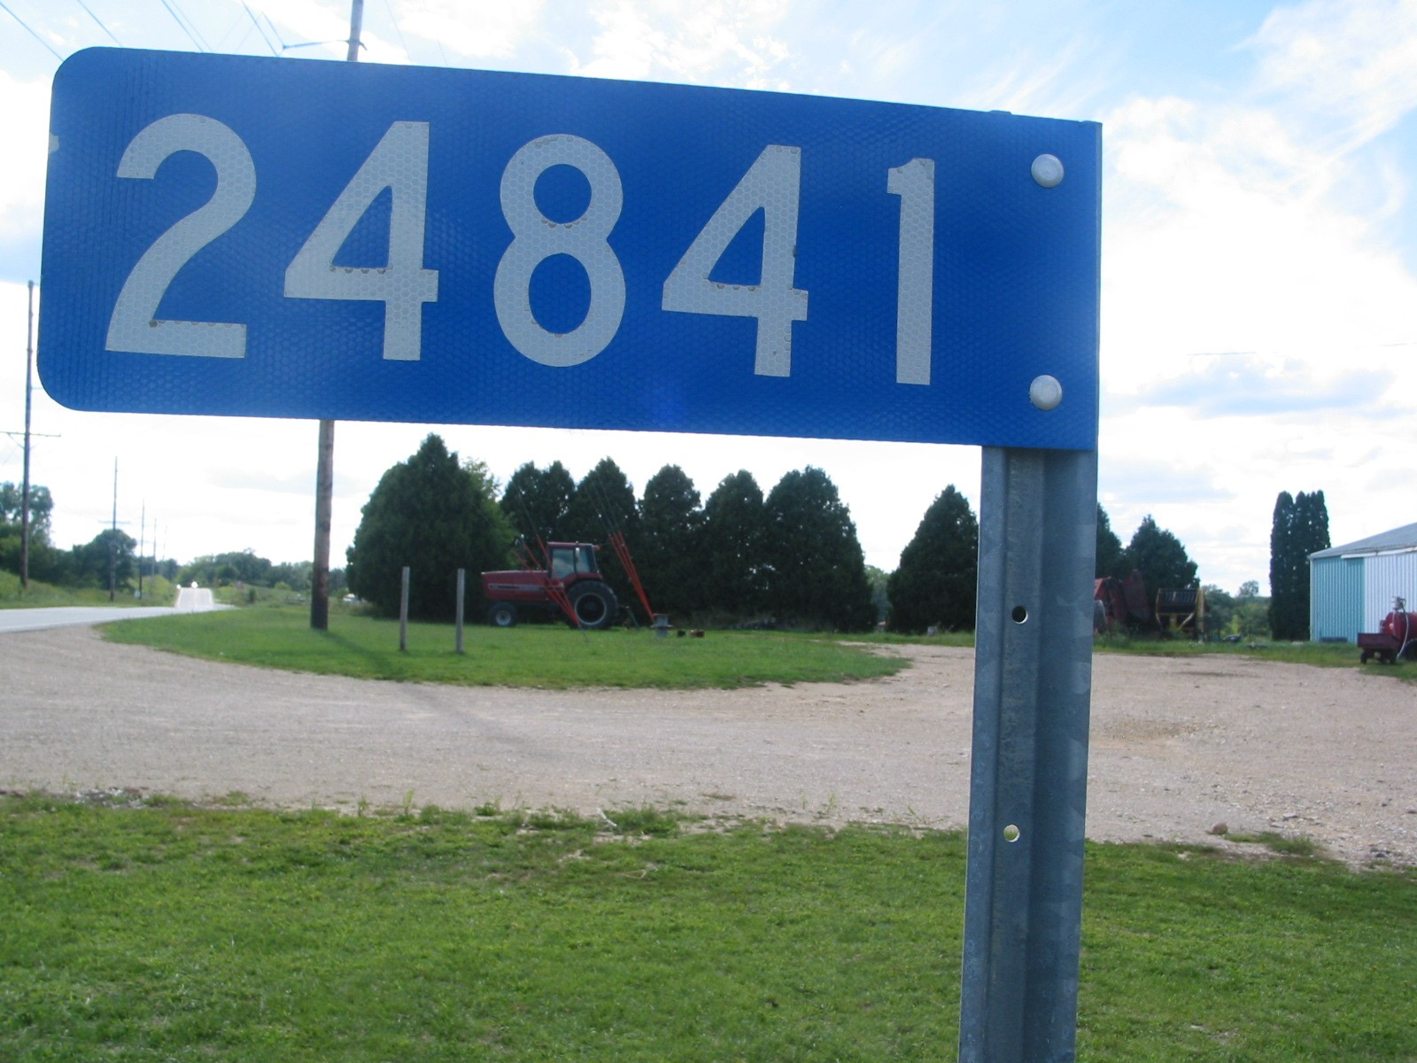
Know your Location
Notes:
A lot of farms today not only include the home farm but rental properties or purchased farms not located adjunct to the home farm. It is important to know the physical address and 911 address of the location. It is recommended that you write down each farm, its 911 address, physical address, and who owned it before. This information should be carried in every moving vehicle that goes from farm to farm. The GPS on your phone can track you in an emergency but that takes time and in an emergency that time could be essential.

Slide 26

Calling 911
Name:
Address or 911 number
Exact nature of the emergency
Do not hang up
Notes:
Instructor Notes:
When a call for emergency services is made, usually to 911, the dispatcher needs several important pieces of information to ensure that assistance is provided in a timely manner. It is extremely important that the caller stay on the line until the dispatcher is adequately informed. In some cases, 911 calls are made and the caller hangs up before an address is provided or the nature of the emergency is explained. In some communities, the 911 dispatcher knows the address and the callers identification. However, the caller’s home address may not be the site where the assistance is needed.
In most cases the 911 dispatcher will ask the following:
Name, first and last, of the call
Address where the incident has occurred, not necessarily the address of the caller
The exact nature of the emergency including the known number of victims and the nature of their injuries if known
It is important for the caller to know their location. So many farmers are renting and buying farms away from the home farm. It is important to write down the name , address, 911 address of each farm they own or rent. Copy this and put it in every vehicle that will go from farm to farm.
Remember, remind the participants to not hang up on the 911 dispatcher until the dispatcher has gotten all the information they need.
Photo courtesy of Dubuque County Iowa dispatch center. Used with permission.

Slide 27


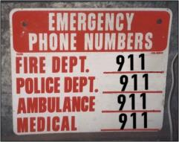
Emergency & First-Response
Preparation Include:
Posted emergency action plan
Employee training on emergency action plans
Appropriate placement of telephones & radios
Posting of emergency phone numbers by each phone
Address and directions for finding all worksites
Pre-determined meeting place following an incident
Notes:
Instructor Notes:
Every employer involved in operating potentially hazardous equipment or facilities such as grain storage and handling operations or other types of agricultural confined spaces should have given consideration to preparing for the potential for emergencies. In fact, at non-exempt grain storage and handling facilities this measure is required under the OSHA rules. Preparation is a key component of emergency management. Trying to locate a phone number or identifying who should be called during an emergency can result in wasted time and greater potential for a minor incident becoming a much more serious one.
Key preparation measures should include:
Posting of an approved emergency action plan for the most probable types of emergencies.
Employee training on the site’s emergency action plan. (This may be required annually.)
Appropriate placement of telephones or other communication devices such as radios or cell phones. (Remember, some devices such as cell phones may not work inside of an agricultural confined space.)
Posting of emergency phone numbers by each phone or having emergency phone numbers preprogrammed into personal cell phones. (Remember, 911 may not be available in rural communities.)
Having the address and directions to each worksite posted by each phone. In many cases, callers will forget how to get to a specific site or give an incorrect address due to the confusion caused by an emergency situation.
Identification of a pre-determined meeting place where all employees can meet following an emergency situation. Young and beginning workers have been known to leave the site after an incident resulting in them being listed as missing. This can lead to unnecessary search and rescue efforts.
Used with permission from Purdue University, Susan Harwood grant SH23575SH3

Slide 28
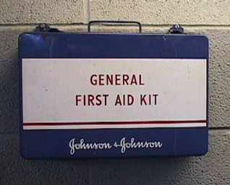
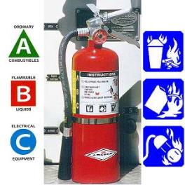
Emergency & First-Response
Preparation Should Also Include:
Access to first aid kit
Appropriate placement of properly rated fire extinguishers
Training of staff in first aid and emergency specific types of response
Access to specialized emergency response protective equipment
Notes:
Instructor Notes:
Emergency and first-response preparation should include other measures designed to mitigate or reduce the impact of an emergency situation. Most of these steps are low cost and take little time to implement. Young and beginning workers should become familiar with all the emergency preparation measures that have been taken in the worksite. Encourage participants to speak up and ask for information and training on what has been done to enhance emergency preparedness. Other measures that most workplaces will have in place include:
Access to first-aid kit
Appropriate placement of properly rated fire extinguishers
Training of staff in first-aid and specific types of emergency response
Access to specialized emergency response protective equipment for the hazards found in the workplace
A call is made to local emergency response services who are better trained or equipped to handle the emergency. Young and beginning workers need to know how they fit in and be made aware of their responsibilities in the event of an emergency.
Used with permission from Purdue University, Susan Harwood grant SH23575SH3

Slide 29
OSHA Section 5(a)(1),
The General Duty Clause of the Act, employers must provide their employees with a workplace free from recognized hazards likely to cause death or serious physical harm.
Notes:
If OSHA found a hazard, they would issue a 5a1-general duty clause violation.

Slide 30
Small Farm Exemption
The Appropriations Act exempts small farming operations from enforcement of all rules, regulations, standards or orders under the Occupational Safety and Health Act. A farming operation is exempt from all OSHA activities if it:
  Employs 10 or fewer employees currently and at all times during the last 12 months; and
  Has not had an active temporary labor camp during the preceding 12 months.
  Immediate family members are considered exempt
Source: OSHA Instruction CPL 02-00-051
Must still provide a safe work place

Slide 31
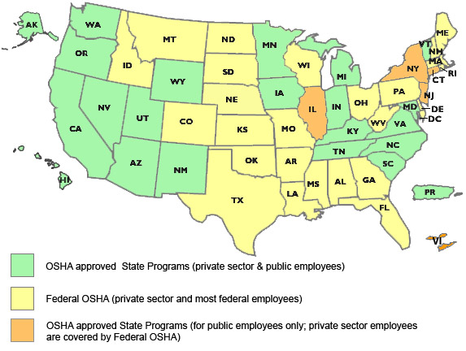
State to State
Important to check with your state OSHA since
There are 22 states with state plans and another 5 states which cover state and local government workers only.
Map of OSHA-approved State Plans
Notes:
‘Twenty-six states, Puerto Rico, and the Virgin Islands have OSHA-approved State Plans. Twenty-two State Plans (21 states and one U.S. territory) cover both private and state and local government workplaces. The remaining six State Plans (five states and one U.S. territory) cover state and local government workers only. ‘

Slide 32
OSHA and Agriculture
OSHA requires the use of personal protective equipment (PPE) to reduce employee exposure to hazards when engineering and administrative controls are not feasible or effective in reducing these exposures to acceptable levels. Employers are required to determine if PPE should be used to protect their workers.
Source: http://www.osha.gov/SLTC/personalprotectiveequipment/

Slide 33
Employee Rights and Responsibilities
You have the right to:
  A safe and healthful workplace
  Know about hazardous chemicals
  Information about injuries and illnesses in your workplace
  Complain or request hazard correction from employer
Notes:
33

Slide 34
Employee Rights and Responsibilities
You have the right to:
  Training
  Access to hazard exposure and medical records
  File a complaint with OSHA
  Participate in an OSHA inspection
  Be free from retaliation for exercising safety and health rights
Notes:
34

Slide 35
Employee Rights and Responsibilities
OSHA website: OSHA website and OSHA offices: Call or Write (800-321-OSHA)
Compliance Assistance Specialists in the area offices
National Institute for Occupational Safety and Health (NIOSH) – OSHA’s sister agency
OSHA Training Institute Education Centers
Doctors, nurses, other health care providers
Public libraries
Other local, community-based resources
Notes:
35

Slide 36

Whistleblower Fact Sheet Location
Whistleblower Fact Sheet
https://www.osha.gov/OshDoc/data_General_Facts/whistleblower_rights.pdf
Moving Ahead for Progress in the 21st Century Act (MAP-21)
Notes:
Review Employee Rights – OSHA Publication Fact Sheet (MAP 21)

Slide 37

Whistleblower Protection Program
Notes:
With in OSHA is the whistle blower program - https://www.whistleblowers.gov/index.html
Website resources
22 statutes

Slide 38
Disclaimers
This material was produced under a grant (SH-27642-SH5) from the Occupational Safety and Health Administration, U.S. Department of Labor. It does not necessarily reflect the views or policies of the U.S. Department of Labor, nor does the mention of trade names, commercial products, or organization, imply endorsement by the U.S. Government.
Notes:
Material possible from
US Dept of Health and Human Services
OSHA

Slide 39
ATV Safety Questions
Notes:
ATV Safety Questions

