Slide 1
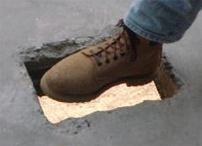
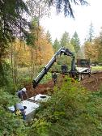
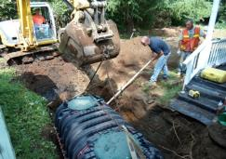
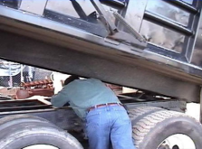
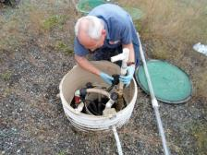
“Safety in the Workplace”
Washington On-Site Sewage Association
“Voice of the Industry”
FOCUS FOUR HAZARDS SAFETY TRAINING – 4 Hour
Notes:
Introduction of topic to class, the speaker.
Depending on class size, the Instructor should have participants introduce themselves and the industry segment they work in.
The ideal class size for interactive participation is 25.
Introduction of Focus Four topics:
NOTES for use:
This targeted training is a strategic effort to reduce injuries and raise awareness to workplace hazards and injuries related to falls, caught in-between/struck by and electrocution, utilizing “in person” training with instructors that have a background in the Onsite industry, training experience that will focus on highlighting common workplace activities and associated hazards that can be mitigated or eliminated through behavior modification and incorporated into small business safety and training programs.
.In this industry, class participants educational levels will range widely depending on the local demographic, sophistication of local/state rulemaking on certification/licensing requirements and will range from college graduates to high school/GED’s or less. The focus audience of this training are workers in the wastewater and associated Onsite industry. Generally, they are described as small business owners and employees with less than 250 employees that design, install, repair and maintain decentralized wastewater systems (septic systems) that are capable of producing 240- 100,000 gpd of wastewater. Typically, this infrastructure is located and/owned privately but in some cases may also include work activities on community systems. The training intends to provide training to small business that experience a higher level of young workers, limited proficiency, minorities and other hard to reach workers.
After the Instructor introduces themselves and depending on class size, a presentation technique that is recommended for attendees of 25 or less, is to allow each participant to tell who they are but may be effectively used in larger groups with experienced trainers and advanced presentation techniques. This activity is intended to be an “ice breaker” and set’s the style and tone of the learning event to be interactive
The key learning objectives follow:
At the end of each training session of the Focus Four, participants will be able to identify specific hazards that relate to their industry segment.
Demonstrate an understanding of how to minimize or eliminate the exposures through modification of work practices in specific tasks
Provide feedback on experience and sharing personal stories of events and near misses in the Focus Four categories
Describe what they have changed personally or in supervisory roles that would mitigate or prevent accidents in the Focus Four categories
Each of the slides in this presentation provides comments and Instructor’s speaking points and perspectives to current application in the industry. The developer’s of this training resource encourage modification of this editable resource that will make it both industry and region specific to reflect local regulatory practice and information from other state approved OSHA plans outside the initial development.

Slide 2

OSHA Susan Harwood Grant
This material was produced under grant number
SH-27631- SH5
From the Occupational Safety and Health Administration, U.S. Department of Labor. It does not necessarily reflect the views or policies of the U.S. Department of Labor, nor does mention of trade names, commercial products, or organizations imply endorsement by the U.S. Government.
Notes:
Recognition slide for grant from OSHA

Slide 3
Credits ─ Sources of Information
U.S. Bureau of Labor Statistics (BLS)
Federal OSHA
WISHA (Washington Industrial Safety and Health Administration)
WOSSA (Washington Onsite Sewage Association)
Oregon-OSHA
OSHA/Kansas
OSHA Missouri
Notes:
Credit to source information for the development of the material.
The Instructor should also make a connection to the audience depending on where (what State) the training is occurring. Principally, to make the point that some states have OSHA approved plans and comments to the differences that may exist.
All of the OSHA Requirements are recognized through State approved plans as minimum requirements.

Slide 4
Disclaimer
This training resource has been produced and does not necessarily reflect the views or policies of the U.S. Department of Labor, and mention of trade names, commercial products, or organizations is not an endorsement by the U.S. Government.
Photos shown in this presentation may depict situations that are not in compliance with applicable OSHA requirements.
The intent of this training is to raise awareness in the Onsite and related Onsite industries in the Focus Four Hazards.
It should NOT be assumed that the discussion contained herein constitute a thorough review of the applicable standards or are intended to provide compliance based training.
Notes:
Housekeeping comments to note the limitations of the presentation. Local county and state regulations may impact the application of rule and states with approved plans from OSHA may have additional restrictions.

Slide 5
Pre Course Quiz #1
Notes:
After the introductions, the instructor should have the participants take the “pre-course” quiz. This can be set up as an interactive exercise and have participants “share” and discuss answers. Afterward the instructor should review the answers with the group and encourage discussion.

Slide 6
What are the OSHA Focus Four Hazards?
Falls
Struck-by
Caught-in/between
Electrocution
Notes:
This is an industry specific training on job site exposures and safety for employers and workers in the Onsite Sewage wastewater industry.
Briefly discuss in the following slides, the Focus Four statistics as it relates to the nationwide Onsite workforce, and review those numbers in relation to similar hazards encountered by OSS (onsite systems) service providers. The training will cover the four focus areas of hazards that are especially important on OSS Onsite sites.
Safety doesn’t happen by accident…it’s a choice. From the highest level in an organization to the lowest level in the organization. Because the relative size of companies in the OSS industry is small (>10) employee’s, personal behaviors, teamwork, and company culture play an important role in safe attitudes in the workplace.

Slide 7
Learning Objectives
  Recognize Employer and Employee responsibilities
  Practice Root Cause Analysis Exercises
  Identify and describe major industry exposures for
  each of the Focus Four Hazards in the Onsite Industry
  Discuss worker behaviors impact on unsafe decisions
  Describe actions you can do to protect yourself
Notes:
Outline the slides the Focus Four learning objectives. The training covers the major four focus areas of hazards that are especially important on OSS Onsite sites. The training doesn’t attempt to show and cover every potential exposure, but provides examples of each of the Focus Four exposures in different setting from potentially low impact (slipping on wet grass and falling to ground to the worst case potential of a fatality during routine tasks of maintenance on equipment.
The intent is to raise awareness, develop critical thinking skills that will allow the learner to appropriately assess the workplace, tasks to be performed and the impact of changing conditions that can help them do their jobs safely, by thinking about doing it differently when needed.
For each of the four hazards, emphasize how recognition, prevention, and training will identify ways that fatalities and injuries can be reduced, what they can do through personal responsibility and what the employer’s responsibilities are under the OSHA rules to keep the workplace safe.

Slide 8
Learning Objectives
Training includes a review of Focus Four:
  Definitions
  Statistics
  Typical Industry and Related Examples
  Your Shared Examples
Notes:
These learning objectives describe additional information for the learner. The last two learning objectives describe participant activities and allows the trainer to set expectations for class participation.

Slide 9
Employer Responsibilities - Summary
Provide a workplace free from serious recognized hazards and comply with standards, rules and regulations issued under the OSH Act.
Examine workplace conditions to make sure they conform to applicable OSHA standards.
Make sure employees have and use safe tools and equipment and properly maintain this equipment.
Notes:
This slide outlines the basic employer responsibilities of an OSHA or state approved Program

Slide 10
Employer Responsibilities - Summary
Use color codes, posters, labels or signs to warn employees of potential hazards.
Establish or update operating procedures and communicate them so that employees follow safety and health requirements.
Notes:
This slide outlines methods that the employer can use to meet their responsibilities under an OSHA or state approved Program

Slide 11
Employer Responsibilities – Summary
Employers must provide safety training in a language and vocabulary workers can understand.
Employers with hazardous chemicals in the workplace must develop and implement a written hazard communication program and train employees on the hazards they are exposed to and proper precautions (and a copy of safety data sheets must be readily available).
Notes:
This slide outlines methods that the employer can use to meet their responsibilities under an OSHA or state approved Program

Slide 12
Employer Responsibilities – Summary
Provide medical examinations and training when required by OSHA standards.
Post, at a prominent location within the workplace, the OSHA poster (or the state-plan equivalent) informing employees of their rights and responsibilities.
Notes:
This slide outlines methods that the employer can use to meet their responsibilities under an OSHA or state approved Program

Slide 13
Employer Responsibilities – Summary
Report to the nearest OSHA office all work-related fatalities within 8 hours, and all work-related inpatient hospitalizations, all amputations and all losses of an eye within 24 hours.
Provide employees, former employees and their representatives access to the Log of Work-Related Injuries and Illnesses (OSHA Form 300).
Notes:
This slide outlines methods that the employer can use to meet their responsibilities under an OSHA or state approved Program

Slide 14
Employer Responsibilities - Summary
Keep records of work-related injuries and illnesses.
  Note: Employers with 10 or fewer employees and employers in certain low-hazard industries are exempt from this requirement.
Notes:
This slide outlines methods that the employer can use to meet their responsibilities under an OSHA or state approved Program
. Note: Many small business owners in this industry have stated that they are exempt from the OSH act all together for having less than 10 employee’s which is incorrect.

Slide 15
Worker Responsibilities and Rights
If you are a worker, you have the right to: request an OSHA inspection for workplace hazards, violations of OSHA standards, or violations of the OSH Act
Have an authorized employee representative accompany the OSHA compliance officer on the workplace inspection;
Meet informally with the OSHA compliance officer (in private, if preferred);
Notes:
This slide outlines the basic employee rights and responsibilities of an OSHA or state approved Program

Slide 16
Worker Responsibilities and Rights
Be notified by your employer of any citations issued for alleged violations of standards at the workplace, and of your employer's requests for variances or for changes in the abatement period;
Contest the abatement time set in any citation issued to your employer by OSHA;
Notes:
This slide outlines the basic employee rights and responsibilities of an OSHA or state approved Program

Slide 17
Worker Responsibilities and Rights
File a complaint with OSHA if you believe that you have been dismissed, demoted, or otherwise discriminated against for exercising rights under OSHA;
File a complaint with Federal OSHA authorities if your State agency fails to administer a State program as effectively as required by OSHA;
Notes:
This slide outlines the basic employee rights and responsibilities of an OSHA or state approved Program

Slide 18
Worker Responsibilities and Rights
Receive information from your employer about hazards and safety measures applicable to the workplace, OSHA standards relevant to your job, and the record of accidents and illnesses in the workplace;
Refuse to work in an imminent danger situation, under certain conditions;
and … Observe the monitoring and measuring of toxic substances in the workplace if you are exposed, and to have access to any records of your exposure.
Notes:
This slide outlines the basic employee rights and responsibilities of an OSHA or state approved Program

Slide 19
What You Are Responsible For…
  Identify major exposures for each of the Focus Four Hazards for your workplace.
  Understand how using Root Cause Analysis to evaluate hazards in your workplace can reduce your exposure
  Identify decisions you can make to protect yourself.
  Understand what your Employer’s responsibilities are to help keep you safe.
Notes:
For each of the four hazards, emphasize the responsibility the employee plays in getting work done: hazard recognition, personal responsibility, situational awareness, prevention, and training all identify ways that fatalities and injuries can be reduced.

Slide 20
What You Are Responsible For…
  Pay Attention!!! (Situational Awareness)
  Learn to recognize Risks
  Make Good Decisions
  Use Appropriate PPE
  Follow Procedures
Notes:
For each of the four hazards, emphasize the responsibility the employee plays in getting work done: hazard recognition, personal responsibility, situational awareness, prevention, and training all identify ways that fatalities and injuries can be reduced.

Slide 21
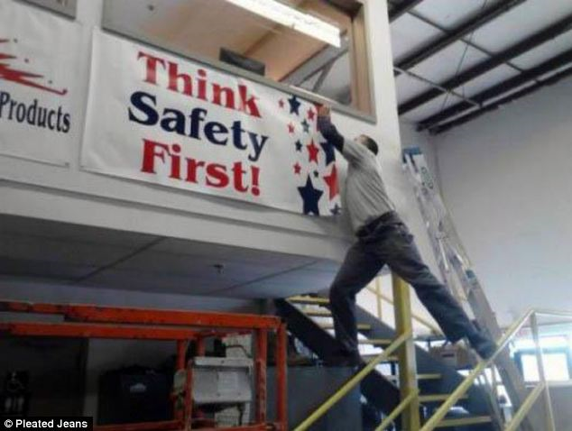
Keep these factors in mind to help prevent injuries from falls:
Notes:
Bridge to topic slide – Darwin Awards.
You can identify risks in the workplace, but you can’t always identify the risk “takers”.
Sometimes, left to their own devices workers solve problems that the employer wouldn’t approve.
“Don’t be this guy!”

Slide 22
Why are the Focus Four Hazards Important?
2014 worker fatalities = 4,251
Notes:
This information is compiled from the Bureau of Labor Statistics….the message here is the trend is increasing fatalities in Construction from previous years.

Slide 23
Focus Four Fatalities are 79% of All Fatalities
Source: Bureau of Labor Statistics
Notes:
2355 Total Fatalities further broken down as a percentage of the 2005 statistic
805 Fall
253 Electrical
570 Struck by
228 Caught in between
499 All Others (includes transportation, inhalation, chemicals, fires, and other related fatalities)

Slide 24
Our Industry does a Great Job at Firefighting
Reactive Management
(Fire Fighting)
When a problem occurs, you simply REACT to it.
The “problem” was never rooted out before it occurred.
It may have been preventable if the root cause had been identified.
Proactive Management
When using a PROACTIVE approach to problem solving, you eliminate potential exposures out of the work flow.
Preventable exposures are identified in advance using safety management tools like JSA’s (job safety analysis).
Notes:
Our OSS industry is renowned for firefighting…In reality, it is the nature of small business and limited resources to approach safety in this manner.
This discussion will set up the root cause analysis exercises in each of the modules.

Slide 25
Employer Management Tools
JSA’s – Job Safety Analysis
Policies and Procedures
Training
Emergency Response/Rescue Planning
Maintenance
Inspections, Internal/External Audits
Compliance and Enforcement
Accident Investigation (Root Cause Analysis)
Notes:
What you measure, you can manage….systems of work like those listed in the slide, provide a consistent method to identify, establish and implement policies and procedures that minimize and/or manage exposures in the workplace

Slide 26
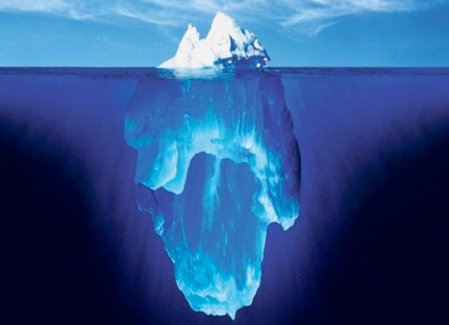
Fixing Problems instead of Fixing Blame
It’s Hard to fix a problem that you don’t know about!
Notes:
What you see is often only the tip of the ice berg, you can only manage risk if your safety program encourages identification of work flows and field procedure that are dangerous….this image demonstrates the point of being able to identify “near misses” before they become fatalities.

Slide 27
Root Cause Analysis and Methodology
How do you get started?
Establishing What You Want to Measure
Accident Reporting and Investigation
Fault Tree Analysis Tools
Notes:
These slides provide an exercise and method on root cause analysis for fatality scenarios that will be used in each of the Focus Four as class exercises in the 8 hour program to develop critical thinking skills of participants
The Five Why’s
Applying What We Learn:
Root Cause Investigation of a Focus Four Fatalities
Group Exercise
Reporting back to the Group

Slide 28
Root Cause Analysis….Another Tool in the Box
A methodical approach to problem solving that identifies the root cause of problems to help understand the underlying causes.
A “Causal Factor” is something that affects the outcome, but is not a root cause.
Removing a “Root Cause” from the work flow will prevent the accident from happening in the future.
Notes:
Understanding root cause methods as an investigative or predictive process. If the employer or worker can identify and remove a poor practice that increases risk, incident exposures will ultimately be reduced and the frequency and severity of accidents in the workplace will be mitigated when properly used and applied.
Examples:
Falls – root cause: improper foot wear…..causal factor: Rain, snow, working on a slope hauling a heavy hose
Struck By – root cause: no hard hat inside a tank doing repair….causal factor: unrecognized slope conditions, loose soil, frost…to warming temperatures in rocks and soil that become dislodged.
Caught in – root cause: loose clothing while working on moving equipment without guards….causal factor: unbuttoned shirt sleeves. Root cause: working under rotating equipment with out LO/TO procedures being accomplished.
Electrocution – root cause: working on equipment that is energized…causal factor: unlicensed electrician doing work does not understand exposure. Root Cause: not using LO/TO procedures.

Slide 29

Root Cause Analysis is NOT….
Notes:
Looking for blame will not help a team understand the “how” of an accident. When a fatality is involved, emotions, pressure from outside are made worse. Having a process in place to allow you to do an investigation will help you understand the gaps in the work processes that contributed to the incident.

Slide 30
Examples:
Falls – root cause: improper foot wear…..causal factor: Rain, snow, working on a slope hauling a heavy hose
Struck By – root cause: no hard hat inside a tank doing repair….causal factor: unknown slope conditions, loose soil, frost…to warming temperatures
Caught in – root cause: loose clothing while working on moving equipment without guards….causal factor: unbuttoned shirt sleeves
Electrocution – root cause: working on equipment that is energized…causal factor: unlicensed electrician doing work does not understand exposure
Notes:
Understanding root cause methods as an investigative process to identify and removes a poor practice that increases incident exposures will ultimately reduce the frequency and severity of accidents in the workplace when properly used and applied.

Slide 31
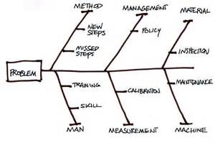
Organizing the Information
What are the core issues involved?
Method
Management
Material
People
Measurement
Machine
Change the parameters
Notes:
This is just one of a number of Fault Tree analysis tools or process that continues to identify all of the causal actions that contribute to an exposure until you can clearly understand what the root cause is and actions taken to mitigate the exposure.

Slide 32
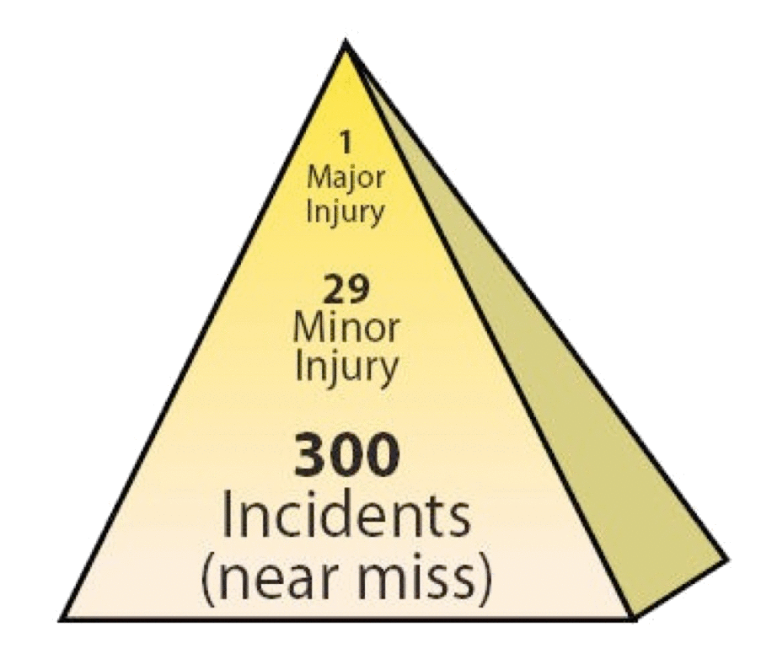
What Do You Measure and Why?
Vehicle Accidents and Property Loss
Occupational Illness’
Injuries with Lost Time Off
Near Misses
Notes:
OSHA Safety Pyramid, but based on the Heinrich “Safety Pyramid” and theory that is essentially a mathematical approach to safety management. If you can adequately identify and respond to “near miss” incidents and incorporate the lessons learned at the bottom of the triangle into work process’, procedures, PPE selection and employee training and workplace compliance to standards, your ability to reduce the exposure of workers to a major injury or fatality is significantly increased.

Slide 33
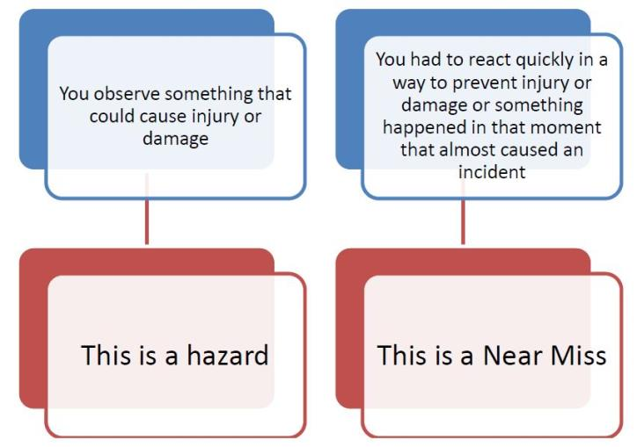
What Is the Difference?
Notes:
Employee “fear” of reporting an unsafe condition is typically a business owner issue. Maybe an employee reported something or asked a question and was rebuked…more than a time or two and they quit asking the questions.
Lack of understanding can be both an employer and employee issue… Employer’s that don’t understand or know about excavation rules can put their companies employee’s at risk. Employee’s that don’t understand or haven’t received training on excavation rules put in place for their safety may make decisions that put them at risk. Worse, the idea of “positive reinforcement for “negative” behaviors, reinforces this mentality when “nothing” happens and they get away with a poor practice.

Slide 34
Common Cause of Accidents by Workers
3. Eyes not on Task
Caught in/Between accidents
Electrocution
4. Line of Fire
Mostly “struck by” accidents
Electrical “Arcing”
Rushing
  Rushing affects
  decision making
  Falls
2. Eyes not on Path
  Slips, trips and fall’s
  Struck by
Notes:
When setting up to evaluate and assess accident prevention in the workplace, you need to consider why accidents happen. These four areas or combinations are examples of root causes.
Shows the relationship between outcomes and four unsafe behaviors by the Worker:
Rushing
Eyes not on Path
Eyes not on Task
Line of fire

Slide 35
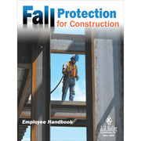
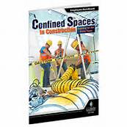
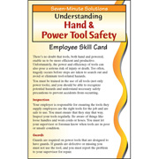

Root Cause Accidents by Employers
Policy and procedures
Process Management
PPE Choices
Training for current employees
Training for new hires
Resistance to change
Resistance to spending money
Notes:
Having Management systems in place provide a consistent approach to identifying and managing worker and business needs to do the job, and to do it safely.
It is not uncommon for small business in the OSS industry to be overwhelmed by the requirements under OSHA or state approved plans. Items 6 and 7 are justification tactics that are commonly used to push back on not starting or implementing items 1-6 in a consistent manner.
“Where do I start?” is another response from small business owners who are willing to begin a program to manage these needs.
Both the OSHA website and many of the state approved plan websites have “basic” outlines of a variety of tools and safety programs that are available for small business owners to download and complete to begin the process of implementing their safety programs.

Slide 36
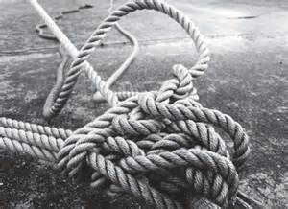
Reducing Accidents = Finding Root Causes
Keep Asking “WHY” until you get an answer you can no longer ask “WHY” about.
Notes:
Fault tree analysis unwinds the knot until you can clearly understand what the root cause is.
The next slide (video) tells a real life story of an accident that was a “struck by” incident, complicated by a confined space entry not resulting in a fatality…but only barely. Following is information for the Instructor to provide for the root cause activity with the participant groups.
The Job: Repair a cracked 3,000 + gallon tank servicing multiple homes in a trailer park/facility
Workers: 4 workers were on the job: 1- Supervisor (entrant), 1- Attendant, 2 Technicians
CSE Protocol:
Equipment was provided and used (tripod and harness)
CSE team did not use a “formal” procedure or “checklist” form to assess the immediate workplace (tank entry).
Training was not in place or limited. Entrant had means to check air quality, but the nature of the work was a cracked wall repair.
CSE assessment was incomplete to the recognized hazards (concrete tank structural integrity).
Workplace description:
Riser to top of tank was 12’ DEEP
Top of tank to tank floor was another 8+ FEET (total depth approx. 20 feet)
3,000 gallon tank had a rising horizontal crack from approximately 4’ from tank floor extending across for several feet and was pouring in water
Fishbone root cause assessment Issues:
Management; CSE policy and procedure was incomplete
Management: No rescue plan in place
Management: No site documentation (as-builts) were made available to employee
Training for hazard recognition and CSE was incomplete (man – training)
Equipment – limited to testing for air quality
Man – 2 employee’s were talking with (distracting) the attendant
Material – Concrete Tank was installed 20+ years ago and prior to any engineering construction standards
Method – Step missed – area water table at 5’ FEET was not considered in the hazard evaluation of a compromised, un-engineered tank that was empty and the sidewall pressure of water and soil at depth
Method – Step used – SOP used of a Roto-Hammer to prepare for injection and wall repair was inappropriate under these conditions

Slide 37
Root Cause Analysis - Activity
Crack repair in a Septic Tank
What is the Problem?
Root Causes?
Method
Management
Material
People (man)
Measurement
Machine
Notes:
The root cause in this accident scenario was that the company confined space entry protocol was understood to be limited to atmospheric testing and controls rather than identification and evaluation of other hazards (external stress from high water table, compromised structure, work practices using a roto hammer, lack of an as-built, and no alternate escape route).
The instructor should allow the group to break-out into their small groups to work through the process, discuss and make their determinations.
The point of the exercise is to learn/practice using the root cause analysis methodology.
This exercise will be completed in each of the Focus Four and the instructor should look for improvement in understanding and application of the use of root cause analysis methods.
The instructor should point out that the application of the methodology in evaluation of work tasks before they take place (proactive JSA) is appropriate to the work place as a preventative measure.

Slide 38
Activity – Root Cause Analysis of Tank Repair
What are the core issues involved?
Method
Management
Material
People
Measurement
Machine
Notes:
The instructor will use this slide as a visual aid during the feedback discussion with the small groups.
Depending on the size of the class, the instructor should recognize feedback from each small group and any additional comments from any participant.

Slide 39
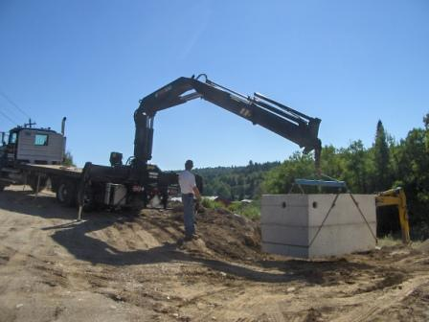
Fatalities & Citations
79% of all fatalities are related to the Focus Four Hazards
85% of all citations and 90% of dollars applied as fines are related to the Focus Four Hazards
Notes:
2 main statistics from Federal OSHA data for OSHA fiscal year 2005, Fatalities and Citations.
This photo illustrates how some or all of the hazards discussed can occur during the same operation, and why the Focus Four exposures are dangerous.
Operator behind equipment (operating remote) in “line of fire” potential, truck angle on slope potentially compromises the tank weight ratio’s and boom extension.
Getting participation: Instructor can ask audience “what are the exposures here?” and “does anyone have a personal experience”
This provides the instructor feedback on if the key learning points are getting across to hazard recognition (pro-active).

Slide 40
Top 10 Focus Four Citations
Subpart | Citations | Total Dollar Value | Description
1926.451 | 8,410 | $7,682,185 | Scaffolding
1926.501 | 5,728 | $7,176,729 | Fall Protection Scope/Applications/Definitions
1926.1053 | 2,122 | $964,811 | Ladders
1926.651 | 1,794 | $2,104,067 | Excavations, General Requirements
1926.503 | 1,581 | $823,501 | Fall Protection Training Requirements
1926.20 | 1,560 | $868,881 | Onsite, General Safety and Health Provisions
1926.100 | 1,519 | $792,414 | Head Protection
1926.453 | 1,379 | $1,285,758 | Manually Propelled Mobile Ladder Stands and Scaffolds
1926.404 | 1,313 | $644,886 | Electrical, Wiring Design and Protection
1926.652 | 1,264 | $3,117,087 | Excavations, Requirements for Protective Systems
1926.405 | 1,157 | $344,814 | Elec. Wiring Methods, Components and Equip, General Use
Citation statistics from Federal OSHA data for OSHA fiscal year 2005
Notes:
It is a busy chart, but these top ten OSHA citations relate to the four basic hazards of electrical struck-by, caught-in-between and falls. Other citations not related to the focus four have been removed from the list.
The Instructor can highlight just one or two of the key citations as it relates to audience make up but should not read the entire slide…key discussion points are frequency, cost and type of injury.

Slide 41

Falls
Notes:
Introduction to Falls slide

Slide 42
Top Fall Protection Citations
Scaffolding General
Fall Protection Scope
Ladders
Fall protection training
Manually propelled scaffolds - Lifts
Citation statistics from Federal OSHA data for OSHA fiscal year 2005
Notes:
As it relates to the OSS industry, fall protection, ladders and fall protection training are most noted….
General Requirements: 1926.451
Duty to have Fall protection: 1926.451
General: requirements for ladders: 1926.1053
Training requirements: 1926.503
Aerial lifts: 1926.453
This slide can be informational to point out that all of these exposures have an enforceable compliance rule associated with them. The Instructor can also bring focus from the “general” to the “specifics” on any of these elements by describing an industry specific relationship, ie: Scaffolding and manually propelled scaffolds and lifts has a low frequency use, if any in the industry, but fall protection and associated training would be specific speaking points.

Slide 43
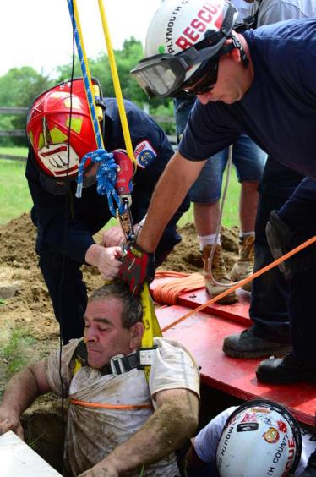
Fall hazards are present at most worksites.
“A fall hazard is anything at your worksite that could cause you to lose your balance or lose bodily support and result in a fall.”
Any walking or working surface can be a potential fall hazard.
Fall Hazard Definition
Notes:
Work activity in photo: rescue from a Confine Space Entry of a tank.
Fall hazards occur in nearly all areas Onsite is performed, and on most of the equipment (scaffolds, ladders, heavy equipment, for example) used in our industry.
More often than not, the solution requires a combination of systems and well-trained employees – there is no “one size fits all” solution to fall protection.
One thing that is true – hazard recognition and awareness along with the correct equipment or procedures will minimize or eliminate the exposure– try to prevent the fall wherever possible. Simply “tying off” creates its own set of hazards.
Getting participation: Instructor can ask audience “what are the exposures here?” (note the position of the chest harness against the victims throat being rescued – is this a problem?, did the PPE not fit in the first place?)

Slide 44
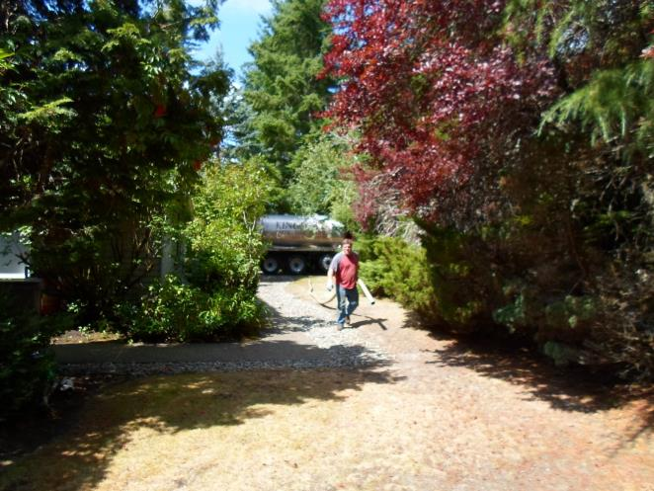
Fall Hazards – Basic Service
What are the exposures here?
What choices do you need to consider?
Notes:
The saying is that “complacency breeds contempt”.
Workers in the industry that have done this thousands of times, (exposing and digging out a tank access and lids) …tripping/slipping on surface may result in a fall and a broken wrist but can also happen lugging heavy sections of hose. Asking the learners about body position and (summer) foot wear will generate some discussion.
The next several slides introduce the “same old” task, but with changing conditions of weather.
Discussion points for the slide:
Clear weather
Flat ground
Two walking surfaces
Footwear (boot year round are appropriate, not tennis shoes)
Consideration of changes in weather, season, topography

Slide 45
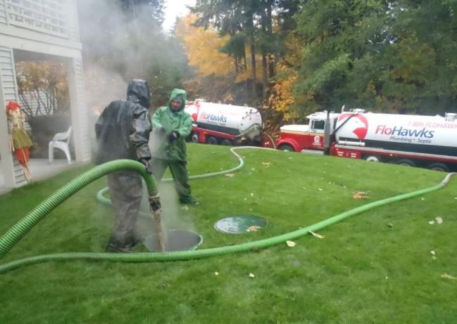
Fall Hazards – Basic Service
What are the exposures here?
Same Basic Job, but what changed?
What choices do you need to consider?
Notes:
Discussion points for the slide:
Rainy weather
Slope
Walking surfaces (long wet grass)
Footwear
Consideration of changes in weather, season, topography

Slide 46
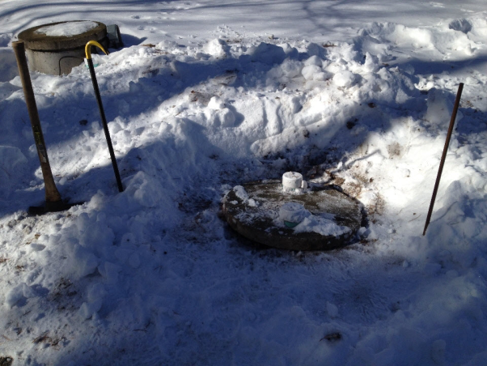
Fall Hazards – Basic Service
When Conditions Change…
What are the exposures here?
What choices do you need to consider?
Notes:
Snow, and changing conditions….tripping/slipping on surface may result in a fall and a broken wrist, but note that a full Septic tank generates heat and when the insulating layers of snow are removed, the conditions may change immediately at the tank lid….the next task on this wet slippery surface is to lift a 75lb lid and move it to the side. Asking the learners about body position and type of foot wear will generate some discussion. Encourage discussion: Slipping and then falling into the tank is the worst case scenario.
Critical thinking skills: A key point to emphasize in this task is that while the work task hasn’t appreciably changed, the conditions have….this will be in contrast in upcoming slides to the thought process that will explore when the tasks are essentially the same, but the worksite is different….and then goes on to discussion when both elements are in play.

Slide 47
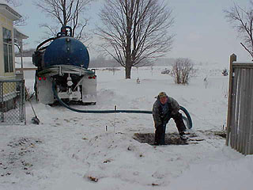
Fall Hazards – Basic Service
When Conditions Change…
What are the exposures here?
What choices do you need to consider?
Notes:
See comments on previous slide….add to the conditions: Person working alone – falls into tank. In addition to the fall is the potential for engulfment and/or drowning.

Slide 48
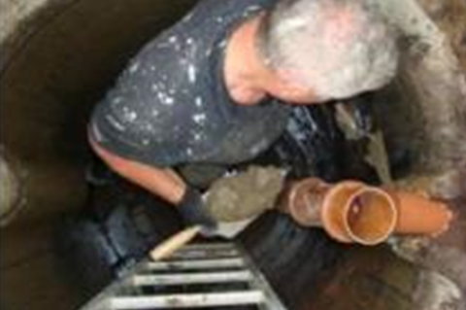
Fall Hazards – Operations and Maintenance
Fall hazards on equipment your installing or repairing, may present exposures.
What are some things that could cause a fall in this situation?
Notes:
Activity: Baffle Repair
This is a common occurrence…
The Instructor can work through this scenario as an exercise, capture comments on a flip chart, or directly engage the participants in an active problem solving scenario. The experience of the group that have “been there” and “done that” should emerge pretty quickly, and the discussion will benefit the participants with practical solutions of shared experience.
To put it in context to the participants, some key points to recognize if offered from the discussion:
Limited work space
no three point contact
no harness or retrieval (CSE violation) method.
Work toward identifying things they man not see in the picture, but likely exist in their work experience: Is it a wet environment? Are the ladder rungs often wet? What kind of footwear would be an appropriate choice to prevent slipping and falling off the ladder? Would a harness connected to the ladder be a good idea? If so, would the ladder need to be rated to the OSHA ladder standards?

Slide 49
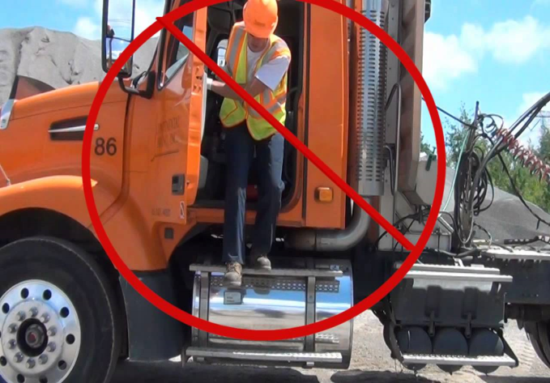
Fall Hazards - Equipment
Getting in and out of service vehicles, trucks present fall hazards.
Different equipment present additional hazards due to weather, wet conditions and accumulation of dirt, oil and grease on contact surfaces.
Notes:
Activity: entry and exiting vehicles or equipment
Fall hazards are present when working on or moving from elevated surfaces. Pump Truck operators are in and out of their trucks numerous times a day. Excavator operators are the same, but the contact surface are not under a standard like vehicles are. Three point contact at all times is the best way to avoid these kinds of accidents. Comment to time of year, weather conditions and time of day (low light). It will be addressed again later in the “struck by” section of the presentation, but it may be worth while to recognize the issue of traffic and traffic controls (note the reflective vest in the picture).

Slide 50
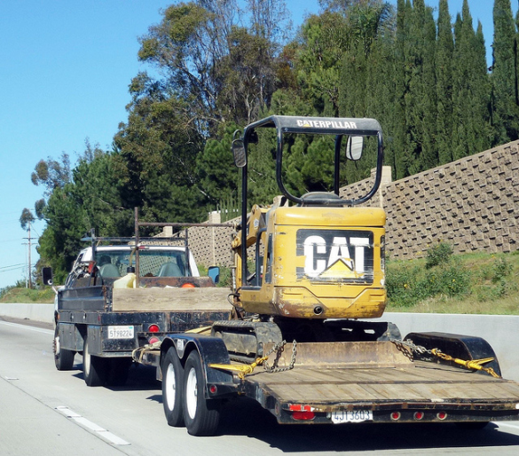
Fall Hazards - Equipment
Getting up and down off of equipment trailers, trucks present fall hazards.
Different equipment present additional hazards due to weather, wet conditions and accumulation of dirt, oil and grease on contact surfaces.
Select offloading area to minimize exposure
Notes:
Activity: Transporting equipment
Fall hazards after slips, trips climbing on and off equipment may increase when a solid three point contact cannot be accomplished. Potential for ankle, knee and back injuries exist when jumping off of P/U tailgates, flatbeds, etc.. “Staging areas” are rarely defined on our industry Onsite sites, so it is dependent on the contractor to select level, flat ground for loading and offloading equipment when possible. Depending on what the piece is, additional consideration is made for close work in residential areas and overhead wires (electrical) exposures.

Slide 51
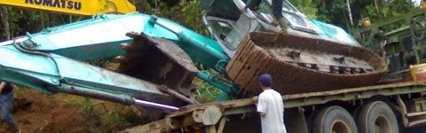
Fall Hazards – Equipment
What could possibly go wrong?
Notes:
Activity: Transporting equipment
Accidents happen….in the heat of the moment, safe decision making needs to be maintained or even intensified. You can make a bad situation worse….The person climbing on an unstable, unsecured load is at great risk. The worker standing at the tail of the flat bed: 1 – Doesn’t need to be there, 2 – is at risk from a serious “struck by” event by standing in the “line of fire” of the Komatsu in the picture that appears to be either trying to stabilize the tipped excavator or in the effort to “right” the excavator, will try to lift and/or swing the boom to the right and reposition the other piece of equipment….

Slide 52
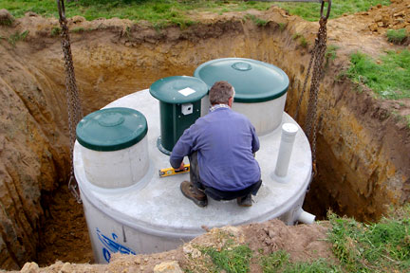
Fall Hazards - Excavations
What are the obvious exposures?
Can you name two others?
What could be done differently?
Notes:
Activity: Tank Installations
Fall hazards exposures on equipment your installing may present new exposures. Working in and around septic tanks in our industry can also combine to multiply the exposure. Stepping across and down onto this tank is easy enough, but what is different when the worker now tries to get out? What changes if it is wet/raining/snowing/cold and the ground surrounding the excavation is unstable or saturated? Are there any “struck by” potentials here? (chains connected to a spreader bar)
Solutions requires a combination of approaches and well-trained employees – there is no “one size fits all” solution to fall protection.
Try to eliminate fall potentials whenever possible, but when you can’t, take a minute or two and pay attention to what could happen.

Slide 53
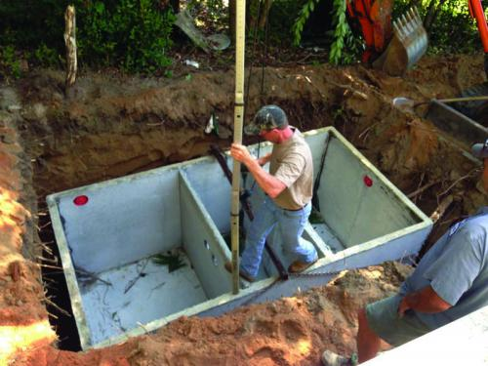
Fall Hazards - Installations
Is this a good idea?
What changes when the worker now tries to get out?
What changes if it is wet/raining snowing or just heavy frost?
Notes:
Activity: Installation and leveling of septic tank.
Installation of septic tanks in our industry can also combine to multiply the exposure. Stepping across and down onto this tank is easy enough, but what is different when the worker now tries to get out?
What changes if it is wet/raining/snowing/cold and the ground surrounding the excavation is open to becoming a fall along with being caught in/or between? Does the potential of the severity of the accident increase?
The Instructor can work through this scenario as an exercise, capture comments on a flip chart, or directly engage the participants in an active problem solving scenario. The experience of the group that have “been there” and “done that” should emerge pretty quickly, and the discussion will benefit the participants with practical solutions of shared experience.

Slide 54
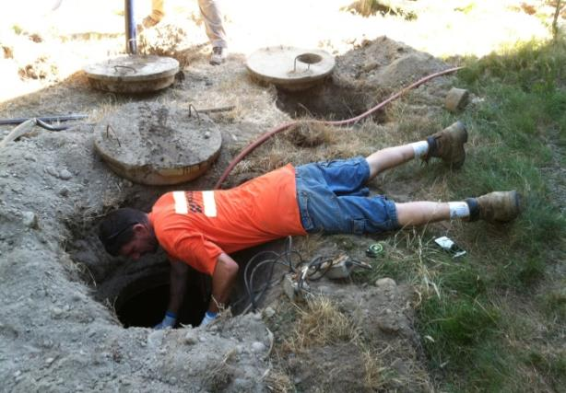
Fall Hazards – Repairs
Being aware of body position for different work tasks can help prevent putting yourself into situations that can be deadly.
If you fall headfirst into a septic tank what the least that will happen to you?
The worst…?
Notes:
Activity: Repair or maintenance
Falling hazards not only include “falling from”, “falling down” but “falling in”. Worker body position and balance contribute to the likelihood of a fall event for any variety of reasons. If it can happen it likely will happen sooner or later. Industry has examples of workers falling head first into system tank components and getting stuck upside down for several hours!
If a hand slips, if the worker overly extends his reach the likely result will be a fall inside the tank. This picture also represents some other safety issues that the Instructor may or may not want to bring into the presentation at this point. (Confined space entry violations)
The Worst? Drowning upside down in the contents of a septic tank…what could be worse than that?...broken neck quadriplegic, long term illness from aspirating grossly contaminated raw human waste? There’s nothing good in this picture…
Another concept to introduce to the class: Behavioral – Positive reinforcement for negative behaviors – the idea of repeatedly doing inappropriate “at risk” tasks and then nothing “bad” happens, results in justification tactics by the worker or employer to continue to approach work tasks with little perception to the real risks.

Slide 55
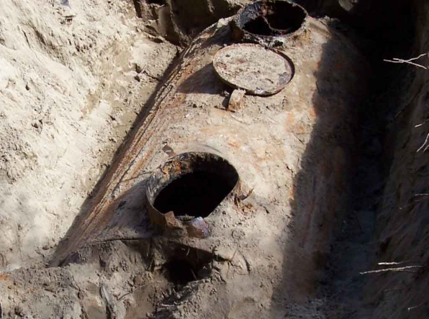
Fall Hazards – Repairs
Identify this hazard ahead of time with Record Documents.
Know the age of system
Look for depressions around tank location
Approach cautiously
Notes:
Activity: Inspection/component failure
Across the country there are hundreds of THOUSANDS single wall steel tanks that were installed in the last 75 years. You could order them out of the Sears and Roebuck catalog and have them delivered. In typical configurations, the top 12’-20’ of the tank would not see water, but would see all of the sewer gasses and resulting oxidation and rusting of the steel from the gasses converting to acid (low pH) and breaking down the tank from the inside. Shallow installs, ground probing present not only very real hazards, but very invisible ones (buried).
When a worker breaks through the surface and fall into one of these tanks, the injury is compounded by “struck by” cuts and abrasions followed by immersion in raw human waste…and all that means. Post accident infections can be severe and difficult to treat, if you don’t drown outright.
The frequency of this situation will vary from location to location around the country based on local and state regulations and how they address replacement requirements on these tanks when discovered. Some states and local health jurisdictions (Washington State), replacement are mandatory when they are identified.

Slide 56
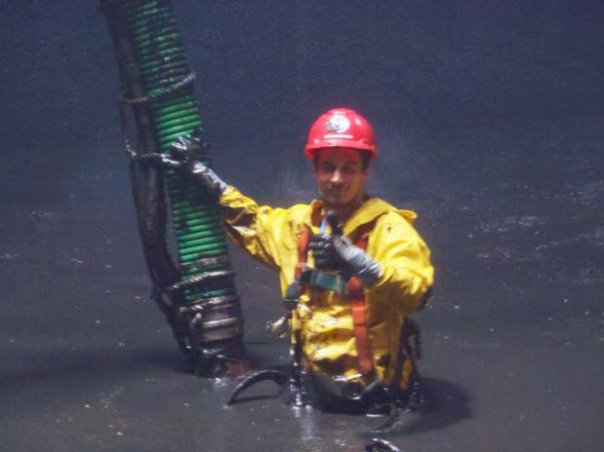
Fall Hazards – Other
When work site changes…
Situational awareness?
What choices do you need to consider?
Notes:
Activity: Pumping out a Sludge Digester
This slide presents an opportunity to shift the discussion to work tasks that are done on system components and maintenance that is upscale in scope as well as put the “fall” exposure into a different perspective.
This picture is of a worker pumping out a large scale “digester” and put the Focus Four Exposures into a different context. When the work changes, the exposures are essentially the same. But some of the auxiliary exposures (like slipping and falling under the surface) are exponentially increased along with the potential severity (drowning, inability to rescue).
While CSE regulations allow for an employee to disconnect from non-entry self rescue equipment in circumstances where it would be more dangerous to be connected (internal structure), steps need to be taken to mitigate the risk. Simply “tying off” creates its own set of hazards.
Instructor can challenge participants to think through what would be the best PPE here? Waders? Life jacket? Some other kind of flotation device?
Highlight on “fit for use”….

Slide 57
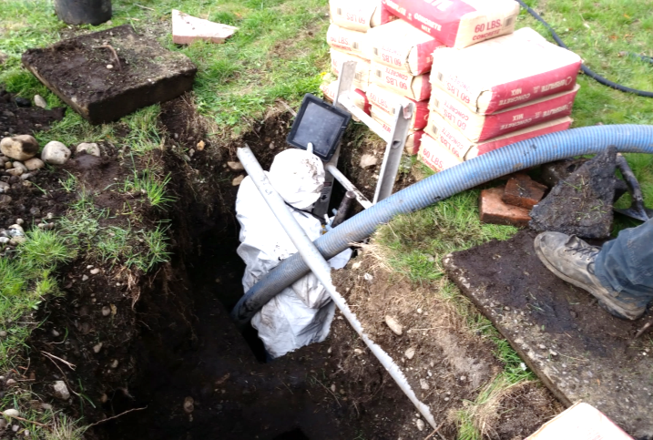
Fall Hazards – Confined Space Entry
When work tasks change…
What are the rules here?
Situational Awareness?
Notes:
Activity: CSE (Confined Space Entry) Cracked Floor Tank repair (2 compartment)
Fall hazards occur in nearly all areas Onsite is performed, and on most of the equipment (ladders, heavy equipment, for example) used in our industry.
As the work becomes more complicated (tank repairs in place) the solution requires a combination of systems and well-trained employees – there is no “one size fits all” solution to fall protection.
One thing that is true – an ounce of prevention is worth a pound of cure – Generally the understanding for compliance under CSE (confined space entry) rules, complicate the Focus Four Falls application and exposures.

Slide 58
Employer Responsibilities
Develop a written fall protection plan.
Identify potential fall hazards prior to each project and during daily walk-arounds. Pay attention to hazards associated with routine and non-routine tasks.
Eliminate the need for fall protection where possible by rescheduling the task, isolating the task or changing the task.
Notes:
This slide outlines the basic employer responsibilities of an OSHA or state approved Fall Protection Program

Slide 59
Employer Responsibilities
Ensure that fall protection equipment is appropriate to the task, in good condition and used properly.
Conduct general fall prevention training on a regular basis.
Train workers on the specific fall hazards identified and on the required personal protective equipment.
Conduct regular inspections of fall protection equipment in accordance with the manufacturer’s recommendations and OSHA’ requirements.
Notes:
This slide outlines the basic employer responsibilities of an OSHA or state approved Fall Protection Program

Slide 60
Worker Responsibilities
Understand your company’s written fall prevention plan.
Attend and participate in fall prevention training.
Use fall protection equipment if required. Assure it is right for the task, fits properly and is in good condition.
Inspect fall protection equipment and devices before each use.
Make sure that tank access holes are protected or secured at the worksite.
Notes:
This slide outlines the basic employee responsibilities of an OSHA or state approved Fall Protection Program

Slide 61
Worker Responsibilities
Choose the correct ladder for the task, read the instructions and be sure that the ladder is in good condition. Check for surrounding hazards, stable footing and the proper angle.
Contact your supervisor if you see fall hazards or have any questions about fall prevention. Do not work until unsafe conditions have been corrected.
Notes:
This slide outlines the basic employee responsibilities of an OSHA or state approved Fall Protection Program

Slide 62
Activity
  Write Down Two Fall Exposures That You Have In Your Workplace
  Write Down a Fall That Happened to You in Your Workplace.
  Write Down What You Recommend To Minimize or Prevent Them.
Notes:
The Instructor, using the appropriate sheet in the workbook handout, should set up this activity and give the participant 3-5 minutes to identify the first three things that come to their mind and write them down in their handout. The next step will be to give them 3-5 minutes to write down how they will minimize them.
Next step is to break them into small groups and have them share the answers and discuss. 5-10 minutes
Appropriate answers to minimize the exposure include: Find another way to do it that eliminates the exposure, Use appropriate PPE (may be specific: harness and tripod, hardhat, footwear), Eyes on task, Not walking backward, Only open component lids that are being worked on, etc.), Training.
An alternate to the activity would be to have them do the first step and then break into teams and problem solve together and use the combined experience of the small group to share experience.

Slide 63
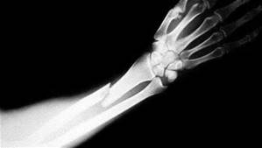
Struck-by
Notes:
Introduction to Struck-by Topic

Slide 64
Primary Causes of Struck-by Fatalities
Flying Objects
  Equipment failure under tension
Falling Objects
  Rigging Failure
  Loose or Shifting Materials
  Equipment tipping over or Malfunction
  Lack of Overhead Protection
Vehicle and Equipment Strikes
  Backing Incidents
  Workers on Foot
Notes:
Examples include: rigging equipment on concrete septic/pump tanks delivered to the jobsite, loose material adjacent to tank excavations without spoil piles being at least 2’ back from edge during placement. Hard hats (PPE) not worn or available, jobsite equipment and traffic (note to comment on jobsites with multiple activities and different subcontractors). Jetter hoses pre-emptively coming out of pipes and swinging around uncontrolled.
It is important to make comment on not only the field activity, but to include some discussion on storage and shop workspaces. Ensuring that shelving is secured and adequate for load carrying (pipe, pump’s, concrete bags, valves, power equipment, welders, cutting tools and grinders are all included in workplace evaluations.
Instructor should call for examples from the audience that are specific to the industry. Availability and use of a “Flip Chart” would be useful to capture comments and ideas. When each segment activity (Septic Feud) is going on, reference back to the flip chart list will reinforce the groups feedback and participation.
Struck By:
13- Equipment, excavator, tools
10- Pipe (materials)
09- Trees/loose branches (soil logs, woods)
08- Loose hoses/ hoses under pressure (pumper, jetter)
06- Release of chain tension on loads

Slide 65
Top Struck-By Citations
Head Protection
Eye and face protection
Criteria for PPE (Subpart B – Power Transmission and Distribution)
Material Handling Equipment
Concrete & Masonry
Citation statistics from Federal OSHA data for OSHA fiscal year 2005
Notes:
This slide can be informational to point out that all of these exposures have an enforceable compliance rule associated with them in addition to any specific examples that may be called out.
All elements of this slide have a corollary in the Onsite industry workplace and can be discussed.

Slide 66
Struck-By Hazards – Definition
“Struck-by” Hazards are produced by forcible contact or impact between the injured person and an object or piece of equipment.
Notes:
Introduction to “Struck by Hazards” and definition.
Instructor can call out the obvious (ladder), but also excavation and engulfment potential (minimum 2’ setback on spoils from excavation edge) and the lack of personal PPE (hard hat) by the worker.
Introduction of themes: Carelessness? Lack of knowledge? Lack of Training? Lack of Procedures?

Slide 67
Struck By Accident
10/26/2014 Age: 32 Fatal? No
Struck by: Maintenance worker was using a right angle grinder with a cut off wheel to cut a 1 1/4 inch square tube made of mild steel. The grinder apparently walked up the steel and kicked back cutting the workers right forearm 6 to 7 inches.
Worker had surgery to repair veins and arm. Worker was hospitalized overnight.
He was transferred to OHSU on 10/28/14 to evaluate repair and blood flow to arm.
Notes:
From Oregon OSH 2014 report: http://www.orosha.org/standards/fatals/pdf/descriptions/acc_fatal_cal-yr14.pdf

Slide 68
Struck-By Hazards – Root Cause Analysis
What are the core issues involved?
Method
Management
Material
People
Measurement
Machine
Notes:
Fault tree analysis unwinds the knot until you can clearly understand what the root cause is.

Slide 69
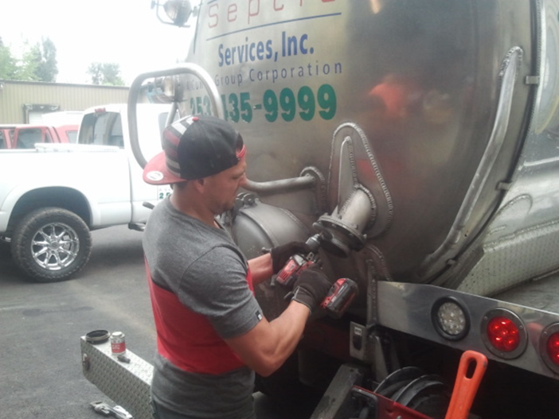
Struck-By Hazards- Hand Tools
Exposures:
Impact to the face and eyes
Root Cause?
“Line of Fire”
Alternatives?
Notes:
Activity: Pump truck vehicle maintenance:
This worker is using a steel brush on a male aluminum threaded 3” nipple.
Exposures are: debris in the face and eye’s from the breakdown of the wire brush and pressure on the threads (heat).
PPE: none
Additional exposures include aerosolized dust and debris from the activity. Swab testing of the male nipple and threads yielded pathogen contamination that was also an exposure added to the dust and material breakdown of the wire brush.
When asking participants what the “root cause” of an accident in this scenario would be, answers like “lack of safety glasses” is a partial answer another might be the worker in the “Line of fire”.
The real root cause is the method: The task of cleaning up the threads is pretty simple here. Could it be done differently ie: a hand held wire brush instead of a power tool?
The pipe threads will be dressed with some kind of thread tape or pipe dope to prevent leaking, and the time to clean it to service ability would be nominal.
The objective with discussion and feedback is to begin to get the participants thinking about the safest way to approach a work task, not the fastest or easiest or cheapest or “that’s the way we’ve always done it”.

Slide 70
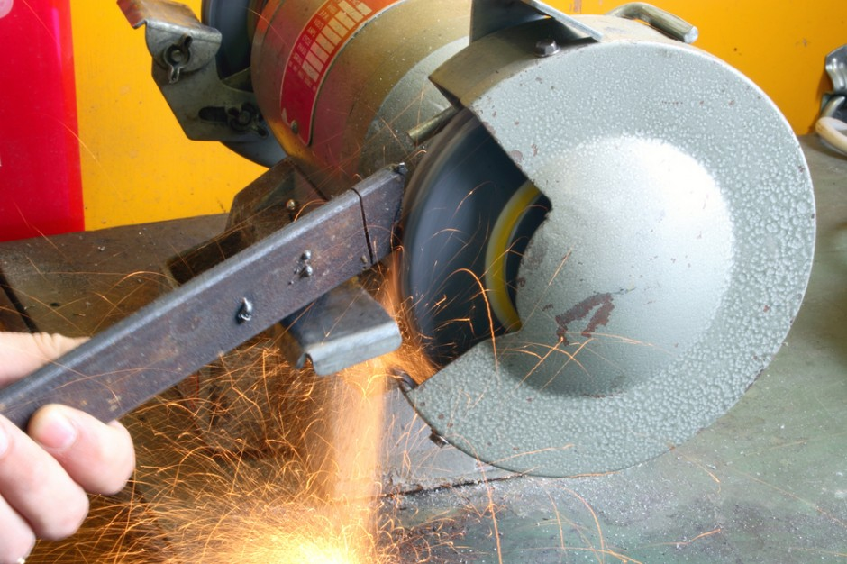
Struck-By Hazards – Abrasive Wheel Machinery
Notes:
Introduction of themes:
Lack of Maintenance (safety guard removed)?
Lack of knowledge?
Lack of Training?
Lack of Procedures?
Root cause? – May be any of the above, but if an accident occurred due to the disintegration of the grinding wheel the “ Line of fire, (no situational awareness)” by side loading the wheel by the metal being worked on.
This slide also sets the stage for a brief discussion on the level of detail that OSHA rule goes to.
It is demonstrated by asking the participants what the “Minimum stand-off distance of the grinding platform to the wheel” is.

Slide 71
Struck-By Hazards – Abrasive Wheel Machinery
1910.215(a)(4) Work rests.
On offhand grinding machines, work rests shall be used to support the work. They shall be of rigid construction and designed to be adjustable to compensate for wheel wear.
Notes:
Code reference – reminder that there are rules in place

Slide 72
Struck-By Hazards – Abrasive Wheel Machinery
1910.215(a)(4)
Work rests shall be kept adjusted closely to the wheel with a maximum opening of one-eighth inch to prevent the work from being jammed between the wheel and the rest, which may cause wheel breakage.
The work rest shall be securely clamped after each adjustment. The adjustment shall not be made with the wheel in motion.
Notes:
Code reference – reminder that there are rules in place

Slide 73
Struck-By Hazards
Exposures?
Bodily injury from being struck by the object being cut or grinded.
Eye injuries from flying debris (for example, chips, metal particles, or a wheel that disintegrates).
Hearing damage from excessive noise while grinding.
Respiratory issues from inhaling dust.
Notes:
A properly conducted JSA (job safety analysis) would identify these key issues

Slide 74
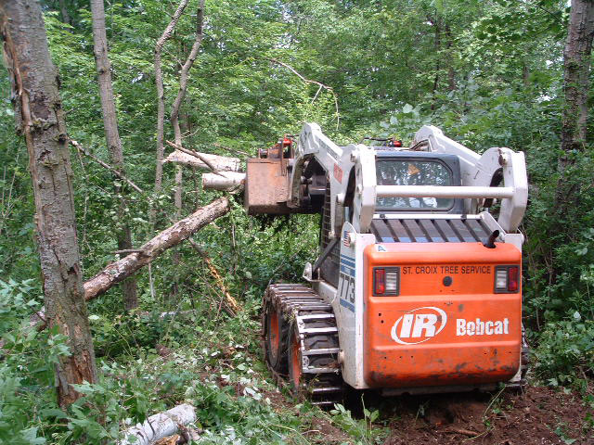
Struck-By Hazards- Brush Clearing for Soil Logs
Exposures:
Impact to the face, eyes and body
Root Cause?
“Line of Fire”
Alternatives?
Notes:
Activity: Brush Clearing:
When asking participants what the “root cause” of an accident in this scenario would be, answers like “situational awareness” is at least part of the answer (site awareness)/evaluation).
The root cause is the worker if an accident occurred would be being in the “Line of fire”.
The task of cleaning brush is pretty simple here.
Awareness and experience on the learning curve contribute to minimizing the exposure. Recognizing “widow makers” or dead fall’s and the stored energy of vegetative species like “vine maple” that don’t break but bend and load before they break helps.
The objective with discussion and feedback is to begin to get the participants thinking about the safest way to approach a work task, not the fastest or easiest or cheapest or “that’s the way we’ve always done it”.
Situational awareness beyond the reach of the equipment is important.

Slide 75
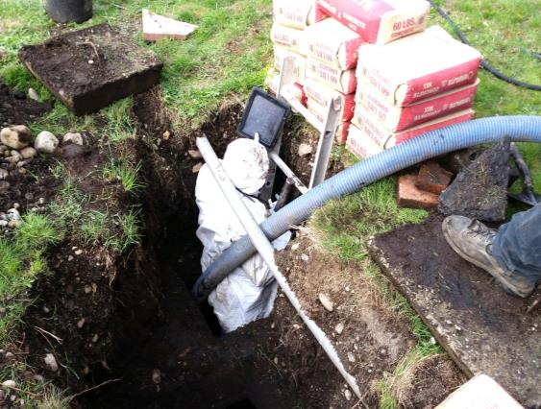
Struck-By Hazards – Confined Space Entry
Exposures:
Falling objects
Root Cause?
“Line of Fire”
Alternatives to reducing the exposure?
Notes:
This work scenario was seen in the previous section, and is here again to reinforce how the severity of an accident is multiplied when more than one element of the Focus Four comes into play.
Exposures are: Struck by; Rock and dirt falling in on the worker (once he is down inside the tank) from his helper kicking things in, excavation of material off of tank inadequate, and made worse by the point loading of approximately 15 bags (900lbs) of cement, which would also fall in and onto the worker if the underlying dirt failed….resulting in a fall potential.
Note to the discussion of changes: This is the common practice so as to minimize handling. Saturated soils from rain or a failed system and sewage on ground could further erode the stability of the underlying materials that the cement bags are stacked on.
PPE: No Hard hat
Additional exposures include aerosolized dust when cutting the bags and dumping them into the tank bottom to effect the repair
This slide has simple animation for the Instructor. It builds on the earlier discussion of root cause analysis and will lays some groundwork for discussion on individual responsibility for safety.

Slide 76
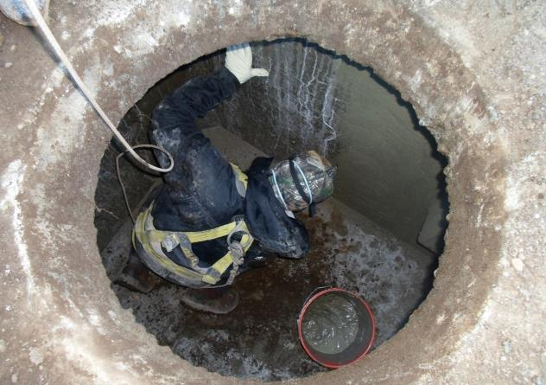
Struck By Hazards
Identify the hazards for the worker in this picture.
Name ONE thing that would help protect him.
Notes:
Similar discussion as previous slide
The result is an increase of the “struck by” Focus Four exposures by workers trying to accommodate their customer demands.
Answers:
Tools dropped or kicked in from above
Materials from the excavation (rocks, dirt, etc.)
Hard hat
Attendant monitoring the area above the CSE entrance
Barrier protection around the entrance (serving the same purpose as a kick plate on an elevated surface in a shop)

Slide 77
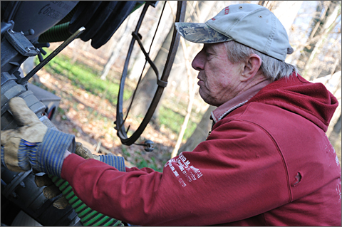
Struck By Hazards
What is the root cause of the “Struck By” accident that is about to happen?
Line of Fire
Notes:
The term “baptism by sewage” is common in the industry, and a relatively common experience that can be demonstrated by a show of hands of participants with O&M service providers in the audience.
Situational awareness (not double checking to ensure that valves are closed, and dog-ears locked in position)
Rushing
Both are contributing to an event potential.
The instructor can engage those who raise their hands to the question with both or either:
What happened?
What do you do differently?

Slide 78
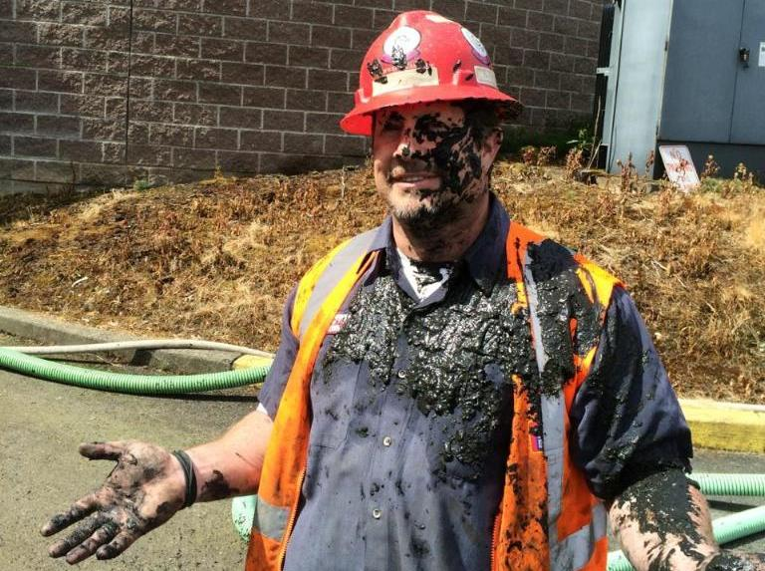
Muddy Wrker
Notes:
Instructor:
While not the same worker in the last picture, this is a real life situation that is common.
Ask participants Root Cause:
(line of fire), and…probably some combination of other elements of Root Cause: Eyes not on task, Rushing,
Was it preventable? How?
If it was, How?
The worker had a suction line going into a digester that started leaking due to friction on the side of the access and hose surging. When he shut off the pump and disconnected the hose to replace it, he didn’t ensure that the hose had “de-energized” the residual pressure in the hose resulting in the bath.
Root cause is really a lack of recognition of the stored energy by an experienced worker and lack of recognition to use a LO/TO protocol to ensure a safe repair procedure.
Since the hose was already leaking (relieving pressure), all he had to do was wait and observe the hose to see when the energy was relieved….line of fire.

Slide 79
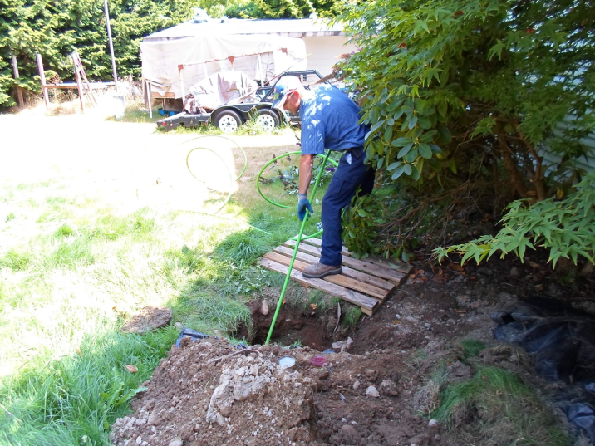
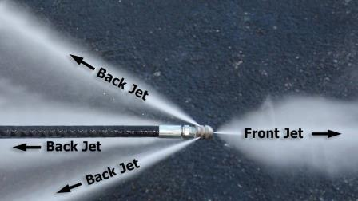
Struck-By Hazards
How does this turn into an accident?
Notes:
High pressure water hoses can cut off body parts when control is lost,
When used in drainfield for cleaning drainfield legs, getting hit with the jetter hose end whipping around if it is pulled out.
Instructor:
Ask group how a “struck by” accident happens.
Ask group (show of hands) how many have had a jetter hose “get away from them”?
Ask them how this might be avoided (turning off jetter before it comes out of pipe).
It is common to mark the jetter hose with some indicator approx. 8’ (feet) back from the tip that can be identified to indicate when to shut off pressure.
A subsequent struck by incident by this company that ended up with a live hose strike and injection of water into the workers chest cavity was caused by a disconnect in communication by the maintenance department that had cut off several feet of hose and didn’t understand the field practice of using electrical tape to indicate the 8’ mark. The repaired hose, with tape now at 5-6’ was pulled out by the employee as normal, but with the shortened length, the hose came out prematurely striking the worker under the armpit in the chest area.

Slide 80
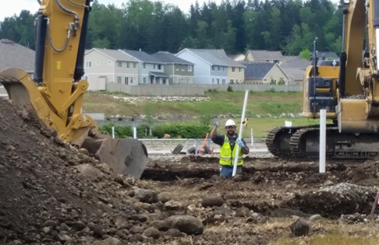
Struck-By Hazards
What are the exposures here?
Not a deep enough excavation to worry about.
Line of fire??
Extra care with multiple pieces of equipment
Notes:
Instructor can engauge participants to identify what is right and what is needed in this work area.
Level ground, decent weather, communication with operator in left hand of picture, no overhead exposures, but, operator in the excavator behind the stick man, cannot see him if he is also digging (see loaded bucket).
Situational awareness by the ground man needs to be very high.

Slide 81
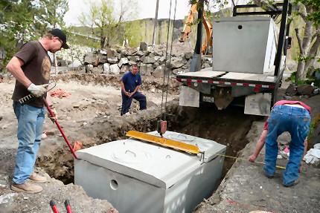
Struck-By Hazards
What’s right about this tank drop?
No one is in the line of fire
No one is the hole
Notes:
Instructor can ask participants to point out good practice and at risk practice.
Good practice includes:
No one inside of the tank excavation
Hazards include:
Delivery truck very close to excavation – what is done different under different soils conditions, saturating rain, etc.
Importantly, the tank service company has a requirement to register and inspect its lifting cables on an appropriate frequency.
Do we think this is commonly done in industry?

Slide 82
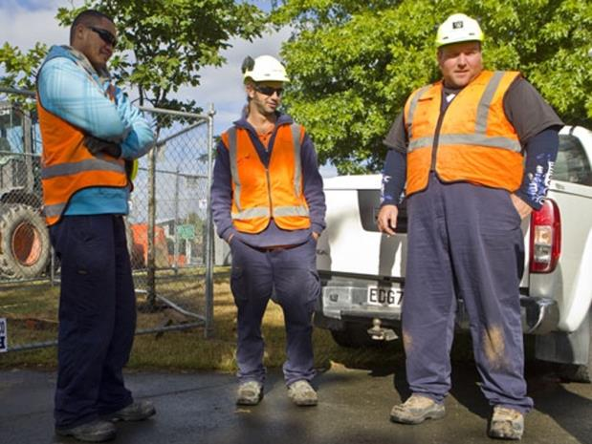
Struck-By Hazards – Traffic Controls
When is reflective gear required?
Guidance Manual on Uniform Traffic Control Devices (MUTCD)
This is what you look like to each other
Notes:
All workers near active traffic, in high rights-of-way, working around moving Onsite equipment or in areas where visibility is limited should wear high visibility clothing.
Clothing should include reflective stripes.
You should refer to the Manual on Uniform Traffic Control Devices (MUTCD) for further guidance.

Slide 83
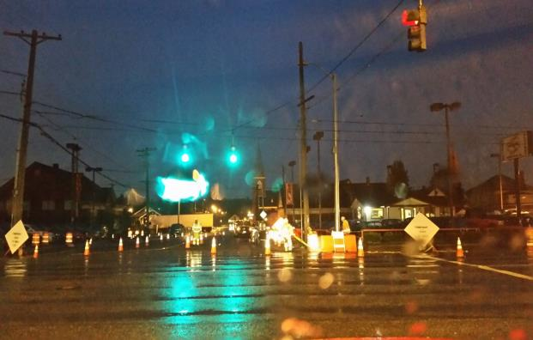
Struck-By Hazards – Traffic Controls
This is what you look like to a driver at 20mph coming off an intersection.
What if the driver is reaching for their coffee?
What if the driver is texting?
Notes:
All workers near active traffic, in high rights-of-way, working around moving Onsite equipment or in areas where visibility is limited should wear high visibility clothing.
Clothing should include reflective stripes.
Highlight the importance of personal responsibility and SITUATIONAL AWARENESS.
You may rely buy cannot depend on your traffic controller (sign holder – “Slow”) to protect you.
Keep an eye on the time of day…workflow traffic through the intersection/area. This picture was taken at approx. 7:20AM in early December.
Know sunrise/sunset times
Have communication set up with other workers if you must turn your back on traffic.
You should refer to the Manual on Uniform Traffic Control Devices (MUTCD) for further guidance.
Refer to the Dept. of Transportation http://safety.fhwa.dot.gov/wz/

Slide 84
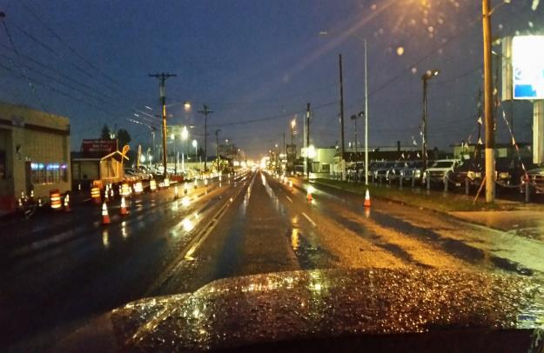
Struck-By Hazards – Traffic Controls
This is what you look like to a driver in low light.
What missing?
Traffic signage
Speed change
Lane change
Notes:
All workers near active traffic, in high rights-of-way, working around moving Onsite equipment or in areas where visibility is limited should wear high visibility clothing.
Low light
Winter
Rain
Road conditions poor
Ice/freezing conditions
Dependence on vehicle operator awareness
7:15 AM traffic commute
5:30 PM traffic commute
Refer to the Manual on Uniform Traffic Control Devices (MUTCD) for further guidance.
Refer to the Dept. of Transportation http://safety.fhwa.dot.gov/wz/

Slide 85
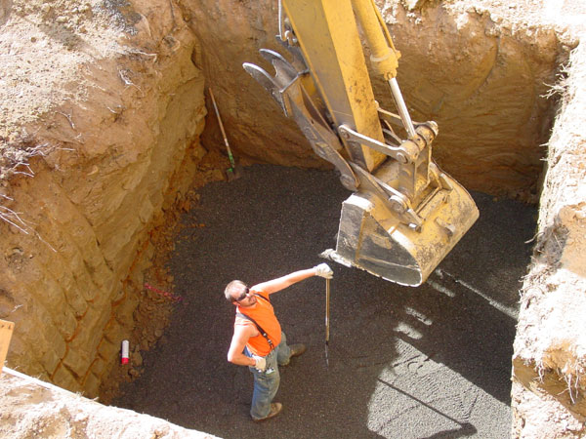
Struck-By Hazards
Exposures?
Debris from surface
Hit by bucket
No way out???
Notes:
Instructor can ask class to identify exposures:
Excess material in bucket, in swing radius of bucket with no eye contact with operator, engulfment with no protection in excavation and a hard hat would be a good idea.
This scenario also violate the excavation/CSE standards with no means of egress.

Slide 86
Struck-By Hazards – Engulfment
Exposures?
Material from above
Equipment
Ladder
Root Cause?
Notes:
Instructor can call out the obvious (ladder), but also excavation and engulfment potential (minimum 2’ setback on spoils from excavation edge) and the lack of personal PPE (hard hat) by the worker.
Introduction of themes: Carelessness? Lack of knowledge? Lack of Training? Lack of Procedures? Is this the business owner or a worker?
If the owner, what kind of example is he setting for his employee’s when he is not on the project?
Root cause? – Line of fire, (no situational awareness or understanding of the exposure)

Slide 87
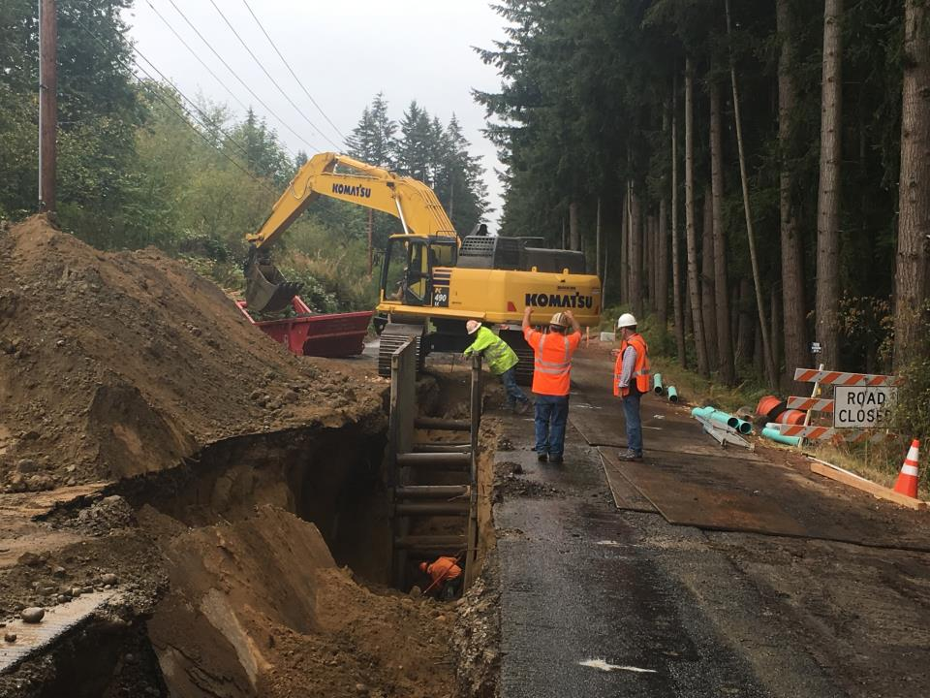
Struck-By Hazards – Engulfment
Exposures?
Material from above
Equipment
Ladder
Root Cause?
Notes:
Work Activity: This is a utility project taken on by a construction company that normally installs OSS and the scope of work is outside of the companies experience.
2,100 feet of sewer pipe laid at an average depth of 22 feet in the roadway in sand.
Instructor should ask for what is right and wrong in the picture to help participants evaluate exposures.
Is the “competent person” onsite making changes to the workflow appropriately?
Clearly the continued caving of ground from spoil pile loading is excessive.
The worker in the excavation does not have a means of egress per the code (note the ladder to the right of the picture.)

Slide 88
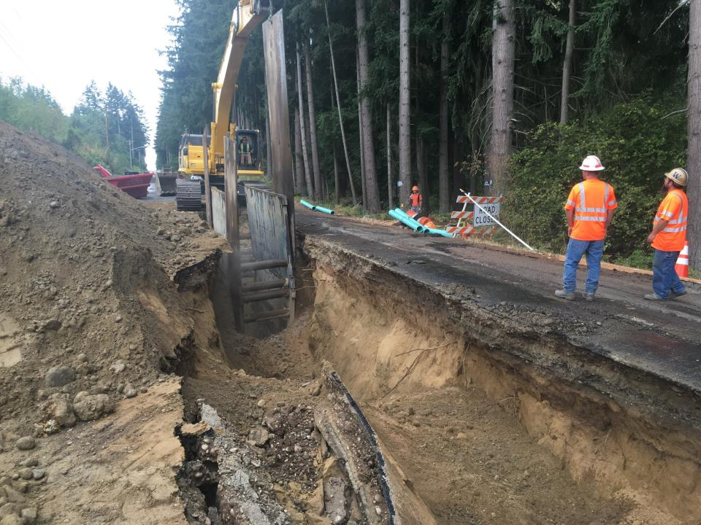
Struck-By Hazards – Engulfment
Exposures?
Material from above
Equipment
Ladder
Root Cause?
Notes:
Instructor can call out the obvious (ladder), but also excavation and engulfment potential (minimum 2’ setback on spoils from excavation edge) and the lack of personal PPE (hard hat) by the worker.
The additional sheets of steel were pounded into place to allow movement of the trench boxes forward.
Instructor should engage the participants to gauge their understanding of excavation and trench requirements under the rule to prevent exposures to engulfment.

Slide 89
Activity
  Write Down Two “Struck By” Exposures That You Have In Your Workplace
  Write Down a “Struck By” That Happened to You in Your Workplace.
  Write Down What You Recommend To Minimize or Prevent Them.
Notes:
The Instructor should set up this activity and give the participant 3-5 minutes to identify the first three things that come to their mind and write them down in their handout. The next step will be to give them 3-5 minutes to write down how they will minimize them.
Last step is to break them into small groups and have them share the answers and discuss. 5-10 minutes
Appropriate answers to minimize the exposure include: Find another way to do it that eliminates the exposure, Use appropriate PPE (may be specific: harness and tripod, hardhat, footwear), Eyes on task, Not walking backward, Only open component lids that are being worked on, etc.), Training.
An alternate to the activity would be to have them do the first step and then break into teams and problem solve together and use the combined experience of the small group to share experience.

Slide 90

Caught-In or Between Hazards
Notes:
Introduction to Caught in/between slide (placeholder, looking for a better graphic)

Slide 91
Caught-In or Between Hazards
According to OSHA, caught-in or -between hazards are defined as:
Injuries resulting from a person being:
Squeezed
Caught or Crushed,
Pinched, or compressed between two or more objects, or between parts of an object.
Notes:
Definition of caught-in or between hazards.

Slide 92
Major Types of Caught-In or Between Hazards
Buried In or By
Pinned Between
Unguarded Parts
Notes:
Examples would include drainfield Onsite, tank excavations, soil logs, unstable ground (wet), soil type for equipment (track vs. rubber tire), skid steers (high center of gravity), greasing equipment (excavators, hydraulics), sewage, grinder pumps. Unsecured shelving in a shop with heavy material or inventory on it.
Instructor should call for examples from the audience that are specific to the industry. Availability and use of a “Flip Chart” would be useful to capture comments and ideas. When each segment activity (Septic Feud) is going on, reference back to the flip chart list will reinforce the groups feedback and participation.

Slide 93
Primary Causes of Caught-In or Between Fatalities
Tank installations
Rotating Equipment
Unguarded Parts
Equipment Rollovers
Equipment Maintenance
Tools
Notes:
Examples would include drainfield Onsite, tank excavations, soil logs, unstable ground (wet), soil type for equipment (track vs. rubber tire), skid steers (high center of gravity), greasing equipment (excavators, hydraulics), sewage, grinder pumps. Unsecured shelving in a shop with heavy material or inventory on it.
Instructor should call for examples from the audience that are specific to the industry. Availability and use of a “Flip Chart” would be useful to capture comments and ideas. When each segment activity (Septic Feud) is going on, reference back to the flip chart list will reinforce the groups feedback and participation.

Slide 94
Caught-In or Between Hazards
The key difference between a Caught event and a Struck event is whether the impact of the object alone caused the injury.
When the impact alone creates the injury, the event should be recorded as Struck. When the injury is created more as a result of crushing injuries between objects, the
event should be recorded as Caught.
Notes:
Refines the definition to clarify the difference between this and struck by hazards

Slide 95
Top Caught-In or Between Citations
Excavations - General Requirements
Excavations – Protective Systems
Wood Working Equipment
Hand and Power Tools
Citation statistics from Federal OSHA data for OSHA fiscal year 2005
Notes:
This slide can be informational to point out that all of these exposures have an enforceable compliance rule associated with them in addition to any specific examples that may be called out.
All elements of this slide except for wood working equipment, have a corollary in the Onsite industry workplace and can be discussed.

Slide 96
Root Cause Analysis - Activity
Caught In/Between– Engulfment
What is the Problem?
Root Causes?
Method
Management
Material
People (man)
Measurement
Machine
Notes:
Instructor can speak to the change in group progress in application of the method and based on the participants performance continue to develop the critical thinking skills when used.

Slide 97
Organizing the Information
What are the core issues involved?
Method
Management
Material
People
Measurement
Machine
Notes:
The victim in the video blames his decision on pressure, but it is more likely that behavioral issue are more at play.
In the initial comments, he see’s himself as a “risk taker” …”hard jobs, steep slopes, we love them!”
In his view, it is what differentiates himself and his company from his competition.
Risk acceptance is fine in a business model, but you also are obligated to ensure that you and your company has the proper training, skills, equipment and willingness to operate appropriately in these work environments.
The instructor should look for examples in small groups that have accurately identified these issues and highlight them to all participants.

Slide 98
How a Fatality Investigation works
2010 – Small Business Fatality – HVAC firm (LLC) was cited for 42 safety and health violations after starting and investigation of a worker fatality when he was crushed by a large steel frame weighing approximately 1,500 lbs.
Penalties assessed: ????
$ 127,200
Notes:
Activity: Understanding the value in proactive vs reactive approaches to workplace safety and management.

Slide 99
How a Fatality Investigation works
Findings: One “Serious” safety violations related to the fatality
“Failing to exercise caution or planning when moving heavy, unstable loads in a vertical position”
Notes:
This is the agencies findings. Root cause method would characterize this as methods and procedures.

Slide 100
How a Fatality Investigation works
Findings: 29 “Other Serious” safety violations related to the workplace.
Equipment lacking
  Seatbelts
  Guards
  Lifting equipment not fit for use
  Electrical exposures/no LO/TO procedures
  Lack of training
Notes:
This is the agencies findings. Root cause method would characterize this as methods and procedures.

Slide 101
How a Fatality Investigation works
Findings: 7 “Less than Serious” safety violations related to the workplace.
Failing to notify the agency within 8 hours
Improperly stored flammables
Fire extinguishers not checked monthly/annually
Daily inspections of fork lifts not done
Labeling of liquefied propane gas cylinders not done or labeling to identify the hazardous nature of the chemical
Notes:
The finding on the investigation continue. In relation to the root cause analysis, several of these would be causal and several (flammables storage and fire extinguishers) unrelated to the actual fatality but indicative to the safety (or lack of) culture in the small business.

Slide 102
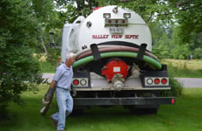
Caught-In or Between Hazards
Have audible back-up alarms
Have a spotter to direct the operator if visibility is restricted
Keep adequate clearance behind the vehicle
Always pay attention to backing equipment
Notes:
Instructor Notes:
Pump truck operators will run with 1 or 2 men depending on the job and the company policy. When there are two employee’s, it is common for one to act as a spotter or guide to the driver backing in to the site. Virtually always at a very low speed, it is still critical for the spotter to always maintain line of sight contact with the driver and maintain enough spacing between the spotter and the vehicle to allow for an exit in the event of a slip, trip or fall. It will take the driver a moment to react, make a determination to stop or just look in the other mirror, anticipating the spotter has moved to the other side of the vehicle.

Slide 103
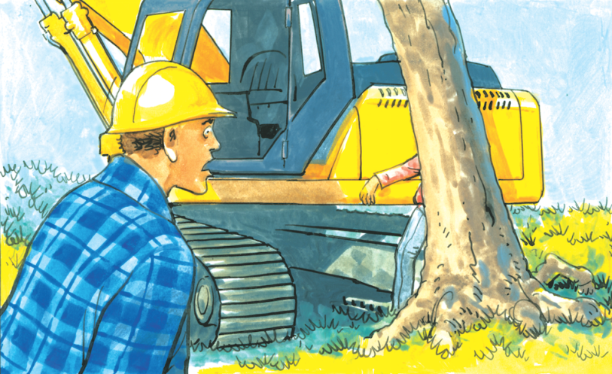
Caught-In or Between Hazards
Notes:
Introduction to potential fatalities based on excavation equipment on site

Slide 104

Caught-In or Between Hazards
Workers under equipment that is insufficiently supported
Notes:
Instructor can have the participants work through the worst practice of this vehicle maintenance.
Obviously, NEVER work under equipment supported only by jacks or their own hydraulics.
All equipment must be properly shut down, parking brakes set and be adequately blocked before maintenance workers can work around or under equipment.
A discussion on worker behavior and risk recognition and situational awareness would be beneficial.

Slide 105

Caught-In or Between Hazards
Trailer secure and on a level surface
Inspect the deck for debris, blocking or chains
Be sure equipment is properly secured
Notes:
Instructor can ask participants if they think this equipment load out is good/bad and offer feedback.
Risks to accidents include many tip-overs occur during the loading or unloading of equipment.
Equipment can also slide off trailers or loading ramps.

Slide 106

Image Backhoe
Notes:
Level ground, decent weather, equipment available that can more than handle the load, no overhead exposures, opera...tor can see worker well….as good a set up as you can get.
Instructor can ask participants what they would change.
Key observations include:
If lifting devices (chains) are rated?
Is the excavator set properly for the pick?
Could the worker on the ground have an exposure based on his position?

Slide 107

Caught-In or Between Hazards
What could possibly go wrong?
Notes:
Instructor can lead participants through this discussion…the slide is animated for the first and third bullet point…and the NO! and Yes! Animations will guide the presentation of the analysis of the situation.
Will an action to prevent one Focus Four exposure, lead to the unintended consequence of exposing the worker to another of the Focus Four exposures?
Ie: if the operator cannot stabilize the equipment for whatever reason, and the helper cables or chains the equipment to something else (see photo with cable off to the right out of picture). Is what he is connecting it to able to actually accomplish the need to act as an anchor?
What is the weight rating of the cable/chain used and what is the load being put on the safety line? Is there a real possibility that it could part and then strike the operator or anyone in the swing radius creating a “struck by” fatality (no hardhat on observer).
If one “underrated or unknown” cable/chain is attached, will two unknowns make any difference?
When exiting the equipment, do you evaluate getting the operator off without injury by a fall or jumping?
Is this an “eye’s not on path” or a “eyes not on task” accident? (both)

Slide 108
Caught-In or Between Hazards
What do you want to do when this happens?
Stabilize the equipment with the boom and bucket?
Does the operator have an injury or death exposure?
What do you need to consider?...Others?
Notes:
Discussion continues

Slide 109

Caught-In or Between Hazards
When delivering tanks what do you need to consider?
Soft Ground
Delivery Angle
Guiding the tank to line up
Notes:
Instructor should discuss: Soil conditions, Soil type, ground saturation, recent weather (rain/snow), High water tables can all contribute to this kind of hazard. Add to that two or three men on the edges of the excavation trying to guide the delivery into the hole and line it up with other pipes, center and level it.

Slide 110

Caught-In or Between Hazards
What are the exposures here?
Tight working area
Who’s in the “”Line of fire??
Communication is tough with worker behind tank
No one is in the line of fire.
Notes:
Activity: Tank install
Experienced workers need to paying extra attention in this situation with tight spaces. Delivery driver operating remote can see only one of the workers. Line of sight communication is lacking and presents a very real Caught in or Between fatality potential. The mass of the tank and the speed of the remote controls are hard to stop and hard to reverse.

Slide 111
Caught-In or Between Hazards
In some tank installations, it is necessary to get the mastic down to seal and in place.
This is a high risk activity the way it is being done.
How could it be done differently?
Notes:
Discussion slide:
Depending on the group make up and size, the Instructor could pose this as an interactive discussion question or break the group into smaller groups and have them do a full analysis of the work task and other workspace considerations and exposures (excavation/engulfment/egress) and report to the group how they would minimize the exposure and do it differently.

Slide 112

Caught-In or Between Hazards
Slings must be inspected before each use
Slings should have tags that indicate capacities
Notes:
Discussion slide:
All nylon and chain slings must have legible tags.
Riggers must understand wire rope sling capacities.
All riggers must know how to inspect slings and properly rigged loads.
Depending on the use of the previous slide for an activity, the Instructor should note to the group and discuss the variation in “slings” on tank delivery trucks and the requirements, inspection and maintenance elements required by the company delivering the tanks.

Slide 113

Caught-In or Between Hazards
Notes:
Discussion slide:
Engulfment issues, is this normal practice for the employer? Would the workers still do it this way if it was raining, or ground saturated?
Message: Workers should never be in this situation

Slide 114

Caught-In or Between Hazards
This worker is out of the driver’s mirror view
This is an example of poor personal responsibility and situational awareness by the worker
Notes:
Discussion slide:
Workers should never get into blind spots of operators and should never get between pieces of equipment unless the equipment is secured.
Instructor can also bring back into the discussion worker behaviors that lead to this exposure: Complacency, Lack of Training, Low situational awareness, new hire?

Slide 115
Caught-In or Between Hazards
1/27/2014 Age: 33 Fatal? No
EMPLOYEE GOT HIS LEFT ARM CAUGHT ON A SHAFT AND BROKE IT:
Employee was working underneath a rotating shaft caught his clothes on the shaft and twisted his arm up breaking it.
Notes:
From Oregon OSH 2014 report: http://www.orosha.org/standards/fatals/pdf/descriptions/acc_fatal_cal-yr14.pdf
Instructor option:
Use the root cause analysis to work through the assessment in small groups or in general class.

Slide 116
Organizing the Information
What are the core issues involved?
Method
Management
Material
People
Measurement
Machine
Notes:
Fault tree analysis unwinds the knot until you can clearly understand what the root cause is.

Slide 117

Caught-In or Between Hazards
This picture represents a graphic published from a Local Health Jurisdiction to represent a soil “test pit” for evaluation of the disposal component.
Does it meet the trench excavation requirements?
Notes:
Instructor discussion:
Does it meet the OSHA trench excavation requirements?
Short answer is no…the Instructor can entertain discussion on why it’s used and why it’s out of compliance to gauge the participant knowledge of trench safety under OSHA and OSHA approved state plan.
It is important to keep in mind that this configuration’s intent is to evaluate soil and determine soil type for a disposal component. It has literally nothing to do with excavation or trench requirements for safety under the rule

Slide 118

Caught-In or Between Hazards
Simple Slope
All simple slope excavations 20 feet or less in depth shall have a maximum allowable slope of 1 ½:1
Figure N-11
Simple Configurations
for Type C Soil
Notes:
Instructor discussion:
Use the root cause analysis to work through the assessment in small groups or in general class.
This would be the crossover to excavation/trench requirements for a typical soil log excavation. Depending on location, local or state health code, these excavations can be left open for extended periods of time (weeks, months and worst case years), depending on the development schedule of the property.
This is a very real and an extreme hazard not only for the workers immediately involved, but for the general public. It is an engulfment (or as previously discussed in Falls), a potential drowning hazard.

Slide 119
Caught-In or Between Hazards
Soil weighs about 100 – 140 lb/cu.ft.
Each foot of depth adds more pressure side pressure
Once the pressure exceeds the ability of the soil to support itself, failure is possible
120
120
120
120
120
Notes:
Instructor discussion:
Discuss the weight of soil.
It only takes a small amount such as 1 cu.ft. to cause a serious injury.
2 cu.ft. (200 lbs) can be enough to heavily restrict a buried victim’s ability to breathe.

Slide 120
Basic Requirements CFR 1926.650-654
Caught-In or Between Hazards
Work must be supervised by a “Competent Person”
Protection is required over 5 feet deep or if there is a possibility of a cave-in
Excavations must be inspected daily and/or with changes
Access/Egress is required over 4 feet deep
A rescue plan must be in place
Notes:
Instructors should review OSHA’s complete excavation standard and be ready to discuss various issues noted in slide.

Slide 121

Trench Shields or Boxes
Caught-In or Between Hazards
Engineered for Type C soils
Can be used with all classes of soils
Shields can be moved horizontally with workers inside
Worker must stay inside shields
Notes:
Instructor discussion:
Trench shields are commonly used for pipe installation work.
When used properly, shields can be much safer, effective and cheaper than sloping methods.
A minimum of two shields should always be available to extend the work area or to help work through intersecting utilities.
Trench boxes must be at least 18" above the ground.

Slide 122

Do not do
Notes:
Instructor discussion:
Trench boxes should not be installed less than the excavation

Slide 123

Image
Notes:
Instructor discussion:
Ask the participants to identify the hazards.

Slide 124

Barricade Requirements of Excavations
Caught-In or Between Hazards
Excavations must be barricaded or marked if they are not readily visible
Notes:
Instructor discussion:
Under the trench rule, inspection, and barricading (protection) is the responsibility of the contractor that created the excavation.
The method is left to the user, but it must be effective.

Slide 125

Rescue Capability
Caught-In or Between Hazards
A rescue plan must be in place
Rescue of a buried worker is a slow and tedious process
Notes:
Instructor discussion:
Most local fire departments are not fully trained or equipped to perform excavation rescue operations.
Excavation rescue must be done extremely carefully as the operations themselves can:
cause additional cave-ins, endangering both the trapped victim and rescuers
create more soil pressure on a buried victim
injure the victim more severely.

Slide 126


Electrocution
Notes:
Introduction to Focus Four Electrocution slide

Slide 127
Primary Causes of Electrocution Fatalities - OSHA
Contact with Overhead Powerlines
Contact with unmarked buried Powerlines
Contact with Live Circuits in Panels
Poorly Maintained Cords and Tools
Lightning Strikes
Notes:
All relative to the Onsite industry. Examples include: Excavators in both new Onsite and existing Onsite during repairs of OSS (onsight systems). Tight working spaces, and un-marked subsurface electrical out of the right of way.
Note to Instructor: Comment on site awareness for outbuildings (shops, garages) that have power and looking for unmarked sources. Non-licensed installation, replacement or modification in the industry is quite common as is DIY homeowner electrical extensions to out buildings.
It is also important to note that there is a high probability that prior, and subsequent maintenance activities on electrical components (pumps, floats, alarms and control panel) may have been installed by OSS certified by non licensed individuals for electrical work.
Most field activities and hand tools today have transitioned to battery operated equipment, but depending on the installation (new Onsite site w/o power) it would not be uncommon to see corded hand tools operating from an extension cord and run off of a generator….in the rain. Use of corded tools in shops would benefit from regular inspection.
Lightning strikes would be rare, and the majority of work is done outside, but paying attention to weather would be preventative.
Instructor should call for examples from the audience that are specific to the industry. Availability and use of a “Flip Chart” would be useful to capture comments and ideas. When each segment activity (Septic Feud) is going on, reference back to the flip chart list will reinforce the groups feedback and participation.

Slide 128
Top Electrical Citations
Electrical, Wiring Design and Protection
Elec. Wiring Methods, Components and Equipment, General Use
Electrical, General Requirements
Electrical, Safety-Related Work Practices, General Requirements
Citation statistics from Federal OSHA data for OSHA fiscal year 2005
Notes:
This slide is informational to point out that all of these exposures have an enforceable compliance rule associated with them in addition to any specific examples that may be called out.
All elements of this slide have a corollary in the Onsite industry workplace and can be discussed.

Slide 129
Definition of Electrocution
Electrocution results when a person is exposed to a lethal amount of electrical energy.
An electrical hazard can be defined as a serious workplace hazard that exposes workers to the following:
  Burns
  Electrocution
  Shock
  Arc Flash/Arc Blast
  Fire
  Explosion
Notes:
BESAFE is the acronym highlighted in bold. Most of the electrical exposures are 110 volts and generally do not exceed 220v in the majority of applications.
Burns to the hands/fingers in OSS components with contact in: Control panels, Alarm panels, Junction boxes in/on risers, Float controls and pumps. Additional exposures that are common are found in the shop and other workplaces with typical building and corded electrical tools.

Slide 130
Burns - Definitions
An electrical burn is a burn that results from electricity passing through the body causing rapid injury.
Electrical burns differ from thermal or chemical burns in that they often cause more subdermal damage.
They can exclusively cause surface damage, but more often tissues deeper underneath the skin have been severely damaged.
Electrical burns are difficult to accurately diagnose, and many people underestimate the severity of their burn.
Notes:
BESAFE is the acronym highlighted in bold. Most of the electrical exposures are 110 volts and generally do not exceed 220v in the majority of applications.
Burns to the hands/fingers in OSS components with contact in: Control panels, Alarm panels, Junction boxes in/on risers, Float controls and pumps. Additional exposures that are common are found in the shop and other workplaces with typical building and corded electrical tools.

Slide 131

Risk of Electrocution
Voltages greater than 50 V across dry unbroken human skin may cause heart fibrillation with electric currents in body tissue that happen to pass through the chest area.
Living human tissue can be protected from damage by the insulating characteristics of dry skin up to around 50 volts. If the skin is wet, that all changes.
Notes:
Instructor discussion continues

Slide 132
Primary Exposure to Electrocution Hazards in Onsite?
What are some specific examples in the Onsite industry?
Unlicensed Installation of Control Panels
Unlicensed Installation and Replacement of Floats
Unlicensed Installation and Replacement of Pumps
Lack of access to Fuse Panels and Controls for LO/TO on a service call
Notes:
Unique electrical exposure to the Onsite Industry: Unlicensed work by industry service providers and contractors is the single greatest exposure to injury and potential fatalities for the Focus Four Electrocution exposure.
Un-isolated energy sources and working on hot components or not ensuring that all energy has been isolated with LO/TO procedures presents a huge risk to workers.
This issue is exacerbated by the fact that service industry workers that work on these systems, post installation have additional exposure to an exceptionally high frequency of electrical work that was initially done by unlicensed electricians.
Another frequent complaint in the industry (and part of the “justification tactics” to go off the reservation) is the lack of knowledge by licensed electricians on wiring the controls for these engineered systems vs. their experience with residential or commercial frame wiring for lights, utilities, HVAC and appliances.
Lightning strikes would be rare, and the majority of work is done outside, but paying attention to weather would be preventative.
Instructor should call for examples from the audience that are specific to the industry. Availability and use of a “Flip Chart” would be useful to capture comments and ideas. When each segment activity (Septic Feud) is going on, reference back to the flip chart list will reinforce the groups feedback and participation.

Slide 133

Electrical Hazards
Electrical wiring Diagrams can be helpful when diagnosing systems!
Good?
Better?
Best?
Notes:
Instructor discussion:
Electrical diagrams if available at all can look like this or worse. Wiring done by unlicensed contractors and/or homeowners, not inspected to code, can present a unique risk.
More complicated systems, and wiring schemes complicate the issue for troubleshooting by unlicensed OSS inspectors/Pumpers/Installers.

Slide 134
Electrical Death Root Cause Exercise
BRIEF DESCRIPTION OF ACCIDENT One employee was climbing a metal ladder to hand an electric drill to the journeyman installer on a scaffold about five feet above him. When the victim reached the third rung from the bottom of the ladder he received an electric shock that killed him.
Notes:
Instructor discussion:
Review with the class the results of their thinking on the root causes of the fatality. If the group is broken into smaller discussion groups, have each of them share the results of their thinking and likely causes.

Slide 135
Organizing the Information
What are the core issues involved?
Method
Management
Material
People (Man)
Measurement
Machine
Notes:
Fault tree analysis unwinds the knot until you can clearly understand what the root cause is.

Slide 136
Electrical Death Root Cause Exercise
17 year old worker
Apprentice
Time on Job – 1 month
Safety Program: Partial
Training: Some
Worksite Inspected Regularly - No
Notes:
Instructor discussion:
Explain the Exercise and have them use the Root Cause analysis worksheet in the participant guide.

Slide 137
Electrical Death Investigation Results
The investigation revealed that the extension cord had a missing grounding prong and that a conductor on the green grounding wire was making intermittent contact with the energizing black wire thereby energizing the entire length of the grounding wire and the drill's frame. The drill was not double insulated.
Notes:
Investigation root causes indicate unsuitable tools in the workplace (maintenance) and modification to the plug…speculation on a personal tool migrating to the workplace.
In our industry, this is common. In upcoming slides the focus of this discussion will be emphasized by the Instructor.
Workers/Owners should evaluate all their tools that can/may be used around electrical components and consider removing and replacement with like tools that are electrical rated.
Ie: Screwdrivers, battery operated drill sets, knives, side cutter’s, any types of pliers (needle nose, etc.)

Slide 138
As a result of its investigation, OSHA issued citations for violations of construction standards.
1. Use approved ground fault circuit interrupters or an assured equipment grounding conductor program to protect employees on construction sites [29 CFR 1926.404(b)(1)].
2. Use equipment that provides a permanent and continuous path from circuits, equipment, structures, conduit or enclosures to ground [29 CFR 1926.404(d)(6)].
3. Inspect electrical tools and equipment daily and remove damaged or defective equipment from use until it is repaired [29 CFR 1926.404(b)(iii)(c)].
Notes:
Instructor should point out the specificity of the rule to these types of incidents. A key point is that these rules, evolved over time (since the 70’s) due primarily to a response to serious of fatal injuries.

Slide 139




Electrical Hazards
Notes:
Lots of features, lots of functions…pressure time dosing 4-12 time per day, Mounds, Sand Filters, Glen-Don, Drip, micro-dosing a hundred times a day, etc.
Virtually all of the pump and control panels available for managing time dosing and flows from the source facility provide wiring schematics. After installation, these are typically found tucked away in the actual control box or in many cases, have a waterproof applique’ with wiring schematics attached to the inside door for pumps, floats and other controls (alarms).
Several but not all control manufacturer’s have “intrinsically safe” protections designed into the electrical control panel. It is important to know which ones do and which ones don’t if you’re going to troubleshoot the system.
Control panels can be a LO/TO point that reliably isolates energy to field components, but given the actual practice in the field, always check at the component to ensure it is not energized.

Slide 140

Electrocution Hazards
Ensure isolation of energy on new installations and existing OSS components.
On Repairs or Installation of electrical components make sure to use proper LO/TO measures.
If access is limited is there somewhere else can you can isolate the energy?
Notes:
The primary protection against the hazards of working with electricity is to de-energize circuits wherever possible.
This work should be performed by trained, qualified personnel who have been provided with the appropriate personal protective equipment.
Once the circuit has been de-energized, it should be tested to ensure that no electrical energy remains.
The Instructor should familiarize themselves with local and state rule. Some states, like Missouri at the time of this writing (11/24/16) had no state licensing requirements and electrical licensing requirements were limited to some of the larger cities.
This exacerbates the electrical exposure issues in the OSS industry dramatically.

Slide 141

Electrocution Hazards Fire
TRUST but VERIFY!
Before work begins, always double check to make sure the circuit is off with appropriate testing equipment.
Notes:
The primary protection against the hazards of working with electricity is to de-energize circuits wherever possible.
This work should be performed by trained, qualified personnel who have been provided with the appropriate personal protective equipment.
Once the circuit has been de-energized, it should be tested to ensure that no electrical energy remains.

Slide 142

Electric Shock
Electric shock is the physiological reaction or injury caused by electric current passing through the body.
It occurs upon contact of a body part with any source of electricity that causes a sufficient current through the skin, muscles, or hair.
Notes:
Most of the electrical applications in OSS are 110 volts and generally do not exceed 220v in the majority of applications, but they do exist in larger systems, multiple pump arrangements.
Voltages greater than 50 V applied across dry unbroken human skin can cause heart fibrillations if they produce electric currents in body tissues that happen to pass through the chest area. The voltage at which there is the danger of increases depending on the conductivity of dry human skin. Living human tissue can be protected from damage by the insulating characteristics of dry skin up to around 50 volts. If the same skin becomes wet, if there are wounds, then even voltage sources below 40 V can be lethal

Slide 143
Electrical Harm
PATH: Harm is related to the path by which current passes through the body.
Notes:
Instructor should describe how even small levels of amperage can cause serious injuries by affecting the electrical system of the body and affecting the heart rhythm.
Critical information is to relate to the participants the relationship of Volts and Amps on the chart and the severity of the injury up to and including a fatality. It is noted that virtually all of the voltages that the OSS industry work with are in the last category of 15/20 amps

Slide 144

Protecting Yourself From Electrical Hazards
Most electrical accidents result from one of the following factors:
Unsafe equipment or installation
Unsafe work area
Unsafe work practices
Notes:
The primary protection against the hazards of working with electricity is to de-energize circuits wherever possible.
This work should be performed by trained, qualified personnel who have been provided with the appropriate personal protective equipment.
Once the circuit has been isolated, it should be tested to ensure that no electrical energy remains.
This licensed electrician’s job was to test the pump function in the tank he was standing in. The tank had approximately 18 inches of water in the bottom and he was standing on some 6 (unstable work surface) inch piping above the water.
Three factors colluded to create an unsafe situation. The installation of the panel was below his knees at floor level by a previous contractor, the area was under construction and had several electrical traces that were live. The worker made a decision of convenience due to his height at 6’2”.
Post evaluation of the work determined that all of the exposures could have been mitigated with a decision to not enter the tank, keep the entrance grate in place and cover with a rubber mat and finally for the worker to simply kneel down on the rubber mat to do his testing procedure.
The decisions that he made and put him at risk were simply a matter of convenience for him to be able to look into the panel. He couldn’t raise it, so he lowered himself!

Slide 145
Electrical Hazards PPE and Tools
What protection does personal equipment offer?
Employees who work directly with electricity should use the personal protective equipment required for the jobs.
Equipment may include rubber insulating gloves, hoods, sleeves, matting, blankets and industrial protective helmets designed to reduce electric shock hazard. All help reduce the risk of electrical accidents.
Notes:
PPE discussion
Proper selection of tools and the need for a procedure to inspect them regularly.
Instructor should engage participants on discussion of “fit for use” regarding most commonly used PPE in electrical work but also reinforce PPE selection as regards:
Nitrile Gloves
Safety Glasses, side shields
Use of dust masks in contaminated areas vs use of dust masks that are N-95 rated for protection against biologic hazards.
Tools (electrical)

Slide 146
Electrical Hazards PPE and Tools
Proper tools help protect workers against electric hazards.
It's important to maintain tools regularly to prevents them from deteriorating and becoming dangerous.
Check each tool before using it. If you find a defect, immediately remove it from service and tag it so no one will use it until it has been repaired or replaced.
When using a tool to handle energized conductors, check to make sure it is designed and constructed to withstand the voltages and stresses to which it has been exposed.
Notes:
PPE discussion
Proper selection of tools and the need for a procedure to inspect them regularly.

Slide 147

Electrical Hazards PPE and Tools
Notes:
Instructor can ask the group what’s in their tool kits….If you’re only going to have one set of these, which would it be?
In our industry, this is common. In upcoming slides the focus of this discussion will be emphasized by the Instructor.
Workers/Owners should evaluate all their tools that can/may be used around electrical components and consider removing and replacement with like tools that are electrical rated.
Ie: Screwdrivers, battery operated drill sets, knives, side cutter’s, any types of pliers (needle nose, etc.)

Slide 148
Employer Responsibilities
All employees should be trained to be thoroughly familiar with the safety procedures for their particular jobs.
When working on electrical equipment some basic procedures to follow are to:
De-energize the equipment and use lockout and tag procedures to ensure that the equipment remains de-energized.
Use insulating protective equipment, and maintain a safe distance from energized parts.
Use appropriately insulated tools for electrical work
Notes:
The primary protection against the hazards of working with electricity is:
This work should be performed by trained, qualified personnel who have been provided with the appropriate personal protective equipment.
To de-energize circuits and use LO/TO procedures appropriately.
Once the circuit has been isolated, it should be tested to ensure that no electrical energy remains.
Ensure that tool used are insulated and “fit for use”

Slide 149


Electrical Hazards - Inspection
Keep Poking….You’ll find that tank yet!!
Issues of electrical fires and failure of UV lights is well documented.
There is also the potential of electric shock from loose wire nuts or exposed conductors.
Notes:
Activity: OSS component locate with steel rod…Electrocution hazard
Instructor can bring discussion on these points:
Unknown wiring inside the property line to outbuildings may present a hazard. Homeowner may be able to provide information, but only if they are home to speak to the service person on site.
Identified power during the locate should be turned off at the source (control box) until the locate is complete.
Awareness, selection of a probe with insulated handle and gloves rated for electrical protection would be better choices.

Slide 150

Electrical Hazards - Inspection
Wiring like this must be protected in closed boxes
There is the potential of electric shock from loose wire nuts or exposed conductors
The hole in the bottom of the junction box is not really there to let water out!
Notes:
Electrical junction boxes for the floats is intended to be waterproof.
It is common (and even a joke often repeated), that you drill a hole in the bottom of the junction box to let the water out (assuming that the system will flood sooner or later).
When properly installed, with proper sized wiring, and lock nuts, they should perform as designed. Alternative installations put the junction box outside of the riser which presents a slightly different set of issues for access for service providers. Lot’s of opinions on “best practice” for installation and subsequent issues.
Proper wire nuts that are designed for harsh and wet environments (including sewer gas) are critical for proper installations. It is not uncommon for service providers to find these with household wire nuts and any variety of electrical tape which are not suitable for the environment and posing a hazard in the future.

Slide 151

Electrical Hazards – Installation – ARC Potential
Typically lasts less than a second
Has extremely high radiant (heat) energy.
Is explosive in nature (exerts great force).
Can ignite or melt conventional work clothing.
Notes:
With a relatively high turnover rate of both installation company employee’s (economy, seasonality), this basic information of a typical power pole configuration is relevant.
The instructor should ask the group what is the minimum standoff distance of equipment from overhead power lines.
The typical answer ranges from 6-8 feet…but the key learning point is that it “depends”. The operator needs to know what the power line wattage. Minimum is 10’ in most residential service applications. Additional distance is required if Kv increases.

Slide 152

Bolt meter
Notes:
Weather conditions can affect free air voltages (dry, windy)…
Consider it’s affect on stand off distance from power lines.

Slide 153

Electrical Hazards - Ensure Adequate Clearance
Install flag warnings at proper distances
If it is difficult for an operator to see the power lines, designate a spotter
If you cannot maintain adequate clearances, have the power company insulate, move or de-energize the line
Notes:
Instructor should discuss the various methods.
Also discuss the fact that it may take a power company several weeks to de-energize or move a line.
Therefore proper pre-planning is a MUST.

Slide 154

Electrical Hazards – Underground Powerlines
Notes:
Instructor should engage participants in a QA if O&M service providers are present.
This scenario presents a unique electrocution hazard. When access for pumper trucks that service OSS have limited line of sight, landscaping and restricted turn radius, it represents a scenario that has happened in our industry.
Temporarily parking in the street and doing a site walk around in these conditions may prevent an accident that will create an electrocution hazard for the operator and or property owner when they come out to ask how you knocked the power out in the house….if its been raining…the restricted area gets larger quickly depending on soil types and saturation levels.
The driver should stay in the vehicle if he suspects an impact with an electrical component and their vehicle and can make a determination of what was just hit.
They would then identify the hazards and PPE, Appropriate PPE (foot wear) for grounding or take appropriate steps to call for assistance.

Slide 155

Electrical Hazards – Underground Powerlines
Industry polls indicate that misidentified locates for utilities approach 25%
Arc Hazards increase and have damaged equipment and put operators at risk.
Stop! Assess the situation before you try to get off the equipment.
Jump clear – when getting off.
Notes:
Either in new or existing construction, this presents a unique electrocution hazard. Excavation activities during construction (new) can present a changing environment. Operators don’t always know if underground utilities have been installed. Temporary power is often established and the operator should have locate information if needed. Doing a site walk around in these conditions may prevent an accident that will create an electrocution hazard for the operator and or other contractor employees onsite….if its been raining…the restricted area gets larger quickly depending on soil types and saturation levels.
Temporary power sources should be inspected prior to work to understand any hazard conditions that exist.
The operator should stay in the vehicle if he can make a determination of what was just hit.
Identify the hazards and PPE: Appropriate PPE (foot wear) for grounding, training and procedures for exiting equipment in a hot zone.

Slide 156
If Contact Occurs
Stay on the machine if possible
Warn all others to stay away
Notify power company immediately
Attempt to move away but assure line is not “connected”
Notes:
Power distribution systems many times have storm trip circuits on them.
These are relays that will trip out for a period of time (Usually 3-30 seconds) to allow a faulted object such as a tree branch to fall away.
These relays will than reset and the line will be re-energized.
This may occur 2-3 times before a breaker actually trips and the power remains out until it is manually reset.

Slide 157

Bail Out Procedures
If you must get out, jump with your feet together
Do not touch the machine
Hop or shuffle out of the area
Notes:
Consensus in industry polling suggests that this is a last resort effort to get clear of the hazard. Worker decisions change when they are in a hazardous situation and working in remote locations (common in the OSS industry) and cell phone coverage is inadequate or non-existent. Pre-job activity planning should include hazard communication needs and arrangements for workers safety.

Slide 158
Summary
Since the inception of OSHA .
  Workplace Fatalities are down 60% +
  Illness and Injury are down 40%
  This also considers that the workforce in the U.S. has more than doubled in size!
Notes:
Discuss these steps to provide continuous improvement and the concept of a “virtuous circle” feedback loop for workers and employers to continue to identify workplace hazards, training needs and employer policy and procedures for safe work practices and appropriate PPE selection and use.
These rules are not in place to be a burden on employers, but have used past experience and fatality or serious injury investigation to put in place rules to help the employer and worker remain safe.

Slide 159
Summary
Source: CDC (NIOSH)
  Construction represents about 8% of the workforce, but….
  Construction accounts for 44% of the occupational fatalities
Notes:
Discuss these steps to provide continuous improvement and the concept of a “virtuous circle” feedback loop for workers and employers to continue to identify workplace hazards, training needs and employer policy and procedures for safe work practices and appropriate PPE selection and use.

Slide 160
Staying Incident Free
Planning
Re-evaluate
Training
PDCA Cycle
Plan
Do
Check
Act
Lessons Learned
Inspection
Oversight
Notes:
Discuss these steps to provide continuous improvement and the concept of a “virtuous circle” feedback loop for workers and employers to continue to identify workplace hazards, training needs and employer policy and procedures for safe work practices and appropriate PPE selection and use in context to risk assessment and mitigation.

Slide 161
Post Quiz #2
Notes:
Instructor should plan to provide participants time to complete this post quiz and review results with participants. Approximately 10-15 minutes plus discussion.

Slide 162

Summary
Focus Four Hazards are responsible for the majority of physical, financial, and emotional losses in Onsite — and they exist on nearly every jobsite.
Safety is everyone's responsibility — ALL of the time.
Notes:
Instructor should reinforce worker responsibility, hazard recognition and employer requirements under the OSH act. Final wrap up should end with answering any additional questions. The Instructor, depending on the use of this resource, and industry or training institution need, could also use this final slide as a participant polling tool to identify any additional exposures or hazards for inclusion into future revisions.

