Slide 1
Tower Climber
Fall Prevention Worker Training
Susan Harwood Grant # SH-27625-SH5
Notes:
The information used in the development of this lesson was taken from OSHA standards for general industry and construction. (§29CFR 1910 and §29CFR 1926).

Slide 2
Acknowledgement
This material was produced under a 2015 Susan Harwood Training Grant (SH-27625-SH5) from the Occupational Safety and Health Administration (OSHA), U.S. Department of Labor. It does not necessarily reflect the views or policies of the U.S. Department of Labor, nor does mention of trade names, commercial products, or organizations imply endorsement by the U.S. Government.
Notes:
Instructor to acknowledge that funding for the development of this training and delivery of the training was provided by the Department of Labor through a Susan Harwood Grant.

Slide 3
Class Organization
The class is organized into six sections. Each section is approximately 45 minutes in length. The following sections and topics are covered in this training:
  Section 1: Introduction
  Section 2: Climbing Techniques
  Section 3: Subpart M Fall Protection
  Section 4: Fall Protection Systems
  Section 5: Personal Protective & Life Saving Equipment
  Section 6: Tower Systems
  Section 7: Safety Plans

Slide 4
Course Objectives
By the end of the five-hour training session, students will be able to demonstrate either the knowledge, skill, or behavior change in the following areas:
  The knowledge and skill to identify various types of fall protection for the tower industry and their components.
  The knowledge and skill to recognize fall hazards and identify abatement methods for fall hazards.
  The knowledge and skill to define the proper use of fall protection equipment and personal fall arrest systems.
  The knowledge to select proper climbing paths.
  The knowledge of OSHA standards.
  The knowledge, skill and behavioral change to understand JSAs and Pre-climb check lists.
Notes:
Instructor may either brainstorm the course objectives through an ice breaker exercise whereby the students introduce themselves, where they work, what they do and finally to list at least one learning objective they have for themselves. The instructor will list each of these by student and then refine the list until he/she arrives at the 6 objectives.
Alternate method: Instructor to read the slide emphasizing the six objectives of the course.

Slide 5
Section1:
Introduction
By the end of this section students will understand the following:
  What is NATE?
  What does NATE do?
  What is OSHA?
  What does OSHA do?
  Why do we need Fall Protection training specific to the Communication Tower Industry?
  What are the class objectives?
Notes:
Unlike other construction industries, tower erection and maintenance has few hazards. Despite these limited hazards, the likelihood of an accident and severity of the accident, if it were to occur in Tower erection and maintenance, is high, and often yields catastrophic results.
This introduction is designed to teach students what hazards are encountered for Tower Climbers. They will also learn about the organization that represents the tower industry – The National Association of Tower Erectors (NATE) – and its functions.
Another important learning objective in this section includes learning about the Occupational Safety and Health Administration (OSHA), specifically: what it does, employee rights, and employer’s responsibilities to safeguard them from hazards associated with tower climbing. Students will learn which OSHA standards apply and why they need specific fall protection training for this industry.

Slide 6
Hazards of Tower Erection:
Below are the major hazards associated with Tower Climbing:
  Falls from great heights.
  Electrical hazards.
  Hazards associated with hoisting personnel and equipment
  Inclement weather,
  Falling object hazards
  Equipment failure’
  Structural collapse of towers.
Notes:
Instructor to emphasize and expand upon each of the major hazards associated with Tower Climbing including:
Falls from great heights. This is the single most significant hazard in Tower erection.
Electrical hazards, such as accidental contact with active, high-voltage power lines.
Hazards associated with hoisting personnel and equipment with base-mounted drum hoists.
Inclement weather, such as high winds, rain, thunder, lightning, etc.
Falling object hazards, possibly from another worker.
Equipment failure, stemming from worn or old equipment.
Structural collapse of towers.

Slide 7
What is NATE?
The National Association of Tower Erectors (NATE) is a non-profit trade association providing a unified voice for tower erection, service and maintenance companies.
Notes:
Instructor to explain that NATE is the non profit trade association for the tower industry.
The National Association of Tower Erectors (NATE) is a non-profit trade association providing a unified voice for tower erection, maintenance and service companies. NATE provides the following services:

Slide 8
What Does NATE Do?
Pursue, formulate and adhere to uniform standards of safety for tower personnel.
Educate the general public, applicable government agencies and clients on continued progress toward safer standards within the industry.
Keep all members informed of issues relevant to the industry.
Provide a unified voice for tower erection, service and maintenance companies.
Facilitate effective safety training for the industry.
Notes:
Instructor to share the mission of NATE which is to advocate for the industry, develop standards, educate members and the public, and to develop and implement safety training programs.
Pursues, formulates and adheres to uniform standards of safety for tower personnel.
Educates the general public, applicable government agencies and clients on continued progress toward safer standards within the industry.
Keeps all members informed of issues relevant to the industry.
Provides a unified voice for tower erection, service and maintenance companies.
Facilitates effective safety training for the industry

Slide 9
What is OSHA?
Occupational Safety and health Administration
OSHA is the Federal Agency responsible for worker safety and health protection.
Notes:
Instructor to explain that the Occupational Safety and Health Act was established in 1970 and signed into law by President Nixon. The William Steiger Occupational Safety and Health Act was established to ensure that every American Worker would be free from existing and predictable hazards which could cause serious injury and or illness to American workers.

Slide 10
What Does OSHA Do?
Works with employers and employees to reduce workplace hazards;
Introduces new or improves upon existing safety and health programs;
Develops safety and health standards that are designed to protect workers;
Enforces the standards through inspection and citations;
Maintains a report and recordkeeping system to monitor job-related injuries and illnesses;
Provides assistance and training to help employers and employees.
Notes:
Instructor to note that OSHA (the Occupational Safety and Health Administration) is a regulatory agency of the federal government that has been established to ensure that the Law is adhered to by regulating employers. This is accomplished by developing standards consistent with the law, educating employers and employees and enforcing the standards on employers.

Slide 11
What Does OSHA Do?
Workers Have the Right To…
Workers Have the Right To…
  Safe and healthful working conditions
  File a confidential complaint with OSHA to have their workplace inspected
  Review records of work-related injuries and illnesses
  Receive training, methods to prevent harm, and the OSHA standards that apply to their workplace
  Use their rights under the law without retaliation or discrimination
  Obtain copies of test results done to find hazards in the workplace
  Obtain copies of their medical records
Source: OSHA 3021-09R 2011, www.osha.gov/workers.html
Notes:
Describe this protection in simple terms or by example. This provision advocates for workers who report complaints which provide a hazard in the environment in which they work. The protection protects them from each of the bulleted points.

Slide 12
What Does OSHA Do?
Employers Must…
  Provide a workplace free from serious recognized hazards and comply with standards, rules and regulations issued under the OSHA Act
  Eliminate or reduce hazards by making feasible changes in working conditions
  Not discriminate against employees who exercise their rights under the Act
  Inform employees of hazards through training, labels, alarms, etc.
  Train employees in a language/vocabulary employees can understand
  Keep accurate records of work-related injuries and illnesses
Source: OSHA 3021-09R 2011, www.osha.gov/workers.html
Notes:
Describe this protection in simple terms or by example. This provision advocates for workers who report complaints which provide a hazard in the environment in which they work. The protection protects them from each of the bulleted points.

Slide 13
What Does OSHA Do?
Whistleblower Protection
Being fired or laid off
Being blacklisted
Demotion
Being denied promotion or overtime
Pay reduction
Reassignment
Benefits denial
Source: OSHA 3021-09R 2011, www.osha.gov/workers.html
Notes:
Describe this protection in simple terms or by example. This provision advocates for workers who report complaints which provide a hazard in the environment in which they work. The protection protects them from each of the bulleted points.

Slide 14
What Does OSHA Do?
How To File A Complaint
  Visit www.osha.gov/workers.htmllor call 800-321-OSHA
  Be prepared to provide specific details about yourself, your company and the type of hazard or discrimination being reported
  Note: A signed complaint is necessary, even if originally phoned in
  Keep a confidential record of all details
  Once a complaint is filed or reported, an inspection is normally warranted (see criteria on website)
Source: OSHA 3021-09R 2011, www.osha.gov/workers.html
Notes:
Describe this protection in simple terms or by example. This provision advocates for workers who report complaints which provide a hazard in the environment in which they work. The protection protects them from each of the bulleted points.

Slide 15
Has OSHA Made a Difference?
Yes!
Since 1970, OSHA has:
Helped cut the work-related fatality rate in half
Worked with employers and workers to reduce workplace injuries and illnesses by 40 percent
Notes:
Describe the reduction of worker fatality rates since OSHA put regulations in place.

Slide 16
Which organization is the unified voice representing the Tower Industry
Introduction
OSHA
NATE
ANSI
NECA

Slide 17
Which is not a function of OSHA?
Introduction
Promulgate new standards
Training
Enforcement of standards
Conducts research on hazards

Slide 18
NATE’s role is to facilitate effective safety training for the industry.
Introduction
True
False

Slide 19
Introduction
Why Do We Need a
Fall Protection
Training Program
Specifically for the
Tower Industry?
Notes:
Instructor to open up a conversation on need to train in the tower industry. The discussion should continue until the following has been identified: Tower fall fatalities are one of the highest among all industries; Tower fall protection is unique as compared to other industries; the cost of fall fatalities challenge the respect owners and regulators have towards the industry.

Slide 20
Why do we need a specific fall protection course for the tower industry?
Introduction
The tower industry fall hazards are unique
Limited anchorage points on towers
Remote locations of tower erection presents unique challenges
All the above

Slide 21
Which answer below represents the greatest Hazard in Tower erection?
Introduction
  Falls from great heights.
  Electrical hazards.
  Hazards associated with hoisting personnel and equipment;
  Falling Objects
  Tower collapse

Slide 22
Section 2:
Climbing Techniques
By the end of this section, students will understand the following:
  Climb Safely and Conserve Energy
  Explain “three points of contact”
  Explain use of skeletal System
  Explain safety considerations for all climbs
Notes:
Tower Climbers have a physically demanding job. It is imperative that workers in this industry understand the physicality and preparation required for climbing. This section of the course details how a tower climber can ascend a structure safely and introduces key pieces of fall prevention equipment. The student should also understand how the human body can assist a climber when dealing with stressful situations.

Slide 23
Climbing Techniques
When you get to a position to rest, always tie-off so you can rest. You must trust your equipment.
Plan the climb
See the climb
Be the climb
Notes:
Instructor to emphasize planning the climb so that the climber can visualize the climb prior to engaging the work.

Slide 24
Pre–Climb Check list
Before You Climb:
Inspect your work environment for any unsafe conditions.
Report unsafe or questionable conditions to Site Supervisor.
Take the appropriate steps to correct or minimize the unsafe condition.
Follow all safety regulations, including employers.
Anticipate environmental and other site related hazards/exposures.
Periodically inspect the site as work progresses
Conduct annual on/off site inspections to ensure compliance and reevaluate work practices and procedures.
Notes:
Instructor to explain the importance of being mindful of the pre-climb checklist each time they climb. Instructor emphasize that following a pre-climb checklist may prevent a catastrophic accident or prevent a fatality.

Slide 25
Pre–Climb Check list
Required Climbing Equipment (Approved by ANSI)
Hard Hat
Approved eye protection
Gloves
Leather climbing boots with good arch support and a defined heel
Work positioning lanyard (fall restraint)
Full body safety harness
Energy absorbing lanyards (fall arrest)
Cable grab/rope grab
Notes:
Instructor note that this is not fundamental to this training however you are trying to get the students to appreciate pre planning their climb by thinking about all PPE that is required. Emphasize to the class that they should secure related tools and equipment in a position that will not impede ascending / descending the tower or ladder.

Slide 26
Climbing Techniques
When inspecting the tower:
Look for the safest and most effective path up and down the tower.
Based on the type of tower, corners may help save energy when climbing.
Look for rest positions; you must know your limits and what you can do…Remain Focused.
Notes:
Instructor to note that this is a continuous evaluation that may or may not divulge a safer more efficient path in descending.

Slide 27
Climbing Techniques
Most common type of climbing in tower work is
Double Lanyard
Maintains 100% tie off when ascending or descending
  Climb to where the hook is at your waist
  Hook the other one, at arms reach above
  Short moves may cause fatigue
  As you climb look at the placement of your hands, feet and line of travel
Notes:
Instructor note that if the tower has no safety climb, you will use double lanyards
Double lanyards become your default level of climbing as you will always have them to use
As you climb, always have one hook on the structure.

Slide 28
Climbing Techniques
“Three points of contact”
Maintain 3 of hands/feet (combination of 2 hands and 1 foot or 1 hand and 2 feet) on the structure at all times when climbing.
By visually watching where you place your extremities, you should only see one move at a time.
Standing or clinging is a point of contact.
You may use an arm or leg lock for short stops.
Notes:
Instructor define three Points of contact is defined as 2 hands, one foot or 2 feet, one hand;
Climbers hands should be free of items while climbing. Hook unused lanyard back to harness;
With an arm lock do not use that hand to manipulate devices, that hand is holding the climber on the tower.

Slide 29
Skeletal system
A climber's skeletal system helps support and makes up the framework of the body and is crucial in order to maintain form
The skeletal structure also protects vital organs and most importantly the spinal cord to reduce damage, even fatally, during a fall or any sort of accident
Legs are much stronger than arm muscles
Notes:
Instructor to note that the skeletal system is crucial to climbing and is what saves our muscles from being excessively damaged. Relying more on bones rather than muscle will also save climbers a lot of energy instead of just using arms all the way up.
Also note that bones have the unique ability to move in incredible ways; for example, a climber who encounters an area where it is too difficult for good hand placements, can use their legs to push them up to a more accessible area.

Slide 30
When you plan your climb you reduce the probability of fall hazards
Climbing Techniques
True
False

Slide 31
Which of these must you do when inspecting a tower?
Climbing Techniques
Looking for the safest and most effective path up and down the tower
Based on the type of tower, corners may help save energy when climbing
Look for rest positions, you must know your limits and what you can do…Remain Focused
All the above

Slide 32
Double lanyards provide 100% fall protection when used as designed?
Climbing Techniques
True
False

Slide 33
You should maintain 2 points of contact at all times
Climbing Techniques
True
False

Slide 34
Section 3:
1926 Subpart M – Fall Protection
By the end of this section students will understand the following:
  Scope and application of this subpart;
  Duty to have fall protection;
  Fall protection systems criteria and practices;
  Training requirements
Notes:
This begins section 3 of the training. It covers Subpart M in 29CFR1926. Subpart M focuses on exclusively on fall protection however there are a number of tasks which are excluded from the standard or are differed in Subpart M to other subparts in 29CFR1926. Also note that for maintenance activities some parts of the General Industry standard 29CFR1910 apply.

Slide 35
Subpart M – Fall Protection
1926.500 Scope, application, and definitions
1926.500(a)(3)(iv) Section 1926.502 does not apply to the erection of tanks, communication and broadcast towers
1926.501 Duty to have fall protection.
1926.502 Fall protection systems criteria and practices.
1926.503 Training requirements.
Notes:
The standard for fall protection deals with both the human and equipment-related issues in protecting workers from fall hazards. O-5

Slide 36
Subpart M applies to:
Subpart M – Fall Protection
Unprotected sides & edges
Leading edges
Hoist areas
Holes
And other areas unrelated to the tower construction industry
Notes:
Instructor should note that while the standard applies to many industries and tasks, the tower industry is concerned with work off rooftops including: unprotected sides and edges, hoist areas and holes in the roof. O-5

Slide 37
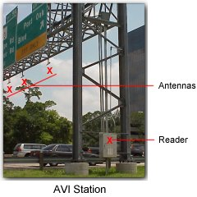
Subpart M applies to:
All tower work including
  Initial construction;
  Replacement of tower components;
  Work off rooftops;
  Tower Construction work off conventional platforms, (concrete pad) as well as non-conventional platforms such as road signs on freeways and highways;
  When installing antennas on above ground water tanks
Notes:
Instructors should note that towers and antennas are constructed off of roadway signs seen on highways. When this type of tower construction takes place, workers also have to be aware of highway work hazards as well as typical hazards seen when erecting towers off platforms. O-5

Slide 38
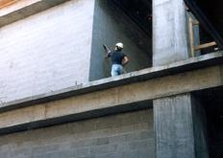
Duty to Have Fall Protection
Subpart M – Fall Protection
"Unprotected sides and edges." Each employee on a walking/working surface (horizontal and vertical surface) with an unprotected side or edge which is 6 feet (1.8 m) or more above a lower level shall be protected from falling by the use of guardrail systems, safety net systems, or personal fall arrest systems.
Known as (Conventional)
Notes:
Instructor should note that the duty to have fall protection applies to construction work at or above six feet. OSHA recognizes the following three methods as conventional fall protection:
Safety Nets
Guardrail systems, and;
Personal Fall Arrest Systems, (PFAS). O-5

Slide 39
Duty to Have Fall Protection
Subpart M – Fall Protection
Walking/working surfaces on which employees are to work have the strength and structural integrity to support them safely.
Notes:
Instructors should share that when constructing towers, the standard requires that the employer determine if the walking/working surfaces on which its employees are to work have the strength and structural integrity to support employees safely. Employees shall be allowed to work on those surfaces only when the surfaces have the requisite strength and structural integrity. O-5

Slide 40
Subpart M - Fall Protection
  Appendix A to Subpart M – Determining Roof Widths
  Appendix B to Subpart M – Guardrail Systems
  Appendix C to Subpart M – Personal Fall Arrest Systems
  Appendix D to Subpart M – Positioning Device Systems
  Appendix E to Subpart M – Sample Fall Protection Plans
Notes:
Instructors should note that appendices are provided to help employers comply with the requirements of the standard. O-5

Slide 41
Fall Protection Training
29th CFR 1926.503 requires employers to establish a training program meeting the following standards:
  For each employee who might be exposed to fall hazards.
  assure that a competent person qualified in the following areas has trained each employee, as necessary.
  A Competent Person must certify training in written form.
Notes:
Fall Protection Training
29th CFR 1926.503 requires employers to provide a training program for each employee who “might” be exposed to fall hazards. Referencing falls to a lower level in height, the word “might” speaks of the possibility of a worker falling more than 6 feet.
The employer is required to establish a training program meeting the following standards:
The employer shall provide a training program for each employee who might be exposed to fall hazards. The program shall enable each employee to recognize the hazards of falling and shall train each employee in the procedures to be followed in order to minimize these hazards.
The employer shall assure that a competent person qualified in the following areas has trained each employee, as necessary.
A Competent Person must certify training in written form. The written certification record shall contain the name or other identity of the employee trained, the date(s) of the training, and the signature of the person who conducted the training or the signature of the employer. In addition when the employer has reason to believe that any affected employee who has already been trained does not have the understanding and skill required by paragraph (a) of this section, the employer shall retrain each such employee.

Slide 42
The three forms of conventional fall protection are: Personal Fall Arrest System, Guardrail system and safety net system
Subpart M – Fall Protection
True
False

Slide 43
Subpart M applies to which of the following answers?
Subpart M – Fall Protection
Leading edges
Hoist areas
Holes
All the above
None of the above

Slide 44
Subpart M covers erection of antennas installed on freeway signs
Subpart M – Fall Protection
True
False

Slide 45
Employers are not required to develop a Fall Protection training program for workers
Subpart M – Fall Protection
True
False

Slide 46
Section 4:
Fall Protection Systems
By the end of this section students will understand the following:
  Prevention methods;
  Criteria for Personal Fall Protection Systems;
  Criteria for Safety Net Systems;
Notes:
This slide starts section 4. OSHA states that employers shall provide and install all fall protection systems required by this subpart for an employee, and shall comply with all other pertinent requirements of this subpart before that employee begins the work that necessitates the fall protection.

Slide 47
Falls
Falls are the leading cause of fatalities in the tower industry.
123 fatal falls have occurred from 2003 to November 2015.
Notes:
Statistic from WirelessEstimator.com. O-5.

Slide 48
Prevention
Fall Protection Systems
Select fall protection systems appropriate for given situations
Use proper construction and installation of safety systems
Supervise employees properly
Use safe work procedures
Train workers in the proper selection, use, and maintenance of fall protection systems
Notes:
Instructor note: OSHA recognizes that accidents involving falls are generally complex events frequently involving a variety of factors.O-5

Slide 49
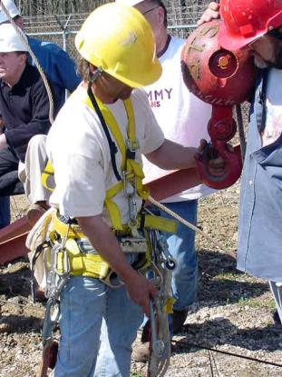
Hook up and Live
Fall Protection Systems
All the fall protection equipment in the world is of no value unless it is used all the time.
Notes:
It is very important to impress on the class that all the fall protection equipment in the world is of no value unless it is used all the time.

Slide 50
Fall Protection Systems (FPS)
Safety Net
PFAS
Notes:
These are the only two forms of conventional fall protection that is used in the tower erection industry. Guardrail systems – while experienced on roof tops are typically fixed structures erected by the building owner and not by the tower company.

Slide 51
Safety Nets
Fall Protection Systems
Installed a maximum of 30' below working level
400 pound drop test or certified by employer or CP
Extends sufficiently from outer edge
Inspected weekly
Objects removed within shift
Border rope strength of 5000 pounds
Notes:
29CFR 1926.105 states: Safety nets shall be provided when workplaces are more than 25 feet above the ground or water surface, or other surfaces where the use of ladders, scaffolds, catch platforms, temporary floors, safety lines, or safety belts is impractical.
Vertical distance from working surface to horizontal plane of net up to five feet; extend net eight feet past working edge.
Between five feet up to ten feet, extend net 10 feet past edge. O-2, O-5
Instructor should emphasize the difficulty of using safety nets during tower erection. Stress the use of Personal Fall Arrest Systems and temporary safety lines.

Slide 52
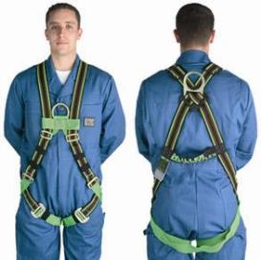
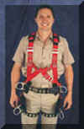
Full Body Harness
Fall Protection Systems
2 Front and back D-rings
Fall Arrest
Front- cable grab, descender
Rear- Double lanyard/rope grab
4 D-rings at the waist
Position to
  Lean:
  Position to
  Sit:
Notes:
To fit the harness correctly, meet with your supplier and learn proper fitting techniques. Standard sizing charts are based on WWII fighter pilots. We are a larger race of people now.

Slide 53
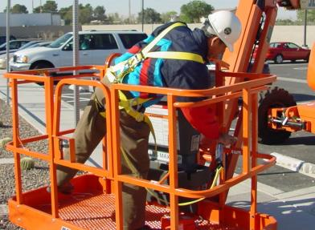
Personal Fall Arrest Systems (PFAS)
Fall Protection Systems
No body belts for fall arrest
Only full body harnesses for PFAS
PFAS
Notes:
Effective January 1, 1998, body belts are not acceptable as part of a personal fall arrest system. Note: The use of a body belt in a positioning device system is acceptable and is regulated under paragraph (e) of section 502. O-5.

Slide 54
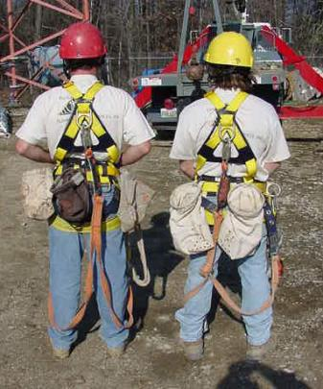
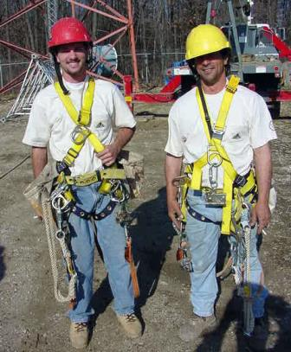
Personal Fall Arrest Systems (PFAS)
Fall Protection Systems
Notes:
Tower hands use PFAS and also positioning devices to perform work on towers. The inevitable result of more equipment is more weight. This can have a serious effect on workers’ ability to climb and move point to point over the course of the work day. But even before the worker gets on the structure a complete inspection of his equipment is required. It is recommended that after his inspection he have his buddy check his gear and he check his buddy's. It is very import to instruct the employee of the importance of wearing his/her harness correctly, and to ensure he/she has the right PFAS to complete assigned tasks. O-5

Slide 55
Personal Fall Arrest Systems (PFAS)
Fall Protection Systems
Personal Fall Arrest Systems must:
  limit maximum arresting force on an employee to 1,800 pounds when used with a body harness;
  be rigged such that an employee can neither free fall more than 6 feet (1.8 m), nor contact any lower level;
  bring an employee to a complete stop and
  limit maximum deceleration distance an employee travels to 3.5 feet
Notes:
Instructor should focus on the need for a qualified person to design a PFAS emphasizing the elements included on this slide.

Slide 56
Fatalities in the tower industry roughly match that of all other industries
Fall Protection Systems
True
False

Slide 57
Which of the following are not part of a fall prevention program?
Fall Protection Systems
Selection of appropriate fall protection systems
Proper construction and installation of safety systems
Allow employees to supervise themselves
Use safe work procedures
Training workers

Slide 58
Body belts are approved for Personal Fall Arrest Systems
Fall Protection Systems
True
False

Slide 59
Which of the following is required as part of a Personal Fall Arrest System?
Fall Protection Systems
  It limits maximum arresting force on an employee to 1,800 pounds
  Rigged so an employee can’t free fall more than 6 feet (1.8 m),
  Must bring an employee to a complete stop
  All the above
  None of the above

Slide 60
Section 5:
Personal Protective & Life Saving Equipment
By the end of this section students will understand the following:
  Definitions of PFAS Components;
  Anchorage Points;
  Additional Requirements;
  Suspension Trauma;
  Rescue Methods
Notes:
This slide starts section 5. The importance to understanding each element that makes up a Personal Fall Arrest System. Emphasize that it is more then a full body harness. It includes other elements. Each as important to the Full Body Harness for effective use.

Slide 61
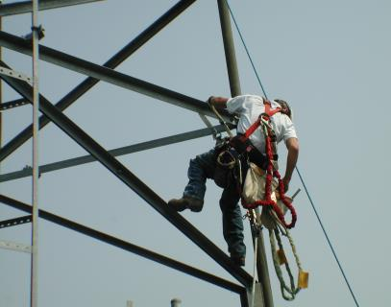
Definitions
Personal Protective & Life Saving Equipment
"Anchorage" means a secure point of attachment for lifelines, lanyards or deceleration devices.
Notes:
Instructor should stress the importance of 5,000 lbs anchorage points for PFAS.

Slide 62
Anchorage
Personal Protective & Life Saving Equipment
Anchorages used for attachment of personal fall arrest equipment shall be independent of any anchorage being used to support or suspend platforms and capable of supporting at least 5,000 pounds (22.2 kn.) per employee attached
Notes:
Instructor should stress the importance of identifying proper anchor points because each structure is unique. Student must be able to recognize criteria proper anchor points on all types of structures.
O-5, O-3

Slide 63
Anchorage
Personal Protective & Life Saving Equipment
As part of a complete personal fall arrest system which maintains a safety factor of at least two; and
Under the supervision of a qualified person
Notes:
Instructor should point out that step-bolts are never used for anchorage. O-5, O-3

Slide 64
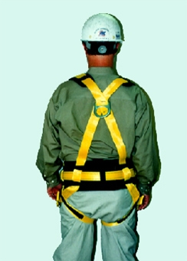
Attachment Point
Personal Protective & Life Saving Equipment
Center of wearers back
Notes:
The attachment point of the body harness shall be located in the center of the wearer's back near shoulder level.

Slide 65
Definitions
Personal Protective & Life Saving Equipment
"Body belt (safety belt)" means a strap with means both for securing it about the waist and for attaching it to a lanyard, lifeline, or deceleration device.
Note: see 1926.104 for the definition for telecommunications
Notes:
The standard contains many definitions.
A few important definitions are covered here. Students should review additional definitions as necessary to gain a thorough understanding of the terms used throughout the standard. O-5

Slide 66
Definitions
Personal Protective & Life Saving Equipment
"Body harness" means straps which will distribute the fall arrest forces over at least the thighs, pelvis, waist, chest and shoulders with means for attaching it to other components of a personal fall arrest system.
Notes:
Instructor should stress the importance of following the manufacturers specifications for harness inspections and maintenance. O-5, O-3

Slide 67
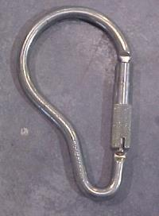
Connector
Personal Protective & Life Saving Equipment
Used to couple (connect) parts of the personal fall arrest system
Notes:
"Connector" means a device which is used to couple (connect) parts of the personal fall arrest system and positioning device systems together.
It may be an independent component of the system, such as a carabiner.

Slide 68
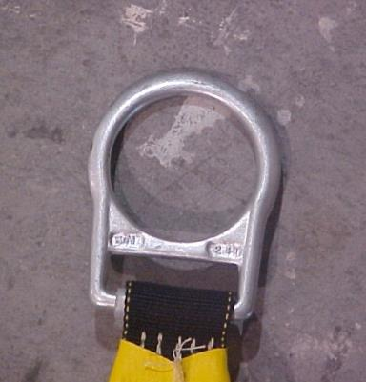
Connector
Personal Protective & Life Saving Equipment
Buckle or D-ring sewn into a body belt or body harness
Notes:
Or it may be an integral component of part of the system (such as a buckle or dee-ring sewn into a body belt or body harness, or a snap-hook spliced or sewn to a lanyard or self-retracting lanyard).

Slide 69
Deceleration Device
Personal Protective & Life Saving Equipment
Limits the energy imposed on an employee during fall arrest. Also known as a shock absorbing lanyard.
Notes:
"Deceleration device" means any mechanism, such as a rope grab, rip-stitch lanyard, specially-woven lanyard, tearing or deforming lanyards, automatic self-retracting lifelines/lanyards, etc.., which serves to dissipate a substantial amount of energy during a fall arrest, or otherwise limit the energy imposed on an employee during fall arrest.

Slide 70
Deceleration Device
Personal Protective & Life Saving Equipment
"Deceleration distance" means the additional vertical distance a falling employee travels, excluding lifeline elongation and free fall distance, before stopping, from the point at which the deceleration device begins to operate.
Notes:
It is measured as the distance between the location of an employee's body belt or body harness attachment point at the moment of activation (at the onset of fall arrest forces) of the deceleration device during a fall, and the location of that attachment point after the employee comes to a full stop.

Slide 71
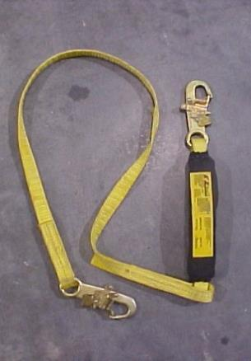
Definitions
Personal Protective & Life Saving Equipment
"Lanyard" means a flexible line of rope, wire rope, or strap which generally has a connector at each end for connecting the body belt or body harness to a deceleration device, lifeline, or anchorage.
Note: see 1926.104(d) for Lanyard definition for Telecommunications
Notes:
Instructor should stress the fact that inspection criteria is important to maintain fall arrest.
O-5, O-3

Slide 72
Lanyard
Cannot be made of natural fiber rope
Must be protected against damage by cuts or abrasions
Each employee must be provided a separate lanyard
Lanyards must have a minimum breaking strength of 5,000 pounds
Notes:
NOTE: These types lanyards can be used for positioning devices but not part of fall arrest systems.

Slide 73
Definitions
Personal Protective & Life Saving Equipment
  "Personal fall arrest system" means a system used to arrest an employee in a fall from a working level.
    It consists of an anchorage, connectors, a body harness and may include a lanyard, deceleration device, lifeline, or suitable combinations of these.
Notes:
Instructor should stress the importance of the completion of the whole system, and not just each component. Ensure all components are compatible as a complete system. The instructor should emphasize developing a rescue plan as part of a complete fall arrest system.
O-5, O-3

Slide 74
Positioning Systems
Personal Protective & Life Saving Equipment
“Positioning device system” means a body belt or body harness system rigged to allow an employee to be supported on an elevated vertical surface and work with both hands free while leaning
Positioning devices are not considered fall protection….PFAS must also be worn in addition to any position device system
Anchorage can handle at least 3000 pounds, according to industry standard*
Notes:
Positioning devices shall be rigged such that an employee cannot free fall more than 2 feet (.9 m).
Positioning devices shall be secured to an anchorage capable of supporting at least twice the potential impact load of an employee's fall or 3,000 pounds (13.3 kn.), whichever is greater.

Slide 75
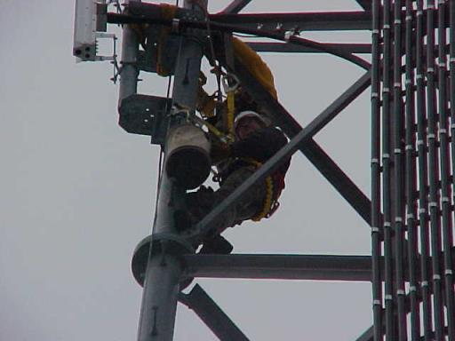
Positioning devices allow hands-free work and not part of a fall protection system.
Personal Protective & Life Saving Equipment
Positioning Systems
Notes:
For hands free work on towers, workers can use positioning devices effectively and safely. The requirements for using this type of fall protection are contained in OSHA Standard 29CFR 1926.502(e). This standard requires an anchorage of at least 3000 lbs. or twice the maximum intended load, whichever is greater, and must limit the workers fall to two feet. There are a number of devices that will allow this to take place. A lineman's body belt, self retracting lifeline and beam strap are several of these devices. However as with the PFAS, all the individual components, such as the full body harness, must be rated at 5000 lbs. Dee-rings and snap hooks must be proof tested to 3600 lbs. tensile load without cracking, braking or taking on permanent deformation.

Slide 76
Snaphooks
Personal Protective & Life Saving Equipment
The locking type with a self-closing, self-locking keeper which remains closed and locked until unlocked and pressed open for connection or disconnection; or
The non-locking type with a self-closing keeper which remains closed until pressed open for connection or disconnection.
As of January 1, 1998, the use of a non-locking snaphook as part of personal fall arrest systems and positioning device systems is prohibited.
Notes:
Instructor should stress that they need to be double locking to prevent rollout. Instructor should strongly consider doing a visual demonstration of “rollout” and compatibility of the snaphook of the component it is snapped onto.
O-5, O-3

Slide 77
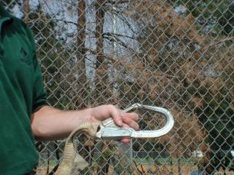
Snaphooks
Personal Protective & Life Saving Equipment
Unless the snaphook is a locking type and designed for the following connections, snaphooks shall not be engaged:
    Directly to webbing, rope, or wire rope
    To each other
    To a D-ring to which another snaphook or other connector is attached
    To a horizontal lifeline
Notes:
To any object which is incompatibly shaped or dimensioned in relation to the snaphook such that unintentional disengagement could occur by the connected object being able to depress the snaphook keeper and release itself.

Slide 78
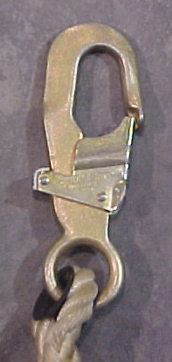
Personal Protective & Life Saving Equipment
Double – Locking Snap hook
Hook Nose
Hook Body
Gate
Release
Lock
Hinge
Eye
Notes:
Instructor should explain nomenclature of a snaphook.
O-5, 0-3

Slide 79
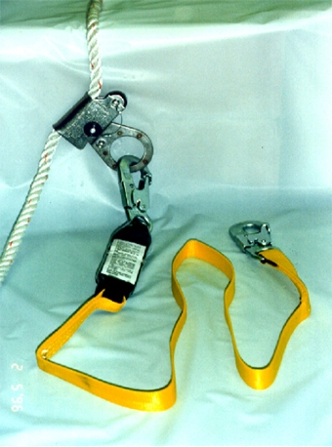
Key parts of a PFAS or safety climb device is a rope grab device and the energy absorbing lanyard and lifeline.
Personal Protective & Life Saving Equipment
Rope Grab System
Notes:
Pictured is a lifeline which is used by attaching it to a anchor point in such a way as to develop a 5000 lb. capacity. This capacity is required by ANSI and OSHA for the entire PFAS and the system must be comprised of individual components that meet this 5000 lb. standard..

Slide 80
Additional Requirements PFAS
Personal Protective & Life Saving Equipment
PFAS used only for fall protection
If subject to impact loading, examined by Competent Person (CP)
Prompt rescue provided
Notes:
Body belts, harnesses, and components shall be used only for employee protection and not to hoist materials.
Personal fall arrest systems and components subjected to impact loading shall be immediately removed from service and not used again until inspected and determined by a competent person to be undamaged and suitable for reuse.
The employer shall provide for prompt rescue of employees in the event of a fall or shall assure that employees are able to rescue themselves.

Slide 81
Additional Requirements PFAS
Personal Protective & Life Saving Equipment
Inspected prior to each use
Not attached to guardrail systems
At hoist areas, allow movement to edge only
Notes:
Personal fall arrest systems shall be inspected prior to each use for wear, damage and other deterioration, and defective components shall be removed from service.
Personal fall arrest systems shall not be attached to guardrail systems, nor shall they be attached to hoists except as specified in other subparts of this Part.
When a personal fall arrest system is used at hoist areas, it shall be rigged to allow the movement of the employee only as far as the edge of the walking/working surface.

Slide 82
Which of the following is not part of a Personal Fall Arrest System?
Personal Protective & Life Saving Equipment
  Full Body Harness
  Anchorage Point
  Body Belt
  Lanyard
  Connectors

Slide 83
It is ok to use non-locking snaphooks as part of personal fall arrest systems and positioning device systems.
Personal Protective & Life Saving Equipment
True
False

Slide 84
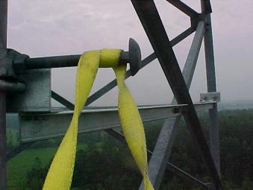
Look at this picture. This is an approved anchorage point.
Personal Protective & Life Saving Equipment
True
False

Slide 85
How often do you need to inspect your PFAS equipment?
Personal Protective & Life Saving Equipment
  Weekly
  At the end of your shift
  Before each use
  Monthly
  None of the above

Slide 86
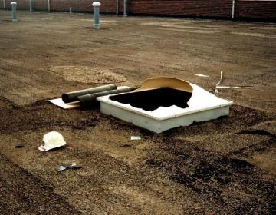
Hazards - Holes and Skylights
Personal Protective & Life Saving Equipment
Protect from: falling through, tripping or stepping into, and objects falling through.
Notes:
Each employee on a walking/working surface shall be protected from tripping in or stepping into or through holes (including skylights) by covers.
Each employee on a walking/working surface shall be protected from objects falling through holes (including skylights) by covers. O-2

Slide 87
Personal Protective & Life Saving Equipment
Hazards - Holes and Skylights Covers
Withstand twice expected load
Secured
Marked with ‘HOLE’ or ‘COVER’
HOLE!!
Notes:
Covering holes and skylights must be performed safely as an abatement method. All covers shall be capable of supporting, without failure, at least twice the weight of employees, equipment, and materials that may be imposed on the cover at any one time.
All covers shall be secured when installed so as to prevent accidental displacement by the wind, equipment, or employees.

Slide 88
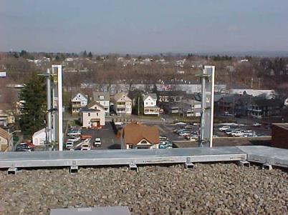
100% fall protection is required within six feet of the edge of the roof.
Personal Protective & Life Saving Equipment
Working Closely to the Edge
Notes:
Antenna and tower work on roofs is covered by the OSHA standard in Subpart M. The specific standard, §29 CFR 1926.501(b)(1), requires that unprotected sides and edges 6 feet or more above any adjacent surface. PFAS and safety nets could be applied here, however, an alternative system could also be restraint lines. O-2ar

Slide 89
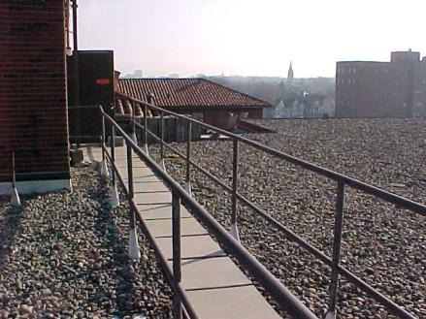
Personal Protective & Life Saving Equipment
Rooftop Walkway Guardrail
Rooftop Walkways guardrails cannot be used as an anchorage point.
Notes:
Rooftop walkways may not be protected by guard railings as is this walkway. If they are provided, the host employer may require that workers who are not working on the walkway use an alternative fall protection system. The guard railing systems are not normally designed and cannot be used as an anchor point for PFAS or positioning device systems.

Slide 90
Suspension Trauma
Personal Protective & Life Saving Equipment
Suspension Trauma Definition:
The medical effects of immobilization in a vertical position
Presents an immediate threat of death to anyone immobilized in a vertical position, (Hanging still in a harness).
Notes:
Suspension trauma can only affect someone who is immobile – specifically not using their leg muscles to any great extent
It does not normally affect people who wear a harness who are actively moving about

Slide 91
Suspension Trauma
Personal Protective & Life Saving Equipment
  Suspension Trauma Effects:
    Gravity pulls your blood into your legs
    The veins in your legs are entwined within the skeletal muscles, and when you move your legs, these muscles squeeze the veins, pushing the blood out of the way
    General feelings of unease
    Dizzy, sweaty and other signs of shock
    Increased pulse and breathing rates
    Then a sudden drop in pulse & Blood Pressure
    Loss of consciousness
Notes:
Humans are not designed to stand upright
Our circulatory system was built for life on all fours
Volume of blood vessels is much greater than that of the blood
There are one-way valves in these veins, so each squeeze can pump the blood a short distance towards the heart
Providing you are walking around, this process makes a ‘heart in each leg’

Slide 92
But what if we’re not pumping?
Personal Protective & Life Saving Equipment
Suspension Trauma
If the muscles are not pumping the blood upwards, it pools in your legs
  You can ‘lose’ several pints and go into shock
Your brain tries ‘shock’ for a while, but of course it doesn’t help – blood is still stuck in your legs.
After a few minutes, it goes for the last-ditch method
If I faint, I fall over. I get the blood back.
THIS IS NOT FAINTING!
Notes:
However you will not be lying flat on the ground. Gravity is still working against you.

Slide 93
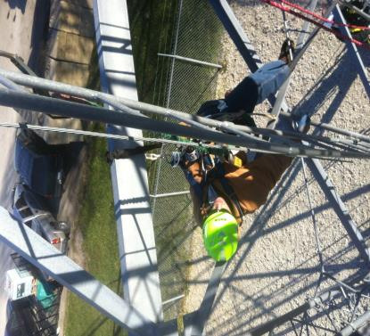
Suspension Trauma
Personal Protective & Life Saving Equipment
Notice the legs dangling
Gravity is holding the blood
Pooled blood can become “stale” in as little as 15-40 minutes
You must act fast
Notes:
The legs must be positioned horizontally in order to maintain blood flow

Slide 94
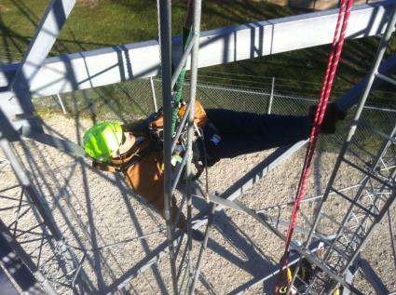
If you fall accidentally and are suspended:
Personal Protective & Life Saving Equipment
Remain calm
  AVOID using your legs…you don’t want blood sent there
  Lift your knees into a sitting position
  Relax as much as possible. Panic makes things worse
  Do not Panic, scream for help until you are heard.

Slide 95
Suspension Trauma
Personal Protective & Life Saving Equipment
If at all possible, climb out of suspension
  Using self-rescue equipment, improvised or otherwise
Get into a sitting position straight after the fall
  Pass the casualty a work seat or improvised platform
All casualties must be ‘immediately rescued’
All that matters is that the legs are lower
than the heart and the leg muscles are immobile.
No other injury is needed.
Anyone released from immobile suspension should be kept in a sitting position for at least 30 minutes
Notes:
Instructor to emphasize that getting in a seated position after a fall is the most critical path of the victim to prevent harnesss induced pathologies.

Slide 96
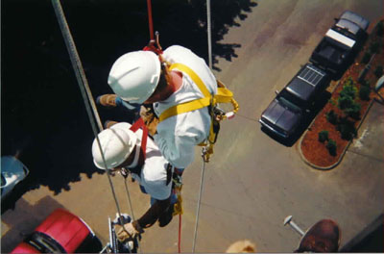
Personal Protective & Life Saving Equipment
Rescue
The employer must provide for prompt rescue of employees in the event of a fall; or assure that employees are able to rescue themselves.
Notes:
In addition to the requirement for workers to use 100% fall protection the employer must assure prompt rescue of fallen employees if the employees cannot rescue themselves. The need to be able to rescue fallen workers is contained in OSHA Standard 29CFR 1926.502(b)(20). This means that high angle rescue training must have been completed by at least one member of the crew and that adequate rescue equipment be present on the site and available for instant use.

Slide 97
Rescue
Personal Protective & Life Saving Equipment
Putting together a comprehensive emergency action plan that deals with those issues specific to your worksite is not difficult
It involves taking what was learned from your workplace evaluation and describing how employees will respond to different types of emergencies
Notes:
A rescue plan helps everyone understand what to do before a fall.

Slide 98
Rescue
Personal Protective & Life Saving Equipment
www.Wirelessestimator.com offers comprehensive jobsite emergency action plans
  The plan should include but not be limited to:
  Company Name Date/ Time (Work to be done)
      Site location/directions Competent person contact
      Emergency phone numbers Communications (cell, landline)
      List of emergency equipment List of possible hazards
      Description of work being done Proximity of rescue personnel
Notes:
You the competent climber should be familiar with this format. Click the link to be taken to this site.
As a class project, have students log in to the above site (if available), or click hyperlink and fill in form(s) together and distribute to class.

Slide 99
Rescue
Personal Protective & Life Saving Equipment
Self Rescue
The ability to remedy the situation should the employee/rescuer become trapped
Assisted Rescue
Pick Off – Rescuer takes victim from landing or platform. Designed to rescue a conscious person.
Line transfer – rescue the victim from a line the victim is attached and transfer the victim to the rescuer’s system to be lowered to the ground.
Notes:
Describe the difference between self rescue and assisted rescue. Emphasize that importance to understand the difference between Pick off rescue verses Line transfer

Slide 100
Rescue
Personal Protective & Life Saving Equipment
Employer Performed Rescue
  At least two trained rescue employees should be on site when work is being done
  Confirm that personal protective equipment and high angle equipment needed to perform rescue is available and accessible on site
Notes:
Instructor should note that when an employer chooses employer performed rescue that they must have trained personnel on site at all times and the equipment necessary to preform the rescue.

Slide 101
Rescue
Personal Protective & Life Saving Equipment
Outside Agency
  Employer should evaluate the rescue agency’s ability to respond to a rescue in a timely manner
  Employer should evaluate the abilities of the rescue agency (skills and equipment)
  Inform the rescue agency of the types of hazards and location of worker’s with contact information
  Ensure communication with rescue agency
Notes:
Instructor should note that if an employer chooses an outside agency to perform rescue duties that the employer must first evaluate the agency for its capabilities and manage all communication between the leadership on the tower project and the agency it hires to perform the rescue.

Slide 102
How many feet away from a rooftop edge or leading edge can you be before fall protection is required?
Personal Protective & Life Saving Equipment
  10 feet
  15 feet
  5 feet
  6 feet
  None of the above

Slide 103
The one benefit of Positioning devices are that they allow for hands-free work.
Personal Protective & Life Saving Equipment
True
False

Slide 104
Which best describes the term Suspension Trauma?
Personal Protective & Life Saving Equipment
  Medical effects from bruises as a result of climbing a tower
  Medical effects from being suspended vertically
  Medical effects from being suspended horizontally
  None of the above

Slide 105
Which is a symptom of Suspension Trauma?
Personal Protective & Life Saving Equipment
  Dizzy, sweaty and other signs of shock
  Increased pulse and breathing rates
  Sudden drop in pulse & Blood Pressure
  Loss of consciousness
  All the above

Slide 106
If you fall accidently and are suspended what should you NOT do?
Personal Protective & Life Saving Equipment
  AVOID using your legs….you don’t want blood sent there.
  Lift your knees into a sitting position.
  Panic, scream for help until you are heard.
  Relax as much as possible. Panic makes things worse.
  If you can, every few minutes swing yourself upside down.

Slide 107
What is the most important thing to remember if you are suspended after a fall?
Personal Protective & Life Saving Equipment
Keep legs lower than the heart and the leg muscles immobile
Get in a standing position after the fall
Scream for help until you are heard
Elevate your legs above the heart muscle and keep swaying them back and forth
None of the above

Slide 108
Two categories of rescue are called self and assisted rescue.
Personal Protective & Life Saving Equipment
True
False

Slide 109
The two types of assisted rescue are pick off and line transfer.
Personal Protective & Life Saving Equipment
True
False

Slide 110
Free Fall Distance
Personal Protective & Life Saving Equipment
"Free fall distance" means the vertical displacement of the fall arrest attachment point on the employee's body belt or body harness between onset of the fall and just before the system begins to apply force to arrest the fall.
Notes:
This distance excludes deceleration distance, and lifeline/lanyard elongation, but includes any deceleration device slide distance or self-retracting lifeline/lanyard extension before they operate and fall arrest forces occur.

Slide 111
Calculation of Total Fall Distance
Personal Protective & Life Saving Equipment
Free Fall Distance
Freefall = 6 feet maximum
Deceleration Distance = 3.5 feet maximum
Lifeline elongation = 2 feet maximum
Total fall before stopping = 11.5 feet
Portion of body landing below attachment point approximately 5 feet
Total clearance below required to avoid contacting lower level may be as great as 16.5 feet or more!
Notes:
Instructor needs to stress the importance of the calculation of the correct personal fall arrest system for the job. Stress the bottom bullet point on this slide. The system depends on the Total Clearance Below.

Slide 112
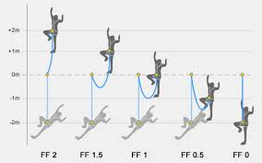
Fall Factor
Personal Protective & Life Saving Equipment
A derived number used to evaluate the shock loads generated on the worker, belaying and anchors that occur when a worker falls.
The higher the fall factor the greater the forces placed on the system:
Fall factor=
Length of fall
divided by
length of rope
Notes:
Belaying refers to a variety of techniques climbers use to exert tension on a climbing rope so that a falling climber does not fall very far.
Limit the forces to 1800#
Based on the anchoring of fall arrest system
Anchor as above your head as possible while still being able to work to lower the fall factor.

Slide 113
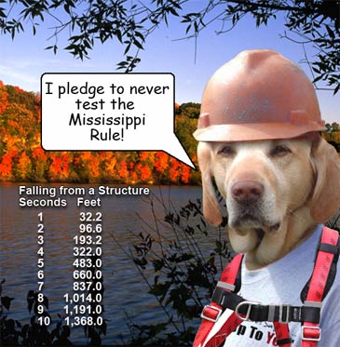
Fall Factor
Personal Protective & Life Saving Equipment

Slide 114
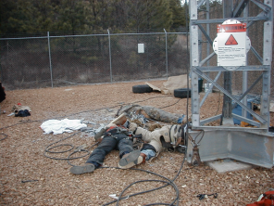
Fatal Fall Exercise
Personal Protective & Life Saving Equipment
Calculate impact of the students’ weight
Acceleration = 32ft/sec²
Force = Mass x Acceleration
Force Calculator: https://www.easycalculation.com/physics/classical-physics/force.php
Conversion to Pounds of Pressure: http://www.convertunits.com/from/newton/to/pound
Notes:
Instructor should conduct an interactive exercise and have student’s calculate their force of impact when falling from a structure. Use the online calculators to help with speed of results.

Slide 115
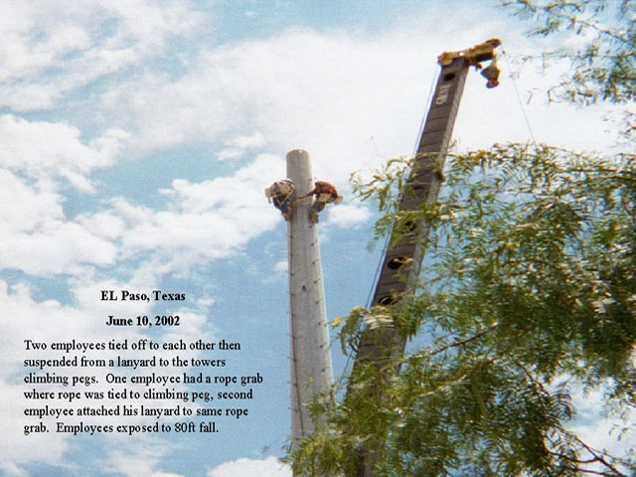
El Paso, Texas June 10, 2002
Notes:
When employees do not use the required equipment or they choose not to follow their employer’s 100% fall protection program or just ignore their fall protection training they have a ten times greater chance to fall and be killed. Falls involving tower hands result in death. OSHA and NIOSH data shows that tower workers are ten times more likely to die on the job than other trade construction workers. This photo was taken by an OSHA compliance officer while driving to another inspection. The employees were brought down and the employer was cited and penalized for violation of the standards.

Slide 116
Section 6:
Tower Systems
By the end of this section students will understand the following:
  Different Tower systems;
  Fall Protection on each tower system;
  Anchorage points on tower systems;
  Fall protection when working with a Gin Pole
Notes:
This slide starts section 6 of the presentation.

Slide 117
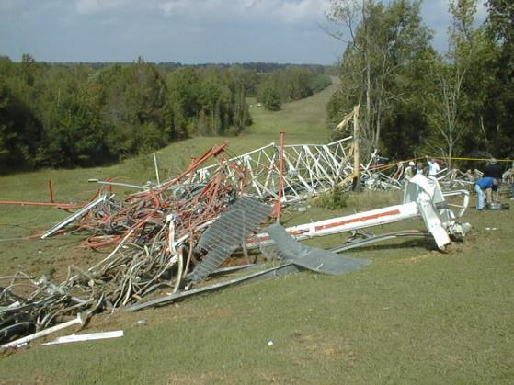
It has to be Safe
Tower Systems
Notes:
Many older towers do not have the structural integrity to withstand the loading of a worker, tools and/or other equipment that may be applied. It is the first consideration and must be assured to prevent tower collapse while workers are on the structure.

Slide 118
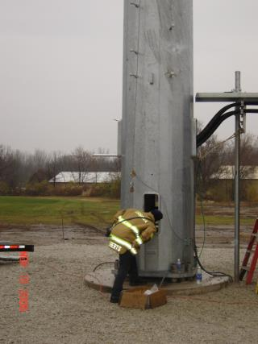
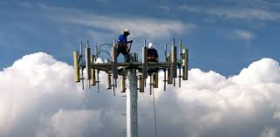
Monopole Towers
Tower Systems
Designed for cables to run on the interior of the tower
Antenna nest at the top of the tower may be the only anchor point
Notes:
Monopoles are one of three tower types. It is an independent structure. Typically it only has one anchorage point. The idea of a monopole tower is that it is more aesthetically pleasing and more often found in urban areas.

Slide 119
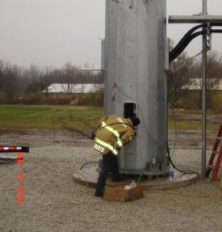
Monopole Towers
Tower Systems
Designed for cables to be inside
The antenna nest may be the only anchor point
Notes:
Demand for space has placed more and more cable outside of the structure creating a climbing hazard.
The antenna nest (pictured below) may be the only trustworthy anchorage point located on the tower for resting. Lifelines are one method for providing fall protection on monopole towers during construction.

Slide 120
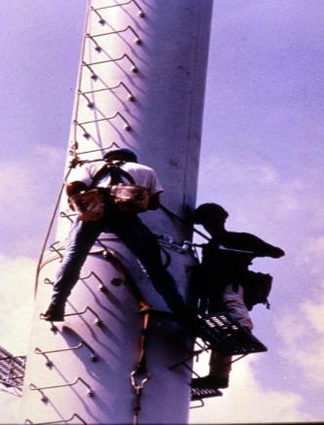
Lifelines are one method for providing fall protection on monopole towers.
Tower Systems
Monopole Towers
Notes:
Separate lifelines are required for all workers on the tower during erection of the tower. It makes no difference if the lifeline is rated at two or even three times the 5000 lb. requirement for each worker. The requirement is for separate lifelines. Reference (§29CFR 1926.502(d)(10)(i). Remember a lifeline must support 5,000 pounds per worker.
Typically anchorage points are found on platforms as you ascend the tower. However there may be no trustworthy anchor connection spots until you reach the top of a monopole. This is an example of why it is so important to complete a JSA prior to project start-up

Slide 121
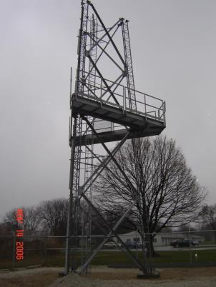
Self Supporting Towers
Tower Systems
Some Self Supporting Towers come with different leg structures
Some provide a different way to climb
Typically possess a triangle base; very few have a square base
Self Supported towers vary in size
Notes:
Some Self-Supporting Tower Systems come with different leg structures. The nature of self-supporting towers provides multiple ways/methods to climb. Given the structure, self-supporting towers typically require less maintenance.
Normally these towers are more maintenance free or require less maintenance, but these towers cannot be erected to great heights. Most self support towers are between 0 and 500 feet tall.
Self-supported tower vary in size, but are built between 0 and 500 feet tall. They are not built to great heights. Most have a triangle base; few have a square base.

Slide 122
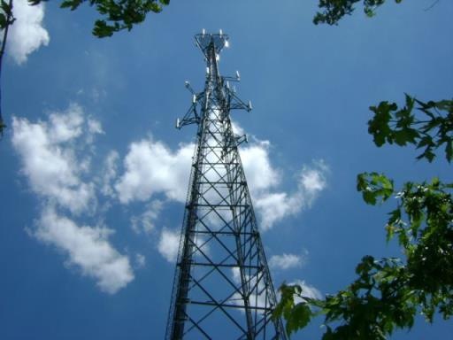
Self-Supported Tower with use of Retractable Lifelines as part of PFAS
Tower Systems
Self Supporting Towers
Notes:
Regardless of what job you’re doing, always maintain a 100 percent tie off.
Adequate anchorage points are found throughout the tower structure. Usually welded tabs on cross braces where they meet the vertical are adequate anchorage points where you can apply your pelican hook on the tab. Double lanyard are always required to maintain 100% fall protection.
In addition to the welded anchorage points, self-supporting towers have safety climb systems built next to the line leg or on the interior where climbing ladders are provided.

Slide 123
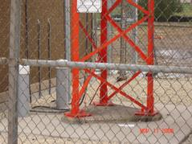
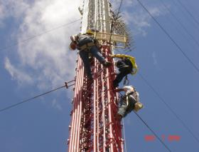
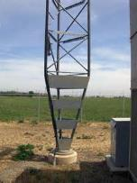
Guyed Towers
Tower Systems
Objects and workers can get in the way
Older form of anchoring a guyed tower.
Typical base of guyed tower
Notes:
Demand for space has placed more and more cable on the exterior of tower structures, especially Guyed Towers. This bulk of cables creates more potential hazards for climbers. Guyed Towers are the most common type of tower climber’s encounter.
Look for safe clean areas to climb The older mount created too much tension as the tower is designed to move with the wind
Newer towers rest solely on a 1 pin system placing more importance on the guy wires.

Slide 124
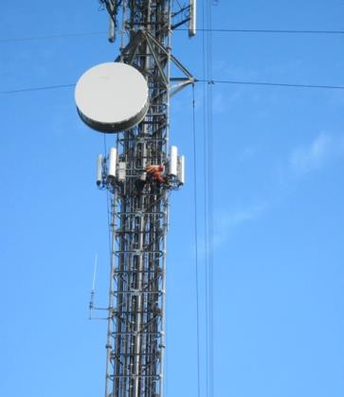
Guyed Towers
Tower Systems
Have a range of 200 feet to greater than 1,000 feet
The Guyed Tower system is supported by exterior cables
Notes:
Guyed towers are the most common type of tower and can be easily overloaded. All components of the tower should be thoroughly inspected by a Competent Person before each climb.

Slide 125
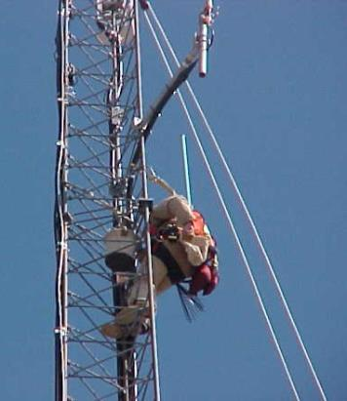
Tower Systems
Guyed Towers
Where are the strongest anchorage points on this tower?
  At the legs
  Where the horizontal and diagonal braces meet (the weld point)
Notes:
The OSHA standard that is applied to of any construction tower activity requires fall protection at 6 feet. O-5, O-4 Can you tell me if he is tied off or not tied off? Have students put arrows to identify anchorage points, and identify where the strongest tie off points are on the different types of towers. There are no engineered anchorage points on guide towers, examples of anchorage points which are acceptable are at weld points which are at horizontal and diagonal members come together or on exterior legs. Here is an example of a guide tower with proper anchorage points. Red arrow identifies personal fall arrest anchorage point. Yellow arrow identifies proper anchor point where all members come together at weld.

Slide 126
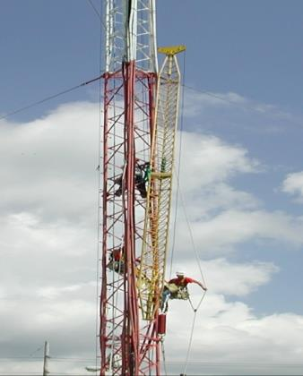
Gin Pole
Tower Systems
A gin pole is an apparatus that is tied to the tower structure, which allows for the hoisting of components and equipment during tower erection
A gin pole is used during construction of new towers
Notes:
A gin pole is used during construction of new towers. A gin pole is an apparatus that is tied to the tower structure itself, which allows for hoisting of components and equipment to erect the next section. All workers more than 25 feet above the ground must use conventional fall protection. Here all three men up are using personal fall arrest systems. All workers are attached to separate lifelines.

Slide 127
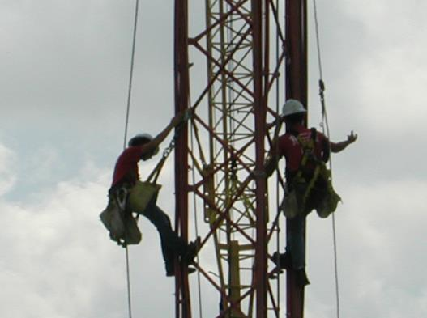
This is an example of one employee using a positioning device in gin pole operations and another using fall protection. Can you tell me which is which?
Tower Systems
Gin Pole
Notes:
Communication is always required between crew members. Hand signals, voice and/or radio communications are all acceptable. The specific requirements contained in OSHA CPL 2-1.056 should be reviewed prior to any employees going up.

Slide 128
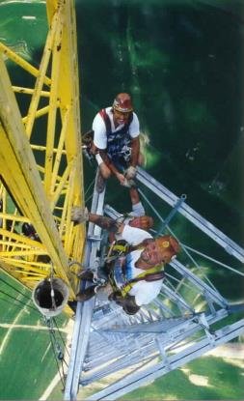
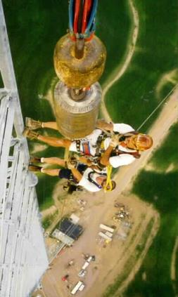
Tower Systems
Gin Pole
Notes:
Employees performing tower work, are required to use 100% fall protection when stationary, moving point-to-point and riding the line. This means that there must be a 100% fall protection program in place and that program must be enforced by management.
Never climb on a gin pole. Always climb and work off the tower maintaining 100% fall protection.

Slide 129
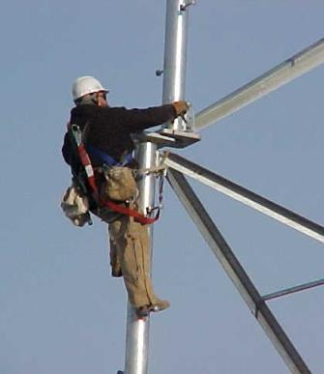
Lanyard web protection / softeners may be required when around sharp angles
Tower Systems
Softeners
Notes:
Natural and synthetic ropes and slings must be protected. Sharp edges will cut them, weakening them and reducing their ability to perform safely. Welding and other hot work can only be performed if workers are using wire rope lanyards and /or wire rope or wire rope core lanyards and positioning devices.

Slide 130
Brainstorming Activities
Notes:
Instructor should introduce this section as a brainstorming session whereby students are invited to participate and share their opinions and values on the photographs shown

Slide 131
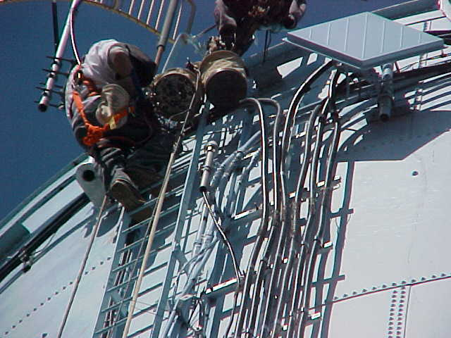
How can this worker better protect himself from falling?
Notes:
This worker is welding and he has attached himself to a fixed ladder rung by a synthetic rope lanyard. There are several serious hazards that need to be discussed with students at this time.
The hazard of welding while using synthetic fall protective equipment is unacceptable. While suspended at heights, hot work can only be done using wire rope or chain lanyards or material that will not burn or melt.) OSHA Standard 29CFR 1926.503;
The ladder rung used as an anchor point is unacceptable because it may not meet the strength requirements of the OSHA standards. It would be much better to attach to the side rail. The worker can move a short distance when working but if the movement is not intended or is unexpected the individual will experience a heart check. ( that feeling one has when, he/she realizes they may have just fallen a several inches or so but their fall protection just saved their life even though it was not properly attached. The anchor point must be capable of withstanding 5000 lbs. or be designed, installed and used as a part of a complete fall arrest system that maintains a safety factor of two. §29CFR 1926.502(d)(15).
Workers must be protected 100% of the time while moving point-to-point. In this case there is no ladder safety climbing device and the worker only has a single lanyard to use in climbing or moving horizontally across the tower face.(§ 29CFR 105(a), 501(b)(15) & OSHA Compliance Directive CPL2-1.36 dated March 3, 2002.
The manufacture of the PFAS will specify the conditions under which the equipment can and can not be used.
The ladder manufacturer must specify the proper installation and use requirements for his equipment may or may not be appropriate for use as a part of a fall protection system.

Slide 132
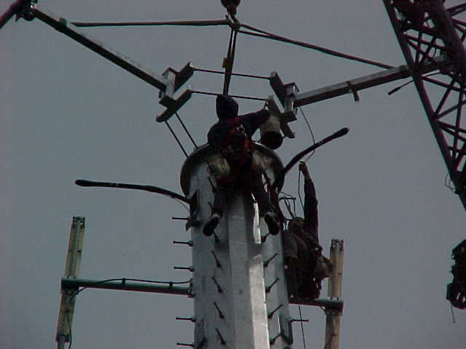
Are step bolts good to use as fall protection anchorage point?
Notes:
Step bolts are not designed for fall arrest anchor points. It is important to reemphasize this fact on all workers. ANSI & OSHA standards require it but workers will use them thinking that they will hold them if they fall because the can climb on them.

Slide 133
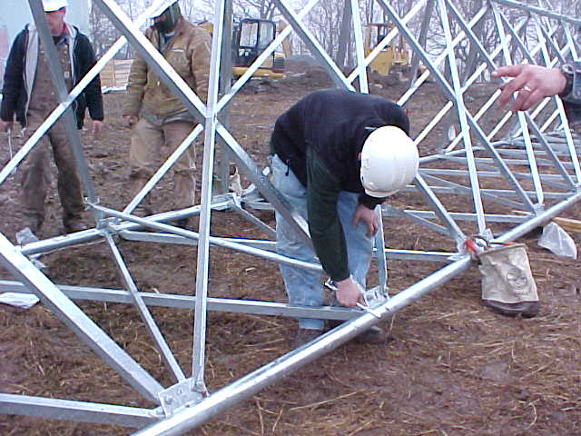
List the reasons it is a better to do as much work on the ground as you can.
Notes:
Generally, work on the ground is much safer than having workers on the tower and can be more efficient. With that concept in mind, the more work that can be completed on the ground minimizes the workers exposure to fall hazards. This is a good concept to use simply because there is a significantly reduced worker exposure.

Slide 134
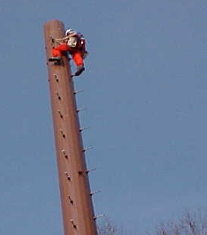
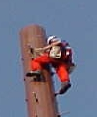
Is this worker properly protected from falling?
Notes:
No.
He has attached his fall protective equipment to the step bolts of the monopole. There are special devices that can be attached to the step bolts that will provide a 5000 lb. anchor point. This device fits 5/8 and ¾ inch step bolts and is tested to 5000 lbs. This meets OSHA and ANSI standards.

Slide 135

Is the worker on the left properly protected from falling?
Notes:
Lifelines and load lines are required to be separate when ascending towers. The worker on the left may not be properly protected from falls because he has tied the load to his lifeline.

Slide 136

How close can he get to the edge before he needs fall protection?
Notes:
The answer is six feet from the lower level when exposed to a fall hazard. This is because the OSHA standard for fall protection, Subpart M is applied to this hazard. A follow-up question might be. What type of fall protection could be used and/or what is the best type of fall protection that could be used? Here the answers could be many: scaffolds, aerial lifts, self-retracting lifelines, restraints or PFAS. Make sure you select the proper fall protection system for the work being performed.

Slide 137

Identify the fall protection systems these workers can use when moving point-to-point.
Notes:
There are several ways of using fall protection when moving point-to-point. One is by attaching a lanyard with a deceleration device attached to the cross members. Other ways are a self retracting lifeline attached to the tower legs or the installation of a vertical lifeline attached to the tower legs. One of the most important things to be brought out in the discussion is the need to have a system that is separate for each employee or is designed, installed, and used in such a way it will not fail under load. This requires a qualified person.

Slide 138

Is a safety climb device required on this ladder?
Notes:
The answer is no. But it should be understood that the reason why is because the top of the ladder is not 24 feet high. It must also be pointed out that fall protection is required for workers on the roof where the antennas are mounted because the roof is more than six feet above the ground. You do not need fall protection to go up the ladder, but once you’re up near the antennas you do.

Slide 139

This parapet wall is 35 inches high. Do workers working on the antenna four feet from the edge need fall protection?
Notes:
Yes, they are required because for the parapet wall to provide enough protection it would have to be the same height as a guard railing system. At least 42 inches high plus or minus 3 inches. § 29CFR 1926.502(b)(1).

Slide 140
Section 7:
Fall Protection Plans
By the end of this section students will understand the following:
  The importance of safety plans
  How to develop a JSA
  Training requirements
Notes:
Section 7 focuses on developing job safety hazard analysis and the importance of planning your tasks before climbing a tower. Re-inforce the concept that proper planning can reduce and even eliminate fall hazards.

Slide 141
Fall Protection Plan
Prepared by qualified person
Specific to site
Changes made by qualified person
Plan kept at site
Notes:
The fall protection plan shall be prepared by a qualified person and developed specifically for the site where the edge work, precast concrete work, or residential construction work is being performed and the plan must be maintained up to date.
A copy of the fall protection plan with all approved changes shall be maintained at the job site.

Slide 142
Fall Protection Plan
Implemented by competent person
Documents why conventional fall protection is infeasible
Discuss measures used to protect workers
FPP
Notes:
The implementation of the fall protection plan shall be under the supervision of a competent person.
The fall protection plan shall document the reasons why the use of conventional fall protection systems (guardrail systems, personal fall arrest systems, or safety nets systems) are infeasible or why their use would create a greater hazard.

Slide 143
WHAT IS A JOB SAFETY ANALYSIS ?
Fall Protection Plan
Method used to break a job task into separate and distinct steps
Evaluate the hazards associated with each step
Determine the appropriate controls needed to control each of the identified hazards
Notes:
Review each point individually and explain that key words used in the presentation such as “hazards” and “controls “ will be clearly defined in just a few minutes, so that we all mean exactly the same thing when we use these key words. (These definitions are also contained in the reference guide that all supervisors will receive for future reference and use).
TRANSITION: “Now that we have an idea of what JSAs are about, let’s review the benefits of applying the use of JSAs in a systematic way...”

Slide 144
BENEFITS OF A JOB SAFETY ANALYSIS
Fall Protection Plan
Identifies unsafe work practices before an accident occurs
Decreases injury rates
Increases quality
Increases productivity
Notes:
Review the benefits of completing JSAs.
If we can identify unsafe work practices before an accident occurs, we can take the steps necessary to decrease injury rates and, in many instances, re-design the job process, equipment or tools to also boost quality and productivity rates.
We will return to the concept of how safety, quality and productivity interact in just a few minutes.
TRANSITION: Now that we have discussed the primary benefits of utilizing JSAs, let’s review the various ways that JSA information can be used...

Slide 145
USES OF A JOB SAFETY ANALYSES
Fall Protection Plan
Evaluate existing jobs
Set up new jobs
Training and re-training tool
Prioritize jobs needing re-design
Ties in closely with other job analyses (quality & productivity studies, RTW)
Reference in accident investigations
Notes:
These are the primary ways in which JSA information is typically used. Review each in turn. Emphasize that the regular and proper completion of JSAs will help to design and manage the manufacturing process not from just a safety standpoint, but from a productivity, quality and compliance standpoint as well.
As a trainer, you are selling the benefits and usefulness of JSAs so that attendees realize and “buy in” to the need for completing them. Take as much time as you need to make sure supervisors understand the importance and benefits of JSAs and why they are seen as the primary source of information in completing and using JSAs (because they are the closest level of management to the work process, they are heavily involved in setting up and modifying jobs, they are the primary trainers of employees, they are aware of past accidents in their respective areas, and they observe employee job performance every day).

Slide 146
DEFINITION OF KEY WORDS
Fall Protection Plan
Job task
Job step
Hazard
Exposure
Control
Accident / Incident
Notes:
The audience will find definitions of each term in their reference guides. Refer supervisors to their reference guides for the first time. Explain that this contains a number of tools that are designed to assist them in the JSA process. Ask them to turn to the definitions page and review the key definitions with them.
To help them understand the terms hazard, exposure and control, give them the following situation of driving a car.
A situation we can all relate to is driving our car on a wet, slick road surface.
Ask the audience to name a hazard (slippery road)
Ask them to list a corresponding exposure (collision or run off the road accident due to loss of steering control or loss of braking control).
List a corresponding control (reduce speed to account for the slick conditions and reduce the degree of the exposure).
TRANSITION: “Let’s review another example of these key terms as applied to the workplace so that we all fully understand them...”

Slide 147
DEFINITION OF KEY WORDS - Example
Fall Protection Plan
Job Task – Walking across the street
Job Step – Walking from one side to another
Hazard – Struck by Traffic
Exposure - injury from being hit by on coming vehicle
Control - Cross street at crosswalk
Accident / Incident – Death or serious injury
Notes:
Review this quick example of a defective ladder. Explain that it is possible to have more than one exposure for each hazard and also possible to have more than one control for each hazard. Make sure that all are comfortable with the terms before moving on.
TRANSITION: “Some people feel that safety is not compatible with production efforts and/or quality efforts. Actually, in most cases, these three work hand in hand. Let’s see why...”

Slide 148
ONE PROCESS, THREE GOALS
Fall Protection Plan
PROCESS
Safety
Productivity
Quality
= Production
Notes:
Safety isn’t a person or thing. It is not your Safety Coordinator and it is not a written safety manual. It is a process, specifically the way our workers perform their jobs collectively each day. At times, they have the proper equipment, tools, job instruction, training and attitude to perform their jobs safely. At other times however, one or more of these elements may be lacking.
Similarly, productivity and quality are the results of the same process as workers complete their jobs each day. Either they have and use the prerequisites to perform the job successfully or they don’t.
Frequently, the method that is the safest way to perform a specific job task is also a highly productive one that results in a high level of quality as well. (Provide an example). Occasionally, this is not true and a compromise solution may be needed to balance the three goals. (Provide example).
All three of these ingredients are intertwined in the same process and all three directly and collectively impact the company’s bottom line results. Therefore studying and improving job methods is extremely important to us all.
Make sure this point is understood & accepted.

Slide 149
WHERE TO START?
Fall Protection Plan
Accident history
Employee complaints
Employee turnover
Absenteeism
Other supervisors & managers
Safety manager
Jobs showing potential for loss
Notes:
Review each of these as sources of information in prioritizing job tasks that need to studied immediately. Initially, the job tasks being studied will be high exposure tasks. Over time, the exposure from job tasks being studied should continually decrease.
However, other factors such as new accidents, equipment changes, and process re-design are likely to continually shuffle the priorities of job tasks to be studied. Job Safety Analysis is a continual process that does not carry a completion date.
TRANSITION: If, after using all of the above information it’s still not clear as to which jobs should be prioritized for JSA usage...

Slide 150
WHEN IN DOUBT, USE COMMON SENSE !
Fall Protection Plan
Notes:
...it’s best just to use our own best judgement and common sense.
TRANSITION: Now that we’ve covered the benefits, uses and need for a Job Safety Analysis program, let's talk about the actual process of completing a JSA. It consists of four basic steps...

Slide 151
One of the benefits of a JSA is it can increase productivity.
Fall Protection Plan
True
False
True benefits of a JSA include: identifying unsafe work practices before an accident occurs, decreasing injury rates, increasing quality and increasing productivity.

Slide 152
Which of these is not a use of a JSA?
Fall Protection Plan
Evaluate existing jobs
Set up new jobs
Training and re-training tool
Prioritize jobs needing re-design
Provide OSHA required fall protection training
Reference in accident investigations

Slide 153
FOUR STEP JSA PROCEDURE
Fall Protection Plan
Identify each major step of the job task
List the hazard(s) to each major step
Define the seriousness of the hazard
Determine the control(s) that would prevent an accident for each hazard identified
Notes:
Briefly describe the 4 steps that comprise all JSAs.
(Don’t spend a lot of time here unless questions develop. Details and tips for completing each of these three steps will be developed later in the presentation).
TRANSITION: Let’s now cover several important tips on the proper completion of all JSAs...

Slide 154
IMPORTANT TIPS
Fall Protection Plan
Evaluate all aspects of the job task, even if performed infrequently
Observe more than one employee doing a specific job task
Observe more than one shift
Take enough time observing the job
Observe a worker actually doing the job, not just describing job
Notes:
Introduce these important tips on overall completion of JSAs. Failure to follow each of these tips can result incomplete information within the JSAs, limiting their effectiveness. Make sure that attendees understand the “why” behind each of these tips. Examples may be useful here.
TRANSITION: After we’ve selected a job task to be evaluated, we’re ready to begin the first step of the JSA...

Slide 155

Fall Protection Plan
Job Hazard Analysis
Fall Protection
Notes:
Introduce this as the flow chart that we will be following in the next few slides. Explain that the basis of a JSA is first defining the task followed by hazards, then control measure catagory and then followed by specific control measures

Slide 156

Fall Protection Plan
Job Hazard Analysis
Fall Protection
Notes:
Transition slide to introduce identifying tasks.

Slide 157
STEP 1:
LIST BASIC JOB STEPS
Fall Protection Plan
Define the job task to be studied
Observe task and break into major steps
Record results
Ensure that information is complete and accurate
Notes:
The first step is to list the major job steps. The idea is not to make the job steps either too broad or too narrow in scope. We’ll run through a few examples that will give you a good feel for what we mean here.
After recording the initial results, take the time to ensure that the information obtained is accurate and complete. Let’s discuss a few additional tips on how to do that.

Slide 158
STEP 1:
GATHERING INFORMATION
Fall Protection Plan
Direct observation
Videotape
Employee participation
Other supervisors
Notes:
Direct observation of a job task is the most common and preferred means of gathering the necessary information for completing a JSA. There may be times when videotaping is necessary so that they can be viewed and analyzed at a later time but these instances are probably limited. (Give example)
In either case, it is important to explain to the employee why the observation is being made and what the results will be used for.
The employee should be asked to perform their job in a normal manner. Pertinent questions should be asked of the worker as needed.
Other employees performing the same job task should be observed including on other work shifts, if possible, to observe various individual approaches to completing the same job task. Other supervisors and managers may also be consulted if appropriate.
TRANSITION: Now that we have covered Step 1, let’s practice the technique on an example together...

Slide 159
STEP 1:
LIST BASIC JOB STEPS
Fall Protection Plan
CASE STUDY
Pavement Markers
Notes:
Introduce a case study to the class and, as a group, complete Step 1 of the JSA, listing the major steps of a job task. A videotaped job task is a good method to visually introduce and evaluate this case study.
As a class exercise, list the major job steps on a blank JSA form.
This exercise will only produce Step 1 of the JSA. The other two steps will be completed by the class after some additional instruction.
You may want to list the major job steps on a flip chart for all to refer to.
TRANSITION: Before moving into completion of JSA Step 2, we need to cover some pointers on identifying hazards in the workplace...

Slide 160
LIST BASIC JOB STEPS
Fall Protection Plan
CASE STUDY
Pavement Markers
1.
Moving about the job site "Mobilization"
2.
Set Up Traffic Control
3.
Manually Remove Existing Pavement Reflectors
4.
Installation of New Pavement Markers Mechanically
5.
Assembly of Casting
Installation of New Pavement Markers by manual insertion of marker into glued slots
6.
7.
Clean Up glue spray equipment and Demobilize
Notes:
Introduce a case study to the class and, as a group, complete Step 1 of the JSA, listing the major steps of a job task. A videotaped job task is a good method to visually introduce and evaluate this case study.
As a class exercise, list the major job steps on a blank JSA form.
This exercise will only produce Step 1 of the JSA. The other two steps will be completed by the class after some additional instruction.
You may want to list the major job steps on a flip chart for all to refer to.
TRANSITION: Before moving into completion of JSA Step 2, we need to cover some pointers on identifying hazards in the workplace...

Slide 161

Fall Protection Plan
Job Hazard Analysis
Fall Protection
Notes:
Instructor to explain that the next step is to define each hazard associated with each task identified in step 1.

Slide 162
STEP 2:
IDENTIFYING HAZARDS
Fall Protection Plan
Ergonomic considerations
Environmental considerations
Physical hazard considerations
Notes:
These key points will help us in identifying the hazards associated with the major job steps.
We have listed hazards as falling into one of three broad categories: ergonomic hazards, environmental hazards, and physical hazards.
Let’s discuss each one of these, starting with ergonomic hazards.

Slide 163
STEP 2:
ERGONOMIC DANGER SIGNS
Fall Protection Plan
Repetitive motions
Excessive manual material handling
Handling materials below knuckle height
Handling materials above shoulder height
Work positioned away from the body
Hand-wringing motions
Twisting of the torso
Notes:
Ergonomics is the process of fitting the job to the worker.
There are many ergonomic hazards in the workplace, but if we can remember several warning signs that indicate that a hazard exist that can be resolved ergonomically, then we will be able to recognize most of the hazards that exist within this broad category.
Review each of the points, one-by-one. Remind the supervisors this information is contained in their reference guides. The next slide is a continuation of this one.
TRANSITION: Now let’s cover environmental hazards...

Slide 164
Fall Protection Plan
STEP 2:
ERGONOMIC DANGER SIGNS
Chemical agents
Biological agents, Insect and rodent bites, Pigeon droppings, (Histoplasmosis)
Ultraviolet (solar) radiation
Temperature extremes
Notes:
The next category of hazards are those related to the environment that the worker performs in.
Hazards in this category include chemical agents (fumes, mists, vapors, etc.), biological agents (bloodborne pathogens), temperature extremes (both high and low extremes are hazardous), and radiation exposure (electric-magnetic fields is one example).
Give a quick example of each type of hazard as it relates to the actual facility.

Slide 165
Fall Protection Plan
STEP 2:
PHYSICAL HAZARD CONSIDERATIONS
Machinery point of operation
Machinery power transmission
Pinch points,nip points
Clearance to fixed objects
Work area layout
Notes:
This final category of hazards is physical hazards, which includes point of operation hazards (hands close to a grinding wheel).
Another type of physical hazard is associated with power transmission devices such as an unguarded drive belt that may pull a worker’s hand or loose sleeve into the machine.
Pinch points and nip points are commonly encountered on conveyor lines where there are in-running rollers that could draw in a worker’s fingertips.
Inadequate clearance to fixed objects results in the hazard of striking the body against the fixed object.
Work area layout, as a whole, can pose a hazard if there in unusual congestion, poor housekeeping, tripping hazards, etc.
TRANSITION: Now that we have a basic understanding of the three basic categories of hazards, let’s return to our case study and, as a group, complete Step #2 for each of the major job steps we identified earlier...

Slide 166
STEP 2:
IDENTIFY AND LIST HAZARDS
Fall Protection Plan
CASE STUDY
Notes:
As a group, list the hazards corresponding to the major job steps. Reinforce earlier principles, such as there can be more than one hazard for each job step.
Continue to list the class responses on the flip chart that was started earlier.
TRANSITION: Before we complete the JSA by working on Step 3, let’s talk about the effectiveness of controls...

Slide 167
STEP 2:
IDENTIFY AND LIST HAZARDS
Fall Protection Plan
CASE STUDY
Mobilization
Struck By Traffic
Struck by or Caught in between
Manually Remove Existing Pavement Reflectors
Slipping, tripping, falling same level
Particles in the Eye
Stepping on Sharp Objects - Puncture to foot
Notes:
As a group, list the hazards corresponding to the major job steps. Reinforce earlier principles, such as there can be more than one hazard for each job step.
Continue to list the class responses on the flip chart that was started earlier.
TRANSITION: Before we complete the JSA by working on Step 3, let’s talk about the effectiveness of controls...

Slide 168


Fall Protection Plan
Job Hazard Analysis
Fall Protection
Notes:
This next step helps us identify how hazardous the hazards identified are. It’s a qualitative measure of risk and severity of the hazard. This is a very important step in the JSA process and it is the most challenging as values between one person and another are different, As a consequence two persons may not rate the same hazard the same way.

Slide 169
STEP 3:
Classifying the Hazard
Fall Protection Plan
Low to High Probability of an accident
Low to high degree of severity if an accident occurs
Example
You have a low probability of being struck by a bus when crossing the street but a high degree of severity in the event you are struck
Notes:
These key points will help us in identifying the hazards associated with the major job steps.
We have listed hazards as falling into one of three broad categories: ergonomic hazards, environmental hazards, and physical hazards.
Let’s discuss each one of these, starting with ergonomic hazards.

Slide 170
STEP 3:
Classifying the Hazard
Fall Protection Plan
Notes:
These key points will help us in identifying the hazards associated with the major job steps.
We have listed hazards as falling into one of three broad categories: ergonomic hazards, environmental hazards, and physical hazards.
Let’s discuss each one of these, starting with ergonomic hazards.

Slide 171
STEP 3:
Classifying the Hazard
Fall Protection Plan
CASE STUDY
Mobilization “Struck By Traffic”
Notes:
As a group, return to the case study and list the recommended job procedures and controls corresponding to the hazards identified in Step 2.
Reinforce earlier principles as needed, such as there can be more than one control for each identified hazard and to utilize the Control Hit List as a means to prioritize the controls to make sure the best possible control is evaluated.
Continue to list the class responses on the flip chart that was started earlier.
This will complete the case study of filling out a sample JSA as a group.

Slide 172
Using the Hazard Probability Chart, Answer the Question How great is the Hazard “Struck by Traffic”?
Fall Protection Plan
High
Serious
Moderate
Low
Struck by Hazard is a High Probability, High Severity Hazard. It is classified as a 1B on your Hazard Probability Chart

Slide 173

Fall Protection Plan
Step 4:
Determining Controls:
Notes:
This next step is important for two reasons. First by training yourself to think about using engineering controls will increase the opportunities for you to remove the hazard altogether instead of simply relying on PPE; the second is identifying the control strategy helps you get into practice to follow OSHA’ recommended hierarchy of controls to eliminate or reduce hazards.

Slide 174
Fall Protection Plan
Step 4:
Determining Controls:
THE CONTROL HIT LIST
The order of precedence and effectiveness of hazard control is the following:
Engineering Controls EC
Administrative Work Practice Controls AWP
Personal Protective Equipment PPE
Notes:
Always follow OSHA’s Hierarchy of Controls to reduce or eliminate hazards. The first control measure is engineering controls, the second is administrative or work practice controls and last is personal protective equipment.

Slide 175
Fall Protection Plan
Engineering Controls.
Engineering controls include the following:
Elimination/minimization of the hazard -- Designing the facility, equipment, or process to remove the hazard, or substituting processes, equipment, materials, or other factors to lessen the hazard;
Enclosure of the hazard using enclosed cabs, enclosures for noisy equipment, or other means;
Isolation of the hazard with interlocks, machine guards, blast shields, welding curtains, or other means; and
Removal or redirection of the hazard such as with local and exhaust ventilation
Notes:
Engineering controls either eliminates, minimize or redirects hazards. It is the most effective manner in which to address a hazard.

Slide 176
Fall Protection Plan
Administrative Work Practice Controls
Administrative controls include the following:
  Written operating procedures, work permits, and safe work practices
  Exposure time limitations (used most commonly to control temperature extremes and ergonomic hazards)
  Monitoring the use of highly hazardous materials
  Signaling, including: alarms, signs, and warnings
  Buddy system such as a spotter
  Meaningful Training not just going through the motions
Notes:
Administrative controls do not change the existence of the presence of a hazard – as engineering controls do. Administrative controls such as written programs and training empower employees to recognize the hazard and follow procedures to reduce the risk when confronted with the hazard.

Slide 177
Fall Protection Plan
Personal Protective Equipment
Personal Protective Equipment -- such as respirators, hearing protection, protective clothing, safety glasses, and hardhats -- is acceptable as a control method in the following circumstances:
  When engineering controls are not feasibe or do not totally eliminate the hazard
  While engineering controls are being developed
  When safe work practices do not provide sufficient additional protection
  During emergencies when engineering controls may not be feasible
Notes:
This is the Control Hit List. It helps to think of controls in categories because some categories have proven more effective than others.
This list of six major categories of controls is listed in a priority order, with the most effective control at the top and the least effective control at the bottom.
Give an example of every control on the list.
Then give an example of a hazard and ask the class if they think the most effective way is to eliminate the hazard (choice #1) or only train the workers that the hazard exists and do nothing else (choice #6). Remind the supervisors that more than one control can be used for each identified hazard.
Remind supervisors that this information is contained in their reference guide.
TRANSITION: Now we’re ready to return to our example and complete the final step of the JSA...

Slide 178

Fall Protection Plan
Step 4:
Determining Controls:
Notes:
Once you understand the differences between the control measures, you can now apply that knowledge to develop specific control measures for each hazard.

Slide 179
Fall Protection Plan
Step 4:
Determining Controls:
CASE STUDY
Mobilization “Struck By Traffic”
Notes:
As a group, return to the case study and list the recommended job procedures and controls corresponding to the hazards identified in Step 2.
Reinforce earlier principles as needed, such as there can be more than one control for each identified hazard and to utilize the Control Hit List as a means to prioritize the controls to make sure the best possible control is evaluated.
Continue to list the class responses on the flip chart that was started earlier.
This will complete the case study of filling out a sample JSA as a group.

Slide 180
Fall Protection Plan
Step 4:
Determining Controls:
CASE STUDY
Struck by Traffic
Utilize flagger to control traffic while mobilizing
Wear Class 2 or 3 Visibility Vests
Stay off of pathway traffic is being directed through.
Notes:
As a group, list the hazards corresponding to the major job steps. Reinforce earlier principles, such as there can be more than one hazard for each job step.
Continue to list the class responses on the flip chart that was started earlier.
TRANSITION: Before we complete the JSA by working on Step 3, let’s talk about the effectiveness of controls...

Slide 181
What type of Control is “Wear Class 2 or 3
Visibility Vests”
Fall Protection Plan
Step 4:
Determining Controls:
Engineering Control, EC
Administrative/Work Practice Control, AWPC
Personal protective equipment, PPE
Again - High Visibility Vests, does not reduce
the hazard therefore it is
Administrative/Work Practice.

Slide 182
What type of Control is “Stay off of pathway which traffic is being directed through”?
Fall Protection Plan
Step 4: Determining Controls:
Engineering Control, EC
Administrative/Work Practice Control, AWPC
Personal protective equipment, PPE
Staying off of the pathway does not change or reduce the hazard therefore it is an AWPC

Slide 183
Training
Training
Training is the key that ties this process together

Slide 184
Training
For each employee who might be exposed to falls
Trained by competent person
Covers fall hazards in work area
Covers procedures for FPS to be used
Notes:
The employer shall provide a training program for each employee who might be exposed to fall hazards. The program shall enable each employee to recognize the hazards of falling and shall train each employee in the procedures to be followed in order to minimize these hazards.
The correct procedures for erecting, maintaining, disassembling, and inspecting the fall protection systems to be used;

Slide 185
Training
Training can take many forms:
  Traditional Classroom training on the hazards and expectations
  Tool Box Safety Talks on the job to ensure that everyone on the crew knows what is expected of them
  Union Based/Sponsored training
  Independent training

