Slide 1
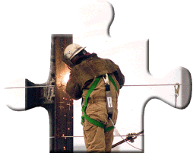
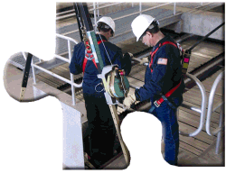
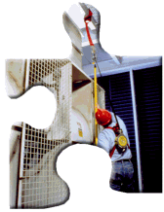
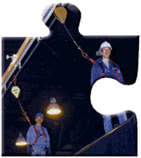

Fall Protection in General Industry
School of Continuing Education & Professional Development Miami Dade College - North Campus
OSHA Susan Harwood Training Grant

Slide 2
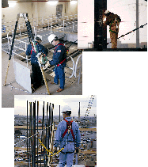
DISCLAIMER
This material was produced under grant # SH-27618-SH5 from the Occupational Safety and Health Administration, U.S. Department of Labor. It does not necessarily reflect the views or policies of the
U. S. Department of Labor, nor does mention of trade names, commercial products, or organizations imply endorsement by the U. S. Government. The U.S. Government does not warrant or assume any legal liability or responsibility for the accuracy, completeness, or usefulness of any information, apparatus, product, or process disclosed.
COPYRIGHT INFORMATION: This material is the copyrighted property of Miami Dade College.
By federal regulation, OSHA reserves a license to use and disseminate such material for the purpose of promoting safety and health in the workplace. Miami Dade College hereby authorizes employers and workplace safety and health professionals to use this material, distributed by or through OSHA, in
their workplaces or practices in accordance with the guidance contained in the material.
To this end, permission is granted to use such copyrighted material solely for non-commercial, instructional, personal, or scholarly purposes. The material may be used and incorporated into other workplace safety and health programs on the condition that no fee may be charged for the subsequent use of the material. Use of the material for any other purpose, particularly commercial use, without the prior, express written permission of the copyright owner/s is prohibited. Furthermore, any modification to the material is prohibited without the prior, express written permission of the copyright owners.
OSHA - Susan Harwood Training Grant

Slide 3

Results of a Fall
The average fatal fall is only 6 feet
A 6’ foot fall generates over 3,200 lb of force – that is the approximate weight of an average midsize car
A fall from 10 feet has an 4 out of 5 probability of causing death or permanent injury
A fall from 11 feet has an 8.5 out of 10 chance of causing death

Slide 4
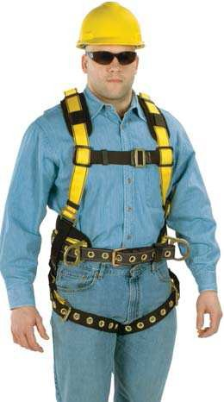
What Happens in the Industry?
Analysis of incidents from a Fortune 500 Company:
When a slip, trip, or other fall happens
  77% of the time the fall incident results in an OSHA Recordable injury or higher
50% of the time, the fall is to the same level
  72% of the walking or working surfaces had sources of contamination (water, product, etc.) that were slipped on
  50% of the walking or working surfaces had sources of contamination (nails, pipes, etc.) that were tripped over
36% of the time, the fall is to a lower level
  16% of the time, the fall involves stairs
  19% of the time, the fall involves a ladder

Slide 5


What Happens in a Fall with a 1.8 m (6 ft) lanyard?
Time | Physical Response | Free-Fall Distance | Velocity
0.1 sec | Unaware | 5.1 cm (2 in) | 1.0 m/s (3.3 ft/s)
0.2 sec | Aware | 20.3 cm (8 in) | 2.13 m/s (7 ft/s)
0.5 sec | Start to Move | 1.22 m (4 ft) | 4.88 m/s (16 ft/s)
0.61 sec | Slight Movement | 1.83 m (6 ft) | 5.97 m/s (19.6 ft/s)
0.7 sec | Impact | 2.41 m (7.9 ft) | 7.01 m/s (23 ft/s)
0.9 sec | Rebound | 3.96 m (13 ft) | 8.84 m/s (29 ft/s)
1.0 sec | Suspend | 4.9 m (16 ft) | 9.75 m/s (32 ft/s)

Slide 6

What is a Fall Hazard?
Types of Fall Hazards:
  Falls to a lower level
  Falls to the same level
  Falls to a higher level
  Slips & Trips

Slide 7

Training Objectives
  Recognition of Fall Hazards
  Review of Applicable Standards/Regulations
  Basic Fall Prevention Principles
  Basic Fall Protection Principles
  Inspection Principles
  Rescue Principles

Slide 8
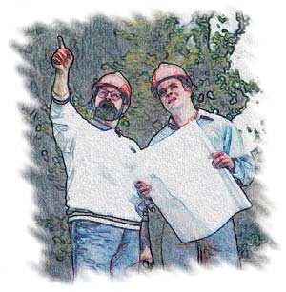
Regulatory Summary
Occupational Safety and Health Administration (OSHA) Regulations
American National Standards Institute (ANSI) Regulations
Canadian Safety Associates (CSA) Regulations

Slide 9
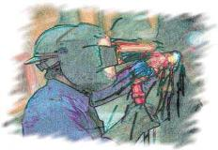
Regulatory Summary - OSHA General Industry
Subpart D, Walking/Working Surfaces Fixed Ladders, Ladder Safety Devices Scaffolding, Boatswain’s Chairs | (d) (5) (j) (4)
Subpart F Powered Platforms Personal Fall Arrest Systems | 1910.66 1910.66, Appendix C
Subpart J, Confined Space | 1910.146
Subpart R, Special Industries | 1910.267
Agricultural Operations
Telecommunications | 1910.268
Electric Power Generation, Transmission and Distribution | 1910.269
OSHA’s Regulations for Marine Terminals and Longshoring | 1917
Marine Terminals
Longshoring | 1918

Slide 10
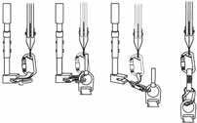
Regulatory Summary - OSHA Construction
Subpart E, Personal Protective Equipment Safety Belts, Linelines, and Lanyards Safety Nets | 1926.104 1926.105
Subpart L, Scaffolding Boatswain’s Chair | 1926.450-454
Subpart M, Fall Protection Scope, Application, Definitions Duty to Have Fall Protection Fall Protection Systems Criteria and Practices Training Requirements | 1926.500 1926.501 1926.502 1926.503
Subpart R, Steel Erection Fall Protection | 1926.750
Subpart X, Ladders | 1926.1053

Slide 11
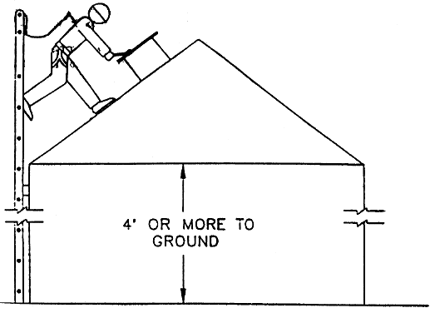
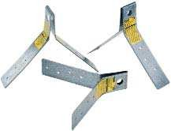
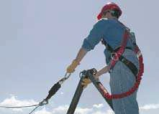
Most Common U.S. Requirements
> 1.2 meters (4 feet) above the working surface for general tasks
– OSHA 1910 - General Industry
> 1.8 meters (6 feet) above the working surface for construction or demolition tasks
– OSHA 1926 - Construction

Slide 12

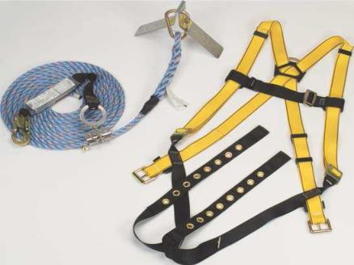
Most Common U.S. Requirements
•Within 1.8 meters (6 feet) of the roof edge

Slide 13
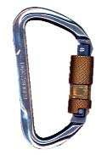

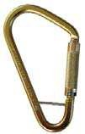
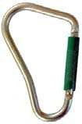



Solution Choices
Use the Hierarchy of Control
  Engineering
  Administrative
  Personal Protective Equipment

Slide 14
Engineering
Eliminate The Risk
Avoid working at height where possible or locate plant and
equipment in safe locations where there’s no risk of a fall.
After all, if you’re not at height, gravity has much less pull.

Slide 15
Administrative
Guard The Hazard
When working at height is essential, ensure that workers aren’t exposed to unnecessary risks by providing a parapet or guardrail to eliminate fall hazards.

Slide 16
Personal Protective Equipment
Protect The Worker
If it’s not possible to eliminate the risk of falling, use the
appropriate fall protection system to help minimize the
consequences of a fall. This is achievable through either
a fall arrest or fall restraint system.

Slide 17
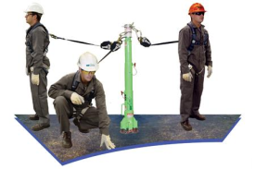
Commonly Used Terms
“Fall Restraint” and “Fall Arrest” are commonly used terms in the industry. Identifying the difference between the two is crucial in terms of understanding where and why a particular system should be used.
FALL RESTRAIN
Used when looking to prevent workers from reaching a point where a fall could happen. It’s generally suited for persons who need to work at the edge of a hazard – for example, maintaining gutters along the edge of a roof.
FALL ARREST
Comes into consideration when a worker can access a point at which a fall can occur. A fall arrest system will safely arrest a fall, which would then be followed by the appropriate rescue procedure.

Slide 18
Examples

Slide 19
Examples

Slide 20
Examples

Slide 21
Examples

Slide 22
Examples

Slide 23
Examples

Slide 24
Examples

Slide 25
Examples

Slide 26
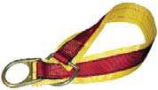
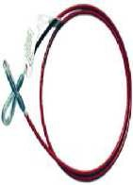

Fall Hazard Analysis
Before finding a solution – the hazard must be evaluated.
Use Hazard or Risk Prediction -- What are the conditions and behaviors to consider?
  How will we get to the work area?
  What are the hazards below the work area?
  How high is the work area?
  Are there holes or openings below or around the work area?
  Are there slip or trip hazards around the work area?
  How difficult is it to rescue someone if they fall?

Slide 27
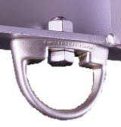
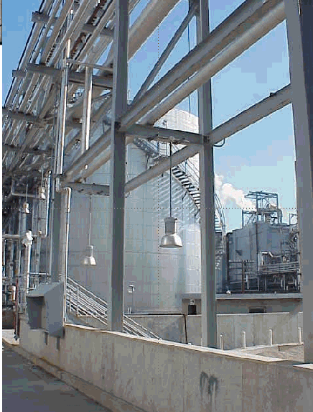
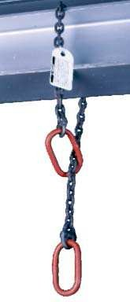
Picture

Slide 28
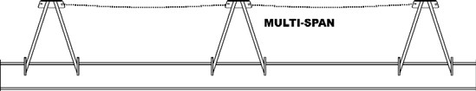
Fall Hazard Solutions
Once fall hazards are identified – work on options for solution
Apply the Hierarchy of Control – first prevent, then protect
  What are my options for Fall Restrain?
  What are my options for Fall Arrest?

Slide 29
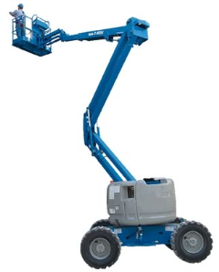
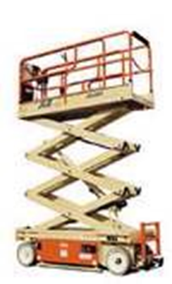
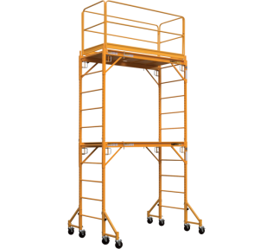
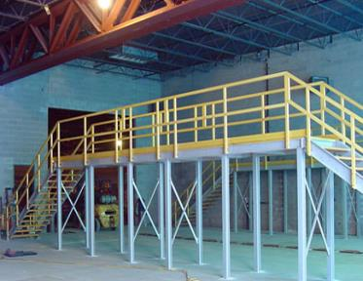
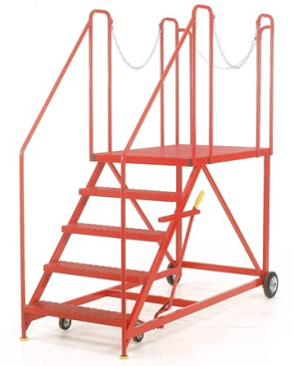
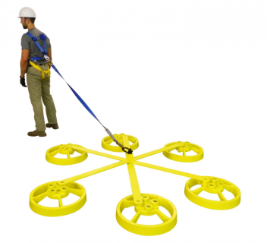
Fall Prevention Options
Platforms and Railings
Lifts
Scaffolding
Ladders
Fall Restraint Systems
Mobile Stairs

Slide 30
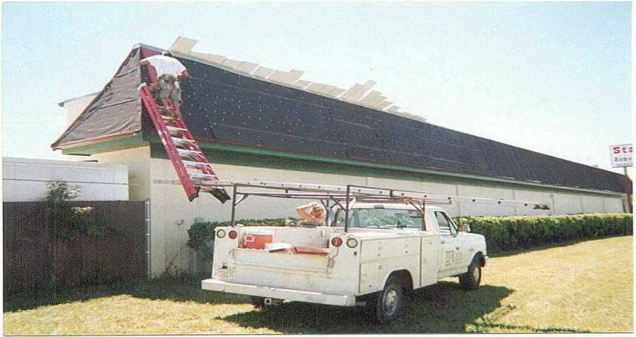
Fall Prevention Options – Ladders
Is this correct ladder usage?

Slide 31
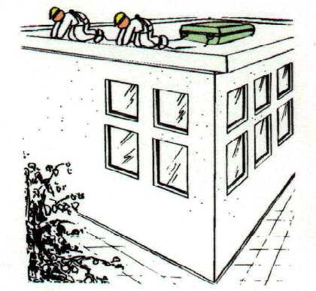
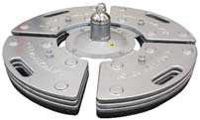
Fall Prevention Options – Fall Restraint
Fall Restraint System
  Used with a fully body harness and anchorage
  Considered a Collective System
Advantages and Disadvantages?

Slide 32


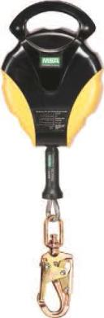
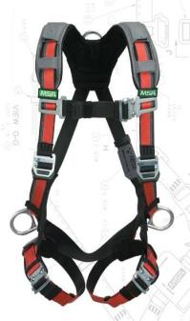
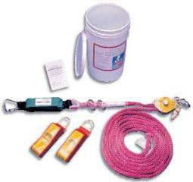
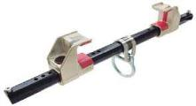

Fall Protection Options – Personal Protective Equipment
Full Body Harness
Energy Absorbing Lanyard
Self-Retracting Lanyard
Connectors
Ladder Climbing Devices
Vertical Lifeline
Horizontal Lifeline
These have specific design and performance requirements, some are established, and some must be engineered.
All these require additional training and background.

Slide 33
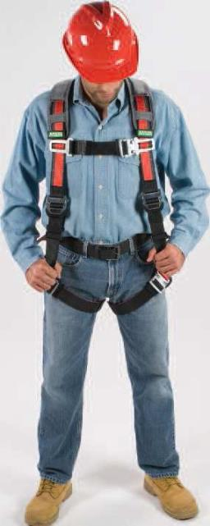
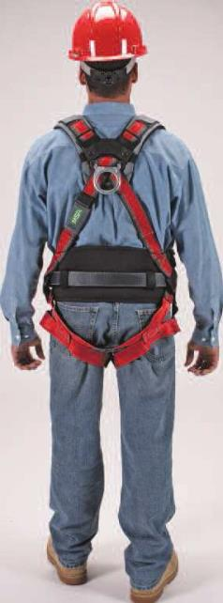
Personal Protective Equipment – Full Body Harness
Full Body Harness
  Leg closures
  No metal above the waist for electrical work
Back D-ring for fall arrest
  Front D-ring for rescue
  Side D’s for positioning
  Kevlar for hot work/welding
What about Body Belts?

Slide 34
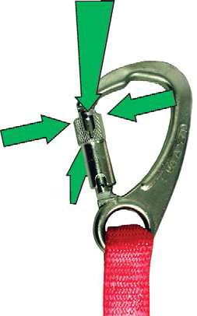
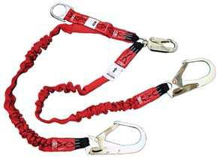
Personal Protective Equipment – Connectors
•Connectors -
Double locking snap hooks
Locking Carabiners – use with horizontal lifelines

Slide 35
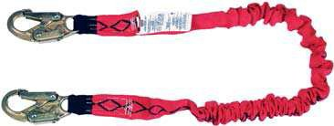
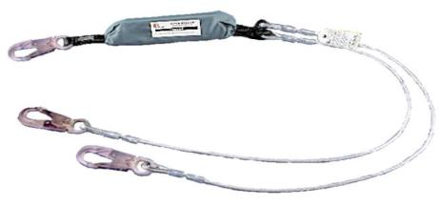
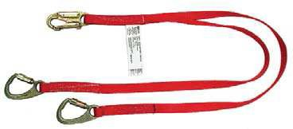
Personal Protective Equipment – Energy Absorbing Lanyard
Energy Absorbing Lanyard
  Energy absorber shock pack
  Double locking snap hooks, or locking carabiner
  Minimal length for the work – no longer than 1.8 m (6 feet)

Slide 36
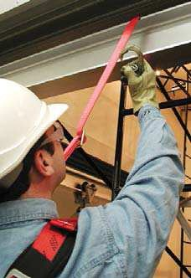
Fall Protection Background – Forces
Maximum Arresting Force
  Force on the body caused by stopping a fall
  Maximum is 1,800 lb. by law
  Minimum force causing body damage = 2,700 lb.
All PPE is designed for a maximum free fall distance of 6 feet and a maximum arresting force of 1,800 lb.
YOUR GOAL:
  Minimize the free fall distance to reduce arresting force

Slide 37

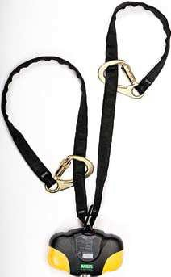
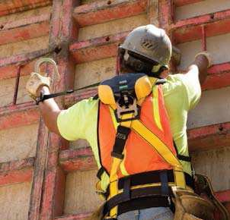
Personal Protective Equipment – Self-Retracting Lanyard
•Self-Retracting Lanyard
Double locking snap hooks
Minimizes free fall distance
Maintain overhead anchorage

Slide 38

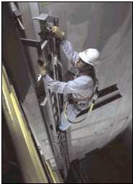
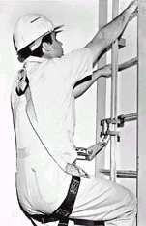

Personal Protective Equipment – Ladder Climbing Device
Ladder Climbing Device --
  Used with Fixed Ladders
  Used with a full body harness
  Minimal length lanyard connected in front

Slide 39

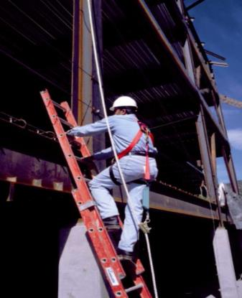

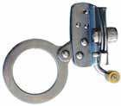

Personal Protective Equipment – Vertical Lifeline
Vertical Lifelines
Rope Grabs

Slide 40



Personal Protective Equipment – Horizontal Lifeline
•Horizontal Lifelines
– Requires a Qualified Person for engineering or anchorage certification

Slide 41

Fall Protection Background – Personal Protective Equipment
What all do we consider before using PPE?
  Free-Fall Distance
  Total Fall Distance
  Maximum Arresting Force
  Anchorage Point Strength and Location
Strength and Location Type of PPE Desired
Best combination for the Work at Heights task

Slide 42





Fall Protection Background – Anchorage Points
Characteristics
  Meets the strength requirement
  Identified
  Available for routine work
  Easy to use
Who specifies the anchorage point?
  Qualified person

Slide 43



Fall Protection Background – Anchorage Points
Reviewed and certified by a qualified engineer
Can use both temporary and permanent anchorage points
Ensure that the anchorage point is high enough for the PPE selected

Slide 44



Fall Protection Background – Anchorage Points
What if I don’t have an identified anchorage point?
  Use a building structural beam (> 30 cm (12 inches) deep and distance between supports < 7.5 m (25 ft))
What if I don’t know what force my anchorage point will hold?
  Minimize the arresting force
Engineers need time to do their work – pre- planning is key!

Slide 45



Fall Protection Background – Anchorage Points
Equipment | Strength Requirement
0.9 m (3 ft) energy absorbing lanyard | 22.2 kN (5,000 lbf) or 2 times the Maximum Arresting Force (MAF)
1.8 m (6 ft) energy absorbing lanyard | 22.2 kN (5,000 lbf) or 2 times the Maximum Arresting Force (MAF)
Self-Retracting Lanyard | 13.3 kN (3,000 lbf) or 2 times the Maximum Arresting Force (MAF)
Vertical Lifeline | 22.2 kN (5,000 lbf) or 2 times the Maximum Arresting Force (MAF) using < or = 0.9 m (3 ft) lanyard
Horizontal Lifeline | Minimum of 22.2 kN (5,000 lbf) or 2 times the Maximum Arresting Force (MAF)

Slide 46

Personal Protective Equipment – Formal Inspection
Inspection/Maintenance --
  Frequency
  Who?
  Documentation?
  What do we do with bad equipment?

Slide 47

Personal Protective Equipment – Formal Inspection
What do we inspect for?
  signs of wear;
  cut or frayed edges;
  damaged grommets,
  burns,
  broken stitches,
  distorted snap hooks,
  loose or distorted rivets

Slide 48

Points of Formal Inspection
Labels
Stitching
Fabric Components
Plastic Components
Metal Components

Slide 49

Personal Protective Equipment – Formal Inspection
Manufacturer’s Formal Inspection Forms
  Model Number
  Serial Number
  Inspector
  Inspection Date
  Date Made is Date of Manufacture
  Disposition – left until last after inspection is complete
  Inspection Points

Slide 50




Personal Protective Equipment Inspection Points of Full Body Harness
Fabric Parts
  Webbing
  Stitching
Metallic Parts
  D-Rings/Oval Rings
  Buckles/Adjusters/Grommets
Plastic Parts
  Back D-ring Locator
  Strap Collar
  Labels
  Tool Belt Support Clips

Slide 51

Examples of PPE Failures
Heat damage

Slide 52

Examples of PPE Failures
Separation of layers – stitching was broken

Slide 53

Examples of PPE Failures
Outside plastic cover is damaged – inside exposed
Stretching due to force or heat – incorrect shape

Slide 54

Examples of PPE Failures
Damage due to spark or heat – surface damaged
Buckling damage

Slide 55

Examples of PPE Failures
Examples of PPE Failures

Slide 56

Fall Protection - Rescue Plan
Each time PPE is used, there must be a rescue plan!
  You must be able to rescue someone in a minimum amount of time.
  Identify the normal conditions and allowances.
  Define the plan during the Hazard and Risk Prediction.

Slide 57






Rescue Equipment
Rescue Cradle
  Person is rescued in a physically neutral position.
Full Body Harness
  May be different
  Allows longer suspension
Anthron
  Self-Rescue
  Great in a panic
Rescue Equipment Kits
  Rescue Utility Set
Rescue Hoist
  Confined Space Application
  Able to reset

Slide 58

Review
Fall Hazard scenarios have options
  Fall Prevention
  Fall Protection
Must choose which solution works best for your work situation
Fall Protection
  Inspection
  Training
  Rescue

Slide 59


Questions?

