Slide 1
Module 2 –
Material Handling
Mechanical and Manual Considerations

Slide 2
Disclaimer
This material was produced under Grant SH-26328-SH4 from the Occupational Safety and Health Administration, U.S. Department of Labor.
It does not necessarily reflect the views or policies of the U.S. Department of Labor, nor does mention of trade names, commercial products, or organizations imply endorsement by the U.S. Government.

Slide 3
Purpose
This presentation is meant to:
  Introduce students to common methods of material handling in warehousing
  Introduce students to storage considerations and associated hazards

Slide 4
Objectives/Outcomes
At the end of the presentation, students will
  Have a heighted sense of awareness for struck-by hazards in warehouse operations
  Realize the importance of general housekeeping in warehousing operations
  Understand the importance of stable lifting, stacking, and storing materials
  Be aware of manual lifting hazards
  Understand the use, limitations, and hazards associated with powered industrial trucks
Notes:
What should be emphasized is that the course is meant to heighten awareness of common hazards in a warehousing environment.

Slide 5

Before we begin……….
Pre-test
Notes:
Note – Image downloaded from an image search on www.google.com.
Image for visual appeal only.
Take about 10 minutes to complete and review the pre-test.

Slide 6

As We Begin, Remember……..
Warehousing can be very complex
Machinery, inventory, noise, temperature, just to name a few
Keep your EYES open!
  Evaluate
  Your
  Entire
  Surroundings
Notes:
Note – Image downloaded from an image search on www.google.com.
Image for visual appeal only.
Hand out OSHA EYES poster for struck-by prevention

Slide 7
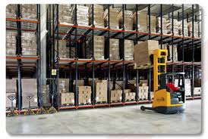
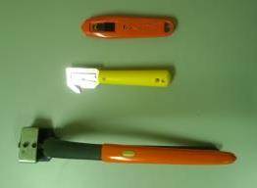
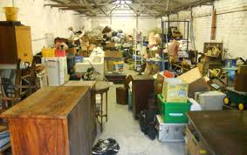
Warehousing Hazard Overview
Physically Demanding
  Ergonomics
Sharps
  Box Cutters
  De-Banding Tools
General Housekeeping
  Cardboard
  Banding
  Wrapping Material
  Pallets
Machinery
  Forklifts
  Trucks (i.e. tugs, semis, etc.)
Notes:
Note – Warehouse images downloaded from an image search on www.google.com. Utility knives and de-banding tool image is a Western Nebraska Community College stock photo.
Images are for visual appeal and highlight future talking points.

Slide 8

OSHA Basics
Employer responsibilities – Employers MUST:
  Provide employees with a safe workplace
  Follow all relevant OSHA safety and health standards
  Inform employees about hazards through training, labels, alarms, color-coded systems, and other methods
  Keep accurate records of work-related injuries and illnesses
  Perform tests in the workplace as required by some OSHA standards
  Post OSHA citations, injury and illness data, and the OSHA poster
  Notify OSHA about serious accidents and fatalities
  Not discriminate or retaliate against workers for using their rights under the law
Notes:
A much more thorough OSHA Basics presentation is available in Module 1. The next five slides are presented in case Module 2 is done as a stand alone presentation. For those who have been through Module 1, this will serve as a quick recap.
Run through the list on the slide one at a time.
Employers have the responsibility to provide safe workplace. Employers must provide their employees with a workplace that does not have serious hazards and follow all relevant OSHA safety and health standards. Employers must find and correct safety and health problems. OSHA further requires employers to try to eliminate or reduce hazards first by making changes in working conditions rather than just relying on masks, gloves, earplugs or other types of personal protective equipment.
The OSHA poster is referenced in this slide. Inform students that they can get a copy of the OSHA poster at https://www.osha.gov/Publications/poster.html. If you have access to the internet, you should take a minute and visit the webpage.
This would also be a good time to discuss the new recordkeeping/reporting requirements. This information is at https://www.osha.gov/recordkeeping2014/index.html.

Slide 9
OSHA Basics
Employee Rights – Employees Have the Right to:
  Working conditions that don’t pose a risk of serious harm
  Information and training about:
    Chemical and other hazards
    Methods to prevent harm
    OSHA standards that apply to their workplace
  Review records of work-related injuries and illnesses
  Get copies of test results done to find and measure hazards in the workplace
  File a complaint asking OSHA to inspect their workplace
  Use their rights under the law without retaliation
Notes:
Employees have the following rights under OSHA:
Working conditions that do not pose a risk of serious harm. • Receive information and training (in a language workers can understand) about chemical and other hazards, methods to prevent harm, and OSHA standards that apply to their workplace. • Review records of work-related injuries and illnesses. • Get copies of test results done to find and measure hazards in the workplace. • File a complaint asking OSHA to inspect their workplace if they believe there is a serious hazard or that their employer is not following OSHA rules. When requested, OSHA will keep all identities confidential. • Use their rights under the law without retaliation. If an employee is fired, demoted, transferred or retaliated against in any way for using their rights under the law, they can file a complaint with OSHA. This complaint must be filed within 30 days of the alleged retaliation.
The next three slides go into Whistleblower Protection to expand on retaliation protection.

Slide 10
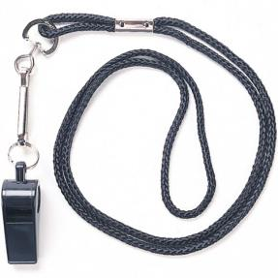
Whistleblower Protection
Section 11(c) of the OSH Act
OSHA's Whistleblower Protection Program enforces the whistleblower provisions of more than twenty whistleblower statutes protecting employees who report violations
Notes:
Note – Image downloaded from an image search on www.google.com.
Image for visual appeal only.
Inform students that they can file a complaint if retaliation occurs related to safety and health. If you have access to the internet, take some time to review basic Whistleblower information at http://www.whistleblowers.gov/ .
At the time of development, there were 22 statutes, including 11(c).
Pass out whistleblower factsheet. This factsheet can be found at https://www.osha.gov/OshDoc/data_General_Facts/whistleblower_rights.pdf.

Slide 11
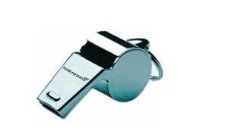
Whistleblower Protection
An employer may not take an adverse action against an employee because the employee engages in protected activity.
Notes:
Note – Image downloaded from an image search on www.google.com.
Image for visual appeal only.
Inform students that they can file a complaint if retaliation occurs related to safety and health. If you have access to the internet, take some time to review basic Whistleblower information at http://www.whistleblowers.gov/ .

Slide 12
Whistleblower Protection
Protected activities may include:
  Making a health and safety complaint to a supervisor
  Making a health and safety complaint to the Government
  Reporting a work-related illness or injury
  Cooperating in an inspection/investigation
  Requesting Safety Data Sheets
  Testifying
  Refusing to do unsafe tasks
Notes:
Note - You can refuse to do a serious dangerous work, but not walk off the job.
See https://www.osha.gov/right-to-refuse.html for details on refusing to do work.

Slide 13
Common Standards for Warehousing
General Duty Clause
  Section 5(a)(1)
    (1) shall furnish to each of his employees employment and a place of employment which are free from recognized hazards that are causing or are likely to cause death or serious physical harm to his employees
Notes:
General Duty Clause can be found at the following web addresses
Section 5(a)(1) https://www.osha.gov/pls/oshaweb/owadisp.show_document?p_table=OSHACT&p_id=3359
It is recommended that you have a copy of these standards available prior to delivering training.
The link to frequently cited standards in warehousing is https://www.osha.gov/pls/imis/citedstandard.naics?p_esize=&p_state=FEFederal&p_naics=4931. General Duty Clause citations totaled $61,388 from October 2013 to September 2014.

Slide 14
Common Standards for Warehousing
Primary General Industry Standards
  29CFR1910 Subpart N – Materials Handling and Storage
    29CFR1910.176 – Handling Materials – General
    29CFR1910.178 – Powered Industrial Trucks
Related Standards
  29CFR1910.1030 – Bloodborne Pathogens
  29CFR1910.22 & 29CFR1910.23-Guarding Floor & Wall Openings & Holes
  29CFR1910.1200 – Hazard Communication
Notes:
Standards can be found at the following web addresses
29CFR1910.176 https://www.osha.gov/pls/oshaweb/owadisp.show_document?p_table=STANDARDS&p_id=9824
29CFR1910.178 https://www.osha.gov/pls/oshaweb/owadisp.show_document?p_table=STANDARDS&p_id=9828
29CFR1910.1030 https://www.osha.gov/pls/oshaweb/owadisp.show_document?p_table=STANDARDS&p_id=10051
It is recommended that you have a copy of these standards available prior to delivering training.

Slide 15

General Considerations
A good place to start
  Ergonomics
  Sharps
  Banding
Notes:
Note – Image downloaded from an image search on www.google.com.
Image for visual appeal only.

Slide 16
Good Practice Considerations - Ergonomics
Defined as…..
  Interdisciplinary science that deals with the interaction of people with the objects they use and the environments in which they function
  (Mustafa B.P., 1997)
  Remember to consider the entire environment (noise, temperature, physical considerations, etc)
Notes:
Definition is from the following text
Pulat, B. Mustafa. (1997). Fundamentals of industrial ergonomics. 2nd ed. Prospect Heights, Ill.: Waveland Press.

Slide 17
Objective of Ergonomics
Maximize safety and production by fitting the task to the person.
Well-Being
Ergonomics
Comfort
Efficiency
Notes:
Take time to discuss safety AND production benefits. No one works efficiently while in pain.

Slide 18

Costs of Ignoring Ergonomics
Poor Production
Increased Lost Time
Higher Medical Costs
Higher Material Costs
Increased Absenteeism
Increased Accidents
Safety Pays!
Notes:
Remember to emphasize all costs, not just medical.
This slide ends with “Safety Pays” because it transitions into an example using OSHA’s Safety Pays program on the next slide. Be ready to transition. If you do not have internet access, skip the next slide.

Slide 19
Cost Estimation Activity
OSHA’s Safety Pays program estimates total costs of injuries or illnesses.
Web Link is https://www.osha.gov/dcsp/smallbusiness/safetypays/index.html
Let’s give an example
Notes:
The Safety Pays program can be found at https://www.osha.gov/dcsp/smallbusiness/safetypays/index.html. Open up a web browser and copy the link into the address bar to go to the website. Review the initial landing page. Click on the Background tab and review that page. Click on the Estimator tab. Enter in sample parameters and click calculate. Note the additional sales needed to cover direct and indirect costs.
If you do not have internet access, skip this slide.

Slide 20
Standard for Ergonomics – General Duty
Ergonomic illnesses and injuries have greatly increased in the past couple of decades
OSHA will generally cite ergonomic hazards under the “General Duty Clause.”
Notes:
No “official” Federal ergonomic standard.

Slide 21

Common Ergonomic Issues in Warehousing
Anthropometric
Musculoskeletal
Cardiovascular
Cognitive
Notes:
Note – Image downloaded from an image search on www.google.com.
Image for visual appeal and simple depiction of proper form while lifting.

Slide 22
Anthropometric
Anthropometric Problems – These relate to the dimensional conflict between functional space geometry and the human body
Examples: Foot/hand controls out of reach, seat is too high/low, etc.
Remedies: Make equipment adjustable/moveable, position loads to minimize movement and twisting
Notes:
Good time to discuss table heights, chair heights, and setting up work areas with materials within normal reach.

Slide 23
Musculoskeletal
Musculoskeletal Problems – These occur when the muscular and skeletal systems are strained
Examples: Muscle pull from single incident, injuries from vibrating machines, repetitive motion/cumulative trauma disorders (RMD/CTD)
Remedies: Job performance aids (carts, padding, etc), team lifting
Notes:
Good time to discuss large muscle issues, like strain from lifting, and issues that may develop from hand-tool use.

Slide 24
Cognitive
Cognitive Problems – These arise when either information overload or underload - processing problems
Examples: Mental fatigue, over-stimulation, boredom
Remedies: Change pace of information; increase illumination; decrease noise; use, don’t abuse multiple senses
Notes:
This is a good time to discuss things like light glare and noise in addition to work flow and pace.

Slide 25

Cardiovascular
Cardiovascular Problems – These problems place stress on the circulatory system, including the heart
Examples: Paced muscular work and work under heat stress
Remedies: Job rotation, climate control, extra water breaks
Notes:
Note – Image downloaded from an image search on www.google.com.
Image for visual appeal only.
Good time to discuss that many warehouse operations are not climate controlled. Environments can be both hot and cold.

Slide 26

Ergonomic Issues are Interconnected
Poor Lighting + Bad Posture = Loss of Focus and Muscle Pull
Heat + Fast Pace + Noise = Heart Stress and Fatigue
Load Out of Reach + Fast Pace = Muscle Pull
Notes:
Note – Image downloaded from an image search on www.google.com.
Image for visual appeal only.
Staging a simple simulation, such as a five or six empty boxes just out of reach, can add value to this slide. After moving the boxes, reposition them closer to and highlight differences in posture and reach.
LAST ERGONOMIC SLIDE – PREPARE TO TRANSITION TO BLADES AND BANDING

Slide 27
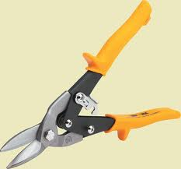
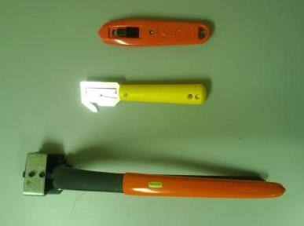
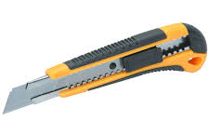
Sharps and Snips
Common Snips and Knife
Better Choices
Notes:
Note – Images on the left were downloaded from an image search on www.google.com. Images on the right are Western Nebraska Community College stock photos.
Image differentiate standard tools from safer tools. The following slides highlight the differences between tools.
It is recommended to have sample tools available to physically highlight differences.

Slide 28
Utility Knives
Insert Video on using Box Cutters
Notes:
The script is as follows:
“Box cutters and de-banding devices are common in warehousing. These tools should be chosen with care. Box cutter blades are essentially razor blades. If not handled properly and sheathed when not in use, deep cuts can result. Safety blades and blades that retract automatically, like the ones shown here, can help reduce the risk of injuries. ”
Delete slide if you have trouble playing the video.

Slide 29
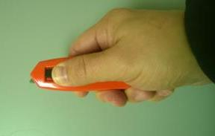
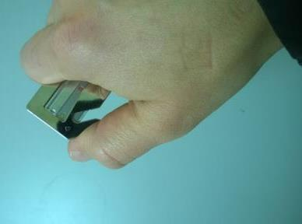
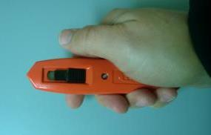
Safety Knives
Self-Retracting
Safety Box Opener
Notes:
Note –Images are Western Nebraska Community College stock photos.
They highlight utility knives with safety features.
Good time to give a demo with live props.

Slide 30
Banding Under Pressure
Insert Video about banding
Notes:
Insert a video clip related to banding. The script is as follows:
“Banding, particularly metal banding, can be under a great deal of tension. If the banding is cut without this in mind, the energy release can create a hazard when the sharp-edged banding swings uncontrollably, leading to severe lacerations and other injuries. Managing this hazardous energy is important and can be done so with special band cutters, like the one shown here. Additionally, personal protective equipment, such as gloves, face shields, and safety glasses, should be worn to prevent injury.”
Delete slide if you have trouble playing the video.

Slide 31
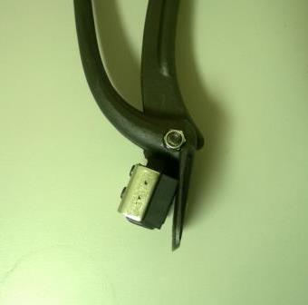
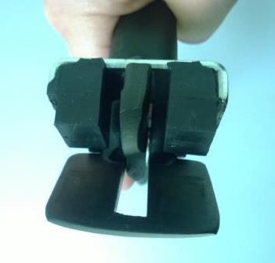
Metal Banding Cutter
Pads to hold metal banding
Cutting Area
Notes:
Note –Images are Western Nebraska Community College stock photos.
They highlight how a pair of metal de-banders works.
Pass around a pair of banding cutters if available.

Slide 32


Bloodborne Pathogens
29CFR1910.1030
Universal Precautions
  PPE
  Limit Contact
Notes:
Note – Images downloaded from an image search on www.google.com.
Image for visual appeal only.
Because utility knives and cutters are used, there is potential for cuts and blood exposure. Discuss safety precautions and personal protective equipment. Tell students that their employer may have a bloodborne exposure control plan and should provide them with specific training on their program.
LAST SLIDE BEFORE BREAK - TRANSITION TO MECHANICAL/FORKLIFT/VECHICLE HAZARDS

Slide 33
Break Time
Notes:
Note – Image downloaded from an image search on www.google.com.
Image for visual appeal only.

Slide 34
Handling Materials - General
29CFR1910.176 requirements when mechanical equipment is used
  Sufficient safe clearances when mechanical equipment used
  (aisles, docks, doorways, turn areas)
  Aisles and passageways must be kept clear and in good repair
  No obstructions across or in aisles that could create a hazard
  Permanent aisles and passageways shall be appropriately marked

Slide 35

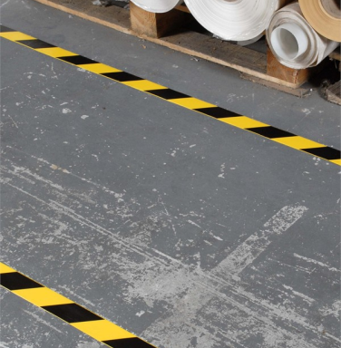
Handling Materials – General
Notes:
Note – Images downloaded from an image search on www.google.com.
Image highlight samples of clear and marked aisles.

Slide 36
Handling Materials – General
29CFR1910.176 requirements for secure storage
  Storage shall not create a hazard
  Materials shall be stacked, blocked, interlocked, and limited in height
  The purpose is to assure stability and security against sliding or collapse
Notes:
The following slide highlights fallen material.

Slide 37
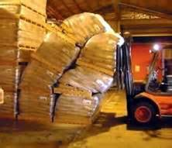
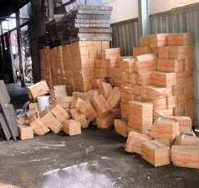
Handling Materials – General
Notes:
Note – images downloaded from an image search on www.google.com.
Images highlight the importance of proper stacking.
At this point, a good reflective questions to ask would be as follows:
Have you ever seen materials or packages stacked more than 2- pallets high or more that 8-feet high without being secured? Is so, what are some obvious safety and loss issues?
Discussion topics can include danger to foot traffic, loss of product, equipment damage, wind/weather considerations, and so on.

Slide 38
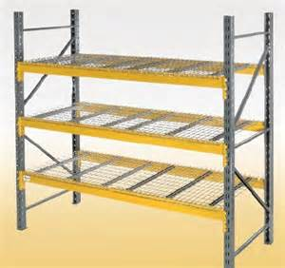
Materials Handling - General
Pallet Racks
  Engineered load
  Designed for easy access & adjustment
  Help maintain clean and orderly areas
Notes:
Note – Image downloaded from an image search on www.google.com.
Image meant to show what a pallet rack looks like.

Slide 39

Handling Materials - General
29CFR1910.176 requirements for housekeeping and clearance
  Storage areas shall be kept free from accumulation of materials that constitute hazards
    Trip hazards
    Fire
    Explosion
    Pests
  Clearance signs to warn of clearance limits shall be provided
Notes:
Note – Image downloaded from an image search on www.google.com.
Image is to highlight clearance sign talking point.

Slide 40
Struck-by Awareness
Insert Video on struck-by hazards
Notes:
Video clip related struck-by hazards. The script is as follows:
“Struck-by incidents are a huge concern in warehouse environments. Motorized pallet-jacks, forklifts, aisle trucks, and semis are commonly used. Whether loaded or unloaded, these pieces of equipment have a number of blind spots. You should never assume that you can be seen. Keep a safe distance from all vehicles and do not approach them unless the operator throttles down energy and motions you over.”
Delete slide if you have trouble playing the video.

Slide 41
Handling Materials – Powered Industrial Trucks
29CFR1910.178 requirements when mechanical equipment is used
  This was the MOST frequently cited standard in 2013-2014 for warehousing
  Per 1910.178(a)(1)
    This section contains safety requirements relating to fire protection, design, maintenance, and use of fork trucks, tractors, platform lift trucks, motorized hand trucks, and other specialized industrial trucks powered by electric motors or internal combustion engines. This section does not apply to compressed air or nonflammable compressed gas-operated industrial trucks, nor to farm vehicles, nor to vehicles intended primarily for earth moving or over-the-road hauling.
Notes:
The link to frequently cited standards in warehousing is https://www.osha.gov/pls/imis/citedstandard.naics?p_esize=&p_state=FEFederal&p_naics=4931.
From October 2013 to September 2014 there were 154 citations and $321,060 in fines for PIT violations. PIT violations are the MOST frequently cited.
.

Slide 42
By Definition…
A Powered Industrial Truck (PIT) is
  A mobile, power-propelled truck used to carry, push, pull, lift, stack or tier materials. [American Society of Mechanical Engineers (ASME) definition]
  Excluded are vehicles used for earth moving and over-the-road hauling.
  Commonly known as forklifts, pallet trucks, rider trucks, fork trucks, or lift trucks.
  Can be powered through electric or combustion engines.

Slide 43
Classes of Commonly-Used PIT’s*
The Industrial Truck Association has placed powered industrial trucks into 7 classes.
  Class I - Electric motor rider trucks
  Class II - Electric motor narrow aisle trucks
  Class III - Electric motor hand trucks or hand/rider trucks
  Class IV - Internal combustion engine trucks (solid/cushion tires)
  Class V - Internal combustion engine trucks (pneumatic tires)
  Class VI - Electric and internal combustion engine tractors
  Class VII - Rough terrain forklift trucks
* Note that this classification refers to commonly-used vehicles and does not include all powered industrial trucks covered by the OSHA standard.

Slide 44
Class I - Electric Motor Rider Trucks
Counterbalanced rider type or stand up
Three wheel electric trucks, sit-down
Counterbalanced rider type, cushion tires, sit-down (high and low platform)
Counterbalanced rider, pneumatic tire, sit-down (high and low platform)

Slide 45
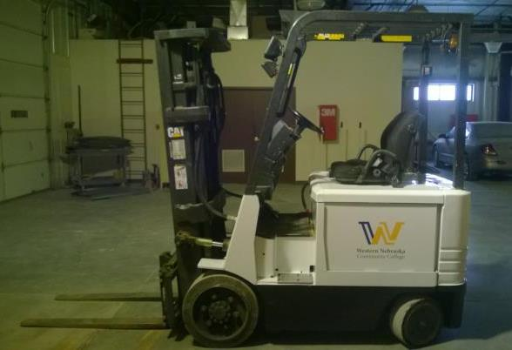
Class I - Electric Motor Rider Trucks
Notes:
Note – Image is a Western Nebraska Community College stock photo.
Image shows a Class I PIT.

Slide 46
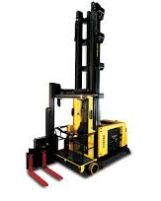
Class II - Electric Motor Narrow Aisle Trucks
High lift straddle
Order picker
Reach type outrigger
Side loaders, turret trucks, swing mast and convertible turret/stock pickers
Low lift pallet and platform (rider)
Notes:
Note – Image downloaded from an image search on www.google.com.
Image shows a Class II Aisle Truck

Slide 47
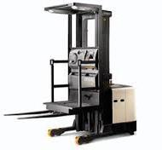
Class II - Electric Motor Narrow Aisle Trucks
High lift straddle
Order picker
Reach type outrigger
Side loaders, turret trucks, swing mast and convertible turret/stock pickers
Low lift pallet and platform (rider)
Notes:
Note – Image downloaded from an image search on www.google.com.
Image shows a Class II PIT’ known as a “stock picker” or “order picker.” Inform the class that these PIT’s have built in anchors for fall arrest.

Slide 48
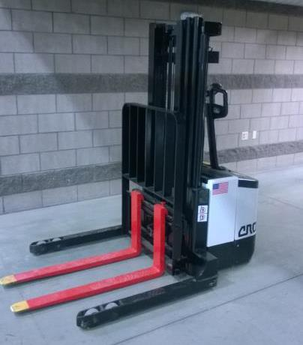
Class III - Electric Motor Hand or Hand/Rider
Low lift platform
Low lift walkie pallet
Reach type outrigger
High lift straddle
High lift counterbalanced
Low lift walkie/rider pallet
Notes:
Note – Image is a Western Nebraska Community College stock photo.
Image meant to show an example of a Class III Walkie-Stacker.

Slide 49
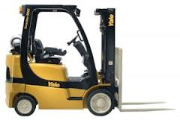
Class IV Internal Combustion Engine Trucks
Cushion (Solid) Tires
Internal Combustion
Beware of Carbon Monoxide
Beware of Hazardous Environments
Notes:
Note – Image downloaded from an image search on www.google.com.
Image shows a Class IV PIT.
One thing to discuss is the added hazard of carbon monoxide on remaining classes of forklifts discussed. Also discuss how combustion engines are often not approved for hazardous areas. Hand out Fatal Fact Sheet #15-254 or similar fact sheets as examples. The Fact Sheet referenced explains how a LP-gas forklift caused an explosion.
Fatal Fact Sheets can be found at https://www.osha.gov/Publications/fatalfacts.html

Slide 50
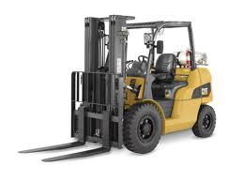
Class V Internal Combustion Engine Trucks
Pneumatic Tires
Notes:
Note – Image downloaded from an image search on www.google.com.
Image shows a Class V PIT.

Slide 51
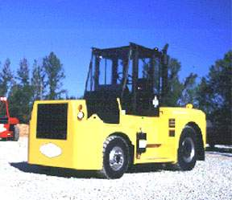
Class VI Electric & Internal Combustion Tractors
Not as routinely used in warehousing as Classes I-V
Notes:
Note – Image downloaded from an image search on www.google.com.
Image shows a Class VI PIT.

Slide 52
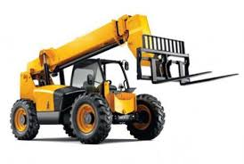
Class VII – Rough Terrain Forklift Trucks
Not as routinely used in warehousing as Classes I-V
Notes:
Note – Image downloaded from an image search on www.google.com.
Image shows a Class VII PIT.

Slide 53
Certification
Just because you can operate a PIT, does not mean you are authorized to do so
PIT operators are to be “certified” by their employer
The employer shall certify that each operator has been trained and evaluated as required by the standard.
Certification does not “transfer” from one business to another.
Notes:
This is a good time to note that because you operate a PIT at one business does not authorize you to operated a different machine for a different employer.

Slide 54
Certification
Certification is employer specific and machine specific.
Certification shall include:
  Name of operator
  Date of training
  Date of evaluation
  Identity of person(s) performing the training and/or evaluation

Slide 55

Performance-Oriented Requirements
The powered industrial truck operator training requirements
  Are performance-oriented
  Permits employers to tailor a training program
  Build their program around workplace characteristics and equipment
This training is NOT meant to certify or authorize you to drive any specific PIT
HOWEVER – You should be informed of PIT training requirements!
Notes:
Note – Image downloaded from an image search on www.google.com.
Image meant to emphasize the age restriction on PIT’s.
Emphasize that this is not a certification course.
Good time to reinforce age requirement in addition to certification. The legal age is 18.

Slide 56

PIT Training Program
Operators shall receive initial training in the following topics
  Truck-related topics
  Workplace-related topics
  The requirements of the standard
Notes:
Note – Image downloaded from an image search on www.google.com.
Image for visual appeal only.

Slide 57

Operator Training
  The employer shall ensure that each powered industrial truck operator is competent to operate a powered industrial truck safely, as demonstrated by successful completion of the training AND evaluation specified in the OSHA standard.
  Prior to permitting an employee to operate a powered industrial truck (except for training purposes), the employer shall ensure that each operator has successfully completed the required training (or previously received appropriate training).
Notes:
Note – Image downloaded from an image search on www.google.com.
Image for visual appeal only.

Slide 58

Operator Training
  Training is a combination of…….
    Formal instruction (e.g., lecture, discussion, interactive computer learning, written material)
    Practical training (demonstrations and exercises performed by the trainee)
    Evaluation of the operator’s performance in the workplace
Notes:
Note – Image downloaded from an image search on www.google.com.
Image for visual appeal only.

Slide 59
Operator Training
  Training Implementation
    Training and evaluation shall be conducted by a person with the knowledge, training and experience to train powered industrial truck operators and evaluate their competence.

Slide 60
Continued/Refresher Training
Refresher training, including an evaluation of the effectiveness of that training, shall be conducted to ensure that the operator has the knowledge and skills needed to operate the powered industrial truck safely.
Refresher training required when:
  Unsafe operation
  Accident or near-miss
  Evaluation indicates need
  Different type of equipment introduced
  Workplace condition changes
  Every three years
Notes:
LAST SLIDE ON PIT’s – TRANSITION TO HAZARD RECOGNITION SLIDES

Slide 61

Hazards…..things to be aware of
Notes:
Note – Image downloaded from an image search on www.google.com.
Image for visual appeal only.

Slide 62
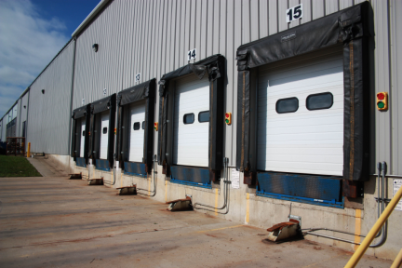
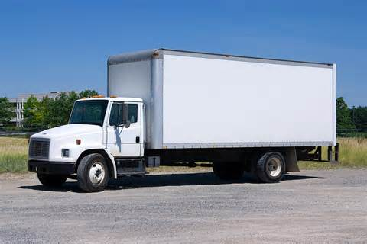
General Vehicle Traffic
Notes:
Note – Images downloaded from an image search on www.google.com.
Images highlight large vehicle traffic.
Warehousing and storage is a subset of the transportation industry. It is important to discuss other vehicle traffic, particularly semi traffic and how a safe distance should be maintained. It is a good time to emphasize the struck-by incidents do not just include forklifts or equipment inside a warehouse.

Slide 63
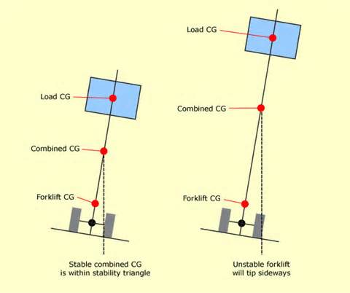
Stability With Forklifts
Forklifts
  Consider Center of Gravity (CG)
Notes:
Note – Image downloaded from an image search on www.google.com.
Image is meant to highlight that a lower load is more stable since the combined center of gravity (CG) is within the stability triangle of the PIT.
Discuss the stability triangle and how load height increases the potential of tipping. Emphasize keeping loads low.

Slide 64
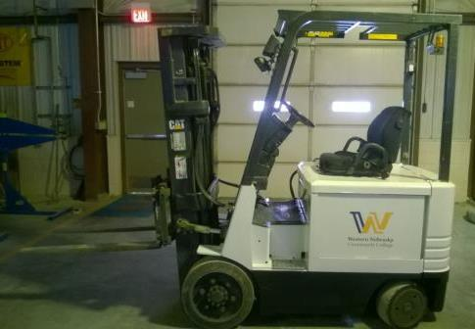

Parking Forklifts
Park appropriately
Notes:
Note – Images are Western Nebraska Community College stock photos.
Image on the left highlights poor parking job. Image on the right highlights an appropriate parting job.
Point out that the picture on the left is not parked correctly. It is in front of an exit door with the forks left high creating a trip hazard. The one on the right is parked in a correct manner.

Slide 65
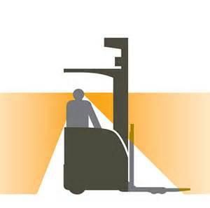
Visibility Around Forklifts
Forklifts
  Stay VISIBLE!!!!!
Notes:
Note – Image downloaded from an image search on www.google.com.
Image is meant to highlight poor visibility on PITs.
Discuss visibility issues from both the operator perspective and pedestrian perspective.

Slide 66

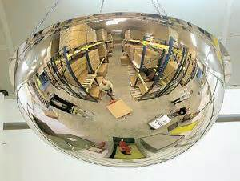
Forklift Traffic
Use your eyes and ears
Notes:
Note – Images downloaded from an image search on www.google.com.
Images are meant to highlight common control devices in warehouses.
Discuss common warehouse practices, such as PIT operators using horns and aisle mirrors meant to help to help prevent collisions.

Slide 67
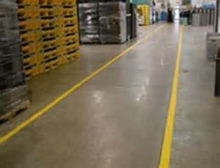
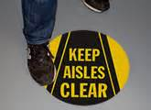
Aisle Traffic
Stay out of aisles where PIT traffic will be
Notes:
Note – images downloaded from an image search on www.google.com.
Images are meant highlight the importance of being in the right traffic areas.
Discuss how many warehouses use markings to control traffic.

Slide 68
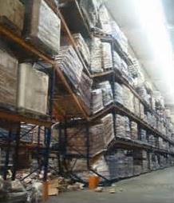
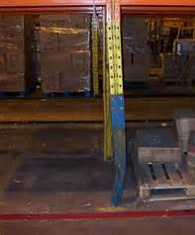
Unsafe Pallet Racking
Notes:
Note – Images downloaded from an image search on www.google.com.
Images highlight pallet racking issues.
Discuss overloading pallet racks, damaged racking systems, and packages sticking out of racks.

Slide 69

Hazardous Materials/Communication
29CFR1910.1200 – Hazard Communication
  Policies and Procedures
  Labeling Systems
  Safety Data Sheets
Notes:
Note – Image downloaded from an image search on www.osha.gov.
Images highlight GHS labels.
It is recommended to give out the OSHA 3491-2012 Quick Card on Hazard Communication.
Here is the link: https://www.osha.gov/Publications/OSHA3491QuickCardPictogram.pdf

Slide 70
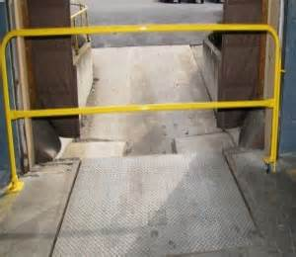
Preventing Falls
  29CFR1910.23 Guarding Floor and Wall Openings and Holes
Notes:
Note – Images downloaded from an image search on www.google.com.
Images meant to highlight fall potential.
Docking areas have a potential for falls, so fall prevention should be used.

Slide 71
In Summary
Warehouse environments have a variety of hazards
  Racking/tipping hazards, slips/trips/falls, struck-by, ergonomic issues, sharps
Keep alert!
Remember to keep your EYES open!

Slide 72

QUESTIONS?
Notes:
Note – Image downloaded from an image search on www.google.com.
Image is for visual appeal only.

Slide 73
Post Test and Evaluation
Notes:
Note – Image downloaded from an image search on www.google.com.
Image for visual appeal only.
Take about 10-15 minutes to complete and review the post-test and complete evaluations.

