Slide 1
Non-Ferrous Founders’ Society Safety & Health Training Program
Hazard Communication/GHS Training Program
Section 6: HazCom/GHS and the Aluminum Foundry
© 2015 All Rights Reserved

Slide 2
HazCom/GHS and the Aluminum Foundry
What are some of the hazards that exist in an Aluminum Foundry?
What are some common manufacturing process/materials in the Aluminum Foundry, and what hazards can these processes/materials present to the foundry worker?
What are some of the Personal Protective Equipment (PPE) items that workers should wear in an Aluminum Foundry?
Notes:
In this section we will learn:
What are some of the hazards that exist in an Aluminum Foundry;
What are some common manufacturing processes/materials in the Aluminum Foundry, and what hazards can these processes/materials present to the foundry worker?
What are some of the Personal Protective Equipment (PPE) items that workers should wear in an Aluminum foundry?

Slide 3
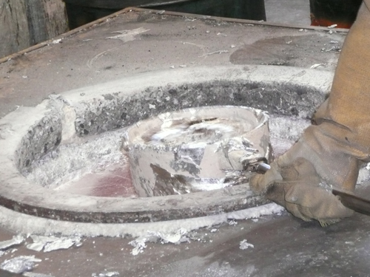
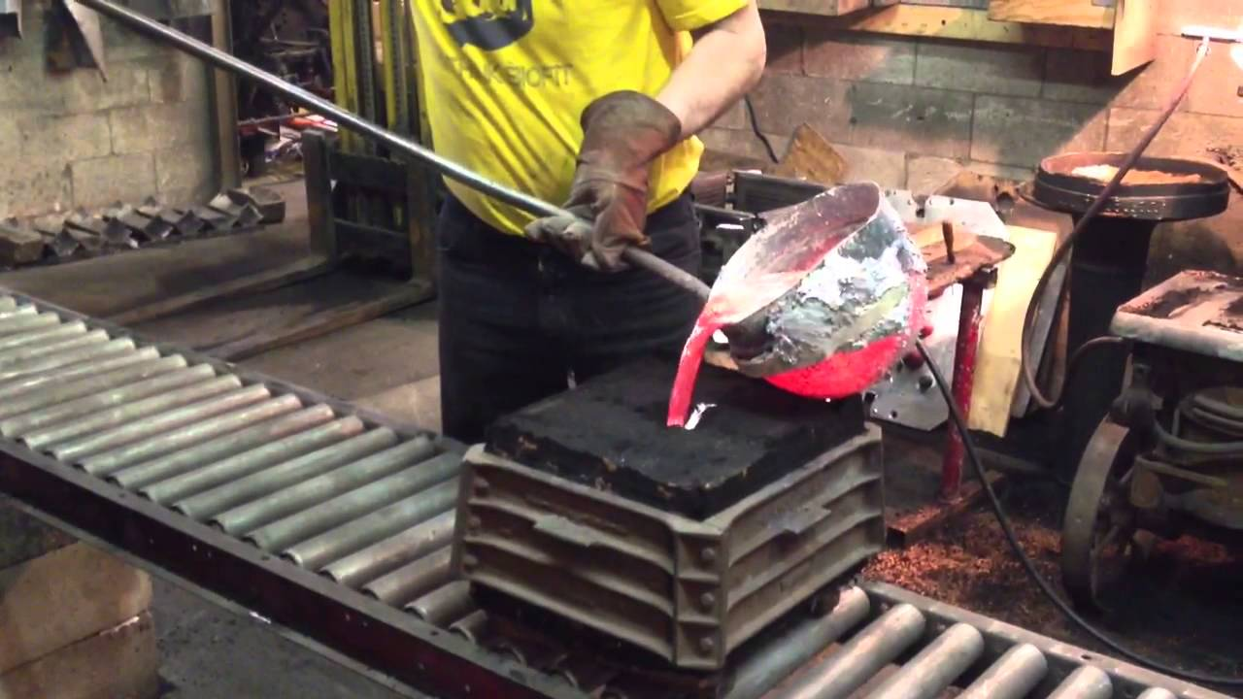
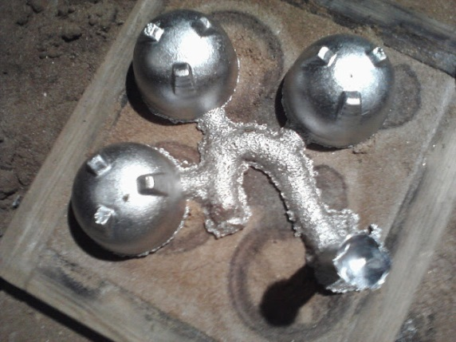
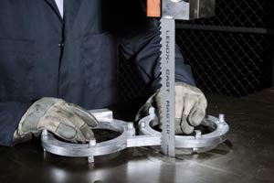
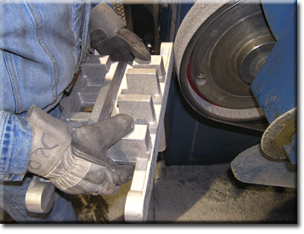
Non-Ferrous Foundry Hazards
Notes:
Aluminum foundries make castings from aluminum and aluminum alloys by heating the metal until it is in the liquid or molten state and then pouring the molten metal into a mold. After the metal cools it becomes a solid again and takes the shape of the void or interior of the mold. This shape, the casting, is then removed and may be further processed or “finished” to remove unwanted metal or molding material that has remained on the surface.

Slide 4
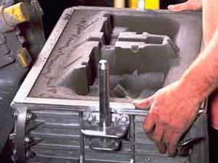
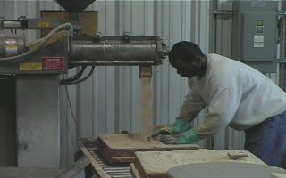
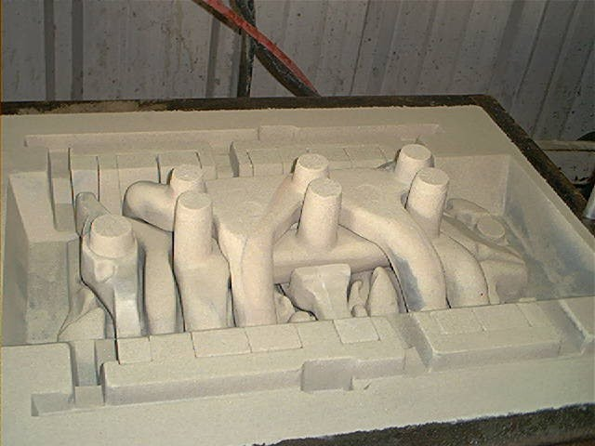
Green Sand/No Bake Molding
Notes:
The two methods of molding used by nearly all aluminum foundries are sand molding or permanent molding. Sand mold foundries use silica or other sands that are mixed with ingredients that make the sand grains stick together to form the mold. If the ingredients used to make the mold are clay and water based, the process is called green sand molding. If other chemicals are used, the process may be called chemically bonded sands or no bake molding.

Slide 5
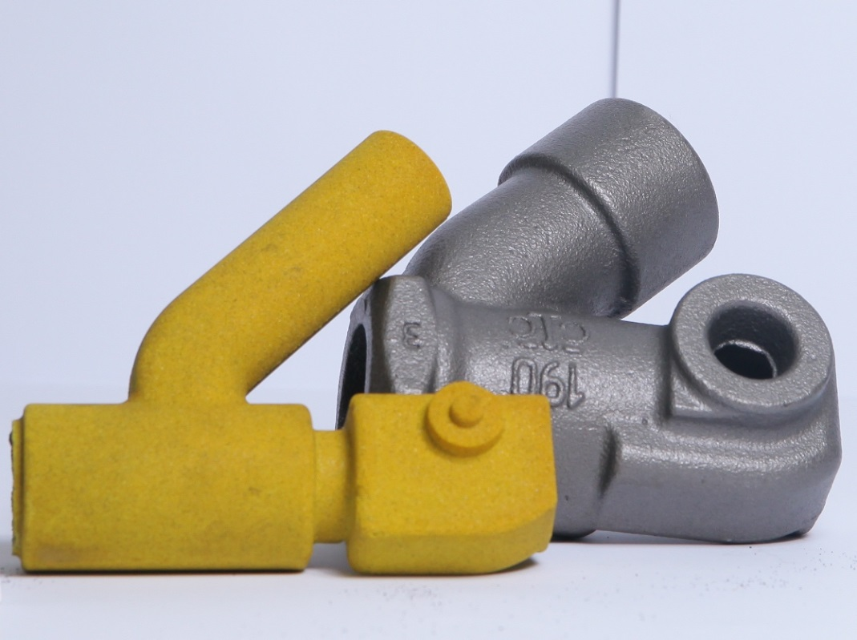
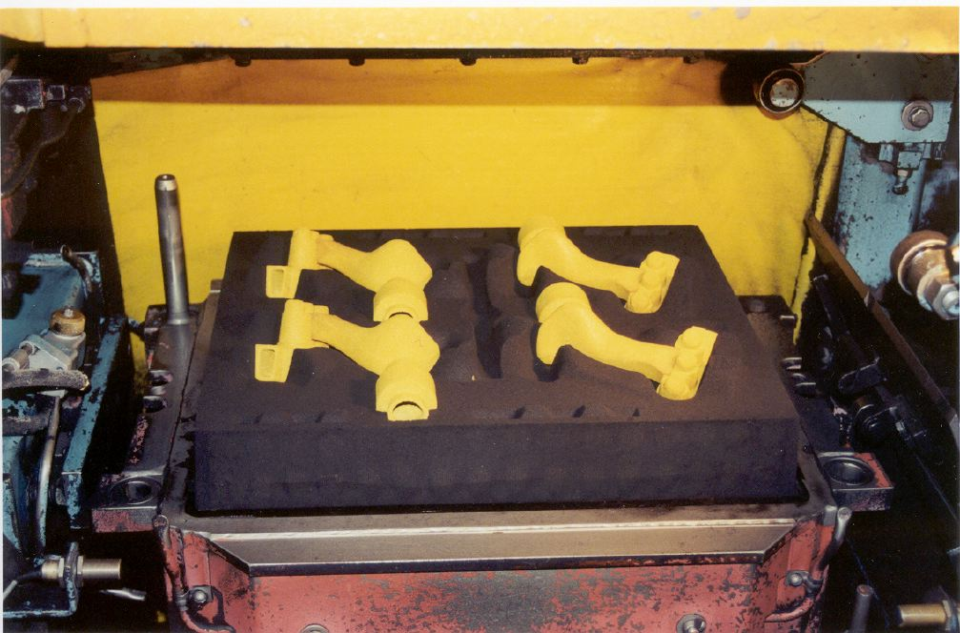
Cores
Notes:
If the casting made in a sand mold has a complex shape or needs a hollow interior, a CORE may be used. This core is usually made from chemically bonded sand, and is placed in the mold before the hot metal is poured into the mold. When the casting has cooled and the core is removed, a hollow cavity remains in the casting.

Slide 6
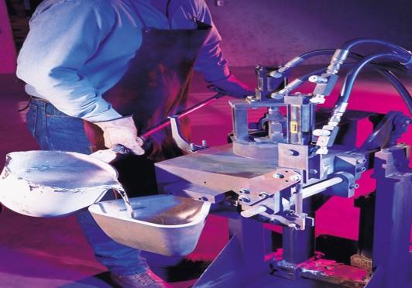
Permanent Mold
Permanent mold foundries do not use sand to make molds
The mold is made out of metal and is used over and over again
Once the cooled casting is removed from the permanent mold, it may need some finishing
Notes:
Permanent mold foundries do not use sand to make molds. Instead the mold is made out of a metal and is used over and over again. Once the cooled casting is removed from the permanent mold, it may also need some finishing- removal of excess metal.

Slide 7
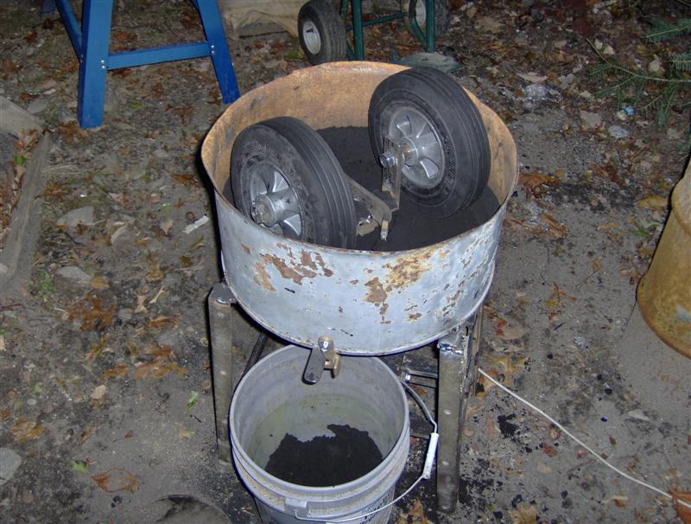
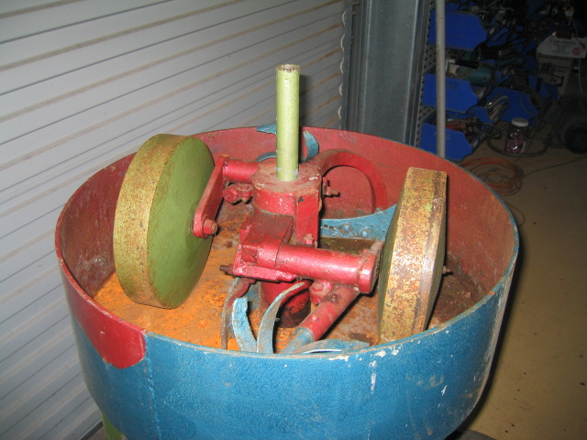
Sand Molding
Sand must be mixed with clay and water in a MULLER and then delivered to the molders
Can be manual or automated systems for feeding the sand systems
If manually loaded, there is a potential exposure to dust from silica and bentonite clay that is added
In automated systems, workers should not be exposed to these dusts
Notes:
SAND MOLDNG
For sand molds, sand must be mixed with clay and water and delivered to the molding machines. Sand mixers (or mullers) are used to mix this molding sand. Mixing systems can be small systems that require workers to dump silica and bentonite clay into the mixer by hand, or they can be automated systems that feed these ingredients into the mixer automatically. If workers must manually load the dry materials into the system, there is a potential for exposure to dust from both the silica and the bentonite clay used to hold the sand grains together. If the system is automated, workers should not be exposed to dust from the process. Automated systems are usually installed with hoods and ductwork that draw dusts away from the work area and sends it out to an air pollution control device.

Slide 8
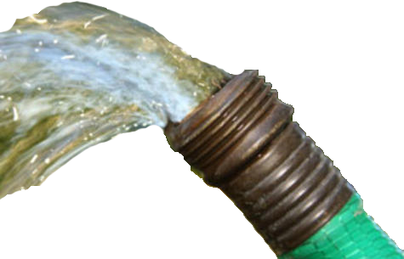
Sand Molding
Once water is added to the system, the amount of dust should be quite low
However, workers who clean out these system can generate excessive dust
Notes:
Once the water is added in the mixer, the amount of dust generated should be quite low. However, if workers must clean out these systems, the cleaning process can generate excessive dust.

Slide 9
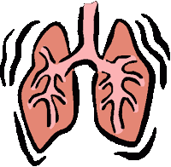
Dust Hazards
Sand can break down into very small pieces or DUST
These particles can become airborne and get into worker breathing zones
Silica sand dust can cause lung damage when workers breathe it in at unsafe levels over time
Small Particles of Silica
Notes:
One of the problems with this sand system is that the moving and handling of the sand can break the sand grains down in size to very small pieces or particles, called dust. These particles can be so small they become airborne and get into the breathing zone of workers. If silica sand is used, this dust can be SILICA dust- a chemical that can cause lung damage or cancer when workers breathe it in at unsafe levels over time.

Slide 10
Permissible Exposure Limits (PEL) for 3 Types of Silica
3 types of Silica
Crystalline Silica
Cristobalite
Tridymite
The PEL for each type of silica are shown in table Z-3 to the left
TABLE Z-3 Mineral Dusts
Substance | mppcf ª | mg/m³
Silica: Crystalline
Quartz (Respirable) . . . . . . . . . . . . . . . . . . | 250^{b} %SiO₂+5 | 10 mg/m^{3 e} %SiO₂+2
Quartz (Total Dust) . . . . . . . . . . . . . . . . . . | . . . . . . . . . | 30 mg/m³ %SiO₂+2
Cristobalite: Use ½ the value calculated from the count or mass formulae for quartz. Tridymite: Use ½ the value calculated from the formulae for quartz.
Notes:
The Occupational Safety and Health Administration sets Permissible Exposure Limits (PEL’s) for three types of silica: crystalline, cristobalite and tridymite. These limits are currently being studied to determine if they need to be updated, but at the present time the allowable levels are shown in table Z-3 provided here.

Slide 11
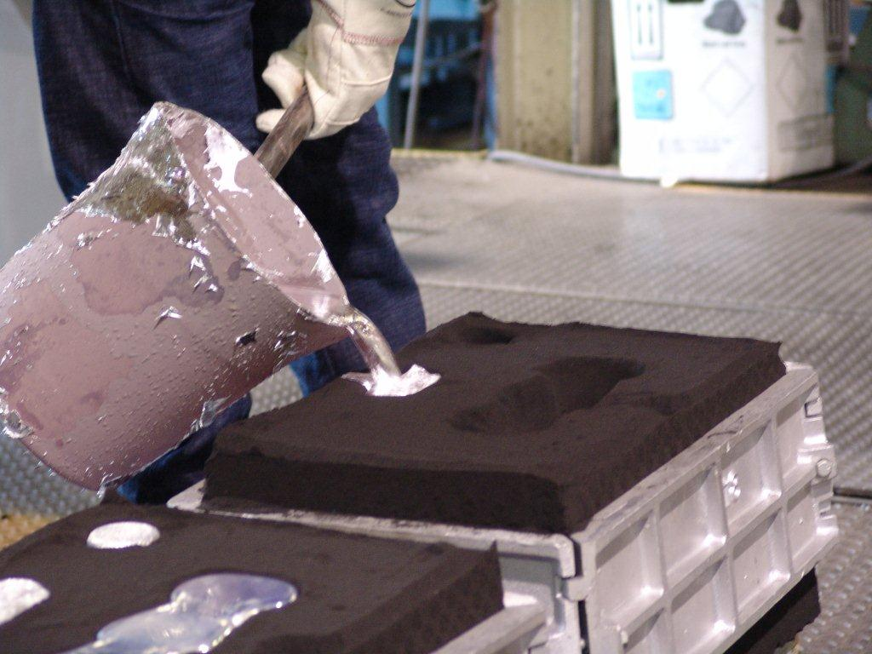
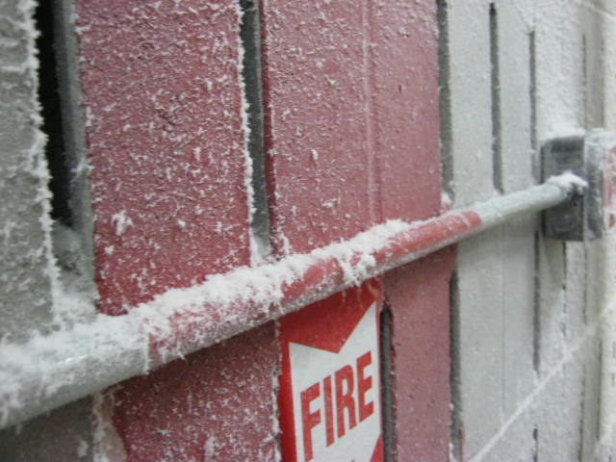
Permissible Exposure Limits (PEL) for 3 Types of Silica
Most aluminum foundry sand systems meet these PELs
The temperature of the aluminum when poured is not high enough to dry out the sand so that dust becomes airborne
Dust may be created when sand must be manually moved or handled, or when heavy equipment runs over sand
Dust allowed to accumulate can be released by wind, air or when the structure is shaken
Notes:
Most aluminum foundry sand systems meet these permissible limits at the present time. This is because the temperature of the metal as it is poured into the mold is not high enough to dry out the sand so that the dust becomes airborne. However, dust can be created if there are upset conditions and the sand must be manually moved or handled. If heavy equipment runs over the sand it can be broken down and become airborne. Sand that is allowed to buildup on rafters or other surfaces can also release dust if there is a burst of wind, air or the structure is shaken.

Slide 12
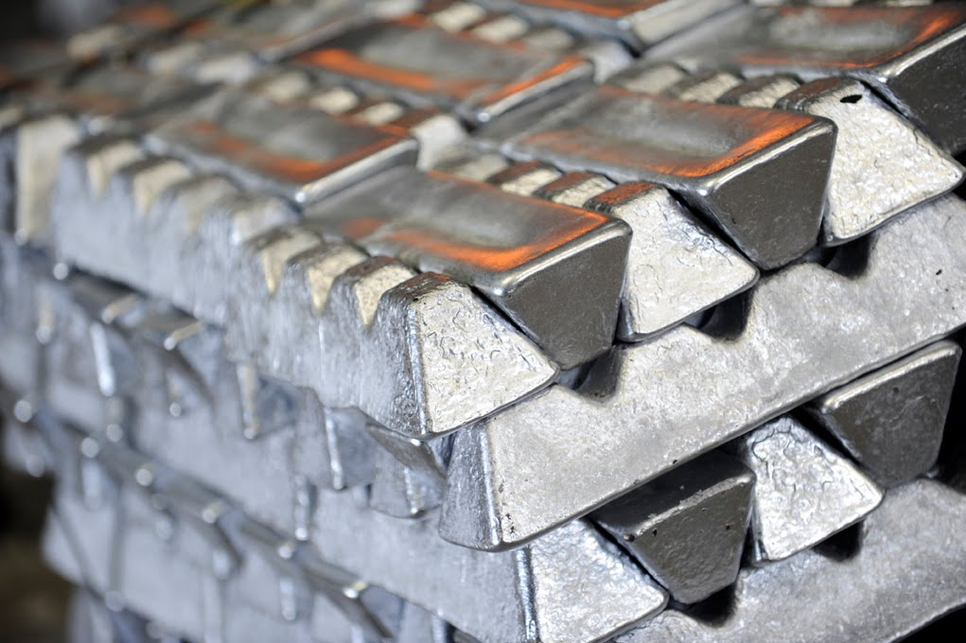
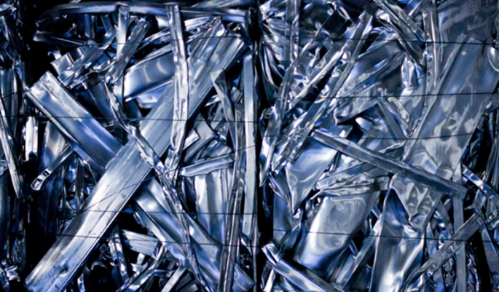
MELTING
Most aluminum foundries buy INGOTS with guaranteed chemistry
Some foundries will buy and melt SCRAP aluminum
Scrap will come in various sizes and may have a range of metal content
Notes:
The aluminum or aluminum alloy comes into the foundry in a solid form. Most aluminum foundries buy INGOTS of aluminum since they these ingots have guaranteed chemistry. Some foundries will buy and used scrap aluminum. This scrap will come in various sizes and may have a range of metal content for each metal in the scrap.

Slide 13
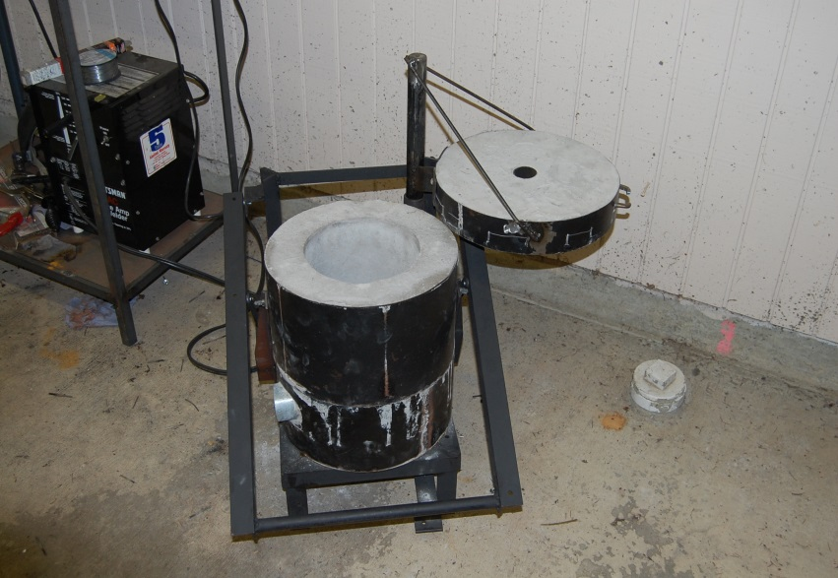
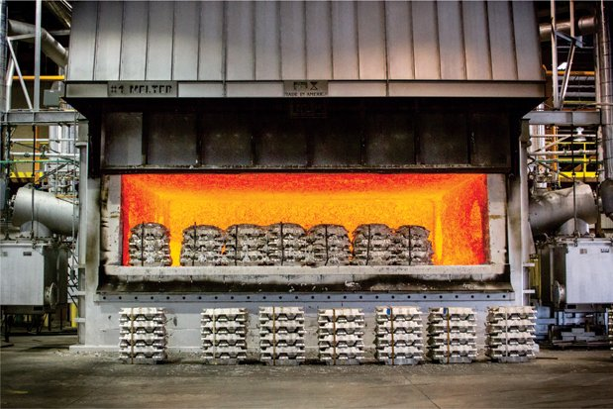
MELTING
Most foundries will return defective castings to the melting process
Metal removed from the casting may also be returned for remelt
Furnaces can be large or small
The source of energy can be electricity, natural gas, propane or oil
Notes:
Most foundries will return to the melting process any castings that were found to be defective . The pieces of metal that are removed from the casting that fed the metal may also be returned for remelt.
Furnaces can be large or small depending on the needs of the foundry. The source of energy can be electricity, natural gas, propane gas, or oil.

Slide 14
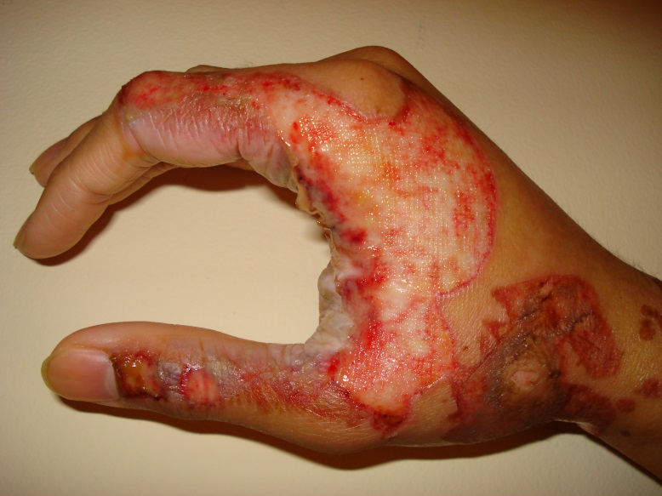
MELTING
Aluminum melts at 1220 degrees Fahrenheit
Aluminum furnaces do not usually create fume
As a result, most aluminum furnaces do not have exhaust hoods
BURNS are always a danger when working near hot metal
PPE must always be worn when there is a danger of burns!
Notes:
Since Aluminum MELTS at 1220 degrees Fahrenheit, the furnaces do not need to be nearly as hot as furnaces used to melt Iron that does not melt until it reaches 2800 degrees Fahrenheit. Aluminum furnaces do not usually create FUME since the Boiling Point for this metal is 4521 degrees Fahrenheit. As a result, most aluminum furnaces in foundries do not have hoods installed to exhaust potential air contaminants.
There is always the danger, however of serious BURNS whenever someone works near hot metal. Proper Personal Protective Equipment must always be used if there is a danger of burns!

Slide 15
Personal Protective Equipment
Recommended minimum basic clothing requirements for any employee working near the melting and pouring areas are:
100% cotton socks and undergarments
100% cotton or wool outer garments
For employees in a hazardous zone (near a furnace or ladle containing molten metal) additional specific clothing and PPE is recommended based on the conditions, such as:
The temperatures, amount and type of molten metal in the furnace, ladle and/or mold
The level of the metal and area of the body that could be impacted by a splash, runout, spark, flame or hot surface
How close is the worker to molten metal and hot surfaces
Notes:
Guidance from a joint effort of a foundry association and OSHA has made these recommendations for all foundries:
Recommended minimum basic clothing requirements for any employee working near the melting and pouring areas are:
• 100% cotton socks and undergarments
• 100% cotton or wool outer garments
For employees in a hazardous zone (such as near a furnace or ladle containing molten metal or other known hazards) additional specific clothing and PPE is recommend based on the conditions in the foundry. Factors that should be considered include:
• The temperatures, amount and the type of molten metal in furnace, ladle and/or mold and the temperatures
• The level of the metal and area of the body that could be impacted by a splash, runout, sparks, flames, or hot surfaces (is the molten metal poured or present above the waist? Above the head?) and how close is the worker to molten metal and hot surfaces (for example, work inside hazard zone around induction furnaces).

Slide 16
Personal Protective Equipment
DO NOT LIST:
Do Not wear Nomex* because all molten metals tend to stick to the fabric
Do Not wear phosphorus treated cotton because molten Aluminum tends to stick to the fabric
Do Not wear polyester, nylon and other manmade materials that can melt and readily ignite
DO LIST:
Do wear pants or leggings that cover the top of the boot to prevent molten metal/sparks from entering the boot
Do wear spats or leggings that cover the lacings if laced boots are worn
Do wear long pants, long sleeve shirts are recommended
Do evaluate the need for spats, leggings and chaps for pouring operations
Do wear clothing that does not trap molten metal/sparks
Do wear any other PPE needed to protect body parts exposed to heat or metal
Notes:
The type of fabric that is worn in the area of molten metal is very important. It is recommended that in Aluminum foundries:
DO NOT LIST
• Do not wear Nomex* because all molten metals tend to stick to the fabric.
• Do not wear phosphorus treated cotton because molten Aluminum tends to stick to the fabric
• Do not wear polyester, nylon, and other manmade materials that can melt and readily ignite.
DO LIST
• Wear pants or leggings that cover the top of the boot to prevent molten metal and sparks from entering the boot. Never tuck pant legs inside the boot.
• If laced boots are worn, spats or leggings that cover the lacings must be used whenever molten metal or sparks could lodge in the tongue area.
• Wear long pants -- long sleeve shirts are recommended.
• For pouring operations the use of spats, leggings, and chaps should be evaluated.
• Wear clothing that does not trap molten metal and sparks (i.e. no cuffs, open pockets, loose legging tops, etc.).
.• Wear any other PPE needed to protect body parts that are exposed to heat or metal .

Slide 17
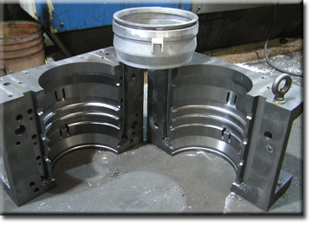
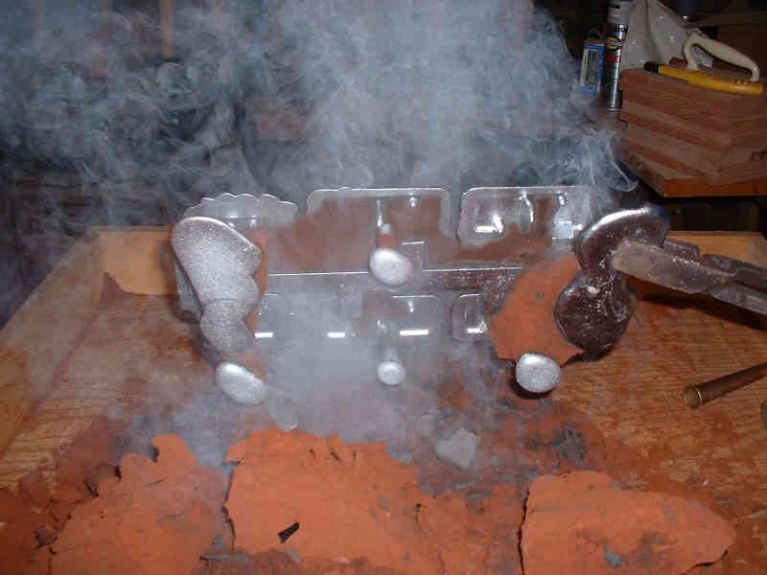
Shakeout
Once the metal is poured into the mold, it must cool and then be removed
There should be no sand on the surface with permanent mold, though the casting will be HOT!
In a sand foundry, the sand mold is broken to remove the casting
Potential hazard from small particles of silica released during shakeout
Notes:
Once the molten metal is poured into the mold, it must cool and then be removed. If it is removed from the PERMANENT MOLD, there should be no sand on the surface to become airborne, but the casting will remain a hazard since it will still be HOT.
However, in a sand mold foundry, the casting is removed and the sand mold should begin to break apart or will be broken to remove the casting. This process is often called shake out. The potential hazard in this operation is the release of small particles of silica that could become airborne and be breathed in.

Slide 18
Respirators
If workers are exposed to airborne silica above the PEL, engineering controls or other measures must be taken to reduce the amount of silica dust to a safe level
Until these measures are put into place, or safe levels can not be achieved, RESPIRATORS must be worn by exposed workers
Respirators are effective, if they are the RIGHT type of respirator and WORN and MAINTAINED properly
If your company requires the use of respirators, a written program is needed along with training and fit testing
Medical questionnaire must be completed for everyone in the program to be sure that the respirator can be safely worn
Notes:
If workers are exposed to airborne silica above the allowable levels as set by OSHA, engineering controls or other measures must be taken to reduce the amount of silica dust to a safe level. Until these measures are put into place or if there are reasons that these safe levels can not be achieved on a regular basis, Respirators must be worn by any workers who are over exposed. Respirators are effective in providing protection, but they must be the RIGHT type of respirator and must be WORN and MAINTAINED properly. If your company requires the use of respirators, a written program is needed along with training and fit testing for those who wear them. A medical questionnaire must be completed for everyone in the program to be sure that the respirator can be safely worn.

Slide 19
Other Potential Airborne Hazards from Mold and Core Making
If molds or cores are made with CHEMICALLY BONDED SAND, the mixing and heating process can release gases and vapors that may be hazardous
The Safety Data Sheet (SDS) will list chemicals that may be a problem either as ingredients, as a result of mixing two ingredients, or as a result of pouring hot metal into the mold and breaking down the chemicals in the mold/core
One substance that may be released is ISOCYANATES
Notes:
If molds or cores are made with CHEMICALLY BONDED SAND, the mixing and heating process can release gases and vapors that may be hazardous. The Safety Data Sheet will list the chemicals that may be a problem either as ingredients or as a result of mixing two ingredients – this is when two chemicals REACT and create a new chemical or condition such as heat - or as a result of pouring the hot metal into the mold and breaking down the chemicals in the mold or core. The hot metal will burn the chemicals and may create a new hazard. One substance that may be released to the air from the core making or chemically bonded sand molding process are ISOCYANATES.

Slide 20
ISOCYANATES
Some commonly used chemical binders used to hold sand together contain ISOCYANATES
ISOCYANATES are chemical compounds that react with other chemicals to make a new chemical with new characteristics
In the foundry, we mix a RESIN and a CATALYST with sands to make a mold or core
ISOCYANATES in some core making systems include Toluene Diisocyantes (TDI) or Methylene Biphenyl Isocyanate (MDI)
If these chemicals are present in your foundry, they will be shown on the Safety Data Sheet (SDS)
Workers exposed to these chemicals can develop ASTHMA
Notes:
Some commonly used chemical binders used to hold the sand together contain ISOCYANATES.
Isocyanates are chemical compounds that react with other chemical compounds to make a new chemical with new characteristics. In the foundry, we can mix a RESIN with a CATALYST with sands to make a mold or core. Both the resin and the catalyst are liquids, but when we mix them together, they REACT and begin to thicken and then they “set” to become solid.
One of the ingredients in SOME – but not ALL core making systems includes isocyanates, usually Toluene Diisocyanates (TDI) or Methylene biphenyl isocyanate (MDI). If these chemicals are in the products used at your foundry, they will be shown on the Safety Data Sheet!
We need to be aware of Isocyanates because workers exposed to these chemicals in the air can develop Asthma.

Slide 21
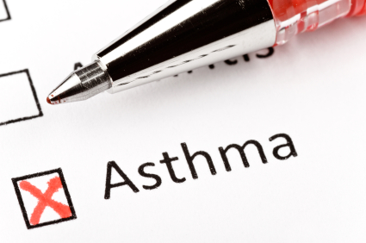
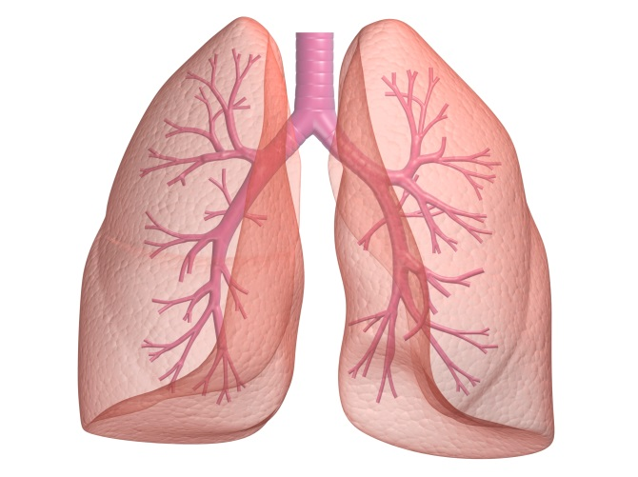
ASTHMA
People who never had asthma can develop it due to workplace exposures to ISOCYANTES
People with asthma may find that their condition gets worse due to workplace exposures to ISOCYANATES
Some people can also become sensitized to the chemical
Some ISOCYANATES (but not all) are classified as potential human carcinogens
It is important to check the Safety Data Sheet (SDS) to see which Isocyanates may be present and WHAT actions should be taken if there is a potential hazard
Notes:
People who never had asthma can develop asthma due to workplace exposures. People who have had asthma for years may find that their condition get worse due to workplace exposures.
Some people can also become sensitive to the chemical and develop a skin rash if it gets on the body. There are some Isocyanates (but NOT all isocyanates) that are classified as potential human carcinogens –chemicals that may cancer.
Since Isocyanates are a GROUP of chemicals and not all of the substances in this group have the same effect on the body, it is important to CHECK THE SDS to see which isocyanate may be present and WHAT actions should be taken if there is a potential hazard.

Slide 22
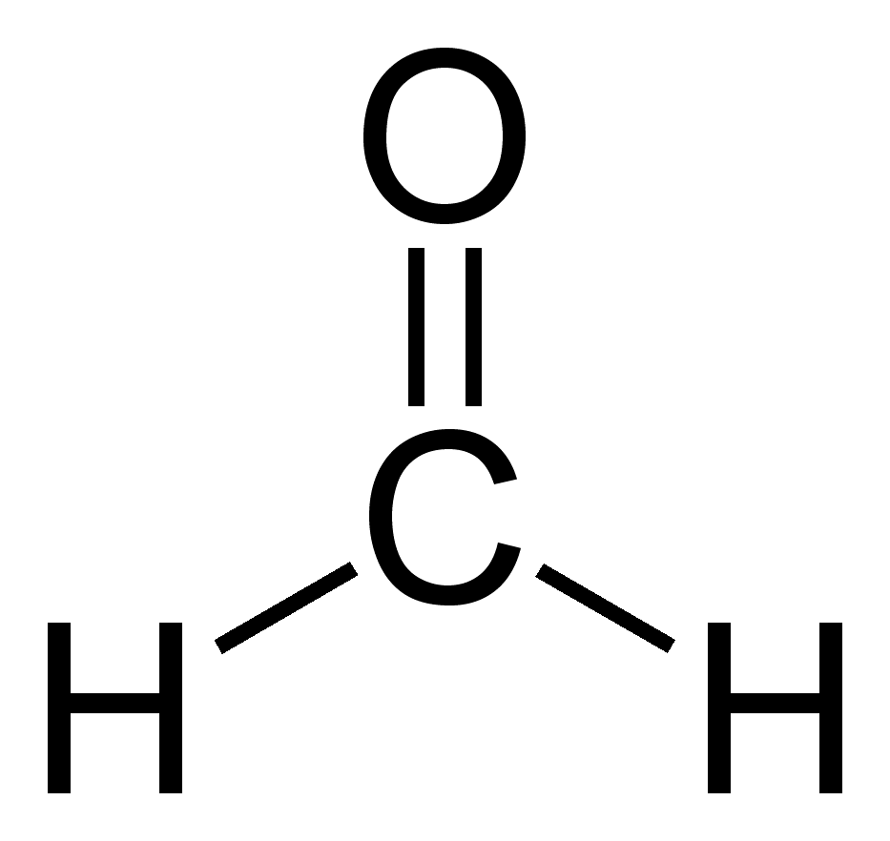
FORMALDEHYDE
One chemical that MAY be in some products used to bind sand together is FORMALDEHYDE
If this chemical is present in the product or is created when used, the Safety Data Sheet (SDS) will show us!
Notes:
One chemical that MAY be in some products used to bind sand together but more often is a result of MIXING the chemicals or the DESTRUCTION or burning of the chemicals when the hot metal is poured into the mold is FORMALDEHYDE.
If this chemical is present in the product or is created when it is used , the Safety Data Sheet will show us!

Slide 23
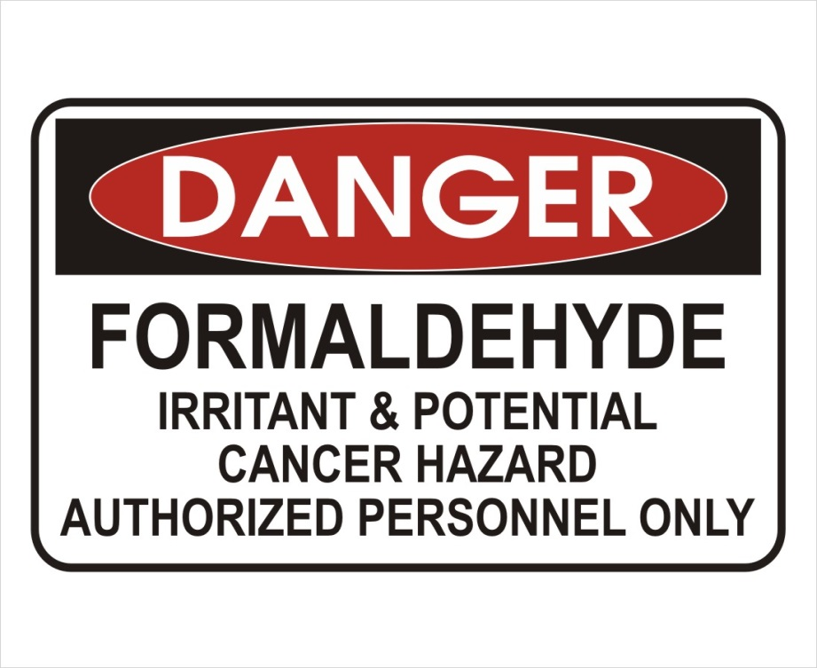
FORMALDEHYDE
A colorless, strong-smelling gas
A sensitizing agent
Classified as a cancer hazard
Eating or drinking FORMALDEHYDE can be fatal
Long term exposure to low levels can cause asthma and skin irritation
Notes:
Formaldehyde is a colorless, strong-smelling gas and is another chemical that is a sensitizing agent. This means that it can cause the cause an allergy like response once a person is exposed to it. Formaldehyde is also classified as a cancer hazard. Eating or drinking formaldehyde can be fatal. Long-term exposure to low levels in the air or on the skin can cause asthma-like respiratory problems and skin irritation such as dermatitis.

Slide 24
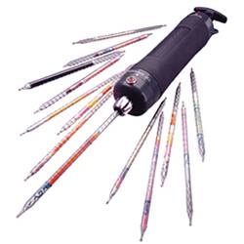
FORMALDEHYDE
If FORMALDEHYDE is present in the workplace, OHSA requires employers to identify all workers who may be exposed by doing AIR SAMPLING to see if exposures are above the PEL set to keep workers safe
Formaldehyde Air Sampling Equipment
Notes:
If formaldehyde is present in the workplace, the OSHA Formaldehyde standard require employers to Identify all workers who may be exposed to formaldehyde by doing air samples to see if exposures are at or above standards set to keep workers safe.

Slide 25
FORMALDEHYDE
It tests show levels of FORMALDEHYDE are at or above the PEL, the company must use feasible engineering and work practice controls to reduce these levels
The PEL for FORMALDEHYDE is 0.75 parts per million measured as an 8-hour Time Weighted Average (TWA)
A second PEL in the form of a short-term exposure limit (STEL) of 2 parts per million which is the maximum exposure allowed during a 15-minute period
Notes:
If the tests show the levels of Formaldehyde are at or above the Permissible Exposure Limit, the company must use feasible engineering and work practice controls to reduce these levels to below the permitted level. The permissible exposure limit (PEL) for formaldehyde in the workplace is 0.75 parts formaldehyde per million parts of air (0.75 ppm) measured as an 8-hour time-weighted average (TWA).
The standard includes a second PEL in the form of a short-term exposure limit (STEL) of 2 ppm which is the maximum exposure allowed during a 15-minute period.

Slide 26
FORMALDEHYDE
All elements of a FORMALDEHYDE program must be in a written document kept up to date by the foundry
OSHA standard includes an ACTION LEVEL of 0.5 parts per million (8 hour TWA). Tests at or above this level require more air sampling, along with training and medical surveillance of the affected workers
If control efforts cannot reduce exposure to acceptable levels, workers will be given respirators and other PPE needed, such as clothing, gloves, aprons, and chemical splash goggles
Notes:
All of the elements of the Formaldehyde program must be in a written document that is kept up to date by the foundry.
The OSHA Formaldehyde standard also includes an action level of – is 0.5 ppm when calculated as an 8-hour TWA. If tests show that formaldehyde is in the at levels that meet or above this action level, there more air sampling will be required along with training and medical surveillance of the affected workers.–
If these controls efforts cannot reduce exposure to the acceptable level, workers will be given
Respirators and any other protective equipment needed such as impervious clothing, gloves, aprons, and chemical splash goggles.

Slide 27
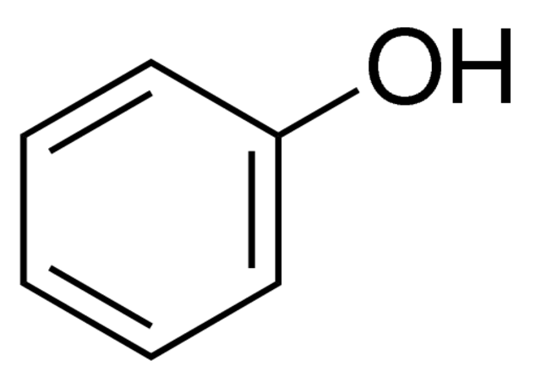
PHENOL
One other chemical commonly found in many core making processes is PHENOL
PHENOL has an odor that is unpleasant to many people
At low levels, PHENOL may be irritating to the eyes, nose and throat
At high concentrations, PHENOL can cause dermatitis or chemical burns
Notes:
One other chemical commonly found in many core making processes is PHENOL. Phenol is a chemical that is used in many ways – from making plastics to use as a disinfectant and ingredient in medications and cosmetics. However, as for many chemicals, the proper amount and use of Phenol is useful and safe, but too much improperly used may be harmful.
At low levels in the foundry, Phenol may be irritating to the eyes, nose and throat. It has an odor that is unpleasant to many people. Sine Phenol is mildly acidic, at high dosages or concentrations it can cause dermatitis or chemical burns.

Slide 28
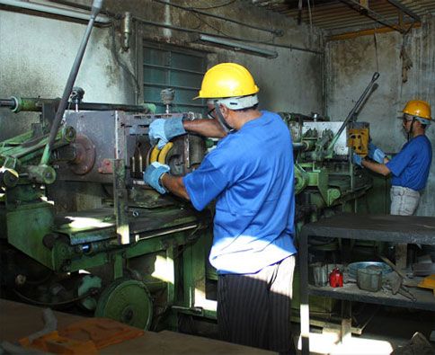
PHENOL
PHENOL is most often used in the core room in solid form
The amount of PHENOL is usually quite small, but the Safety Data Sheet will report if it is present and how much is used in the product
Notes:
Phenol is most often used in the foundry in the core room in the solid form. The amount of Phenol is usually quite small, but the Safety Data Sheet will report if this chemical is present and how much is used in the product.

Slide 29
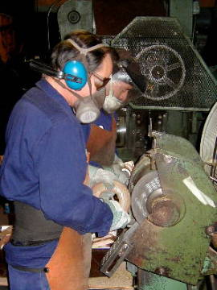
Cleaning and Finishing
Band saws may be used to separate castings from the gates and runners
Excess metal may also be removed with hand held or stationary grinders
Belt sanders may finish the surface of the casting
Blast systems use abrasive materials to produce the external finish on castings
Notes:
Once the casting is removed from the Permanent Mold or the Sand Mold, it may require removal of unwanted metal or sand (only for sand molds).
Band saws may be used to separate castings from the gates and runners – the hollow system in the mold that delivers the metal to the mold where the casting shape is located.
Excess metal may also be removed with hand held or stationary grinders. Belt sanders may finish the surface of the casting or they may be placed in a blast system where abrasive materials are used to produce the final external finish of the metal piece.

Slide 30
Cleaning and Finishing
If any silica sand remains on the casting, it could become airborne and present the same hazards as in sand system operations
The finishing/grinding processes may also remove very small particles of aluminum from the casting
If the particles are small enough, they can become airborne and be breathed by workers, causing metal fume fever
Metal fume fever is a flu like illness that lasts for a day or two with headache, fever and chills
Large amounts of aluminum dust breathed in over time can damage the lungs by scarring as well
Notes:
In these processes, if there is any silica sand remaining on the casting, it could become airborne and present the same hazards described in the sand system operations. Airborne silica can cause lung damage and is a potential lung carcinogen.
The grinding and finishing processes may also remove very small particles of aluminum from the casting. If these particles are small enough, they can become airborne and be breathed in by workers in the area. If enough of this dust is breathed in, it can cause “metal fume fever” – a flu like illness that lasts for a day or two with head ache, fever and chills as symptoms. As for any dust, if large amounts are breathed in over time the lungs can be damaged by scarring as well.

Slide 31
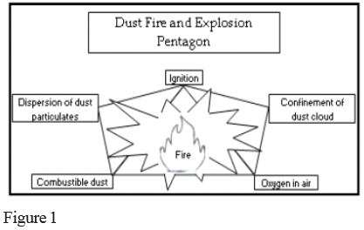
Combustible Dust
Aluminum dust is a combustible solid, and under certain conditions it can be an explosion and fire hazard
Conditions required for a combustible dust explosion:
Fuel source (combustible dust)
Heat or ignition source
An oxidizer (oxygen in the air)
Sufficient quantity and concentration to create a cloud
Confinement
Notes:
Aluminum dust has one other very important characteristic. Aluminum in the solid form is a metal we safety use to make our pipe and pots and pans. But Aluminum in very small particle size is a combustible solid – and under certain conditions, can be an explosion and fire hazard.
These types of dust explosions require certain conditions – conditions that we want to AVOID in the foundry:
First, there must be the fuel source this would be the combustible dust
Second , there must be a heat or ignition source (e.g., electrostatic discharge, an electric current arc, a glowing ember, a hot surface, welding, or a flame); and
Third, an oxidizer (oxygen in the air – fires require oxygen to burn).
Fourth, the chance of danger is most present when the combustible dust is in the air in sufficient quantity and concentration to create a dust cloud.
Finally, it the dust cloud in confined in a container, an area, or equipment, the dust cloud could ignite, burn rapidly, and may even explode. I
if there is combustible dust that is built up on equipment, rafters or other surfaces, this explosion could shake these surfaces causing the dust that way on them to become airborne. Then this dust in turn could also ignite and burn or explode in a secondary event.

Slide 32
Combustible Dust
How do we prevent a dust explosion?
Find out if there is a combustible dust in your plant (the SDS can help identify the products you use that can create a combustible dust)
Engineering control are required to be sure that the hoods, ductwork and dust collectors themselves don’t become a hazard since they collect or concentrate the dust
Control the sources of ignition in any area where there is a combustible dust hazard
Have a good housekeeping program for floors and horizontal surfaces to keep dust accumulations to a minimum
Notes:
How do we prevent a Dust Explosion? First we need to find out if there is combustible dust – and the Safety Data Sheet can help to identify if the products we use can be or create a combustible dust.
If there is combustible dust, special engineering controls are required to be sure that the hoods, ductwork and dust collectors themselves don’t become a hazard since they will collect or concentrate the dust.
We must also control the sources of ignition in any area where there is a combustible dust hazard. This means no smoking, no open flames, and special electrical systems may be required.
The facility needs to have a good housekeeping program for floors and horizontal surfaces, (and ducts, pipes, hoods, ledges, and beams) so that we keep dust accumulations or build up to a minimum.

Slide 33
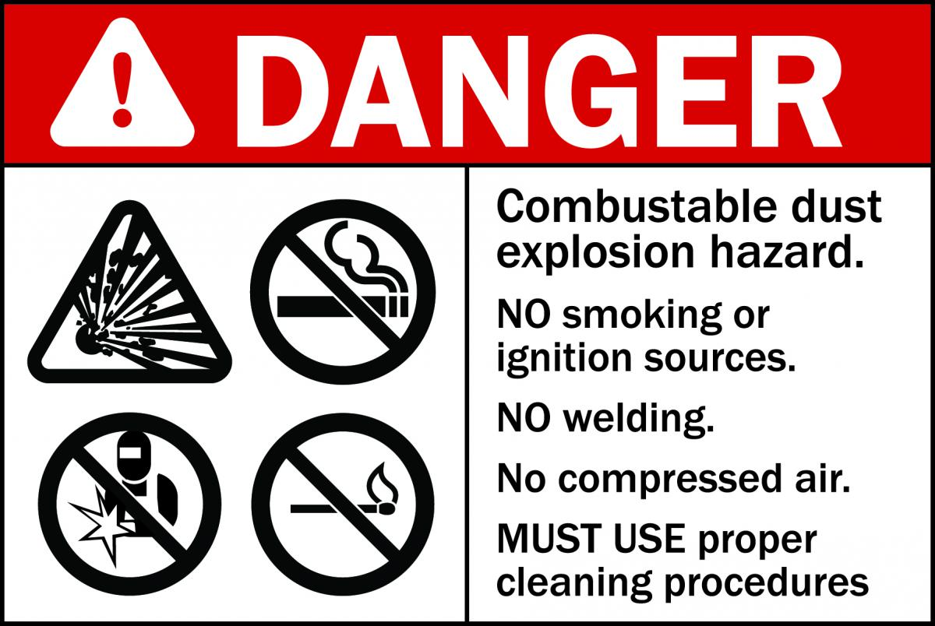
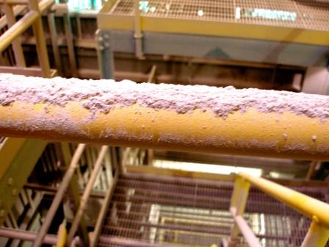
Combustible Dust
Workers in these areas need to be trained on the explosion hazards of combustible dusts and on the protection measures to avoid them
The foundry has an emergency action plan, including details on how to respond to a combustible dust explosion!
Other engineering controls and equipment modifications may be required after the company has evaluated the potential hazard and how to prevent fires/explosions
Notes:
Workers in these areas need to be trained on the explosion hazards of combustible dusts and on the Protection Measures to avoid them.
The facility has an emergency action plan, and how to respond to a combustible dust explosion should be included!
Other engineering controls and equipment modifications may also be required after the company has evaluated the potential hazard and how to prevent fires and explosions.

Slide 34
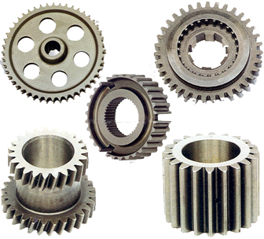
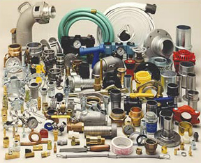
Work Safely!
We can safely make the Aluminum castings that are so important to daily life by understanding the chemicals and processes we use in the aluminum foundry!
Notes:
Aluminum is a very important metal in our modern world. Aluminum castings are used in our homes, in our cars and trucks and at our workplace. We can safely make the Aluminum castings that are so important to us by understanding the chemicals and processes we use in the nonferrous foundry!

Slide 35
Acknowledgements
This material was produced under grant number SH-26318-SH4 from the Occupational Safety and Health Administration, U.S. Department of Labor. It does not necessarily reflect the views or policies of the U.S. Department of Labor, nor does mention of trade names, commercial products, or organizations imply endorsement by the U.S. Government

Slide 36
Non-Ferrous Founders’ Society Safety & Health Training Program
For further information about this or other training modules:
Non-Ferrous Founders’ Society
1480 Renaissance Drive, Suite 310
Park Ridge, IL 60068 847/299-0950 http://www.nffs.org

