Slide 1
Non-Ferrous Founders’ Society Safety & Health Training Program
Hazard Communication/GHS Training Program
Section 1: Worker’s Rights under OSHA
© 2015 All Rights Reserved

Slide 2
Have you ever heard of OSHA?
The Occupational Safety and Health Act of 1970
Passed to prevent workers from being killed or seriously harmed at work
Requires employers to provide safe working conditions
Created the Occupational Safety and Health Administration (OSHA)
Sets and enforces protective workplace safety and health standards.

Slide 3
Am I Covered By OSHA?
OSHA covers…
Private sector
Jobs under the federal government
Federal OSHA does not cover…
Public sector (municipal, county and state government jobs)

Slide 4
OSHA Standards
How do OSHA standards protect me?
There are standards for Construction work, Agriculture, Maritime Operations, and General Industry
OSHA standards…
Describe the methods that employers must use to protect their employees from hazards;
Limit the amount of hazardous chemicals workers can be exposed to;
Require the use of certain safe practices and equipment; and
Require employers to monitor hazards and keep records of workplace injuries and illnesses.

Slide 5
OSHA Standards
Can I assume my workplace is safe if it meets
OSHA standards?
OSHA does not cover many workplace hazards
Good workplace safety programs must go beyond OSHA standards.

Slide 6
OSHA Standards
What can I do if there is a hazard at my
workplace that OSHA standards do not cover?
OSHA’s General Duty Clause: All employers must provide a workplace free from recognized hazards:
Includes hazards that may not be adequately covered by any standard
Employers are still obligated to remove or control the hazards
There are other laws which may be utilized to help workers in situations not covered by OSHA.

Slide 7
Employer Responsibilities
Employers have the responsibility to…
Provide their employees with a workplace that does not have serious hazards and follow all relevant OSHA safety and health standards;
Inform employees about chemical hazards through training, labels, alarms, color-coded systems, chemical information sheets and other methods;
Keep accurate records of work-related injuries and illnesses;
Perform tests in the workplace, such as air sampling, required by some OSHA standards;
Provide hearing exams or other medical tests required by OSHA standards;

Slide 8
Employer Responsibilities
Employers have the responsibility to…
Post OSHA citations, injury and illness data, and the OSHA poster in the workplace where workers will see them;
Notify OSHA within 8 hours in the event of a worker fatality;
Notify OSHA within 24 hours of the hospitalization of 1 or more employees;
Notify OSHA within 24 hours of any amputations or loss of an eye by an employee; and
Not discriminate or retaliate against workers for using their rights under the law.

Slide 9
What if OSHA standards are not met in the workplace?
Know your rights!
Take action!

Slide 10
Workers’ Rights Under the OSH Act
Workers have the right to…
Ask OSHA to inspect their workplace
Use their rights under the law without retaliation and discrimination;
Receive information and training about hazards, methods to prevent harm, and the OSHA standards that apply to their workplace. The training must be in a language you can understand;
Notes:
Do you know any of your rights as a worker under the OSH Act?

Slide 11
Workers’ Rights Under the OSH Act
Workers have the right to…
Get copies of the test results done to find hazards in the workplace;
Review records of work-related injuries and illnesses; and
Get copies of their medical records.
Notes:
Do you know any of your rights as a worker under the OSH Act?

Slide 12
Workers’ Rights Under the OSH Act
Workers have the right to…
Refuse to do dangerous work, but are only protected against termination or discipline by OSHA if:
You have a “reasonable belief that there is a real, imminent danger of death or serious injury”;
You first ask your employer or supervisor to eliminate the danger;
You have no reasonable alternative to refusing to do the work; and
The danger is so urgent that you cannot risk waiting for OSHA inspection.
If all points are present, you can refuse to do dangerous work and you might be protected.
Notes:
Do you know any of your rights as a worker under the OSH Act?

Slide 13
If OSHA standards are not met in the workplace…
So what else can I do? You have the right to file a complaint!
How do I file a complaint with OSHA?
File a complaint yourself or have a representative file one for you and ask OSHA to inspect your workplace
Go to www.osha.gov and download the correct form, fill it out, and send it to the nearest OSHA office or
Call 1-800-321-OSHA (6742) to ask them to send you the form
Tell OSHA to keep your identity confidential

Slide 14
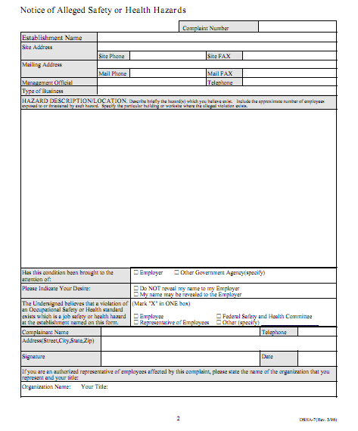
What happens when I file a complaint?
Complaints online or by phone will be resolved informally over the phone with your employer
Written complaints signed by a worker/representative are likely to result in an on-site OSHA inspection

Slide 15
During The Inspection
You have the right to:
Go along with the inspection in your area (This helps the inspector identify problems)
Talk privately with the OSHA inspector
Call the inspector
Find out the results of the OSHA inspection

Slide 16
Can I be discriminated against for exercising my health and safety rights?
Employers cannot punish you in any way for:
Reporting an injury or illness;
Complaining to your employer, union, OSHA or other agencies about safety and health problems;
Filing safety and health grievances;
Participating in safety and health committees; or
Participating in OSHA inspections and other OSHA-related activities.
If you have been fired, demoted, transferred or discriminated against in any way for using your rights under the law, you must file a complaint with OSHA within 30 days.

Slide 17
Conclusion
OSHA helps prevent workers from being killed or seriously harmed at work, and requires that employers provide their employees with working conditions that are free of known dangers
Employers have the responsibility to provide a safe workplace
Workers are entitled to safe working conditions
The relationship between employers and workers should be professional, understanding and fair

Slide 18
Additional Information
Additional Information on Worker’s Rights and Employer Responsibilities is available from OSHA!
Occupational Safety and Health Administration
U.S. Department of Labor
1-800-321-OSHA (6742)
www.osha.gov

Slide 19
Acknowledgements
This material was produced under grant number SH-26318-SH4 from the Occupational Safety and Health Administration, U.S. Department of Labor. It does not necessarily reflect the views or policies of the U.S. Department of Labor, nor does mention of trade names, commercial products, or organizations imply endorsement by the U.S. Government

Slide 20
Non-Ferrous Founders’ Society Safety & Health Training Program
For further information about this or other training modules:
Non-Ferrous Founders’ Society
1480 Renaissance Drive, Suite 310
Park Ridge, IL 60068 847/299-0950 http://www.nffs.org

