Slide 1
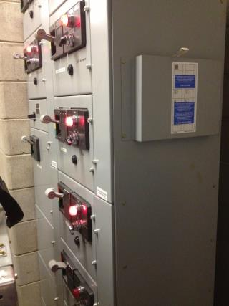
Electrical Safety - Module 6
Electrical Warehouse
Worker Hazards
in Structural Steel
Fabricating and
Supply Companies
Notes:
Module 6 presents electrical hazards in steel fabrication and supply companies.

Slide 2
Electrical Safety - Module 6 slide 2
OSHA Grant Information
This material was produced under grant number
SH-26316-SH4 from the Occupational Safety and Health Administration, U.S. Department of Labor. It does not necessarily reflect the views or policies of the U.S. Department of Labor, nor does mention of trades names, commercial products, or organizations imply endorsement by the U.S. Government.
Notes:
Speaker to provide grant materials acknowledgment.

Slide 3




Electrical Safety – Module 6
This program was developed by faculty and students in the School of Planning Design and Construction at Michigan State University in conjunction with
the American Institute of Steel Construction - Safety Committee and the University of Puerto Rico
March 2015

Slide 4
Electrical Safety - Module 6
Learning Outcomes: Participants shall be able to:
Demonstrate understanding of the risks of working with electricity
Demonstrate ability to recognize electrical safety hazards
Demonstrate understanding of safe use of cords
Demonstrate understanding of the need for de-energizing for routine parts replacement such as changing drill bits, blades etc.
Demonstrate understanding of the need to Lock/Tagout equipment when servicing equipment
Notes:
This slide identifies the intended learning outcomes of the module on electrical hazards.

Slide 5
Electrical Safety - Module 6 slide 5
Special Issues for fabrication and supply companies
Safe electrical use of all shop tools and equipment
Routine maintenance and changing out of tools such as drill bits or punches requires de-energizing the tool.The
company should have procedures to isolate energy
for routine shop practices (changing bits, dies blades)
Anything with energy potential needs to be locked out and tagged before guards can be removed
When electrical parts are exposed the power needs to be removed and locked out
Only qualified electricians may service electrical
components
Electricians should use PPE
Notes:
This slide lays out some of the special electrical hazards that may exist in steel fabrication and supply shops.

Slide 6
Electrical Safety - Module 6 slide 6
Employers are responsible for complying with:
OSHA 1910 Subpart S
And applicable editions of:
NFPA 70E® Standard for Electrical Safety in the
Workplace
The National Electrical Code (NEC)
NFPA® 70B Electrical Equipment Maintenance.
Link to NFPA 70E Standard for Electrical Safety in the Workplace
Notes:
This slide indicates that employers are responsible for complying with OSHA 1910 Subpart S as well as applicable NFPA standards.

Slide 7
Electrical Safety - Module 6 slide 7
What causes shocks?
Electricity travels in circuits-normally through a conductor
Sometimes a person’s body mistakenly becomes part of the circuit causing electrical shocks
Adapted from SH-20-843-SH0
Notes:
This slide presents the causes of shocks.

Slide 8
Electrical Safety - Module 6 slide 8
What causes shocks?
Shocks occur when a person’s body completes the current path with:
“Both wires of an electrical circuit
One wire of an energized circuit and the ground
A metal part that accidently becomes energized
Another conductor that is carrying the current”
When a person receives a shock, current flows through the body and the ground
Source OSHA 3075-2002 (Revised)
Notes:
This slide presents more information on what causes shocks.

Slide 9
Electrical Safety - Module 6 slide 9
Factors impacting severity of shock
“Amount of current flowing through the body
The current’s path through the body
The length of time the body remains in the circuit
The current frequency”
Quality of grounding
Working in wet conditions
Dryness or wetness of skin
Source OSHA 3075-2002 (Revised)
Notes:
This slide presents information on factors which influence the severity of shocks.

Slide 10
Electrical Safety - Module 6 slide 10
Milliamperes and Amps
1000 milliamperes = 1 Amp
Typical Tools and Rated Amperage
Typical (hand held) ½ portable drill 4-7 Amps
Industrial Drill Press 10-15 Amps
Grinder (hand held) 15 Amps
Notes:
This slide presents amperages for some tools commonly used in steel shops.

Slide 11
Electrical Safety - Module 6 slide 11
Effects of Electric Current and Body Reaction
“Below 1 milliamp Generally not perceptible
1 milliamp Faint tingle
5 milliamps Slight shock felt; not painful but disturbing. Average individual can let go. Strong involuntary reactions can lead to other injuries.
(Women)
6–25 milliamps Painful shock, loss of muscular control*
9–30 milliamps The freezing current or “let-go” range.*
(Men) Individual cannot let go, but can be thrown away from the circuit if extensor muscles are stimulated.”
Source: Next slide
Notes:
This slide presents the physical impacts of current on the human body.

Slide 12
Electrical Safety - Module 6 slide 12
Effects of Electric Current in the Human Body
“50 –150 milliamps Extreme pain, respiratory arrest, severe muscular contractions. Death is possible.
1,000 –4,300 milliamps Rhythmic pumping action of the heart ceases. Muscular contraction and nerve damage occur; death likely.
10,000 milliamps Cardiac arrest, severe burns; death probable”
Source OSHA 3075-2002 (Revised)
Source: W.B. Kouwenhoven, “Human Safety and Electric Shock,” Electrical Safety Practices, Monograph, 112 , Instrument Society of America, p. 93. November 1968.
Notes:
This slide is a continuation of the previous slide and presents the physical impacts of higher currents on the human body

Slide 13
Electrical Safety - Module 6 slide 13
Other Effects - Burns
Electrical Burns
Arc Flash Burns
Thermal Contact Burns
Notes:
This slide presents other physical effects of electricity on the human body.

Slide 14
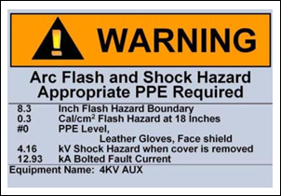
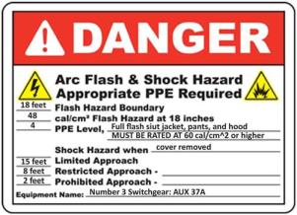
Electrical Safety - Module 6 slide 14
Arc Flash
“An arc flash is a short circuit through the air in an electrical panel box or any other piece of energized electrical equipment.”
“The circuit is completed through the air, the air breaks down to where it offers little‐to‐no resistance to the flow of electricity.”
“The tremendous amounts of energy released in an arc flash make for a very bright, very hot, and very loud explosion.”
Source SH‐20999‐10‐60‐F‐21
Notes:
This slide presents the concept of “Arc Flash” and indicates that sometimes physical current can travel through the air between parts, requiring no physical contact of the parts.

Slide 15
Electrical Safety - Module 6 slide 15
Arc Flash- Causes
Dropped tools in panels, inadvertent contact during servicing of equipment, corrosion of components, moisture, animals
Only qualified individuals should work on electrical equipment
Source SH‐20999‐10‐60‐F‐21
Notes:
This slide presents the causes of arc flash.

Slide 16
Electrical Safety - Module 6 slide 16
Arc Flash- Protective Measures
NFPA 70E® Standard for Electrical Safety in the
Workplace identifies practices which can help reduce
arc flash potential and injury
Source SH‐20999‐10‐60‐F‐21
Notes:
NFPA 70E is a standard addressing electrical safety in the workplace and identifies requirements which when implemented can reduce potential for arc flash injury

Slide 17
Electrical Safety - Module 6 slide 17
Arc Flash- Protective Measures
Electrical Equipment should only be serviced by
a qualified individual
Wear all PPE
De-energize the circuit
Use Safe Work Practices
Insulation
Guarding
Ground Fault Circuit Interrupters (GFCI)
Grounding (secondary protection)
Barricades
Limited Approach Zones
Restricted Approach Zones
Prohibited Approach Zones
Source SH‐20999‐10‐60‐F‐21
Notes:
This slide identifies arch flash protective measures.

Slide 18
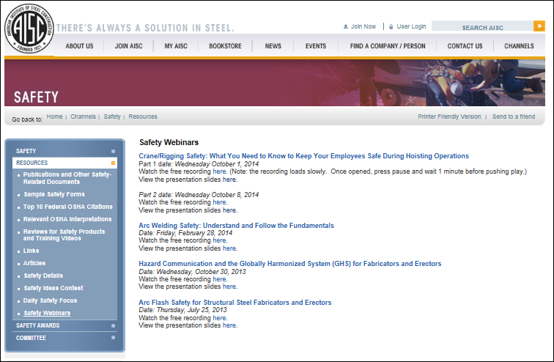
Electrical Safety - Module 6 slide 18
Arc Flash- Protective Measures
For more information AISC has an Arc Flash Webinar posted
at its website
Link to AISC safety webinars
Notes:
The American Institute of Steel Construction (AISC) has a webinar on how to reduce arch flash in steel companies.

Slide 19
Electrical Safety - Module 6 slide 19
Electricity can cause explosions and or fires if the conditions are right.
Bad insulation, static electricity, and overloaded circuits all contribute to explosions.
Notes:
This slide addresses electrical explosions.

Slide 20
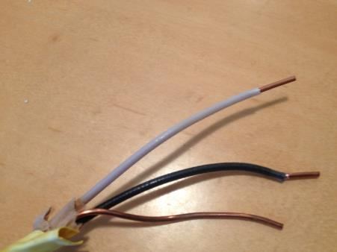
Electrical Safety - Module 6 slide 20
What is an electrical circuit?
Electricity flows from a voltage source through a conductive path to a load and returns to the voltage source
Neutral
Hot wire
Grounding wire
Notes:
This slide describes electrical circuits.

Slide 21
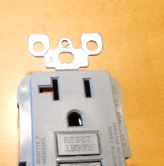
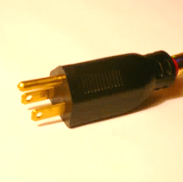
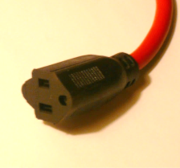
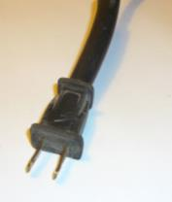
Electrical Safety - Module 6 slide 21
Polarity
Certain electrical using devices are sensitive to polarity so it is important that circuits be wired properly and proper plugs are used.
Larger slot and third prong limits reversing polarity
Notes:
This slide presents the concept of polarity.

Slide 22
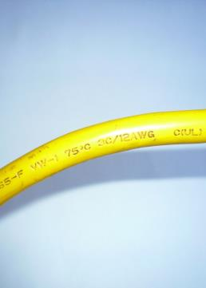
Electrical Safety - Module 6 slide 22
Insulating the Conductors
Simplest way to protect workers from
energized wires is by insulation
  Rubber/plastic coatings on wires
  prevent shock, fires, short circuits
  and provide strain relief
  Must be suitable for voltage
  Check insulation on cords and
  equipment before using them
  Small defects in cords and
  equipment will allow leakage
  Insulation is subject to damage
Cover on electrical cord
serves as insulation
Notes:
This slide presents the importance of insulation of electrical wires and basic insulation requirements.

Slide 23
Electrical Safety - Module 6 slide 23
Types of grounding protection
Equipment is grounded through the use of a grounding conductor- usually a copper wire that is insulated with a green cover or a bare copper or stranded copper wire.
Electrical systems components such as hard wired equipment and fixture boxes are grounded back to the electrical panel which is grounded to the ground through ground rods.
Source OSHA 3075-2002 (Revised
Notes:
This slide presents background on electrical grounding.

Slide 24
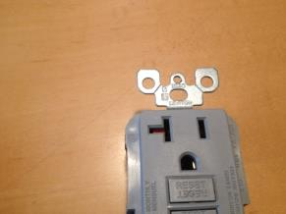
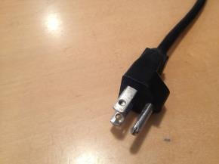
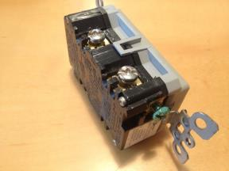
Electrical Safety - Module 6 slide 24
The importance of grounding protection
Grounding a tool intentionally creates a low resistance path that connects to the earth
Secondary protective measure that helps protect a worker
Does not guarantee you won’t get a shock-but reduces the risk
For grounding prong Grounding prong Ground screw
Notes:
This slide presents the importance of electrical grounding.

Slide 25
Electrical Safety - Module 6 slide 25
Types of grounding protection
Fuses
Circuit Breakers
Located at the panel or at the device and break the circuit when too much current flows through the circuit.
Ground - Fault Circuit Interrupters (GFCI)
Source OSHA 3075-2002 (Revised
Notes:
This slide presents types of electrical grounding.

Slide 26
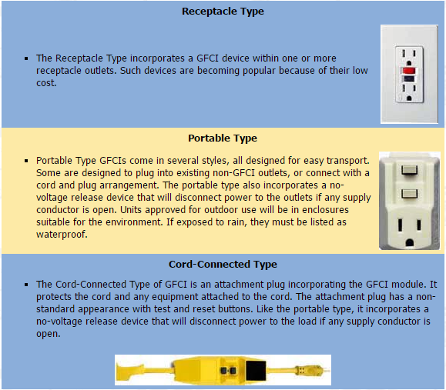
Electrical Safety - Module 6 slide 26
Ground-Fault Circuit Interrupters
1/10 of an ampere (amp) of electricity going through the body for just 2 seconds is enough to cause death.
A GFCI can sense a current differential due to a ground fault and breaks
the circuit
Image from
Link to Ground Fault Circuit Interrupters on OSHA Website
Notes:
This slide introduces Ground Fault Circuit Interrupters (GFCI) as a type of electrical grounding.

Slide 27
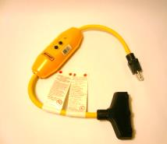
Electrical Safety - Module 6 slide
Ground Fault Circuit Interrupters
Can detect a change in current of 5
millamperes and shut off power in
less than 1/40 of a second.
Can be installed in the service
entrance panel, receptacle, branch
circuit panel, extension cord or with
generators.
Source OSHA 3075-2002 (Revised)
Notes:
This slide explains amperage difference detected by GFCI and explains where GFCI can be located in a circuit.

Slide 28
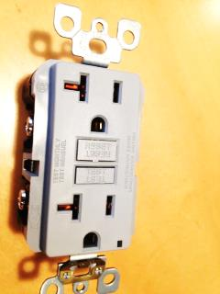
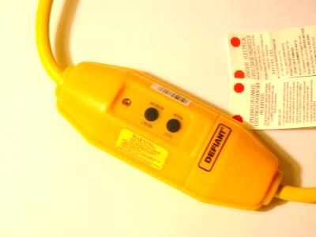
Electrical Safety - Module 6 slide 28
GFCI
Should be used whenever work will be done in a possibly wet environment such as outdoors, basements, garages or an other potentially wet location.
GFICI test and reset buttons
Notes:
This slide depicts example GFCI locations.

Slide 29
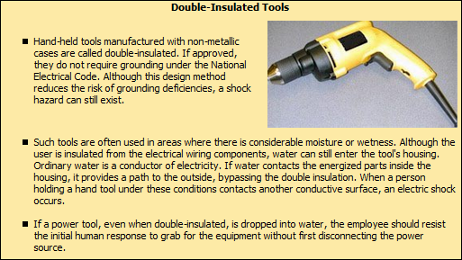
Electrical Safety - Module 6 slide 29
https://www.osha.gov/SLTC/etools/construction/electrical_incidents/powertools.html
Notes:
This slide presents “double insulated tools”.

Slide 30
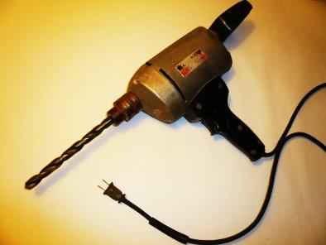
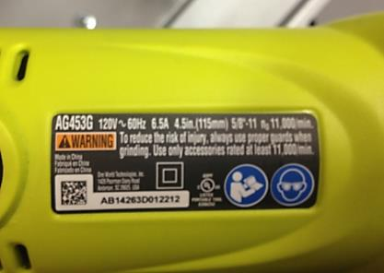
Electrical Safety - Module 6 slide 30
Double Insulated Tools
Double insulated drill
Double box on label
indicates double insulated tool
https://www.osha.gov/SLTC/etools/construction/electrical_incidents/powertools.html
Notes:
This slide depicts a portable drill as an example and shows a double insulated tool label.

Slide 31
Electrical Safety - Module 6 slide 31
Assured Equipment Grounding Program
OSHA 1910 Subpart S
Alternative to GFCI protection.
By shift inspection of cords to guarantee continuity of grounding conductor and correct connection of conductor (polarity)
Must have daily inspection for missing pins, insulation damage, internal damage
Inspection must be done by competent person
Keep records
Source 1910.304
Notes:
This slide identifies OSHA 1910 Subpart S Assured Equipment Grounding Program as an alternative for using GFIC.

Slide 32
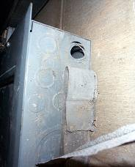
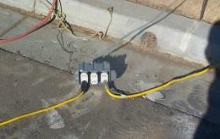
Electrical Safety - Module 6 slide 32
Safe Practices-Guard Conductors
Protect workers from energized lines
by guarding/shielding the wires
  Use boxes, covers, enclosures and
  conduit to prevent contact with wires
  Boxes/panels must be free of
  missing ‘knock-outs’
  Electrical equipment operating at
  50 volts or more must be guarded
Missing knockout
Open box
https://www.osha.gov/dte/grant_materials/fy07/sh-16589-07/focus_four_hazards_english.ppt
Notes:
This slide presents the importance of guarding workers from electrical current by the use of insulated wires, electrical box covers and equipment guarding.

Slide 33
Electrical Safety - Module 6 slide 33
Safe Practices- Using equipment-Grounding
Use GFCIs or have an assured equipment grounding program
Use double-insulated tools and equipment, distinctively marked.
Visually inspect all electrical equipment before use.
Remove from service any equipment with frayed cords, missing ground prongs, cracked tool casings, etc.
Ground all power supply systems, circuits, and equipment.
Do not remove ground prongs from cord
Avoid standing in wet areas when using electrical power tool.
Check equipment grounds- are they there and working?
Check polarity - receptacle tester
GFCI’s? - ground fault circuit interrupter
Link to Grounding on OSHA website
Link to Powertools on OSHA Website
Notes:
This slide presents important reminder tips on grounding to promote electrical risk avoidance.

Slide 34
Electrical Safety - Module 6 slide 34
Extension Cords-Selection
Flexible cords must be marked with type, size and # of
conductors
Select cords suitable for electrical load
Do not use cords that are not 3-wire type, or not designed
for hard-usage, or have been modified
Should have third prong
Use only cords, connection devices, and fittings that are
equipped with strain relief.
Use only hard use or extra hard use cords
Remove from service and damaged cords
Link to Powertools on OSHA Website
Notes:
This slide presents information on electrical cords

Slide 35
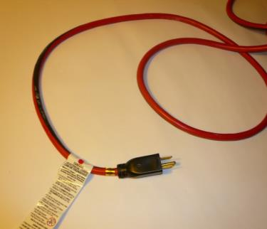
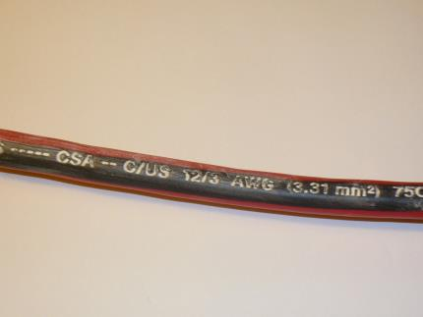
Electrical Safety - Module 6 slide 35
Extension Cords-Selection
3 prong electrical extension cord
Cord markings showing
3-12 gauge wires (amperage
varies with cord length)
Link to Powertools on OSHA Website
Notes:
This slide indicates electrical cord identification markings.

Slide 36
Electrical Safety - Module 6 slide 36
Selection of cords
The National Electrical Code (NEC) has
designations for extension cords
Hard service cords (types S, ST, SO, STO)
Junior service cords (types SJ, SJO, SJT, SJTO)
Other designations reflect use conditions such as,
for outdoor use, indoor use, oil resistant etc.
Also reflect insulation covering materials
Link to Regulations Standards 29 CFR
Notes:
Selection of electrical cords which are suitable for the task is important. This slide identifies some of the electrical cord types and duty classifications.

Slide 37
Electrical Safety - Module 6 slide 37
Extension Cord – Safe Use Practices
Do not run through doors or windows
Protect cords from sharp edges
  Do not pass cords through door ways
  – protect from pinch points
Do not modify cords or use them
incorrectly.
Remove cords from receptacles by
pulling on the plugs, not the cords.
Damaged cord- remove
from service
Link to Electrical Incidents - Power Tools
Notes:
This slide lays out safe use practices when using electrical cords.

Slide 38
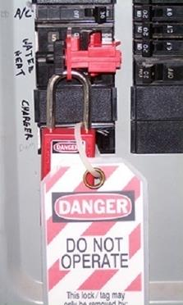
Electrical Safety - Module 6 slide 38
Lockout/tagout
Tags identify that work is
being done. Tag all controls that
are to be deactivated in the
course of work
Equipment or circuits rendered
inoperative and tagged at all
points where they could be
energized
Photo from Certified Safety Construction Worker Compliance Training Center
developed under OSHA Grant SH-20-843-SH0
Lockout
Notes:
This slide presents concepts of lockout and tagout.

Slide 39
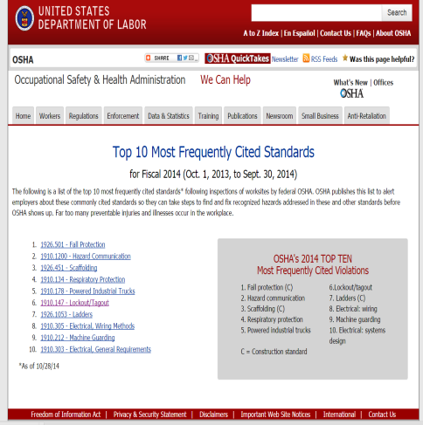
Electrical Safety - Module 6
Frequently cited
Lockout/tagout ranks 6th as one of the most cited standards for fiscal year 2014
Link to Top 10 Most Frequently Cited Standards
Notes:
Lockout/tagout rank sixth among frequently cited OSHA standards.

Slide 40
Electrical Safety - Module 6 slide 40
OSHA Standard
1910.147: “This standard covers the servicing and maintenance of machines and equipment in which the unexpected energization or start up of the machines or equipment, or release of stored energy, could harm employees. This standard establishes minimum performance requirements for the control of such hazardous energy”.
Source: 1910.147 Subpart J – General Environmental Controls
Notes:
OSHA Standard 1910.147 addresses de-energizing equipment during servicing.

Slide 41
Electrical Safety - Module 6 slide 41
What is Hazardous Energy?
The unexpected startup or release of stored energy during the servicing and maintenance of machines and equipment.
Energy sources including electrical, mechanical, hydraulic, pneumatic, chemical, thermal or other sources in machines and equipment
Equipment should only be serviced by a qualified electrician
Link to Control of Hazardous Energy on OSHA Webiste/
Notes:
This slide defines hazardous energy.

Slide 42
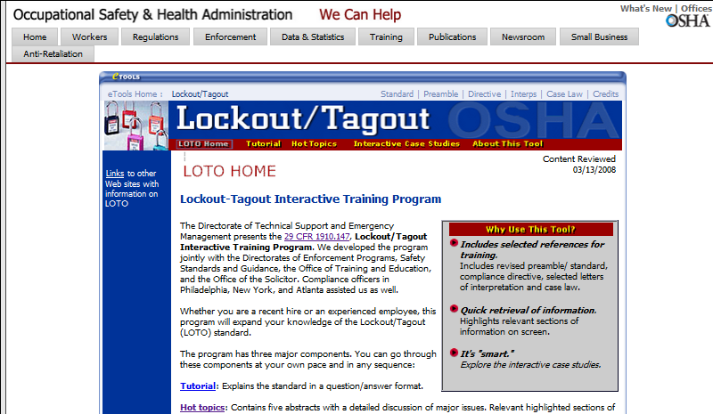
Electrical Safety - Module 6 slide 42
For more information on Lockout/tagout visit OSHA’s Interactive Training Program
Link to Lockout-Tagout Interactive Training Program
Notes:
OSHA has an interactive training program on Lockout/Tagout.

Slide 43
Electrical Safety - Module 6 slide 43
Personal Protection
What personal equipment should be used?
Rubber insulating:
Gloves
Hoods
Sleeves
Matting Blankets
Line hose
(no metal hardhats)
All help reduce the risk of electrical accidents
Notes:
The slide presents the PPE that should be used when working with electricity.

Slide 44
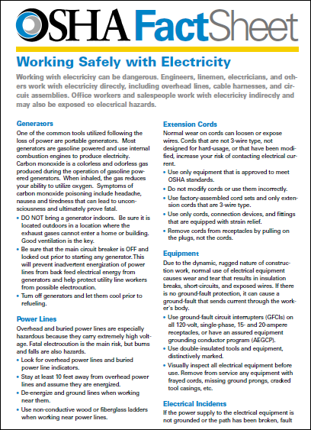
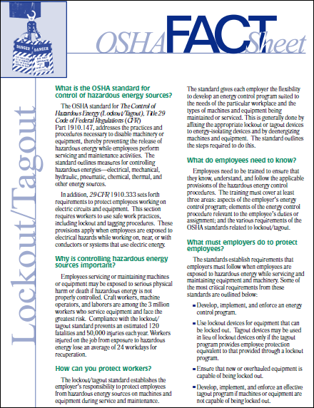
Electrical Safety - Module 6 slide 44
OSHA Resources
Notes:
This slide presents an electrical safety fact sheet available from the OSHA website.

Slide 45
Electrical Safety - Module 6 slide 45
Look out for these unsafe conditions
Improper grounding
Exposed electrical parts
Inadequate wiring
Damaged insulation
Overloaded circuits
Working in wet conditions
Inadequate PPE when working on electrical items
Damaged tools and equipment
Not de-energizing equipment for routine maintenance-disconnect from power supply
Improper Lock-out/Tag-out for electrical servicing of equipment
Unqualified personnel working on electrical equipment
Notes:
This is a cautionary slide that indicates potential unsafe electrical conditions.

Slide 46
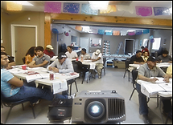
Electrical Safety - Module 6 slide 46
In class exercise-learning
Activity on de-energizing
equipment
Photo from OSHA 3686-09 2010
Notes:
The speaker should distribute and administer the electrical safety exercise on de-energizing shop equipment.

Slide 47
Electrical Safety - Module 6 slide 47
Group Learning Objectives:
Participants shall be able to determine the means to de-energize various equipment
Notes:
The objective of the electrical safety in-class exercise is to have attendees consider means to de-energize different types of equipment that they may have in their shop.

Slide 48
Electrical Safety - Module 6
Group Learning Activity Part A
In groups of 4-5 discuss the four scenarios and
determine the process for de-energizing the equipment.
Complete the template
Notes:
The speaker should provide instructions on the electrical exercise.

Slide 49
Electrical Safety - Module 6 slide 49
Activity Materials Provided
Fact Scenarios
Question and Answer Template
Notes:
The attendees should work with the fact scenarios and question and answer templates in completing this exercise.

