Slide 1
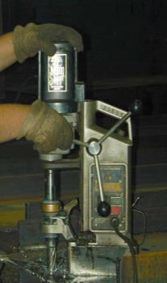
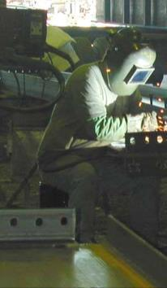
Preventing Musculoskeletal Injuries Module 5
Special Warehouse
Worker Hazards
in Structural Steel
Fabricating and
Supply Companies
1
Notes:
Module 5 focuses on the prevention of musculoskeletal injuries in steel warehousing activities.

Slide 2
Preventing Musculoskeletal Injuries Module 5
OSHA Grant Information
This material was produced under grant number
SH-26316-SH4 from the Occupational Safety and Health Administration, U.S. Department of Labor. It does not necessarily reflect the views or policies of the U.S. Department of Labor, nor does mention of trades names, commercial products, or organizations imply endorsement by the U.S. Government.
Notes:
Speaker to provide grant materials acknowledgment.

Slide 3
Preventing Musculoskeletal Injuries Module 5
Program Development
This program was developed by faculty and students in the School of Planning, Design and Construction at Michigan State University in conjunction with
the American Institute of Steel Construction - Safety Committee and the University of Puerto Rico
March 2015

Slide 4
Preventing Musculoskeletal Injuries Module 5 slide 4
Learning Outcomes: Participants shall be able to:
Demonstrate understanding of the principles of ergonomics and their applications
Use good work practices, including proper lifting techniques
Demonstrate awareness of work tasks that may lead
to pain or injury
Recognize early symptoms of MSDs
4
Notes:
This slide presents the key intended learning outcomes from this module.

Slide 5
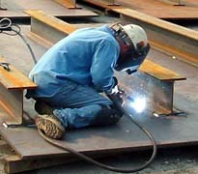
Preventing Musculoskeletal Injuries Module 5 slide 5
MSDs Emphasis in Steel Companies
Repetitive stress, improper lifting, awkward position, body twists causes damage both short and long term
Change position including height of the work, rotate workers, fatigue mats, and anti-vibration gloves all help
Stretching helps
Working in an awkward position
Photo from CIANBRO
5
Notes:
This slide introduces musculoskeletal injuries that can occur in steel handling.

Slide 6
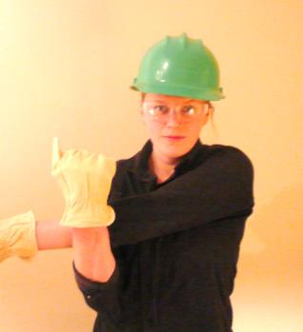
Preventing Musculoskeletal Injuries Module 5 slide 6
Stretching & Wellness*
Shoulder Stretch
In Class Stretching Exercise
Instructor Lead Class in Stretching demonstration
Source CIANBRO
Notes:
Speaker should demonstrate stretching methods and lead attendees in an in-class stretching exercise.
Presenter’s Notes:
You are a professional Workplace Athlete. You owe it to the only body you have to keep it in shape…not only for the job…but also for a satisfying life. A personal fitness plan is vital to your successful career and life. You would keep yourself fit for competition if you played on a professional sports team. There is a little difference between professional sports and your job. You must keep fit for your job or you will suffer needlessly. You will not perform well. You will go home exhausted and sore from the day’s work. You know that it is worth the effort. Just ask anyone who is involved in such a program.
Benefits of a Cardiovascular Work out
Sleep better
Lose weight, gain weight, or maintain weight, depending on your needs
Improve your resistance to fight infections
Lower your risk of cancer, heart disease and diabetes
Help your brain work better, making you smarter
Makes you feel better-happier mood
CLEANS OUT THE carburetor
Stretching
Stretches help prevent Injuries. Warming up before work is the best way to reduce the risk of these injuries. Cold joints, tendons and muscles are more likely to get strained or sprained by sudden movement or exertion. Benefits of pre-work stretches are.
Raises the heart rate so that the body is prepared for physical exertion
Speeds up nerve impulses so that reflexes are enhanced
Reduces muscle tension
Sends oxygenated blood to the muscle groups
Reduces the risk of injury, particularly to connective tissue like tendons
Increases flexibility and joint mobility.

Slide 7
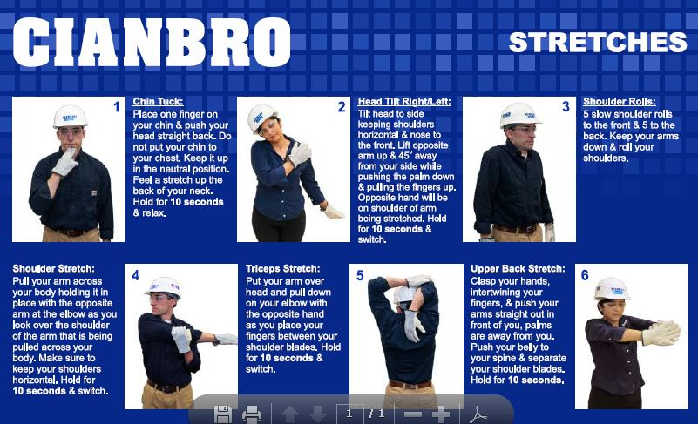
Preventing Musculoskeletal Injuries Module 5 slide 7
Notes:
This slide depicts the stretching methods used in the in-class stretching exercises.

Slide 8
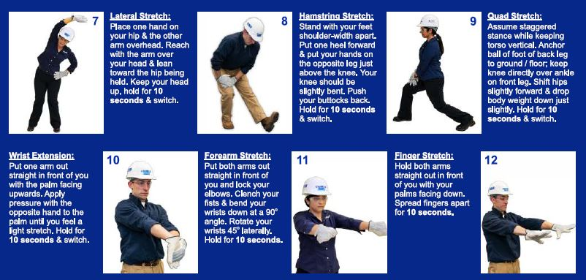
Preventing Musculoskeletal Injuries Module 5 slide 8
Notes:
This slide depicts additional stretching methods used in the in-class stretching exercises.

Slide 9
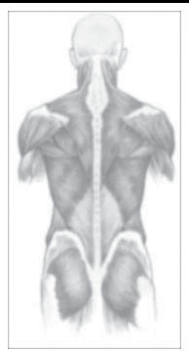
Preventing Musculoskeletal Injuries Module 5 slide 9
What Are Musculoskeletal Disorders (MSDs)?
An injury or disorder of the muscles, nerves, tendons, joints, cartilage, and spinal discs.
They also include soft tissue and repetitive motion injuries and disorders.
Illustration sources Back Injury Prevention For the Landscaping and Horticultural Services Industry, K-State Research and Extension, Kansas State University, Manhattan, Kansashttps://www.osha.gov/dte/grant_materials/fy06/46g6-ht22/back_injury_prevention.pd
Notes:
This slide defines musculoskeletal disorders (MSDS).

Slide 10
Preventing Musculoskeletal Injuries Module 5 slide 10
MSD IMPACT
“Work related MSDs are among the most frequently reported causes of lost or restricted work time
In 2011, the Bureau of Labor Statistics (BLS) reported
the 387,820 MSD cases accounted for 33% of all
worker injury and illness cases in 2011.”
Link to Ergonomics on OSHA Website
10
Notes:
This slide addresses the impact and frequency of MSDS in the workplace.

Slide 11
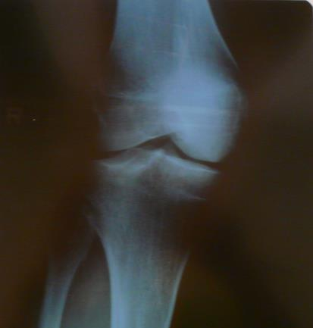
Preventing Musculoskeletal Injuries
Module 5 slide 11
MSDs Affect Many
Parts of the Body
“Back
Neck
Shoulders
Arms
Elbows
Wrists
Fingers”
Knees
Source CIANBRO
X Ray of knee with cartilage damage
Notes:
This slide identifies parts of the body affected by MSDS.

Slide 12
Preventing Musculoskeletal Injuries Module 5 slide 12
Symptoms:
“Soreness
Swelling
Skin Discoloration
Numbness
Tingling
Burning
Radiating Pain
Decreased Strength
Decreased Movement”
These usually develop gradually
but sometimes can appear suddenly
Source: CIANBRO
Notes:
This slide identifies symptoms of MSDS.

Slide 13
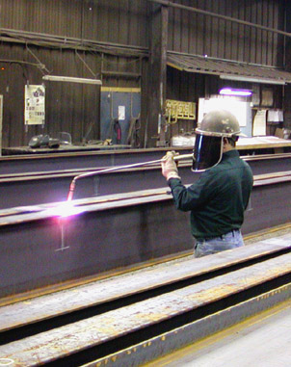
Preventing Musculoskeletal Injuries Module 5 slide 13
slide 13
Risk Factors for MSD Injuries?
Awkward postures
Improper lifting
Pulling-pushing-lifting
heavy loads
Repetition
Excessive force
Contact injuries
Static posture
Vibration
Unsuitable tools
Extreme temperature
Awkward motion demands
13
Notes:
This slide identifies key risk factors for MSDS.

Slide 14
Preventing Musculoskeletal Injuries Module 5 slide 14
MSD Injury Factors
Intensity of exposure (How Much?)
Frequency of the exposure (How Often?)
Position and movement (How Positioned?)
Duration of the exposure (How Long?)
Keeping in mind that it could be a combination of all these factors.
Force + Repetition + Posture + Duration = Increased risk
of a MSD
Source CIANBRO
14
Notes:
This slide presents a method for assessing the risk of MSDS.

Slide 15
Preventing Musculoskeletal Injuries Module 5 slide 15
Conditions Aggravated with:
“Age
Stress
Physical conditioning”
“Lack of exercise
Poor nutrition
Poor sleep
Generally unhealthy lifestyle habits
Injuries outside of work”
15
Notes:
This slide presents conditions which may aggravate MSDS.

Slide 16
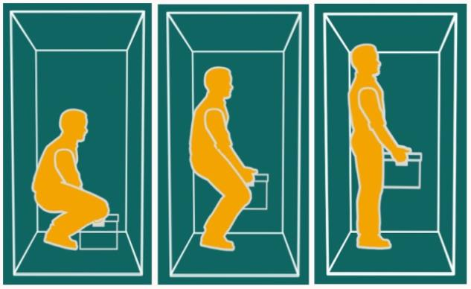
Preventing Musculoskeletal Injuries Module 5 slide 16
Picture Perfect Lifting
Avoid torso twisting (rotation) while lifting
Source CIANBRO
16
Notes:
This slide depicts proper lifting posture.

Slide 17
Preventing Musculoskeletal Injuries Module 5 slide 17
Back Injuries
“The back is the most frequently injured body part. Once
injured, the risk of recurrence doubles
Low back injuries represent over 90% of all injury claims
Second only to the common cold in lost work days
Back pain costs American businesses an estimated $30
billion each year
4 out of every 5 people will experience back pain
in their lifetime”
Notes:
This slide addresses the impact of back injuries in the work place.

Slide 18
Preventing Musculoskeletal Injuries Module 5 slide 18
Back
“The back supports the upper body, protects your spinal cord and allows flexibility”
“Most of the stress when lifting and bending is absorbed by the lower back
To take some pressure away from the spine, your abdominal and back muscles contract to give added support”
Notes:
This slide presents information on the spine and stresses placed on the spine when lifting.

Slide 19
Preventing Musculoskeletal Injuries Module 5 slide 19
“Causes of Back Injury
Improper lifting techniques
Overexertion
Poor posture
Medical factors (age, other disabilities, etc.)
Slips and falls
Excessive weight
Lack of exercise
Stress”
19
Notes:
This slide identifies the causes of back injuries.

Slide 20
Preventing Musculoskeletal Injuries Module 5 slide 20
“Symptoms of Back Injury
Pain
Stiffness
Numbness in the legs
Limited ability to sit or stand
Muscle weakness, spasms and strains
Decreased range of motion”
20
Notes:
This slide identifies the symptoms of back injuries.

Slide 21
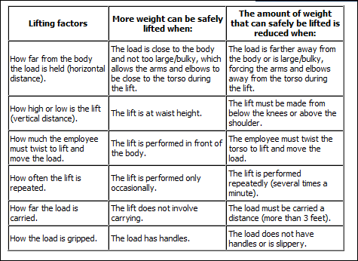
Preventing Musculoskeletal Injuries Module 5 slide 21
Lifting Considerations
Link to Vibration on OSHA Website
21
Notes:
This slide indicates considerations for lifting including lifting factors, lifting conditions and weight that can be lifted under certain conditions.

Slide 22
Preventing Musculoskeletal Injuries Module 5 slide 22
Plan your job lift
“Reduce the weights you lift
Reduce the distance you carry a load
Eliminate twisting
Reduce the frequency of lifting
Lift in a safe range
When Lifting…
Keep the load close to the body
Keep your feet apart for a stable stance
Position your feet prior to lifting to eliminate twisting
Don’t lift beyond your safe limit. Get help”!
Source: CIANBRO
Notes:
This slide indicates strategies for reducing back injuries from lifting, including planning the lift and lifting basics.

Slide 23
Preventing Musculoskeletal Injuries Module 5 slide 23
Improper vs. Proper Lifting
“See the force on the disk when bending at the waist vs. bending at the knees and lifting?”
Source: CIANBRO
Notes:
This slide depicts the impact on the spine of proper and improper lifting.

Slide 24
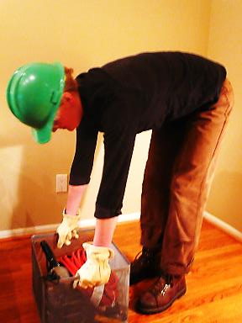
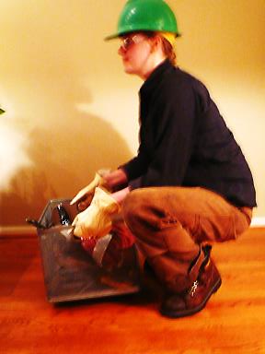
Preventing Musculoskeletal Injuries Module 5 slide 24
Heads Up Not Butts Up
Bad
Good
Lifting with back
Lifting with legs
Source: CIANBRO
Notes:
This slide depicts good posture and bad posture for lifting.

Slide 25
Preventing Musculoskeletal Injuries Module 5 slide 25
Heads Up Not Butts Up
In Class Lifting Demonstration
Instructor Lead Class Lifting Demonstration
Select a volunteer-lift an object from the floor
Notes:
The speaker should conduct an in-class lifting demonstration. Have an attendee lift a light object and critique the attendee’s posture.

Slide 26
Preventing Musculoskeletal Injuries Module 5 slide 26
Vibration Exposure
“Whole body vibration (WBV) is a form of mechanical vibration transmitted through a supporting surface to the body. Like in equipment or a truck seat.
Vibration from hand tools can be dampened by anti-vibratory gloves, tool wraps or even by choosing tools that provide less vibration.”
Source; CIANBRO
26
Notes:
This slide introduces the concept of vibration related injuries.

Slide 27
Preventing Musculoskeletal Injuries Module 5 slide 27
Vibration in steel shops
Grinders
Sanders
Drills
Chipping hammers and chisels
Notes:
This slide lists some of the tools which can cause vibration that are commonly used in steel shops.

Slide 28
Preventing Musculoskeletal Injuries Module 5 slide 28
H.A.V.S. Symptoms (Hand-Arm Vibration Syndrome)
“Tingling or numbness in fingers and palm
Spasms in fingers
Blanching of the fingers
Chronic disorder usually irreversible
Can develop from repeated and prolonged exposure to
vibration
Damage to the blood vessels, nerves, and muscles
Half of the 1.5 million American workers who use
vibrating tools will develop some form of HAVS (NIOSH)
5% of the general population suffers from HAVS”
Notes:
This slide introduces the concept of HAVS (Hands-Arms- Vibration Syndrome).

Slide 29
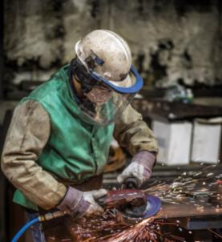
Preventing Musculoskeletal Injuries Module 5 slide 29
H.A.V.S. Risk Factors
“Repeated and prolonged exposure
to hand-held vibrating tools
Improper tool use
Forceful tool grip
Aggravated by
Temperature - Cold
Damp environment
Smoking”
Vibration from grinding can be
minimized by the use of vibration
dampening tools and anti-vibration
gloves
Photo from Cianbro
Notes:
This slide identifies risk factors for HAVS.

Slide 30
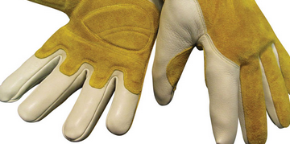
Preventing Musculoskeletal Injuries Module 5 slide 30
H.A.V.S Control PPE
Wear full-fingered, certified anti-vibration gloves to
reduce exposure to vibration
Wear ANSI Compliant Gloves appropriate for the hazard
Anti vibration gloves
Notes:
Anti-vibration gloves may help prevent HAVS.

Slide 31
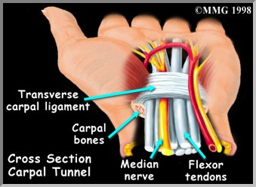
Preventing Musculoskeletal Injuries Module 5 slide 31
Hands and wrist damage is a fast
growing class or worker’s
compensation claims
“Wrist injuries accounted for more
than half of all MSDs
5 million U.S. workers suffer from
repetitive stress injuries to the wrist
Occurs when the median nerve is compressed and inflamed.”
Notes:
This slide presents the impact of hand and wrist injuries in the workplace.

Slide 32
Preventing Musculoskeletal Injuries Module 5 slide 32
Carpel Tunnel Syndrome
“Causes
Repetition
Sustained exertions
Awkward wrist and positions
Symptoms
Tingling and pain in the hand and
Numbness in wrist
Muscle atrophy at base of thumb”
Notes:
This slide presents background on Carpel Tunnel Syndrome.

Slide 33
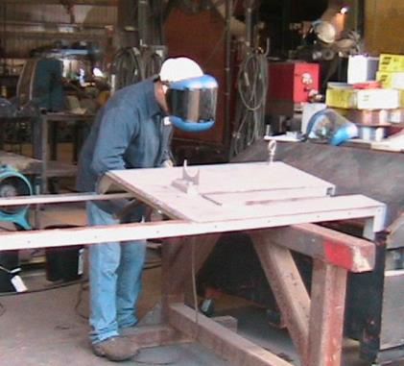
Preventing Musculoskeletal Injuries Module 5 slide 33
What Is “Ergonomics?”
Fitting the job to the
Worker.
Elevate the work to avoid kneeling and reaching
Photo Source CIANBRO
Notes:
This slide introduces the concept of “ergonomics” and fitting the job to the worker.

Slide 34
Preventing Musculoskeletal Injuries Module 5 slide 34
What is Ergonomics?
“The science of adapting work-stations, tools, equipment, and job techniques to be compatible with human anatomy and physiology to reduce the risk of Musculoskeletal Disorder injuries due to Ergonomic Stressors.”
“Fit the job to the person” rather than the “person to the job.”
Notes:
This slide defines “ergonomics”.

Slide 35
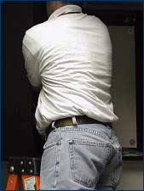
Preventing Musculoskeletal Injuries Module 5 slide 35
Ergonomic Risk Factors
Poor body mechanics
Restrictive workstations
Awkward postures
Working overhead
Working below the knees
Hand tools that do not meet the requirements of the job
Photo source Link to Awkward Posture Photo on OSHA Website
Source CIANBRO
Notes:
This slide identifies ergonomic risk factors.

Slide 36
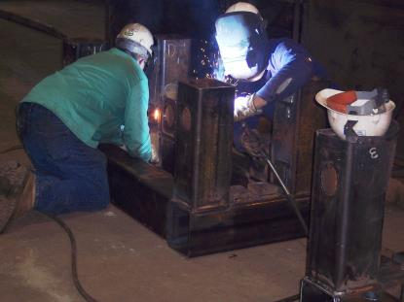
Preventing Musculoskeletal Injuries Module 5 slide 36
What awkward postures do you work in?
Risks from above shoulders and below the knees work
Workers kneeling during fabrication
Photo from CIANBRO
Notes:
This slide asks attendees to identify the awkward positions they use as part of their job.

Slide 37
Preventing Musculoskeletal Injuries Module 5 Slide 37
37
Ergo Tips-Reduce Bending Over to Work
Reduces the strain on your back from stooping
Reduces leg fatigue from holding a squatting position
Allows your feet to be flat on the floor with your ankles in their natural position instead of balancing on the balls of your feet and stretching the tendons at the backs of your ankles
Source: CIANBRO
Notes:
This slide presents ergonomic tips for reducing injuries from bending.

Slide 38
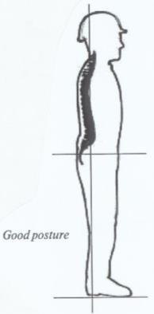
Balanced Tool Belts
Preventing Musculoskeletal Injuries Module 5 slide 38
Ergo Tips
Suspending Tools
Source: CIANBRO
Notes:
This slide depicts tool balancers to help support the weight of tools and to reduce stress on workers of holding tools and unbalanced tool weights.

Slide 39
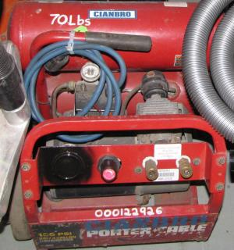
Preventing Musculoskeletal Injuries
Module 5 slide 39
Ergo Tips
Mark loads over 50 lbs to
warn workers of heavy loads
Marking lifting load
Photo from CIANBRO
Notes:
This slide presents an ergonomic tip to label heavy loads on tools to warn workers of lifting hazards

Slide 40
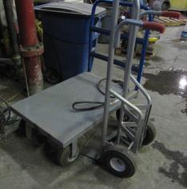
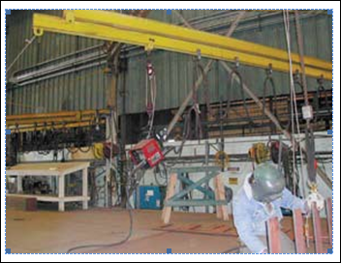
Preventing Musculoskeletal Injuries
Module 5
Ergo Tips
Use equipment such as hoist balancers, jib cranes, carts or forklifts to decrease the need for lifting, pushing and pulling loads.
Hand Cart
Job Crane
Photo from CIANBRO
Photo form OSHA 3341-03N 2008
Notes:
This slide presents an ergonomic tip to use equipment such as jib cranes, carts, forklifts and pallet jacks to reduce the need to lift and move heavy loads by themselves.

Slide 41
Preventing Musculoskeletal Injuries Module 5 slide 41
Job Rotation
“Job rotation is vital when conducting demanding repetitive tasks.
When planning out the job keep in mind that good job rotations are those that have team members using different muscle groups between tasks or at the very least less demanding tasks”.
Source: CIANBRO
Notes:
This slide introduces the concept of job rotation to reduce repetitive motion injuries.

Slide 42
Preventing Musculoskeletal Injuries Module 5 slide 42
Early Reporting of MSD Symptoms
Addressing injuries early can help prevent them from becoming more serious.
Source: 3341-03N 2009
42
Notes:
This slide presents the need to report injuries early to help prevent them from becoming more severe.

Slide 43
Preventing Musculoskeletal Injuries Module 5 slide 43
Use of the General Duty clause
“OSHA will use the General Duty Clause to cite employers for ergonomic hazards. Under the OSH Act's General Duty Clause, employers must keep their workplaces free from recognized serious hazards, including ergonomic hazards. This requirement exists whether or not there are voluntary guidelines”
Link to Standards and Enforcement FAQs on OSHA Website
Notes:
This slide indicates that OSHA may use the “general duty” clause to cite workplace risks from ergonomic factors. Employers have a responsibility to protect workers from unsafe work practices.

Slide 44
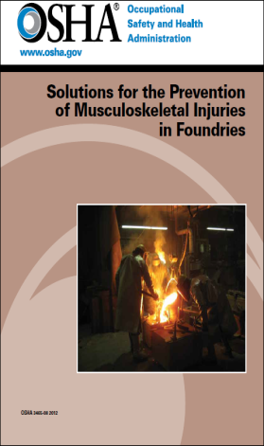
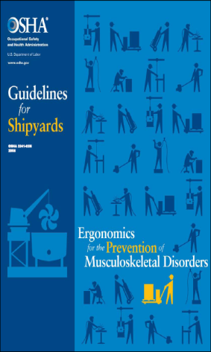
Preventing Musculoskeletal Injuries Module 5 slide 44
OSHA Publishes several useful guides
for other industries that have parallels to steel fabrication companies and service centers.
OSHA 3465-08 2012
OSHA 3341-03N 2008
Notes:
OSHA publishes a number of helpful resources on preventing musculoskeletal injuries in related industries such as foundries and shipbuilding which also handle irregular heavy materials.

Slide 45
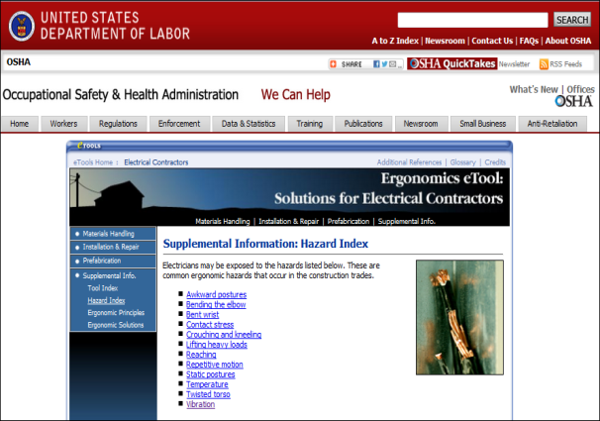
Preventing Musculoskeletal Injuries Module 5 slide 45
OSHA Resources
Link to Vibration on OSHA Website
Notes:
OSHA publishes a helpful resource on preventing musculoskeletal injuries for electrical workers who also work in awkward positions.

Slide 46
Preventing Musculoskeletal Injuries Module 5 slide 46
Summary Key Points
“Use your brain, not your back.
Work smarter, not harder.
Fix the job, not the worker.
Use safe ergonomic habits at home”
Source: CIANBRO
Notes:
This slide summarizes key points of the presentation on reducing musculoskeletal injuries.

Slide 47
Musculoskeletal Safety
Module 5
Sources
Link to grant training material on injury prevention
Link to Ergonomics on OSHA Website
Link to Solutions to Control Hazards on OSHA Website
Link to Server Error (File not Found)
Link to Server Error (File not Found)
Link to OSHA Publication 3465
Link to grant training materials - jeopardy game
Link to bulletin Standaup Forklift Under-ride Hazards
Link to Computer Workstattions eTool
Link to Ergonomics Training on OSHA Website
Link to Trucking Industry on OSHA Website
lwww.safetyservicescompany.com/.../warehouse-safety-general-guide. OSHA
CIANBROSafety Bulletin-Ergonomics
Grandjean E. “Fitting the task to the Man”, Taylor & Francis London, 1988
Lauren Hebert, “Personal Ergonomic Guide material handling Low Back Tasks”
Construction Occupational Health Program, UMass
Notes:
This slide lists a number of informational resources available from OSHA and other organizations for reducing musculoskeletal injuries.

Slide 48
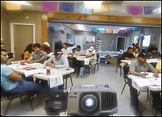
Musculoskeletal Safety Module 5
Questions?
Photo from OSHA 3686-09 2010
Notes:
The speaker should encourage attendees to ask questions about Module 5 content.

