Slide 1
Hazard Communication - Module 4
Special Warehouse
Worker Hazards
in Structural Steel
Fabricating and
Supply Companies
Photo from Douglas Steel Fabricating Corporation
Notes:
This module presents hazard communication requirements.

Slide 2
Hazard Communication - Module 4
OSHA Grant Information
This material was produced under grant number
SH-26316-SH4 from the Occupational Safety and Health Administration, U.S. Department of Labor. It does not necessarily reflect the views or policies of the U.S. Department of Labor, nor does mention of trades names, commercial products, or organizations imply endorsement by the U.S. Government.
Notes:
Speaker to provide grant materials acknowledgment.

Slide 3
Hazard Communication – Module 4
Program Development
This program was developed by faculty and students in the School of Planning, Design and Construction at Michigan State University in conjunction with
the American Institute of Steel Construction - Safety Committee and the University of Puerto Rico
March 2015

Slide 4
Hazard Communication - Module 4 slide 4
Learning Outcomes: Participants shall be able to:
Demonstrate an understanding of what information is found in an SDS
Demonstrate an understanding of how to navigate an SDS to locate information
Demonstrate an understanding of “pictograms”
Demonstrate an understanding of requirements for secondary containers
Notes:
This slide lays out the intended learning outcomes from this hazard communication module.

Slide 5
Hazard Communication- Module 4
Content Overview
Hazard Communication and the Globally Harmonized System (GHS)
What is GHS?
Overview of the changes to the HazCom Standard
Labeling requirements
Safety Data Sheets (SDS) format – 16 sections
Pictograms
Secondary containers
Notes:
This slide presents a general overview of the hazard communication module.

Slide 6
Hazard Communication - Module 4 slide 6
OSHA publishes a
helpful guide for small
entities on hazard
Communication
OSHA 3695-03 2014
Notes:
OSHA publishes a useful guide addressing hazard communication in small business entities.

Slide 7
Hazard Communication - Module 4
Hazard Communication Requirements
“OSHA’s HCS, 29 CFR 1910.1200, addresses the informational needs of employers and workers with regard to chemicals.” OSHA 3695-03 2014
“(b)(2) This section applies to any chemical which is known to be present in the workplace in such a manner that employees may be exposed under normal conditions of use or in a foreseeable emergency.“
29 CFR 1910.1200
Notes:
OSHA HCS, 29 CFR 1910.1200 addresses hazard communication.

Slide 8
Hazard Communication - Module 4
What is GHS?
The Globally Harmonized System of Classification and Labeling of Chemicals
A system for standardizing and harmonizing the classification and labeling of chemicals.
Defining health, physical, and environmental hazards
of chemicals
Creating classification processes that use available data on chemicals for comparison with the defined hazard criteria
Communicating hazard information, as well as protective measures, on labels and Safety Data Sheets (SDS)
Source: Hazard Communication and the Globally Harmonized System (GHS) for Fabricators and Erectors Webinar: http://www.aisc.org/content.aspx?id=35368
Notes:
This slide describes the Globally Harmonized System of Classification and Labeling of Chemicals.

Slide 9
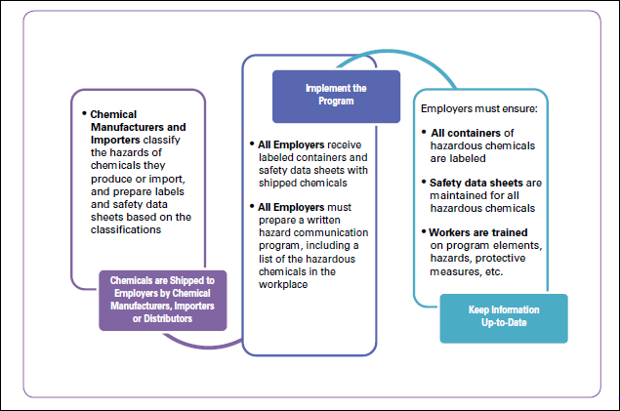
slide 9
Hazard Communication - Module 4
Source: Small Entity Compliance Guide for Employers That Use Hazardous Chemicals OSHA 3695-03 2014
Notes:
This slide depicts the Globally Harmonized System of Classification and Labeling of Chemicals.

Slide 10
Hazard Communication - Module 4 slide 10
Employee Information and Training:
HazCom 1994
“Right to Know”
Employees need to know the information on the chemicals is available and how to get the information on the hazards involved
HazCom 2012
“Right to Understand”
Employees need to understand and identify the hazards related to a chemical by pictogram and reading the label on the product
Source: Hazard Communication and the Globally Harmonized System (GHS) for Fabricators and Erectors Webinar: http://www.aisc.org/content.aspx?id=35368
Notes:
This slide presents the changes from the 1994 standard of “right to know” to the 2012 standard of “right to understand”.

Slide 11
Hazard Communication - Module 4 slide 11
HazCom 2012- Employee Information and Training:
Clarifies that the labels on shipped containers and workplace labels must be explained, as well as SDS format
Workers are required to be trained on the new label and SDS formats before all the provisions of the rule are effective
Employers were required to train employees regarding the new label elements and Safety Data Sheets format by December 1, 2013
Source: Hazard Communication and the Globally Harmonized System (GHS) for Fabricators and Erectors Webinar: http://www.aisc.org/content.aspx?id=35368
Notes:
This slide lays out employee information and training requirements under the 2012 standard.

Slide 12
Hazard Communication - Module 4 slide 12
Training details:
Label elements
Train employees on the type of information that the employee would expect to see on the new labels
How they might use that information
Product identifier, Signal word, Hazard statement(s), Pictogram(s), Precautionary statement(s), and name, address and phone number of the responsible party
Source: Hazard Communication and the Globally Harmonized System (GHS) for Fabricators and Erectors Webinar: http://www.aisc.org/content.aspx?id=35368
Notes:
This slide provides details of the 2012 training requirements.

Slide 13
Hazard Communication - Module 4 slide 13
Training details – continued:
General understanding of how the elements interact
For example - explain there are 2 signal words:
Danger means a more severe hazard within a hazard class
Warning is for the less severe hazard
Safety Data Sheet Format
Train the employees on the standardized 16 section format and the type of information they would find in the various sections.
Source: Hazard Communication and the Globally Harmonized System (GHS) for Fabricators and Erectors Webinar: http://www.aisc.org/content.aspx?id=35368
Notes:
This slide provides additional details of the 2012 training requirements.

Slide 14
slide 14
Hazard Communication - Module 4
Content
“Safety Data Sheet” (rather than “Material Safety Data Sheet”) uses a 16-section format.
Source: Hazard Communication and the Globally Harmonized System (GHS) for Fabricators and Erectors Webinar: http://www.aisc.org/content.aspx?id=35368
Notes:
This slide indicates new terminology of “SDS” which replaces “MSDS” and indicates there is a 16 section format.

Slide 15
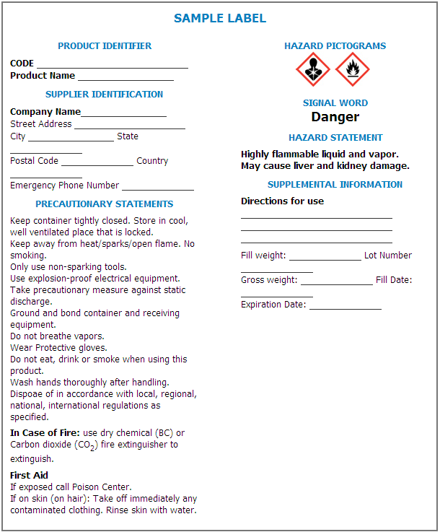
Labels
There are several label elements:
Symbols called “Pictograms”
Signal Words
Hazard Statements
Precautionary Statements
Product Identification
Supplier/ Manufacturer Identification
www.osha.gov/Publications/HazComm_QuickCard_Labels.html
Notes:
This is an example of the new label style that is to appear on product labels beginning no later than June 1, 2015 (or Dec. 1, 2015 for distributers who still have product in inventory after the June 1, 2015 deadline).
The type of required information is noted in blue. The actual statements and information will vary depending on the specific health and physical classification of the product.
This slide describe label elements including pictograms, signal words, precautionary statements, as well as product and manufacturer identifiers.

Slide 16
Hazard Communication - Module 4 slide 16
HCS Pictograms
and Hazards
Source: Small Entity Compliance Guide for Employers That Use Hazardous Chemicals OSHA 3695-03 2014
Notes:
This slide presents the pictogram system.

Slide 17
Hazard Communication - Module 4 slide 17
Red Borders
Red borders are required
Red borders increase comprehensibility
Source: Hazard Communication and the Globally Harmonized System (GHS) for Fabricators and Erectors Webinar: http://www.aisc.org/content.aspx?id=35368
Notes:
This slide presents the requirement for red borders around pictograms.

Slide 18
Hazard Communication - Module 4 slide 18
Labels: Pictograms –
Health Hazards*
Acute toxicity (Less Severe):
Irritant
Dermal sensitizer
Acute toxicity (harmful)
Narcotic effects
Respiratory tract irritation
Acute toxicity (Severe)
Source: Hazard Communication and the Globally Harmonized System (GHS) for Fabricators and Erectors Webinar: http://www.aisc.org/content.aspx?id=35368
Notes:
This slide presents sample pictograms for Acute Toxicity, of “severe” and “less severe” nature.
These 2 pictograms are specific to acute toxicity (short-term exposure). The skull and crossbones is for any substance that is classified as having acute toxicity in health hazard category 1-3. The acute toxicity health class, category 4 (least hazardous) is represented by an exclamation mark.
If the substance is properly labeled, these 2 pictograms will never appear on the same label. It will be one or the other with skull and crossbones representing the more severe hazard.
Additional information for labeling and language associated with these pictograms is found in Appendix C of the Haz Com Standard.

Slide 19
Hazard Communication - Module 4 slide 19
Labels: Pictograms –
Health Hazards*
Carcinogen
Respiratory sensitizer
Reproductive toxicity
Target organ toxicity
Mutagenicity
Aspiration hazard
Skin corrosion
Serious eye damage/
Eye irritation
Metal corrosion
Source: Hazard Communication and the Globally Harmonized System (GHS) for Fabricators and Erectors Webinar: http://www.aisc.org/content.aspx?id=35368
Notes:
This slide presents sample pictograms for “Health” hazards.
*Most employees should be familiar with the pictogram for corrosion on the left.
The pictogram to the right is called the “health hazard” pictogram and is represented by the silhouette of a person with a starburst across the chest. This is used indicate that the substance is a chronic and/or target organ hazard.

Slide 20
Hazard Communication - Module 4 slide 20
Labels: Pictograms/
Physical Hazards*
Flammables
Self reactives
Pyrophorics
Self heating
Emits flammable gas
Organic peroxides
Explosives
Self reactives
Organic peroxides
Source: Hazard Communication and the Globally Harmonized System (GHS) for Fabricators and Erectors Webinar: http://www.aisc.org/content.aspx?id=35368
Notes:
This slide presents pictograms for “Physical” hazards.
*The next 2 slides (4 pictograms) represent physical hazards.

Slide 21
Hazard Communication - Module 4 slide 21
Labels: Pictograms – Physical Hazards*
Corrosive to Metals
Oxidizer
Gases under Pressure
Source: Hazard Communication and the Globally Harmonized System (GHS) for Fabricators and Erectors Webinar: http://www.aisc.org/content.aspx?id=35368
Notes:
This slide presents additional pictograms for “Physical” hazards.
Note that the corrosive pictogram used to designate corrosion to metal is the same pictogram used for skin corrosion/serious eye damage/eye irritation under the health hazard classification.
Not all health hazards represented by this pictogram are corrosive to metal so it is important to look for additional information on the label and in the SDS.
Oxidizers are chemicals that can emit oxygen and increase the risk of fire.

Slide 22
Hazard Communication - Module 4 slide 22
Labels: Signal Word*
These are words used to indicate the severity of the hazard and alert employees to the potential hazard
Only two signal words will appear:
“DANGER”(more severe hazard)
“WARNING” (less severe hazard)
Not all labels will have a signal word
Some chemicals are not hazardous enough to require that a signal word appear on the label
Source: Hazard Communication and the Globally Harmonized System (GHS) for Fabricators and Erectors Webinar: http://www.aisc.org/content.aspx?id=35368
Notes:
This slide describes the “signal word” concepts of “Danger” and “Warning”.
*In the past, there have been several signal words that may have been used to indicate a hazard like caution, warning, danger.
The GHS permits the use of only 2 signal words: “Danger” and “Warning”. Only 1 of the signal words is permitted to appear on the label based on the classification of the chemical.

Slide 23
Hazard Communication - Module 4 slide 23
Labels: Hazard Statement*
There are specific hazard statements that must appear on the label based on the chemical hazard classification
Examples:
Flammable liquid and vapor
Causes skin irritation
May cause cancer
Source: Hazard Communication and the Globally Harmonized System (GHS) for Fabricators and Erectors Webinar: http://www.aisc.org/content.aspx?id=35368
Notes:
This slide identifies required hazard statements on labels when applicable.
*Definition of Hazard Statement:
"Hazard statement" means a statement assigned to a hazard class and category that describes the nature of the hazard(s) of a chemical, including, where appropriate, the degree of hazard.
Manufacturers, importers and distributers use the classification system outlined in GHS to identify which statements must appear in the SDS and on the label found in Appendix C.

Slide 24
Hazard Communication - Module 4 slide 24
Label: Precautionary Statements*
Precautionary statements describe recommended measures that should be taken to protect against hazardous exposures, or improper storage or handling of a chemical
Examples:
Wear respiratory protection
Wash with soap and water
Store in a well ventilated place
Not necessarily a mandate for employees to follow
Source: Hazard Communication and the Globally Harmonized System (GHS) for Fabricators and Erectors Webinar: http://www.aisc.org/content.aspx?id=35368
Notes:
This slide identifies the use of “precautionary” statements on labels.
*Definition of precautionary statement:
"Precautionary statement" means a phrase that describes recommended measures that should be taken to minimize or prevent adverse effects resulting from exposure to a hazardous chemical, or improper storage or handling.
The employer is to evaluate the precautionary statements to determine if these need to be followed by employees. This decision may be based on several factors:
How chemical used
Where it is used (ventilation concerns)
How much of the chemical is used (quantity)
Air sampling or testing results (permissible exposure limits)
How long the chemical is used (time)
Other considerations
For example: A precautionary statement may state “Wear respiratory protection”; however, employees may not be required to wear a respirator based on the employer’s evaluation of the factors listed above (how, where, how much, time, pel).

Slide 25
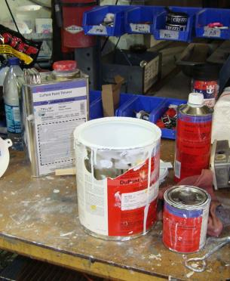
Hazard Communication - Module 4 slide 25
Label: Other Information*
Other information that may be included on the label:
Physical state
Color
Hazards not otherwise classified
Route of exposure
Storage and disposal
Hazard prevention and emergency
Response instructions
Source: Hazard Communication and the Globally Harmonized System (GHS) for Fabricators and Erectors Webinar: http://www.aisc.org/content.aspx?id=35368
Notes:
This slide indicates “other information” that may be included on a label.
*This is discretionary information that may be provided by the manufacturer, importer or distributer. This information is not required to be on the label; however it will be found in the SDS.

Slide 26
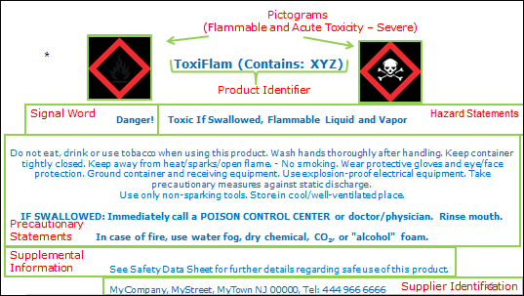
Hazard Communication - Module 4 slide 26
*Modified from Link to GHS/Hazcom on OSHA Website
Source: Hazard Communication and the Globally Harmonized System (GHS) for Fabricators and Erectors Webinar: Link to the Webinar on AISC.org website
Notes:
This slide presents a sample label.

Slide 27
Hazard Communication - Module 4 slide 27
Label Example:
Source: Hazard Communication and the Globally Harmonized System (GHS) for Fabricators and Erectors Webinar: http://www.aisc.org/content.aspx?id=35368
Notes:
This slide presents expanded detail on the sample label included in slide 26.

Slide 28
Hazard Communication - Module 4 slide 28
Labels: Secondary containers*
Secondary labeling systems are still permitted
Must be consistent with the revised HazCom standard
No conflicting hazard warnings or pictograms
May use written materials (e.g., signs, placards, etc.) in lieu of affixing labels to individual stationary process containers.
Employer can use GHS compliant labels (same as shipping)
HMIS Label
NFPA Label
HEALTH
FIRE
REACTIVITY
PPE
Source: Hazard Communication and the Globally Harmonized System (GHS) for Fabricators and Erectors Webinar: http://www.aisc.org/content.aspx?id=35368
Notes:
This slide presents information on “secondary” containers and indicates they are still permitted but have requirements for use.
HMIS = Hazardous Materials Information System (National Paint and Coatings Association)
NFPA = National Fire Protection Association
GHS vs. HMIS / NFPA 704
NFPA & HMIS systems number “4” indicates a severe hazard.
Under GHS HazCom standard, when a manufacturer, importer, distributer classifies a chemical, a category “4” is the least severe and category “1” in the most severe.
GHS hazard category numbers may be noted in SDS; NOT required to be present on the container label.

Slide 29
Hazard Communication - Module 4 slide 29
Workplace Labeling*
The current HCS allows employers to use workplace-specific labeling systems as long as they provide the required information
However, such workplace label systems may need to be updated to make sure the information is consistent with the new classifications
NFPA/HMIS Systems*
Source: Hazard Communication and the Globally Harmonized System (GHS) for Fabricators and Erectors Webinar: http://www.aisc.org/content.aspx?id=35368
Notes:
This slide indicates that employers can still use workplace labeling systems if they provide the required information, but they may need to be updated.
*Note: You can use other labeling systems provided they do not conflict with OSHA requirements. NFPA and HMIS systems do not conflict and can be used.

Slide 30
Hazard Communication - Module 4 slide 30
Label Example:
Source: Hazard Communication and the Globally Harmonized System (GHS) for Fabricators and Erectors Webinar: http://www.aisc.org/content.aspx?id=35368
Notes:
This slide shows an example of the new style of label.

Slide 31
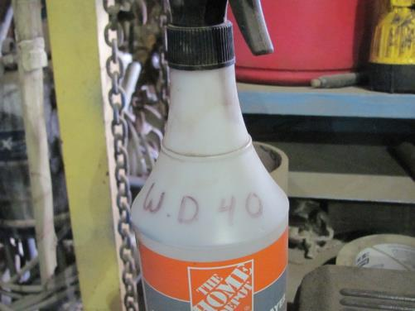
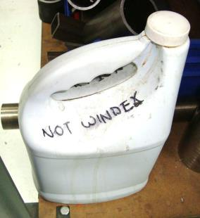
Hazard Communication - Module 4 slide 31
Label: Identification
Source: Hazard Communication and the Globally Harmonized System (GHS) for Fabricators and Erectors Webinar: http://www.aisc.org/content.aspx?id=35368
Notes:
This slide depicts acceptable and unacceptable examples of workplace labeling.

Slide 32
Hazard Communication - Module 4 slide 32
Safety Data Sheets - HazCom 2012
Mandates 16-section SDS headings, order of information, and what information is to be provided under the headings
Sections 12-15 are non-mandatory
Source: Hazard Communication and the Globally Harmonized System (GHS) for Fabricators and Erectors Webinar: http://www.aisc.org/content.aspx?id=35368
Notes:
This slide introduces the 16 section format for Safety Data Sheets (SDS).

Slide 33
Hazard Communication - Module 4 slide 33
16-Section Safety Data Sheet
Identification of the substance or mixture and of the supplier
Hazards identification
Composition/information on ingredients substance/mixture
First aid measures
Firefighting measures
Accidental release measures
Handling and storage
Exposure controls/personal protection
Physical and chemical properties
Stability and reactivity
Toxicological
Ecological information (non mandatory)
Disposal considerations (non mandatory)
Transport information (non mandatory)
Regulatory information (non mandatory)
Other information including information on preparation and revision of the SDS
Hazard Communication and the Globally Harmonized System
(GHS) for Fabricators and Erectors
Webinar: http://www.aisc.org/content.aspx?id=35368
Notes:
This slide lists the 16 sections of Safety Data Sheets (SDS).

Slide 34
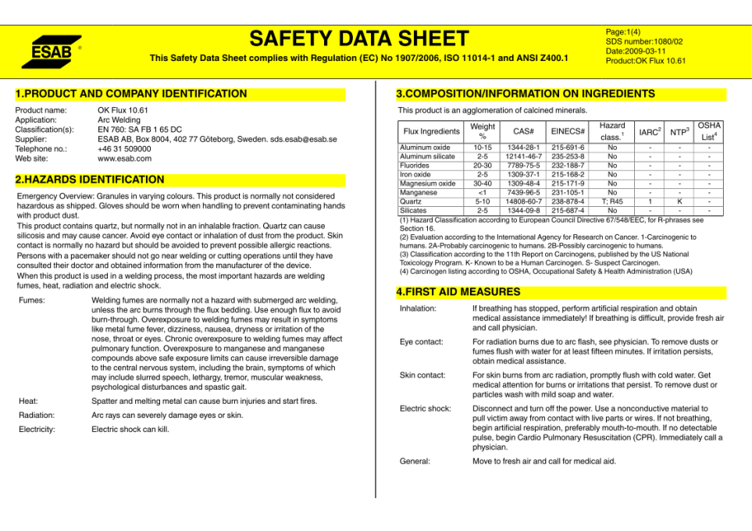
Safety Data Sheet example
Source: Hazard Communication and the Globally Harmonized System (GHS) for Fabricators and Erectors Webinar: http://www.aisc.org/content.aspx?id=35368
Notes:
This slide shows a sample SDS.

Slide 35
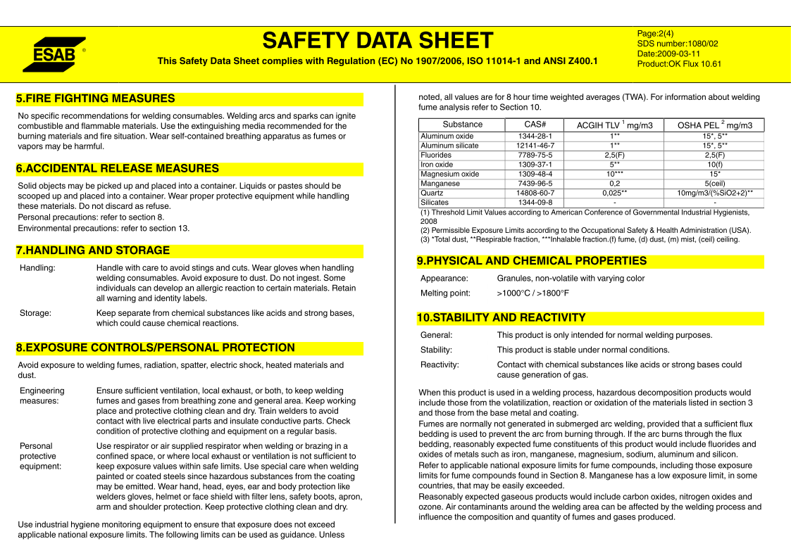
Safety Data Sheet page 2
Source: Hazard Communication and the Globally Harmonized System (GHS) for Fabricators and Erectors Webinar: http://www.aisc.org/content.aspx?id=35368
Notes:
This slide shows details of the sample SDS

Slide 36
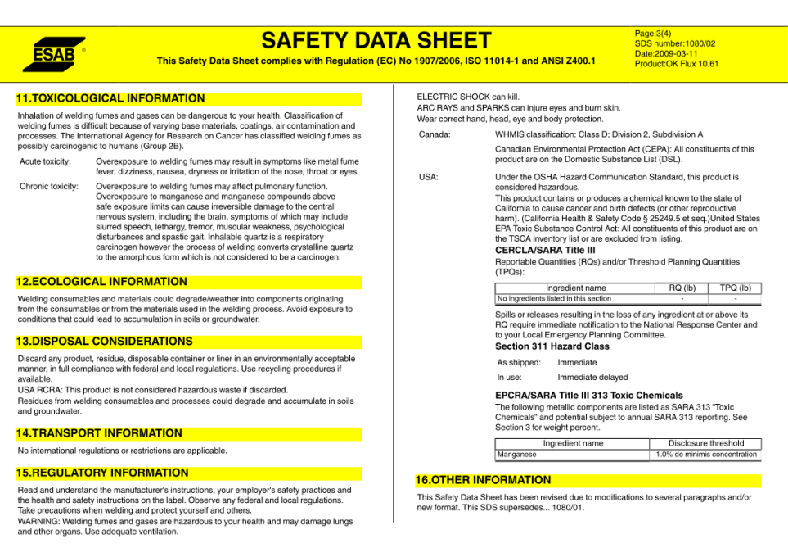
Safety Data Sheet page 3
Source: Hazard Communication and the Globally Harmonized System (GHS) for Fabricators and Erectors Webinar: http://www.aisc.org/content.aspx?id=35368
Notes:
This slide shows details of the sample SDS.

Slide 37
Hazard Communication - Module 4 slide 37
Supplemental Employee Training*
Details of the facility specific hazard communication program:
Location and availability of written program and SDS’s
Physical hazards, health hazards and hazards not otherwise classified (HNOC) of chemicals in work area
Chemical list, location, and use of hazardous chemicals
Secondary container labeling system
Specific procedures to protect employees from the chemical hazards
Methods used to detect the presence or release of hazardous chemicals (sensor alarms, odors, visual other monitoring devices)
Source: Hazard Communication and the Globally Harmonized System (GHS) for Fabricators and Erectors Webinar: http://www.aisc.org/content.aspx?id=35368
Notes:
This slide shows supplemental training requirements for employees.
NOTE: Training does not meet the requirements of the Haz Com standard if the employer fails to provide facility specific instruction to employees on the following:
Location and availability of written program and SDSs
Physical hazards, health hazards and hazards not otherwise classified (HNOC) of the chemicals in the work area
Chemical list, location and use of hazardous chemicals
Secondary container labeling system
Specific procedures to protect employees from the chemical hazards
Methods used to detect the presence or release of hazardous chemicals (sensor alarms, odors, visual other monitoring devices

Slide 38
Hazard Communication - Module 4 slide 38
Final Steps to complete training - Supplemental Training (to be provided by employer)*
Employers must provide employees with the details of the facility specific hazard communication program:
Location and availability of written program and SDSs
Specific information related to chemicals in the facility
Physical Hazards
Health Hazards
Hazards not otherwise classified
Source: Hazard Communication and the Globally Harmonized System (GHS) for Fabricators and Erectors Webinar: http://www.aisc.org/content.aspx?id=35368
Notes:
This slide shows the requirement for a specific plan and that information must be accessible.
Employers must provide facility specific instruction to employees as described on this slide and the next slide to be compliant with the Haz Com training requirements.
Employers must also maintain and periodically review the written Haz Com program for the facility which contains all of the information on this slide and the next slide.

Slide 39
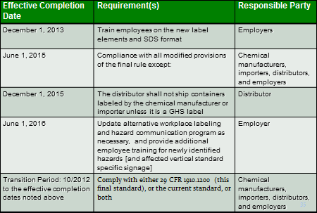
Hazard Communication - Module 4 slide 39
Effective Dates and Requirements*
Source: Hazard Communication and the Globally Harmonized System (GHS) for Fabricators and Erectors Webinar: http://www.aisc.org/content.aspx?id=35368
Notes:
This slide shows the required dates for implementation of the GHS.
*This chart was provided by Federal OSHA with one addition which is noted in brackets.
Effective June 1, 2016 - Vertical chemical specific standards with signage will be changing to harmonize with 1910.1200 Haz Com. Added text in brackets to reflect this.

Slide 40
Hazard Communication - Module 4 slide 40
Other Effected Standards
Signage standards are also impacted
Source: Hazard Communication and the Globally Harmonized System (GHS) for Fabricators and Erectors Webinar: http://www.aisc.org/content.aspx?id=35368
Notes:
This slide indicates that signage requirements may also be impacted and may need to be updated.

Slide 41
Hazard Communication - Module 4 slide 41
Health Standards
The substance-specific standards generally pre-date the HCS, and do not have a comprehensive approach to hazard communication.
The final rule references HazCom 2012 in each standard to ensure they have all the protections of the rule.
Regulated area signs will need to be updated to reflect the new language.
Employers have until June 1, 2016 to update the signs.
Source: Hazard Communication and the Globally Harmonized System (GHS) for Fabricators and Erectors Webinar: http://www.aisc.org/content.aspx?id=35368
Notes:
This slide provides information about requirements to update signs and effective dates.

Slide 42
Hazard Communication - Module 4 slide 42
Other Standards Affected - Signage Requirements
Asbestos
Carcinogens
Vinyl Chloride
Inorganic Arsenic
Lead
Chromium (VI)
Benzene
Coke Oven Emissions
Acrylonitrile
Ethylene Oxide
Formaldehyde
Methylenedianiline
1,3-Butadiene
Methylene Chloride
DANGER
WARNING
New Sign
“LEAD”
LEAD
MAY DAMAGE FERTILITY
OR THE UNBORN CHILD
CAUSES DAMAGE TO THE
CENTRAL NERVOUS
SYSTEM
DO NOT EAT, DRINK OR
SMOKE IN THIS AREA
LEAD WORK AREA
POISON
NO SMOKING OR EATING
Source: Hazard Communication and the Globally Harmonized System
(GHS) for Fabricators and Erectors
Webinar: http://www.aisc.org/content.aspx?id=35368
Notes:
This slide identifies hazards that may need to be addressed by sign updates.
*This slide lists the other standards that are affected by the Haz Com/GHS change. Language on required signs in the listed standards will be harmonized with Haz Com and GHS.
Fore example the sign for lead will be changed as noted above.
Refer to the signage handout CET 5533 or MIOSHA website document:
http://www.michigan.gov/documents/lara/lara_miosha_cet5533_402987_7.docx

Slide 43
Hazard Communication - Module 4 slide 43
Know where your company SDSs
are located and if they are accessible!
Where is the specific location?
Notes:
The speaker should emphasize that employees must know where SDS are located and have access to the information. Speaker should ask employees where this information is located in their shops.

Slide 44
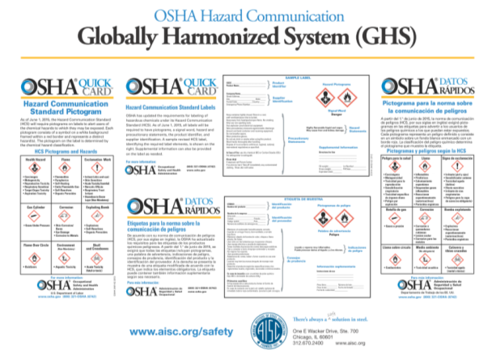
Hazard Communication - Module 4 slide 44
Other Sources
Link to GHS on OSHA Website
Notes:
This slide presents a variety of OSHA information addressing the GHS.

Slide 45
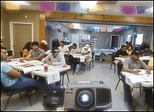
Hazard Communication - Module 4 slide 45
In class exercise-learning
Activity
Part A-Group Activity-
Navigate an SDS and
extract key information
Part B-Create an SDS
Locator for your shop
Photo from OSHA 3686-09 2010
Notes:
Speaker to introduce the Module 4 in-class exercise. Refer to Module 4 Part A and Part B exercise documents

Slide 46
Hazard Communication - Module 4 slide 46
Group Learning Objectives:
Participants shall be able to navigate an SDS and extract key information.
Notes:
Speaker should emphasize that workers need to know how to navigate an SDS.

Slide 47
Hazard Communication - Module 4 slide 47
Group Learning Activity Part A
In groups of 4-5 navigate the SDS provided and
answer the questions about the product.
Notes:
Speaker to distribute and administer the in-class exercise on navigating an SDS. Distribute the “Chemical Stuff” handout.

Slide 48
Hazard Communication - Module 4 slide 48
Group Learning Activity Part B
You are informing a co-worker of where SDS’s
are located in your shop. In groups of 4-5 discuss and
describe where your SDS’s can be found in your
shop.
Where can they be found? Create an SDS locator to
document your answer on the template provided.
Notes:
Speaker to administer Part B creating an SDS locator. Where can SDS be found in your shop?

Slide 49
Hazard Communication - Module 4 slide 49
Activity Materials Provided
Part A
Question and Answer Template
Sample SDS
Part B
SDS Locator Template
Notes:
Speaker to present the answers to the Part A exercise on navigating an SDS and should encourage attendees to discuss where the SDS are located in their shop.

Slide 50
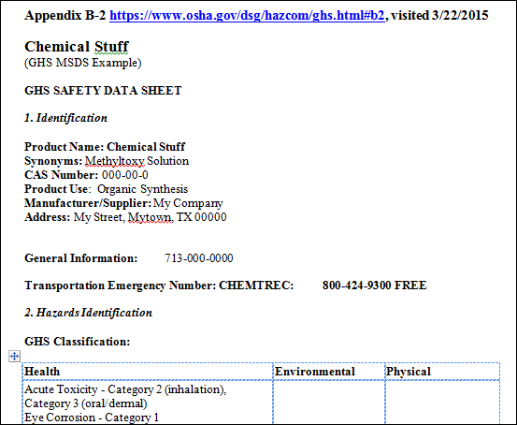
Hazard Communication - Module 4 slide 50
Source Appendix B-2 Link to Appendix on OSHA Website, visited 3/22/2015
Link to pdf on OSHA Website, visited 9/28/2016
Notes:
“Chemical Stuff” example used for the Module 4 Part A exercise.

