Slide 1
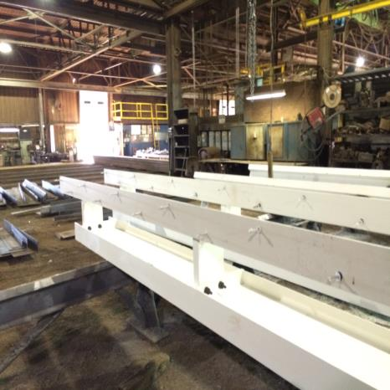
Hazards Overview - Module 1
Special Warehouse
Worker Hazards
in Structural Steel
Fabricating and
Supply Companies
Fabricated elements ready for shipping
Notes:
This module provides an overview of steel warehouse worker hazards.

Slide 2
Hazards Overview - Module 1 slide 2
OSHA Grant Information
This material was produced under grant number
SH-26316-SH4 from the Occupational Safety and Health Administration, U.S. Department of Labor. It does not necessarily reflect the views or policies of the U.S. Department of Labor, nor does mention of trades names, commercial products, or organizations imply endorsement by the U.S. Government.
Notes:
Speaker to provide grant materials acknowledgment.

Slide 3




Hazards Overview – Module 1
Program Development
This program was developed by faculty and students in the School of Planning, Design and Construction at Michigan State University in conjunction with
the American Institute of Steel Construction - Safety Committee and the University of Puerto Rico
March 2015

Slide 4
Hazards Overview - Module 1
Learning Outcomes: Participants shall be able to:
Identify special characteristics of steel fabricating and supply companies which vary from other industries that involve warehousing activities
Identify key warehousing activities which take place in steel companies
Identify and recognize broad hazards which may exist in warehousing activities in steel companies
Develop a hazard map
Notes:
Speaker should explain the four key learning objectives of the training module.

Slide 5
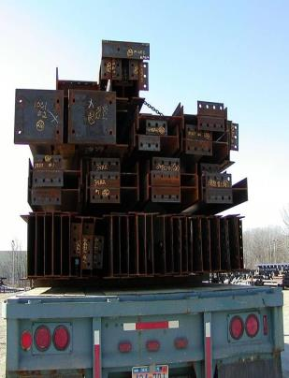
Hazards Overview - Module 1 slide 5
Special Characteristics of Steel Companies
Must load, unload, move, fabricate, paint, load, store and ship large, heavy, long, irregular shapes
Individual beam and column members may weigh several tons and large column sections could approach 10 tons
Columns and beams loaded
For shipping
Notes:
Speaker should emphasize the unique aspects of the steel handling industry. Engage attendees in identifying other unique aspects.

Slide 6
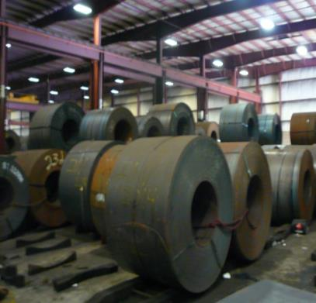
Hazards Overview - Module 1 slide 6
Special Characteristics of Steel Companies
Steel coils handled in steel service centers may routinely weigh 10-20 tons or more with the largest weighing up to 50 tons
Ten ton steel coils
Notes:
Speaker should emphasize the unique aspects of the steel handling industry. Engage attendees in identifying other unique aspects.

Slide 7
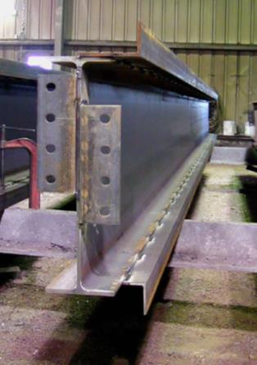
Hazards Overview - Module 1 slide 7
Special Characteristics of Steel Companies
Once fabricated with connection material each shape becomes a custom shape that may be difficult to stack, store, and load
Material is received from trucks or rail
Requires movement of material from the truck or rail to storage area within the shop or in an outside yard
Material must be stacked and stored
Fabricated beam with connection
work
Notes:
Speaker should emphasize the unique aspects of the steel handling industry. Engage attendees in identifying other unique aspects.

Slide 8
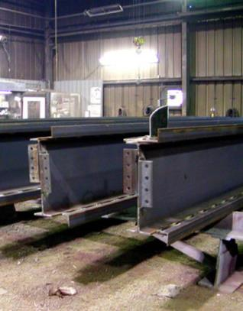
Hazards Overview - Module 1 slide 8
Special Characteristics of Steel Companies
Material must be moved within the shop to stations for various operations; such as cutting, punching, shearing, drilling,
welding, shot blasting, or painting.
Some parts are moved by hand such as rolling for certain shop operations
Material must be moved
between work stations
Fabricated beams
Notes:
Speaker should emphasize the unique aspects of the steel handling industry. Engage attendees in identifying other unique aspects.

Slide 9
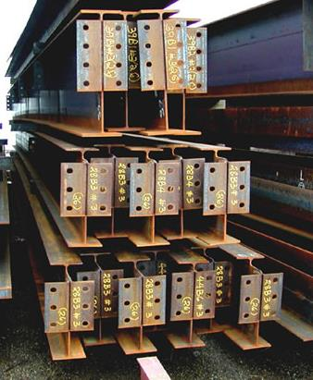
Hazards Overview - Module 1 slide 9
Special Characteristics of Steel Companies
Finished material must be moved
to storage and loading areas
Finished material must be
stored and loaded for shipping
Beams ready for shipping
Notes:
Speaker should emphasize the unique aspects of the steel handling industry. Engage attendees in identifying others.

Slide 10
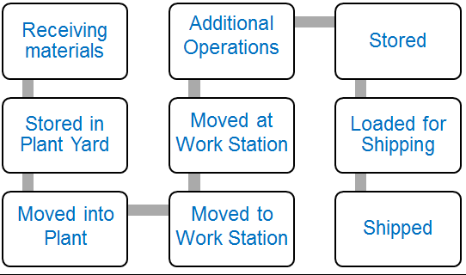
Hazards Overview - Module 1 slide 10
Generalized flow of material in a fabrication plant
Notes:
This slide presents a generalized process map depicting stages of steel handling in a fabrication shop.

Slide 11
Hazards Overview - Module 1 slide 11
♦
Equipment Use-Identifying Points of Risk
♦
♦
♦
♦
♦
♦
♦
♦
♦
♦
Notes:
Speaker should engage attendees in identifying points of risk.

Slide 12
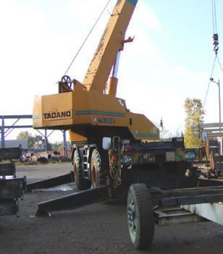
Hazards Overview - Module 1 slide 12
Material Handling Equipment commonly used:
Rail for receiving and shipping
Trucks for receiving and shipping
Powered Industrial Trucks (Forklifts)
Carts
Overhead cranes
Mobile cranes
Jibs
Industrial magnetic lifting devices
Slings, wire ropes and alloy chains
Lifting hardware
Process equipment (not in curriculum)
Humans
Mobile crane used to load
material for shipping
Notes:
This slide identifies typical equipment used for steel handling.

Slide 13
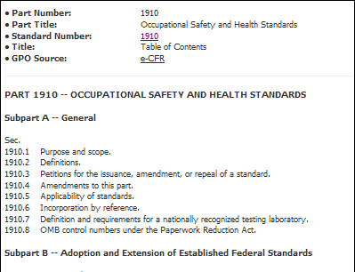
Hazards Overview - Module 1 slide 13
Material Handling Equipment Safety Considerations
Directly applicable OSHA Standard
Manufacturer’s guidelines
Steel company guidelines
Link to OSHA Standards
Notes:
This slide identifies three sources of safety guidelines.

Slide 14
Hazards Overview - Module 1 slide14
Material Handling Equipment Safety Considerations
Equipment specific information such as load limit charts
Operating manuals
Operator training
Inspection requirements
Safe operating practices
Personal Protective Equipment (PPE)
Equipment servicing and maintenance
Routine adjustments
Guards
Energy source (electrical, diesel, hydraulic, magnetic)
Notes:
This slide identifies equipment considerations which influence safety.

Slide 15
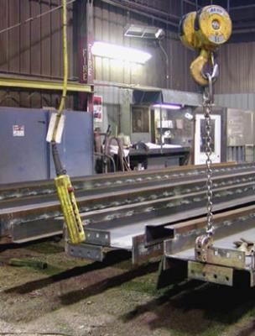
Hazards Overview - Module 1 slide 15
Hazards can flow from moving of materials:
Struck by and caught between
Dropped loads
Tipping of loads or stored
materials
Overhead crane used to
move material in shop
Notes:
This slide identifies key sources of hazards when moving materials.

Slide 16
Hazards Overview - Module 1 slide 16
Hazards can flow from moving of materials:
Musculoskeletal injuries (back injuries, strains and sprains) related task ergonomics, lifting practices, repetitive tasks
Pinches
Cuts and scrapes from sharp edges
Slips and falls
Notes:
This slide identifies key sources of hazards when moving materials.

Slide 17
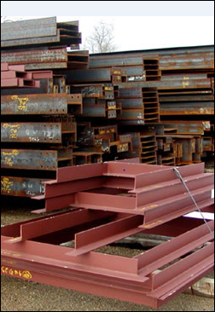
Hazards Overview - Module 1 slide 17
Material Storage Considerations
Storage and stacking of irregular
shapes
Storage of containers (bolts,
hardware, welding materials etc.)
Storage of chemicals such as
paints, solvents, lubricants
Racking systems
Stability of stored material
Fabricated elements
Stacked for loading
Notes:
This slide identifies material storage considerations which impact safety.

Slide 18
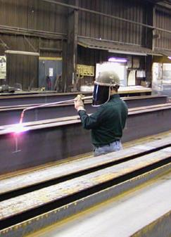
Hazards Overview - Module 1 slide 18
Other types of hazards:
Shop operations
Use of chemicals, solvents, and paints requiring Safety Data Sheets (SDS)
and Hazard Communication (HazCom)
Electrical hazards from use of hand
tools and equipment
De-energizing equipment for service and maintenance Lockout/Tagout (LOTO)
The need for respiratory protections
Need for use of Personal Protective Equipment (PPE)
PPE during fabrication
Notes:
This slide identifies hazards in shops that flow from non-material handling activities.

Slide 19
Hazards Overview - Module 1 slide 19
OSHA Standards emphasized in this training:
1910 OSHA General Industry Regulations
Subpart N Materials Handling
1910.176 Handling Materials
1910.178 Powered Industrial Trucks
1910.179 Overhead and Gantry Cranes
1910.180 Truck Cranes
1910.184 Slings
Notes:
Speaker should identify the OSHA 1910 Standards addressed by the training.

Slide 20
Hazards Overview - Module 1 slide 20
OSHA Standards Emphasized in this training:
1910 OSHA General Industry Regulations
Subpart S Electrical
1910.333 Selection and use of work practices
Subpart J
1910.147 The Control of Hazardous Energy (Lockout/Tagout)
Subpart I Personal Protective Equipment
1910.34 Respiratory Protection (Subpart I)
Subpart Z
1910.1200 Hazard Communication
Notes:
Speaker should identify the OSHA 1910 Standards addressed by the training.

Slide 21
Hazards Overview - Module 1 slide 21
Frequently cited safety standards in structural steel fabrication and erection by Federal OSHA from October 2011 through September 2012
link - no longer valid Date visited December 7, 2014
Notes:
This slide presents the OSHA standards most frequently cited for steel fabrication and erection.

Slide 22
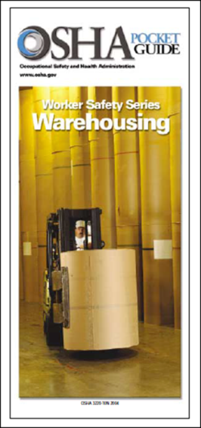
Hazards Overview - Module 1 slide 22
Warehouse operations can present a wide variety of potential hazards for the worker.
OSHA provides several documents on other industries that have useful information on warehousing hazards that can supplement this presentation.
OSHA 3220-10N 2004
Notes:
This slide presents information available from OSHA on warehouse worker safety.

Slide 23
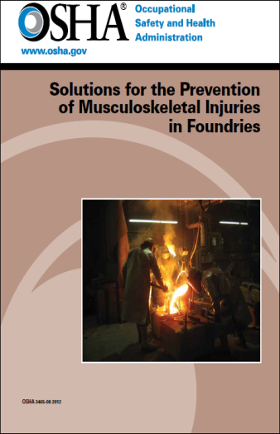

Hazards Overview - Module 1 slide 23
OSHA 3465-08 2012
OSHA 3341-03N 2008
Notes:
This slide presents information available from OSHA on preventing musculoskeletal injuries in foundries. Hazards in fabrication shops and steel handling have similarities because of the large heavy shapes that are handled.

Slide 24
Hazards Overview - Module 1 slide 24
The 10 OSHA standards most frequently cited in warehousing were:
1. Forklifts
2. Hazard communication
3. Electrical, wiring methods
4. Electrical, system design
5. Guarding floor & wall openings and holes
6. Exits
7. Mechanical power transmission
8. Respiratory protection
9. Lockout/tagout
10. Portable fire extinguishers
OSHA 3220-10N 2004
Notes:
This slide presents the top ten most frequently cited OSHA standards in warehousing.

Slide 25
Hazards Overview - Module 1 slide 25
Summary of Key Points:
Warehousing activities in steel companies offer unique challenges because of the size, weight, and irregular nature of the material being handled, processed, and stored
Each point in the material handling chain offers some potential risk of injury
Notes:
Speaker should summarize key points of the training module.

Slide 26
Hazards Overview - Module 1 slide 26
Hazard Mapping
Hazard maps can be developed to map hazards within a facility, process, or environment. Hazard maps are frequently used to access risks of severe climate events such as tornadoes or floods, but can also be used to identify hazards in a work environment.
Key locations and/or processes can be identified, which present hazards, and the nature of those hazards can be captured through group discussion.
Purposes:
To examine the hazards in our industries.
To learn how to develop a Hazard Map that workers can use to identify and locate hazards so that those hazards can be targeted for elimination.
To learn the importance of making Hazard Mapping a participatory process that involves as many coworkers as possible.
This Activity has three tasks.
Notes:
Speaker should present hazard mapping as a tool for engaging attendees in recognizing risks in handling steel.

Slide 27
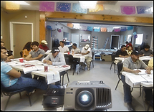
Hazards Overview - Module 1 slide 27
Learning Activity:
Hazard Mapping exercise
Photo from OSHA 3686-09 2010
Notes:
Speaker should present the learning activity group exercise. Distribute the written exercise sheets Part A and Part B. Distribute the Hazard Map flow diagram. Distribute the Hazard Map Template for attendees to record their answers. Attendees should also mark the Hazard Map with markers. Please note this activity requires the presenter to bring red and blue markers for use by attendees in marking the Hazard Map.

Slide 28
Hazards Overview - Module 1 slide 28
Learning Activity:
Part A - Identify key equipment
used at each material step
Part B - Map “caught between” and struck by” hazards at each step in the material handling chain
This hazard mapping material was adapted from materials originally developed under grant SH-17813-SH08 from the Occupational Safety and Health Administration, U.S. Department of Labor
Notes:
Speaker should present the learning activity group exercise. Distribute the written exercise sheets Part A and Part B. Form groups of 3-4 people. Distribute markers to groups.

Slide 29
Hazards Overview - Module 1 slide 29
Group Learning Activity Learning Objectives:
Participants shall be able to demonstrate ability to identify “caught between” and “struck by” hazards in the workplace.
Notes:
Conduct exercise. 15 Minutes. Circulate and guide attendees.

Slide 30
Hazards Overview - Module 1 slide 30
Group Learning Activity Part A
Part A Group Activity - In groups of 4-5 Identify
key equipment used at each material handling step
and indicate them on the material flow map.
Notes:
Attendees should work on group activity A.

Slide 31
Hazards Overview - Module 1 slide 31
Group Learning Activity Part B
Part B - Map hazards – in your group now map the
“caught between” and “struck by” hazards at each
step in the material handling chain.
Notes:
Attendees should work on group activity B

Slide 32
Hazards Overview - Module 1 slide 32
Activity Materials Provided
Part A
Equipment Identification activity instructions
Process flow map
Report out template
Part B
Hazard Mapping activity instructions
Process flow map
Report out template
Notes:
Have at least one group report out their analysis.

