Slide 1
BLOODBORNE PATHOGENS and needlestick exposure

Slide 2
OSHA - Susan Harwood Training Grant
DISCLAIMER: This material was produced under grant number SH-26274-SH4 from the Occupational Safety and Health Administration, U.S. Department of Labor. It does not necessarily reflect the views or policies of the U. S. Department of Labor, nor does mention of trade names, commercial products, or organizations imply endorsement by the U. S. Government. The U.S. Government does not warrant or assume any legal liability or responsibility for the accuracy, completeness, or usefulness of any information, apparatus, product, or process disclosed.
COPYRIGHT INFORMATION: This material is the copyrighted property of Miami Dade College. By federal regulation, OSHA reserves a license to use and disseminate such material for the purpose of promoting safety and health in the workplace. Miami Dade College hereby authorizes employers and workplace safety and health professionals to use this material, distributed by or through OSHA, in their workplaces or practices in accordance with the guidance contained in the material.
To this end, permission is granted to use such copyrighted material solely for non-commercial, instructional, personal, or scholarly purposes. The material may be used and incorporated into other workplace safety and health programs on the condition that no fee may be charged for the subsequent use of the material. Use of the material for any other purpose, particularly commercial use, without the prior, express written permission of the copyright owner/s is prohibited. Furthermore, any modification to the material is prohibited without the prior, express written permission of the copyright owners.

Slide 3

What is OSHA?

Slide 4
OSHA
I
G
H
T
S
A
N
D
E
S
P
O
N
S
I
B
I
L
I
T
I
E
S
E
m
p
l
o
y
e
r
s
m
u
s
t
:
•
F
o
l
l
o
w
a
l
l
r
e
l
e
v
a
n
t
O
S
H
A
s
a
f
e
t
y
a
n
d
h
e
a
l
t
h
s
t
a
n
d
a
r
d
s
.
•
F
i
n
d
a
n
d
c
o
r
r
e
c
t
s
a
f
e
t
y
a
n
d
h
e
a
l
t
h
h
a
z
a
r
d
s
.
•
I
n
f
o
r
m
e
m
p
l
o
y
e
e
s
a
b
o
u
t
c
h
e
m
i
c
a
l
h
a
z
a
r
d
s
t
h
r
o
u
g
h
t
r
a
i
n
i
n
g
,
l
a
b
e
l
s
,
a
l
a
r
m
s
,
c
o
l
o
r
-
c
o
d
e
d
s
y
s
t
e
m
s
,
c
h
e
m
i
c
a
l
i
n
f
o
r
m
a
t
i
o
n
s
h
e
e
t
s
a
n
d
o
t
h
e
r
m
e
t
h
o
d
s
.
•
N
o
t
i
f
y
O
S
H
A
w
i
t
h
i
n
8
h
o
u
r
s
o
f
a
w
o
r
k
p
l
a
c
e
f
a
t
a
l
i
t
y
o
r
w
h
e
n
t
h
r
e
e
o
r
m
o
r
e
w
o
r
k
e
r
s
a
r
e
h
o
s
p
i
t
a
l
i
z
e
d
(
1
-
8
0
0
-
3
2
1
-
O
S
H
A
[
6
7
4
2
]
)
.
•
P
r
o
v
i
d
e
r
e
q
u
i
r
e
d
p
e
r
s
o
n
a
l
p
r
o
t
e
c
t
i
v
e
e
q
u
i
p
m
e
n
t
a
t
n
o
c
o
s
t
t
o
w
o
r
k
e
r
s
.
*
•
K
e
e
p
a
c
c
u
r
a
t
e
r
e
c
o
r
d
s
o
f
w
o
r
k
-
r
e
l
a
t
e
d
i
n
j
u
r
i
e
s
a
n
d
i
l
l
n
e
s
s
e
s
.
•
P
o
s
t
O
S
H
A
c
i
t
a
t
i
o
n
s
,
i
n
j
u
r
y
a
n
d
i
l
l
n
e
s
s
s
u
m
m
a
r
y
d
a
t
a
,
a
n
d
t
h
e
O
S
H
A
“
J
o
b
S
a
f
e
t
y
a
n
d
H
e
a
l
t
h
-
I
t
’
s
T
h
e
L
a
w
”
p
o
s
t
e
r
i
n
t
h
e
w
o
r
k
p
l
a
c
e
w
h
e
r
e
w
o
r
k
e
r
s
w
i
l
l
s
e
e
t
h
e
m
.
•
N
o
t
d
i
s
c
r
i
m
i
n
a
t
e
o
r
r
e
t
a
l
i
a
t
e
a
g
a
i
n
s
t
a
n
y
w
o
r
k
e
r
f
o
r
u
s
i
n
g
t
h
e
i
r
r
i
g
h
t
s
u
n
d
e
r
t
h
e
l
a
w
.
*
E
m
p
l
o
y
e
r
s
m
u
s
t
p
a
y
f
o
r
m
o
s
t
t
y
p
e
s
o
f
r
e
q
u
i
r
e
d
p
e
r
s
o
n
a
l
p
r
o
t
e
c
t
i
v
e
e
q
u
i
p
m
e
n
t
.
E
m
p
l
o
y
e
e
s
h
a
v
e
t
h
e
r
i
g
h
t
t
o
:
•
W
o
r
k
i
n
g
c
o
n
d
i
t
i
o
n
s
t
h
a
t
d
o
n
o
t
p
o
s
e
a
r
i
s
k
o
f
s
e
r
i
o
u
s
h
a
r
m
.
•
R
e
c
e
i
v
e
i
n
f
o
r
m
a
t
i
o
n
a
n
d
t
r
a
i
n
i
n
g
(
i
n
a
l
a
n
g
u
a
g
e
w
o
r
k
e
r
s
c
a
n
u
n
d
e
r
s
t
a
n
d
)
a
b
o
u
t
c
h
e
m
i
c
a
l
a
n
d
o
t
h
e
r
h
a
z
a
r
d
s
,
m
e
t
h
o
d
s
t
o
p
r
e
v
e
n
t
h
a
r
m
,
a
n
d
O
S
H
A
s
t
a
n
d
a
r
d
s
t
h
a
t
a
p
p
l
y
t
o
t
h
e
i
r
w
o
r
k
p
l
a
c
e
.
•
R
e
v
i
e
w
r
e
c
o
r
d
s
o
f
w
o
r
k
-
r
e
l
a
t
e
d
i
n
j
u
r
i
e
s
a
n
d
i
l
l
n
e
s
s
e
s
.
•
G
e
t
c
o
p
i
e
s
o
f
t
e
s
t
r
e
s
u
l
t
s
d
o
n
e
t
o
f
i
n
d
a
n
d
m
e
a
s
u
r
e
h
a
z
a
r
d
s
i
n
t
h
e
w
o
r
k
p
l
a
c
e
.
•
F
i
l
e
a
c
o
m
p
l
a
i
n
t
a
s
k
i
n
g
O
S
H
A
t
o
i
n
s
p
e
c
t
t
h
e
i
r
w
o
r
k
p
l
a
c
e
i
f
t
h
e
y
b
e
l
i
e
v
e
t
h
e
r
e
i
s
a
s
e
r
i
o
u
s
h
a
z
a
r
d
o
r
t
h
a
t
t
h
e
i
r
e
m
p
l
o
y
e
r
i
s
n
o
t
f
o
l
l
o
w
i
n
g
O
S
H
A
r
u
l
e
s
.
h
e
n
r
e
q
u
e
s
t
e
d
,
O
S
H
A
w
i
l
l
k
e
e
p
a
l
l
i
d
e
n
t
i
t
i
e
s
c
o
n
f
i
d
e
n
t
i
a
l
.
•
U
s
e
t
h
e
i
r
r
i
g
h
t
s
u
n
d
e
r
t
h
e
l
a
w
w
i
t
h
o
u
t
r
e
t
a
l
i
a
t
i
o
n
o
r
d
i
s
c
r
i
m
i
n
a
t
i
o
n
.
I
f
a
n
e
m
p
l
o
y
e
e
i
s
f
i
r
e
d
,
d
e
m
o
t
e
d
,
t
r
a
n
s
f
e
r
r
e
d
o
r
d
i
s
c
r
i
m
i
n
a
t
e
d
a
g
a
i
n
s
t
i
n
a
n
y
w
a
y
f
o
r
u
s
i
n
g
t
h
e
i
r
r
i
g
h
t
s
u
n
d
e
r
t
h
e
l
a
w
,
t
h
e
y
c
a
n
f
i
l
e
a
c
o
m
p
l
a
i
n
t
w
i
t
h
O
S
H
A
.
T
h
i
s
c
o
m
p
l
a
i
n
t
u
s
t
b
e
f
i
l
e
d
i
t
h
i
n
3
0
d
a
y
s
o
f
t
h
e
a
l
l
e
g
e
d
i
s
r
i
i
t
i
W
The Occupation Safety and Health Act of 1970 was passed to prevent workers from being killed or seriously harmed at work. This law created the OSH Act, which sets and enforces protective workplace safety and health standards.
OSHA also provides information, training, and assistance to employers and workers.
Under the OSH Act, employers have the responsibility to provide a safe workplace.

Slide 5
Why is OSHA important to you?
OSHA began because, until 1970, there were no national laws for safety and health hazards.
On average, 15 workers die every day from job injuries.
Over 5,600 Americans die from workplace injuries annually.
Over 4 million non-fatal workplace injuries and illnesses are reported.

Slide 6
OSHA History
OSHA stands for the Occupational Safety and Health Administration, an agency of the U.S. Department of Labor
OSHA’s responsibility is worker safety and health protection
On December 29, 1970, President Nixon signed the OSH Act
This Act created OSHA, the agency, which formally came into being on April 28, 1971

Slide 7
OSHA’S Mission
The mission of OSHA is to save lives, prevent injuries and protect the health of America’s workers.
Some of the things OSHA does to carry out its mission are:
  developing job safety and health standards and enforcing them through worksite inspections,
  maintaining a reporting and recordkeeping system to keep track of job-related injuries and illnesses, and
  providing training programs to increase knowledge about occupational safety and health.

Slide 8
Your Rights under OSHA
You have the right to:
  A safe and healthful workplace
  Know about hazardous chemicals
  Information about injuries and illnesses in your workplace
  Complain or request hazard correction from employer
  Training
  Hazard exposure and medical records
  File a complaint with OSHA
  Participate in an OSHA inspection
  Be free from retaliation for exercising safety and health rights

Slide 9
OSHA Training
Must be done annually for returning employees and new hires
Attendance sheet must be kept on file for 3 years
All employees who are assigned to tasks where occupational exposure may take place must be provided with information and training at the time of initial assignment
Training must include Q&A

Slide 10
Record Keeping
Medical records during employment
Injury Log
Sharps Injury Log must be kept for 5 years
Training Records must be kept for 3 years

Slide 11
Filing a Complaint
Workers may bring up safety and health concerns in the workplace to their employers without fear of discharge or discrimination, as long as the complaint is made in good faith.
OSHA regulations [29CFR 1977.9(c)] protect workers who complain to their employer about unsafe or unhealthful conditions in the workplace.
Department of Labor 800-321-OSHA (6742)

Slide 12
What are Bloodborne Pathogens
Bloodborne pathogens are infectious microorganisms in human blood that can cause disease in humans.
These pathogens include, but are not limited to, hepatitis B (HBV), hepatitis C (HCV) and human immunodeficiency virus (HIV). Needlesticks and other sharps-related injuries may expose workers to bloodborne pathogens.
Workers in many occupations, including first aid team members, housekeeping personnel in some industries, nurses and other healthcare personnel may be at risk of exposure to bloodborne pathogens.

Slide 13
Which employees are covered by OSHA's Bloodborne Pathogen Standard?
Employees having "reasonably anticipated" exposure to blood or OPIM through skin, eye, mucous membrane, or broken skin by: (needlesticks, human bites, cuts, abrasions) that result from the performance of an employee's job duties.
The hazard of exposure to bloodborne pathogens affects employees in many types of employment and is not restricted to the healthcare or emergency service industry.

Slide 14
What is the definition of blood and other potentially infectious materials (OPIM)?
Blood means human blood, human blood components, and products made from human blood.
"Other potentially infectious materials" means the following:

Slide 15
What is the definition of blood and other potentially infectious materials (OPIM)?
Human body fluids: semen, vaginal secretions, cerebrospinal (head ), amniotic (birth fluid), peritoneal (abdomen), pericardial (heart), pleural (lung, chest), synovial (joints), saliva in dental procedures, any body fluid visibly contaminated with blood, and all body fluids in situations where it is difficult or impossible to differentiate between body fluids.
Any unfixed tissue or organ (other than intact skin) from a human (living or dead).
HIV-containing cell or tissue cultures, organ cultures, and HIV- or HBV-containing culture medium or other solutions as well as blood, organs, or other tissues from experimental animals infected with HIV or HBV.

Slide 16
Chain of Infection
For disease to be spread, it requires that all of the following conditions be present:
An adequate number of pathogens, or disease-causing organisms.
A reservoir or source that allows the pathogen to survive and multiply ( blood).
A mode of transmission from the source to the host.
An entrance through which the pathogen may enter the host.

Slide 17

Chain of Infection cont.
A susceptible host ( one who is not immune)
Effective infection control strategies prevent disease transmission by interrupting one or more links in the chain of infection.

Slide 18
Modes of Transmission
Direct Contact – Occurs when microorganisms are transferred from one infected person directly to another person. For example, infected blood from one person enters a care giver’s body through an open cut.

Slide 19
Modes of Transmission
Indirect contact – involves the transfer of an infections agent through a contaminated object or person. For example, a care giver doesn’t wash hands in between caring for someone with infected body fluids and other patients. For Example, Parenteral contact with a needle stick.

Slide 20
Modes of Transmission
Airborne transmission- occurs when droplets or small particles contain infectious agents that remain effective over time and distance in the air. Tuberculosis is a common disease spread this way. Bloodborne pathogens are not typically spread this way

Slide 21
INFECTIOUS DISEASES
HIV/AIDS
Hepatitis
TB

Slide 22

HIV/AIDS

Slide 23
What is AIDS?
Acquired Immunodeficiency Syndrome
First reported in the US in 1981
Caused by the HIV (human immunodeficiency virus)
Kills or damages cells of the body’s immune system, destroying the bodies ability to fight infections and certain cancers.

Slide 24
How is HIV Transmitted?
Most commonly by unprotected sex with an infected partner.
Also spread through contact with infected blood.
Frequently spread among injection drug users by the sharing of contaminated needles or syringes.
Women can transmit HIV to their babies during pregnancy or birth.

Slide 25
AIDS Transmission in the US
More than one million cases of AIDS have been reported in the US since 1981.
As many as one million Americans may be infected with HIV.
Growing most rapidly among women and minority populations.
Leading killer of African-American males ages 25-44
Affects 7 times more African-Americans and 3 times more Hispanics than whites.

Slide 26
Infection
The person can be exposed to HIV and not become infected. It is also possible that infection can occur from one single contact with an infected person. Everyone is different. Enough virus must get into the bloodstream in order for infection to occur, and this happens most often through sexual and blood to blood contact.

Slide 27
Disease Process
When HIV enters the body and the bloodstream, it attacks certain cells. Its favorite target is the T4 helper lymphocyte ( also known as T-cells or CD4+). T-cells are critical part of the immune system.
Without T-cells, the body cannot effectively fight off most diseases and infections.

Slide 28
Common Misconceptions About HIV Transmission
HIV does not survive well in the environment – Transmission remote.
HIV transmission between family members in a household setting is very rare.
There is no know risk of HIV transmission to co-workers, clients, or consumers from contact in food service establishments.
Casual contact like “kissing” is not a risk for transmission of HIV.

Slide 29
More Misconceptions
Biting is not a common way of transmitting HIV.
Contact with saliva, tears, or sweat has never been shown to result in transmission of HIV.
HIV is not transmitted by insects.

Slide 30
HIV can infect anyone who practices risky behaviors
Sharing drug needles or syringes.
Having sexual contact with an infected person without using a condom.
Having sexual contact with someone whose HIV status is unknown.
Having a sexually transmitted disease appears to make a person more susceptible to getting HIV infection during sex with infected partners.

Slide 31
Symptoms of HIV Infection
Flu-like illness within 1-2 months after exposure to the virus.
More persistent or severe symptoms may not appear for 10 years or more after HIV infection.
Decline in the number of CD4 positive T cells.
As the immune system worsens – Complications start to take over.

Slide 32
Other Symptoms
Lack of energy
Weight loss
Frequent fevers and sweats
Persistent of frequent yeast infections (oral or vaginal)
Persistent skin rashes or flaky skin
Pelvic inflammatory disease in women that does not respond to treatment
Short-term memory loss
Frequent and severe herpes infections

Slide 33
Opportunistic infections and Conditions
At about the time an HIV-infected person is diagnosed with AIDS, one or more opportunistic infections or conditions will appear. This is because the immune system can no longer protect the body from these diseases. An individual with a healthy immune system does not usually get opportunistic infections.

Slide 34
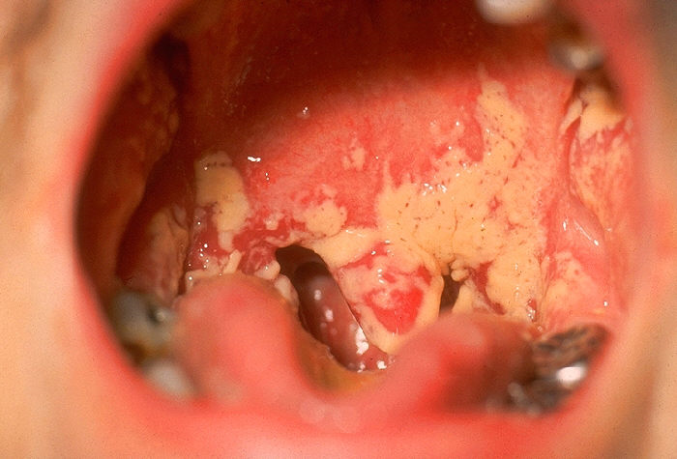
Oral Candiasis (Thrush)

Slide 35
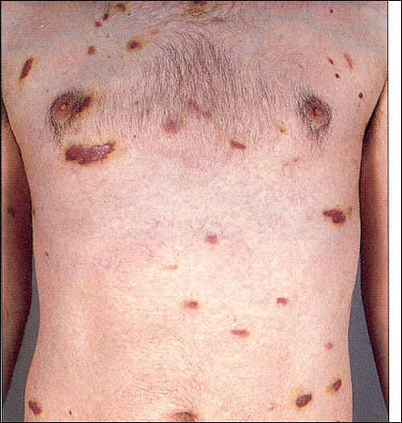
Kaposi’s sarcoma (KS)
Kaposi’s sarcoma (shown) is a rare cancer of the blood vessels that is associated with HIV. It manifests as bluish-red oval-shaped patches that may eventually become thickened. Lesions may appear singly or in clusters.

Slide 36
Time
The time from the infection with HIV until opportunistic infection appear is, on average, about ten years. Since each individual is different and people get infected with varying amounts of virus during exposure, this “incubation” period may be as short as about two and as long as fifteen years.

Slide 37
Symptoms of Opportunistic Infections
Coughing and shortness of breath
Seizures and lack of coordination
Difficult or painful swallowing
Mental symptoms such as confusion and forgetfulness
Severe and persistent diarrhea
Fever
Vision loss
Nausea, abdominal cramps, and vomiting
Weight loss and extreme fatigue
Severe headaches
Coma

Slide 38
Testing
Anyone can get a blood test for antibodies to HIV. The body produces antibodies that attempt to destroy a foreign invader – in this case, HIV. Antibody blood tests are done confidentially or anonymously at any County Health department in Florida. An individual can also be tested at their doctor’s office and at other testing sites.

Slide 39
PREVENTION
No vaccine for HIV is available.
Only way to prevent infection is to avoid behaviors that put you at risk of infection.
Condoms
Routine use of gloves and/or goggles when anticipating contact with blood or body fluids.
Washing hands and other skin surfaces immediately after contact with blood or body fluids.
Careful handling and disposing of sharp instruments during and after use.

Slide 40
Prevention
Abstinence
Mutual monogamy
Drugs
Condoms

Slide 41
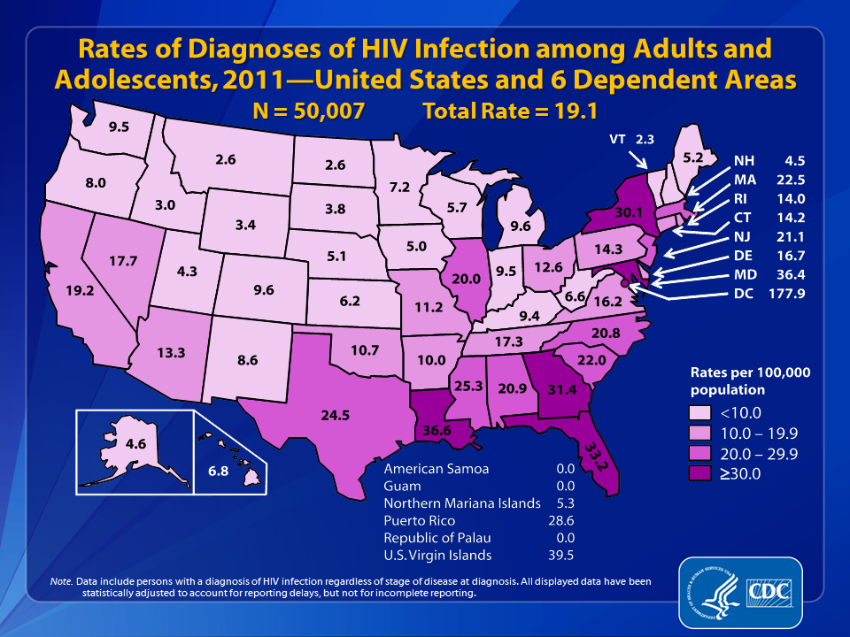
Rate of HIV infection Diagnoses

Slide 42
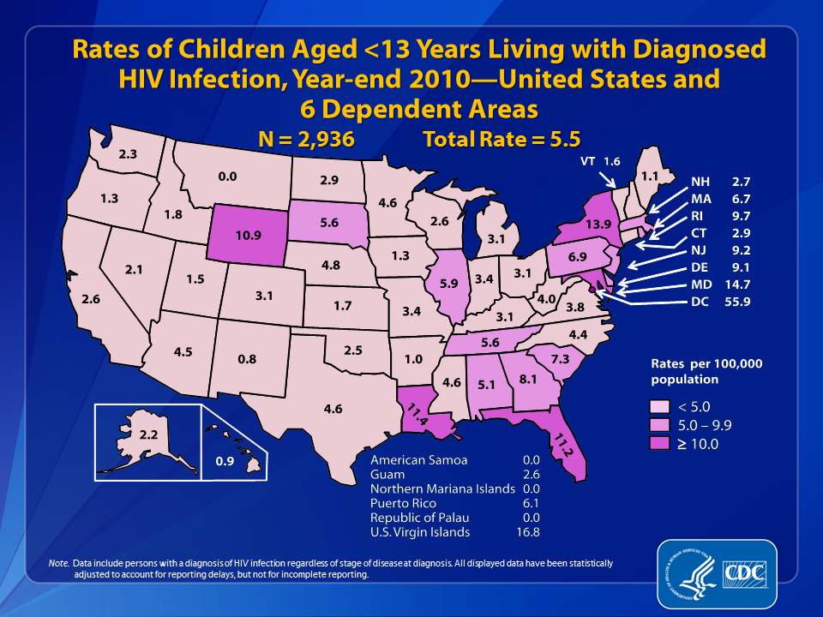
Rate of Children diagnosed HIV positive
Notes:
Estimated rates (per 100,000 population) of children living with diagnosed HIV infection at the end of 2010 in the United States and 6 dependent areas are shown in this slide.
Areas with the highest estimated rates of children living with diagnosed HIV infection at the end of 2010 were the District of Columbia (55.9), the U.S. Virgin Islands (16.8), Maryland (14.7), New York (13.9), Louisiana (11.4), Florida (11.2), and Wyoming (10.9).
The District of Columbia (i.e., Washington, DC) is a city; please use caution when comparing the rate of persons living with diagnosed HIV infection in DC with the rates in states.
Data include persons with a diagnosis of HIV infection regardless of stage of disease at diagnosis. All displayed data are estimates. Estimated numbers resulted from statistical adjustment that accounted for reporting delays, but not for incomplete reporting.
Persons living with a diagnosis of HIV infection are classified as children based on age at year-end 2010.

Slide 43
Occupational HIV Transmission and Prevention among Health Care Workers
Fewer than 60 cases of occupational transmission of HIV to health care workers have occurred in the United States. The proper use of gloves and goggles, along with safety devices to prevent injuries from sharp medical devices, can help minimize the risk of exposure to HIV in the course of caring for patients with HIV. When workers are exposed, the Centers for Disease Control and Prevention (CDC) recommends immediate treatment with a short course of antiretroviral drugs to prevent infection.

Slide 44
Documented Transmissions
As of 2010, 57 documented transmissions and 143 possible transmissions had been reported in the United States.
No confirmed cases of occupational HIV transmission to health care workers have been reported since 1999. Underreporting of cases to CDC is possible, however, because case reporting is voluntary.
Health care workers who are exposed to HIV-infected blood at work have a 0.3% risk of becoming infected. In other words, 3 of every 1,000 such injuries, if untreated, will result in infection.

Slide 45
HIV Disclosure Policies and Procedures
If your HIV test is positive, the clinic or other testing site will report the results to your state health department.
Your state health department will then remove all of your personal information (name, address, etc.) from your test results and send the information to the U.S.
Centers for Disease Control and Prevention (CDC).
CDC is the Federal agency responsible for tracking national public health trends. CDC does not share this information with anyone else, including insurance companies.

Slide 46
HIV at work
HIV at Work
The impact of the HIV/AIDS epidemic on the workplace gets bigger each year. That’s because people between the ages of 25-44 are most affected by HIV/AIDS—and they also make up over 50% of our nation’s 121 million workers.
If you are living with HIV, it’s important that you know how HIV/AIDS laws affect you at work. Here are some of the most important ones:
The Americans with Disabilities Act of 1990 (ADA) prohibits employment discrimination on the basis of disability. The ADA covers businesses that employ 15 or more people and applies to employment decisions at all stages. U.S. courts have ruled that, even if you have asymptomatic HIV, you are protected under this law.
The mission of the Occupational Safety and Health Administration (OSHA) is to save lives, prevent injuries, and protect the health of America's workers. To accomplish this, Federal and state governments work in partnership with the more than 100 million working men and women and their 6.5 million employers who are covered by the Occupational Safety and Health Act of 1970.

Slide 47
Laws Protect People Living with HIV/AIDS
If you are living with HIV/AIDS, you are protected against discrimination under Section 504 of the Rehabilitation Act of 1973 and Title II of the Americans with Disabilities Act of 1990 (ADA). Under these laws, discrimination means that you are not allowed to participate in a service that is offered to others, or you are denied a benefit, because of your HIV disease.

Slide 48
Privacy
The Office for Civil Rights (OCR) also enforces the Privacy Rule under the Health Insurance Portability and Accountability Act of 1996 (HIPAA), which protects the privacy of your health information and gives you the right to review and make corrections to your medical records.

Slide 49
Viral Hepatitis
Hepatitis is an inflammation of the liver.
Several different viruses cause viral hepatitis:
A, B, C, D, and E
Hepatitis can be short-term or chronic

Slide 50
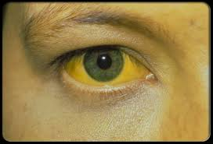
Symptoms of Viral Hepatitis
Jaundice (yellowing of the skin and eyes)
Fatigue
Abdominal pain
Loss of Appetite
Nausea
Vomiting
Diarrhea
Low grade fever
Headache
Some people do not have symptoms

Slide 51
Hepatitis A
Spread through food and water contaminated by feces from an infected person.
Rarely spread through contact with infected blood.
People at risk – International travelers, day care children and employees.
Prevention – Vaccine & avoiding tap water when traveling internationally and practicing good hygiene and sanitation

Slide 52
Hepatitis A
HAV spread more easily in group settings such as daycare centers or nursing homes
HAV cannot become a chronic illness, it rarely causes long term problems.

Slide 53
Treating Hepatitis A
There is no cure for HVA. The virus will run its course. Treat signs and symptoms as you would do with the flu , including drinking fluids and getting plenty rest. During recovery avoid fatty foods. DO NOT DRINK ALCOHOL, which can damage your liver.

Slide 54


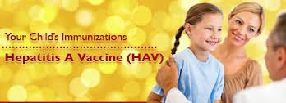
Prevention from Spreading
Wash your hands
After bathrooms
Before preparing food or eating
Avoid working in public areas until symptoms are gone

Slide 55
Hepatitis B
Hepatitis B is a liver disease that results from infection with the Hepatitis B virus.
Hepatitis B is usually spread when blood, semen, or another body fluid from a person infected with the Hepatitis B virus enters the body of someone who is not infected. This can happen through sexual contact with an infected person or sharing needles, syringes, or other drug-injection equipment.
Hepatitis B can also be passed from an infected mother to her baby at birth.

Slide 56
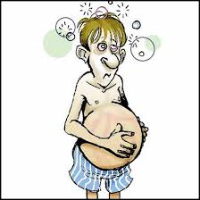
HBV Signs and Symptoms
Abdominal pain
Nausea/vomiting
Diarrhea
Jaundice
Tiredness
Loss of appetite
Joint pain

Slide 57
Preventing the Spread HBV
The best way to prevent Hepatitis B is by getting vaccinated.
Hepatitis B vaccination is recommended for all infants, older children and adolescents who were not vaccinated previously, and adults at risk for HBV infection.

Slide 58
HBV
Approximately 1.2 million people in the United States had hepatitis B in 2010, according to the U.S. Centers for Disease Control. Hepatitis B spreads through contact with bodily fluids, and the Occupational Safety and Health Administration requirements on hepatitis B vaccines protect workers who may come in contact with the virus during work.

Slide 59
Employer Responsibility
OSHA requirements tell employers to offer hepatitis B vaccines to workers that may come in contact with any potentially infections substances at work.
OSHA specifically lists first-aid personnel, morticians, correctional facilities staff, health care workers, law enforcement officers and launderers as types of workers employers must offer the vaccine to, although it also requires employers to offer the vaccine to other types of employees who may come in contact with the virus through work.

Slide 60
Timeline
Employers should offer the hepatitis B vaccine to workers within 10 days after hiring the workers for a job that may bring them in contact with materials containing the virus.

Slide 61
Right to Decline
If an employer offers an employee the hepatitis B vaccine, the employee can choose to decline the vaccine.
OSHA requires employees who decline the vaccine to fill out a declination form that the employer can keep as a record.

Slide 62
Declination Statement
Declination Statement
I understand that due to my occupational exposure to blood or other potentially infectious materials I may be at risk of acquiring hepatitis B virus (HBV) infection. I have been given the opportunity to be vaccinated with hepatitis B vaccine, at no charge to me; however, I decline hepatitis B vaccination at this time. I understand that by declining this vaccine I continue to be at risk of acquiring hepatitis B, a serious disease. If, in the future I continue to have occupational exposure to blood or other potentially infectious materials and I want to be vaccinated with hepatitis B vaccine, I can receive the vaccination series at no charge to me.

Slide 63
Exposure
Employees who choose not to get the vaccine or who have not had the vaccine yet but plan to get it in the future should get examined by a health care professional and tested for hepatitis B and HIV after a possible exposure to infected bodily fluids.
The health care professional, however, is only required by OSHA to treat the worker, and should not report test results to the employer.

Slide 64
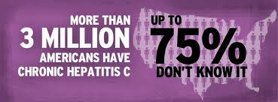
Hepatitis C
Hepatitis C is a liver disease caused by the Hepatitis C virus (HCV). HCV infection sometimes results in an acute illness, but most often becomes a chronic condition that can lead to cirrhosis of the liver and liver cancer.

Slide 65
Transmission
Contact with the blood of an infected person, primarily through sharing contaminated needles or other equipment to inject drugs. Transmission has also occurred from needle stick injuries in health care settings; unsafe injection practices and other lapses in infection control in health care settings; being born to a mother who has Hepatitis C; and through blood transfusions and organ transplants before 1992, when widespread screening of the blood supply began in the United States.

Slide 66
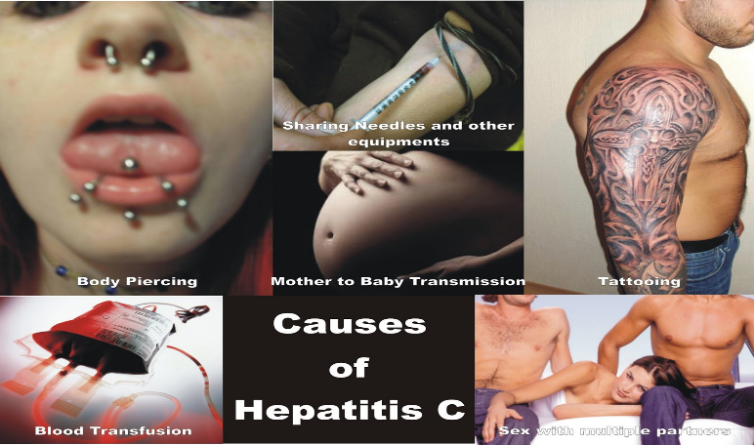
Causes of Hepatitis C

Slide 67
Vaccination
There is no vaccine for Hepatitis C.
Hepatitis C virus (HCV) infection is the most common chronic bloodborne infection in the United States; approximately 3.2 million persons are chronically infected. Although HCV is not efficiently transmitted sexually, persons at risk for infection through injection drug use might seek care in STD treatment facilities, HIV counseling and testing facilities, correctional facilities, drug treatment facilities, and other public health settings where STD and HIV prevention and control services are available.

Slide 68
Hepatitis C and Health Care
After a needle stick or sharps exposure to HCV-positive blood, the risk of HCV infection is approximately 1.8% (range: 0%–10%).
Although a few cases of HCV transmission via blood splash to the eye have been reported, the risk for such transmission is expected to be very low. Avoiding occupational exposure to blood is the primary way to prevent transmission of bloodborne illnesses among health care personnel. All health care personnel should adhere to Standard Precautions. Depending on the medical procedure involved, Standard Precautions may include the appropriate use of personal protective equipment (e.g., gloves, masks, and protective eyewear).

Slide 69
Standard Precautions
There are no CDC recommendations to restrict a health care worker who is infected with HCV. The risk of transmission from an infected health care worker to a patient appears to be very low. All health care personnel, including those who are HCV positive, should follow strict aseptic technique and Standard Precautions, including appropriate hand hygiene, use of protective barriers, and safe injection practices.

Slide 70
Tuberculosis
Tuberculosis (TB) is caused by a bacterium called Mycobacterium tuberculosis. The bacteria usually attack the lungs, but TB bacteria can attack any part of the body such as the kidney, spine, and brain. If not treated properly, TB disease can be fatal.

Slide 71
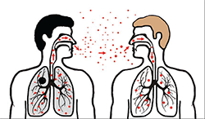
How TB is Spread?
TB is spread through the air from one person to another.
The TB bacteria are put into the air when a person with TB disease of the lungs or throat coughs, sneezes, speaks, or sings.
People nearby may breathe in these bacteria and become infected.

Slide 72
TB is not spread by:
TB is NOT spread by
shaking someone’s hand
sharing food or drink
touching bed linens or toilet seats
sharing toothbrushes
kissing

Slide 73
What is Latent TB?
TB bacteria can live in the body without making you sick. This is called latent TB infection. In most people who breathe in TB bacteria and become infected, the body is able to fight the bacteria to stop them from growing. People with latent TB infection do not feel sick and do not have any symptoms.

Slide 74
Latent TB Infection
People with latent TB infection do not feel sick and do not have any symptoms. People with latent TB infection are not infectious and cannot spread TB bacteria to others. However, if TB bacteria become active in the body and multiply, the person will go from having latent TB infection to being sick with TB disease.

Slide 75
What is Active TB disease?
TB bacteria become active if the immune system can't stop them from growing.
When TB bacteria are active (multiplying in your body), this is called TB disease.
People with TB disease are sick. They may also be able to spread the bacteria to people they spend time with every day.

Slide 76
Symptoms of TB disease include:
a bad cough that lasts 3 weeks or longer
pain in the chest
coughing up blood or sputum
weakness or fatigue
weight loss
no appetite
chills
fever
sweating at night

Slide 77
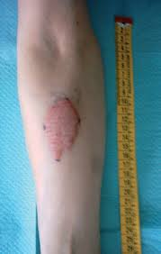
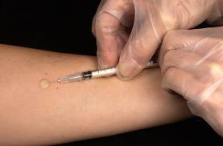
Testing for TB Infection
There are two kinds of tests that are used to detect TB bacteria in the body:
the TB skin test (TST) and TB blood tests. These tests can be given by a health care provider or local health department. If you have a positive reaction to either of the tests, you will be given other tests to see if you have latent TB infection or TB disease.

Slide 78
Treatment for TB Disease
TB disease can be treated by taking several drugs, usually for 6 to 9 months. It is very important to finish the medicine, and take the drugs exactly as prescribed. If you stop taking the drugs too soon, you can become sick again. If you do not take the drugs correctly, the germs that are still alive may become resistant to those drugs. TB that is resistant to drugs is harder and more expensive to treat.

Slide 79
Exposure Control Strategies
universal precautions
immunization
good personal work habits
containment
personal protective equipment
decontamination
emergency procedures for
accidental exposures

Slide 80
Universal Precautions
Universal precautions are work practices that reduce your risk of exposure to pathogens found in blood and particularly HBV and HIV.
A government regulation referred to as the "Bloodborne Pathogen Rule" requires that employees with a risk of occupational exposure receive training in universal precautions and other safety measures.
At-risk employees are those individuals whose work responsibilities could potentially bring them in contact with blood and body fluids.

Slide 81
Preventing Accidental Exposures
Most occupational exposures to bloodborne pathogens occur accidentally from:
needle sticks
injuries from sharp objects
splashes to the eyes, nose, and mouth
contact with broken skin

Slide 82
Preventing Accidental Exposures
Eliminate the use of needles and sharp instruments whenever possible. Choose safer alternatives for your work tasks.
When use of needles and sharps is required, place used items directly into a sharps container located within easy reach. Remember that recapping should be avoided, because it increases your risk of needle stick injuries.
Use only labeled, leak-proof, puncture-resistant sharps containers to help avoid accidental exposure of co-workers and waste handlers down the line.

Slide 83
Engineering Control
These are methods to reduce employee exposure by isolating the hazard.
Sharps disposal containers
Self-sheathing needles
Safer medical devices
Needle less systems
Sharps with engineered sharps injury protections

Slide 84

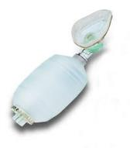

Engineering Control
Contaminated needles and/or sharps must not be bent or Recapped
Contaminated sharps must be placed in appropriate containers as soon as possible after use.
Readily available hand washing facilities

Slide 85
Needle Stick and Engineering Act
“… means controls that isolate or remove the bloodborne pathogens hazard from the workplace.”

Slide 86
Needle Stick and Engineering Act
  Sharps with Engineered Sharps Injury Protections - [SESIP]
  Needleless Systems

Slide 87
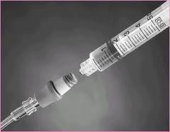
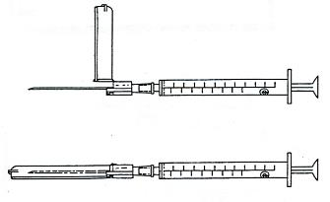
“SESIP”
Sharps with Engineered Sharps Injury Protections
Non-needle sharp or a needle with a built-in safety feature or mechanism that effectively reduces the risk of an exposure incident

Slide 88
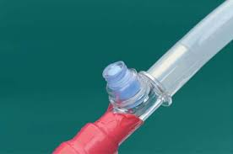
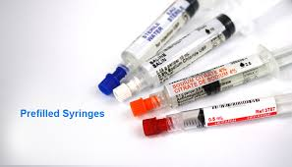
Needleless Systems
Device that does not use a needle for:
  Collection of bodily fluids
  Administration of medication/fluids
  Any other procedure with potential percutaneous exposure to a contaminated sharp

Slide 89
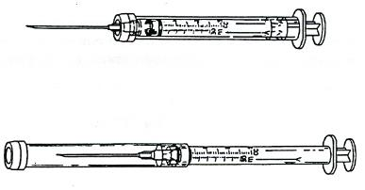
Hypodermic syringes with
“Self-Sheathing” safety feature

Slide 90
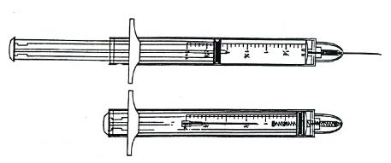
Hypodermic syringes with “Retractable Technology” safety feature

Slide 91
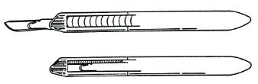
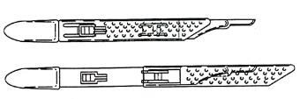
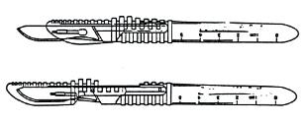
Disposable scalpels with safety features
Retracted position
Protracted position
Protracted position
Notes:
Single use disposable scalpels with blades that retract or sheath. Most of these devices do not lock. Be careful.
After use, safely place the scalpel in a sharps box.

Slide 92
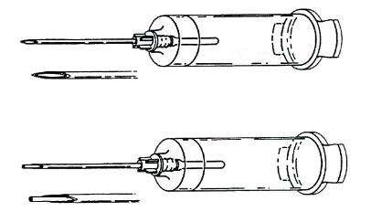
Phlebotomy needle with
“Self-Blunting” safety feature

Slide 93
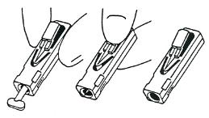
Retracting lancets with safety features

Slide 94
Work Practice Control
These are practices that reduce the
possibility of exposure by changing the way a
task is performed:
handling and disposing of contaminated sharps
handling specimens
handling laundry
cleaning contaminated surfaces and items.

Slide 95
Work Practice Control
Controls aimed at reducing or minimizing the employee’s exposure to blood and body fluids
Covering all open skin lesions
Minimizing the splashing, splattering, spraying or generation of droplets of blood or body fluids
Wash hands and body parts after contact with blood and body fluids
Forbidding eating, drinking, after contact with blood and body fluids

Slide 96
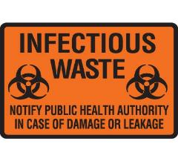

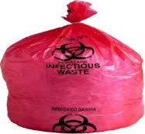
Work Practice Control
Housekeeping
Never reach into contaminated sharps disposal containers
Place regulated waste in closable and labeled or color-coded containers
Use labels and sign to communicate hazards

Slide 97


Work Practice Control
Use mechanical means, brush and dust pan, tongs to pick up broken glassware
Remove and replace protective coverings when contaminated
Discard all regulated waste according to regulations

Slide 98
Decontamination
All equipment and work surfaces must be cleaned and decontaminated with an EPA approved disinfectant after:
Contact with blood or OPIM
After completion of procedures and after any spills of blood or OPIM
Waste disposal/Laundry

Slide 99
Environmental Protection Agency
EAP
destroy or irreversibly inactivate certain microorganisms on hard, inanimate surfaces, and objects
efficacy testing against Staphylococcus aureus, Salmonella cholerasuis and Pseudomonas aeruginosa. The bacteria Pseudomonas aeruginosa hides behind biofilm and is difficult to eliminate. Killing this bacteria is required for "hospital grade disinfectant".
Also as part of this evaluation process, products are assigned to a toxicity category: The categories range from category 1 (highly toxic) to category 4 (no exposure warnings required on the label).

Slide 100
Exposure Control Plan
Employers must have a written, complete hazard communication program that includes information on:
  Container labeling
  Material Safety Data Sheets (MSDSs)
  Worker training
  The training must include the physical and health hazards of the chemicals and how workers can protect themselves; including specific procedures the employer has implemented to protect workers, such as work practices, emergency procedures, and personal protective equipment

Slide 101
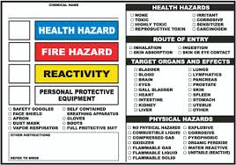
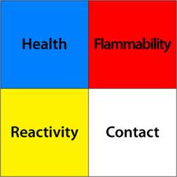

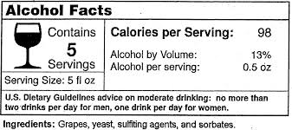
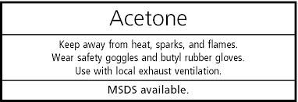
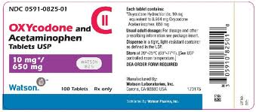
Exposure Control Plan

Slide 102
Training
Workers have a right to get training from employers on a variety of health and safety hazards and standards that employers must follow.
Some required training covers topics such as: bloodborne pathogens, noise, confined spaces, fall hazards in construction, personal protective equipment, along with a variety of other subjects.

Slide 103
Personal Protective Equipment
PPE provides protection against exposure to infectious materials and must be routinely used when contact with blood or body fluids is anticipated.
Selection of PPE is task oriented.
Under normal conditions it prevents blood and body fluids from reaching an employee’s:
work clothes, street clothes, undergarments
skin, mouth, eyes, other mucus membranes.

Slide 104
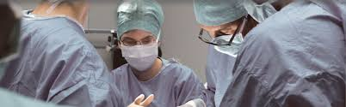
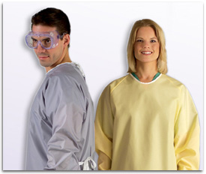

Personal Protective Equipment

Slide 105

Wash your Hands
When visibly contaminated with blood or OPIM
After using the washroom
After removing gloves
Before and after patient contact
After sneezing in your hands
Before and after eating, handling food, drinking or smoking.

Slide 106

Technique for Hand Washing
Use soap and running water
Rub your hands vigorously for 10 – 15 seconds
Wash all surfaces: • Backs of hands, wrists, between fingers and under nails
Rinse well
Dry hands with a disposable towel

Slide 107
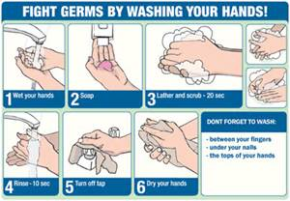
Technique for Hand Washing

Slide 108
OSHA Training
Must be done annually for returning employees and new hires
Attendance sheet must be kept on file for 3 years
All employees who are assigned to tasks where occupational exposure may take place must be provided with information and training at the time of initial assignment
Training must include Q&A

Slide 109
Complaint
Workers may bring up safety and health concerns in the workplace to their employers without fear of discharge or discrimination, as long as the complaint is made in good faith.
OSHA regulations [29CFR 1977.9(c)] protect workers who complain to their employer about unsafe or unhealthful conditions in the workplace.
Department of Labor 800-321-OSHA (6742)

Slide 110
Record Keeping
Medical records during employment
Injury Log
Sharps Injury Log 5 years
Training Records 3 years

Slide 111
Post-Exposure Evaluation and Follow-up
An exposure incident is a specific eye, mouth, other mucous membrane, non-intact skin, or parenteral contact with blood or OPIM.
This evaluation and follow-up must be at no cost to the worker and includes documenting the route(s) of exposure and the circumstances under which the exposure incident occurred; identifying and testing the source individual for HBV and HIV infectivity, if the source individual consents or the law does not require consent; collecting and testing the exposed worker’s blood, if the worker consents; offering post exposure prophylaxis; offering counseling; and evaluating reported illnesses.
The healthcare professional will provide a limited written opinion to the employer and all diagnoses must remain confidential.

Slide 112
Post Exposure Procedure
If you have been contaminated by blood, you may have been exposed to Hepatitis B, Hepatitis C, and/or HIV.
Wash off the exposed area immediately.
Report the incident to your Manager in order to receive proper post-exposure evaluation and follow-up.

Slide 113
Post Exposure Procedure
Employees must seek medical attention immediately.
The doctor’s visit is free of charge.
The employee reserves the right to decline medical attention
The employee must provide the reason for the declination in writing
A record of this declination must be kept on file

Slide 114
Post Exposure and Follow-up
Medical expenses incurred because of an exposure incident are covered by the employer
Forms and supporting documentation must be submitted to Risk Management.
Your Manager will be able to assist you in filing the appropriate forms.

Slide 115

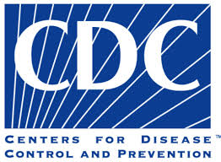
References
For more information or to file a complaint visit the OSHA Website at www.osha.gov or call 1-800-321-6742

Slide 116
The End

