Slide 1
HAZARD Communication

Slide 2
Learning objective
Upon completion of this unit you will be able to summarize the components of the OSHA hazard communications standard and implement a compliant Haz Com Program on your farm.

Slide 3
Learner outcomes
1. Identify employer requirements and responsibilities as outlined in the OSHA Hazard Communication Standard (OSHA 29CFR1910.1200 – issued in 1983).
2. List the main sections of a written Hazard Communication Program and describe appropriate information to include for each section.
3. Identify label requirements and warning signs

Slide 4
Learner outcomes
4. Identify main sections of a Material Safety Data Sheet and define key terms found in each section.
5. Identify key components for preparing and implementing as employee-training program for Hazard Communication.
6. Review the new Globally Harmonized System for Classification and Labeling of chemicals and interpret major changes form the current Hazard Communication Standard.

Slide 5

introduction
Referred to as HAZ COM or Right to Know
Employees have the right to know about hazardous chemicals in the workplace

Slide 6

introduction
Employees have the right to protect themselves from hazards
Most frequently cited standard for dairy

Slide 7
Chemical Manufacturer’s Responsibility
Determination of why the chemical is hazardous and provide information to purchasers
Appropriate labels and material safety date sheets (MSDS)

Slide 8
Employer Responsibility
Any workplace where employees may be exposed to hazardous chemicals must have a Hazard Communication Program

Slide 9
Elements of a haz com program
Inventory & assessment of hazardous chemicals
System for maintaining Material Safety Data Sheets (MSDS)
Chemical labels and warning signs
Training programs
Written hazard communication programs

Slide 10
inventory
Do a physical inventory of all chemicals used on the premises
Must have a MSDS for each chemical
  If MSDS is needed contact supplier/ manufacture of find it on the internet
  Do not allow employees to use a chemical until the MSDS is received

Slide 11
General rule
Eliminating the use of hazardous chemicals by substituting with safer products is always preferred

Slide 12
Hazard Assessment
Employer is responsible for assessing the hazards of the chemicals
  Evaluate the potential to cause adverse health effects

Slide 13
physical Hazard
A chemical with scientific evidence that it is a combustible liquid, a compressed gas, explosive, flammable, an organic peroxide, an oxidizer, unstable, or water reactive.

Slide 14
health Hazard
A chemical with scientific evidence that acute (immediate) or chronic (long-term) health effects may occur in employees who are exposed.
  Carcinogens, toxic irritants, corrosives, sensitizers, or damaging to lungs, skin, mucus membranes, or eyes

Slide 15
question
What are some examples of chemicals that have either a physical or a health hazard on your farm?

Slide 16
Hazardous chemical information
29CFR1910, Subpart Z, all chemicals listed are hazardous
  Note that this is not a complete list of chemicals.
“Threshold Limit Values for Chemical Substances and Physical Agents in the Work Environment” published by the American Conference of Governmental Industrial Hygienists ( ACGIH)

Slide 17
Standard Requirements
Employers have a copy of MSDS for each chemical
MSDS must be readily available to all employees
Must be in English but having additional copies in other languages is advised

Slide 18
Standard Requirements
Designate a person who is responsible to maintain the MSDS documents / online files.
Determine a system that works for your farm to maintain the MSDSs

Slide 19
Standard Requirements
Teach employees how to use the MSDS and where they are located
Determine procedures for updating when new chemical come onto the property
Retain copies of the old MSDSs for 30 years following disuse

Slide 20
Standard Requirements
MSDSs
  Prepared by the manufacturer
  No Specific format is required
GHS changes these to Safety Data Sheets (SDS)

Slide 21
Material safety data sheets
Eight Sections:
Manufactures name and address
Hazardous ingredients identity
Physical / Chemical Characteristics
Fire / explosion hazards
Reactive data
Health hazard data
Precautions for safe handling
Control measures

Slide 22
Msds activity
Class activity: Copper Sulfate

Slide 23
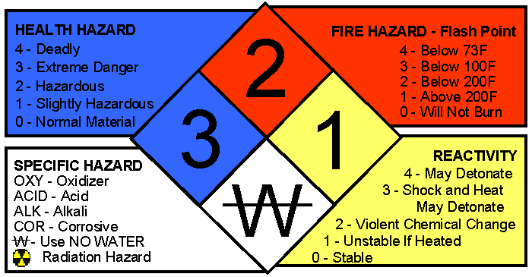
Hazard classification
National Fire Protection Association = fire diamond
Copper Sulfate health-3, fire-0, reactivity-0

Slide 24
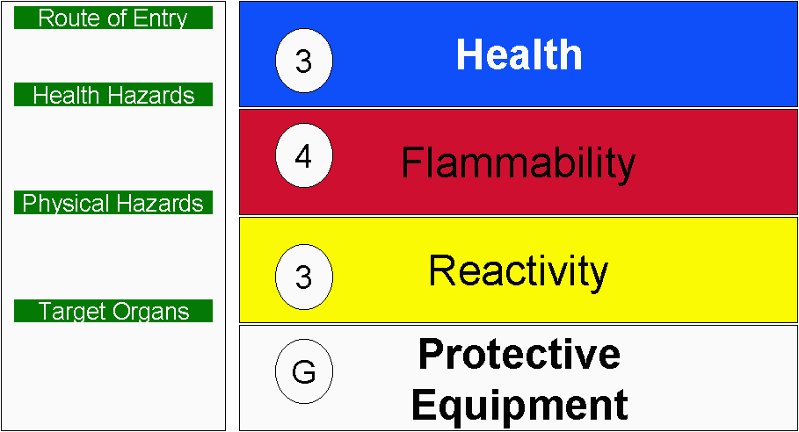
Hazard classification
Hazardous Material Identification System (HMIS)

Slide 25
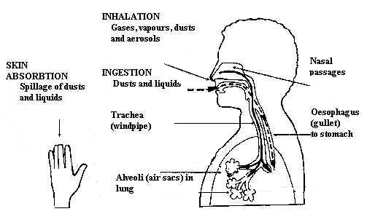
Route of entry
Inhalation
Skin absorption
Ingestion
Injection

Slide 26
Route of entry copper sulfate cuso₄
Inhalation: irritation to the mucus membrane & upper respiratory tract
Skin absorption: Slight skin irritant
Ingestion: Toxic
Eyes: Severe irritation irreversible damage
Injection: Shouldn’t cause problems

Slide 27
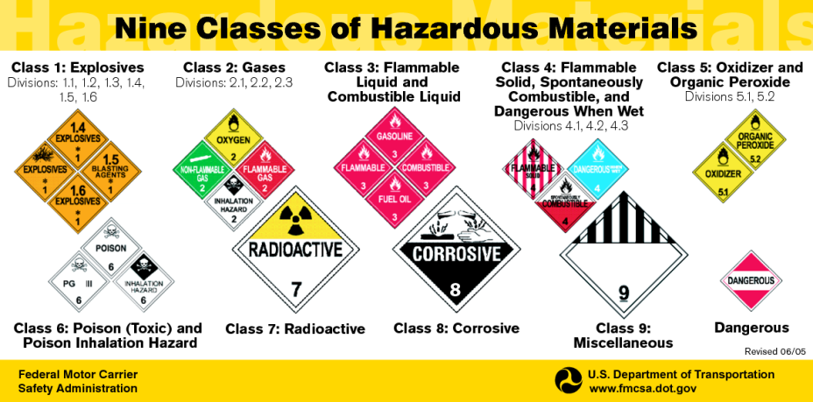
Hazard Classification

Slide 28
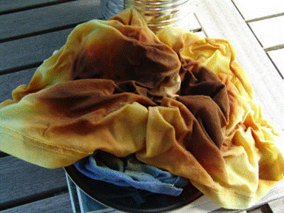
Flammability
How easily will something burn
Flammable liquids: Gasoline / ethanol
Flammable solids: oily fabrics
CuSO₄: Not flammable, will emit toxic fumes when heated over 400°

Slide 29
corrosive
Chemical that destroys living tissue or breaks down metal
Can be a solid, liquid, or gas
Fertilizers, manure, sanitizers, and acid rinses
CuSO₄: Irreversible eye damage

Slide 30
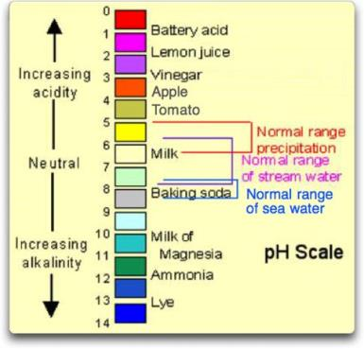
PH
pH is a scale of 0-14 that represents the acidity or alkalinity of an aqueous solution.
Pure water has a pH of 7 = neutral solution
Acids have a pH < 7
Bases have a pH > 7
Particular safety concerns
on the extremes of the pH scale.
Pipeline cleaners range from
a pH of 10 to 14.

Slide 31
Farm Example
Chemical pH: Foot bath starts with a pH of 6 in 5% solution, as cows walk through and manure accumulates the pH will rise.

Slide 32

Flash point
How easily an item ignites
Lower flashpoint = higher flammability
Materials with flashpoint under 100° are regulated
Includes oils or gasoline
CuSO₄: N/A

Slide 33
sensitization
Allergic reaction develops over time
  Dizziness
  Eye / throat irritation
  Chest tightness
  Nasal Congestion
Ex: Formaldehyde

Slide 34

Target organs
Indicate what bodily organs are affected
Lungs
Skin
Kidneys
Nervous System

Slide 35

Chemical labels & warning signs
Manufactures: Identification of chemical, hazard warnings, name, and address of manufacturer
Transferred to new container,
MUST be labeled
Portable containers do not have
to be labeled if used immediately
by the person who made the transfer. (Teat Dip)

Slide 36
Employer labels
If a chemical is transferred to another container the new container must be labeled
Containers may be unlabeled if they are for immediate use by dispenser only
Must be in English; may include
other languages

Slide 37

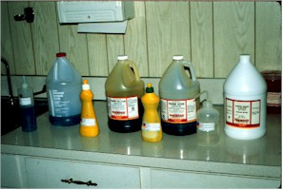
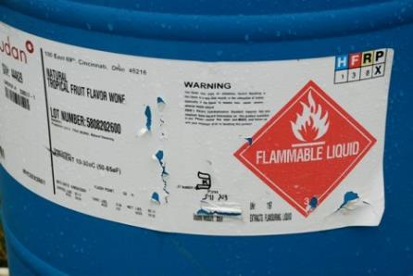
Good vs. Bad lables
Good labels

Slide 38
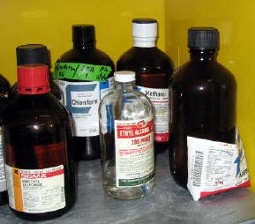


Good vs. Bad lables
Bad labels

Slide 39

Employee training
Employees must be trained prior to handling chemicals
Explain MSDSs
Must be in a language that employees understand
Can group like chemicals together

Slide 40
Employee training
Train based on what chemicals they will encounter in normal activities
If employee was trained by previous employer that training may be sufficient
Location of MSDSs

Slide 41

Record keeping
Keep records of all trainings
Employee name, date, trainer & credentials, topic outline
Evaluation / quiz

Slide 42

Written plans
Inventory
Obtain needed MSDS (s)
Proper Labeling
Outline Training
Methods to inform outside contractors

Slide 43

Global harmonization
Changes that must be made by December 2013
Hazard Classifications: Provide specific criteria physical and health hazard
Labels: all labels will have same pictograms and wording for hazard statements
Safety Data Sheets (SDS): change from 9 to 16 sections

Slide 44
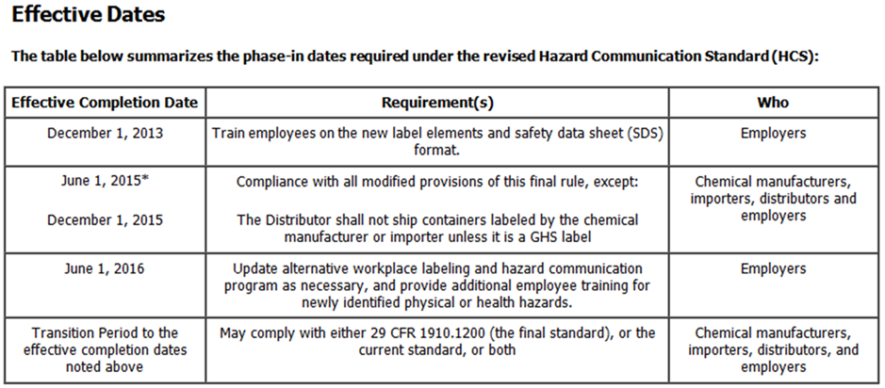
Ghs: Phase –in dates

Slide 45
Ghs: new hazard classifications
Explosives
Flammable Gases
Flammable Aerosols
Oxidizing Gases
Gases Under Pressure
Flammable Liquids
Flammable Solids
Self-Reactive Substances

Slide 46
Ghs: new hazard classifications
Pyrophoric Liquids (Ignite spontaneously in air)
Pyrophoric Solids
Self Heating Chemicals
Substances which emit flammable gases when in contact with water
Oxidizing Liquids
Oxidizing Solids
Organic Peroxides
Corrosive to Metal

Slide 47



Ghs: pictograms
Carcinogen
Mutagenicity
Respiratory Sensitizer
Target Organ Toxicity
Aspiration Toxicity
Reproductive Toxicity
Flammables
Pyrophorics
Self Heating
Emits Flammable Gas
Self Reactives
Organic Peroxides
Irritant
Skin Sensitizer
Acute Toxicity (harmful)
Narcotic Effects
Respiratory Tract Irritant

Slide 48



Ghs: pictograms
Gases Under Pressure
Corrosives
Skin Corrosion / Burns
Eye Damage
Corrosive to Metals
Explosives
Self Reactives
Organic Peroxides

Slide 49



Ghs: pictograms
Oxidizers
Environmental issues
Aquatic toxicity
Acute Toxicity (severe)

Slide 50
Ghs: label requirements
Signal words indicate level of severity:
  Danger: more severe
  Warning: less severe
Hazard statement: certain statements assigned to categories of hazards
Precautionary statement: describes recommended measures to minimize or prevent adverse effects

Slide 51
Ghs: new safety data sheets format
Identification
Hazard(s) identification
Composition / information on ingredients
First-aid measures
Fire fighting measures
Accidental release measures

Slide 52
Ghs: new safety data sheets format
Handling and storage
Exposure controls / personal protection
Physical and chemical properties
Stability and reactivity
Toxicology information

Slide 53
Ghs: new safety data sheets format
#12-15: on the SDS but not required by OSHA
Ecological information
Disposal considerations
Transportation information
Regulatory information
Other information, including data for preparation

Slide 54
resources
OSHA Hazard Communication Main Page:
www.osha.gov/dsg/hazcom/index.html
A Guide to Globally Harmonized systems of classification and Labeling of Chemicals:
  www.osha.gov/dsg/hazcom/ghs.html#3.0

Slide 55
review
What are the five main components of a hazard Communication Program?

Slide 56
review
What are some examples of hazardous chemicals you may encounter on your farm?

Slide 57
review
What information must be included on a chemical inventory?

Slide 58
review
Through what routes can a person be contaminated by a chemical?

Slide 59
review
What is the purpose of global harmonization?

Slide 60
This material was produced under grant number SH-22318-11 from the Occupational Safety and Health Administration, U.S. Department of Labor. It does not necessarily reflect the views or policies of the U.S. Department of Labor, nor does mention of trade names, commercial products, or organizations imply endorsement by the U.S. Government.

