Slide 1

Process Mapping
Presented By The University of Texas-School of Public Health
This material was produced under grant number SH-22316-SH-1 from the Occupational Safety and Health Administration, U.S. Department of Labor. It does not necessarily reflect the views or policies of the U.S. Department of Labor, nor does mention of trade names, commercial products, or organizations imply endorsement by the U.S. Government.

Slide 2
Learning Objectives
By the end of this module participants should be able to:
Identify the importance of process mapping
Identify the four different types of process mapping
Develop a detailed process map
Explain the value of Functional Process Maps

Slide 3
The DMAIC Process with Tools
DAY 1
Define
Phase
1&2
Measure
Tools:
Voice of Customer (VOC) Analysis
Process Mapping
Value Stream Mapping
Analyze
Improve
Control

Slide 4
Importance of Process Mapping
Possible benefits
Document and understand the actual process
Show the relationship of Process Steps
Develop a list of potential Xs to assist in building Y = f(X)
Determine Value-Added (VA), Business-Value-Added (BVA), and Non-Value-Added (NVA) steps of a process
Communicate information
Train employees on the process
Characteristics of
Value Stream Map

Slide 5

What Is A Process Map?
A Process Map is a graphical representation of the steps involved in a process or portion of a process

Slide 6
What is different between Process Mapping and VSM?
Process Mapping
Possible benefits
Value Stream Mapping
A Process Map is a graphical representation of the steps involved in a process or portion of a process
There are many types of Process Maps at different levels of detail and used for different purposes. Some of the more typical are:
A pictorial representation of the Flow of Material People and Processes Information
Specific data associated with each step
Touch Time and Cycle Time
Volume
Resources
Errors/rework

Slide 7
4 Types of the Process Map
High-Level
Common
Detailed
Functional
Used in project definition and scoping
- e.g., SIPOC
Used to display the steps in the process.
First step in constructing a Detailed Map
Adds inputs/
outputs, VA/
BVA/NVA, and classification of inputs to the Common Process Map
-eg., Value Stream/Detailed Process Map
Breaks the steps into functional areas, frequently mapped against a time line

Slide 8
Versions Of A Process
Possible benefits
At Least Three Versions
What you think it is...
What it actually is...
What you would
like it to be...

Slide 9
Levels Of A Process
Business
Process
(“Strategic”)
Business Development
Core
Functional
Departments
Business Processes
Sales
Underwriting
Contracting
Customer
Service
Sub-process
High-level Process Map
Supplier
Customer
Terms
Terms
Docs
Negotiate
Close
(ext.) Customers
(int.) Cust. Service Dept.
Underwriters
Detailed
Sub-process Map
Detailed
Sub-process
Tasks
Procedures

Slide 10
SIPOC – A High-level Process Map
(Covered In Project Definition Module)
A High-level Process Map should describe:
Major tasks and activities
The boundaries of the process
The Process Output Variables (POV)
Who receives the outputs (customers)
What does the customer require of the outputs
The Process Input Variables (PIV)
Who supplies the inputs (suppliers)
What does the process require of the inputs
SIPOC: Supplier, Inputs, Process, Outputs, Customers.
S : Supplier
I : Inputs
P : Process
O : Outputs
C : Customers
Notes:
LP: Tailor examples of the “types of customers”

Slide 11
Common Process Map
A common Process Map should describe:
All of the steps within the bounded process
The flow relationship between the steps including loops and\decision points
Distribution of material flow
This is a first step in building a detailed Process Map
This is sometimes referred to as a simple Flowchart.
Notes:
Need a Healthcare example

Slide 12
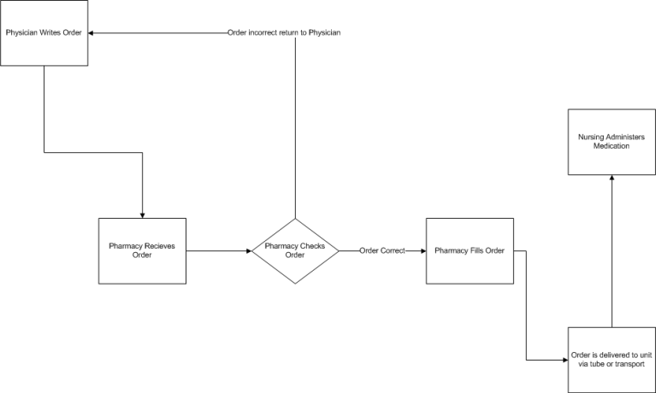
Common Process Map Example
Notes:
Bob to replace this with a Healthcare example

Slide 13
Detailed Process Map
A detailed Process Map should describe:
All of the steps within the scope of the project (frequently a subset of what was mapped in the common Process Map)
The flow relationship between the steps including loops and decision points
Distribution of material flow
All inputs and outputs by step
The Value-Add status of each step – VA, BVA, or NVA
One of the best tools to develop the list of PIVs.
Notes:
Healthcare Example

Slide 14
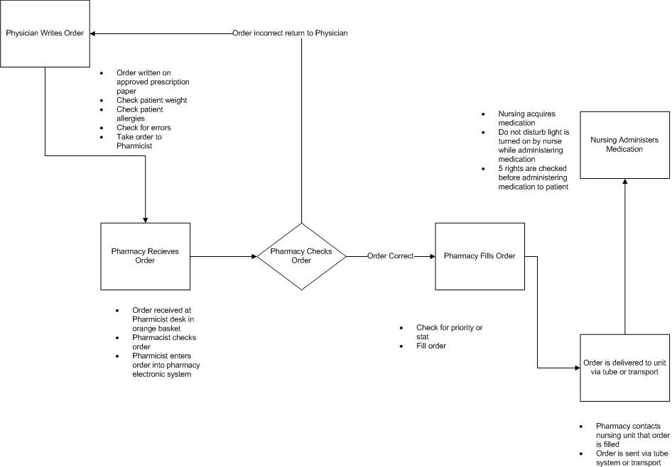
Detailed Process Map Example
Notes:
Healthcare Example

Slide 15
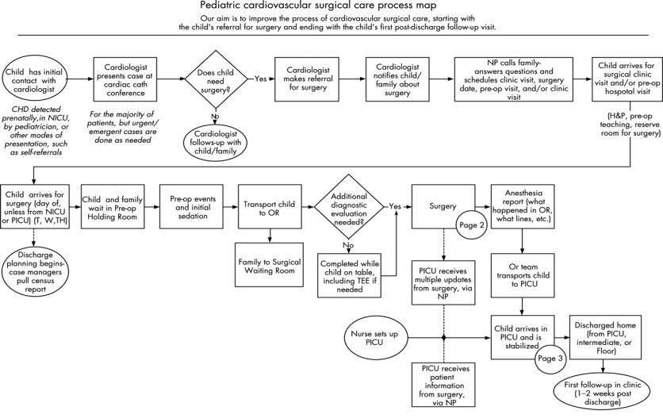
Detailed Process Map Example
Notes:
Healthcare Example

Slide 16
Tips In Process Mapping
Clarify process boundaries
Use verbs to describe steps
Do not include “who” in step description
Combine, eliminate duplicates, clarify steps
Analyze/review from finish to start
Process Mapping is best done as a team
Involve stakeholders
Cross-functional teams are generally recommended
“Walk the process”, repeatedly
Ask lots of questions
Map the process at the “right” level

Slide 17
Exercise # 1: Process Mapping

Slide 18
What Level Of Magnification Is Required?
High-level Maps provide:
60,000 foot view of the process
Inputs, outputs, customers, suppliers (at macro level)
Mid-Level Maps provide:
Clear view of all steps in the process
Sequence of steps, loops, etc
Detailed Maps provide:
Evaluation of Value-Add status for all steps within the bounded or confined area of the process
Inputs, outputs for all steps within confined area of the process

Slide 19
Definitions – Activity Types
Value-Added
Any activity or task that transforms the deliverables of a process in such a way that the client is aware of it and is willing to pay for it
Any activity that, when left out, would impact product performance and/or customer satisfaction
Business-Value-Added
Necessary to support Value-Added steps in the current process
Includes those activities that do not add value but are currently required by regulation or law
When left out, may not directly impact the customer or incur dissatisfaction
Non-Value-Added
Any activity that, when left out, does not directly impact the customer or the business

Slide 20
Definitions – Input Types
Controllable (C)
These are inputs that you can adjust or control while the process is being setup or running, e.g., speed, feed rate, temperature, pressure. These are sometime referred to as “knob” variables
Standard Operating Procedures (S)
These are procedures that are part of the process and have been defined and documented. The goal here is to make sure that we document the true procedure, e.g., cleaning, safety, loading of components, setup
Noise (N)
These are things you cannot control or choose not to control due to cost or difficulty, e.g., ambient temperature or humidity, operator training

Slide 21
Process Mapping The 8 Step Methodology
Create the Top Level SIPOC, defining the scope of the process (start and end)
Map all activities needed in the production of a “good” product or service within the scope from Step 1
If desired narrow the focus to that portion of the map that is critical to the project
For the activities from Step 3, designate as VA, BVA, or NVA
List outputs for each activity from Step 3
List inputs for each activity from Step 3
Classify all inputs as C, S, or N
Clearly identify all data collection points

Slide 22
Why List The Inputs And Outputs?
Project improvements are based on finding Y = f(X)
Must have a list of potential Xs to start the investigation
The Process Map is an excellent tool for identifying potential Xs
Outputs from one Process Step are usually the inputs for the next Process Step
To identify the list of potential Xs or PIVs, fill the top of the funnel.
Notes:
Lisa I believe was going to replace Y=f(x) with systems theory?

Slide 23
Links To Other Tools
The detailed Process Map provides input to:
Cause and Effects Matrix
Failure Mode and Effects Analysis (FMEA)
Control Plan
Multi-Varied Studies
DOE planning

Slide 24
Summary
Process mapping shows the relationship of process steps.
There are 4 different types of process maps such as;
high-level,
common,
detailed, and
functional
A functional process map describes the steps in the bounded process, separated into functional areas and internal customer-supplier relationships.

Slide 25

Thank You

