Slide 1

Hazard Communication ( HAZCOM) and the Globally Harmonized System of Classification and Labeling of Chemicals (GHS)
Understanding the changes

Slide 2
Sponsorship
Department of Labor
Occupational Health and Safety Administration (OSHA)
Susan Harwood Training Grant
This material was produced under Susan Harwood grant number 22315-11-60-F-72 Occupational Safety and Health Administration, U.S. Department of Labor. The contents in this presentation do not necessarily reflect the views or policies of the U.S. Department of Labor, nor does the mention of trade names, commercial products, or organizations imply endorsement by the U.S. Government.

Slide 3
Work Team
UNIVERSITY OF PUERTO RICO
Río Piedras Campus
Division of Continued Education and Professional Studies
(DECEP)
Migdalia Ruiz, MS – Project Director
Lymari Orellana, MS, Trainer
Adaliz López, MS, Trainer
Carmen Vázquez, BSSI, CIHT, Trainer

Slide 4
Global Harmonization System (GHS)
Overview

Slide 5
What is GHS?
  acronym for:
  Globally
  Harmonized
  System of Classification and Labeling of Chemicals
GHS

Slide 6
What is GHS?
  It is A SYSTEM. Elements of this system will be adopted by OSHA, to classify and communicate hazards of chemicals based on a common set of criteria
  GHS is a harmonized system for the classification and labeling of chemicals covering health, physical and environmental hazards.
  It provides a basis for the harmonization of regulations related to the handling of chemical materials at a global level.
Notes:
This system defines hazards, creates a classification process and communicates the information on labels and safety data sheets
Harmonization – implies the coordination, organization, management and synchronization of several elements. In this case of several criteria regarding handling of chemical materials.
A Harmonized System can be defined as the adjustment of differences and inconsistencies among different systems to make them uniform or mutually compatible. The GHS system is composed of several elements in such a way that the end result is an aligned system based on a common approach

Slide 7
What is GHS?
  GHS establishes
    Harmonized definitions of hazards
      Physical , health, environmental
    Specific criteria for labels
      Pictograms, signal words, hazard and precautionary statements
    Harmonized format for safety data sheets
      16 sections (ANSI format)
Notes:
7
The GHS covers physical, health, and environmental hazards. The work was divided in three parts:
Classification criteria for physical hazards – developed by United Nations Subcommittee/ International Labor Organization (ILO), based on the harmonized criteria for transport goods
Classification criteria for health and environmental hazards- developed under the Organization for Economic Cooperation
Hazard communication elements – developed by ILO

Slide 8

How was GHS developed?
United Nations Organization (UN) initiative since 1992 to provide a system for the standard handling of chemicals
The system used as reference several existing system from various countries. It is now available for adoption by competent authorities around the world.
Revision 3 of the GHS will be used by OSHA as the reference for the proposed Hazard Communication rule
Notes:
UN Globally Harmonized System of Classification and Labeling of Chemicals, third revision is sometimes called the “purple book”

Slide 9
Principles of Harmonization
Harmonization should not reduce the level of protection.
Requires changes in all existing systems .
The scope includes both hazard classification criteria and hazard communication tools (labels, SDS’s).
Notes:
9

Slide 10
Principles of Harmonization
Target audiences include consumers, workers, transport workers and emergency responders.
Information should be presented in a comprehensive manner to all audiences
Regarding chemicals Confidential Business Information (CBI) should be protected without compromising worker safety.
Notes:
10

Slide 11
Guiding Principles
All hazardous chemicals are covered to some extent, including mixtures
The GHS does not include requirements for additional testing for health hazards nor establishes uniform test methods
The system should take account existing data from testing for hazard determination.
Notes:
Information should be presented in more than one way, symbols, words, phrases, to ensure comprehension even to low literacy populations…
The comprehensibility of the components of the system should take account of existing studies and evidence gained from testing.

Slide 12
Why is the GHS needed?
The correct handling of chemicals requires that material information be provided by means of labels, symbols and data sheets.
Differences in countries regulations have resulted in non standardized information for the same material leading to mishandling and /or unsafe situations

Slide 13

Why is the GHS needed?
These differences impact both protection and trade.
  Protection: inconsistent information for the same chemical can lead to mishandling.
  Trade: compliance with multiple regulations regarding hazard classification and labelling is costly and time-consuming.
Notes:
The global chemical industry generates almost two trillion dollars / year and impacts millions of workers globally.

Slide 14
Application of GHS
The system is created as a “building-block” (modular) approach
  This means that each authority / agency/ adopts the “blocks” that are applicable to existing or new regulations under their scope
    For Example: one regulatory agency is expected to adopt provisions for various elements such as labels and SDS, while the other agency only adopts provisions for labels due their sector of interest
Notes:
14
GHS evaluated the provisions of existing systems and agreed upon common provisions that addressed the needs of the different countries involved.
The system that harmonizes the classification and labeling of chemicals, covering physical, health, and environmental hazards.
It is not a model regulation or standard that can simply be adopted. It consists of non-mandatory recommendations and explanatory text.

Slide 15

Building Block approach
Hazard classes
Health
Physical
Acute Toxicity
Skin
Explosives
Category 1-4
Category 1-6
The building blocks are the hazard classes and categories and each competent authority adopts the building blocks that are applicable to their specific sector.
Notes:
The system was created as a “building block/ modular” approach.

Slide 16
Hazard Communication (HCS) adopts GHS
Affecting what?

Slide 17
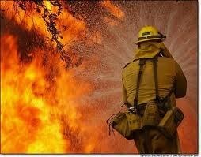



Target Sectors
GHS targets these sectors :
    Workplace
    Consumers
    Transport
    Emergency Responders
Notes:
Workplace – GHS will impact the physical and health hazard criteria, the label and safety data sheet elements and format and the employee training requirements. The environmental hazards may not be covered by all workplace systems
Consumers – GHS will impact mainly the labels of products with the adoption of the GHS hazard criteria
Transport - US Department of Transportation (DOT) has adopted GHS in the labels of dangerous goods
Emergency responders - the adoption of GHS hazard criteria should improve worker safety and safety practices when handling chemical substances

Slide 18
GHS impact
Based on those sectors GHS impacts several US agencies:
Environmental Protection Agency (EPA)
  Pesticides Program
Consumer Product Safety Commission (CPSC)
  User end of products or materials
Department of Transportation (DOT)
  Hazardous Materials Regulations

Slide 19
GHS impact
Occupational Safety and Health Administration (OSHA)
  Under HAZCOM, OSHA has more requirements affected by the GHS than any other US agency
    hazards,
    labels,
    material safety data sheets,
    training
  Main impact is on the Hazard Communication Standard which covers 945,000 hazardous chemical products and 7 million workplaces.
Notes:
OSHA is the competent authority regarding safe use of chemical in the work place the impact of GHS will reach an estimated 7 million workplaces in US .

Slide 20
HCS History
First publication on Nov.1983. Only covered manufacturing sector. Final Rule was published on Aug 1987 covering all employers except for the construction industry (temporary)
Supreme Court decision to enforce all provisions in all industrial segments was on Feb 1990.
Publication of final rule on Feb. 1994 including technical amendments and minor changes
Notes:
There has been no major revision to the rule since then, only minor changes

Slide 21
HCS Framework
Purpose - to ensure that the hazards of all chemicals produced or imported are evaluated, and that information concerning their hazards is transmitted to employers and employees.
Scope – worksites where employees could be exposed to hazardous chemicals
Notes:
Chemicals are used in every type of worksite at different levels. The amount of workers potentially exposed covers millions around the world.

Slide 22
HCS Framework
How – transmiting information by means of a complete hazard communication program that includes:
list of hazardous chemicals present
container labeling and other forms of warning,
material safety data sheets and
employee training
Notes:
Information must be conveyed in English (other languages are permitted), to employers and employees in different ways so that all types of workers and workplaces can be reached

Slide 23
Responsibilities under HCS
OSHA requires to manufacturers and importers to evaluate the hazards related to chemicals they produce or import.
  This evaluation will be changed to a hazard classification
Employers are required to inform their employees about the hazards related to chemicals they might be exposed to and corresponding protective measures.
  Labels and safety data sheets change
  Training needs to include GHS adopted elements

Slide 24
GHS main elements
Classification criteria
  Standardized for health, physical and environmental hazards
Hazard communication elements
  Labels
    Standardized elements and format
  Safety Data Sheets
    Standardized sections and format
Notes:
24
The phrases used to indicate the degree (severity) of a hazards is called a category should be consistent across different hazard types.

Slide 25
GHS – Hazard Classification
Health, Physical, Environmental

Slide 26

GHS: Environmental Hazards
Hazardous to the Aquatic Environment
  Acute – injury after short term exposure
  Chronic – injury during the organism life cycle
  Includes fish, crustaceans, and algae or other aquatic plants
The environmental hazards are not covered by OSHA . The competent authority for those would be EPA

Slide 27


GHS – Health Hazards
What’s new?...

Slide 28
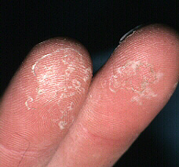
GHS Health Hazards (10)
Acute Toxicity
Skin corrosion/Irritation
Serious eye damage/eye irritation
Respiratory or skin sensitization
Germ cell mutagenicity
Carcinogenicity
Reproductive toxicity
Target organ system toxicity – Single exposure
Target organ system toxicity – repeated exposure
Aspiration hazard
Notes:
Each of these hazard classes is divided into hazard categories. Not all hazard categories were adopted for the hazard classes

Slide 29
Definitions: Health Hazards
Acute toxicity “refers to those adverse effects occurring following oral or dermal administration of a single dose of a substance, or multiple doses given within 24 hours, or an inhalation exposure of 4 hours”.
  Substances are assigned to one of five included categories based on oral, dermal, and inhalation toxicity. OSHA did not adopt category 5
Notes:
OSHA as the competent authority did not completely adopt the Acute Toxicity category, leaving severity category 5 out

Slide 30

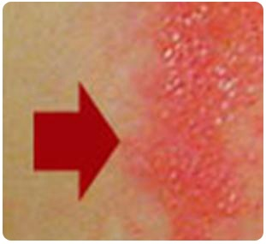
Definitions: Health Hazards
Skin corrosion is defined as “the production of irreversible damage to the skin; namely, visible necrosis through the epidermis and into the dermis, which was followed by the application of a test substance for up to 4 hours”.
  GHS does not require additional testing. Based on available data for that chemical
Corrosive reactions are typified by ulcers, bleeding, bloody scabs.
Visible damage to skin after contact with substance
Notes:
30
Basically, contact with skin for up to four hours produces irreversible damage.
OSHA is not adopting Category 3 of the skin corrosion/irritation health hazard

Slide 31

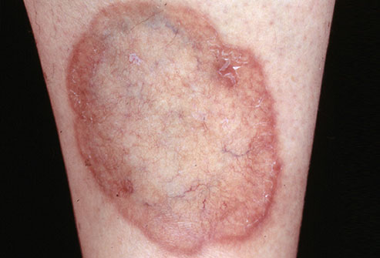
Definitions: Health Hazards
Skin irritation is defined as “the production of reversible damage to the skin following the application of a test substance for up to 4 hours”.
  OSHA adopted two categories
  for the Skin Corrosion/ irritation hazard class
Before contact
After contact
Notes:
31
Basically, contact with skin for up to four hours produces reversible damage.

Slide 32
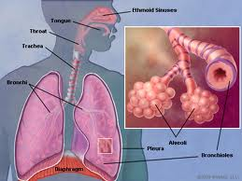
Definitions: Health Hazards
Skin sensitizer “means a chemical that induces an allergic response following skin contact”.
Respiratory sensitizer “means a chemical that will lead to hypersensitivity of the airways following inhalation of the chemical”.
  There are two categories for the Respiratory or Skin Sensitization hazard class
Notes:
32

Slide 33
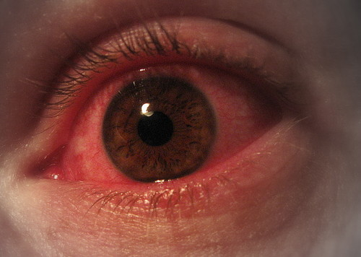
Definitions: Health Hazards
Two categories for eye hazards
Eye irritation is defined as “the production of changes in the eye following the application of test substance to the anterior surface of the eye, which are full reversible within 21 days of application”.

Slide 34

Definitions: Health Hazards
Serious eye damage is defined as the production of tissue damage in the eye, or serious physical decay of vision, following application of a test substance to the anterior surface of the eye, which is not fully reversible within 21 days of application”.

Slide 35


Definitions: Health Hazards
Germ Cell Mutagenicity
A mutation “is defined as a permanent change in the amount or structure of the genetic material in a cell”.
The term mutagenic and mutagen “will be used for agents giving rise to an increased occurrence of mutations in populations of cells and/or organisms”.
Two categories in this hazard class

Slide 36
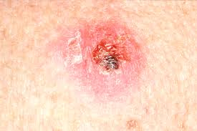
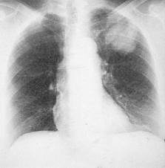
Definitions: Health Hazards
Carcinogen “means a substance or a mixture of substances which induce cancer or increase its incidence.”
  Substances and mixtures which have induced benign and malignant tumors in well-performed experimental studies on animals are considered also to be presumed or suspected human carcinogens.
Two categories in this hazard
Skin cancer
Lung cancer
Notes:
Substances that have induced tumors of any kind will be considered carcinogens, unless there is strong evidence that the mechanism of tumor formation is not relevant for humans.

Slide 37


Definitions: Health Hazards
Reproductive toxicity “includes adverse effects on sexual function and fertility in adult males and females, as well as adverse effects on development of the offspring”.
  Adverse effects on development of the offspring means “any effect of chemicals which interferes with normal development of the conceptus either before or after birth”.
Two categories in this hazard

Slide 38

Definitions: Health Hazards
Specific Target Organ Toxicity (STOT)
  Single exposure means “specific, non-lethal target organ toxicity arising from a single exposure to a chemical”.
  Repeated exposure requires more than one instance of exposure.

Slide 39

Definitions: Health Hazards
STOT is caused by chemicals that are specific target organ toxicants and, as such, present a potential for adverse health effects in people who are exposed to it.
  STOT – single exposure has three hazard categories
  STOT – repeated exposure has two hazard categories.

Slide 40

Definitions: Health Hazards
Aspiration means “the entry of a liquid or solid chemical directly through the oral or nasal cavity, or indirectly from vomiting, into the trachea and lower respiratory system”.
  Includes severe acute effects such as chemical pneumonia, varying degrees of pulmonary injury or death following aspiration.
  Only one category adopted
Notes:
Category 2 of Aspiration Hazard was not adopted by OSHA.

Slide 41





GHS – Physical Hazards
New Definitions…

Slide 42
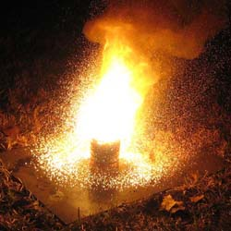
GHS Physical Hazards (16)
Explosives
Flammable gases
Flammable aerosols
Oxidizing gases
Gases under pressure
Flammable liquids
Flammable solids
Self-reactive substances and mixtures
Pyrophoric liquids
Pyrophoric solids
Self-heating substances and mixtures
Substances and mixtures which, in contact with water, emit flammable gases
Oxidizing liquids
Oxidizing solids
Organic peroxides
Corrosive to metals
Notes:
OSHA has the adopted GHS criteria for all physical hazards. The physical hazards criteria in Appendix B are based on the UN Recommendations for the Transport of Dangerous Goods (RTDG) already used by US DOT in the hazards material regulations . Therefore the transport labels remains the same.

Slide 43

Physical Hazards…
Explosive Substances and Mixtures
    Solid or liquid substances capable of producing gas at such a high temperature and pressure that it can cause damage to surroundings.
    Divided in 6 categories based on type of damage produced
Notes:
These are similar to the subcategories for the transport sector.
Pyrotechnic chemicals are included even when they do not evolve gases.
A pyrotechnic chemical is a chemical designed to produce an effect by heat, light, sound, gas or smoke or a combination of these as the result of non-detonative self sustaining exothermic chemical reactions.
An explosive item is an item containing one or more explosive chemicals.
A pyrotechnic item is an item containing one or more pyrotechnic chemicals.
An unstable explosive is an explosive which is thermally unstable and/or too sensitive for normal handling, transport, or use.
An intentional explosive is a chemical or item which is manufactured with a view to produce a practical explosive or pyrotechnic effect.

Slide 44

Physical Hazards...
Flammables, include
  Flammable Gases
  Flammable Aerosols
  Flammable Liquids
  Flammable Solids
Notes:
Flammables
Flammable Gases
Have a flammable range in air at 20 degrees C (68 F) and a pressure of 101.3 kilopascals (14.7 psi).
Flammable Aerosols
They are compressed, liquefied or pressurized gas that eject from the container in a foam, powder or liquid state. Classification of aerosols will depend upon concentration of flammables and heat of combustion among other test s
Flammable Liquids
Any liquid with a flash point of 93 degrees C ( 199.4 F) or less. Divided in 4 categories based on flash point and boiling point temperature
Flammable Solids
A solid, usually in a powder or granular form, that is easily combustible through friction like some metal powders. Divided in 2 categories based on burning time, burning rate and behavior when wet.

Slide 45

Physical Hazards...
Flammable gas means a gas having a flammable range with air at 20°C (68 F) and a standard pressure of 101.3 kPa (14.7 psi).
  Two categories
Notes:
.

Slide 46
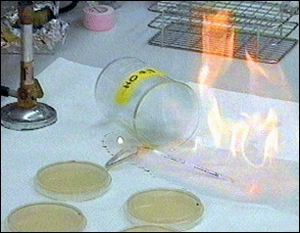

Physical Hazards...
Flammable Liquids
  Any liquid with a flash point of 93 degrees C (199.4 F) or less.
  Four categories
Flammable Solids means a solid, usually in a powder or granular form, that is easily combustible through friction
  Two categories
Notes:
Flammable Solids
A solid, usually in a powder or granular form, that is easily combustible through friction like some metal powders. Divided in 2 categories based on burning time, burning rate and behavior when wet.

Slide 47
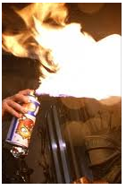
Physical Hazards...
Aerosol means “any non-refillable receptacle containing a gas compressed, liquefied or dissolved under pressure, and fitted with a release device allowing the contents to be ejected as particles in suspension in a gas, or as a foam, paste, powder, liquid or gas.”
Flammable Aerosols
  Contain Flammable components
  Two categories

Slide 48

Physical Hazards …
Oxidizing gas “means any gas which may, generally by providing oxygen, cause or contribute to the combustion of other material more than air does”. One category.
Oxidizing Liquids and Solids
  Though not necessarily combustible on their own, generally by yielding oxygen cause or contribute combustion of other material.
  Three categories
Notes:
Oxidizers provide oxygen thus enhancing flammabililty

Slide 49

Physical Hazards ...
Gases Under Pressure
  Gases contained in a receptacle at a pressure of 200 kPa (29 psi) or more, which are liquefied or liquefied and refrigerated
  Includes 4 groups: compressed gases, liquefied gases, dissolved gases and refrigerated liquefied gases
Notes:
Contained in a receptacle at not less 200 kPa (29 psi) @ 20 ºC (68 F). May explode from container if heated
Compressed gas is entirely gaseous at -50ºC (-58 F)
Liquefied gas is partially liquid at temperatures over 50ºC (122 F)
Refrigerated liquefied gas is partially liquid because of its low temperature
Dissolved gas is a gas dissolved in a liquid phase solvent

Slide 50
Physical Hazards …
Self-reactive chemicals are thermally unstable liquid or solid chemicals liable to undergo a strongly exothermic decomposition even without participation of oxygen (air).
Divided in 7 categories similar to those in the transport sector
Excludes oxidizers, organic peroxides and explosives.
Notes:
A self-reactive chemical is regarded as possessing explosive properties when in laboratory testing the formulation is liable to detonate, to deflagrate rapidly or to show a violent effect when heated under confinement.

Slide 51

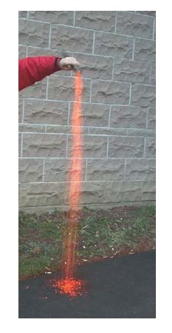
Physical Hazards …
Pyrophoric Solids/ Liquids means a solid liquid “which, even in small quantities, is liable to ignite within five minutes after coming into contact with air”.
  Mildly pyrophoric solids can be handled in the air for brief periods of time.
  One category for each
Notes:
The minimum temperature at which these liquids can ignite is below room temperature.

Slide 52
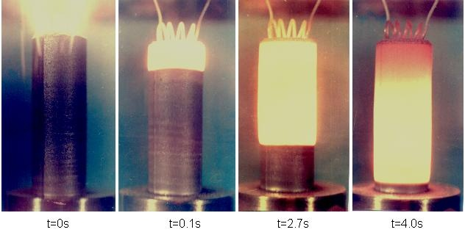

Physical Hazards …
Self-Heating Chemicals
  Solids or liquids, other than pyrophoric, which by reaction with air and without energy supply is liable to self heat. (Two categories)
  They require large amounts of material and long periods of time to ignite.
Notes:
52
These are not pyrophorics

Slide 53

Physical Hazards …
Chemicals which in contact with water, Emit Flammable Gas are solid or liquid chemicals which, by interaction with water, are liable to become spontaneously flammable or to give off flammable gases in dangerous quantities
  Divided into 3 categories

Slide 54
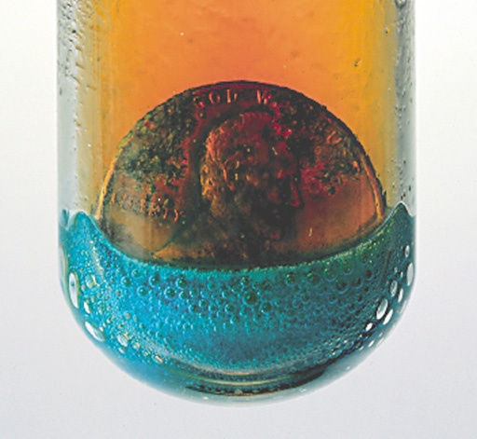

Physical Hazards …
Corrosive to Metals “means a chemical which by chemical action will materially damage, or even destroy, metals”
  One category.
Organic Peroxides
  Organic liquids or solids that can decompose explosively, burn rapidly, be sensitive to friction and react dangerously with other chemicals.
  7 categories similar to those in transport sector
Notes:
The categories are divided based upon material explosive properties. Peroxides can decompose in an explosive manner, burn rapidly, be sensitive to friction and react dangerously with other chemicals

Slide 55
GHS – Hazard Communication Tools
Labels

Slide 56
Label Components
    Product identifier
    Supplier identifier
    Chemical identity
    Hazard pictograms*
    Signal words*
    Hazard statements*
    Precautionary information - mandatory
  *Standardized Based on Appendixes

Slide 57

Product Identifier
States the identity of the chemical, including all the ingredients that contribute to the hazard of the mixture.
Unique means by which the chemical can be identified within the particular use setting.
Notes:
Name or number used for a hazardous product on a label and on the SDS.
UN proper shipping name should also be used on the package when the chemical (substance or mixture) is covered by the UN RTDG.

Slide 58
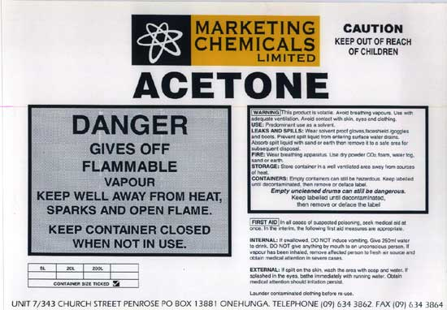
Supplier Information
Supplier Identification
Name, address and telephone number of the manufacturer or supplier of the hazardous chemical.
Notes:
58

Slide 59
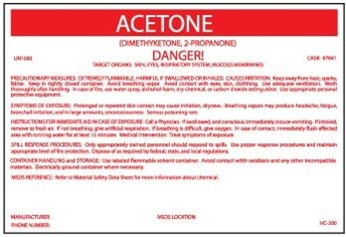
Chemical identity
A name that will uniquely identify a chemical.
For Substances
  Name as determined by IUPAC or CAS,
  or technical name as determined by ISO.
Notes:
IUPAC – International Union of Pure and Applied Chemistry
CAS – Chemical Abstract Service
ISO – International Organization for Standardization

Slide 60
Chemical identity
For Mixtures
  Identities of all ingredients contributing to health hazards, OR
  All ingredients that contribute to the hazard of the mixture.
Notes:
60
Identities of all ingredients contributing to
acute toxicity,
skin or eye corrosion,
germ cell mutagenicity,
carcinogenicity,
reproductive toxicity,
skin or respiratory sensitisation,

Slide 61
GHS - Pictograms
These are new…

Slide 62
Pictograms
Display health, physical and environmental hazard information.
New health hazard symbol.

Slide 63
Pictograms
Pictograms feature a white background with a red border instead of a solid orange background.
Harmful chemicals are marked with an exclamation mark.
Notes:
63

Slide 64





GHS Pictograms
Exploding bomb Explosives; Self Reactive; Organic Peroxides | Skull and Crossbones Acute toxicity (severe) | Flame Flammables; Pyrophorics; Self-Heating; Emits Flammable Gas; Self Reactive; • Organic Peroxides
Gas Cylinder Gases under pressure | Health Hazard Carcinogen; Mutagenicity; Reproductive Toxicity; Respiratory Sensitizer; Target Organ Toxicity; Aspiration Toxicity | Flame over circle Oxidizers
Corrosion Corrosives | Exclamation mark Irritant; Skin Sensitizer; Acute Toxicity (harmful); Narcotic effects; Respiratory Tract Irritant; Hazardous to Ozone Layer | Environmental Aquatic Toxicity (OSHA did not propose this pictogram)

Slide 65
Pictogram Shape & Colour
For transport, pictograms will not change
For other sectors, pictograms will have a black symbol on a white background with a red diamond frame.
For the same hazard, where a transport pictogram appears, the GHS pictogram should not appear.
Notes:
For transport, pictograms will have the background and symbol colors currently used.
For other sectors, pictograms will have a black symbol on a white background with a red diamond frame. A black frame may be used for shipments within one country. OSHA will maintain the red border.
The transport pictogram has precedence over the GHS pictogram if the same hazard is present

Slide 66






Transport Pictograms
Explosives Flammables
(class 1) (class 3, 4)
Gases Oxidizers
(class 2) (class 5)
Toxic Corrosives
(class 6) (class 8)
Notes:
These classes are similar to the ones seen in the previous slide, illustrating harmonization between systems

Slide 67
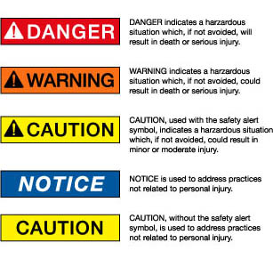
Signal Words
These words are used to alert the reader of health, physical, and environmental hazards, and the hazard’s level of severity
“Danger” and “Warning” are the only two signal words used.
Notes:
67
Words shown here are those used by the ANSI Z129.1 standard, American National Standard for hazardous Industrial Chemicals – Precautionary Labeling.
Danger – most harmful to person, because of toxicity or exposure, more severe or persistent effects
Warning - less harmful to person, lower levels of exposure or toxicity or temporary harmful effects
Lower levels of danger or exposure typically used “Caution” or “Notice” as the warning word
Studies showed people identify these words with different levels of risks or hazards, but saw little differences between the words Caution and Warning

Slide 68
Pause
Notes:
Take a moment to answer any questions of material discussed up to here. Make quick review on board

Slide 69

GHS - Hazard statements
… On the labels

Slide 70
Hazard Statements
GHS label should include appropriate hazard and precautionary information.
A hazard statement is a phrase assigned to a hazard class that describes the nature of the hazard, and its level of severity.
  “Highly Flammable,” “Unstable Explosive,” “Toxic if Inhaled”.
There are three types: Physical, Health and Environmental
Notes:
The hazard statements have codes associated to them. OSHA has not adopted the codes but has identified statements corresponding to each hazard class. Please refer to Appendix C of the proposed rule for more information.

Slide 71
Precautionary Information
Phrases indicate measures recommended to help minimize or prevent the effects resulting from exposure, improper storage or handling of hazardous products
Precautionary statements include provisions for storage, handling, response and disposal
Proposed Appendix C contains, among other information, statements recommended for each level of hazard within each hazard class.
Notes:
Take a moment to show example of Appendix C and how to read information given here.
The GHS document includes examples of precautionary statements which can be used. The intent is to harmonize precautionary statements in the future. As with hazard, precautionary statements, have codes which will not be adopted by OSHA.

Slide 72
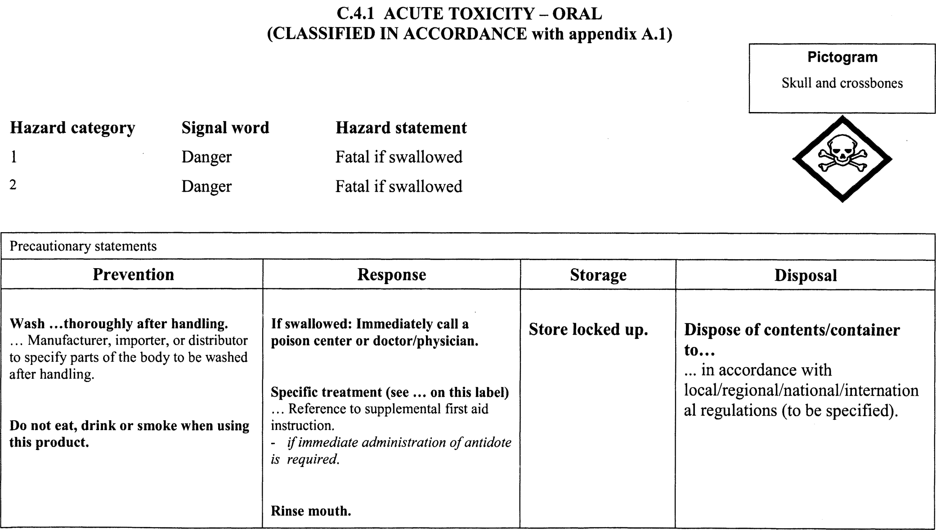
Appendix C

Slide 73
Precedence
Where a chemical is classified for a number of hazards, and the precautionary statements are similar, the most stringent shall be included on the label (this will be applicable mainly as preventive measures).
An order of precedence may be imposed by the manufacturer, importer or responsible party in situations where phrases concern “Response.”
Notes:
To reduce the variation of non-standardized information, supplementary information on the label is limited to when it provides further detail and does not contradict or cast doubt on the validity of the standardized hazard information, or when it provides precautionary information about unclassified hazards.
However OSHA recommends placing appropriate precautionary measures under the supplemental information of unclassified hazards.

Slide 74

GHS – Hazard Communication Tools: Safety Data Sheets
From MSDS to SDS

Slide 75
Role of the SDS in the GHS
Primary Use of SDS: The Workplace
Employers and workers use them as an information source about hazards of a chemical substance or mixture and to obtain advice on safety precautions.
SDS information can be used by those involved in the transport of dangerous goods and emergency responders.
Notes:
It’s information enables the employer to develop an active program of worker protection measures, including training specific to the workplace.

Slide 76
When is an SDS required?
An SDS should be produced for all chemicals (substances and mixtures) which meet the harmonized criteria for physical, health or environmental hazards under the GHS and …
For all mixtures which contain substances that meet the criteria for:
  Carcinogens,
  Toxic to reproduction or
  TOST in concentrations exceeding the cut-off limits specified by the criteria for mixtures.

Slide 77
Safety Data Sheet content
1. Identification
2. Hazard (s) identification
3. Composition/ information on ingredients
4. First-aid measures
5. Fire-fighting measures
6. Accidental release measures
7. Handling and storage
8. Exposure control/ personal protection
9. Physical and chemical properties
10. Stability and reactivity
11. Toxicological information
12. Ecological information
13. Disposal considerations
14. Transport information
15. Regulatory information
16. Other information
OSHA proposes sections 1-11 and 16 be mandatory
Not under OSHA jurisdiction

Slide 78

Global Harmonization System(GHS)
Exercises

Slide 79
Exercise on Pictograms
Determine the type of hazard based on the pictograms below
Notes:
Divide participants into small groups. Provide groups with reference information. Allow 10 minutes for exercise and discussion
Health – Carcinogen; Mutagenicity; Reproductive Toxicity; Respiratory Sensitizer; Target Organ Toxicity; Aspiration Toxicity
Crossbones – Acute toxicity
Exclamation - Irritant; Skin Sensitizer; Acute Toxicity (harmful); Narcotic effects; Respiratory Tract Irritant; Hazardous to Ozone Layer
Different hazards are identified with these pictograms

Slide 80
Exercise on Pictograms
Determine what pictogram would use the following chemical using the information provided
Material is extremely toxic to humans
Keep away from flames and sparks.
Corrosive to metals
Notes:
80
Skull and crossbones - toxic
Flame - flammable
Corrosion

Slide 81
Exercise on Hazards
Determine the type of precautionary statement (prevention, response, storage, disposal) of these materials given the following information
Wear cold insulating gloves
Dispose of contents in accordance with local regulations
If exposed: call poison center or doctor/ physician
Stored in a well ventilated place
Notes:
81
Wear cold insulating gloves - handling
Dispose of contents in accordance with local regulations - disposal
If exposed: call poison center or doctor/ physician - response
Stored in a well ventilated place - storage

Slide 82
Data Sheets Exercise
Using the data sheet provided, identify in which section of the data sheet you can find the following
  Health effects
  Flammability of material
  Storage precautions
  Toxicity of material
  Material identity
Notes:
Section 4 – First aid supplemented by section 2
Section 9 – Physical and chemical properties
Section 7 – Storage and handling
Section 11 - Toxicological information
Section 1 – Identification

Slide 83
Labels Exercise
With the information provided for each chemical, identify the following elements of the label. Please reference Appendix C
  Pictogram
  Signal words
  Hazard statements
  Precautionary statement
Notes:
Divide the participants into small groups and provide them with Appendix C. Indicate the name and hazard classification (heath/ physical) for the selected chemical. Instruct participants to fill out the label template.
SDS for the following Chemicals are available
Manufacturing sector – pesticides such as Aldrin, Malathion (toxic), solvents like Toluene, Xylene, (flammable)
Service sectors – solvent such as Acetone Turpentine (toxic, flammable) , Formaldehyde (toxic), PCB’s, Wax floor (irritants), cleaners such as Clorox, Lysol (corrosives),
Participants are expected to correctly identify in Appendix C the reference information for the corresponding hazard category. Allow 15 minutes for exercise and discussion.

Slide 84

Proposed changes to HCS
Old vs. new….

Slide 85
Current rule
Current HAZCOM standard rule
  (a) Purpose
  (b) Scope and Application
  (c) Definitions
  (d) Hazard Determination
  (e) Written Hazard Communication Program
  (f) Labels and Other Forms of Warning
  (g) Material Safety Data Sheets
  (h) Employee Information and Training
  (i) Trade Secrets
  (j) Effective Dates
  Appendices A - E

Slide 86
Current rule to be revised
Appendices
Appendix A (mandatory) – Health hazards definitions
Appendix B (mandatory) – Hazard determination
Appendix C (advisory) – Information sources [removed 1996]
Appendix D (mandatory) – Trade secret definition
Appendix E (advisory) – Compliance guidelines

Slide 87
Organization of the new rule
(a) Purpose
(b) Scope and Application
(c) Definitions
(d) Hazard Classification
(e) Written Hazard Communication Program
(f) Labels and Other Forms of Warning
(g) Safety Data Sheets
(h) Employee Information and Training
(i) Trade Secrets
(j) Effective Dates
Appendices A -F

Slide 88
… new rule
Appendices
Appendix A (mandatory) – Health hazards criteria
Appendix B (mandatory) – Physical Hazard criteria
Appendix C (mandatory) – Allocation of Label Elements
Appendix D (mandatory) – Safety Data Sheets
Appendix F (non mandatory) - Guidance for Hazard Classifications Re: Carcinogenicity
Appendix E (mandatory) – Definition of "Trade Secret"

Slide 89
Proposed changes
Basic Framework will not change
  The scope and application is basically unchanged
  Minimum changes to written program requirements, worker training, and trade secret provisions
Changes from performance oriented to specification standard using standard criteria
Notes:
Scope and Application will not change, since all current exemptions will apply, and no testing is required
The change is from a performance-oriented to a specification standard and affects mainly
Hazard Classifications
Includes a detailed and specific approach to the hazard classification step providing defined Hazard classes
Introduces the concept of severity of response in the criteria
Most of these hazard classes are also sub-divided into “hazard categories” to reflect the degree of severity of the effect
Labels format and
Safety Data Sheet format

Slide 90
Section comparison
Where are the changes

Slide 91
Purpose
(a) Purpose
  The primary modification to this paragraph is to state affirmatively that part of the purpose is to harmonize with international requirements..
  The word evaluation was substituted with classification to be consistent with GHS provisions

Slide 92
Scope and Application
(b) Scope and Application
  No substantive changes are proposed, only terminology changes in accordance with GHS
    Hazard determination changed to hazard classification
    Use of word classify , in lieu of assess
    MSDS are changed to Safety Data Sheets
  Elimination of Appendix E reference

Slide 93
Definitions
(c) Definitions
  OSHA has changed a number of the definitions, as well as the actual terms used, to be consistent with the GHS.
  The terms removed from this section are generally relevant primarily to the hazard classification process which are defined in Appendices A (Health hazards) and B (Physical hazards).
Notes:
Added the following definitions: Classification, Hazard category, Hazard class, Hazard statement, Label elements, Pictogram, Precautionary statement, Product identifier, Safety data sheet, Signal word, Substance, and Unclassified hazard.
Deleted the following definitions: Combustible liquid, Compressed gas, Explosive, Flammable, Flashpoint, Hazard warning, Identity, Material safety data sheet, Organic peroxide, Oxidizer, Pyrophoric, Unstable (reactive), and Water-reactive.
Revised the following definitions: Chemical, Chemical name, Hazardous chemical, Health hazard, Label, Mixture, and Physical hazard, Trade secrets.

Slide 94
Definitions : Health Hazards
Health hazards are assigned to Appendix A of the proposed rule
Appendix A begins with an introduction that includes information related to the principles of classification from GHS chapter I
Definitions and specific classification criteria from GHS chapter 3 is discussed
Notes:
Definitions have either been modified or adopted to be consistent with GHS

Slide 95
Definitions: Physical Hazards
Physical hazards are assigned to Appendix B of the proposed rule
Appendix B begins with an introduction that includes information related to the principles of classification from GHS chapter 2
Definitions and specific classification criteria were adopted to be consistent with GHS

Slide 96

GHS- Hazard classification
How to determine hazard…

Slide 97
Proposed changes
(d) Hazard Classification
  Appendixes A and B covers extensively criteria for health and physical hazards respectively
  OSHA has included the general provisions for hazard classification in paragraph (d) of the revised rule, and added extensive appendixes that address the criteria for each health or physical effect.
  The hazard classification criteria contained in the HCS proposal is test method- neutral. That is, the person classifying a chemical should use available data and no additional testing is required to classify a chemical.
Notes:
GHS has specific criteria for each health and physical hazard, along with detailed instructions for hazard evaluation and determinations as to whether mixtures of chemicals is covered.

Slide 98
Hazard statements
Hazard information contained in Appendix C of the proposed rule, for each hazard class:
    the pictogram,
    signal word,
    the proposed hazard statement
      Health or Physical
    the proposed types of precautionary statements
      Prevention, Response, Storage, Disposal
Notes:
Chemical manufacturers and importers must classify each chemical they produce or import:
OSHA proposed to add a supplemental hazard class called “unclassified hazard”.
Includes any other hazard otherwise not classified such as combustible dusts and asphyxiant hazard

Slide 99
Hazard statements
The text of all applicable hazard statements shall appear on the label, except as otherwise specified.
Hazard statements may be combined where appropriate to reduce the information on the label and improve readability, as long as all of the hazards are conveyed as required.
Notes:
The information in italics shall be included as part of the hazard statement as provided.
For example: “causes damage to organs (state all organs affected) through prolonged or repeated exposure (state route of exposure if no other routes of exposure cause the hazard)”.
[“causes damage to liver and pancreas through prolonged or repeated exposure by inhalation or ingestion]
When a backslash or diagonal mark [/] appears in the precautionary statement text, it indicates that a choice has to be made between the separated phrases
For example, “Keep away from heat/sparks/open flame/ hot surfaces ”.
[ “Keep away from hot surfaces]
When three full stops […] appear in the precautionary statement text, they indicate that all applicable conditions are not listed.
For example, in “Use explosion-proof electrical/ventilating/lighting/.../equipment”, the use of “...” indicates that other equipment may need to be specified, by the manufacturer, importer, or responsible party.
When text in italics is used in a precautionary statement, this indicates specific conditions applying to the use or allocation of the precautionary statement
For example, “Use explosion-proof electrical/lighting/.../equipment” is only required for flammable solids “if dust clouds can occur”.
Text in italics is intended to be an explanatory, conditional note and is not intended to appear on the label..

Slide 100
Hazard Statements
Where the manufacturer, importer, or distributor chooses to add supplementary information on the label, the placement of such information shall not interfere with information required by this section.
Notes:
Where an ingredient with unknown acute toxicity is used in a mixture at a concentration > 1%, a statement that × percent of the mixture consists of ingredient(s) of unknown toxicity is required on the label

Slide 101
Proposed labels, safety data sheets and training
Written program elements…

Slide 102
Proposed changes
(e) Written Hazard Communication Program
  The GHS does not have provisions regarding hazard communication programs, and thus this paragraph is essentially the same as in the current HCS. No substantive (only terminology) changes have been made in this paragraph of the HCS.
  Key elements of this program are labels, safety data sheets and employee training

Slide 103

Proposed changes
(f) Labels and Other forms of Warning
  Under this paragraph, chemical manufacturers and importers must provide a label that includes a harmonized signal word, pictogram, and hazard and precautionary statements for each hazard class and category. In addition, precautionary statements must also be provided, as well as product identifier and supplier information.

Slide 104
Proposed changes
(f) Labels and Other forms of Warning
  New mandatory Appendix C indicates what specific information is to be provided for each hazard class and category once a chemical is classified.
  OSHA will require the use of pictograms, specific signal words, hazard and precautionary statements in accordance with GHS provisions
Notes:
These proposed requirements are significantly different from the existing HCS, which allows chemical manufacturers to use the language they believe is appropriate to convey hazards.
The existing HCS does not require the use of pictograms, specific signal words, hazard and precautionary statements. The proposal’s approach will both improve communication aspects of the label, and facilitate compliance by providing the specific information to be included based on the hazard classification.
The GHS uses nine pictograms to convey the health, physical, and environmental hazards. The proposed HCS requires eight of these pictograms, the exception being the environmental pictogram, since environmental hazards are not within OSHA’s jurisdiction.

Slide 105

Preparing the label
10 Health Hazard Classifications Appendix A
16 Physical Hazard Classifications Appendix B
Designation of Categories of Hazard
Determines Label Elements
Pictogram – Hazard Statement – Signal Word - Precautionary Statements
Once a chemical has been classified, the label preparer can obtain the relevant harmonized information from Appendix C for the label

Slide 106
Notes:
106

Slide 107
Workplace label example
Example GHS Inner Container Label (e.g., bottle inside a shipping box)
ToxiFlam (Contains: XYZ)
Danger! Toxic If Swallowed, Flammable Liquid and Vapor
Do not eat, drink or use tobacco when using this product. Wash hands thoroughly after handling. Keep container tightly closed. Keep away from heat/sparks/open flame. - No smoking. Wear protective gloves and eye/face protection. Ground container and receiving equipment. Use explosion-proof electrical equipment. Take precautionary measures against static discharge.
Use only non-sparking tools. Store in cool/well-ventilated place.
IF SWALLOWED: Immediately call a POISON CONTROL CENTER or doctor/physician. Rinse mouth.
In case of fire, use water fog, dry chemical, CO₂, or "alcohol" foam.
See Safety Data Sheet for further details regarding safe use of this product.
MyCompany, MyStreet, MyTown NJ 00000, Tel: 444 999 9999

Slide 108
Proposed changes
(g) SDS…
  Found in proposed Appendix D, changes include a 16 section format with specific information contained in each section. Sections 1-11, 16 are mandatory
  Section 1. Identification: The requirements in this section are not new with two exceptions. The format and the requirement to identify recommendations for use of the chemical and restrictions on use are new.
Notes:
This format is the same as the ANSI standard on safety data sheets, which is already familiar to U.S. employers.
The current HCS requires similar information, but allows any format to be used. A uniform approach will improve the effectiveness of the safety data sheet, as well as making it easier for employers to comply

Slide 109
Proposed changes
(g) SDS…
  Section 2. Hazard(s) identification: employer must identify the hazards by means of a hazard determination, and must classify a hazardous chemical according to the changed conditions provided in proposed Appendices A and B.
  A separate SDS will be required for each mixture rather than one for each chemical comprising the mixture
  Pictograms, standardized hazard statements, signal words, and precautionary statements are now required.

Slide 110

Proposed changes
(g) SDS…
  Section 3. Composition/ information on ingredients. No new requirements other than format and the requirement that a separate SDS will be required for each mixture rather than one for each chemical comprising the mixture
  Section 10. Stability and reactivity. Although the information on conditions to avoid and hazardous decomposition products are new to HCS, it has been required in the ANSI Z400.1 standard.

Slide 111
Proposed changes
(g) SDS…
  Sections contain no new requirements , only format
  Section 4. First-aid measures.
  Section 5. Fire-fighting measures.
  Section 6. Accidental release measures.
  Section 7. Handling and storage.
  Section 8. Exposure controls /Accidental release measures.
  Section 9. Physical and chemical properties.
  Section 11. Toxicological information
  Section 16. Other information

Slide 112
Proposed changes
(g) SDS…
  To be GHS-compliant in the SDS, the requirements for these sections are provided but compliance is outside of OSHA jurisdiction.
  Section 12. Ecological information
  Section 13. Disposal considerations
  Section 14. Transportation information
  Section 15 Regulatory information
  These are all Non mandatory sections.
Notes:
Section 15. Regulatory information (Non-mandatory). To be GHS-compliant the requirements for this section are provided, but compliance is outside of OSHA jurisdiction. However, OSHA has asked for comment on whether it should require reference in this section to OSHA standards governing the use of the product in the workplace.

Slide 113
Proposed changes
(h) Employee Information and Training
  Indicates that the new label and data sheet formats and presentation of information must be discussed in training. To make sure information is comprehensible
  All employers will be required to conduct additional training to ensure that their employees are familiar with the standardized labels and safety data sheets.
  Other training provisions remain the same.
Notes:
Training discusses the details of the HCS program provided by employer including explanation of labels received on shipped containers and workplace labeling system used by employer, the SDS including the order information and how the employees can obtain and use hazard information

Slide 114
Proposed changes
(i) Trade Secrets
  The proposal includes few changes from the existing standard.
  The GHS requires disclosure of the percentage composition of mixtures on the SDS. The proposal adopts this requirement, but allows the manufacturer to claim trade secret protection for this requirement, only if worker safety is maintained and the provisions of trade secret are followed.

Slide 115

Proposed changes
(j) Effective Dates
  OSHA is proposing that all of the revised provisions in the proposed HCS become effective in three years.
  Training is being required in 2 years after the effective date (completion of final rule) , so employers and employees will recognize and understand the new labels and safety data sheets as they are received.

Slide 116

Approach to Other Standards
Many other OSHA standards contain criteria related to defining hazards, as well as other provisions that rely on those criteria
OSHA undertook a comprehensive review of its rules to identify what needed to be changed
OSHA has proposed modifications to all of those standards that it determined needed to be consistent with the GHS

Slide 117
Other OSHA Standards
1926.152 Flammable and Combustible Liquids.
All substance specific standards that contain a generic hazard communication statement.
1910.119 Process Safety Management Standard
1910.1450 Occupational Exposure to Hazardous Chemicals in Laboratories
Notes:
Harmonizing the definitions of flammable liquids with GHS definitions.
Removing the term combustible liquid.
Maintaining scope by combining flashpoint cutoffs with the GHS categories
Specific standards affected are 1910.1001, 1910.1003-1015, 1910.1017-1018, 1910.1025-29, 1910.1043-1050 for general industry
Specific standards affected are 1926.60, 1926.62, 1926.1101, 1926.1127 for construction

Slide 118

Global Harmonization System(GHS)
Summary and References

Slide 119
Why does OSHA needs it?
OSHA’s Hazard Communication Standard (HCS) has performance-oriented requirements for labels and safety data sheets, producing inconsistencies in the communication of the hazard
A standardized approach for labels and safety data sheets is preferred. Adoption of the GHS will address this domestic concern and also align OSHA with DOT’s Hazard Criteria

Slide 120
Proposed rule
Under the proposed rule, the hazard determination requirements are not performance-oriented.
  Definitions section, Appendix A and B provide information for health and physical hazard determination
The proposed rule uses the GHS concept of “classification” instead of determination of a hazardous effect .
  Appendix C provides hazard criteria for classification
Notes:
OSHA proposes to adopt the GHS hazard classes except for the following categories:
Acute toxicity: Category 5
Corrosion/irritation: Category 3
Aspiration hazard: Category 2
The environmental category is not included

Slide 121
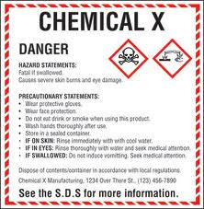
Proposed changes
Hazard classification: Provides specific classification criteria for health and physical hazards, for chemicals (substances / mixtures).
Labels: Chemical manufacturers and importers will be required to provide a label that includes a harmonized signal word, pictogram, and hazard statement for each hazard class and category. Precautionary statements must also be provided.

Slide 122

Label Modifications
!
Pictograms
Two Signal Words
  Danger
  Warning
Hazard statements
Precautionary statements
OSHA maintains the approach in the current HCS that allows employers to use workplace-specific labeling systems as long as they provide the required information and make sure the information is consistent with the new classifications. However workplace label system must be maintained up to date, be prominently displayed in English and other appropriate language
Notes:
A pictogram consists of a hazard symbol surrounded by a red square set at a point. The pictograms may look familiar, as they have symbols that are taken from the Transport sector.
There are three new pictograms the exclamation point, an attention getter, the dead tree and fish for environmental hazards and the “star man” for health hazards.
Line 1 pictograms: Skull and Crossbones, Flame, Gas cylinder, Exclamation mark,
Line 2 pictograms: Health Hazard, Flame over circle, Corrosion, Exploding bomb
Environment, not adopted
A hazard statement is a phrase assigned to a hazard class and category that describes the nature of hazards of a hazardous product, including, where appropriate, the degree of hazard. A signal word is a word used to indicate the relative level of severity of hazard and alert the reader to a potential hazard on the label.

Slide 123


Proposed changes
Safety Data Sheets: Will now have a specified 16-section format. Revisions every 3-5 years
Information and training: The proposed standard will require that workers are trained within two years of the publication of the final rule to facilitate recognition and understanding of the new labels and safety data sheets.
Notes:
OSHA is proposing to adopt the SDS format (ANSI model) where sections 1 -11 and section 16 be mandatory and sections 12 -15 would be non-mandatory
MSDS revisions every 3-5 years
Appendix D, Safety Data Sheets, provides the details of what is to be included in each section
Required information:
Chemicals recommended use & restrictions
GHS class and classifications of the substances & mixtures and any regional information
GHS labeling elements
CAS # of hazardous components and impurities
The criteria for MSDS component disclosure also differs between the two systems. The level of hazardous components can be given as ranges or concentrations under GHS, whereas the HCS specifies percentages.

Slide 124
How does this affect the workplace
Employers
  Initial employee training on pictograms, signal words, hazard and precautionary statements
  Minimal training on new SDS format
  Continue to maintain the updated SDS. Update within 3 months of new and significant information
For manufacturers
  Initial start-up costs associated with reclassification, producing new labels, safety data sheets, training.

Slide 125
Benefits of Harmonization
Benefits for users and producers of chemicals, countries, and international organizations.
  Enhance protection of humans and environment.
  Facilitate chemical international trade.
  Reduce duplicate testing and evaluation.
  Aid countries and international organizations in the proper handling of chemicals.
Notes:
Costs
Management Familiarization
One-time employee training
Reclassifying chemicals, revising SDSs and labels
Benefits
Reduce confusion/Increase comprehension of hazards
Better downstream risk management
Facilitates training
Helps address literacy problems
Other benefits include facilitation of international trade in chemicals
Costs
(1) OSHA estimates that the cost of classifying chemical hazards in accordance with the GHS criteria and revising safety data sheets and labels to meet new format and content requirements will be a total of $11 million a year on an annualized basis.
(2) OSHA estimates that training for employees to become familiar with new warning symbols and the revised safety data sheet format under GHS will cost a total of $44 million a year on an annualized basis.
(3) Although not a requirement in the proposed rule, OSHA estimates annualized costs of $42 million a year for management to become familiar with the new GHS system and to engage in other management-related activities such as coordinating changes to a company’s hazard communication program, as necessary, to facilitate adoption of GHS.
Benefits
(1) Using a harmonized approach will lessen the amount of time that manufacturers need to produce SDSs in future years. (Annualized cost savings: an estimated $16 million a year.)
(2) Personnel in the manufacturing sector whose job function involves the use of SDSs or the movement of hazardous chemicals will improve their productivity as a result of the proposed rule. (Annualized cost savings: an estimated $569 million a year.)
(3) Providing training to new employees as required by the existing OSHA HCS will be simplified and take less time as a result of the standardized label elements and consistent SDS formatting under GHS. (Annualized cost savings: not estimated.)
(4) For firms engaging in, or considering engaging in, international trade, a harmonized system for hazard classification and labeling will reduce the amount of time required to prepare labels and SDSs for other countries and will generally increase trade opportunities. (Annualized international trade benefits: not estimated.)

Slide 126
OSHA’s Rulemaking
OSHA published the Proposed rule in the Federal Register on September 30, 2009 (74 FR 50280-50549)
Companies will have:
  2 years to implement training requirements
Manufacturers, Suppliers, Distributors
  3 years from final rule to come in compliance
Approved State Plans
  6 months from final rule to adopt provisions

Slide 127

Additional Information
OSHA’s website on GHS
  http://www.osha.gov/dsg/hazcom/global.html
UN Website
  http://www.unece.org/trans/danger/publi/ghs/ghs_welcome_e.html

Slide 128

HAZCOM- GHS
?

Slide 129
