Slide 1
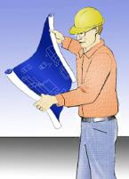

Competent Person Program
Applied to Fall Protection:
Managing A Fall Protection Competent Person Program
7.5-hour
University of Medicine & Dentistry of New Jersey (UMDNJ)
School of Public Health (SPH)
Office of Public Health Practice (OPHP)
Copyright © 2012
UMDNJ School of Public Health
All rights reserved

Slide 2
Federal Disclaimer
This material was produced under grant number SH-22313-11-60-F-34 from the Occupational Safety and Health Administration, U.S. Department of Labor. It does not necessarily reflect the views or policies of the U.S. Department of Labor, nor does mention of trade names, commercial products, or organizations imply endorsement by the U.S. Government.

Slide 3
Competent Persons Introduction
The term "Competent Person"
Defined as "one who is capable of identifying existing and predictable hazards in the surroundings or working conditions which are unsanitary, hazardous, or dangerous to employees, and who has authorization to take prompt corrective measures to eliminate them.
There are currently no specific standards regarding competent persons.
How then do employers know who is or can be a Competent Person?

Slide 4
Construction superintendent sentenced for willful disregard of OSHA safety standards following worker's death
Robert Christopher Kennedy has been sentenced in U.S. District Court for the Western District of Pennsylvania to six months of house arrest and three years of probation for willfully endangering workers at a Washington County, Pa., construction site. Kennedy's intentional disregard for OSHA's safety standards contributed to the fatal fall of Carl Beck from a 40-foot pitched roof in August 2009.
Mr. Kennedy was the superintendent for Hospitality Builders, the general contractor on the worksite where the fatality occurred. His guilty plea follows the 2010 sentencing of Beck's employer, Christopher Franc, who was on the roof when the worker fell. Investigators found that immediately after Beck's death, Kennedy told Franc to put fall protection equipment on the roof to mislead OSHA investigators into believing that the gear was in place before the fall. In 2010, OSHA cited Franc's construction company for 10 per instance willful citations for failing to protect workers from falls, for a proposed fine of $539,000

Slide 5
Rights and Responsibilities
The Occupational Safety and Health Act of 1970: “General Duty Clause”
5. General Duties
(a) Each employer
(1) shall furnish to each of his employees employment and a place of employment which are free from recognized hazards that are causing or are likely to cause death or serious physical harm to his employees;
(2) shall comply with occupational safety and health standards promulgated under this Act.
(b) Each employee shall comply with occupational safety and health standards and all rules, regulations, and orders issued pursuant to this Act which are applicable to his own actions and conduct.

Slide 6
Rights and Responsibilities: Training
1926.21 Safety training and education (Subpart C)
General requirements. The Secretary shall, pursuant to section 107(f) of the Act, establish and supervise programs for the education and training of employers and employees in the recognition, avoidance and prevention of unsafe conditions in employments covered by the act.
(b) Employer responsibility.
(1) The employer should avail himself of the safety and health training programs the Secretary provides.
(2) The employer shall instruct each employee in the recognition and avoidance of unsafe conditions and the regulations applicable to his work environment to control or eliminate any hazards or other exposure to illness or injury.

Slide 7
Rights and Responsibilities: Fall Protection Training
1926.503 Training requirements (Subpart M)
(a) Training Program.
(1) The employer shall provide a training program for each employee who might be exposed to fall hazards. The program shall enable each employee to recognize the hazards of falling and shall train each employee in the procedures to be followed in order to minimize these hazards.
(2) The employer shall assure that each employee has been trained, as necessary, by a competent person qualified in the following areas….
(b) Certification of training.
(1) The employer shall verify compliance with paragraph (a) of this section by preparing a written certification record. The written certification record shall contain the name or other identity of the employee trained, the date(s) of the training, and the signature of the person who conducted the training or the signature of the employer.
(c) Retraining. When the employer has reason to believe that any affected employee who has already been trained does not have the understanding and skill required by paragraph (a) of this section, the employer shall retrain each such employee.

Slide 8
Most Frequently Cited in 2010
1. 1926.451 – Scaffolding - (same rank as 2009) - 9,093 violations - Scaffold accidents most often result from the planking or support giving way, or from the employee slipping or being struck by a falling object.
2. 1926.501 – Fall Protection - (same rank as 2009) - 6,771 violations - Any time a worker is at a height of four feet or more, the worker is at risk and needs to be protected. Fall protection must be provided at four feet in general industry, five feet in maritime and six feet in construction.
3. 1910.1200 – Hazard Communication - (same rank as 2009) - 6,378 violations - Chemical manufacturers and importers are required to evaluate the hazards of the chemicals they produce or import, and prepare labels and safety data sheets to convey the hazard information to their downstream customers.
4. 1910.134 – Respiratory Protection - (same rank as 2009) - 3,803 violations - Respirators protect workers against insufficient oxygen environments, harmful dusts, fogs, smokes, mists, gases, vapors and sprays. These hazards may cause cancer, lung impairment, other diseases or death.
5. 1926.1053 – Ladders - (was #7 in 2009) - 3,072 violations - Occupational fatalities caused by falls remain a serious public health problem. The US Department of Labor (DOL) lists falls as one of the leading causes of traumatic occupational death, accounting for eight percent of all occupational fatalities from trauma.

Slide 9
Competent Person Models and Benchmarking
Best practices are means and methods that have proven themselves in the marketplace, business or government to achieve some beneficial end. Best Practices often bring about higher levels of compliance than codes or minimal standards prescribe. In business there exists a technique referred to as benchmarking where companies look around at other more successful companies and strive to follow the more successful models. Provide a means of comparison against existing polices, practices and procedures.

Slide 10
Are there any risks of falls on our jobsites?
Have there been any fall related accidents or citations?
Does the company have a Fall Protection Program that fits the tasks employees regularly perform?
What Equipment does the company use?
What do other companies do to protect workers from falls.
Is our workforce trained and do they follow their training in the field?
What are the attitudes and aptitudes of employees?
Assess
Can we eliminate fall hazards by prefabrication or substitution?
Fall Protection Equipment
Job specific Subpart M training
Write Fall Program
Create Fall Protection Field Checklists, Form, templates.
Rescue Equipment
Write recordkeeping harness inspection logs, safe work plan templates and pre-task surveys.
Designate Competent Persons organization structure.
Control
Consultant
&
Committee
Review
Trials
Benchmark
Perform Subpart M Training
Competent Person Training
Create Toolbox Talks
Hands-on Harness Training
Guardrail systems training
Employee’s role in fall plan
Practice Rescue Drills
Safety & Health Bulletins
Train
Test Runs
Competent
Person
Review
Implement
Perform frequent and regular inspections of sites.
Review Competent Person daily pre-task inspections of fall protection controls.
Frequent communications with fall protection competent persons.
End of week employee fall protection debriefings
Accident or incident investigations
Monitor
Sample Fall Protection System

Slide 11
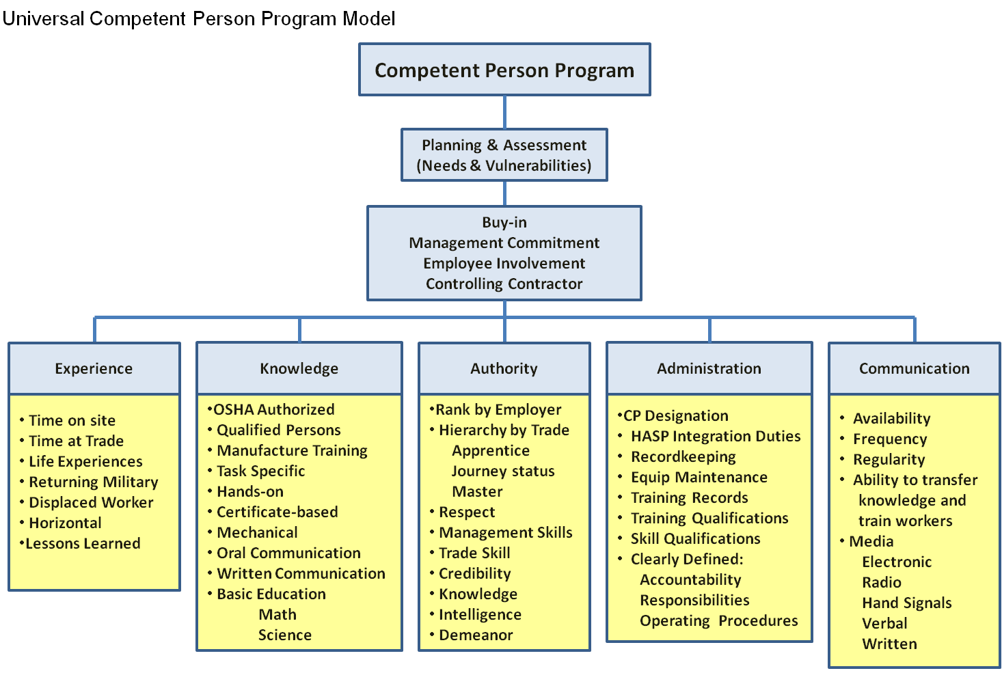
Universal Competent Person Program Model

Slide 12
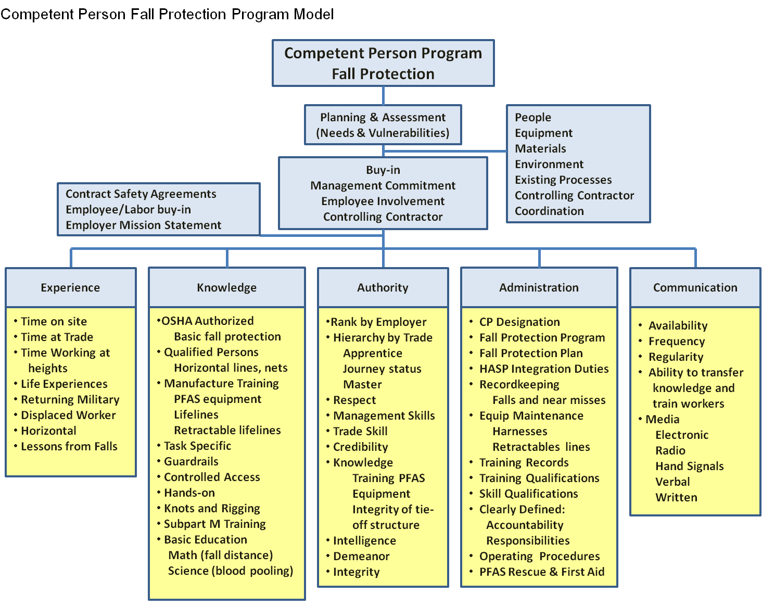
Competent Person
Fall Protection
Program Model

Slide 13
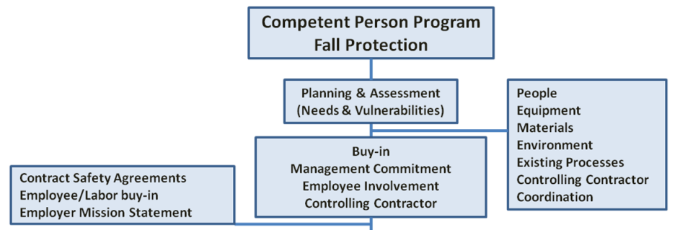
Competent Person
Fall Protection
Program Mode
Management
Structure

Slide 14
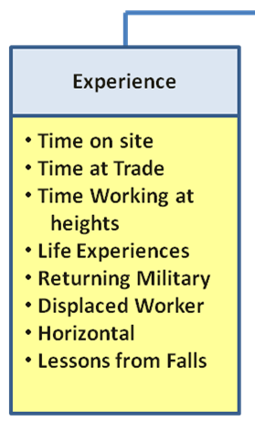

Slide 15
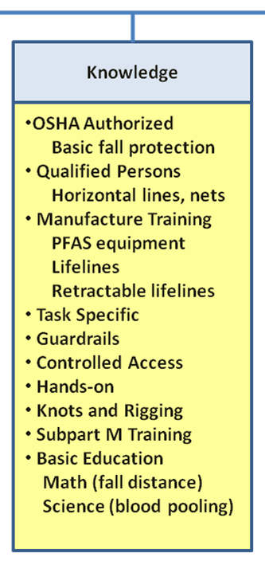

Slide 16
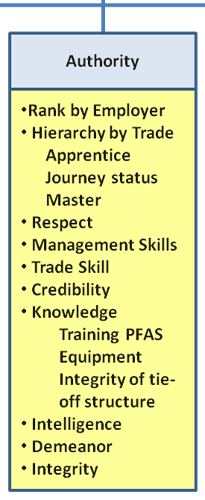

Slide 17
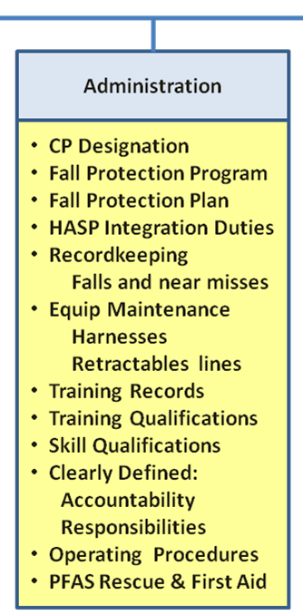

Slide 18
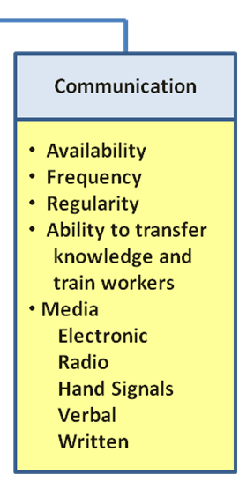

Slide 19
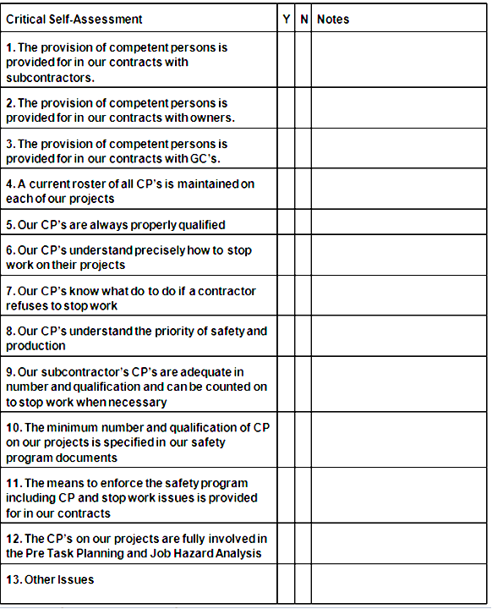
x
x
x
x
x
x
x
x
x
x
x
x

Slide 20
Fall Protection Fatal Facts

Slide 21
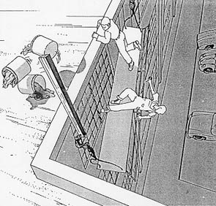
ACCIDENT SUMMARY No. 14
A BRIEF DESCRIPTION OF ACCIDENT
Two employees were painting the exterior of a three-story building when one of the two outriggers on their two-point suspension scaffold failed. One painter safely climbed back onto the roof while the other fell approximately 35 feet to his death. The outriggers were inadequately counterweighted with three 5-gailon buckets containing sand and were not secured to a structurally sound portion of the building. Neither painter was wearing an approved safety belt and lanyard attached to an independent lifeline.
INSPECTION RESULTS
As a result of its investigation, OSHA issued citations for five serious and two other than serious violations of its construction standards. OSHA's construction safety standards include several requirements which, if they had been followed here, might have prevented this fatality.

Slide 22
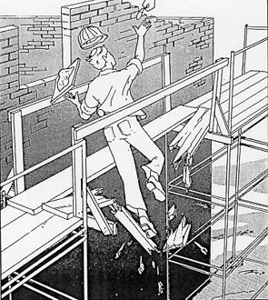
ACCIDENT SUMMARY No. 27
BRIEF DESCRIPTION OF ACCIDENT
A crew laying bricks on the upper floor of a three-story building built a six-foot platform spanning a gap between two scaffolds. The platform was correctly constructed of two 2" × 12" planks with standard guardrails; however, one of the planks was not scaffold grade lumber and also had extensive dry rot in the center. When a bricklayer stepped on the plank it disintegrated and he fell 30 feet to his death.
INSPECTION RESULTS
As a result of its investigation, OSHA issued a citation alleging two serious violations of its standards. Had OSHA construction safety standards been followed, this fatality might have been prevented.

Slide 23
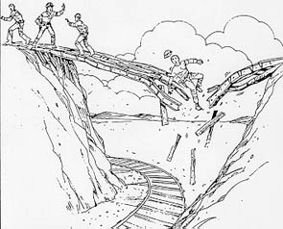
ACCIDENT SUMMARY No. 47
BRIEF DESCRIPTION OF ACCIDENT
Three employees, under their supervisor's guidance, were demolishing a vehicular bridge 23 feet above a railroad track. The railroad was anxious to have the job completed as quickly as possible because soil erosion and disintegration of structural members had caused the bridge to shift. At the time of the accident the central flooring had been removed and two workers were on the remaining wooden walkway when they felt the bridge move. The supervisor noticed the movement also and called to both men to get off the bridge. One worker ran to safety, but the other froze and fell with the bridge when it collapsed. He died 11 days later. No engineering survey was undertaken to determine safe methods for demolition [29 CFR 1926.850(a)].
INSPECTION RESULTS
Following its inspection OSHA cited the employer for one serious violation for failing to conduct an engineering survey of the structure before permitting employees to begin work.

Slide 24
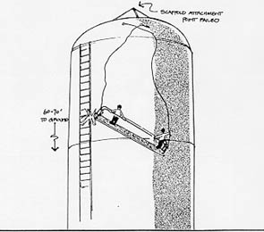
ACCIDENT SUMMARY No. 56
BRIEF DESCRIPTION OF ACCIDENT
Two employees were sandblasting a 110 foot water tank while working on a two-point suspension scaffold 60-70 feet above the ground. The scaffold attachment point failed, releasing the scaffold cables, and the scaffold fell to the ground. The employees were not tied off independently, nor was the scaffold equipped with an independent attachment system.
INSPECTION RESULTS
As a result of the investigation, OSHA issued a serious citation for eight violations and five other violations.

Slide 25
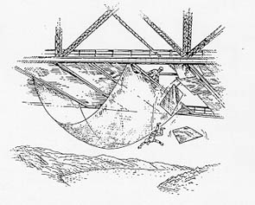
ACCIDENT SUMMARY No. 66
A BRIEF DESCRIPTION OF ACCIDENT
An employee had placed metal bridge decking onto the stringers of the bridge deck to be welded. When the first decking was placed down on the stringers, the employee apparently stepped onto the decking that he had just placed down in order to put down the next decking. The decking the employee stepped onto was not secured in place, resulting in the employee falling approximately 80 feet into the river. Safety nets were being used under another section of the bridge but had not been moved forward as the crew moved to another area.
INSPECTION RESULTS
As a result of its investigation, OSHA issued a serious citation for the alleged violations of 29 CFR 1926.105(a) and 1926.106(a).

Slide 26
Effectively Using Competent Person Training
150 explicit OSHA regulatory references requiring training
  Have full management commitment
  Be relevant to the trainees day-to-day activities.
  Affect the trainee’s behavior in the workplace.
  Stimulate the trainees to think critically.
  Be interesting to engage discussion and increase saturation.
  Teach principles, procedures and the nature of various hazards.
  Demonstrate the “whole picture” and an employee’s context within.
  Allow ample time for adult trainees to practice.
  Create documentation of training.
  Make sure the environment for field training is conducive to learning.
  Allows for questions and elaborations (means of evaluation).
  Gauge saturation of information (means of evaluation).
  Skews “general” advise to specific tasks at hand.
  Reinforces the principles of such talks by example.
  Have a means of evaluation.

Slide 27
“Toolbox talks”
Stress recognition and avoidance of unsafe conditions.
Reinforcing employee.
Focus on what is important and or mandatory.
Have a structured format:
  Introductory statement
  Guided discussion
  Provide for follow up questions
Note: For tracking, recordkeeping, disciplinary or even legal purposes, many companies utilize employee “sign-in sheets” that provide acknowledgement that they have received the training and the instructor (competent person or qualified person) also acknowledged that he/she has presented the toolbox talk or training.

Slide 28
Competent Person: Structured Skills Training
Graduated progression based on training and experience,
Occupational mentoring
Establish a clear delineated path consisting of any combination of training and experience that provides the required knowledge, skills, and abilities for workers to perform certain tasks and use certain equipment.
Established several task statements for each level of ability.
Provide a means of assessing ability level, i.e.: skills testing, performance based testing and time working alongside a mentor using certain materials, equipment or energy sources.

Slide 29
1926.502 (d) Personal fall arrest systems (20) The employer shall provide for prompt rescue of employees in the event of a fall or shall assure that employees are able to rescue themselves.

Slide 30
Competent Person Guided Practice, Drills, Fall Arrest Protection Rescue
A plan of action is refined, improved and made easier to execute by practicing through drills.
emergency plans.
retrieval equipment.
Follow-up evaluation of drill.
Note:
Untrained attempts to rescue can lead to further injury to a fallen worker or injury and death of would-be rescuers.
Questions:
How difficult is it to execute a plan of rescue if you work alone in Personal Fall Arrest?
Can workers work alone in PFAS?

Slide 31
Tips and Techniques of Best Adult Training
Adult learners need to “connect the dots” by cognitively putting key concepts together.
They too must realize some appreciative benefit from the discourse.
Adults (and many children) desire to answer the “why” question. The explanation of the nature of a hazard helps the adult learner to cognitively “buy-in” to policies and procedures.

Slide 32
Tips and Techniques of Best Adult Training
Start with a briefing asking questions to identify what functions, duties, concerns, needs, deficits and vulnerabilities.
Guide the group.
Rely on group experience, background and expertise.
Stay focused on basic principles of lessons.
Facilitate dialogue but rein when drifting.
Encourage questions:
  Make discussion more interesting.
  Bring up important things you might not have covered.
  Allows instructor to sense saturation.
  Keeps it “alive” and moving by being interactive.
End with Debriefing or evaluation of saturation.

Slide 33
Developing a Competent Person
Fall Protection Training Program
Questions to Ask:
  Where are employees subject to fall hazards at or above 6 feet?
  Are workers subject to falls onto impalement hazards, dangerous equipment or sources of uncontrolled energy?
  Are workers trained to recognize a properly built guardrail system or other fall protection systems?
  Are workers trained how to wear full-body harnesses and use personal fall arrest systems?
  Does the company have a fall protection program in its Health and Safety Plan (HASP)?
  Is housekeeping maintained through all phases of work?
  Do all workers have “certified” fall protection training?
  Has anyone ever fallen on one of our sites?
  Have there been any near misses on our sites?
  Are there open holes on our sites?

Slide 34
Qualifications for Competent Person
Training requirements
1926.503 (2)
(The employer shall assure that each employee has been trained, as necessary, by a competent person qualified in the following areas:
The nature of fall hazards in the work area;
The correct procedures for erecting, maintaining, disassembling, and inspecting the fall protection systems to be used;
The use and operation of guardrail systems, personal fall arrest systems, safety net systems, warning line systems, safety monitoring systems, controlled access zones, and other protection to be used;
The role of each employee in the safety monitoring system when this system is used;
The limitations on the use of mechanical equipment during the performance of roofing work on low-sloped roofs;
The correct procedures for the handling and storage of equipment and materials and the erection of overhead protection; and
The role of employees in fall protection plans;
The standards contained in this subpart.

Slide 35
Certification of Fall Protection Training
Most contractors do not know that fall protection training is required for almost all workers on construction sites and that employers shall have a written certification record available that will contain the:
Name or other identity of the employee trained,
Date of the training,
Signature of the person who conducted the training or the signature of the employer.
Note : If the employer relies on training conducted by another employer the certification record shall indicate the date the employer determined the prior training was adequate rather than the date of actual training.

Slide 36
Retraining for Fall Protection Training
Retraining: When the employer has reason to believe that an employee does not have the proper understanding and skill required by the fall protection training or when there are changes in the workplace, changes in the types of fall protection systems or equipment to be used render previous training obsolete; or inadequacies in employee's knowledge or behavior around protection systems or equipment indicate that the employee has not retained the requisite understanding or skill.

Slide 37
Competent Person Responsibility
In your fall protection training, all trainees must be made aware of their respective designated competent persons.
The competent person:
  Has the knowledge and experience needed to identify fall hazards.
  Has authority to eliminate fall hazards.
  Has authority to stop work if unsafe conditions exist.
  Can evaluate fall hazards and protections.
  Assesses workers who use fall protection systems.
  Conducts safety inspections.

Slide 38
Gravity
Fall Protection: The Hazard
The Nature of Gravity

Slide 39
Newton’s 3 Laws of Motion
An object in motion tends to stay in motion and an object at rest stays at rest.
Force = Mass X Acceleration
For every action, there is an equal and opposite reaction.

Slide 40
Force = Weight
(on Earth)
Weight is Relative – Mass is Not
On the Moon you would weigh about 1/6th your weight measured on Earth, but you have the same mass.
200lbs on Earth = 33lbs on The Moon
At a 10,000 foot Altitude You Weigh 1% Less
200lbs @ 10,000 feet 198lbs

Slide 41
Force = Mass x Acceleration
F=M A(A being Gravity)
Force=Mg
M
Scale (200lbs)

Slide 42
Force = Mass x Acceleration
F=MA (In an Elevator standing on scale)
Going Up
Going Down
A
M
M
A
Heavier
Lighter

Slide 43
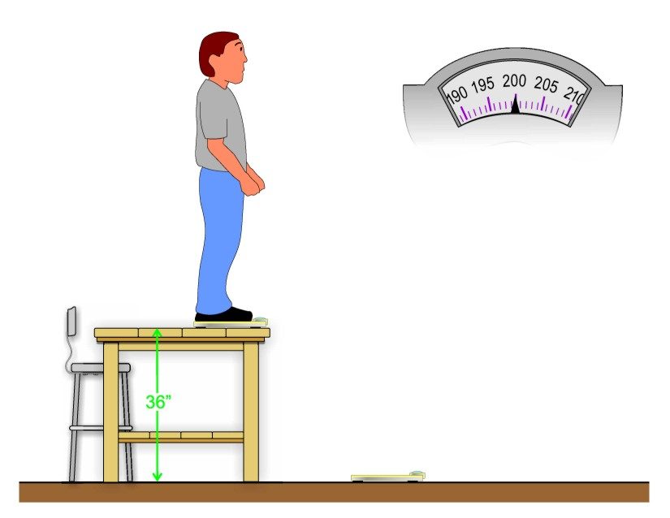
Scale
Scale

Slide 44
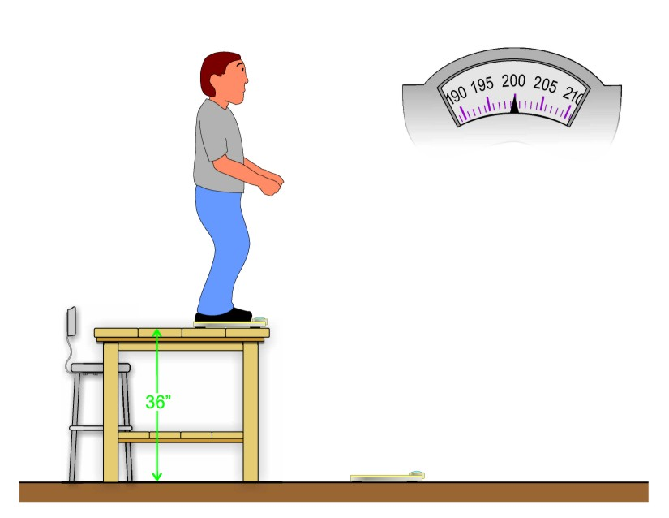
Scale
Scale

Slide 45
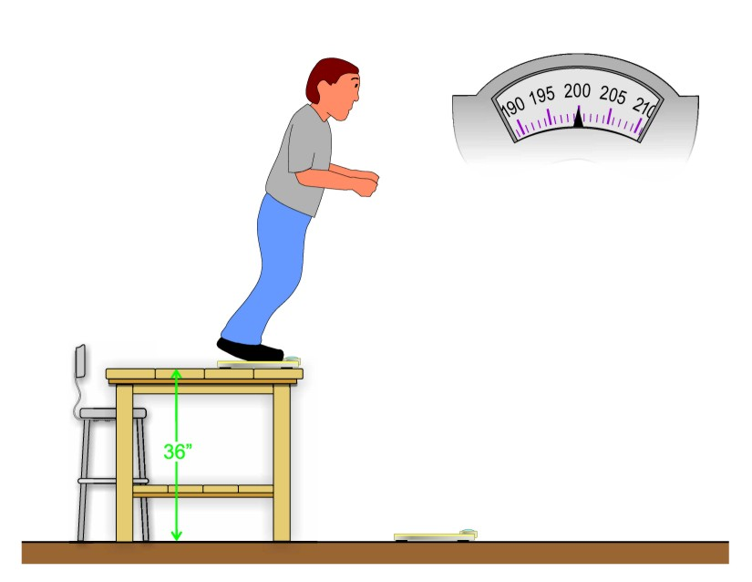
Scale
Scale

Slide 46
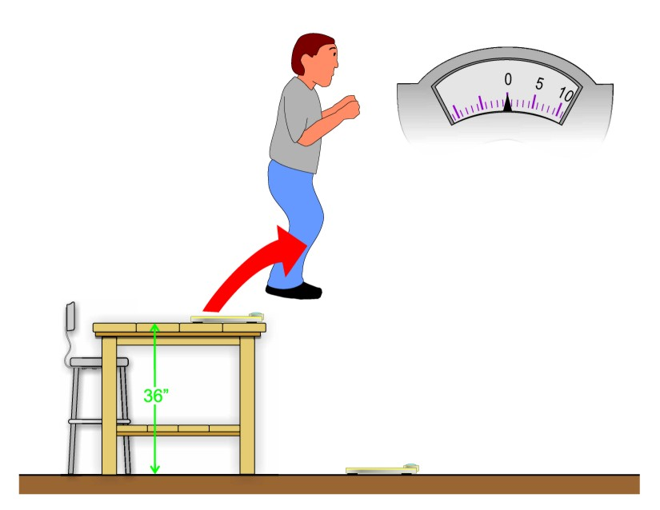
Scale
Scale

Slide 47
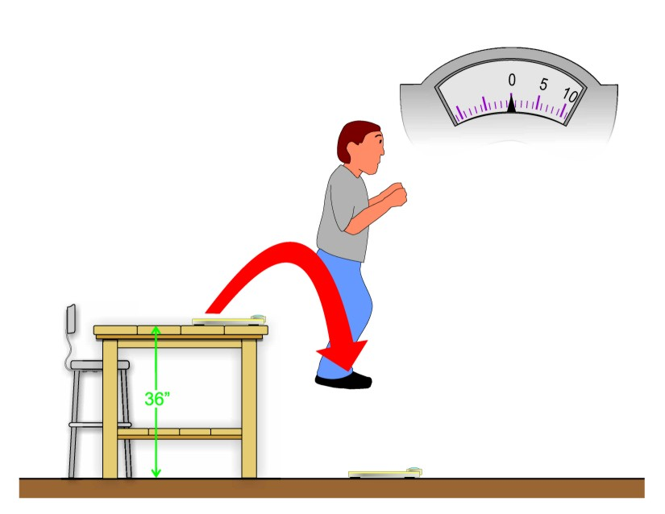
Scale
Scale

Slide 48
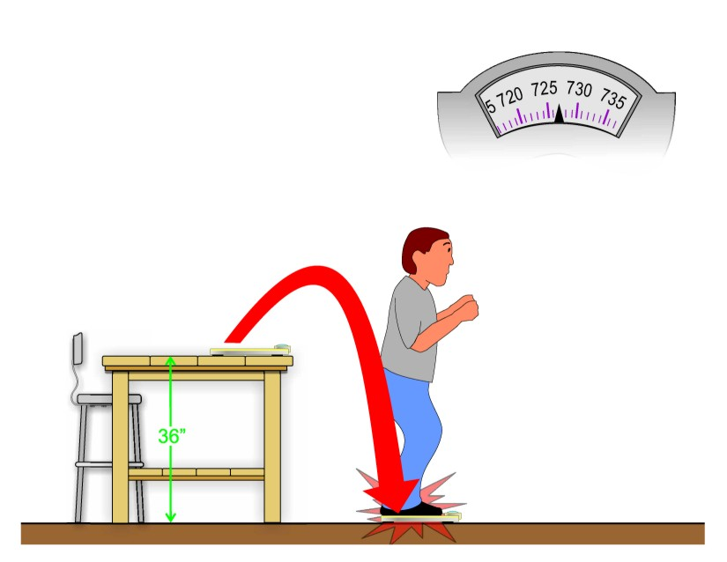
Scale
Scale

Slide 49

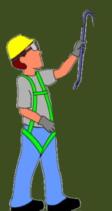
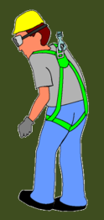

Contact Forces: Tension and Compression
Equilibrium
Gravity pushes down
Compression
(Normal Force)
C=Mg
Earth
pushes up
Tension
(Responsive-Repulsive force)
(T=Mg or MA)

Slide 50
Tension Force
The tension force is the force that is transmitted through a string, rope, cable or wire when it is pulled tight by forces acting from opposite ends. The tension force is directed along the length of the wire and pulls equally on the objects on the opposite ends of the wire

Slide 51


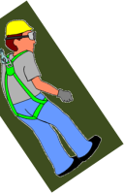
Contact Forces: Tension T = W + ma = m(g + a)
Pulley
Rope
Smaller Mass
Larger Mass

Slide 52
Contact Forces: Tension T = W + ma = m(g + a)
Pulley
Rope
Exact Same
Weight
Exact Same
Weight
Smaller Mass
Larger Mass

Slide 53

Sag Angle (horizontal lifelines)
Angle Tension
30º
5,000 lbs

Slide 54
Sag Angle (horizontal lifelines)
Angle Tension
3º
72,000 lbs

Slide 55
Force = Mass x Acceleration
F=M A (A being Gravity)
Force=Mg
Freefall You are Weightless nothing is pushing on you
32 feet/second²
or
9.8 meters/second²
Terminal Velocity 93-125 mph (150-200 km/h) human falling. Depends on aerodynamics and mass.
(achieved at 1500 feet)
4.5 seconds 100 meter
22mph per sec increase
Human average walking speed = 3mph
Human average running speed = 7mph

Slide 56


Acceleration In terms EVERYONE can Understand
Free Falling
0-60 mph
2.7 Seconds
2.7
Sports Car
0-60 mph
3.6 Seconds
3.6

Slide 57
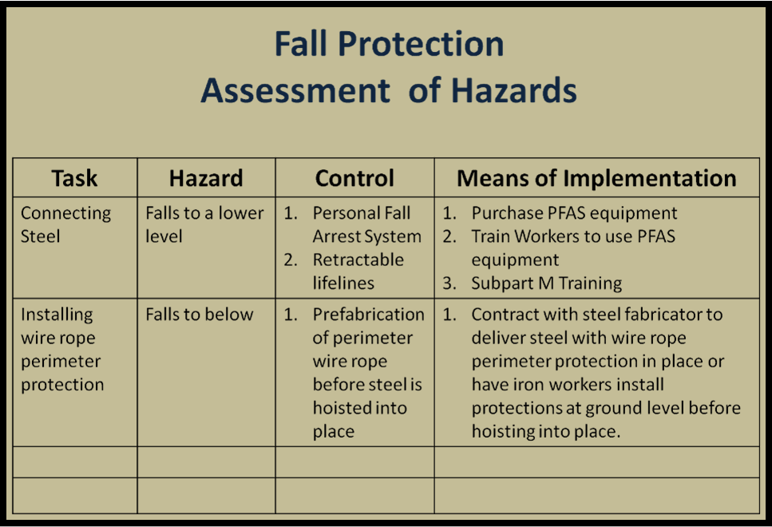
Hierarchy of Controls

Slide 58
Fall Protection Training
Most people are unaware of the actual forces involved with falling. Many workers simply don’t realize the extreme forces of gravity and this oversight often leads them to second guess all the OSHA associated numbers, such as a tie-off point of 5000lbs, which could dangle the weight of a mid-size pick-up truck from, as being excessive or overkill, while in fact these numbers are based on simple mathematic formulas. So there exists a disconnect between theory and the so called “real world.”.
Training MUST connect the two!
&
The Competent Person is Responsible to Train

Slide 59
Using Personal Fall Arrest Systems Safely
Ensure that personal fall arrest systems will, when stopping a fall:
  Limit maximum arresting force to 1,800 pounds.
  Neither free fall more than 6 feet nor contact any lower level.
  Limit maximum deceleration distance to 3½ feet.
  Have sufficient strength to withstand twice the potential impact at a free falling distance of 6 feet, or the free fall distance permitted by the system, whichever is less
  Remove systems and components from service immediately if they have been subjected to fall impact, until inspected by a competent person and deemed undamaged and suitable for use.
  Promptly rescue employees in the event of a fall, or assure that they are able to rescue themselves.
  Inspect systems before each use for wear, damage, and other deterioration, and remove defective components from service.
  Do not attach fall arrest systems to guardrail systems or hoists.
  Rig fall arrest systems to allow movement of the worker only as far as the edge of the walking/working surface, when used at hoist areas.

Slide 60
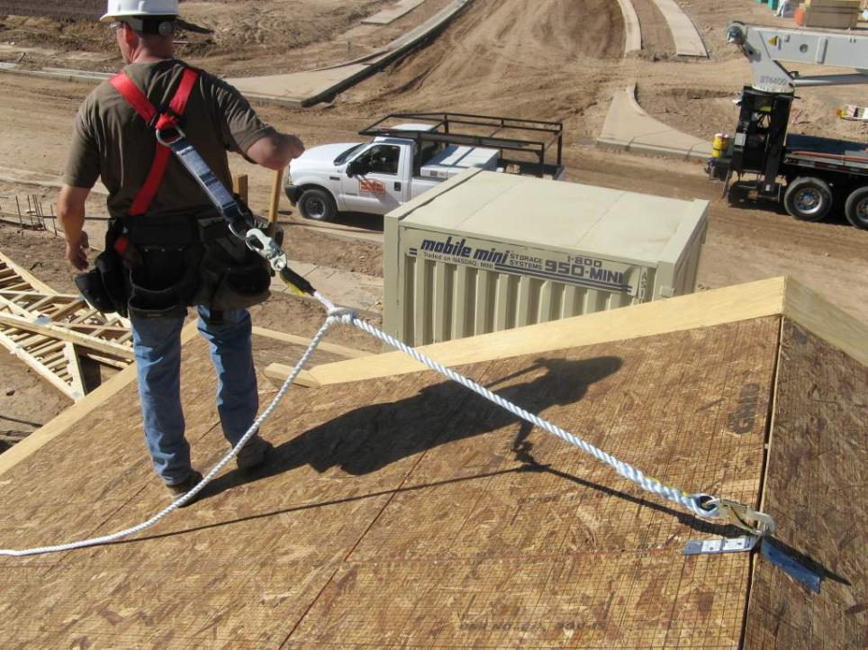
Personal Fall Arrest System (PFAS) Components
4. Shock Absorbing Lanyard
5. Full Body Harness
2. Life Line
1. Anchor Point
3. Rope Grab

Slide 61
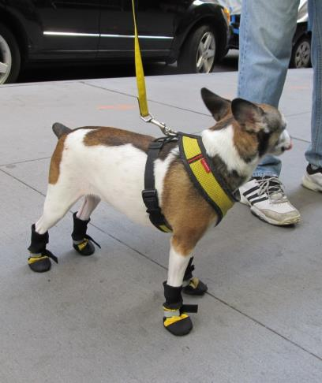
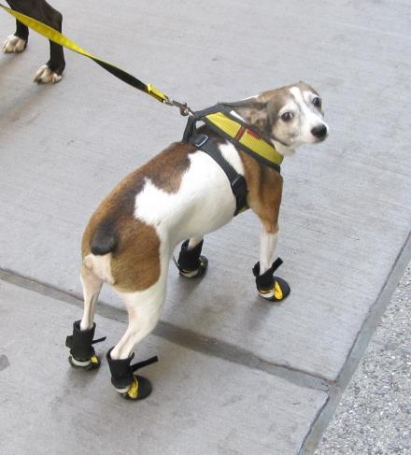
Personal Protection Equipment is Essential &
Everyone should use it and use is properly!

Slide 62
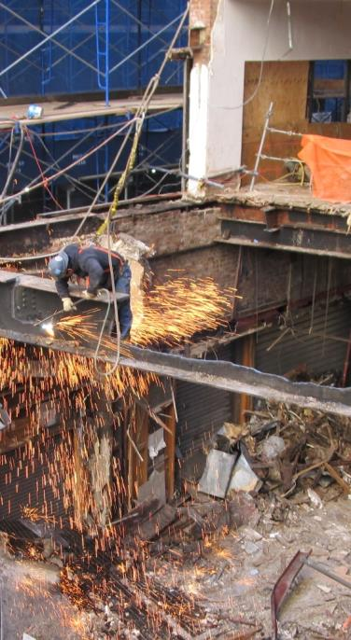
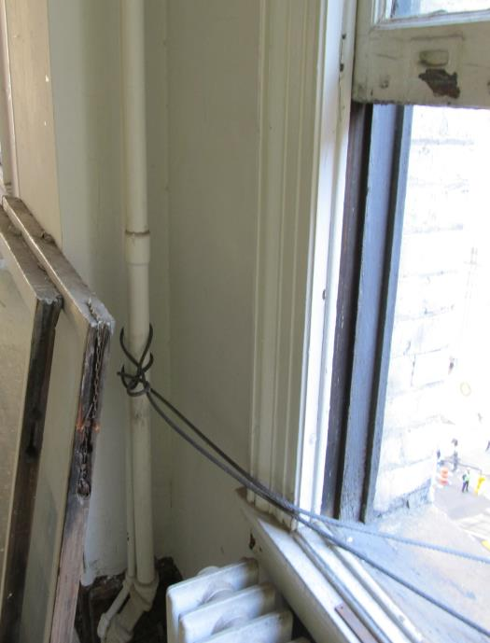

Slide 63
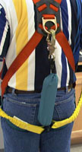
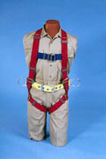

Slide 64
Vertical Lifelines & Lanyards
Vertical lifelines or lanyards must have a minimum breaking strength of 5,000 pounds, and be protected against being cut or abraded. Each employee must be attached to a separate vertical lifeline, except during the construction of elevator shafts, where two employees may be attached to the same lifeline in the hoistway, provided: Both employees are working atop a false car that is equipped with guardrails.
The strength of the lifeline is 10,000 pounds (5,000 pounds per employee).
All other lifeline criteria have been met.

Slide 65
Self-retracting vertical lifelines
Self-retracting vertical lifelines and lanyards that automatically limit free fall distance to 2 feet or less must be capable of sustaining a minimum tensile load of 3,000 pounds when in the fully extended position. If they do not automatically limit the free fall to 2 feet or less, ripstitch lanyards, and tearing and deforming lanyards, must be capable of sustaining a minimum tensile load of 5,000 pounds when in the fully extended position.

Slide 66


Slide 67
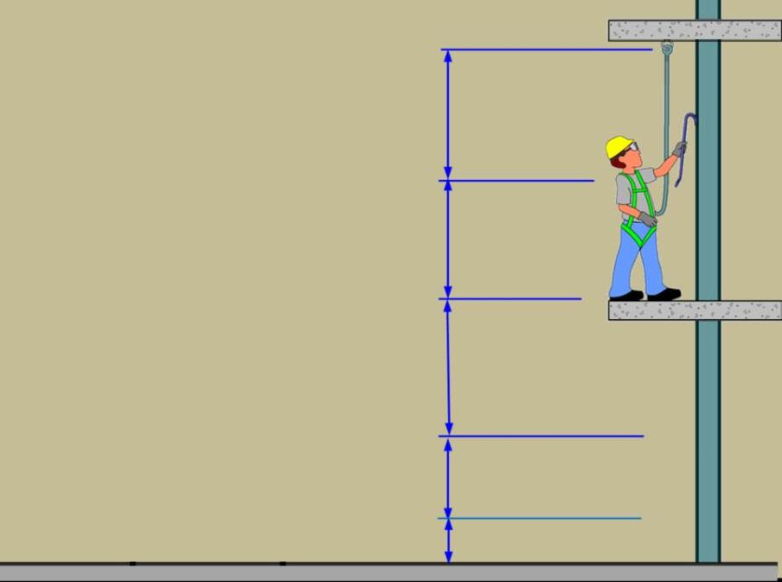
Distance to tie-off point (Slack)
Height of Dee-ring to heels of worker
Maximum Freefall 6 feet (1800lbs)
Maximum Deceleration 3.5 feet

Slide 68
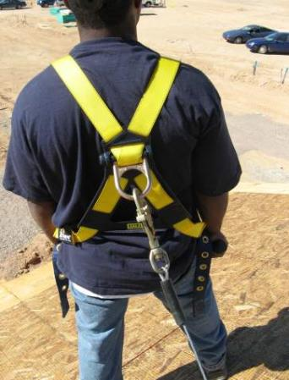
Using a Personal Fall Arrest System (PFAS), cont.
Proper Wear:
Locate the attachment of the body harness in the center of your back, near the shoulder level, or above your head.

Slide 69
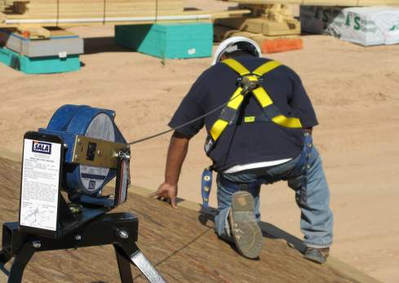
Using a PFAS, cont.
Proper Wear:
If using a retractable lifeline attach it directly to the D-ring on the full-body harness.

Slide 70
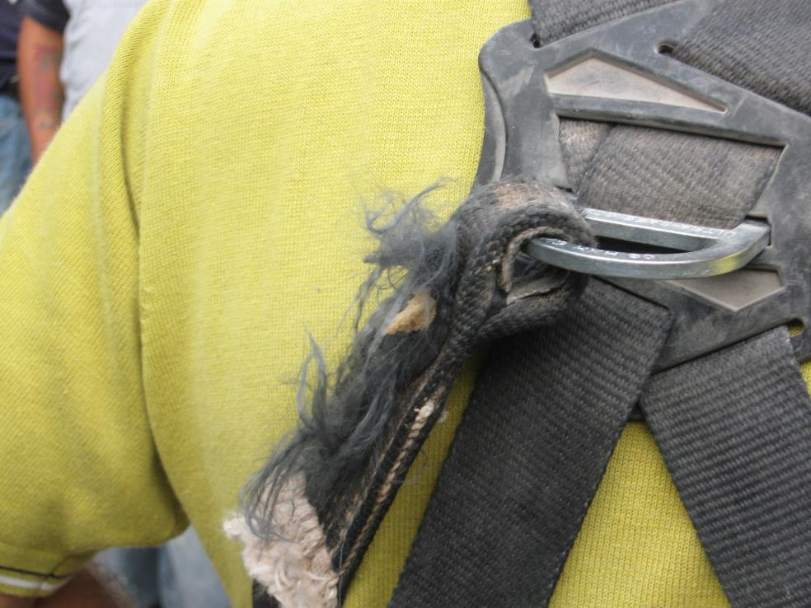
Notes:
This workers PFAS harness is worn and frayed. 1926.502 (21) Personal fall arrest systems shall be inspected prior to each use for wear, damage and other deterioration, and defective components shall be removed from service.

Slide 71
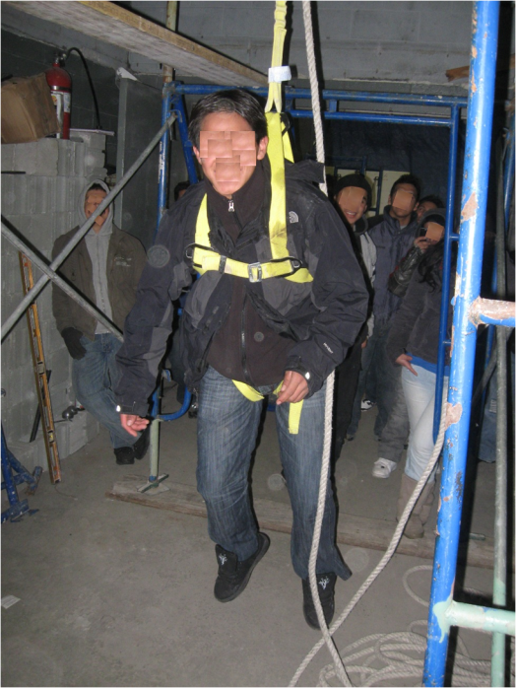
Training in how to:
How to Use
How to Inspect
How to maintain
How to Rescue

Slide 72
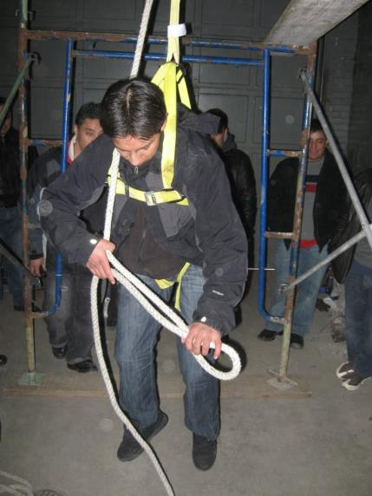
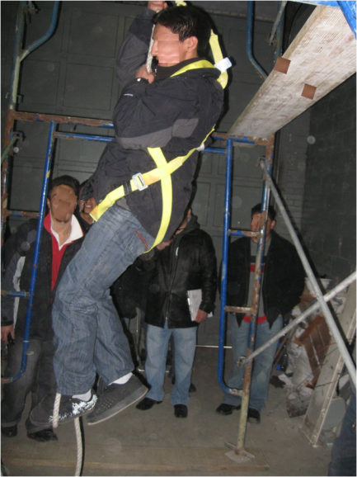
Providing you are not hurt already, after a fall, you have about 15 minutes until you may suffer very serious injury…..

Slide 73
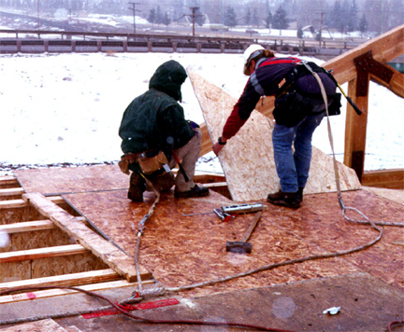
Fall Protection Planning
Lanyards and Personal Fall Arrest System (PFAS) in use
Fall protection systems and work practices
must be in place before you start work.
(Workers are tied-off together)
Notes:
Reference 1926 Subpart M App C
An employer may use a variety of fall protection systems to protect employees. These systems must meet OSHA requirements. The competent person must make frequent and regular inspections, as required, to determine if these systems meet OSHA requirements before employees rely on these systems. More detail may be found in 29 CFR 1926.502.
Employers engaged in leading edge work, precast concrete erection work, or residential construction work who can demonstrate that it is infeasible or it creates a greater hazard to use conventional fall protection equipment may develop a fall protection plan that provides other measures to be taken to reduce or eliminate fall hazards for workers. Fall protection plans must conform to OSHA provisions and be prepared by a qualified person. Although a fall protection is required, it does not have to written, nor does it have to be site specific. Fall protection plans must identify locations where conventional fall protection methods cannot be used and set up controlled access zones and any necessary safety monitoring systems.
See STD 3-0.1A

Slide 74
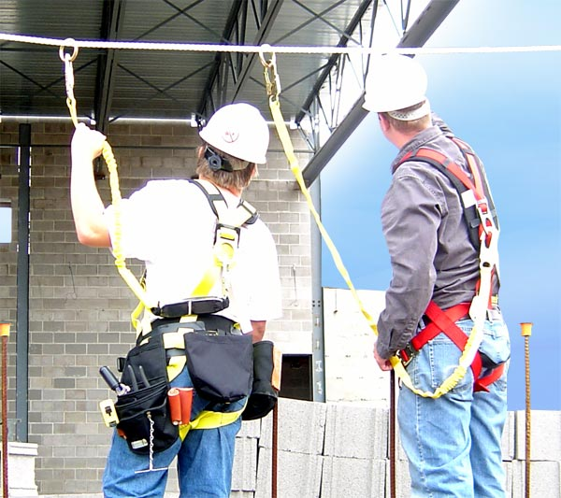
5,000 lbs
5,000 lbs
10,000 lbs.
Designed and installed by a qualified person and work overseen by a qualified person

Slide 75
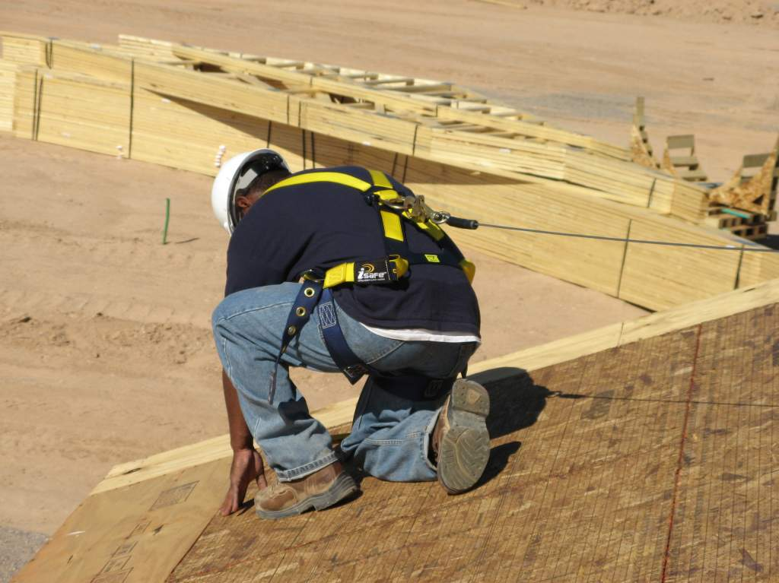

Slide 76
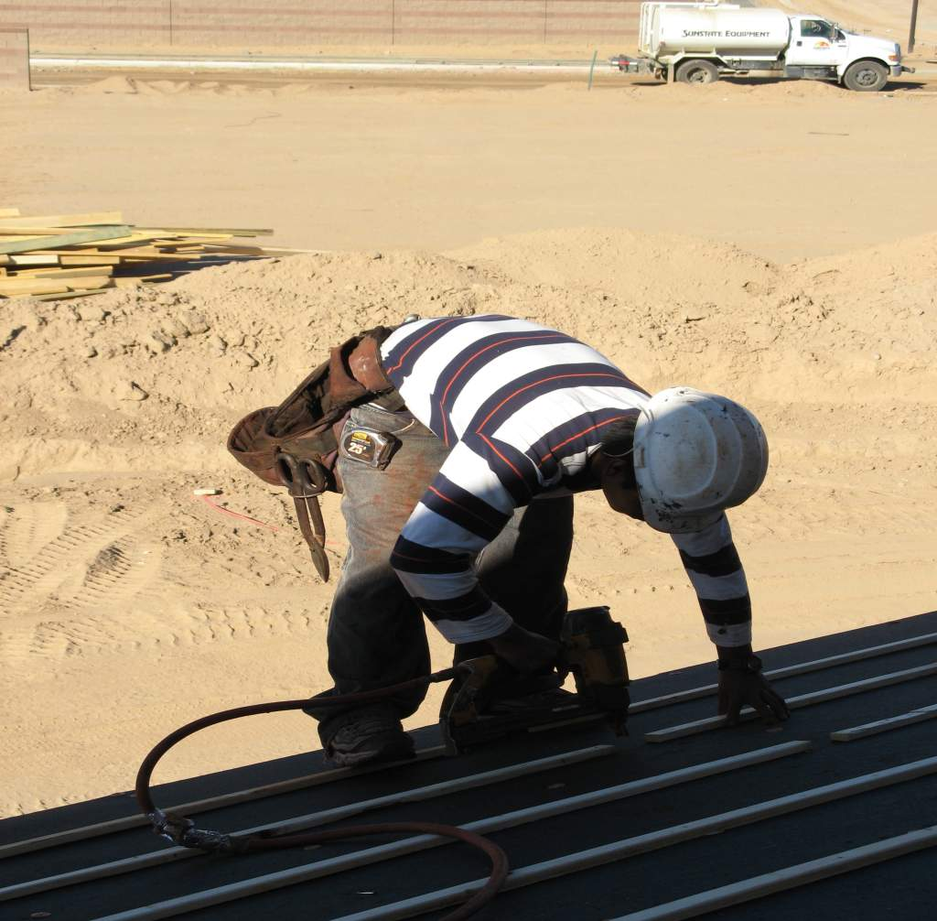
Notes:
Worker has no means of fall protection. 1926.501 (b)(1) Unprotected sides and edges. Each employee on a walking/working surface (horizontal and vertical surface) with an unprotected side or edge which is 6 feet (1.8 m) or more above a lower level shall be protected from falling by the use of guardrail systems, safety net systems, or personal fall arrest systems.

Slide 77
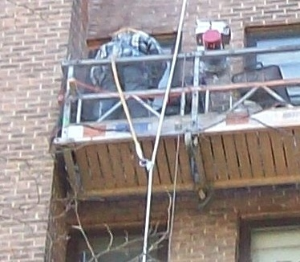

Slide 78

Restraint Systems
These are systems designed to prevent the user from reaching an area where free-fall could occur so no free-fall is possible, as in leading edge roof work. Here are some elements and examples of restraint systems.
Body Support: Full Body Harness or Body Belt
Connecting Component: Rope or web lanyard
Anchorage Connector: Tie-Off Adapter, Roof Anchor
Anchorage: Beam or Support Structure

Slide 79

Fall Arrest
These systems are designed to stop a free-fall of up to 6 feet, and limit the maximum forces of a user to 1800 pounds or less, as in steel erection or elevated maintenance work. The following are the four elements of a fall arrest system and some examples.
Body Support: Full Body Harness
Connecting Component: Shock Absorbing Lanyard, Self-Retracting-Lifeline, RopeGrab
Anchorage Connector: Carabiner, Tie-Off Adapter, Trolly, Roof Anchor
Anchorage: Beam or Support Structure

Slide 80
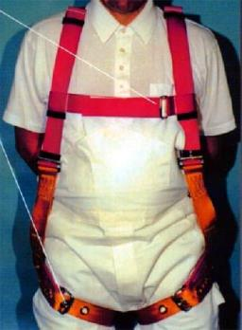
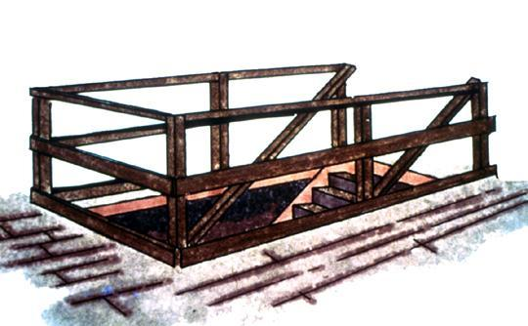
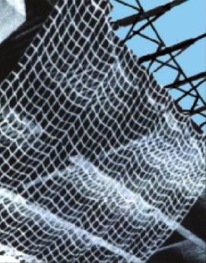
Fall Protection Options
Personal Fall
Arrest System
(PFAS)
Guardrails
Safety Net
Notes:
Reference 1926.501(b)(1)
General rule: If an employee can fall six feet or more onto a lower level, fall protection must be provided.
What type of fall protection will I need?
In most cases, a guardrail system, a safety net system, or a personal fall arrest system must be used. In some cases fences, barricades, covers, equipment guards or a controlled access zone may be used.
Employees must be protected not just from falling off a surface, but from falling through holes and from having objects fall on them from above.

Slide 81
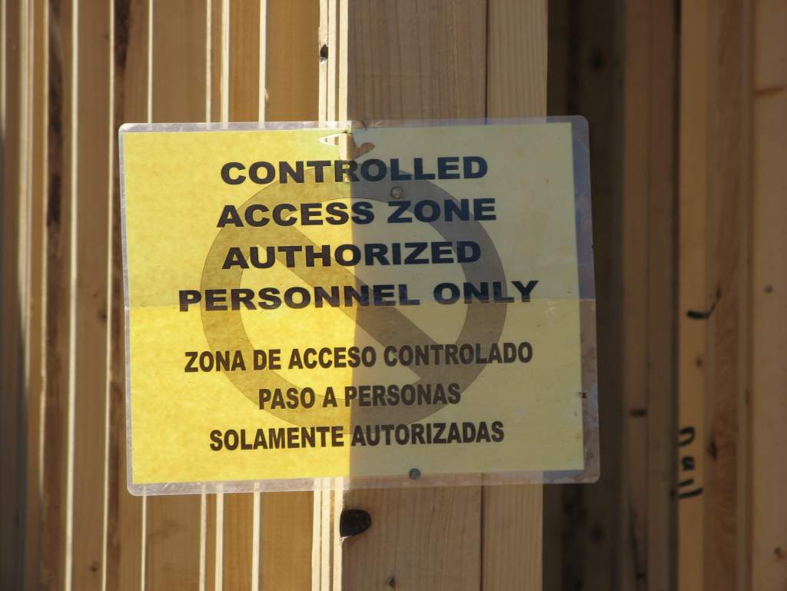

Slide 82
Alternate methods of Fall Protection
    Controlled Access Zones....for leading edge work..close off the area to all but trained personnel.....overhand bricklaying......control lines consists of ropes, wires, tapes etc.... flagged at 6 foot intervals.....new steel standard mentions the “controlled decking zone” as another alternative to conventional fall protection.....

Slide 83
Alternate methods of Fall Protection
    Safety Monitoring System.....when other systems are not feasible....designated person....monitor the safety of employees...competent to recognize fall hazards.....warns the employees...same walking/working surface...within visual sighting ......no other responsibilities.....

Slide 84
Alternate methods of Fall Protection
    Fall Protection Plan is allowed only in leading edge work, pre-cast concrete erection...or residential construction.......if it can be proven that conventional fall protection is infeasible......
OSHA Regulations Standards
29 C.F.R. §1926
Safety and Health Regulations for Construction
Subpart M, Appendix E – Sample Fall Protection Plan

Slide 85
Scaffolds

Slide 86
Scaffolding Competent Person Duties
Select and direct employees who erect, dismantle, move, or alter scaffolds.
Determine if it is safe for employees to work on or from a scaffold during storms or
high winds and to ensure that a personal fall arrest system or wind screens protect
these employees.
To train employees involved in erecting, disassembling, moving, operating, repairing,
maintaining, or inspecting scaffolds to recognize associated work hazards.
1926.454(b)
To inspect scaffolds and scaffold components for visible defects before each work
shift and after any occurrence which could affect the structural integrity and to
authorize prompt corrective actions.
1926.451(f)(3)
To determine if a scaffold will be structurally sound when intermixing components
from different manufacturers. 1926.451(b)(10)
To determine if galvanic action has affected the capacity when using components of
dissimilar metals.
1926.451(b)(11)

Slide 87
Interior and Exterior Scaffolding
Scaffolding that is 10 ft. or higher must be equipped with guardrails.
A competent person must supervise the set-up and take down of all scaffolding.
Walls that support exterior scaffold must be capable of supporting, without failure, the weight of the scaffold and four times the maximum intended load on the scaffolding.
Scaffolding must be fully planked, and planks must be secured so they cannot move.

Slide 88
Scaffold Use
No increasing working height with makeshift devices
Ladders only used on scaffolds if:
  Platform units secured
  Ladder placed against other surfaces, scaffold secured
  Legs on same platform or stabilized
  Ladder legs secured
Notes:
Ladders shall not be used on scaffolds to increase the working level height of employees, except on large area scaffolds where employers have satisfied the following criteria:
When the ladder is placed against a structure which is not a part of the scaffold, the scaffold shall be secured against the sideways thrust exerted by the ladder;
The platform units shall be secured to the scaffold to prevent their movement;
The ladder legs shall be on the same platform or other means shall be provided to stabilize the ladder against unequal platform deflection, and
The ladder legs shall be secured to prevent them from slipping or being pushed off the platform.

Slide 89
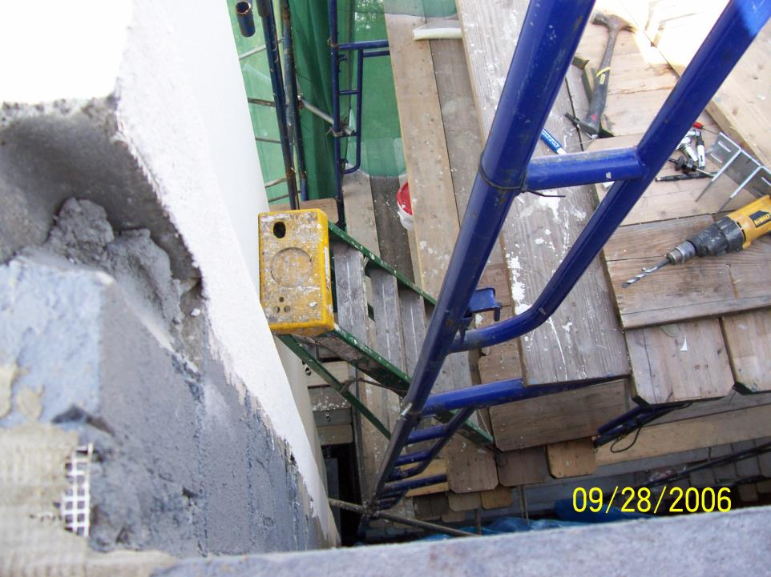

Slide 90
GENERAL REQUIREMENTS
FOR ALL SCAFFOLDS
Scaffold Platform Construction
Front Edge of All Platforms
-- No more than 14” from the face of the work
-- 3” from the face for outrigger scaffolds
-- 18” from the face for plastering and lathing operations
-- Platforms 10’ and less to extend at least 6” but not more than 12” past support unless designed and installed and/or guarded properly
-- Platforms greater than 10’ no more than 18” past support unless designed and installed and/or guarded properly….
Notes:
10

Slide 91
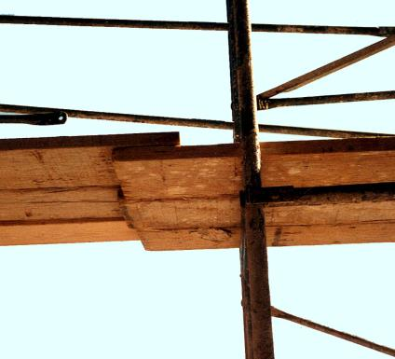
Scaffold Plank Overhang
Scaffold Platform Construction
-- Each abutted end of plank shall rest on a separate support surface
-- Overlap platforms not less than 12” only over supports, unless restrained to prevent movement
Notes:
11

Slide 92

Guardrails
Install along open sides & ends
Front edge of platforms not more than 14 inches from the work, unless using guardrails and/or PFAS
Top rails - 38 to 45 inches tall
Midrails halfway between toprail and platform
Toeboards at least 3-1/2 inches high
When a crosspoint of crossbracing is used as a midrail, it
must be between 20 inches and 30 inches above the work
platform. 1926.451(g)(4
Notes:
Reference 1926.451(g)(1), (g)(4), (b)(3), and Appendix A, paragraph 1d.
38 inch minimum guardrail height where guardrail is primary fall protection.
36 inch minimum guardrail height where fall arrest systems are primary fall protection.
Protect from falling between the top rail and surface, by using midrails, screens or mesh.
Protective barriers must be strong enough to support a falling employee. Wood, chain and wire rope may be used for top rails and midrails.
Top rails - 36-48 inches tall when using the crossbracing as the top rail
When crossbracing is used as a midrail, it must be between 20 and 30 inches above the work platform.
Guardrails are not required:
• when the front end of all platforms is less than 14 inches from the face of the work
• when outrigger scaffolds are three inches or less from the front edge
• when employees are plastering and lathing 18 inches or less from the front edge

Slide 93


Slide 94

How are we doing here?

Slide 95


Slide 96


Slide 97


Slide 98


Slide 99


Slide 100

OSHA Plank Disqualifiers

Slide 101


Slide 102


Slide 103

Scaffold Height
20’
  The height of the scaffold should not be more than four times its minimum base dimension unless guys, ties, or braces are used
5’
Guying ties, and braces—Supported scaffolds with a height-to-base of more than 4:1 shall be restained from tipping by guying, tying, bracing, or the equivalent. 1926.451(c)(1)

Slide 104


Proper Scaffold AccessTags
A warning tag should be placed on the partially erected scaffold to indicate that it is not complete and should not be used. This tag should remain in place until the scaffold is completed and final inspection has been done. Upon final inspection, an "approved" tag
will take it's place

Slide 105

Moving Scaffolds
Employees can’t be on a moving scaffold unless:
  Surface is level
  Height to base ratio is 2 to 1
  Outriggers are installed on both sides of scaffolds
Employees can’t be on scaffold part beyond the wheels
Competent person must be on site to supervise
Notes:
1926.451(f)(5)
Scaffolds shall not be moved horizontally while employees are on them, unless they have been designed by a registered professional engineer specifically for such movement or, for mobile scaffolds, where the provisions of 1926.452(w) are followed.
1926.452(w)(6)
Employees cannot ride on scaffolds unless::
The surface on which the scaffold is being moved is within 3 degrees of level, and free of pits, holes, and obstructions;
The height to base width ratio of the scaffold during movement is two to one or less, unless the scaffold is designed and constructed to meet or exceed nationally recognized stability test requirements
Outrigger frames, when used, are installed on both sides of the scaffold;
When power systems are used, the propelling force is applied directly to the wheels, and does not produce a speed in excess of 1 foot per second;
No employee is on any part of the scaffold which extends outward beyond the wheels, casters, or other supports.

Slide 106


Slide 107

Housekeeping

Slide 108


Slide 109


Slide 110

It’s Better than This

Slide 111



Slide 112


Aerial Lifts
(articulating boom lifts)

Slide 113

Boom lift anchorage point
Manufacturer’s
instructions
This information is located in manual, which must be read

Slide 114


Slide 115


Slide 116


Slide 117


Slide 118


Slide 119


Slide 120


Slide 121


Slide 122


Slide 123


Slide 124
Suspended Scaffolds
Counterweights non-flowable material
Only specifically designed counterweights allowed
Counterweights secured to outrigger beams by mechanical means
Counterweights not removed until scaffold is disassembled
Notes:
Counterweights shall be made of non-flowable material. Sand, gravel and similar materials that can be easily dislocated shall not be used as counterweights.
Only those items specifically designed as counterweights shall be used to counterweight scaffold systems. Construction materials such as, but not limited to, masonry units and rolls of roofing felt, shall not be used as counterweights.
Counterweights shall be secured by mechanical means to the outrigger beams to prevent accidental displacement.
Counterweights shall not be removed from an outrigger beam until the scaffold is disassembled.

Slide 125

Suspended Scaffolds
Tiebacks secured to structural anchorage
Not standpipes, vents, or conduit
Support devices (cornice hooks, parapet clamps) made of steel or equivalent and supported by bearing blocks
Tiebacks set perpendicular to building face
Notes:
Secured against movement by tiebacks installed at right angles to the face of the building or structure, or opposing angle tiebacks shall be installed and secured to a structurally sound point of anchorage on the building or structure. Sound points of anchorage include structural members, but do not include standpipes, vents, other piping systems, or electrical conduit.
Tiebacks shall be equivalent in strength to the hoisting rope.

Slide 126

Suspended Scaffolds
Four wraps minimum on winding drum hoists
Use of repaired wire rope prohibited
Wire rope inspected by Competent Person prior to each shift
Damaged rope must be replaced
4 wraps at lowest
point of hoist travel
Notes:
When winding drum hoists are used on a suspension scaffold, they shall contain not less than four wraps of the suspension rope at the lowest point of scaffold travel. When other types of hoists are used, the suspension ropes shall be long enough to allow the scaffold to be lowered to the level below without the rope end passing through the hoist, or the rope end shall be configured or provided with means to prevent the end from passing through the hoist.
The use of repaired wire rope as suspension rope is prohibited.
Wire suspension ropes shall not be joined together except through the use of eye splice thimbles connected with shackles or coverplates and bolts.

Slide 127

Suspended Scaffolds
Gas powered equipment not allowed
Power gears and brakes enclosed
Manual hoists require positive crank to descend
Secondary breaking device required or overspeed descent
Notes:
Gasoline-powered equipment and hoists shall not be used on suspension scaffolds.
Gears and brakes of power-operated hoists used on suspension scaffolds shall be enclosed.
In addition to the normal operating brake, suspension scaffold power-operated hoists and manually operated hoists shall have a braking device or locking pawl which engages automatically when a hoist makes either of the following uncontrolled movements: an instantaneous change in momentum or an accelerated overspeed.
Manually operated hoists shall require a positive crank force to descend.

Slide 128
Scaffold Access
Scaffold more than two feet above or below a point of access ladders, stairs, ramps or other similar access provided
No cross braces for access!
Hook on ladders positioned so as not to tip the scaffold
Bottom rung within 24 inches of supporting level
Over 35 feet, rest levels every 35 feet
Notes:
When scaffold platforms are more than 2 feet (0.6 m) above or below a point of access, portable ladders, hook-on ladders, attachable ladders, stair towers (scaffold stairways/towers), stairway-type ladders (such as ladder stands), ramps, walkways, integral prefabricated scaffold access, or direct access from another scaffold, structure, personnel hoist, or similar surface shall be used. Crossbraces shall not be used as a means of access.
When hook-on and attachable ladders are used on a supported scaffold more than 35 feet (10.7 m) high, they shall have rest platforms at 35-foot (10.7 m) maximum vertical intervals.

Slide 129
Scaffolds Access
Erectors and dismantlers provided with:
  Safe means of access; Competent Person determines if feasible
  Based on conditions and scaffold type
  Attachable ladders installed ASAP
  Horizontal members used for access not more than 22 inches apart
  No cross braces for access
Notes:
The employer shall provide safe means of access for each employee erecting or dismantling a scaffold where the provision of safe access is feasible and does not create a greater hazard. The employer shall have a competent person determine whether it is feasible or would pose a greater hazard to provide, and have employees use a safe means of access. This determination shall be based on site conditions and the type of scaffold being erected or dismantled.
Hook-on or attachable ladders shall be installed as soon as scaffold erection has progressed to a point that permits safe installation and use.
When erecting or dismantling tubular welded frame scaffolds, (end) frames, with horizontal members that are parallel, level and are not more than 22 inches apart vertically may be used as climbing devices for access, provided they are erected in a manner that creates a usable ladder and provides good hand hold and foot space.

Slide 130
Suspension scaffolds Use
  Ropes large enough for safe functioning of brake and hoist mechanism(s)
  Suspension ropes shielded from heat sources
  No damage from chemicals allowed
  No working on scaffolds during storms or high winds unless Competent Person determines safe & protection with PFAS or wind screens
Notes:
Suspension ropes supporting adjustable suspension scaffolds shall be of a diameter large enough to provide sufficient surface area for the functioning of brake and hoist mechanisms.
Suspension ropes shall be shielded from heat-producing processes. When acids or other corrosive substances are used on a scaffold, the ropes shall be shielded, treated to protect against the corrosive substances, or shall be of a material that will not be damaged by the substance being used.
Work on or from scaffolds is prohibited during storms or high winds unless a competent person has determined that it is safe for employees to be on the scaffold and those employees are protected by a personal fall arrest system or wind screens. Wind screens shall not be used unless the scaffold is secured against the anticipated wind forces imposed.

Slide 131

Use
Platforms shall not deflect more than 1/60 of the span when loaded.

Slide 132
Use
When welding from suspended scaffolds:
  Isolate overhead support or insulated thimble used to attach suspension wire rope to its hanging support
  Suspension wire rope covered with insulating material extending at least 4 feet above the hoist
  Each hoist shall be covered with insulated protective covers;
  Grounding conductor shall be connected from the scaffold to the structure
  If scaffold grounding lead becomes disconnected, shut of welder until reconnected
Notes:
To reduce the possibility of welding current arcing through the suspension wire rope when performing welding from suspended scaffolds, the following precautions shall be taken, as applicable:
An insulated thimble shall be used to attach each suspension wire rope to its hanging support (such as cornice hook or outrigger). Excess suspension wire rope and any additional independent lines from grounding shall be insulated;
The suspension wire rope shall be covered with insulating material extending at least 4 feet (1.2 m) above the hoist. If there is a tail line below the hoist, it shall be insulated to prevent contact with the platform. The portion of the tail line that hangs free below the scaffold shall be guided or retained, or both, so that it does not become grounded;
Each hoist shall be covered with insulated protective covers;
In addition to a work lead attachment required by the welding process, a grounding conductor shall be connected from the scaffold to the structure. The size of this conductor shall be at least the size of the welding process work lead, and this conductor shall not be in series with the welding process or the work piece;
f the scaffold grounding lead is disconnected at any time, the welding machine shall be shut off; and

Slide 133

An active welding rod or uninsulated welding lead shall not be allowed to contact the scaffold or its suspension system.

Slide 134


Slide 135
Suspension Scaffolding (Swing)
Each employee 10 feet (3.1 meters) above a lower level shall be protected from falling
Lifelines shall be independent of support lines and suspension ropes and not attached to the same anchorage point as the support or suspension ropes.
A competent person shall inspect the ropes for defects prior to each workshift and after every occurrence which could affect a rope's integrity, evaluate the direct connections that support the load, and determine if two-point and multi-point scaffolds are secured from swaying.
Do not use repaired wire ropes.
Tiebacks secured to structurally sound anchorage on the building or structure, not standpipes, vents, other piping systems, or electrical conduit.
A single tieback shall be installed perpendicular to the face of the building or structure. Two tiebacks installed at opposing angles are required when a perpendicular tieback cannot be installed.
Only those items specifically designed as counterweights shall be used. Sand, gravel, masonry units, rolls of roofing felt, and other such materials shall not be used as counterweights.
Counterweights used for suspended scaffolds shall be made of materials that cannot be easily dislocated.
Counterweights shall be secured by mechanical means to the outrigger beams

Slide 136
Fall Prevention and Protection in Residential Construction
With the issuance of the new directive, all residential construction employers must comply with 29 CFR 1926.501(b)(13). Residential construction employers generally must ensure that employees working six feet or more above lower levels use guardrails, safety nets, or personal fall arrest systems.
If the employer can demonstrate that use of conventional fall protection methods is infeasible or creates a greater hazard, it must ensure that a qualified person:
  Creates a written, site-specific fall protection plan in compliance with 29 CFR 1926.502(k); and
  Documents, in that plan, the reasons why conventional fall protection systems are infeasible or why their use would create a greater hazard The new directive interprets “residential construction” as construction work that satisfies both of the following elements:

Slide 137

Examples of Various Fall Protections Applied to Residential Construction

Slide 138

Examples of Various Fall Protections Applied to Residential Construction
Concrete Anchors Rebar Anchors Roof Anchors

Slide 139


Examples of Various Fall Protections Applied to Residential Construction
Roof Anchor Brackets Nets

Slide 140


Examples of Various Fall Protections Applied to Residential Construction
Bracket Scaffold Guardrails Mobile Scaffolds

Slide 141



Examples of Various Fall Protections Applied to Residential Construction
Bracket Scaffold Aerial Lift Truss Bracket Anchor

Slide 142
Covers
    Support twice the weight applied....covers secured.....to prevent accidental displacement....by wind, employees, or equipment....needed to close any gap (hole) more than 2” wide.... Marked “Hole” or “Cover”

Slide 143

Must be marked with the word "HOLE" or "COVER”

Slide 144
General Requirements
Housekeeping
All places of employment, passageways, storerooms, and service rooms shall be kept clean and orderly and in a sanitary condition.
The floor of every workroom shall be maintained in a clean and, so far as possible, a dry condition.
Every floor, working place and passageway shall be kept free from protruding nails, splinters, holes, or loose boards.
Good housekeeping prevents fires.
Bad housekeeping is a breeding place for all types of accidents.

Slide 145
Protection of Open-Sided Floors & Platforms
Regardless of height, open-sided floors, manholes, walkways, platforms, or runways above or adjacent to dangerous equipment or similar hazards shall be guarded with a standard railing and toeboard or covered with an appropriate cover.

Slide 146

Walkways and Ramps
Guard ramps, runways, and other walkways
Notes:
Reference 1926.501(b)(6)
Ramps, runways, and other walkways must be protected by guardrail systems when employees can fall 6 feet or more.
The walking/working surface must be strong enough to support employees safely. If not, employees may not work on the surface. This knowledge will be gained during frequent and regular inspections made, as required, by competent persons designated by the employer.

Slide 147

Fall Protection -
Residential Construction
In All general construction, you must be protected if you can fall more than 6 feet
Notes:
Reference 1926.501(b)(13)
This is correct for activities not covered by STD 3-0.1A
All other activities – refer to STD 3-0.1A, Interim Fall Protection Guidelines for Residential Construction

Slide 148

Sides & Edges - Improper Guarding
This 1/4" nylon rope alone is not a proper way to guard this open floor
Notes:
Reference 1926.502(b)
What’s wrong with this?
¼ inch rope is allowed, but it must meet the criteria of 1926.502(b)(3), etc.
no midrail
no toeboards
- sagging is not allowed

Slide 149

Sky Lights and Other Openings
Notes:
Reference 1926.501(b)(4)(i), 1926.501(b)(10), 1926.501(b)(11), and 1926.502(i)
Covers must be:
-- able to support at least twice the weight of employees, equipment, and materials that may be imposed on them at one time.
-- secured to prevent accidental displacement from wind, equipment, or workers’ activities.
-- color coded or bear the markings “HOLE” or “COVER.”
Holes - 1926.501(b)(4):
Personal fall arrest systems, covers, or guardrail systems shall be erected around holes (including skylights) that are more than 6 feet above lower levels.
NOTE – All floor holes must be protected against slips/trips – even if less than 6 feet

Slide 150

Floor Holes
Improperly
Covered
Cover completely and securely
If no cover, can guard with a guardrail
Notes:
Reference 1926.501(b)(4)

Slide 151

Excavations
Guard excavations more than 6 feet deep when they are not readily seen because of plant growth or other visual barriers
In addition to needing guarding, this excavation is not properly shored
Notes:
Reference 1926.501(b)(7)
Employees at the edge of an excavation 6 feet or more deep shall be protected from falling by guardrail systems, fences, barricades, or covers.
If walk-ways are used to permit workers to cross over excavations, guardrails are required on the walkway if the fall would be 6 feet or more to the lower level.

Slide 152

Wall Openings
Wall opening
If you work near wall openings 6 feet or more above lower levels you must be protected from falling
Notes:
Reference 1926.501(b)(14)
Employees working on, at, above, or near wall openings (including those with chutes attached) where the outside bottom edge of the wall opening is 6 feet or more above lower levels and the inside bottom edge of the wall opening is less than 39 inches above the walking/working surface must be protected from falling by the use of
either a guardrail system, a safety net system, or a personal fall arrest system.

Slide 153


Slide 154

Top-rail @ 42”
Mid-rail @ 21”
Toeboard @ 3-1/2”
Notes:
This photo shows a properly installed guardrail system around a stairwell opening.
Top-rail = 42in.
Mid-rail = 21in.
Toeboard = 3 ½ in. (4in. Nominal)

Slide 155

Guardrails For Elevated Workers
When using stilts, increase the height of the top edge of the top rail to an amount equal to the height of the stilts.

Slide 156
Less than 39”
Notes:
The guardrail was installed in this window at one point in time, but was removed to deliver material through the window and was never replaced. 1926.451 (b) Guardrail systems. Guardrail systems and their use shall comply with the following provisions:
(1) Top edge height of top rails, or equivalent guardrail system members, shall be 42 inches (1.1 m) plus or minus 3 inches (8 cm) above the walking/working level. When conditions warrant, the height of the top edge may exceed the 45-inch height, provided the guardrail system meets all other criteria of this paragraph.

Slide 157
Requirements for Handrails and Stair rails
Toprail
  36 in. (.9 m) above the tread vertically in line with the riser
  Install handrail 3” from wall
Midrail
  Halfway between toprail and stair stringer
Toe Board
  Minimum of 3 1/2 in. (4 in. nominal) (10.2 cm)
Weight Requirement
  At least 200 lbs. (90.9 kg)

Slide 158

Notes:
Is this an acceptable stairrail/guardrail system?
Point out the deficiencies with the stairrail/guardrail.

Slide 159



Slide 160

Notes:
Handrails are not provided along stairs. 1926.1052 (c) Stairrails and handrails. The following requirements apply to all stairways as indicated:
(1) Stairways having four or more risers or rising more than 30 inches (76 cm), whichever is less, shall be equipped with:
(i) At least one handrail; and
(ii) One stairrail system along each unprotected side or edge.

Slide 161


Slide 162
Hole Covers
Secured and marked cover which protects workers from tripping or stepping into or through a hole and keeps objects from falling through a hole
Protects against falls through hazards in this category:
  Floor Holes
Notes:
A hole cover is a secured and marked cover which protects workers from tripping or stepping into or through a hole on walking/working surfaces and keeps objects from falling through a hole.

Slide 163
Safety Net Systems
System consisting of connectors and net installed below a working surface; designed to prevent a worker from contacting a lower level or structure in the event of a fall.

Slide 164
Stay Clear of Falling Objects
Do not work under or near a hazard or hazardous process.
Do not allow other workers below your work area.
If you are not directly involved, stay clear of these activities:
  Lifting of a balloon-framed wall
  Truss or rafter installation
  Roof sheathing work
  Work in a attic

Slide 165
Protect Impalement Hazards
Guard all protruding ends of steel rebar.
Use appropriate rebar caps.
Bend rebar so exposed ends are no longer upright.
Secure a 2x4 (5.1 x 10.2 cm) over the exposed rebar.
Do not use Mushroom type caps.

Slide 166



Protect Impalement Hazards, cont.

Slide 167

Notes:
A roof bracket is installed according to manufacture’s specifications providing adequate anchorage point for fall protection.

Slide 168

Swing Fall Hazard
Minimize swing falls:
Work directly below the anchor.
Do not extend your work zone more than 30º from the anchor.
Manage the slack in the rope.

Slide 169

Swing Fall Hazard, cont.
On most homes, multiple anchor points will be required to manage swing-fall hazards.
It is also important to locate anchor points at a height that prevents striking a lower level should a fall occur.

Slide 170

Proper Height Extension Ladders
When using an extension ladder for access to another level, the ladder must extend at least 3 ft. above the landing to provide a hand hold for getting on and off the ladder.

Slide 171

Pitch Extension Ladders
Extension ladders should be used at a 4 to 1 pitch (1.2 to .3 m).
For every 4 ft. (1.2 m) in height, the bottom of the ladder should be 1 ft. (.3 m) away from the structure.
Example:
20 ft. (height) ÷ 4 ft. = 5 ft. pitch

Slide 172

Pitch Stepladders
Stepladders are designed for use in an opened-and-locked position.
Do not use a stepladder that is folded or in a leaning position
Do not use top step of ladder to stand
Notes:
Workers is standing on top step of ladder. 1926.1053 (b)(13) The top or top step of a stepladder shall not be used as a step.

Slide 173
Secure and Stabilize Ladders
Extension ladders should be secured at the top or bottom to prevent movement.
The base of an extension ladder must be secured in place by using the safety feet on the ladder or other effective means.

Slide 174

Secure and Stabilize Ladders, cont.

Slide 175
Secure and Stabilize Ladders
Slippery Surfaces
Never use a ladder on a slippery surface, unless it is secured to prevent movement.
  Wet or slippery surfaces may require a cleat.
  Ladder feet should dig into the ground, and the ladder should be secured at the bottom to prevent movement/slipping.

Slide 176

Loose Soil
Notes:
On loose soil or a soft base, dig feet into the ground and competent person must make assessment. 1926.1060 (a) The employer shall provide a training program for each employee using ladders and stairways, as necessary. The program shall enable each employee to recognize hazards related to ladders and stairways, and shall train each employee in the procedures to be followed to minimize these hazards.
(1) The employer shall ensure that each employee has been trained by a competent person in the following areas, as applicable:
(i) The nature of fall hazards in the work area;
(ii) The correct procedures for erecting, maintaining, and disassembling the fall protection systems to be used;
(iii) The proper construction, use, placement, and care in handling of all stairways and ladders;
(iv) The maximum intended load-carrying capacities of ladders used; and
(v) The standards contained in this subpart.

Slide 177

Firm Base
Notes:
On a firm base, set feet level and on the rubber pads. 1926.1060 (a) The employer shall provide a training program for each employee using ladders and stairways, as necessary. The program shall enable each employee to recognize hazards related to ladders and stairways, and shall train each employee in the procedures to be followed to minimize these hazards.
(1) The employer shall ensure that each employee has been trained by a competent person in the following areas, as applicable:
(i) The nature of fall hazards in the work area;
(ii) The correct procedures for erecting, maintaining, and disassembling the fall protection systems to be used;
(iii) The proper construction, use, placement, and care in handling of all stairways and ladders;
(iv) The maximum intended load-carrying capacities of ladders used; and
(v) The standards contained in this subpart.

Slide 178

Secure and Stabilize Ladders, cont.
Uneven Surface
When the surface is not level, use a ladder leveler (accessory) to provide even contact points.

Slide 179
Maintain a Safe Position on Ladders
Face the ladder when ascending or descending.
Maintain three points of contact at all times.
Keep your body centered on the ladder.
Never let your belt buckle pass either ladder siderail

Slide 180


Scaffold Grade Plank Stamps
Notes:
SPIB - Southern Pine Inspection Bureau
WCLB - West Coast Lumber Inspection Bureau
Solid sawn wood used as scaffold planks shall be selected for such use following the grading rules established by a recognized lumber grading association or by an independent lumber grading inspection agency.
Such planks shall be identified by the grade stamp of such association or agency. The association or agency and the grading rules under which the wood is graded shall be certified by the Board of Review, American Lumber Standard Committee, as set forth in the American Softwood Lumber Standard of the U.S. Department of Commerce.

Slide 181

Notes:
Planks with visible defects, such as bowing and cracks (as shown in this slide) must not be used.

Slide 182

Steel Erection

Slide 183


Slide 184


Yesterday
(status quo)
Today
(sometimes)

Slide 185


Slide 186


Slide 187


Slide 188
Steel Erection
Employees who are on a walking/working surface with an unprotected edge more than 15 feet above a lower level must be protected by conventional fall protection.
While working at heights over 15 and up to 30 feet, connectors must be provided with a complete personal fall arrest system or other allowable fall protection, and wear the equipment necessary for tying off.

Slide 189
Steel Erection Connectors
While working at heights over 15 and up to 30 feet, connectors must:
be provided with a complete personal fall arrest system or other allowable fall protection, and wear the equipment necessary for tying off.
Posses Traing

Slide 190

Controlled Decking Zone
A controlled decking zone (CDZ) can be established as a substitute for fall protection where metal decking is initially being installed and forms the leading edge of a work area over 15 and up to 30 feet above a lower level.
Employees who are not engaged in leading-edge work and properly trained in the hazards involved are prohibited from entering the CDZ.

Slide 191

Controlled Decking Zone
No more than 90 feet wide and 90 feet deep from any leading edge, not exceed 3,000 square feet of unsecured decking, have designated and clearly marked boundaries with control lines or the equivalent, have safety deck attachments placed from the leading edge back to the control line, and have at least two safety deck attachments for each metal decking panel.
Final deck attachments and the installation of shear connectors are prohibited from being done in the CDZ.

Slide 192

Controlling Contractor Fall Protection
The steel erector may leave fall protection in place so it may be used by other trades only if the controlling contractor has directed the steel erector to leave the fall protection in place, and has inspected and accepted control and responsibility of the fall protection before authorizing other trades to work in the area

Slide 193

Debriefing

