Slide 1
Preventing Sprains,
Strains, and Repetitive Motion Injuries
State Building & Construction Trades Council of California, AFL-CIO, 2012

Slide 2

OSHA Grant Number
This material was produced under grant number SH-22310-11-60-F-6 from the Occupational Health and Safety Administration, U.S. Department of Labor. It does not necessarily reflect the views or policies of the U.S. Department of Labor, nor does mention of trade names, commercial products, or organizations imply endorsement by the U.S. Government.
Notes:
Tell the class: This is a training on job site health and safety for construction workers, unions, and employers. It was produced by the Labor Occupational Health Program at UC Berkeley for the State Building and Construction Trades Council of California, AFL-CIO. The program is funded by federal OSHA.
The focus of this training is on Musculoskeletal Disorders (MSDs) and ergonomics. We will define these terms in this course.

Slide 3
Credits ̶ Sources of Information
Cal/OSHA
Worker Occupational Safety and Health Training Program, The Commission on Health and Safety and Workers' Compensation, California, Department of Industrial Relations
The Center for Construction Research and Training (CPWR)
U.S. Bureau of Labor Statistics, 2003-2009 Survey of Occupational Injuries and Illnesses and Current Population Survey (Calculations by the CPWR Data Center.)
NIOSH
eLCOSH Images
Oregon OSHA Online Course 1201: Introduction to Ergonomics
Washington OSHA (WISHA)
Liberty Mutual, Workplace Safety Index, 2011
Canadian Centre for Occupational Health and Safety (CCOHS)
Notes:
Tell the class: Information from the sources listed on the slide were used to develop this program.

Slide 4
Workshop Objectives
After completing this workshop, you will be able to:
Define and explain the terms Musculoskeletal Disorders (MSDs) and ergonomics.
Identify 3-5 risk factors for MSD injuries.
Analyze a job task for risk factors.
Identify 3-5 solutions to eliminate or reduce MSDs.
Recognize the elements of a comprehensive ergonomics program.
Notes:
Ask the class: Do you have any questions about the course and its purpose?

Slide 5

Why This Class…
In 2010, 25% of construction injuries were from musculoskeletal disorders (MSDs).
Photo Credit: Matt Gillen/NIOSH, elcoshimages.org
Notes:
Tell the class: According to the Bureau of Labor Statistics (BLS), in 2010 Musculoskeletal Disorders (MSDs) accounted for 25% of all workplace injuries in construction. This is a big source of injury and disability for construction workers which is why the State Building & Construction Trades Council of California (AFL-CIO) is focusing on this issue. We will describe the term “MSDs” in the next slide.
(Note: The total number of nonfatal occupational injuries and illnesses involving days away from work for construction in 2010 was 74,950 days. The lost days from musculoskeletal disorders in construction in 2010 was 19,120 days, which is 25.5%.)
Note: The photo is of the Las Vegas Strip construction, 2008. CPWR conducted a site safety assessment of two construction sites in Las Vegas and coordinated OSHA 10-hour training for workers on those sites as a result of an agreement between the Perini Building Company and the Southern Nevada Building and Construction Trades Council. The agreement, signed on June 3, 2008, put an end to a day-long walk-out of construction workers concerned about safety issues on the site where six workers were killed in an 18-month period.
Source: Bureau of Labor Statistics (BLS) and CPWR.

Slide 6
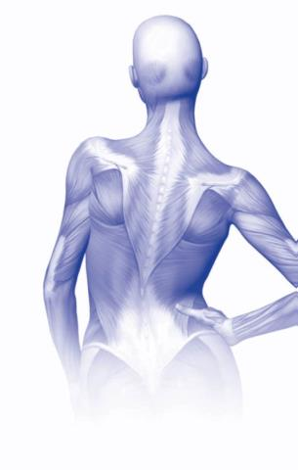
What Are Musculoskeletal Disorders (MSDs)?
An injury or disorder of the muscles, nerves, tendons, joints, cartilage, and spinal discs.
What are some examples of MSDs?
Carpal tunnel syndrome (CTS)
Tendinitis
Bursitis
Illustration Source: Occupational Health and Safety Council of Ontario
Notes:
Ask the class: What are examples of MSDs? (Instructor writes what students say on the flipchart).
Tell the class:
Carpal tunnel syndrome (CTS) - Carpal tunnel syndrome is pressure on the median nerve -- the nerve in the wrist that supplies feeling and movement to parts of the hand. It can lead to numbness, tingling, weakness, or muscle damage in the hand and fingers. Using tools that don’t fit your hand properly can cause this type of injury.
Tendinitis – this occurs when tendons rub against the bone and get swollen. Tendinitis refers to inflammation of the tendon. For example, swinging a sledge hammer repeatedly can cause tendinitis in the elbow.
Bursitis – this occurs when the fluid-filled sac (bursa) that lies between a tendon and skin, or between a tendon and bone, gets inflamed. Bursae are found in the knee, elbow, shoulder and wrist. The main symptom of bursitis is pain. In some cases, especially for shoulder bursitis, people may experience some restriction of movement and stiffness. For example, working in an awkward overhead position for extended periods of time can cause bursitis in the shoulder.
See handout: What are MSI’s? Constructive Ideas, Worksafe BC.

Slide 7
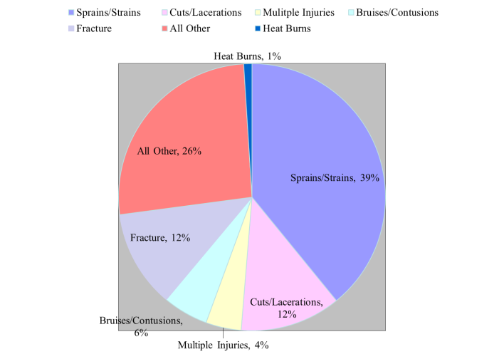
MSDs: The Leading Construction Injury
Notes:
Tell the class:
1. The sprains/strains category in this slide includes other MSDs: carpal tunnel syndrome, tendinitis, and back pain.
2. The "All Other" category includes chemical burns, amputations, general soreness/pain (except when it's back pain only), crushing injuries, suffocation, eye disorders such as welder's flash, respiratory diseases, hernias, and seizures, among others.
Source: Bureau of Labor Statistics (BLS).

Slide 8
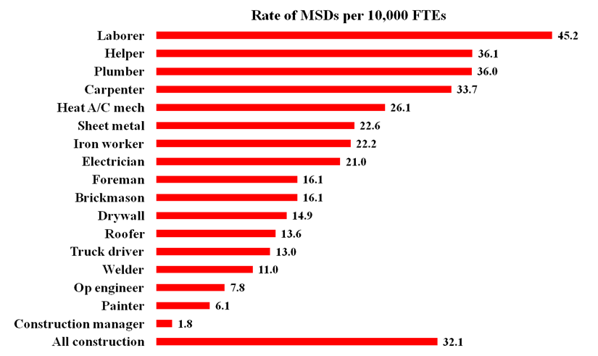
Rate Of MSDs In Construction, By Selected Occupations, 2003-2009
Source: U.S. Bureau of Labor Statistics, 2003-2009 Survey of Occupational Injuries and Illnesses and Current Population Survey. Calculations by The CPWR Data Center. Graph: CPWR Data Center.
Notes:
Tell the class: In this slide you see the rate of MSDs. The rate of injury is calculated based on 10,000 workers. For example, looking at the graph, 45.2 laborers out of 10,000 suffered a lost time injury from an MSD. This means that 4.5 workers out of 1,000 were hurt badly enough that they had to take time off work for their MSD
injury.
In comparison, the overall incidence rate for musculoskeletal disorders with days away from work was 32 cases per 10,000 full-time workers in 2010. So laborers got hurt at a higher rate than the average worker (45.2 v.s 32).
Source: U.S. Bureau of Labor Statistics, 2003-2009 Survey of Occupational Injuries and Illnesses, 2003-2009 Current Population Survey, CPWR.

Slide 9
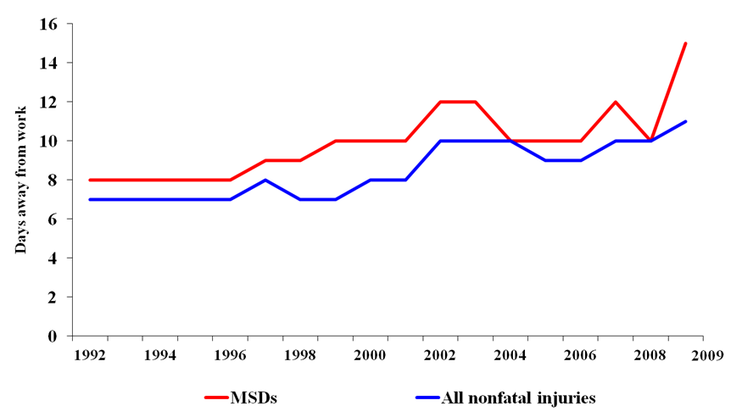
Days Away From Work, MSDs vs. All Nonfatal Construction Injuries , 1992-2009
Source: U.S. Bureau of Labor Statistics, 1992-2009 Survey of Occupational Injuries and Illnesses Graph: CPWR Data Center.
Notes:
Tell the class: MSDs continue to be the biggest cause of non-fatal injuries for construction workers.
Source: U.S. Bureau of Labor Statistics, 2003-2009 Survey of Occupational Injuries and Illnesses, CPWR.

Slide 10
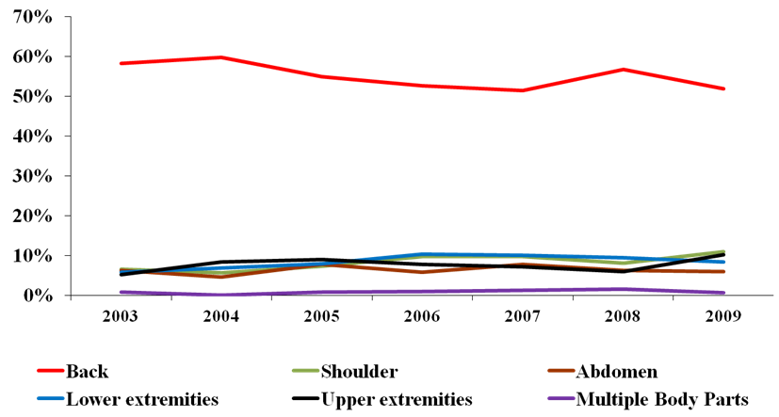
MSDs By Body Part In Construction, 2003-2009
% of MSDs
Source: U.S. Bureau of Labor Statistics, 2003-2009 Survey of Occupational Injuries and Illnesses,
Current Population Survey. Calculations by The CPWR Data Center. Graph: CPWR Data Center.
Notes:
Review the information on the slide. Note that back injuries are the most common MSD.
Source: U.S. Bureau of Labor Statistics, 2003-2009 Survey of Occupational Injuries and Illnesses, CPWR.

Slide 11
Cost Of Injuries
Source: Liberty Mutual Workplace Safety Index Findings
© 2011 Liberty Mutual Group. All Rights Reserved
Notes:
Tell the class: As you can see from this slide, overexertion by excessive lifting, pushing, pulling, is a major cause of MSDs and accounts for 25% of all workers’ compensation costs.
Our task is to find out what the problem is and how to fix it. The first step is to identify symptoms which are often the first indicator there is a problem.
According to the 2011 Liberty Mutual Workplace Safety Index, the most disabling workplace injuries and illnesses in 2009 amounted to $50.1 billion in direct U.S. workers compensation costs. The top five injury causes – overexertion, fall on same level, fall to lower level, bodily reaction, and struck by object – accounted for 71.7 percent of the costs in 2009.
Overexertion was first-place. This category includes injuries related to lifting, pushing, pulling, holding, carrying, or throwing. These type of injuries cost businesses $12.75 billion in direct costs and accounted for more than a quarter of the overall national burden.
Source: 2011 Liberty Mutual Workplace Safety Index.

Slide 12
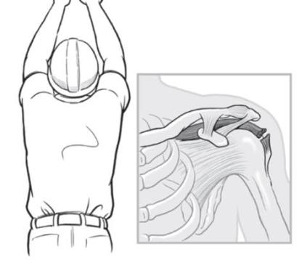
What Is “Ergonomics?”
Fitting the job to the
Worker.
Illustration Source: Simple Solutions, NIOSH
Notes:
Ask the class: What does the term “ergonomics” mean? Is it a hazard, injury
or solution?
Tell the class: The word is used to describe the science of fitting the job to the worker, not the worker to the job. MSDs are the problem and ergonomics is the solution.
The term "ergonomics" comes from the Greek words "ergon," meaning work and "nomoi," meaning natural laws. Ergonomists study the relationship of the human body to the demands of a work environment.
Serious injuries can occur if tools, tasks, and equipment are poorly designed and don’t fit workers properly. This can put workers at increased risk of musculoskeletal disorders. Musculoskeletal disorders are among the most common job injuries, and are very costly for both workers and employers.

Slide 13
What Are 4 Terms Commonly Used For “Ergonomic” Injuries?
    Cumulative trauma disorders (CTDs). Injuries involving strain which develop, or build up over time.
    Repetitive strain injuries (RSIs). Injuries affecting muscles, nerves and tendons by repetitive movement and overuse. The condition mostly affects the upper body.
    Musculoskeletal disorders (MSDs). Injuries and disorders to soft body tissues including muscles, nerves, tendons, ligaments, joints, cartilage, and spinal discs.
    Repetitive motion injuries (RMIs). An injury to the body that is caused by performing the same motion over and over again thereby straining a body part.
Notes:
Tell the class: These terms do not refer to different conditions. Many of these types of injuries can be described in all four ways. We will mainly use the term musculoskeletal disorders or MSDs in this training. "Ergonomics" is a general term that has different meanings to different audiences. Most often, this term is applied to work-related musculoskeletal disorders (MSDs). The U. S. Department of Labor defines an MSD as an injury or disorder of the muscles, nerves, tendons, joints, cartilage, and spinal discs. MSDs do not include disorders caused by slips, trips, falls, motor vehicle accidents, or similar accidents.
Background Information:
-You have more than 600 muscles in your body. They do everything from pumping blood throughout your body to helping you lift heavy objects at work.
-Nerves tell the muscle when to relax and when to contract.
-Tendons attach from bone to muscle.
-Ligaments attach from bone to bone.
-A joint is where two bones come together allowing for movement of the skeleton.
-Cartilage is the smooth covering over the ends of bones in a joint.
-Discs are actually composed of two parts: a tough outer portion and a soft inner core, and the configuration has been likened to that of a jelly doughnut. There are 23 discs in your spine.
See handout: What Are Musculoskeletal Disorders? WOSH Specialist Training.

Slide 14
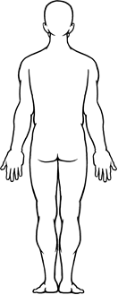
Where Does It Hurt:
Body Mapping Exercise
Notes:
Tell the class: There are many ways to illustrate the types of physical problems people have on the job. One way is to create “body maps” that show where workers are experiencing discomfort or pain. Creating body maps involves drawing a simple outline of the body, and then showing visually where on the body someone has pain.
Instructions for the activity:
Post the body map on the flipchart.
Give each participant a set of red dot stickers.
Ask people to come up and post dots on the body map to mark where they feel pain or discomfort during or after a day’s work.
Tell them to place dots even if others have already posted them in the same place.
After everyone has posted their dots, ask the group to look at the map. Draw attention to the areas of the body where the most dots appear.
Tell the class: The areas on the body map where the stickers are grouped are places where workers commonly experience pain and discomfort – the neck, back, shoulders, and wrists. These pains can be symptoms of various MSDs.

Slide 15
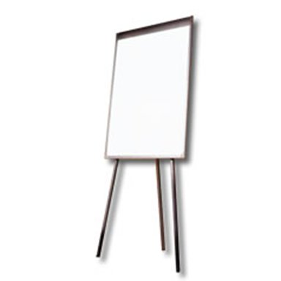
What Construction Job Tasks Cause Pain?
Notes:
Create a new flipchart page, and label it Job Tasks That May Cause Pain.
Ask the class: What construction jobs can cause pain? What specific tasks put workers at risk? List what people say on the flipchart. Save this flipchart page for use in the next activity.
Job Tasks That May Cause Pain (Your flipchart list might look like this:)
Drilling overhead
Installing carpet
Lifting heavy sheetrock
Hammering
Lifting mason bricks
Roofing.
Tell the class: Once you identify jobs that cause pain, the next step is to look at a job more closely to identify what puts a worker at risk of injury. This is called conducting an ergonomic job analysis. To demonstrate this, we will now analyze a job task together.

Slide 16
“Ouch” Activity
OUCH
OUCH
OUCH
Notes:
Post the flipchart from the last activity and pick one activity (task) to be demonstrated. Ask for a volunteer to demonstrate the job task. Give everyone in the class some ouch stickers.
Ask the class: Will someone demonstrate this job task in front of the class?
Tell the class: While our volunteer is demonstrating the task, please come up and
place an ouch sticker on the parts of the work’s body where he/she might be experiencing pain.
Ask the class: Why did you place stickers on these parts of the volunteer’s body – what movements or positions did you see that might cause pain? Record people’s answers on a flipchart labeled Risk Factors. Save this flipchart page to compare to the next slide.
Depending on the task, examples of harmful movements might include:
Bending the back or neck
Reaching overhead
Lifting something heavy
Pulling or pushing
Repetitive movements.
Tell the class: What you’ve just done is a kind of ergonomic job evaluation. You watched someone perform a work task and then identified ergonomic-related risk factors.

Slide 17
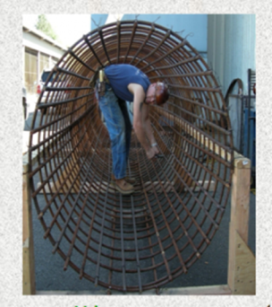
What Risk Factors Can Cause MSD Injuries?
Awkward postures
Repetition
Excessive Force
Static posture
Vibration
Poorly Designed Tools
Extreme temperature
Poor work organization
Photo Credit: Iron Workers, Washington State Department of Labor and Industries, elcoshimages.org
Notes:
Tell the class: A risk factor is anything that can increase your risk of injury. The more risk factors you have, the more likely you will be injured.
We are going to look at examples of each of these risk factors in the next slides.
See handout: Risk Factors for Ergonomic Injuries, WOSH Specialist Training.

Slide 18
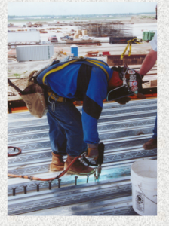
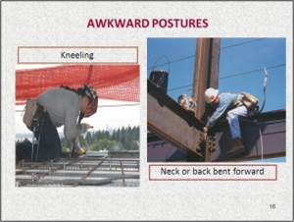
Awkward Postures
What awkward postures do you work in?
Photo Credit: Iron Workers, Washington State Department of Labor and Industries, elcoshimages.org
Notes:
Ask the class: What awkward postures do you work in?
Awkward postures can include:
Bending
Working overhead
Kneeling
Twisting
Reaching far in front of you to pick up something
Working with a bent wrist.
Tell the class: The term awkward postures refers to any posture where the body parts are away from their comfortable, neutral position (e.g., a bent back, a bent wrist or arms raised above the head). Awkward postures are not always harmful. It is only when they are repeated frequently or performed for a long time.

Slide 19
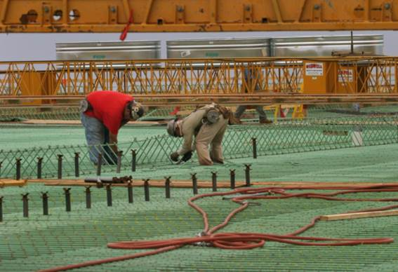
Repetition
What jobs require repetition?
Photo Credit: Earl Dotter, elcoshimages.org
Notes:
Ask the class: What jobs require you to repeat the same movement over and over?
What physical symptoms do you have from doing this kind of work (e.g., waking up at night with pain in arm, numbness in fingers, swelling in hands or arms, etc.)?
Tell the class: Repeating the same motion over and over places stress on your muscles and joints. The amount of stress depends on these factors:
How quickly the job is done
How long the job is done
How much force the job requires, and
How much recovery time there is between motions.

Slide 20
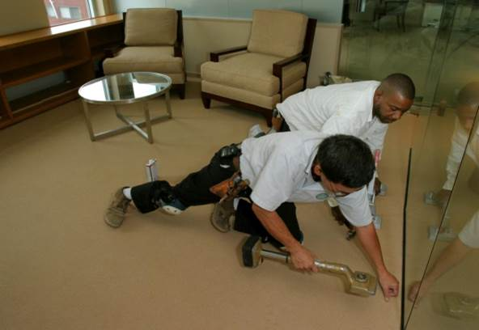
Excessive Force
What jobs require excessive force?
Photo Credit: Earl Dotter, elcoshimages.org
Notes:
Ask the class: What jobs require you to use a lot of force? How do you know when it’s too much force?
Tell the class: Some common jobs that require a lot of force include:
Lifting something heavy and carrying it
Pushing or pulling heavy objects
Using a tool handle that is too small. This may result in pinching, squeezing or griping the handle, which can tire the hand
Using a glove that is too large and doesn’t fit properly. This will require more force to hold onto a tool. This can affect women and other workers who may have smaller hands
Using a heavy tool that is not balanced may require a lot of force to control.

Slide 21
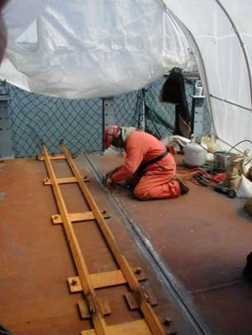
Static Posture
What jobs require work in a static or stationary position?
Photo Credit: Mount Sinai/ CHEP, elcoshimages.com.
Notes:
Ask the class: What jobs require work in a static or stationary position?
Tell the class: Stationary/static postures, or positions that a worker must hold for long periods of time, can restrict blood flow and damage muscles. Long periods of standing can also cause foot pain.

Slide 22
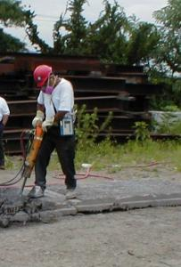
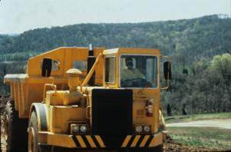
Vibration
What jobs expose you to vibration?
Photo Credit: Mount Sinai/CHEP,
elcoshimages.org
Photo Credit: John Ruckus/NIOSH, elcoshimages.org
Notes:
Ask the class: What jobs expose you to vibration?
Tell the class: The two main types of vibration that can lead to musculoskeletal injuries are: 1) hand/arm vibration: and, 2) whole body vibration.
Background information:
Hand/arm vibration
Exposure to hand/arm vibration occurs when working with air-operated, pneumatic, electric, or power tools. Exposure to hand/arm vibration primarily damages vascular and nerve tissue, typically of the hand and fingers. Too much vibration can damage the blood vessels in your hand and can cause Raynaud’s syndrome or “white finger.”
Raynaud’s syndrome occurs when blood vessels and nerves in the hands constrict from conditions such as cold temperature or vibration. The skin can become pale, waxy-white or purple. The disorder is sometimes called "white finger," "wax finger" or "dead finger.“ In the workplace it is most commonly associated with "hand-arm vibration syndrome."
Whole body vibration
Exposure to whole body vibration occurs when your body comes into contact with a vibrating surface, like a seat, pedal or floor, of heavy vehicles or machinery. Whole body vibration exposure has been shown to be a strong contributor to lower back injuries.

Slide 23
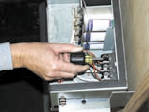
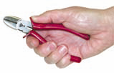
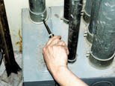

Poorly Designed Tools
What’s the problem with these tools?
Photo Credit: Easy Ergonomics: A Guide to Selecting Non-Powered Hand Tools, Cal/OSHA, NIOSH
Notes:
Ask the class: What is the problem with these tools?
Do you use tools that are poorly designed? If so, what are they?
Tell the class: If you use a tool that does not fit your hand or use the tool in a way it was not intended, you might develop an injury, such as carpal tunnel syndrome, tendinitis, or muscle strain.
Problems with the tools in this slide include the following:
The small screw driver in the top left photo requires a pinch grip and will require more work to do the job.
The screw driver in the bottom left photo has too long of a handle for the work space. The worker has to work in an awkward position.
The cutters in the top right photo don’t fit the hand properly, putting pressure against the palm of the hand which may cause an injury.
The long nose pliers in the bottom right photo have the wrong handle, requiring the worker to bend his wrist.
In addition, tools may not be designed to fit smaller hands, like a woman’s hand.
Power tools should be used whenever possible to avoid repetition.
Source: Easy Ergonomics: A Guide to Selecting Non-Powered Hand Tools. Authors: CDC, Cal/OSHA, NIOSH.

Slide 24
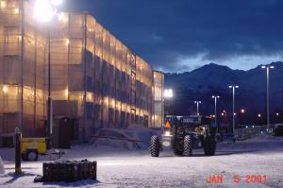

Extreme Temperature
Do you work in cold or hot conditions for extended periods of time?
Photo Credit: NIOSH, elcoshimages.org
Photo Credit: LOHP, Federal OSHA.
Notes:
Ask the class: Do you work in cold or hot conditions for extended periods of time?
Tell the class: Working in cold temperatures for extended periods of time can reduce the blood flow to your hands and fingers creating numbness. This can cause loss of grip and may damage your hands and wrists.
Working in excessive heat can lead to muscle fatigue which may increase risk of sprains and strains.

Slide 25

Poor Work Organization
This refers to the way jobs are structured, carried out, and supervised, for example:
Production schedule demands
Infrequent rest breaks
Not enough workers
Poor planning
Poor supervision
Have you experienced poor work organization?

Slide 26
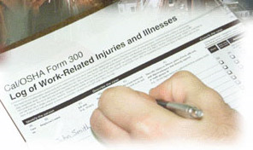
Identifying Risk Factors
What are some other ways to identify risk factors on your job?
Employer records (OSHA 300 logs, workers’ comp info., etc.)
Worker surveys or interviews
Walk around inspections
Job evaluations
Photo Source: Cal/OSHA Consultation
Notes:
Ask the class: What are some other ways to identify risk factors on your job?
Tell the class:
1. Employer Records
Most employers are required to keep a record, called the Cal/OSHA Log 300, of reported work-related injuries or illnesses. You can request this log to see whether workers have MSDs and where they are occurring. By reviewing this log you can identify work areas that might need attention.
2. Worker Surveys or Interviews
Your co-workers are often the best source of information on the potential problems posed by their jobs. You can conduct a written survey or talk to people individually.
See handout: Worker Health Survey, WOSH Specialist Training.
3. Walkaround Inspections
Another useful way to find jobs or tasks that may pose problems is to conduct a walk around inspection of the work area.
See handout: Inspection Checklist, WOSH Specialist Training.
4. Job Evaluations.
During a job evaluation, use a checklist or similar form to record risk factors, as well as to track your progress in resolving a problem. There are many checklists available that can be used to do this, including a Job Safety Analysis (JSA) or Job Hazard Analysis (JHA).
See handout: Construction Ergonomics Checklist, CPWR

Slide 27
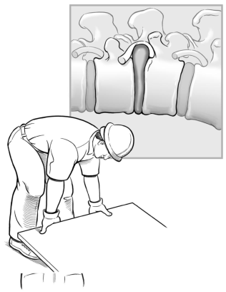
Problem Solving
What are some ways to prevent strains, sprains, and Musculoskeletal Disorders (MSDs)?
Better materials
Better tools
Improved work methods
Better work organizaiton
Training
Stretch and flex, and
Personal protective equipment (PPE)
Illustration Source: Simple Solutions, NIOSH
Notes:
Tell the class: Ergonomic solutions are used to help fit the workplace to the worker. They help eliminate or reduce risk factors. We are going to briefly discuss each of these solutions in the next slides.
As you discuss the solutions on the next slides ask if anyone has implemented any of these solutions and what they thought of them.

Slide 28
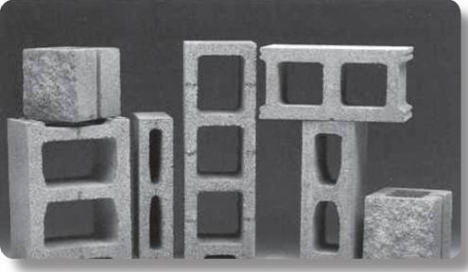
Solution: Better Materials
How can building materials be improved?
Better materials should be:
Lighter weight
Packaged in smaller units
Redesigned – like the blocks in this photo.
Photo Source: NIOSH Publication No. 2007-122: Simple Solutions: Ergonomics for Construction Workers
Notes:
Tell the class: Contractors can make changes with architects and designers in selecting the material they use for the job. For example, using lighter ladders made out of fiberglass or ordering 3-foot wide drywall.
Ask the class: Why are the bricks in the photo a better design?
Tell the class: In this photo the block was redesigned with handholds for easier carrying and to make it lighter.
Background Information on bricklaying:
It is not uncommon for a bricklayer to handle 200 concrete masonry units per day, and they each weigh 38 lbs or more,” said Jennifer Hess, PhD. “That means a bricklayer handles about 7,600 lbs of block during an 8-hour work day. In a week of this work, he lifts the equivalent of more than five Ford F-350 pick-up trucks. Both bricklayers and mason tenders perform physically demanding work, day after day.”
Source: Researchers Identify Incentives And Barriers To Adoption Of Back-Saving Best Practices Among Masonry Contractors, CPWR, August 16, 2010.

Slide 29

Solution: Better Hand Tools
Do you use poorly designed tools on your job?
What should you look for in a hand tool?
The best tool is one that:
• Fits the job you are doing
• Fits the work space available
• Reduces the force you need to apply
• Fits your hand
• Can be used in a comfortable work position
Notes:
Ask the class: Do you use poorly designed tools on your job? If so, please describe them.
What would you look for in a hand tool?
The best tool is one that:
• Fits the job you are doing.
• Fits the work space available.
• Reduces the force you need to apply. It should be balanced and not tip backwards or forwards.
• Fits your hand. It should be comfortable in your hand — not too thick, too small or too short. It should have a non-slip handle made of soft material, like rubber or plastic. No sharp edges, finger grooves or ridges in the handle.
• Can be used in a comfortable work position.
See handout: Checklist For Hand Tool Selection. Adapted from Easy Ergonomics: A Guide to Selecting Non-Powered Hand Tools, Cal/OSHA/NIOSH.

Slide 30
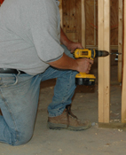
Power Tools
How should you select a power tool?
It should have a long trigger.
It should have low vibration and noise levels.
It should be heavy enough to do the job, but not add strain.
Use a power tool instead of a hand tool when you can.
Photo Source: Ergonomics eTool: Solutions For Electrical Contractors, Federal OSHA
Notes:
Tell the class: Use a power tool when you can. A power tool can reduce repetition and damage to your hand.

Slide 31
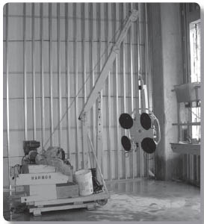
Solution: Improved Work Methods
How can the work be done differently to reduce risk factors at your job?
Use platforms, lifts and forklifts
Use hoists or chain falls
Use carts and dollies
Make smaller loads
Use power tool instead of hand tools
Power vacuum lifter avoids manual lifting
Notes:
Ask the class: How can work be done differently to reduce risk factors at your job?
Refer to examples on the slide.

Slide 32
Solution: Better Planning and Organization
How can risk factors be reduced by better planning and organization?
Plan the work ahead of time
Deliver materials close to where they will be used
Have proper equipment at the job site
Minimize bending, reaching or twisting – work at waist level whenever possible
Use the buddy system – get help
Notes:
Ask the class: How can risk factors be reduced by better planning and organization?
Refer to examples on the slide.

Slide 33
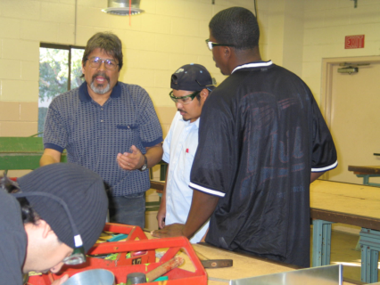
Solution: Training
What should training include?
Risk factors
Symptoms of MSDs
Impact of MSDs on workers’ lives
Solutions
What training have you
received about MSDs or
ergonomics?
Photo Credit: Debra Chaplan, State Building & Construction Trades of California
Notes:
Ask the class: What training have you received about MSDs or ergonomics at work?
Tell the class: Training on MSDs should occur before a person starts their job. It should include:
Understanding how risk factors can increase their chance of injury
Learning about solutions
Learning about new equipment, tools and work methods
Discussing how to make ergonomic changes.

Slide 34
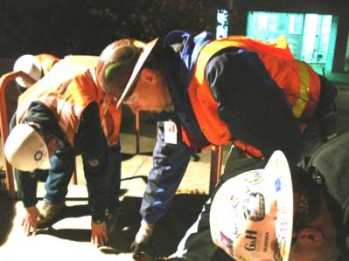
Solution: Stretching
How many of you have participated in a worksite stretch and flex program? What are the pros and cons?
Photo Source: University of Washington
Notes:
Ask the class: How many of you have participated in a worksite stretch and flex program? What are the pros and cons?
Pros may include:
Team building-people interact with each other
Open communication with crew members
Easy to implement
Low cost solution.
Cons may include:
Not taken seriously
Exercises may not be done properly
Puts pressure on workers to take the responsibility for solutions
Workers may feel self-conscious.
Talk to your medical provider before participating in any stretch & flex program. Stretching programs are usually conducted during the morning safety briefing and are usually 5-10 minutes long. You should exercise judgment and should not perform motions that may aggravate previous injuries or other physical conditions
Remember—these programs are not a solution in and of themselves to MSDs.

Slide 35
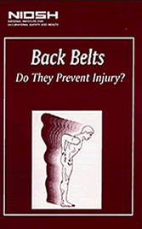
Solution: Personal Protective Equipment (PPE)
The National Institute for Occupational Safety and Health (NIOSH) recommends that employers not rely on back belts to protect workers.
What are some examples of PPEs that can help reduce MSDs?
Shoulder pads
Knee pads
Vibration reducing gloves
Notes:
Tell the class: Back belts have been studied extensively and experts have concluded that they are not effective in preventing back injuries. The National Institute for Occupational Safety and Health (NIOSH) recommends that employers not rely on back belts to protect worker from repeated lifting, pushing, pulling, twisting, or bending. Instead, NIOSH recommends that employers implement a comprehensive ergonomics program that includes workplace assessment, hazard reduction, and worker training.
The National Institute for Occupational Safety and Health (or NIOSH) is the United States’ federal agency responsible for conducting research and making recommendations for the prevention of work-related injury and illness. NIOSH is part of the Centers for Disease Control and Prevention (CDC) within the U.S. Department of Health and Human Services.
Ask the class: What are some examples of PPEs that can help reduce MSDs?
Shoulder pads
Knee pads
Vibration reducing gloves

Slide 36
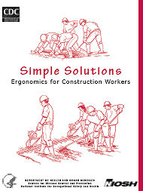
Implementing Solutions
What are some challenges implementing solutions?
Costs too much
Slows down production
Equipment not available
Change isn’t easy
Preventing MSD hazards is less
expensive and more effective than
trying to control them later.
Notes:
Ask the class: How do we address these challenges?
Points to raise in the discussion:
MSDs are the leading cause of workers’ compensation claims. Most MSDs can be prevented. Implementing changes can reduce costs in the long run.
MSD injuries can be painful and disabling. Reducing MSDs can reduce the impact of workers’ injuries on their families and communities. Employers can save money by eliminating the costs of hiring and training others to replace injured workers.
Investing in new tools and equipment can help reduce MSDs and improve production.
Change may not come easily. However, workers are creative and should be asked for their input. Workers can often come up with new ways to approach things to help make work safer and more efficient.

Slide 37
Small Group Activity - Solutions
Break into small groups.
View construction photo.
Complete Construction Solutions Worksheet:
  Identify risk factors
  Identify solutions
    What changes can the worker make on his/her own?
    What changes can a contractor make?
    What can the union do?
Each small group reports back on their findings.
Notes:
Instructions for this activity:
Break the class into 5 small groups with 4-5 people in each group.
Ask everyone to take out the Construction Solutions Worksheet.
Give each small group a different construction task trigger photo to discuss:
Group #1: Screeding
Group #2: Handling Drywall
Group #3: Rebar Tying
Group #4: Overhead Drilling
Group #5: Caulking
4. Tell the class: We’ve discussed MSD risk factors and various solutions that can be used to eliminate or reduce them. You will now work in small groups to analyze one specific construction job. Identify the risk factors in the job task. Then come up with solutions that can be used. Once your group comes up with solutions, think about how these ideas can be implemented back in your workplace. Also answer the questions on your worksheet about changes the worker, contractor and union can make.
After 15 minutes, bring the class back together. Ask each group to identify the job task they had, explain the risk factors and their solutions. Record their solutions on the flipchart.
After all groups report back, you will lead a discussion on what changes the worker can make on his/her own, what changes the contractor can make, and what the union can do. This discussion will take place on slide # 47.

Slide 38
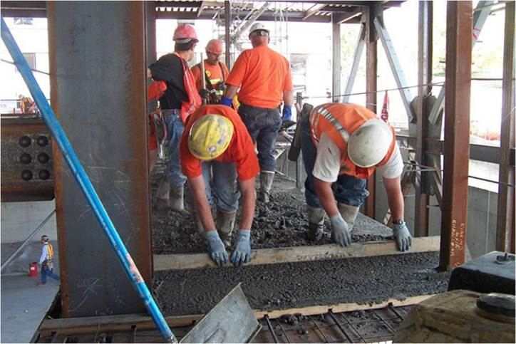
Small Group #1: Screeding
Photo Credit: Cement Masons/Washington State Department of Labor and Industries, elcoshimages.com
Notes:
After small groups have met for 15 minutes, bring them back together to report on their task. Start with screeding.
Ask the class: Will the recorder for group #1 please report back their answers for screed operations?
After the screeding small group has reported, show the next slide to make sure the group has included all the points on that slide.

Slide 39
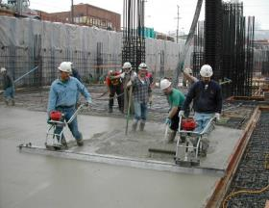
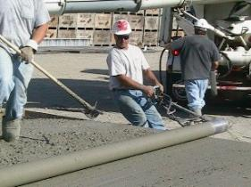
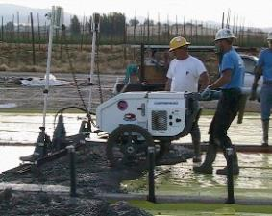
Screed Solutions
Manual Screed
Roller screed
Walk-behind screed
Photo Source: Ergonomic Interventions in Construction: Evaluation, Diffusion, and Adoption, Steve Hecker
Notes:
Risks factors might include:
working in an awkward posture bent over
using a forceful motion to grip and pull the board over the wet concrete
using excessive force with arms and shoulders
Repetition.
These motions put major stress on your back, knees, hands, arms, and shoulders, which may lead to serious muscle or joint injuries.
Solutions might include:
Using better equipment like a motorized walk-behind screed. This equipment greatly eliminates frequent and prolonged stooping, screeding in a stooped position and repeated arm and shoulder movements. Little effort is needed to move the plow over the concrete surface.
Other solutions include the manual screed and roller screed, however, they involve some limited pushing and pulling.
See handout: Construction Solutions, Motorized Concrete Screeds, CPWR.

Slide 40
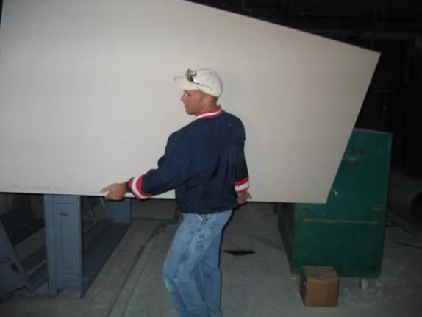
Small Group #2: Handling Drywall
Photo Source: Ergonomic Interventions in Construction: Evaluation, Diffusion, and Adoption, Steve Hecker
Notes:
After small groups have met for 15 minutes, bring them back together to report on their task. Continue with handling drywall.
Ask the class: Will the recorder for group #2 please report back their answers for handling drywall?
After the handling drywall small group has reported, show the next slide to make sure the group has included all the points on that slide.

Slide 41
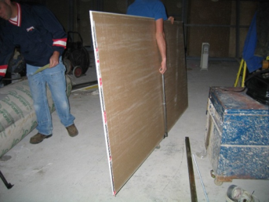
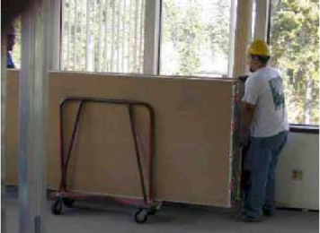
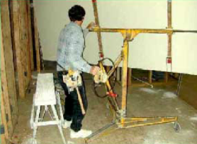
Drywall Solutions
Photo Source: Ergonomic Interventions in Construction: Evaluation, Diffusion, and Adoption, Steve Hecker
Notes:
Risks factors might include:
Pressure put on hands to grip and carry the drywall
Carrying heavy material in an awkward position.
Solutions might include:
Using a strap or handles to carry drywall
Using a cart to carry drywall
Using a stand to lift and position the drywall in place
Use the buddy system—get help to carry drywall.
See handout: Drywall Installers: Prevent Back, Wrist, Neck and Shoulder Injuries, California Department of Health Services, California Department of industrial Relations.
See handout: Back & Lifting Checklist, from Tailgate Meetings That Work: A Guide to Effective Construction Safety, LOHP and SBCTC.

Slide 42
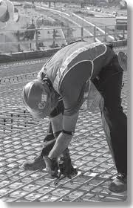
Small Group #3: Rebar Tying
Photo Source: Construction Solutions: Solution: Rebar-Tying Tools, CPWR
Notes:
After small groups have met for 15 minutes, bring them back together to report on their task. Continue with rebar tying.
Ask the class: Will the recorder for group #3 please report back their answers for rebar tying?
After the rebar tying small group has reported, show the next slide to make sure the group has included all the points on that slide.

Slide 43
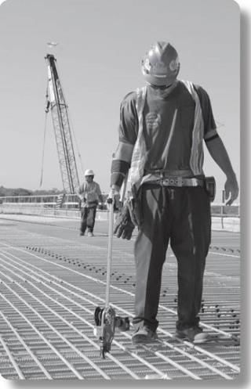
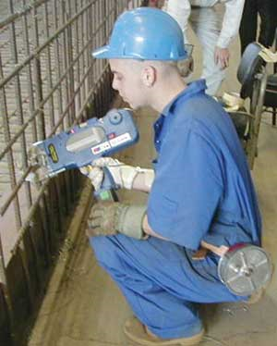
Rebar Tying Solution
Photo Source: Rebar-Tying Machines Part 1 (Part of Construction Safety Magazine, Volume 12, Number 4, Winter 2001/02, Ontario Canada.)
Photo Source: Construction Solutions: Solution: Rebar-Tying Tools, CPWR
Notes:
Risks factors might include:
Working in a static, stooped and prolonged position
Bending the wrist in an awkward position to twist and tie the wire
Using excessive force to grip the pliers
Repeating the same motion over and over.
Solutions might include:
Use a rebar-tying tool. This lowers your risk of hand and wrist injury because it reduces the hand motions required to use the pliers. It also allows you to work standing up, so there is less stress on your lower back due to stooping and bending.
Use a rebar tying gun. This equipment allows workers to work upright and avoid the bending, twisting, and awkward postures of tying rebar at ground level. In addition, working with rebar-tying guns requires only one hand. Workers can lean on their knee with the other hand and thereby support their trunk. This in turn decreases some of the muscle activity and muscle fatigue that occur with manual tying.
See handout: Construction Solutions, Rebar-Tying Tools, CPWR.

Slide 44
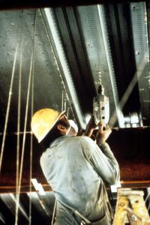
Small Group #4: Overhead Drilling
Photo Credit: NIOSH/John Rekus, elcoshimages.org
Notes:
After small groups have met for 15 minutes, bring them back together to report on their task. Continue with overhead drilling.
Ask the class: Will the recorder for group #4 please report back their answers for overhead drilling?
After the overhead drilling small group has reported, show the next slide to make sure the group has included all the points on that slide.

Slide 45
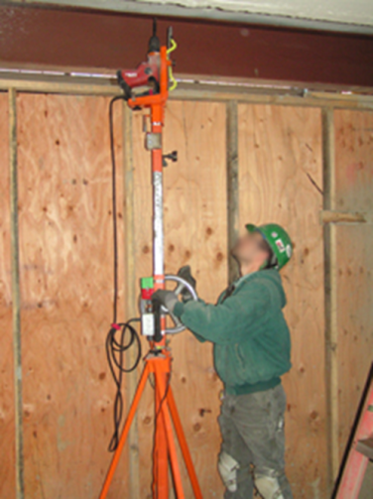
Overhead Drilling Solution
Photo Source: Ergonomics, David Rempel, University of California
Notes:
Risks factors might include:
Working overhead with arms and neck in a fixed, awkward hard-to-hold position This creates stress on the arms, neck, shoulders, and back
Using a heavy tool that creates vibration in the hands and arms
Gripping with hands to hold the tool and forcing it upwards
Repetition.
One solution:
Use an overhead drill press. It reduces arm fatigue and injuries in workers who repeatedly drill overhead. The final design allows drilling to be done efficiently and prevents the extreme fatigue workers usually experience from overhead drilling.
Source: UCSF Overhead Drilling Project, David Rempel.
See handout: Drilling Overhead. Occupational Health Branch, California Department of Public Health.

Slide 46
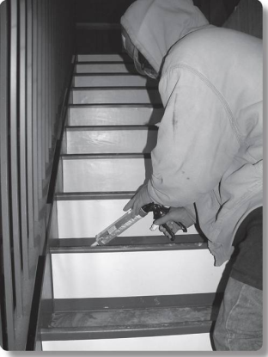
Small Group #5: Caulking
Photo Source: Construction Solutions: Solution: Power Caulking Guns, CPWR
Notes:
After small groups have met for 15 minutes, bring them back together to report on their task. Continue with caulking.
Ask the class: Will the recorder for group #5 please report back their answers for caulking?
After the caulking small group has reported, show the next slide to make sure the group has included all the points on that slide.

Slide 47
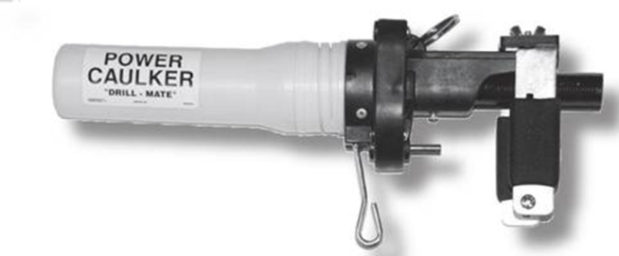
Power Caulking Gun Solution
Photo Source: Construction Solutions: Solution: Power Caulking Guns, CPWR
Notes:
Risks factors might include:
Using force to pull the trigger. The more pressure your gun requires to pull the trigger the greater your chance of injury. You may have to exert even more force when you apply a thicker sealant material.
Repetition. If you use these guns often and for long periods of time, you are at risk of stressing the soft tissues in your hand, wrist, and forearm.
Using a poorly designed tool. Bending your wrist or twist your forearm when pulling the trigger, increases risk of injury. Your chance of developing an injury increases if the gun you use has sharp edges or grooves on the trigger, or has a wide span between the trigger and the grip, forcing you to stretch your hand.
One solution:
Use a power caulking gun, which may be powered by a battery or compressed air. It eliminates the need for pulling the trigger to apply the caulk or sealant. This reduces the required grip force and hand pressure and will reduce fatigue and strain.
See handout: Construction Solutions, Power Caulking Guns, CPWR.

Slide 48
What Can You Do To Get Solutions Implemented?
What changes can the worker do on his/her own?
What changes can a contractor make?
What can the union do?
Illustration Source: NIOSH Publication No. 2007-122: Simple Solutions: Ergonomics for Construction Workers
Notes:
Ask the class the questions on the slide and lead a discussion on each one. Record what is said for each question on the flipchart. Then proceed with the slide show.
Examples of changes the worker can make:
Report problems early
Ask for help when needed
Suggest solutions to your employer
Rest your hands when using the same tool for long periods of time
Invest in hand tools with better grips and handles.
Examples of changes a contractor can make:
Purchase better materials (lighter, in smaller units, etc.)
Purchase newly designed tools. Keep tools sharp and in good condition
Improve work methods: use platforms, lifts, hoists, carts and dollies
Plan work with ergonomics in mind: deliver materials where they will be used, arrange work to reduce bending, reaching and twisting
Make realistic production schedules, have enough workers for the job
Provide training for superintendent, foremen and workers
Encourage reporting of MSD symptoms and injuries
Support a comprehensive program to reduce MSDs on the job.
See handout: Construction Foreman: An Ergonomic Approach to Cost Reduction, Cal/OSHA
Examples of what the union can do:
Work with employers to make sure a comprehensive ergonomics program is in place, and that workers are trained and given proper tools and equipment.
Make sure information about MSDs and ergonomics is taught in apprenticeship programs.

Slide 49

Cal/OSHA’s Ergonomics Standard
The standard requires employers to take action to prevent repetitive motion injuries if:
Two workers have reported repetitive motion injuries within a 12-month period
—and—
These injuries are a result of performing identical work and are diagnosed by a physician.
Notes:
Tell the class: Cal/OSHA has an ergonomics standard. Note that the standard is in the General Industry Safety Orders (GISO) but it applies to construction. The standard has limitations. It does not take effect unless the two conditions stated in the slide are met. If this happens, the employer must establish an ergonomics program to minimize repetitive motion injuries. The employer must:
Evaluate work activities that are stressful to the body.
Implement controls such as redesigning workstations, adjusting tools, or rotating jobs.
Train workers on the symptoms and causes of repetitive motion injuries, the importance of early reporting and diagnosis, and the methods the employer uses to control or reduce the problem.
Cal/OSHA also has limited resources to enforce the standard. While Cal/OSHA may be a resource, it is best if you can work with your employer to get a comprehensive ergonomics program established in your workplace.
See handout: California’s Ergonomic Standard, WOSH Specialist Training and the Resource section in the course binder.

Slide 50

Components of an Ergonomics Program
What should be included in an Ergonomics program to reduce MSDs?
Management commitment and worker involvement
Hazard Information and Reporting
Job Hazard Analysis and Control
Training
MSD Medical Management
Program Evaluation
Notes:
Tell the class: Federal OSHA does not have an ergonomics standard. Federal OSHA issued an ergonomics standard in 2000 but it was repealed in 2001 before it took effect. The following components of a comprehensive ergonomics program are suggestions adapted from the proposed federal OSHA Ergonomics standard:
Management commitment and worker involvement. The employer assigns responsibility to set up and manage the ergonomics program, provides resources and training to ensure participation in the program and communicates with workers about their concerns.
Hazard Information and Reporting. A system to report and evaluate MSD symptoms and injuries without fear of reprisal. Information is provided to workers that explains how to identify and report MSD symptoms.
Job Hazard Analysis and Control. Job evaluation to identify risk factors. Elimination of MSD hazards or reduce them to the extent feasible.
Training. Managers and workers are trained on MSD hazards, signs and symptoms, and how to report MSDs. Employees must also be trained/retrained when a problem is identified, when new hazards are identified or when changes are made to the job that may increase their exposure to MSD hazards.
MSD Management. The employer must respond promptly to workers with MSDs, and provide medical management of injury cases.
Program Evaluation. The employer must evaluate their ergonomics program annually.

Slide 51
Workers Are The Experts
Workers are the experts in what they do.
.
Participatory Ergonomic Programs emphasize worker participation and include five steps:
identification of musculoskeletal disorders and workplace hazards that may cause these problems,
analysis of workplace hazards,
development of solutions to reduce or eliminate hazards,
implementation of solutions, and
evaluation of the solution's effectiveness.
Notes:
Tell the class: An expert approach to ergonomics makes specialists, such as safety managers or industrial engineers, the primary directors of workplace changes. In contrast, participatory ergonomics is based on the belief that workers are the experts in identifying problems and finding solutions. In order to successfully do this, workers should receive training on workplace hazards, musculoskeletal disorders that could be caused by these hazards, and ergonomic solutions. They should also be involved in the identification and analysis of hazards in the workplace, and the development of solutions that could reduce these hazards.
In contrast to the expert approach, participatory ergonomics has been adopted by many companies to aid in the control of workplace hazards. Participatory ergonomic programs are initially put into operation with the assistance of an occupational safety and health specialist. These specialists provide training and technical expertise, however, the long-term goal is to develop worker in-house expertise with the specialist only acting as a consultant as needed. Participatory ergonomics has also been associated with improvements in worker satisfaction, productivity, product quality, awareness of company goals, and communication. Participatory ergonomic programs have been used effectively in several construction environments and have been known to increase morale among workers.
Source: Reducing Sprains and Strains in Construction through Worker Participation: A Manual for Managers and Workers with Examples from Scaffold Erection. Koningsveld, Ernst A.P., Peter Vink, Isle J.M. Urlings, and Annelise M. de Jong. 1998. Study funded by CPWR.

Slide 52
Workshop Review
What key points did you learn in this workshop?
Ergonomics is the process of fitting the job to the worker.
Musculoskeletal Disorders (MSDs) are injuries affecting the muscles, bones, tendons, ligaments, nerves, and soft body tissues.
MSDs are one of the most costly workplace injuries.
MSD risk factors include: awkward postures, repetition, excessive force, static posture, vibration, poorly designed tools, extreme temperature, poor work organization.
Solutions include: better materials, better tools, improved work methods, better work organization, training, stretching, and personal protective equipment (PPE).
Cal/OSHA has an ergonomics standard, but it is very limited.
A comprehensive ergonomics program involves workers.
Notes:
Let participants respond, then review the points on the slide.

Slide 53

Workshop Evaluation
Thank you for attending the workshop.
Please take a moment to evaluate this workshop so we can improve it.
Notes:
Tell the class: Thank you for attending this training. Please take a few moments to complete the evaluation.
Collect the evaluation forms and return them to Laura Boatman at the State Building & Construction Trades Council of California.

