Slide 1

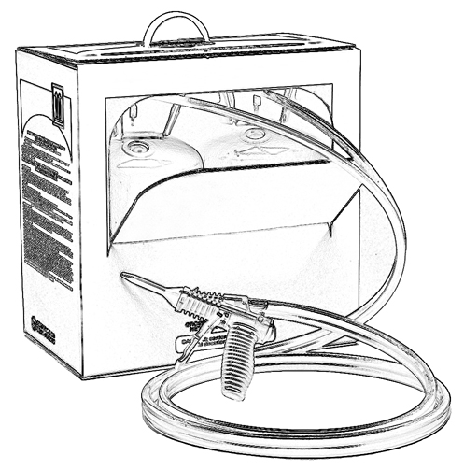


Unit 9:
Personal Protective Equipment
When Using Two-Component
Low Pressure SPF

Slide 2

Grant Provided by the Occupational Safety and Health Administration (OSHA), U.S. Department of Labor (DOL)
This material produced under grant SH-22308-SH1 from the Occupational Safety and Health Administration (OSHA), U.S. Department of Labor.
It does not necessarily reflect the views or policies of the U.S. Department of Labor, nor does mention of trade names, commercial products, or organizations imply endorsement by the U.S. Government.

Slide 3
Welcome to Unit 9
In this unit, you will learn about personal protective equipment (PPE) including:
Protective clothing
Eye and face protection
Respiratory protection
Notes:
Narration:
In this unit, you will learn about personal protective equipment, or PPE, including:
Protective clothing,
Eye and face protection, and
Respiratory protection.

Slide 4

Safety Data Sheets (SDS)
Refer to SDS for information on appropriate Personal Protective Equipment (PPE) for the chemicals with which you will be working.
Notes:
Narration:
For specific information on appropriate personal protective equipment, or PPE, for the chemicals with which you are working, refer to the manufacturer’s Safety Data Sheet, or SDS.

Slide 5
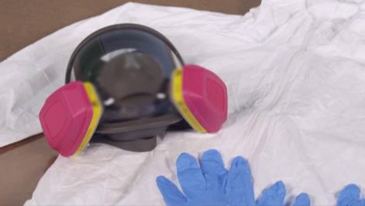
Personal Protective Equipment (PPE)
Engineering controls and work practices help prevent skin and eye contact and inhalation overexposure.
PPE is used to help prevent exposure.
This is an example of good PPE selection for a typical interior
two-component low pressure SPF application. Additional PPE options are discussed later in this Unit.
Notes:
Narration:
Engineering controls and work practices help prevent skin and eye contact and inhalation overexposure from chemicals. PPE is used to prevent exposure.

Slide 6
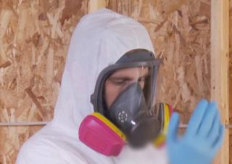
Who needs to wear PPE?
Wear appropriate PPE for protection from A-side (Iso) and B-side chemicals when working in the immediate spray area while low pressure SPF is being applied.
This includes sprayers and helpers.
Notes:
Narration:
Everyone who is working in the immediate spray area while two-component low pressure spray foam is being applied wears appropriate personal protective equipment for protection from A-side and B-side chemicals and vapors.
This includes the sprayer, helpers in the spray area, and anyone who enters the area.

Slide 7
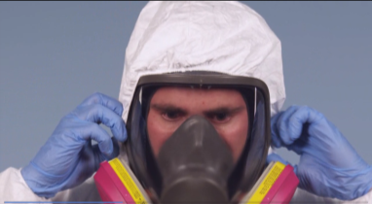
When is PPE Required?
  PPE is required during and for a period after spraying.
  Contact your manufacturer for information specific
  to your product.
  For an interior two-component low pressure SPF application, some manufacturers recommend a one hour re-entry time. This may vary depending on a number of variables.
Notes:
Narration:
Sprayers and helpers need to be protected because of the potential for chemical overexposure to SPF chemicals during and for a period after spraying.
Contact the manufacturer for information specific to the low pressure SPF product you are using. For interior two-component low pressure spray polyurethane foam applications, some manufacturers recommend a one hour re-entry time. This period may vary depending on a number of factors, so always follow the manufacturer’s guidance.

Slide 8

PPE Guidance for Two-Component
Low Pressure SPF
Typical PPE worn during two-component low pressure SPF application includes:
safety glasses or goggles
protective clothing that covers the skin
fabric gloves fully coated with nitrile,
neoprene, butyl rubber, or PVC
a full-face or half-face Air-Purifying Respirator (APR) or Powered Air-Purifying Respirator (PAPR)
Helpers in the immediate spray area typically wear the same PPE, including respiratory protection.
Notes:
Narration:
During two-component low pressure SPF application, applicators and helpers typically wear:
Safety glasses or goggles
Protective clothing that covers the skin
Gloves, such as fabric gloves fully coated with nitrile, neoprene, butyl rubber, or PVC
and a full-face or half-face Air-Purifying Respirator (APR) or Powered Air-Purifying Respirator (PAPR)
Note that helpers in the immediate spray area typically wear the same PPE, including the same type of respiratory protection.

Slide 9
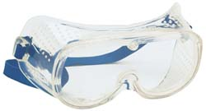
Eye Protection
Safety glasses (with side shields) or goggles can help protect eyes from SPF chemicals.
These are worn when spraying a low pressure kit/system (along with a half-face air-purifying respirator).
Notes:
Narration:
Safety glasses (with side shields) or goggles can help protect eyes from SPF chemicals.
These are worn when spraying a low pressure kit or system, often in combination with a half-face air-purifying respirator.

Slide 10
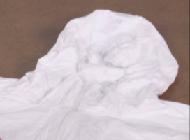
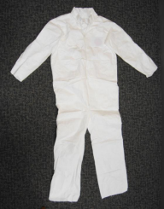
Skin Protection
Protective clothing that covers skin is suggested.
Disposable suits are typically used.
If clothing comes in contact with SPF liquid chemicals (A-side and/or B-side), dispose of the clothing.
Do not wear it home.
Notes:
Narration:
When spraying two-component low pressure SPF, protective clothing that covers skin is suggested.
Spray applicators and helpers typically wear a hooded disposable coverall to cover skin and clothing.
If clothing comes in contact with A-side and/or B-side liquid SPF chemicals, dispose of the clothing. Do not wear it home.

Slide 11
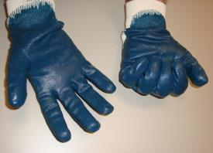
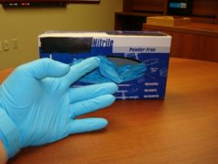
Gloves
What type of gloves?
For applicators and helpers, consider fabric gloves fully coated with nitrile, neoprene, butyl rubber, or PVC.
Some workers wear work gloves over the chemical resistant gloves.
Notes:
Narration:
Gloves are worn to protect the skin from contact with chemical liquids and foam while using low pressure SPF kits and systems.
When applying SPF, applicators and helpers typically wear fabric gloves fully coated with nitrile, neoprene, butyl rubber, or PVC.

Slide 12
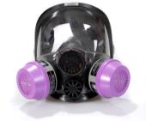
Respiratory Protection - OSHA
OSHA has established a Respiratory Protection Standard, 29 CFR 1910.134, to regulate the use of respirators in the workplace. OSHA requires employers:
to provide respiratory protection when it is needed to protect worker health.
to develop and implement a written respiratory protection program with required worksite-specific procedures and elements for required respirator use.
Notes:
Narration:
OSHA has established a Respiratory Protection Standard, 29 code of federal regulations 1910.134, to regulate the use of respirators in the workplace.
OSHA requires employers to provide appropriate respiratory protection when respiratory protection is needed to protect the health of workers. Employers are also required to develop and implement a written respiratory protection program with required worksite-specific procedures and elements for required respirator use. For those who are self-employed, follow the manufacturer’s guidance regarding proper respiratory protection.

Slide 13
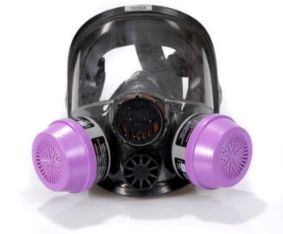
Respiratory Protection -
Generally, spray polyurethane foam manufacturers recommend that you wear an appropriate air-purifying respirator ANYTIME you are spraying two-component low pressure SPF.
Consider organic vapor cartridges with P100 particulate pre-filters that can provide protection from SPF chemicals in many cases.
Notes:
Narration:
Generally, spray polyurethane foam manufacturers recommend that you wear an appropriate air-purifying respirator ANYTIME you are spraying two-component low pressure SPF. Consider organic vapor cartridges with the P100 particulate pre-filters that can provide protection from SPF chemicals in many cases.

Slide 14
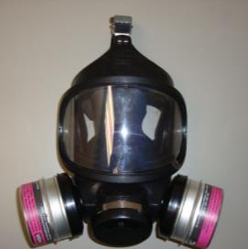
Respiratory Selection - NIOSH
OSHA requires the use of National Institute for Occupational Safety and Health (NIOSH)-certified respirators.
Visit the NIOSH website www.cdc.gov/niosh/ for information on respirator selection.
Notes:
Narration:
OSHA requires the use of National Institute for Occupational Safety and Health (NIOSH)-certified respirators.
Visit the NIOSH website for helpful information on respirator selection.

Slide 15
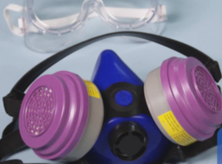
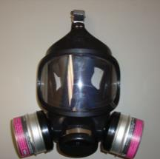
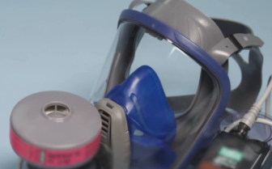
Respirators for Two-Component
Low Pressure SPF Application
Types of air-purifying (APR) respirators commonly used during two-component low pressure SPF application include:
Powered air-purifying respirator, PAPR
Half-face APR
Full-face APR
Notes:
Narration:
Types of air-purifying (APR) respirators commonly used during two-component low pressure SPF application include: half-face APRs, full-face APRs and powered air-purifying respirators or PAPRs. APRs provide the user with a breathing source by drawing air through the cartridges during breathing.
OSHA and NIOSH are important resources regarding respirator requirements and selection. Professional judgment must also be exercised in making a respirator determination, taking into account the specifics of the job site and application.

Slide 16

Half-Face Air-Purifying Respirator (APR)
Half-Face APR:
Provides a breathing source by drawing air through the cartridges
Lighter weight than full-face APRs
Only tight-fitting facepieces are available so it may not be used if facial hair interferes with the face-to-facepiece seal
Worn in combination with safety glasses or goggles to protect eyes
Notes:
Narration:
Half-face air-purifying respirators are considered a good option for two-component low pressure SPF application. They have the advantage of being lighter weight than full-face APRs. This type of respirator is designed to fit tightly for a face-to-facepiece seal. Therefore, it may not be used if anything impedes the seal, such as facial hair. Half-face APRs are worn in combination with safety glasses or goggles so that eyes are protected from the SPF chemicals.

Slide 17
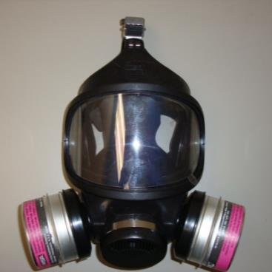
Full-Face Air-Purifying Respirator (APR)
Full-Face APR:
Can provide five times* more respiratory protection than half-face APR’s, with eye and skin protection from chemical exposure
Shield helps protect the face from irritants and contaminants
Only tight-fitting facepieces are available so it may not be used if facial hair interferes with the face-to-facepiece seal
*29CFR1910.134(d)(3)(i)(A)
Notes:
Narration:
Another common type of respirator worn during two-component low pressure SPF application is the full-face air-purifying respirator. It can provide five times more respiratory protection than a half-face APR and its full shield helps protect the face from irritants and contaminants.
Like the half-face APR, only tight-fitting facepieces are available so it may not be used if facial hair interferes with the face-to-facepiece seal.

Slide 18
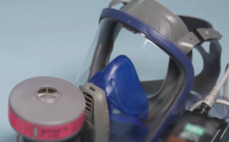
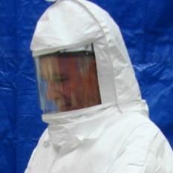
Powered Air-Purifying
Respirator (PAPR)
PAPRs are similar to APRs except air is drawn through filters using a battery-operated blower unit.
PAPRs may have a tight or loose-fitting facepiece.
Loose-fitting PAPRs can accommodate facial hair since a face-to-facepiece seal is not required.
PAPRs may provide a cooling effect due to airflow in the facepiece. Maintain an appropriate battery charge to provide sufficient airflow.
Notes:
Narration:
Another type of respirator used is the Powered Air-Purifying Respirator, or PAPR. It is similar to the APR, but with the PAPR, the breathing air is pulled through the cartridges using a battery-operated blower unit. PAPRs are available with a tight-fitting or loose-fitting hooded facepiece. A loose-fitting PAPR can usually accommodate facial hair, such as a beard, since a face-to-facepiece seal is not needed.
They can also provide breathing comfort and a cooling effect since air is circulated through the facepiece.

Slide 19
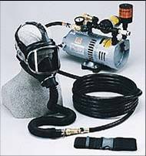
Supplied Air Respirator (SAR) -
Common for two-component high pressure SPF application
Although not typically worn during two-component low pressure SPF application, Supplied Air Respirators (SAR) are commonly used for two-component high pressure SPF application:
Typically used for interior and
some exterior high pressure SPF application
Facepiece is connected to a breathing air source outside the spray area using a hose
May have a tight-fitting or loose-fitting (hooded) facepiece
May provide a cooling effect due
to air movement
Notes:
Narration:
Although we’ve reviewed the types of respirators typically worn during low pressure SPF application, another type of respirator that may be used on the job site is a Supplied Air Respirator, or SAR. These are commonly worn during interior and some exterior high pressure SPF application, where there may be a greater risk of exposure to SPF vapors and mists due to the higher heat and pressure used with these systems. With an SAR, the user’s facepiece is connected to an external air source away from the spray area using a hose.
SAR’s may have a tight-fitting facepiece, as shown in the picture, or they may have a loose-fitting or hooded respirator facepiece. The tight-fitting SAR can provide a higher degree of protection than a loose-fitting SAR or an air-purifying respirator. Depending on the worksite temperatures, the SAR may provide a cooling effect.

Slide 20
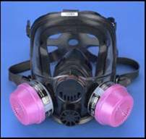
APR and PAPR - Cartridges
When applying low pressure SPF, an organic vapor cartridge (black) used with a P100 particulate pre-filter (magenta) may be recommended.
If you have any doubt about which
cartridge to use, contact the respirator
supplier for advice.
Notes:
Narration:
The organic vapor cartridge with the P100 particulate pre-filter provides protection from SPF chemicals in many cases. Refer to the SDS for specific information about the chemicals with which you are working.
Respirator cartridges are color-coded based on the NIOSH color coding scheme. For organic vapors, cartridges are black in color. The P100 particulate filters are magenta in color. If you have any doubt which cartridge to use, contact the respirator supplier for advice.

Slide 21
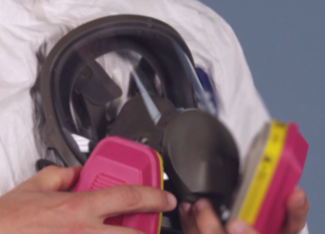
APR and PAPR –
Cartridge Change Out
Change out respirator cartridges according to your employer’s change out schedule to prevent chemical breakthrough.
Frequency of cartridge change out depends on the concentration of chemicals in the air and the amount of time in the work area, among other factors.
Consult with the respirator manufacturer for guidance.
Notes:
Narration:
APR and PAPR cartridges are changed out to prevent chemical breakthrough. Chemical breakthrough means that you are exposed to a chemical even when you are wearing a respirator and have a proper fit. This can occur when the cartridge has been used up and no longer is able to remove the chemicals.
Cartridges need to be replaced according to a respirator cartridge change out schedule. Employers are required by OSHA to have a cartridge change out schedule. How frequently the cartridge needs to be changed out depends on the chemical concentration in the air and the amount of time in the work area, among other factors. Consult with the respirator manufacturer for guidance.

Slide 22

Tight-fitting and Loose-fitting (Hooded) Respirator Facepieces
Tight-fitting:
medical evaluation required by OSHA
annual fit testing is required by OSHA
user seal check each time mask is worn
face clean shaven in areas that contact seal
refit after change in facial structure due to orthodontia, injuries, weight gain or loss
Loose-fitting (Hooded):
medical evaluation required
annual fit testing not required
no facial hair limitations
Notes:
Narration:
As mentioned earlier, respirators may be tight-fitting or loose-fitting. Tight-fitting APRs can be used for low pressure SPF application. As with all respirators, a medical evaluation is required before using a tight-fitting respirator or a loose-fitting hooded respirator. The loose-fitting respirators or hoods are available with PAPR and SAR.
However, with the loose-fitting hooded respirator, annual fit testing is not required by OSHA. Facial hair is not permitted on the portions of the face that come in contact with the seal when wearing a tight-fitting respirator. There are no facial hair limitations with loose-fitting hooded respirators.

Slide 23
Respirator Medical Evaluations
OSHA requires employers to provide medical evaluations to employees before issuing respirators or fit testing.
Evaluation typically includes a questionnaire and sometimes a physical.
Talk to your employer about getting this done.
Notes:
Narration:
Because wearing a respirator can be physically demanding, OSHA requires employers to provide medical evaluations to evaluate an employee’s ability to wear a respirator. The medical evaluation is required to be completed before being fit tested or wearing the respirator in the workplace. This evaluation typically includes a questionnaire and sometimes a physical is needed for further evaluation. Talk to your employer about getting this done.

Slide 24
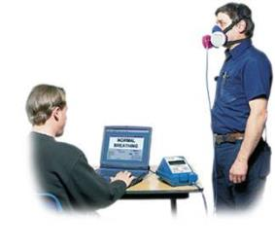
Fit Testing
OSHA requires that fit testing be completed on the make, model, and size of respirator used on the job.
Facial hair is not permitted on portions of the face that comes in contact with the seal when wearing a tight-fitting respirator.
OSHA requires fit testing to be completed prior to issuance and repeated annually.
Notes:
Narration:
OSHA requires that fit testing be completed with a mask of the same make, model, and size of respirator that will be used on the job.
Remember that facial hair is not permitted on portions of the face that comes in contact with the seal when wearing a tight-fitting respirator.
OSHA requires that fit testing be completed prior to issuance and annually to determine whether a seal can be obtained between the user’s face and respirator facepiece.

Slide 25
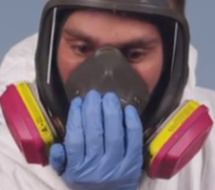
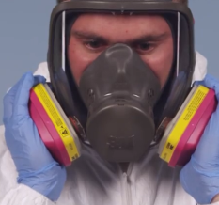
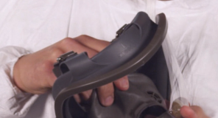
User Seal Check Considerations
  Conducting a user seal check each time a
  tight-fitting respirator is worn is important prior to entering the work area.
Positive pressure seal check.
Place palm over exhalation valve and exhale gently. Mask will bulge out slightly if seal is good.
Negative pressure seal check.
Place palms over cartridges to seal them and inhale. Mask will collapse slightly if seal is good.
  Follow manufacturer’s instructions for the respirator you are using.
Notes:
Narration:
A user seal check is conducted when wearing a tight-fitting respirator facepiece each time the respirator is worn and prior to entering the work area. It is important to note that even with an acceptable fit test, it is important to complete a user seal check, both positive and negative pressure, each time you wear the mask. Follow manufacturer’s instructions for the respirator you are using.

Slide 26
Employer Responsibility for
Personal Protective Equipment
With some exceptions, OSHA requires employers to provide:
personal protective equipment (PPE), including replacement PPE, at no cost to employees
a written respiratory protection program, where respirators are necessary to protect the health of the employee or whenever respirators are required by the employer.
Notes:
Narrative:
With some exceptions, OSHA requires employers to provide PPE, including replacement PPE, at no cost to employees. OSHA also requires employers to develop a written respiratory protection program where respirators are necessary to protect the health of an employee or whenever respirators are required by the employer. For those who are self-employed, consider including proper PPE and a maintenance program as part of your business planning.

Slide 27
Unit 9 Summary
In this unit, you learned about personal protective equipment (PPE) including:
Protective clothing
Eye and face protection
Respiratory protection
Notes:
Narration:
In this unit, you learned about personal protective equipment, or PPE, including:
Protective clothing,
Eye and face protection, and
Respiratory protection.

Slide 28
Unit 9 Review
Knowledge
Into
Action
Notes:
Narration:
Now let’s put your knowledge into action.

Slide 29
Unit 9: Q1 Debrief
  Typical PPE worn during two-component low pressure SPF application includes _____.
  protective clothing and gloves
  protective clothing, gloves and hearing protection
  hearing protection and respiratory protection
  protective clothing, gloves, eye protection, and respiratory protection
Notes:
Typical PPE worn during two-component low pressure SPF application includes _____.
protective clothing and gloves
protective clothing, gloves and hearing protection
hearing protection and respiratory protection
protective clothing, gloves, eye protection, and respiratory protection

Slide 30
Unit 9: Q1 Debrief
  Typical PPE worn during two-component low pressure SPF application includes _____.
  protective clothing and gloves
  protective clothing, gloves and hearing protection
  hearing protection and respiratory protection
  protective clothing, gloves, eye protection, and respiratory protection
Notes:
The correct answer is D. Typical PPE worn during two-component low pressure SPF application includes protective clothing, gloves, eye protection, and respiratory protection.

Slide 31
Unit 9: Q2 Debrief
The following statements regarding respirator use when applying two-component low pressure SPF are true, except:
Manufacturers recommend that you wear an appropriate air-purifying respirator (APR) anytime you are spraying two-component low pressure SPF.
Gloves and protective clothing are not needed when wearing an air-purifying respirator (APR).
Types of respirators commonly used for two-component low pressure application include half-face APRs, full-face APRs and powered air-purifying respirators (PAPRs).
OSHA established a Respiratory Protection Standard to regulate the use of respirators in the workplace.
Notes:
The following statements regarding respirator use when applying two-component low pressure SPF are true, except:
Manufacturers recommend that you wear an appropriate air-purifying respirator (APR) anytime you are spraying two-component low pressure SPF.
Gloves and protective clothing are not needed when wearing an air-purifying respirator (APR).
Types of respirators commonly used for two-component low pressure application include half-face APRs, full-face APRs and powered air-purifying respirators (PAPRs).
OSHA established a Respiratory Protection Standard to regulate the use of respirators in the workplace.

Slide 32
Unit 9: Q2 Debrief
The following statements regarding respirator use when applying two-component low pressure SPF are true, except:
Manufacturers recommend that you wear an appropriate air-purifying respirator (APR) anytime you are spraying two-component low pressure SPF.
Gloves and protective clothing are not needed when wearing an air-purifying respirator (APR).
Types of respirators commonly used for two-component low pressure application include half-face APRs, full-face APRs and powered air-purifying respirators (PAPRs).
OSHA established a Respiratory Protection Standard to regulate the use of respirators in the workplace.
Notes:
The correct answer is B. Gloves and protective clothing ARE required by OSHA when wearing an air-purifying respirator (APR).

Slide 33
Unit 9: Q3 Debrief
Air-purifying respirator (APR) and powered air-purifying respirator (PAPR) cartridges are changed out _____ to prevent chemical breakthrough.
when they develop an unpleasant odor
annually
according to the employer’s cartridge change out schedule
once a month
Notes:
APR and PAPR cartridges are changed out _____ to prevent chemical breakthrough.
When they develop an unpleasant odor
annually
according to the employer’s cartridge change out schedule
once a month

Slide 34
Unit 9: Q3 Debrief
Air-purifying respirator (APR) and powered air-purifying respirator (PAPR) cartridges are changed out _____ to prevent chemical breakthrough.
when they develop an unpleasant odor
annually
according to the employer’s cartridge change out schedule
once a month
Notes:
The correct answer is C. Air-purifying respirator and powered air-purifying respirator cartridges are changed out according to the employer’s cartridge changeout schedule to prevent chemical breakthrough.

Slide 35
Unit 9: Q4 Debrief
  When wearing a tight-fitting respirator, it is important for a respirator user to conduct a user seal check _________.
  each time the respirator is worn
  weekly
  annually
  only if multiple users share the respirator
Notes:
When wearing a tight-fitting respirator, is important for a respirator user to conduct a user seal check _________.
each time the respirator is worn
weekly
annually
only if multiple users share the respirator

Slide 36
Unit 9: Q4 Debrief
  When wearing a tight-fitting respirator, it is important for a respirator user to conduct a user seal check _________.
  each time the respirator is worn
  weekly
  annually
  only if multiple users share the respirator
Notes:
The correct answer is A. A user seal check, both positive and negative pressure, is conducted each time the respirator is worn.

Slide 37
Unit 9 Completed
Continue to Unit 10
Return to the Main Menu
Notes:
Narration:
You have completed Unit 9.

