Slide 1

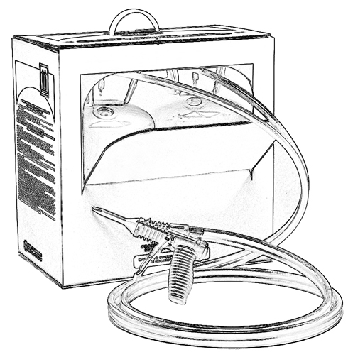


Unit 5:
Potential Effects of Exposure
to the A-side (Iso)
Two-Component Low Pressure
Spray Polyurethane Foam (SPF)

Slide 2

Grant Provided by the Occupational Safety and Health Administration (OSHA), U.S. Department of Labor (DOL)
This material produced under grant SH-22308-SH1 from the Occupational Safety and Health Administration (OSHA), U.S. Department of Labor.
It does not necessarily reflect the views or policies of the U.S. Department of Labor, nor does mention of trade names, commercial products, or organizations imply endorsement by the U.S. Government.

Slide 3
Welcome to Unit 5
In this unit, you will learn about:
Potential effects of A-side (Iso) exposure to the eyes, skin and respiratory system
A-side (Iso) sensitization
Notes:
Narration:
In this unit, you will learn about:
Potential effects of A-side or Iso exposure to the eyes, skin, and respiratory system
A-side or Iso sensitization

Slide 4
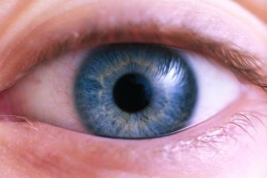
A-side (Iso) Exposure Effects - Eyes
Possible A-side (Iso) irritation eye effects include:
Tearing
Redness
Swelling
Burning
Stinging
Possible temporary injury to the cornea
Notes:
Narration:
Here are some possible irritation effects of exposure to the A-side or Iso, to your eyes.
Eye contact with the A-side or Iso may cause tearing, redness, swelling, burning and stinging.
It may also cause temporary injury to the cornea – the outside layer of the eye.

Slide 5
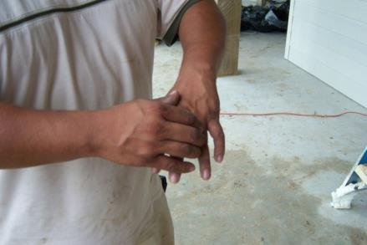
A-side (Iso) Exposure Effects - Skin
Possible skin irritation effects due to A-side exposure include:
Skin discoloration
Itching
Swelling
Rash
Notes:
Narration:
Be aware of possible skin irritation effects of exposure to the A-side or Iso including skin discoloration, itching, swelling, or rash.
On the other hand, it is possible to be exposed to A-side chemicals and experience no skin irritation.

Slide 6

A-side (Iso) Exposure-
Short-term Respiratory Effects
Exposure to the A-side (Iso) may include possible respiratory irritation effects such as:
Sore throat
Coughing
Chest tightness or discomfort
Shortness of breath
Notes:
Narration:
Be aware of the possible respiratory irritation effects of exposure to the A-side.
Symptoms of exposure may include: sore throat, coughing, a feeling of tightness in the chest or discomfort, and shortness of breath. These may occur immediately after exposure.
It is also possible to be exposed to A-side chemicals and experience no short–term respiratory effects.

Slide 7
A-side (Iso) Exposure –
Long-term Respiratory Effects
Normal Loss with Age
Lung
Function
(FEV₁)
Accelerated Lung Function Loss from Long-term Exposure
Time
Notes:
7
Narration:
A possible consequence of long-term A-side or Iso exposure is a decrease in lung function.
As this graph shows, lung function in adults normally reduces with age. Long-term exposure to the A-side or Iso, could further decrease lung function.

Slide 8
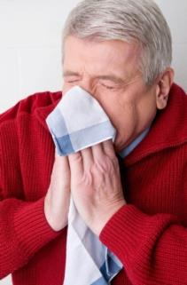
A-side (Iso) Exposure - Sensitization
Sensitization is the development of an unusual sensitivity to a substance resulting in an allergic response after future exposures.
Potential effects due to A-side (Iso)
sensitization:
Skin rash
Asthma-like respiratory response
Notes:
Narration:
Sensitization is a possible effect of A-side or Iso exposure.
Sensitization is the development of an unusual sensitivity to a substance. It is like an allergic response.
Potential effects due to A-side or Iso sensitization include: a skin rash or an asthma-like respiratory response.

Slide 9

A-side (Iso) Exposure-
Sensitization Symptoms
Once sensitized, a respiratory sensitization reaction may occur immediately after exposure or be delayed, including:
Coughing
Shortness of breath
Wheezing
Chest tightness
Asthma attack
Asthma attacks may be life-threatening.
Notes:
Narration:
Once sensitized, a respiratory sensitization reaction may occur immediately after exposure or be delayed.
Some symptoms of respiratory sensitization include: coughing, shortness of breath, wheezing, chest tightness or asthma attack.
Asthma attacks may be life-threatening.

Slide 10
Sensitization
Once a person is sensitized to the A-side (Iso), he cannot become unsensitized.
He can have a reaction even below the occupational exposure limit.
Limit*
No adverse
health effects
Notes:
10
Narration:
A sensitized person can have a reaction even when the air concentrations are below the occupational exposure limit and others on the jobsite do not experience effects.

Slide 11
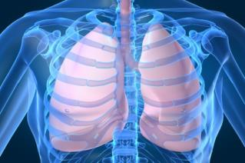
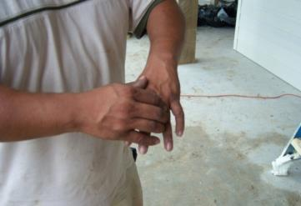
A-side (Iso) Exposure - Sensitization
Sensitization may occur following inhalation or skin contact.
Notes:
Narration:
Sensitization can occur following inhalation or skin contact. The symptoms may be immediate or delayed.
11

Slide 12
Possible Causes of
A-side (Iso) Sensitization
Possible causes of A-side (Iso) sensitization:
A single inhalation exposure to the A-side (Iso) over the exposure limit without appropriate PPE.
Repeated unprotected inhalation exposure exceeding the exposure limit for the A-side (Iso) without appropriate PPE
Repeated unprotected skin contact with the A-side (Iso)
Notes:
Narration:
Sensitization to the A-side, or Iso, can result from a single inhalation exposure to the A-side over the exposure limit without appropriate PPE. It can also be caused by repeated unprotected inhalation exposure exceeding the exposure limit for the A-side without appropriate PPE.
For example, you could develop sensitization by repeatedly going into a room without respiratory protection too soon after spray foam is applied.
Also, animal tests indicate that skin contact with methylenediphenyl diisocyanate or MDI can play a role in the development of respiratory sensitization to the A-side or Iso.

Slide 13

Consequences of Sensitization
Respiratory sensitization to the A-side (Iso) is permanent
If diagnosed with sensitization, contact your employer and your healthcare provider because you may be instructed not to work with isocyanates
Notes:
Narration:
Respiratory sensitization to the A-side is permanent.
If you are diagnosed with sensitization to the A-side, contact your employer and healthcare provider because you may be instructed not to work with isocyanates.

Slide 14
Unit 5 Summary
In this unit, you learned about:
Effects of A-side (Iso) exposure to the eyes, skin and respiratory system
A-side (Iso) sensitization
Notes:
Narration:
In this unit, you learned about:
Effects of A-side or Iso exposure to the eyes, skin, and respiratory system
and A-side or Iso sensitization

Slide 15
Unit 5 Review
Knowledge
Into
Action
Notes:
Narration:
Now it’s time to put your knowledge into action.

Slide 16
Unit 5: Q1 Debrief
Which is a potential effect of A-side (Iso) exposure?
irritation of the eyes
skin irritation
respiratory irritation
all of the above
Notes:
Which is a potential effect of A-side (Iso) exposure?
irritation of the eyes
skin irritation
respiratory irritation
all of the above

Slide 17
Unit 5: Q1 Debrief
Which is a potential effect of A-side (Iso) exposure?
irritation of the eyes
skin irritation
respiratory irritation
all of the above
Notes:
The correct answer is D. All of the statements are correct.

Slide 18
Unit 5: Q2 Debrief
Which statement is true about sensitization to the A-side (Iso)?
It is the development of an unusual sensitivity to a substance resulting in an allergic response after future exposures.
Sensitization may occur following inhalation.
Sensitization may occur following skin contact.
All of the above.
Notes:
Which statement is true about sensitization to the A-side (Iso)?
It is the development of an unusual sensitivity to a substance resulting in an allergic response after future exposures.
Sensitization may occur following inhalation.
Sensitization may occur following skin contact.
All of the above.

Slide 19
Unit 5: Q2 Debrief
Which statement is true about sensitization to the A-side (Iso)?
It is the development of an unusual sensitivity to a substance resulting in an allergic response after future exposures.
Sensitization may occur following inhalation.
Sensitization may occur following skin contact.
All of the above.
Notes:
The correct answer is D. All of the statements are correct.

Slide 20
Unit 5: Q3 Debrief
Respiratory sensitization can lead to asthma, which can be life-threatening. Which of the following symptoms is not a typical symptom of a respiratory sensitization reaction?
blisters forming on the skin
shortness of breath
coughing
chest tightness
Notes:
Respiratory sensitization can lead to asthma, which can be life-threatening. Which of the following symptoms is not a typical symptom of a respiratory sensitization reaction?
blisters forming on the skin
shortness of breath
coughing
chest tightness

Slide 21
Unit 5: Q3 Debrief
Respiratory sensitization can lead to asthma, which can be life-threatening. Which of the following symptoms is not a typical symptom of a respiratory sensitization reaction?
blisters forming on the skin
shortness of breath
coughing
chest tightness
Notes:
The correct answer is A. Blisters forming on the skin is not a typical symptom of a respiratory sensitization reaction.

Slide 22
Unit 5: Q4 Debrief
If diagnosed with sensitization to the A-side (Iso), contact your healthcare provider. You may be ____________.
instructed not to work with isocyanates
asked to stop lifting heavy spray foam equipment
instructed to temporarily isolate yourself from others until the sensitization clears up
None of the above
Notes:
If diagnosed with sensitization to the A-side (Iso), contact your healthcare provider. You may be ____________.
instructed not to work with isocyanates
asked to stop lifting heavy spray foam equipment
instructed to temporarily isolate yourself from others until the sensitization clears up
none of the above

Slide 23
Unit 5: Q4 Debrief
If diagnosed with sensitization to the A-side (Iso), contact your healthcare provider. You may be ____________.
instructed not to work with isocyanates
asked to stop lifting heavy spray foam equipment
instructed to temporarily isolate yourself from others until the sensitization clears up
None of the above
Notes:
The correct answer is A. You may be instructed not to work with isocyanates if you are diagnosed with sensitization to the A-side (Iso).

Slide 24
Unit 5 Completed
Continue to Unit 6
Return to the Main Menu
Notes:
Narration:
You have completed Unit 5.

