Slide 1
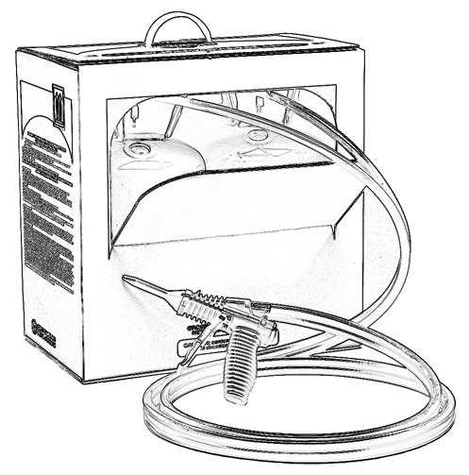
Unit 3:
Potential Chemical Exposure
During Two-Component
Low Pressure SPF Application

Slide 2
Grant Provided by the Occupational Safety and Health Administration (OSHA), U.S. Department of Labor (DOL)
This material produced under grant SH-22308-SH1 from the Occupational Safety and Health Administration (OSHA), U.S. Department of Labor.
It does not necessarily reflect the views or policies of the U.S. Department of Labor, nor does mention of trade names, commercial products, or organizations imply endorsement by the U.S. Government.

Slide 3
Welcome to Unit 3
In this unit, you will learn about:
Routes of exposure
Effects of chemical exposure
Exposure limits
Some risk factors for chemical exposure
Notes:
Narration:
In this unit, you will learn about:
Routes of exposure
Effects of chemical exposure
Exposure limits
And some risk factors for chemical exposure

Slide 4
Routes of Exposure
There are three possible ways you can be exposed to a chemical:
Inhalation, or breathing chemical vapors
Skin and eye contact
Ingestion
Notes:
Narration:
You’ve already learned that spray polyurethane foam, or SPF, is made by mixing and spraying different chemicals. Now we will talk about the three possible ways you can be exposed to a chemical, including:
Inhalation, or breathing chemical vapors
Skin and eye contact
Ingestion

Slide 5
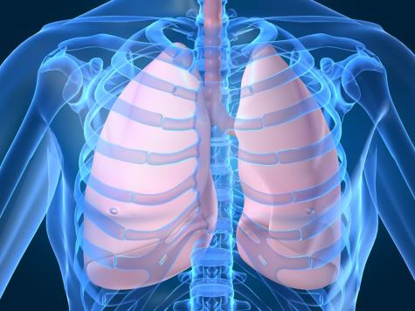
Routes of Exposure - Inhalation
Avoid breathing SPF chemical vapors.
Notes:
Narration:
The first is inhalation or breathing in chemical vapors.

Slide 6
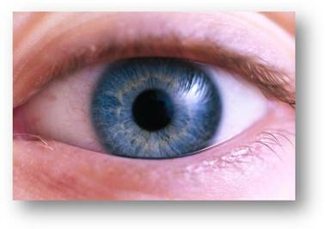
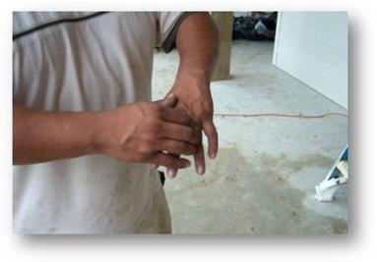
Routes of Exposure – Skin and Eye Contact
Avoid skin and eye contact with SPF chemicals.
Notes:
Narration:
The second way you can be exposed to chemicals is by skin or eye contact.

Slide 7
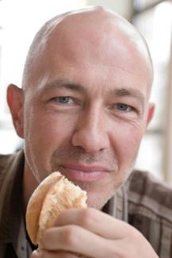
Routes of Exposure - Ingestion
AVOID eating, drinking, or other hand-to-mouth contact near SPF chemicals.
Remove gloves and wash your hands after working with chemicals.
Notes:
Narration:
The third way chemicals can enter your body is by incidental ingestion. This can occur when eating, drinking or if other hand-to-mouth contact occurs near chemicals. To avoid ingestion, remove gloves and wash your hands after working with chemicals.

Slide 8
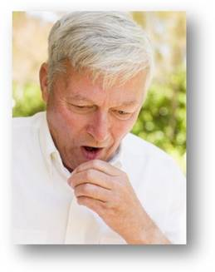
Exposure - Chronic Effects
Chronic effects are long-term, sometimes permanent, health effects due to repeated exposure to certain chemicals.
Sometimes, chronic effects can occur at concentrations below which acute (short-term) effects are experienced.
Notes:
Narration:
Chronic effects are long-term, sometimes permanent, health effects due to repeated exposure to certain chemicals. Sometimes, chronic effects can occur at concentrations below which acute, or short-term effects, are experienced.

Slide 9
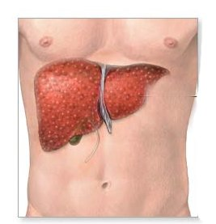
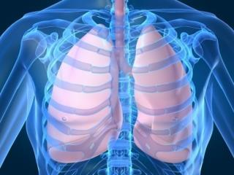
Exposure- Examples of Chronic Effects
Chronic exposure to the SPF A-side (Iso) chemical may cause reduced lung function
Chronic exposure to alcohol may cause liver damage
Notes:
Narration:
For example, one effect of chronic exposure to alcohol may be liver damage.
An effect of chronic exposure to the A-side (Iso) chemicals in spray foam may be reduced lung function.
You’ll learn more about chemicals used in low pressure SPF and their potential health effects in upcoming units.

Slide 10
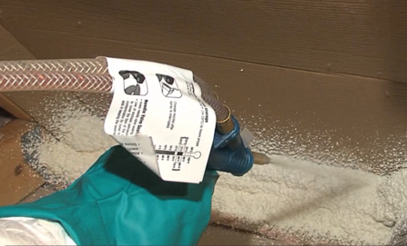
Avoid Exposure to Low Pressure SPF Chemicals
Spraying a two-component low pressure kit/system can release SPF chemicals into the air that could pose a potential inhalation and skin exposure hazard.
Avoid exposing yourself or others to potential inhalation and/or skin exposure hazards.
(more in later Units)
Notes:
Narration:
When you use a two-component low pressure kit or system, it can release SPF chemicals into the air that could pose a potential inhalation and skin exposure hazard.
Avoid exposing yourself and others to potential inhalation and/or skin exposure hazards when using low pressure SPF products.

Slide 11
What Are Exposure Limits?
Exposure to certain chemicals - whether from skin or eye contact, breathing, or eating- can in some cases cause health effects.
OSHA and other expert organizations have set limits for some chemicals on the amount to which you can be exposed before requiring PPE.
Notes:
Narration:
Exposure to certain chemicals – whether from skin or eye contact, breathing, or eating – can in some cases cause health effects. Thus, OSHA and other expert organizations have set limits for some chemicals on the amount to which you can be exposed before requiring PPE.

Slide 12
Types of Exposure Limits
Occupational exposure limits are air concentration limits set by government regulators and expert organizations intended to protect healthy workers from some effects due to chemical exposure. Limits include:
Average exposure during a work shift (8 hours)
Average short-term exposure (10 - 15 minutes)
Maximum concentration not to be exceeded
Wear required respiratory protection for the job being performed if limits may be exceeded.
Notes:
Narration:
Occupational exposure limits are air concentration limits that have been set by government regulators and expert organizations intended to protect healthy workers from some effects due to chemical exposure.
These may be an average concentration over a period of time, such as an 8-hour shift or 10 to 15 minute short-term exposure, or as a maximum concentration not to be exceeded.
If someone works in an area where these concentrations may be exceeded, appropriate respiratory protection should be worn.

Slide 13
Examples of Exposure Limits
OSHA Permissible Exposure Limit - PEL
National Institute of Occupational Safety and Health (NIOSH) Recommended Exposure Limit - REL
American Conference of Governmental Industrial Hygienists (ACGIH) Threshold Limit Values - TLV
Limit
Notes:
Narration:
OSHA has established legally enforceable occupational exposure limits called Permissible Exposure Limits or PELs.
The National Institute of Occupational Safety and Health, or NIOSH, has established Recommended Exposure Limits or RELs for some chemicals as well.
The American Conference of Governmental Industrial Hygienists (ACGIH) is an expert organization which has established Threshold Limit Values or TLVs.

Slide 14
Understanding Exposure Limits
Applicable exposure limits can be found on the Safety Data Sheet (SDS).
Some chemicals you work with may or may not have exposure limits.
Consult the SDS for appropriate precautions when working with these chemicals as well.
Limit
Notes:
Narration:
Applicable exposure limits can be found on the Safety Data Sheet or SDS.
It is important to note that some chemicals you work with may or may not have exposure limits.
Consult the SDS for appropriate precautions when working with these chemicals as well.

Slide 15
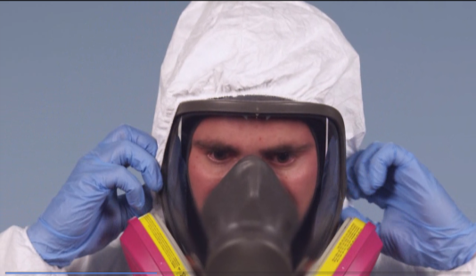
Some Risk Factors for Chemical Exposure
Personal Protective Equipment (PPE) that is incorrectly selected or used could lead to chemical exposure.
This is an example of PPE that may be used for two-component low pressure SPF application. Pictured is a full-face air purifying respirator. PPE and other respirator options will be discussed in Unit 9.
Notes:
Narration:
What is a situation that could cause you to be exposed?
Personal protective equipment, or PPE, that is incorrectly selected or used could lead to chemical exposure.
We’ll be discussing PPE in more detail in Unit 9.

Slide 16
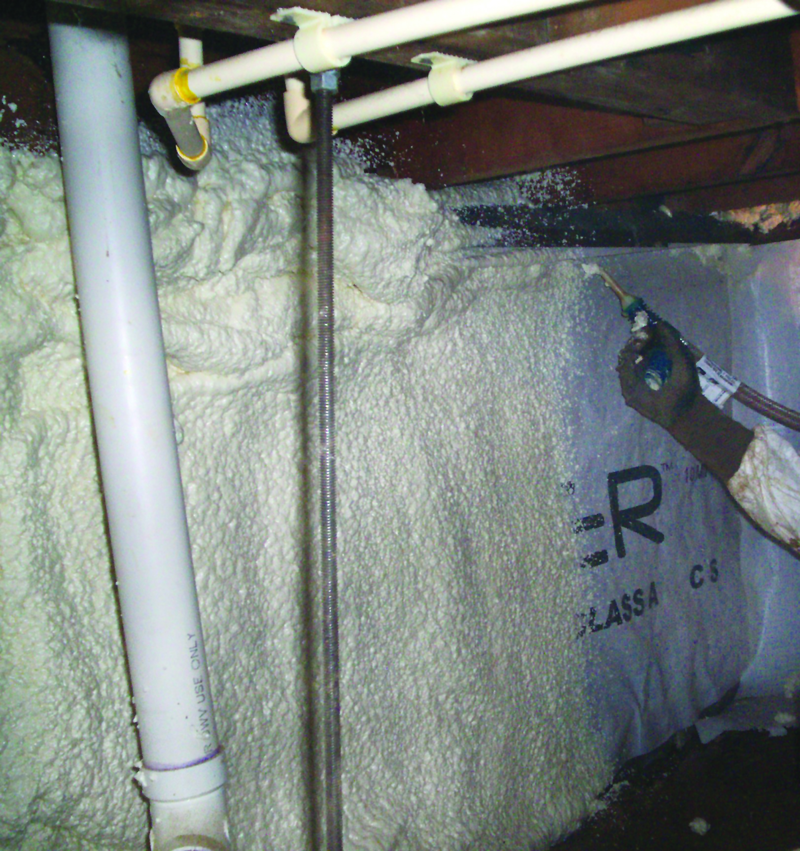
Some Risk Factors for Chemical Exposure
Handling SPF chemicals in poorly ventilated areas without personal protective equipment (including an appropriate respirator) could lead to chemical exposure.
Weatherization projects may take place in confined areas, such as crawl spaces and attics, where ventilation may be limited.
Notes:
Narration:
Another possible way to be exposed is handling SPF chemicals in poorly ventilated spaces without personal protective equipment, including a respirator.
Weatherization projects using low pressure SPF kits and products are sometimes done in enclosed spaces, such as attics and crawl spaces. These areas typically do not “air out” as quickly as open areas. Confined spaces tend to keep more SPF chemicals in the air longer.

Slide 17
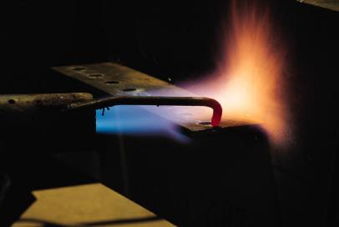
Preventing Accidental Ignition
Keep all hot work safely away from spray foam and liquid chemicals. Use a heat shield to prevent accidental ignition (more in Unit 11).
Notes:
Narration:
Keep all hot work safely away from spray foam and liquid chemicals. Consider using a heat shield to prevent accidental ignition.

Slide 18
Unit 3 Summary
In this unit, you learned about:
Routes of exposure
Effects of chemical exposure
Exposure limits
Some risk factors for chemical exposure
Notes:
Narration:
In this unit, you learned about:
Routes of exposure
Effects of chemical exposure
Exposure limits
And some risk factors for chemical exposure

Slide 19
Unit 3 Review
Knowledge
Into
Action
Notes:
Narration:
Now it’s time to put your knowledge into action.

Slide 20
Unit 3: Q1 Debrief
_____ is a possible way a worker can be exposed to a chemical.
Inhalation, or breathing chemical vapors
Skin or eye contact
Ingestion
All of the above
Notes:
_____ is a possible way a worker can be exposed to a chemical.
Inhalation, or breathing chemical vapors
Skin or eye contact
Ingestion
All of the above

Slide 21
Unit 3: Q1 Debrief
_____ is a possible way a worker can be exposed to a chemical.
Inhalation, or breathing chemical vapors
Skin or eye contact
Ingestion
All of the above
Notes:
The correct answer is D. All of the above are possible ways a worker can be exposed to a chemical.

Slide 22
Unit 3: Q2 Debrief
Occupational exposure limits are __________ set by government regulators and expert organizations to protect healthy workers from effects due to chemical exposure.
acceptable odor levels
air concentration levels
frequency and length of employee breaks
all of the above
Notes:
Occupational exposure limits are __________ set by government regulators and expert organizations to protect healthy workers from effects due to chemical exposure.
acceptable odor levels
air concentration levels
frequency and length of employee breaks
all of the above

Slide 23
Unit 3: Q2 Debrief
Occupational exposure limits are __________ set by government regulators and expert organizations to protect healthy workers from effects due to chemical exposure.
acceptable odor levels
air concentration levels
frequency and length of employee breaks
all of the above
Notes:
The correct answer is B. Occupational exposure limits are air concentration levels set by government regulators and expert organizations to protect healthy workers from effects due to chemical exposure.

Slide 24
Unit 3: Q3 Debrief
Which of the following is not true about potential chemical exposure when applying two-component low pressure SPF?
Chronic effects are long-term, sometimes permanent, health effects due to repeated exposure to certain chemicals.
Two-component low pressure kits can release chemicals into the air that could pose a potential inhalation and/or skin exposure hazard.
It is not necessary to wear any personal protective equipment (PPE).
Personal protective equipment that is incorrectly selected or used could lead to chemical exposure.
Notes:
Which of the following is not true about potential chemical exposure when applying two-component low pressure SPF?
Chronic effects are long-term, sometimes permanent, health effects due to repeated exposure to certain chemicals.
Two-component low pressure kits can release chemicals into the air that could pose a potential inhalation and/or skin exposure hazard.
It is not necessary to wear personal protective equipment (PPE).
Personal protective equipment that is incorrectly selected or used could lead to chemical exposure.

Slide 25
Unit 3: Q3 Debrief
Which of the following in not true about potential chemical exposure when applying two-component low pressure SPF?
Chronic effects are long-term, sometimes permanent, health effects due to repeated exposure to certain chemicals.
Two-component low pressure kits can release chemicals into the air that can pose a potential inhalation and/or skin exposure hazard.
It is not necessary to wear any personal protective equipment (PPE).
Personal protective equipment that is incorrectly selected or used could lead to chemical exposure.
Notes:
The correct answer is C. Proper personal protective equipment is required when using two-component low pressure SPF.

Slide 26
Unit 3 Completed
Continue to Unit 4
Return to the Main Menu
Notes:
Narration:
You have completed Unit 3.

