Slide 1
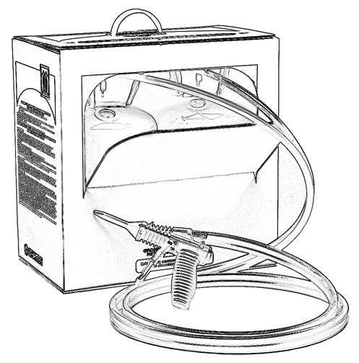
Unit 13:
Handling, Storage and Disposal
of Low Pressure SPF Products

Slide 2
Grant Provided by the Occupational Safety and Health Administration (OSHA), U.S. Department of Labor (DOL)
This material produced under grant SH-22308-SH1 from the Occupational Safety and Health Administration (OSHA), U.S. Department of Labor.
It does not necessarily reflect the views or policies of the U.S. Department of Labor, nor does mention of trade names, commercial products, or organizations imply endorsement by the U.S. Government.

Slide 3
Welcome to Unit 13
In this unit, you will learn about:
Low pressure SPF product handling, storage and disposal.
Notes:
Narration:
In this unit, you will learn about:
Low pressure SPF product handling, storage and disposal.

Slide 4
Before You Start
Before you start work, become familiar with:
Safety Data Sheet (SDS) for each chemical used
SPF kit/system operation manual and product labels
Worksite procedures
Notes:
Narration:
Before you start work, familiarize yourself with the Safety Data Sheet (SDS) for each chemical used.
Review the operating manual and product label for the spray polyurethane foam product you are using and understand worksite procedures.

Slide 5
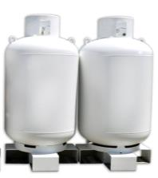
Handling Considerations
When using or handling insulating foam sealants or low pressure SPF kits/systems:
Wear proper personal protective equipment (See Units 1 and 9)
If moving heavy SPF refillable system tanks or drums, handling equipment can help prevent injuries
Notes:
Narration:
When using or handling insulating foam sealants or SPF kits/systems, wear proper personal protective equipment.
If moving heavy SPF refillable system tanks or drums, the use of handling equipment, such as a fork lift, can help prevent injuries.

Slide 6
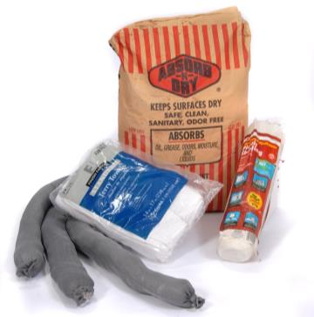
Spill Containment
Keep spill containment and clean up materials handy at the job site.
Notes:
Narration:
Keep spill containment and clean up materials well stocked and handy at the job site.

Slide 7
Canister/Cylinder Storage
Ingredients are pressurized so….
Store full or partially used insulating foam sealant cans or SPF kits/systems upright and at temperatures consistent with manufacturer’s instructions.
Avoid exposure to open flame or extreme temperatures (avoid freezing or hot temperatures). For example, high heat can cause a can/cylinder explosion due to pressure build-up.
Avoid puncturing the can or cylinder.
Notes:
Narration:
Low pressure SPF ingredients are pressurized so store full or partially used insulating foam sealant cans or SPF kits and systems upright and at temperatures consistent with the manufacturer’s instructions.
Avoid exposure to open flame or extreme temperatures. Prevent the product from freezing and avoid leaving it in direct sunlight or hot temperatures. For example, high heat can cause a can or cylinder explosion due to pressure build-up. Also, avoid puncturing the can or cylinder.

Slide 8
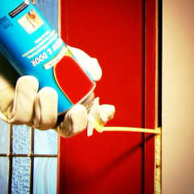
Insulating Foam Sealant - Disposal
Empty cans may be disposed of as
non-hazardous household waste.
Follow manufacturer’s instructions.
For full or partially used cans, refer to the product label for disposal instructions.
Follow all federal, state and local regulations.
After initial use, a partially used can may be reused for a limited time if stored in cool and dry conditions. Follow manufacturer’s instructions.
Notes:
Narration:
When disposing of insulating foam sealant, empty cans may be disposed of as non-hazardous household waste. Follow the manufacturer’s instructions.
For full or partially used cans, refer to the product label for disposal instructions.
Follow all federal, state and local regulations.
After initial use, a partially used can may be reused for a limited time if stored in cool and dry conditions. Follow the manufacturer’s instructions.

Slide 9
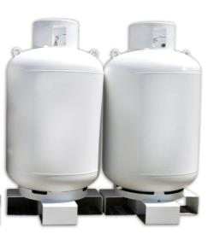
Low pressure SPF kit/system -Disposal
Disposable Cylinders/Tanks:
Dispose of empty cylinders or tanks in accordance with federal, state and local regulations.
Refillable Systems:
Some manufactures of LP refillable systems may accept used cylinders and tanks for reuse. Check with your supplier.
Trimmings:
Foam trimmings can be disposed of as non-hazardous household waste.
Notes:
Narration:
When disposing of two-component low pressure kits or systems, be sure to follow all federal, state and local regulations.
Some manufactures of low pressure refillable systems may accept used cylinders and tanks for reuse.
You may want to check with your supplier to see if this is an option. Foam trimmings can be disposed of as non-hazardous household waste.

Slide 10
Unit 13 Summary
In this unit, you learned about:
Low pressure SPF product handling, storage and disposal.
Notes:
Narration:
In this unit, you learned about:
Low pressure SPF product handling, storage and disposal.

Slide 11
Unit 13 Review
Knowledge
Into
Action
Notes:
Narration:
Now let’s put your knowledge into action.

Slide 12
Unit 13: Q1 Debrief
The following is true regarding low pressure SPF canister/cylinder storage except:
Store at temperatures consistent with manufacturer’s instructions.
Store insulating foam sealant cans or low pressure SPF kits in an upright position.
Avoid puncturing the can or cylinder.
The cans/cylinders are non-pressurized so there is no risk of explosion.
Notes:
The following is true regarding low pressure SPF canister/cylinder storage except:
Store at temperatures consistent with manufacturer’s instructions.
Store insulating foam sealant cans or low pressure SPF kits in an upright position.
Avoid puncturing the can or cylinder.
The cans/cylinders are non-pressurized so there is no risk of explosion.

Slide 13
Unit 13: Q1 Debrief
The following is true regarding low pressure SPF can/cylinder storage except:
Store at temperatures consistent with manufacturer’s instructions.
Store insulating foam sealant cans or low pressure SPF kits in an upright position.
Avoid puncturing the can or cylinder.
The cans/cylinders are non-pressurized so there is no risk of explosion.
Notes:
The correct answer is D. Low pressure SPF ingredients are pressurized in the cans or cylinders.

Slide 14
Unit 13: Q2 Debrief
___________ may be disposed of as non-hazardous household waste in accordance with federal, state and local regulations.*
55 gallon drums used for high pressure SPF chemical storage
Empty insulating foam sealant cans
Partially used two-component low pressure SPF cylinders/tanks
All of the above
* Disposal regulations are subject to change.
Notes:
___________ may be disposed of as non-hazardous household waste in accordance with federal, state and local regulations.
55 gallon drums used for high pressure SPF chemical storage
Empty insulating foam sealant cans
Partially used two-component low pressure SPF cylinders/tanks
All of the above

Slide 15
Unit 13: Q2 Debrief
___________ may be disposed of as non-hazardous household waste in accordance with federal, state and local regulations.*
55 gallon drums used for high pressure SPF chemical storage
Empty insulating foam sealant cans
Partially used two-component low pressure SPF cylinders/tanks
All of the above
* Disposal regulations are subject to change.
Notes:
The correct answer is B. Empty insulating foam sealant cans may be disposed of as non-hazardous household waste in accordance with federal, state and local regulations.

Slide 16
Unit 13: Q3 Debrief
Do not abandon or leave behind cylinders or tanks of unreacted chemicals from a low pressure kit or system. Dispose of waste chemicals in accordance with _____ regulations.*
federal
state
local
all of the above
* Disposal regulations are subject to change.
Notes:
Do not abandon or leave behind cylinders or tanks of unreacted chemicals from a low pressure kit or system. Dispose of waste chemicals in accordance with _____ regulations.
federal
state
local
all of the above

Slide 17
Unit 13: Q3 Debrief
Do not abandon or leave behind cylinders or tanks of unreacted chemicals from a low pressure kit or system. Dispose of waste chemicals in accordance with _____ regulations.*
federal
state
local
all of the above
* Disposal regulations are subject to change.
Notes:
The correct answer is D. All of the above. Dispose of waste chemicals in accordance with federal, state, and local regulations.

Slide 18
Unit 13 Completed
Continue to Unit 14
Return to Main Menu
Notes:
Narration:
You have completed Unit 13.

