Slide 1
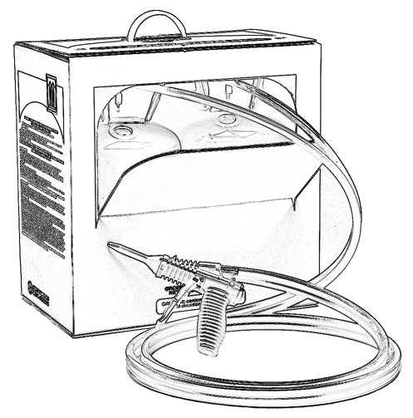
Unit 11:
Thermal Decomposition
When Using Two-Component
Low Pressure SPF

Slide 2
Grant Provided by the Occupational Safety and Health Administration (OSHA), U.S. Department of Labor (DOL)
This material produced under grant SH-22308-SH1 from the Occupational Safety and Health Administration (OSHA), U.S. Department of Labor.
It does not necessarily reflect the views or policies of the U.S. Department of Labor, nor does mention of trade names, commercial products, or organizations imply endorsement by the U.S. Government.

Slide 3
Welcome to Unit 11
In this unit, you will learn about:
Thermal decomposition and suggestions to help prevent it
Notes:
Narration:
In this unit, you will learn about:
Thermal decomposition and suggestions to help prevent it.

Slide 4
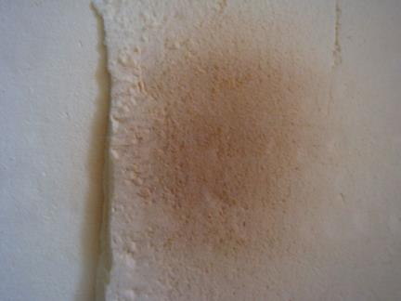
Thermal Decomposition
There is potential during spray polyurethane foam application for thermal decomposition.
Notes:
Narration:
There is potential during spray foam application for thermal decomposition.

Slide 5
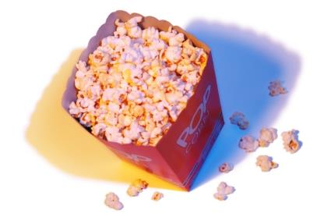
Thermal Decomposition
An example of thermal decomposition is when you microwave popcorn for too long and the kernels are charred.
There is a burnt odor and charred appearance.
Notes:
Narration:
An example of thermal decomposition is when you microwave popcorn too long, you cause some of the popped kernels to become charred. They will have a burnt odor and a charred appearance.

Slide 6
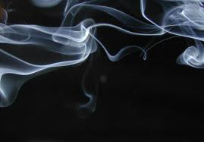
Thermal Decomposition of SPF - What can happen?
What can happen if the foam is overheated?
smoke and vapors may be produced
the foam product can break down
Notes:
Narration:
What can happen if spray foam is overheated?
When the foam is overheated, it can break down and produce smoke, and / or vapors that contain various chemicals. This breakdown is often referred to as thermal decomposition.

Slide 7
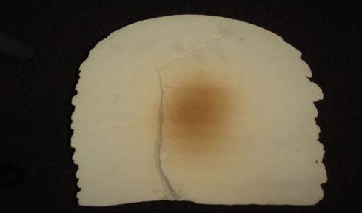
Thermal Decomposition
Heat given off during foam curing can result in possible scorching, smoldering or fire.
(an example of scorched foam)
Notes:
Narration:
Heat given off during the curing of foam can result in possible scorching, smoldering or fire.

Slide 8
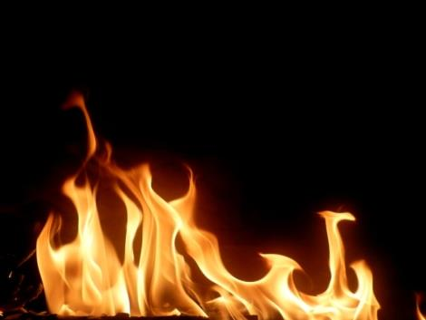
Thermal Decomposition of SPF
Spray polyurethane foam can burn!
Notes:
Narration:
It needs to be clearly understood: Spray polyurethane foam can burn! SPF is formulated with flame retardants to meet building codes. However, building codes are developed to allow occupants time to exit the building, not to prevent the structure from burning.
Many building materials, like wood, can burn. Foam burns too.

Slide 9
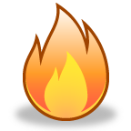
Thermal Decomposition- Finished Foam
Potential by-products of thermal decomposition of SPF include:
Carbon monoxide
Carbon dioxide
Hydrogen cyanide
Nitrogen oxides
Hydrocarbons
Isocyanic acid
Isocyanate
Others
Notes:
Narration:
The potential by-products of thermal decomposition of spray foam include: carbon monoxide, carbon dioxide, hydrogen cyanide, nitrogen oxides, hydrocarbons, isocyanic acid, isocyanate, as well as other chemicals specific to the formulations. Some of these by-products are potentially hazardous chemicals.
When foam burns in an enclosed space, these chemicals could displace oxygen and create a potentially hazardous atmosphere.

Slide 10
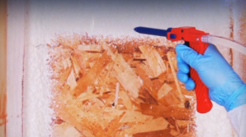
Preventing Thermal Decomposition
Thermal decomposition can occur while spraying low pressure foam.
Consider the following to prevent potential for thermal decomposition:
refer to manufacturer’s instructions for specific information
avoid spraying too thickly in any one lift/pass (up to 2” maximum is common)
allow sufficient cooling time before applying the next lift/pass
Notes:
Narration:
As mentioned earlier, thermal decomposition can occur while spraying. Consider the following preventive steps. Follow the SPF manufacturer’s instructions for application thickness and other guidance. Avoid spraying too thickly in any one lift/pass.
If you apply the foam too thickly then it may get hot enough in the center of the foam to cause thermal decomposition. Allow sufficient cooling time between lifts according to manufacturer’s instructions.

Slide 11
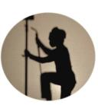
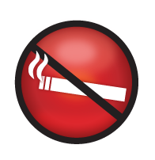
Preventing Thermal Decomposition – Additional Considerations
What are some additional ways to help prevent thermal decomposition of foam?
no welding or sources of ignition near installed foam until it is covered with a thermal barrier (e.g., drywall)
no cutting with a torch
no smoking in the spray area
Notes:
Narration:
Here are some additional considerations to help prevent thermal decomposition of foam:
Do not weld or place other sources of ignition near installed foam until it is covered with a thermal barrier, such as drywall. Avoid cutting with a torch on or near installed foam and refrain from smoking.

Slide 12
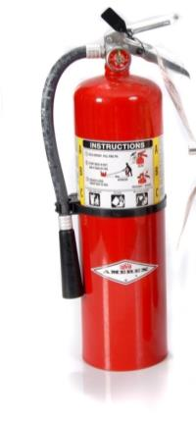
ABC Fire Extinguisher
Keep an ABC fire extinguisher near the work zone.
Notes:
Narration:
Keep an ABC type fire extinguisher near the work zone.

Slide 13
Unit 11 Summary
In this unit, you learned about:
Thermal decomposition and suggestions to help prevent it
Notes:
Narration:
In this unit, you learned about:
Thermal decomposition and suggestions to help prevent it.

Slide 14
Unit 11 Review
Knowledge
Into
Action
Notes:
Narration:
Now let’s put your knowledge into action.

Slide 15
Unit 11: Q1 Debrief
Which of the following is not true about thermal decomposition that can potentially occur when SPF is overheated?
Heat given off during curing can result in possible scorching, smoldering and fire.
Low pressure spray polyurethane foam will not burn.
Smoke and vapors may be produced.
SPF is formulated with flame retardants to meet building codes.
Notes:
Which of the following is not true about thermal decomposition that can potentially occur when SPF is overheated?
Heat given off during curing can result in possible scorching, smoldering and fire.
Low pressure spray polyurethane foam will not burn.
Smoke and vapors may be produced.
SPF is formulated with flame retardants to meet building codes.

Slide 16
Unit 11: Q1 Debrief
Which of the following is not true about thermal decomposition that can potentially occur when SPF is overheated?
Heat given off during curing can result in possible scorching, smoldering and fire.
Low pressure spray polyurethane foam will not burn.
Smoke and vapors may be produced.
SPF is formulated with flame retardants to meet building codes.
Notes:
The correct answer is B. Spray polyurethane foam can burn if it is overheated.

Slide 17
Unit 11: Q2 Debrief
Which of the following is true regarding techniques to help prevent thermal decomposition of SPF?
Keep the foam cool by turning up the fans.
Follow manufacturer’s recommendation on lift thickness and time between lift/pass.
Apply the foam in as thick a lift as possible.
None of the above.
Notes:
Which of the following is true regarding techniques to help prevent thermal decomposition of SPF?
Keep the foam cool by turning up the fans.
Follow the manufacturer’s recommendation on lift thickness and time between lift/pass.
Apply the foam in as thick a lift as possible.
None of the above

Slide 18
Unit 11: Q2 Debrief
Which of the following is true regarding techniques to help prevent thermal decomposition of SPF?
Keep the foam cool by turning up the fans.
Follow manufacturer’s recommendation on lift thickness and time between lift/pass.
Apply the foam in as thick a lift as possible.
None of the above.
Notes:
The correct answer is B. To prevent thermal decomposition, follow the manufacturer’s recommendation on lift thickness and time between lift/pass.

Slide 19
Unit 11 Completed
Continue to Unit 12
Return to the Main Menu
Notes:
Narration:
You have completed Unit 11.

